Slide 1
WG2 discussion
Conveners: G. Ciovati, D. Kostin, Y. Yamamoto

Slide 2
Topics
High gradient
High Q
Cavity fabrication and preparation
Instrumentation

Slide 3
Gradient:
Reduce field emission:
Do we need more stringent clean room assembly protocols?
Should we push for alternative cleaning techniques: plasma cleaning, dry ice cleaning?
Will X-ray mapping help?
Will most weld issues & local repair become secondary if CBP is used immediately after fabrication?
Any new idea on how to analyze defects at quench locations? What about quench at high field?
Is re-entrant shape going to be pursued further?
Could CBP adapted for low-beta cavity structures to improve gradient?

Slide 4
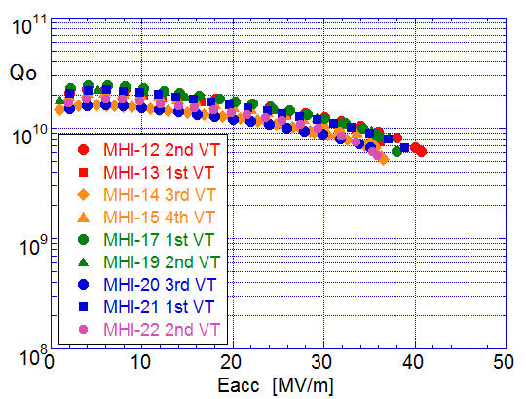
Q₀:
9-cell cavity results from KEK show systematically lower Q₀-values than those treated/tested at DESY. Why?
How do we maintain high Q₀ of cavities in cryomodules?
Will thin film technology be ready for any of the upcoming projects (ESS, MYRRHA, NGLS, PX…)?

Slide 5
Cavity fabrication and material
do we believe we know all on how to build/prepare cavities: is the R&D saturated? Are there differences in material/preparation for high Q or high gradient application?
pros/cons different cavity fabrication/Nb material techniques: seamless and large-grain
who/how will continue pursuing alternatives such as large-grain, seamless options (ILC HiGrade?) for higher Q/gradient
what do we learn (or have learned) from cavity industrialization: big numbers and companies doing the process

Slide 6
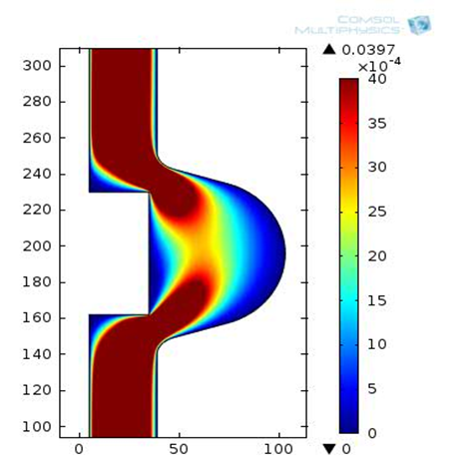
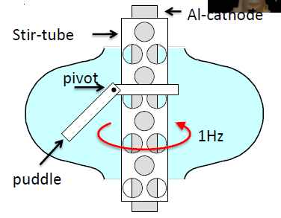
VEP
Compare recipes between CEA and Cornell: acid agitation, amount of removal needed…
Is the ultimate goal to replace horizontal EP? Because of economy or performance?
6 V
25 l/min
19 C
60 μm removal
14 V
15-19 C
< 10 μm removal

Slide 7
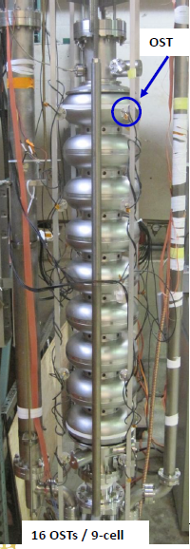
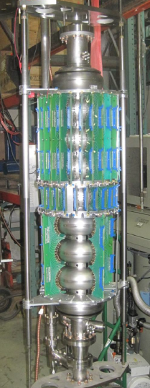
Instrumentation to learn from cavity tests
what more do we need?
second sound system: as reliable as T-map? Can it replace T-mapping?

