Slide 1
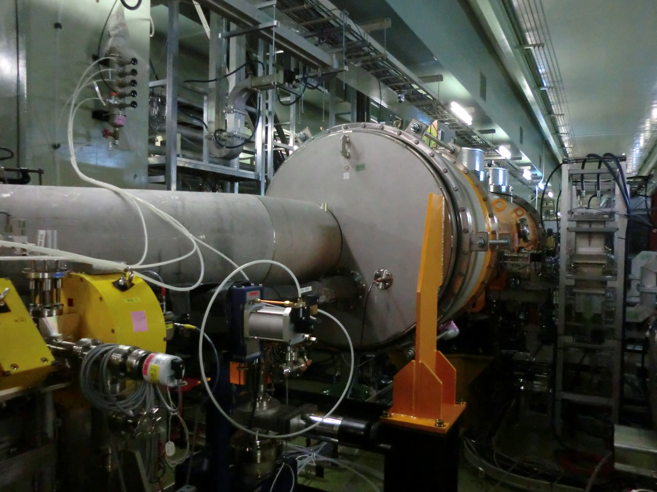
HOM-BPM study in STF for cavity miss-alignment detection
A.Kuramoto
Graduate University for Advanced Studies (KEK)
TTC meeting at Jefferson Lab
5 November 2012

Slide 2
Purpose of research
Find electric center of superconducting cavity by using beam induced HOM (dipole mode).
Detect cavity miss-alignment of cavity offset, tilt and bending.
Using two dipole modes.
π/9 mode of 1st dipole passband
Beam pipe mode

Slide 3
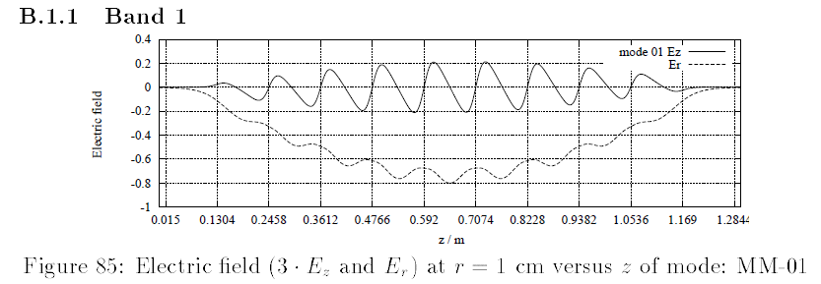
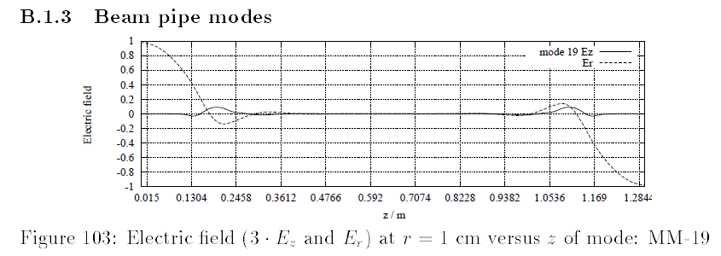
Idea
Cavity center
Find electric center in the middle of cavity by using π/9 mode of 1st dipole passband.
Find electric center at beam pipe by using beam pipe mode.
Detect cavity tilt and bending from combination of two electric centers.
Cavity end
Electric fields in a TDR-like TESLA 9-cell cavity calculated with magnetic boundary by R.Wanzenberg

Slide 4
requirement
To detect π/9 mode -> use narrow band BPF +high gain RF amp.
Big offset of electrical center is expected for beam pipe mode (main coupler, HOM coupler disturbance)-> bead-pull measurement is required.

Slide 5
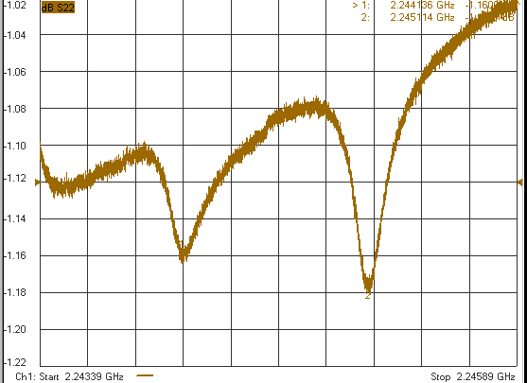
Bead-pull measurement
Example of measurement
2
1
S22
Ceramic bead is used.
Electric field is measured in the left side beam pipe.
2.244 GHz
2.245 GHz

Slide 6
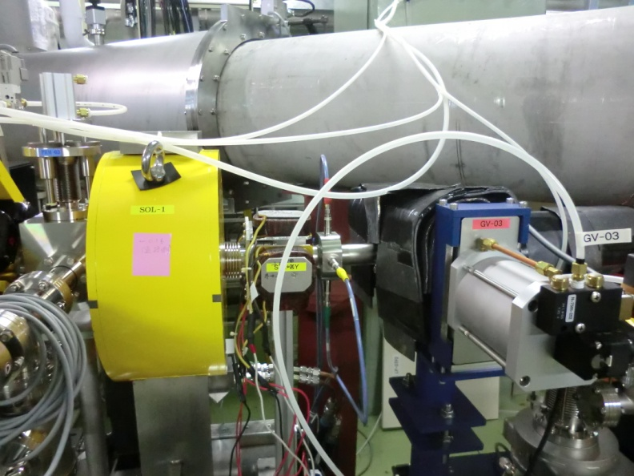
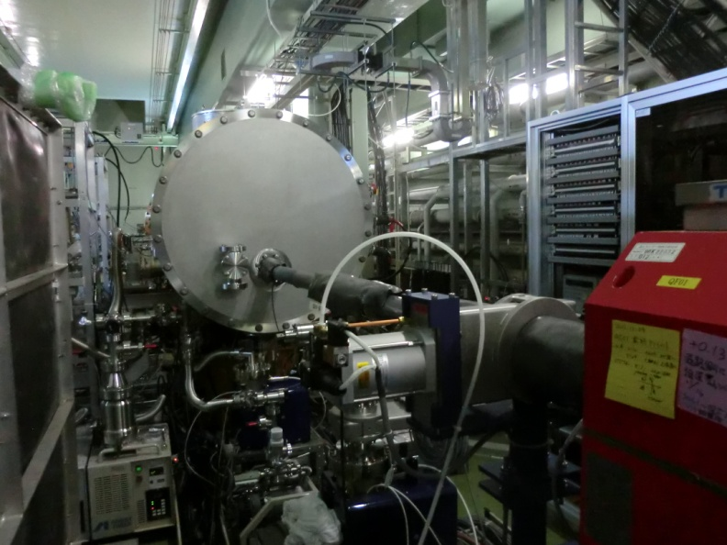
STF accelerator
Beam energy : 40 MeV (RF Gun out 3 MeV)
Bunch charge : 62 pC
Number of bunch : 162500 (1 ms, 162.5 MHz)
Repetition : 5 Hz
SC cavity : 19 MV/m + 21 MV/m
Dipole
magnet
B
PM
B
PM
e⁻

Slide 7
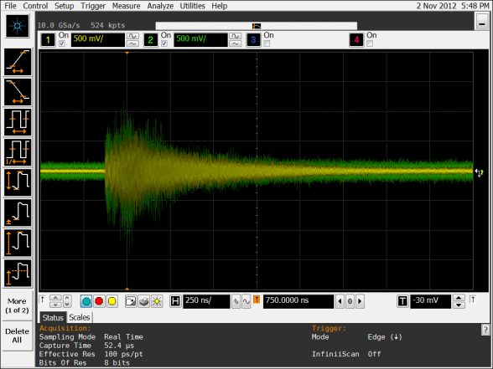
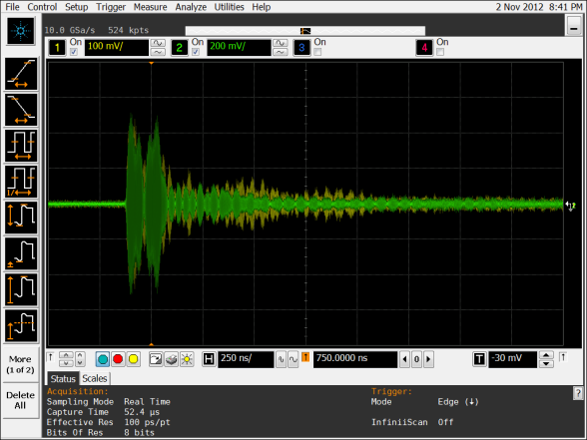
Set up for induced HOM measurement
Dipole
magnet
B
PM
B
PM
e⁻
MHI-12
MHI-13
Dipole
magnet
16 bunch
40pC/bunch
HOM1
HOM2
DSO9404A (Agilent Technologies)
A
A
A
HPF
HPF
AMP
AMP
AMP
highpass filter
(Mini-Circuits)
VHF-1500+
AMP (Mini-Circuits)
ZX60-6013E+：gain=15dB
BPF
bandpass filter
(Trilithic)
1.59-1.695 GHz
10.0 GSa/s,524 kpts

Slide 8
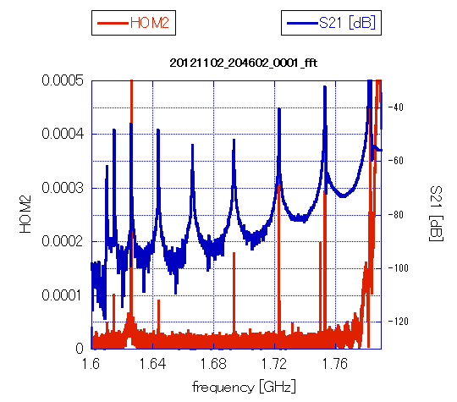
π/9 mode of 1st dipole passband
Oscilloscope waveform
π/9 mode’s spectrum is founded.
Signal is small.
Plot of amplitude vs. beam position doesn’t show V-shape.

Slide 9
Example of V-shape; 3π/9 mode of 1st dipole passband
3π/9 mode’s amplitude is big.
Plot of amplitude vs. beam position for 3π/9 mode describes V-shape.

Slide 10
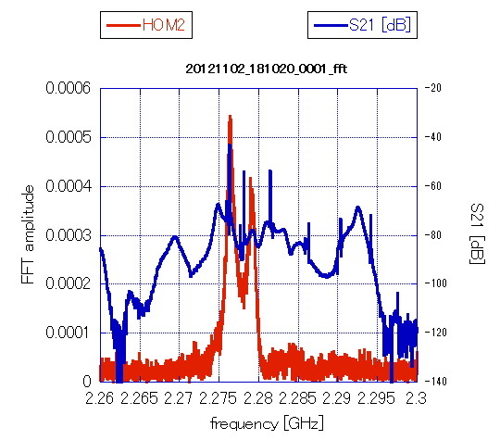
Beam pipe mode
Oscilloscope waveform
X position of Electric center for beam pipe mode is bigger than 3000 μm.
Due to beam kick effect?
Coupler is inserted from +X direction. The detail calculation is on going.

Slide 11
Summary
The study of cavity miss-alignment (offset, tilt, bending) detection using beam induced HOM is presented.
The beam induced HOM signals were detected by changing beam orbit.
Measurement of electrical center to mechanical center is under performing by bead-pull method.

Slide 12
Beam kick effect by coupler RF field is expected because Beam energy is too low (injection 3 MeV).
More detailed measurement is on a way in this STF beam run.
More high energy beam experiment and RF off experiment are required (for example at FLASH).
end

