Slide 1
Results on second sound method
Juliette Plouin – CEA Saclay
TTC Meeting @ JLab, 06 Nov. 2012

Slide 2
Outline
How to localize a quench spot with 2nd sound wave propagation
Results at Saclay
Problem of the « too fast » second sound wave
Possible explanation
Perspective at Saclay

Slide 3
Quench localization by 2nd sound method
Sensor OST 1
In superfluid helium, heat flux is generated by the quench as a 2nd sound wave, whose velocity is supposed to be known (~20m/s)
This 2nd sound wave is detected by n OST sensors placed around the cavity
The time of arrival of each of the n signals is measured
quench
RF
Sensor OST 2
RF
The RF field is increased in the cavity
A quench spot appears on the cavity
RF power propagates from the spot into the He
Sensor OST 3
The distance between the quench spot and each sensor is calculated (distance=speed*time)
The quench spot localization is determined by triangulation
Alternative to temperature mapping.
Only few sensors are necessary in the cryostat
Can only be used in superfluid helium (T < 2,17 K)

Slide 4
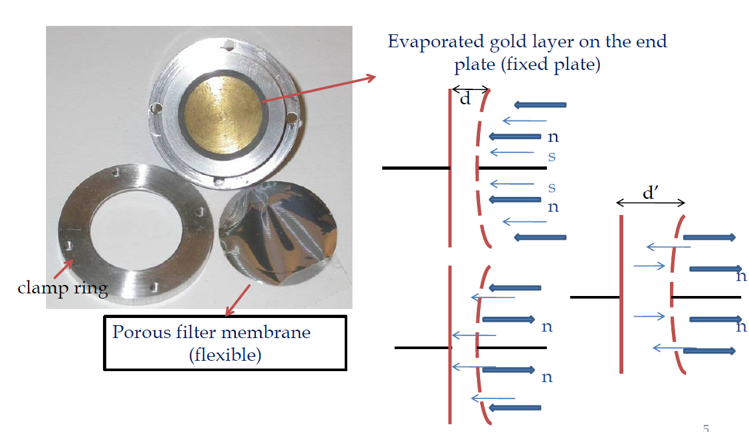
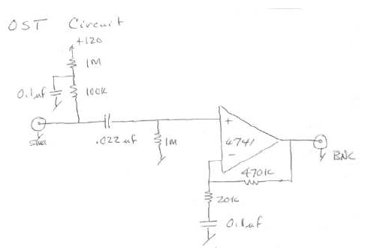
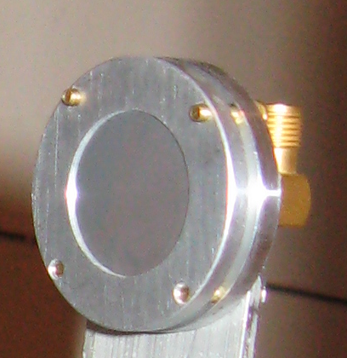
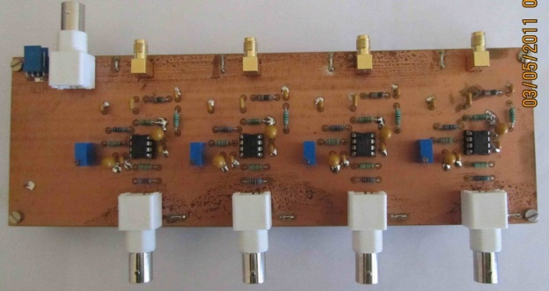
2nd sound wave sensors:
Oscillating Superleak Transducers
Kitty Liao, CERN
A flexible and porous plate is deformed by the arrival of 2nd sound wave.
This results in capacity change between the two plates (fixed and flexible)
We got 8 OSTs from Cornell, and should get some more from CERN
OSTs are polarized by a 120 V, DC, and signal is amplified and filtered by a circuit
Cornell
CEA

Slide 5
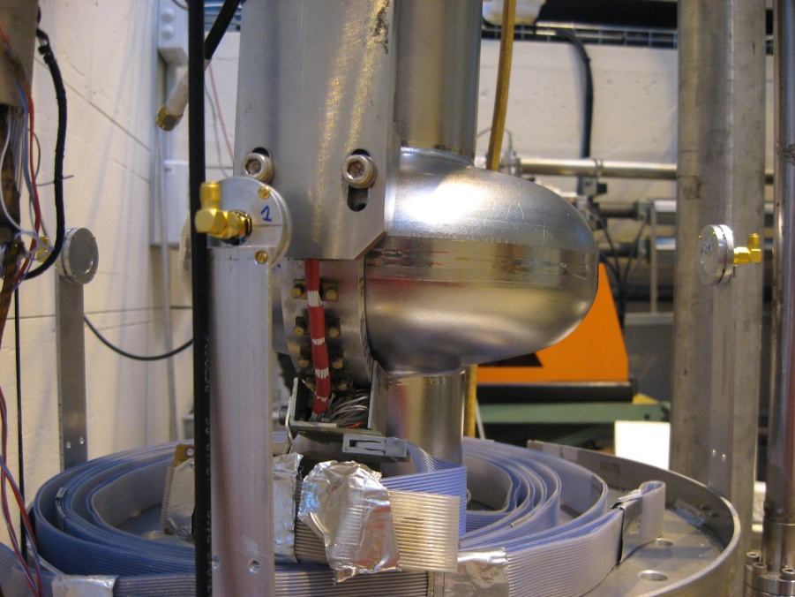
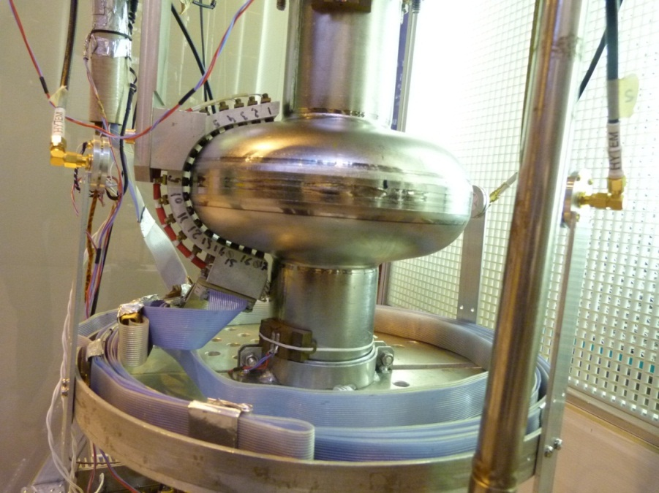
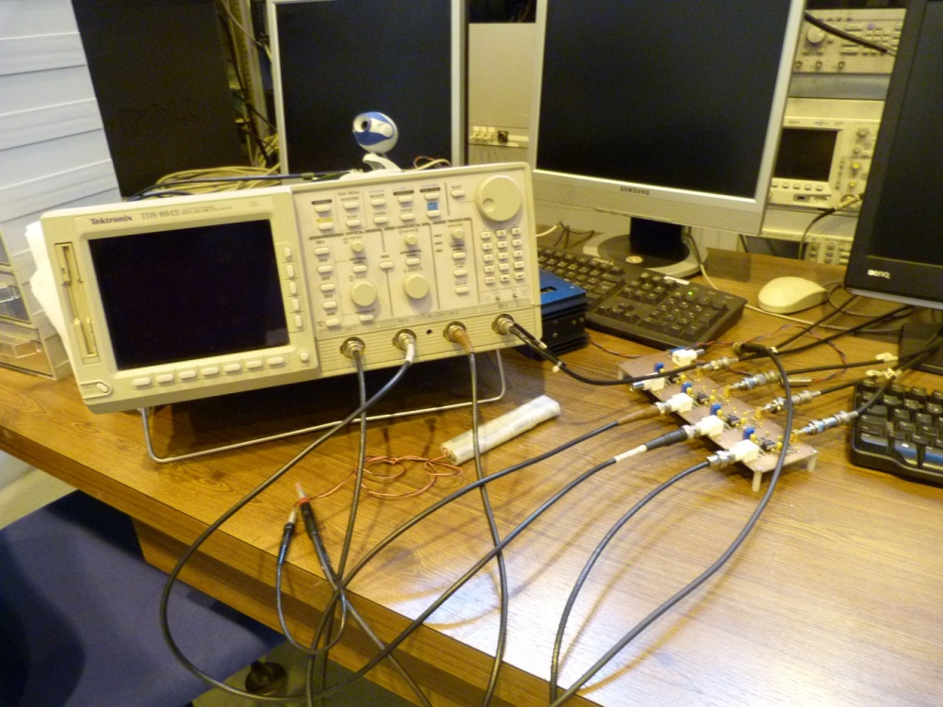
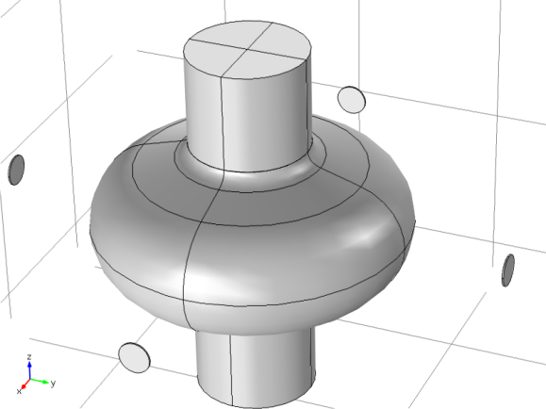
Tests on a monocell cavity in vertical cryostat at CEA
Monocell cavity 1,3 GHz
OSTs
Temperature mapping
4 OSTs are placed around the cavity, in the equator plane

Slide 6
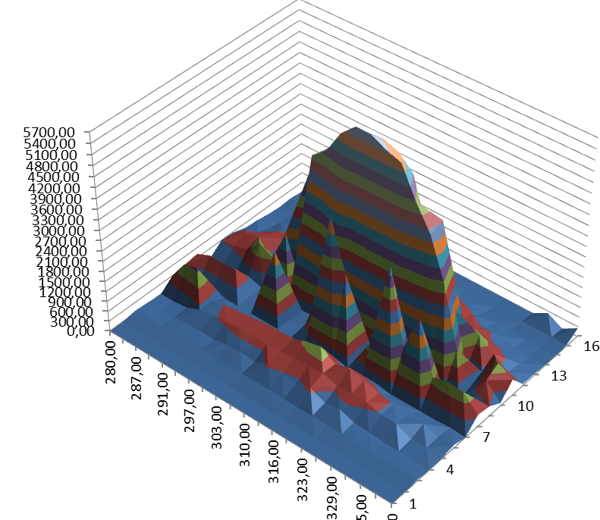
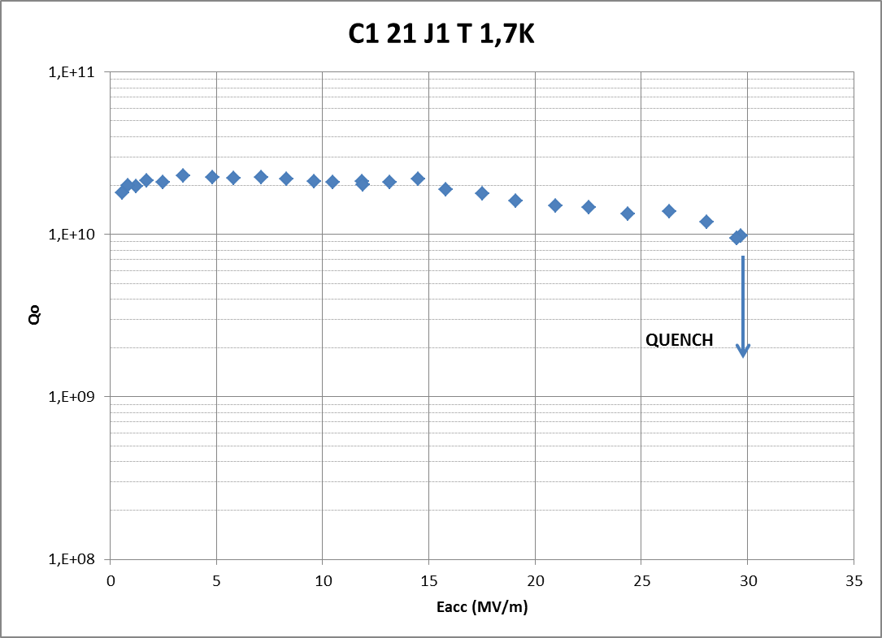
Localization with temperature mapping
30 MV/m
Sensor number
azimuth
Cavity from top
Quench is localized on the equator, between OST#2 and OST#3

Slide 7
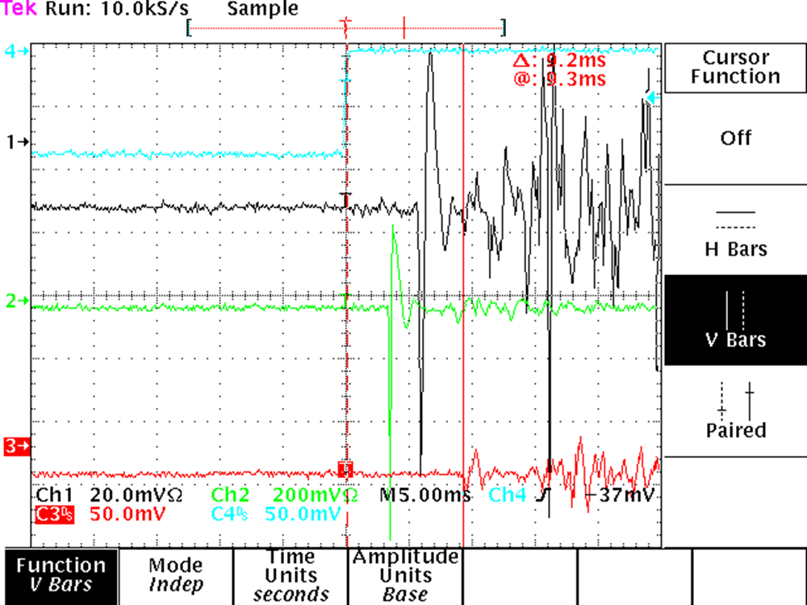
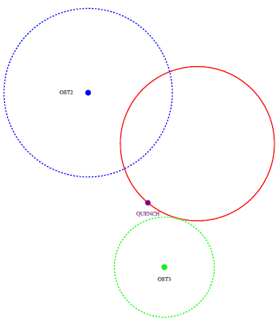
Localization with OSTs
Quench
OST # 2
OST # 3
Δt₃
OST # 4
OST # 2
Circles with diameters (Δt*20 m/s) are drawn from the 2 nearest OST (nearly in direct sight of quench location)
The circles don’t intersect : it looks like a « too fast » 2nd sound wave !
OST # 3
NB : here the triangulation is made in 2D, since quench and OSTs are in the same plane)

Slide 8
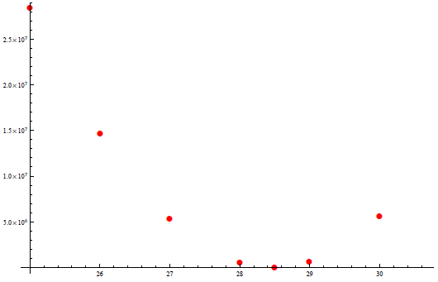
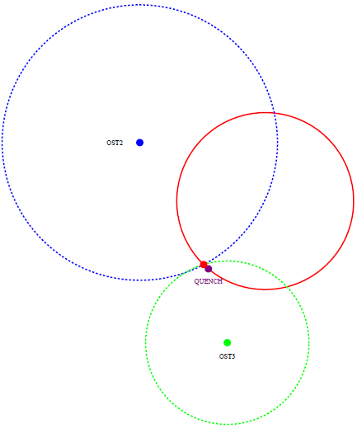
Triangulation by fonction minimization
The 2D fonction F(x,y)=
is built
The velocity v2s is used as a parameter and varied
For each v2s value, the couple (x,y), minimizing F(x,y) and being on the cavity equator is calculated
Minimum of F(x,y)
(dimensionless)
28
29
v = 20 m/s
v = 28,5 m/s
v2s (m/s)
It fits with 28.5 m/s…

Slide 9
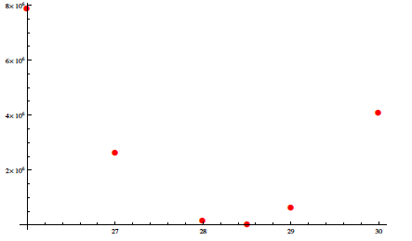
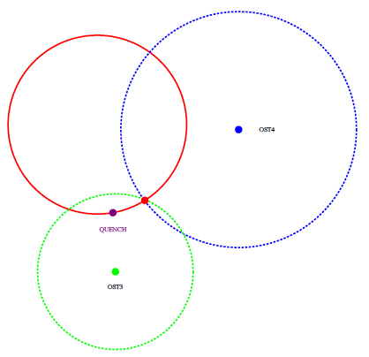
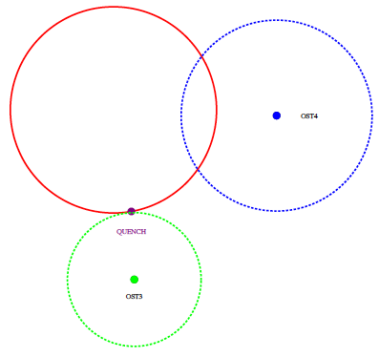
Results for another test with same cavity
The cavity still quenches on the equator (@ 30 MV/m).
Minimization of F(x,y) also leads to v=28.5 m/s
But the quench location given by this minimization is not so close from the temperature sensors location.
28 m/s
28.5 m/s
29 m/s
v = 20 m/s
OST # 4
OST # 4
Position given by temp. array
v = 28,5 m/s
OST # 3
OST # 3

Slide 10
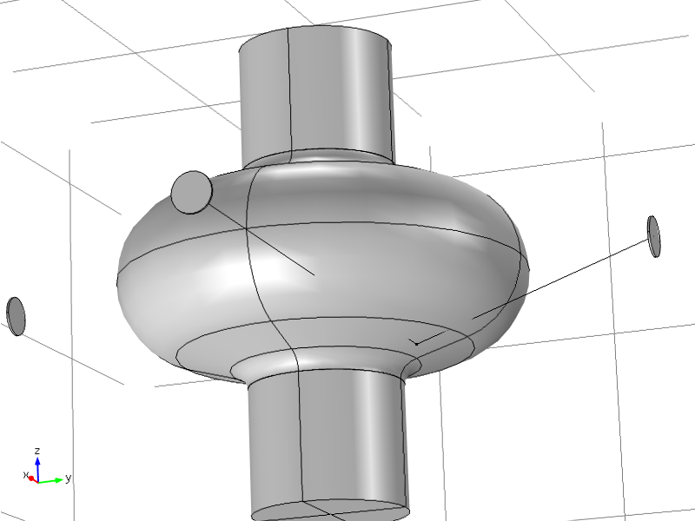
Comparison between 3 tests results
Distance to 2 closest OSTs
Time of signal arrival
Corresponding velocity
Dec. 2011, cavity A Quench @ 30 MV/m
9,5 cm | 17,5 cm
3,5 ms | 5,9 ms
27 m/s | 30 m/s
Jun. 2012, cavity A Quench @ 30 MV/m
7,2 cm | 18 cm
3,3 ms | 5 ms
22 m/s | 36 m/s
Oct. 2012, cavity B Quench @ 34 MV/m
12 cm | 16 cm
3,1 ms | 5,7 ms
39 m/s | 28 m/s
Quench near to iris
Quench at equateur
The velocity is always higher than expected 20m/s
This phenomenon of « too fast » 2nd sound wave has been found by several labs :
@ CERN (Kitty Liao)
@ DESY (Felix Schlander)

Slide 11
Hypothesis : large quench spot ??
Heat first propagates into Niobium before reaching external surface of the cavity ; then it propagates into helium.
We thus should detect a hot spot of few cm rather than a quench point
niobium
helium
t₁
t₂
t₃
« Modeling Quench Propagation in Superconducting Cavity Using COMSOL » – I. Terechkine, FNAL note
« New method to improve the accuracy of quench position measurement on a superconducting cavity by a second sound method » – Z.C. Liu and al. (Phys. Rev. Special Topics, Accelerators and Beams, sept 2012)
Quench spot of 2-3 cm
This phenomena doesn’t seem sufficient to explain « too fast » 2nd sound wave

Slide 12
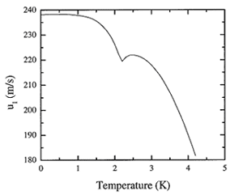
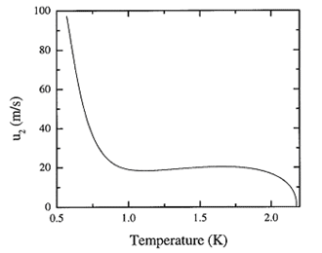
Hypothesis : 1st or 2nd sound ??
1st sound (pressure)
2nd sound (heat)
The 2nd sound wave only exists below lambda point (T<2,17 K)
between 1 et 2K : 220-240 m/s
Between 1 et 2K : env. 20 m/s
Source: R. Donnelly
Source: R. Donnelly
λ point
Hypothesis : heat from quench propagates in helium :
First as a 1st sound wave (200 m/s), since helium is locally above λ point
Then as a 2nd sound wave (20 m/s) while the power density decreases, and helium goes below λ point
This could explain the « too fast » 2nd sound wave.
1st sound
t₁
t₂
2nd sound
t₃

Slide 13
Perspectives in Saclay
Develop the 2nd sound quench localization technique
Automatization of the method
Triangulation program..
But, we have to use this method with more accuracy, and thus, learn more about the involved phenomena
Influence of the spot size
Heat propagation in He II
We plan experiments using a heater in He II to generate the heat wave
Spot size in known
Power density can be varied
and maybe experiments on a Nb cavity, where the quench would be caused at the desired Eacc by an external source (solenoid ? Laser ?)
correlation between power density and velocity of the heat wave ?

Slide 14
Thank you !

