Slide 1
Quench studies of seamless 9-cell cavities and comparison with welded cavities
Ari D. Palczewski – JLAB
P. Kneisel, R.L. Geng. G. Eremeev - JLAB
W. Singer, X. Singer, I. Jelezov - DESY
Roy Crooks - Black Laboratories L.L.C.
TESLA Technology Collaboration (TTC) Meeting November 5-8, 2012 Thomas Jefferson National Accelerator Facility
Jefferson Science Associates, LLC under U.S. DOE Contract No. DE-AC05-06OR23177

Slide 2
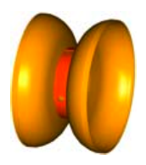
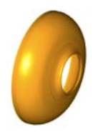
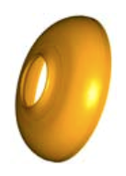
Welded cavities -19 welds + stiffening rings welds
Inside/outside iris welds
Outside equator welds
Graphic from Hitoshi Hyano

Slide 3
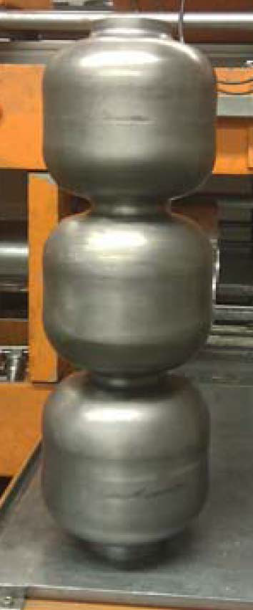
Seamless cavity manufacturing – 4 welds + stiffening rings welds
4 welds – less welds less errors
Outside iris welds only

Slide 4
9 cell Seamless cavity testing at JLAB
Z164 9 cell – welded at E. Zanon
Z163 9 cell – welded at E. Zanon
Black Labs Seamless - welded at JLAB
-(Black Laboratories, L.L.C.)

Slide 5
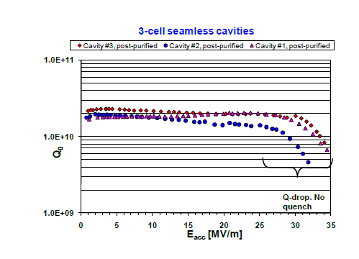
Z164 – 3-3cell All BCP and 1250C 2 hours with titanium
No FE and Q drop from BCP – no quench
Published in SRF2009, THPPO058, pg 731

Slide 6
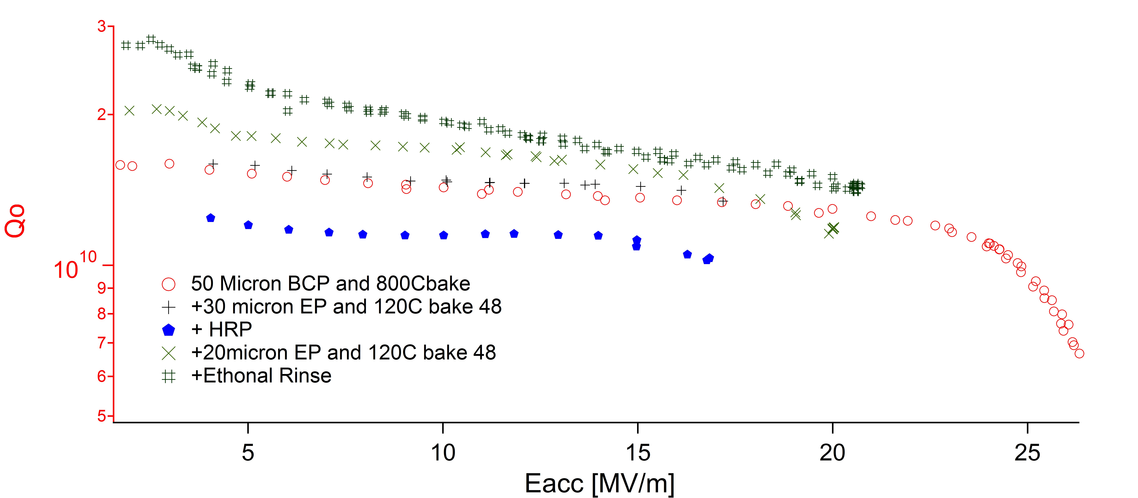
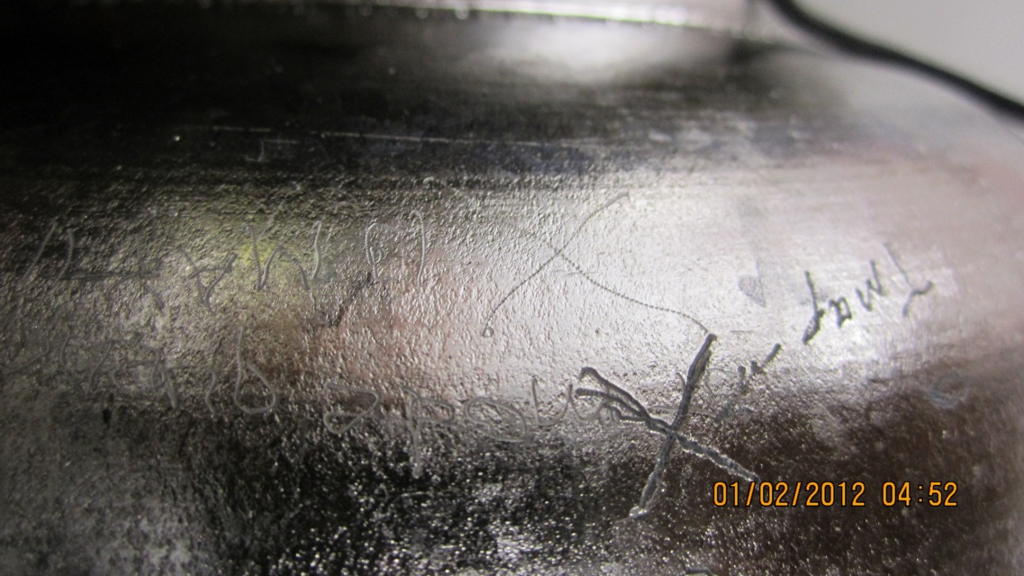
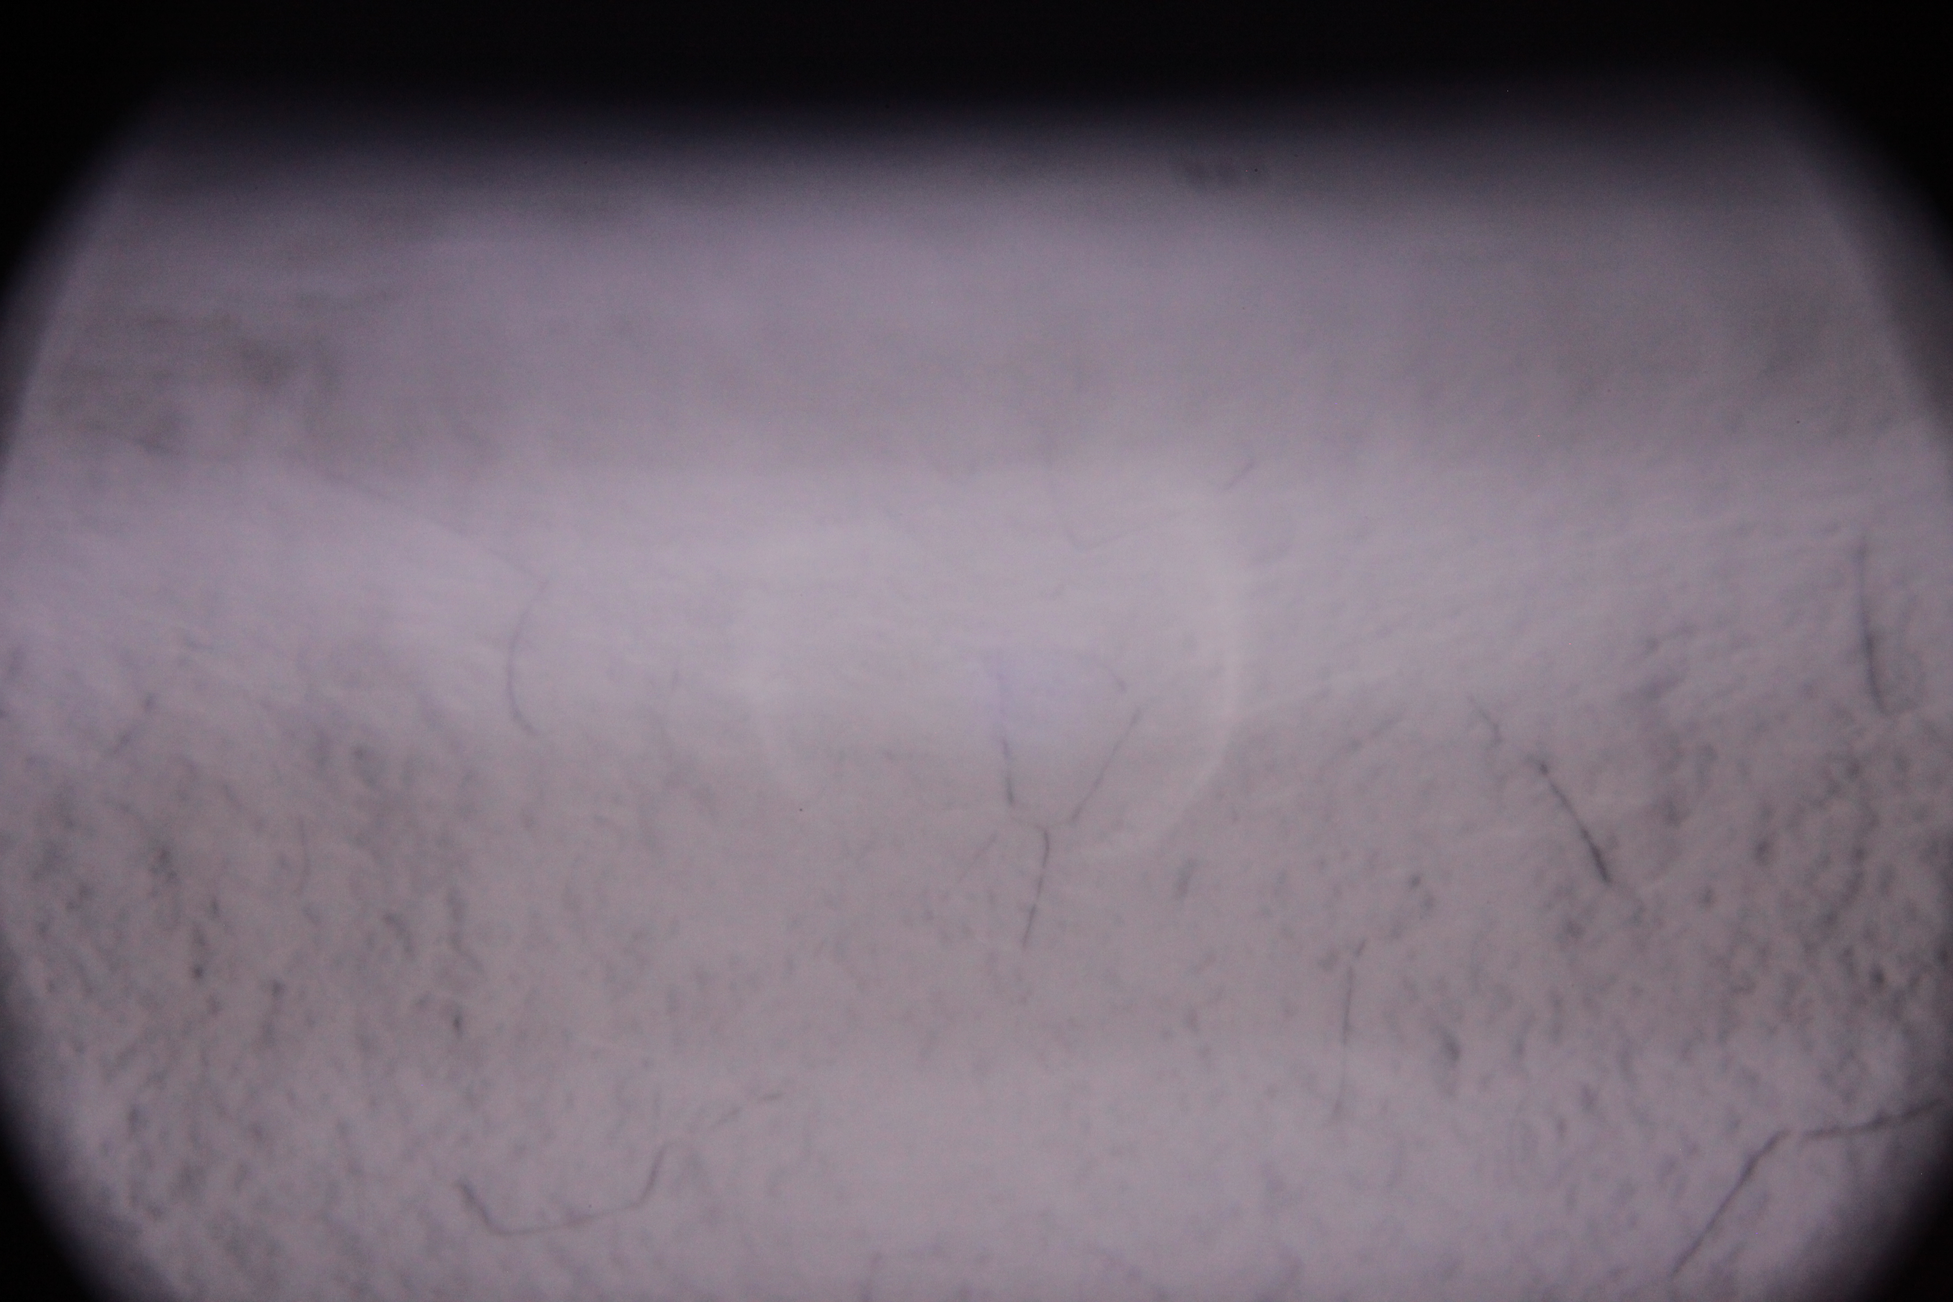
Z164 – history and quench location
Q-slope
No easily identifiable defect
But in hard to see location
OST
Cell 4

Slide 7
Z64 vs. Welded cavities (NR1)
Z164 quench no defect found 20MV/m
(nothing obvious)
NR1 cat eye defect in weld 17MV/m

Slide 8
Z163 - History
Welding of 3-3cell cavities (E. Zanon)
50 μm BCP(RI)
144 μm EP (DESY)
HT 800 C (DESY)
25 μm EP (DESY)
Alcohol rainse (DESY)
130°C for 48 h– Test 33MV/m quench cell 8 at/close to stiffing ring
-(All others go to 40MV/m)
35um EP (JLAB)
120°C for 48 h (JLab) - Test 33MV/m quench cell 9 equator
-(cell 8 @35MV/m)

Slide 9
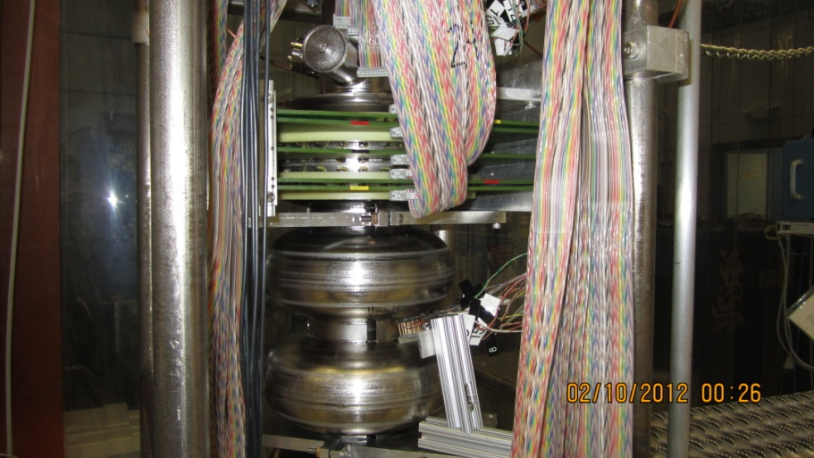
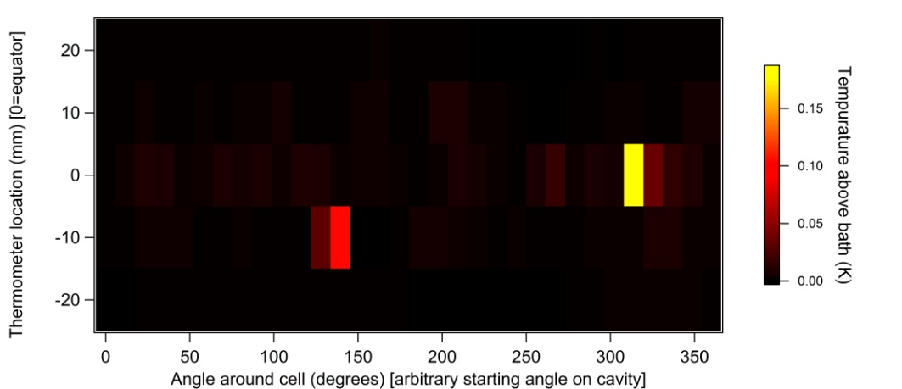
Preheating cell 9 Quench (ohmic)
No Quench below 40MV/m at DESY

Slide 10
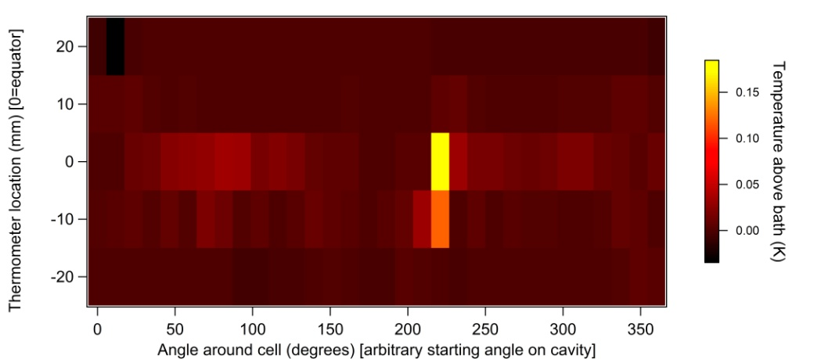
Preheating cell 1 no Quench (ohmic+? [magnetic?])
Quench @ 40MV/m at DESY

Slide 11
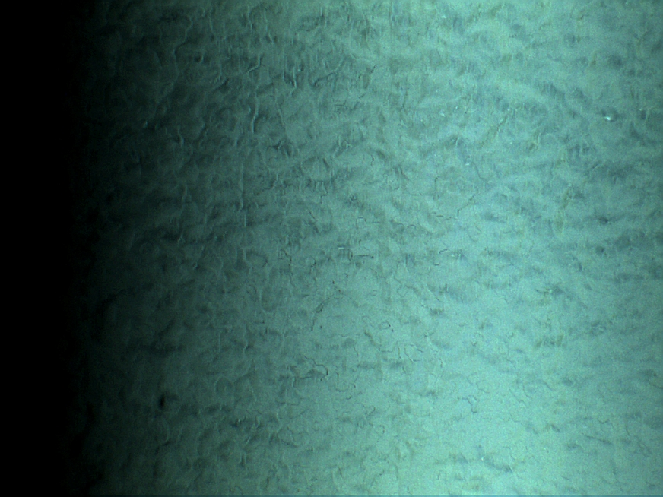
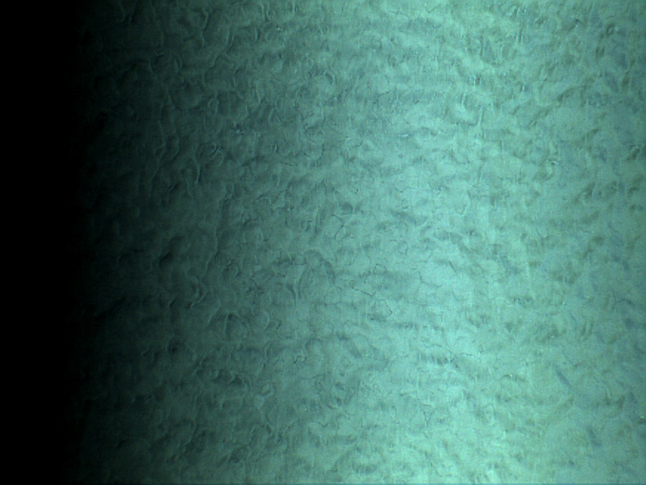
Z163 Optical inspection
Cell 9 equator quench location
Cell 9 remote location
No defect found , very rough surface
Optical inspection of cell 8 could not be completed because of location
No inspection in cell 1

Slide 12
Z163 vs. Welded cavities
Only 1 cell limits the cavity, all the rest go above 35
No defect found at high fields, similar to most high gradient cavities
A12 quench @ 32 MV/m
Z163 equator quench @ 33MV/m

Slide 13
Black labs seamless 9 BCP only - Field Emission loaded

Slide 14
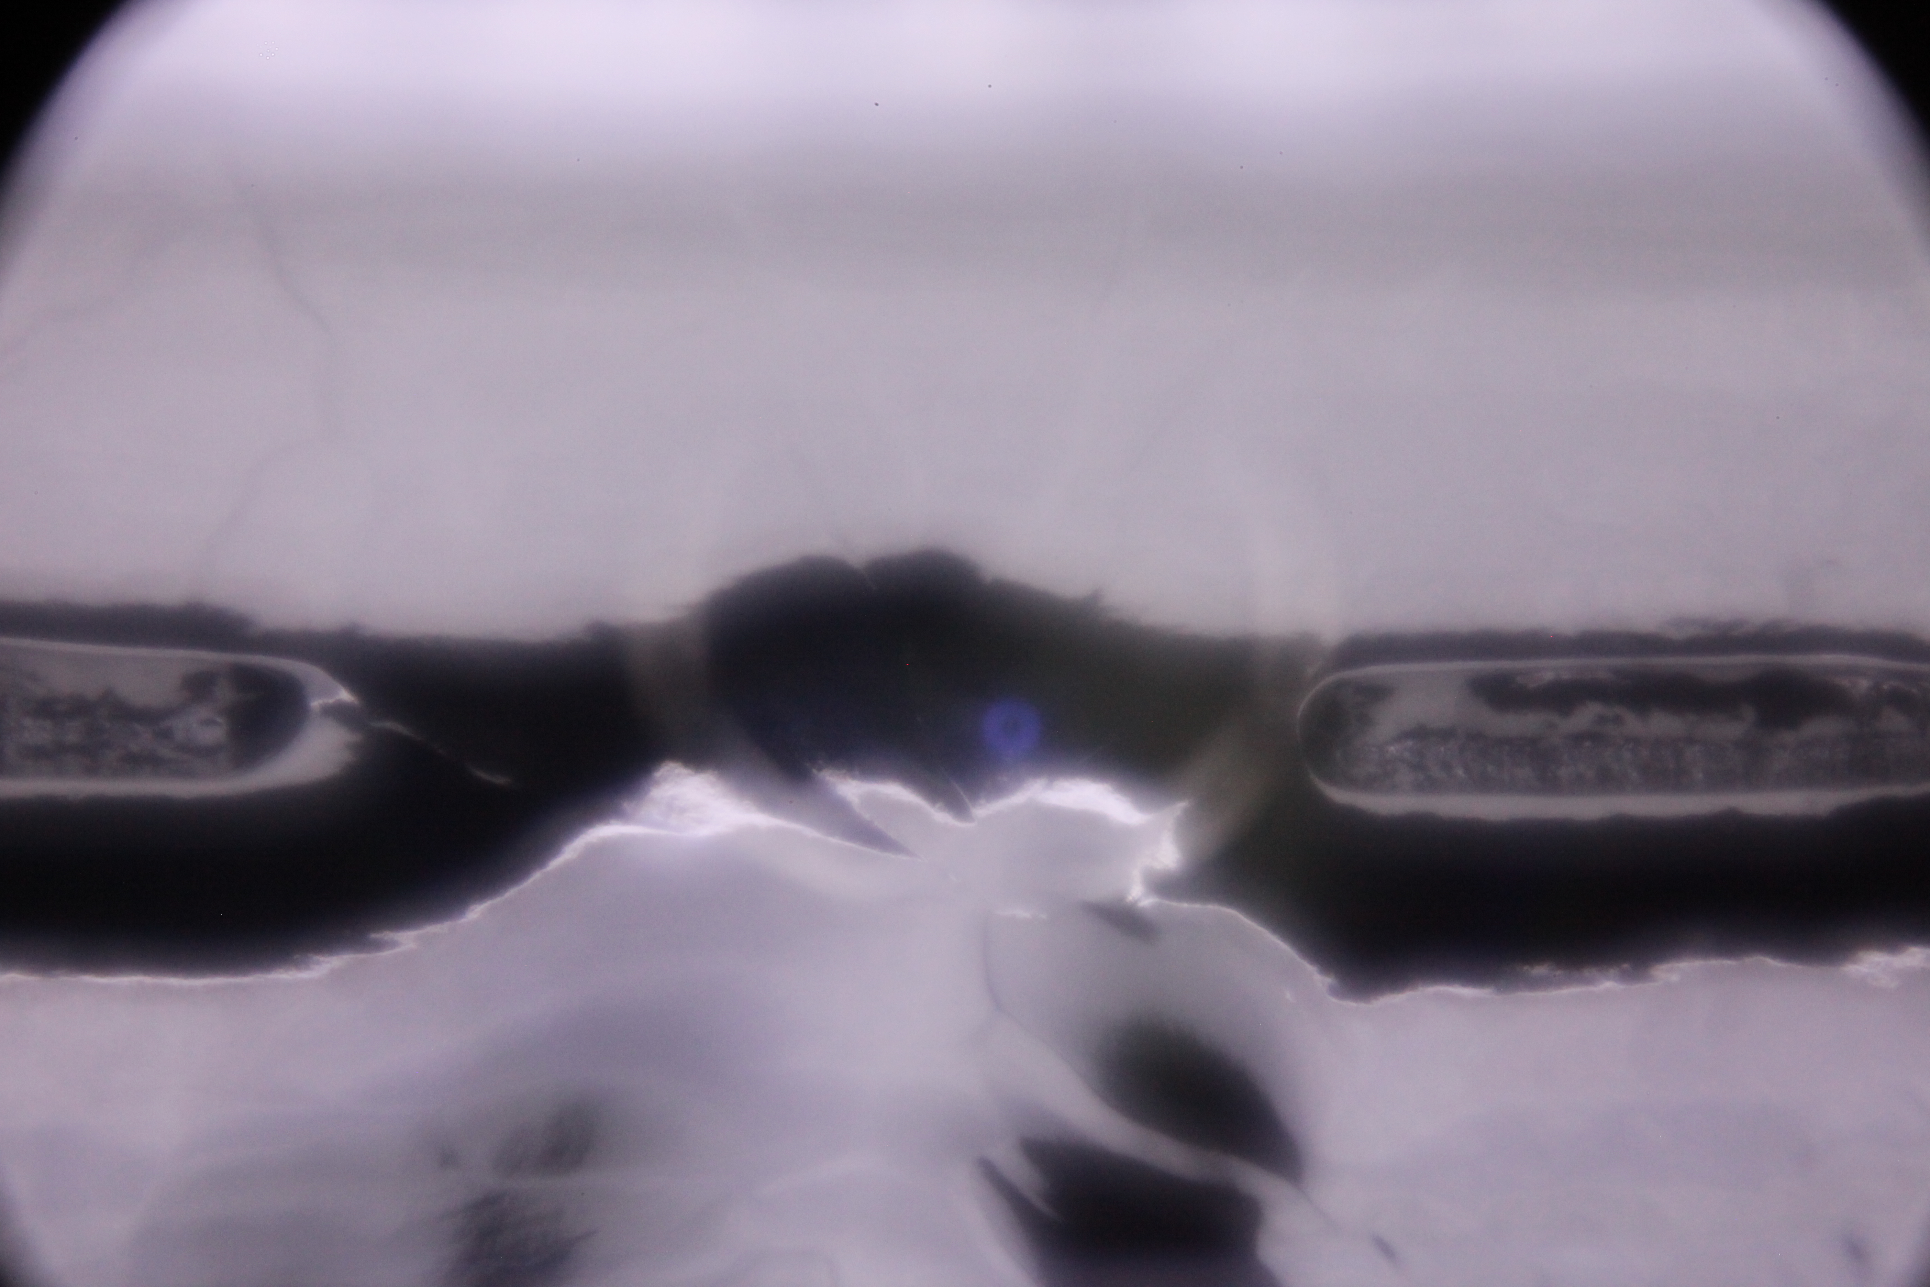
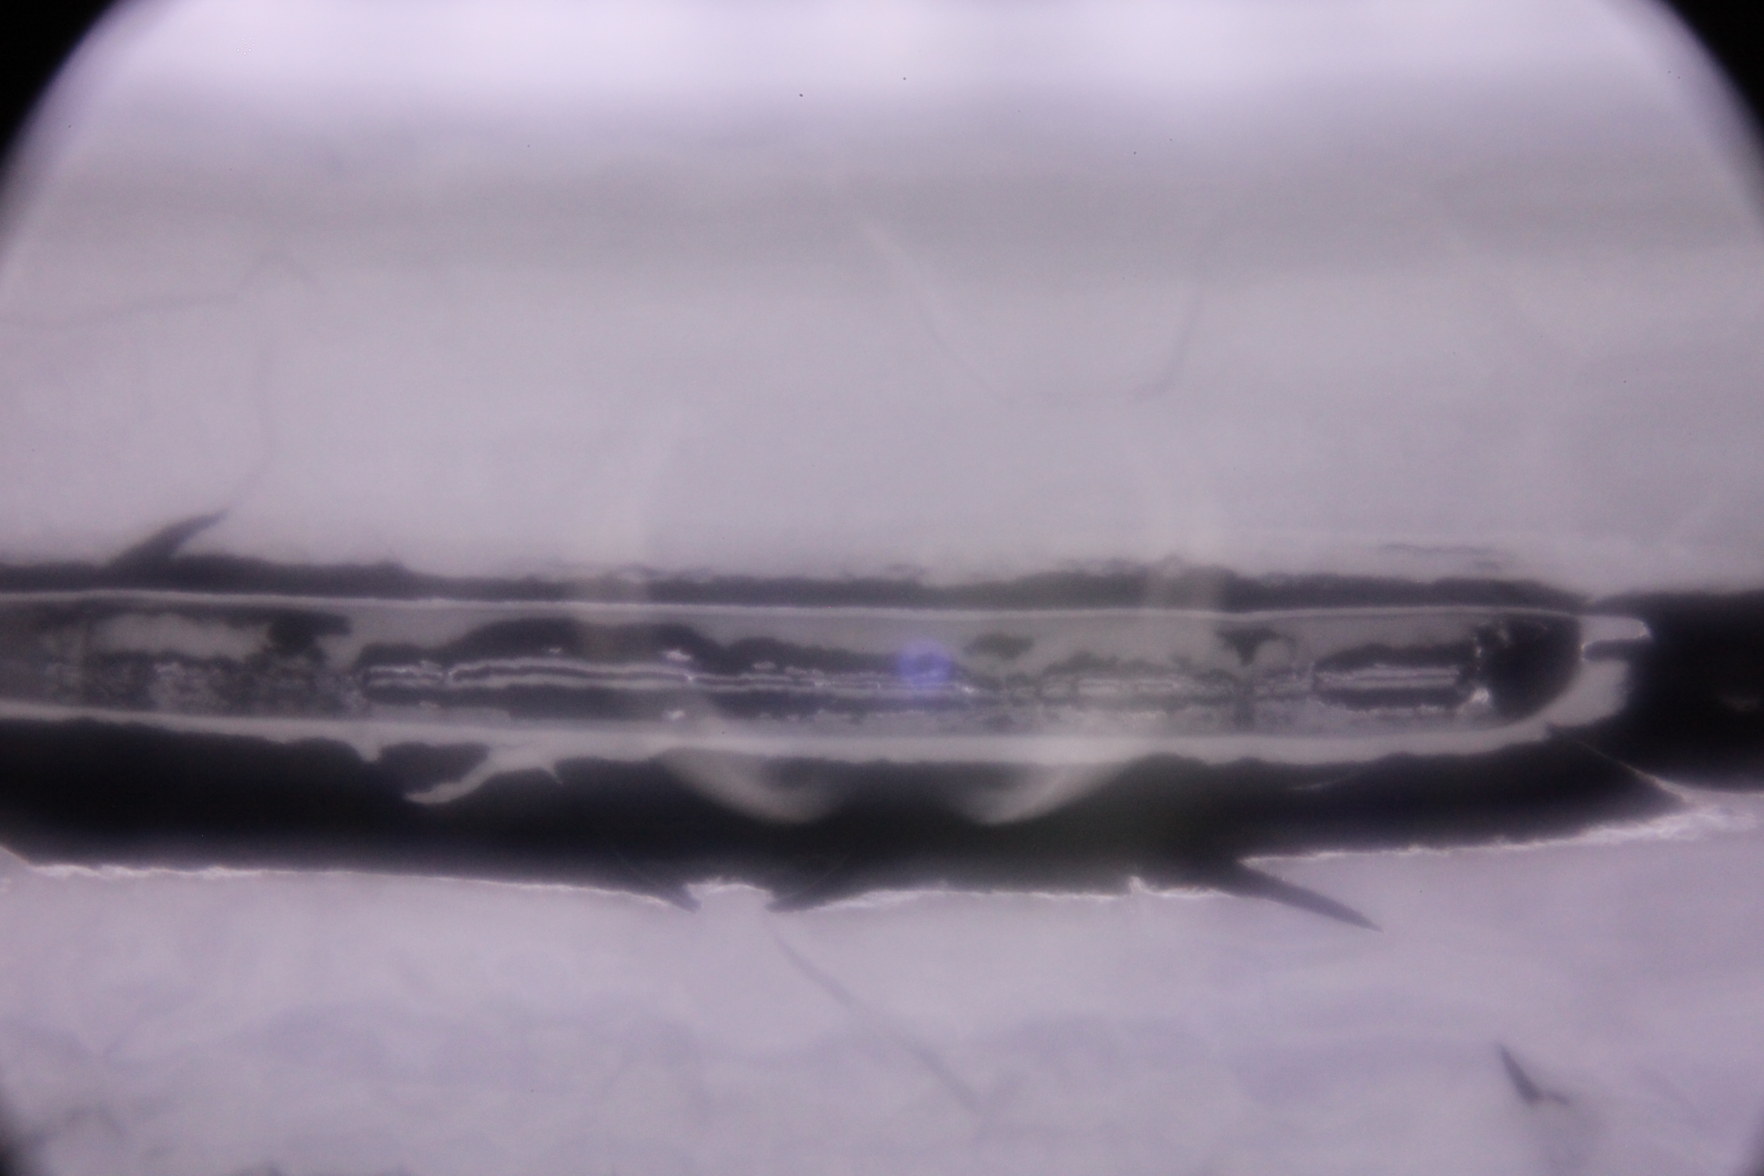
Black Labs seamless 9 Iris 4
Incomplete weld over 2 small sections of iris, FE loading

Slide 15
BL-seamless9 vs. welded c100-8 FE limited from iris defect
Iris 4 from scratch
Iris 4 from incomplete weld

Slide 16
Interesting testing and processing notes - deviation from standard cavities
All cavities have Lorenz force detuning closer to 6 Hz/(MV/m)² rather than 3.5 Hz/(MV/m)² for standard ILC (thinning on side wall above stiffening ring)
Welding for full penetration iris welds has not been optimized as well as equator full penetration welds
Electro-polishing fluctuates as the inner surface is very rough as compared to stamped/welded cavities

Slide 17
Welded vs. Seamless cavities
Both quench at low as wells as high fields.
Multi-cell cavities are still limited to a single defect in a single cell, all other cells go above 35MV/m.
Seamless cavities tend to quench off of equator?
Both have linear (ohmic) as well as non-linear preheating with field^2.
Both have no optically identifiable quench location as high fields.
Field emission has been comparable, with some cavities having more than others.
Z163 and z164 were probably contaminated from Al from now replaces fixture (see THPO055 SRF2011) – not inherent to hydro-forming.

Slide 18
Backup slides

Slide 19
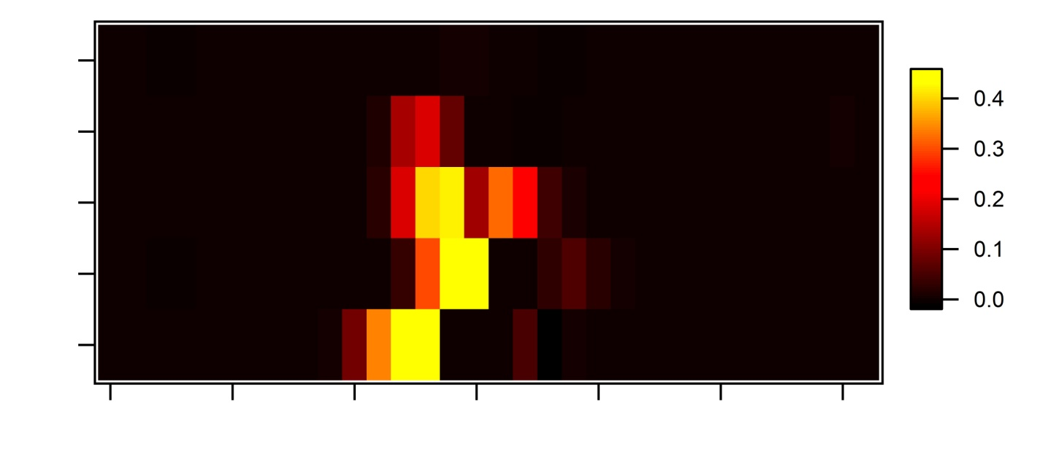
Z164 (DESY Seemless 1) – cell 4 Quench location verification with temperature mapping
T-mapping
convergent spot on broken thermometer – error is three thermometers wide
OST convergent spot-
No thermometer at location because of boards coverage area
Careful preheating not taken, but seemed to start at zero field (possibly metalic)
Quench limited at 21MV/m

Slide 20
Z164 – 3-3cell All BCP and 1250C 2 hours with titanium
No FE and Q drop from BCP – no quench
Published in SRF2009, THPPO058, pg 731

Slide 21
Individual Cell Performance Z163
Pi-mode equivalent gradient [MV/m]
Cell #

