Slide 1
A Maze-Solving Algorithm Using Quantum Computing
Jefferson Laboratory
Computing Round Table: Quantum Computing
Scott Pakin
6 March 2018
LA-UR-17-30456

Slide 2
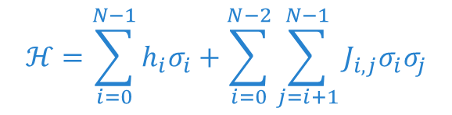
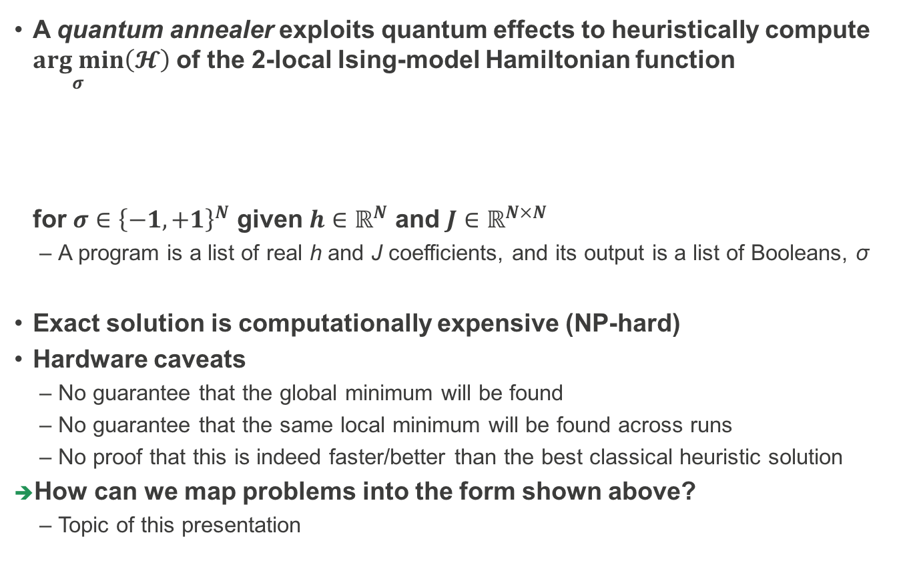
Quantum Annealing
A quantum annealer exploits quantum effects to heuristically compute $\underset{σ}{arg min}\left(𝓗\right)$ of the 2-local Ising-model Hamiltonian function
for $σ∈{\left\{−1, +1\right\}}^{N}$ given $h∈ℝ^{N}$ and $J∈ℝ^{N×N}$
  A program is a list of real h and J coefficients, and its output is a list of Booleans, σ
Exact solution is computationally expensive (NP-hard)
Hardware caveats
  No guarantee that the global minimum will be found
  No guarantee that the same local minimum will be found across runs
  No proof that this is indeed faster/better than the best classical heuristic solution
How can we map problems into the form shown above?
  Topic of this presentation
$$ℋ=\sum_{i=0}^{N−1}{h_{i}σ_{i}}+\sum_{i=0}^{N−2}{\sum_{j=i+1}^{N−1}{J_{i,j}σ_{i}σ_{j}}}$$

Slide 3
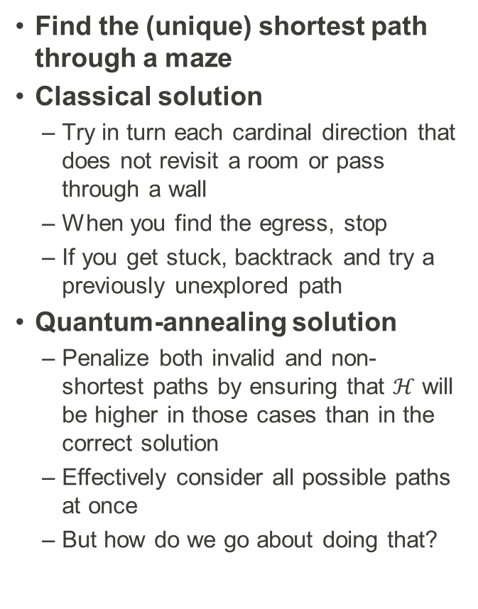
Running Example
Find the (unique) shortest path through a maze
Classical solution
  Try in turn each cardinal direction that does not revisit a room or pass through a wall
  When you find the egress, stop
  If you get stuck, backtrack and try a previously unexplored path
Quantum-annealing solution
  Penalize both invalid and non-shortest paths by ensuring that $ℋ$ will be higher in those cases than in the correct solution
  Effectively consider all possible paths at once
  But how do we go about doing that?
A
B
C
D
E
F
1
2
3
4
5
Ta da!
6

Slide 4
Running Example
Find the (unique) shortest path through a maze
Classical solution
  Try in turn each cardinal direction that does not revisit a room or pass through a wall
  When you find the egress, stop
  If you get stuck, backtrack and try a previously unexplored path
Quantum-annealing solution
  Penalize both invalid and non-shortest paths by ensuring that $ℋ$ will be higher in those cases than in the correct solution
  Effectively consider all possible paths at once
  But how do we go about doing that?
A
B
C
D
E
F
1
2
3
4
5
6

Slide 5
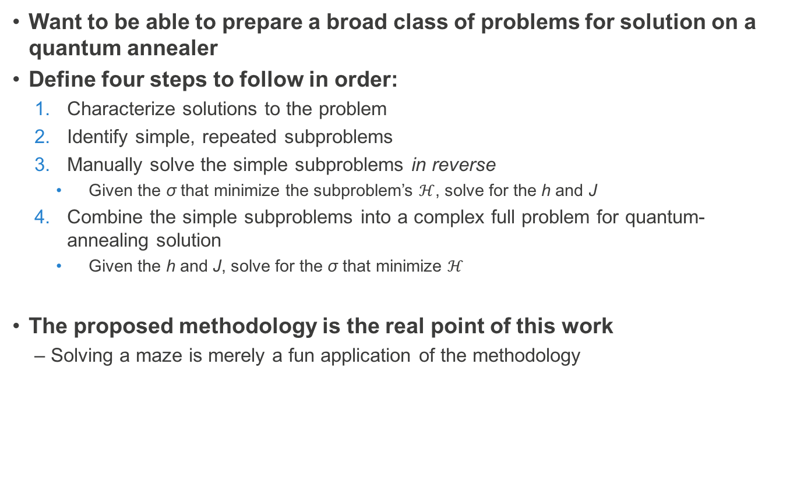
Methodology
Want to be able to prepare a broad class of problems for solution on a quantum annealer
Define four steps to follow in order:
  Characterize solutions to the problem
  Identify simple, repeated subproblems
  Manually solve the simple subproblems in reverse
    Given the σ that minimize the subproblem’s $ℋ$, solve for the h and J
  Combine the simple subproblems into a complex full problem for quantum-annealing solution
    Given the h and J, solve for the σ that minimize $ℋ$
The proposed methodology is the real point of this work
  Solving a maze is merely a fun application of the methodology

Slide 6

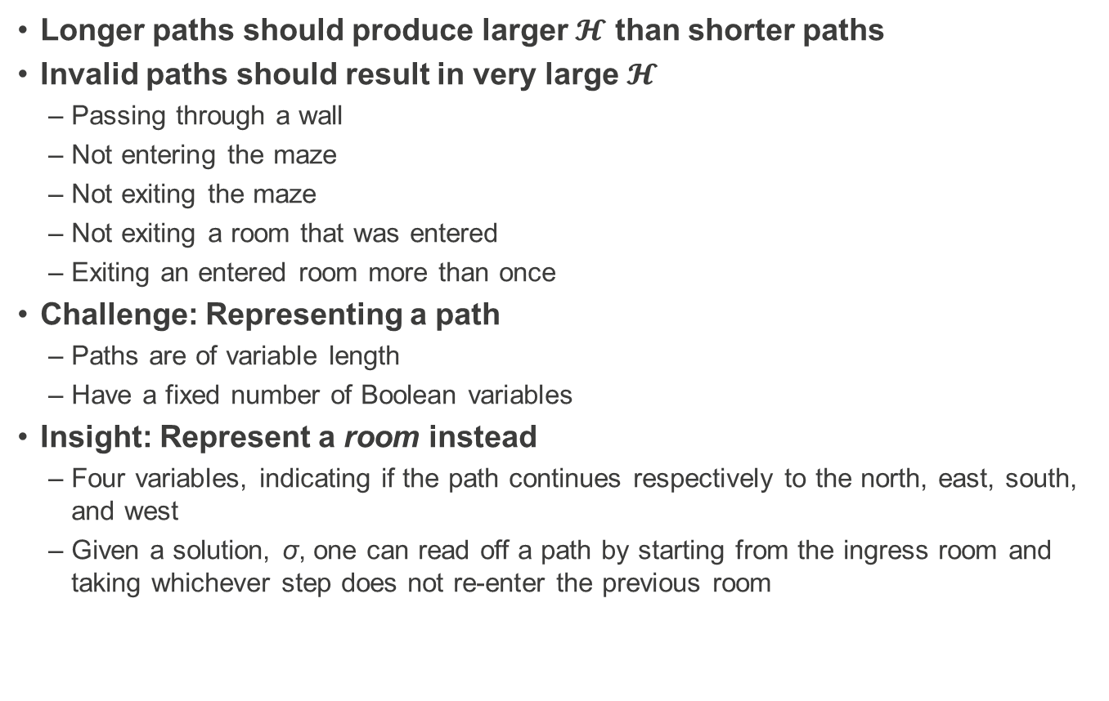
Step 1: Characterize Solutions
Longer paths should produce larger $𝓗$ than shorter paths
Invalid paths should result in very large $𝓗$
  Passing through a wall
  Not entering the maze
  Not exiting the maze
  Not exiting a room that was entered
  Exiting an entered room more than once
Challenge: Representing a path
  Paths are of variable length
  Have a fixed number of Boolean variables
Insight: Represent a room instead
  Four variables, indicating if the path continues respectively to the north, east, south, and west
  Given a solution, σ, one can read off a path by starting from the ingress room and taking whichever step does not re-enter the previous room
$$\begin{matrix} & σ_{N} & \\ σ_{W} & & σ_{E} \\ & σ_{S} & \end{matrix}$$

Slide 7

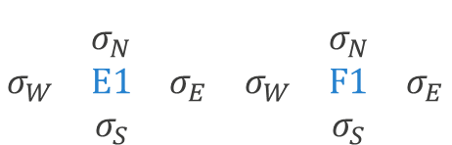

Step 2: Identify Subproblems
The ingress and egress must both be used
  Technically, no difference between the two
A path must not pass through a wall
The subpath that goes through each room must be valid
Want F1’s $σ_{N}$ to be True
Want E1’s $σ_{W}$ to be False
$$\begin{matrix} & & & & & \\ & σ_{N} & & & σ_{N} & \\ σ_{W} & E1 & σ_{E} & σ_{W} & F1 & σ_{E} \\ & σ_{S} & & & σ_{S} & \end{matrix}$$

Slide 8
Step 2: Identify Subproblems
The ingress and egress must both be used
  Technically, no difference between the two
A path must not pass through a wall
The subpath that goes through each room must be valid
✅
❎
✅
✅
❎
❎

Slide 9
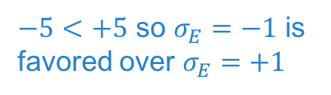
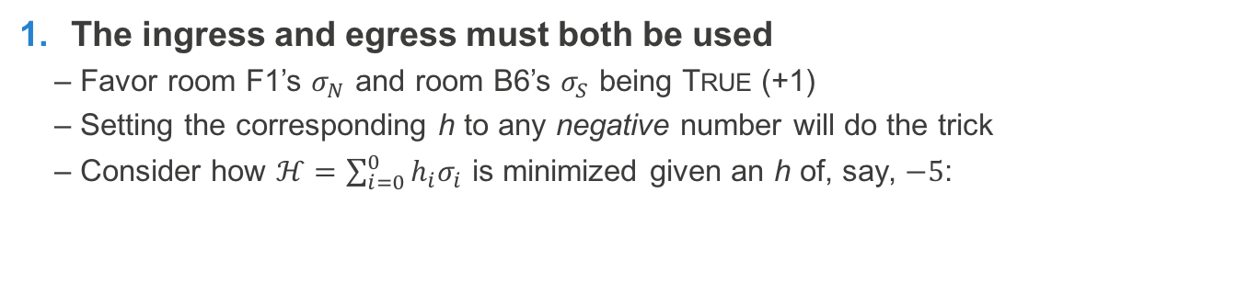
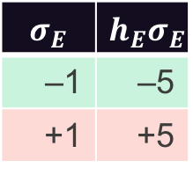

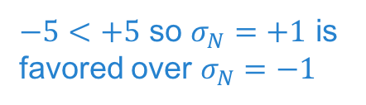
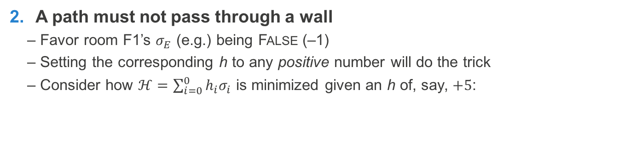
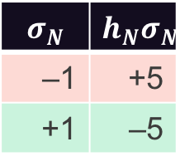

Step 3: Manually Solve the Simple Subproblems
The ingress and egress must both be used
  Favor room F1’s $σ_{N}$ and room B6’s $σ_{S}$ being True (+1)
  Setting the corresponding h to any negative number will do the trick
  Consider how $ℋ=\sum_{i=0}^{0}{h_{i}σ_{i}}$ is minimized given an h of, say, $−5$:
$$σ_{N}$$ | $$h_{N}σ_{N}$$
–1 | +5
+1 | –5
$$\begin{matrix} & σ_{N} & \\ σ_{W} & F1 & σ_{E} \\ & σ_{S} & \end{matrix}$$
$−5<+5$ so $σ_{N}=+1$ is favored over $σ_{N}=−1$
A path must not pass through a wall
  Favor room F1’s $σ_{E}$ (e.g.) being False (–1)
  Setting the corresponding h to any positive number will do the trick
  Consider how $ℋ=\sum_{i=0}^{0}{h_{i}σ_{i}}$ is minimized given an h of, say, $+5$:
$$σ_{E}$$ | $$h_{E}σ_{E}$$
–1 | –5
+1 | +5
$$\begin{matrix} & σ_{N} & \\ σ_{W} & F1 & σ_{E} \\ & σ_{S} & \end{matrix}$$
$−5<+5$ so $σ_{E}=−1$ is favored over $σ_{E}=+1$

Slide 10
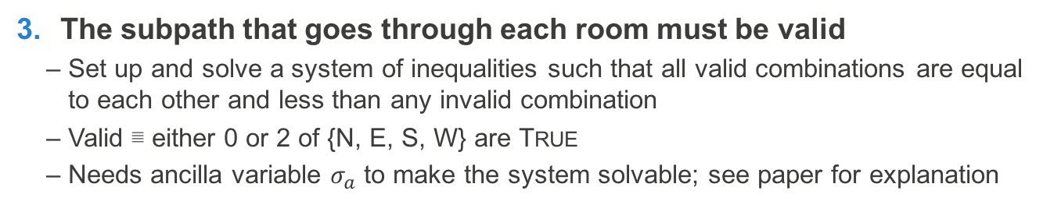
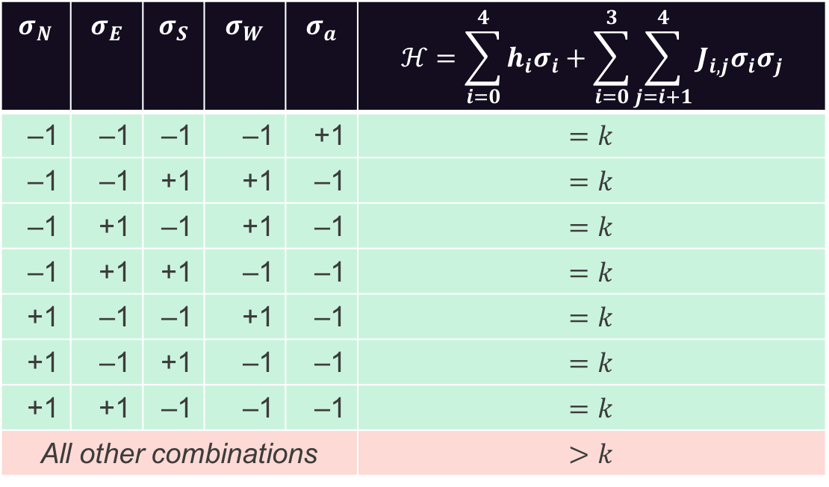
Step 3: Manually Solve the Simple Subproblems
The subpath that goes through each room must be valid
  Set up and solve a system of inequalities such that all valid combinations are equal to each other and less than any invalid combination
  Valid ≣ either 0 or 2 of {N, E, S, W} are True
  Needs ancilla variable $σ_{a}$ to make the system solvable; see paper for explanation
$$σ_{N}$$ | $$σ_{E}$$ | $$σ_{S}$$ | $$σ_{W}$$ | $$σ_{a}$$ | $$ℋ=\sum_{i=0}^{4}{h_{i}σ_{i}}+\sum_{i=0}^{3}{\sum_{j=i+1}^{4}{J_{i,j}σ_{i}σ_{j}}}$$
–1 | –1 | –1 | –1 | +1 | $$=k$$
–1 | –1 | +1 | +1 | –1 | $$=k$$
–1 | +1 | –1 | +1 | –1 | $$=k$$
–1 | +1 | +1 | –1 | –1 | $$=k$$
+1 | –1 | –1 | +1 | –1 | $$=k$$
+1 | –1 | +1 | –1 | –1 | $$=k$$
+1 | +1 | –1 | –1 | –1 | $$=k$$
All other combinations |  |  |  |  | $$>k$$

Slide 11
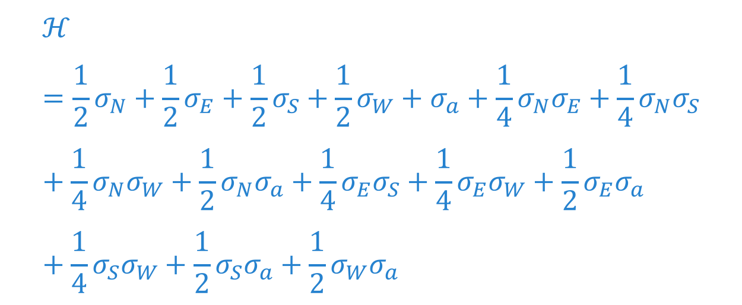
Step 3: Manually Solve the Simple Subproblems
The subpath that goes through each room must be valid
  Set up and solve a system of inequalities such that all valid combinations are equal to each other and less than any invalid combination
  Valid ≣ either 0 or 2 of {N, E, S, W} are True
  Needs ancilla variable $σ_{a}$ to make the system solvable; see paper for explanation
$$ℋ=\frac{1}{2}σ_{N}+\frac{1}{2}σ_{E}+\frac{1}{2}σ_{S}+\frac{1}{2}σ_{W}+σ_{a}+\frac{1}{4}σ_{N}σ_{E}+\frac{1}{4}σ_{N}σ_{S}+\frac{1}{4}σ_{N}σ_{W}+\frac{1}{2}σ_{N}σ_{a}+\frac{1}{4}σ_{E}σ_{S}+\frac{1}{4}σ_{E}σ_{W}+\frac{1}{2}σ_{E}σ_{a}+\frac{1}{4}σ_{S}σ_{W}+\frac{1}{2}σ_{S}σ_{a}+\frac{1}{2}σ_{W}σ_{a}$$

Slide 12
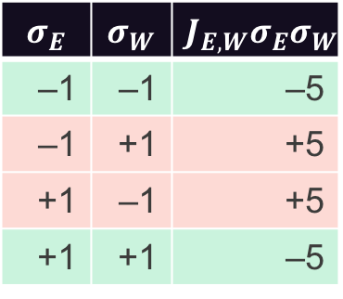
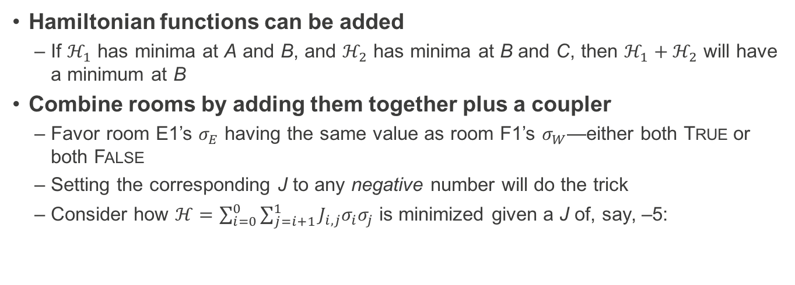
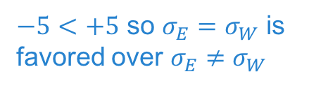
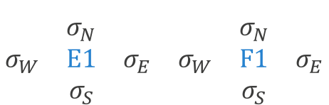
Step 4: Combine Subproblems
Hamiltonian functions can be added
  If $ℋ_{1}$ has minima at A and B, and $ℋ_{2}$ has minima at B and C, then $ℋ_{1}+ℋ_{2}$ will have a minimum at B
Combine rooms by adding them together plus a coupler
  Favor room E1’s $σ_{E}$ having the same value as room F1’s $σ_{W}$—either both True or both False
  Setting the corresponding J to any negative number will do the trick
  Consider how $ℋ=\sum_{i=0}^{0}{\sum_{j=i+1}^{1}{J_{i,j}σ_{i}σ_{j}}}$ is minimized given a J of, say, –5:
$$σ_{E}$$ | $$σ_{W}$$ | $$J_{E,W}σ_{E}σ_{W}$$
–1 | –1 | –5
–1 | +1 | +5
+1 | –1 | +5
+1 | +1 | –5
$$\begin{matrix} & & & & & \\ & σ_{N} & & & σ_{N} & \\ σ_{W} & E1 & σ_{E} & σ_{W} & F1 & σ_{E} \\ & σ_{S} & & & σ_{S} & \end{matrix}$$
$−5<+5$ so $σ_{E}=σ_{W}$ is favored over $σ_{E}≠σ_{W}$

Slide 13
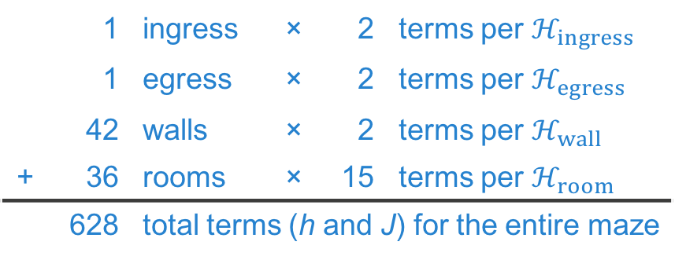
The Final Hamiltonian Function
Too big to list here in its entirety, but here’s a summary:
Requires 219 variables (σ)
Maps to 580.25 ± 39.71 physical qubits on LANL’s D‑Wave 2X quantum annealer
  Physical topology is a degree-6 graph—very sparse for what we need
  Randomized, heuristic embedder maps logical variables to one or more physical qubits and adjusts h and J coefficients accordingly
 | 1 | ingress | × | 2 | terms per $ℋ_{ingress}$
 | 1 | egress | × | 2 | terms per $ℋ_{egress}$
 | 42 | walls | × | 2 | terms per $ℋ_{wall}$
+ | 36 | rooms | × | 15 | terms per $ℋ_{room}$
 | 628 | total terms (h and J) for the entire maze

Slide 14
Evaluation
Performance
  Measured complete, end-to-end performance, including compilation, remote job enqueuing, and execution (10,000 anneals) on the quantum annealer
  Total time: 20.3 ± 14.8 seconds
  Slow for a 6×6 maze but only 0.2 seconds were actually spent on the 10,000 anneals
Correctness
  All quantum computers, including quantum annealers, are stochastic devices
  How many times do we need to run the maze program to get a correct answer?
Annealing time (μs) | Correct solutions |  | Correct solutions with postprocessing
5 | 7 | (1.4/s) | 4,730 | (946.0/s)
20 | 241 | (12.1/s) | 4,561 | (228.1/s)
2000 | 394 | (0.2/s) | 505,905 | (253.0/s)

Slide 15
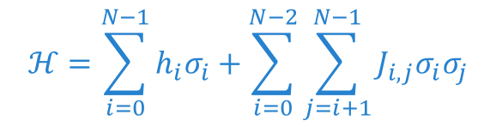
Summary
Proposed a methodology to map problems into the form
Defined a four-step process:
  Characterize solutions to the problem
  Identify simple, repeated subproblems
  Manually solve the simple subproblems in reverse
  Combine the simple subproblems into a complex full problem for quantum-annealing solution
Demonstrated the approach on maze solution
  Basic idea: If each room has a valid—including empty—path through it, then then the global path is both correct and minimal
Designed to be a general technique
  Circuit satisfiability: Subproblem is a binary operator (and, or, not, etc.)
  Map coloring: Subproblem is a region of the map
Now go forth and program a quantum annealer!
$$ℋ=\sum_{i=0}^{N−1}{h_{i}σ_{i}}+\sum_{i=0}^{N−2}{\sum_{j=i+1}^{N−1}{J_{i,j}σ_{i}σ_{j}}}$$

