Slide 1
ESnet6 Project update
Patty Giuntoli
Presented to JLab
3-April-2018

Slide 2

Each generation of ESnet is a project as well as a transformation of the facility:
ESnet6 is a significant change for the organization
MFEnet and HEPnet
(1986)
ESnet 1
ESnet 2
ESnet 3: Sprint ATM
ESnet 4: 2005 – 2011
Science Data Networking (SDN)
Carrier Services
ESnet 5: 2011 -
100G, Packet & Optical
ESnet performs optical design and provisioning
ESnet6: 2022-
Greenfield optical build, programmable network, n Tbps

Slide 3
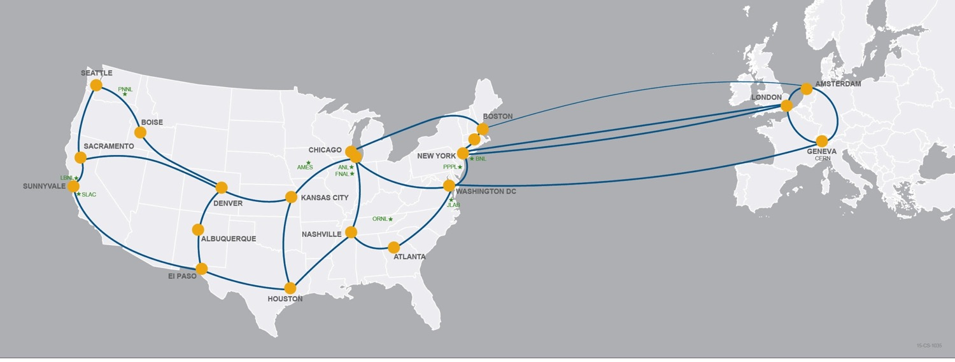
ESnet is a dedicated mission network engineered to accelerate a broad range of science outcomes.
ESnet5 has provided unique capabilities, optimized for science, since 2011
Now, ESnet5 infrastructure is nearing end-of-life and capacity demands continue to increase, driving the need for a new network: ESnet6
To continue to meet Mission needs, capability gaps must be resolved:
Capacity: Network must be able to serve increasing demand
Reliability and Resiliency: Replace end-of-life equipment, improve cybersecurity protection
Flexibility: Network needs to adapt to changing compute models, multi-facility workflows (superfacility), real-time data analysis, streaming
ASCR approved ESnet6 Mission Needs (CD0) December 2016
Notes:
Capacity
Support for High Luminosity LHC for HEP projecting 16x increase in data
Data-Intensive science and experiments ex. Light sources need 1 Tbps
Supporting convergence of compute and data systems through ECP

Slide 4
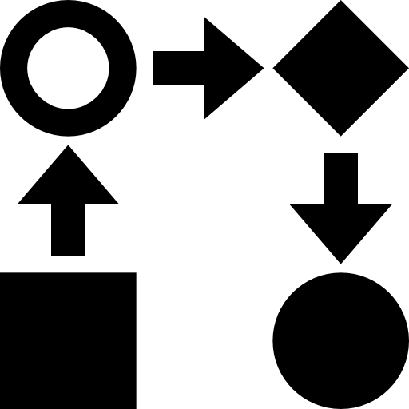


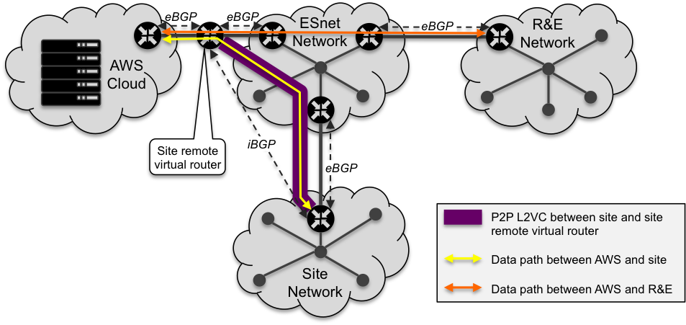
ESnet6 Architecture Design Process
Input on requirements are documented as workflows, which are then formalized as services, driving the technical requirements.
Workflows
Example workflow:
Use of Cloud compute resources as an extension of the site’s resources.
Services
Example Service:
Virtual Private Cloud
Service Description
Service Attributes
  Scale
  Scope
  Demarcation
Functional Requirements
Technical
Requirements
Example Requirements:
L2VPN
  EVPN
  MPLS
  ISIS-SR
  BGP-SR-TE
e/iBGP
…

Slide 5
Service attributes & Defining characteristics
Services
Characteristics that define end-user services
Drive functional & technical requirements:
hardware, software, systems components
Scale & Scope
Defines required hardware capabilities
Control & data-plane interaction
Defines software functions needed to support the services
Service Level Expectations
Defines systems behavior

Slide 6
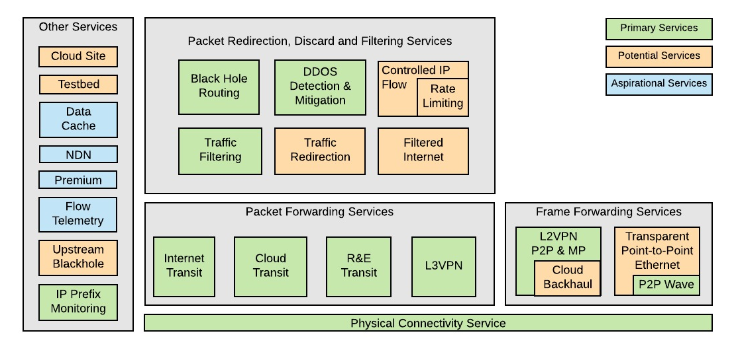
ESnet6 Network Services

Slide 7
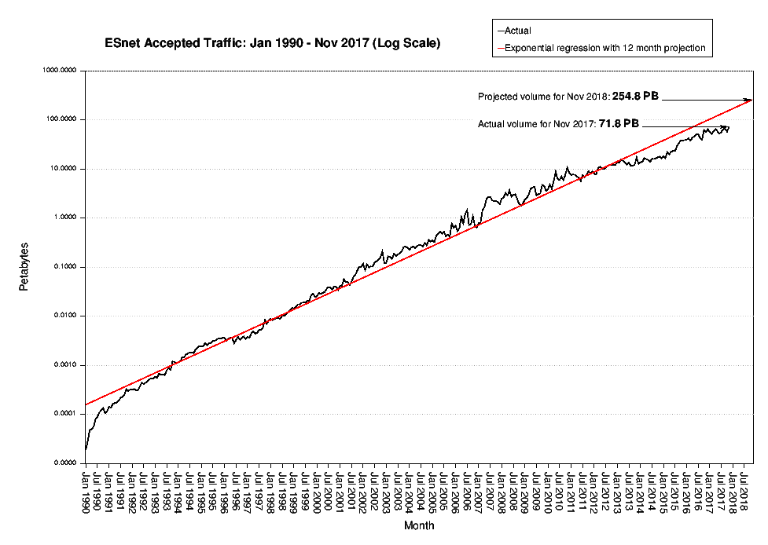
Our vision drives four major approaches.
Mission Need #1: Capacity and Capability to handle exponential traffic growth
Factor of 10 growth every 47 months
77 PB – Dec ‘17

Slide 8
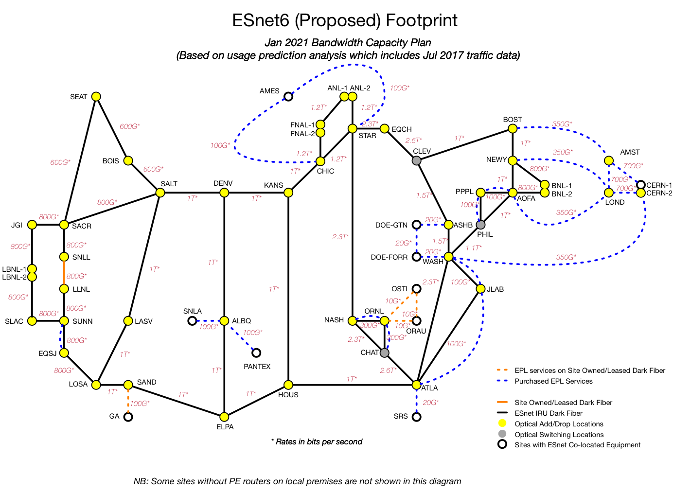
ESnet6 Day-1 Planned Capacity (Jan 2021)
Notes:
output of traffic projection for day 1 ESnet6
This chart is our near term driver for capacity
handout
East coast to Chicago is highest bw area
working to automate
expect to repeat analysis every 6 mos
SNMP counters for edge interfaces
Netflow data
6 months of netflow -> develop traffic matrix
Scale per-router totals accoording to long term trendline
Lay out this traffic on ESnet6 topo
- netflow traffic matrix
Account for bursts: 5x

Slide 9
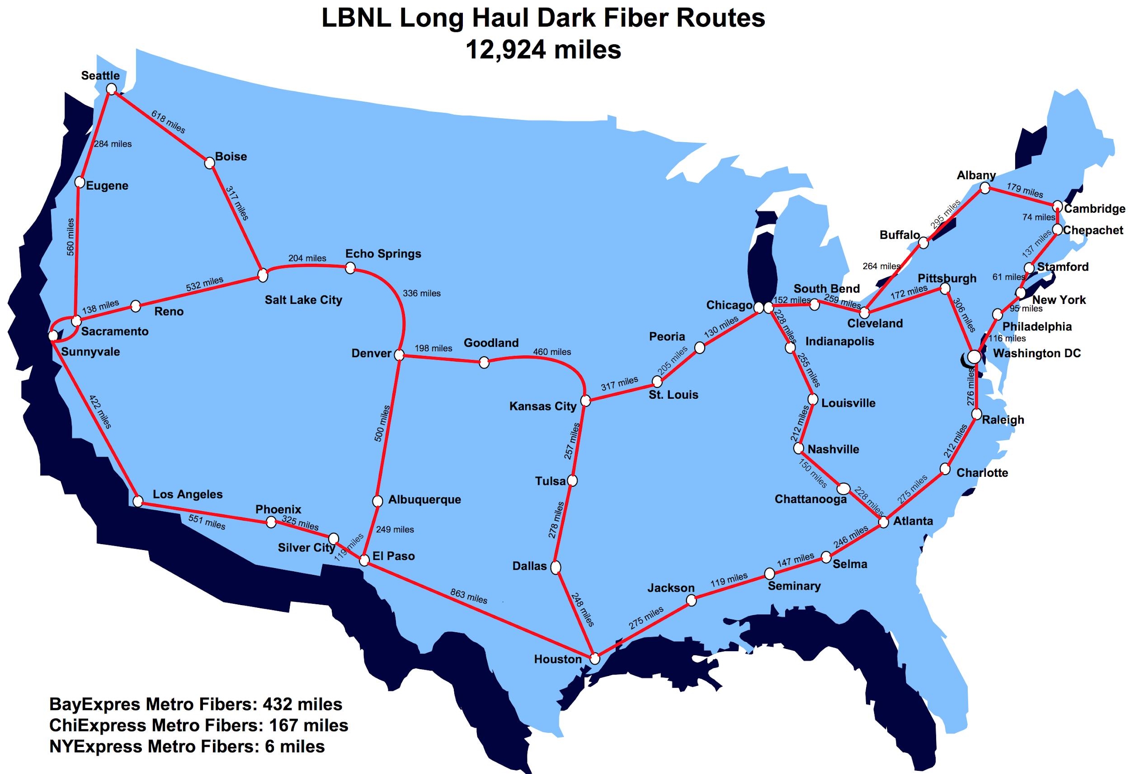
The ESnet Dark Fiber Footprint - A Clean Canvas

Slide 10
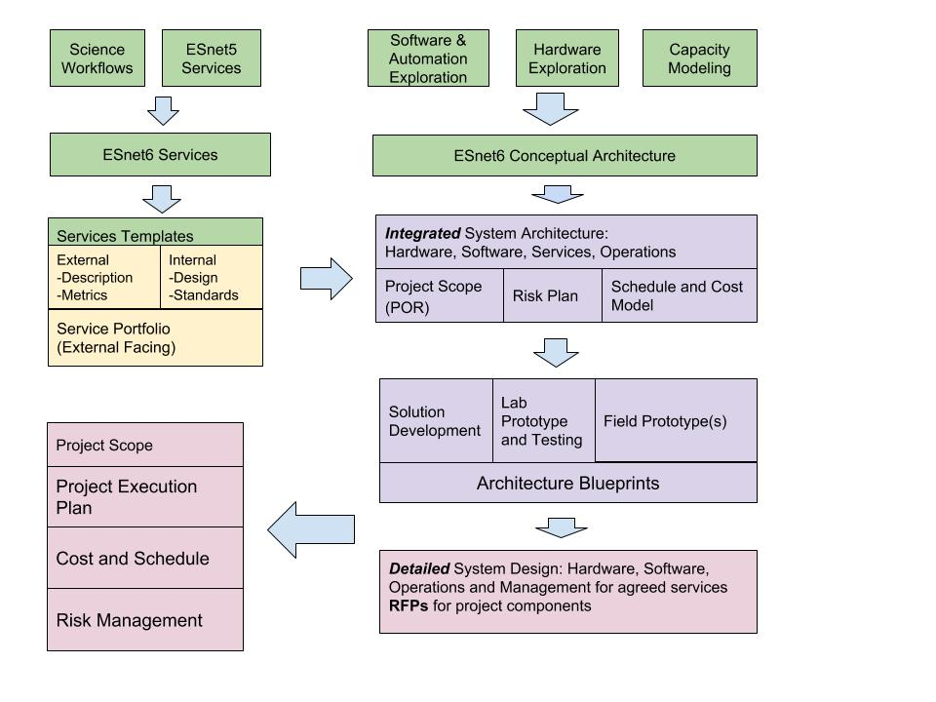
ESnet6 Project Execution Flow

Slide 11




ESnet6 Optical Core Characteristics
Orchestration
and Automation
Services Edge
Programmable, Flexible, Dynamic
Monitoring and
Measurement
“Hollow” Core
Programmable, Scalable, Resilient
Data plane Programmable Switch
Compute Cluster
Core Switch Router
Optical Services Transponder
Platform
Open Line System
MOTIVATION
Optical disaggregation allows cost effective scaling of long haul bandwidth and transponder vendor flexibility.
CAPABILITIES
Enables light path connections within the Core.
Network Appliance
Edge Switch Router
Hardware | Software | Systems | Security
Flexible grid system Colorless and directionless (not contention-less) programmable wavelength switching Flexibility to support 3rd party transponders (Open Line system) API for programmatic access* *NB: If needed for 3rd party optical NMS | Physical simulation, modeling, and topology**^{, +, ++} Path computation and provisioning**^{, ++} Root cause analysis**^{, +} NB-API for network statistics, automation and (multi-layer resource) orchestration** **NB: Potentially dedicated optical NMS functions and capabilities ⁺NB: Function of “Monitoring and Measurement” component ⁺⁺NB: Function of “Orchestration and Automation” component | Operations, Administration, Maintenance, Provisioning, Troubleshooting (OAMPT) functions***^{, +, ++} ***NB: Integrated management system to manage disaggregate optical systems components ⁺NB: Function of “Monitoring and Measurement” component ⁺⁺NB: Function of “Orchestration and Automation” component | Physical access controls Access restriction to management and control plane Policy enforced execution of management and control functions
Notes:
capability: enable optical connections between core devices
Open line system - single vendor from ROADM to ROADM
Flexgrid
colorless/directionless
transponders from different vendor launching into OLS
2 options for wavelength launch
motivation: key to driving bw costs down

Slide 12
ESnet6 Packet Core Characteristics
Orchestration
and Automation
Services Edge
Programmable, Flexible, Dynamic
Monitoring and
Measurement
“Hollow” Core
Programmable, Scalable, Resilient
Data plane Programmable Switch
Compute Cluster
Core Switch Router
Optical Services Transponder
Platform
Open Line System
MOTIVATION
CAPABILITIES
Simplified core feature set (vs core+edge) allows switch/router platforms w/ greater scaling and resiliency.
Enables resilient (P2P) packet “tunnels” within the Core by leveraging traffic engineering, protection, restoration, and QoS functions.
Network Appliance
Edge Switch Router
Hardware | Software | Systems | Security
Deep buffers to support bursts and aggregation QoS functions to prioritize traffic API for programmatic access Cost optimize for capacity augmentation | Modeling and topology*^{, +, ++} Path computation, traffic engineering, and provisioning*^{, ++} Protection and recovery* Root cause analysis⁺ Capacity planning⁺ *NB: Potentially “in-skin” functions and capabilities ⁺NB: Function of “Monitoring and Measurement” component ⁺⁺NB: Function of “Orchestration and Automation” component | OAMPT functions^{+, ++} Network information collection, analysis, and archiving⁺ ⁺NB: Function of “Monitoring and Measurement” component ⁺⁺NB: Function of “Orchestration and Automation” component | Physical access controls Access restriction to management and control plane Policy enforced execution of management and control functions
Notes:
capability: provisioning packet tunnels between edge devices
made up of core switch/routers
restoration & resiliency functions, along with QoS and TE
motivation: simplified feature set allows platforms w/ greater scaling. It also increases resiliency since we're exercising small

Slide 13
ESnet6 Services Edge “Low-Touch Path” Characteristics
Orchestration
and Automation
Services Edge
Programmable, Flexible, Dynamic
Monitoring and
Measurement
“Hollow” Core
Programmable, Scalable, Resilient
Data plane Programmable Switch
Compute Cluster
Core Switch Router
Optical Services Transponder
Platform
MOTIVATION
Open Line System
CAPABILITIES
Well-defined service edge that takes advantage of commodity switch/router scaling to support edge complexity, maintaining simplicity in the core.
Enables service instantiations by employing (FIB) isolation, encapsulation, prioritization, forwarding, and filtering functions.
Network Appliance
Edge Switch Router
Hardware | Software | Systems | Security
Deep buffers to manage fan-in/out and speed mismatches QoS functions to prioritize traffic Internet scale routing API for programmatic access | Protocols for external (customer) interactions* Service instantiations⁺⁺ Usage anomaly detection⁺ *NB: Potentially “in-skin” functions and capabilities ⁺NB: Function of “Monitoring and Measurement” component ⁺⁺NB: Function of “Orchestration and Automation” component | OAMPT functions^{+, ++} Network information collection, analysis, and archiving⁺ ⁺NB: Function of “Monitoring and Measurement” component ⁺⁺NB: Function of “Orchestration and Automation” component | Physical access controls Access restriction to management and control plane Policy enforced execution of management and control functions Threat detection Data plane protection and access restrictions
Notes:
2 variants of service edge
"low-touch path"
capability: map ingress traffic to services, make forward decision, and hand off to core
made up of edge switch routers
- internet scale
- in-skin protocol stack
motivation: separation of concerns to keep simplicity in core; leverage market scaling

Slide 14
ESnet6 Services Edge “High-Touch Path” Characteristics
Orchestration
and Automation
Services Edge
Programmable, Flexible, Dynamic
Monitoring and
Measurement
“Hollow” Core
Programmable, Scalable, Resilient
Data plane Programmable Switch
Compute Cluster
Core Switch Router
Optical Services Transponder
Platform
Open Line System
CAPABILITIES
MOTIVATION
Enables new service creations by providing flexible packet pipeline configurations to facilitate custom encapsulations and match forwarding.
Maximizes flexibility of services while minimizing risk by segregating high touch path.
Network Appliance
Edge Switch Router
Hardware | Software | Systems | Security
Compute resources (and necessary virtualization) to support NFV / VFN Programmable data plane (e.g. FPGA, NPU) API for programmatic access | NFV / VFN functions (e.g. telemetry, IDS, SDX, etc) Service instantiations⁺⁺ ⁺⁺NB: Function of “Orchestration and Automation” component | OAMPT functions (including compute resources)^{+, ++} Network information collection, analysis, and archiving⁺ ⁺NB: Function of “Monitoring and Measurement” component ⁺⁺NB: Function of “Orchestration and Automation” component | Physical access controls Access restriction to management and control plane Policy enforced execution of management and control functions Threat detection Data plane protection and access restrictions
Notes:
"high touch path"
capability: enables new services via custom encapsulations and/or forwarding decisions beyond L2/L3
programmable data plane and compute
NFV
full access to the packet processing pipeline (FPGA, NPU)
PDP - line rate
motivation: maximize flexibility for new services while minimizing risk
de-risk:
generally in parallel w/ low-touch equipment
deployment timeline: later to procure and deploy
maximize time for prototyping and market shakeout (rapidly changing area)

Slide 15
ESnet6 Orchestration and Automation, Monitoring and Measurement Characteristics
Orchestration
and Automation
Services Edge
Programmable, Flexible, Dynamic
Monitoring and
Measurement
“Hollow” Core
Programmable, Scalable, Resilient
Data plane Programmable Switch
Compute Cluster
Core Switch Router
Optical Services Transponder
Platform
Open Line System
MOTIVATION
Building a “zero” touch network and enabling intelligent functions
CAPABILITIES
Network Appliance
Enables the management and scaling of services.
Edge Switch Router
Hardware | Software | Systems | Security
Compute resource (and necessary virtualization) to support orchestration and automation, and monitoring and measurement functions | NFV / VFN functions (e.g. telemetry, IDS, SDX, etc) Workflow management and service instantiation | Multi-layer/resource OAMPT functions Network information collection, analysis, and archiving HA for services Data storage resiliency | Access controls Policy enforced execution of orchestration and automation functions Data security and integrity
Notes:
capability: enables management of services
ESnet6 scale requires automation for both ops & provisioning
federated set of software components
providing monitoring & measurement data including faults
snmp, streaming telemetry, APIs
orchestration and automation platforms
motivation:·
aspirational "zero" touch network
declarative style service configuration w/ automated instantiation
enabling intelligent functions in network
eg fiber cut reactions

Slide 16
Guiding Principles
Zero touch self regulating network
  Avoid manual intervention in the daily operations of the network;
  Prioritize automation of frequent operations over infrequent ones;
  Manage network via a declarative interface.
Highly available fault stream
  Without fault the operational state of the network is unknown;
  A basic fault monitoring system must always be available.
Engineers must be able to take corrective action
  If orchestration is not available then EMS or direct CLI access is acceptable.
Clearly defined source of truth for all configuration data
  Reduce data bloat and operational errors by maintaining a single “master” within the network.
Leverage proven cloud technologies where applicable
  Whether locally or remotely hosted, cloud technologies have matured into a reliable scalable runtime solution.
Notes:
Zero Touch Network Management
Manage network via an declarative interface
Avoid manually configuring devices.
Network can detect security anomalies
Traffic pattern analysis;
Bro data.
Network can detect large flows for redirection
Traffic pattern analysis;
Flow data.
Network can predict failures and over-subscription scenarios
Analytic models analyze measurement and monitoring data.

Slide 17
Software Architecture
Software Pillars:
Feedback Loop:
Enhanced User Experience
Orchestration & Automation
Intelligent Assurance
Automated
Fulfillment
Adaptive Security
Reactive Analytics
Data Collection
Unified Data Model
Normalized Mediation
External/Back Office Systems
Analytics
API Driven Network
Notes:
two views of the software arch
left:
high level view of abstract components and relationships
At bottom: network elements and other data sources
mediation layer: adapts various NEs interactions and configs
composed into unified data model
portals and dashboards for internal/external consumers
right:
functional view
closed feedback loop
human or automated triggering of state change

Slide 18
ESnet5 vs ESnet6 Key Differences
 | ESnet5 | ESnet6
Optical System | Closed optical system with single vendor integration of transponders and line system | Optical disagreggation with open line system and flexible transponder selection
Core Transport | Hop-by-hop routing at each node. | Logical tunnels switched through core with forwarding decisions made at service edge.
Automation | 80% of configuration is hand-curated. | Focus on orchestration and automation with goal of removing CLI from workflows
Programmable Data Plane | Nonexistent | Colocated programmable data plane and compute enable new services

Slide 19
ESnet6 Proposed Project Timeline
Jan: R&D Architecture Review
May: R&D Conceptual Architecture Selection
ESnet6 Service Starts
ESnet6
Project
Close-out
Sep: In-Process Review
Feb: CDR
Network Build
Project Funding
CY2017
CY2018
CY2019
CY2020
CY2021
CY2022
Apr: Director’s Review
Mar/Apr: CD2/3
ESnet5 Decommissioning Starts
Jun: CD1/3a
Jan: Director’s Review
Assumes project funding in FY18

Slide 20
Conceptual Design Review: Strong endorsement
Design meets mission and of continued innovation
Snapshot from the Executive Summary CDR report

