Slide 1
BSM Physics at the LHC, HERA
Few topics that could be interesting for EIC
Elisabetta Gallo
19/12/2018

Slide 2
For HERA results
Results taken from old slides

Slide 3
Leptoquarks
e
e,ν
e
q
e
+
q
+
LQ
q
LQ
e
λ
LQ
LQ
LQ
q
q
q
e,ν
q
e
LQ
q
LQ
e

Slide 4
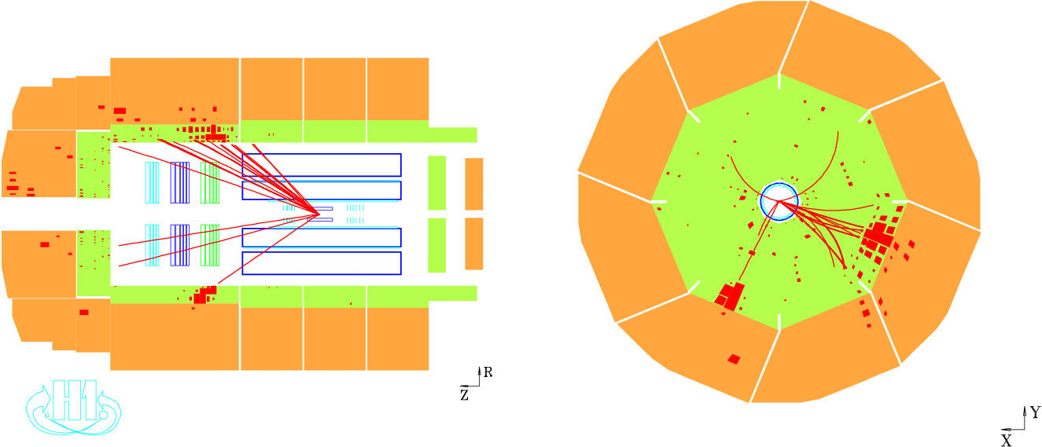
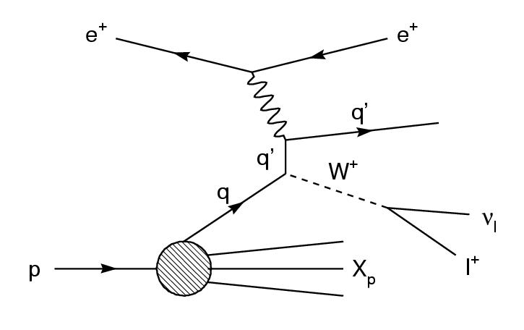
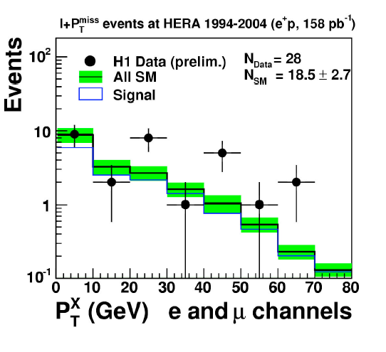
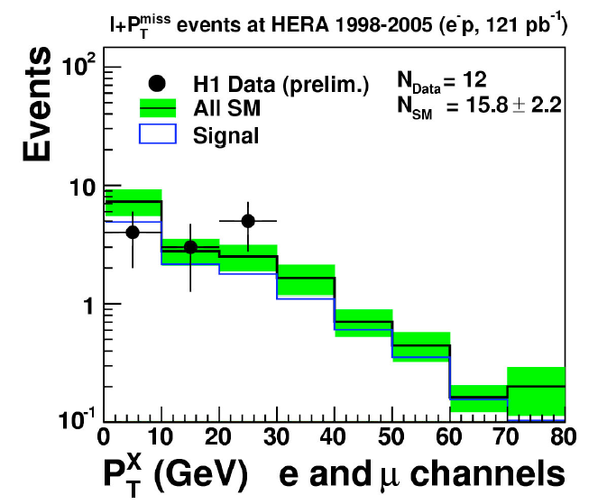
Isolated leptons at HERA
ν
X
e,μ
Analysis is optimized for the main SM process which is W production
positrons
electrons
Excess at high P_{T}^{X} observed by H1 in e⁺p collisions

Slide 5
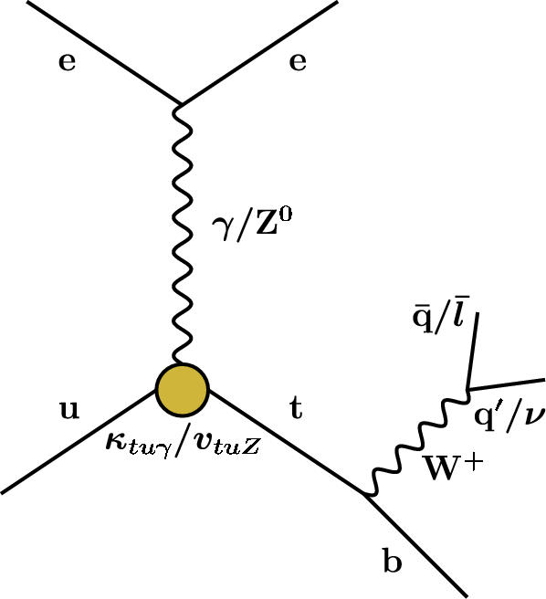
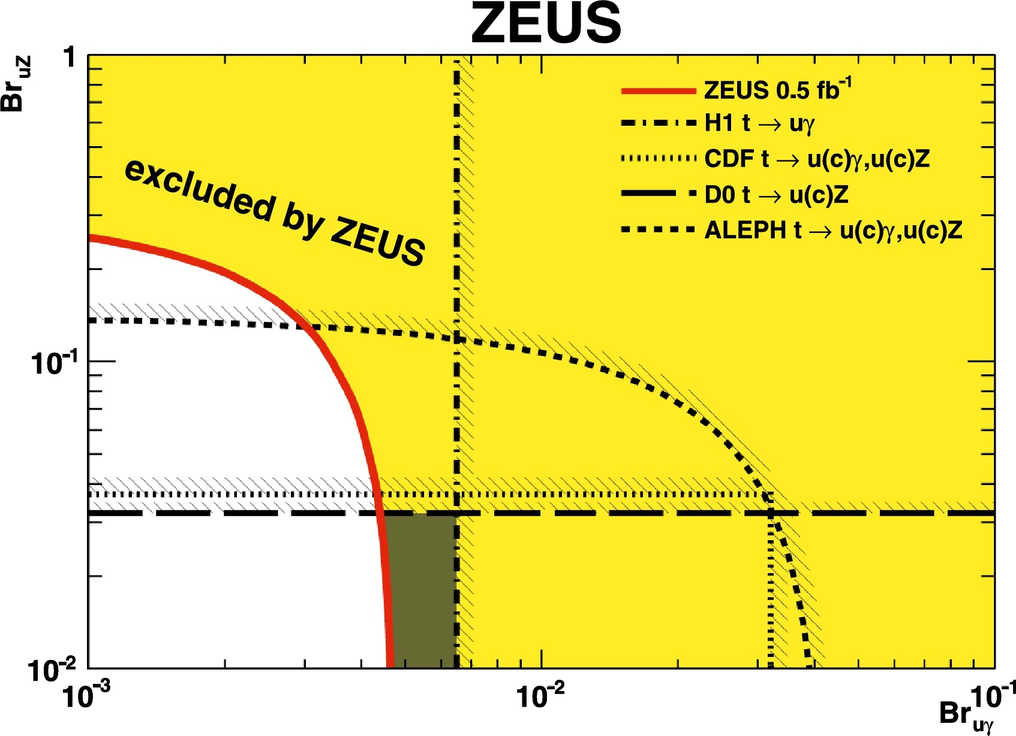
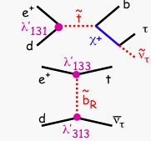
Isolated leptons at HERA
No excess seen by ZEUS, events analyzed in terms of anomalous single top production at HERA I
Some possible diagrams in R-parity violation SUSY to explain the H1 excess

Slide 6
Multileptons in H1 and doubly-charged Higgs
Excess of events in 2e, 3e in H1, explanation could have been doubly-charged Higgs. Limits set at the end of HERA.

Slide 7
Quark radius, NC and CC cross sections
Limits on W_{R} around 200 GeV

Slide 8
LHC results
Results taken from slides at recent conferences
on whatever is coupling to a lepton and a quark

Slide 9
LHC
LHC luminosity
Run 1: 2010-2012 at $\sqrt{s}=7,8 TeV$
Run2: 2015-2018 at $\sqrt{s}=13 TeV$
The increased luminosity and c.m. energy has boosted BSM searches at the LHC.
Ratio of parton luminosities.
First of all I am not an expert, at DESY we do exotica, but different searches.
I collected few results/slides which I thought important for ep physics.
Many different searches, recently focused on dark matter, SUSY, heavy resonances (boosted techniques), long-lived particles.
More than 100 Exotica papers in ATLAS/CMS only in 2016.

Slide 10
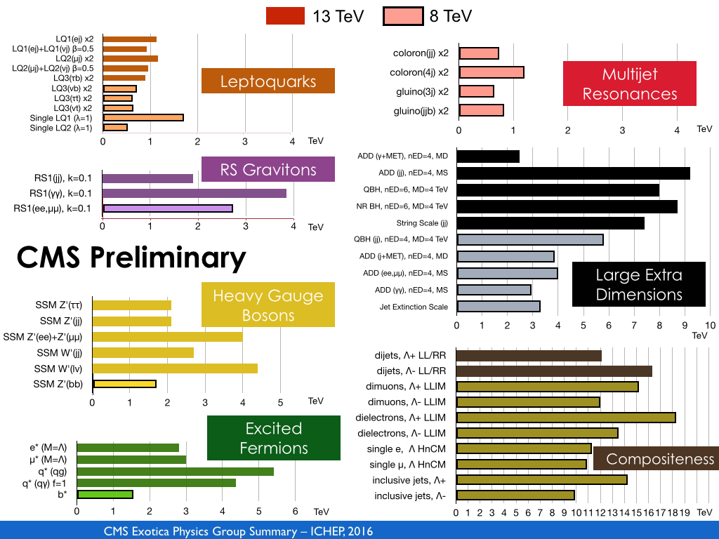
Searches at CMS

Slide 11
Searches at ATLAS, more recent compilation

Slide 12
Search for Leptoquarks in pairs
Use of BRW model, assume narrow resonances.
Searches in 1st, 2nd, 3rd generation.
The limit depends on the branching ratio $β,$ and not on $the coupling to lq, λ,$this is opposite to ep.
From slides at SUSY conference at Mumbai

Slide 13
Recently a lot of interest
Consistent set of anomalies observed recently in flavour:
1) b -> c, charged current, tau versus other lepton
Observed by 3 experiments
Plots taken from a seminar from Isidori at a CMS meeting

Slide 14
Recently a lot of interest
Consistent set of anomalies observed recently in flavour:
2) b -> s, neutral currents, muon versus electron
Anomalies observed in angular distributions and other observables by LHCb.
Results and fits seem to point to the fact that there could be new physics in
b -> s$μμ, and not in b→see$

Slide 15
Recently a lot of interest
Slide taken from a CMS meeting
Anomalies are all seen in lepton-quark couplings. Explanation could be a LQ coupling to 3rd generation

Slide 16
LQ searches, pair and single production
Slide taken from a CMS meeting,
plot from arXiv:1706.07808
At high mass, single LQ production dominates over pair production, the crossing point depends on $λ and the quark generation$

Slide 17
Search for heavy neutrinos N_{R}, W_{R}
At HERA
Stringent limits on W_{R}

Slide 18
SUSY R-parity violation
LHC started to look for RP-conserving SUSY, due to the very clear signature of missing transverse energy.
But recently they have started looking also for RPV SUSY, example here.

Slide 19
Search for massive long-lived particles decaying semileptonically in the LHCb detector
arXiv:1612.00945
Look for massive long-lived particles (LLP) in the mSUGRA model, where the neutralinos can decay in muon+jets. Signature is a displaced vertex.
LLP mass: [20-80] GeV, lifetime: [5-100] ps
LLP not so high mass, coupling to l+quarks

Slide 20
Doubly Charged Higgs
Slides from M. D’Alfonso at HH

Slide 21
Conclusion
We have taken only 3% of whole LHC/HL-LHC data. Expect also $\sqrt{s}=14 TeV$ at some point.
It is clear that LHC has put very high mass constraints on a lot of models.
But we still look and find “strange” things also at much lower energies.
Recent results from LHCb on LFV seems to point to a leptoquark.
It shows that one can look for new physics also at lower energy and ep is a much “cleaner” environment compared to LHC.
b- and c-tagging, tau reconstruction, long-lived particles important.
Also a lot of PDFs results from LHC by now. We at DESY are involved in W-charge asymmetry (u/d), W+charm (strange), jet cross sections (gluon at mid-high x), top

