Slide 1
C75 System Specifications
C75 Implementation and Project Review
15th February 2018, JLab
Frank Marhauser

Slide 2
Outline
C75 energy gain and contingency and corresponding gradient specifications
Unloaded Q (Q₀) specification (prospect of large grain niobium material)
Microphonics allowance with respect to usable generator power
Power input coupler’s (FPC) external Q (Q_{ext}) specification
Field emission specification rationale

Slide 3
Energy Gain and Accelerating Field (E_{acc})
Energy gain baseline requirement for C75 cryomodules:
Accumulated energy gain shall be 75 MeV (when leaving CMTF after acceptance testing)
With 7.5% contingency (similar to C100):
RF system shall allow operating up to 20.5 MV/m per cavity (considering usable generator power and microphonics)
Cryomodule may achieve 80.625 MeV
Parameter | Unit | Baseline | with 7.5% Contingency
Energy Gain | MeV | 75 | 80.625
Effective accelerating voltage per cavity | MV | 9.375 | 10.078
Corresponding accelerating field per cavity (on crest acceleration) | MV/m* | 19.07 | 20.5
* Nominal active cavity length: 0.4916 m
Notes:
Red Interior Page Design 1

Slide 4
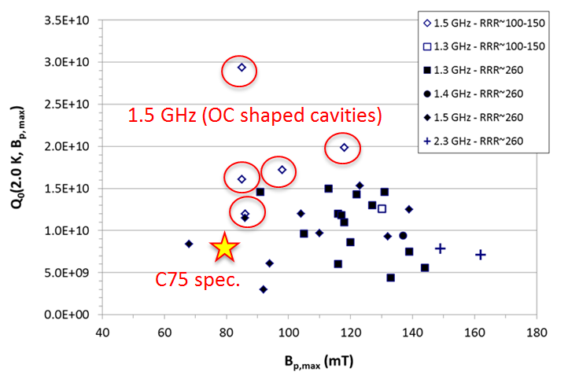
Q₀-Specification (at T = 2.07 K)
Cavity Type | Q₀ specification | E_{acc} (MV/m)
C20/C25 | 2.4e9 | 5
C50 | 6.8e9 | 12.5
C100 | 7.2e9 | 19.2
C75 | 8e9 | 19.07
B_{pk} = 80 mT (~86 mT at 20.5 MV/m)
Prospects to benefit from (medium-purity) large-grain (LG) ingot Niobium
Distribution of quality factors at 2 K just below the quench field limit (over 30 single- and multi-cell cavities) as a function of quench fields for cavities made from CBMM ingot material of different purity. The findings for LG cavities with OC shape are highlighted (red circles) and exceed the specification (star symbol) for the C75 cavity.
Notes:
Red Interior Page Design 1

Slide 5
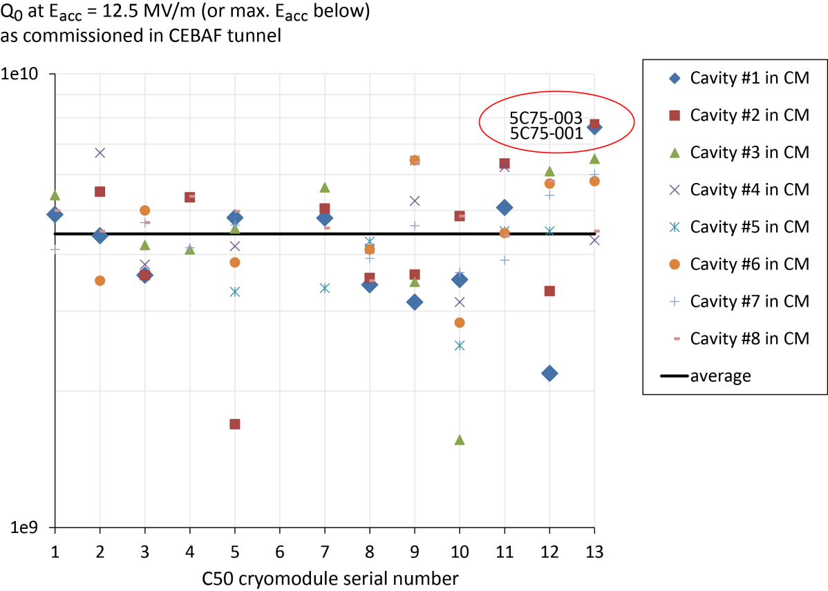
C50 Q₀-Degradation Experience
What we know so far (C75 prototype cavity pair in C50-13)
C75 prototype cavities show highest Q₀-values among all refurbished C50 cavities (close to 8e9)
Notes:
Red Interior Page Design 1

Slide 6
Potential Q₀ and E_{acc} degradation
VTA and C50-13 commissioning results in CEBAF (1L13) including C75 cavity pair (Mike Drury, Nov. 2017)
Cav. # | Cav. Type | Cav. SN | E_{acc,max} VTA MV/m | E_{acc,max} CEBAF commiss. MV/m | Q₀ VTA | Q₀ (2.07K) CEBAF commiss. | Q₀ degradation VTA → CEBAF % | Performance limit
1 | C75 HC LG | 5C75-001 | 19.4 | 19.1 | 9.0e9 | 7.6e9 | 15.1 | Quench
2 | C75 HC LG | 5C75-003 | 13.7 | 14.2 | 8.3e9 | 7.7e9 | 7.6 | Quench
3 | C50 OC FG | ia274 | 18.3 | 16.6 | 9.6e9 | 6.5e9 | 32.3 | Quench
4 | C50 OC FG | ia345 | 19.9 | 17.4 | 8.5e9 | 4.3e9 | 49.4 | Waveguide vacuum
5 | C50 OC FG | ia366 | 9.2 | 9.2 | 7.6e9 | 7.0e9 | 25.6 | Quench
6 | C50 OC FG | ia351 | 15.1 | 14.0 | 7.8e9 | 5.8e9 | 25.6 | Quench
7 | C50 OC FG | ia038 | 18.0 | 16.9 | 7.0e9 | 6.0e9 | 14.3 | Quench
8 | C50 OC FG | ia260 | 17.0 | 15.5 | 6.7e9 | 4.5e9 | 32.8 | Quench
Avg. |  |  | 16.3 | 15.4 | 8.1e9 | 6.2e9 | 22.3
Persistent Q-loss in C50 cavities still not fully understood
After upgrades to ‘magnetic hygiene’ including cavity magnetic shielding
For the C75 prototype pair one must consider series of in-house fabrication issues
Q₀ and quench limit related to Electron Beam welding issues (G. Ciovati et al., Cavity Fabrication Tech Note, May 2017)
Lessons learned to be applied with next C75 cavities
Procurement of C75 cavities: EB welding at commercial vendor may mitigate performance issues (vendors are liable for mechanical fabrication, QC imposed)
Notes:
Red Interior Page Design 1

Slide 7
Microphonics
What we know so far
T. Powers, Microphonics measurements for C50-13/1L-13,10/31/2017)
Microphonic detuning (6·δf_{rms}) < 30 Hz for both C75 cavities
Microphonic detuning measured for C50-13 cavities in CEBAF (1L13). Each of the values are the maximum values measured among several data sets (3-5) taken for each cavity
Cavity Location | Cavity SN | Microphonic detuning δf_{rms} Hz | 6· δf_{rms} Hz | Microphonic peak detuning δf_{pk} Hz
1 | 5C75-001 | 4.7 | 28.2 | 11.9
2 | 5C75-003 | 4.8 | 29.0 | 18.2
3 | ia274 | 3.8 | 22.5 | 14.4
4 | ia345 | 3.6 | 21.5 | 14.8
5 | ia366 | 5.8 | 34.5 | 20.7
6 | ia351 | 3.0 | 17.9 | 7.5
7 | ia038 | 3.9 | 23.4 | 14.5
8 | ia260 | 3.9 | 23.3 | 15.3
Average value |  | 4.2 | 25.0 | 14.7
Notes:
Red Interior Page Design 1

Slide 8
Maximum Usable Generator Power
Maximal generator power (P_{g}): 8 kW
Note: Attenuation in WR650 transmission line is ~0.2dB/100 ft.
We have 15 meter (~50 ft.) transmission line length → ~0.1 dB loss
Other losses (e.g. insertion losses of waveguide filter, klystron circulator) to be added
Sum assumed is 0.6 dB (cf. J.A. Fugitt, T.L. Moore, “CEBAF Superconducting Cavity RF Drive System”, typical waveguide losses of 0.5 dB for 15 m)
Maximum usable generator power: 7 kW
Notes:
Red Interior Page Design 1

Slide 9
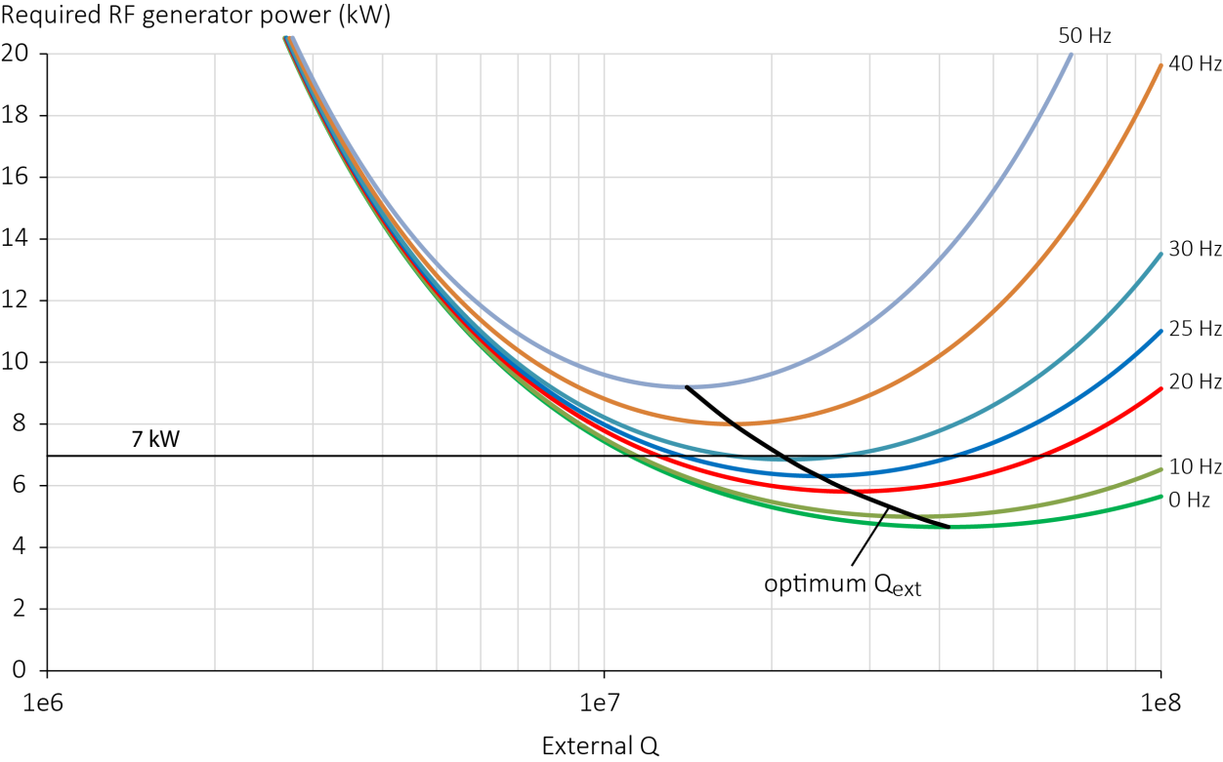
Input Coupler Q_{ext} Specification
Must consider full beam loading (I_{b} = 460 µA) and up to E_{acc,max} = 20.5 MV/m
Usable P_{g} = 7 kW constraints microphonics allowance to ~31 Hz
Optimum Q_{ext} around 2e7 with realistic microphonic detuning levels
7 kW threshold
Parameters used: R/Q = 525.4 Ω, E_{acc} = 20.5 MV/m, L_{act} = 0.4916 m, I_{b} = 460 µA, and Q₀ = 8e9
Notes:
Red Interior Page Design 1

Slide 10
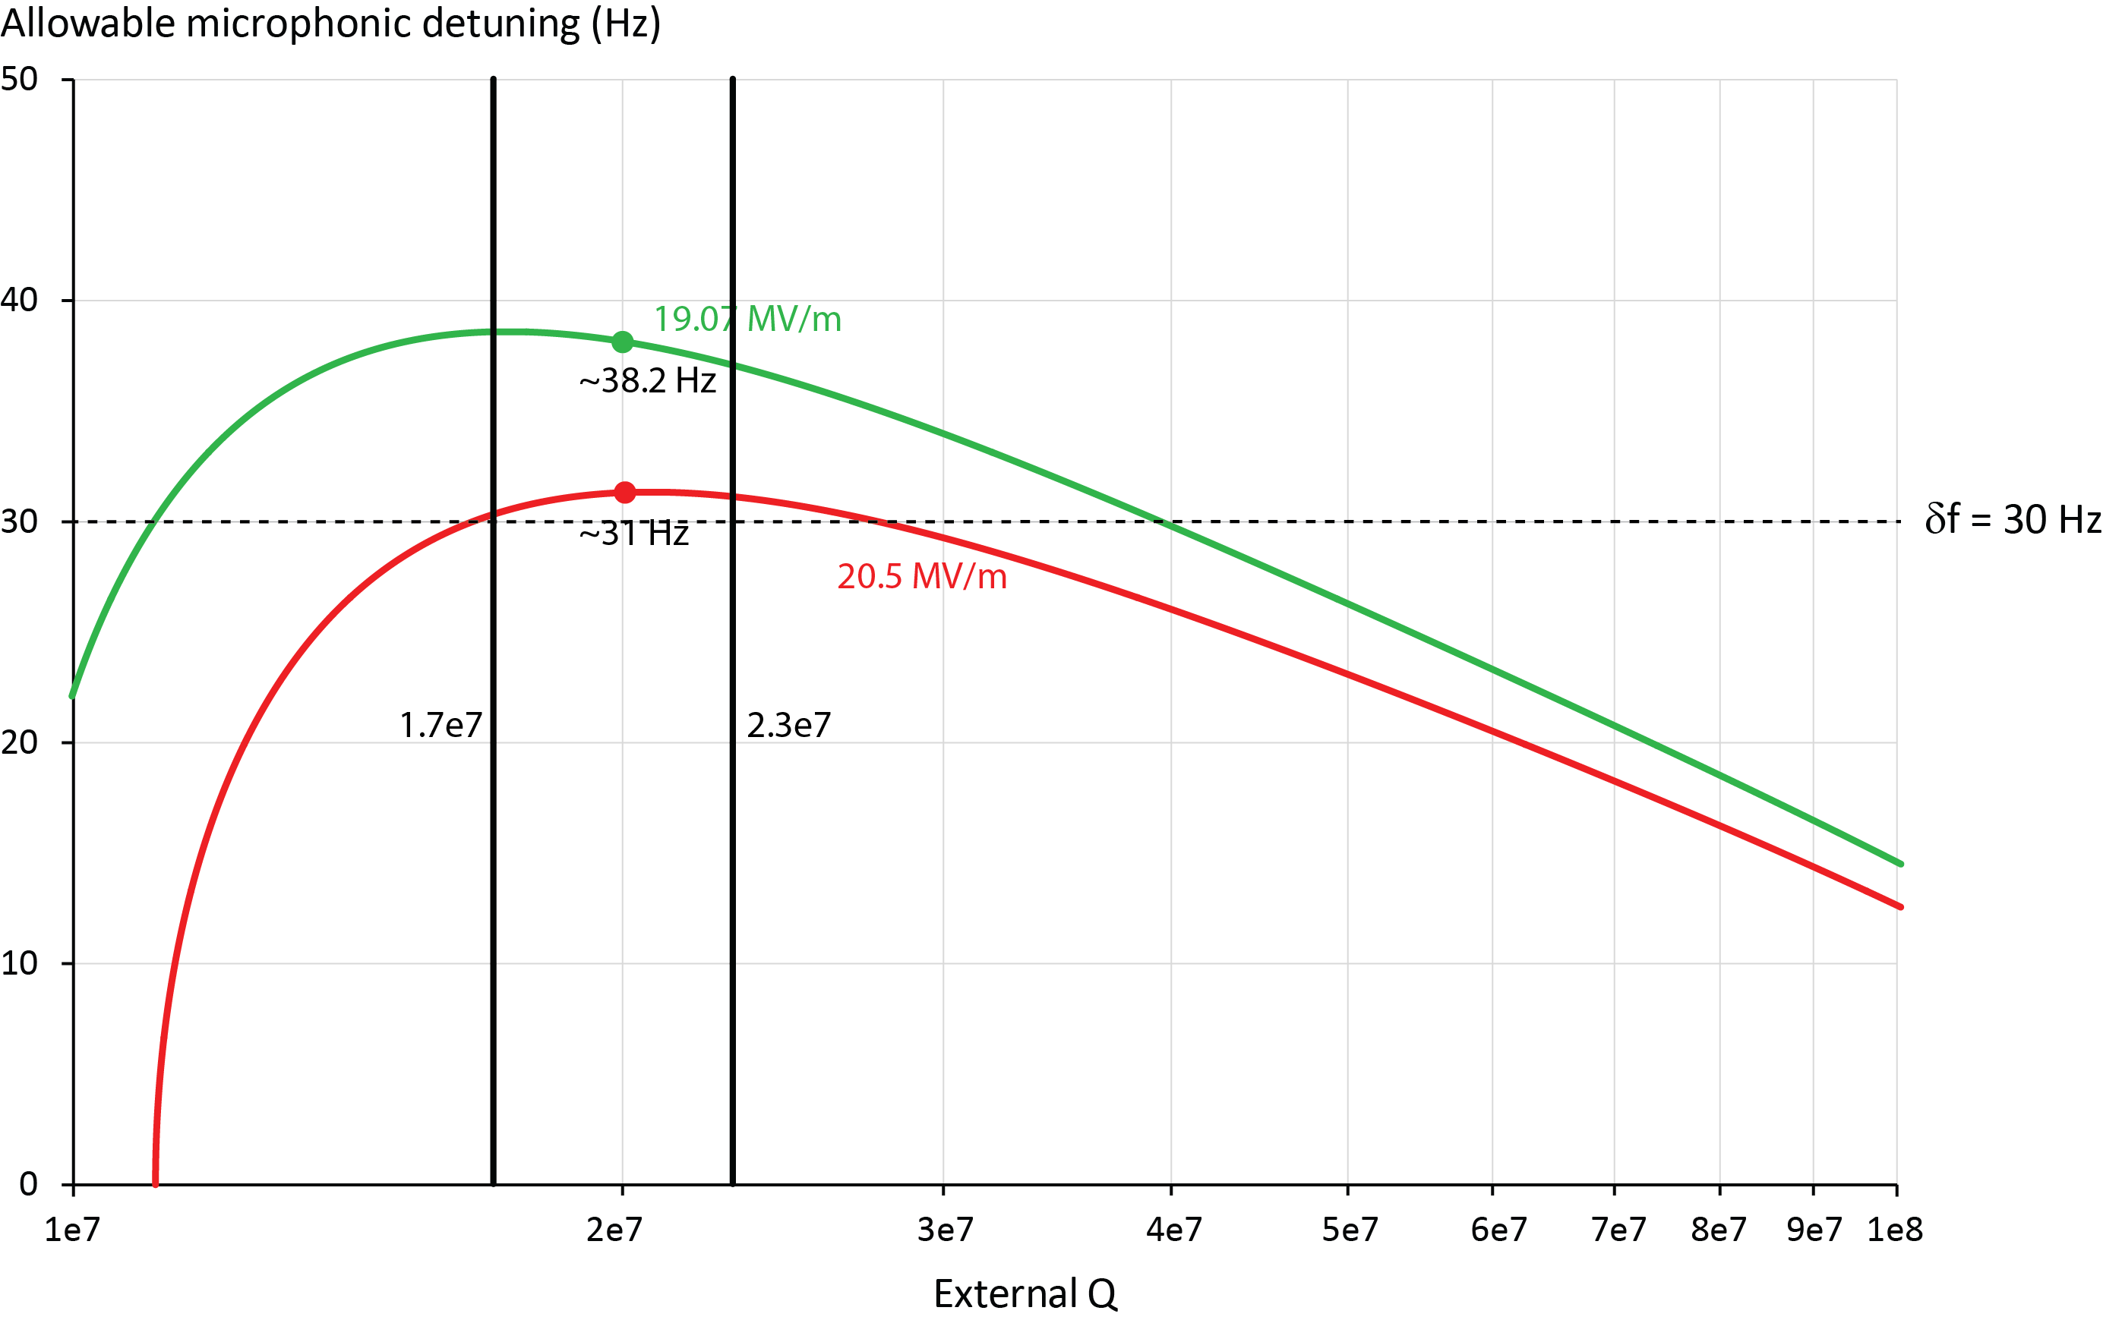
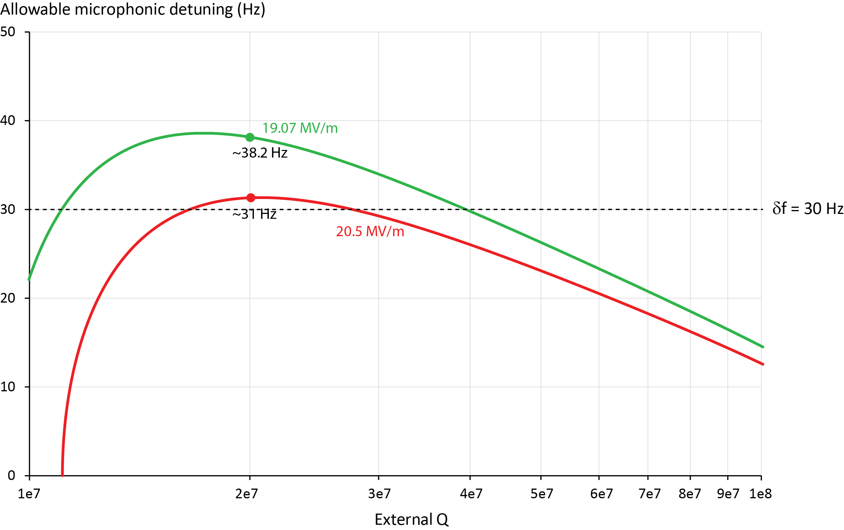
Q_{ext} Specification vs. Microphonics Allowance
Based on microphonics measurements in C50-13 for C75 cavity pair (6·δf_{rms} close to 30 Hz), E_{acc} = 20.5 MV/m can be supported by RF system at full beam loading (I_{b} = 460 µA), when usable generator power is 7 kW
At Q_{ext} = 2e7 the peak microphonics allowance relaxes at smaller accelerating fields (e.g. 38.2 Hz at 19.07 MV/m)
E.g.: A Q_{ext} = 1e7 does not support required accelerating fields for a C75 CM at full beam loading
Q_{ext} = 2e7 ± 15 %
Parameters used: R/Q = 525.4 Ω, L_{act} = 0.4916 m, I_{b} = 460 µA, and Q₀ = 8e9
Notes:
Red Interior Page Design 1

Slide 11
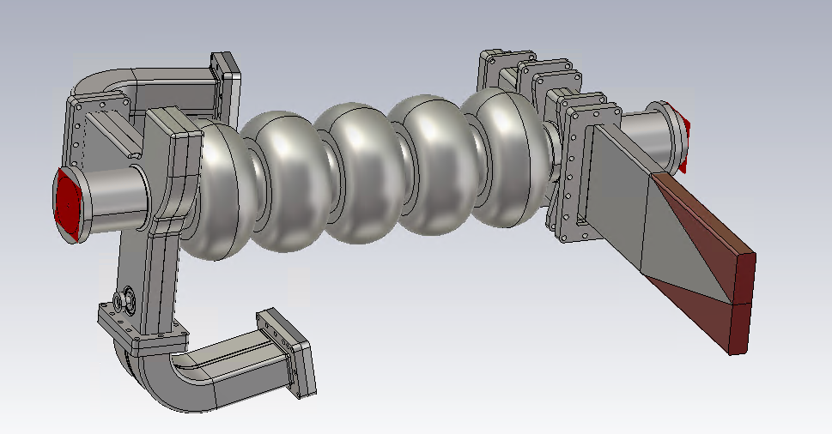
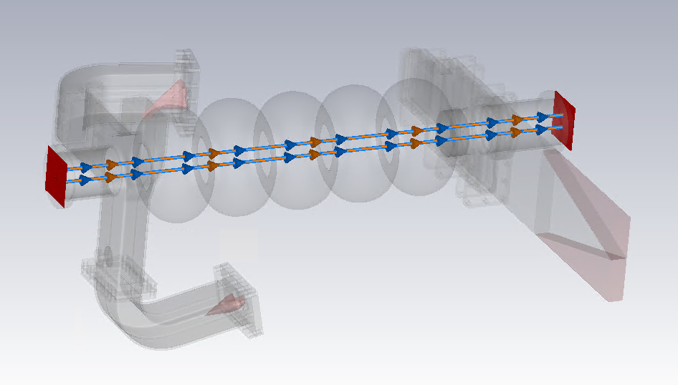
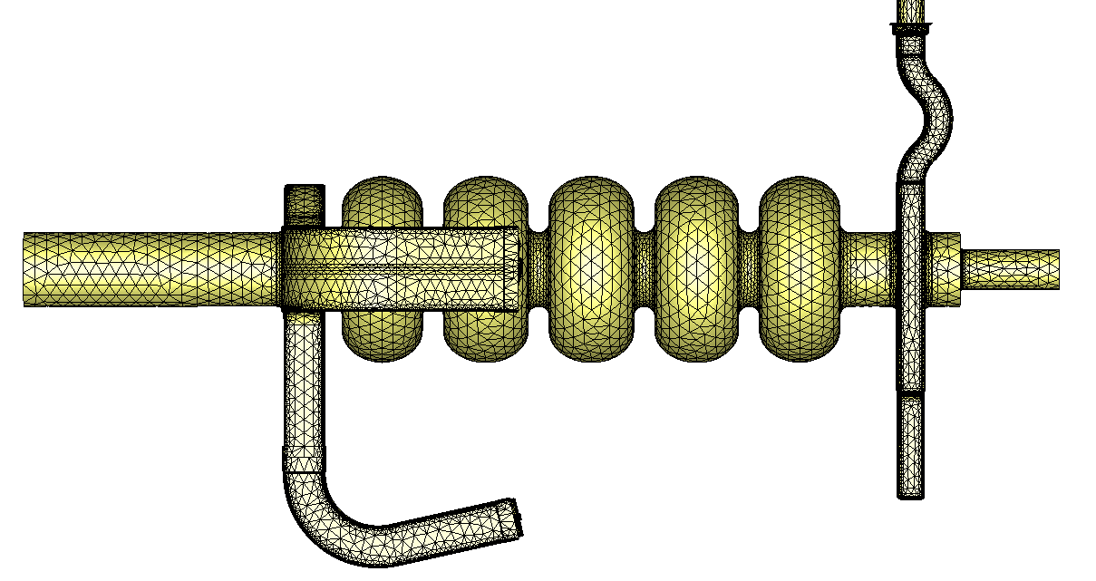
HOM Impedance Specification
Specifications for HOM Impedance Threshold for Beam Breakup Instability (BBU) follow C100 cavity rationales
BBU Impedance threshold for deflecting HOMs: R_{tr} = 2e10 Ω/m (stretched goal 1e10 Ω/m , cf. G. Krafft et al., JLAB-TN-09-015)
Definition: R_{tr} = R/Q(r)/(k·r²)·Q_{l}
R/Q = HOM’s characteristic impedance, Q_{l} = loaded Q of HOM, r = radial offset, k = wave number
Numerical Analysis done to survey HOM impedance spectrum
1) Short wakefield calculation to identify crucial HOMs (spectrum not resolved)
2) Complex Eigenmode calculations to resolve individual HOMs and calculate R/Qs and loaded Qs (used tetrahedral mesh with dogleg and inner tube adapter)
Notes:
Red Interior Page Design 1

Slide 12
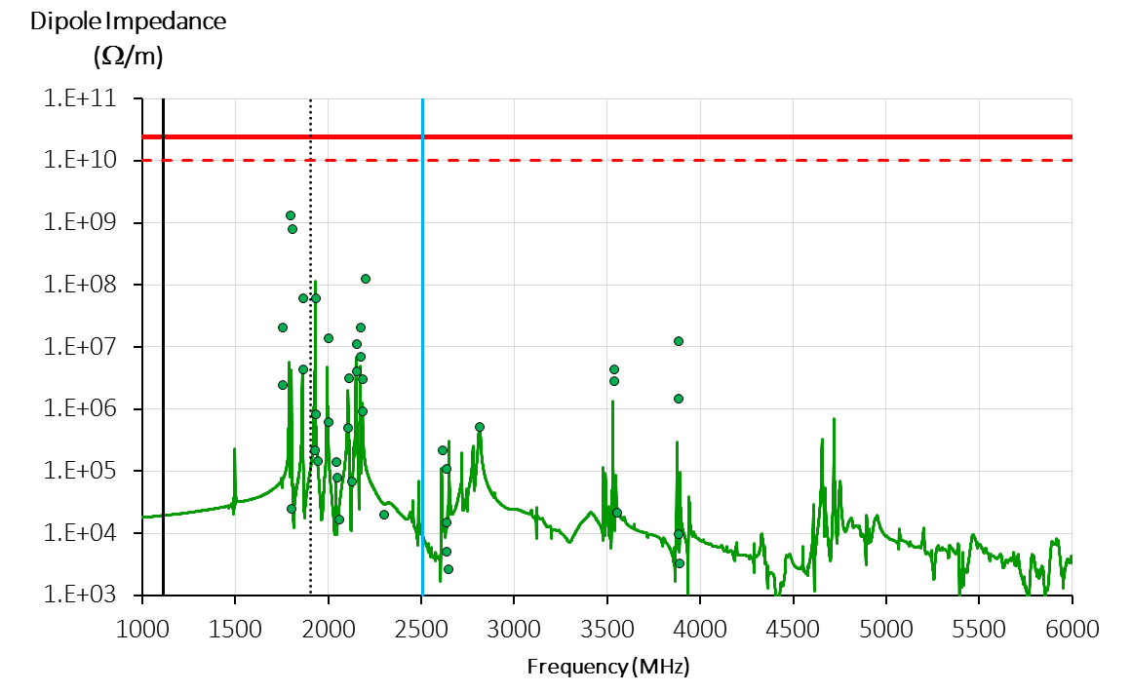
C75 Cavity HOM Impedance Spectrum
FPC cutoff
HOM waveguide cutoff
Short (~140m) wakefield calculation
(peaks not resolved)
TE11 beam tube cutoff
Eigenmode calculations
BBU threshold (12 GeV)
BBU threshold (stretched goal)
Old CEBAF cavity design: In this regime only FPC works as a
HOM damper → Cannot verify in VTA w/o proper setup
These HOM have strong monopole component
not subtracted from dipole impedance → worst case
Notes:
Red Interior Page Design 1

Slide 13
Field Emission (FE)
Specification follows experience with LCLS-II:
Provide field-emission free cavities up to quench field limit in the VTA prior assembly rather than defining an upper field limit for FE onset
Could imply more effort, be prepared for cavity retreatment
Risk: Potential re-treatment cycles impact availability of cavities for string assembly (schedule) and implies more costs
First re-treatment is typically high-pressure rinse (high success rate for LCLS-II)
Improve procedures for clean cavity string assembly
VTA vs. CEBAF commissioning for C50-13 cavities (M. Drury):
Cav. # | Cav. Type | Cav. SN | E_{acc,max} VTA MV/m | E_{acc,max} CEBAF MV/m | FE onset VTA MV/m | FE onset CEBAF commiss. MV/m
1 | C75 HC LG | 5C75-001 | 19.4 | 19.1 | 17.9 | - after RF conditioning
2 | C75 HC LG | 5C75-003 | 13.7 | 14.2 | 9.9 | 10.9
3 | C50 OC FG | ia274 | 18.3 | 16.6 | 15.6 | -
4 | C50 OC FG | ia345 | 19.9 | 17.4 | 15.0 | 9.4
5 | C50 OC FG | ia366 | 9.2 | 9.2 | 8.5 | -
6 | C50 OC FG | ia351 | 15.1 | 14.0 | 14.1 | -
7 | C50 OC FG | ia038 | 18.0 | 16.9 | - | -
8 | C50 OC FG | ia260 | 17.0 | 15.5 | 10.9 | 7.5
Notes:
Red Interior Page Design 1

Slide 14
C75 RF Specification Table
Parameter | Unit | Value | Comments
Energy gain per CM | MeV | 75 | Max. 80.625 MeV with 7.5% contingency, 8 cavities per CM
Operating RF frequency | MHz | 1497 | with cavity under compression
Operating temperature | K | 2.07 | 29 ± 0.1 Torr nominal helium pressure
Maximum beam current | µA | 460
Microphonic detuning δf (rms) | Hz | 5
Microphonic detuning δf (peak) | Hz | 30
Average accelerating field (E_{acc,avg}) | MV/m | 19.07 | U_{eff} = 9.375 MV, E_{pk} = 46.6 MV/m, B_{pk} = 79.7 mT (δf = 38.6 Hz max . allowable)
Maximum accelerating field (E_{acc,max} = E_{acc,avg} +7.5%) | MV/m | 20.5 | U_{eff} = 10.08 MV, E_{pk} = 50.1 MV/m, B_{pk} = 85.7 mT (δf = 31 Hz max . allowable)
Maximum beam loading | kW | 4.6 | At E_{acc} = 20.5 MV/m, 4.3 kW at E_{acc} = 19.07 MV/m
Remanent magnetic field in CM | mG | 10 | After cryomodule degaussing (absolute field)
Allowable RF window losses | W | ≤ 2 | As measured in special setup in Dewar at 2 K (low power) and extrapolated to 5 kW forward power
Q₀ at T= 2.07 K |  | ≥ 8e9 | up to E_{acc} = 19.07 MV/m (incl. all RF losses)
Cavity wall losses (P_{c}) | W | 20.9/24.2 | for E_{acc} = 19.07/20.6 MV/m at Q₀ = 8e9
Usable generator power (P_{g}) | kW | 7 | using 8 kW klystrons assuming 0.6 dB attenuation in transmission line from klystron
Q_{ext} FPC |  | 2e7 ± 15 % | adjustment to higher Q_{ext}-values possible by WR650 stub tuning
Resonant bandwidth (f₀/Q_{l}) | Hz | 75
HOM dipole impedances R_{tr} | Ω/m | ≤ 2e10 | R_{tr} = R/Q(r)· Q_{l_HOM}/(k·r²) BBU impedance threshold is 2e10 Ω/m for 12 GeV baseline physics with 460 µA max., stretched goal is 1e10 Ω/m
Notes:
Red Interior Page Design 1

Slide 15
Questions ?

Slide 16
Backup Slides

Slide 17
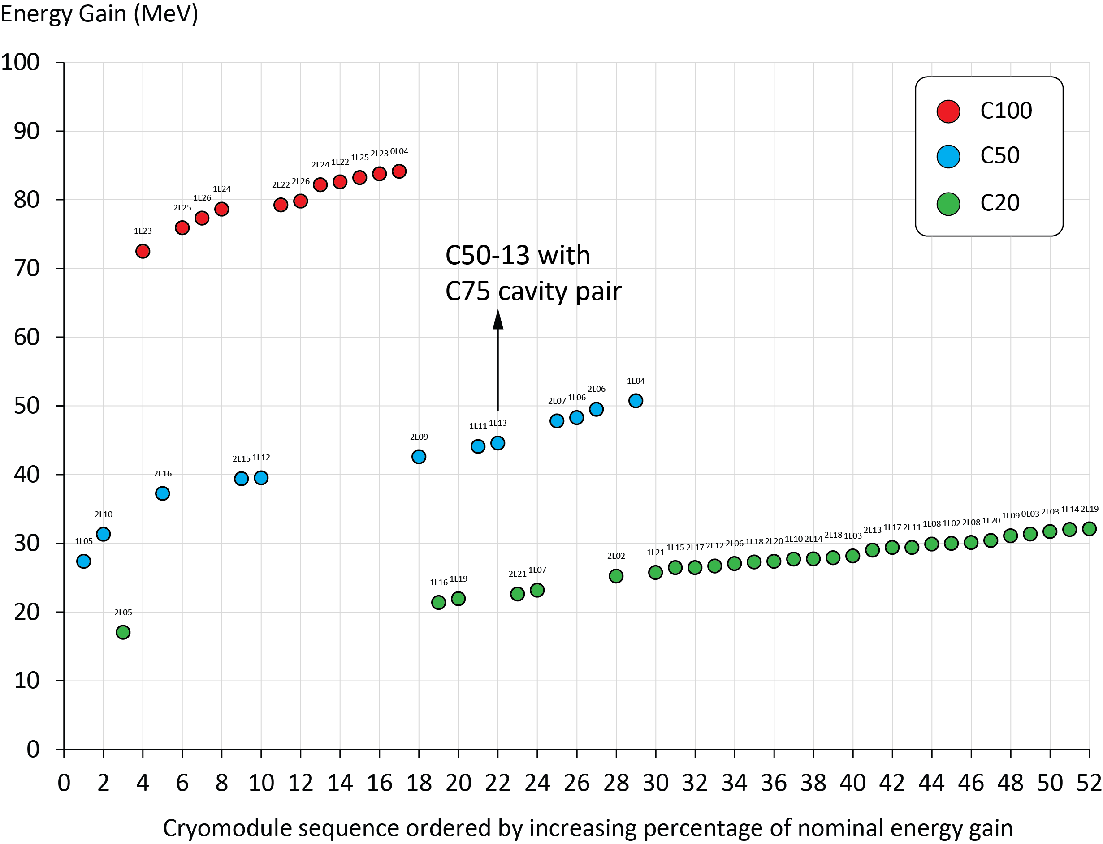
CEBAF Actual Cryomodule Energy Reach
CEBAF RF dashboard status: 2/6/2018
Cryomodule Type | Energy Gain (MEV) Avg. ± STD | % of nominal
C20 | 27.5 ± 3.6 | 137
C50 | 41.9 ± 7.3 | 84
C100 | 79.9 ± 3.7 | 80
Notes:
Red Interior Page Design 1

Slide 18
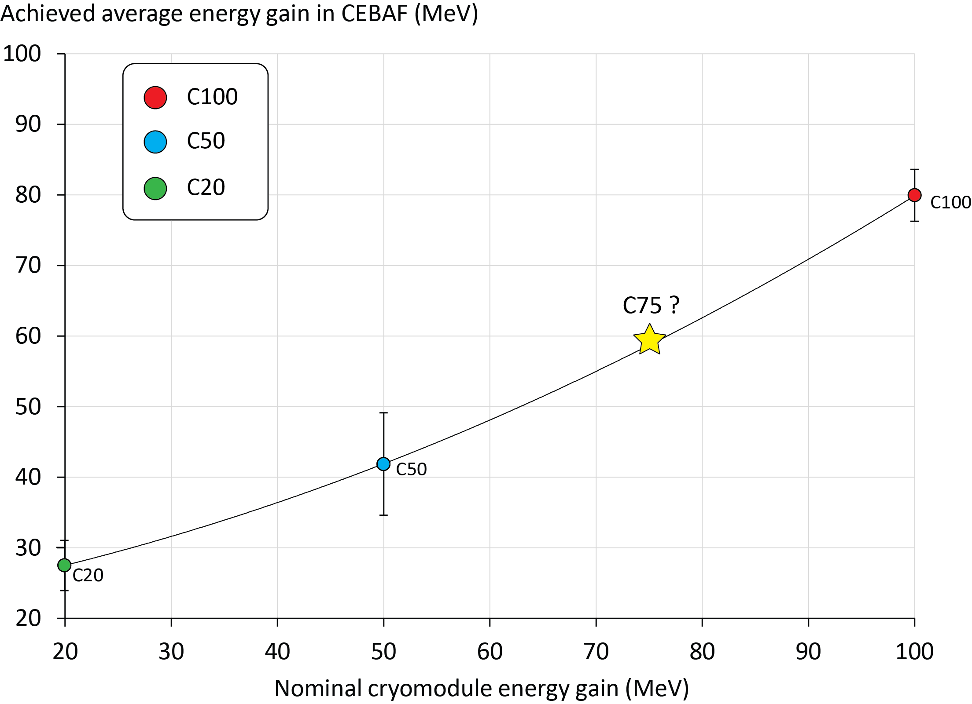
CEBAF Actual Cryomodule Energy Reach
CEBAF RF dashboard status: 2/6/2018
Cryomodule Type | Energy Gain (MEV) Avg. ± STD | % of nominal
C20 | 27.5 ± 3.6 | 137
C50 | 41.9 ± 7.3 | 84
C100 | 79.9 ± 3.7 | 80
C75 | ~60 ? | ~80 ?
Notes:
Red Interior Page Design 1

Slide 19
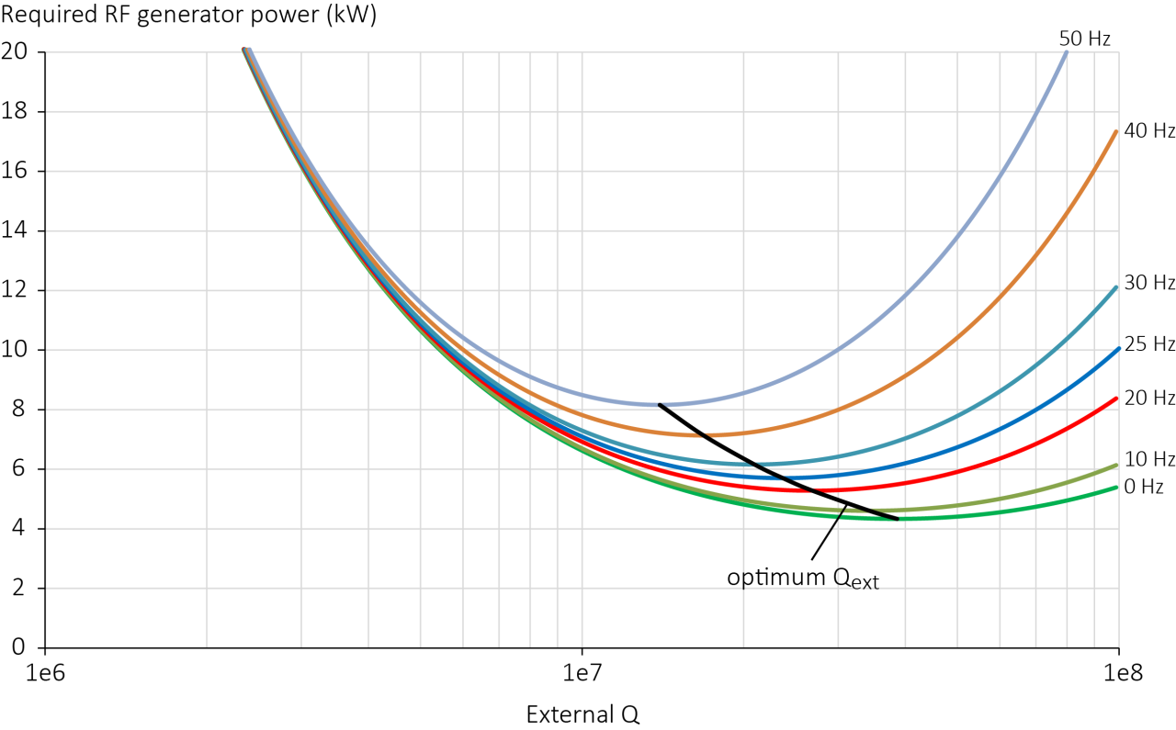
Q_{ext} Specification
At E_{acc,max} = 19.07 MV/m
Parameters used: R/Q = 525.4 Ω, E_{acc} = 19.07 MV/m, L_{act} = 0.4916 m, I_{b} = 460 µA, and Q₀ = 8e9
Notes:
Red Interior Page Design 1

Slide 20
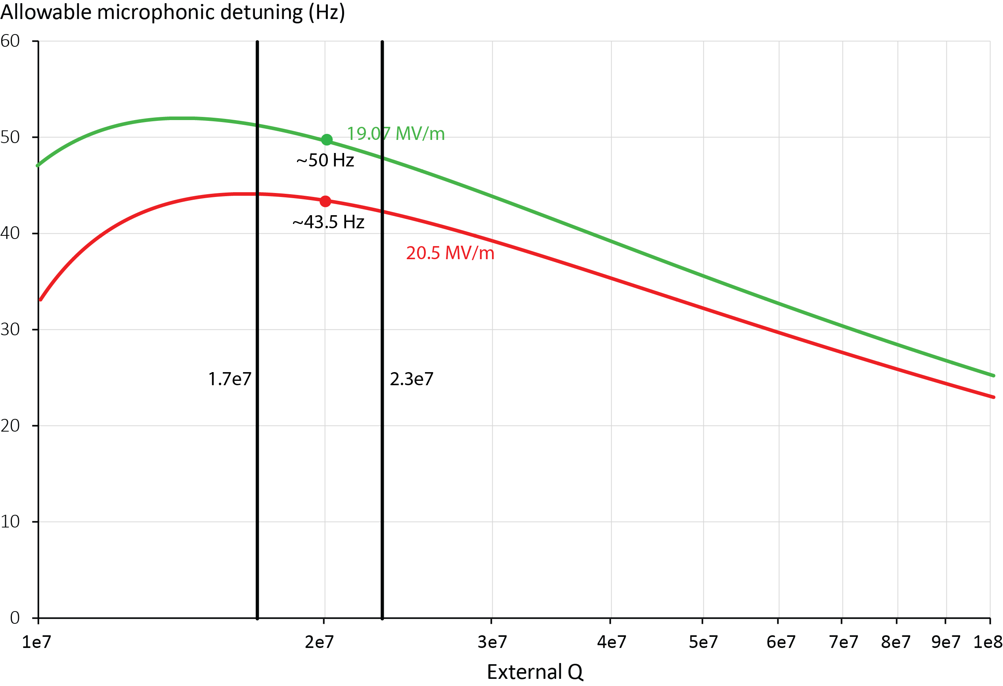
Q_{ext} Specification vs. Microphonics Allowance
Half beam loading (I_{b} = 230 µA), P_{g} = 7 kW
Parameters used: R/Q = 525.4 Ω, L_{act} = 0.4916 m, I_{b} = 230 µA, and Q₀ = 8e9
Notes:
Red Interior Page Design 1

Slide 21
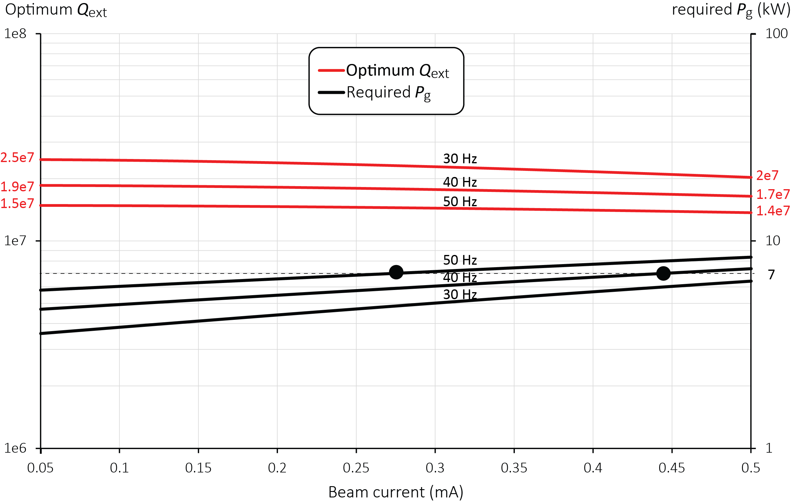
Optimum Q_{ext} with Beam Current and Microphonics
Nominal E_{acc} = 19.07 MV/m
Efforts to suppress microphonics by design (cf. talk on cavity design)
Parameters used: R/Q = 525.4 Ω, L_{act} = 0.4916 m, Q₀ = 8e9
Notes:
Red Interior Page Design 1

