Slide 1
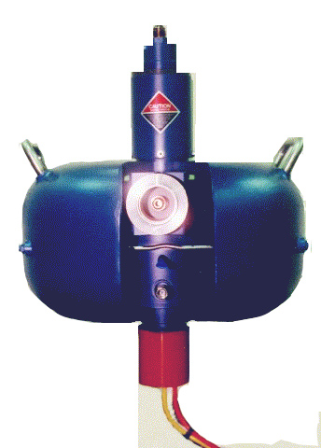
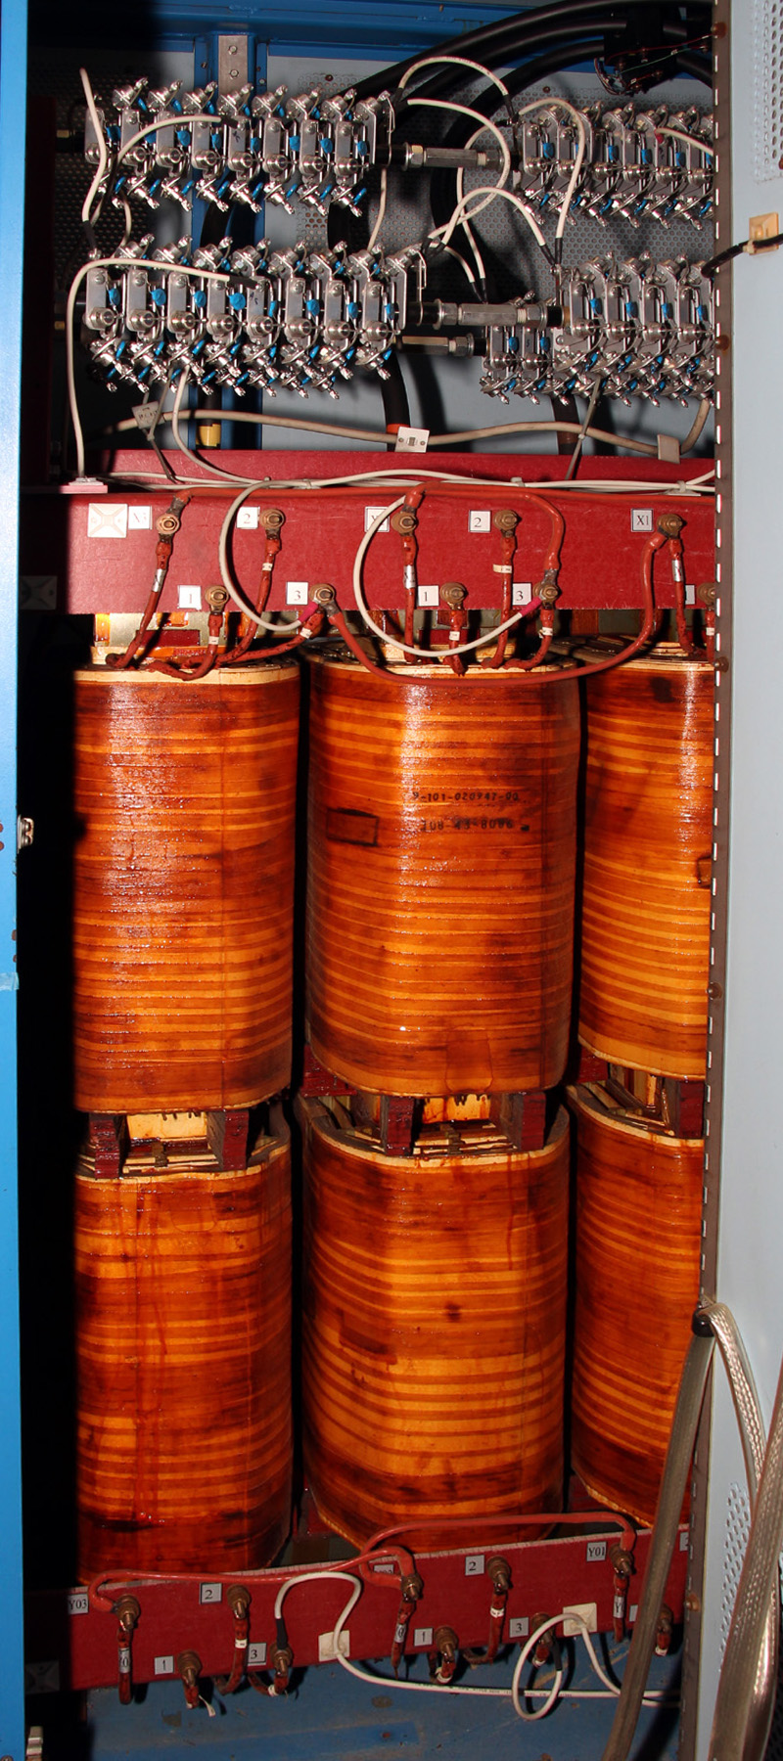
RF Power for C75 - Resources
RF Power U[grade for C75
Richard Nelson

Slide 2
Major Tasks
Major tasks (nearly identical to 0L04 mods)
Procurement of materials
Remove old parts from cathode power supply
Transformer, choke, capacitors, HV deck, contactors…
Modify enclosure to accommodate new components
Place & installation new parts
Transformer, choke, capacitors, HV deck, contactor, SCR controller, crowbar
Wiring, cabling, interlocks
Change controls & interface from analog and CAMAC to HPA controller & digital FCC
Waveguide replacement (HPA – tuners & circulators)

Slide 3
Tasks
Bulk of the tasks accomplished by RF techs
Installation, wiring, etc.
Transformer move and welding with assistance
Some software support to adapt digital controls
Testing
DC, controls, interlocks
RF (into shorts first)
Final waveguide connect to C75 CM followed by full-up testing

Slide 4
Major Procurements
Klystrons will be purchased regardless and as ongoing spares & replacements
~77k for CPS upgrade components
HV step-up transformer, choke, capacitor, contactor, crowbar, SCR controller
~80k for circulators (5kW to 8 kW capability)
May be able to reuse existing units with load rebuild
~19k for waveguide tuners & misc. waveguide
Exact pricing depends on quantities
Ideally multiple year contracts would be placed or larger buys up front
Cost advantage for 1 time buys

Slide 5
Labor & Procurements
Task/Milestone | Note | SE | EE/CS | ET | ED | Labor Total | Materials
HPA Controller |  | 0 | 1 | 0.4 | 0
Network Modifications |  | 0.2 | 0.2 | 0.2
Software Modifications |  | 0.2 | 0.4
8 kW Klystrons/test/install | proc separate | 0.5 | 1 | 2 | 1
8 kW Circulators * |  | 0.2 | 0.2 | 2 | 0.4 |  | 80,000
Waveguide (tuners) |  | 0.2 |  | 2 | 0.2 |  | 17,500
CPS Upgrade (rebuild) |  | 0.4 | 1 | 4 | 1 |  | 77,000
HPA Interlocks, CAMAC conversion |  | 0.2 | 1 | 2 | 0.4 |  | 2,500
HPA/CM Waveguide Installation |  | 0.4 | 1 | 3 | 1 |  | 2,000
Electrical Work (cable, conduit, breaker) |  |  | 0.4 | 2 | 0.6 |  | 2,000
AC Distribution& A/C (facilities) | separate
Commissioning, HV, shorts |  |  | 0.6 | 2
RF Power Commissioning |  | 0.2 | 1 | 2 | 0.4 |  | 1,000
Total (weeks) |  | 3 | 7.2 | 18.4 | 5 | 33.6 | 182,000
* may be able to use existing circulators

Slide 6
Non-optimized Draft Schedule

Slide 7
Summary
Labor requirements well understood
Quantities & talents
This project should be familiar as it’s close to 0L04 upgrade
Dual work areas (HPA & CPS modifications) should allow parallel work with adequate staff to reduce completion time
Could extend to working 2 zones in parallel
Actual labor pool will depend on staff size, work load, priorities

