Slide 1
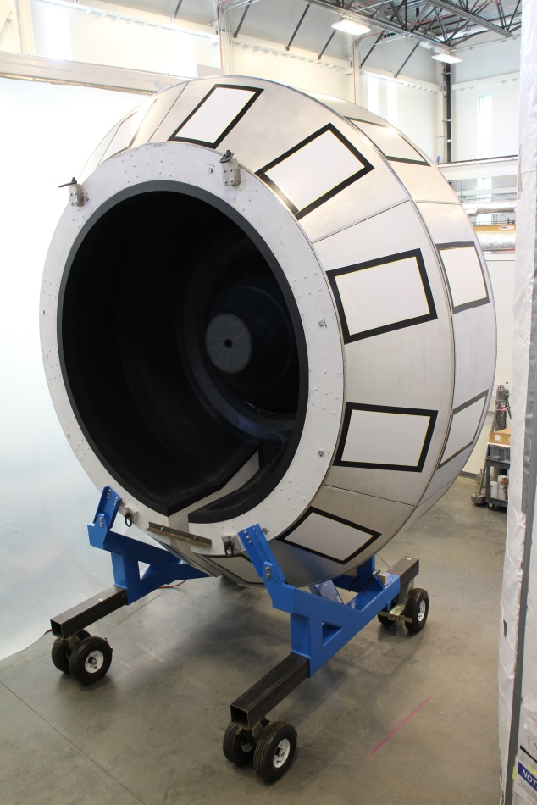
High Threshold Cerenkov Counter
Youri Sharabian, Jefferson Lab
Collaborating Institutions:
Argonne National Laboratory
California State University
Fairfield University
Institute of Theoretical and Experimental Physics
Rensselaer Polytechnic Institute
University of Connecticut
North Carolina Agricultural and Technical State University
Florida International University

Slide 2
Outline
General Description
MC Simulation and Tests
PMT Calibration
Controls
Channels Response Equalization
Electron Detection Efficiency
Plans
Summary

Slide 3
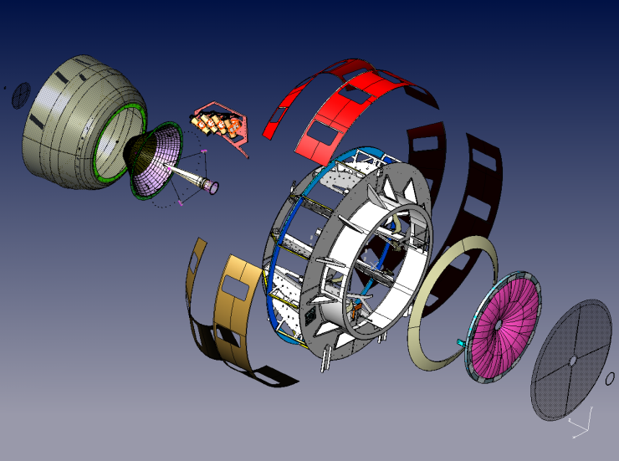
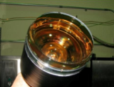
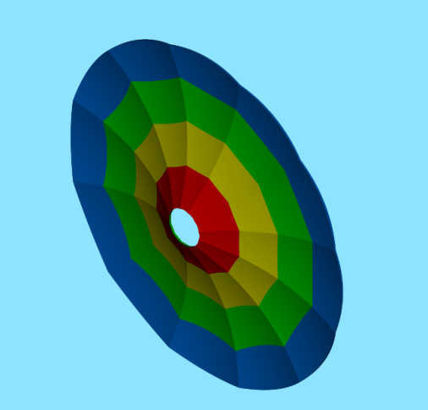
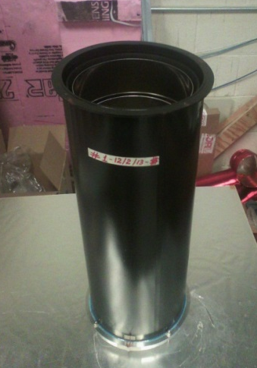
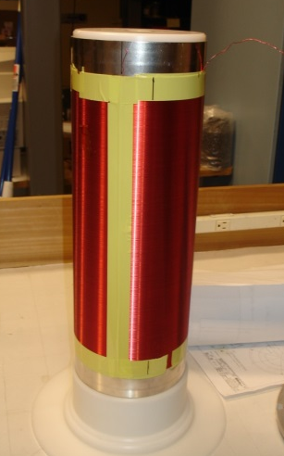
HTCC Parameters
General Description
Optics and Components
Working gas: CO₂@1atm, 25ºC
Maintenance Hatches
Entry Dish
PMT Mounting Plate
Shells
Entry Cone
Entry Cone
Moller Cup
Mirror
Exit Window
Weldment Part
8 ft.
5° < θ < 35° Δφ = 360°
PMT Mounting Unit
Radiation Lengths :
Requirement As built
CO₂ 0.9% 0.9%
Mirror 0.8% 0.5%
(200 Mg/cm²) (130 Mg/cm²)
Compensation Coil

Slide 4
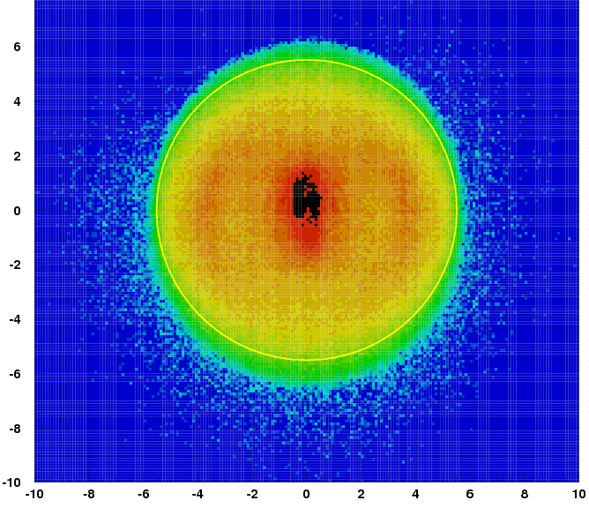
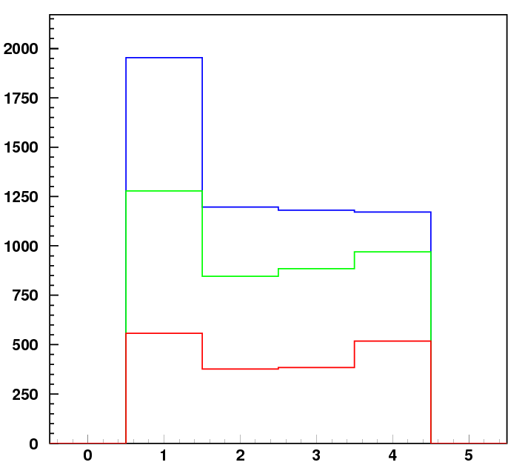
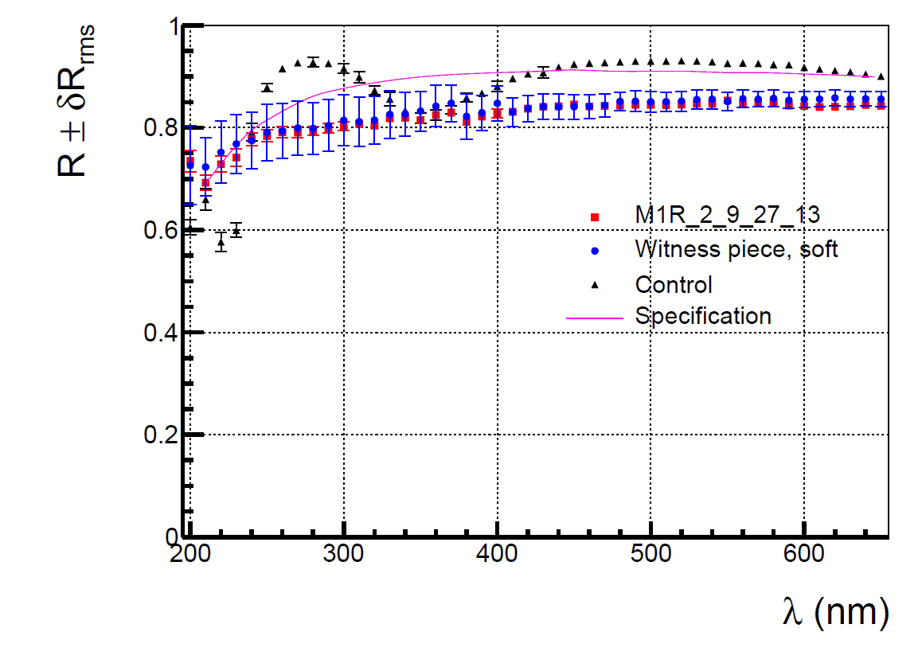
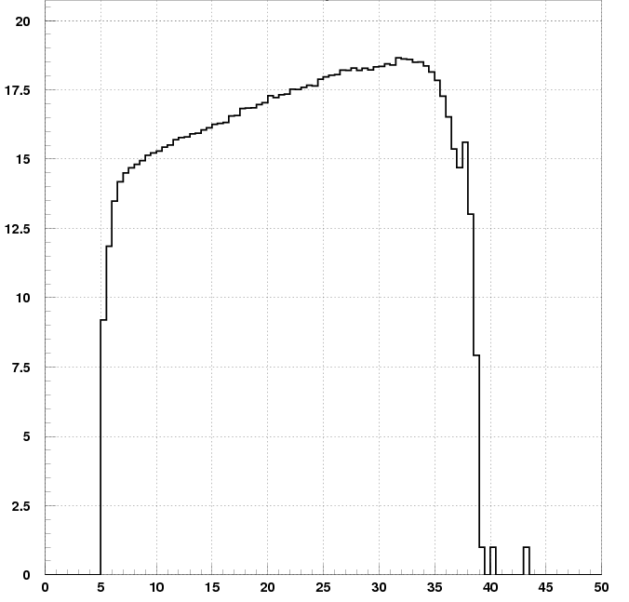
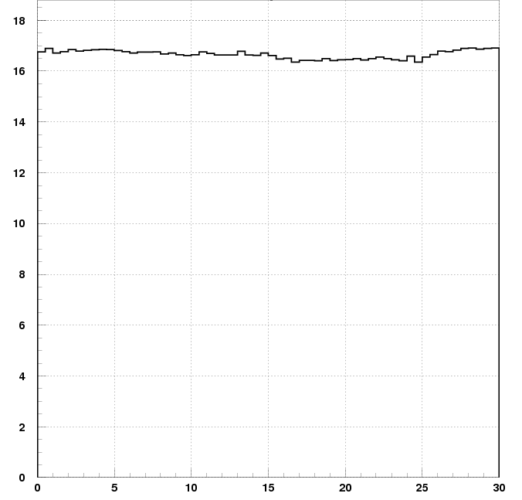
Performance Results
MC Simulation and Tests
Light collection pattern
Rejection of π- mesons
Reflectance of mirrors
Target 10cm
5T Field
2 GeV Electrons
η_{e}= 99.90%
N_{p.e.}3
cm
N_{p.e.}2
N _{p.e.}1
, nm
Channels
Geometry Test (Rasterized Laser Beam)
cm
Signal strength, Quartz PMT
N_{phe} y 17
Focal plane #4
Focal plane #1R
Photoelectrons
Focal plane #3
Focal plane #2
, deg
Parameters of the components meet Technical Requirements
,deg

Slide 5
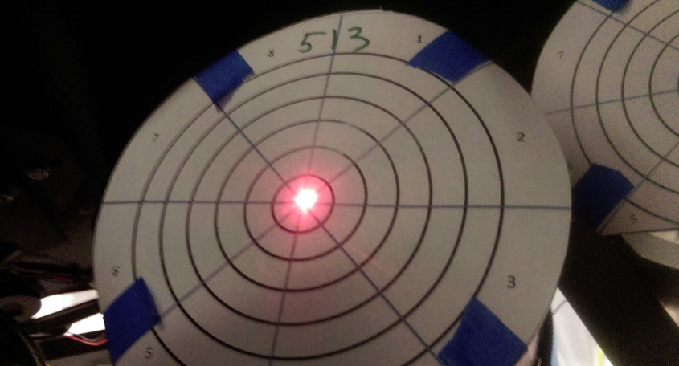
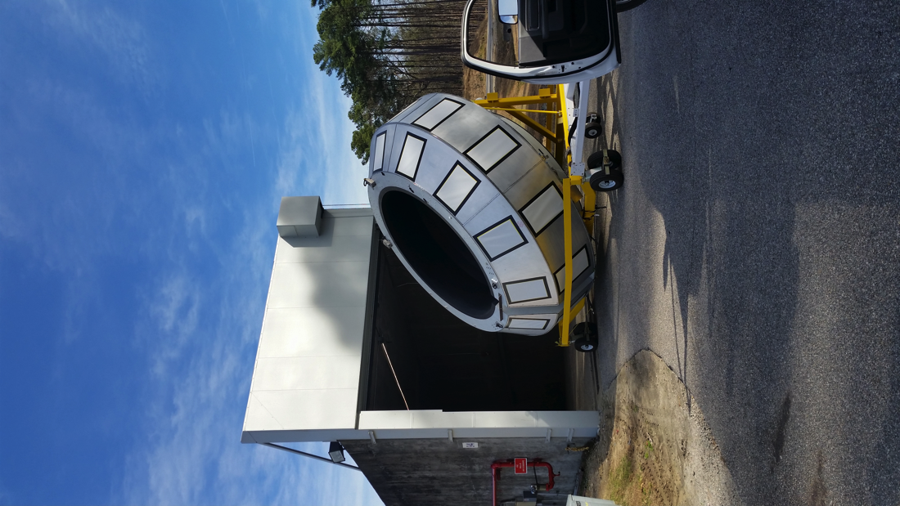
HTCC Hardware Status (continued)
MC Simulation and Tests
Alignment of Components
Alignment of the PMT Mounting Units
Before and after alignment
Alignment of the PMTs was mostly done in the TEDF building. It has been
completed after the HTCC was moved to the Hall

Slide 6
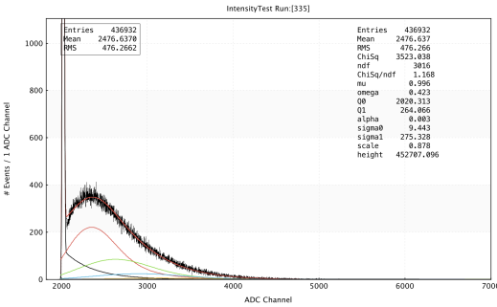
PMT Calibration
New approach used in the HTCC light monitoring provides reliable, stable and simplified analysis of PMT performance
Light is uniformly distributed among 48 PMTs using 4“ integrating sphere and plastic fiber optics of equal length
The single photoelectron peak position is found using a fit function describing the photomultiplier response
This approach can be used at different light of intensity in wide range, i.e. does not require light of the same intensity in different equalization runs
Calibration software has been designed to provide gain equalization of PMTs which have dark noise relatively so high that makes impossible observation of a single photoelectron signal
HTCC LMS
Definitions
Q₀ and σ₀
Parameter | Description
µ | Mean number of P.E.
ω | Probability of type II background
Q₀ | Pedestal position
Q₁ | Position of SPE peak
α | Exponential slope of type II
σ₀ | Width of pedestal
σ₁ | Width of PE distributions
scale | Normalization function
Height | ~Total number of events
Q₁, ~ Gain
SPE Peak

Slide 7
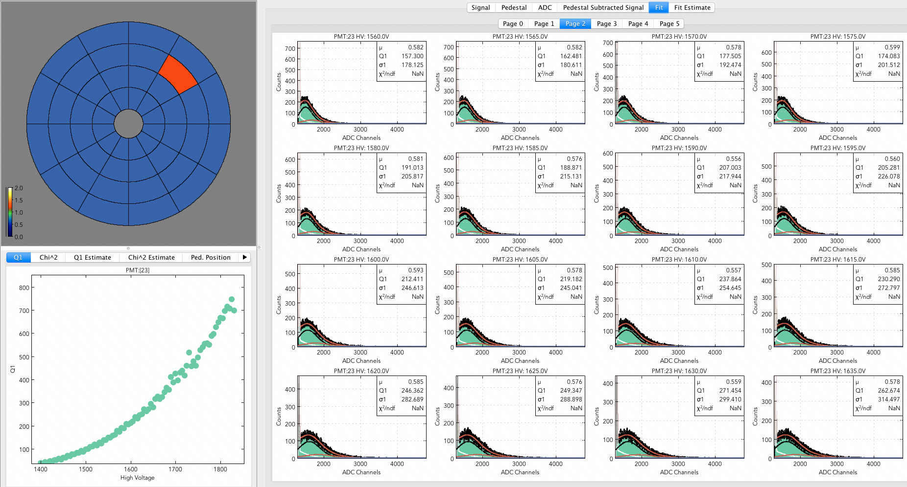
PMT Calibration
Typical fits of PMT response to LMS light of constant intensity
as function of High Voltage

Slide 8
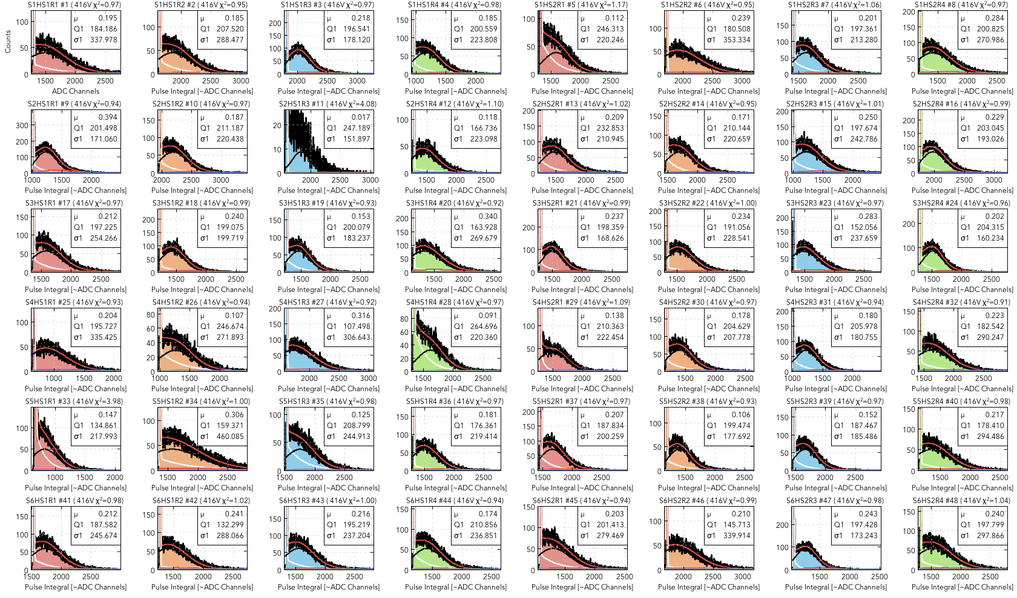
PMT Calibration
Typical PMTs response of HTCC channels to LMS light of constant intensity
HS1 R1
HS1 R2
HS1 R3
HS1 R4
HS2 R1
HS2 R2
HS2 R3
HS2 R4
S1
S2
S3
S4
S5
S6
Calibration of all channels has been done at Central Solenoid OFF and currents of 60%, 100%

Slide 9
Two PMT Response Functions at 0.6 Solenoid
PMT Calibration
Bellamy
Degtiarenko

Slide 10
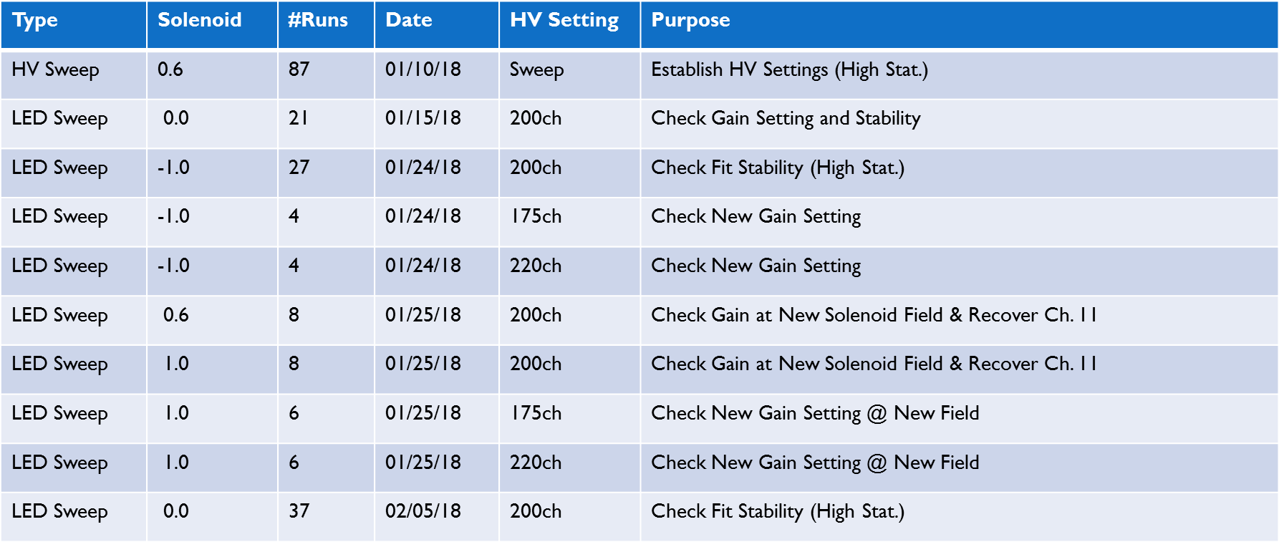
PMT Calibration
Recent HTCC Calibration Runs

Slide 11
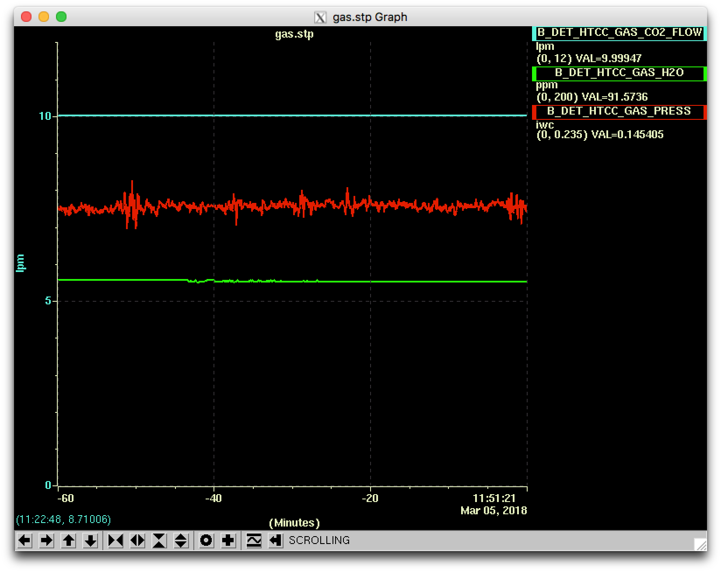
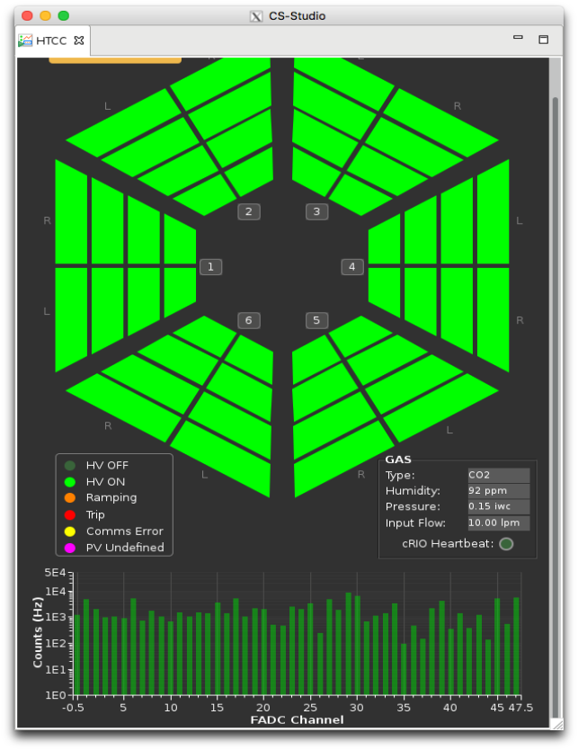
Main HV control screen
HTCC Software Status (continued)
Controls
Operations of the HTCC are supported by Slow Controls available at all times. The detector is to be continuously purged with dry Oxygen Dioxide or other dry gases as required. Than monitoring and operations controls of the gas supply lines are to be backed up by UPS in the hall and by generator used in case of power outage for extended period of time.
HTCC Gas Control Tab
HTCC Expert GUI
Status of channels and of gas system is shown

Slide 12
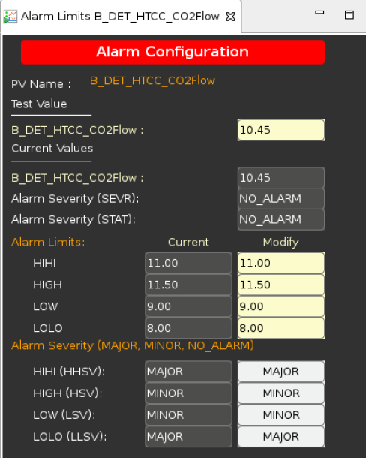
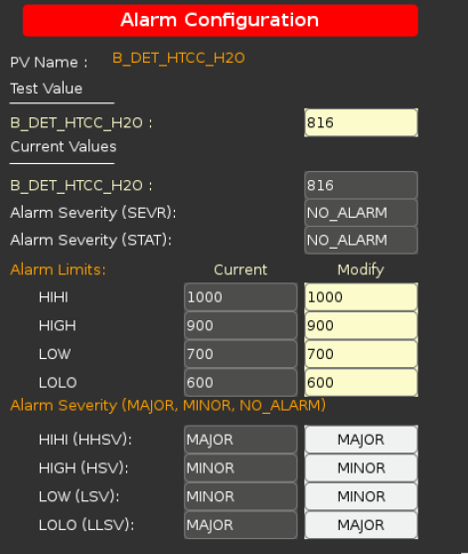
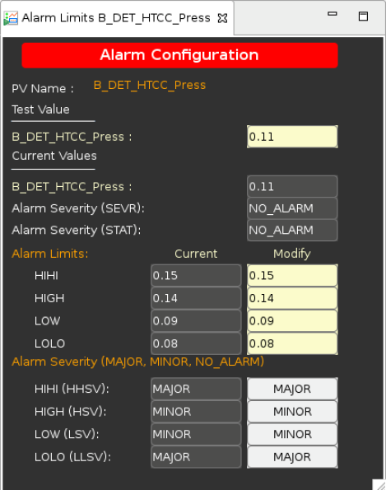
HTCC Software Status (continued)
Controls
Single Channel Control GUI
HTCC Alarm Screens
CO₂ flow rate
CO₂ Absolute Humidity
Differential pressure

Slide 13
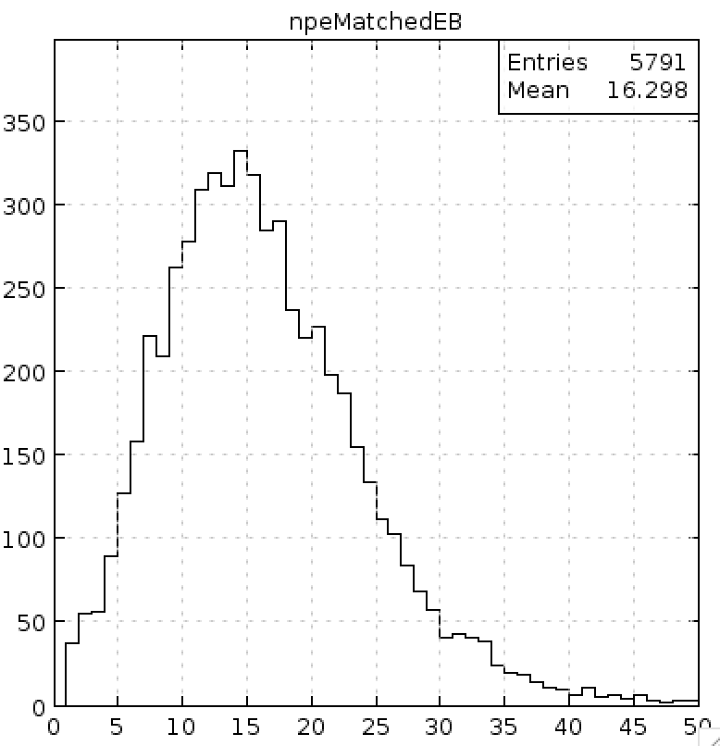
Channels Response Equalization
Signal Strength in Channels (12 channels per Ring)
S1 HS1
S1 HS2
S2 HS1
S2 HS2
S3 HS 1
S3 HS2
R1
2GeV
Run #2476
EB Match
Single Hit
Torus 0.6
Solenoid 0.6
R2
R3
S4 HS1
S4 HS2
S5 HS1
S5 HS2
S6 HS1
S6 HS2
Run 2043
R1
Target Full
Beam 5nA
Torus -0.85
Solenoid 1
R2
R3
N_{phe}=16.3
N_{phe}

Slide 14
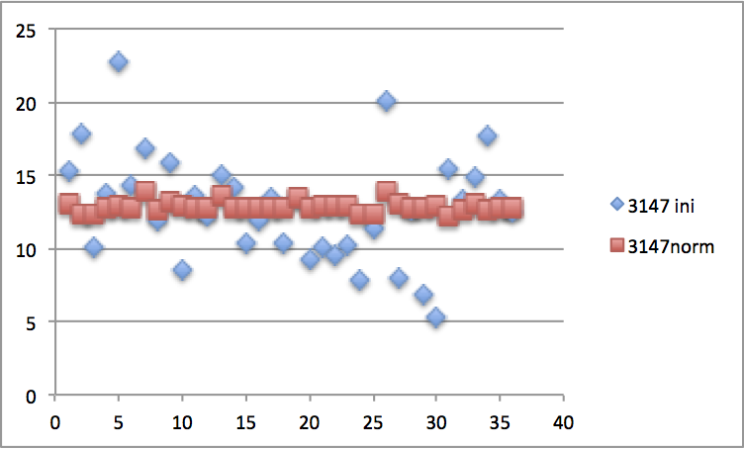
Channels Response Equalization
Channels response before ( ) and after equalization ( )
10.6 GeV
Run #3147
EB Match
Single Hit
Torus 1.0
Solenoid –1.0
Equalization have been done for R1, R2 and R3 only. R4 statistics is low.
Corrections depend on the Solenoid current.

Slide 15
Electron Detection Efficiency
h=(990.2)%
Currently the HTCC effective threshold (after equalization) is 2phe
It is worth to set the threshold of 3phe and then compare results on background
2 GeV data. Vertex cuts applied.
HTCC FADC readout threshold ~ 2.5 phe
No charged pion background. Events of elastic scattering of electrons used only
At lower threshold of 1phe expected efficiency can be higher than 99%

Slide 16
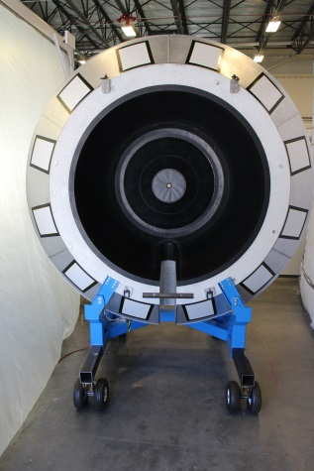
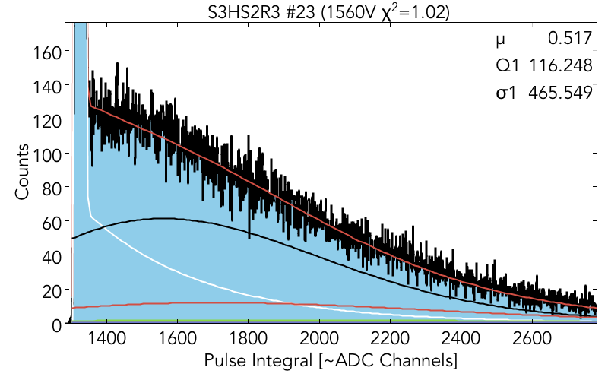
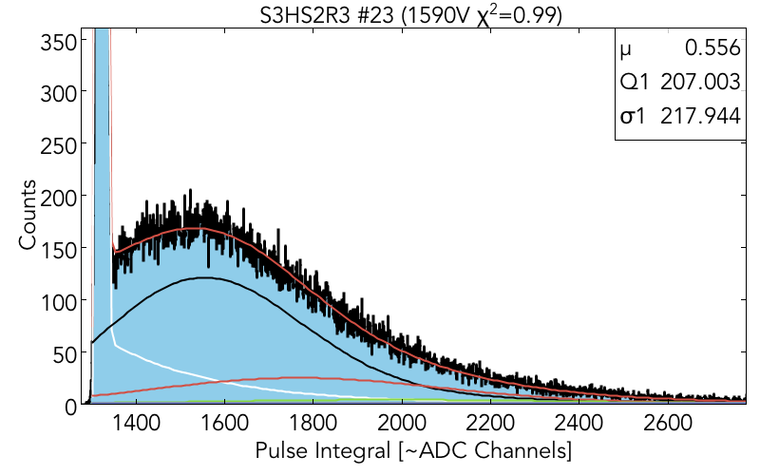
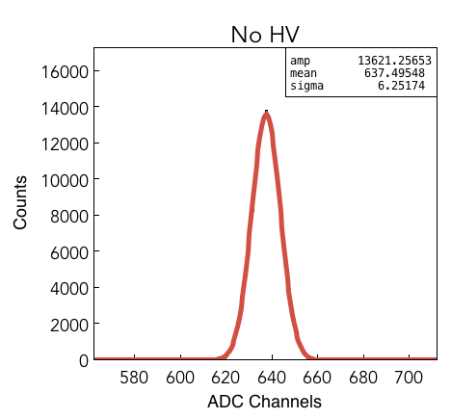
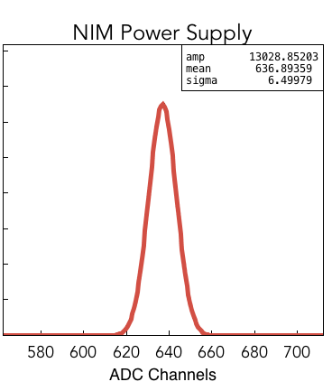
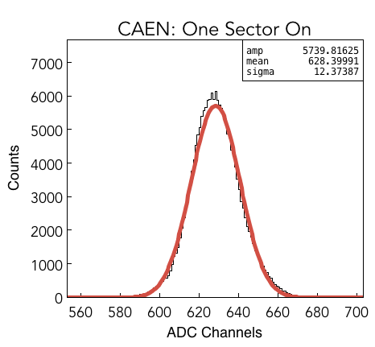
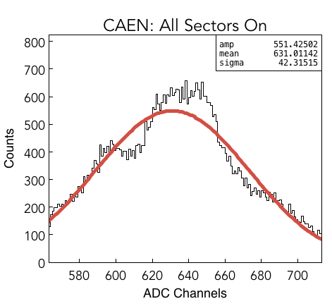
Plans
Changes of the PMT responses have been observed multiple times. Remedy – replacement of PMTs and bases. But it has been observed also that the performance of some PMT depends on temperature requiring replacement of components as well. Test are necessary.
Replacement procedure takes too much time and needs to be considerably reduced. OSP needs to be modified.
PMTs change performance as function of the fringe field generated by Solenoid. Values for the compensation current have to be established to reduce number of calibration runs. Additional tests (without beam) needed.
There is an unacceptable amount of noise coming from the CAEN HV power supply most likely being picked up by active HV divider. More tests are needed.
Before
After
Power Supply | ⬧
No HV | 6.25
NIM | 6.50
CAEN (One Sector) | 12.38
CAEN (All Sectors) | 42.32

Slide 17
Summary
PARAMETER | DESIGNED | CURRENT | COMPLETED
Working Gas | CO₂@1atm, 25ºC | CO₂@1atm, 25ºC | ✔
Angular Coverage | ϑ= 5º – 35º; f= 0º – 360º | ϑ = 5º – 35º;  = 0º – 360º | ✔
Threshold | 15 MeV/c (electrons) | 15 MeV/c (electrons) | ✔
Threshold | 4.9 GeV/c (charged pions) | 4.9 GeV/c (charged pions) | ✔
Pion Rejection@2GeV/c | 10³ (electron detection efficiency h~99.9%) | h99 %, threshold of 2.5 phe | ✔
Pion Rejection@4GeV/c | 0.5x10³ (electr. detec. efficiency h~99.9%) | h99 %, threshold of 2 phe | ✔
Overall Dimensions | 15 ft, L = 6 ft along beam direction | 15 ft, L = 6ft along beam dir. | ✔
Mirror Type | Combined Ellipsoidal, OD = 8 ft | Combined Ellipsoidal, Ø8 ft | ✔
Mirror Structure | Composite | Acryl + PMI Foam + Acryl | ✔
Mirror Thickness | 200 mg/cm² | (130 – 135) mg/cm² | ✔
Number of Channels | (12x4) = 48 | (12x4) = 48 | ✔
Photomultiplier Tubes | 5” Photomultiplier Tubes with quartz window | ET 9823QKB (5”, quartz win.) | ✔
Number of Reflections |  2 | 1 (80%) + 2 (20%) | ✔
Magnetic Field | 35 Gauss (along PMT axis) | 50 Gauss (along PMT axis) | ✔
Magnetic Shield | Multilayer with compensation coil | Multilayer with compens. coil | ✔

