Slide 1
Acceptance Corrections: Bin-by-Bin Method vs. Matrix Conversion Method
Nikolay Markov, Brandon Clary and
Kyungseon Joo
University of Connecticut
CLAS Collaboration Meeting
March 8, 2018

Slide 2
Acceptance Corrections
Unfold true distributions from measured distributions

Slide 5
Acceptance Corrections
Bin-by-bin method
D_{i} = A_{i} T_{i}
D_{i} is # of measured events in i^{-th} bin
T_{i} is # of true events in i^{-th} bin
A_{i} is the acceptance of i^{-th} bin
where A_{i} = N_{REC} / N_{GEN} for i^{-th} bin
2. Matrix Method
D_{i} $=$ ∑M_{ij} T_{j}
M_{ij} is the acceptance matrix
where $M_{ij}$=$N_{REC}^{i}$/ $N_{GEN}^{j}$

Slide 6
Bin-by-Bin Method
D_{i} = A_{i} T_{i}
D_{i} is # of measured events in i^{-th} bin
T_{i} is # of true events in i^{-th} bin
A_{i} is the acceptance of i^{-th} bin
where
1. $A_{i}$=$N_{REC}^{}$/ $N_{GEN}^{}$for i^{-th} bin
2. $A_{i}$=$M_{ii}$ from $M_{ij}$=$N_{REC}^{i}$/ $N_{GEN}^{j}$

Slide 7
3 Simple Event Generators (Inclusive scattering)
Beam energy: 10.6 GeV
W flat, [1.0: 5.0] GeV
Electron lab φ angle flat, [0: 360] degrees
Q² [1.0: 10.0] GeV²
Flat
1/ Q⁴
sin(2*Q²) + 1.5

Slide 8
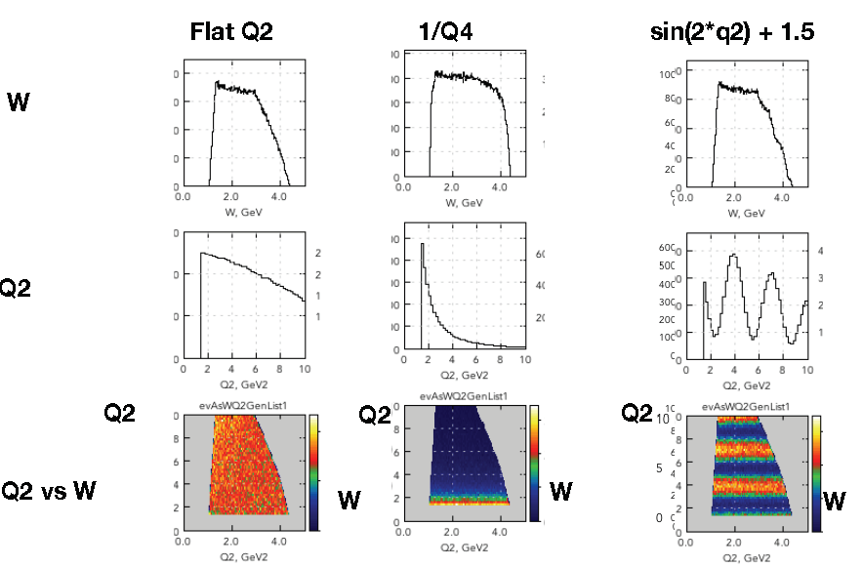
Generated Events

Slide 9
Simulation and reconstruction
GEMC 4a.2.1
Coatjava 4a.8.3
Torus - 100%
Solenoid - 100%
MICROMEGAS in
Electron PID:
EB electron id
Fiducial cut

Slide 10
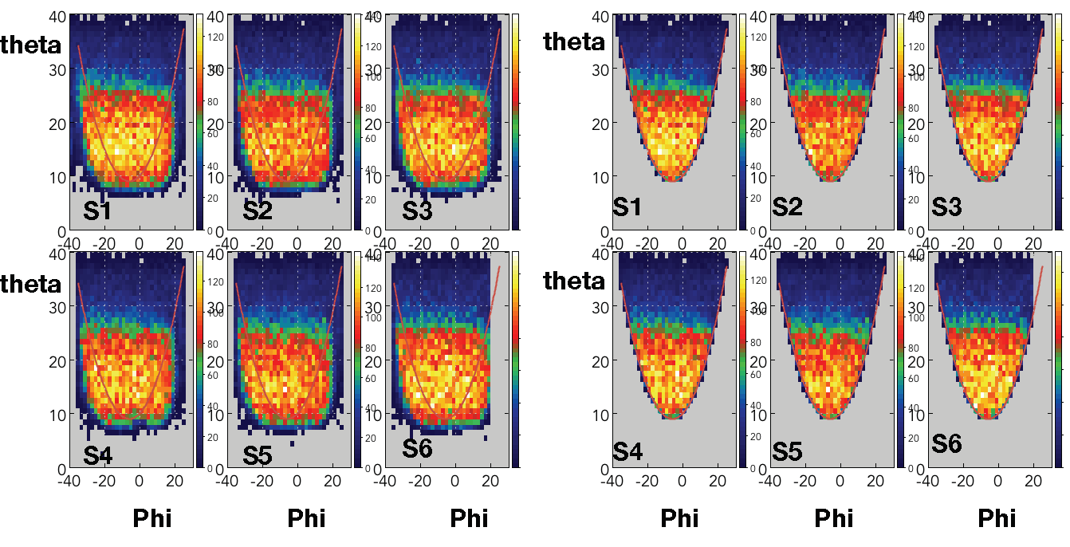
Fiducial Cut

Slide 11
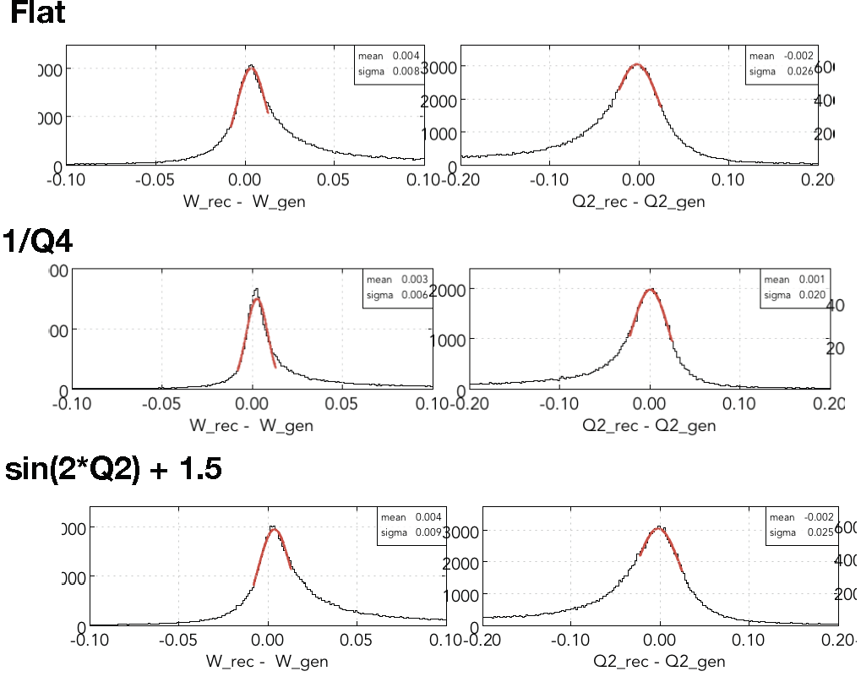
Resolutions
W
Q²
σ_{Q2} = 0.02 GeV²
σ_{W} = 10 MeV

Slide 12
Acceptances and Purity
$${ACC}_{T}=\frac{N_{rec}}{N_{gen}}=\frac{N_{rec}^{gen}+N_{rec}^{migrated}}{N_{gen}}$$
: Total acceptance
$${ACC}_{P}=\frac{N_{rec}^{gen}}{N_{gen}}$$
: Pure acceptance
$${ACC}_{M}=\frac{N_{rec}^{migrated}}{N_{gen}}$$
: Migrated acceptance
${ACC}_{T}={ACC}_{G}+$ ${ACC}_{M}$
$${Purity}_{}=\frac{N_{rec}^{gen}}{N_{rec}}=\frac{N_{rec}^{gen}}{N_{rec}^{gen}+N_{rec}^{migrated}}$$

Slide 13
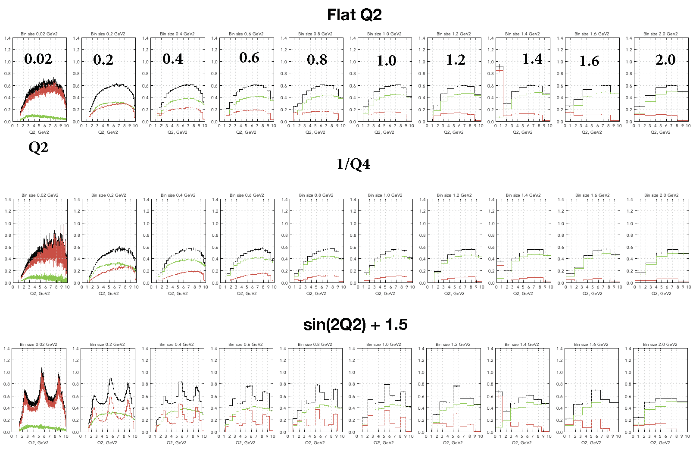
Acceptances vs. Models
σ_{Q2} = 0.02 GeV²
$${ACC}_{T}=\frac{N_{rec}}{N_{gen}}$$
0
10.0
$${ACC}_{P}=\frac{N_{rec}^{gen}}{N_{gen}}$$
$${ACC}_{M}=\frac{N_{rec}^{migrated}}{N_{gen}}$$

Slide 14
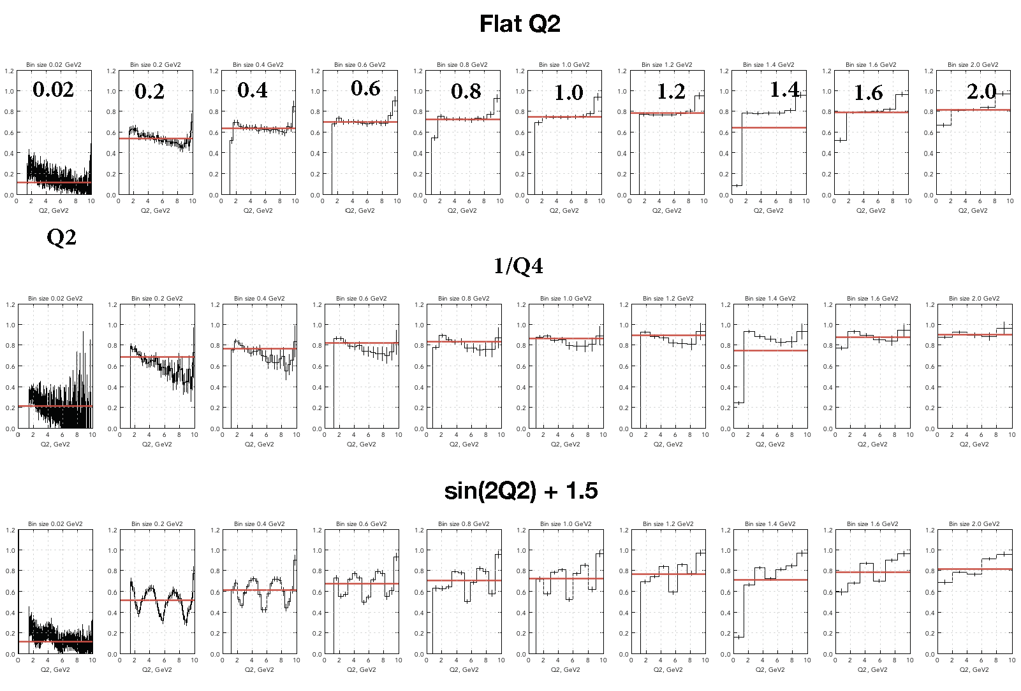
Purity vs. Models
σ_{Q2} = 0.02 GeV²
0
10.0
$${Purity}_{}=\frac{N_{rec}^{gen}}{N_{rec}}$$

Slide 15
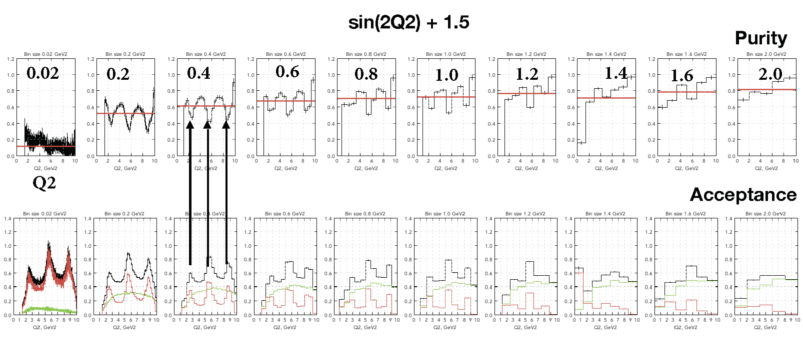
Purity vs. Acceptances
σ_{Q2} = 0.02 GeV²
0
10.0

Slide 16
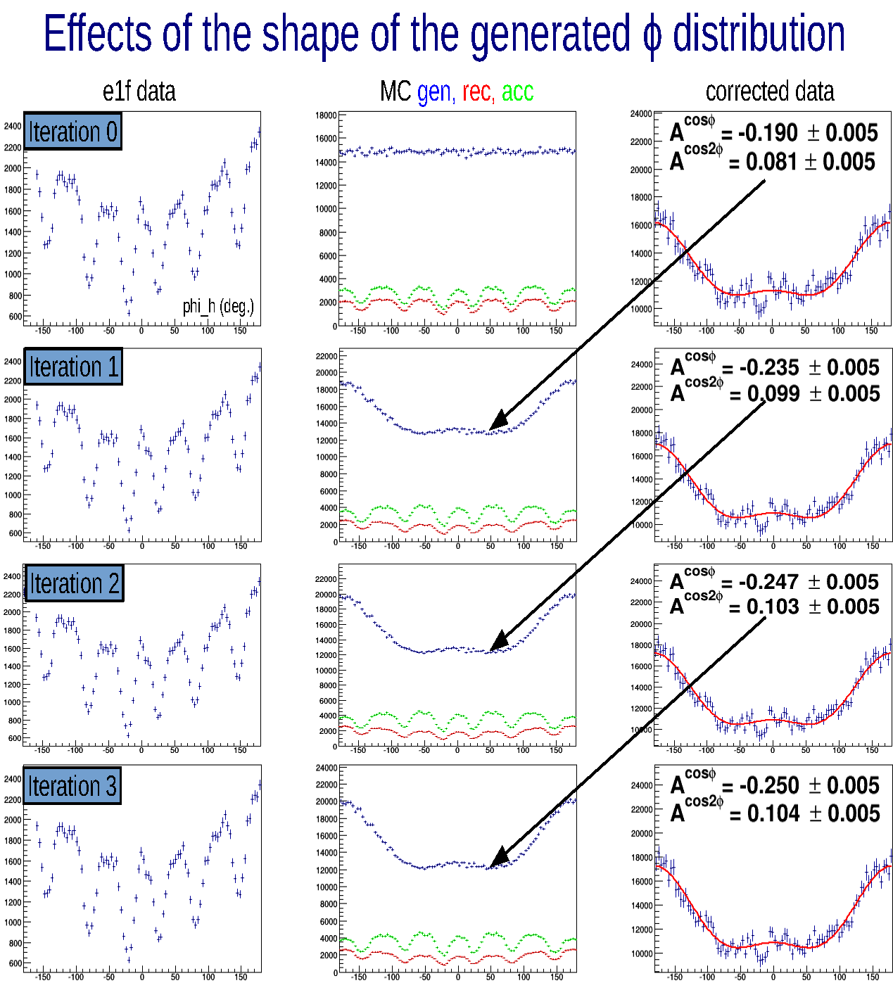
Iterative Unfolding using Bin-by-Bin Method N. Harrison PhD Thesis for pion SIDIS

Slide 17
Bin Size Matters
Large bin size may result in a loss of sensivity to high frequency components or acute changes.
Small bin size may create high sensitive to bin migrations and event generator dependence.

Slide 18
Matrix Method
D_{i} $=$ ∑M_{ij} T_{j}
where $M_{ij}$=$N_{REC}^{i}$/ $N_{GEN}^{j}$

Slide 19
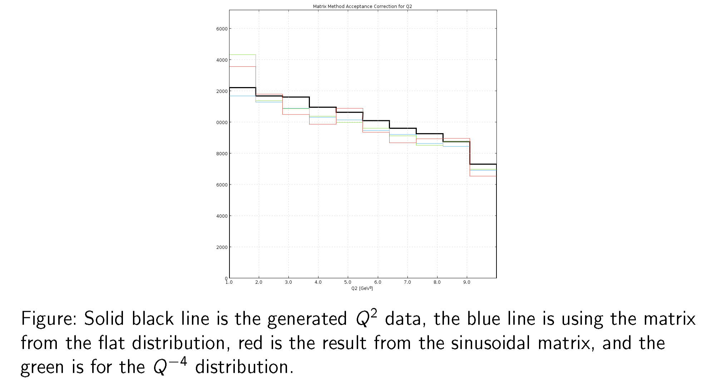
Metrix Method 10 Bins

Slide 20
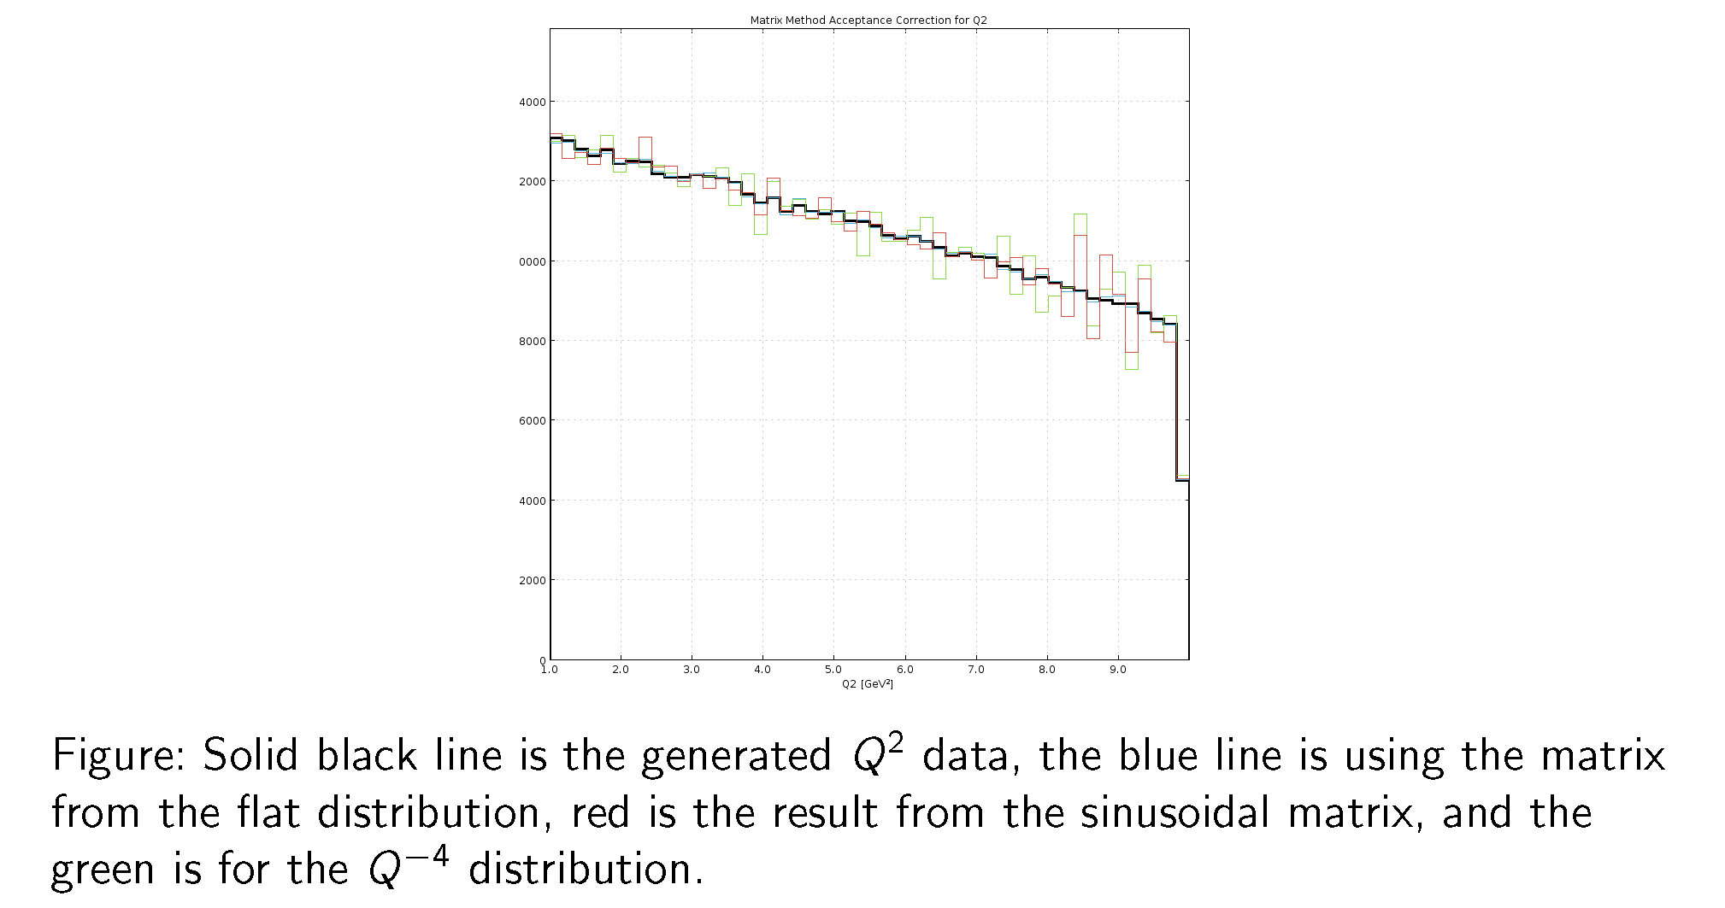
Metrix Method 50 Bins

Slide 21
Summary
We showed that acceptance is sensitive to event generator models due to bin-migrations even for binnings with much larger than tracking resolution bin sizes.
We need to avoid bins with very low purity values to minimize systematic errors.
We showed that matrix conversion method is less sensitive to event generator models due to bin-migrations, but it is difficult to implement it for multi-dimensional analysis.

Slide 22
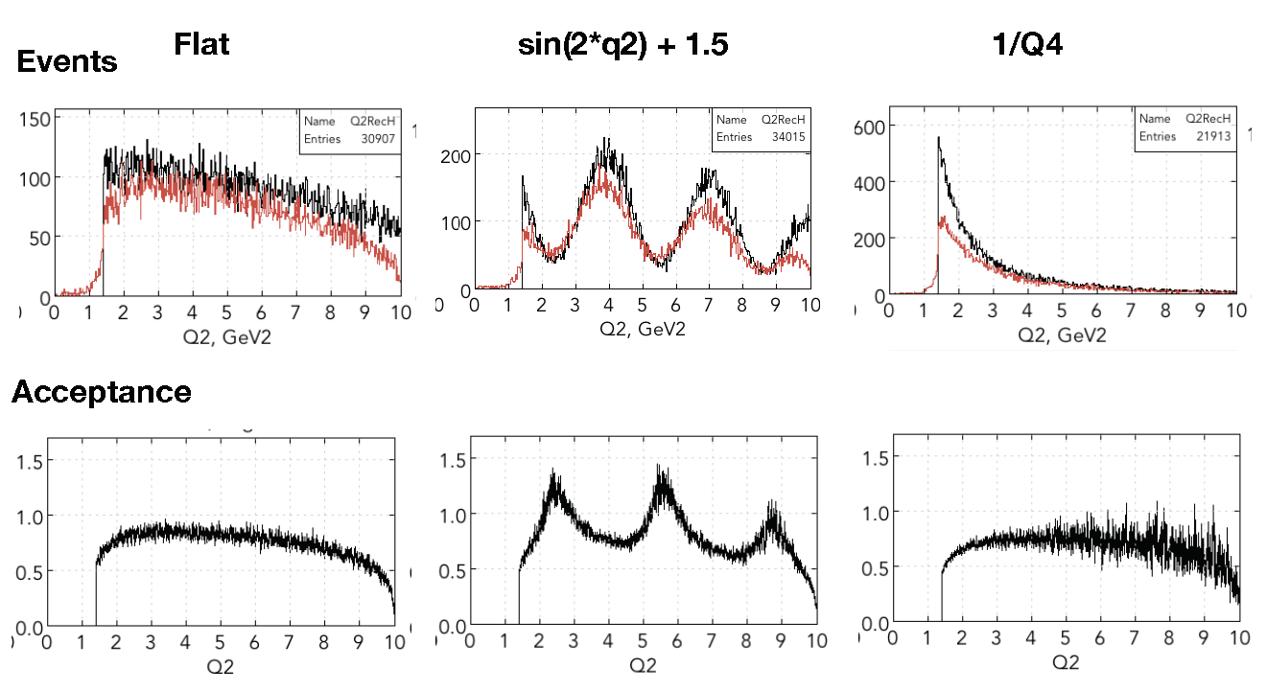
Generated Events vs. Reconstructed Events
GEN
REC
REC
GEN

