Slide 1
TOF Systems Settings/Calibration/Performance Status and Plans
Daniel S. Carman
Jefferson Laboratory
FTOF
CTOF

Slide 2
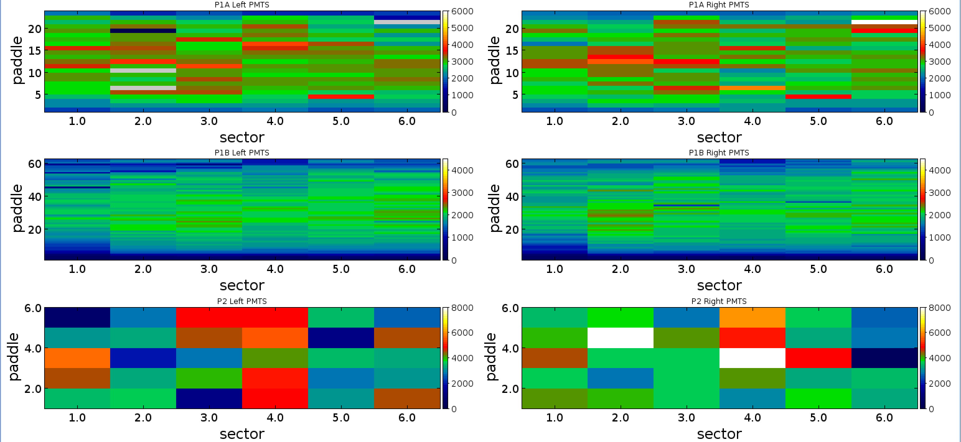
TOF Hardware Status
S1
S2 | P1a #6L | Bad divider
 | P1a #10L | Bad divider
 | P1a #19L | Bad divider
S3
S4
S5
S6 | P1a #21L | Bad divider
FTOF
CTOF
Counter #14 not installed due to space issues; to be installed before fall 2018 run

Slide 3
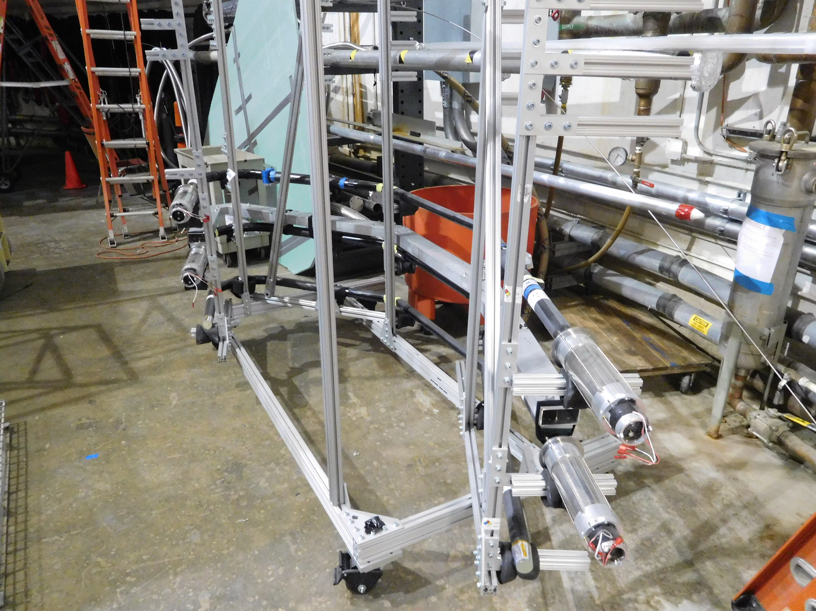
TOF Hardware Status
S1
S2 | P1a #6L | Bad divider
 | P1a #10L | Bad divider
 | P1a #19L | Bad divider
S3
S4
S5
S6 | P1a #21L | Bad divider
FTOF
CTOF
Counter #14 not installed due to space issues; to be installed before fall 2018 run
CTOF Group Leader

Slide 4
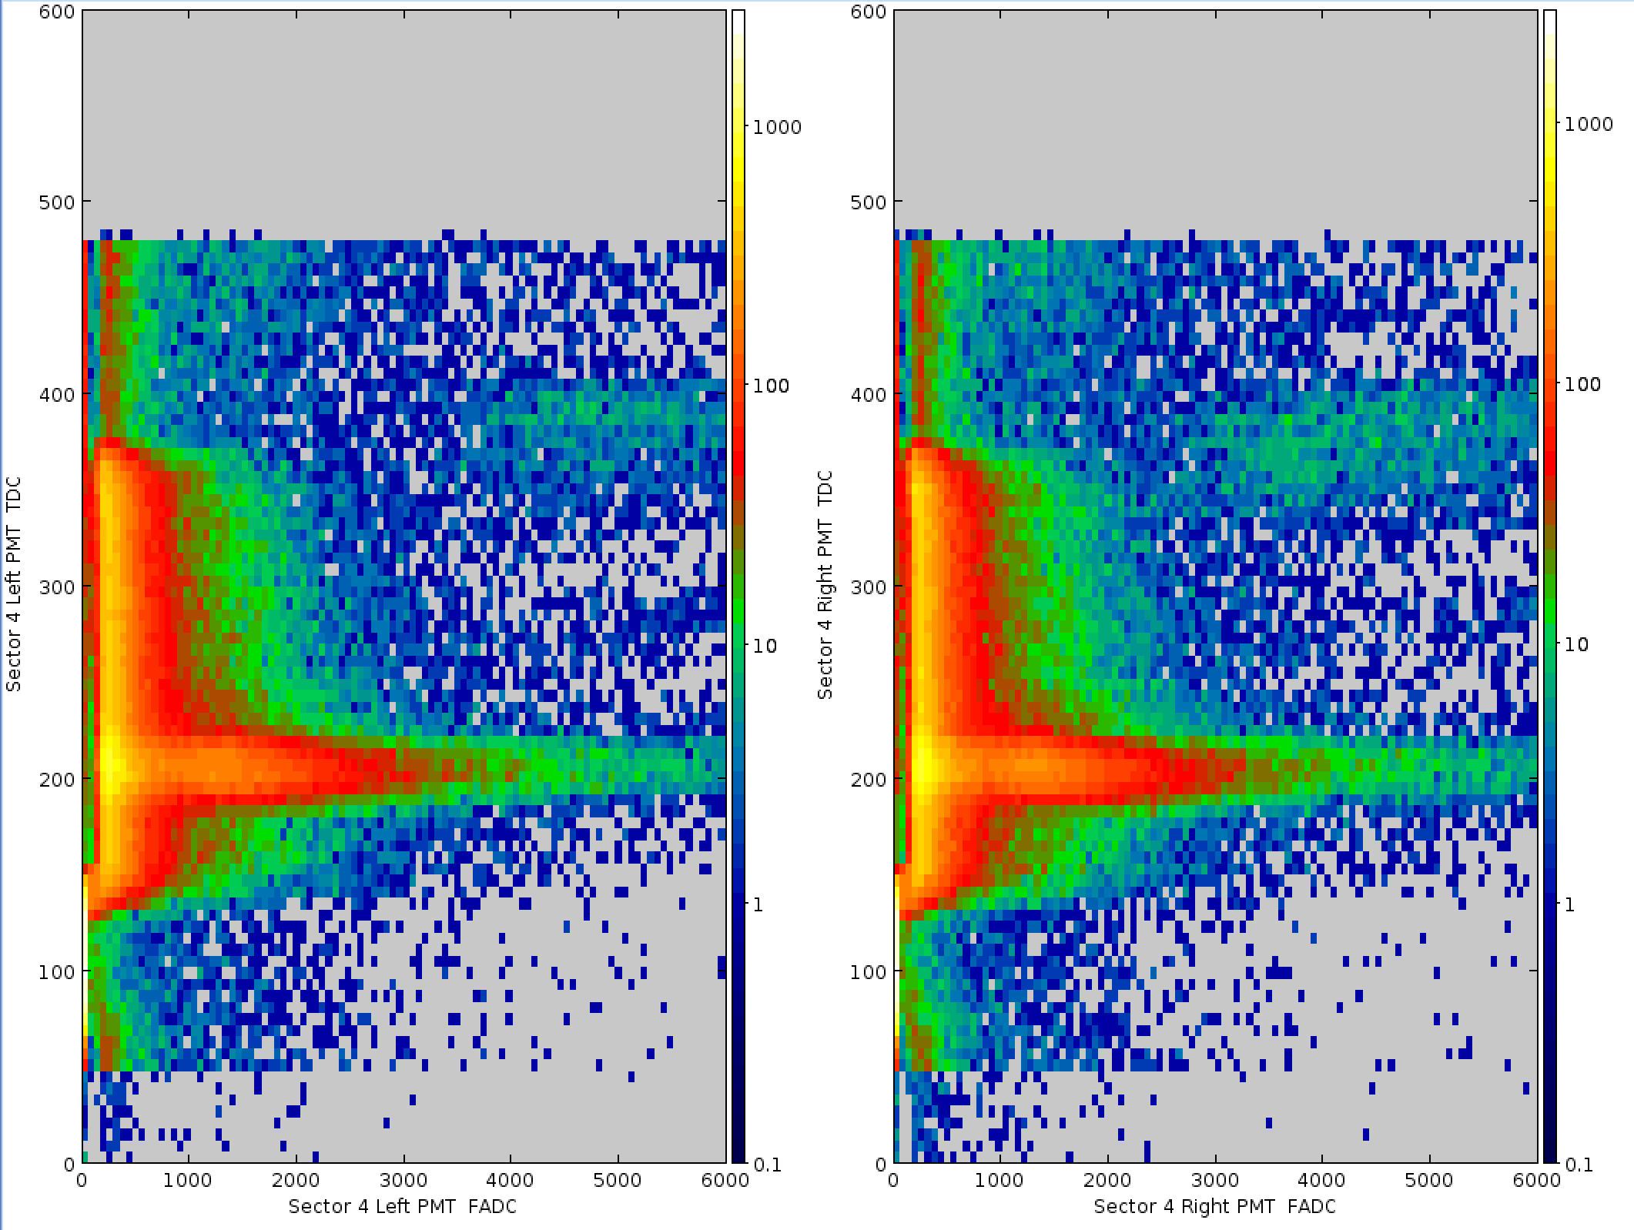
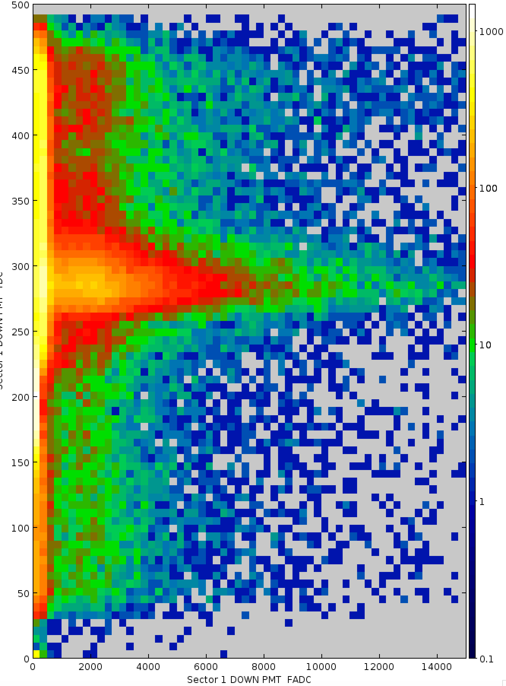
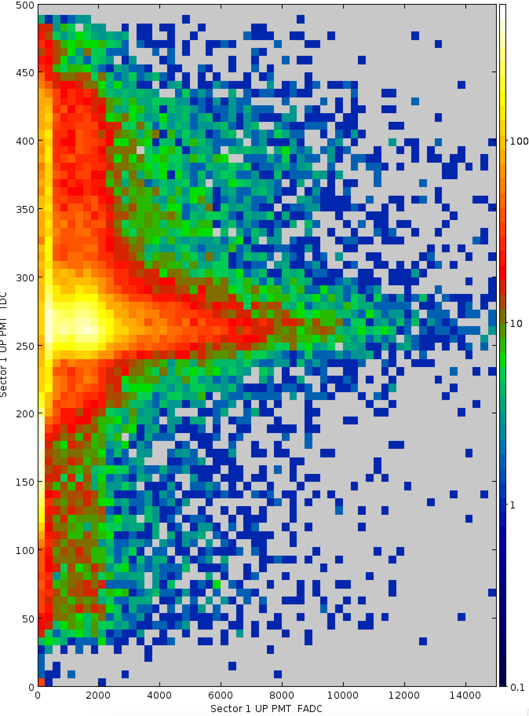
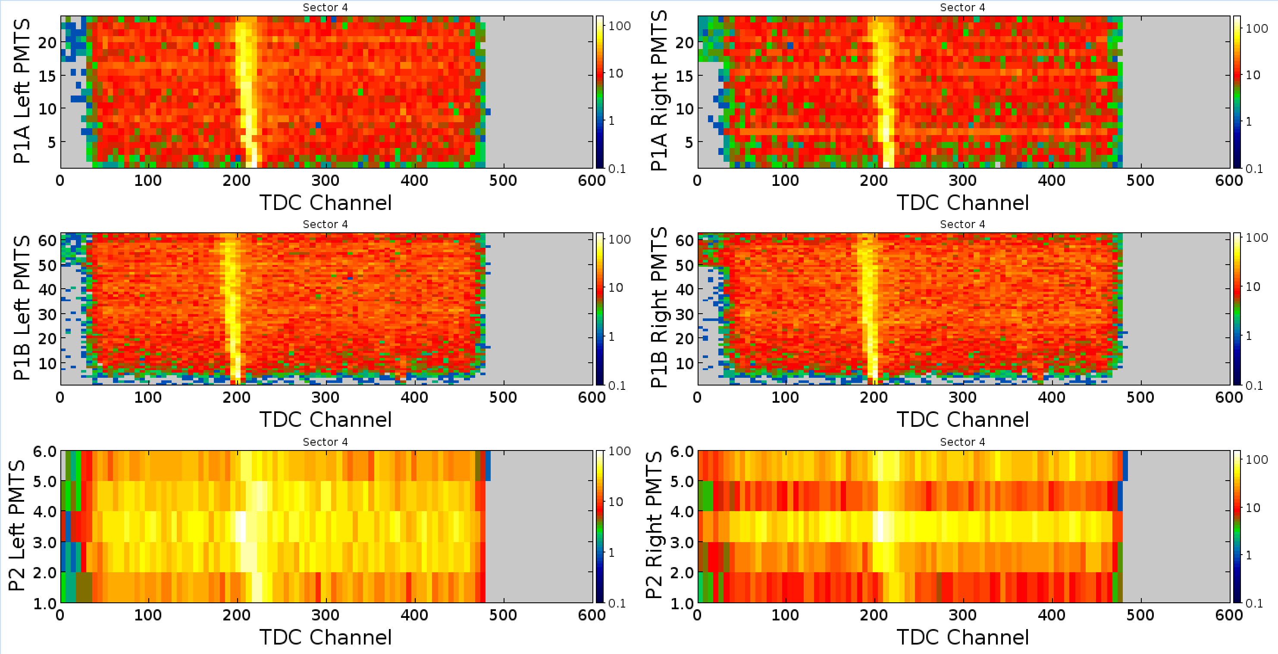
TOF TDC Setup
FTOF
CTOF
t (ns)
t (ns)
FADC
FADC
TDC time windows set at 500 ns
Disc. width/thr = 35 ns/-35 mV (FTOF), 100 ns/-20 mV (CTOF)

Slide 5
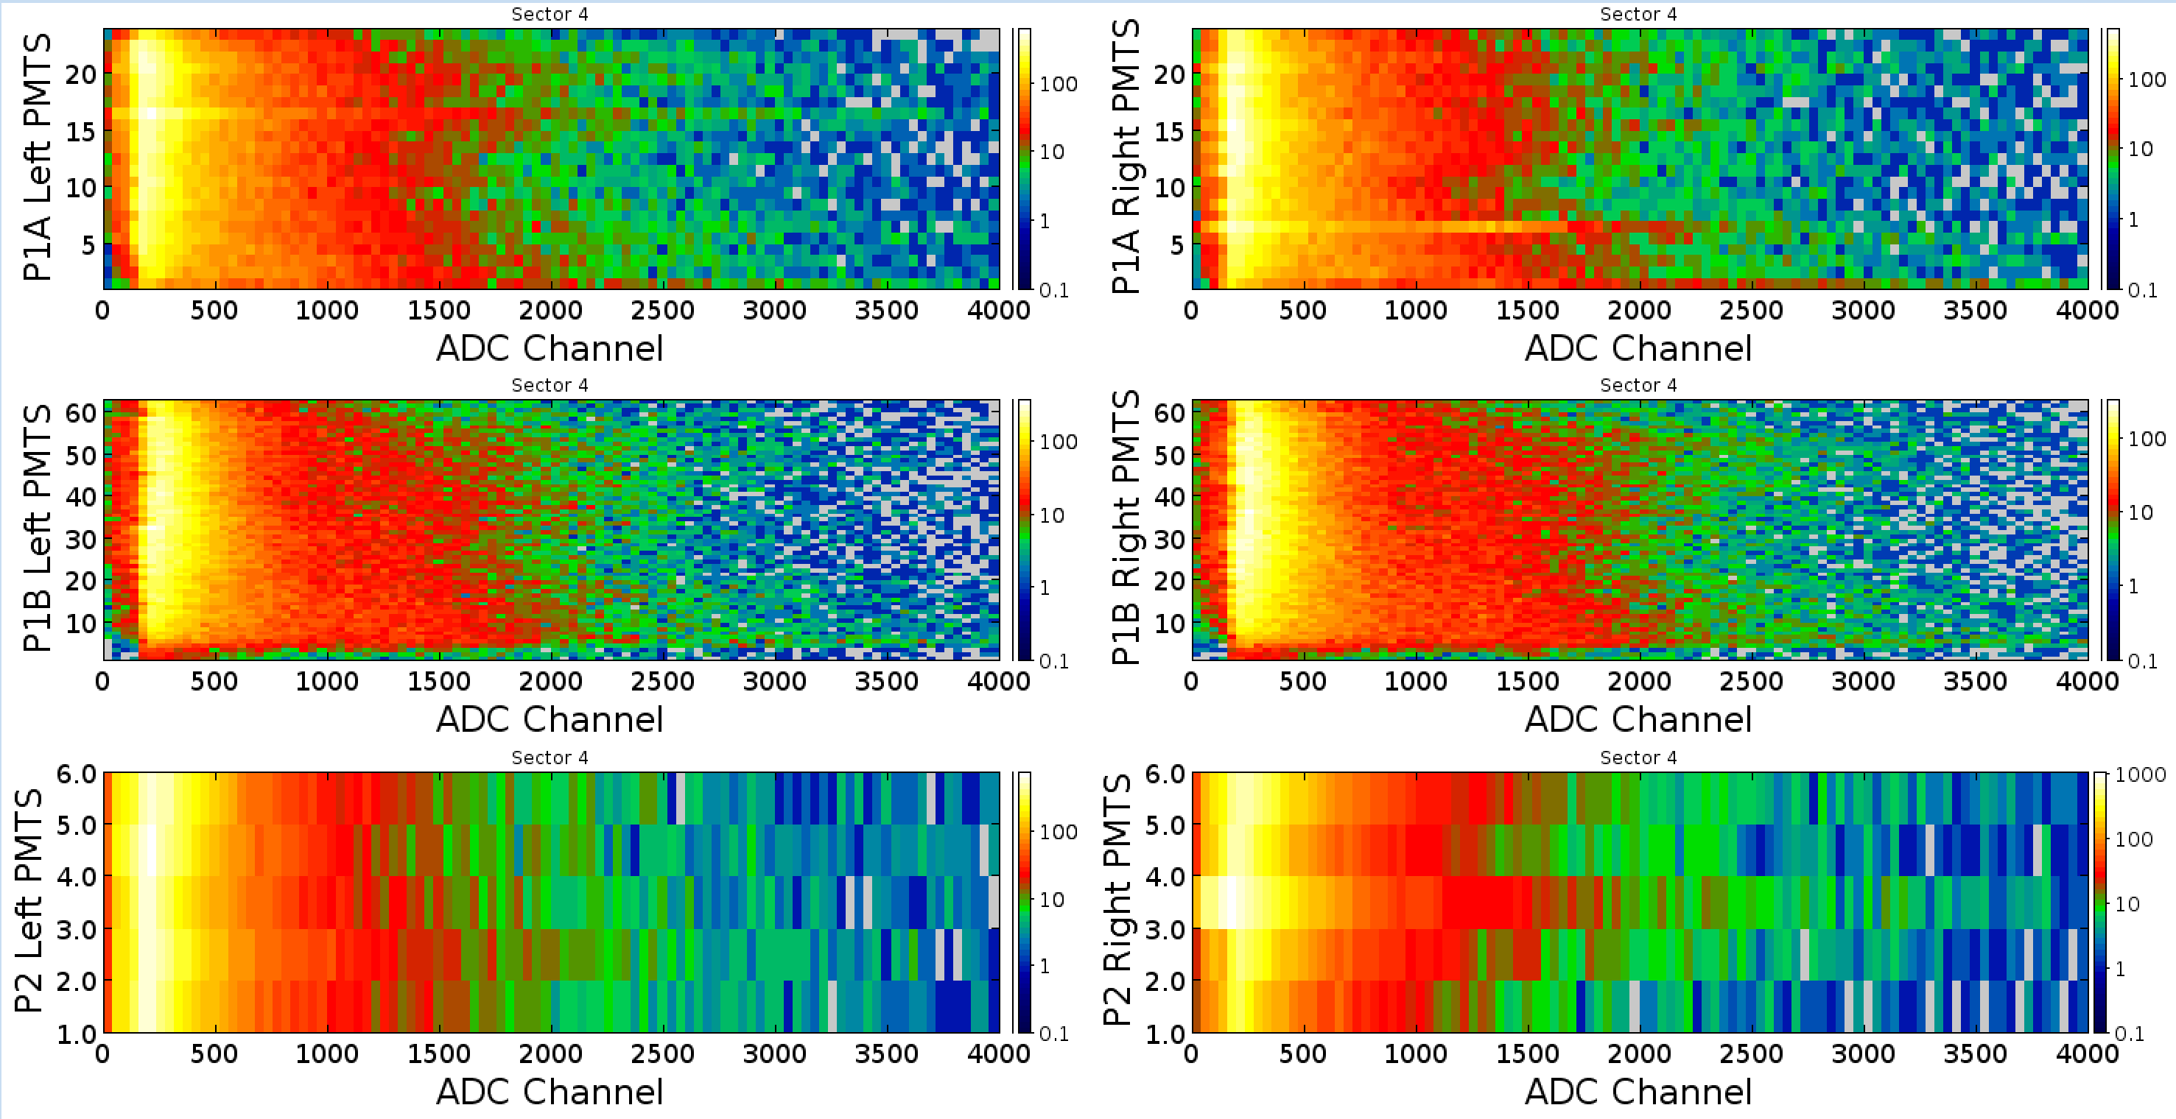
TOF FADC Setup
FTOF
CTOF
FADC window: 296 ns (74 samples)
TET threshold: 60
(1 MeV FTOF, 0.5 MeV CTOF)
NSB/NSA = 8/28 FTOF, 12/60 CTOF

Slide 6
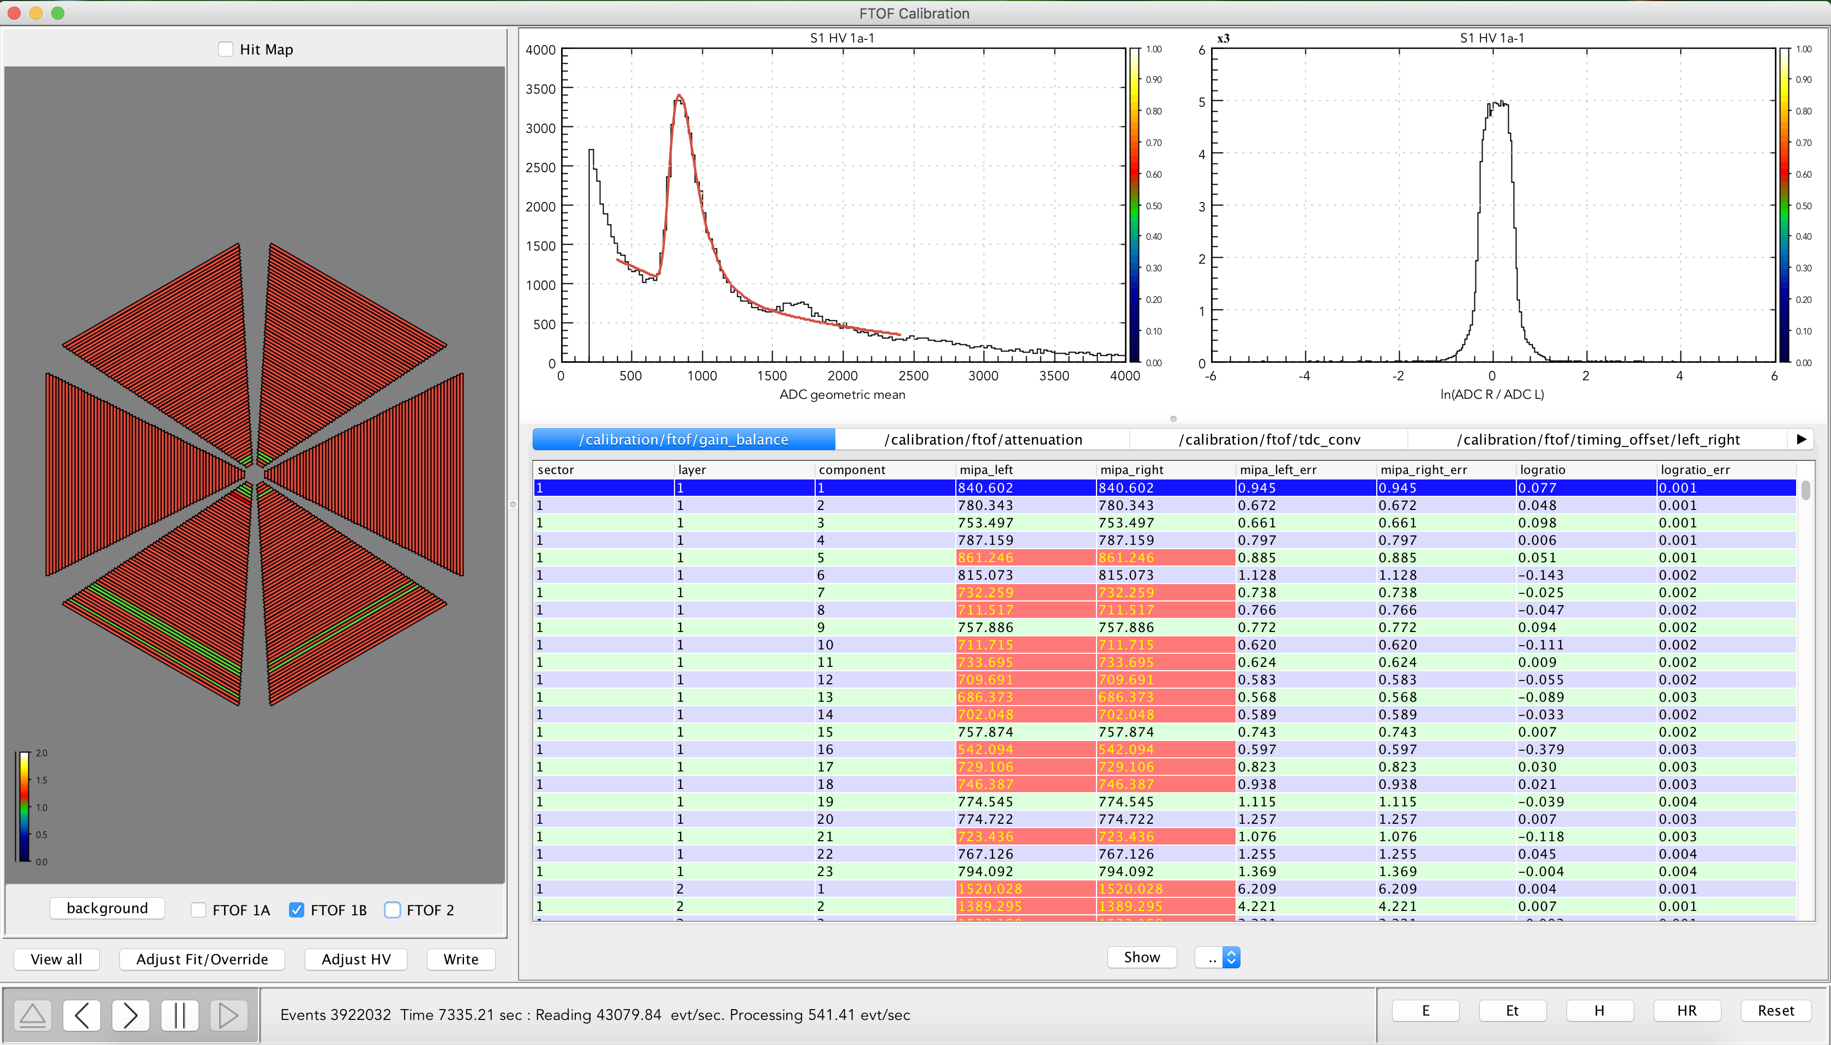
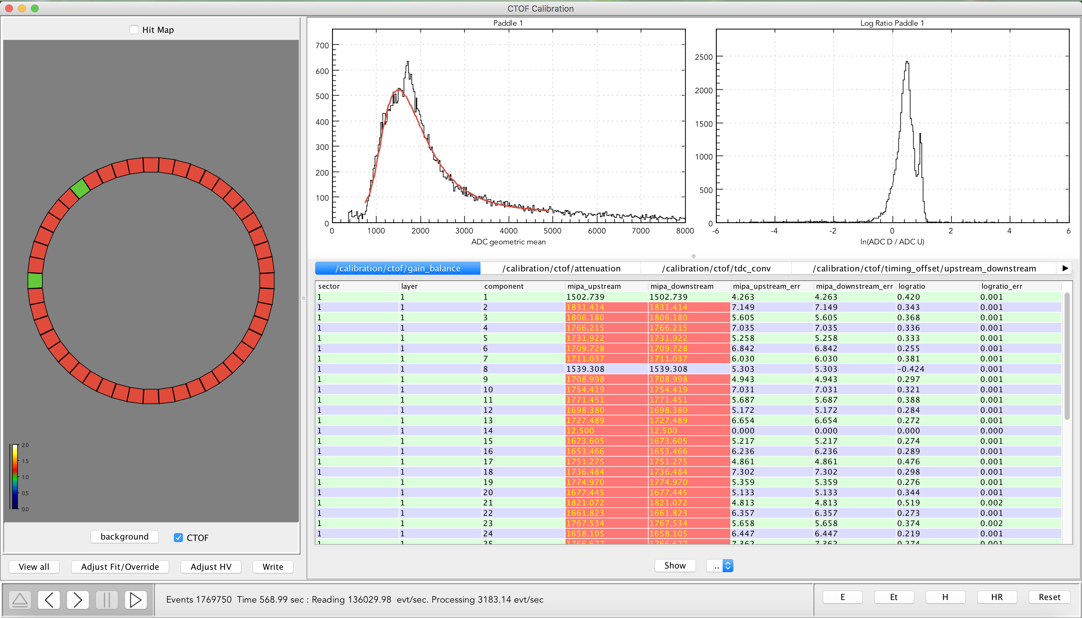
Calibration Suites
Timing Calibrations
1 | PMT Timing Diff.
2 | Attenuation Length
3 | Effective Velocity
4 | Time-Walk (FTOF only)
5 | RF Offset
6 | P2P Offset
Timing calibrations are an iterative procedure that rely on multiple passes through a data file for optimal resolution
Intimately tied in with
quality of tracking

Slide 7
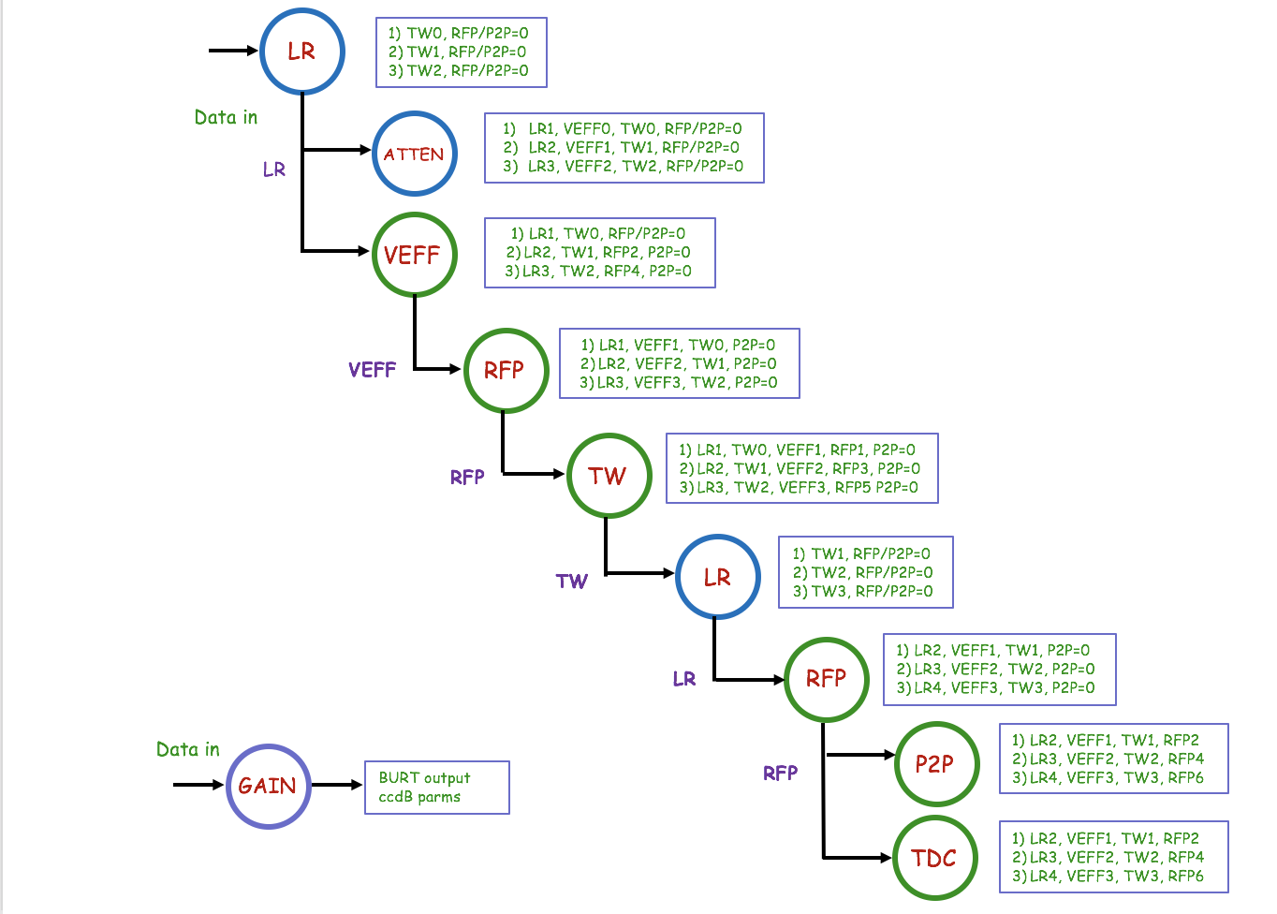
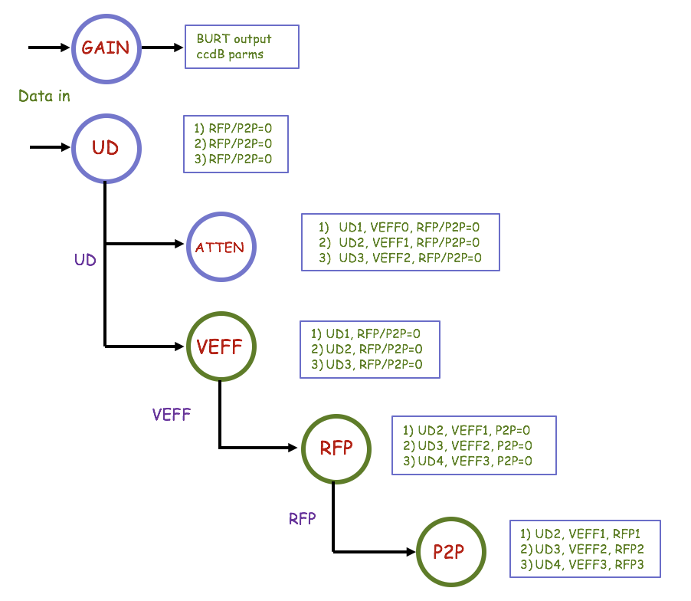
TOF Calibration Flowcharts
FTOF
CTOF

Slide 8
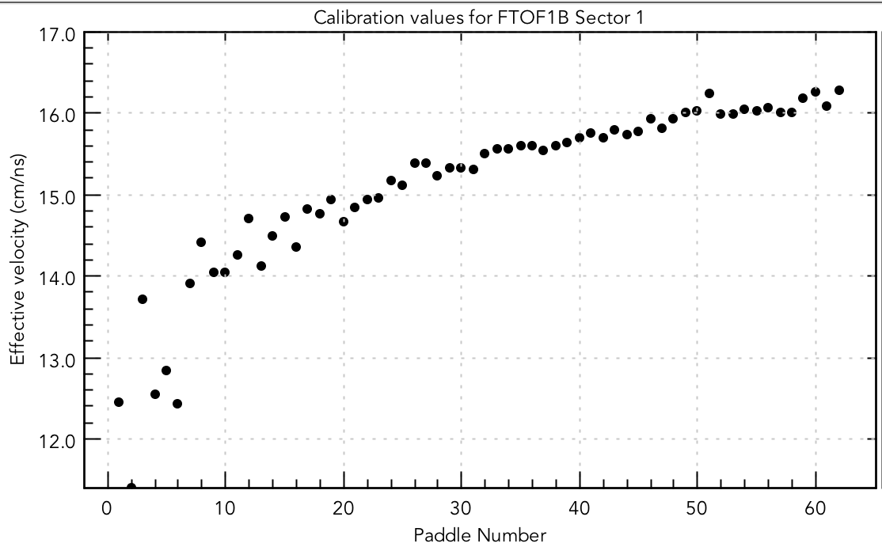
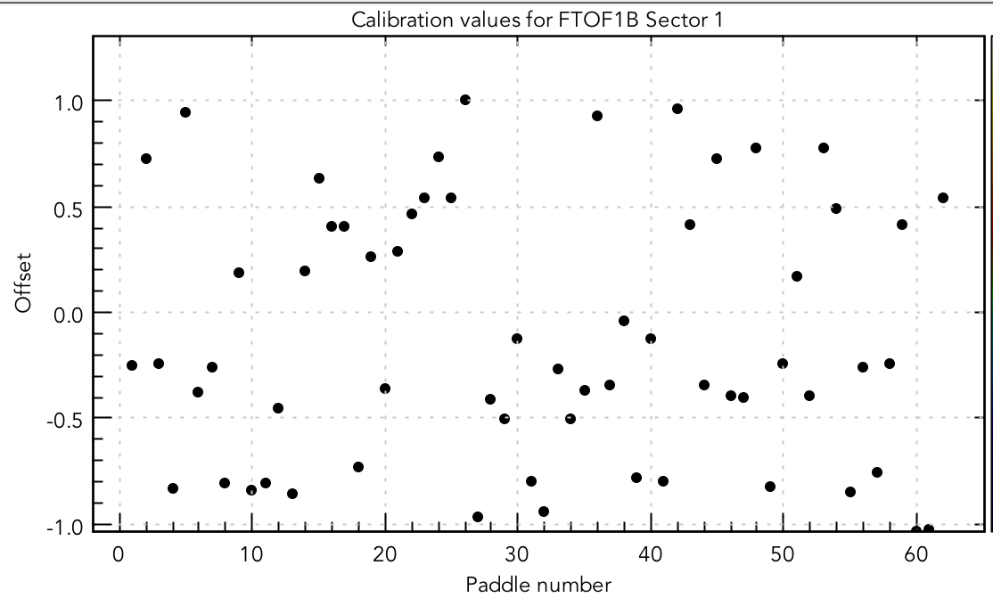
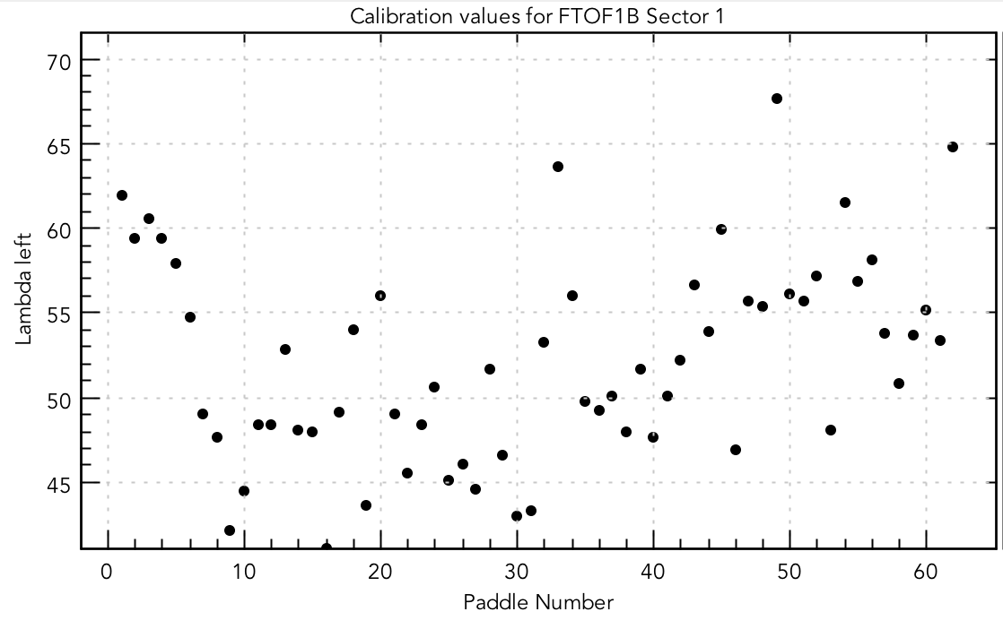
FTOF Calibration Constants
LR
VEFF
RF
(ns)
ATTEN
TW
P2P

Slide 9
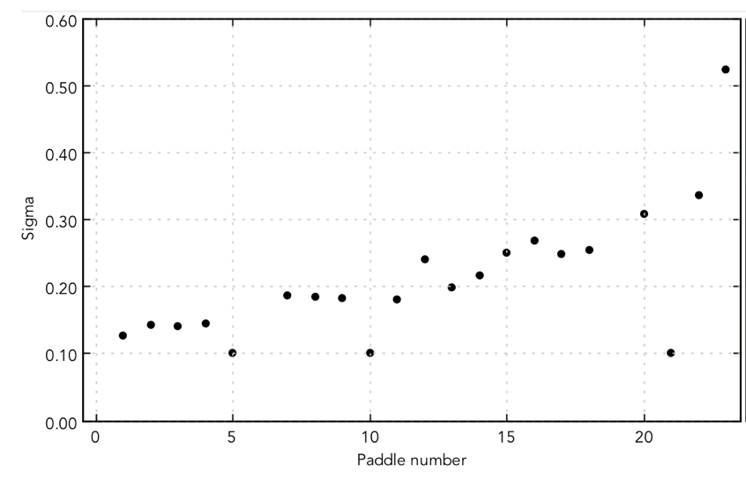
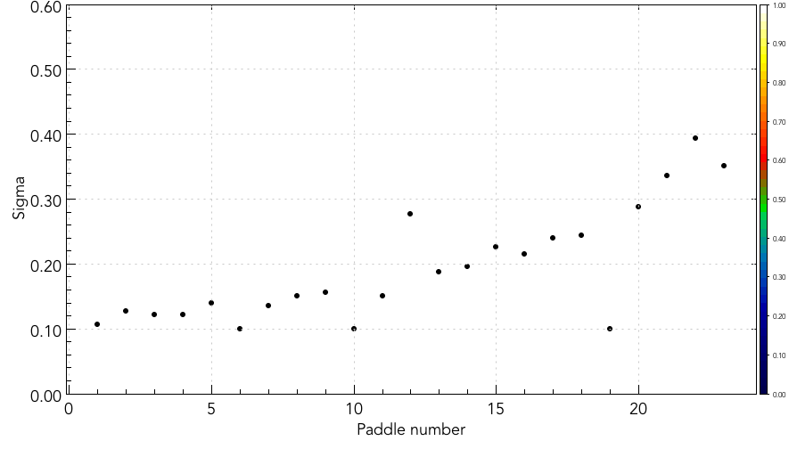
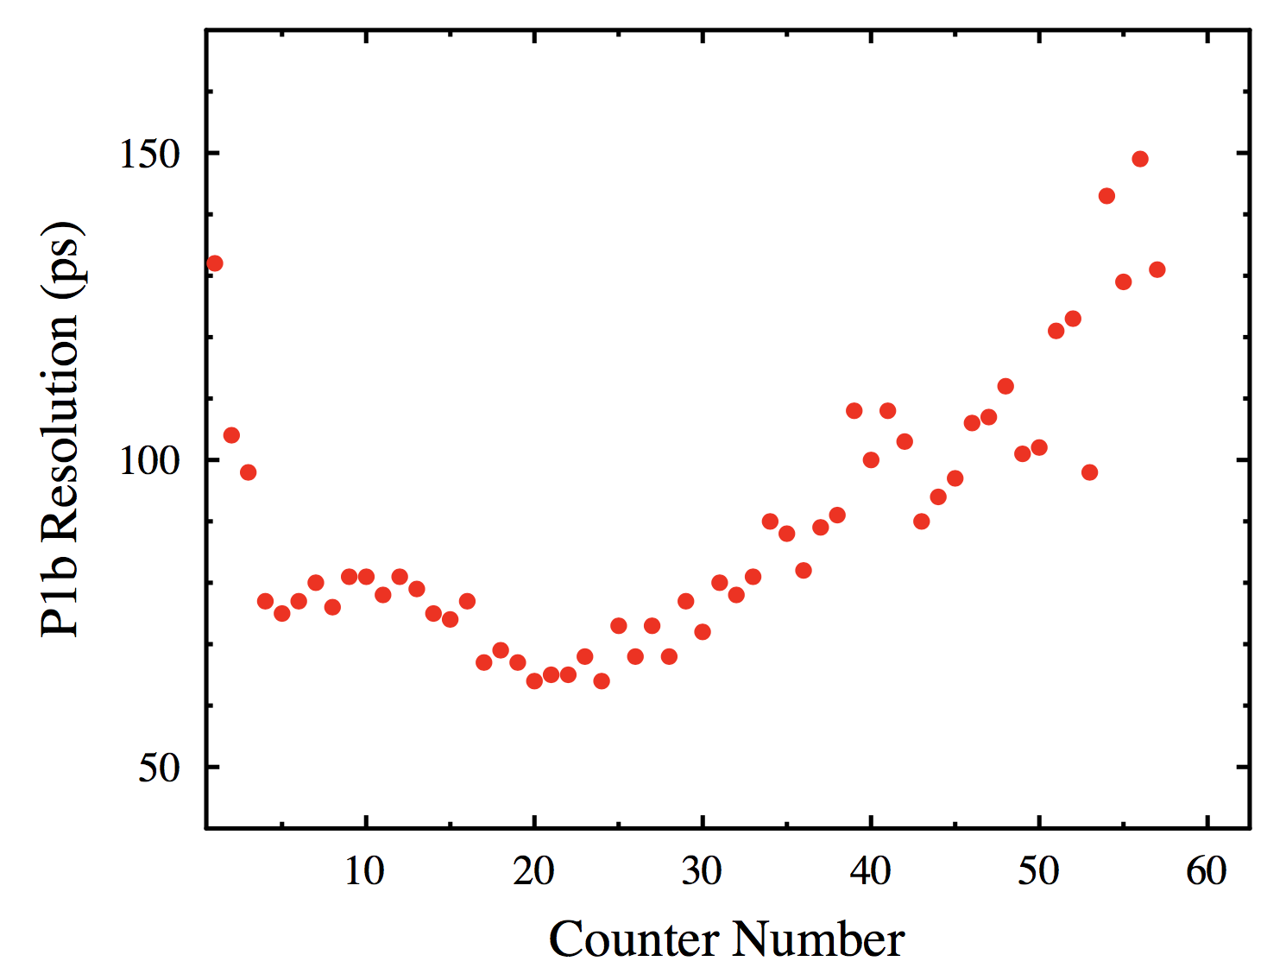
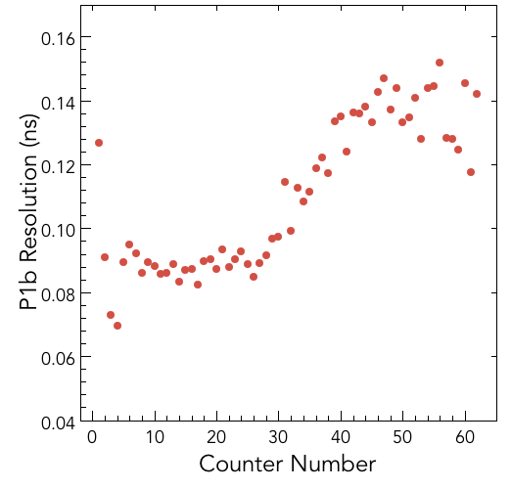
FTOF Calibration Comparison
FTOF S2 p1a
KPP data
runs
804-810
FTOF S2 p1a
Eng. Run data
runs
2052-2058
P1a Resolution (ns)
P1a Resolution (ns)
design specs
FTOF S2 p1b
KPP data
FTOF S2 p1b
Eng. Run data
design specs
runs
804-810
runs
2052-2058

Slide 10
FTOF Calibration
Strong correlation remains with hit position as position dependent time-walk correction is not yet taken into account
this is work in progress

Slide 11
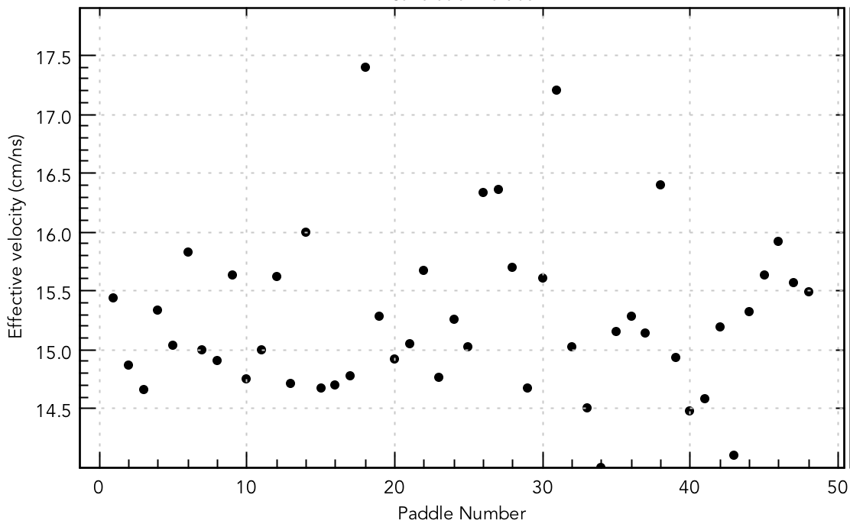
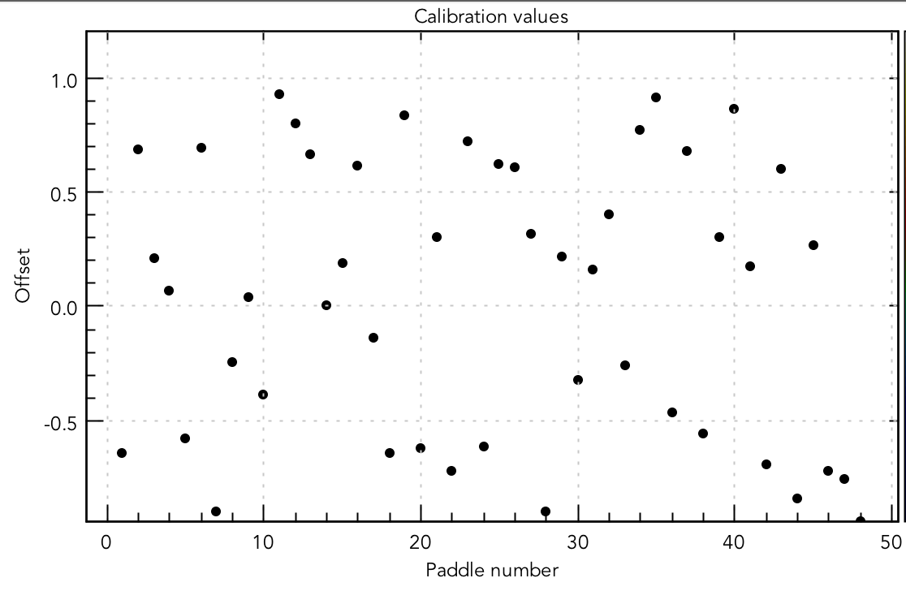
CTOF Calibration Constants
UD
VEFF
P2P
ATTEN
RF

Slide 12
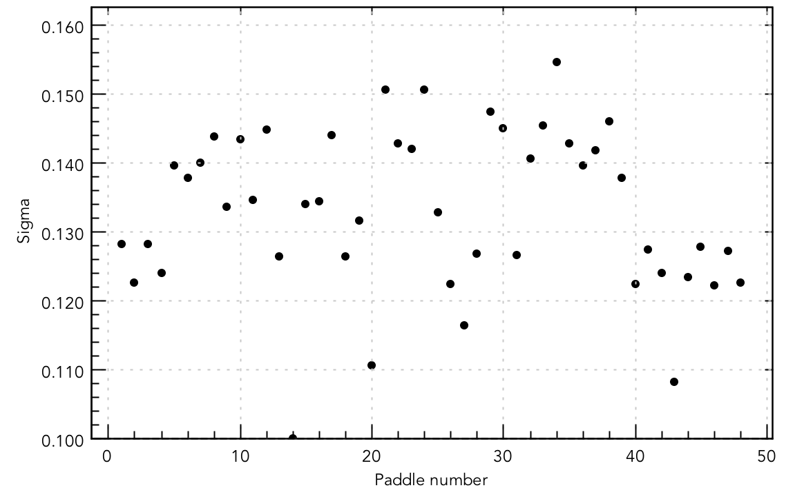
CTOF Calibration
Resolution (ns)
Counter Number
Design specifications for CTOF: 65 ps
CTOF calibrations not possible during KPP due to lack of solenoid magnet

Slide 13
CTOF Calibration
Strong correlations remain with v_{z}, hit position, path length that point to issues with path length and geometry

Slide 14
System Calibrations
Runs | E_{b} (GeV) | i (nA) | Torus/Solenoid
2052-2058 | 10.6 | 5 | 85% (nin) / -100%
2091-2093 | 10.6 | 25 | -85% (nin) / -100%
2193-2195 | 10.6 | 10 | 100% (nout) / -100%
2475-2478 | 2.2 | 2 | 60% (nout) / +60% (CTOF only)
3050 | 6.4 | 15 | 100% (nin) / -100%
3105 | 6.4 | 10 | 75% (nout) / -100%

Slide 15
Remaining Work
FTOF
Optimize Forward Tracking (DC+FMT) to optimize path length resolution
Include correct torus/solenoid field maps to improve tracking
Improve time-walk algorithm to account for position dependent response
Include updated INL tables into TDCs
Include Forward Carriage survey data
CTOF
Resolve current issues with CVT tracking algorithm
Complete CVT (SVT+MM) alignment
Include CTOF survey data (radial shifts vs. counter number)
Include updated INL tables into TDCs
Include correct CTOF counter geometry in reconstruction

Slide 16
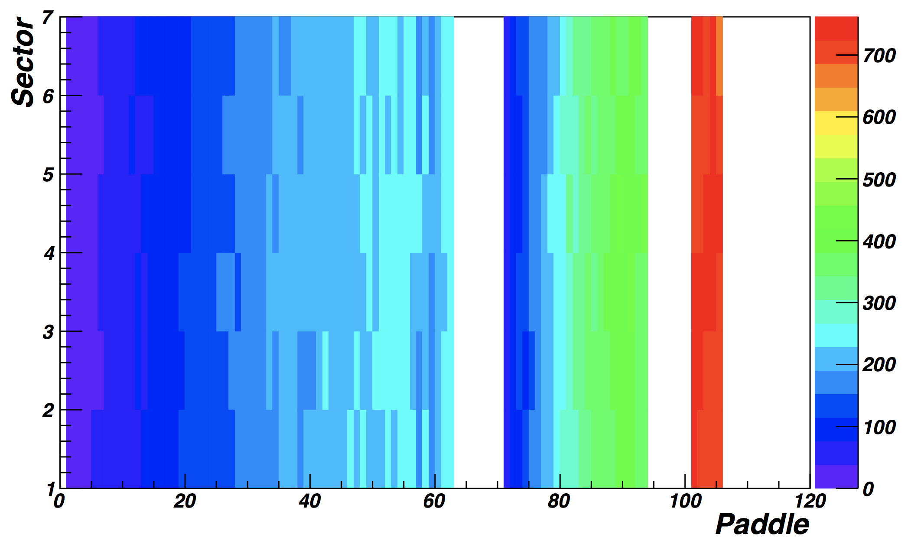
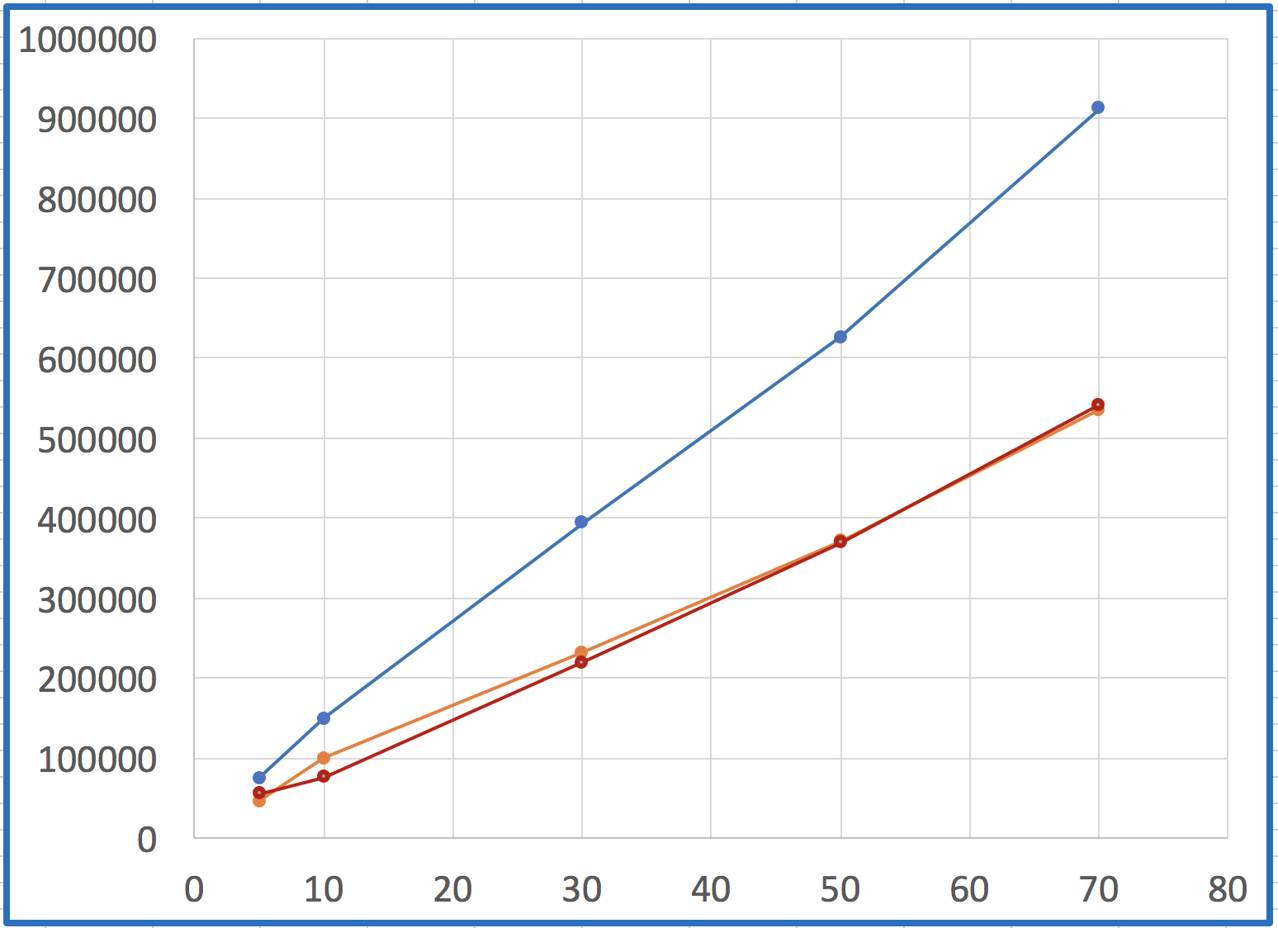
FTOF Rate Studies
p1b p1a p2
Hz
kHz
p1a
p1b
p2
i, nA
GEMC simulation at L_{nom}:
10.6 GeV, FT-On
100% torus, 100% solenoid
1 MeV E_{dep} threshold
Rates from beam studies:
Presented as average over panels
Based on FADC scalers
FADC threshold ~0.25 MeV

Slide 17
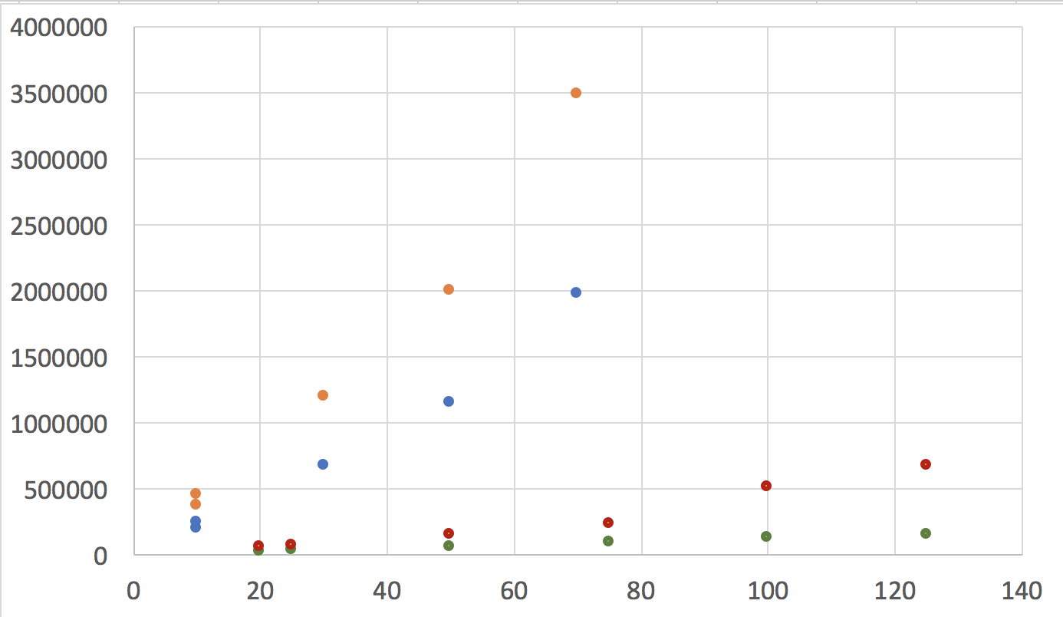
CTOF Rate Studies
<R>, Hz
D
TET=20
(200 keV)
U
D
TET=100
(1 MeV)
U
i, nA
Simulations of CTOF rates for L_{nom}:
5 MHz/counter with 0 threshold
150 kHz at 1 MeV threshold
Good agreement with simulations
CLAS12-Note 2017-016

Slide 18
Summary
FTOF and CTOF hardware is in very good shape
The CLAS12 time-of-flight systems performed as expected during the Engineering Run under a broad range of conditions even up to ~150 nA
The calibrations of the detectors have been completed for data collected under a number of different conditions
Systematic studies of the detectors are getting underway
The FTOF calibrations are showing performance very close to expectations – once the remaining work to improve the reconstructions and calibrations is completed - full agreement is expected relative to design specs
The CTOF calibrations are a factor of two worse than expectations due to the current state of CVT tracking and the CTOF geometry approximations in the reconstruction code; development work in progress

