Slide 1

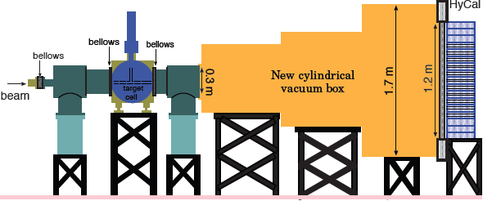
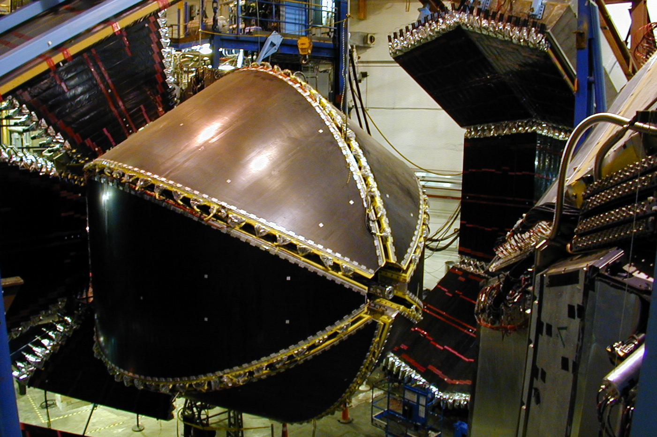
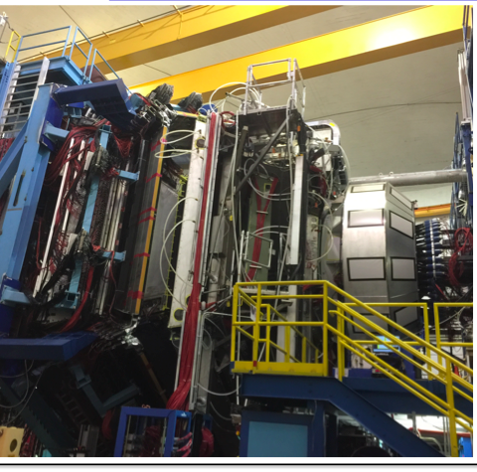


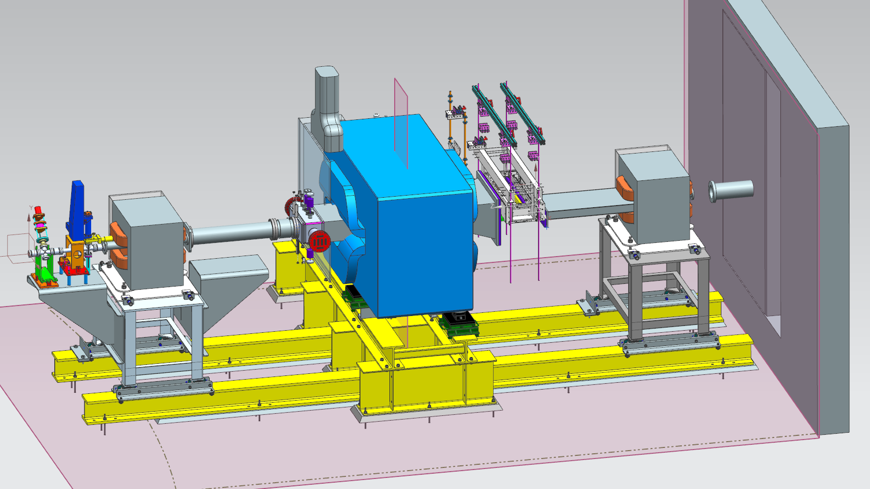
Status of Hall B
CLAS12
Volker D. Burkert
HPS Collaboration May 22, 2018

Slide 2
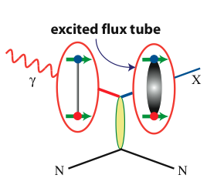
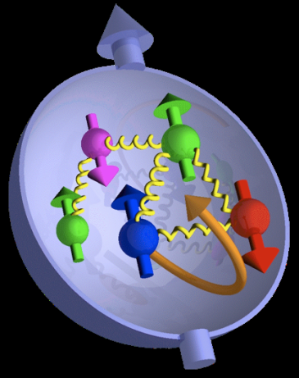
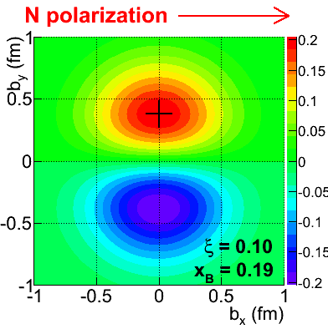
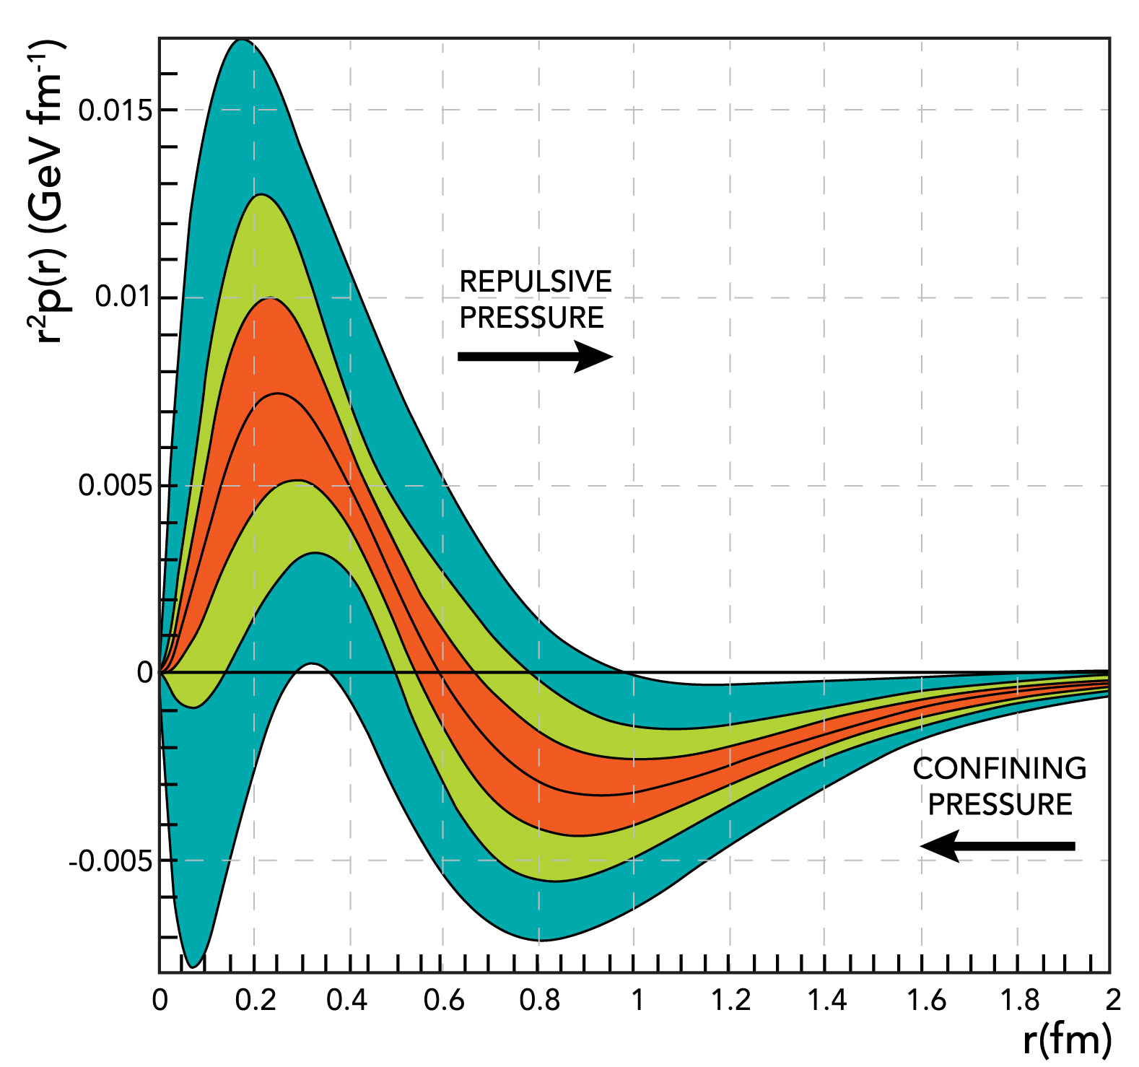
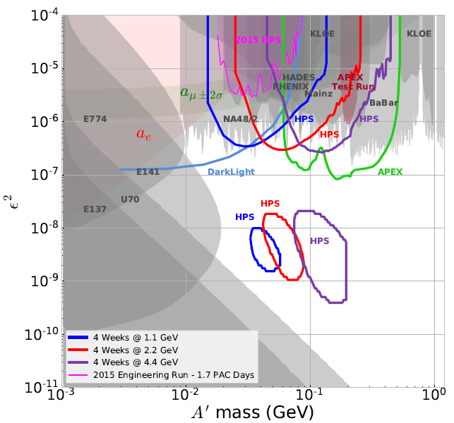
Jefferson Lab Science Questions
What is the role of glue in the spectroscopy of light mesons and baryons?
What does the orbital angular momentum contribute to the proton’s spin?
Revealing the landscape of nucleon substructure through 3D imaging at the femtometer scale.
Unraveling the forces that confine the quarks in the proton?
Can we discover evidence for physics beyond the standard model of particle physics?
Hall B experimental program plays an important role
in addressing these questions

Slide 3
Hall B Overview
CLAS12 installation completed and operational, including all user driven upgrades (MicroMegas, Forward Tagger, Central Neutron Detector, Ring Imaging Cherenkov Detector)
Engineering run was successfully completed – achieved design luminosity
L = 10³⁵cm⁻²s⁻¹
CLAS12 first physics runs RG-A (13 proposals)
  Completed first installment of RG-A (~ 20%)
Continued flow of publications/talks from CLAS/CLAS12 results
  204 science papers + 39 technical papers published in refereed journals
  > 2,200 talks at conference (> 1,375 invited)
  > 175 PhD theses completed on CLAS results [27 in progress]
  12 PhD theses in progress on CLAS12
Other Hall B experiments
  Proton Radius experiment – 2 PhD theses in process, results expected this fall
  Heavy Photon Search – 5 PhD theses completed, 4 in progress, 48 talks, 26 invited, 1st publication in review.

Slide 4
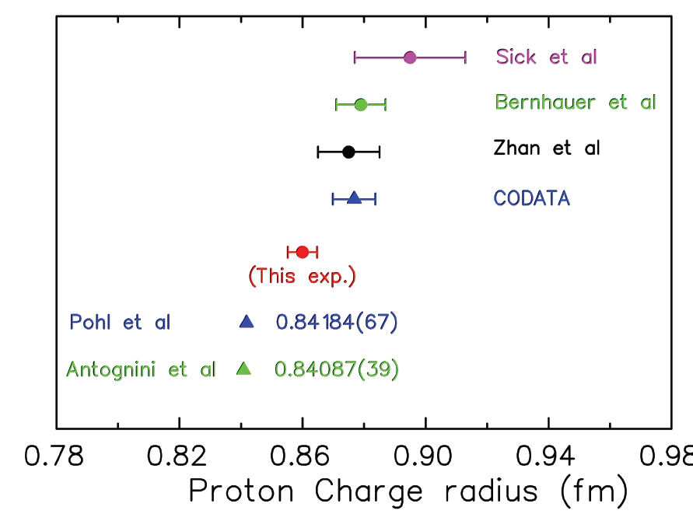
Proton Radius Experiment
Hall B
Experiment ran in 2016
Elastic e-p
scattering
Atomic H
PRad@JLab:
(projected)
Muonic H
Goal: Resolve the discrepancy with
non-magnetic detection system,
higher precision and lowest min. Q²
Preliminary G_{E} slope seems
to favor smaller radius

Slide 5
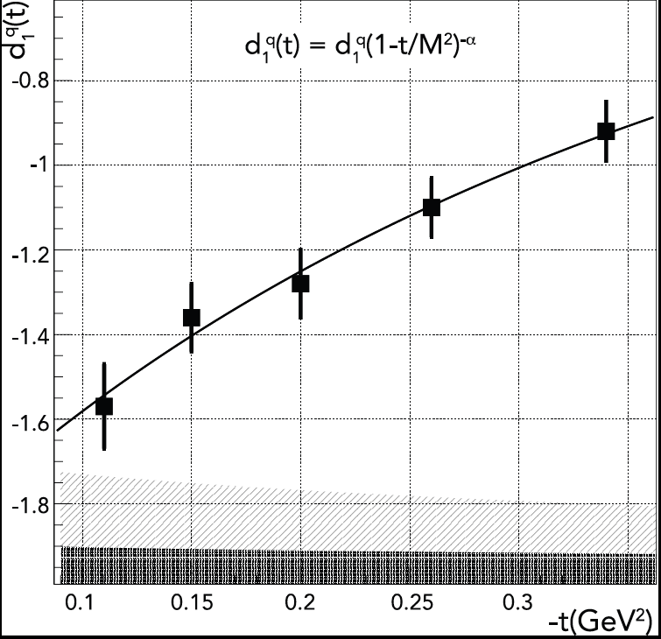

The Pressure Distribution in the Proton
The first determination of this basic property of the proton
The pressure distribution inside the proton
V. D. Burkert, L. Elouadrhiri & F. X. Girod
From CLAS DVCS/BSA
and DVCS cross sections determine CFF H(ξ,t)
Gravitational Form Factor d₁(t)
Nature 557 (2018) no.7705, 396-399

Slide 6
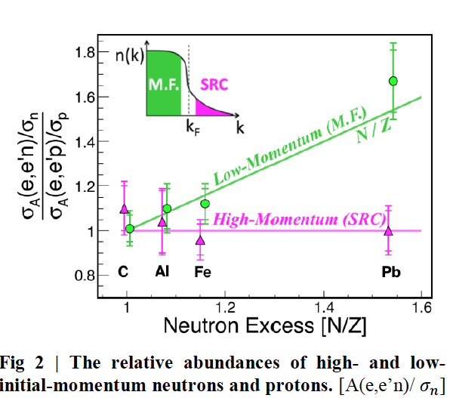
EG2/Mining – Abundance of hi/lo momentum protons/neutrons
M. Duer et al., CLAS collaboration
(Submitted to Nature)

Slide 7
Physics Publications
Hall B
 | HSWG | DPWG | NPWG | ALL
2000 | - | 1 | 1 | 2
2001 | 2 | 3 | - | 5
2002 | 3 | - | 1 | 4
2003 | 7 | 4 | 1 | 12
2004 | 3 | 3 | 4 | 10
2005 | 7 | 3 | 2 | 12
2006 | 8 | 4 | 3 | 15
2007 | 7 | 2 | 3 | 12
2008 | 4 | 6 | 2 | 12
2009 | 8 | 7 | 4 | 19
2010 | 4 | 2 | 4 | 10
2011 | 3 | 1 | 4 | 8
2012 | 6 | 3 | 2 | 11
2013 | 8 | 6 | 2 | 16
2014 | 5 | 6 | 1 | 12
2015 | 4 | 5 | 3 | 12
2016 | 7 |  |  | 7
2017 | 12 | 7 | 1 | 20
2018 | 1 | 4 |  | 5
SUM | 97+1 | 63+4 | 38 | 200+5
5
10
15
publ
subm.
updated 18 May 2018

Slide 8

Detector Systems
CLAS12
Hall B
Forward Detector (FD)
TORUS magnet
HT Cherenkov Counter
Drift chamber system
LT Cherenkov Counter
Forward ToF System
Pre-shower calorimeter
E.M. calorimeter
Forward Tagger
RICH detector
Central Detector (CD)
Solenoid magnet
Silicon Vertex Tracker
Central Time-of-Flight
Central Neutron Detector
  - MicroMegas
Beamline
Diagnostics
Shielding
Targets
Polarimeter
Faraday Cup
MM
CND
FT
Number of readout channels > 100,000
RICH
https://www.jlab.org/Hall-B/clas12-web/

Slide 9
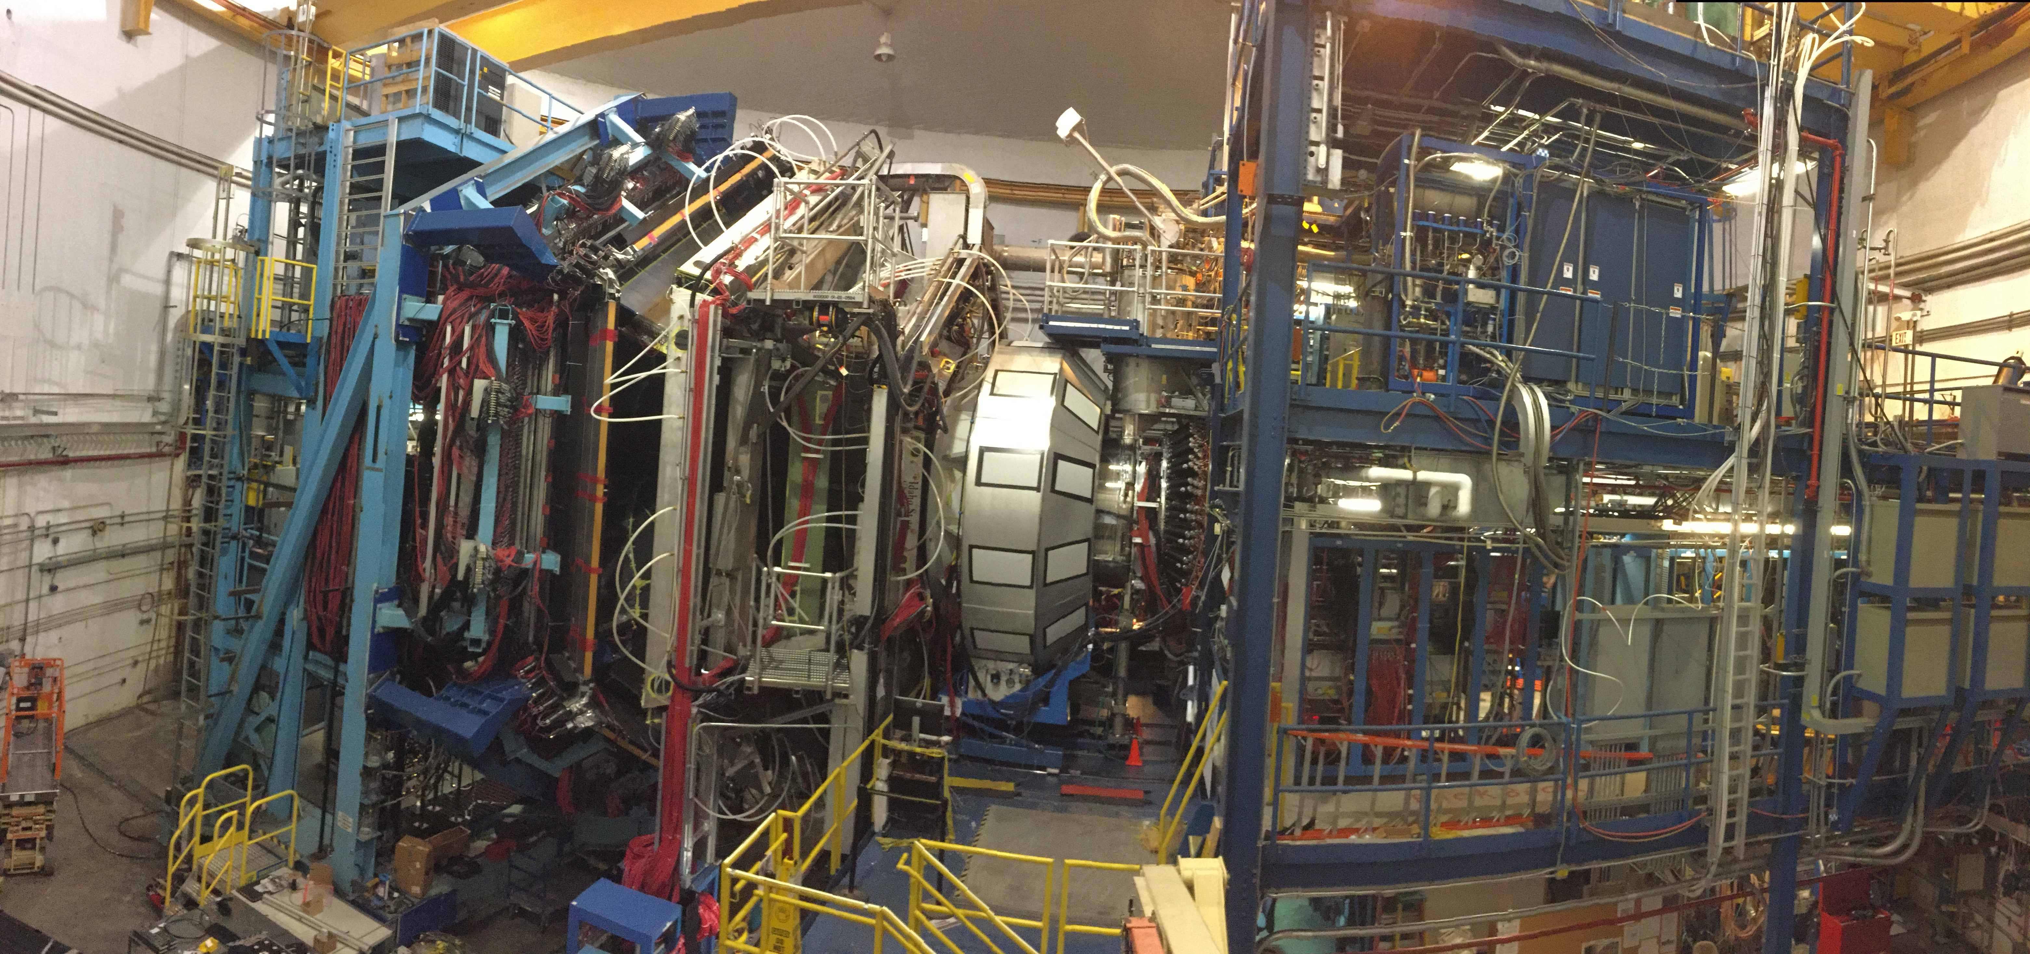
CLAS12
Detector Systems
Hall B
Forward Detector
Central Detector
Complete detector system with base equipment and collaboration driven upgrades

Slide 10
CLAS12
DC Occupancies (random trigger)
10³⁵cm⁻²s⁻¹
3.0
R1
R1: 250ns
R2: 500ns
R3: 750ns
FT- OFF
2.5
/
R3
DC Occupancy (%)
/
2.0
/
1.5
/
R2
I=75nA
L=10³⁵cm⁻²s⁻¹
1.0
0.5
25
50
75
100
125
150
Beam current (nA)
Specifications exceeded !
Beam current (nA)

Slide 11
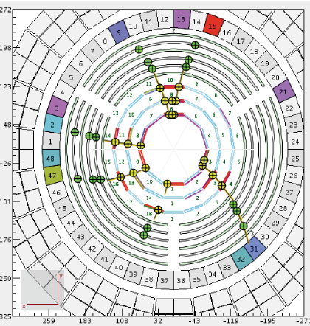
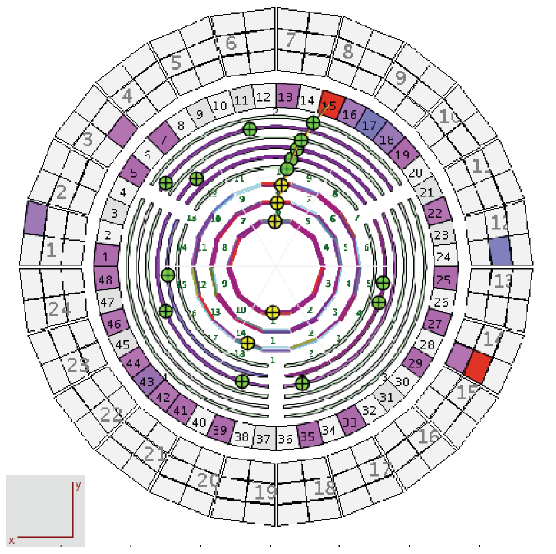
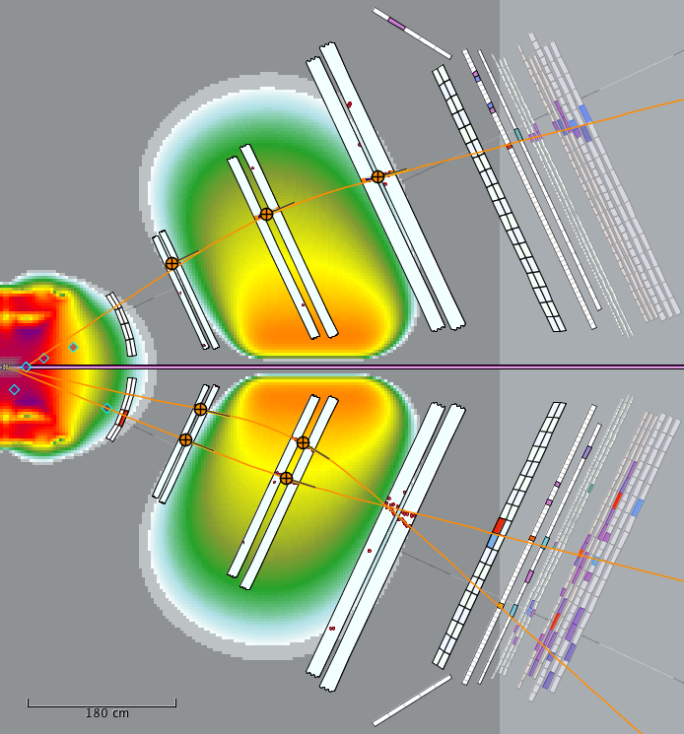
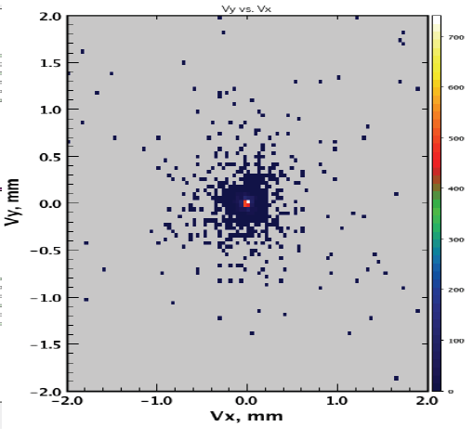
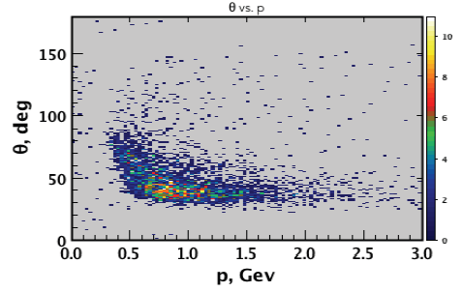
Tracking CVT and DC monitoring

Slide 12
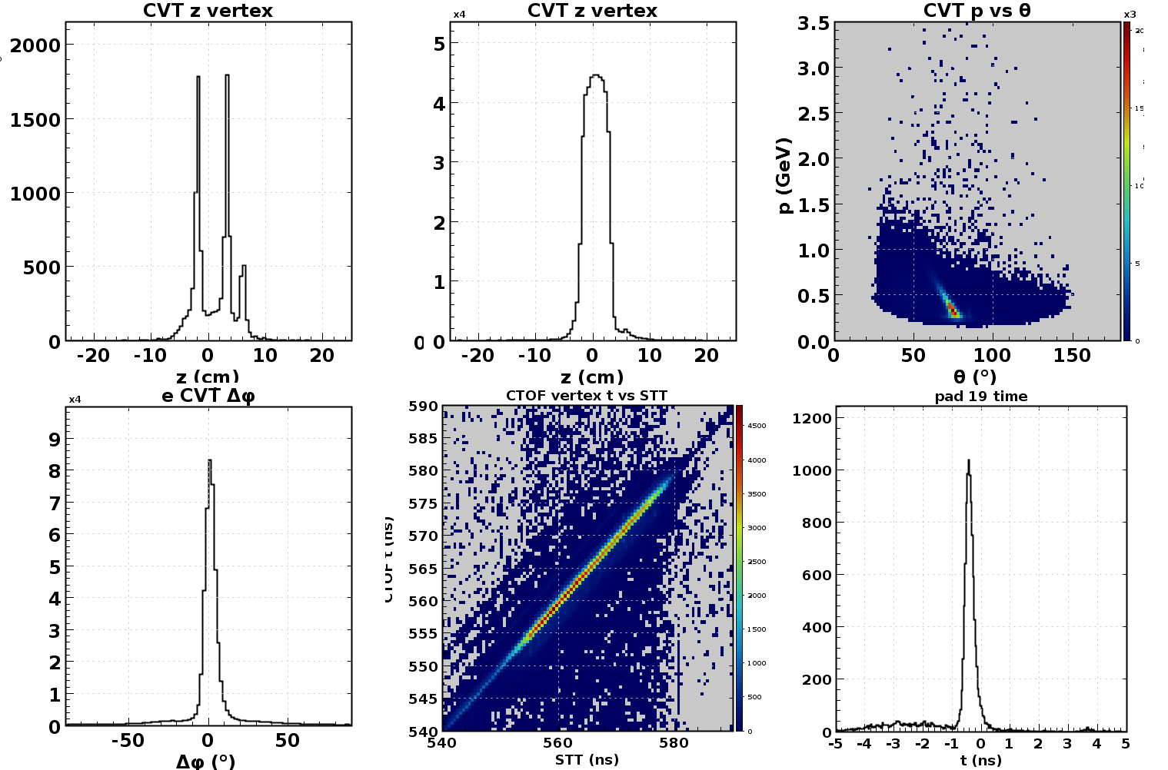
Track Reconstruction
CVT Resolutions
Empty target
Full Target
Elastic peak
in θ vs p
Correlations with FD
DC – CVT ɸ
CTOF vs STT
CTOF pad time

Slide 13
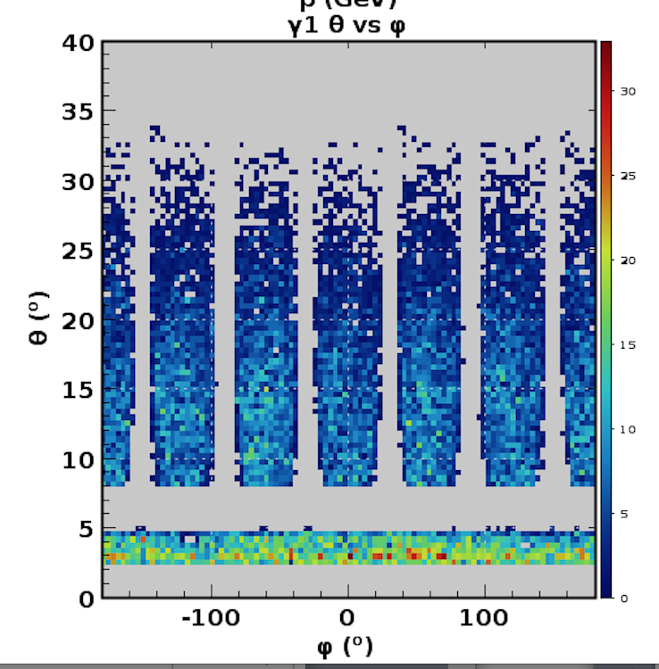
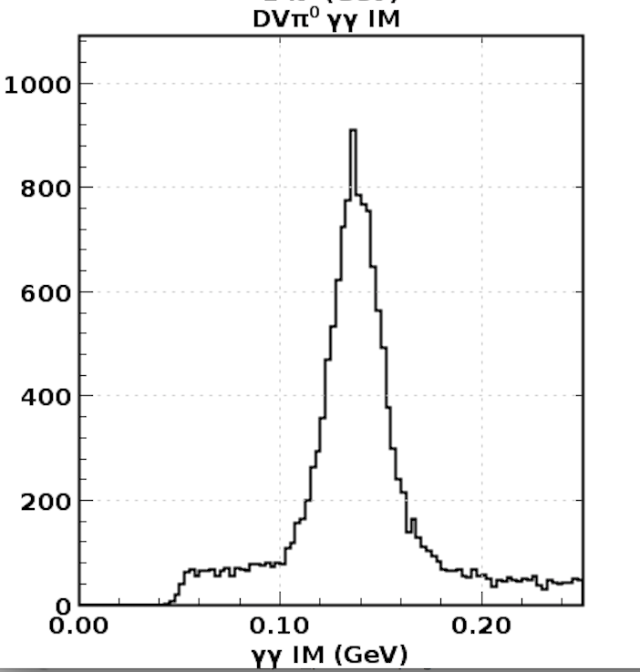
CLAS12 Particle Identification
Time-of-Flight paddles in FD and CD
Photons in ECAL/FTCAL
pions
Kaons
FTOF
protons
CTOF
pions
protons

Slide 14
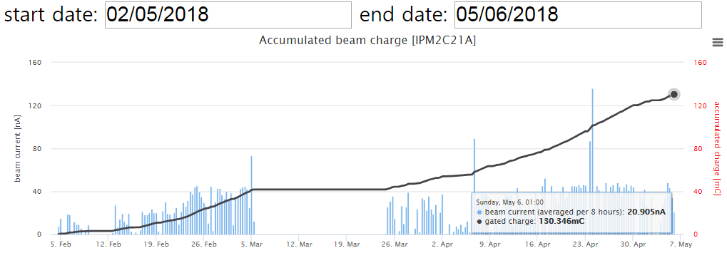
RG-A Production Accumulated Charge
Completed detector setting
Start 10.6 GeV RGA data taking
Machine Down
Machine
retuning

Slide 15
Estimate of % completion of RG-A individual experiments

Slide 16
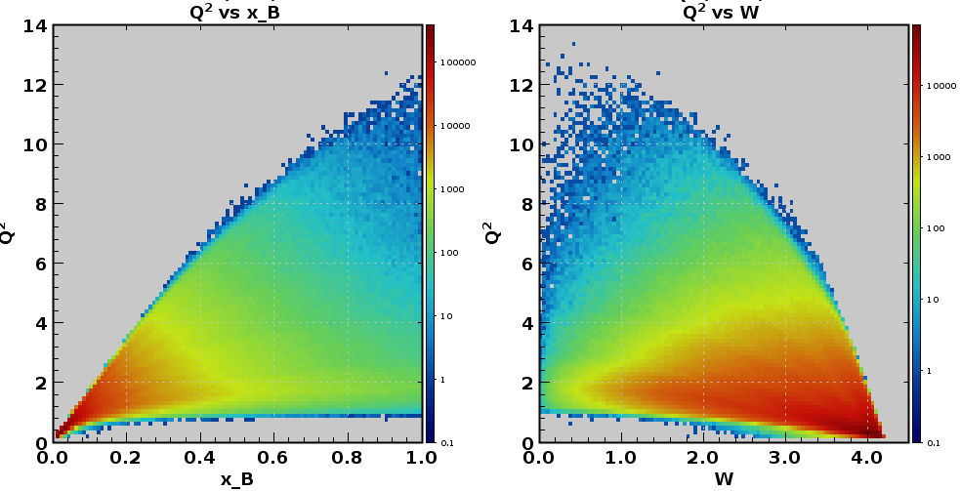
CLAS12 Kinematic Reach at 10.6 GeV
Beam energy at 10.6 GeV Torus current 3770 A, electrons out-bending, Solenoid magnet at -100%.
High Q²
elastic scattering
DIS
Q²
N*
x_{B}
W (GeV)

Slide 17
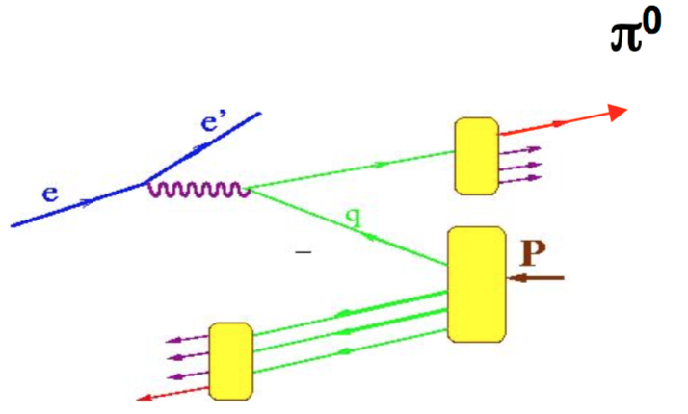
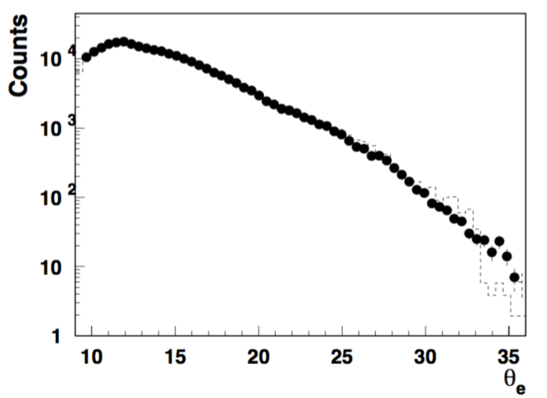
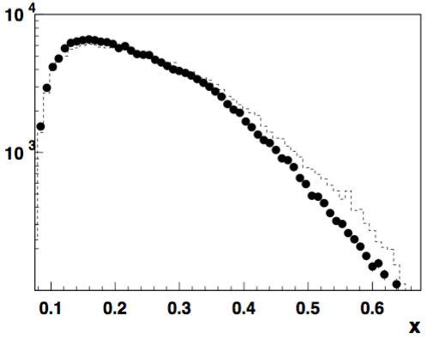
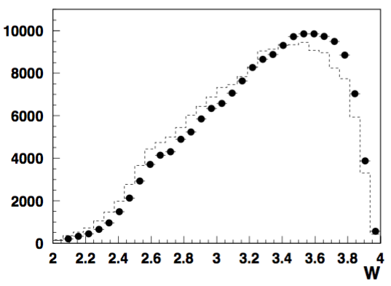
SIDIS - ep → e’π⁰X
e’π⁰X/ e'X ratio : Ratio of semi-inclusive π⁰ to inclusive electron need good control over acceptance for neutrals, radiative corrections
In a wide kinematical range scattered lepton distributions are consistent with SIDIS-MC (Lund)
Small fraction of data from the Spring run.

Slide 18
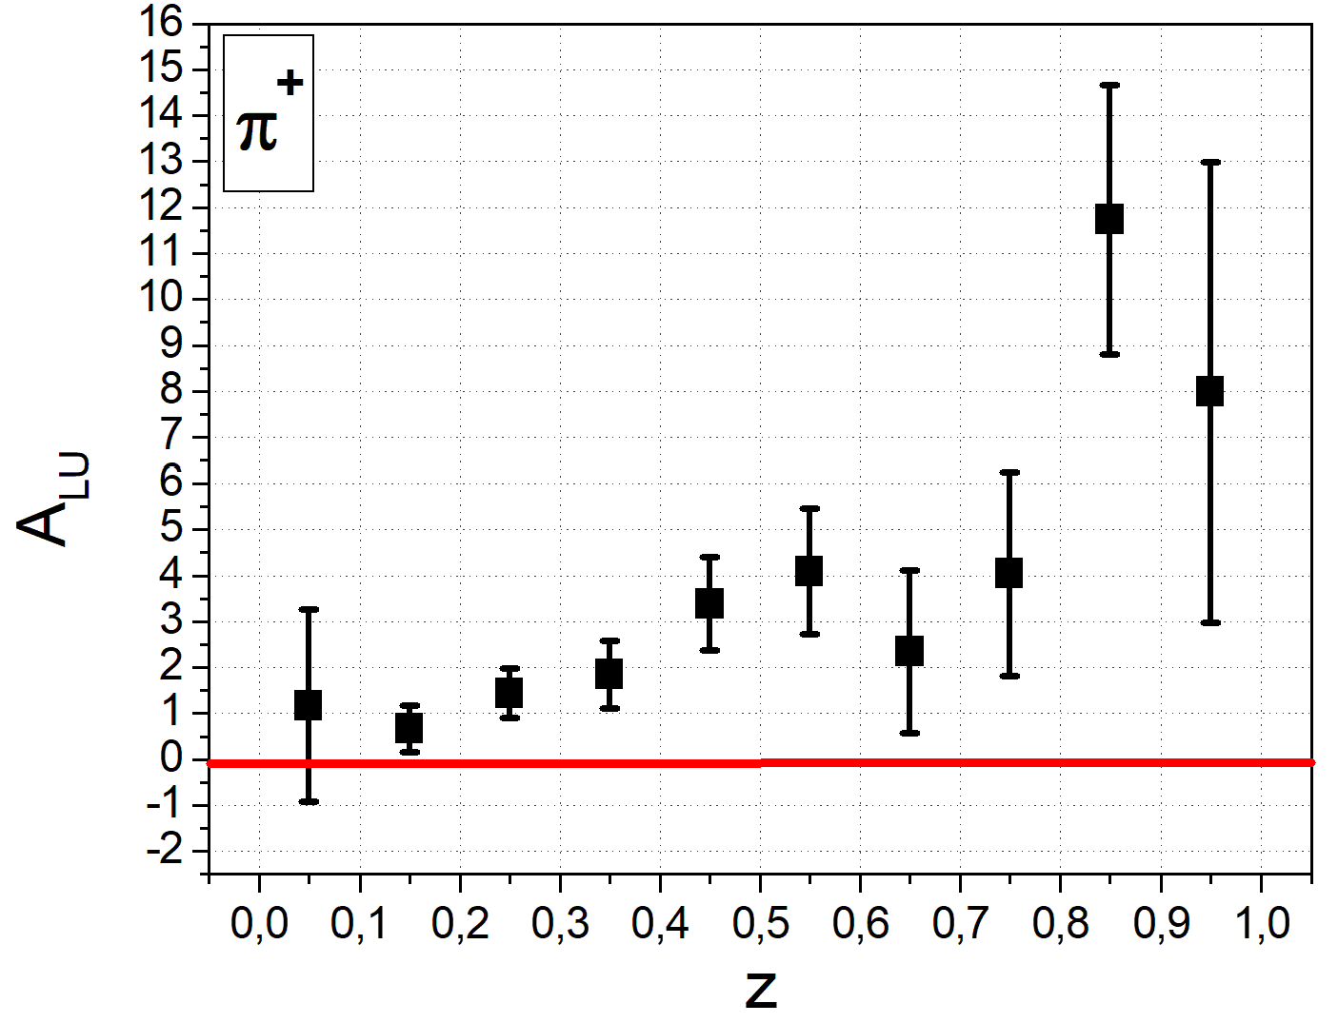
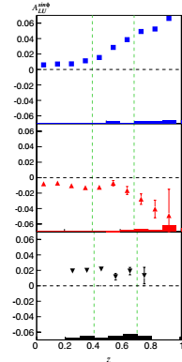
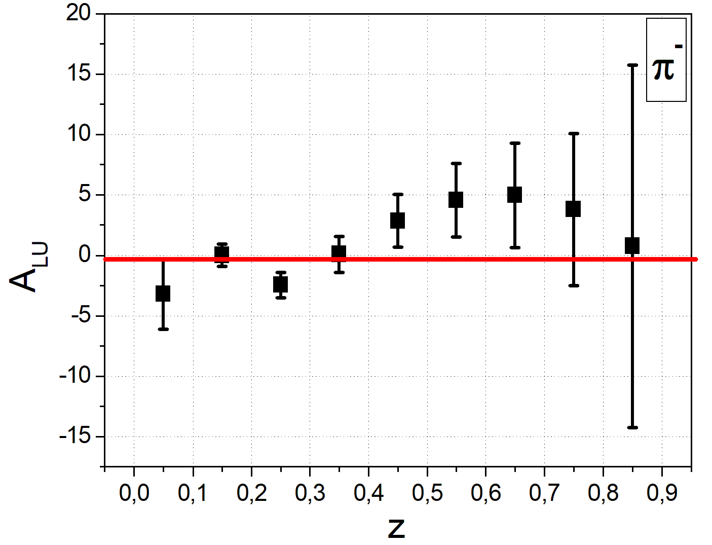
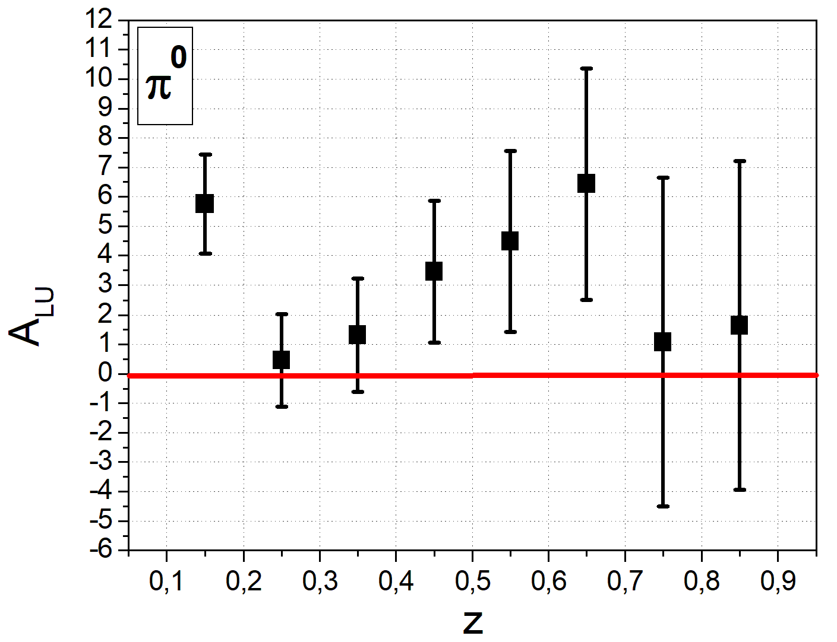
SIDIS - Beam Spin Asymmetry
RAW BSA
This represent 0.3 % of the RG-A spring data
PRELIMANIRY
CLAS 12 - 10.6 GeV
CLAS 6 - 5.498 GeV

Slide 19
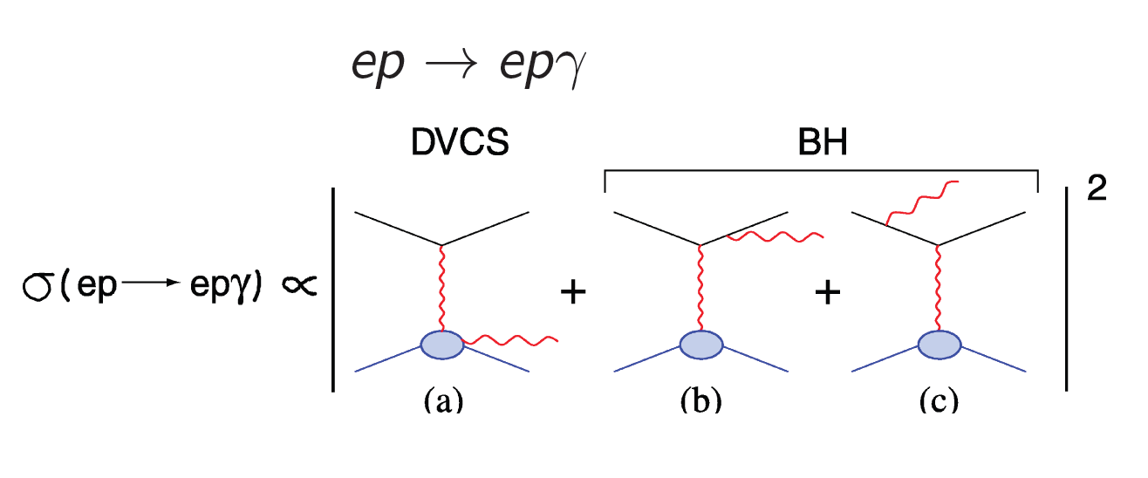
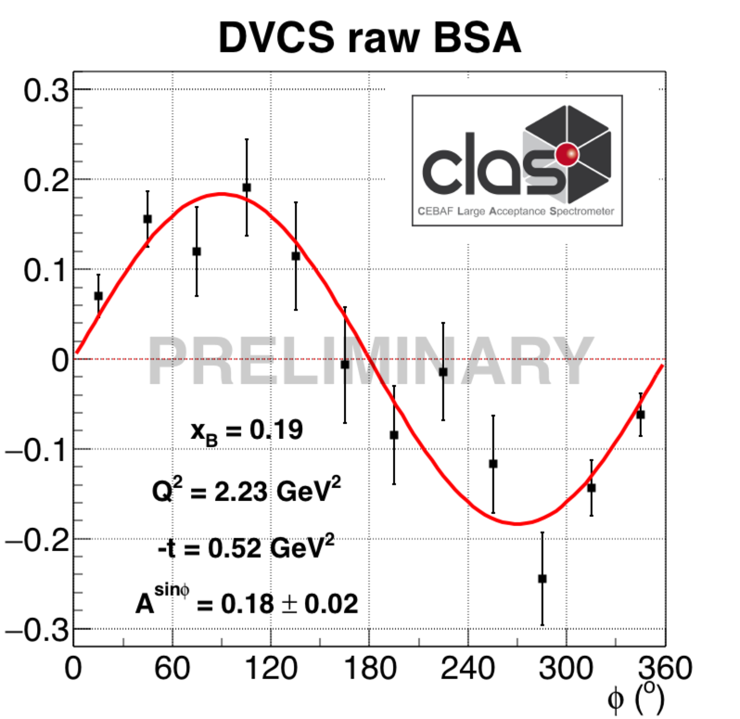
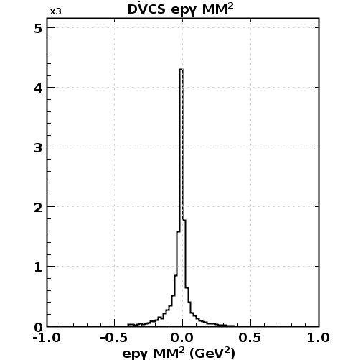
DVCS - Beam Spin Asymmetry
First DVCS Physics data from CLAS12
Exclusivity of the DVCS process

Slide 20
Hall B Run schedule
Schedule | Experiment | Energy (GeV) | Polarization | Days | Total days
CY 2018
8/22 -10/19 | RG-A | 10.6 | max | 59
10/22 – 11/15 | RG-A | 10.6 | max | 25 | 84
11/19 – 12/09 | RG-K | 7.5 | max | 21
12/13 – 12/19 | RG-K | 6.5 | max | 7 | 28
CY 2019
01/30 – 03/10 | RG-B | 10.6 | max | 40
06/10 – 08/04 | HPS | 4.55 | - | 56 | 56
10/01 – 11/24 | RG-B | 10.6 | max | 55 | 95
11/24 – 12/20 | TBD | 10.6 | max | 24

Slide 21
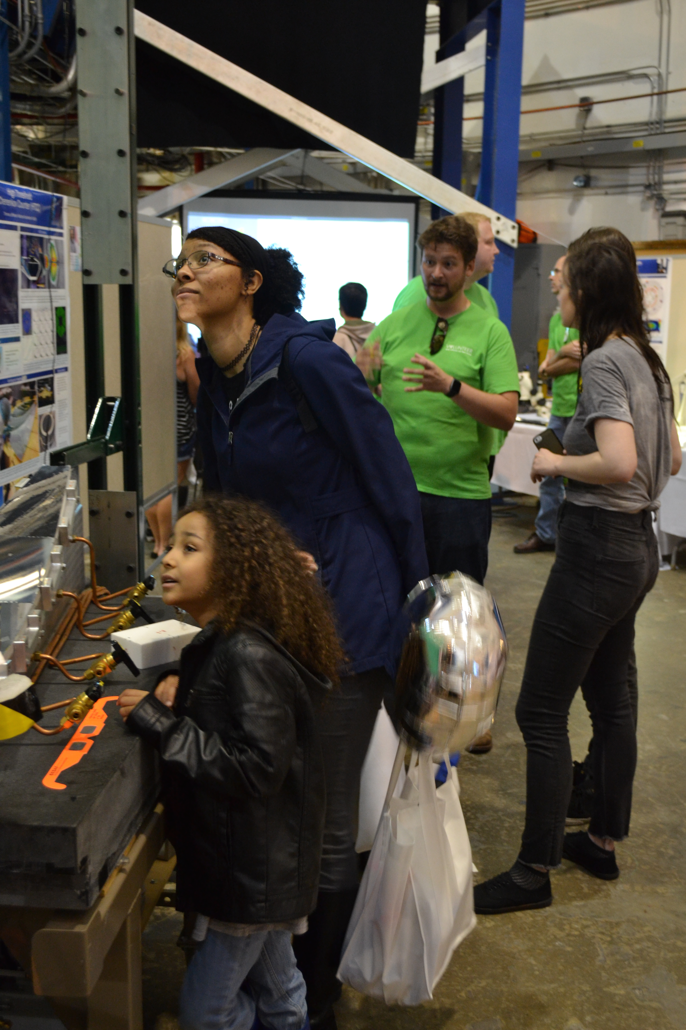
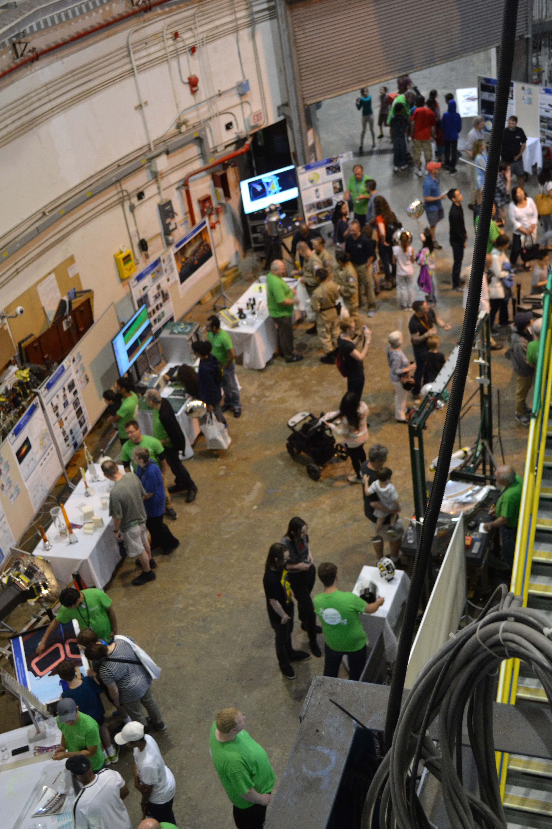
Dark Matter

Slide 22
Conclusions
CLAS12 construction has been completed, magnets and detector commissioned
Data taking started for RG-A this spring
First preliminary data show detectors and magnets are performing well
Full luminosity achieved during commisioning
Plan to submit a series of talks to DNP 2018
CLAS continues to generate high impact science in a variety areas of hadron physics, expect PRad and first HPS results this year
Outlook for 2018/2019 operation look promising

