Slide 1


HALL C SIDIS PROGRAM
Rolf Ent
Jefferson Lab
Joint Hall A/C Summer Meeting,
June 21, 2018

Slide 2
Exploring the 3D Nucleon Structure
After decades of study of the partonic structure of the nucleon we finally have the experimental and theoretical tools to systematically move beyond a 1D momentum fraction (x_{Bj}) picture of the nucleon.
    High luminosity, large acceptance experiments with polarized beams and targets.
    Theoretical description of the nucleon in terms of a 5D Wigner distribution that can be used to encode both 3D momentum and transverse spatial distributions.
Deep Exclusive Scattering (DES) cross sections give sensitivity to electron-quark scattering off quarks with longitudinal momentum fraction (Bjorken) x at a transverse location b.
Semi-Inclusive Deep Inelastic Scattering (SIDIS) cross sections depend on transverse momentum of hadron, P_{h⊥}, but this arises from both intrinsic transverse momentum (k_{T}) of a parton and transverse momentum (p_{T}) created during the [parton → hadron] fragmentation process.

Slide 3

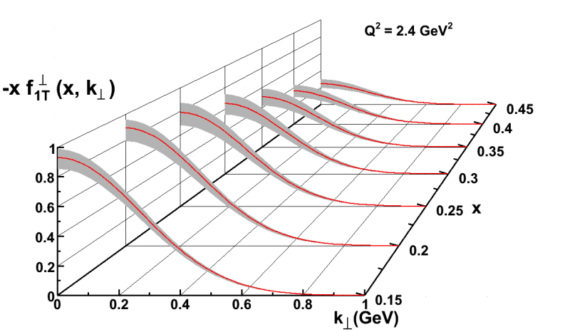
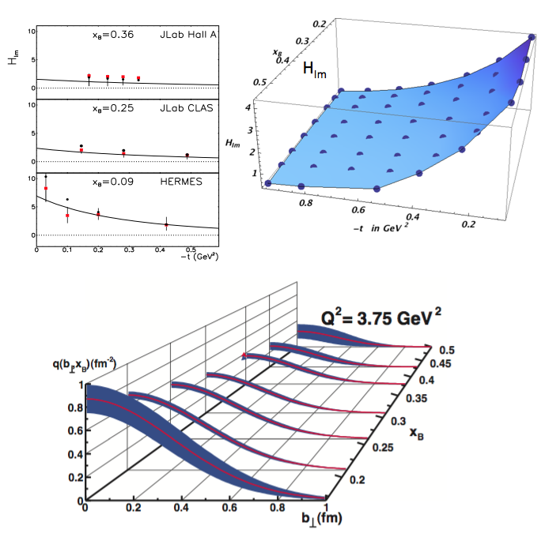
New Paradigm for Nucleon Structure
5D
TMDs
– Confined motion in a nucleon
(semi-inclusive DIS)
GPDs
– Spatial imaging
(exclusive DIS)
Requires
− High luminosity
− Polarized beams and targets
− Sophisticated detector systems
3D
Major new capability with JLab12

Slide 4
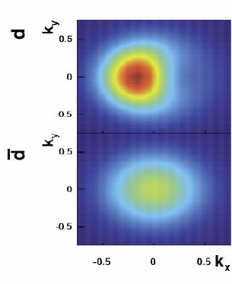
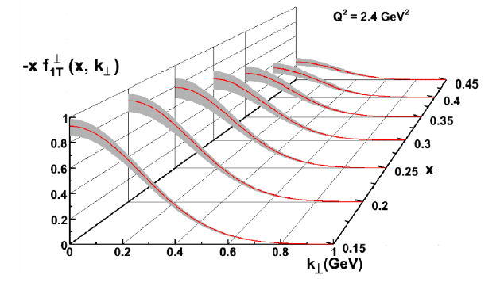
Momentum Tomography with TMDs
JLab/12 GeV Goal → Precision in 3D Momentum Imaging of the Nucleon!
Sivers function for d-quarks extracted from model simulations with a transverse polarized ³He target.
δk_{x}
d-quark momentum tomography for Sivers function. The d-quark momentum density shows a distortion and shift in k_{x}. A non-zero δk_{x} value requires a non-zero orbital angular momentum.
12 GeV ~ Valence Quark Region (x > 0.1)

Slide 5
validate basic reaction mechanism of SIDIS at JLab energies and then spin and flavor dependence of quark transverse momentum distributions
Overall Goal of Jefferson Lab SIDIS Program
There are indications from both theory (lattice, chiral constituent quark model) and experimental data of different k_{T} dependences of quark flavor distributions
Hall C SIDIS program concentrates on the validation and the transverse momentum dependence of unpolarized SIDIS cross sections

Slide 6
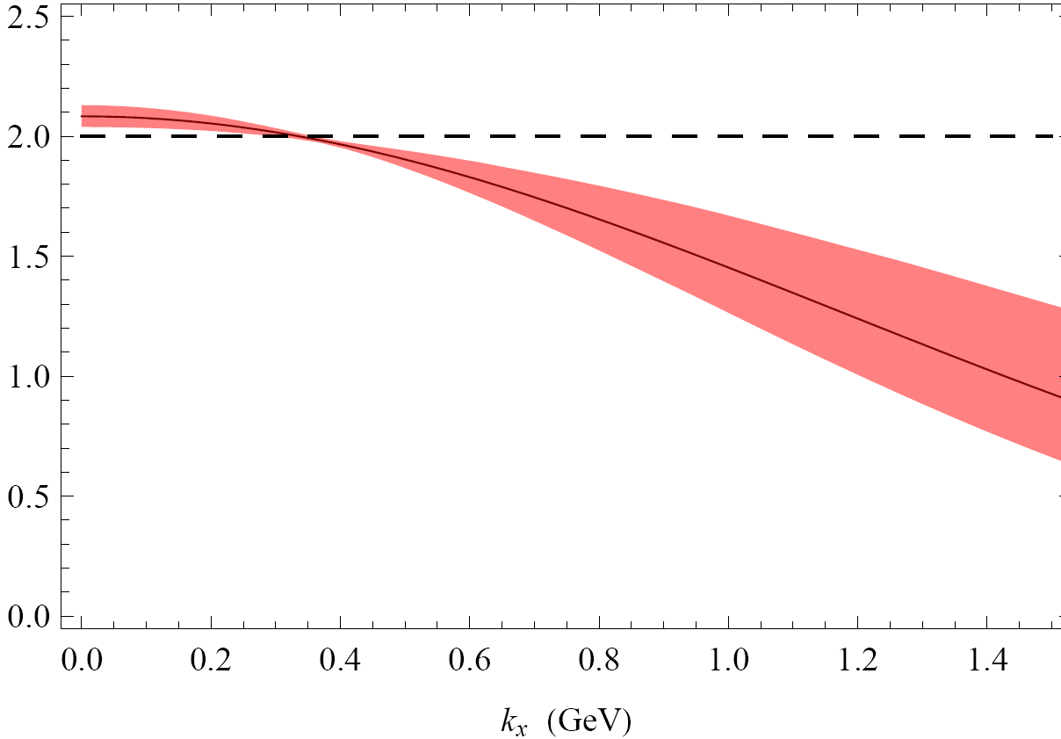
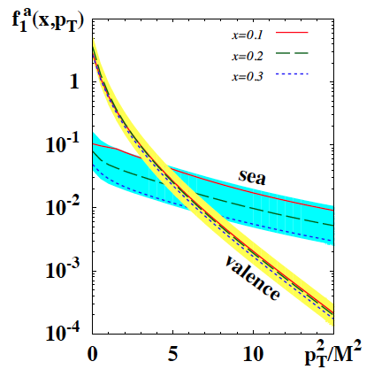


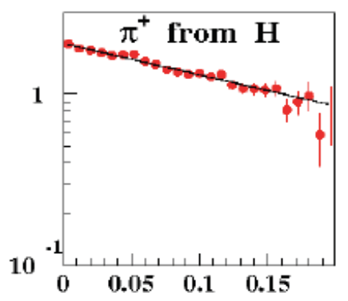
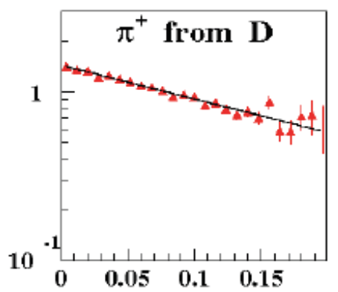

Probing the flavor-dependence of k_{T}-distributions
Higher probability to find more sea
& d-quarks at
large k_{T}
Measurements of hadronic multiplicities provide a crucial input for studies of k_{T} dependence of spin independent distributions
B.Musch et al PRD83 (2011) 094507
P.Schweitzer et al. arXiv:1210.1267
0 0.5 1.0
HERMES, PRD 87 (2013) 074029
COMPASS, EPJC 73 (2013) 2531
Hall-C: Phys.Rev. C85 (2012) 015202
COMPASS Preliminary
h⁺ from D
0.30 < z < 0.6
<x> = 0.054 <Q²>=4.57
M^{h} (arbitrary units)
There are indications from both theory (lattice, chiral constituent quark model) and experimental data of the k_{T} dependence of quark flavor distribution.
6

Slide 7
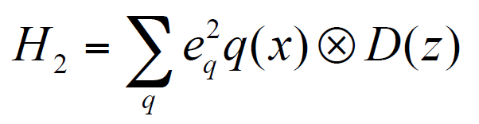
Hall C SIDIS Program – basic (e,e’π) cross sections
(and (e,e’K))
Why need for (e,e’π) cross sections?
PAC37 Report: “the cross sections are such basic tests of the understanding of SIDIS at 11 GeV kinematics that they will play a critical role in establishing the entire SIDIS program of studying the partonic structure of the nucleon. In particular they complement the CLAS12 measurements in areas where the precision of spectrometer experiments is essential, being able to separate P_{T} and φ-dependence for small P_{T}.”
Basic precision cross section measurements:
Crucial information to validate theoretical understanding
  Convolution framework requires validation for most
  future SIDIS experiments and their interpretation
  Can constrain Q² dependence & TMD evolution
  Questions on target-mass corrections and ln(1-z) re-summations require precision large-z data
σ
f
Goal: Measure the basic SIDIS cross sections of π⁺, π⁻, π⁰ (and K⁺) production off the proton (and deuteron), including a map of the P_{T} dependence (P_{T} ~ Λ < 0.5 GeV), to validate⁽*⁾ a flavor decomposition and the k_{T} dependence of (unpolarized) up and down quarks
⁽*⁾ Can only be done using spectrometer setup capable of %-type measurements (an essential ingredient of the global SIDIS program!)

Slide 8
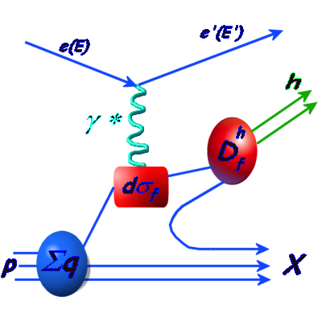

SIDIS – Flavor Decomposition
DIS probes only the sum of quarks and anti-quarks → requires assumptions on the role of sea quarks
Solution: Detect a final state hadron in addition to scattered electron
SIDIS
→ Can ‘tag’ the flavor of the struck quark by measuring the hadrons produced: ‘flavor tagging’
M_{x}² = W’² ~ M² + Q² (1/x – 1)(1 - z)
Z = E_{h}/ν
Measure inclusive (e,e’) at same time as (e,e’h)
Leading-Order (LO) QCD
after integration over p_{T} and φ
NLO: gluon radiation mixes
x and z dependences
Target-Mass corrections at large z
ln(1-z) corrections at large z
: parton distribution function
: fragmentation function

Slide 9
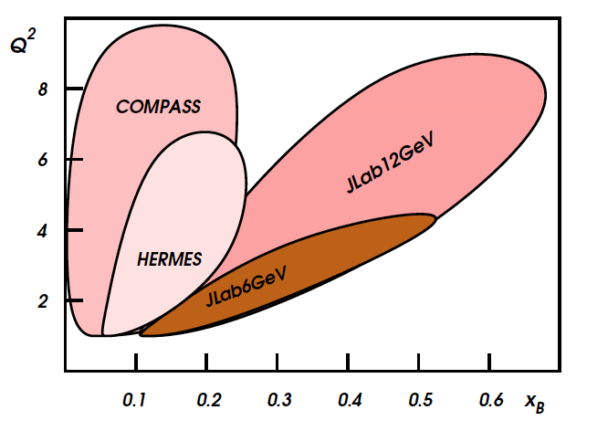
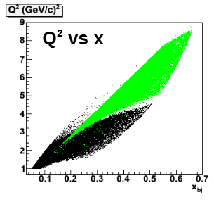
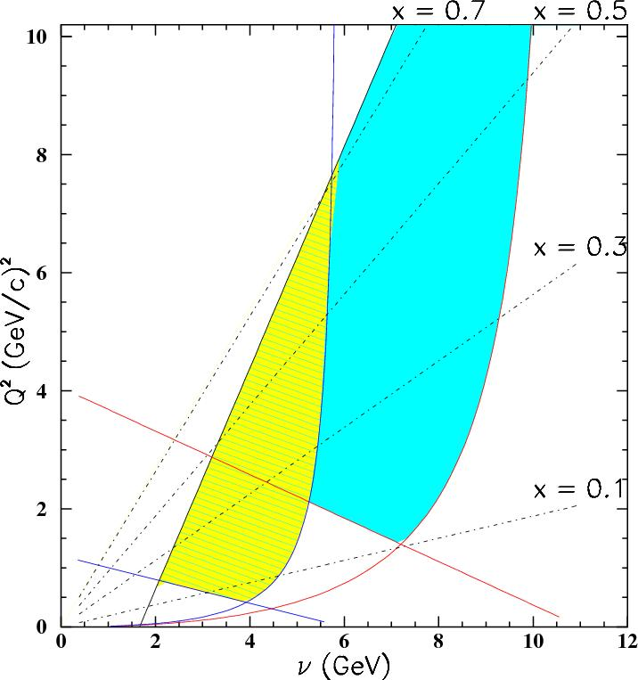
Need precision over range in Q² @ fixed x
SoLID
Still many complications:
Description valid? At what energies?
TMD evolution
Target-Mass effects
ln(1-z) resummation
Symbols and rectangles indicate the kinematics of approved Hall C experiments within the available phase space

Slide 10
TMDs and SIDIS – General Formalism
General formalism for (e,e’h) coincidence reaction w. polarized beam:
[A. Bacchetta et al., JHEP 0702 (2007) 093]
(Ψ = azimuthal angle of e’ around the electron beam axis w.r.t. an arbitrary fixed direction)
If beam is unpolarized, and the (e,e’h) measurements are fully integrated over φ, only the F_{UU,T} and F_{UU,L} responses, or the usual transverse (σ_{T}) and longitudinal (σ_{L}) cross section pieces, survive.

Slide 11
R = σ_{L}/σ_{T} in (e,e’π) SIDIS
Knowledge on R = σ_{L}/σ_{T} in SIDIS is essentially non-existing!
If integrated over z (and p_{T}, φ, hadrons), R_{SIDIS} = R_{DIS}
R_{SIDIS} = R_{DIS} test of dominance of quark fragmentation
R_{SIDIS} may vary with z
At large z, there are known contributions from exclusive
and diffractive channels: e.g., pions from Δ and ρ → π⁺π⁻
R_{SIDIS} may vary with transverse momentum p_{T}
Is R_{SIDIS}^{π+} = R_{SIDIS}^{π-} ? Is R_{SIDIS}^{H} = R_{SIDIS}^{D} ?
Is R_{SIDIS}^{K+} = R_{SIDIS}^{π+} ? Is R_{SIDIS}^{K+} = R_{SIDIS}^{K-} ? E12-06-104 measures kaons too! (with ~20% of pion statistics)
“A skeleton in our closet”
π
σ
f
quark

Slide 12
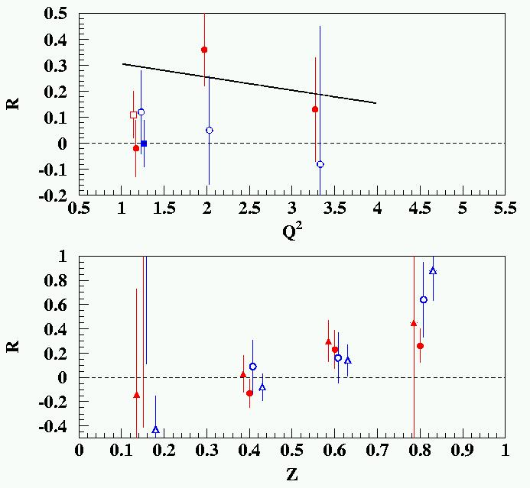
R = σ_{L}/σ_{T} in SIDIS (ep → e’π^{+/-}X)
Knowledge on R = σ_{L}/σ_{T} in SIDIS is essentially non-existing!
“Semi-inclusive DIS”
π
“Deep exclusive scattering” is the z → 1 limit of this “semi-inclusive DIS” process
quark
Σe_{q}²q(x) D_{q}^{p}(z)
Here, R_{SIDIS} → R_{DIS} disappears with Q²
Here, R = σ_{L}/σ_{T} ~ Q² (at fixed x)
Only existing data: Cornell 70’s data (H and D, π⁺ and π⁻)
R_{DIS}
Conclusion: “data consistent with both R = 0 and R = R_{DIS}”
Some hint of large R at large z in Cornell data?

Slide 13
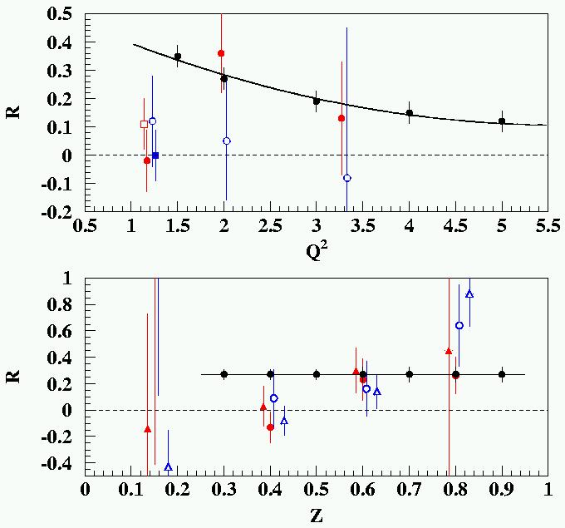
Longitudinal Cross Section: R = σ_{L}/σ_{T} in SIDIS
R_{DIS} is in the naïve parton model related to the parton’s transverse momentum:
R = 4(M²x² + <k_{T}²>)/(Q² + 2<k_{T}²>).
R_{DIS} → 0 at Q² → ∞ is a consequence of scattering from free spin-½ constituents
Only existing SIDIS data: Cornell 70’s (H and D, π⁺ and π⁻)
R_{DIS}
Knowledge on R_{SIDIS} is non-existing
R_{SIDIS} may (will!) vary with z, and with p_{T}
(JLab E12-06-104 will scan versus p_{T} too)
Knowledge on R_{SIDIS} needed for any TMD-related asymmetry
Even if one can relate R_{SIDIS} to a flavor- dependent average transverse momentum in a naïve parton model
(W. Melnitchouk et al, in progress), R_{SIDIS} can not easily be integrated
in a global TMD analysis as it is
sensitive to gluon and HT effects.
R_{DIS} (Q² = 2 GeV²)

Slide 14
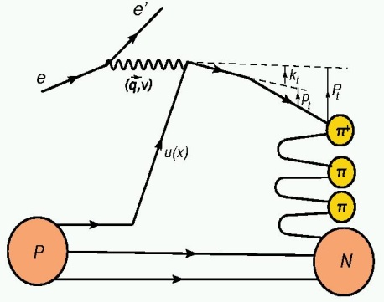
TMDs and SIDIS – General Formalism
General formalism for (e,e’h) coincidence reaction w. polarized beam:
[A. Bacchetta et al., JHEP 0702 (2007) 093]
(Ψ = azimuthal angle of e’ around the electron beam axis w.r.t. an arbitrary fixed direction)
If beam is unpolarized, and the (e,e’h) measurements are fully integrated over φ, only the F_{UU,T} and F_{UU,L} responses, or the usual transverse (σ_{T}) and longitudinal (σ_{L}) cross section pieces, survive.
Unpolarized k_{T}-dependent SIDIS: F_{UU}^{cos(φ)} and F_{UU}^{cos(2φ)}, in framework of Anselmino et al. described in terms of convolution of quark distributions f and (one or more) fragmentation functions D, each with own characteristic (Gaussian) width. Transverse momentum widths of quarks with different flavor (and polarization) can be different.
Final transverse momentum of the detected pion P_{t} arises from convolution of the struck quark transverse momentum k_{t} with the transverse momentum generated during the fragmentation p_{t}.
P_{t} = p_{t} + z k_{t} + O(k_{t}²/Q²)

Slide 15
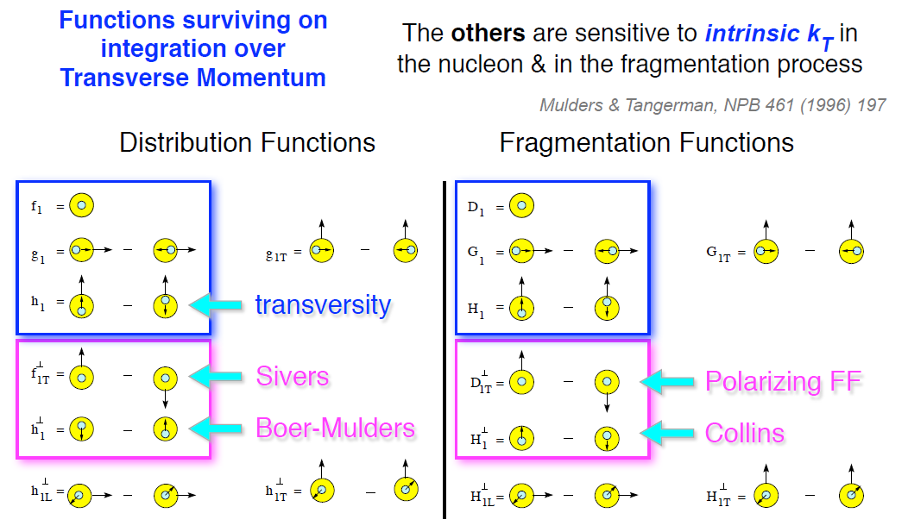

TMDs and 3D FFs
D_{a}^{h}(z, p_{t}²; Q²)
Pretzelosity

Slide 16
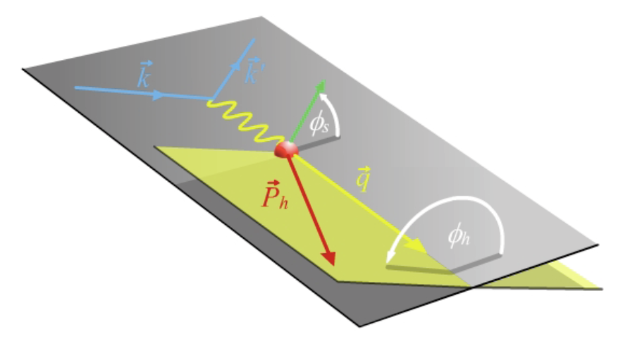
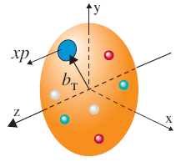
TMDs Accessible through Semi-Inclusive Physics
Separate Sivers and Collins effects
Sivers angle, effect in distribution function: (φ_{h}-φ_{s})
Or other combinations: Pretzelosity: (3φ_{h}-φ_{s})
Collins angle, effect in fragmentation function: (φ_{h}+φ_{s})
Kaons enabled by Hall B RICH (INFN/DOE) and Hall C Aerogel (NSF)
Naturally, two scales:
High Q: localized probe
to “see” quarks and gluons
Low P_{T}: sensitive to confining scale
to “see” their confined motion
+ Theory input: TMD QCD factorization
TMD QCD evolution
target angle
hadron angle
Scattering Plane
Pay attention to this one!

Slide 17
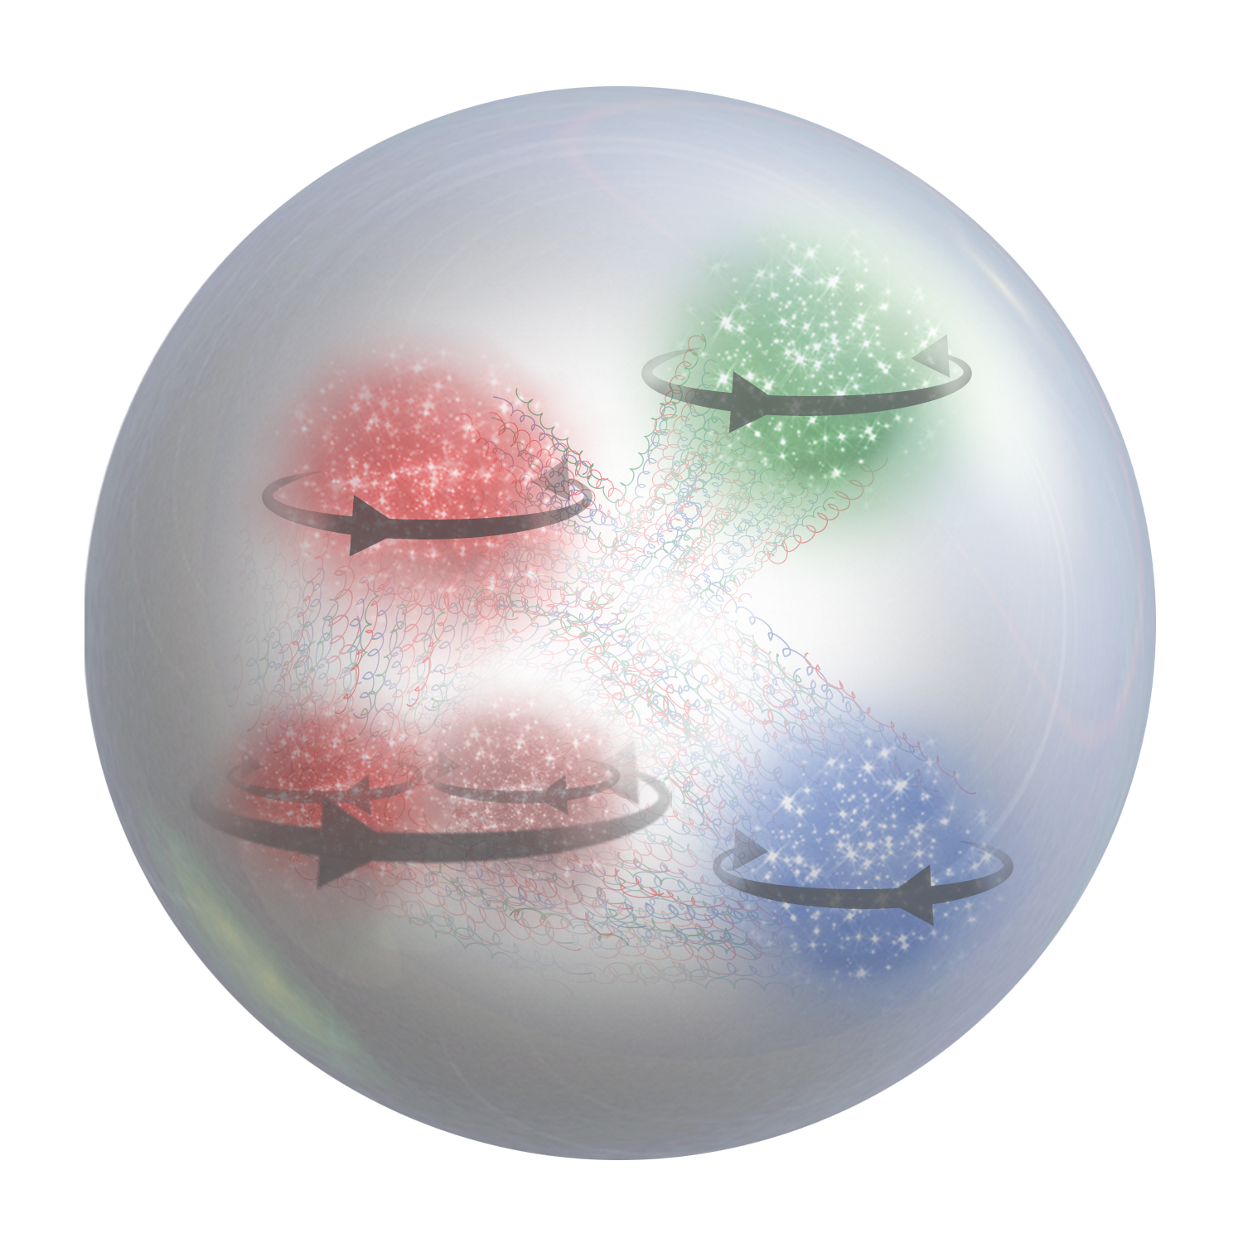


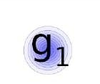
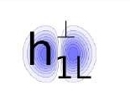

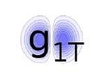
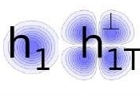
Features of 3D Distributions/TMDs
σ
f
Ex. TMD PDF for a given combination of parton and nucleon spins
quark polarization
U
L
T
transverse position and momentum of partons are correlated with the spin orientations of the parent hadron and the spin of the parton itself
transverse position and momentum of partons depend on their flavor
transverse position and momentum of partons are correlated with their longitudinal momentum
spin and momentum of struck quarks are correlated with remnant
quark-gluon interaction play a crucial role in kinematical distributions of final state hadrons, both in semi-inclusive and exclusive processes
T
U
f₁
h₁
Boer-Mulders
nucleon polarization
L
g_{1L}
T
h_{1L}
helicity
worm-gear
T
,
T
T
f_{1T}
g_{1T}
h₁
h_{1T}
Sivers
worm-gear
transversity
pretzelosity

Slide 18
Hall C SIDIS Program (typ. x/Q² ~ constant)
HMS + SHMS (or NPS) Accessible Phase Space for SIDIS; w. typical z range 0.3-0.65
Accurate cross sections for validation of SIDIS factorization framework and for L/T separations
11 GeV phase space
E12-13-007
Neutral pions:
Scan in (x,z,P_{T})
Overlap with
E12-09-017 &
E12-09-002
6 GeV phase space
Charged pions:
E12-06-104
L/T scan in (z,P_{T})
No scan in Q² at fixed x: R_{DIS}(Q²) known
Parasitic with E12-13-010
E12-09-017
Scan in (x,z,P_{T})
E00-108 (6 GeV)
+ scan in Q²
at fixed x
E12-09-002
+ scans in z

Slide 19
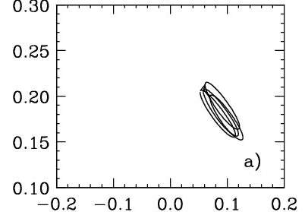
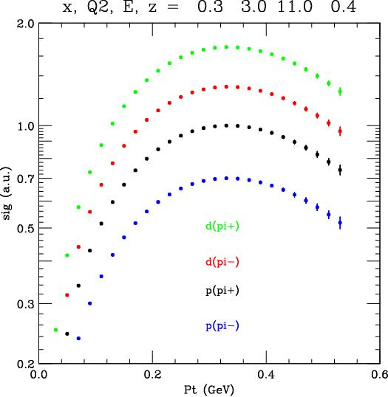
Hall C SIDIS Program – basic (e,e’π) cross sections
Goal: Measure the basic SIDIS cross sections of π⁺, π⁻, π⁰ (and K⁺) production off the proton (and deuteron), including a map of the P_{T} dependence (P_{T} ~ Λ < 0.5 GeV), to validate⁽*⁾ a flavor decomposition and the k_{T} dependence of (unpolarized) up and down quarks
σ
f
⁽*⁾ Can only be done using spectrometer setup capable of %-type measurements (an essential ingredient of the global SIDIS program!)
π^{+/-}
x = 0.32
z = 0.55
Example
<p_{t}²> (favored)
(Kinematics II, z = 0.4 bin only)
Cross Section (a.u.)
<k_{t}²> (up)
Basic precision cross section measurements:
Crucial information to validate theoretical understanding
  Convolution framework requires validation for most
  future SIDIS experiments and their interpretation
  Can constrain Q² dependence & TMD evolution
  Questions on target-mass corrections and ln(1-z) re-summations require precision large-z data
π⁰ with Neutral-Particle Spectrometer (NPS)

Slide 20
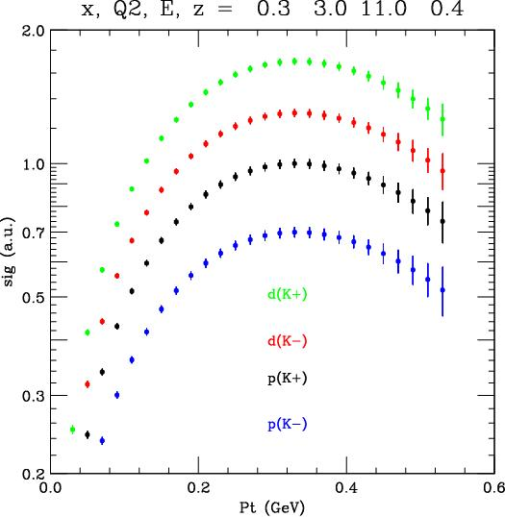
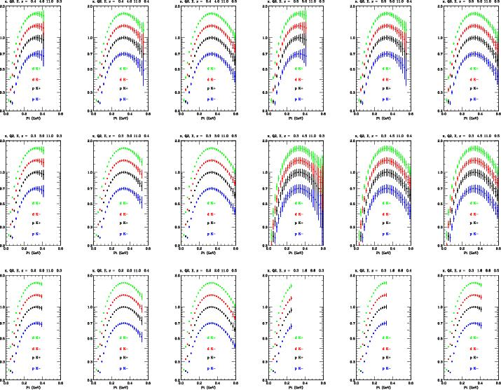
Hall C Projected Results – Kaons
III
IV
II
VI
I
V

Slide 21
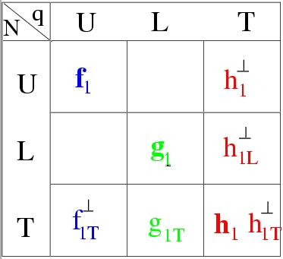
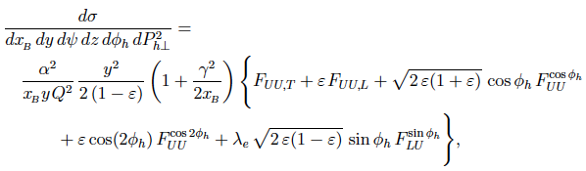
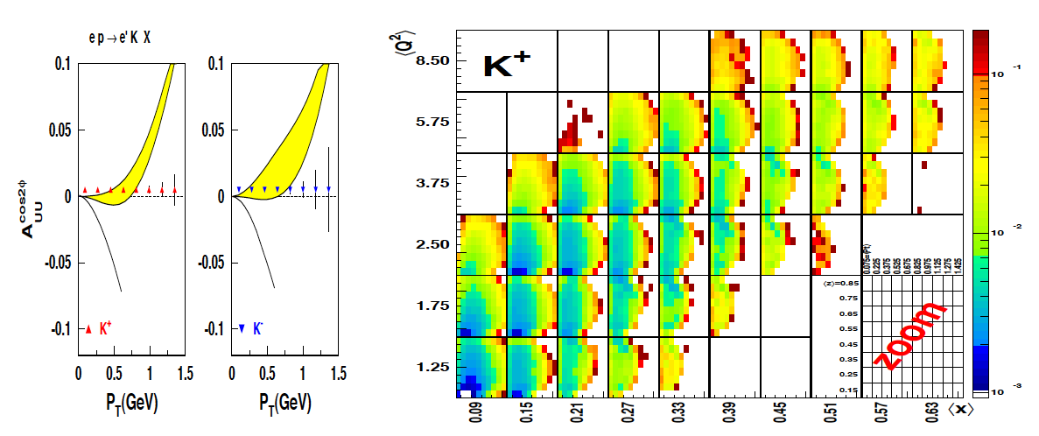
SIDIS π/K on unpolarized protons/deuterons
E12-06-112
Kaons
E12-09-008
E12-09-017
(CLAS12)
(Hall C, Kinematics II, z = 0.4 bin only)

Slide 22
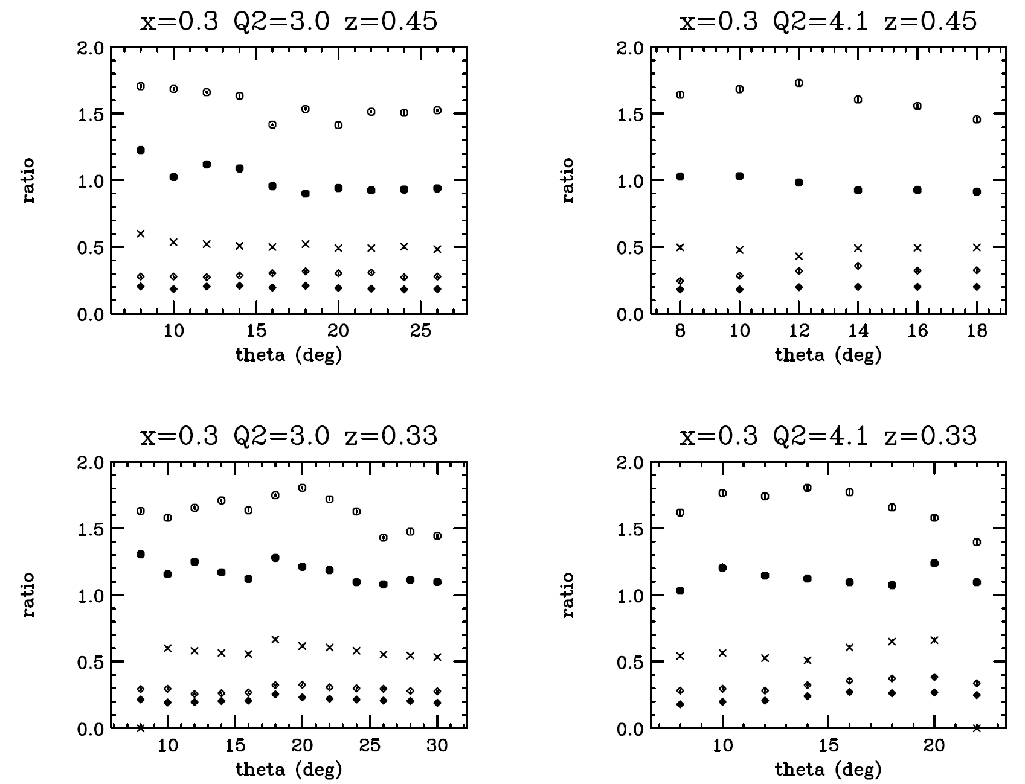
E12-09-017 Quasi-Online Results – Pions
not normalized by target density: just ratios of counts/mC corrected for computer dead time.
Ratio to pi+ from LH2 of
pi+ from LD2 (open circles)
pi+ from Al (open diamonds)
pi- from LH2 (crosses)
pi- from LD2 (filled circles)
pi- from Al (filled diamonds)
Anashe Bandari & Peter Bosted

Slide 23
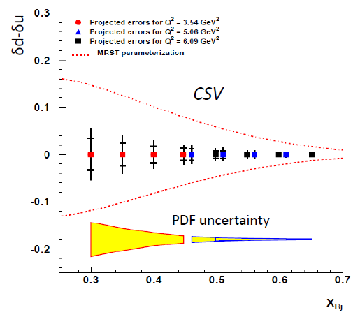
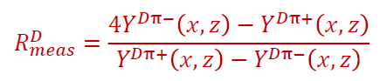
Hall C E12-09-002: The Hunt for CSV
Charge symmetry (CS) is an approximate symmetry in the nuclear world, respected to better than 1%: M_{p} ≈ M_{n}, energy levels in mirror nuclei (after Coulomb corrections), …
At the quark level CS implies u^{p}(x,Q²) = d^{n}(x,Q²), d^{p}(x,Q²) = u^{n}(x,Q²). This is widely assumed but never thoroughly checked by experiment!
In QCD charge symmetry violation (CSV) originates from EM interactions (small at high energies) and δm = m_{d} – m_{u}.
Naively, CSV ~ (m_{d} – m_{u})/<M>, where <M> ~ 0.5 – 1 GeV from the strong Hamiltonian → one expects an ~1% effect
Experiment aims, assuming a thorough understanding of the SIDIS reaction mechanism is validated, to extract CSV info from the charged-pion yield ratio on a D target.

Slide 24
Hall C SIDIS Program – basic (e,e’π) cross sections
(Hall C’s basic SIDIS cross section data at a 6-GeV JLab showed agreement with partonic expectations laying the foundation for a vigorous 12-GeV SIDIS program. PRL 98 (2007) 022001; PL B665 (2008) 20; PRC 85 (2012) 015202. At a 12-GeV JLab, Hall C’s role will be again to provide basis SIDIS cross sections, furthering our understanding.)
Low-energy (x,z) factorization, or possible convolution in terms of quark distribution and fragmentation functions, at JLab-12 GeV must be well validated to substantiate the SIDIS science output. Many questions remain at intermediate-large z (~0.2-1) and low-intermediate Q² (~2-10 GeV²).
Why need for (e,e’π⁰) beyond (e,e’π^{+/-})?
(e,e’π⁰) experimental advantages:
☺ no diffractive ρ contributions
☺ no exclusive pole contributions
☺ reduced resonance contributions
☺ proportional to average D
Further advantages:
Can verify: σ^{πo}(x,z) = ½ (σ^{π+}(x,z) + σ^{π-}(x,z))
Confirms understanding of flavor decomposition & of k_{T} dependence

Slide 25
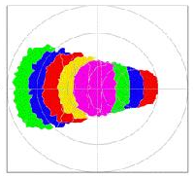
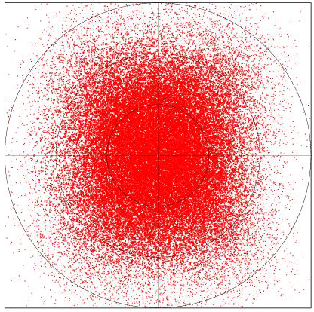
HMS + SHMS: P_{T} coverage HMS + NPS: P_{T} coverage
E12-09-017 E12-13-007
Can do meaningful π^{+/-} measurements at low p_{T} (down to 0.05 GeV) due to excellent momentum and angle resolutions!
Basic π⁰ SIDIS cross sections with excellent precision, and very good momentum and angle resolutions!
Excellent φ coverage
up to P_{T} = 0.2 GeV
Sufficient up to P_{T} = 0.4 GeV
→ coverage at φ = 0, π
Limited up to P_{T} = 0.5 GeV
→ use f(φ) from CLAS12
Excellent φ coverage
up to P_{T} = 0.3 GeV
Good up to P_{T} = 0.4 GeV
Limited up to P_{T} = 0.5 GeV
→ use f(φ) from CLAS12
π^{+/−}
π⁰
φ = 90º
φ = 90º
p_{T} = 0.6
p_{T} = 0.6
p_{T} = 0.4
p_{T} = 0.4
φ = 180º
φ = 0º
φ = 180º
φ = 0º
φ = 270º
φ = 270º

Slide 26
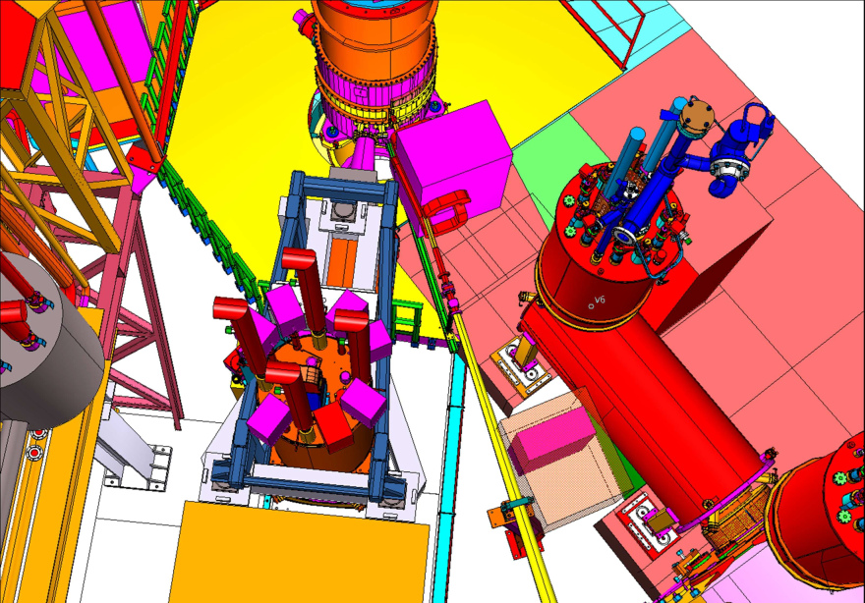
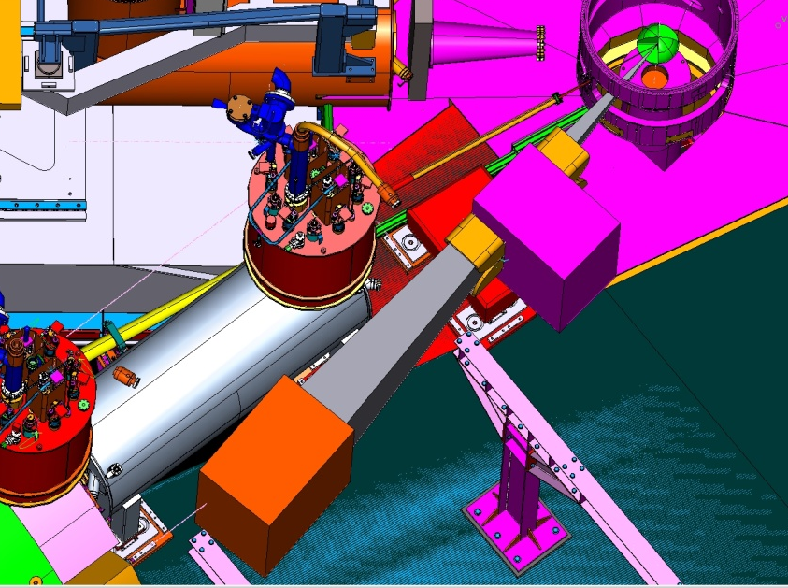
The Neutral-Particle Spectrometer (NPS)
The NPS is envisioned as a facility in Hall C, utilizing the well-understood HMS and the SHMS infrastructure, to allow for precision (coincidence) cross section measurements of neutral particles (γ and π⁰). The NPS will be remotely rotatable off the SHMS platform.
NPS angle range: 5.5 – 30 degrees NPS angle range: 25 – 60 degrees
The large interest for such a device can be exemplified by the PAC-approved science program:
E12-13-007 – Measurement of Semi-inclusive π⁰ production as Validation of Factorization
E12-13-010 – Exclusive Deeply Virtual Compton and Neutral Pion Cross Section Measurements in Hall C
(E12-13-007 & E12-13-010 runs as one run group – first run group in Hall C)
E12-14-003 – Wide-angle Compton Scattering at 8 and 10 GeV Photon Energies
E12-14-005 – Wide Angle Exclusive Photoproduction of π⁰ Mesons (runs as run group with E12-14-003)
E12-17-008 – Polarization Observables in Wide-Angle Compton Scattering at large s, t and u (Cond. Approved)
NPS cantelevered off SHMS platform
NPS on SHMS platform
Magnet
Under construction with NSF/MRI grant support (CUA, ODU, Ohio, Orsay, Glasgow, Yerevan, JLab, …)
Magnet
Detector
Detector

Slide 27
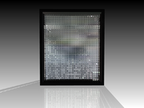
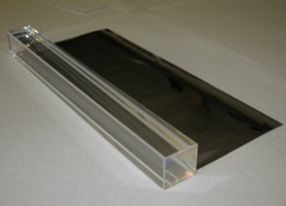
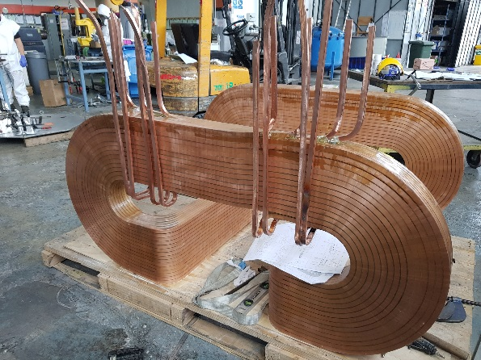
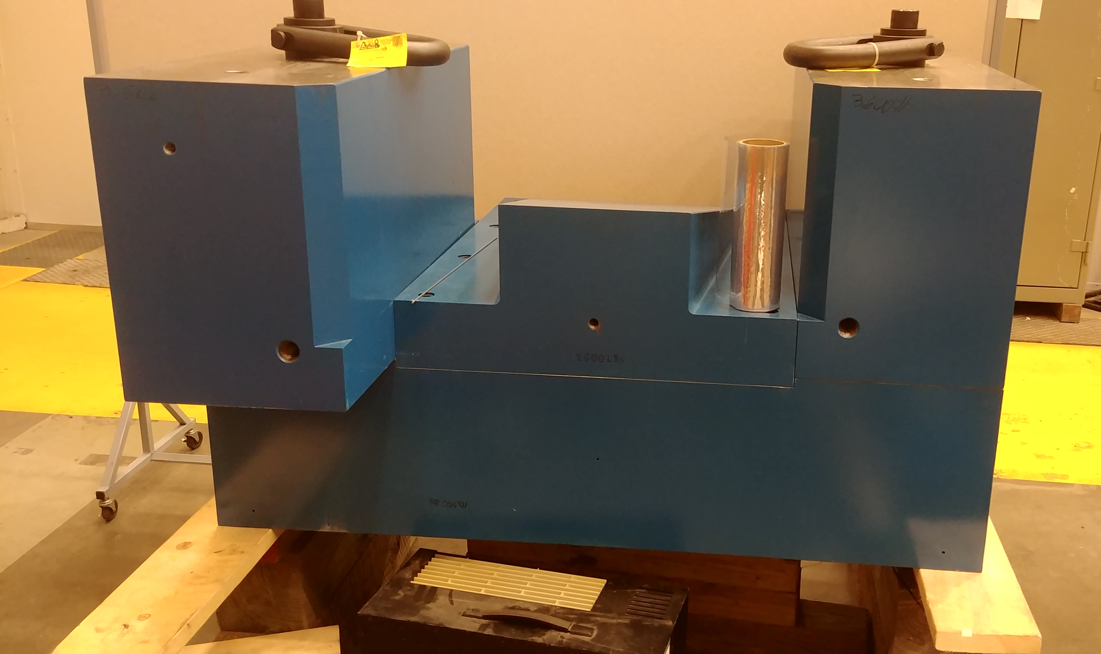
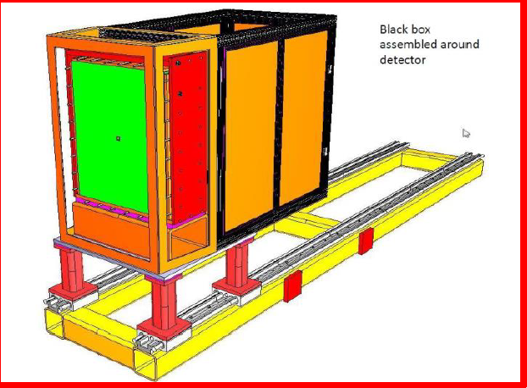
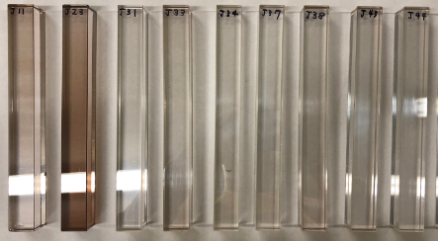
NPS Project Status
PbWO₄
NPS
Four fully approved experiments, supported by NSF MRI PHY-1530874 (CUA, OU, ODU), international (IPN-Orsay, Glasgow, Yerevan), and JLab
Magnet: corrector coil, main coil and yoke steel at JLab, assembly has started, testing and field map next
Main coil before shipping
PMT and HV bases: design drawings final, prototyping, procurement started, first articles received
Frame and integrated systems: concepts and initial design complete, detailed drawings to be presented later this year, prototype tests ongoing
Crystals: 460 crystals procured from SICCAS in 2017, 400 SICCAS + 100 CRYTUR procurement ongoing in 2018, full crystal testing facilities established at CUA and IPN-Orsay, chemical analysis and crystal growth in collaboration with Vitreous State Laboratory @ CUA, synergy with EIC crystal calorimeter R&D.
NPS crystal prototype and irradiation studies

Slide 28
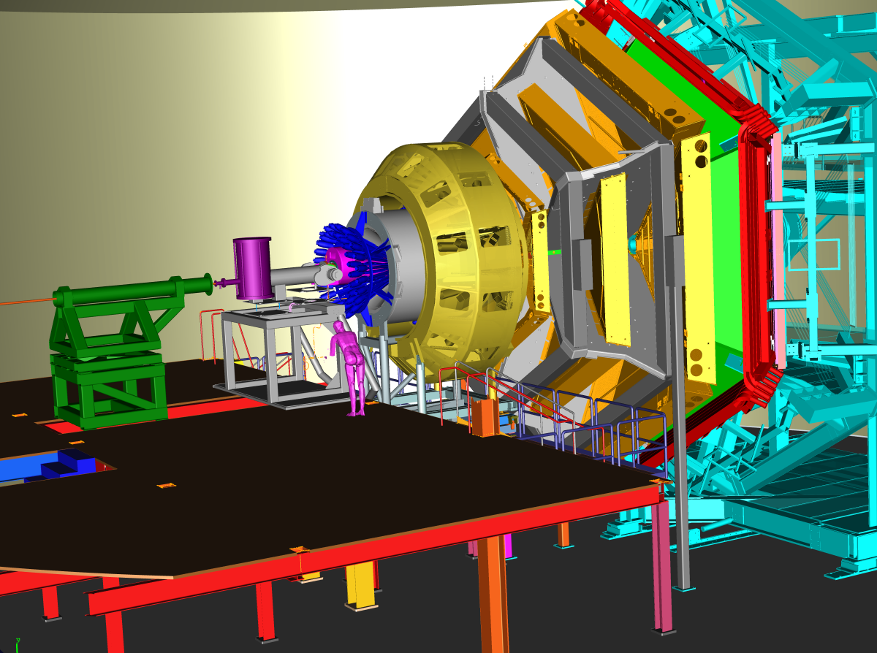
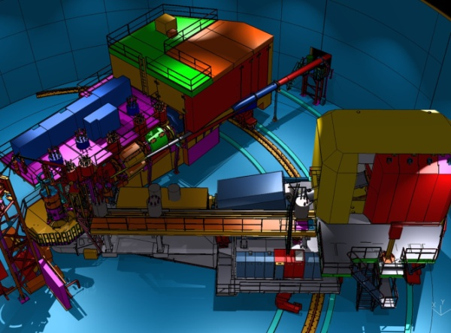
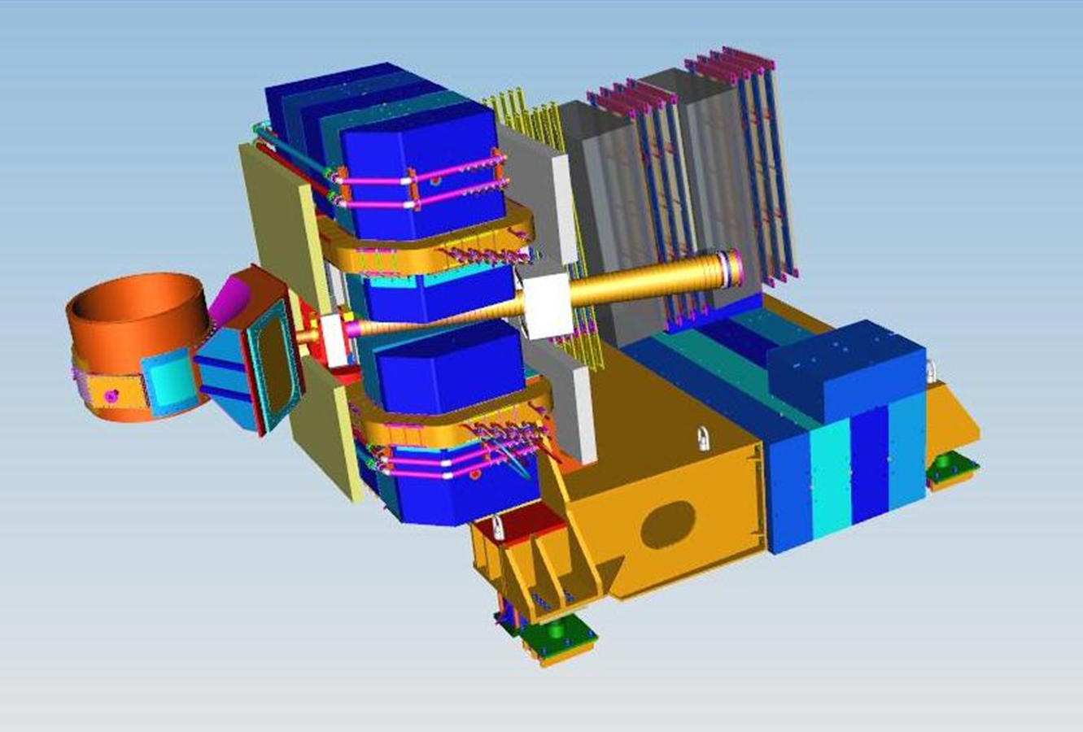
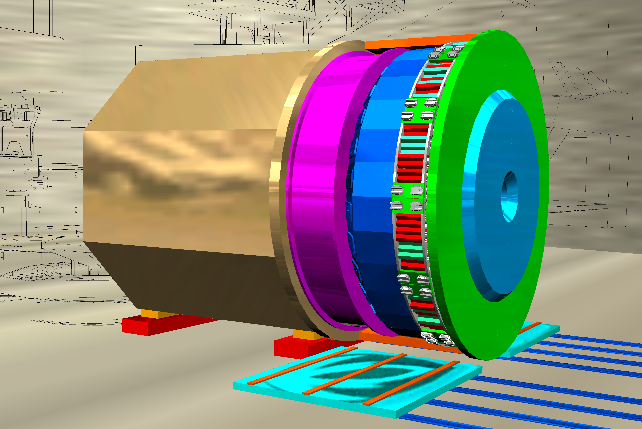
Together Stronger: SIDIS/TMD with 12 GeV
CLAS12 in Hall B
General survey, medium lumi
SHMS, HMS, NPS in Hall C
L-T studies, precise π⁺/π⁻/π⁰ ratios
SBS in Hall A
High x, High Q², 2-3D
SOLID in Hall A
High lumi and acceptance – 4D

Slide 29
Summary
Overall goal of Jefferson Lab SIDIS Program (in x > 0.1 region):
validate basic reaction mechanism of SIDIS at JLab energies
and then
spin and flavor dependence of quark transverse momentum distributions
There are indications from both theory (lattice, chiral constituent quark model) and experimental data of different k_{T} dependences of quark flavor distributions
Hall C SIDIS program concentrates on the validation and the transverse momentum dependence of unpolarized SIDIS cross sections

Slide 31
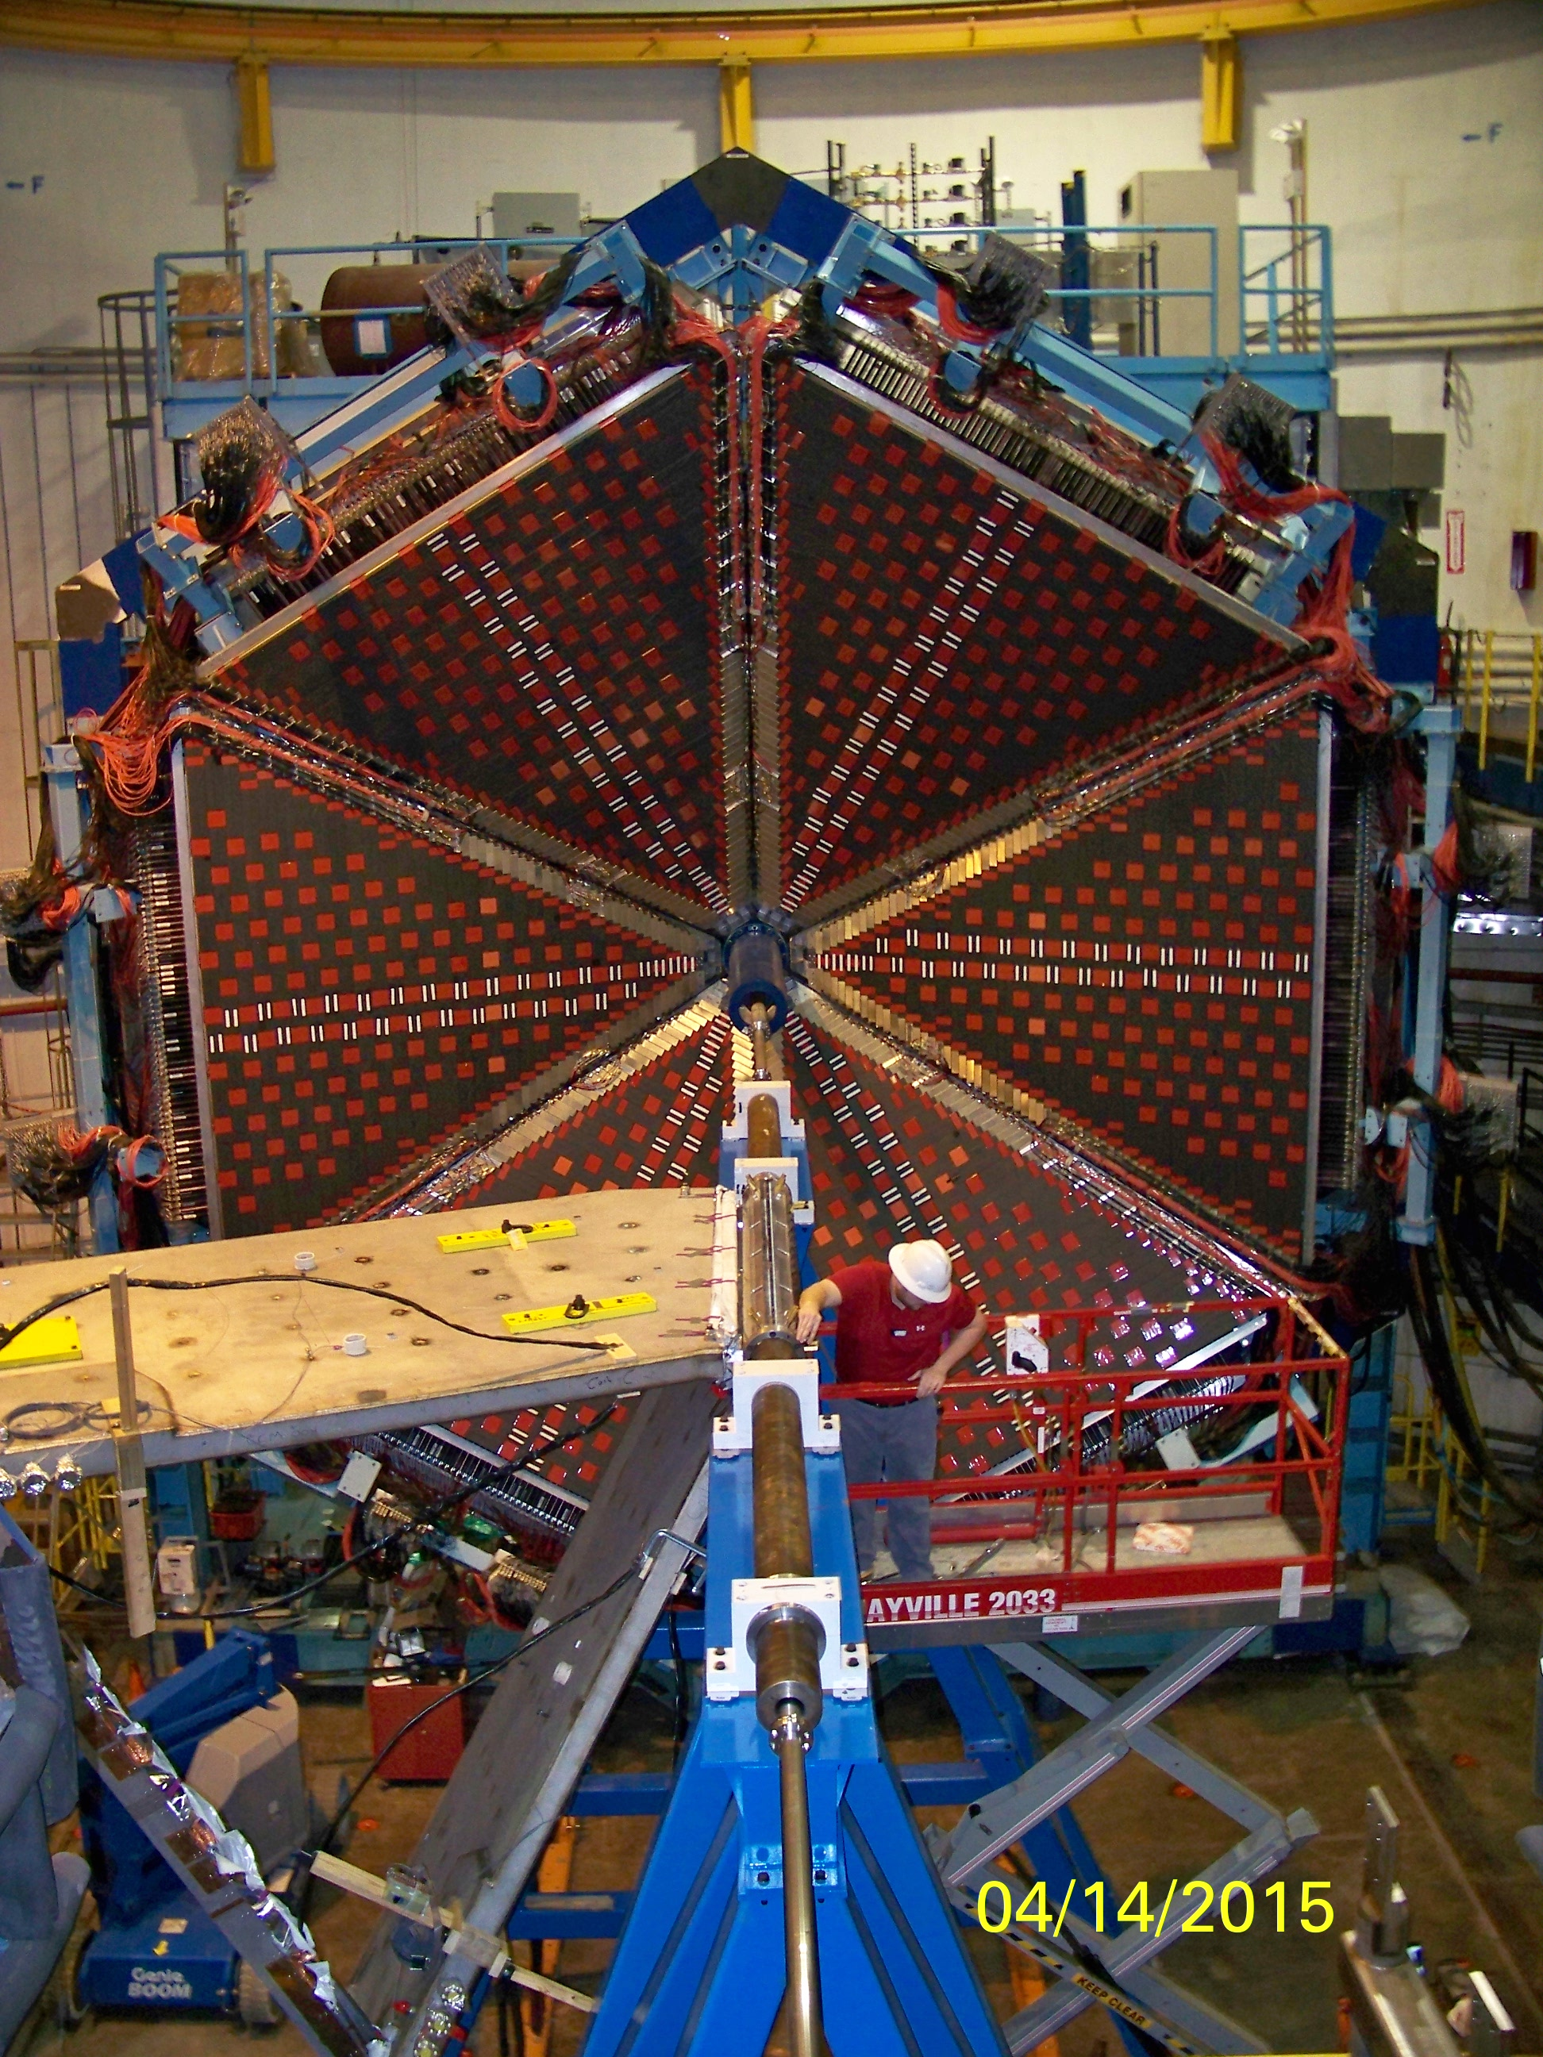
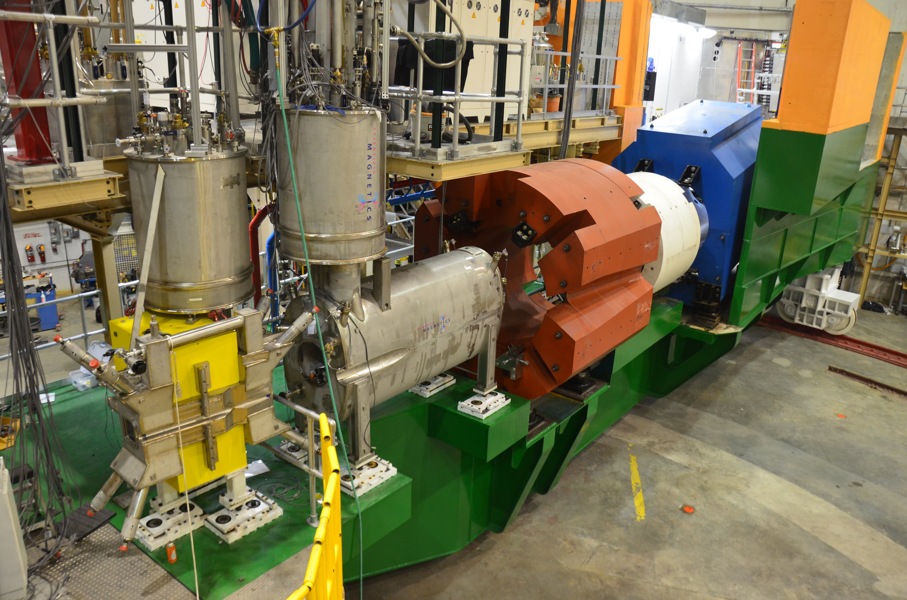



12 GeV (GPD/TMD) Scientific Capabilities
Hall B – understanding nucleon structure via generalized parton distributions
Hall C – precision determination of valence quark properties in nucleons/nuclei
SIDIS/DES cross-section factorization tests
TMDs and GPDs comprehensive study
Hall A – polarized 3He, future new experiments (e.g., SBS, MOLLER and SoLID)
Ultimate TMD statistical precision in valence region
Notes:
31
Note BSM not included in project

Slide 32
Transverse Momentum Structure of Nucleon – TMDs
(Quantum phase-space quark distribution in the nucleon)
5D
Integrate over
spatial dimensions
Quark spin polarization
Transverse Momentum-dependent Distributions (TMD)
Nucleon polarization
3D imaging of the nucleon in momentum space
3D
JLab has planned a complete SIDIS program with π/K to access quark TMDs

Slide 33
TMDs and 3D FFs
D_{a}^{h}(z, p_{t}²; Q²)
Pretzelosity

Slide 34

3D Fragmentation
D_{h}ª(z, p_{t}²; Q²)
Final transverse momentum of the detected pion P_{t} arises from convolution of the struck quark transverse momentum k_{t} with the transverse momentum generated during the fragmentation p_{t}.
Ex. p_{t}-dependent FF for a given combination of parton and hadron species
Spin-Spin Correlations
Spin-Momentum Correlations
σ
Unpolarized
f
D_{a}^{h}(z, p_{t}²; Q²)
Polarizing FF
Polarizing FF
Understanding of the 3D structure of fragmentation into a hadron requires studies of transverse momentum, spin and hadron species dependence
Collins
Collins

Slide 35

Lessons from the 70s to Now
The emergence of hadrons – mass from massless gluons and nearly-massless quarks
Basis on Parton Model Intuition:
Localization in space-time & momentum
Lorentz contraction, time dilation, causality
Sharp separation of scales (…)
Ideas about string-like hadronization
Issues: no direct connection with field theory
Sharp separation of scales?
Final state evolution in space-time??
1977
Space-time view of parton model idea of hadronization (in γ*p CM frame)
History/timeline
Late 60s/early 70s: Parton Model
QCD ~ 1974
Factorization ~ 1980
~2008 Transverse spin physics provokes new definition of pdfs (TMDs) - Back to need for separation of scales

Slide 36


Successful predictions at High E
Z production at the LHC

Slide 37

To Disembroil the Lund String
Excellent description of high-energy transverse momentum spectra
    → Lund model must do something right…
Started from best quantum mechanical insight of the time (Schwinger)
Incorporates acquisition of mass and transverse momentum
The transverse momentum acquired in the LUND string model a la Schwinger is about what we see from the (early stage) TMD analyses.
Is there reciprocity between TMDs and fragmentation?
What does the Lund Model know that we don’t know?

