Slide 1

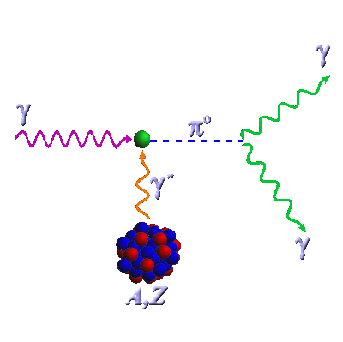

Final results from PrimEx I and II
Ilya Larin
University of Massachusetts Amherst
for the PrimEx-II Collaboration

Slide 2
Outline
Physics motivation
Experimental methods
The PrimEx experiment
PrimEx results

Slide 3
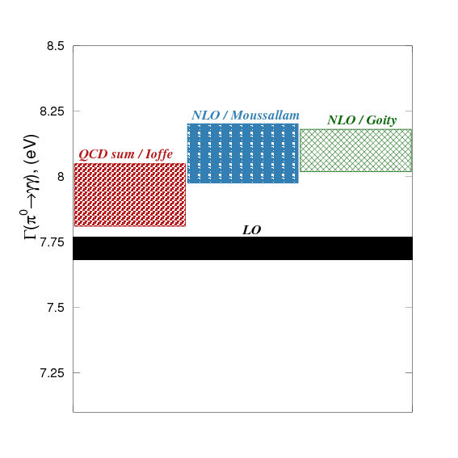
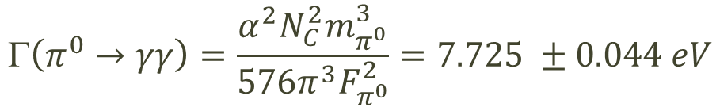
QCD predictions for Γ(π⁰→γγ)
π⁰→ γγ proceeds primarily via chiral anomaly
Chiral anomaly predicts exact value for decay width at the leading order and massless quarks:
Next to the leading order corrections have been calculated taking into account different quark masses and mixing effects with percent level precision:
  J.Goity et al.: 8.1eV±1.0%
  K.Kampf, B.Moussalam: 8.09±1.4%
  B.Ananthanarayan et al.: 8.06±1.0%
  B.Ioffe, A.Oganesian (QCD sum rules): 7.93±1.5%
γ
π⁰
γ
$$\left(π^{0}→γγ\right)=\frac{α^{2}N_{C}^{2}m_{π^{0}}^{3}}{576π^{3}F_{π^{0}}^{2}}=7.725 ±0.044 eV$$

Slide 4
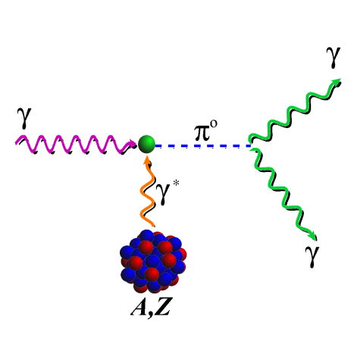
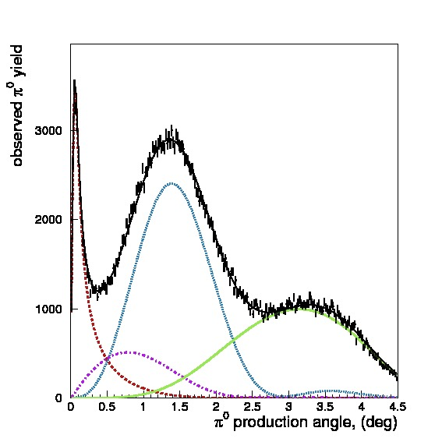
Γ(π⁰→γγ): experimental methods and measurements:
Primakoff method
π⁰ photoproduction in nucleus coulomb field
Coulomb part of photoproduction cross section needs to be extracted:
Challenge: separate Coulomb and Strong photoproduction
Most recent measurement (preceding PrimEx):
  Cornell (1974) Γ(π⁰→ γγ ) = 7.92eV±5.3%
Primakoff
Strong coherent
Interference
Strong Incoherent

Slide 5
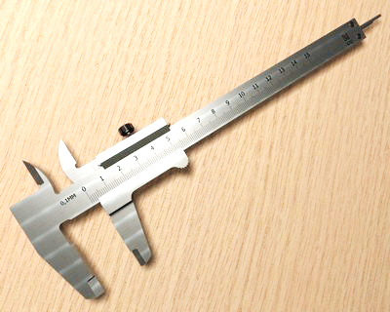
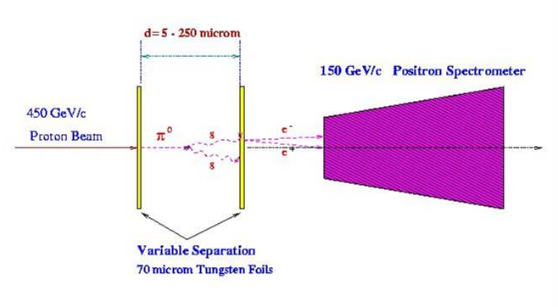
Γ(π⁰→γγ): experimental methods and measurements:
Direct measurement
Direct decay length measurement
Decay length is only ~20μm at 100GeV
Limited by unknown π⁰ momentum spectrum
No need to know production mechanism and cross section
Measurements:
  CERN (1984) Γ(π⁰→ γγ ) = 7.34eV±3.1%
π
π⁰
π⁰

Slide 6
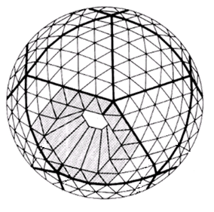
Γ(π⁰→γγ): experimental methods and measurements: production in e⁺e⁻ collisions
“Photoproduction” on virtual γ*γ* in e⁺e⁻ collisions
No need to separate coulomb and strong production
Photoproduction cross section needs to be extracted
Limited by the luminosity of crossing beams accuracy
Measurements:
  CBAL (1988) Γ(π⁰→ γγ ) = 7.75eV±6.4%

Slide 7
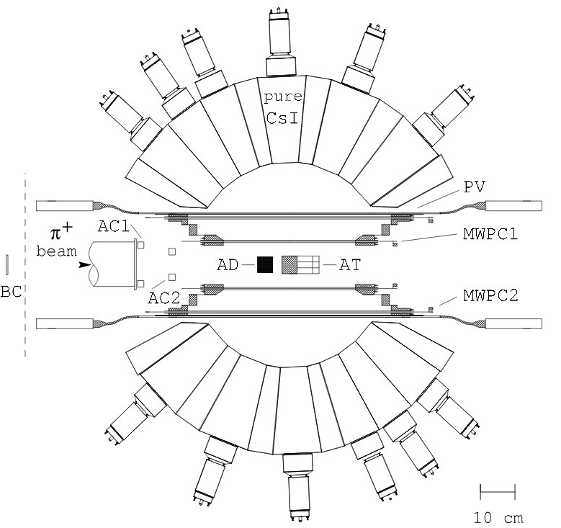
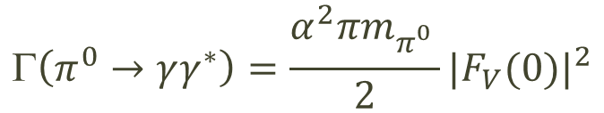
Γ(π⁰→γγ): experimental methods and measurements: π⁺ radiative decay measurement
Γ(π⁰→ γγ) can be calculated from π⁺→ eνγ radiative decay parameters
π⁺→ eνγ decay in rest analysis
Γ(π⁰→ γγ) extracted from vector form factor F_{V}(0):
Measurements:
  PIBETA (2009) Γ(π⁰→ γγ ) = 7.65eV±13%
$$\left(π^{0}→γγ^{∗}\right)=\frac{α^{2}πm_{π_{}^{0}}}{2}{|F_{V}(0)|}^{2}$$

Slide 8
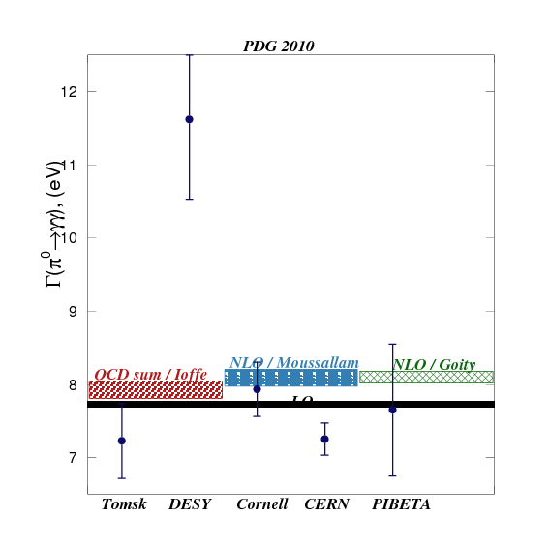
Γ(π⁰→γγ) status: theory calculations and previous measurements
Measurement | Method | Result [eV]
PIBETA, 2009 | π⁺ decay | 7.65 ± 1.0
CERN, 1984 | Direct | 7.25 ± 0.22
CBAL, 1988 | Collider | 7.75 ± 0.6
Cornell, 1974 | Primakoff | 7.92 ± 0.42
PDG average | SF=2.6 | 7.74 ± 0.43

Slide 9
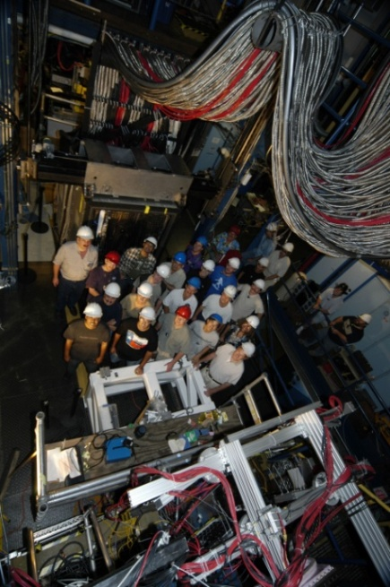
PrimEx Milestones
  1999: Proposal approved by PAC15
  2000: NSF awarded MRI $1M grant to develop experimental setup
  2002: Reapproved by PAC22 (E02-103) with A rating
  2004: PrimEx-I Installation, Commissioning and Data taking (22 days)
  2007: PrimEx-I Preliminary result released at APS meeting
  2007: PrimEx-II proposal approved by PAC33
  2009: PrimEx-I Final result reported
  2010: PrimEx-II Detector upgrade and Data taking (28 days)
  2011: PrimEx-I result published (PRL 2011, Vol 106, P. 162303)
  2018: PrimEx-II Final result approved by the PrimEx Collaboration

Slide 10
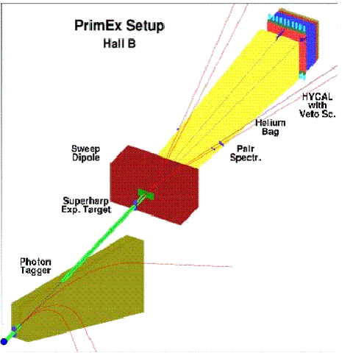
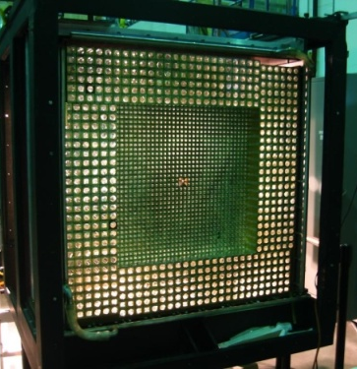
PrimEx Setup
Tagging facility:
  Precise photon beam flux control
  High resolution beam energy and time
Hybrid EM calorimeter:
  Excellent energy, spatial and time resolution
  Large geometrical acceptance
Pair spectrometer for additional flux monitoring
Ability to control apparatus systematics by QED processes

Slide 11
PrimEx upgrade for the 2nd run
  PrimEx-II used 8% r.l. Carbon and new 10% r.l. Silicon targets:
    PrimEx-II successfully collected twice more statistics on Carbon compare to PrimEx-I and about 5 times more statistics on Silicon compare to PrimEx-II Carbon
  Tagger energy range in the trigger have been increased by factor of ~1.5
  Central part of HyCal was upgraded with individual TDC modules:
    out of time clusters were rejected
  Upgraded DAQ electronics were used since the middle of PrimEx-II
    This main data subset was used in the analysis
  New island calorimeter reconstruction algorithm has been implemented, replacing old 5x5 algorithm
  HyCal closer to the target: 7.0m vs 7.3m (larger acceptance)

Slide 12
PrimEx I and II data chart
PrimEx-I
¹²C
²⁰⁸Pb
PrimEx run | Target | Thickness [% r.l.] | Beam flux [×10¹²] | Beam energy [GeV]
I | ¹²C | 5 | 1.4 | 4.9…5.5
I | ²⁰⁸Pb | 5 | 0.72 | 4.9…5.5
II | ¹²C | 8 | 2.0 | 4.4…5.3
II | ²⁸Si | 10 | 5.3 | 4.4…5.3
²⁸Si
PrimEx-II

Slide 13
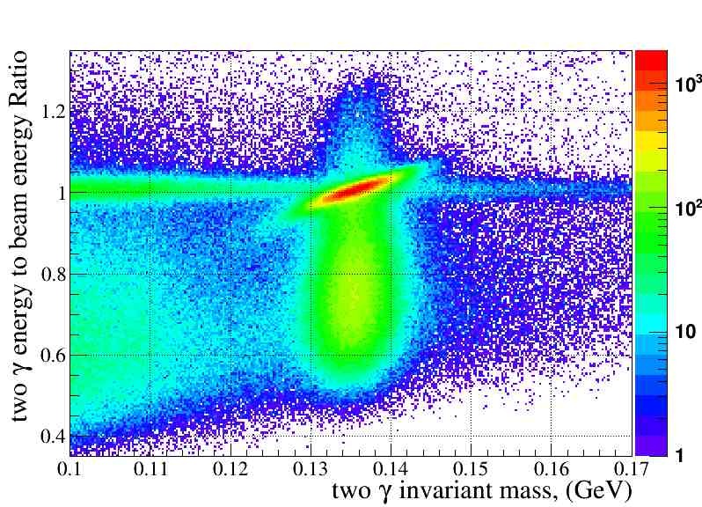

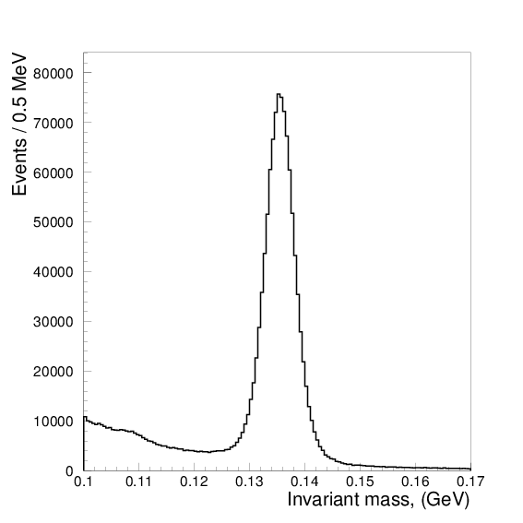
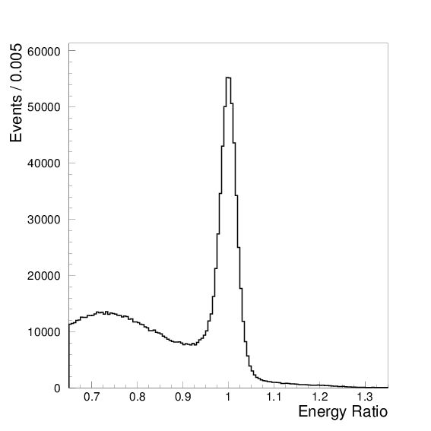
π⁰→γγ event selection
Invariant mass
Exclusive π⁰
photoproduction
Electromagnetic backgr
π
Elasticity

Slide 14
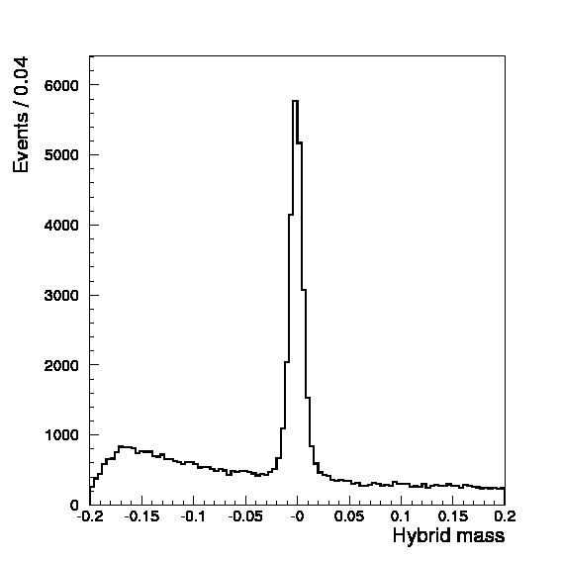
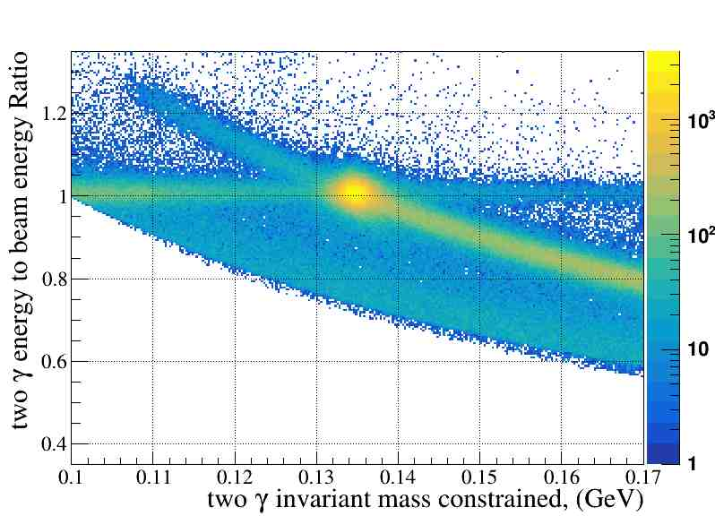
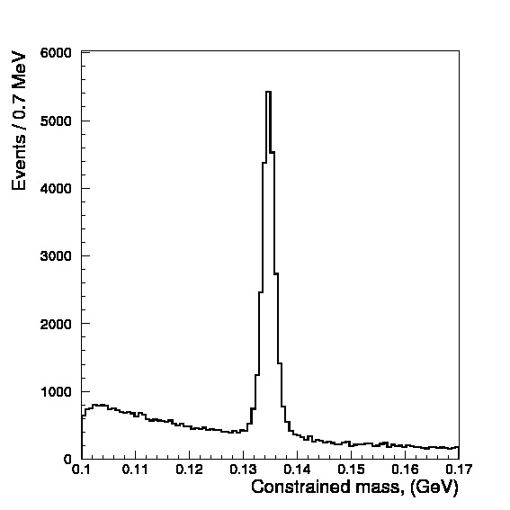
Elastic π⁰ yield extraction
Analysis H
  Hybrid mass analysis (H):
  analyze rotated axes projection
“Hybrid” mass
Analysis C
  Constraint mass analysis (C):
  correct calorimeter energies so they give the sum exactly equal to beam energy
Energy constraint mass

Slide 15
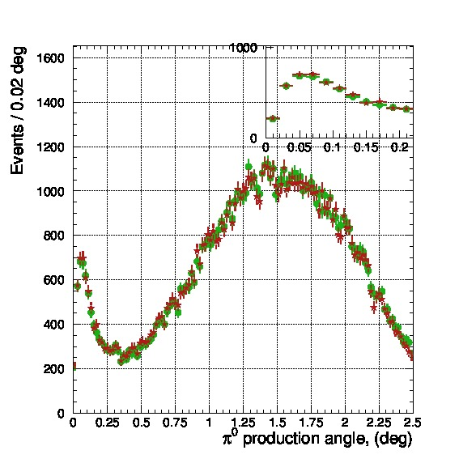
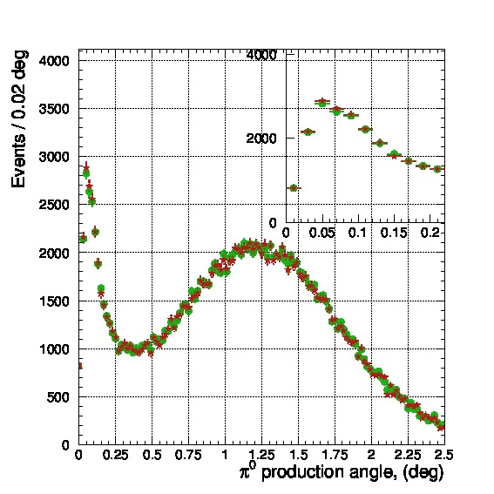
Comparison of PrimEx-II yield extraction methods
- Hybrid mass
- Constrained mass
¹²C
²⁸Si
Extracted π⁰ yield up to 2.5 deg.
method | ¹²C | ²⁸Si
Hybrid mass | 83,751 | 165,329
Constr. mass | 84.015 | 165,736

Slide 16
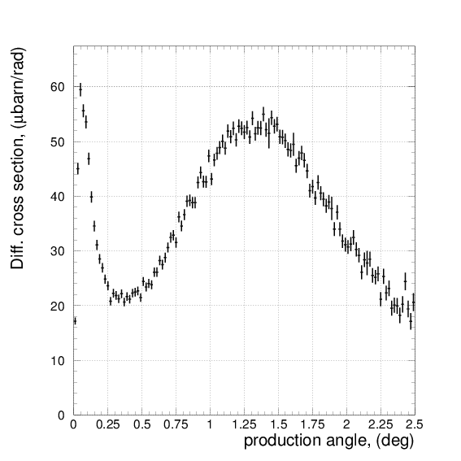
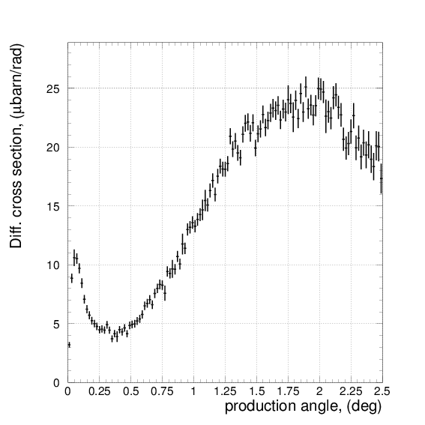
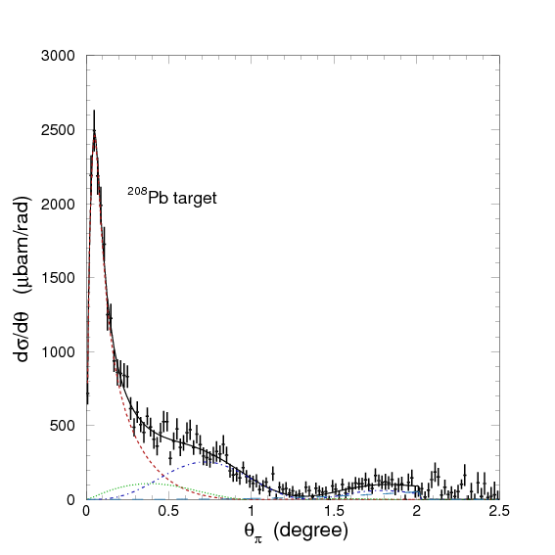
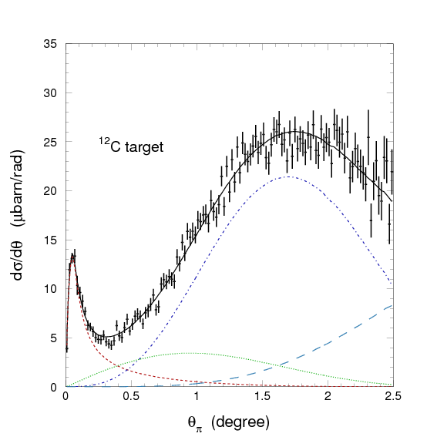
Differential cross section vs production angle
²⁸Si
¹²C
PrimEx-II: 4.45GeV…5.3GeV photon beam energy
²⁰⁸Pb
¹²C
PrimEx-I: 4.9GeV…5.5GeV photon beam energy

Slide 17
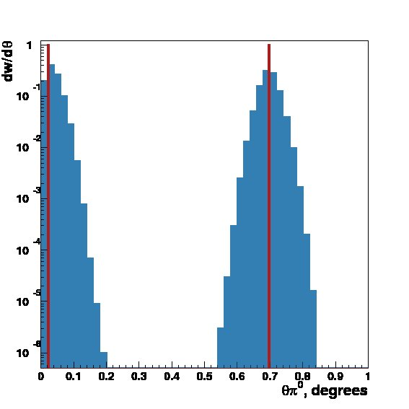
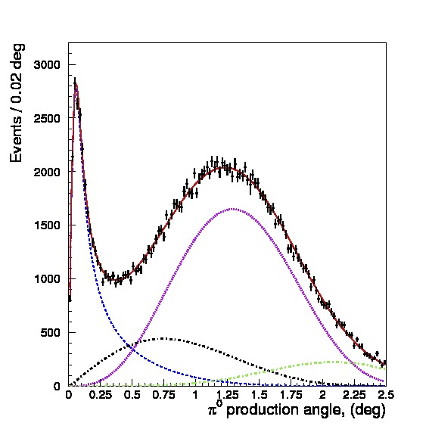
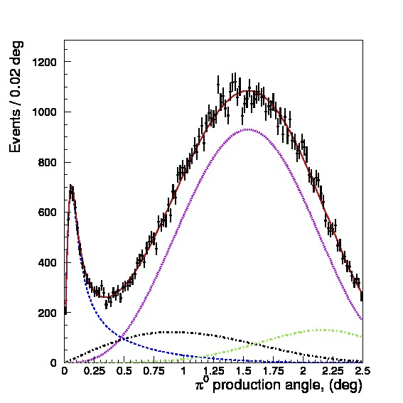
Fit to extract Γ(π⁰→γγ)
Theory functions have been folded with experimental resolution and setup acceptance to fit the data
²⁸Si
¹²C

Slide 18
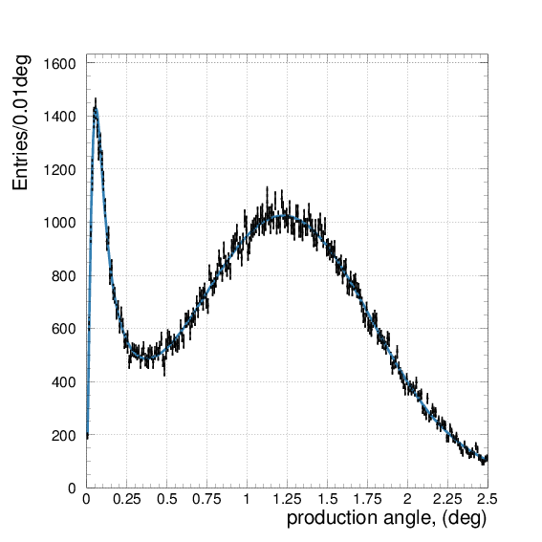
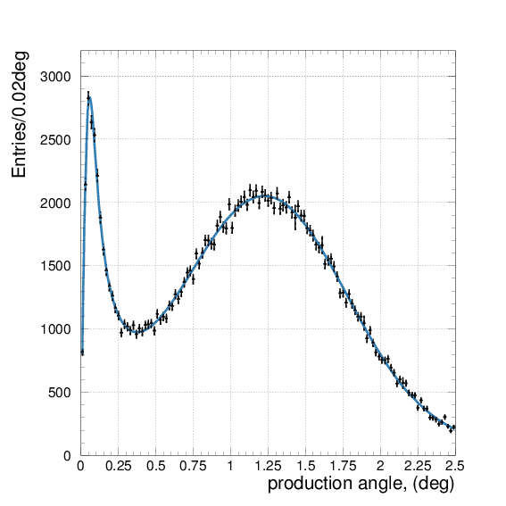
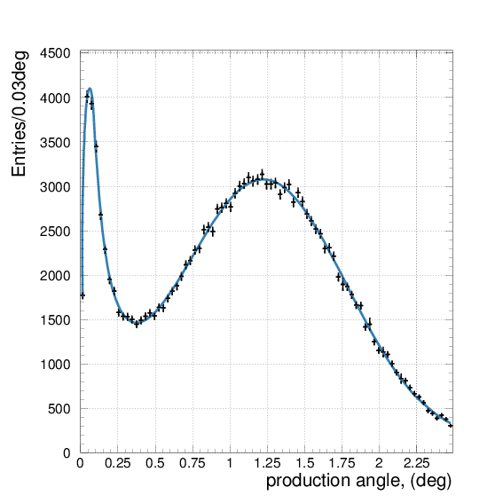
PrimEx-II π⁰ yield fit, Silicon target
0.01° binning
0.02° binning
0.03° binning
Γ = 7.769±0.066eV
χ2/Ndf = 0.956
Γ = 7.769±0.064eV
χ2/Ndf = 1.225
Γ = 7.776±0.064eV
χ2/Ndf = 1.052

Slide 19
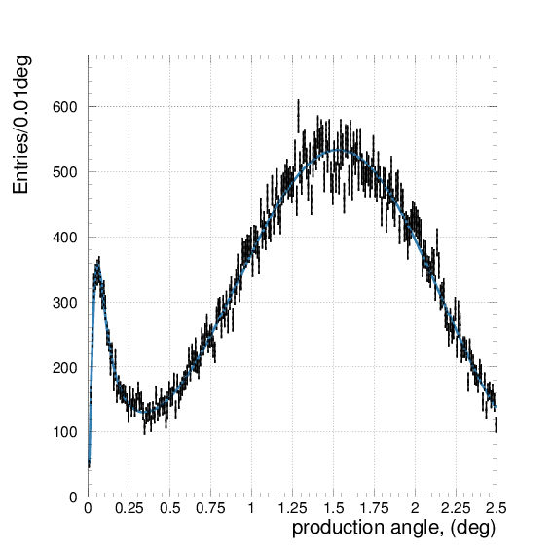
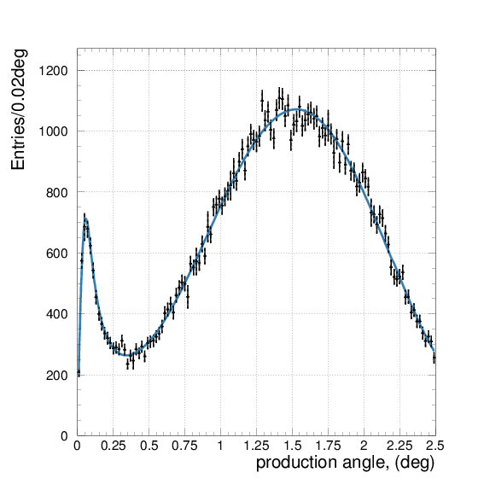
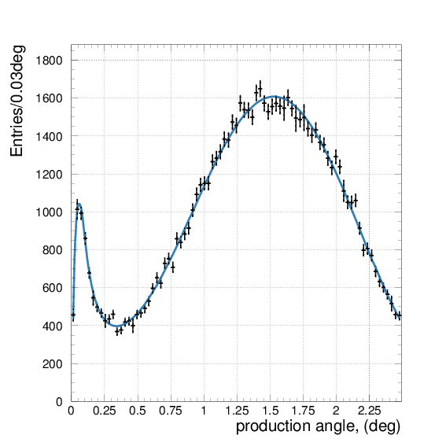
PrimEx-II π⁰ yield fit, Carbon target
0.01° binning
0.02° binning
0.03° binning
Γ = 7.708±0.129eV
χ2/Ndf = 1.073
Γ = 7.750±0.134eV
χ2/Ndf = 1.040
Γ = 7.752±0.146eV
χ2/Ndf = 1.052

Slide 20
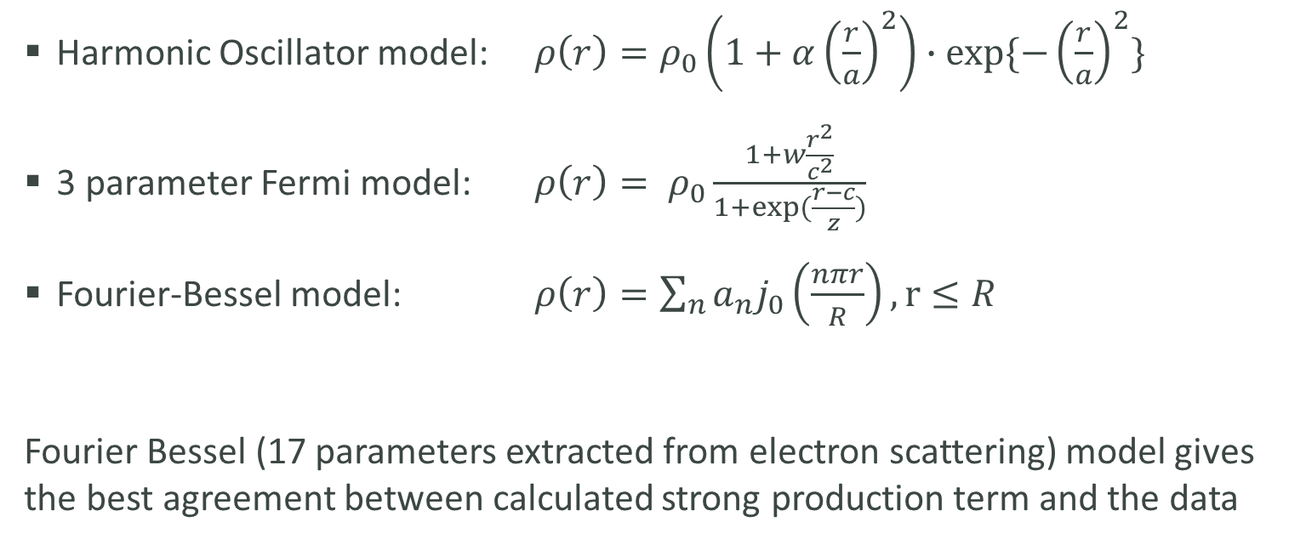
Nuclear density models used for Form Factors calculations
Harmonic Oscillator model: $ρ\left(r\right)=ρ_{0}\left(1+α{\left(\frac{r}{a}\right)}^{2}\right)∙exp⁡\{−{\left(\frac{r}{a}\right)}^{2}\}$
3 parameter Fermi model: $ρ\left(r\right)= ρ_{0}\frac{1+w\frac{r^{2}}{c^{2}}}{1+exp⁡(\frac{r−c}{z})}$
Fourier-Bessel model: $ρ\left(r\right)=\sum_{n}{a_{n}j_{0}\left(\frac{nπr}{R}\right)}, r≤R$
Fourier Bessel (17 parameters extracted from electron scattering) model gives the best agreement between calculated strong production term and the data

Slide 21
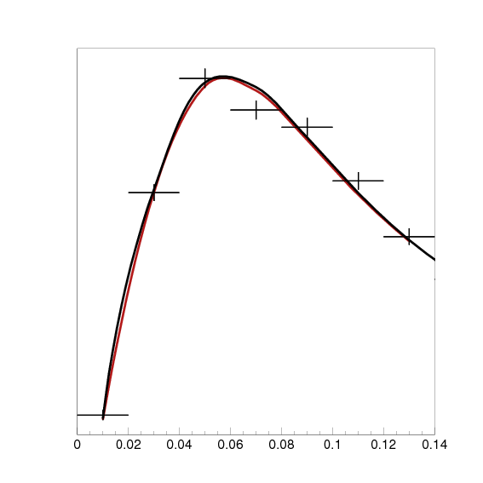
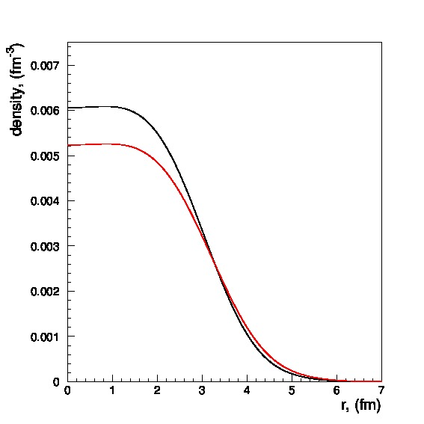
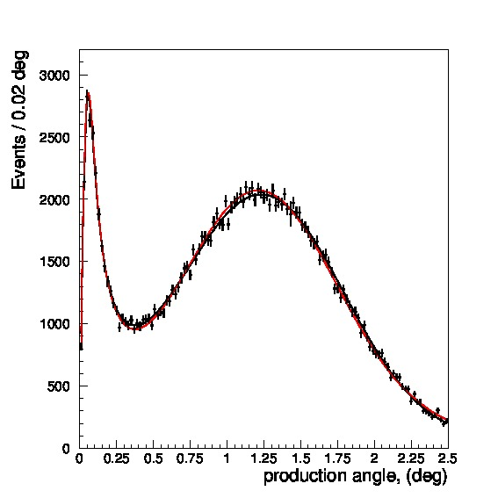
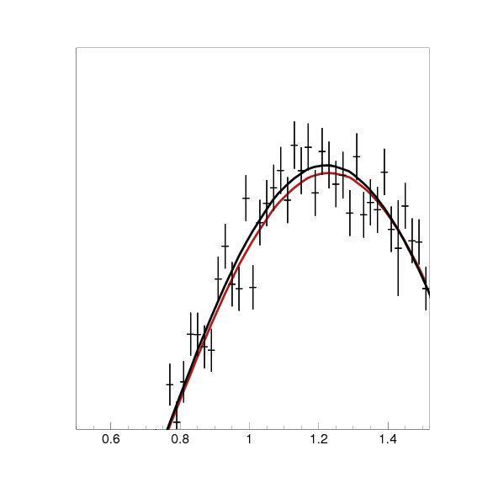
Model parameters: strong nucleus radius
nominal
inflated
nuclear density
π⁰ yield fit curves
Obtained cross section has few times less statistical uncertainty than PrimEx-I data and is sensitive to nucleus strong radius with (sub) percent level precision

Slide 22
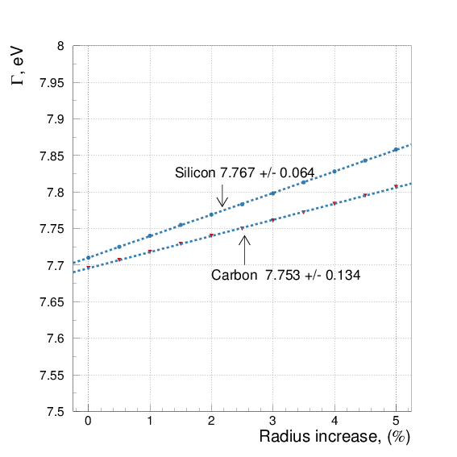
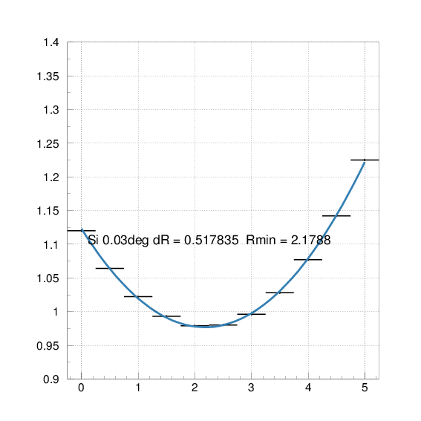
Γ(π⁰→γγ) value vs Strong radius increase
Radius increase, minimizing χ²:
Si ΔR = +2.2% ± 0.4% (stat.)
C ΔR = +2.5% ± 1.4% (stat.)
has been used in the final result, statistical uncertainty of this procedure is going directly to the theory systematics:
Si ΔΓ = +0.74% ± 0.14% (syst.)
C ΔΓ = +0.74% ± 0.39% (syst.)
Fit χ²/Ndof dependence vs strong radius inflation [%]

Slide 23
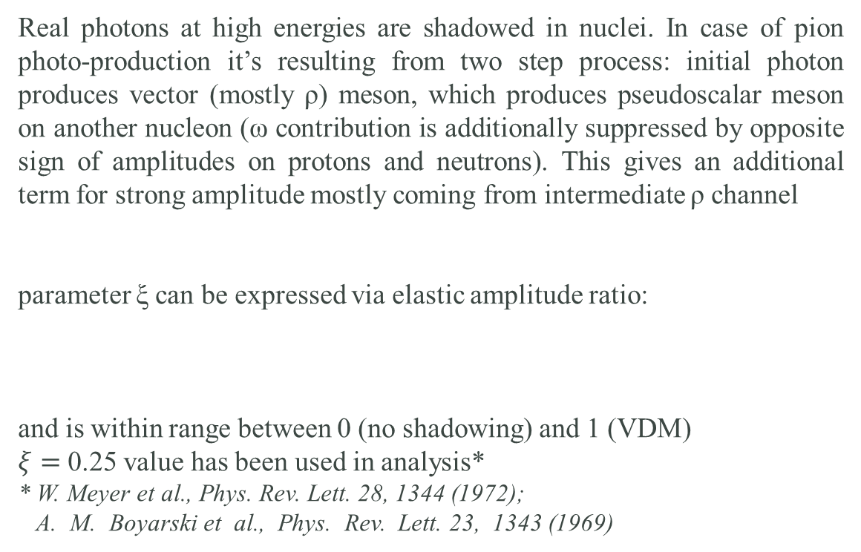



Model parameters: “Second step” contribution (“shadowing” effect)
Real photons at high energies are shadowed in nuclei. In case of pion photo-production it’s resulting from two step process: initial photon produces vector (mostly ρ) meson, which produces pseudoscalar meson on another nucleon (ω contribution is additionally suppressed by opposite sign of amplitudes on protons and neutrons). This gives an additional term for strong amplitude mostly coming from intermediate ρ channel
parameter ξ can be expressed via elastic amplitude ratio:
and is within range between 0 (no shadowing) and 1 (VDM)
$ξ=$ 0.25 value has been used in analysis*
* W. Meyer et al., Phys. Rev. Lett. 28, 1344 (1972);
A. M. Boyarski et al., Phys. Rev. Lett. 23, 1343 (1969)
π⁰
γ
$$T_{st}\left(q\right)=\left(\vec{h}∙\vec{q}\right) φ\left(0\right) (F_{st} − ξF_{I})$$
γ
π⁰
$$\vec{h}=\left[\vec{k}×\vec{ε}\right]/k$$
ρ, ω
+ ξ
P
ω, ρ
ω, ρ
$$ξ= \frac{f\left(γN→ρN\right)f(ρN→πN)}{f\left(ρN→ρN\right)f(γN→πN)}$$
A
A
A
A

Slide 24
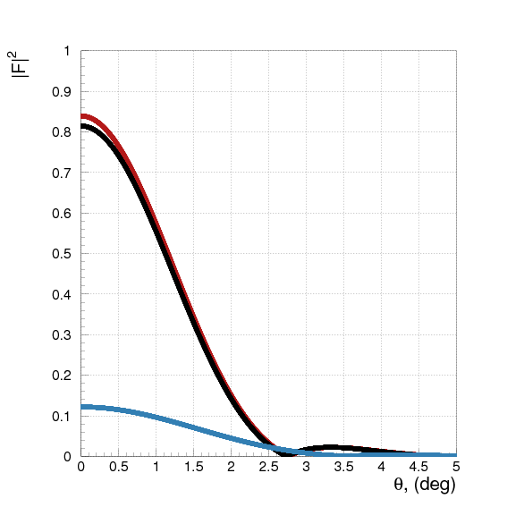
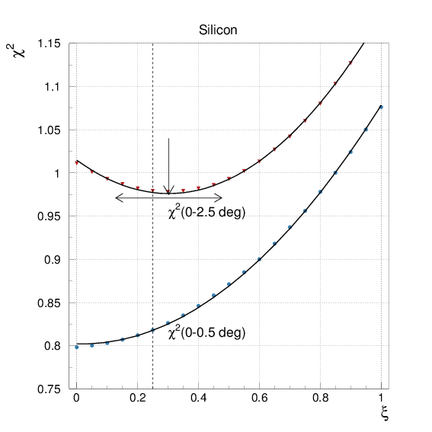



Fit χ² sensitivity to shadowing parameter
Strong FF and shadowing
Data fit χ2 vs shadowing parameter
Obtained PrimEx-II cross section has few times less statistical uncertainty than PrimEx-I data and show sensitivity to shadowing parameter value.
Used in the analysis value ξ=0.25* is in agreement with the value giving the best fit χ²: ξ=0.30±0.17
$${\left|F_{st}\right|}^{2}$$
$${\left|F_{I}\right|}^{2}$$
$${\left|F_{st}−ξF_{I}\right|}^{2}$$
* W. Meyer et al., Phys. Rev. Lett. 28, 1344 (1972);
A. M. Boyarski et al., Phys. Rev. Lett. 23, 1343 (1969)

Slide 25
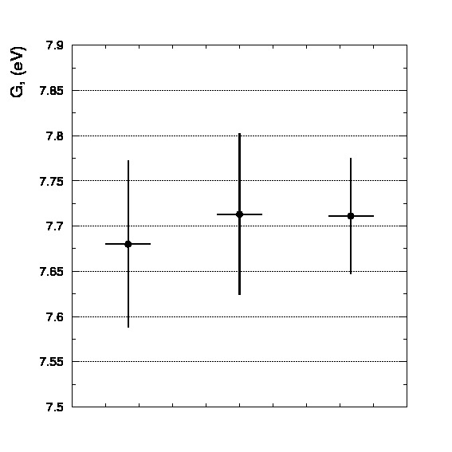
PrimEx systematic uncertainty control
  Measurement systematics:
  Well known QED processes have been measured periodically during run time (dedicated Compton runs)
  Photon beam flux control:
  Dedicated total absorption counter runs have been taken periodically
  Additional luminosity control with pair spectrometer
  Model uncertainty:
  Model parameters have been varied within their uncertainties to estimate introduced systematics level
  Yield extraction uncertainty:
  A set of Monte-Carlo data samples has been generated with predefined parameters (Γ(π⁰→γγ) , φ, coherent amplitude). Γ(π⁰→γγ) has been extracted and compared with predefined value: found no shift of average values and statistical spread
  Run time stability
  (PrimEx-II Silicon target):
Total
100nA beam current
90nA beam current

Slide 26
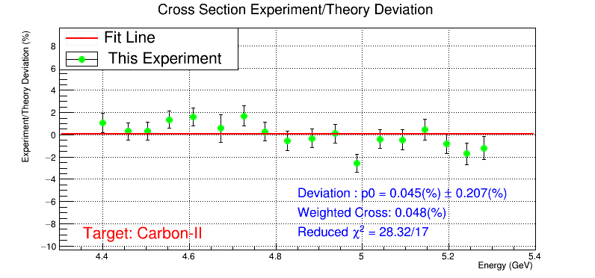
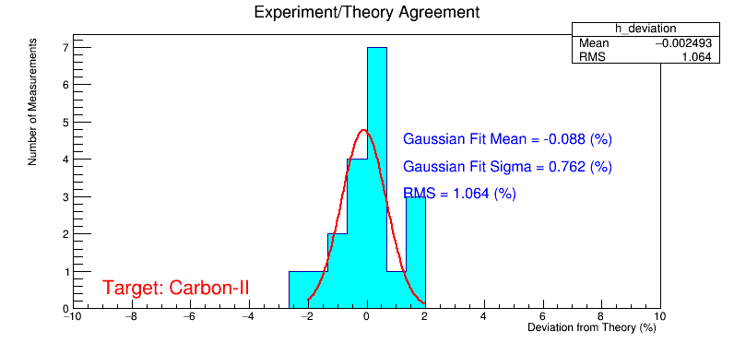
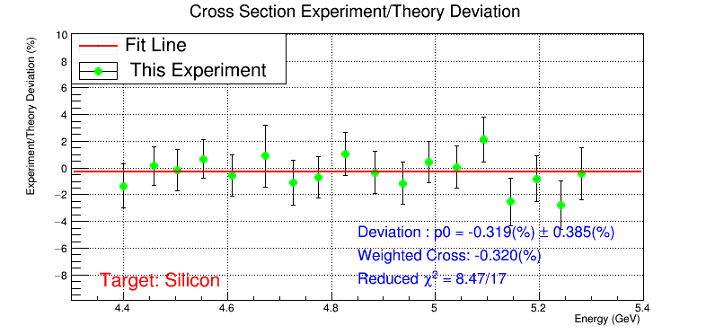
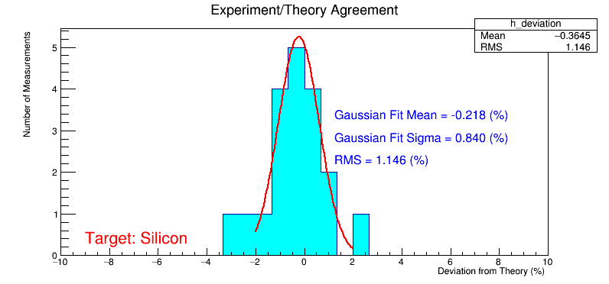

Verification with Compton cross section
  Compton cross section deviation from theory prediction
  Compton event
  vs photon beam energy Projected points
¹²C
Dipole
Magnet OFF
²⁸Si
  Reconstructed Compton vertex
  extracted cross sections are in agreement with theory prediction at the level of systematic uncertainty of 1.5%

Slide 27
PrimEx-II Γ(π⁰→γγ) systematic breakdown for ²⁸Si
πN cross section 0.1%
Shadowing effect amplitude 0.31%
Nuclear coherent parameterization 0.08%
Incoherent model 0.08%
Non-zero spin admixture ≤0.1%
Nuclear strong vs EM radius 0.20%
Total 0.40%
Energy 0.14%
Position 0.05%
Slope 0.09%
Width 0.12%
Total 0.24%
beam
Absolute tagging ratio 0.37%
Electron counting 0.55%
Beam collimation 0.18%
Relative tagging ratio 0.4%
Total 0.80%
Background shape 0.4%
Fitting range 0.4%
Empty target subtraction 0.2%
Fit parameter uncertainty 0.5%
Signal accounting 0.55%
Omega/rho background subtraction 0.09%
Bin migration at zero angle 0.2%
dN/dθ binning 0.01°, 0.02°, 0.03° 0.12%
Extraction from MC test 0.2%
Total 0.93%
Theory
Photon Beam Flux
π⁰ yield extraction
Density 0.35%
Thickness 0.03%
Purity <0.01%
Total 0.35%
Trigger efficiency <0.1%
ADC errors <0.1%
Dead channels <0.1%
Total 0.1%
target
Monte
Carlo
Target absorption 0.24%
Pi0 angular resolution 0.17%
Pi0 two gamma decay branching 0.034%
Calorimeter geometry 0.05%
Calorimeter energy response 0.45%
Limited statistics 0.02%
Total 0.54%
DAQ
Gamma energy cut 0.1%
Pion energy cut <0.1%
Time window 0.05%
Wrong beam candidate 0.10%
Total 0.18%
Event selection

Slide 28
Combined result uncertainty
Systematic uncertainty items:
Analysis | Nucleus | Γ(π→γγ) result | Target atoms | Theory parameters | Yield | Other terms | Syst. | Stat. | Total
Hybrid mass | Si | 7.83eV | 0.4% | 0.4% | 0.9% | 1.0% | 1.4% | 0.8% | 1.6%
Analysis (H) | C | 7.78eV | 0.1% | 0.6% | 1.1% | 1.0% | 1.6% | 1.5% | 2.2%
 | Si & C | 7.82eV | 0.3% | 0.4% | 0.9% | 1.0% | 1.4% | 0.7% | 1.6%
Constrained | Si | 7.77eV | 0.4% | 0.4% | 1.0% | 1.0% | 1.5% | 0.8% | 1.7%
Analysis (C) | C | 7.75eV | 0.1% | 0.5% | 1.1% | 1.1% | 1.6% | 1.7% | 2.4%
 | Si & C | 7.76eV | 0.3% | 0.3% | 1.0% | 1.1% | 1.5% | 0.8% | 1.7%
(H) & (C) | Si | 7.80eV | 0.4% | 0.4% | 0.9% | 1.0% | 1.5% | 0.8% | 1.7%
combined | C | 7.77eV | 0.1% | 0.5% | 1.1% | 1.1% | 1.6% | 1.6% | 2.3%
 | Si & C | 7.79eV | 0.3% | 0.3% | 1.0% | 1.0% | 1.5% | 0.7% | 1.6%
The different target data have been combined assuming systematics (except related to the target and nucleus density) are correlated. Two analyses have been combined with the equal weights and assuming correlated systematics.

Slide 29
PrimEx I and II Γ(π⁰→γγ) uncertainty
Item | PrimEx-I | PrimEx-II
Beam parameters | 0.4% | 0.2%
Photon flux | 1.0% | 0.8%
Target | 0.1% | 0.3%
DAQ | 0.1% | 0.1%
Event selection | 0.5% | 0.2%
Monte-Carlo simulation | 0.6% | 0.6%
Yield extraction | 1.6% | 1.0%
Photoproduction theory parameters | 0.3% | 0.4%
Systematics | 2.1% | 1.5%
Statistical | 1.8% | 0.7%
Total | 2.8% | 1.6%
Better beam quality
Main target density known
with less precision
Statistically driven systematics
(improved statistics)
High statistics data suggests
a small adjustment
for strong nucleus radius

Slide 30

PrimEx I vs PrimEx II result
Run | Target | Γ(π⁰→γγ), eV
PrimEx-I | ¹²C | 7.79±0.24
PrimEx-I | ²⁰⁸Pb | 7.85±0.28
PrimEx-II | ²⁸Si | 7.80±0.13
PrimEx-II | ¹²C | 7.77±0.18

Slide 31



PrimEx-I result changed PDG landscape on Γ(π⁰→γγ) part
  PDG 2010
  before PrimEx-I
  (Sf = 2.6)
  PDG 2012
  with PrimEx-I
  (Sf = 1.2)
  PrimEx-II

Slide 32
Summary
  Two PrimEx experiments have been successfully carried out
  PrimEx-II reduced measurement error down to 1.6%,
  which is the most precise measurement to the date
  Compton cross section measurement verifies PrimEx systematical
  uncertainty for the cross section on the 1.5% level
  Result has been recently approved by the PrimEx-II Collaboration
  PrimEx-I physics result:
  Γ(π⁰→γγ) = 7.82eV ± 0.14eV (1.8%) stat. ± 0.17eV(2.1%) syst.;
  ± 0.22eV(2.8%) total
  PrimEx-II physics result:
  Γ(π⁰→γγ) = 7.79eV ± 0.06eV (0.7%) stat. ± 0.12eV(1.5%) syst.;
  ± 0.13eV(1.6%) total

Slide 33
PrimEx members and institutions
PrimEx-II
Z.Ahmed, P.Ambrozewicz, V.Baturin, V. Burkert, E.Clinton, P.Collins, D.Dale, S.Danagoulian, A.Deur,
A.Dolgolenko, G.Fedotov, J.Feng, L.Gan, H.Gao, A.Gasparian, N.Gevorgyan, S.Gevorgyan, O.Glamazdin, L.Guo, C.Harris,
E.Isupov, M.Ito, H.Kang, M.Khandaker, F.Klein, O.Kosinov, S.Kowalski, M.Kubantsev, A.Kubarovsky, V.Kubarovsky,
I.Larin, D.Lawrence, M.Levillain, H.Lu, L.Ma, V.Matveev, A.Micherdzinska, R.Miskimen, B.Morrison, I.Nakagawa,
K.Park, E.Pasyuk, W.Phelps, R.Pedroni, D.Protopopescu, D.Rimal, C.Salgado, A.Sitnikov, D.Sober, S.Stepanyan,
V.Tarasov, S.Taylor, D.Weygand, M.Wood, L.Ye, Y.Zhang, B.Zihlmann
PrimEx-I
A.Ahmidouch, P.Ambrozewicz, A.Asratyan, K.Baker, L.Benton, A.M.Bernstein, V.Burkert, E.Clinton, P.Cole, P.Collins,
D.Dale, S.Danagoulian, G.Davidenko, R.Demirchyan, A.Deur, A.Dolgolenko, G.Dzyubenko, R.Ent, A.Evdokimov, J.Feng,
M.Gabrielyan, L.Gan, A.Gasparian, S.Gevorkyan, A.Glamazdin, V.Goryachev, V.Gyurjyan, K.Hardy, J.He, M.Ito, L.Jiang,
D.Kashy, M.Khandaker, P.Kingsberry, A.Kolarkar, M.Konchatnyi, A.Korchin, W.Korsch, S.Kowalski, M.Kubantsev,
V.Kubarovsky, I.Larin, D.Lawrence, X.Li, P.Martel, V.Matveev, D.McNulty, B.Mecking, B.Milbrath, R.Minehart,
R.Miskimen, V.Mochalov, S.Mtingwa, I.Nakagawa, S.Overby, E.Pasyuk, M.Payen, R.Pedroni, Y.Prok, B.Ritchie,
T.E.Rodrigues, C.Salgado, A.Shahinyan, A.Sitnikov, D.Sober, S.Stepanyan, W.Stephens, A.Teymurazyan, J.Underwood,
A.Vasiliev, V.Verebryusov, V.Vishnyakov, M.Wood, S.Zhou
Arizona State University, Tempe, AZ, Catholic University of America, Washington, DC, Chinese Institute of Atomic Energy, Beijing, China, Eastern Kentucky University, Richmond, KY, George Washington University, Washington, DC, Hampton University, Hampton, VA, Institute for High Energy Physics, Chinese Academy of Sciences, Beijing, China, Institute for High Energy Physics, Protvino, Moscow region, Russia, Institute for Theoretical and Experimental Physics, Moscow, Russia, Kharkov Institute of Physics and Technology, Kharkov, Ukraine, Massachusetts Institute of Technology, Cambridge, MA, Moscow Engineering Physics Institute, Moscow, Russia, Norfolk State University, Norfolk, VA, North Carolina A&T State University, Greensboro, NC, North Carolina Central University, Durham, NC, Thomas Jefferson National Accelerator Facility, Newport News, VA, Tomsk Polytechnic University, Tomsk, Russia, Idaho State University, Pocatello, ID, University of Illinois, Urbana, IL, University of Kentucky, Lexington, KY, University of Massachusetts, Amherst, MA, University of North Carolina at Wilmington, Wilmington, NC, University of Virginia, Charlottesville, VA, Yerevan Physics Institute, Yerevan, Armenia

