Slide 1
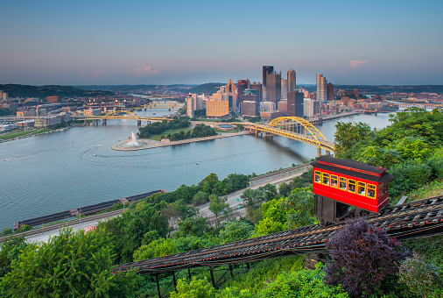
Duquesne Group Interest in CLAS12
Fatiha Benmokhtar
***Pittsburgh, Pennsylvania.
- DNP 2017
- MENU 2019
- EIC-UG 2020

Slide 2
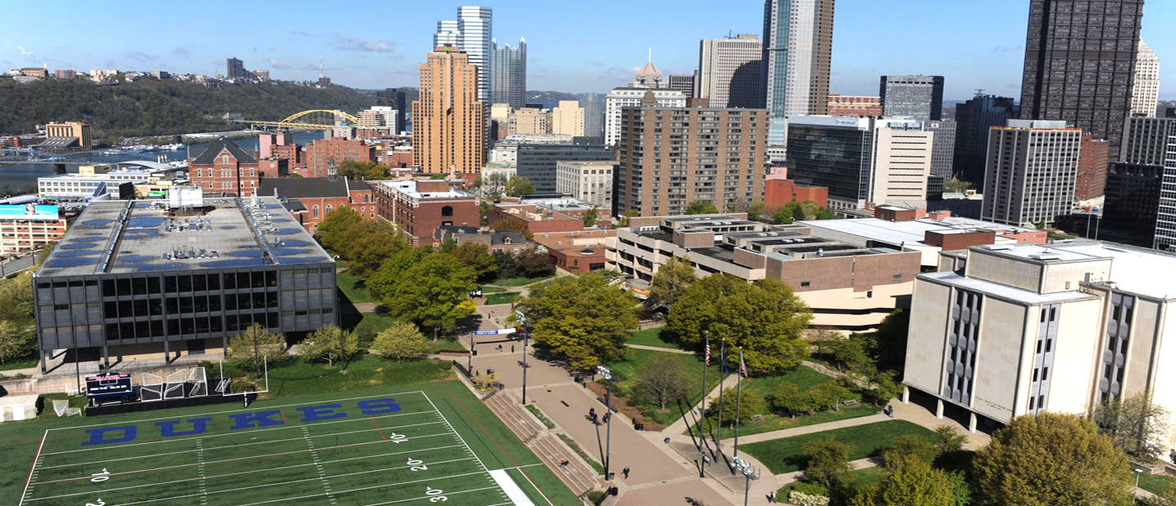
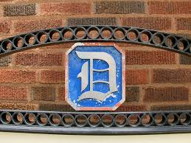
Duquesne University
https://www.duq.edu/
Physics department:
- 4 Tenure/tenure-track Faculty: Cosmology, Condensed Matter, Atomic Physics and Experimental Nuclear Physics.
Undergraduate department.
Teaching load: 1 Course per semester.
Research and Student Mentoring are Important
Physics or Physics/Engineering Duq/Pitt.

Slide 3
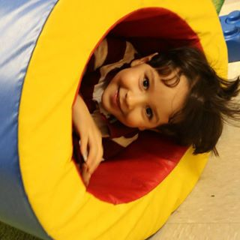
Fatiha Benmokhtar
Assistant Professor
JLab since T20 ( Masters degree 1997-1999, Algiers/Grenoble )
2004- PhD from Hall A (Rutgers Dec. 2004). 3He(e,e’p)X
2005-2008: Postdoc UMD, DAQ expert and analysis coordinator of G0 Backward experiment.
2008-2010 Research Associate CMU: Hall B proposal and G0 analysis + publications.
2010-2012: Assistant Professor CNU. 4He in Hall A + RICH Hall-B.
2012-2014: Visiting Professor: Duquesne University, 4He, RICH Hall-B
2014- Now: Assistant Professor, Kaon SIDIS, RICH Hall B, 4He. Partial support from JLab for first 3 years.
2012-Now: - Supported by NSF grant.
- Support from Dean Reeder @ Duquesne.
- SULI.
Future Physicist…?

Slide 4
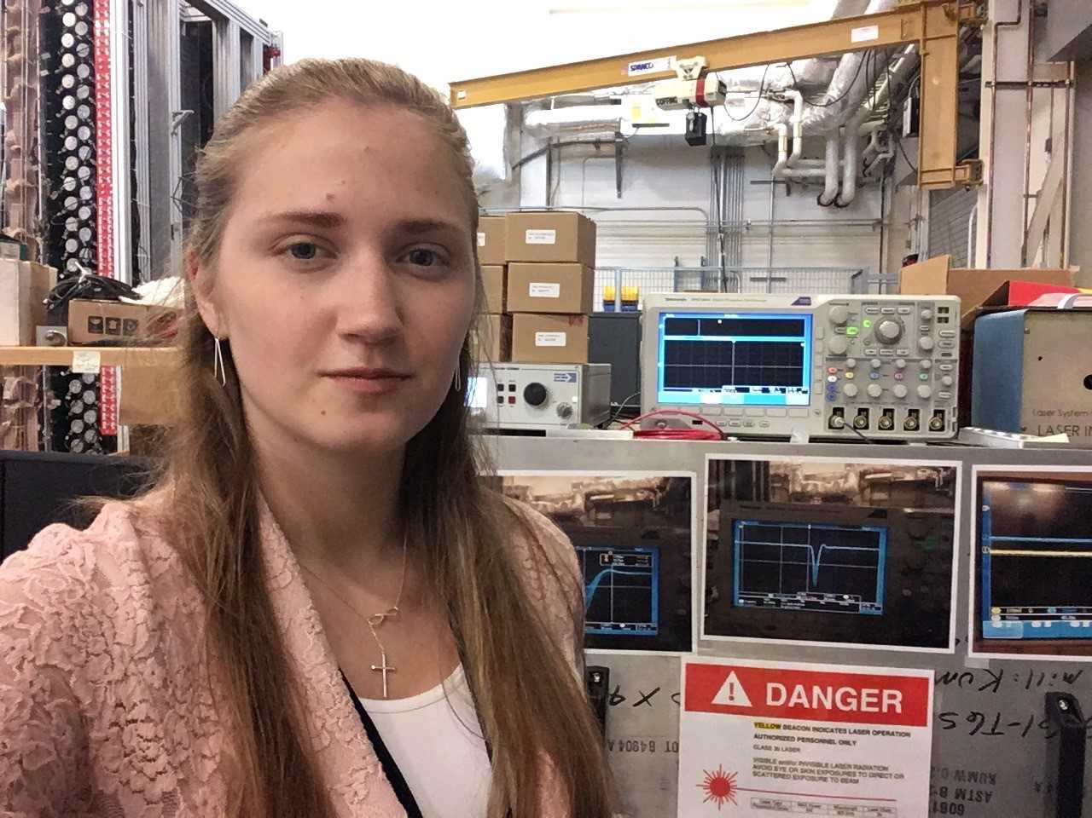
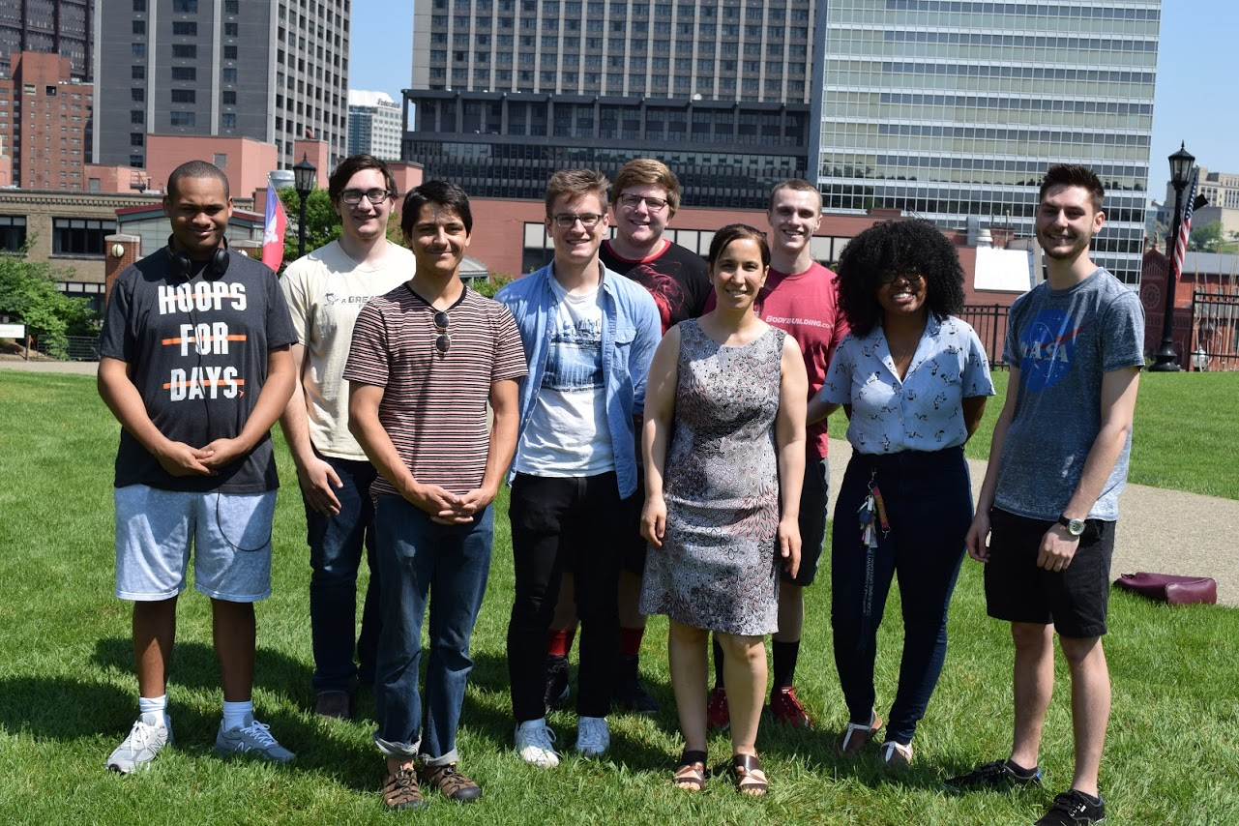
Body Guards!
(just this summer)

Slide 5
Why Interest in CLAS12?

Slide 6
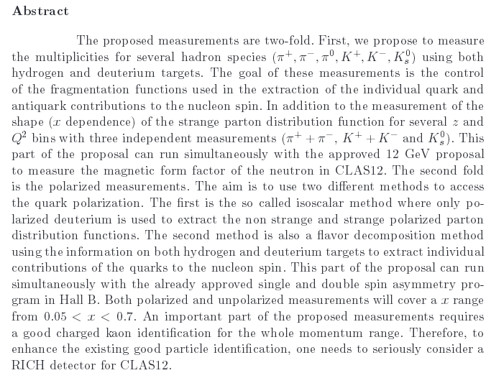
E12‐09‐007 CLAS12 – Jefferson Lab
(H. Avakian, F. Benmokhtar, A. EL Alaoui, K. Hafidi & M. Mirazita)
Studies of Parton Distributions Using Semi-Inclusive Production of Kaons

Slide 7
E12‐09‐007 CLAS12 – Jefferson Lab
(H. Avakian, F. Benmokhtar, A. EL Alaoui, K. Hafidi & M. Mirazita)
Flavor decomposition
Unpolarized Measurements
Polarized Measurements
Proton
Deuteron
Deuteron
Proton
Measure Multiplicities
(π⁺, π⁻, π⁰, K⁺, K⁻, K_{s}⁰)
Measure Multiplicities
(π⁺ + π⁻, K⁺ + K⁻, K_{s}⁰)
Measure Asymmetries
(e⁻, π⁺ + π⁻, K⁺ + K⁻, K_{s}⁰)
Measure Asymmetries
(e⁻, π⁺, π⁻, π⁰, K⁺, K⁻, K_{s}⁰)
Isoscalar Method
Extract shape of
Extract
*Extraction of Δu − Δd to test whether or not the light sea is symmetrically polarized
Flavor Decomposition
Extract

Slide 8
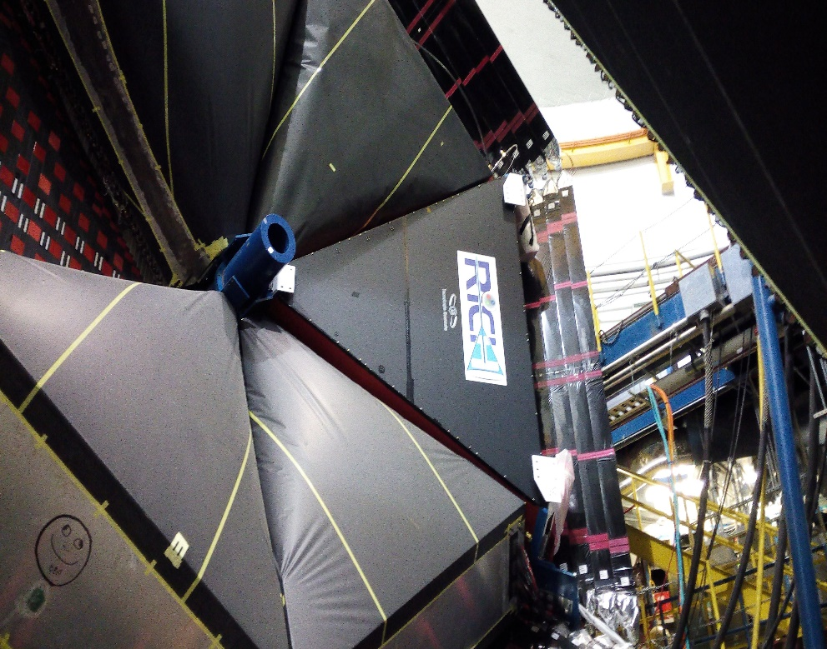
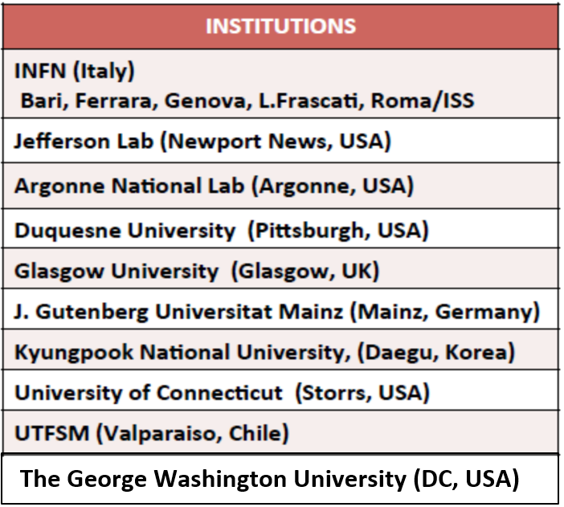
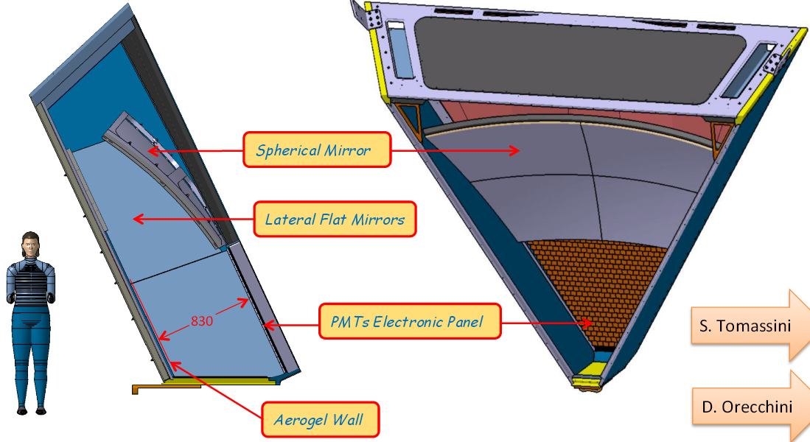
RICH for CLAS12
Replace one LTTC with a Ring Imaging CHerenkov
GeV/c | 1 | 2 | 3 | 4 | 5 | 6 | 7 | 8 | 9 | 10
π/K
π/p
K/p
e/π
TOF
LTCC
RICH
HTCC
TOF
RICH
LTCC
LTCC
HTCC
HTCC
TOF
LTCC
LTCC
RICH
HTCC
EC/PCAL

Slide 9
What did we do so far? And what are we doing now?
Participation in RICH Prototype tests: 2012-2014. A. Witchger.
MA-MPT Characterization: 2016-2018: A. Lendacky, M. Benninghoff & E. Aaron.
Full Slow Control Monitoring: 2017-2018: Justin Goodwill.
Online Monitoring system for RICH- 2017: Justin Goodwill.
RICH in Test DB, and now in CCDB. A. Lendacky & C. McCauley.
(some extra work: add functionality to CCDB, work on java API,.)
RICH Geometry development ( Gemc and Java ): R.Trotta, J. Goodwill & N. Trotta
Analysis of Calibration data taken this spring (Scalers): C. Pecar and Josh Goodwill
Analyze Kaon 6 GeV data from eg2-c, HIPOs created, R. Behary,

Slide 10
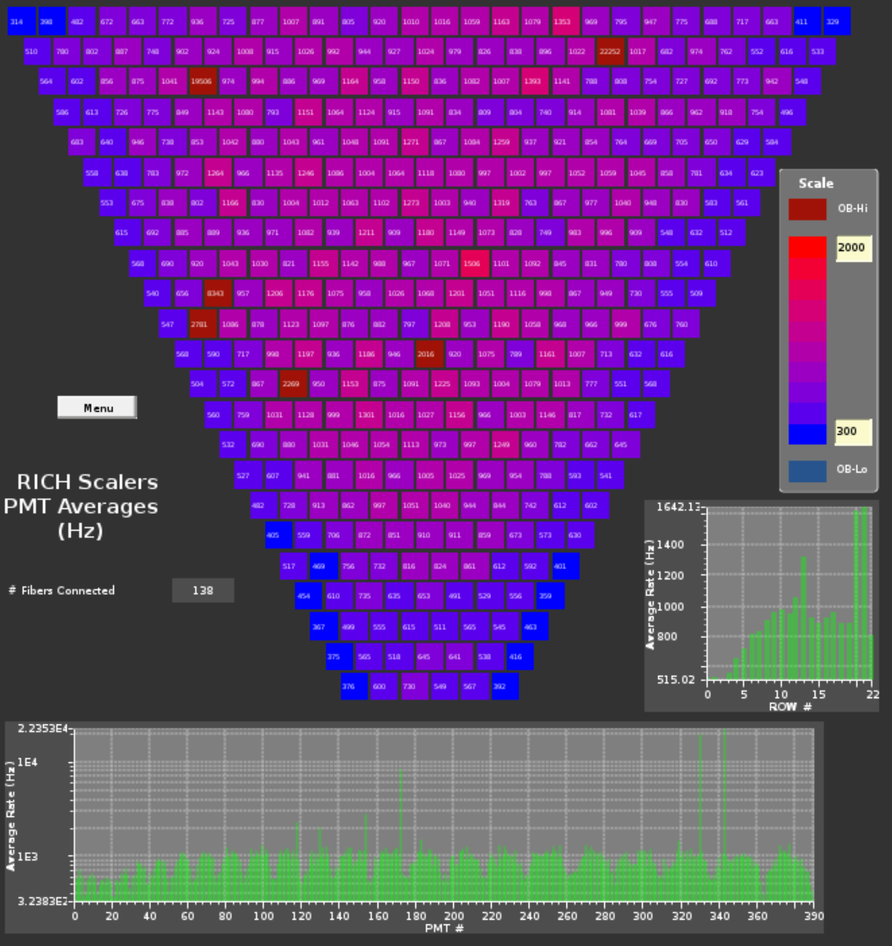
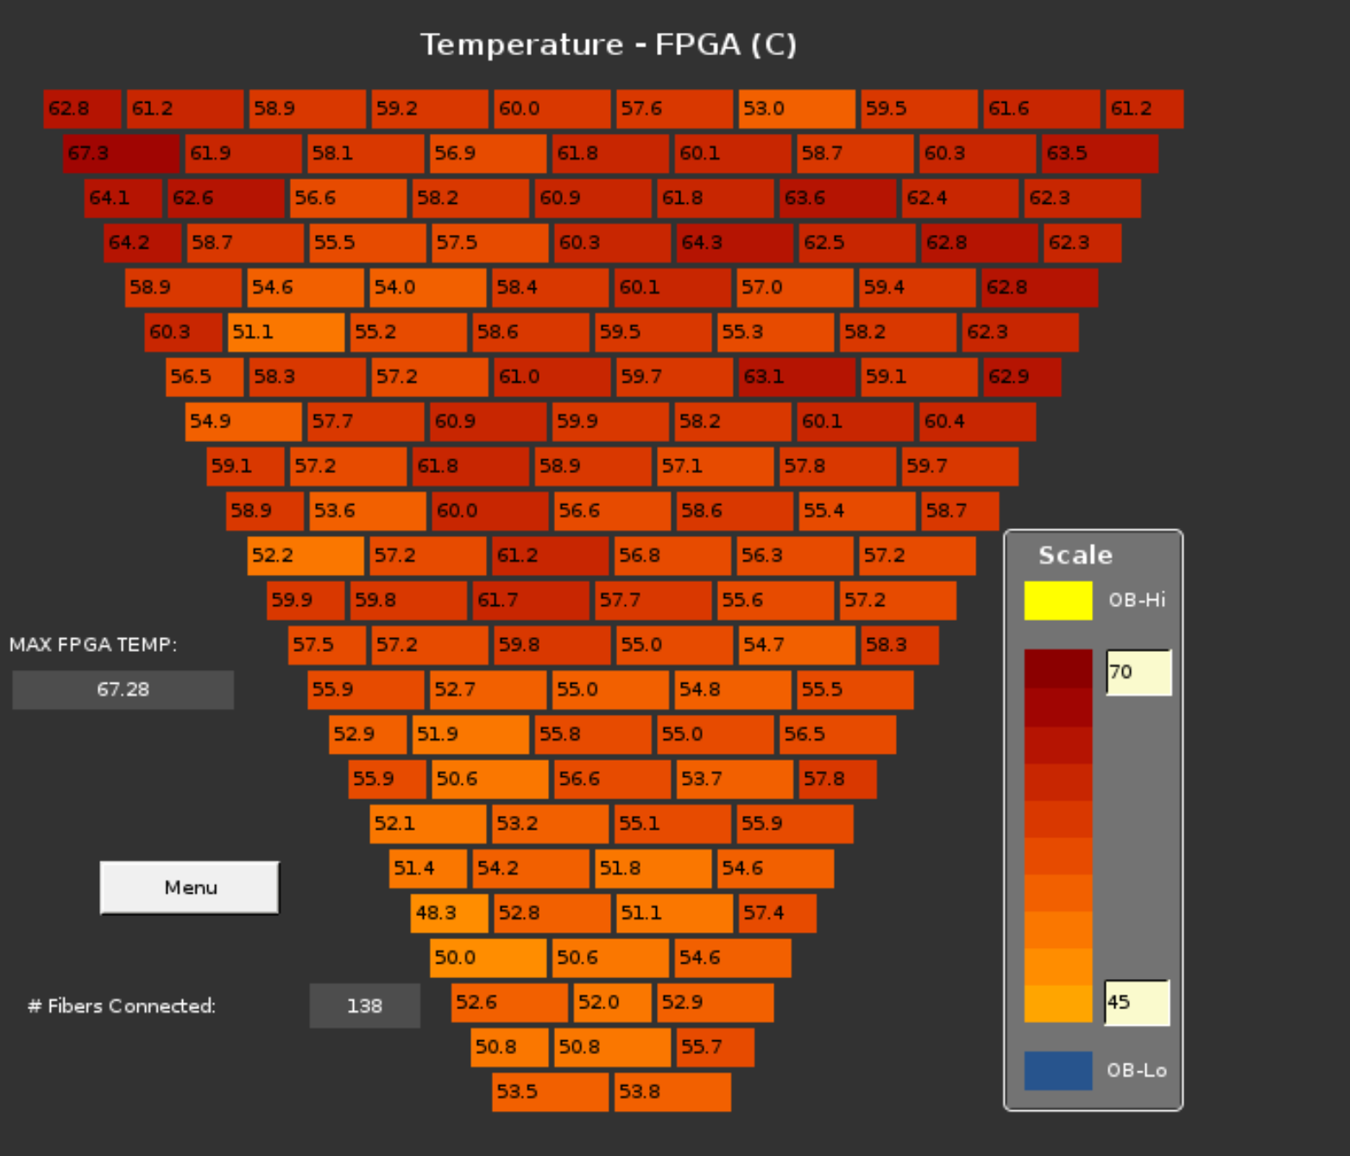
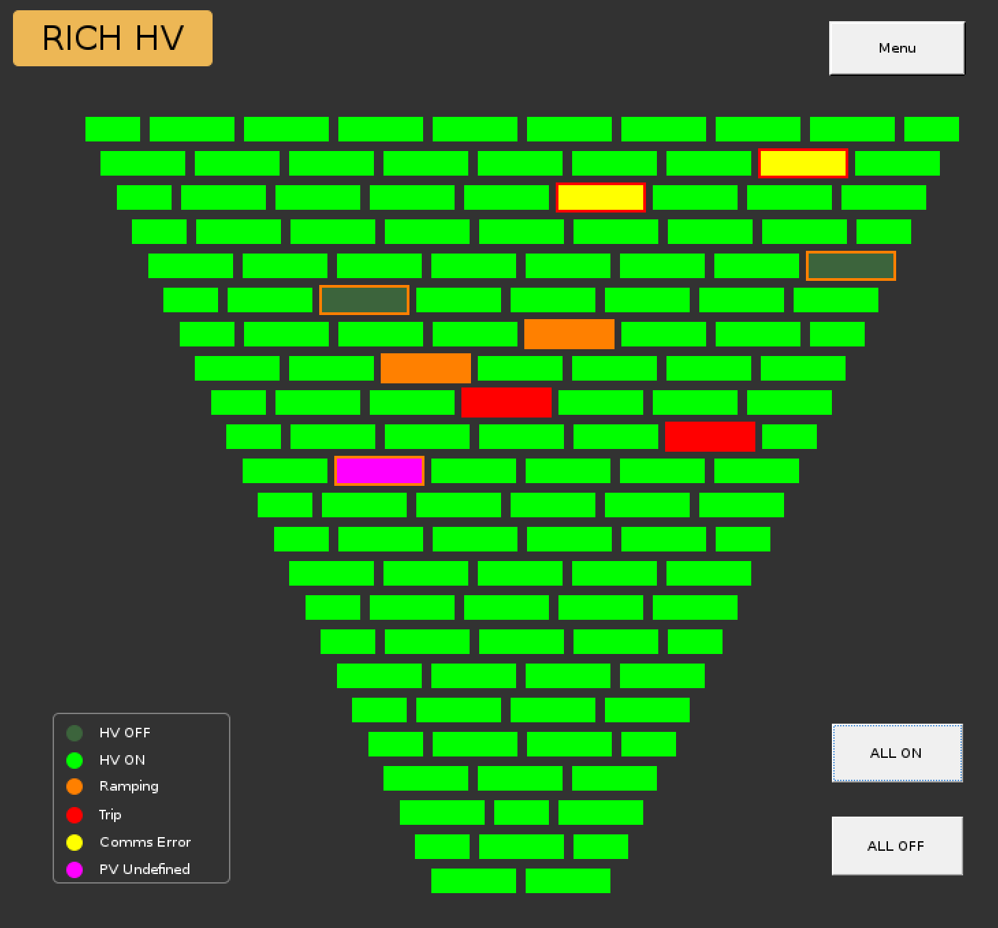
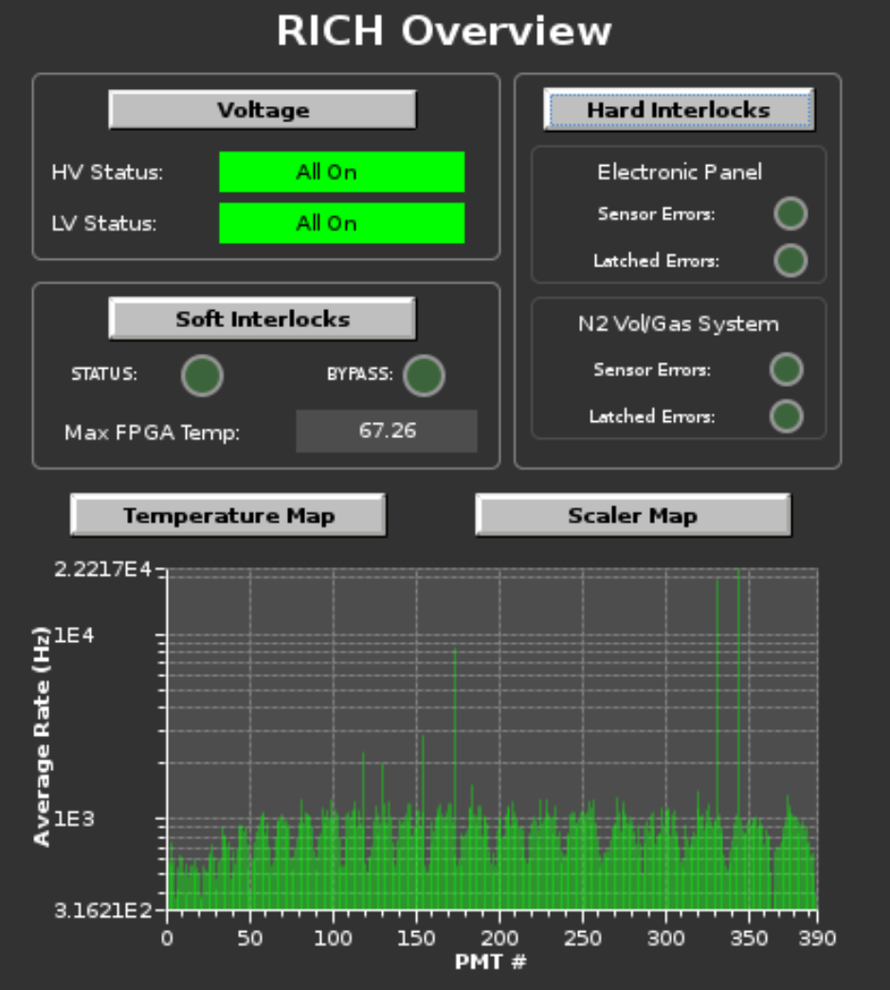
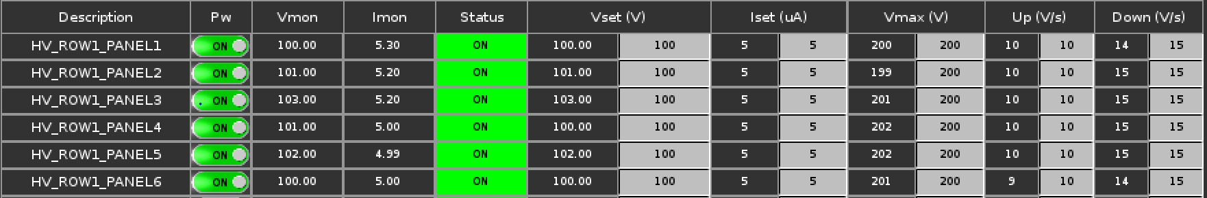
Example: Slow Control (Justin Goodwill)

Slide 11
Near Future Plans:
Continue the Analysis of Calibration data: Connor Pecar & Joshua Goodwill
Continue RICH CCDB management: Collin McCauley
Finish RICH Geometry development for reconstruction (Gemc and Java ):
N.Trotta & W. Smoot: Aerogel Partition.
Analysis of future RICH data : Connor Pecar and Joshua Goodwill
Write programs for Fragmentation functions from the Pi0 data,
(translate to Kaons in the future). Collin McCauley

Slide 12
Future Plans:
- A second RICH is under Construction. Will be done in 2020. Duquesne will continue active participation in the project.
Write programs for Parton Distributions analysis.
With Polarized targets, after 2020, active participation in the data collection and data analysis towards the extraction of the flavors.
Interest in Deep Processes in general.

Slide 13
Conclusion:
- With past and current contributions of the Duquesne group to CLAS12, and with our future plans, we wish to officially join CLAS12 as a full member Institution.
Thank you!

Slide 14
Backup

Slide 15
RICH Publications with Duquesne
- More publications coming…
- N.I.M. 2017 “The large-area hybrid-optics RICH detector for the CLAS12 spectrometer”, DOI:
10.1016/j.nima.2017.01.020
Eur.Phys.J. A 52, 23 (2016)
“Test of the CLAS12 RICH large-scale prototype in the direct proximity focusing configuration”
N.I.M 2014 v. 766; p. 22-27 “The large-area hybrid-optics CLAS12 RICH detector: Tests of innovative components”
N.I.M. 2015 “Investigation of Hamamatsu H8500 phototubes as single photon detectors” DOI: 10.1016/j.nima.2015.03.068

Slide 16
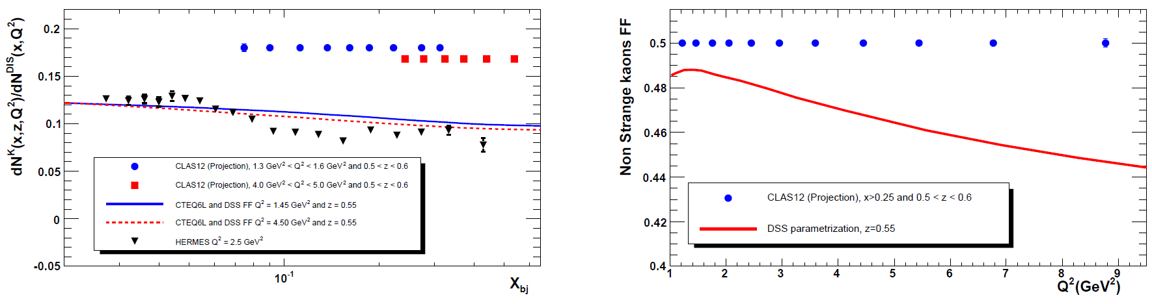
Expected Precisions
Kaon Multiplicities and Frag. Func.

Slide 17
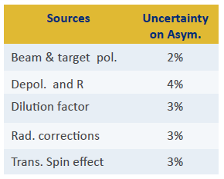
Projections – Flavor decomposition (1) - 10% systematics on asymmetries
Corrections:
17

Slide 18
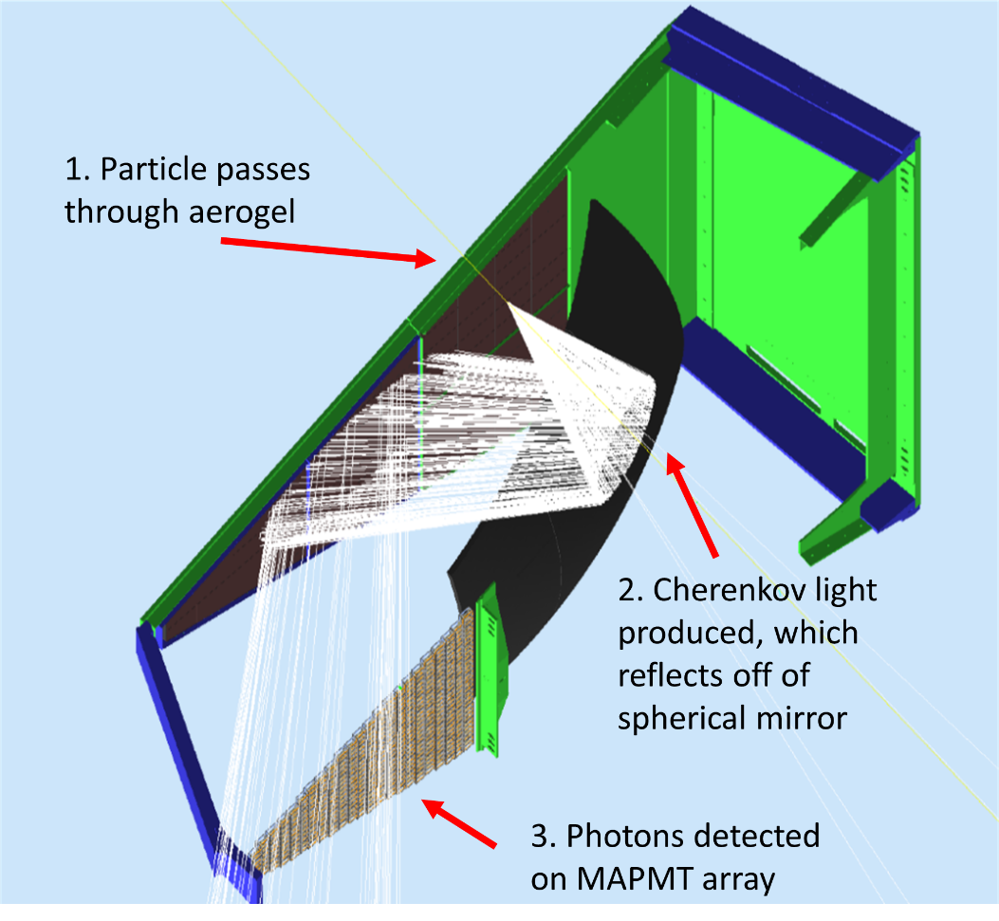
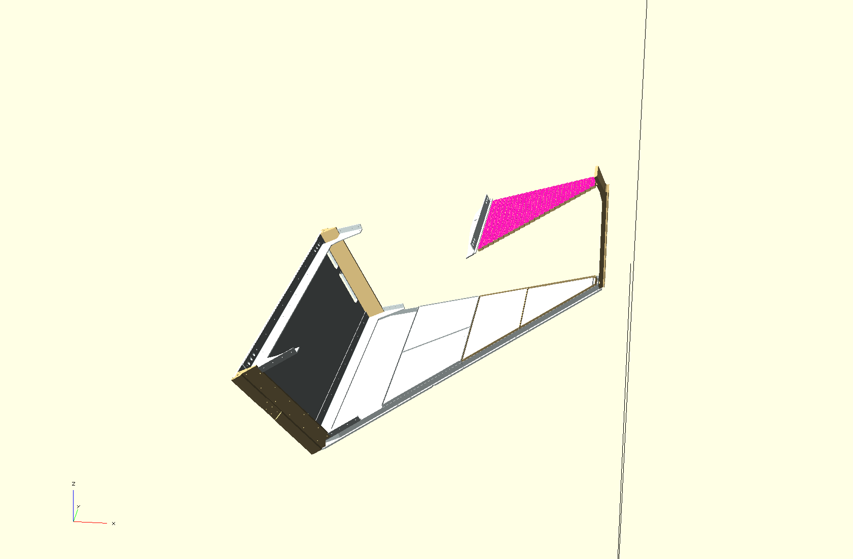
RICH Design
Gemc simulation
Java reconstruction
18

Slide 19
Projections – Flavor decomposition (2) - 10% systematics on asymmetries
Corrections:
F. Benmokhtar, CIPANP 2018
19

Slide 20
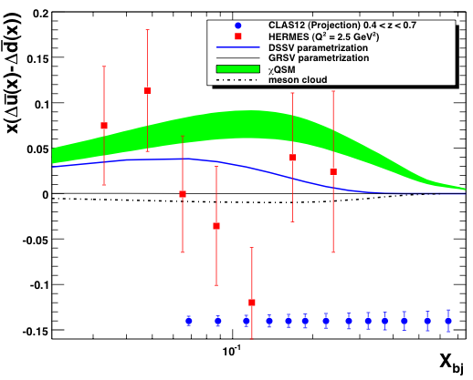
Projections (3) - 10% systematics on asymmetries
Test whether or not the light sea is symmetrically polarized
Corrections:
F. Benmokhtar, CIPANP 2018
F. Benmokhtar, CIPANP 2018
20

Slide 21
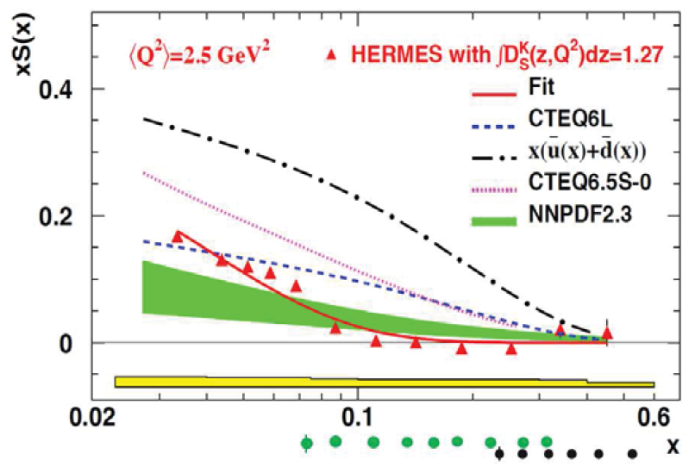
Expected Precisions x S(x)

Slide 22
