Slide 1
Towards a 3D Landscape of Nucleons and Nuclei
Zein-Eddine
Meziani
Argonne National Laboratory
Introduction
Partonic imaging of the nucleon in position and momentum
Partonic description of nuclei in position and momentum
Summary

Slide 2
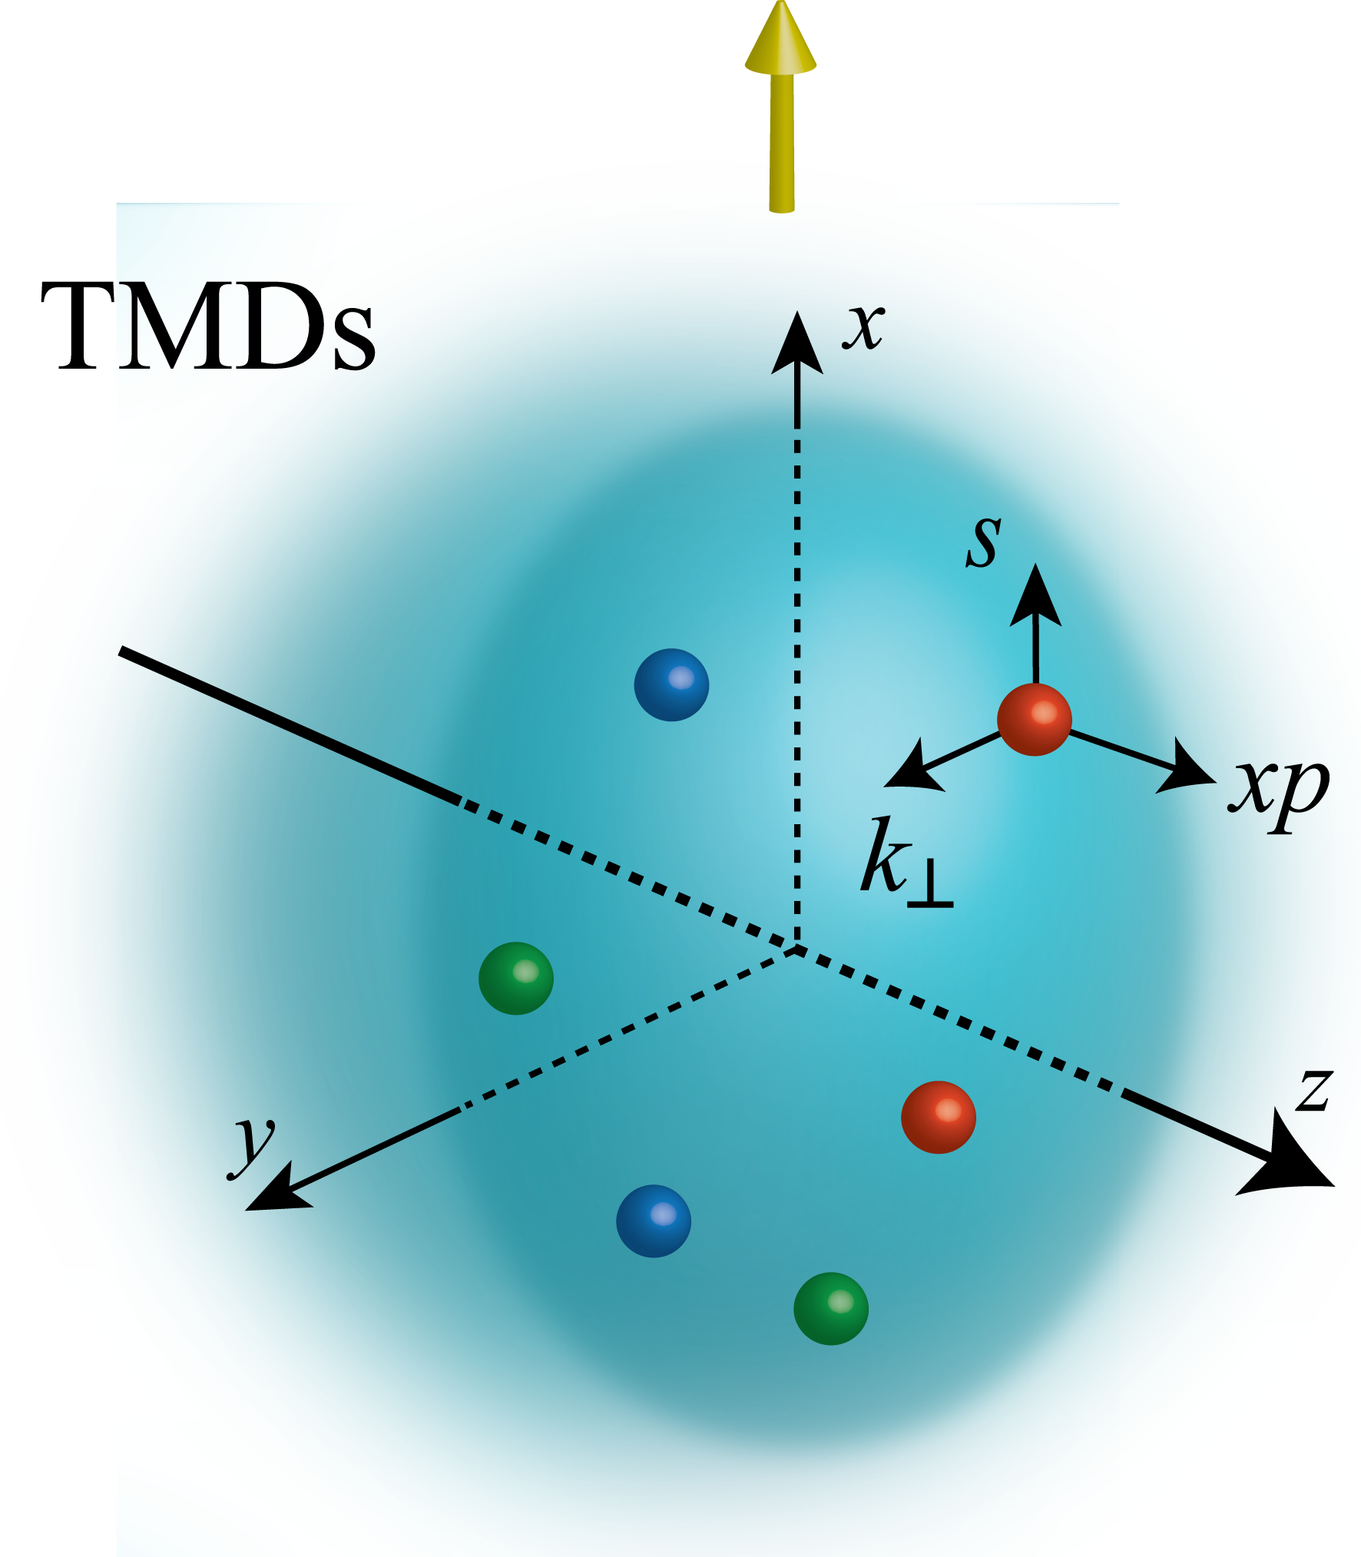
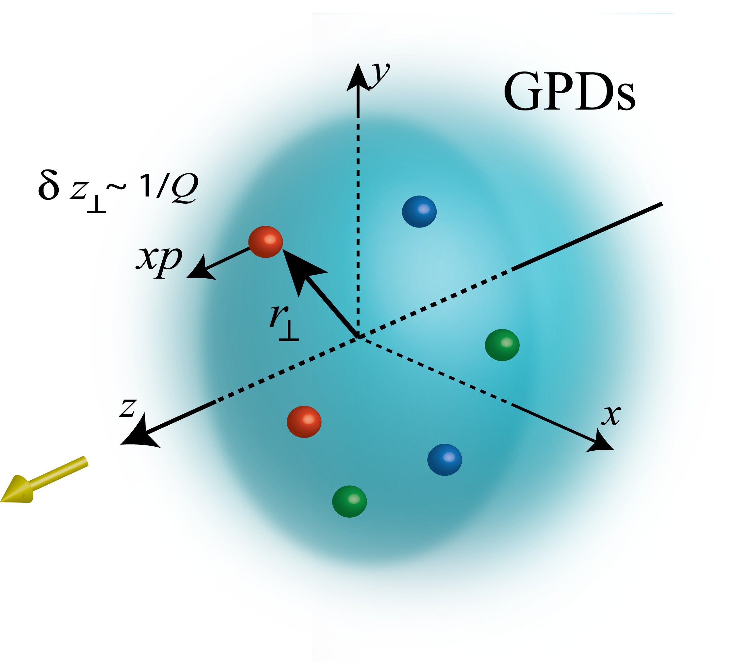
Unified View of Nucleon Structure
W_{p}^{u}(x,k_{T},r_{T} ) Wigner distributions
Transverse Momentum Dist.
Generalized Parton Dist.
dr_{T}
d²k_{T}
TMD f₁^{u}(x,k_{T}), h₁^{u}(x,k_{T})‏
GPD
Tomography
dx & Fourier Transformation
d²k_{T}
d²r_{T}
PDFs
f₁^{u}(x), .. h₁^{u}(x)‏
Form Factors
G_{E}(Q²),
G_{M}(Q²)‏
1D

Slide 3
Science Goals
Exploring our understanding of QCD
Factorization
Evolution, universality
Distributions of confined partons
charge and matter distributions, pressure distribution and spin distribution.
Dynamics of confined motion of partons
Orbital motion, spin-orbit correlations, phases
Hadron formation, hadron propagation, coherence.
Rest frame vs infinite momentum frame
Models of the nucleon
Lattice QCD
Moments of pdfs, quasi-pdfs….
Question in Nuclear Physics:
When does a nucleus behaves as
one coherent collection of partons?

Slide 4
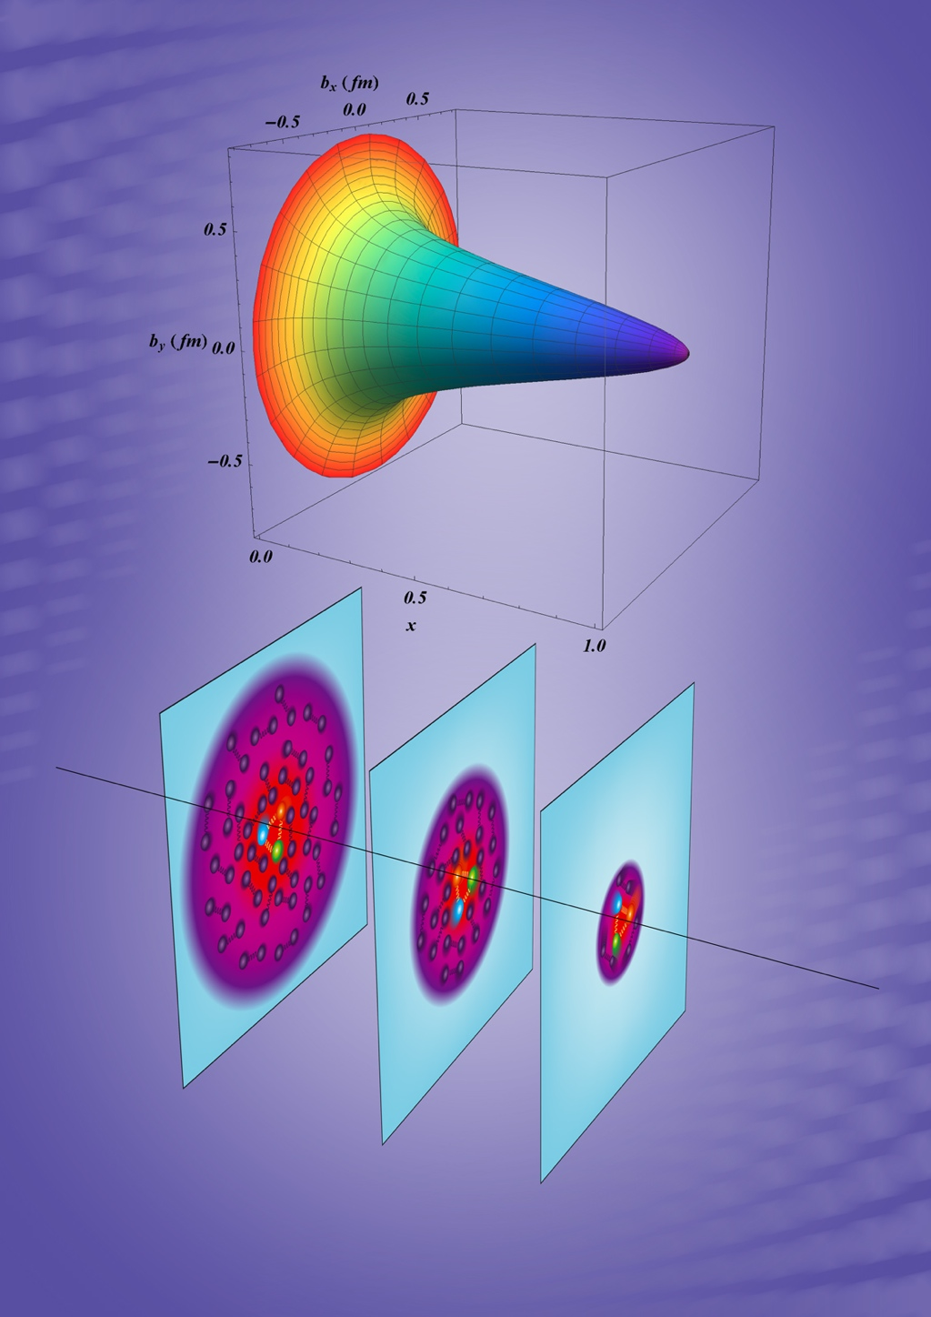
3D Imaging of Nucleons & Nuclei
R. Dupré, M. Guidal, S. Niccolai and M. Vanderhaeghen
Eur. Phys. J. A 53, no. 8, 171 (217)
New theoretical framework within QCD
Non-local matrix elements linked to measurements
Wigner distribution for a unified picture
GPDs, TMDs: 3D images in space and momentum
Valence Quarks: Proof of principle achieved using JLab 6 GeV data, 12 GeV data are forthcoming in the short term.
Gluons and Sea quarks: EIC is the key facility
3D imaging is intimately linked to profound questions about intrinsic properties of the system in relation to its partonic constituents
Confinement size of charge and of matter, total mass, total spin
The nucleus: a laboratory to study partons coherence, partons propagation, partons saturation, parton hadronization.
2D+1 quark spatial charge distribution in a proton
accessible with JLab @ 12 GeV

Slide 5
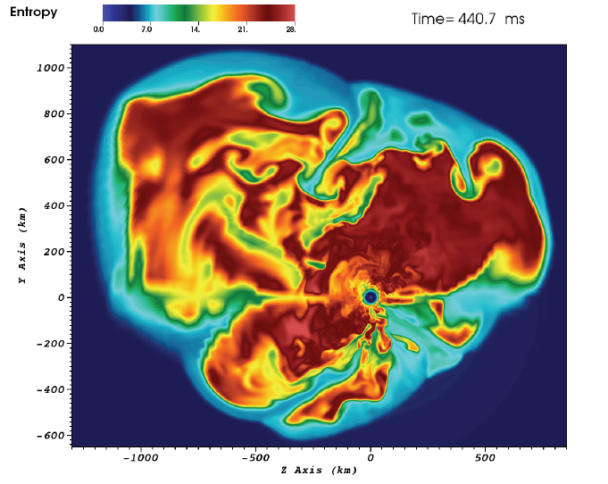
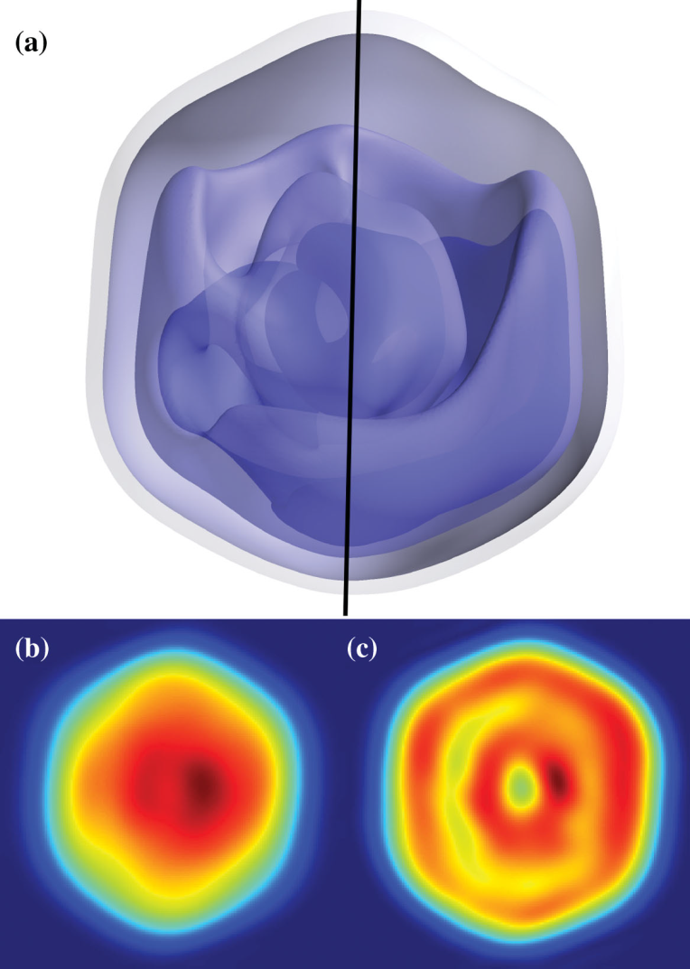
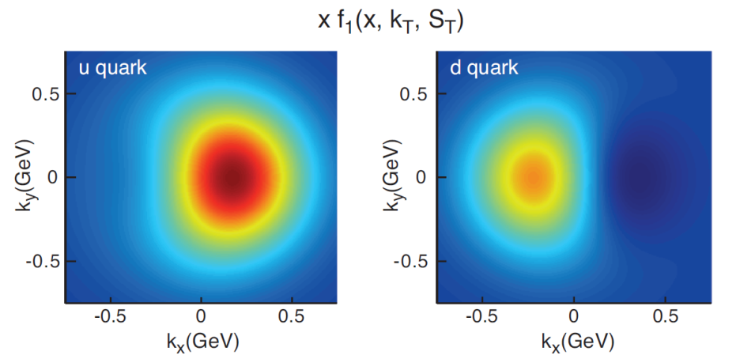
Science in 3-Dimensions
3D simulation of
15M supernova
(ORNL)
Predicted quark
TMD for a
polarized proton
(accessible with
JLab @ 12 GeV)
Prediction informed by
A global analysis of data from
HERMES, COMPASS and Jlab 6
Mimivirus imaged at LCLS
(SLAC)
X=0.1

Slide 6
Experimental tools to access GPDs & TMDs
Semi-Inclusive reactions: e+p/A → e’+h(π,K,…)+X
Detect scattered lepton in coincidence with identified hadrons (mesons)
Semi-Inclusive Deep Inelastic Scattering (SIDIS)
Challenge:
High polarized luminosity combined with large acceptance detectors
5 key variables x,Q², z, p_{T} and angle between leptonic and hadronic plane
Fine binning needed
Exclusive reactions: e+p/A → e’+ p’/A’+ (γ,π,K,…)
Detect all final states including recoiling nucleon or nucleus
Deep Virtual Compton Scattering (DVCS) when detecting the real photon
Deep Virtual Meson Production (DVMP) when detecting
Challenge:
High polarized luminosity combined with large acceptance detectors
4 key variables x,Q²,t and angle between leptonic and production plane ( )
Fine binning needed

Slide 7
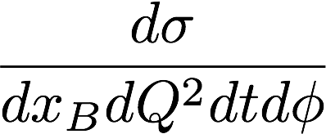
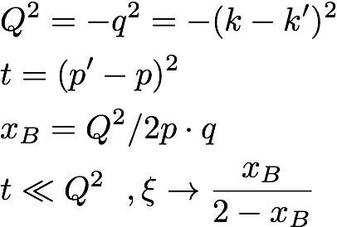
Deeply Virtual Compton Scattering A clean probe of GPDs
k’
Q² >> 1 GeV²
k
2
GPDs
p
p’
At large Q²: QCD factorization theorem
At twist-2: 4 quark helicity conserving GPDs:
Key: Q² leverage needed to test QCD scaling
High statistics required for a clean extraction

Slide 8
Separating GPDs Through Polarization Measurements of Compton FF
ep epγ
σ⁺ − σ⁻
σ⁺ + σ⁻
Δσ
2σ
ξ = x_{B}/(2-x_{B})
A =
=
k = -t/4M²
Polarized beam, unpolarized target:
~
~
Δσ_{LU} ~ sinφ{F₁H + ξ(F₁+F₂)H +kF₂E}dφ
H, H, E
Kinematically suppressed
Unpolarized beam, longitudinal target:
~
~
H, H
Δσ_{UL} ~ sinφ{F₁H+ξ(F₁+F₂)(H + … }dφ
Unpolarized beam, transverse target:
H, E
Δσ_{UT} ~ sinφ{k(F₂H – F₁E) + ….. }dφ
Global analysis of polarized and unpolarized data needed for GPDs separation

Slide 9
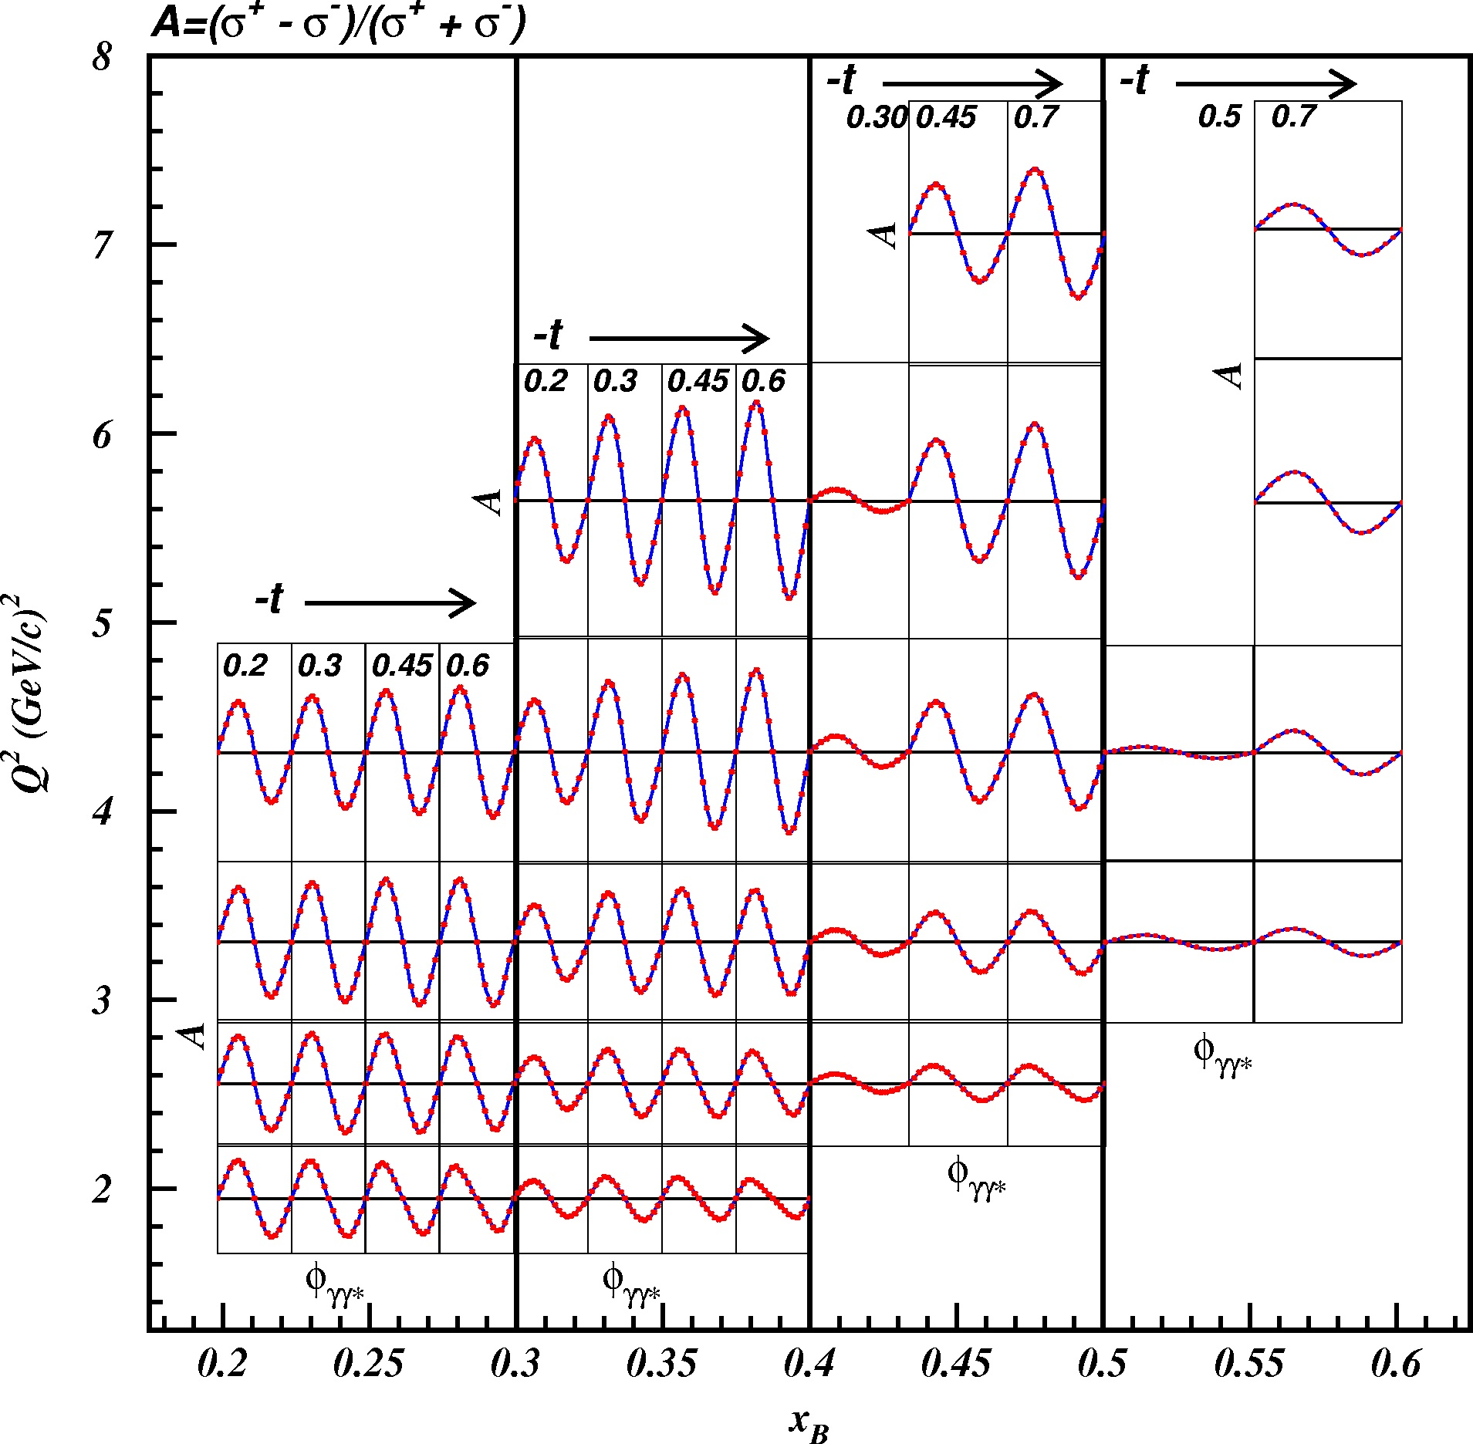
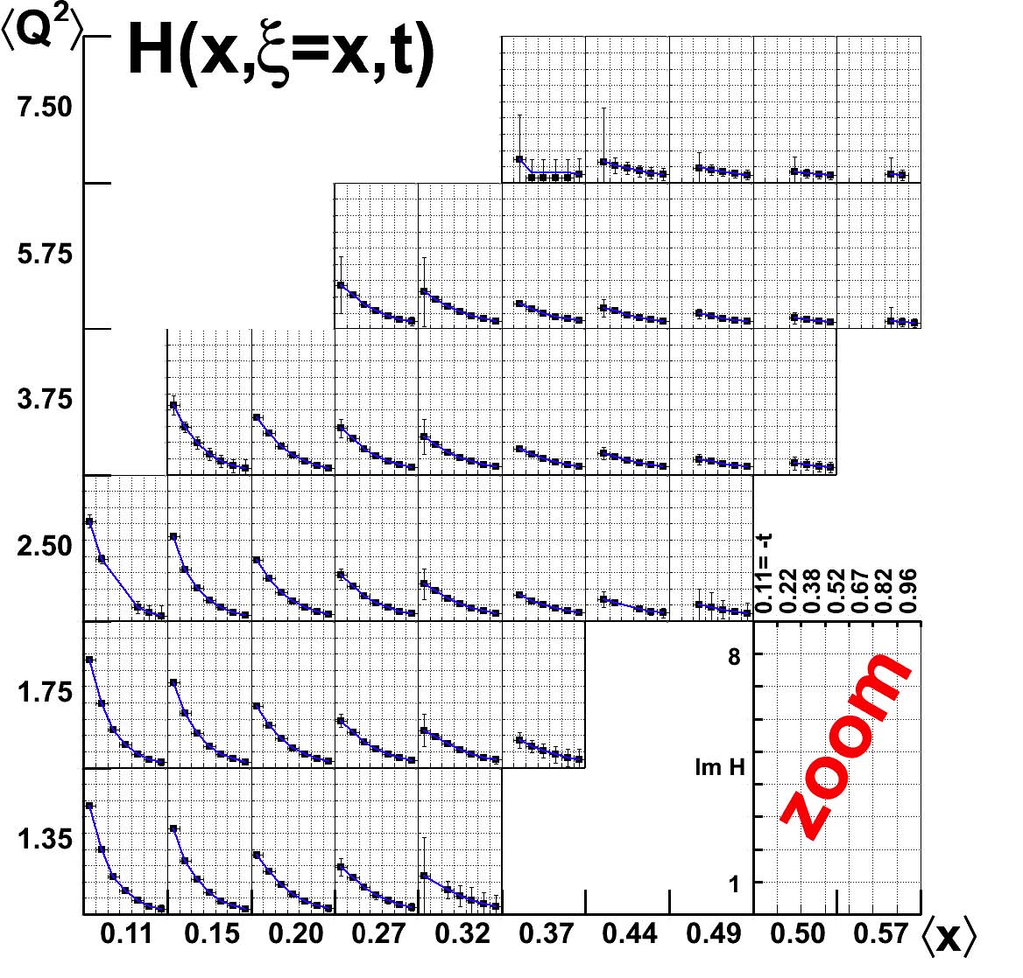
Proton Beam Spin Asymmetry A_{LU} (CLAS 12 projections)
80 days @ 10 ³⁵ cm⁻²s⁻¹
Polarized beam at 85%
E12-06-009

Slide 10
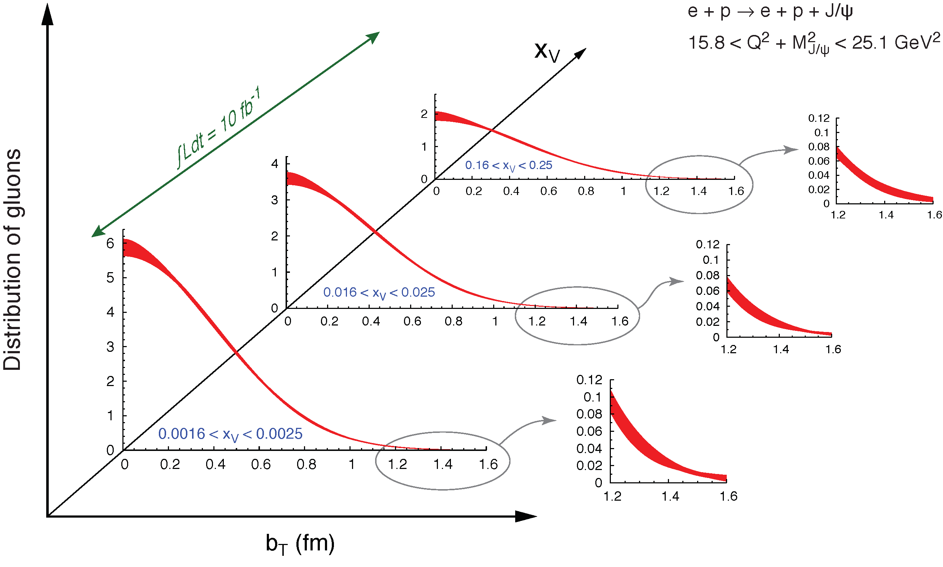
Projected Proton Transverse Profile for quarks and gluons
EIC
Gluons
JLab with CLAS12
Valence quarks

Slide 11
The Approved SIDIS Experiments in the 12 GeV Era at JLab
Hall A (polarized ³He and NH₃)
Super Bigbite Spectrometer
E12-09-018: SIDIS, 64d A-
SoLID
E12-11-108: Target Single Spin Asymmetries in SIDIS (e,eπ±) Reaction on a Transversely Polarized Proton Target. 120d A
E12-10-006: Target Single Spin Asymmetries in SIDIS (e,eπ±) Reaction on a Transversely Polarized ³He target at 8.8 and 11 GeV 90d A
E12-11-007: Asymmetries in SIDIS (e,eπ±) Reaction on a Londitudinally Polarized ³He target at 8.8 and 11 GeV ³He, 35d A
Hall C (unpolarized targets)
SMS-SHMS
E12-06-104: Measurement of the ratio R= L/sigmaT in SIDIS, 30d A
E12-13-007 Measurement of Semi-Inclusive πº Production as Validation of Factorization, 40d A-
Hall B (unpolarized and polarized NH3, ND3, HD)
CLAS12
C12-11-111 SIDIS on Tranversely Polarized Target (HDICE)
C12-12-009 Measurement of transversity with di-hadrons production in SIDIS with transversely polarized target (HDICE)
E12-06-112 Probing the Proton's Quark Dynamics in Semi-Inclusive Pion Production at 12 GeV, 38d A
E12-09-008 Studies of the Boer-Mulders Asymmetry in Kaon Electroproduction with Hydrogen and Deuterium Targets, 38d A-
E12-07-107 Studies of Spin-Orbit Correlations with Longitudinally Polarized Target 38d A-
E12-09-009 Studies of Spin-Orbit Correlations in Kaon Electroproduction in DIS with polarized hydrogen and deuterium targets, 38d B+
E12-06-112A/E12-09-008A Semi-Inclusive \Lambda electroproduction in the Target Fragmentation Region
E12-06-112B/E12-09-008B Higher-twist collinear structure of the nucleon through di-hadron SIDIS on unpolarized hydrogen and deuterium.

Slide 12
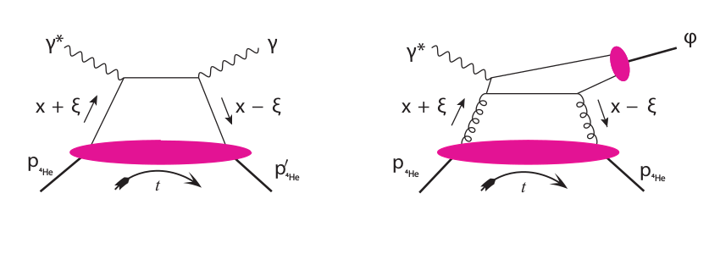
Nuclear Physics with Partons; A New Paradigm
Scanning quarks in ⁴He
Scanning the gluons in ⁴He
Direct 3D partonic tomography using Coherent DVCS and DVMP on nuclei
Investigate nuclei beyond the sum of nucleons
Studying coherent phenomena at the partonic level
Involving lattice to explore new phenomena at the partonic level
Providing lattice data in the phase space that is not available

Slide 13
What do we know about ⁴He?
A. Camsonne et al. PRL 112, 132503 (2014)
J. Seely et al., PRL 103, 202301 (2009)
⁴He Charge form factor
EMC effect
¹²C
⁸Be
⁴He
Nucleonic description

Slide 14
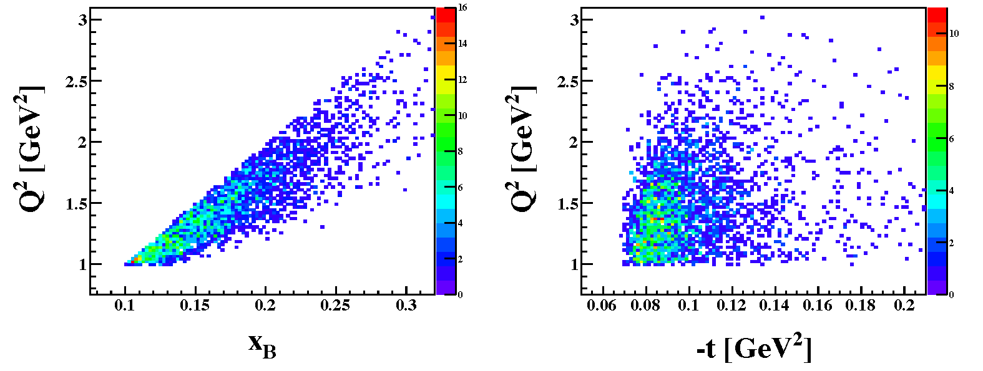
DVCS on spin zero nuclei: ⁴He; Proof of Principle Example
A first DVCS experiment was performed at Jefferson Lab using a 6 GeV beam. It is JLab E08-024 performed with CLAS in Hall B.
⁴He is a nucleus that can be described by one chiral-odd GPD .
Two channels are accessible with nuclear targets a coherent and incoherent channel; we consider the more potent being Coherent DVCS.
The challenge: luminosity, exclusivity and small phase space at 6 GeV beam energy.
M. Hattawy et al. PRL 119 (2017) no.20, 202004

Slide 15
A follow-up JLab Proposal For CLAS 12 Partonic structure of nuclei, W. Armstrong et al., arXiv:1708.00888 [nucl-ex]. See also arXiv:1708.00891 [nucl-ex] and arXiv:1708.00835
Spokespeople: W. Armstrong, N. Baltzell, R. Dupré, K. Hafidi, M. Hattawy, Z.-E. M(contact), M. Paolone
CLAS12 Detector
IPN Orsay
Argonne
ALERT detector

Slide 16
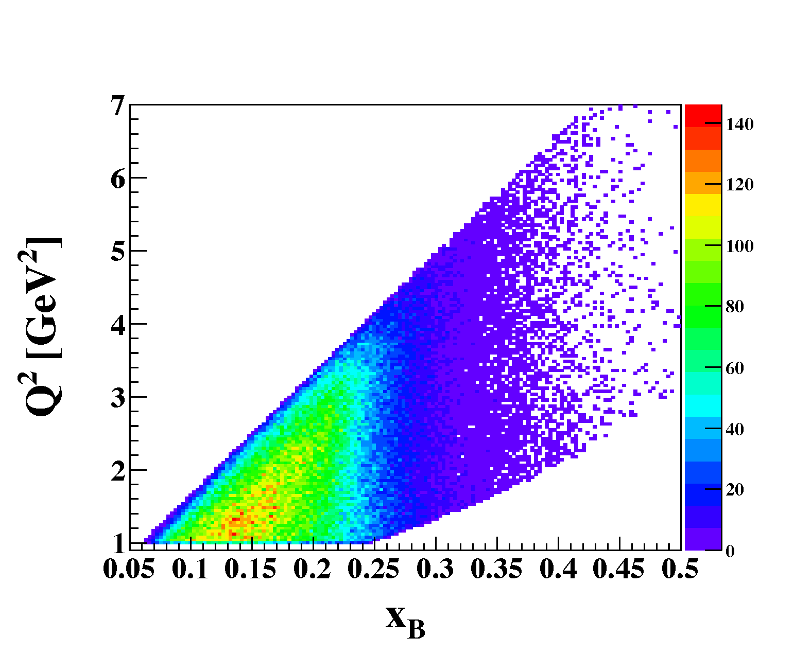
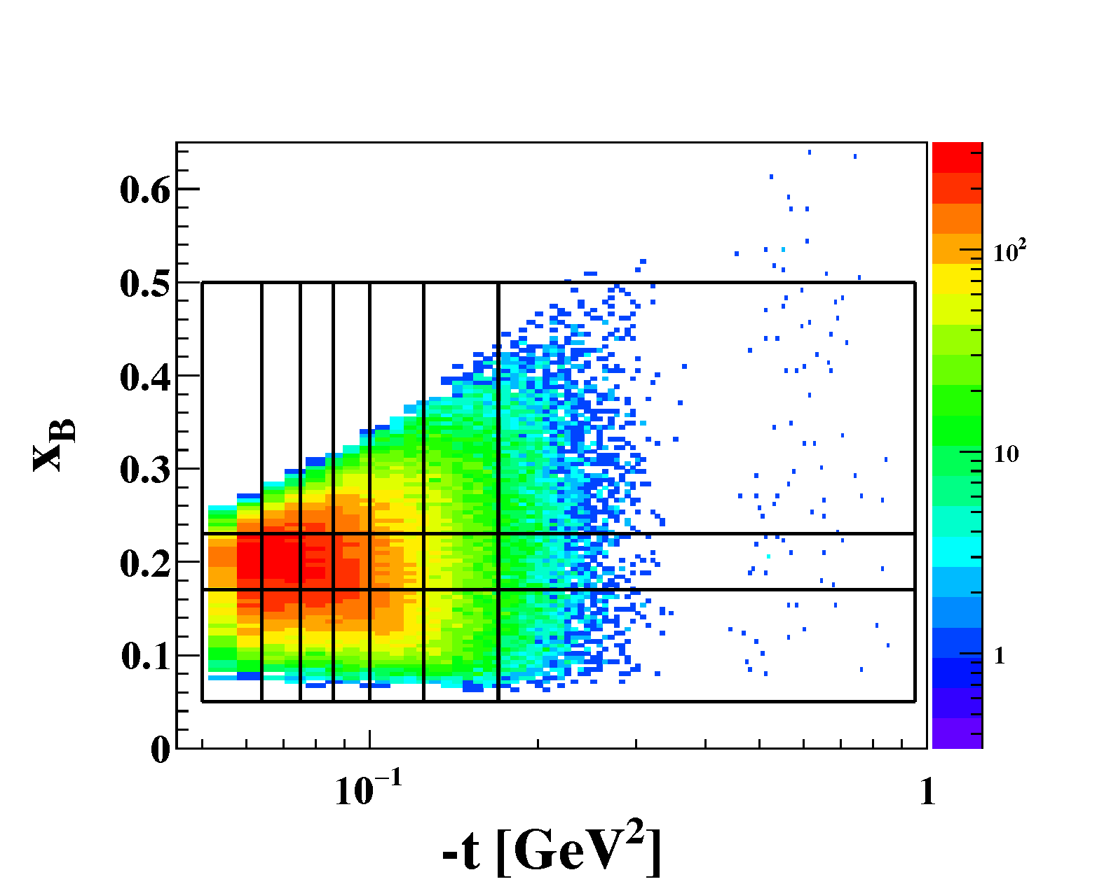
CLAS12 in combination with ALERT
It is proposed to measure the partonic structure of ⁴He, namely quarks and gluons GPDs using DVCS and DVMP (phi production)
For exclusivity CLAS12 detector will be used in combination with a new recoil detector known as ALERT
Advantages:
Wider kinematic range
Higher statistics allowing 3D binning
More precise CFF extractions

Slide 17
Projected data with CLAS12 and ALERT: Valence Quarks
Asymmetry
Imaginary Part of GPD H_{A}
Valence Quarks

Slide 18
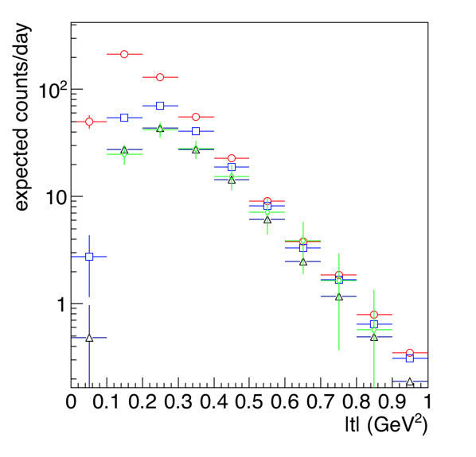
Projected data with CLAS12 and ALERT: Gluons
Deep Electroproduction of phi with subsequent phi decay into K⁺K⁻

Slide 19
Charge and matter density profiles in ⁴He: Projected Results

Slide 20
Coherent production at an EIC using Production
EIC White paper

Slide 21
Challenges with Nuclei
Jefferson Lab will provide information in the valence region
Coherent DVCS is safer, in terms of factorization, than coherent DVMP for the energy range involved.
The decrease in cross section due to the form factor requires CLAS12 high luminosity 10³⁵ cm⁻²s⁻¹ and higher.
Exclusivity requirement difficult for fixed heavy targets
The Q² should be large enough to insure factorization and the handbag diagram approach.
EIC will provide information on the sea and gluon dominated region
Coherent DVCS and DVMP in a wide kinematic range will be accessible
DVMP with heavy quarkonia can provide more direct information on gluons
Recoiling nuclei will a little be easier to detect than in fixed target experiments
The luminosity is critical for the DVCS process for zero spin.

Slide 22
Confined Motion of Quarks and Gluons in ⁴He
One of the transverse momentum dependent distribution functions is known as the Boer-Mulders function
It corresponds to transversely polarized quarks in unpolarized nucleons.
The observable that contains the Boer-Mulders function is the angular modulation of the hadron plane with respect to the lepton plane.
It would be important to understand the EMC effect in the transverse momentum dependent distributions in comparison to the longitudinal case.
With the Boer-Mulders function there is no need to polarize the target and separate structure effect from spin effects.
JLab 12 will start such a program using nuclear targets
EIC will be the ultimate machine for such studies since it has wide kinematic flexibility to validate the global analysis of data.
The challenge is having high luminosity and thus statistics to be able to provide bin in 5 –dimensions

Slide 23
Summary
The 3D landscape of nucleon and nuclei is challenging but not impossible.
JLab 12 GeV is poised to make progress toward 3D imaging of the valence quark region of light nuclei
An EIC with high polarized luminosity and variable energy with comprehensive recoil detection is key to probe the gluonic and sea quark landscape of nuclei
Lattice calculations need to use the data for benchmark but should also guide the experiments in the corners of the phase space not accessible by experiment.

Slide 24
“Polarized”
THANK YOU

