Slide 1
IR Design Considerations and Machine Detector Interface for Electron Ion Colliders
8th Workshop of the APS Topical Group on Hadronic Physics from Wednesday, 10 April to Friday, 12 April 2019, Denver, Colorado, USA
Brett Parker
April 11, 2019

Slide 2
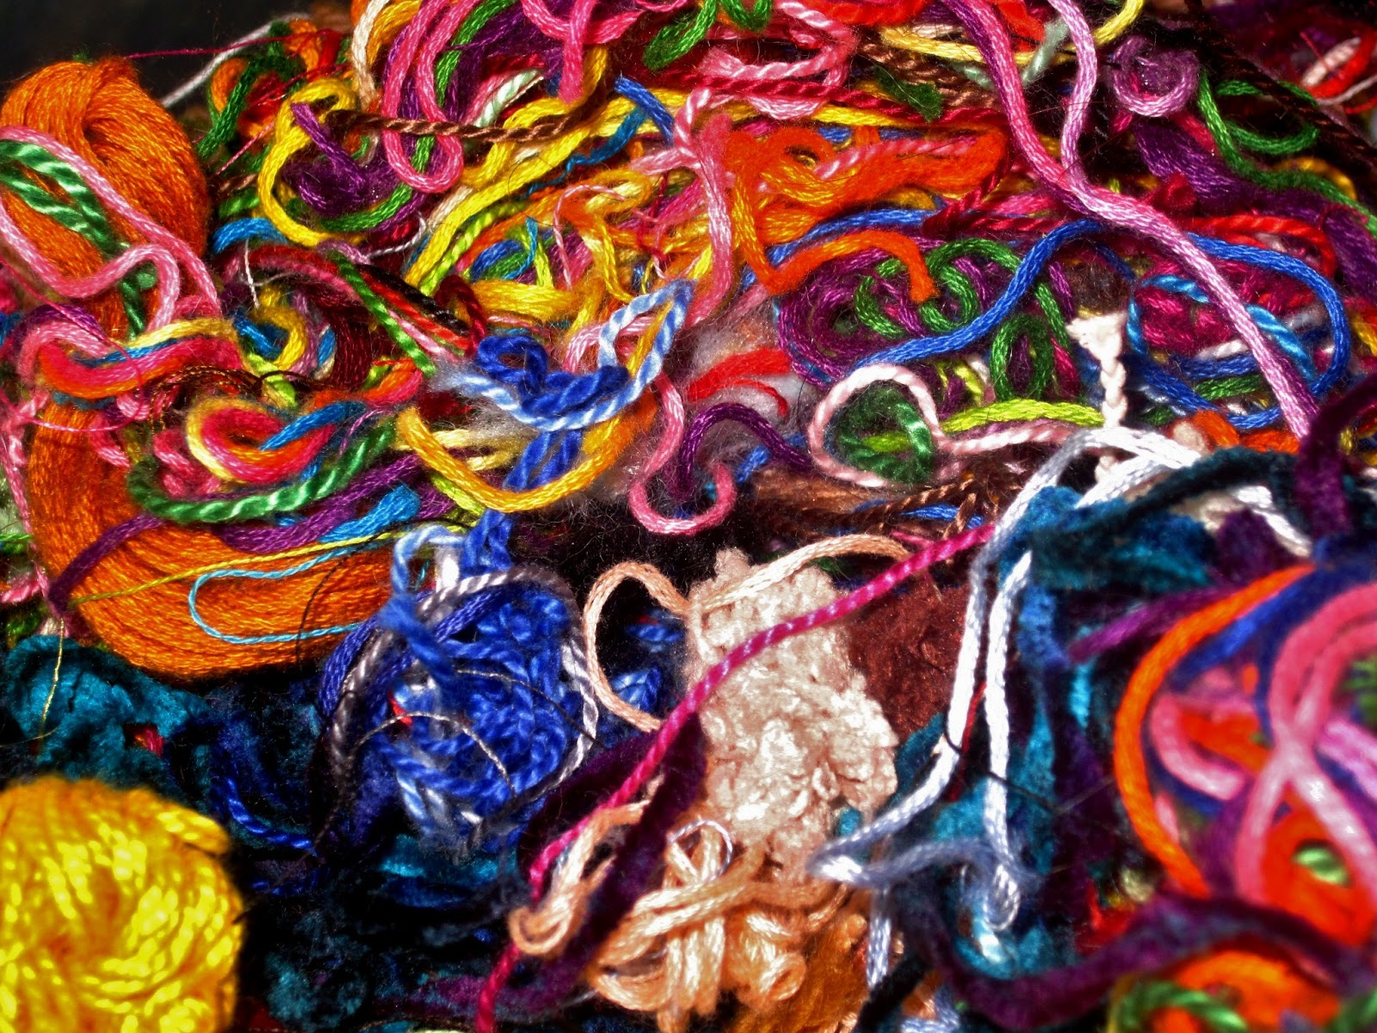
EIC Machine Detector Interface (MDI) Introduction
*
Experimental Goals
Accelerator Operations
IR Magnet Performance
*This presentation ruthlessly borrows slides from other presentations... please wait for a list of sources when the end credits roll by.

Slide 3
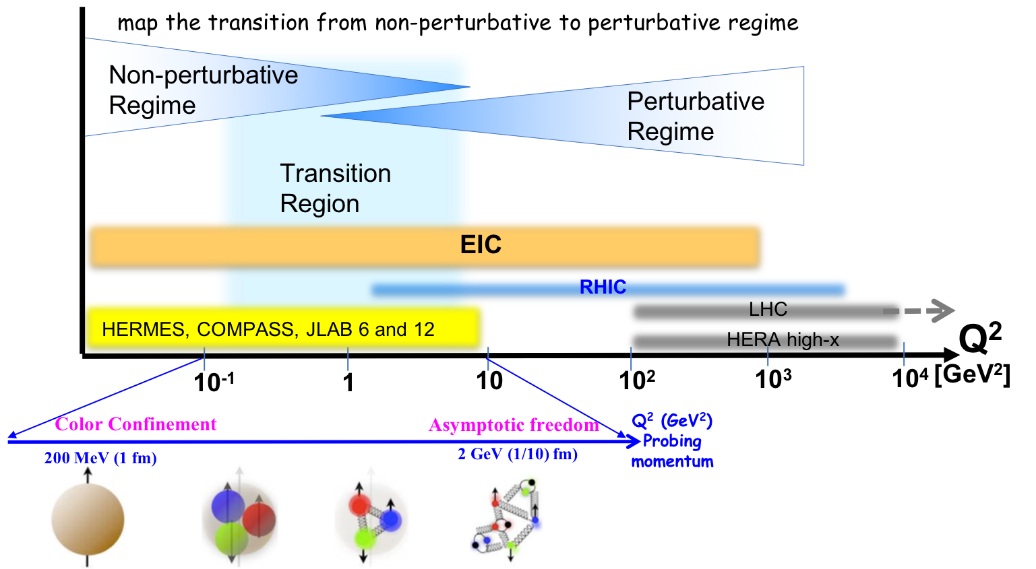
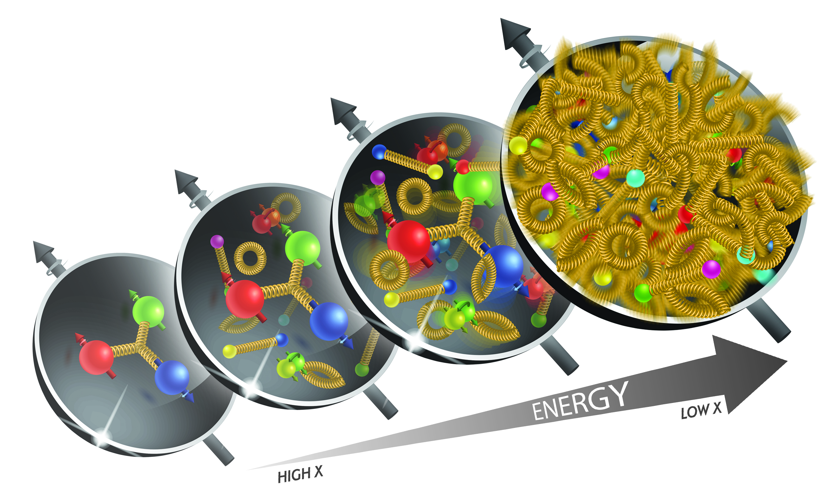
What is needed to address EIC Physics?
large kinematic coverage:
access to x and Q² over a wide range
→ center-of-mass energy √s: 20 – 140 GeV
polarized electron and hadron (p,d,He-3) beams:
access to spin structure of nucleons and nuclei
Spin vehicle to access the spatial and momentum structure of the nucleon in 3d
Full specification of initial and final states to probe q-g structure of NN and NNN interaction in light nuclei
nuclear beams: D to Pb
accessing the highest gluon densities → saturation
quark and gluon interact with a nuclear medium
high luminosity 10³³⁻³⁴ cm⁻²s⁻¹:
mapping the spatial and momentum structure of nucleons and nuclei in 3d
access to rare probes, i.e. Ws

Slide 4
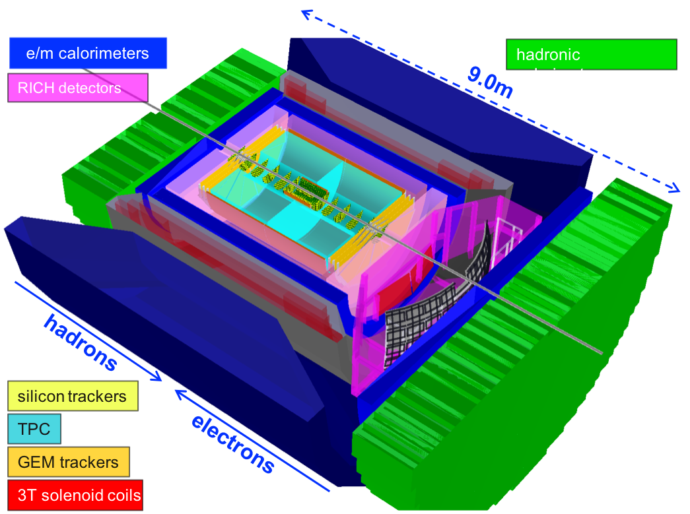
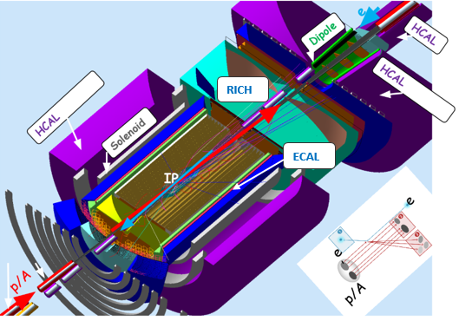
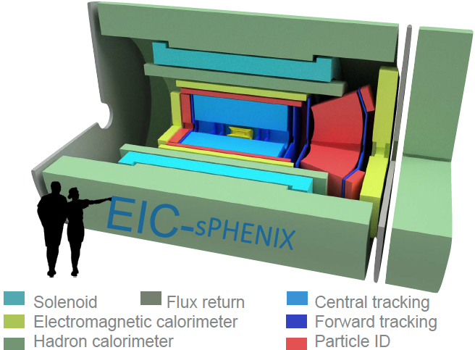
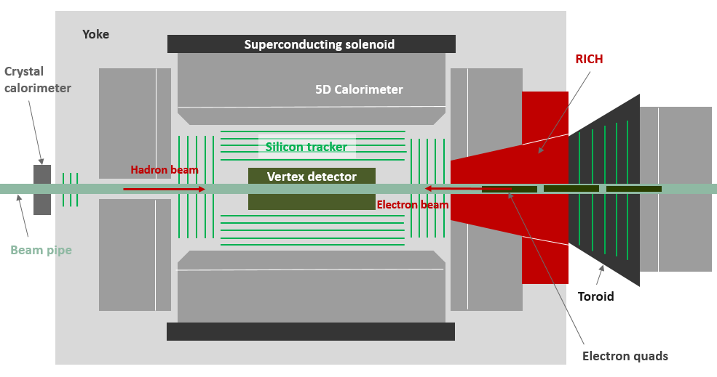
Current EIC General Purpose Detector Concepts
Brookhaven concept: BEAST
Jefferson lab concept: JLEIC
sPHENIX → EIC
Argonne concept: TOPSiDE

Slide 5


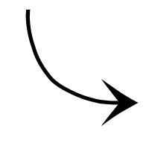


What does an idealized EIC detector have?
Central Detector/Solenoid
Ion beamline
Scattered Electron
Electron beamline
Dipole
Dipole
Forward (Ion) Detector
Particles Associated
with struck parton
Particles Associated
with Initial Ion
Ideal is to measure everything, everywhere. ~100% acceptance for the whole event!

Slide 6
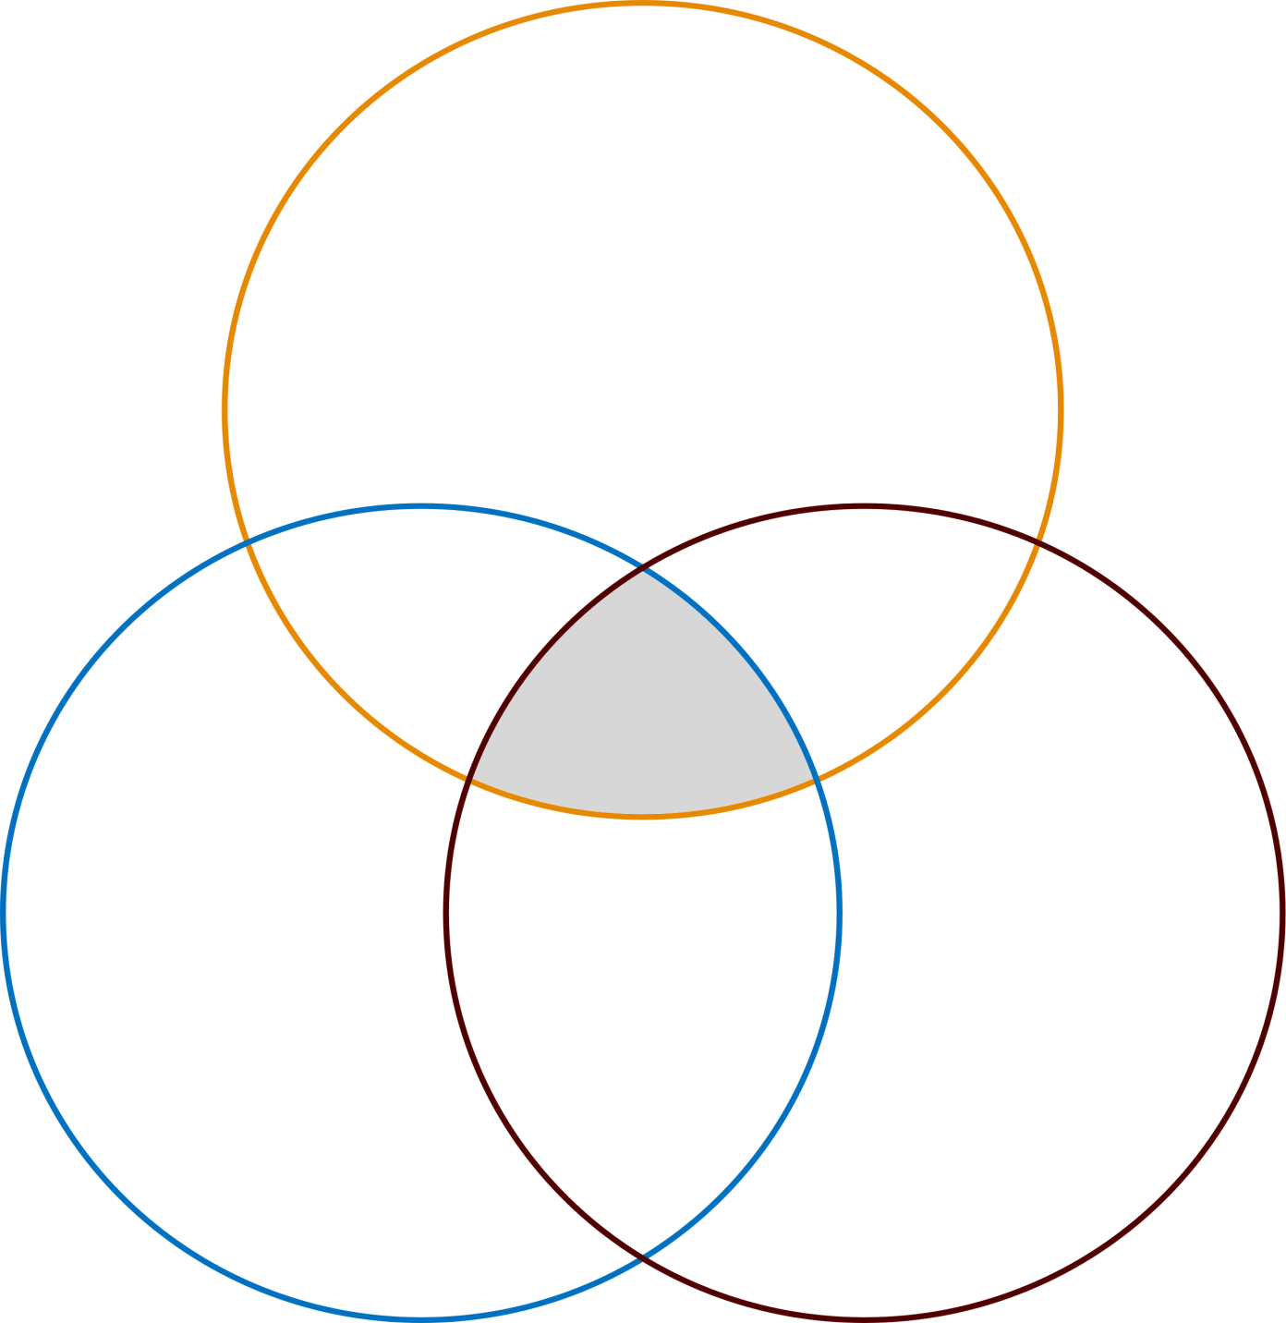
EIC IR Design Optimization Logic
Experimental Goals
Forward Charged Acceptance
Forward Neutral Acceptance
Rear Acceptance (Polarization & Luminosity Measurements)
Detector / IR Magnet Overlap
Accelerator Operations
IR Magnet Performance
The IR designer’s challenge is to prove that the valid solution space is not of measure zero.
All OK
Coil Stress Limit
Beam Pipe Design (Lose Aperture)
Field Strength
Coil End Fields (e-beam)
Magnet Strength (Peak Beta)
Field Leakage (e-Beam Synrad)
Field Quality (Harmonic errors, Local Correction Coils)
Magnet Apertures (e-beam & hadron injection)

Slide 7
EICs are unique colliders.
EIC
LHC /RHIC
collide different beam species: ep & eA
consequences for beam backgrounds
  hadron beam backgrounds,
  i.e. beam gas events
  → synchrotron radiation
asymmetric beam energies
boosted kinematics
  high activity at high |η|
High repetition rate
JLEIC: 2.1ns eRHIC 8.7ns between bunches
crossing angle
eRHIC 25mrad JLEIC: 50mrad
wide range in center of mass energies
factor 7
both beams are polarized
→ stat uncertainty: ~ 1/(P₁P₂ (∫L dt )^{1/2})
collide the same beam species: pp, pA, AA
→ beam backgrounds
  hadron beam backgrounds,
  i.e. beam gas events, high pile up
symmetric beam energies
kinematics is not boosted
  most activity at midrapidity
moderate repetition rate
25 ns between bunches
no crossing angle yet
limited range in center of mass energies
LHC: factor 2
RHIC: factor 26 in AA and 8 in pp
no beam polarization
→ stat uncertainty: ~1/(∫L dt )^{1/2}
Differences impact detector acceptance and possible detector technologies

Slide 8
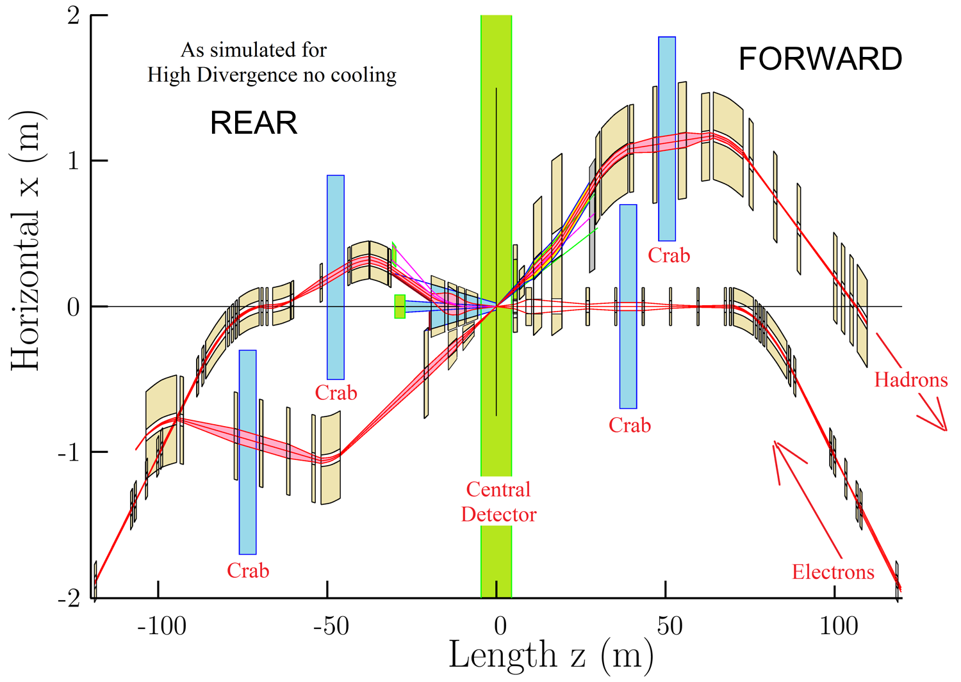
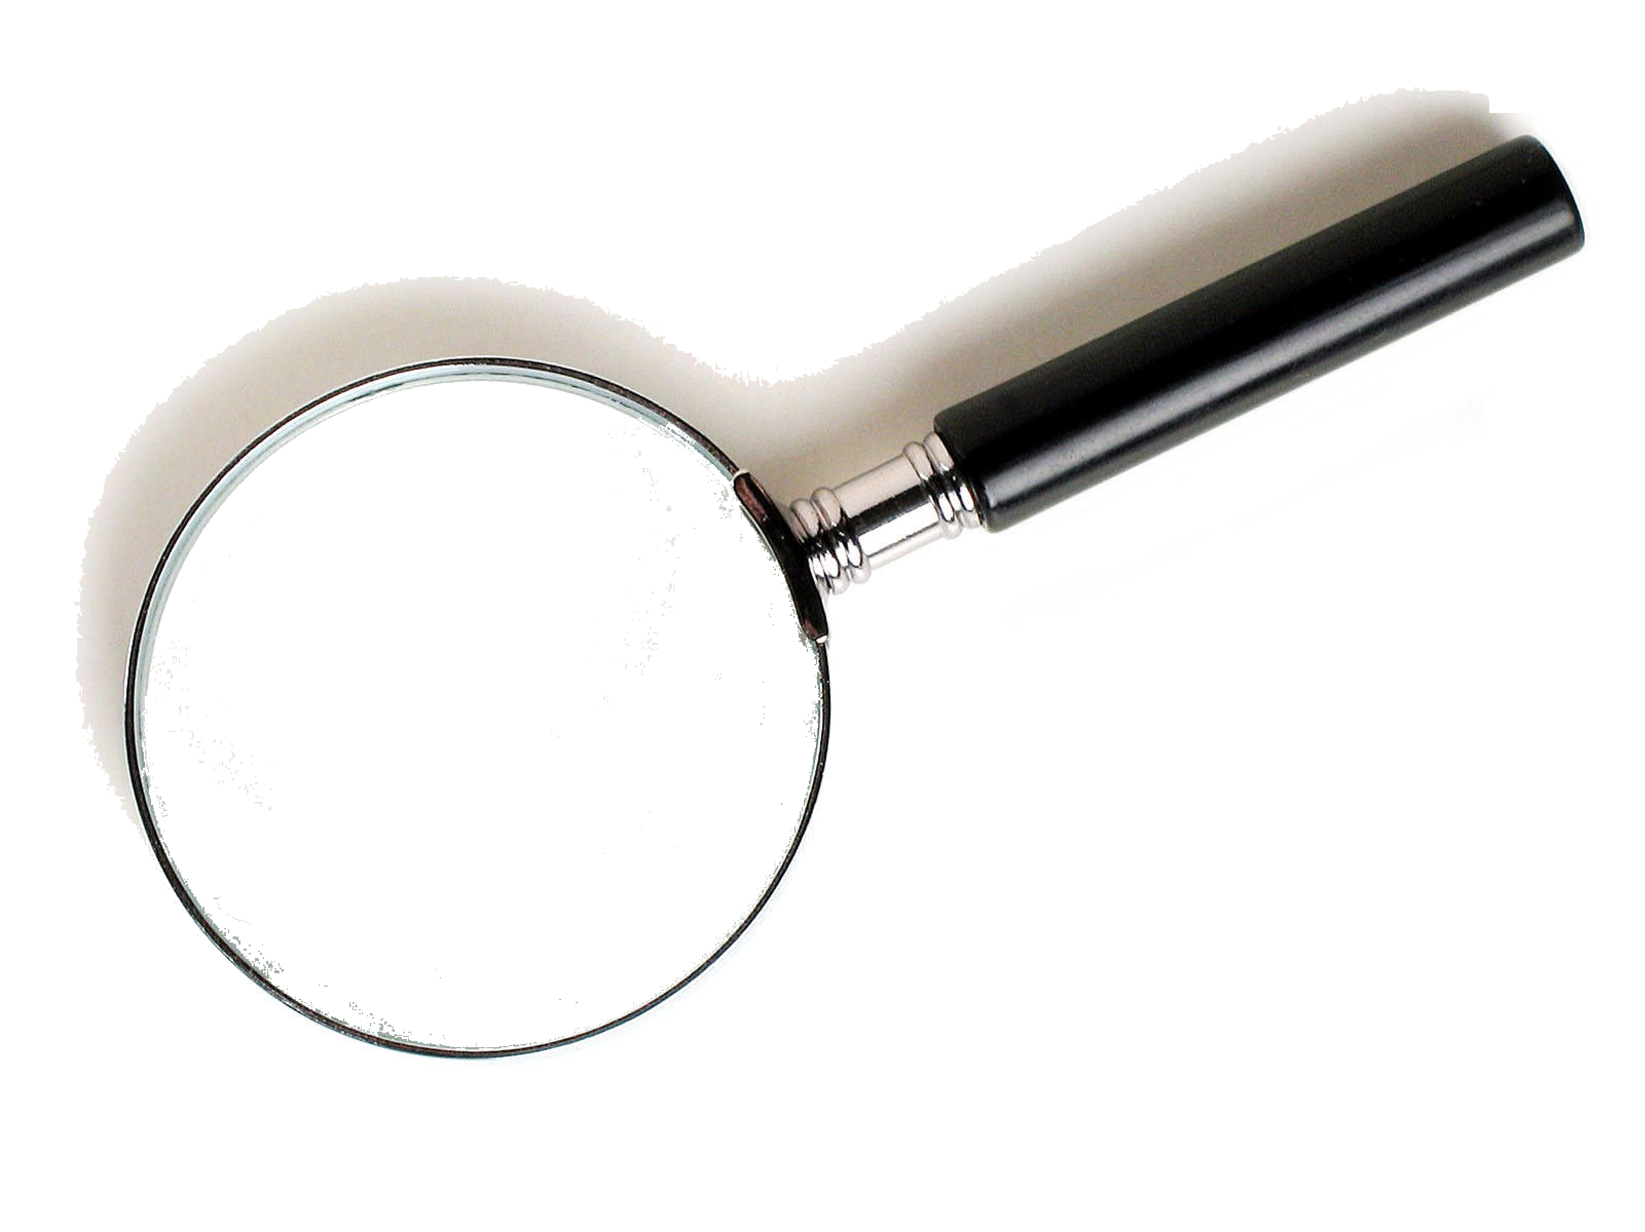
IR Design Overview and Conventions
(Outgoing Hadrons)
(Incoming Electrons)
Crossing Angle?
(Incoming Hadrons)
(Outgoing Electrons)
eRHIC Example

Slide 9
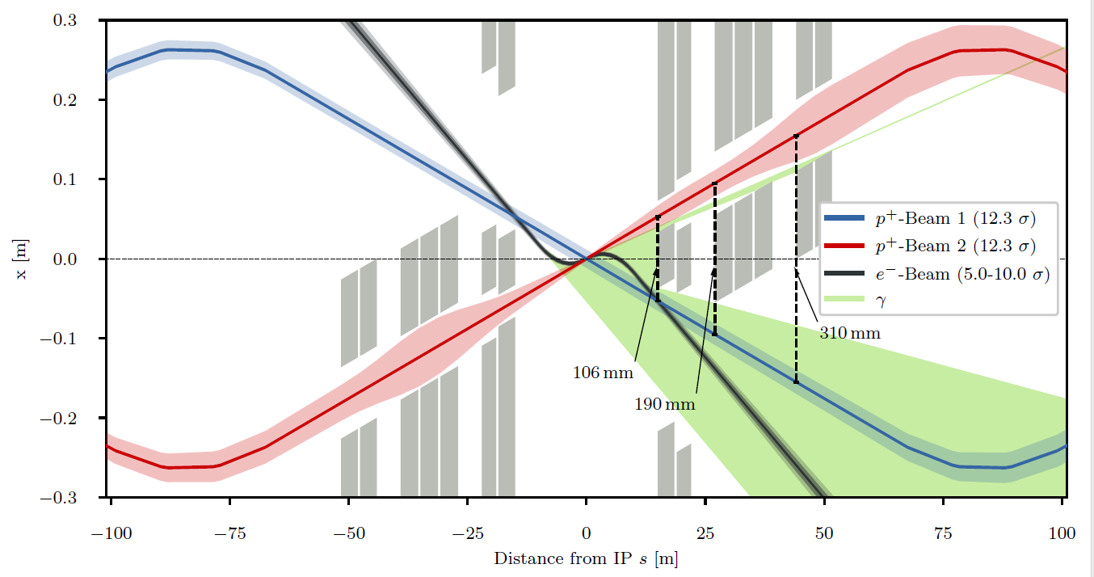
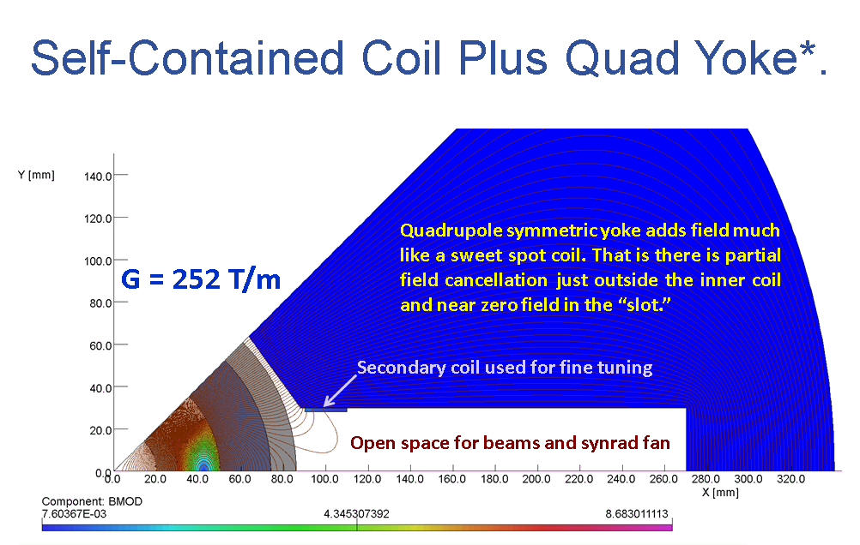
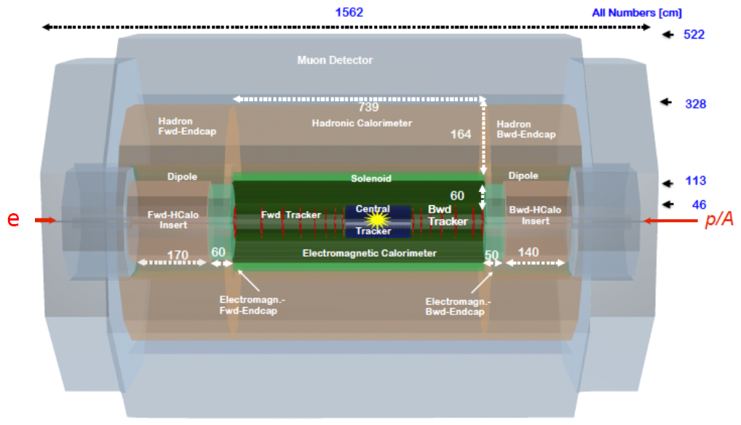
For our EIC, why use a crossing angle?
Electrons
Colliding Protons
Non-colliding Protons
Both dipole and solenoid fields are here
LHeC Example
Synrad
Does not have RICH
LHeC
Forward Side
Rear Side
We learn from HERA-II experience that synrad driven background needs careful study.

Slide 10
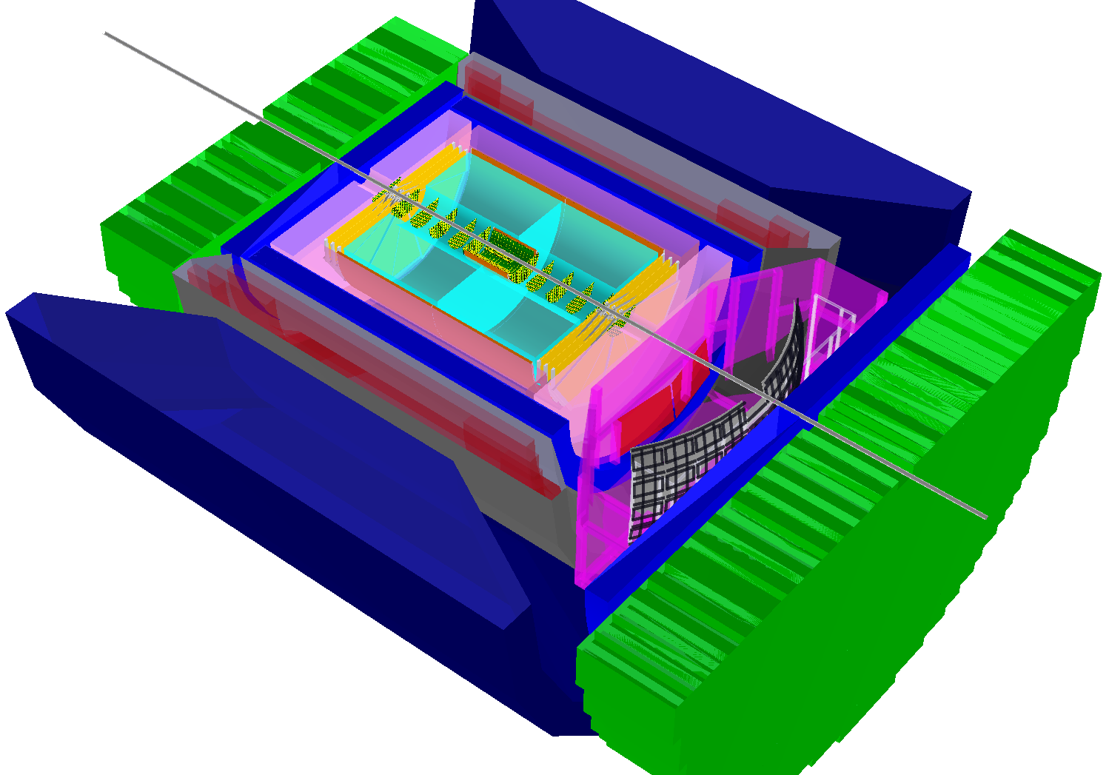
For our EIC, why use a crossing angle?
The HERA and LHeC concepts use separation dipoles to get the beams apart...
and dipoles generate
synrad which can lead to
backgrounds to avoid.
But a crossing angle
geometry needs Crab
Cavities so not to lose
too much luminosity...
hadronic calorimeters
RICH detectors
e/m calorimeters
9.0m
3T solenoid coils
BNL concept: BEAST
hadrons
silicon trackers
The answer is PID.
electrons
TPC
GEM trackers

Slide 11

For our EIC, why use a crossing angle?
EIC PID
needs
are more demanding
then your
normal
collider detector
EIC
needs absolute
particle numbers at
high purity and low
contamination
E

Slide 12
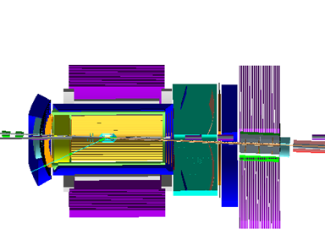
For our EIC, why use a crossing angle?
Placing small radius dipoles inside the detector blocks acceptance.
hadronic calorimeters
RICH detectors
e/m calorimeters
9.0m
3T solenoid coils
Dipole here?
So integrate dipole with solenoid, but then cannot use a RICH!
No dipoles here!
“Projective” field for a RICH not compatible with a large diameter dipole.
Dipole here?
RICH
BNL concept: BEAST
RICH
hadrons
silicon trackers
electrons
TPC
GEM trackers
For RICH want tracks aligned with magnetic field
JLab concept: JLEIC

Slide 13
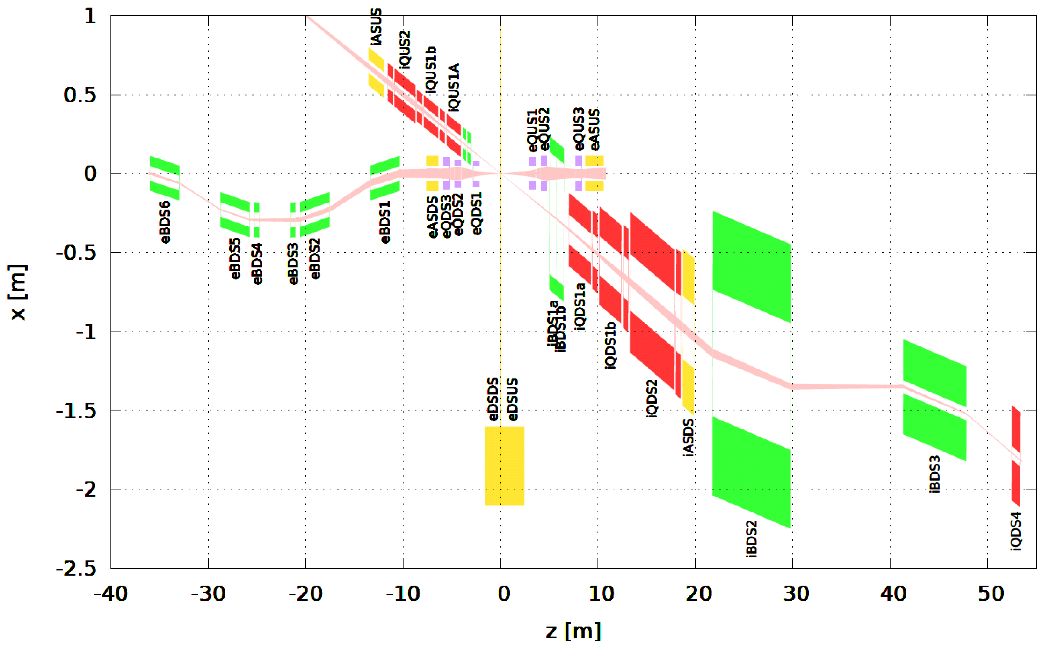
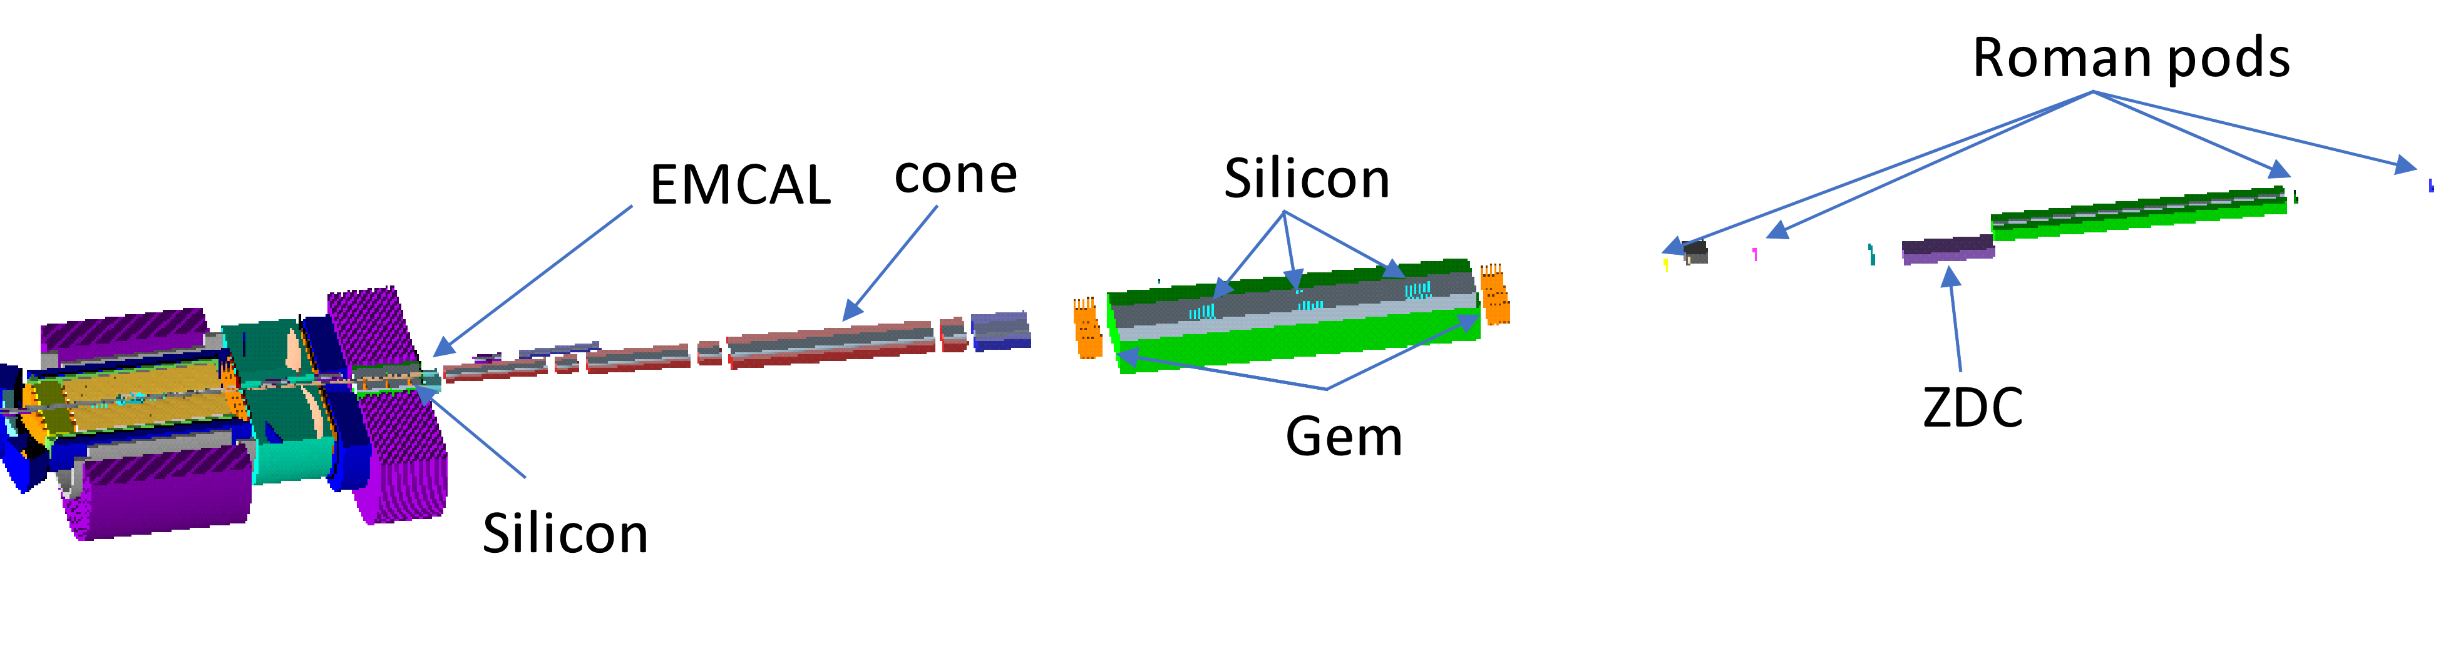
JLEIC IR Design Layout Schematic
Rear Side
Forward Side
Lumi Monitor
Spectrometer Dipole
e-Tagger
Roman Pots
Polarimeter Chicane
(Triple function on rear side)
(Charged and neutral particle acceptance)
JLEIC Example
ZDC
Roman Pots
JLEIC
Forward Side

Slide 14
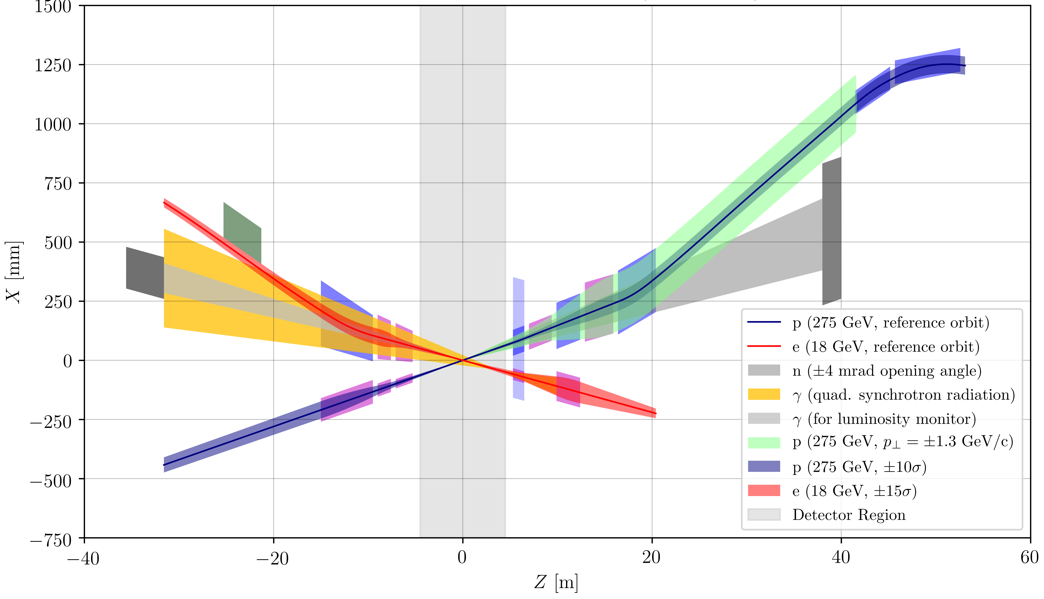
eRHIC IR Design Aperture Schematic
B2B
Rear Side
Forward Side
B2A
Roman Pots
±4.5 m Detector Space
Lumi Monitor
e-Tagger
B1
ZDC
B0
Q2
B2
C1X
Q2
Q1
Q1
Q1A
Q0
Q2
Q1B
Q1
Electrons
Protons
eRHIC Example

Slide 15
Detector Requirements
Exclusive Reactions in ep/eA:
Exclusivity criteria:
  eA: large rapidity coverage → rapidity gap events
    HCal for 1<η<4.5
  ep: reconstruction of all particles in event
    wide coverage in t (=p_{t}²) → Roman pots
eA: large acceptance for neutrons from nucleus break-up
  Zero Degree Calorimeter
    veto nucleus breakup
    determine impact parameter of collision
→ Poses stringent requirements on IR design
t=p_{t}²
scattered protons
-4.5<η<4.5
DVCS – photon kinematics:
Cuts: Q²>1 GeV, 0.01<y<0.85
break-up neutrons

Slide 16

Forward Scattered Neutrons
Diffractive physics in eA
Measure spatial gluon distribution in nuclei
Reaction:
→ Momentum transfer t = |pAu-pAu′|²
Au
suppress
by detecting
break-up
neutrons
Requirement:
Need at +/- 4 mrad beam element free
cone before the zero degree calorimeter
to detect the breakup neutrons
No nuclear dependence for heavy A
there neutrons are also critical to
reconstruct collisions geometry
L. Zheng, ECA, J-H. Lee arXiv:1407.8055
  precision neutron energy
  reconstruction → transv. size of ZDC
Physics requires forward
scattered nucleus needs to
stay intact
Veto breakup through
neutron detection
Notes:
spin-dependent gluon distribution

Slide 17
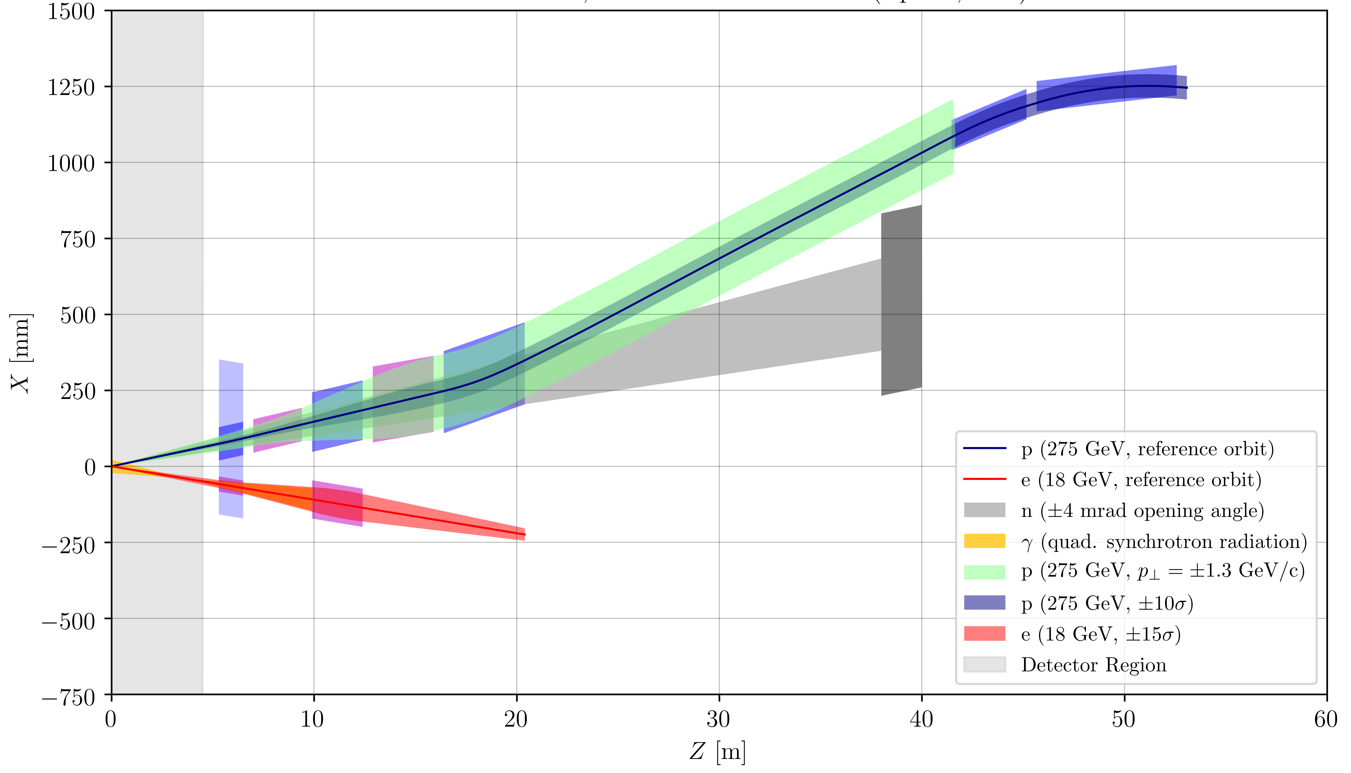
eRHIC Forward Magnet Apertures
eRHIC Example
Roman Pot Region
B2BPF
B2APF
Closest Large Aperture, High Field Quadrupole
B1PF
ZDC
Spectrometer Dipole
Q2PF
B0PF
C1XPF
Q1PF
Q0EF
Q1EF
Forward Side

Slide 18
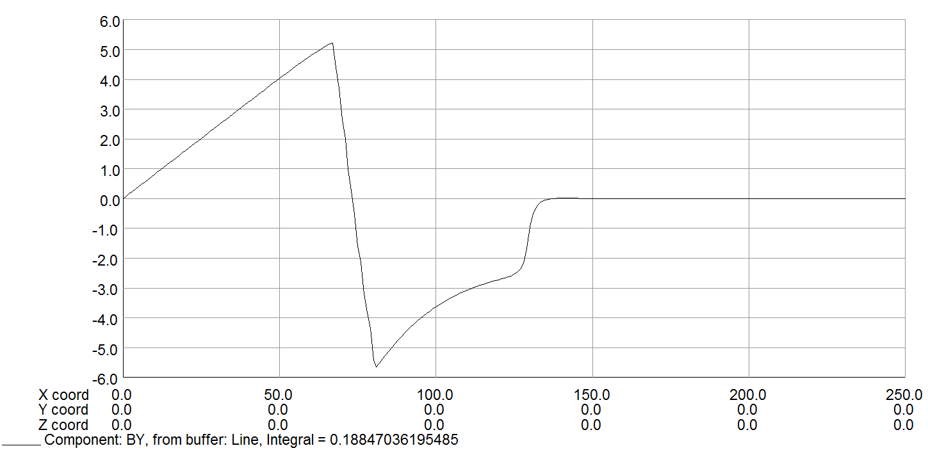
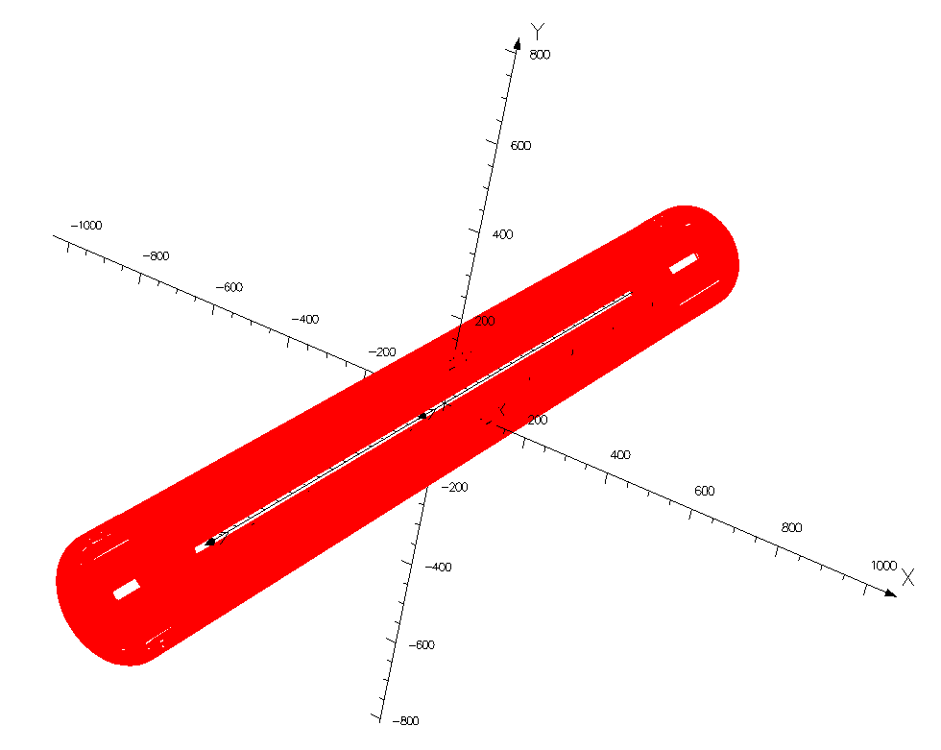
Compact Forward Magnet Example
Direct Wind, NbTi, Actively Shielded eRHIC Q1PF
Q1PF B_{y} Field
Quad Field
Zero Field Region
“Pole Tip Field” = 4.4 T
B_{Y} (T)
Main Coil
Shield Coil
Return Flux
X (mm)
R_{apt} = 55 mm
Efficiency Factor = 90%
G_{net} @ 275 GeV = 80.8 T/m
Forward magnets must have large apertures to accommodate neutrons and forward charged particles.
But combination of large aperture and large gradient mean a large B-field at the coil....
However, the electron beam must be shielded from any large external fields.
Budget for outer structure was set to accommodate the electron beam pipe.

Slide 19
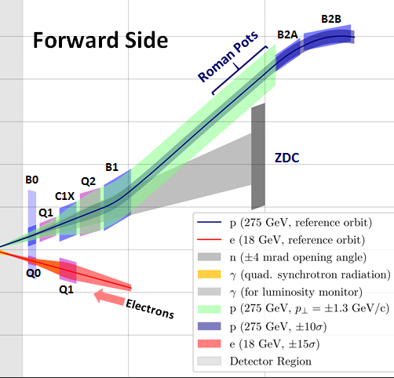
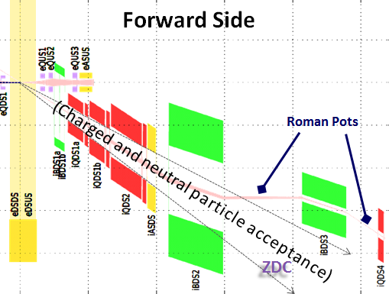
Very forward scattered particles
The very forward scattered particles are critical to detect for elastic/diffractive physics and not detectable in main detector.
Proton
eRHIC
Note:
Main detector acceptance starts at 35 mrad
Full p_{T} coverage of proton critical for physics
p_{T} = p’_{L} sin(Θ) p’_{L} > 97% of p_{Beam}
0.65 < Θ (mrad) < 10
  → 0.2 GeV < p_{t} < 1.3 GeV
small p_{T}-acceptance limited by
beam divergence, emittance and beta-function
  rule of thumb keep 10σ between
  Roman Pot and beam
large p_{T}-acceptance limited by magnet apertures
JLEIC

Slide 20
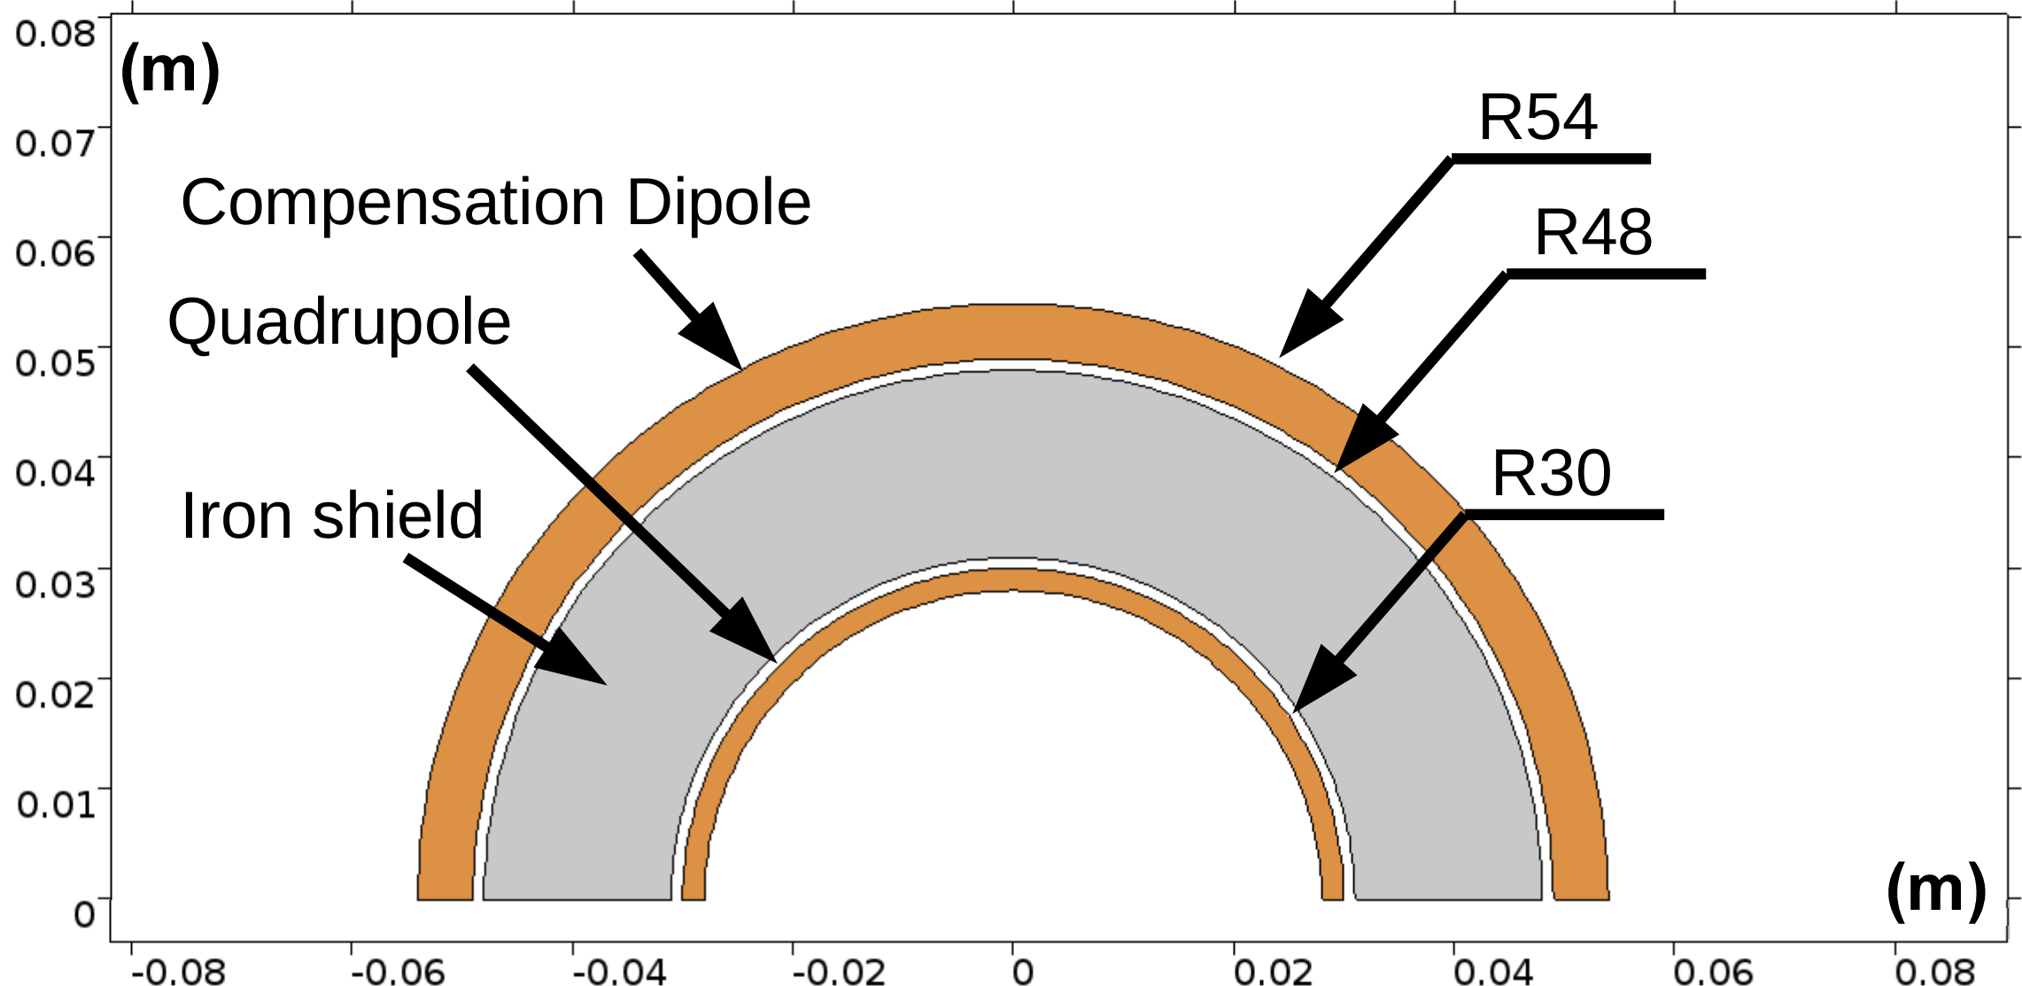
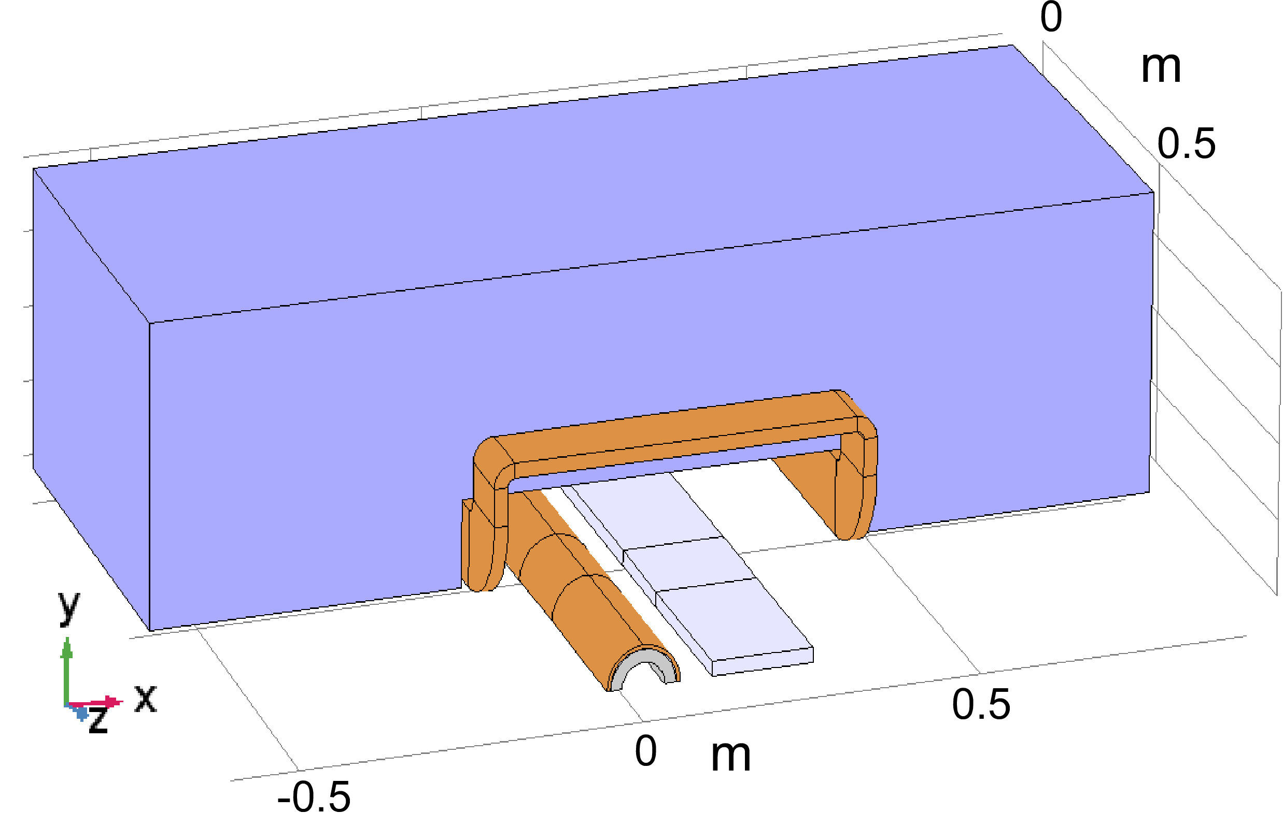
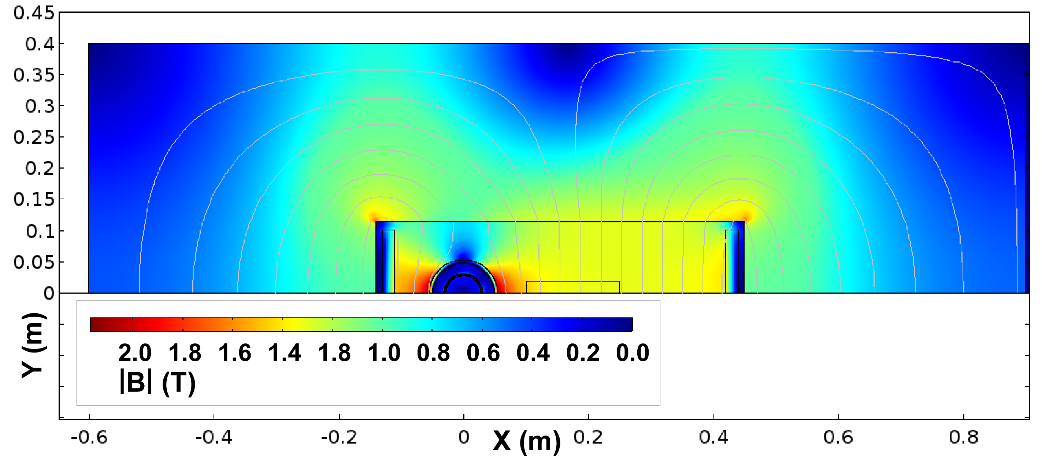
Shielding e-Beam Inside Spectrometer Dipole
eRHIC B0PF/Q0EF
1.3 T Cancel Coil Detail
B0 Magnetic Yoke
Magnet is aligned with the e-beam, so p-beam enters at 25 mrad angle.
Superconducting Coils
Q0EF
Both eRHIC and JLEIC need to pass an e-beam through main aperture of first hadron spectrometer dipole (B0PF).
eRHIC even places a quad (Q0EF) inside.
This slide shows how, with a combination of a bucking dipole and passive shielding, this can be accomplished.
There are also other options for doing this with various tradeoffs possible.
e-Beam
Experimental
Detector Here

Slide 21
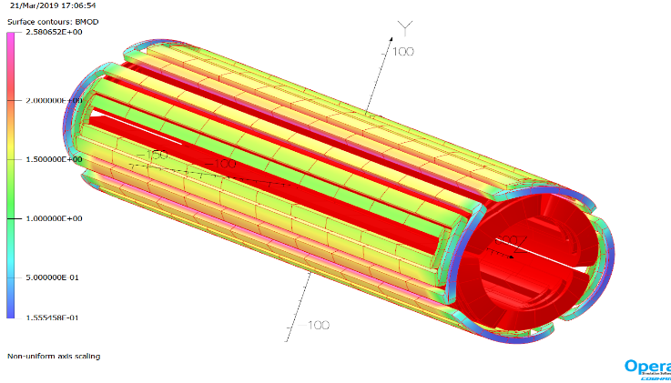
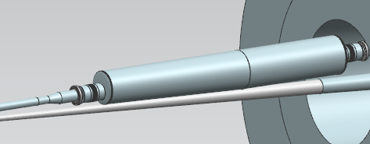
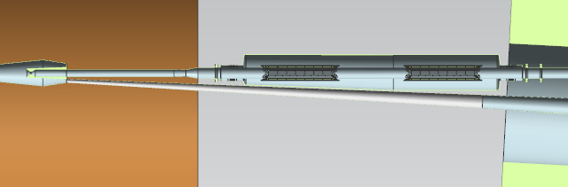
JLEIC Magnets and Component Integration
JLEIC iQUS1a
IR designs require production of many new challenging magnets (fortunately NbTi seems to be ok and Nb₃Sn may not be needed).
JLEIC Example
(Magnet yoke not shown)
But there are still quite significant engineering challenges in order to fit everything in very
restricted available
space!
e beam
eQUS1
eQUS2
Detector Solenoid
ion beam
~2.6 m
iBDS1

Slide 22
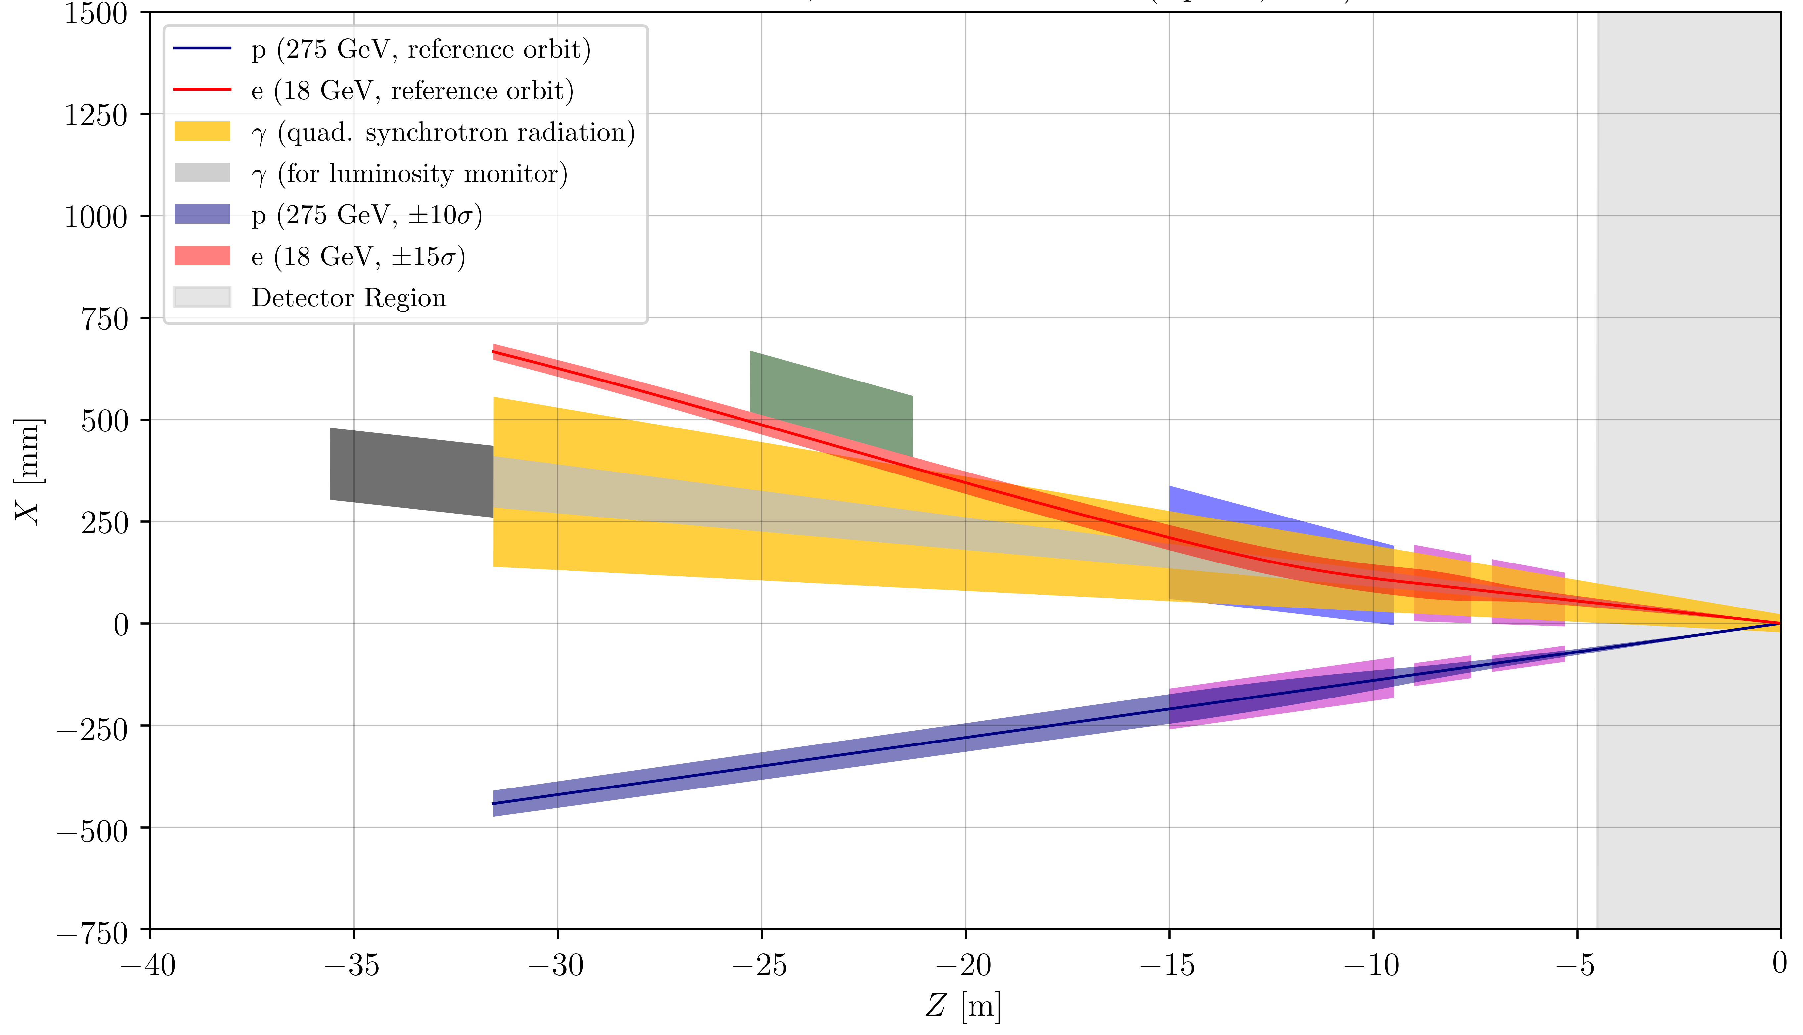
eRHIC Rear Side Magnet Apertures
eRHIC Example
Dipole bend to separate e-beam from lumi photons and quad synrad fan and analyze rear going electrons from physics events.
e-Tagger
Electrons
Lumi Monitor
Bethe-Heitler γs
Tapered aperture magnets
For eRHIC, the e-polarimetry chicane is located elsewhere.
Synrad
Protons
Rear Side

Slide 23
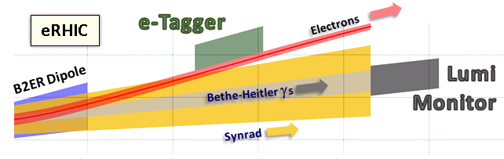
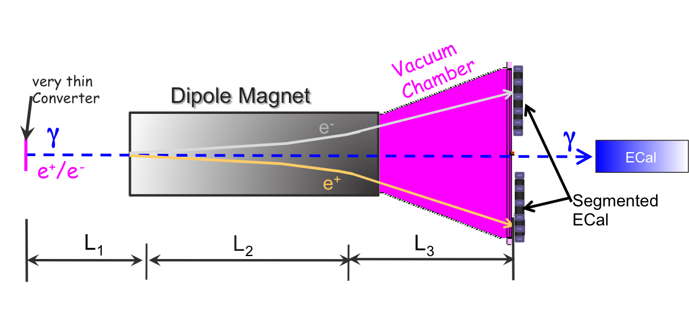
Requirements for Lepton Beam
Luminosity Detector
Concept:
Use Bremsstrahlung ep → epγ as reference cross section
different methods:
  Bethe Heitler, QED Compton, Pair Production
Hera: reached 1-2% systematic uncertainty
Goals for Luminosity Measurement:
Integrated luminosity with precision δL/L< 1%
Measurement of relative luminosity:
physics-asymmetry/10 → ~10⁻⁴ – 10⁻⁵
EIC challenges:
with 10³³ cm⁻²s⁻¹ one gets on average 23 bremsstrahlungs
photons/bunch for proton beam
→ A-beam Z²-dependence
Need more sophisticated solution
BH photon cone < 0.03 mrad
→ acceptance completely dominated by lepton beam size
Lumi Monitor Schematic
pair spectrometer
low rate
High precision measurement for physics analysis
The calorimeters are outside of the primary synchrotron radiation fan
zero degree photon calorimeter
high rate
Fast feedback for machine tuning
measured energy proportional to # photons
subject to synchrotron radiation
Workgroup explores common issues

Slide 24
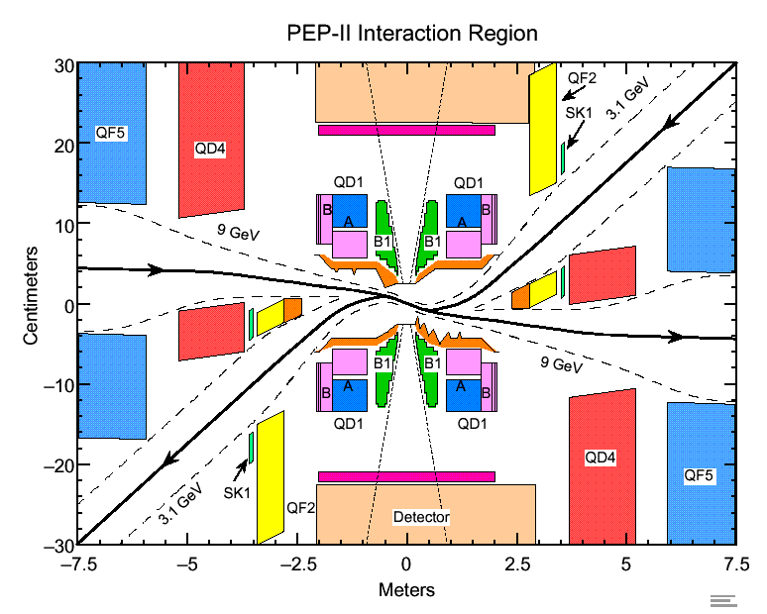
Managing Synrad Backgrounds at an EIC
Look to have only soft bends, well upstream of the IR region.
And use upstream masks to control upstream synrad that is unavoidably generated.
Look to limit the maximum synrad critical energy to be less than 40 keV (k-edge of W).
Look to let residual synrad fan pass completely though central detector region on to absorbers and masks far from IP.
Look to block as much synrad backscatter albedo as possible with downstream masks.
For eRHIC rear side design the rear side apertures are tapered to allow passage of synrad cone generated by upstream quads.
B-Factory designs must take into account complex synrad masking
B-Factories put our challenges in perspective.
In addition to using existing synrad codes to estimate and mitigate the anticipated backgrounds, we also collaborate with B-factory experts who have a lot of experience dealing with such backgrounds.

Slide 25
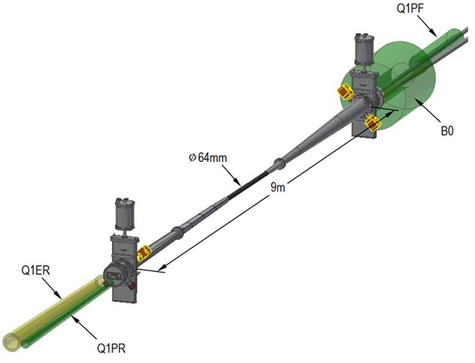
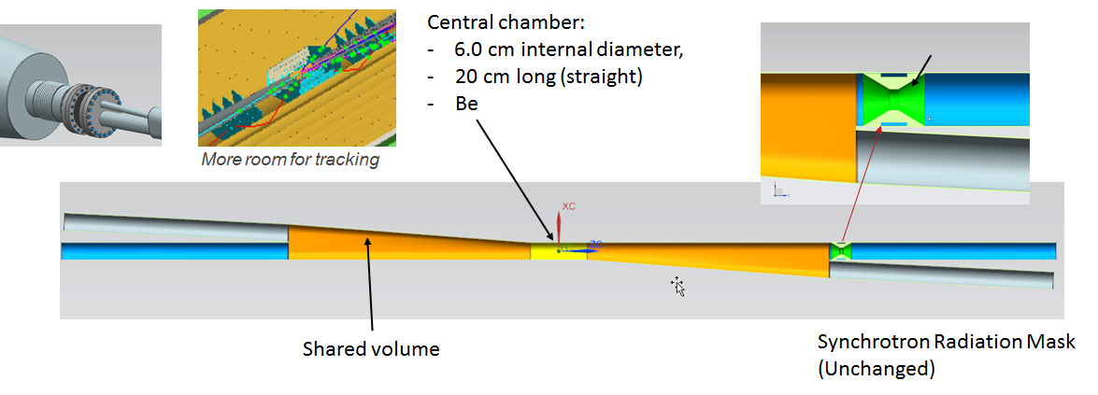
Detector Beam Pipes for an EIC
eRHIC Central Beam Pipe
Small diameter, thin walled Be in center region.
Smooth tapers and transitions to limit energy deposited by beam in trapped modes (wakes).
Need to provide beam tube cooling and for any Higher Order Mode (HOM) damping absorbers.
Need to provide adequate vacuum pumping.
eRHIC / Beast plans include in situ bakeout.
JLEIC Central Beam Pipe

Slide 26
... and there is still plenty more work that needs be done to realize an EIC
EICUG IR / Luminosity Working Group
interface between accelerator / IR design and the
physics requirements
proper implementation of the physics program in particular for forward / backward detection
Conveners:
• Accelerator / IR: C. Montag (BNL), V. Morozov (JLab)
• Physics: C. Hyde (ODU), A, Kiselev (BNL)
EICUG Working Group on Polarimetry
plan / develop the optimal methods and techniques for
measuring the electron and ion beam polarization with high
precision
Conveners
E.-C. Aschenauer (BNL), D. Gaskell (JLab)

Slide 27
...and I would like to thank many people
Elke-Caroline Aschenauer
Roman Martin
Tim Michalski
Vasiliy Morozov
Robert Palmer
Renuka Rajput-Ghoshal
Dmitry Romanov
Michael Sullivan
Mark Wiseman
Holger Witte
...for much of the material presented today.

