Slide 1

GPDs Studies at the EIC
Salvatore Fazio
Brookhaven National Lab
8th Workshop of the APS topical Group on Hadronic Physics
Denver CO
10-12 April 2019
Notes:
S. Fazio – Brookhaven National Laboratory

Slide 2
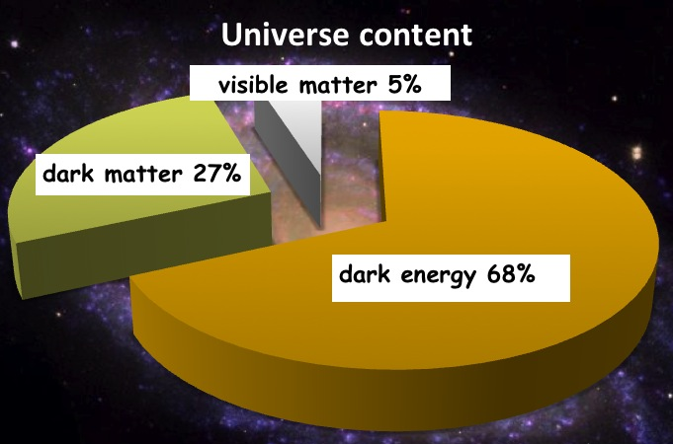
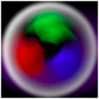

What do we know?
This is us !!!
protons, neutrons, electrons
Proton
10⁻¹⁵m
increase
beam energy
Quarks and Gluons
10⁻¹⁷m
To investigate the nucleon’s partonic structure, the previous and only e+p collider, HERA, was built
The x (of Bjorken) variable: fraction of the nucleon’s momentum carried by the interacting parton
HERA’s discovery:
Gluon density dominates at x<0.1
Proton:
Quark-Masses: ~1% M_{p}
Mass of the “visible matter” is completely dominated by gluons, QCD dynamics
→ We need a high-energy high-luminosity polarized Electron-Ion Collider!
Notes:
Counter-intuitively the best way is through an EM process: DIS
y = inelasticity = fraction of the incoming electron energy carried by photon in the rest frame of the nucleon
The structure function F2 is sensitive to the sum of quark and anti-quark momentum distribution in the nucleon.
The apparent scaling of the data with Q2 at large x in early DIS data from SLAC was termed “Bjorken scaling” and motivated the parton model.
In the parton model, FL = 0, while in QCD, it is directly proportional to the gluon structure function, FL(x,Q2) ~ aS xG(x,Q2), at low x.
DGLAP: fixed x -> evolution along Q2
sigma (gamma N) = sig_T + sig_L
sig_L ~ FL
sig_tot ~ F2/Q^2
\frac{d^2 \sigma^{ep \rightarrow eX}}{dx dQ^2} = \frac{4 \pi \alpha^2_{e.m.}}{xQ^4} \left[ \left(1-y+\frac{y^2}{2} \right ) F_2(x,Q^2) - \frac{y^2}{2} F_L(x,Q^2) \right]

Slide 3



Most Compelling Physics Goals
How are sea quarks and gluons, and their spins, distributed
in space and momentum inside the nucleon?
How do the nucleon properties emerge from them and
their interactions?
What happens to the gluon density in nuclei?
Does it saturate at high energy?
gluon
emission
gluon recombination
?
Does this saturation give rise to a gluonic matter with universal properties in all nuclei, even proton?
=
How does a dense nuclear environment affect the quarks and gluons, their correlations and interactions?
How do color-charged quarks and gluons, and colorless jets, interact with a nuclear medium?
How do the confined hadronic states emerge from these quarks and gluons?
How do the quark-gluon interactions create nuclear binding?
See Y. Hatta’s talk on plenary session

Slide 4
Multi-dimensional Imaging of Quarks and Gluons
Wigner functions
offer unprecedented insight into confinement and chiral symmetry breaking
W(x,b_{T},k_{T})
Momentum
space
Coordinate
space
∫d²b_{T}
∫ d²k_{T}
f(x,k_{T})
f(x,b_{T})
Spin-dependent 3D momentum space
images from semi-inclusive scattering
→ TMDs
Spin-dependent 2D coordinate space (transverse) + 1D (longitudinal momentum) images from exclusive scattering
→ GPDs
Direct access to W(x,b_{T},k_{T})
for gluons through diffractive di-jets measurements at an EIC under investigation
Yoshitaka Hatta, Bo-Wen Xiao, and Feng Yuan [Phys. Rev. Lett. 116, 202301 (2016)]
H. Mäntysaari, N. Mueller, B. Schenke [arXiv:1902.05087]

Slide 5



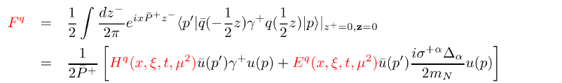
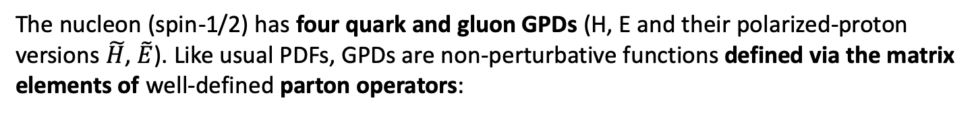
Generalized Parton Distributions
Longitudinal momentum & helicity distributions
transverse charge & current densities
parton densities
form factors
GPDs
The nucleon (spin-1/2) has four quark and gluon GPDs (H, E and their polarized-proton versions $\tilde{H}$, $\tilde{E}$). Like usual PDFs, GPDs are non-perturbative functions defined via the matrix elements of well-defined parton operators:

Slide 6
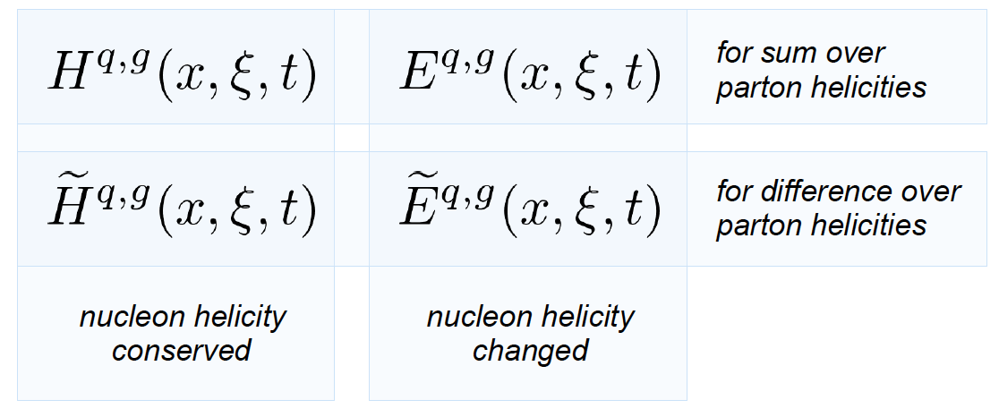
Accessing the GPDs in exclusive processes
Dominated by H
slightly dependent on E
Requires a positron beam
done @ HERA
sin(Φ_{Τ}−φ_{Ν})
governed by E and H
Requires a polarized proton-target
responsible for total orbital angular momentum through Ji sum rule
a window to the SPIN physics

Slide 7

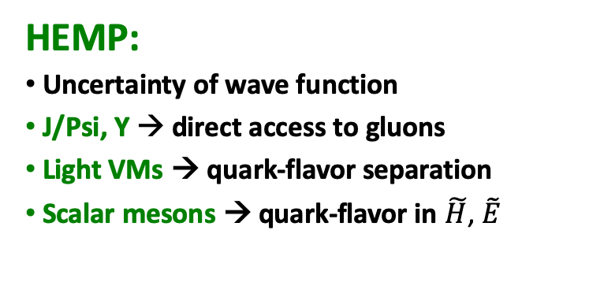
Exclusive Vector Meson and real photon production
DVCS (γ)
HEMP (ρ, ω, φ, J/ψ, Υ, π⁰)
^{γ*}
^{γ}
^{γ*}
V
IP
p
p
square 4-momentum at the p vertex:
p
p
t
t
Scale:
Q²
Q² + M²
DVCS:
Very clean experimental signature
No VM wave-function uncertainty
Access whole sets of GPDs
Hard scale provided by Q²
Sensitive to both quarks and gluons [via Q² dependence of xsec (scaling violation)
HEMP:
Uncertainty of wave function
J/Psi, Y → direct access to gluons
Light VMs → quark-flavor separation
Scalar mesons → quark-flavor in $\tilde{H}$, $\tilde{E}$
See also slide 16

Slide 8
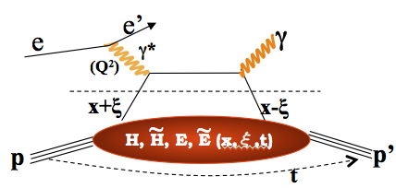
DVCS at an EIC
E.C. Aschenauer, S. F., K. Kumerički, D. Müller JHEP09(2013)093
DVCS signal
Bethe-Heitler QED bkgd.
Comprehensive EIC studies
Signal extraction “a la HERA”
xSec meas.: Specific requirements to suppress BH
keep BH/sample below 60% at high energies
Radiative Corrections evaluated
detector acceptance & smearing
t-slope: b=5.6 compatible with H1 data
|t|-binning is (3*resolution)
5% systematic uncertainties
Overlap with HERA:
Large impact on current fits at low x
Overlap with JLAB12:
Sanity check
Intermediate region:
Fine mapping of the GPDs evolution
HERA results limited by lack of statistics
EIC: the first machine to measure cross sections and asymmetries

Slide 9
DVCS at a high luminosity collider
The code MILOU by E. Perez, L Schoeffel, L. Favart [arXiv:hep-ph/0411389v1]
is Based on a GPDs convolution by: A. Freund and M. McDermott [http://durpdg.dur.ac.uk/hepdata/dvcs.html]
EIC will provide sufficient lumi to bin in multi-dimensions
wide x and Q² range needed to extract GPDs
√s = 45 GeV
√s = 140 GeV
… we can do a fine binning in Q2 and W… and even in |t|

Slide 10
BH fraction
Q²
cuts keep BH below 60% of the sample at large y > 0.5
20 x 250 GeV²
BH subtraction will be not an issue for y<0.6
BH subtraction will be relevant at lower energies and large y, in some of the x-Q² bin
BUT…
higher-lower √s kin. overlapping:
x-sec. measurements at a higher √s at low-y can cross-check the BH subtraction made at lower √s
x
y

Slide 11

Contribution from ISR
Fraction of ISR events for three Q²-bins as fct of x for two EIC beam energy combinations.
ONLY 15% of the events emit a photon with > 2% energy of the incoming electron
ISR photons with E_{γ} < 0.02 E_{e} do not result in a significant correction for the event kinematics.
q₃
DVCS
&
BH -ISR

Slide 12
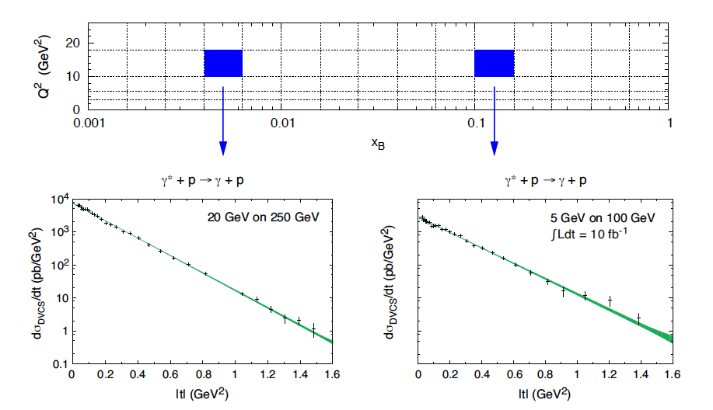
DVCS differential cross section
Luminosity: 10 fb⁻¹
Measurement dominated by systematics
Fourier transf. of dσ/dt → partonic profiles
DVCS

Slide 13
Transverse target-spin asymmetry
[E.C. Aschenauer, S. F., K. Kumerički, D. Müller JHEP09(2013)093]
Theory curves show different assumptions for E
Transversely polarized protons: sin(Φ_{Τ} − φ_{Ν})
gives access to GPD E
Access to orbital angular momentum through “Ji sum rule”
[X.D. Ji, Phys. Rev. Lett. 78, 610 (1997)]

Slide 14
DVCS-based imaging
A global fit over all mock data was done, based on: [Nuclear Physics B 794 (2008) 244–323]
Known values q(x), g(x) are assumed for H^{q}, H^{g} (at t=0 forward limits E^{q}, E^{g} are unknown)
Fourier
Fourier
Unpolarized-proton
sea-quarks
Polarized-proton
sea-quarks
Unpolarized-proton
gluons
E.C. Aschenauer, S. F., K. Kumerički, D. Müller, JHEP09(2013)093

Slide 15
Spatial Imaging – as in the EIC White Paper
E.C. Aschenauer, S. F., K. Kumerički, D. Müller, JHEP09(2013)093
Unpolarized proton
sea-quarks
Polarized proton
sea-quarks
Unpolarized proton
gluons
Shift due to GPD E
Impact of EIC (based on DVCS only):
Excellent reconstruction of H^{sea}, and H^{g} (from dσ/dt)
Reconstruction of sea-quarks GPD E
Other capabilities still to be evaluated?
GPD H-Gluon is nice but can be much better by including J/ψ
Access to GPD E-gluon → orbital momentum (Ji sum rule)
Flavor Separation of GPDs (VMP and/or DVCS on deuteron)
Nuclear imaging (modification of GPDs in p+A collisions)

Slide 16
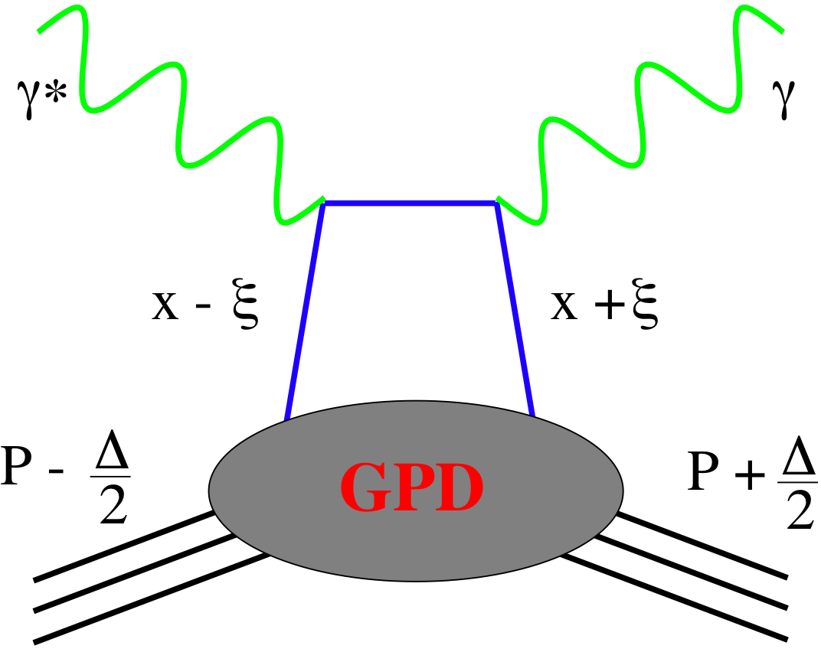
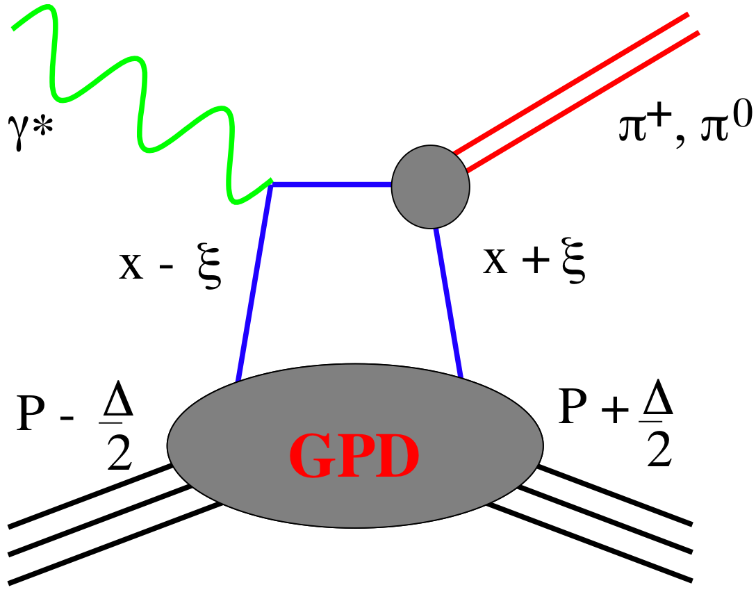
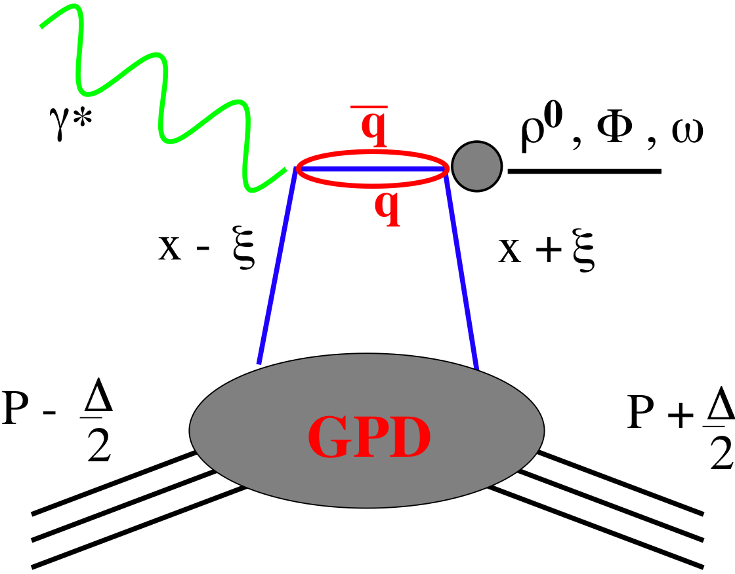








How to separate flavors?
Hard Exclusive Meson Production (HEMP) → a powerful tool!
quantum numbers of final state select different GPD
DVCS
pseudo-scalar mesons
vector mesons
$$H^{q }$$
$$E^{q }$$
$$\tilde{H^{q}}$$
$$\tilde{E^{q}}$$
$$\tilde{H^{q}}$$
$$\tilde{E^{q}}$$
$$H^{q }$$
$$E^{q }$$
π⁰ | 2Δu+Δd
η | 2Δu−Δd
ρ⁰ | 2u+d, 9g/4
ω | 2u−d, 3g/4
φ | s, g
ρ⁺ | u−d
J/ψ, Y | g
DVCS on protons and neutrons also separates quark u/d flavors
We do not have a real neutron target → Use Deuterium

Slide 17
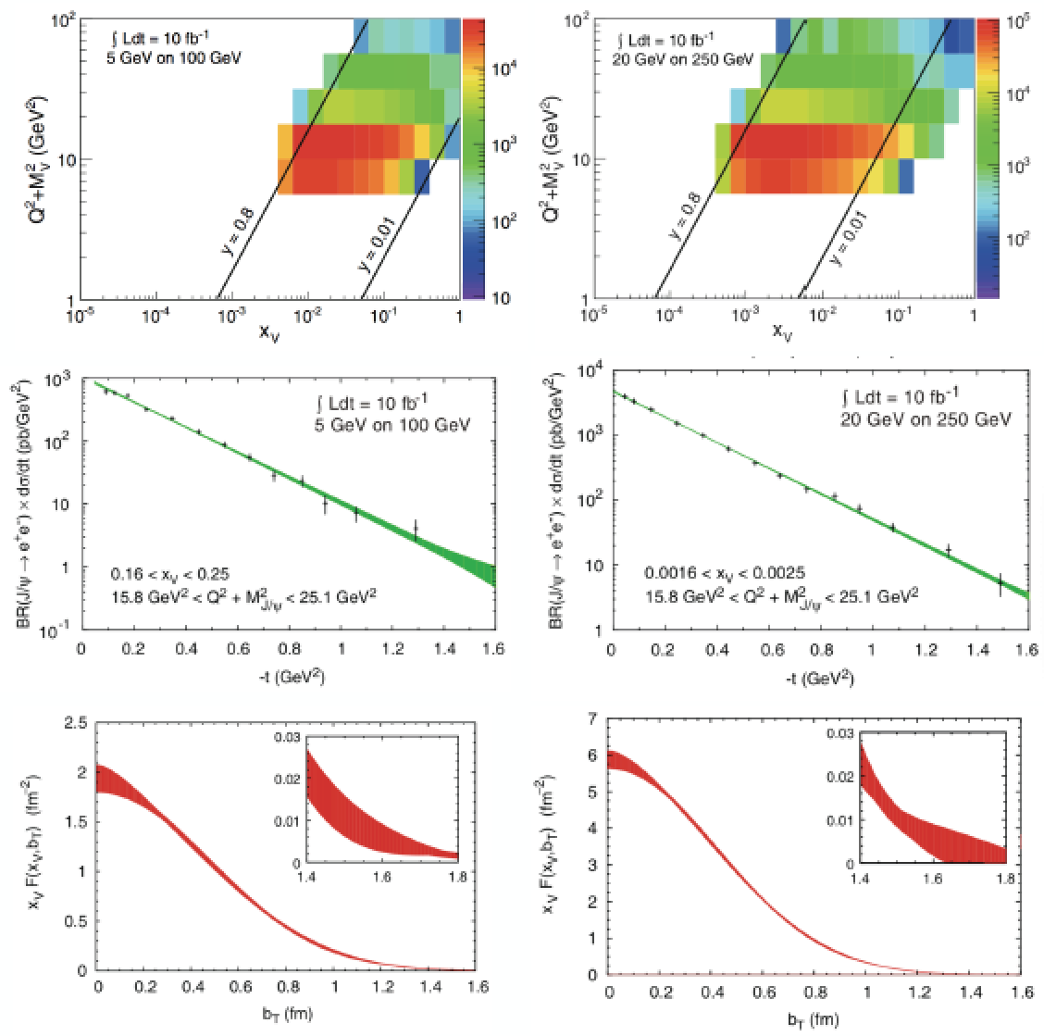
Imaging gluons with J/ψ
EIC White Paper
Luminosity: 10 fb⁻¹
Measurement dominated by systematics
Fourier transf. of dσ/dt → partonic profiles
Average gluon densities

Slide 18
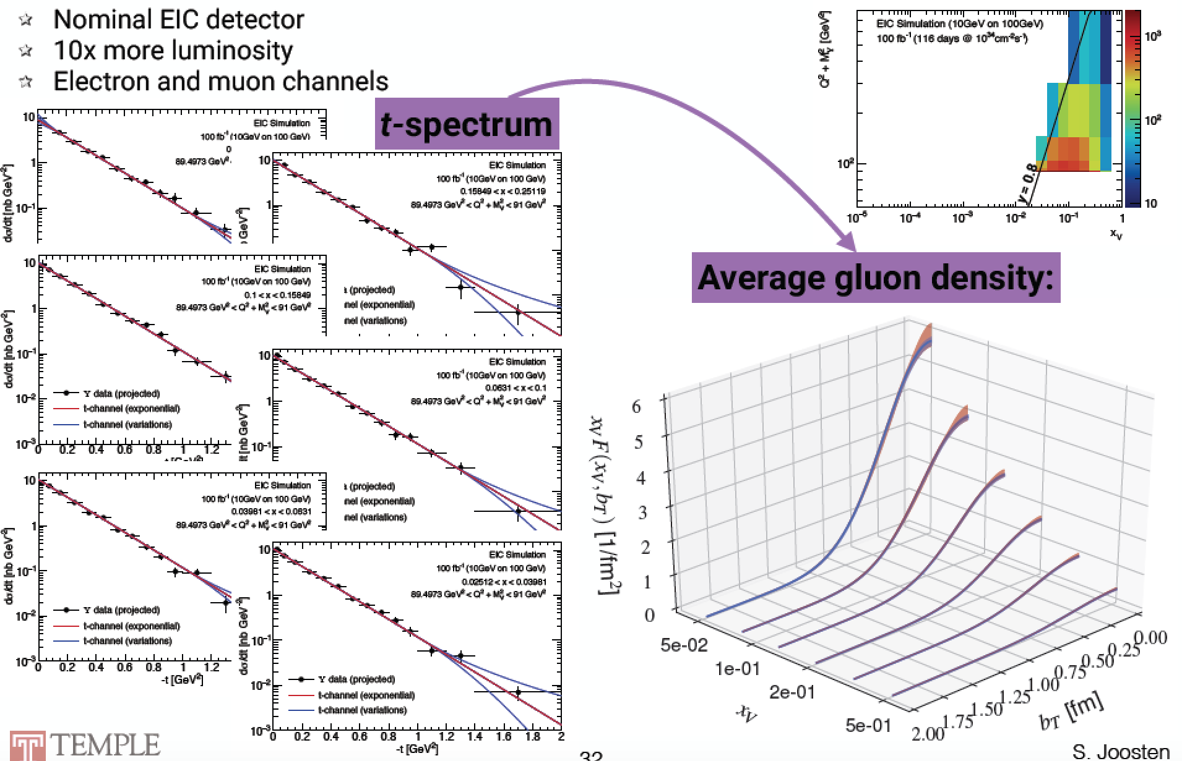
Imaging gluons with Y(1s)
S. Joosten, Z.-E. Meziani 2018 EICUG Meeting

Slide 19
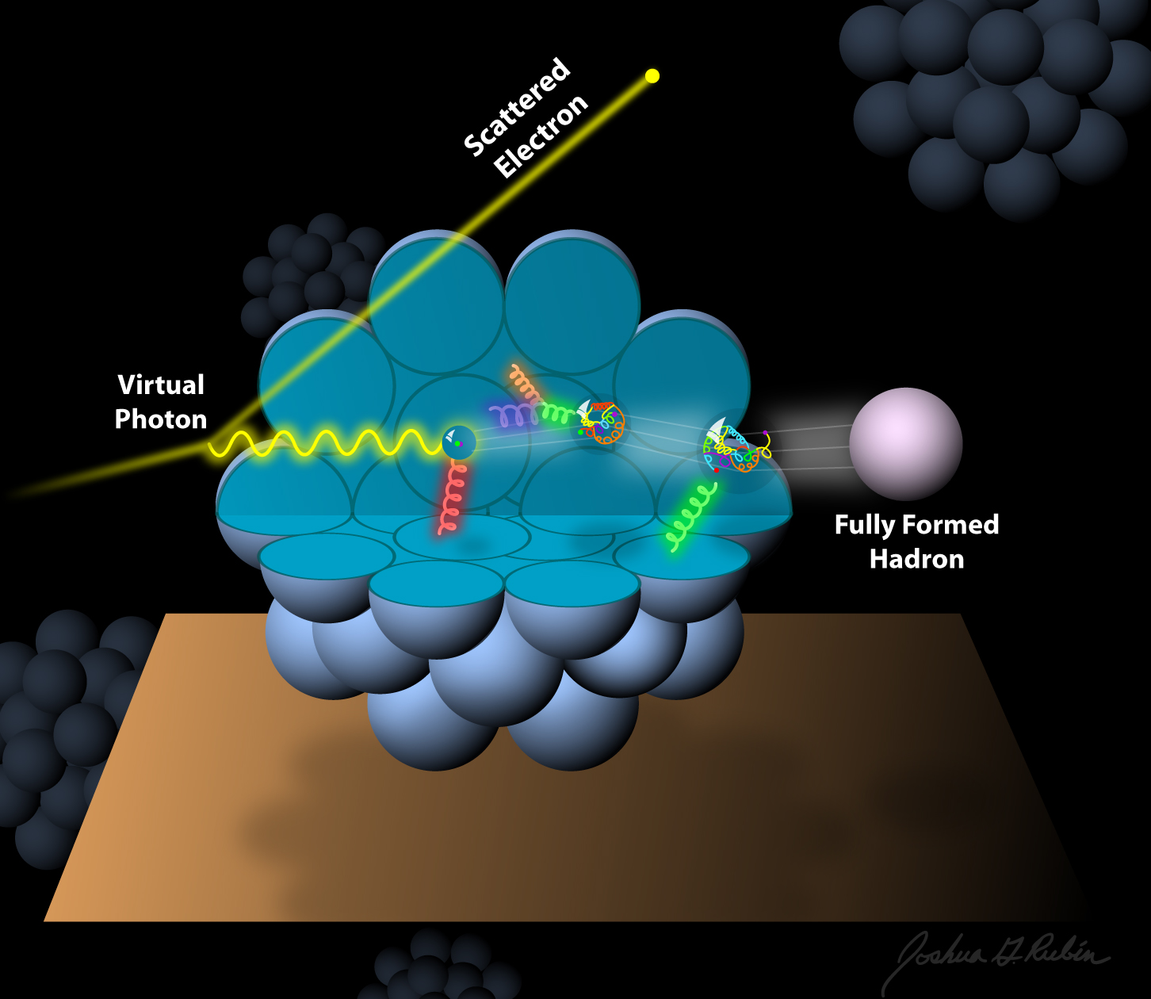
Nuclear PDFs and GPDs
an Electron-Ion Collider (EIC)
How does the nuclear environment affect the distribution of quarks and gluons and their interaction in nuclei?
Incoming
Electron Beam
Where does the saturation of the gluon density set in?

Slide 20
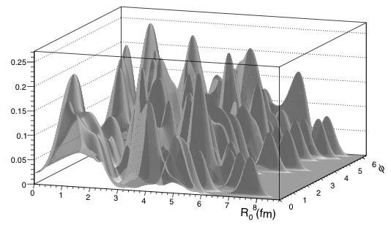
Imaging the gluons in nuclei
Diffractive physics in eA
Measure spatial gluon distribution in nuclei
Reaction:
→ Momentum transfer t = |pAu-pAu′|²
  Hot topic:
      Lumpiness of source?
      Just Wood-Saxon+nucleon g(b_{T})
      coherent part probes “shape of black disc”
      incoherent part (large t) sensitive to “lumpiness” of the source [= proton] (fluctuations, hot spots, ...)
e + Au → e′ + Au′ + J/ψ, φ, ρ
possible Source distribution with b_{T}^{g} = 2 GeV⁻²
suppress
by detecting
break-up
neutrons
J/ψ
Sensitive to saturation effects!
Physics requires forward scattered nucleus needs to stay intact
Veto breakup through neutron detection
φ
Notes:
spin-dependent gluon distribution

Slide 21
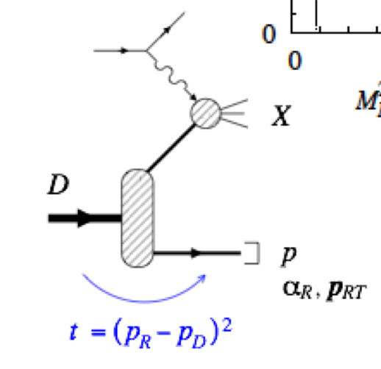
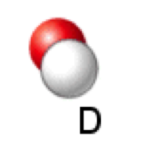
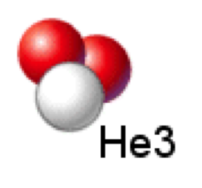
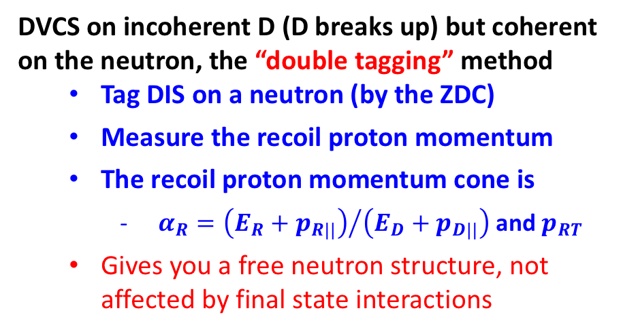
Measuring neutron via spectator tagging
Possibility to study neutron structure
DVCS on neutron compared to proton is important for flavor separation
𝛾
DVCS on incoherent D (D breaks up) but coherent on the neutron, the “double tagging” method
  Tag DIS on a neutron (by the ZDC)
  Measure the recoil proton momentum
  The recoil proton momentum cone is
    $α_{R}={\left(E_{R}+p_{R||}\right)}/{\left(E_{D}+p_{D||}\right)}$ and $p_{RT}$
  Gives you a free neutron structure, not affected by final state interactions
Polarized He3 also experimentally easy, proton contributions cancel out!

Slide 22
Summary on GPDs
We studied and quantified the capability of an EIC to provide high precision and fine binned DVCS and meson production measurements of both cross sections and asymmetries over a large phase-space. This opens an unprecedented possibility for
Accurate 2+1D imaging of the polarized and unpolarized quarks and gluons inside the hadrons, and their correlations
Investigate the proton-spin decomposition puzzle (total orbital angular momentum)
To do list
Include mesons in global fits (flavor separation, precision on gluons)
Study of GPDs in nuclei (and possible gluon saturation effects)

Slide 23
Back up

Slide 24
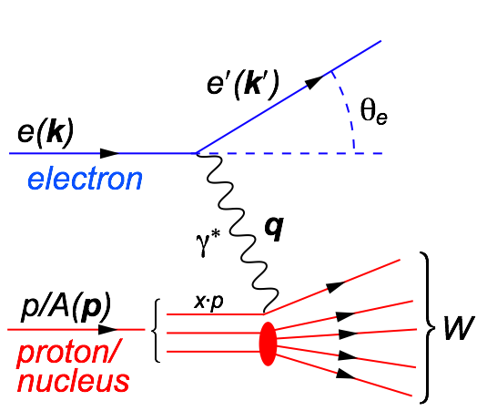
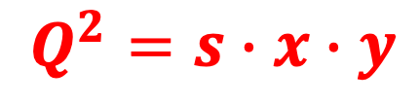
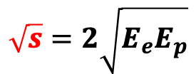
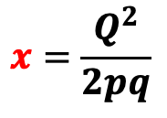
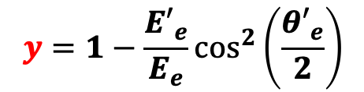
Our Tool: Deep Inelastic Scattering
Kinematics:
$$Q^{2}=2E_{e}{E′}_{e}\left(1−\cos{θ_{e′}}\right)=−{\left(k−k^{′}\right)}^{2}=−q^{2}$$
Measure of resolution power
$$y=1−\frac{{E′}_{e}}{E_{e}}\cos^{2}\left(\frac{{θ′}_{e}}{2}\right)$$
$$x=\frac{Q^{2}}{2pq}$$
$$\sqrt{s}=2\sqrt{E_{e}E_{p}}$$
Measure of inelasticity
Measure of momentum fraction of struck quark
Center-of-mass energy of electron-hadron system
All variables are correlated:
$$Q^{2}=s∙x∙y$$
DIS:
As a probe, electron beams provide unmatched precision of the electromagnetic interaction
Direct, model independent, determination of kinematics of physics processes
Indirectly probes gluons with high precision

Slide 25
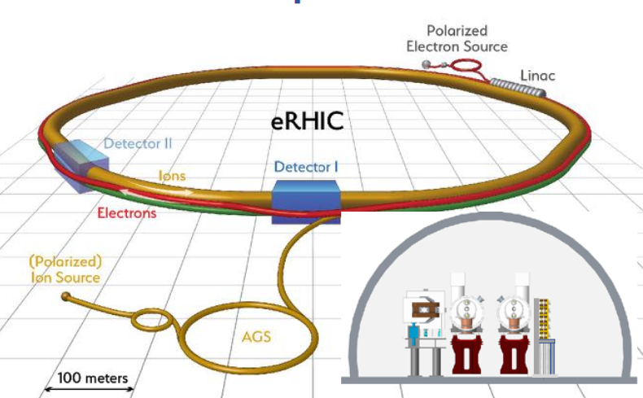
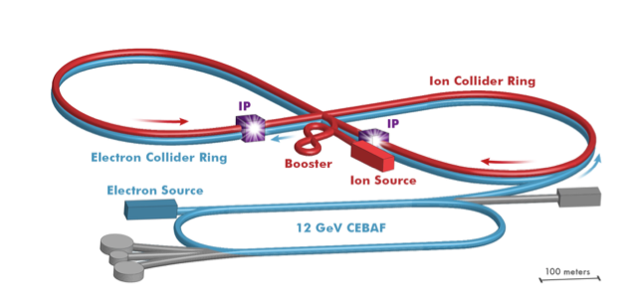
Ingredients for a High Resolution “Femtoscope”
Large center-of-mass coverage: √s_{e+p} = 20 - 100(140) GeV
Access to wide kinematic range in x and Q²
Polarized electron and hadron beams:
access to spin structure of nucleons and nuclei
Spin vehicle to access the 3D spatial and momentum structure of the nucleon
Nuclear beams:
Accessing the highest gluon densities → amplification of saturation phenomena
High luminosity: L_{ep} ~ 10³⁴ cm⁻²sec⁻¹ (→ 100-1000 times HERA)
Detailed mapping the 3D spatial and momentum structure of nucleons and nuclei
Access to rare probes
All these requirement can be addressed by a future Electron-Ion Collider
JLEIC

Slide 26
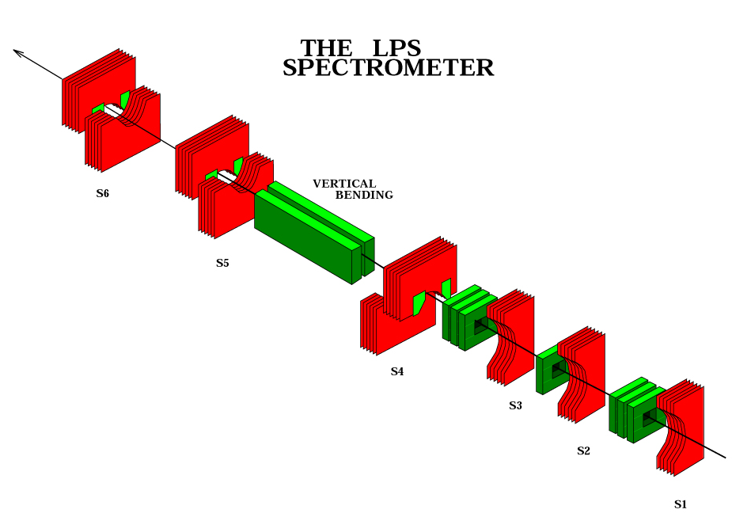
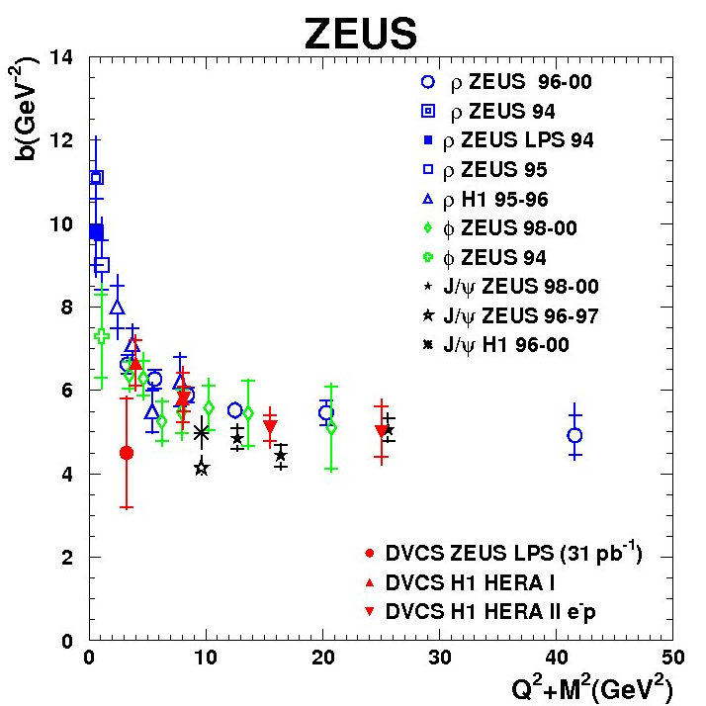
DVCS & VMPs at HERA
ZEUS released the only DVCS
measurement with Roman Pots
Spectrometer at HERA
No p-dissociation background
0.08 < |t| < 0.53 GeV²
Low geometrical acceptance → low statistics
This detector was removed after the HERA II upgrade → L = 31 pb⁻¹
dσ/dt measured for the first time by a direct measurement of the outgoing proton 4-momentum using the Leading Proton Spectrometer (roman pots)
The ZEUS result still statistically compatible with H1, but hints for a flatter trend

Slide 27
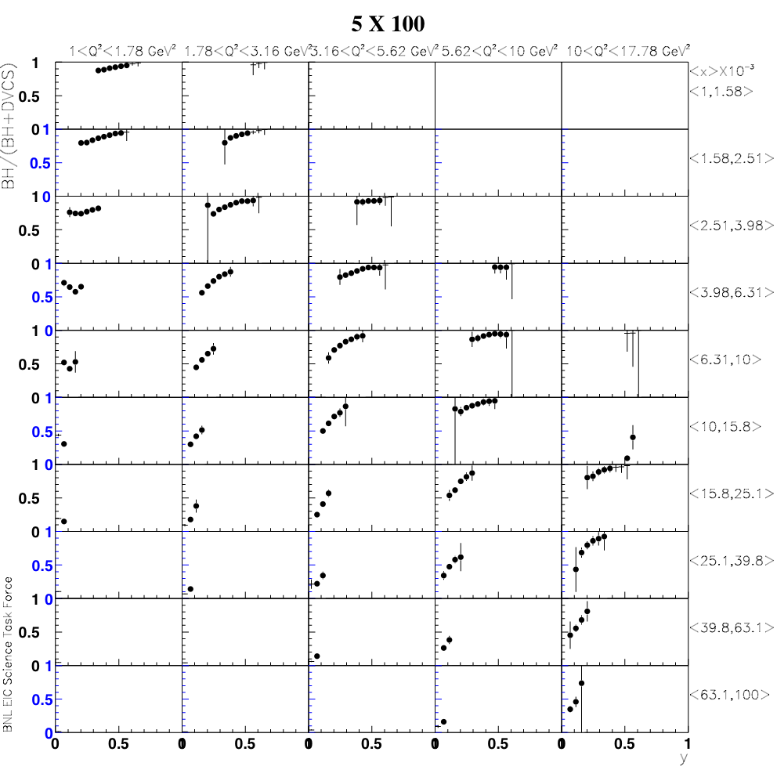
BH fraction
Q²
5 x 100 GeV²
BH subtraction will be relevant at low beam-energies, at large y, depending on the x-Q² bin
x
y

Slide 28
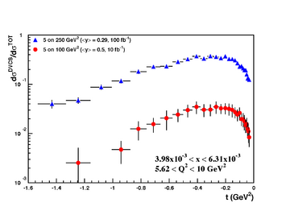
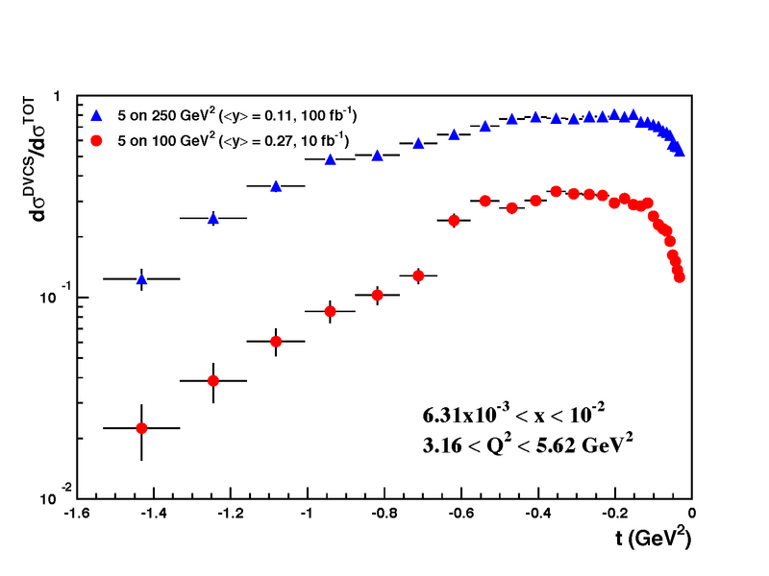
Rosenbluth separation
Rosenbluth separation of the electroproduction cross section into its parts
The statistical uncertainties include all the selection criteria to suppress the BH
exponential |t|-dependence assumed

