Slide 1

Recent Theoretical Developments in Small Systems
Matthew D. Sievert
with Jacquelyn Noronha-Hostler
8th Workshop of the
Topical Group on Hadron Physics
Friday, April 12, 2019
M. Sievert
Theory Developments in Small Systems
1 / 26

Slide 2
Overview
1. “Dilute,” “Dense,” and Small Systems
2. “Flow” and “Non-Flow” in Multiparticle Cumulants
3. Non-Flow Correlations in the Literature
M. Sievert
Theory Developments in Small Systems
2 / 26

Slide 3
Overview
1. “Dilute,” “Dense,” and Small Systems
2. “Flow” and “Non-Flow” in Multiparticle Cumulants
3. Non-Flow Correlations in the Literature
M. Sievert
Theory Developments in Small Systems
2 / 26

Slide 4
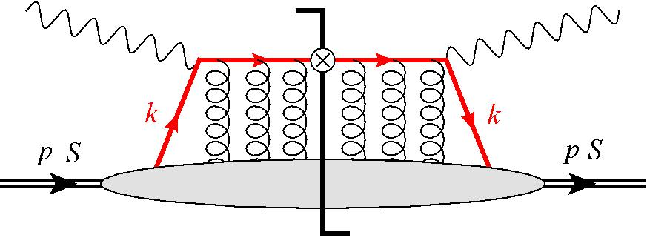
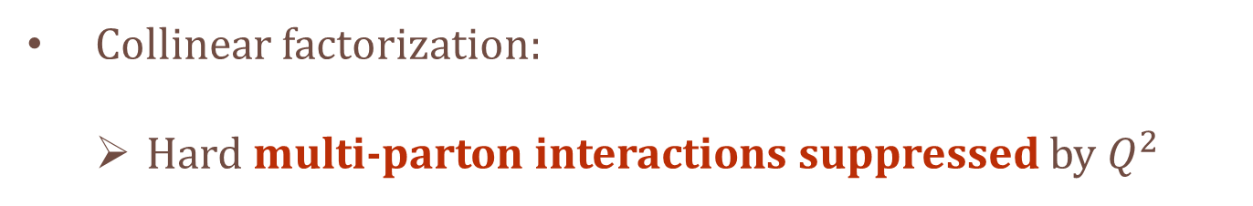
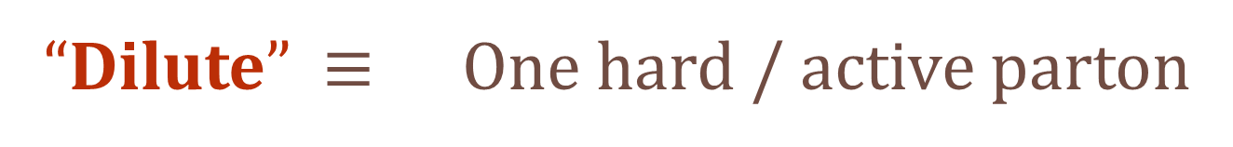
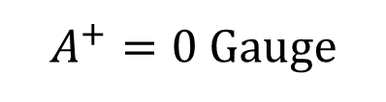
“Dilute” Scattering in the Twist Expansion
Inclusive DIS
on the proton
$A^{+}=0$ Gauge
“Dilute” $≡$ One hard / active parton
Collinear factorization:
  Hard multi-parton interactions suppressed by $Q^{2}$
M. Sievert
Theory Developments in Small Systems
3 / 26

Slide 5
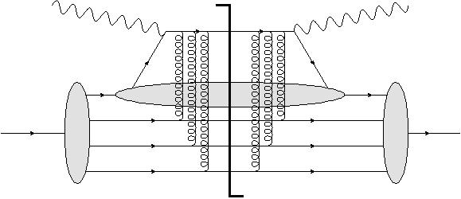
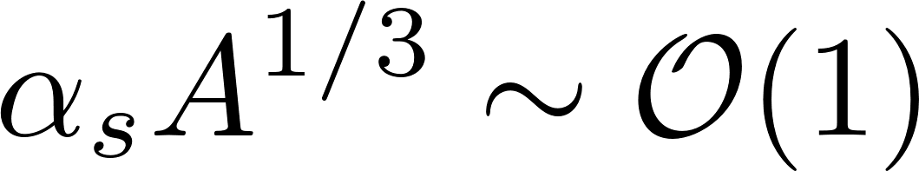
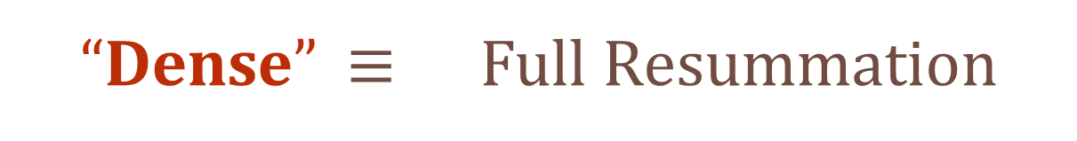
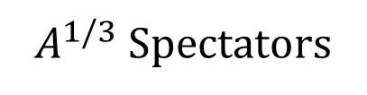
“Dense” Scattering in (e.g.) a Heavy Nucleus
$A^{1/3}$ Spectators
“Dense” $≡$ Full Resummation
Requires a parametrically large charge density
Enhancement of independent multi-parton interactions
M. Sievert
Theory Developments in Small Systems
4 / 26

Slide 6
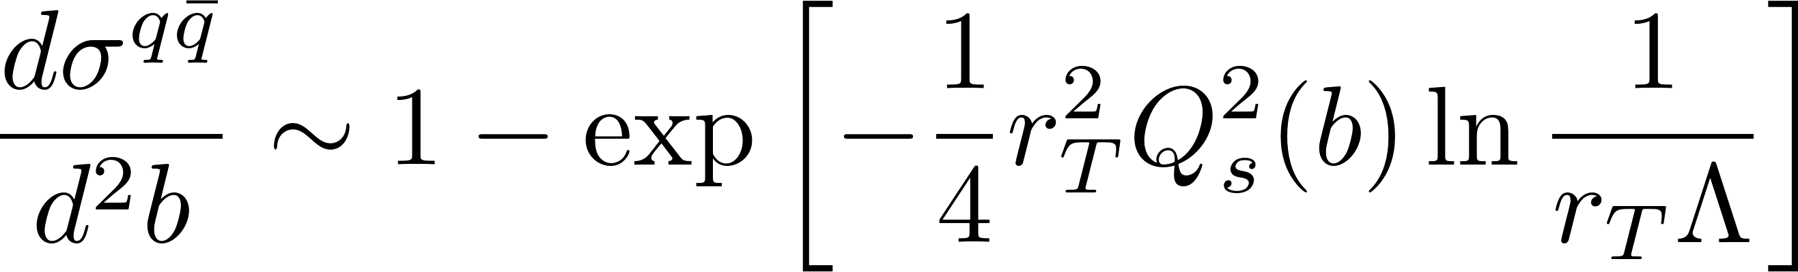
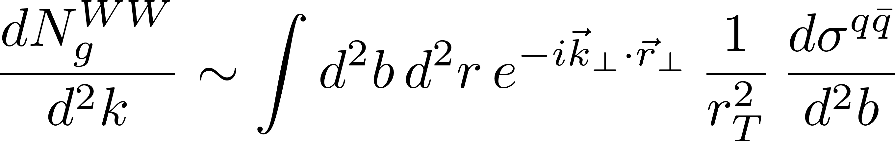
“Dilute / Dense” – Classical Gluon Fields
A parton scattering multiple times on independent sources can be exponentiated
Resummation is equivalent to a background of classical gluon fields
A. Accardi et al., Eur. Phys. J. A52 (2016)
M. Sievert
Theory Developments in Small Systems
5 / 26

Slide 7
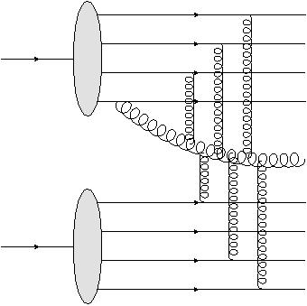
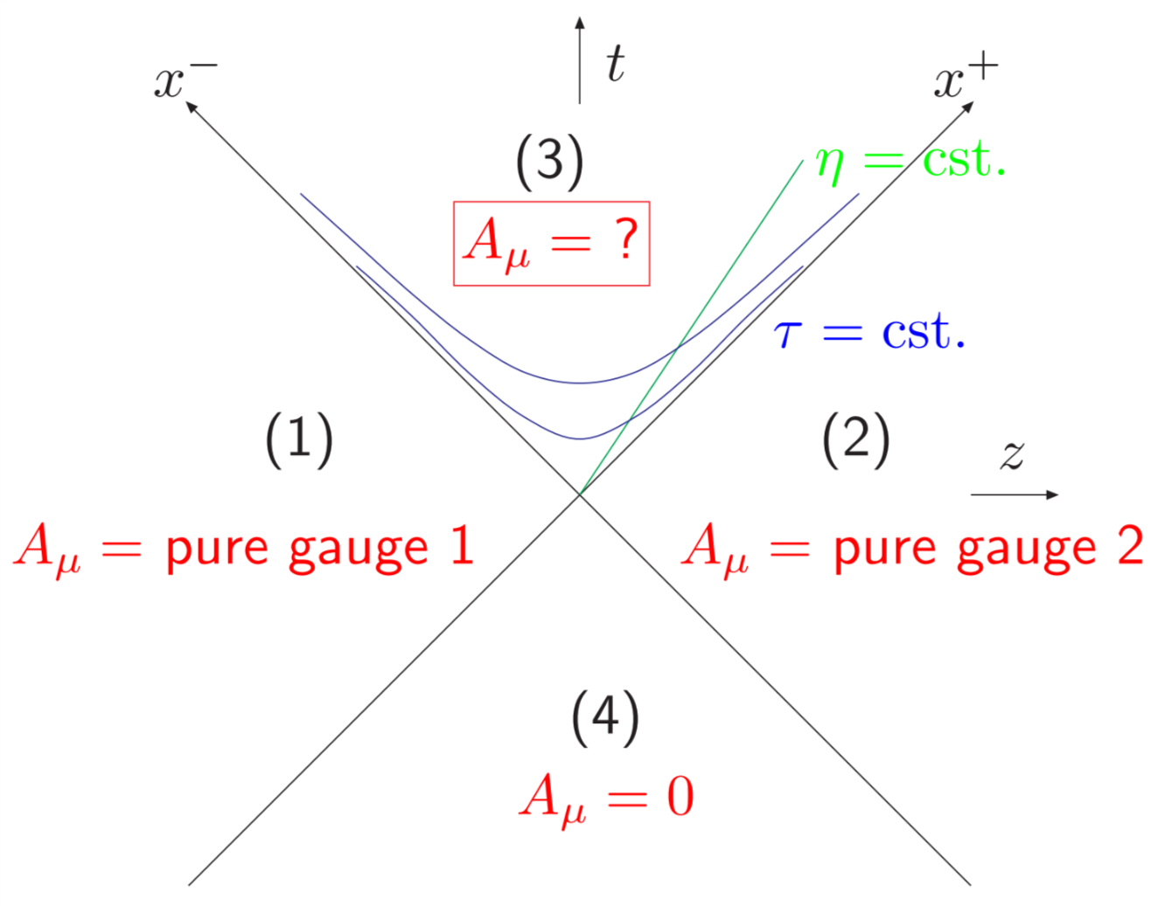
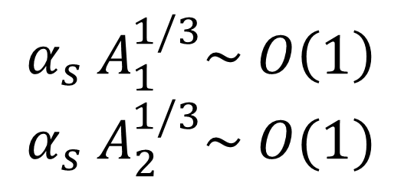
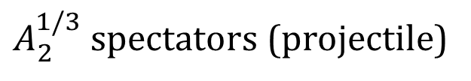
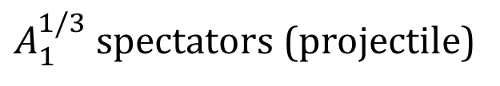
“Dense / Dense” – Classical Yang Mills
$A_{1}^{1/3}$ spectators (projectile)
$$α_{s} A_{1}^{1/3}\sim O\left(1\right)$$
$$α_{s} A_{2}^{1/3}\sim O(1)$$
$A_{2}^{1/3}$ spectators (projectile)
A “Dense / Dense” scattering requires simultaneous resummations
  This task is currently unsolved in QCD
What is done is to carry over the conclusion about classical fields
  Solve the classical Yang-Mills equations for two colliding nuclei
T. Lappi, Phys. Lett. B643 (2006)
M. Sievert
Theory Developments in Small Systems
6 / 26

Slide 8
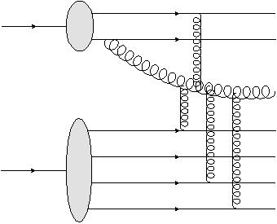
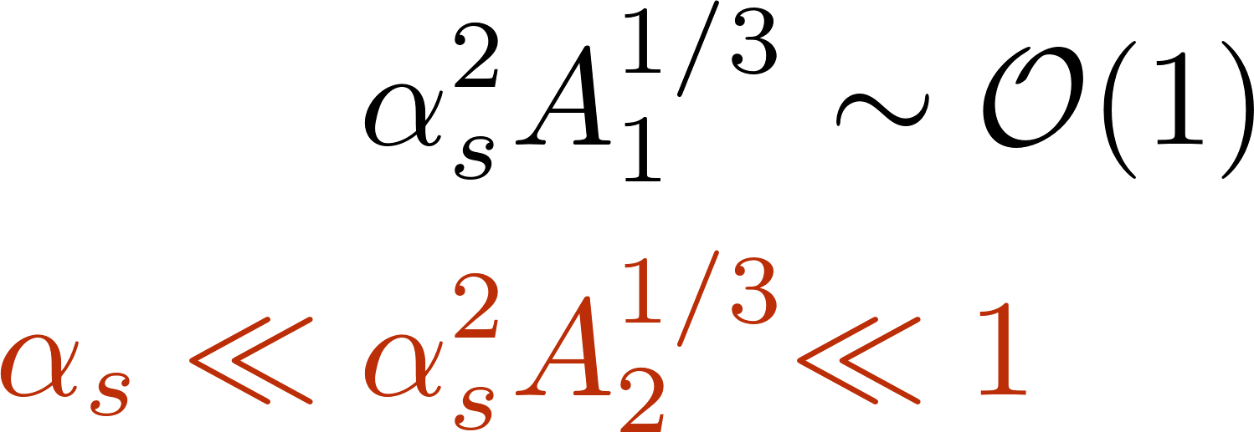


“Semi-Dilute / Dense” – Bridging the Known to the Unknown
$$A_{1}^{1/3}$$
$$A_{2}^{1/3}$$
Asymmetric collision: step from dilute/dense toward dense/dense
  High density target: fully resummed multiple rescattering
  Moderate density projectile: density-enhanced corrections order by order
Appropriate for “heavy-light” ion collisions, i.e.) Cu + Au
Y. Kovchegov, D. Wertepny, Nucl. Phys. A906 (2013)
A. Kovner, M. Lublinsky, Int. J. Mod Phys. E22 (2013)
M. Sievert
Theory Developments in Small Systems
7 / 26

Slide 9
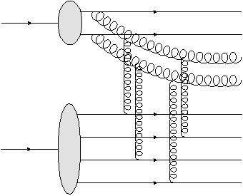
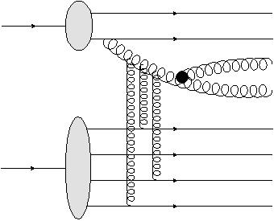
Correlations in Small Systems: Buyer Beware
“Glasma graphs”
“Dilute / dense”
“Dilute / dilute”
Included
Excluded
For high densities, correlations are driven by independent emission of particles
  The high-pT “dilute” limit does not reproduce the truly “dilute” regime
Caution: high densities may be assumed for correlations in small systems!
M. Sievert
Theory Developments in Small Systems
8 / 26

Slide 10
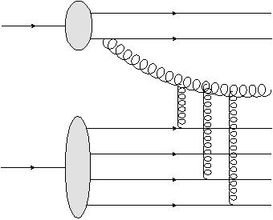
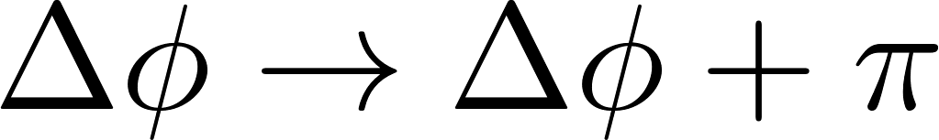
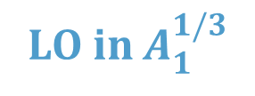

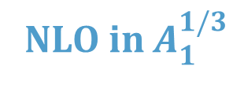



Gluon Correlations in Semi-Dilute / Dense
$$A_{1}^{1/3}$$
$$A_{1}^{1/3}$$
LO in $A_{1}^{1/3}$
NLO in $A_{1}^{1/3}$
$$A_{2}^{1/3}$$
$$A_{2}^{1/3}$$
Correlations at mid-rapidity are dominated by soft gluons
At leading-density, 2-gluon correlations are symmetric
  Reflective of Bose enhancement
Antisymmetric correlations enter at next-to-leading density
Multi-gluon correlations known up to 3 (Leading / dense) and 4 (Leading / Leading)
T. Altinoluk et al., Phys. Lett. B751 (2015), JHEP 1805 (2018)
Y. Kovchegov, D. Wertepny, Nucl. Phys. A906 (2013), A925 (2014)
Y. Kovchegov, V. Skokov, Phys. Rev. D97 (2018)
M. Sievert
Theory Developments in Small Systems
9 / 26

Slide 11
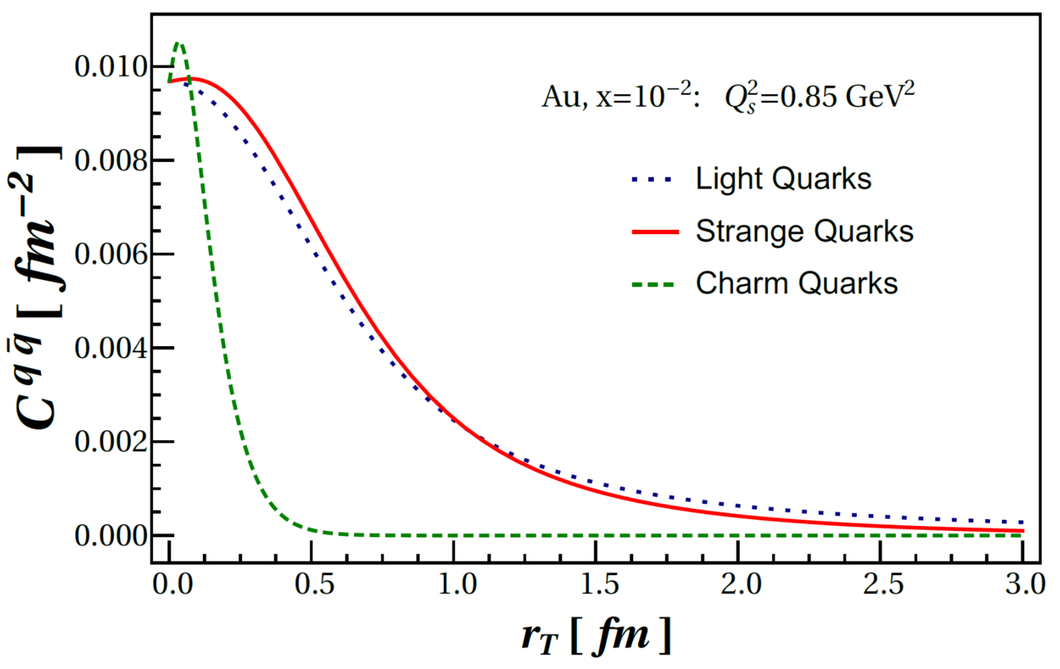
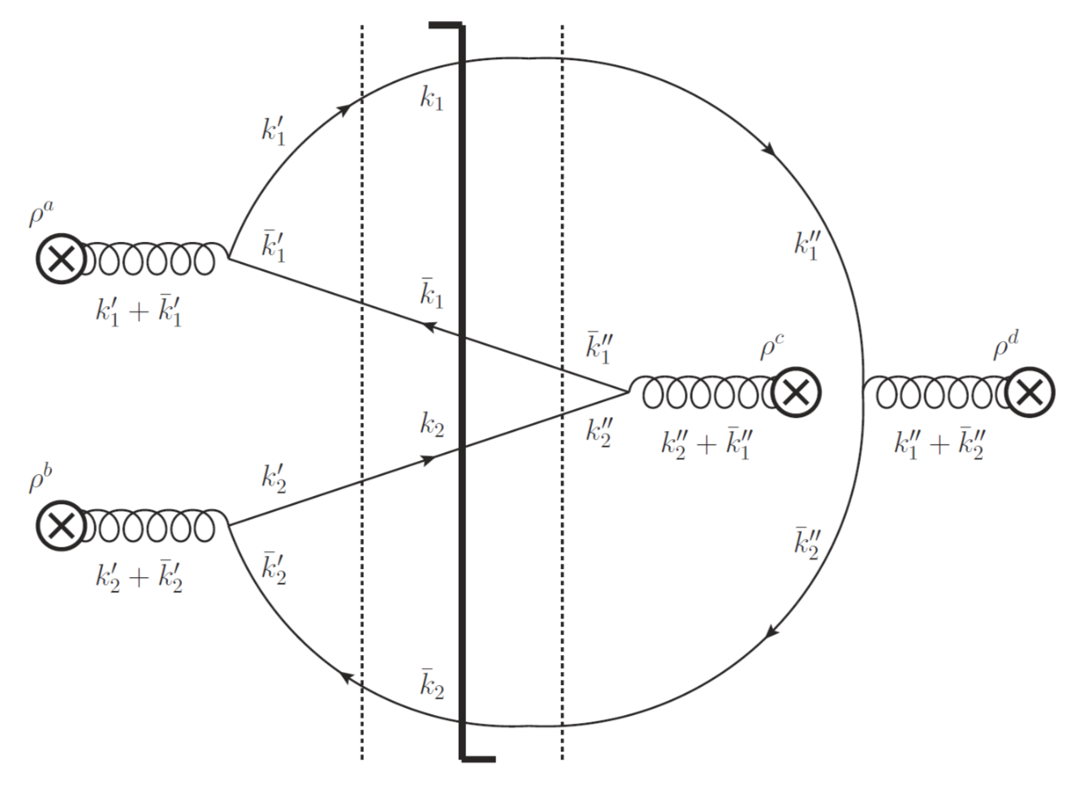
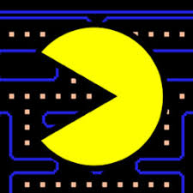
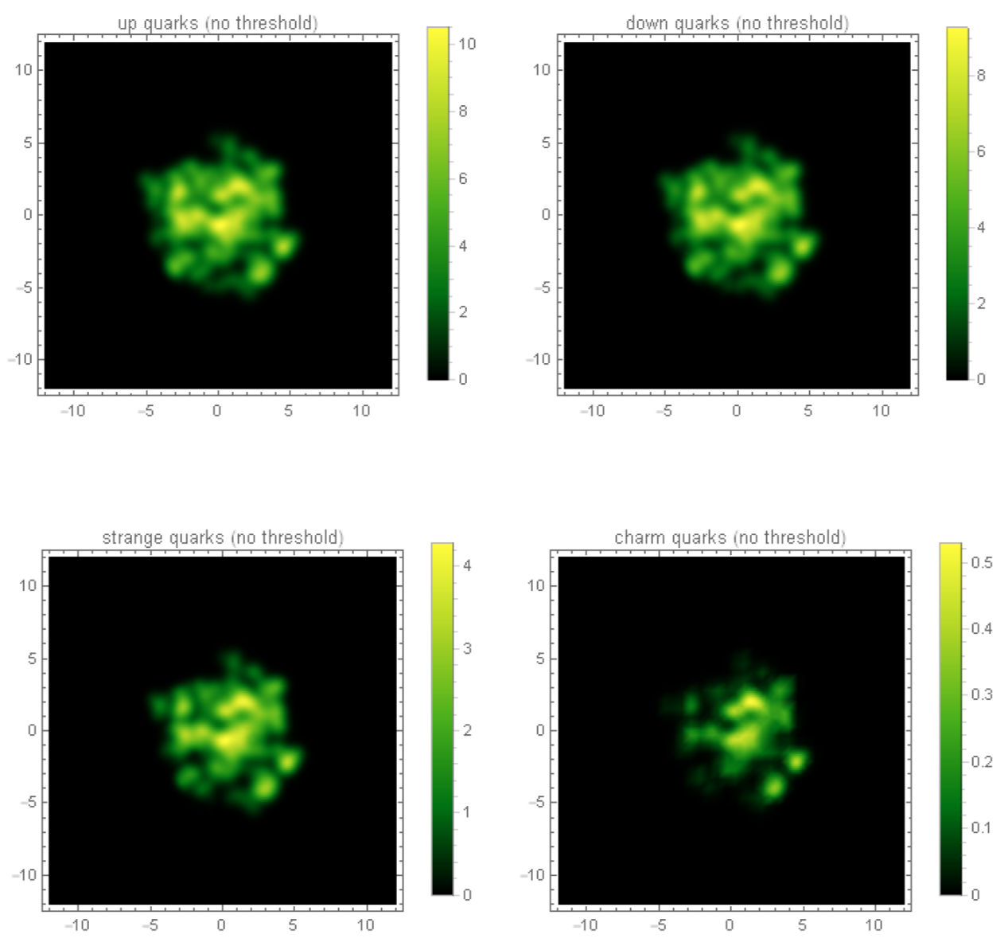
Quark Correlations in Semi-Dilute / Dense
Spatial Correlations
“Pauli Blocking” Correlations
M.D.S. et al., JHEP 1807 (2018) 003
T. Altinoluk et al., Phys. Rev. D95 (2017)
M.D.S. et al., JHEP 1902 (2019) 024
u quarks
c quarks
M.D.S. et al.,
in preparation
M. Sievert
Theory Developments in Small Systems
10 / 26

Slide 12
Overview
1. “Dilute,” “Dense,” and Small Systems
2. “Flow” and “Non-Flow” in Multiparticle Cumulants
3. Non-Flow Correlations in the Literature
M. Sievert
Theory Developments in Small Systems
11 / 26

Slide 13
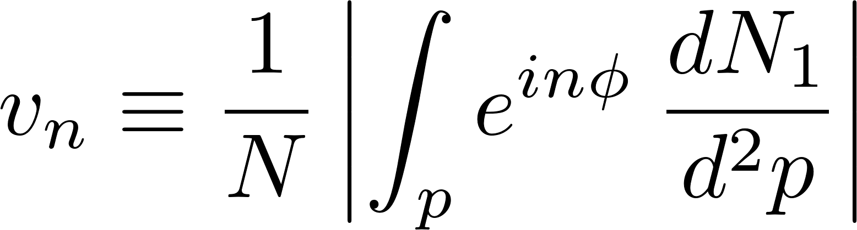
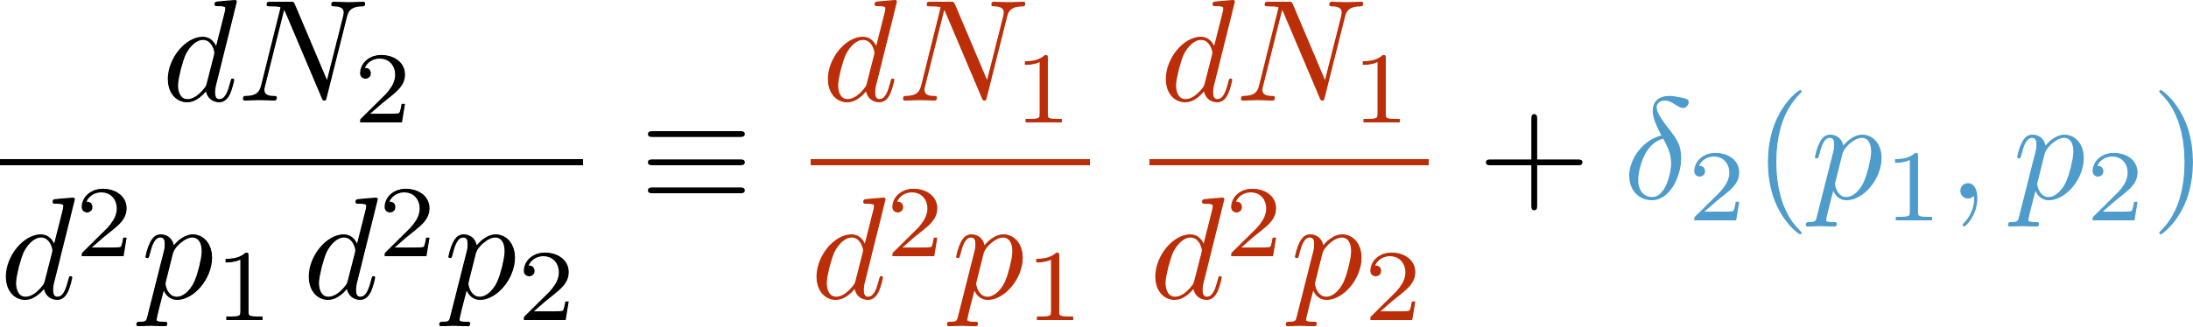
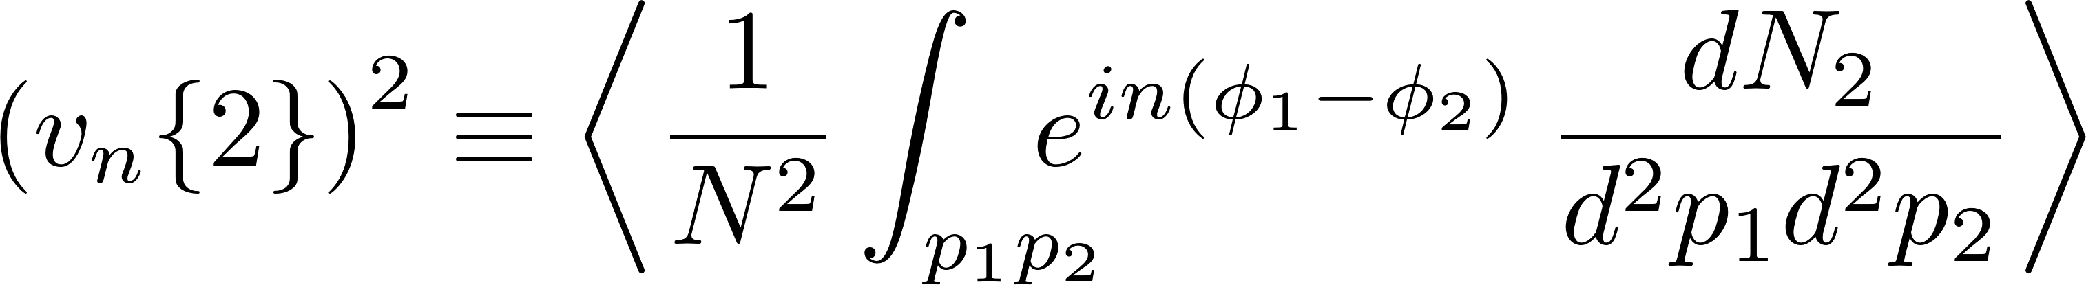
“Flow” versus “Non-Flow”
“Flow” refers to any source of anisotropy in the single-particle distribution in an event
Multi-particle distributions arise both from independent production (flow) and dynamical correlations (non-flow)
“Flow”
“Non-Flow”
Cumulants are observables that are differently sensitive to flow and non-flow
M. Luzum, H. Petersen, J. Phys. G41 (2014)
M. Sievert
Theory Developments in Small Systems
12 / 26

Slide 14
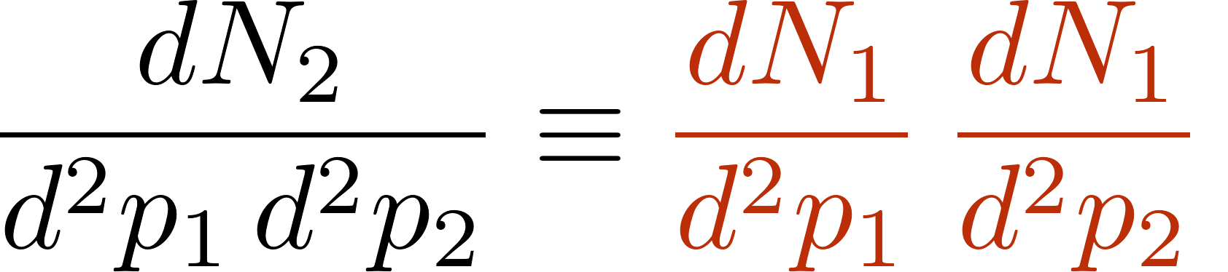
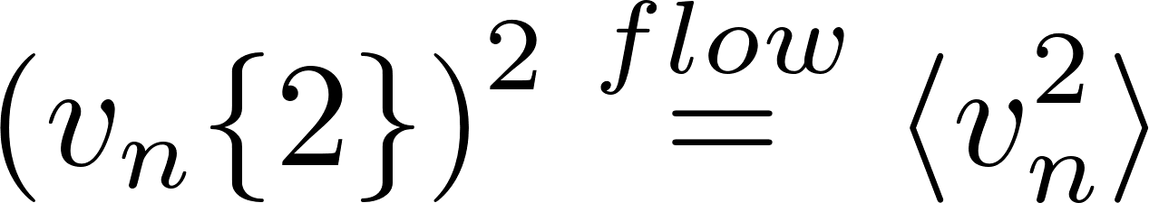
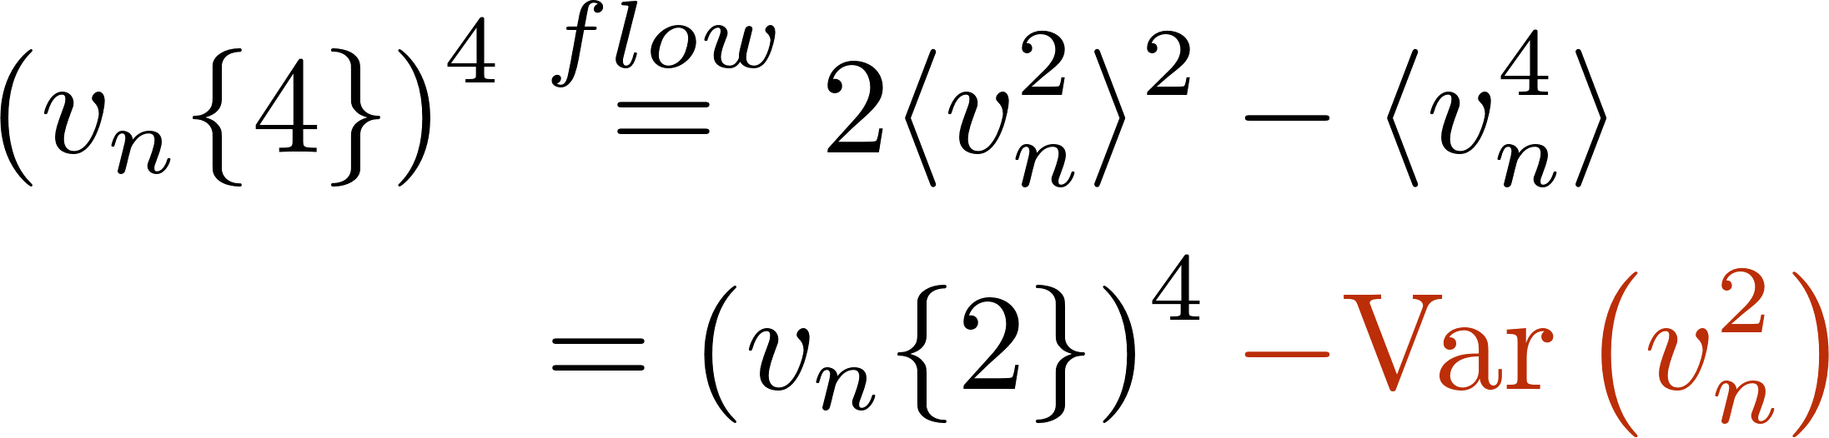
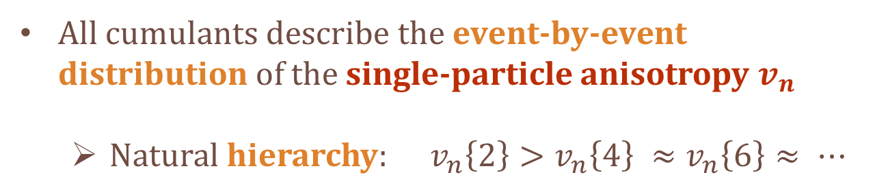
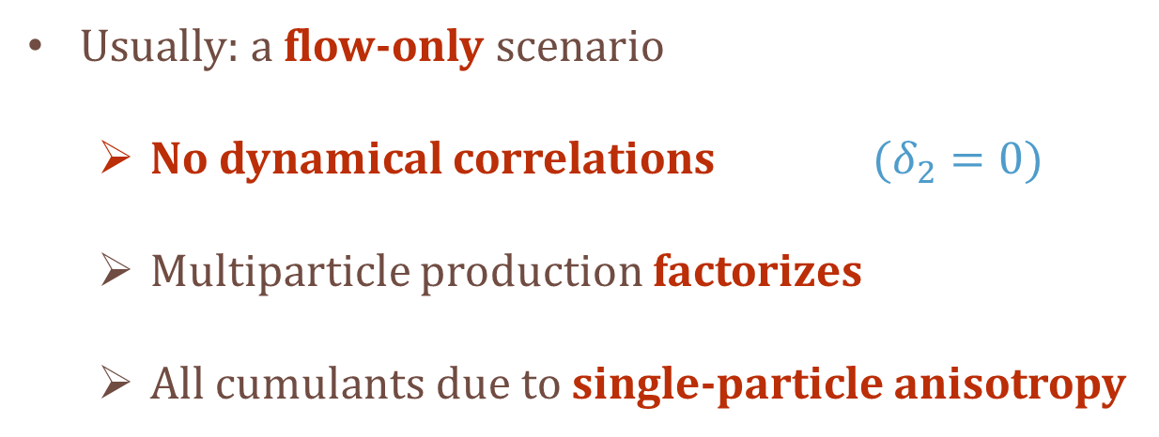
Multiparticle Cumulants: Flow Scenario
Usually: a flow-only scenario
  No dynamical correlations $(δ_{2}=0)$
  Multiparticle production factorizes
  All cumulants due to single-particle anisotropy
“Flow” only
All cumulants describe the event-by-event distribution of the single-particle anisotropy $v_{n}$
  Natural hierarchy: $v_{n}\left\{2\right\}>v_{n}\left\{4\right\} ≈v_{n}\left\{6\right\}≈ ⋯$
M. Luzum, H. Petersen, J. Phys. G41 (2014)
M. Sievert
Theory Developments in Small Systems
13 / 26

Slide 15
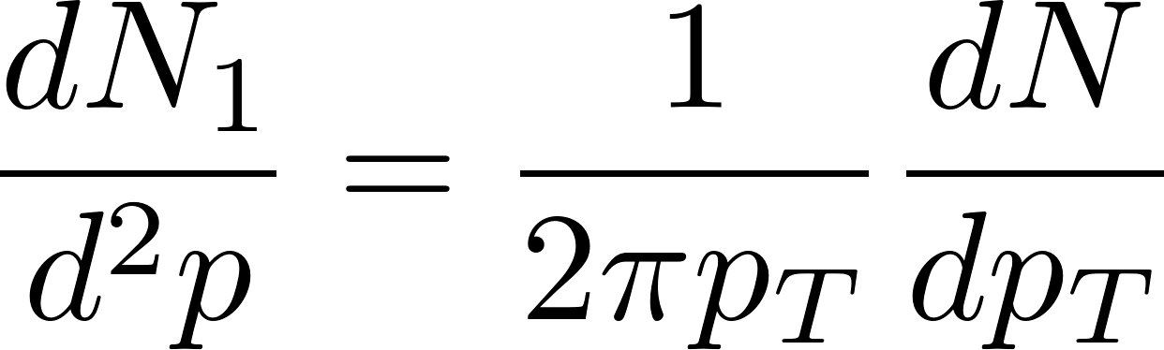
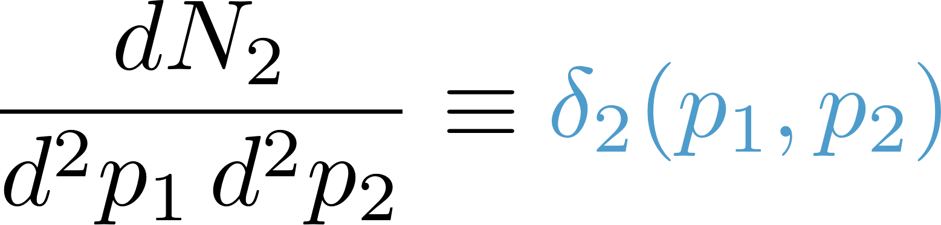
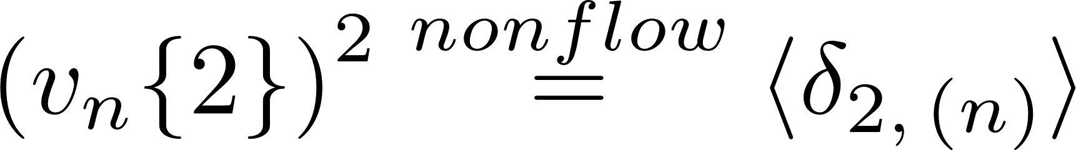

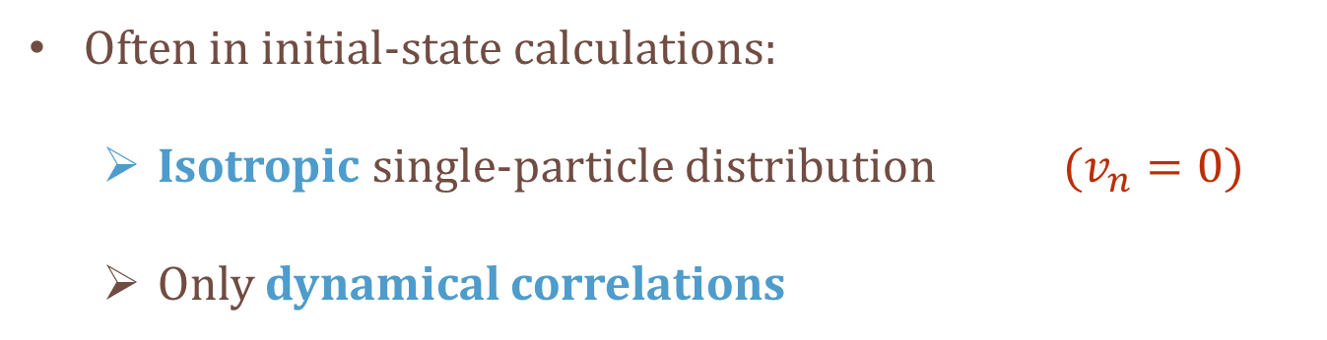
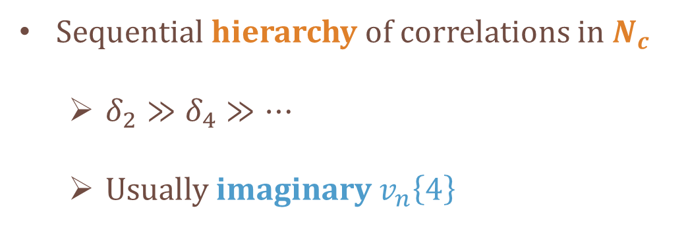
Multiparticle Cumulants: Non-Flow Scenario
M.D.S. et al., in preparation
Often in initial-state calculations:
  Isotropic single-particle distribution $(v_{n}=0)$
  Only dynamical correlations
M. Luzum, H. Petersen, J. Phys. G41 (2014)
“Non-Flow” only
Sequential hierarchy of correlations in $N_{c}$
  $δ_{2}≫δ_{4}≫⋯$
  Usually imaginary $v_{n}\left\{4\right\}$
M. Sievert
Theory Developments in Small Systems
14 / 26

Slide 16
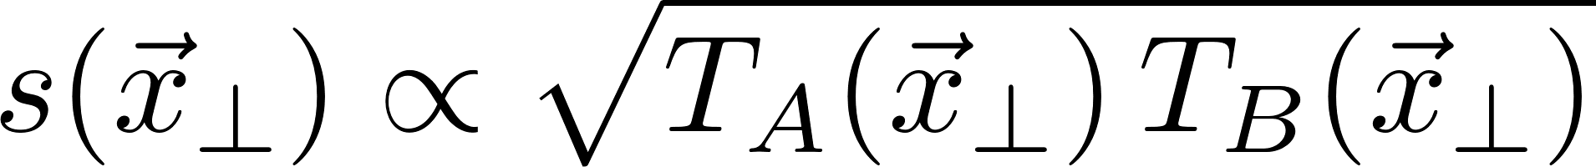
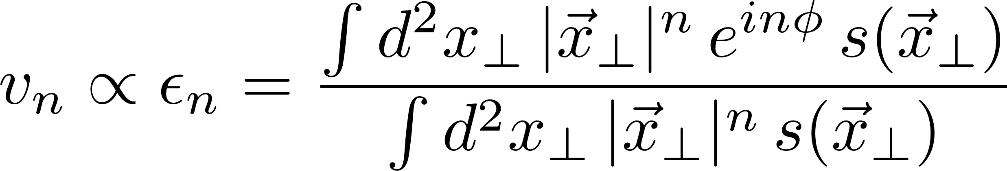
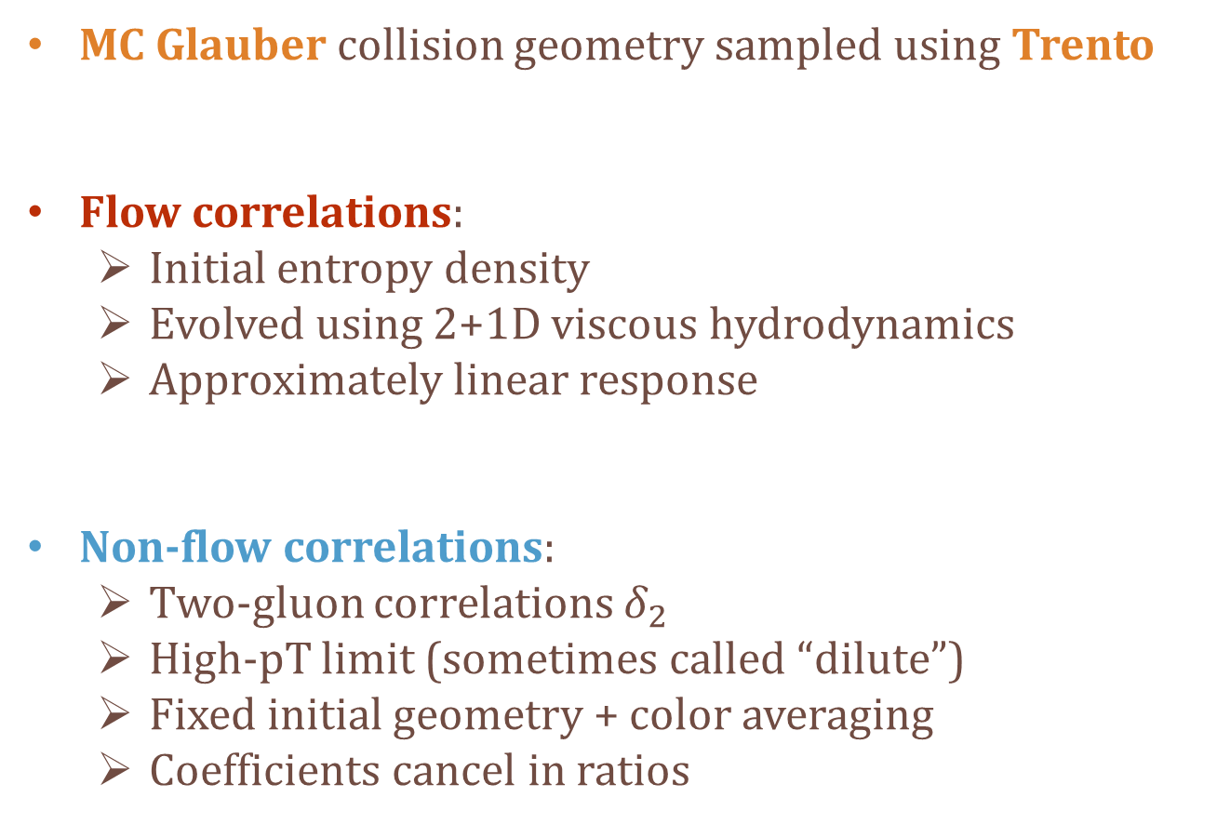
Comparing Flow vs Non-Flow Correlations
MC Glauber collision geometry sampled using Trento
Flow correlations:
  Initial entropy density
  Evolved using 2+1D viscous hydrodynamics
  Approximately linear response
Non-flow correlations:
  Two-gluon correlations $δ_{2}$
  High-pT limit (sometimes called “dilute”)
  Fixed initial geometry + color averaging
  Coefficients cancel in ratios
v-USPhydro
M.D.S. et al., in preparation
M. Sievert
Theory Developments in Small Systems
15 / 26

Slide 17
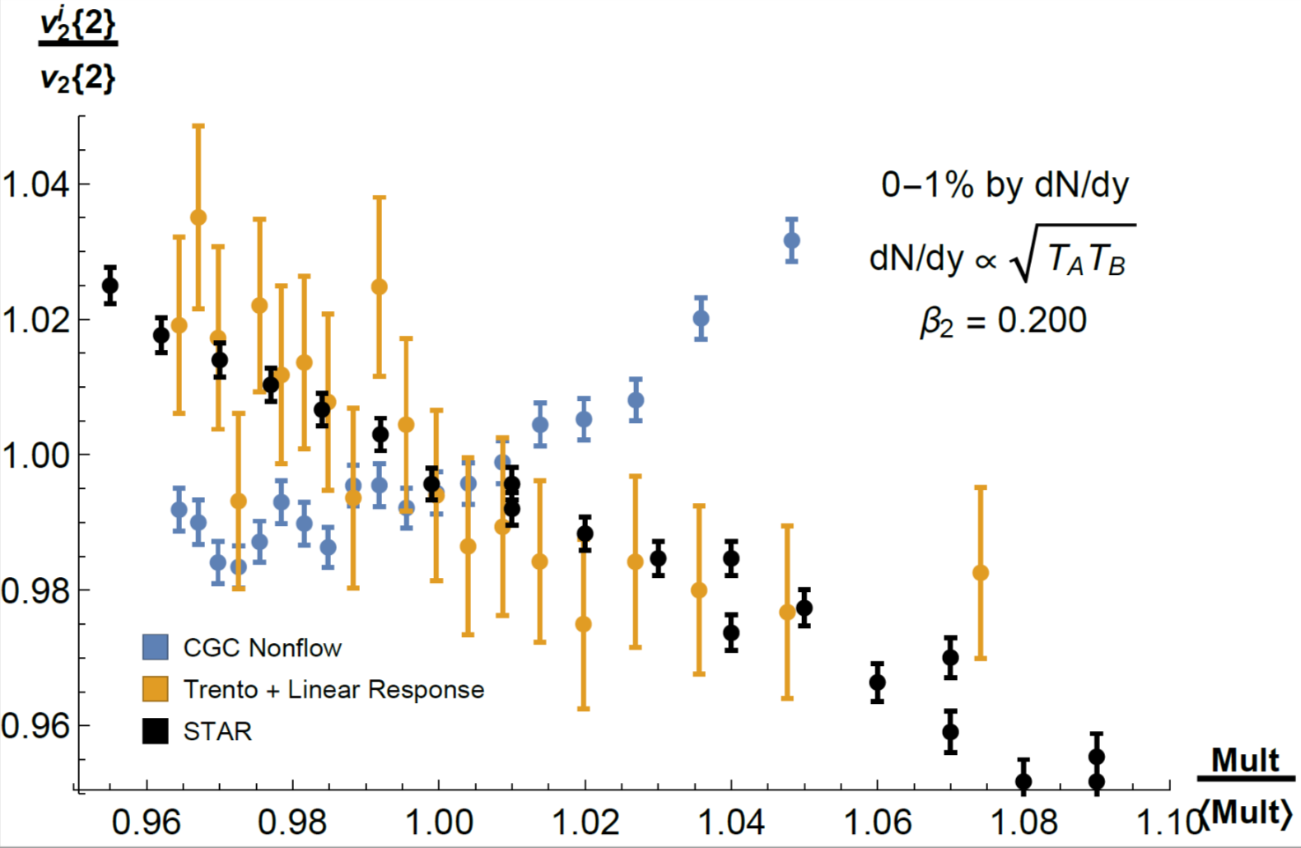
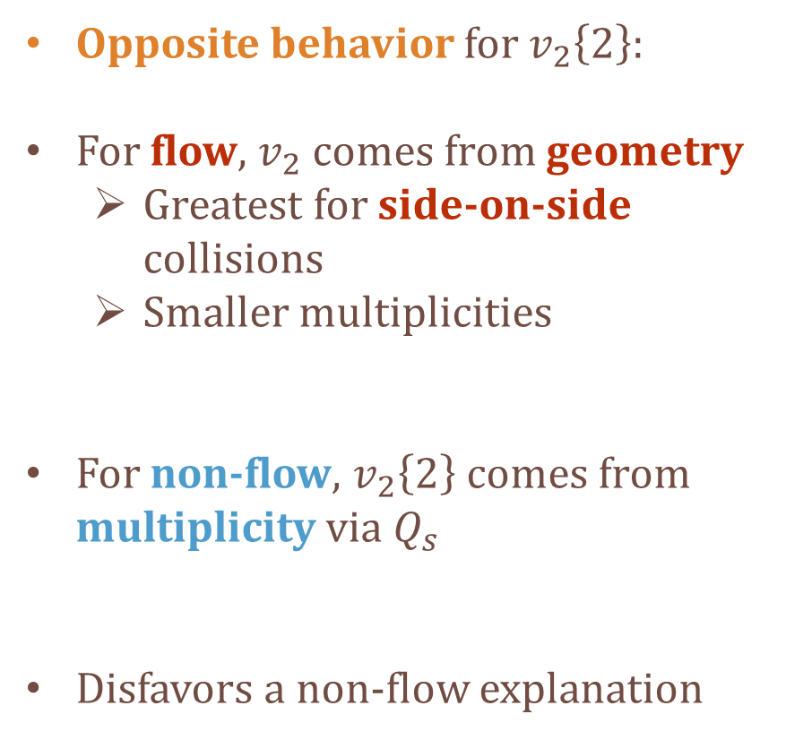
Results: Flow vs Non-Flow in UU
Opposite behavior for $v_{2}\left\{2\right\}:$
For flow, $v_{2}$ comes from geometry
  Greatest for side-on-side collisions
  Smaller multiplicities
For non-flow, $v_{2}\left\{2\right\}$ comes from multiplicity via $Q_{s}$
Disfavors a non-flow explanation
M.D.S. et al., in preparation
PRELIMINARY
M. Sievert
Theory Developments in Small Systems
16 / 26

Slide 18
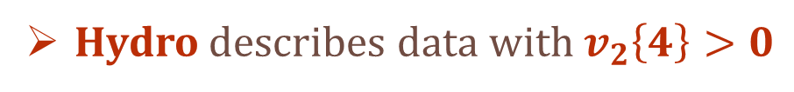

Results: Flow vs Non-Flow in UU
PRELIMINARY
M.D.S. et al., in preparation
PRELIMINARY
Hydro describes data with $v_{2}\left\{4\right\}>0$
For CGC non-flow, $v_{2}\left\{4\right\}$ is imaginary
M. Sievert
Theory Developments in Small Systems
17 / 26

Slide 19
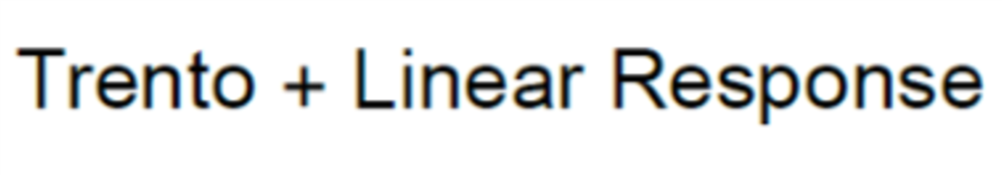
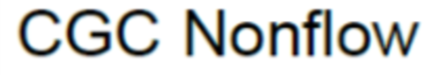
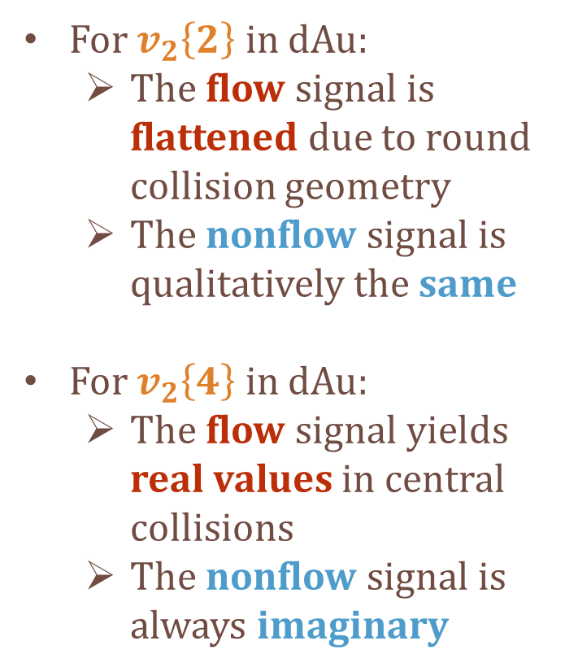
Results: Flow vs Non-Flow in dAu
PRELIMINARY
M.D.S. et al., in preparation
For $v_{2}\left\{2\right\}$ in dAu:
  The flow signal is flattened due to round collision geometry
  The nonflow signal is qualitatively the same
For $v_{2}\left\{4\right\}$ in dAu:
  The flow signal yields real values in central collisions
  The nonflow signal is always imaginary
M. Sievert
Theory Developments in Small Systems
18 / 26

Slide 20
Overview
1. “Dilute,” “Dense,” and Small Systems
2. “Flow” and “Non-Flow” in Multiparticle Cumulants
3. Non-Flow Correlations in the Literature
M. Sievert
Theory Developments in Small Systems
19 / 26

Slide 21
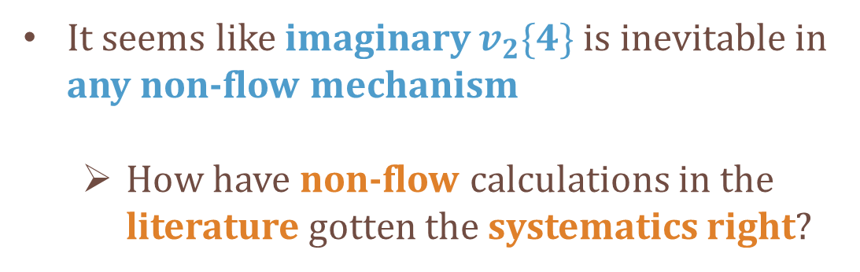
Non-Flow in the Literature
Dusling et al., Phys. Rev. D97 (2018)
Dusling et al.,
Phys. Rev. D97 (2018),
It seems like imaginary $v_{2}\{4\}$ is inevitable in any non-flow mechanism
  How have non-flow calculations in the literature gotten the systematics right?
M. Sievert
Theory Developments in Small Systems
20 / 26

Slide 22



A Seminal Benchmark: The “Parton Model”
Dusling et al., Phys. Rev. D97 (2018), Phys. Rev. Lett. 120 (2018)
Valence quarks from projectile + correlated color fields
  Independently sampled from Gaussian geometry
  Non-flow correlations due to color averaging
M.D.S. et al., in preparation
Obtains $v_{2}\{4\}$ which can be real or imaginary…
  Static geometry does not fluctuate
  Driven entirely by dynamical 4-particle correlations
any sign
M. Sievert
Theory Developments in Small Systems
21 / 26

Slide 23








A Fresh Interpretation of the Parton Model
Real values of $v_{2}\{4\}$ is an accident of the
over-simplified parton model
  Will be broken in more realistic models with fluctuating geometry
  Apparent from different $N_{c}$ scaling of $v_{2}\{4\}$
Dusling et al., Phys. Rev. D97 (2018)
$v_{2}\{4\}$ does not scale like $\frac{1}{N_{c}^{4}}$
Rather: $\frac{1}{N_{c}^{6}}$ because $Var=0$
Dusling et al., Phys. Rev. D97 (2018)
K. Fukushima, Y. Hidaka.,
JHEP 1711 (2017)
M. Sievert
Theory Developments in Small Systems
22 / 26

Slide 24




Cumulant Hierarchies… And Lack Thereof
Significant misattribution to the origin of $v_{2}\{4\}$
  Write that 2-particle correlations drive higher cumulants
  Plot the flow-like hierarchy of the Abelian theory for $N_{c}=1$
Dusling et al., Phys. Rev. Lett. 120 (2018)
K. Fukushima, Y. Hidaka.,
JHEP 1711 (2017)
Actually due to successively higher multiparticle correlations
  Successive suppression of higher cumulants
  $v_{2}\left\{2\right\}>v_{2}\left\{4\right\}>v_{2}\left\{6\right\}>⋯$
$N_{c}=1$ !!!
M. Sievert
Theory Developments in Small Systems
23 / 26

Slide 25

The Next Benchmark: MSTV
Mace et al., Phys. Rev. Lett. 121 (2018), and arXiv:1901.10506
Event-by-event fluctuations:
  MC Glauber geometry
  Event-by-event color fields: operators in $ρ_{p}$, $ρ_{t}$
Two-gluon correlations from semi-dilute / dense expressions
  Inherently factorized at operator level (density-enhanced)
M. Sievert
Theory Developments in Small Systems
24 / 26

Slide 26


Thoughts on the Physics of MSTV
Cumulants arise from single-particle anisotropies of color fields
  Flow!
  Naturally gets 2-particle systematics
Open questions (for me):
  What do they get for $v_{2}\{4\}$ ?
  Interpretation of the “distribution” $\frac{dN}{d^{2}k}$ ?
  What does the averaging really do to the flow?
M. Sievert
Theory Developments in Small Systems
25 / 26

Slide 27
Outlook
In Preparation:
  A systematic analysis of flow vs. non-flow contributions in general
  Quantitative flow vs. non-flow results for UU and small systems
Next steps:
  The parton model, revisited – a useful toy to turn on / off flow and non-flow
  Detailed analysis of color-flow mechanisms in MSTV
  Flow from density gradients in the CGC…?
see D. Wertepny talk: DIS2019
M. Sievert
Theory Developments in Small Systems
26 / 26

