Slide 1

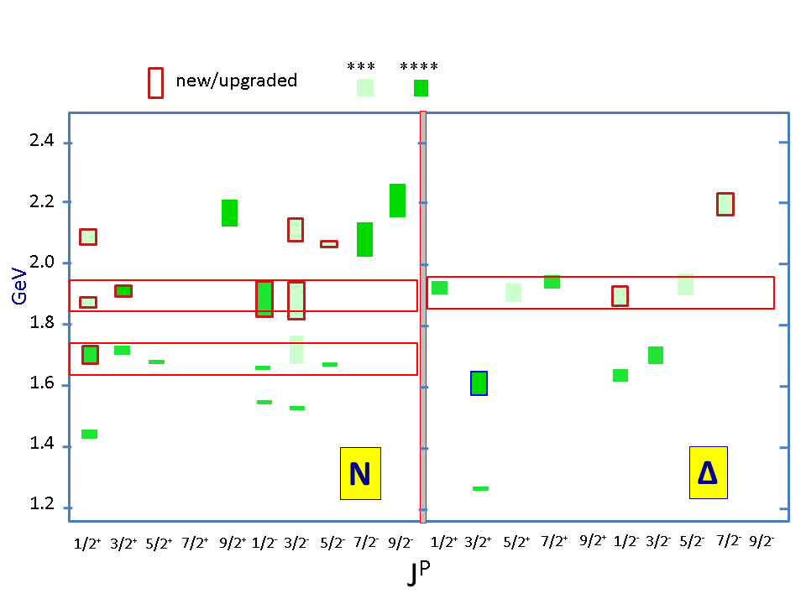
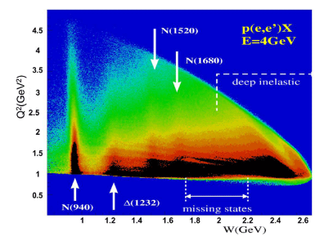



New Baryon States from Exclusive Meson Photo- and Electroproduction
N’(1720)3/2⁺
V.I. Mokeev, V.D. Burkert
Jefferson Laboratory
N* spectrum and insights into strong QCD
New N* states from exclusive meson photoproduction off protons
Evidence for new N’(1720)3/2⁺ baryon state
Insight into the structure of new baryon states
8th Workshop of the APS Topical Group on Hadronic Physics

Slide 2
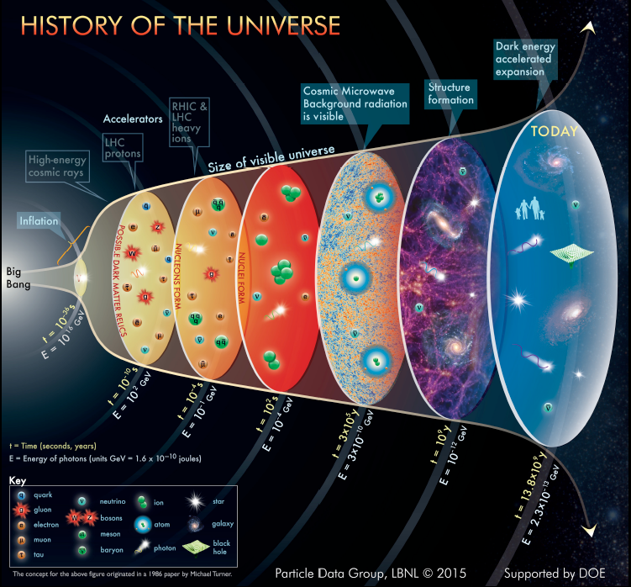
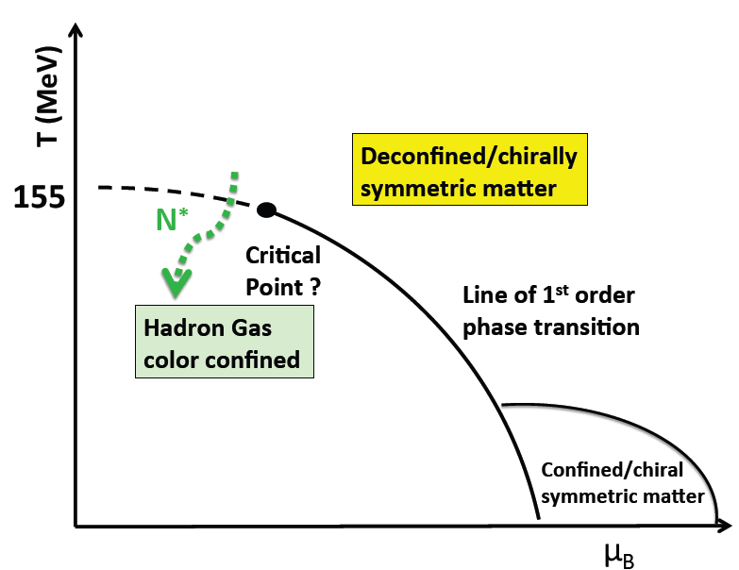
Nucleon Resonances in the Emergence of Hadronic Matter and Strong QCD
Dramatic events occurred in the micro-second old universe during the transition from the deconfined quark and gluon phase to the hadron phase.
N*
hot QCD
Quark-gluon confinement emerges
Chiral symmetry of QCD is broken
Quarks and gluons acquire mass
Baryon resonances form
strong QCD
??
This transition was shaped by the full baryon spectrum

Slide 3
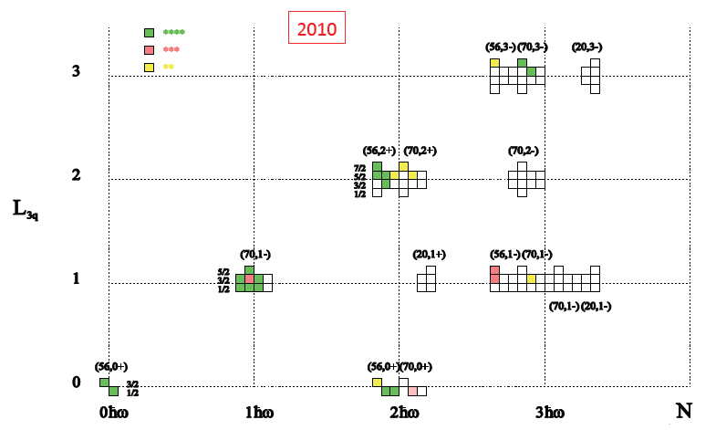
SU(6)xO(3) spin-flavor symmetry and ``missing” resonances
SU(6)xO(3) Spin-Flavor Symmetry and ``Missing” Resonances
Continuum QCD: Chen Chen et al.,
arxiv:1901.04305[nucl-th];
Si-xue Qin et al., arxiv:1902.00026
[nucl-th]
Lattice QCD: R. Edwards et al.,
Phys. Rev. D84 (2011) 074508.
SU(6)×O(3)
“missing” states
Studies of the N*-spectrum were driven by a guess for the ``missing” baryon states expected from the underlying SU(6) xO(3) symmetry and supported by exploratory lattice/continuum QCD results on the N*-spectrum.
Notes:
This shows the 2010 status of baryon states that have been associated with quark model states shown in this SU(6)xO(3) symmetry scheme. The color code indicating the confidence level in their existence. Clearly there are many open boxes where states are predicted but have not observed.

Slide 4
Exclusive Photoproduction in the Nucleon Resonance Region
Combination of continuous electron beams and detectors of ~4π acceptance
allow us to determine types of all final particles and their 4-momenta in each reaction.
Most exclusive photoproduction channels in the resonance region were studied.
Eγ, GeV

Slide 5

2-Body Photoproduction off Protons: Data and Analysis Approaches
✔ - data acquired ✔ - analyzed/published
Observable | σ | Σ | T | P | E | F | G | H | T_{x} | T_{z} | L_{x} | L_{z} | O_{x} | O_{z} | C_{x} | C_{z}
pπ⁰ | ✔ | ✔ | ✓ |  | ✓ | ✓ | ✓ | ✓
nπ⁺ | ✔ | ✔ | ✓ |  | ✔ | ✓ | ✓ | ✓
pη | ✔ | ✓ | ✓ |  | ✔ | ✓ | ✓ | ✓
pη’ | ✔ | ✓ | ✓ |  | ✓ | ✓ | ✓ | ✓
K⁺Λ | ✔ | ✔ | ✔ | ✔ | ✓ | ✓ | ✓ | ✓ | ✓ | ✓ | ✓ | ✓ | ✔ | ✔ | ✔ | ✔
K⁺Σ⁰ | ✔ | ✔ | ✔ | ✔ | ✓ | ✓ | ✓ | ✓ | ✓ | ✓ | ✓ | ✓ | ✔ | ✔ | ✔ | ✔
K^{+*}Λ | ✔ |  |  | ✔ |  |  |  |  | SDME
K^{0*}Σ⁺ | ✔ | ✓ |  |  |  |  |  |  |  |  | ✓ | ✓ | SDME
γp→X
Coupled-channel approaches for N* parameter extraction from exclusive
meson photoproduction data off the proton
Bonn-Gatchina A.V. Anisovich et al., Eur. Phys. J. A53, 242 (2017).
A.V. Anisovich et al., Eur. Phys. J. A50, 129 (2014).
A.V. Anisovich et al., Eur. Phys. J. A48, 15 (2012).
Argonne-Osaka H. Kamano et al., Phys. Rev. C94, 015201 (2016).
H. Kamano et al., Phys. Rev. C88, 035209 (2013).
GWU-Julich D. Rönchen et al., Eur. Phys. J. A51, 70 (2015).
D. Rönchen et al., Eur. Phys. J. A50, 101 (2014).
Notes:
Many exclusive 2-body processes have been measured, including diff. cross sections, beam polarization asymmetries, recoil polarization, and target polarization asymmetries and many double-polarization observables, both for hydrogen and deuterium targets. In the following several slides I will show measurements of 4 reaction channels and what we have learned about baryon resonances from these.
The most complete data sets are in Lambda and Sigma hyperon production where also the Lambda recoil polarization is measured. The second set is vector meson production where the spin-density matrix elements are also determined, and finally, single pion production including polarization asymmetries on proton and neutrons.

Slide 6
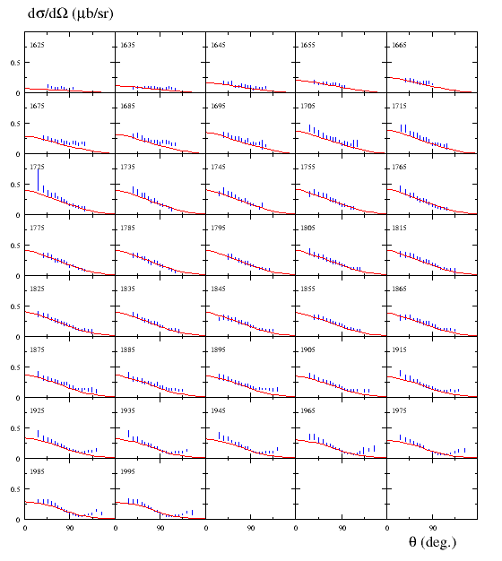
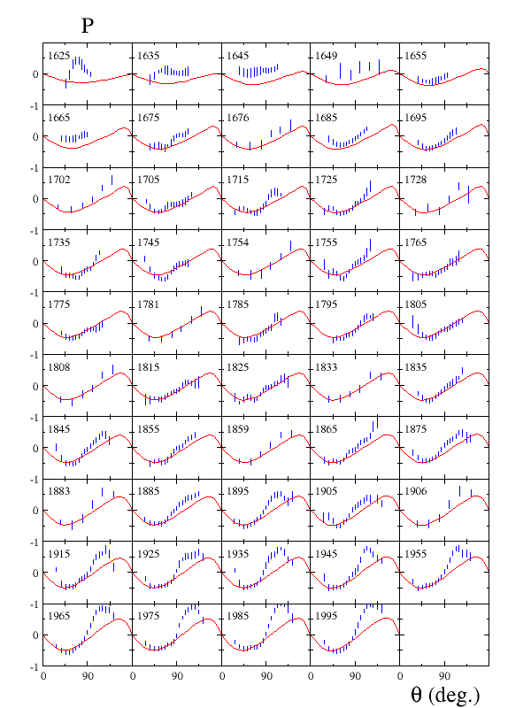
Establishing the N* Spectrum
Hyperon photoproduction γp→K⁺Λ→K⁺pπ⁻ from CLAS
ANL-Osaka coupled-channel analysis
Includes ***, **** PDG12 states
1935
1935
Discrepancies indicate contributions are missing from the fit?
PDG(2010) states insufficient to fit KΛ data
Shows the importance of polarization data

Slide 7
Establishing the N* Spectrum, cont’d
Hyperon photoproduction γp→K⁺Λ→K⁺pπ⁻ from CLAS
Bonn-Gatchina multichannel analysis:
9 new resonances were included
M. McCracken et al. (CLAS), Phys. Rev C 81, 025201 (2010)
A.V. Anisovich et al, EPJ A48, 15 (2012)
Notes:
..

Slide 8
Advances in Exploration of the N*-Spectrum
Several new nucleon resonances (``missing” states) have been discovered with the decisive impact of the CLAS open strangeness photoproduction data. A.V. Anisovich et al.,
Phys. Lett. B782, 662(2018), V.D. Burkert, Few Body Syst. 59, 57 (2018).
Nucleon resonances listed in Particle Data Group (PDG) tables
N*/Δ* Spectrum 2019
State N(mass)J^{P} | PDG pre 2016 | PDG 2018*
N(1710)1/2⁺ | *** | ****
N(1880)1/2⁺ |  | ***
N(1895)1/2⁻ |  | ****
N(1900)3/2⁺ | ** | ****
N(1875)3/2⁻ |  | ***
N(2100)1/2⁺ | * | ***
N(2120)3/2⁻ |  | ***
N(2000)5/2⁺ | * | **
N(2060)5/2⁻ |  | ***
Δ(1600)3/2⁺ | *** | ****
Δ(1900)1/2⁻ | ** | ***
Δ(2200)7/2⁻ | * | ***
The next step: A description of the exclusive electroproduction data off the proton with the same masses and hadronic decay widths as in photoproduction will support the existence of new baryon states.

Slide 9
Interpretation of the Structure at W~1.7 GeV in π⁺π⁻p Electroproduction
M. Ripani et al., CLAS Collaboration
Phys. Rev. Lett. 91, 022002 (2003).
conventional states only, consistent with PDG 02
implementing N’(1720)3/2⁺ candidate or only conventional states with different N(1720)3/2⁺ Nππ decays than in PDG 02
Two equally successful ways for the data description:
No new states, different than in PDG 02’ N(1720)3/2⁺ Nππ hadronic decay widths:
 | Γ_{tot,} MeV | BF(πΔ) % | BF(ρp) %
N(1720)3/2⁺ decays fit to the CLAS Nππ data | 126±14 | 64-100 | <5
N(1720)3/2⁺ PDG 02’ | 150-300 | <20 | 70-85
σ, μbn
new N’(1720)3/2⁺ and regular N(1720)3/2⁺:
 | Γ_{tot,} MeV | BF(πΔ) % | BF(ρp) %
N’(1720)3/2⁺ New | 119±6 | 47-64 | 3-10.
N(1720)3/2⁺ Conventional | 112±8 | 39-55 | 23-49
W, GeV

Slide 10
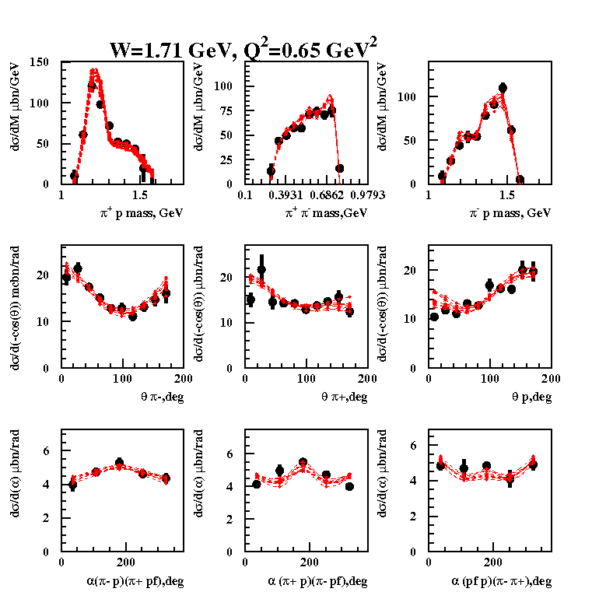
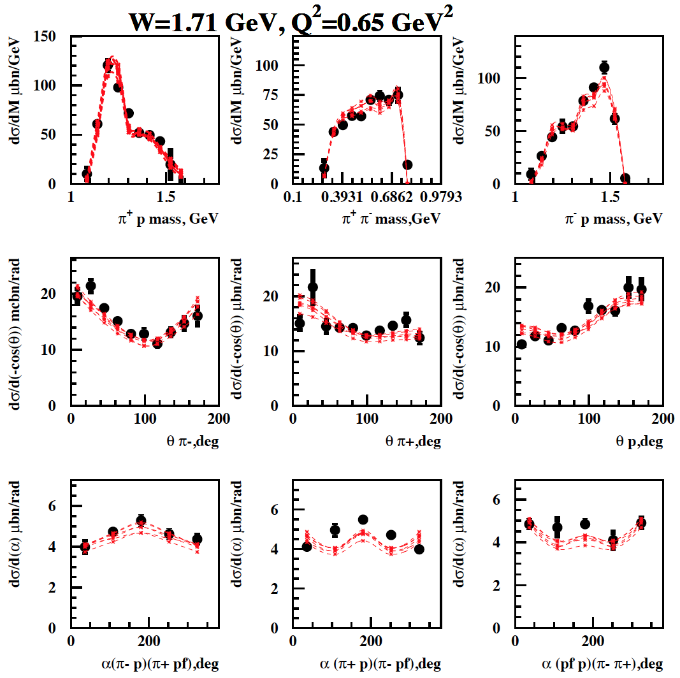
Analysis of the ep→ e’π⁺π⁻p CLAS data at W~1.7 GeV in the JM model
Conventional N*-states with πΔ, ρp couplings fit to the data
N’(1720)3/2⁺ candidate state is included in the fit
2.85<χ²/d.p.<3.03 (1.66 GeV<W<1.76 GeV)
2.56<χ²/d.p.<2.80 (1.66 GeV<W<1.76 GeV)
Fit of θ_{π−}, θ_{π+}, θ_{p} angular distributions requires essential contribution(s) from the resonance(s) of J^{π}=3/2⁺.
Single state of J^{π}=3/2⁺ should have major πΔ (>60%) and minor ρp (<5%) decays in order to reproduce
pronounced Δ−peaks in π⁺p and to avoid ρ-peak formation in the π⁺π⁻ mass distributions.

Slide 11
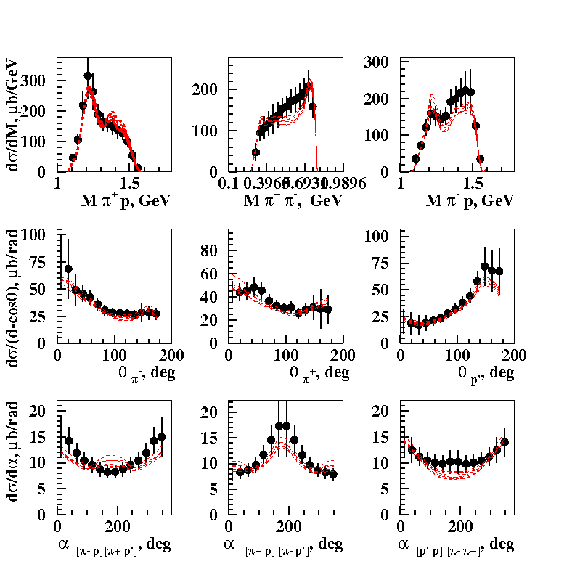
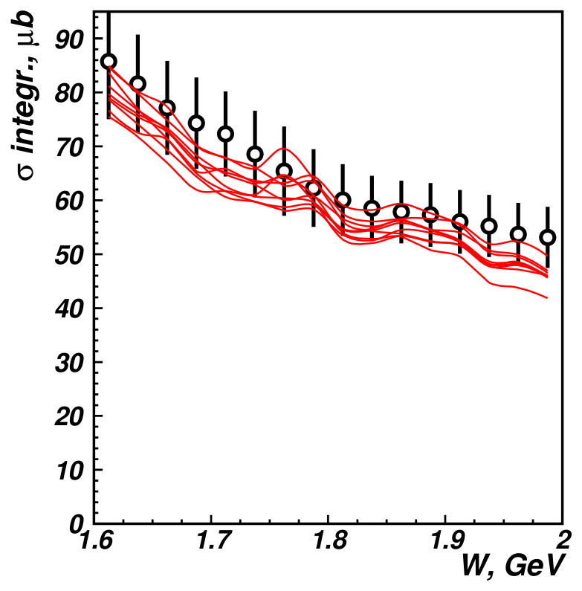
Description of the CLAS π⁺π⁻p Photoproduction off Protons Data with/without the New State N’(1720)3/2⁺
E.N. Golovach et al., CLAS Collaboration, Phys. Lett. B 788, 371 (2019).
One-fold differential cross sections
Fully integrated cross sections
W=1.71 GeV
Almost the same quality of the photoproduction data description was achieved with and without N’(1720)3/2⁺ new state:
N(1720)3/2⁺ and N’(1720)3/2⁺ 1.19 < χ²/d.p. < 1.28
N(1720)3/2⁺ only 1.08 < χ²/d.p. < 1.26
Would it be possible to describe photo- and electroproduction data with Q²-independent resonance masses
and total and partial hadron decay widths?
11

Slide 12
Evidence for the Existence of the New State N’(1720)3/2⁺ from Combined π⁺π⁻p Analyses in both Photo- and Electroproduction
N(1720)3/2⁺ hadronic decays from the CLAS data fit with
conventional resonances only
N* hadronic decays from the data fit that
incorporates the new N’(1720)3/2⁺ state
 | BF(πΔ), % | BF(ρp), %
electroproduction | 64-100 | <5
photoproduction | 14-60 | 19-69
Resonance | BF(πΔ), % | BF(ρp), %
N’(1720)3/2⁺ electroproduction photoproduction | 47-64 46-62 | 3-10 4-13
N(1720)3/2⁺ electroproduction photoproduction | 39-55 38-53 | 23-49 31-46
Δ(1700)3/2⁻ electroproduction photoproduction | 77-95 78-93 | 3-5 3-6
The contradictory BF values for N(1720)3/2⁺ decays to the πΔ and ρp final states deduced from photo- and electroproduction data make it impossible to describe the data with conventional states only.
The successful description of the π⁺π⁻p photo-
and electroproduction data achieved by
implementing new N’(1720)3/2⁺ state with
Q²-independent hadronic decay widths of
all resonances contributing at W~1.7 GeV
provides strong evidence for the existence of
the new N’(1720)3/2⁺ state.
12

Slide 13
The Parameters of the new N’(1720)3/2⁺ State from the CLAS Data Fit
The photo-/electrocouplings of the N’(1720)3/2⁺ and conventional N(1720)3/2⁺ states:
N’(1720)3/2⁺
Resonance | Mass, GeV | Total width, MeV
N’(1720)3/2⁺ | 1.715-1.735 | 120±6
N(1720)3/2⁺ | 1.743-1.753 | 112±8
N(1720)3/2⁺
N’(1720)3/2⁺ is the only new resonance for which data on electroexcitation amplitudes have become
available.
Gaining insight into the ``missing” resonance structure will shed light on their peculiar structural
features that have made them so elusive, as well as on the emergence of new resonances from QCD.
13

Slide 14
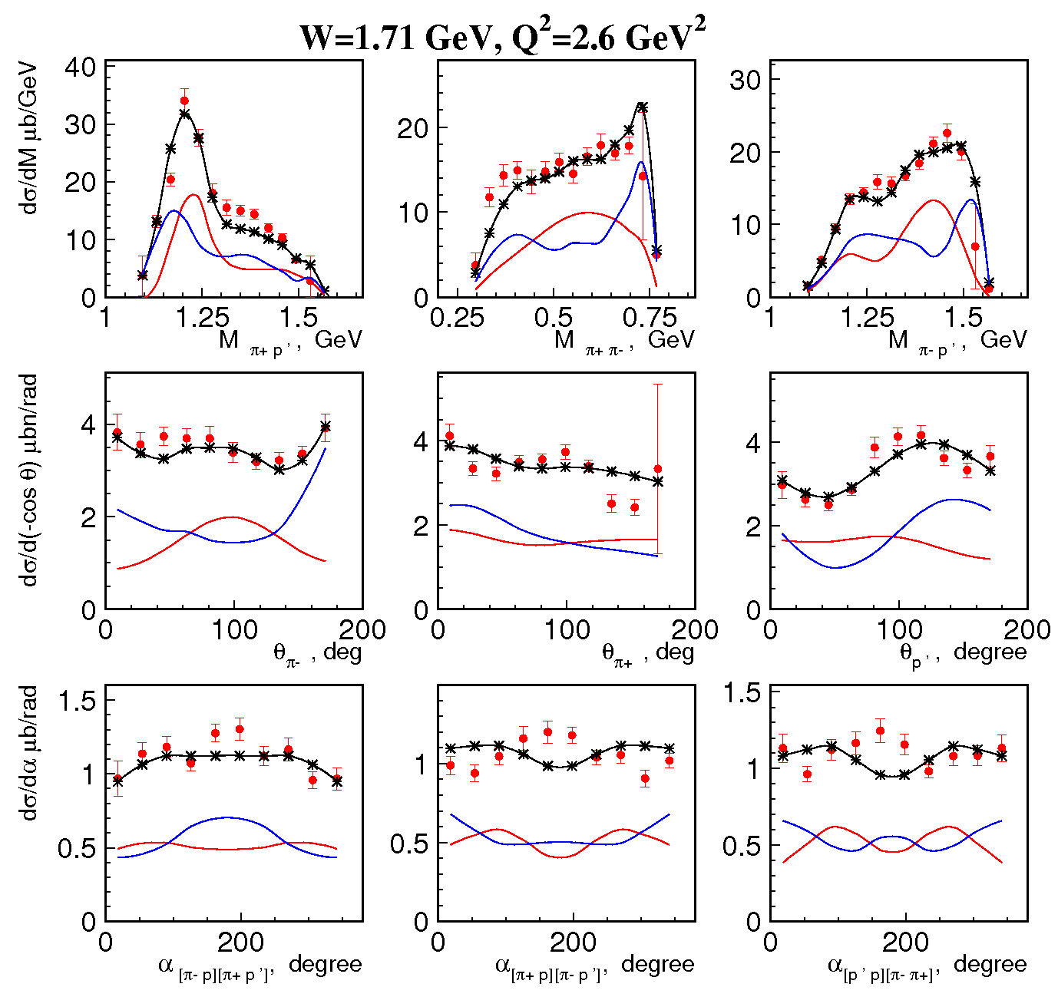
Future Extension of the Results on N’(1720)3/2⁺ Electrocouplings
JM18 model version adjusted to the
preliminary A.Trivedi & R.W. Gothe
data
Resonant contributions
Non-resonant contributions
Significant resonant contributions and
pronounced differences in behavior
of the resonant /non-resonant contributions
seen in all nine one-fold differential cross
sections.
In the near term future electrocouplings of the new baryon state N’(1720)3/2⁺ will become available in 5
Q²-bins at 2.0 GeV²<Q²<5.0 GeV²
14

Slide 15
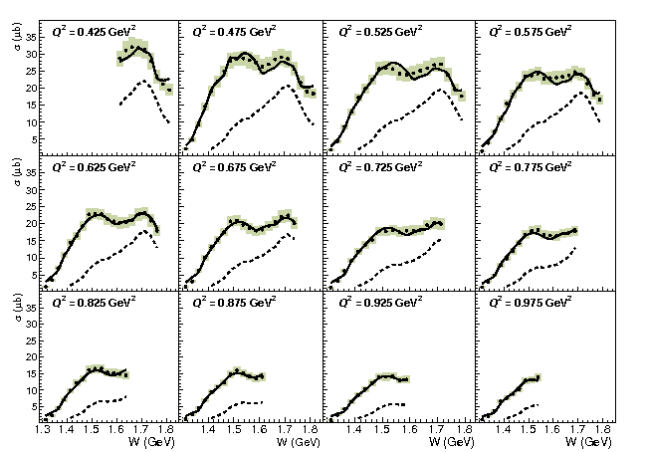
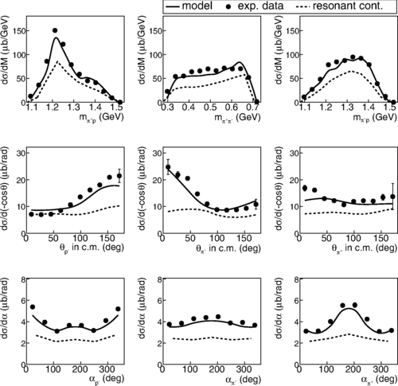
Recent CLAS Data on π⁺π⁻p Electroproduction off Protons at 0.4<Q²<1.0 GeV²
G. V. Fedotov, Iu. A. Skorodumina et al., CLAS Collaboration, Phys. Rev. C98, 025203 (2018). (USC Group)
JM model/TWOPEG EG analysis:
9 one-fold differential cross sections at W<1.8 GeV and
0.4 GeV² <Q² <1.0 GeV² of the best statistical and
systematical accuracy obtained with minimal bin size
over Q² ever achieved (ΔQ²= 0.05 GeV²)
resonant contribution
full cross section
Promising prospect to obtain 8 additional points on Q²-evolution of N’(1720)3/2⁺ electrocouplings in the range of 0.4 GeV² < Q²< 0.8 GeV² .
15

Slide 16
Conclusions and Outlook
CLAS data on exclusive meson photo- and electroproduction have considerably extended our knowledge on the excited nucleon state spectrum.
The new N(1895)1/2⁻ and N(1900)3/2⁺ resonances with the four star PDG ratings were established in the global multi-channel analysis of the exclusive photo- and hadroproduction channels with a major impact from the CLAS KΛ, KΣ photoproduction data. The long-term objective of the discovery of some of the ``missing” baryon states has been achieved!
Combined studies of exclusive π⁺π⁻p photo-/electroproduction off proton data have revealed convincing evidence for the existence of the new N’(1720)3/2⁺ resonance.
The results on N’(1720)3/2⁺ electrocouplings offer insight into the particular structural features which make ``missing” resonances different - joint effort with the hadron structure theory developments.
Observation of new baryon states in exclusive electroproduction data with Q²-independent masses, total, and partial hadronic decay widths will support their existence in a nearly model-independent way, completing the exploration of the N* spectrum in the experiments with electromagnetic probes.
16

Slide 17
Back Up

Slide 18
Accessing the Nature of N’(1720)3/2⁺ New State
CQM evaluation of N(1720)3/2⁺ and N’(1720)3/2⁺ electrocouplings assuming [56,2+] and [20,1+] SU(6)-assignments, respectively. If the CLAS results on N’(1720)3/2⁺ electrocouplings will be reproduced, then the N’(1720)3/2⁺ is the long time awaited double-orbital excitations over ρ- and λ-degrees of freedom in three-quark system.
DSE evaluation of the spectrum of excited nucleon states with J^{p}=3/2⁺ will either confirm the emergence of N(1720)3/2⁺ and N’(1720)3/2⁺ quark cores from QCD or will elucidate the limit of applicability of the quark-dynamical-di-quark interactions currently employed for the N* spectrum description.
Observation of N’(1720)3/2⁺ can extend our knowledge on the interactions of three dressed quarks in generation of ``missing” resonance quark core shedding light on potential di-quark radial excitations or extra-components in the quark core structure such as dressed gluons, dressed qq-bar pair, etc.

Slide 19
N* Spectrum as a Window into the Strong QCD
Studies of the excited nucleon state spectrum offers an access to the approximate
symmetries underlying generation of the N* states in the strong QCD regime.
Allow us to explore whether almost exact at ~GeV mass scale chiral symmetry
of QCD evolves into approximate O(3)xSU(6) symmetry, when the orbital momentum conservation imposed by O(3)-symmetry breaks the chiral symmetry, making impossible the existence of the parity-doublet states, required by the chiral symmetry.
If it is a case, then we have to observe more excited nucleon states then have
been reported in the PDG16 listing.

Slide 20
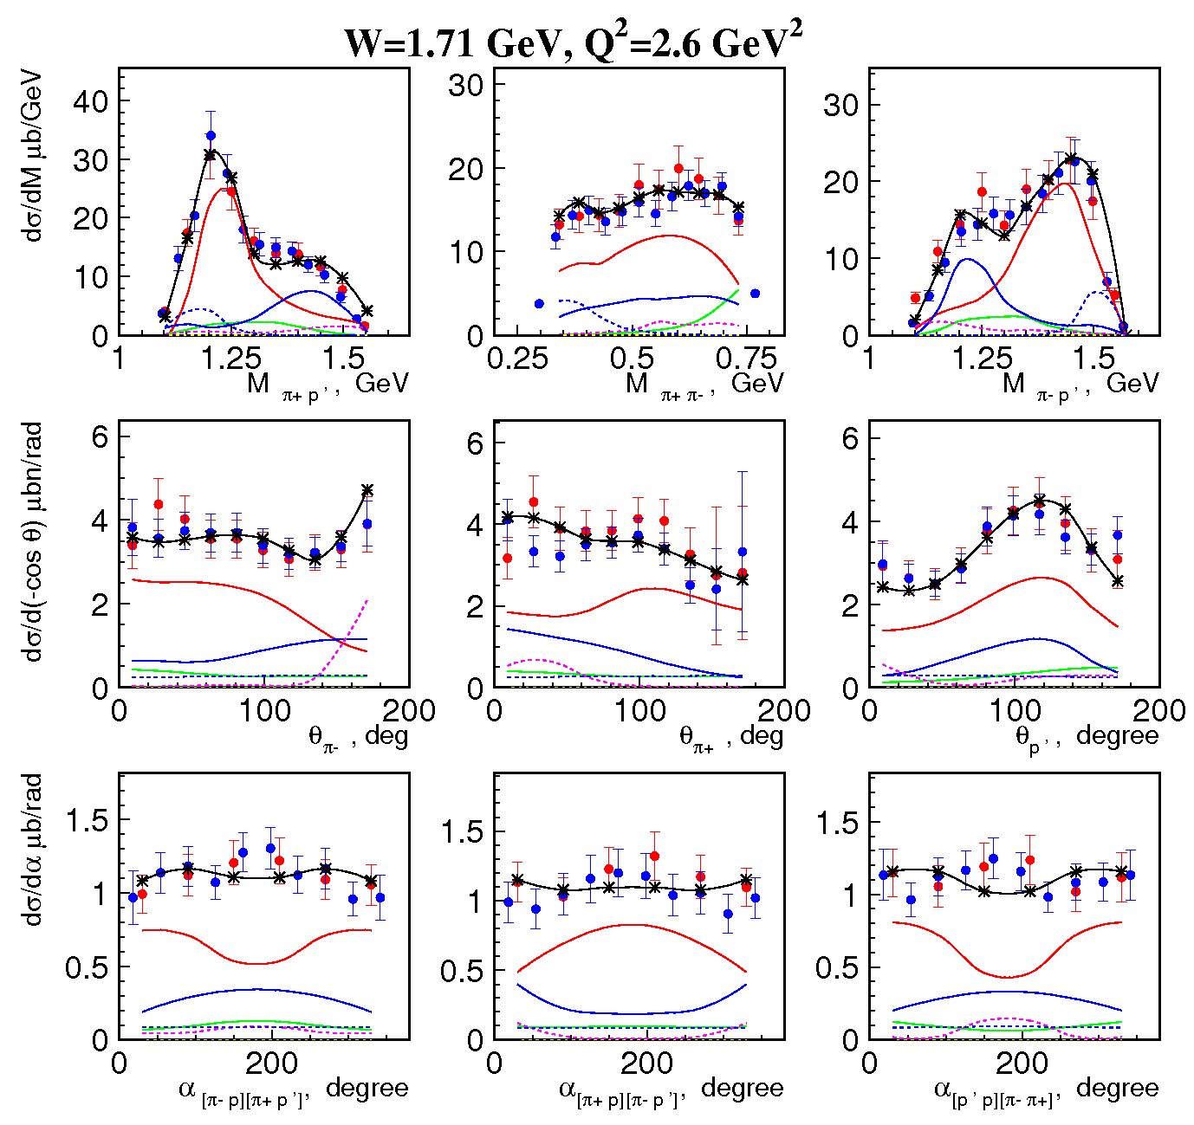
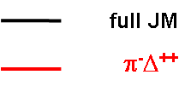
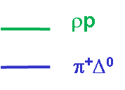
Extending the Kinematical Coverage of π⁺π⁻p Electroproduction off Proton Data
Two data sets at
1.40 GeV <W<2.0 GeV and
2.0 GeV² < Q² < 5.0 GeV² :
red - E. Isupov et al., CLAS Coll.,
Phys. Rev. C96, 025209 (2017).
blue - preliminary, A.Trivedi,
R.W. Gothe, USC.
JM18 results:
π⁺ N(1520)3/2⁻
π⁺ N(1680)5/2⁺
The JM18 model offers a good
description of both π⁺π⁻p
electroproduction off protons data
sets

Slide 21
Polarization Observables in Meson-Baryon Photoproduction Channels
16 different observables
They are described by different bi-
linear combinations of amplitudes
Combined fit of all observables offers rigorous constraints on the reaction amplitude at the real energy axis

Slide 22
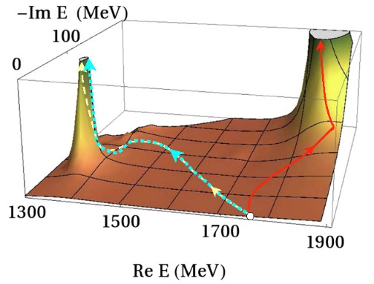





Connecting Nucleon Resonance Properties to the Photoproduction Observables
γ + p→Meson (M) + Baryon (B)
Breit-Wigner parameterization
and the amplitude poles:
γ
M
γ
M
$T_{res}$=$\frac{T\left(R→MB\right)T(γp→R)}{M_{N^{∗}}^{2}−W^{2}−iΓ_{N^{∗}}(W)M_{N^{∗}}}$
N*
P
Resonant
contributions
B
P
Non-resonant
contributions
B
M’
M’
+
M’’
B’
B
B’
B
Hadronic final state interactions (FSI)
Constrain exclusive photoproduction amplitudes by fitting them to the differential cross sections and polarization asymmetries.
Incorporate the FSI effects→ Global multi-channel analyses of all exclusive photo-/hadro-production channels.
Make analytical continuation of reaction amplitudes into the complex energy plane and:
a) locate poles Resonance masses (M_{N*}) and total widths (Γ_{N*}) ;
b) determine residues Resonance photocouplings and partial hadronic decay widths.

Slide 23
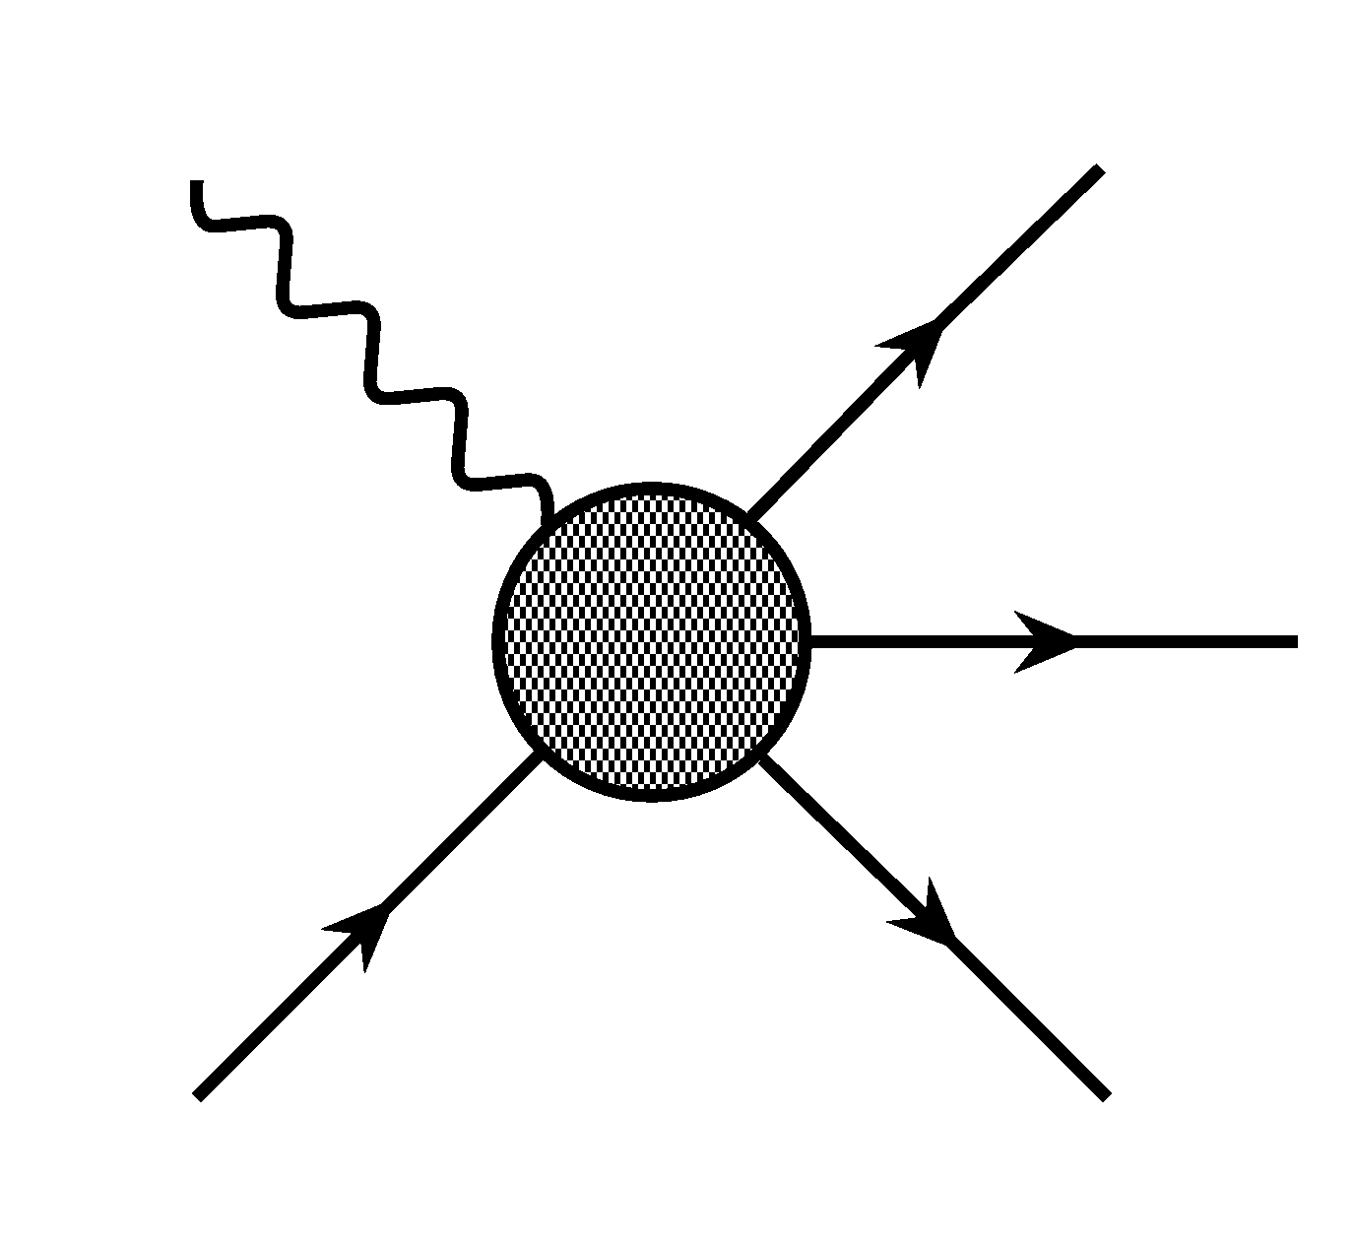
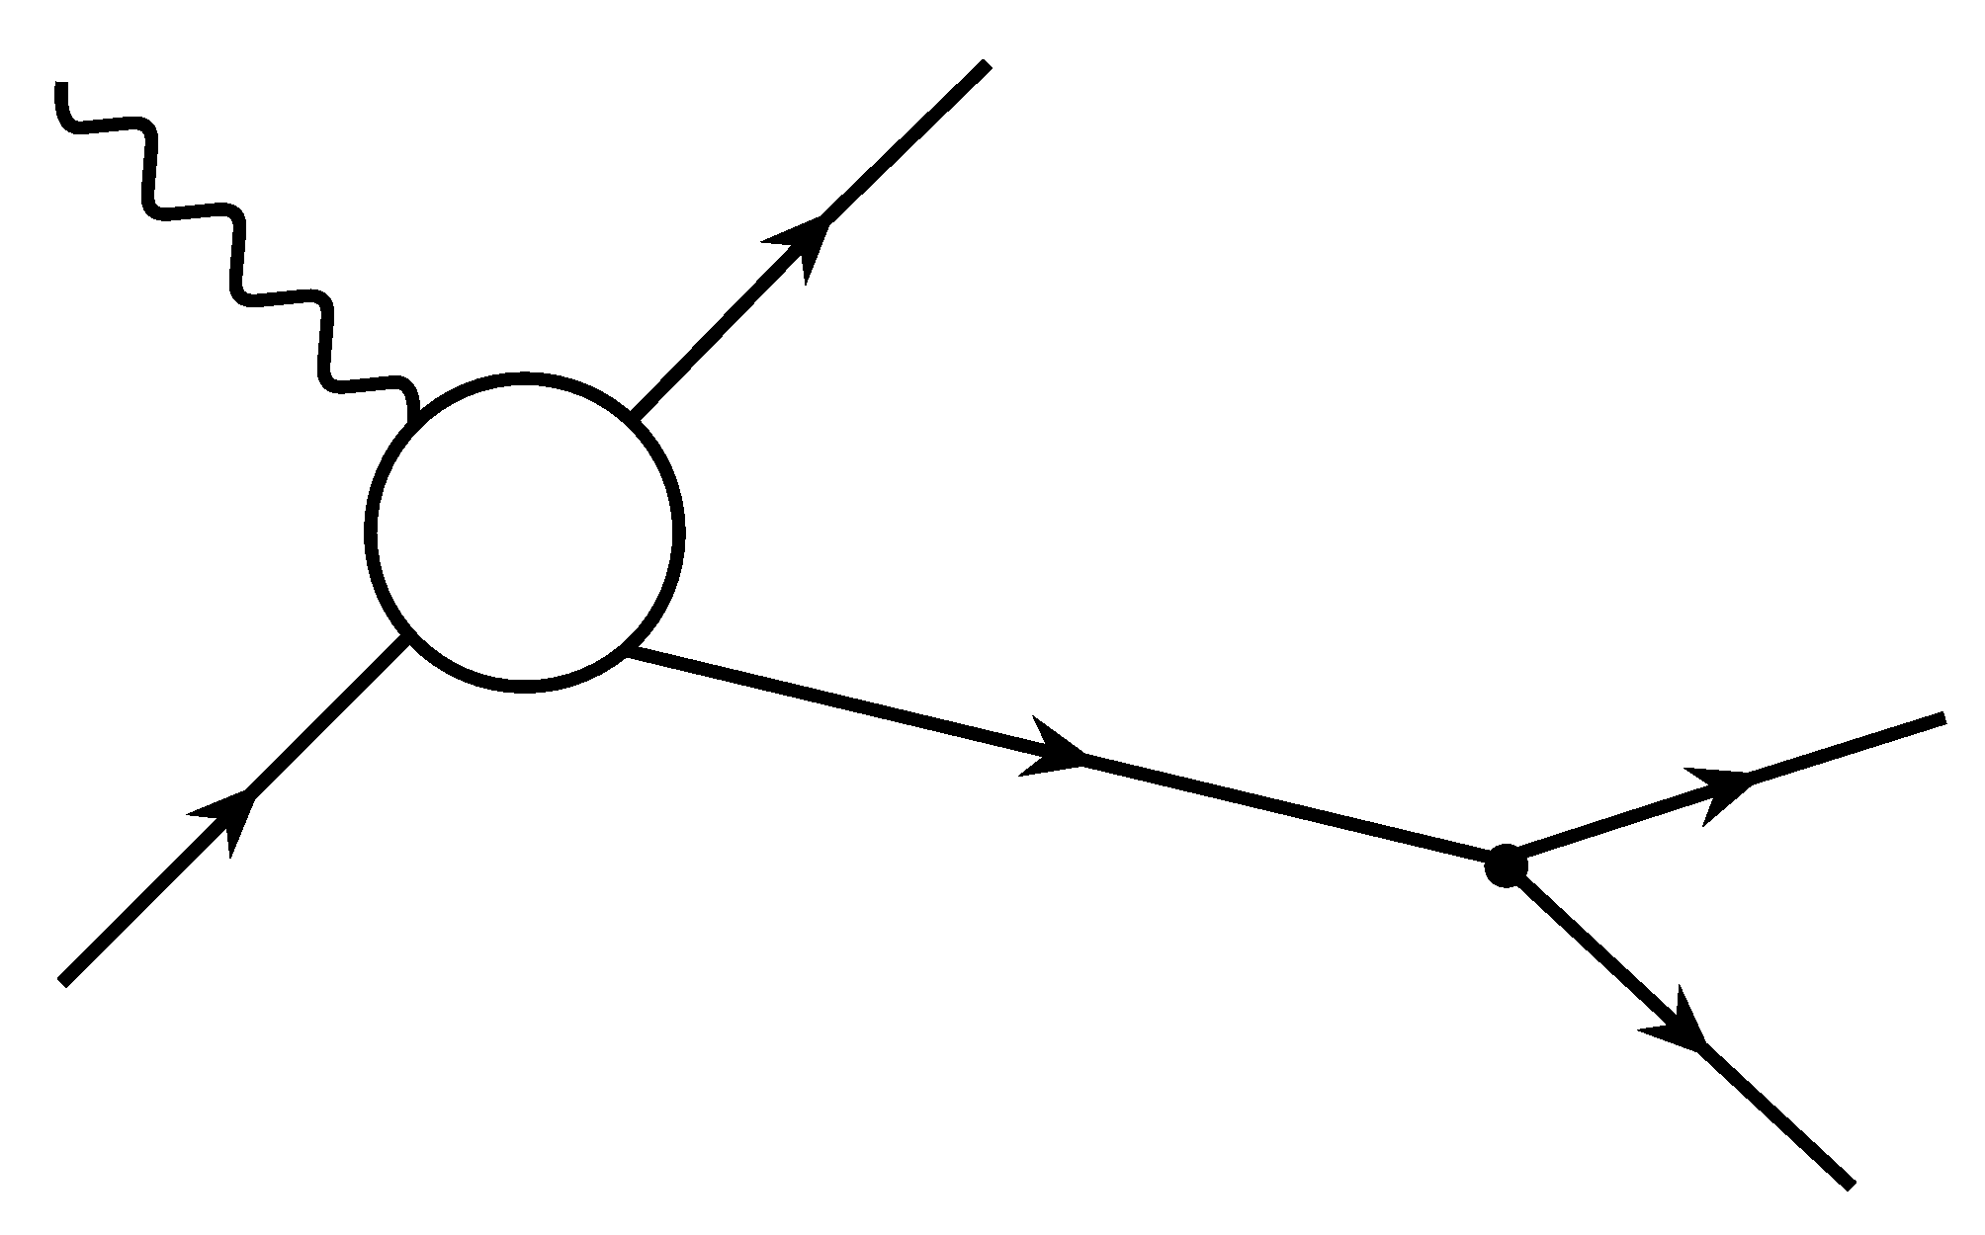
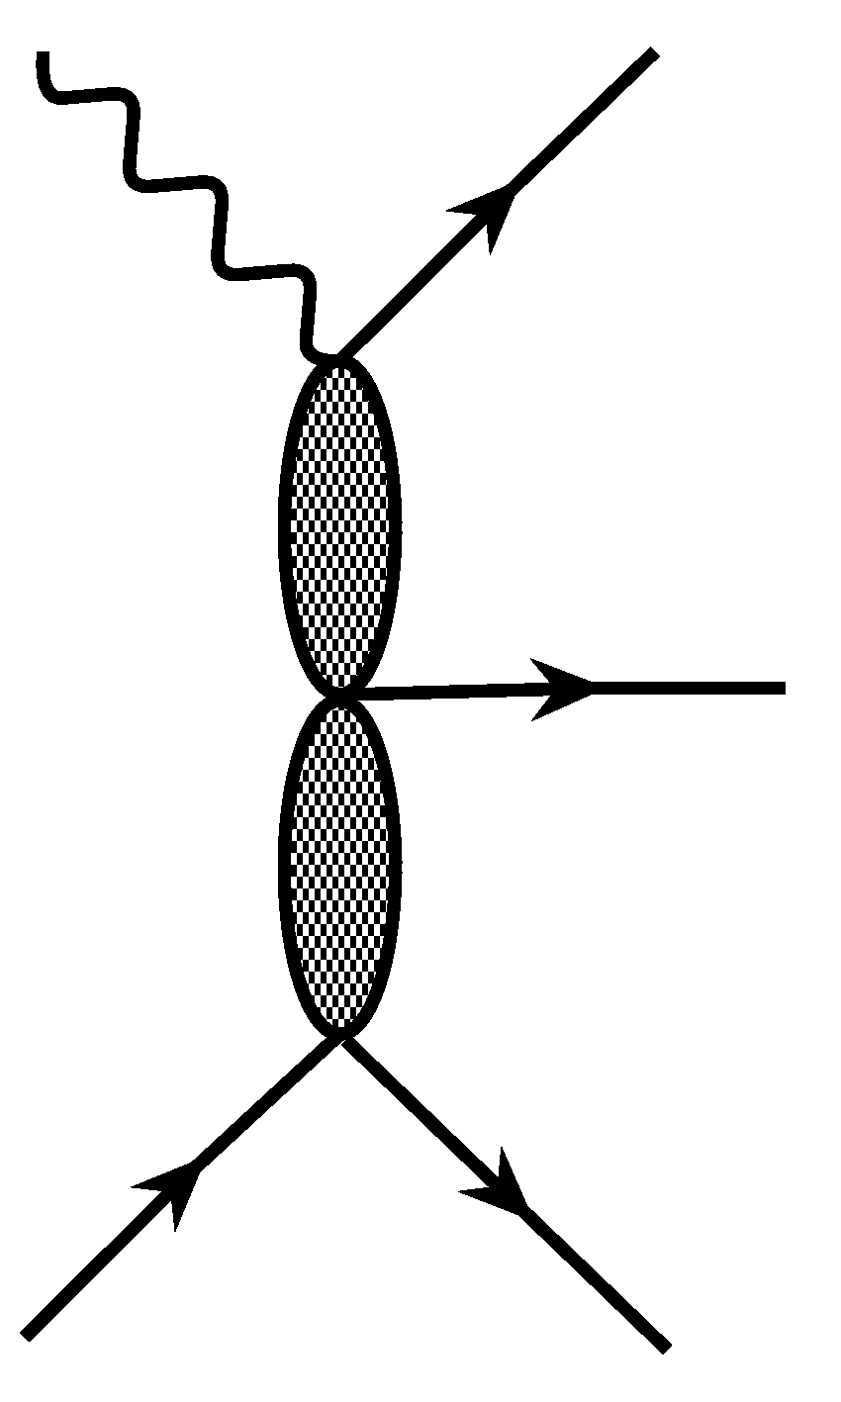
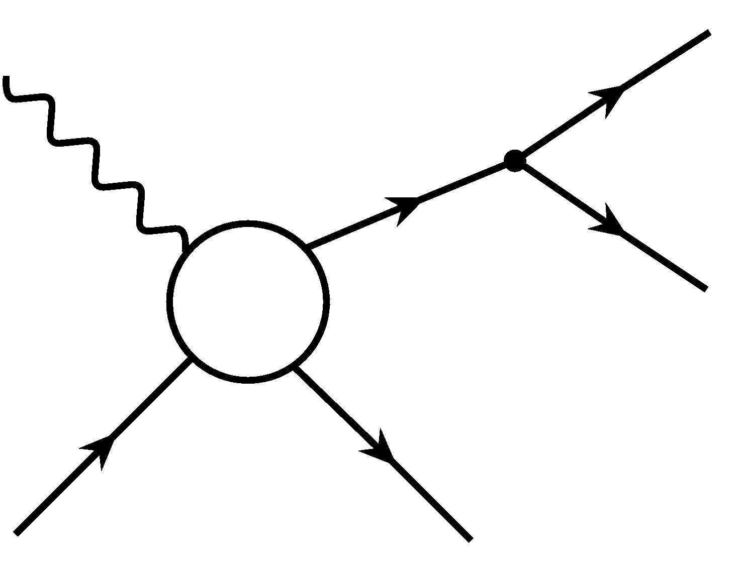
JM Model for Analysis of π⁺π⁻p Photo-/Electroproduction
Major objectives: extraction of γ_{r},_{v}pN* photo-/electrocouplings and πΔ, ρp decay widths
γ
π⁻
γ
π^{−/+}
Δ^{++/0} (1232)3/2⁺, N⁰ (1520)3/2⁻,
Δ⁺⁺ (1600)3/2⁺, N⁰(1680)5/2⁺
π⁺
=
five channels with
unstable intermediate
meson/baryon and direct
π⁺π⁻p production;
N* contribute to πΔ
and ρp channels only;
unitarized Breit-
Wigner ansatz for
resonant amplitudes;
phenomenological
parameterization of the
other meson-baryon
channel amplitudes (see
Ref. 2)
π
p
p
p’
γ
p’
π⁻
π⁻, π⁺, …
γ
ρ,σ
π⁺
π⁺, π⁻, …
+
+
p
p’
p
p’,p’, …
V.I. Mokeev, V.D. Burkert et al., (CLAS Collaboration) Phys. Rev. C86, 035203 (2012).
V.I. Mokeev, V.D. Burkert et al., Phys. Rev. C80, 045212 (2009).
V.I. Mokeev, V.D. Burkert et al., Phys. Rev. C93, 025206 (2016).
Good description of π⁺π⁻p photo-/electroproduction off protons cross sections at 1.4 GeV<W<2.0 GeV and 0.2 GeV²<Q²<5.0 GeV²
Notes:
Last diagram 1&2) meson meson 3) meson baryon exchange bubbles, more generally 2q and 3q exchange.

