Slide 1
Beam Asymmetry for photoproduced $ω$ mesons off bound protons in deuterons
Olga Cortes Becerra
Update:11/15/2018

Slide 2
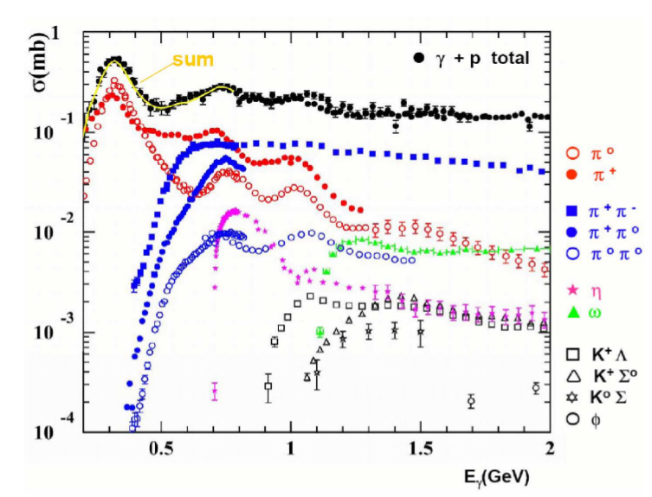
Motivation
Hadron spectroscopy
Bound nucleon
There are some technicalities that have to be taken into account:
Fermi momentum smearing the distributions
Moving to the CoM frame has to take into account the Fermi momentum
All particles have to be detected
How we treat the bound proton will give us a hint on how to treat bound neutron data (all neutron data)

Slide 3
Previous measurements: free proton
P. Roy et al., Physical Review C 97, 055202 (2018)

Slide 4
Previous measurements: bound proton
V. Vegna et al., Physical Review C 91, 065207 (2015)

Slide 5
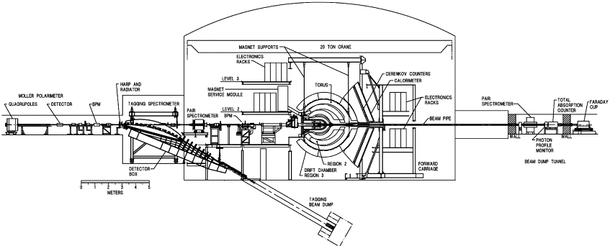
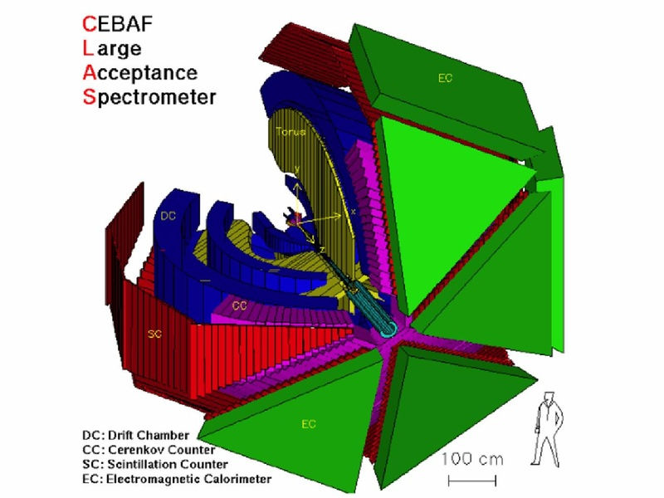
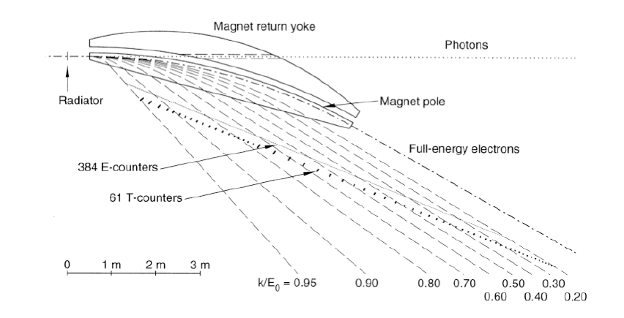
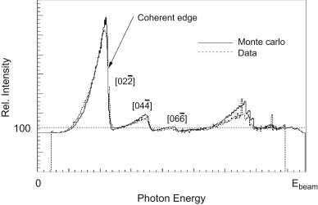
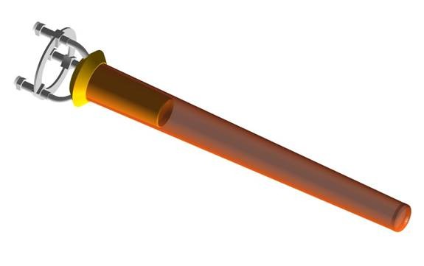
Experimental Layout: Quick reminder of g13
g13b:
Real photon. $E_{γ}=1.1−2.3 \text{GeV}$
Linearly polarized photons: Coherent Bremsstrahlung
40 cm deuterium target

Slide 6
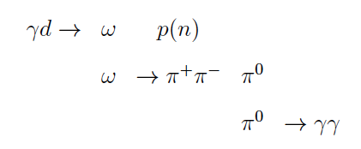
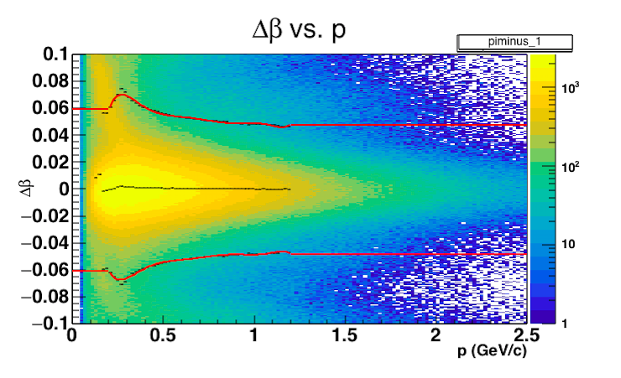
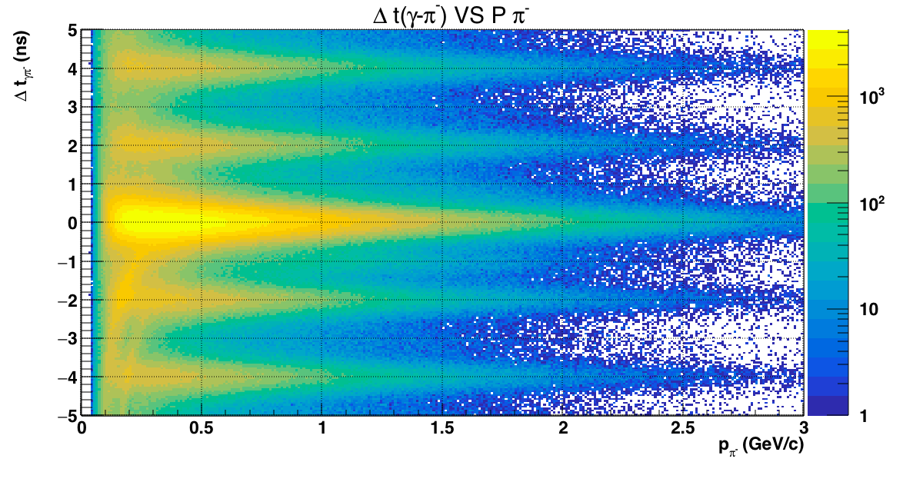
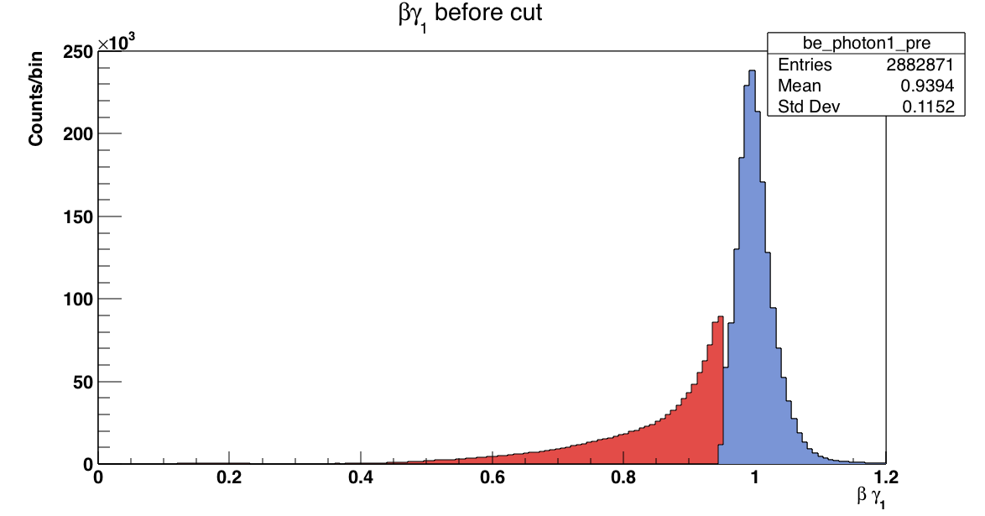
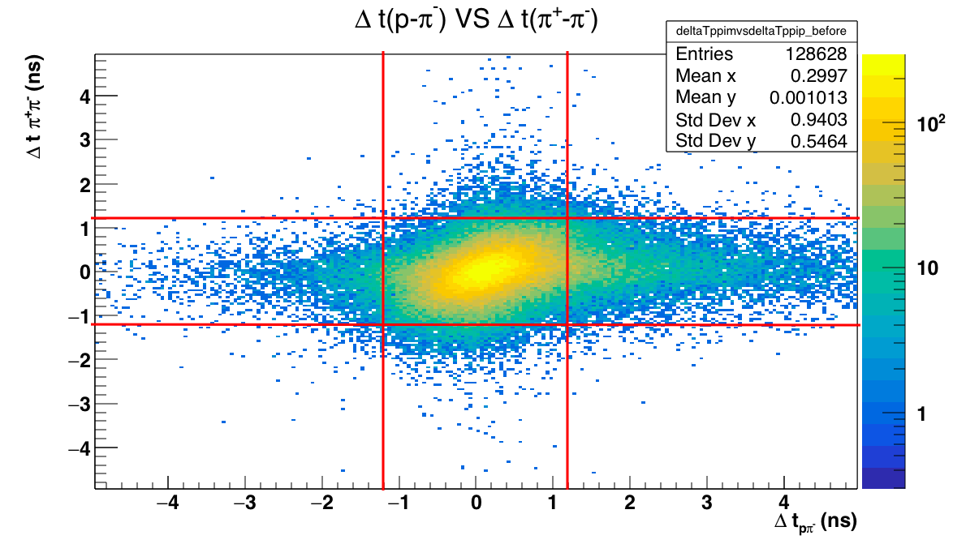
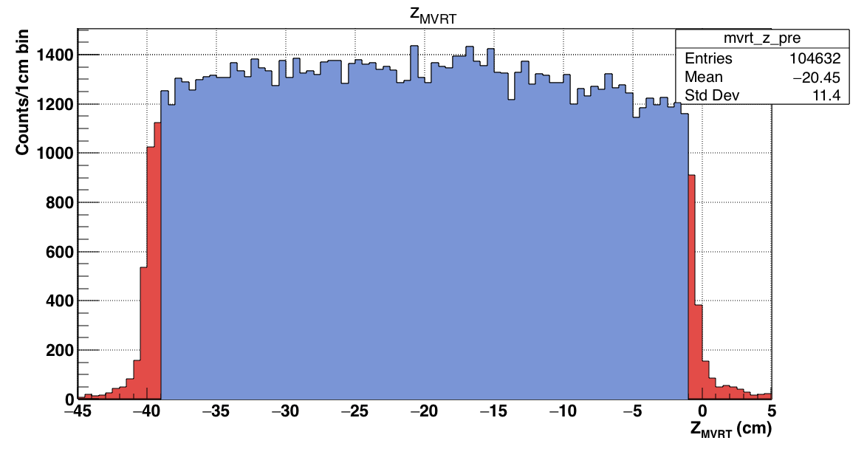
Data Analysis: Event Reconstruction
Charged particle identification
Incident photon identification
Neutral particle identification
Other cuts

Slide 7
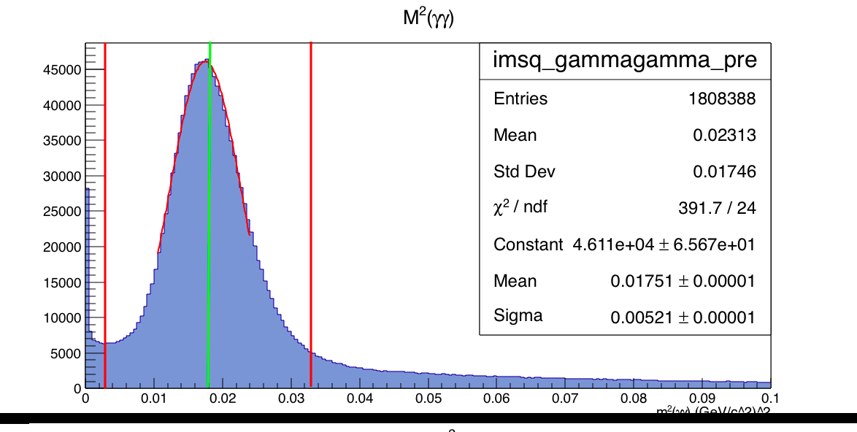
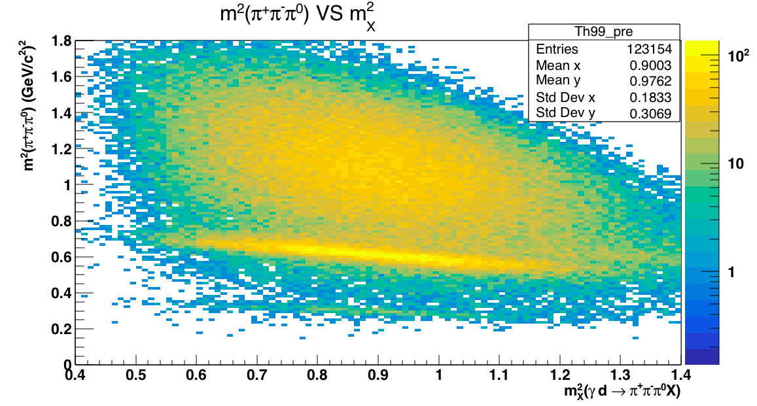
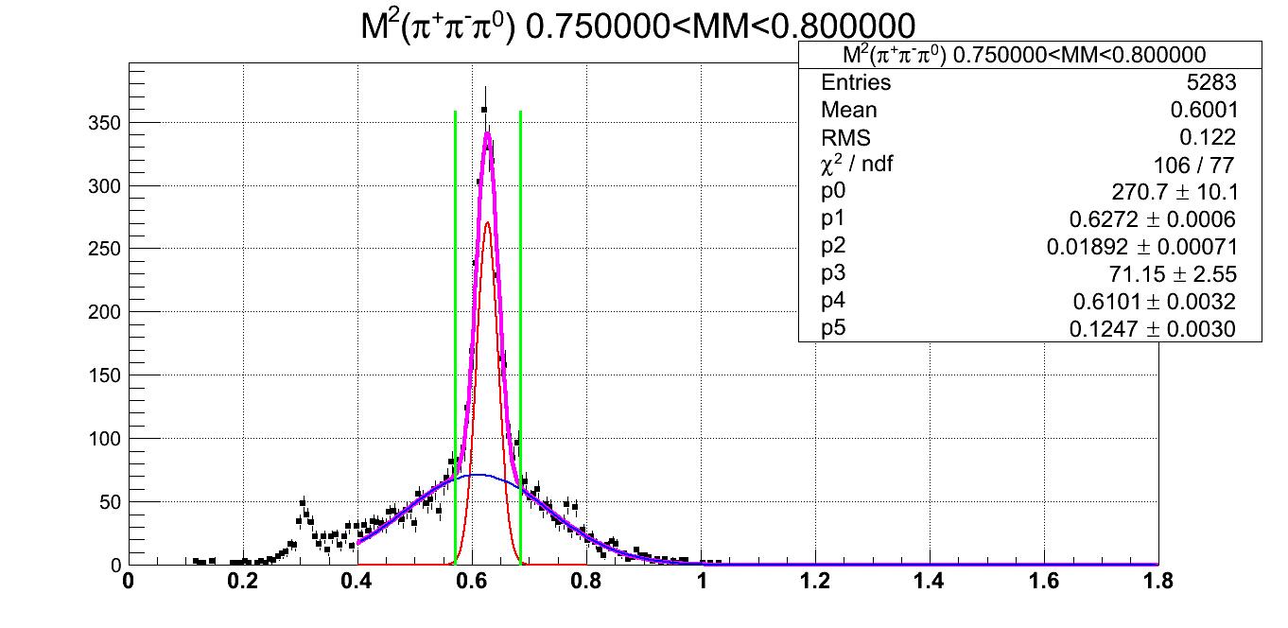
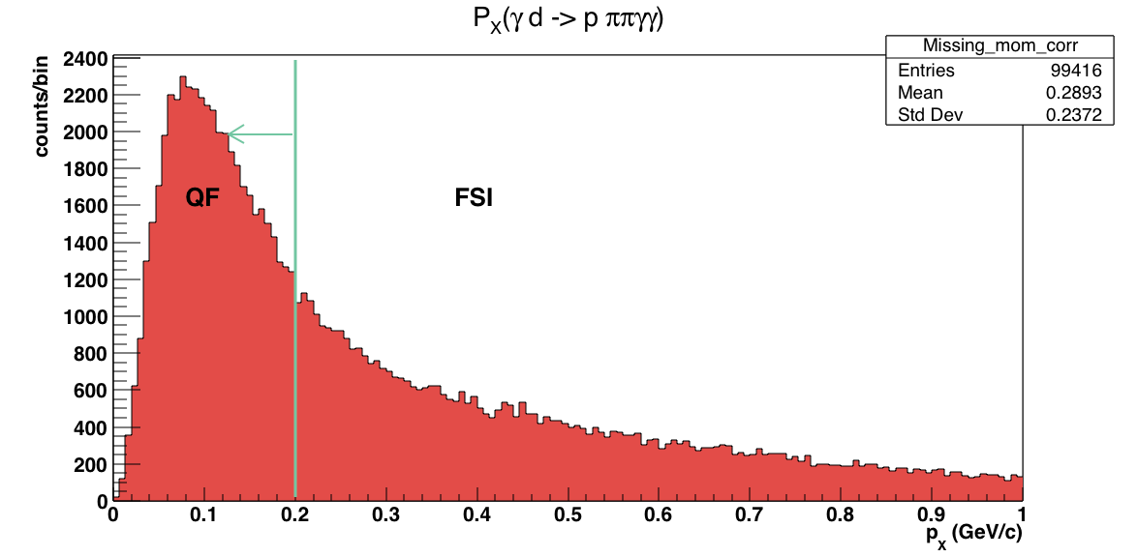
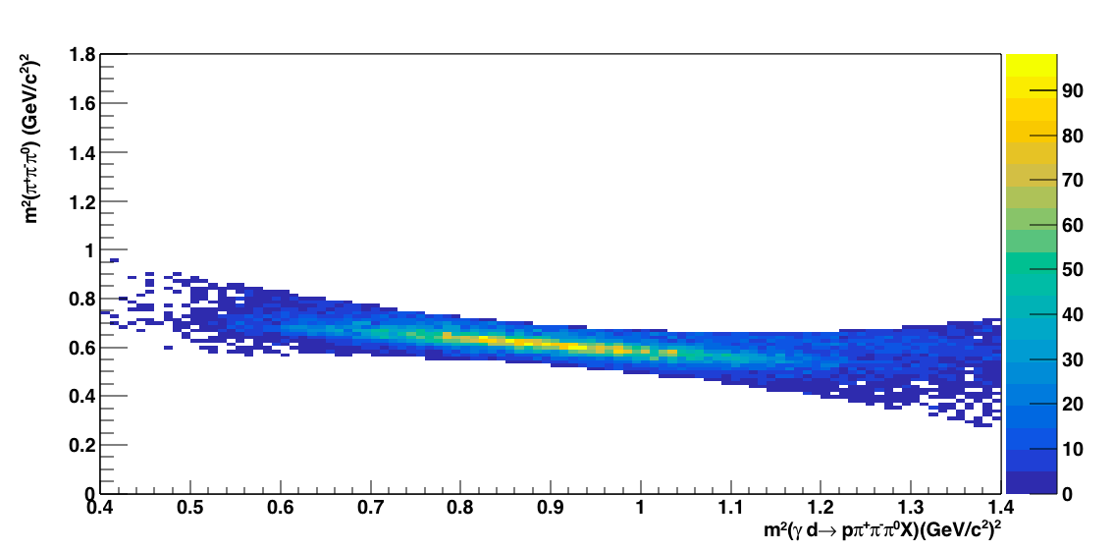
Data analysis: Event reconstruction
Non-resonant background
$$ω$$
$$η$$

Slide 8
Handling Background

Slide 9
Handling Background

Slide 10
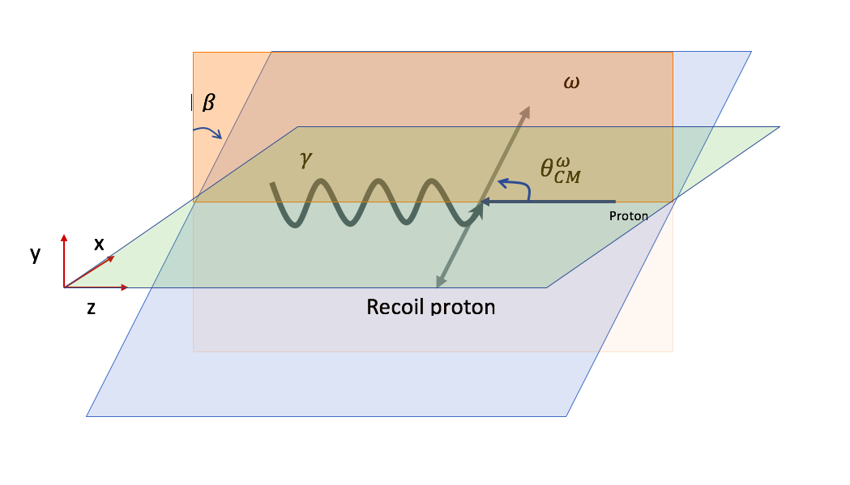
Beam Asymmetry
Polarization Vector
Perpendicular:
Parallel:
Production Plane
Background corrected

Slide 11
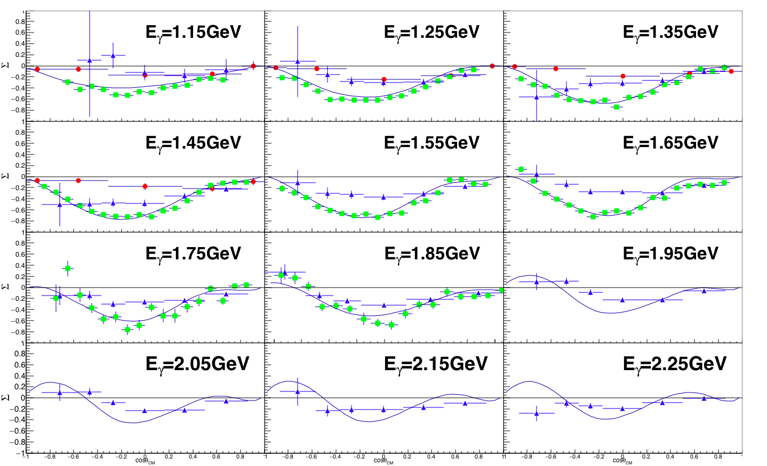
Preliminary Results
This work quasi free GRAAL (Vegna et al. 2015) Free proton CLAS (Collins et a..2017)
Preliminary

Slide 12
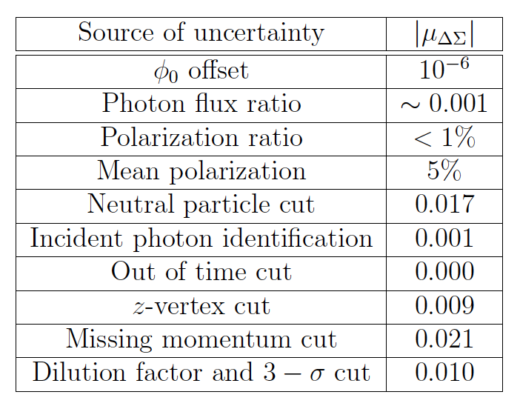
Systematic Uncertainties:
Largest source of uncertainty
Compared 0.2 GeV/c with 0.15 GeV/c cut

Slide 13
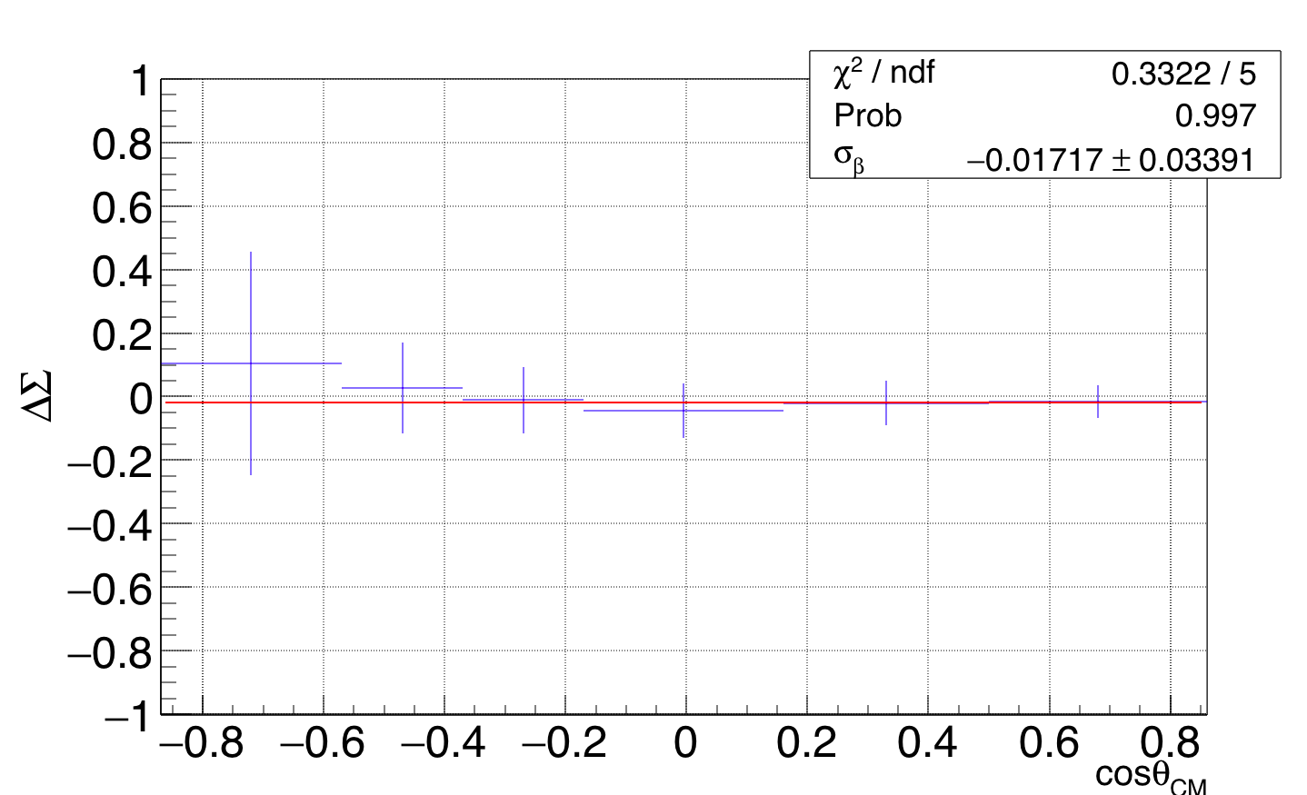
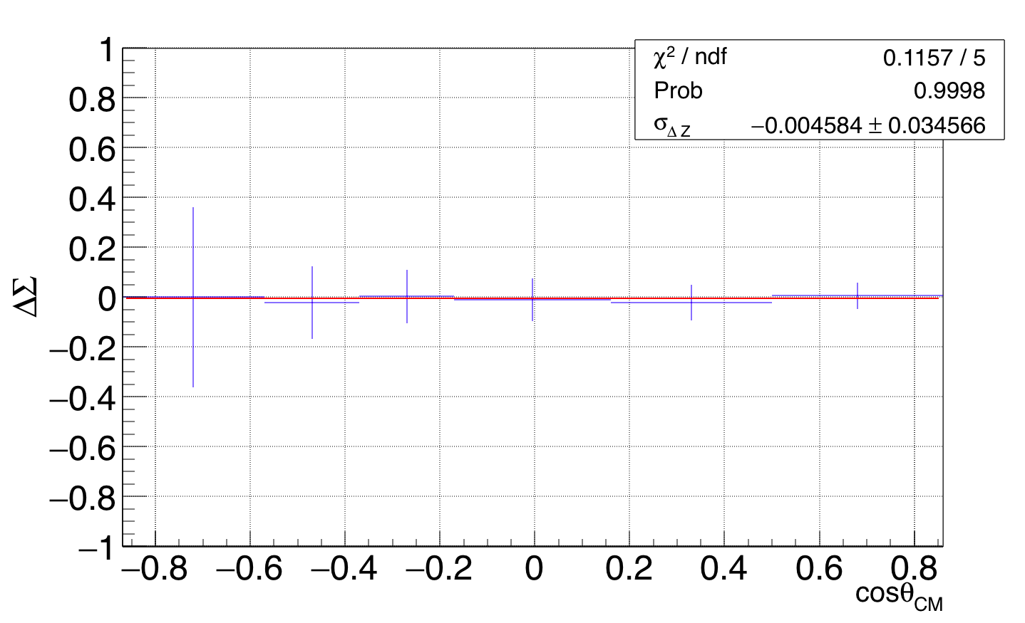
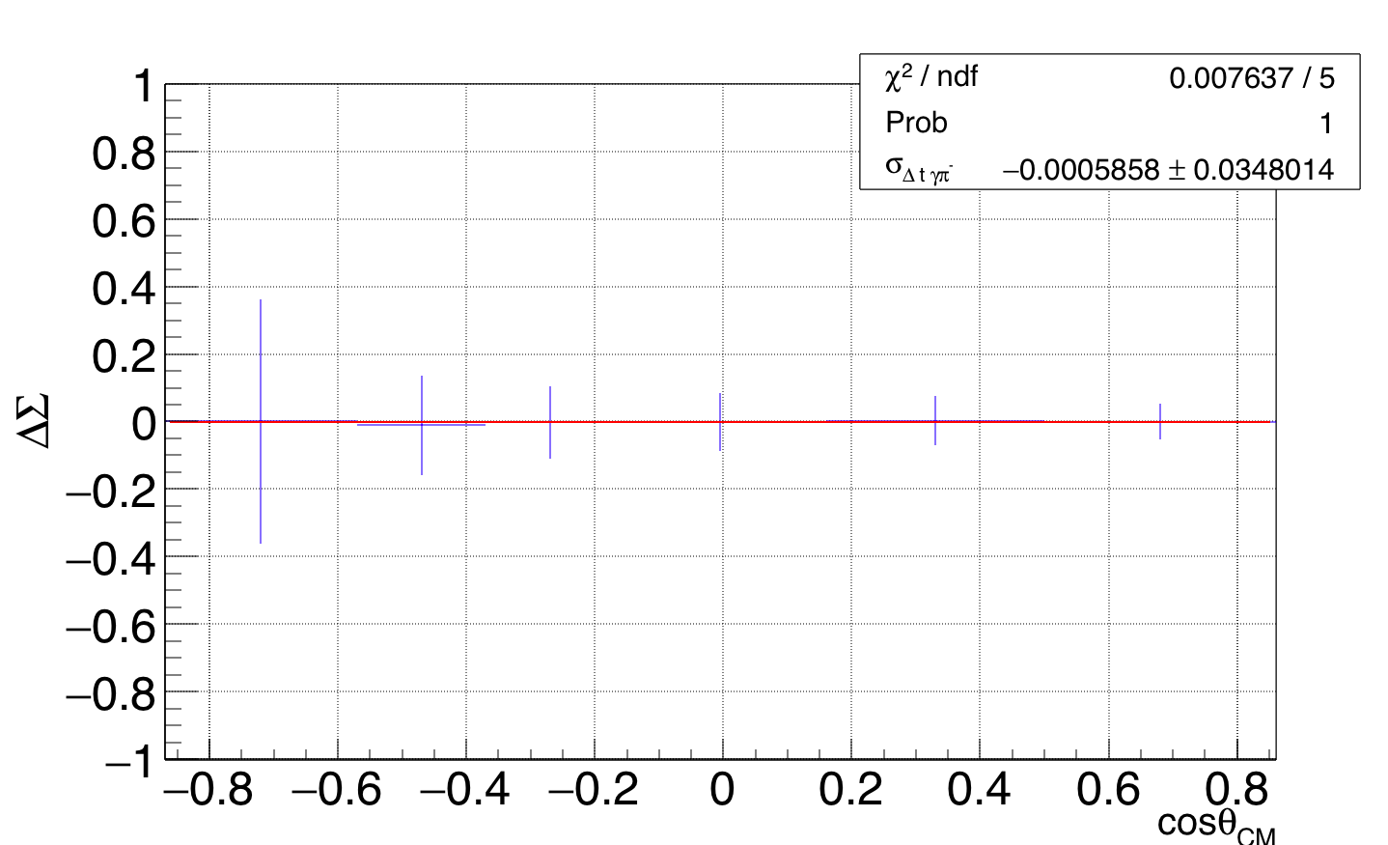
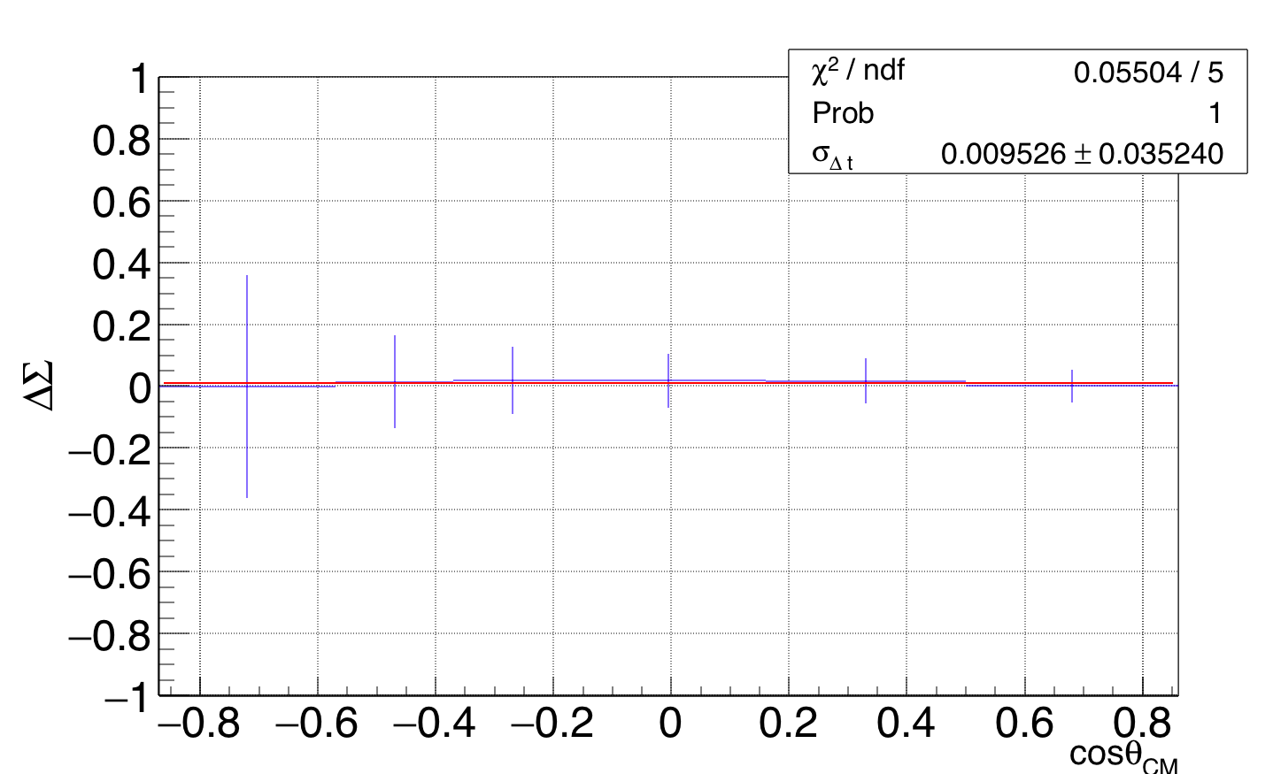
Systematic Uncertainties: related with event selection
z-vertex
Neutral particle identification
Out of time cut
Photon identification cut

Slide 14
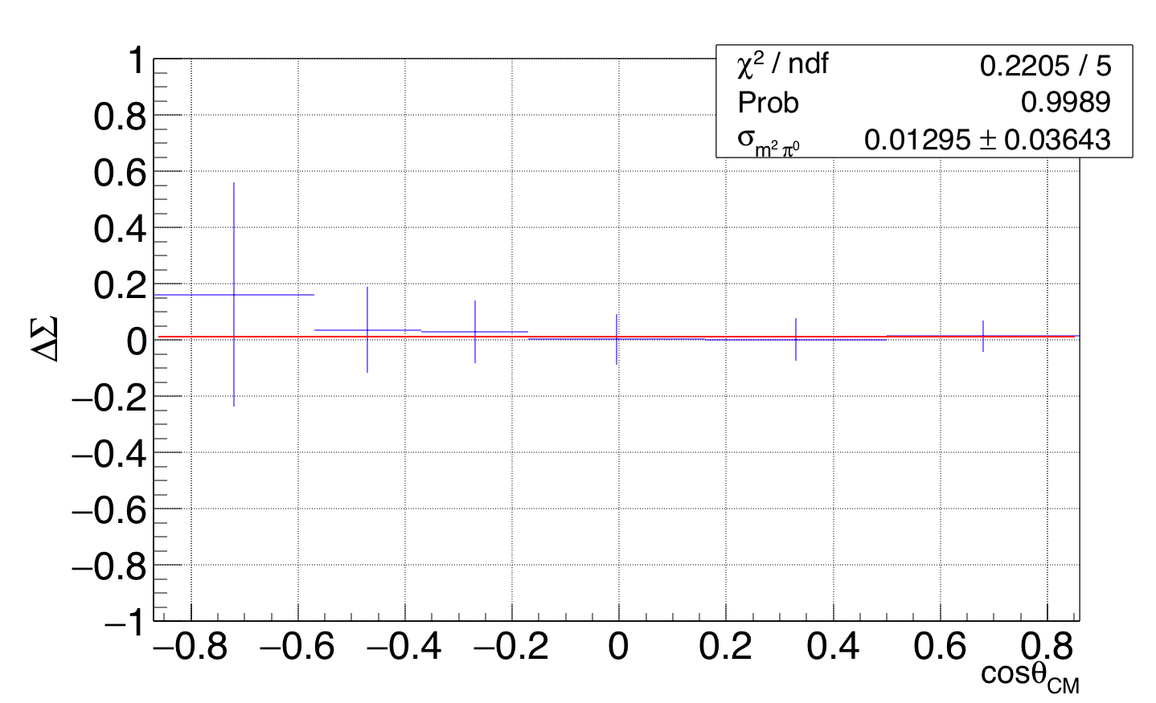
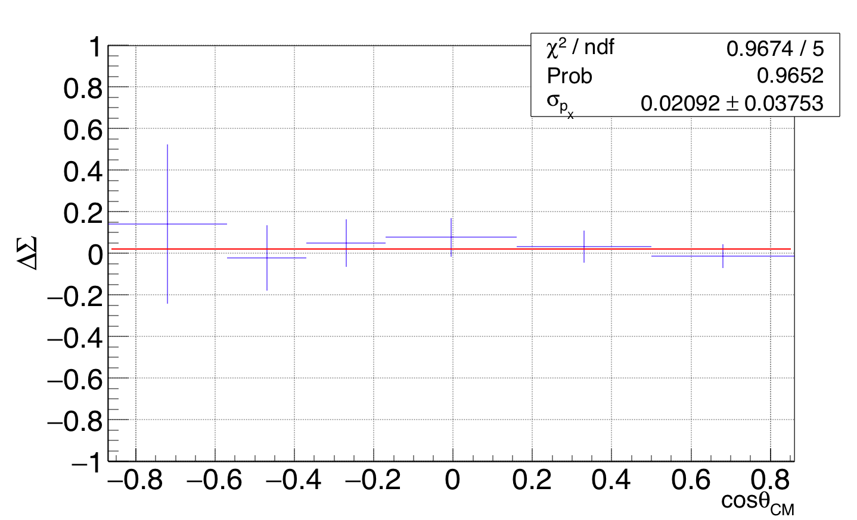
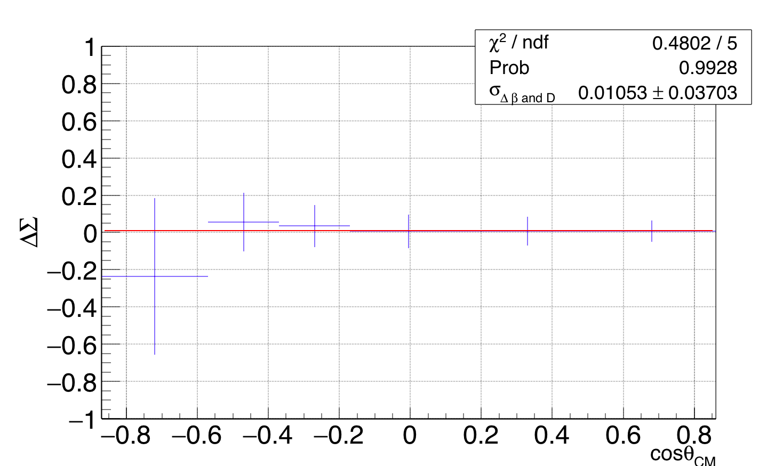
Systematic Uncertainties: related with event selection
Systematic Uncertainties: related with event selection
$π^{0}$ reconstruction
p missing cut
3$σ$ cut - dilution factor
14

Slide 15
Summary and Outlook
The $ω$ channel is relevant in the study of missing resonances predicted constituent quark models
We calculated the Beam Spin asymmetry for the photoproduced $ω$ mesons off the bounded proton in the deuteron for $E_{γ}=1.1−2.3 \text{GeV}$.
Comparison with previous quasi-free data from GRAAL collaboration (V. Vegna et al.) agrees at low energy bins. The amplitude of the asymmetry reported in this work is larger than GRAAL reported results at $E_{γ}=1.45 \text{GeV}$.
Our results, compared to the free events reported from CLAS collaboration (P. Collins et al.) are in general smaller in amplitude for middle angle range.
We estimated the systematic uncertainty of the beam asymmetry due to the missing momentum cut as 0.021. Possible small FSI background over the quasi-free events. This needs to be furthered analyzed.
Goal to submit analysis note by February.

Slide 16
Thank you!
Questions? Comments?

Slide 17
Backup slides

