Slide 1
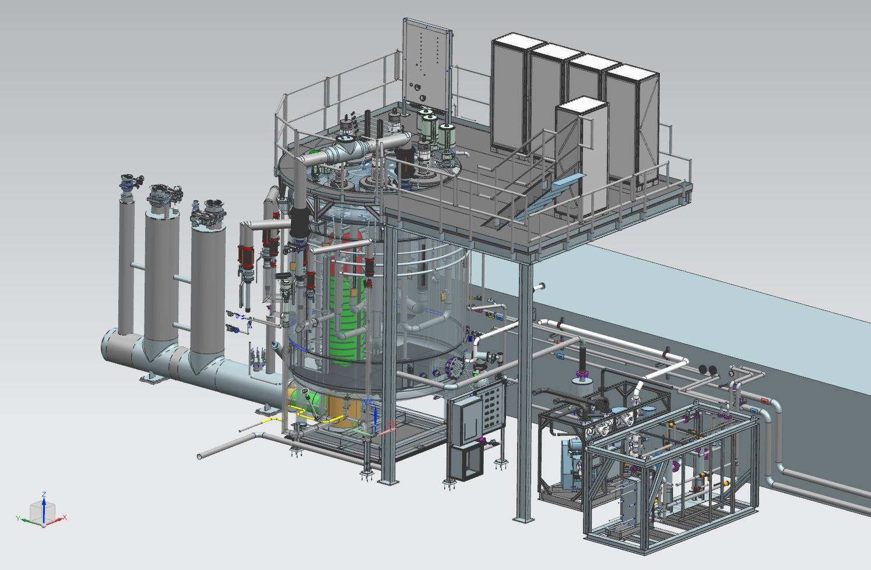
SC1R Installation Review
Introduction
Kelly Dixon

Slide 2
Outline/Agenda

Slide 3
Charge
This Installation Review (IR) will focus on the following phases of installation:
SC1 disconnection and CHL modifications
SC1 removal to TEDF
SC1R transportation from TEDF to CHL
Installation of SC1R
Platform installation and other building modifications
Utility piping and systems
Electrical, controls and instrumentation installation
Piping and u-tube tie-ins
Items missed at the FDR (MLI)
We would like you to address the following questions with respect to the above work scope:
Have the FDR comments been satisfactorily addressed?
Is the plan to remove and install the cold box sound?
SC1R Installation Review - Introduction

Slide 4
Charge (cont.)
3. If the fabrication proceeds as planned, will the installation plan likely allow the cold box to be ready within required timeframe given the planned resources and available facilities? Items to be evaluated are:
Demolition schedule and associated labor
The installation schedule and associated labor.
It is anticipated that a readiness review will be held in ~12 months to evaluate the following items:
Equipment Status
Commissioning plan
Accelerator schedule
The committee is asked to produce a report in the format of “Findings” (statements of fact), “Comments” (statements of opinions), “Recommendations” (actions that must be completed before the cold box removal and installation actions are to take place). A bulleted list is sufficient.
SC1R Installation Review - Introduction

Slide 5
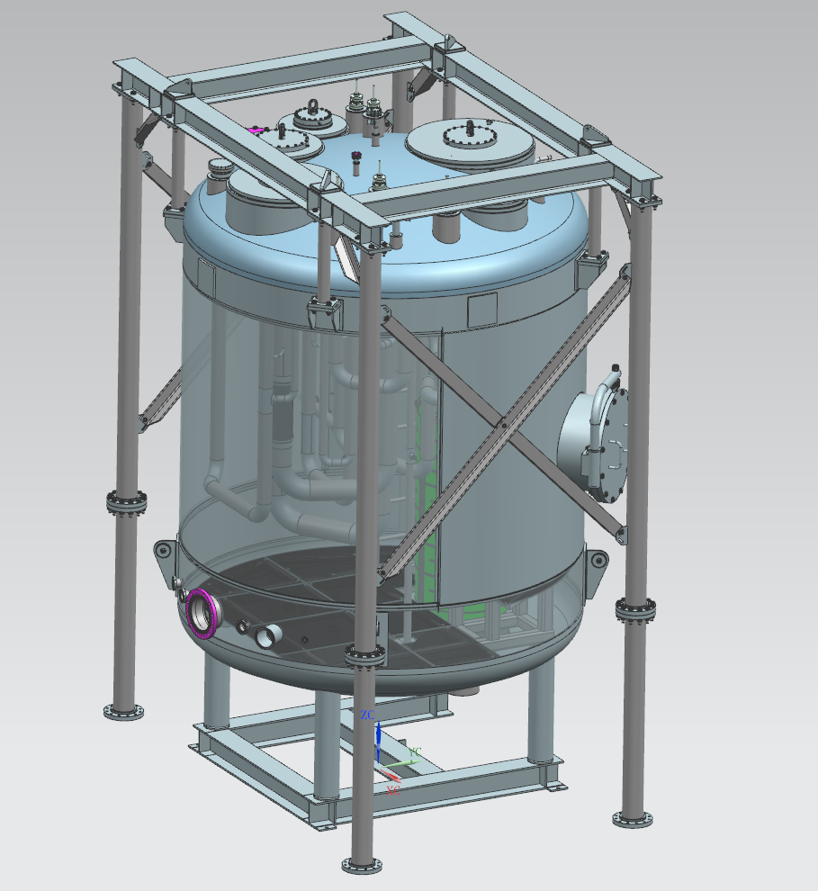
Design Status
CAD 3D Modelling Complete
  internal aux. and process piping,
  external piping includes
    water
    air
    He purge
    He cooldown/recovery
    relief
  conduits and trays
180 Released Drawings
  all but vacuum piping remains
SC1R Installation Review - Introduction

Slide 6
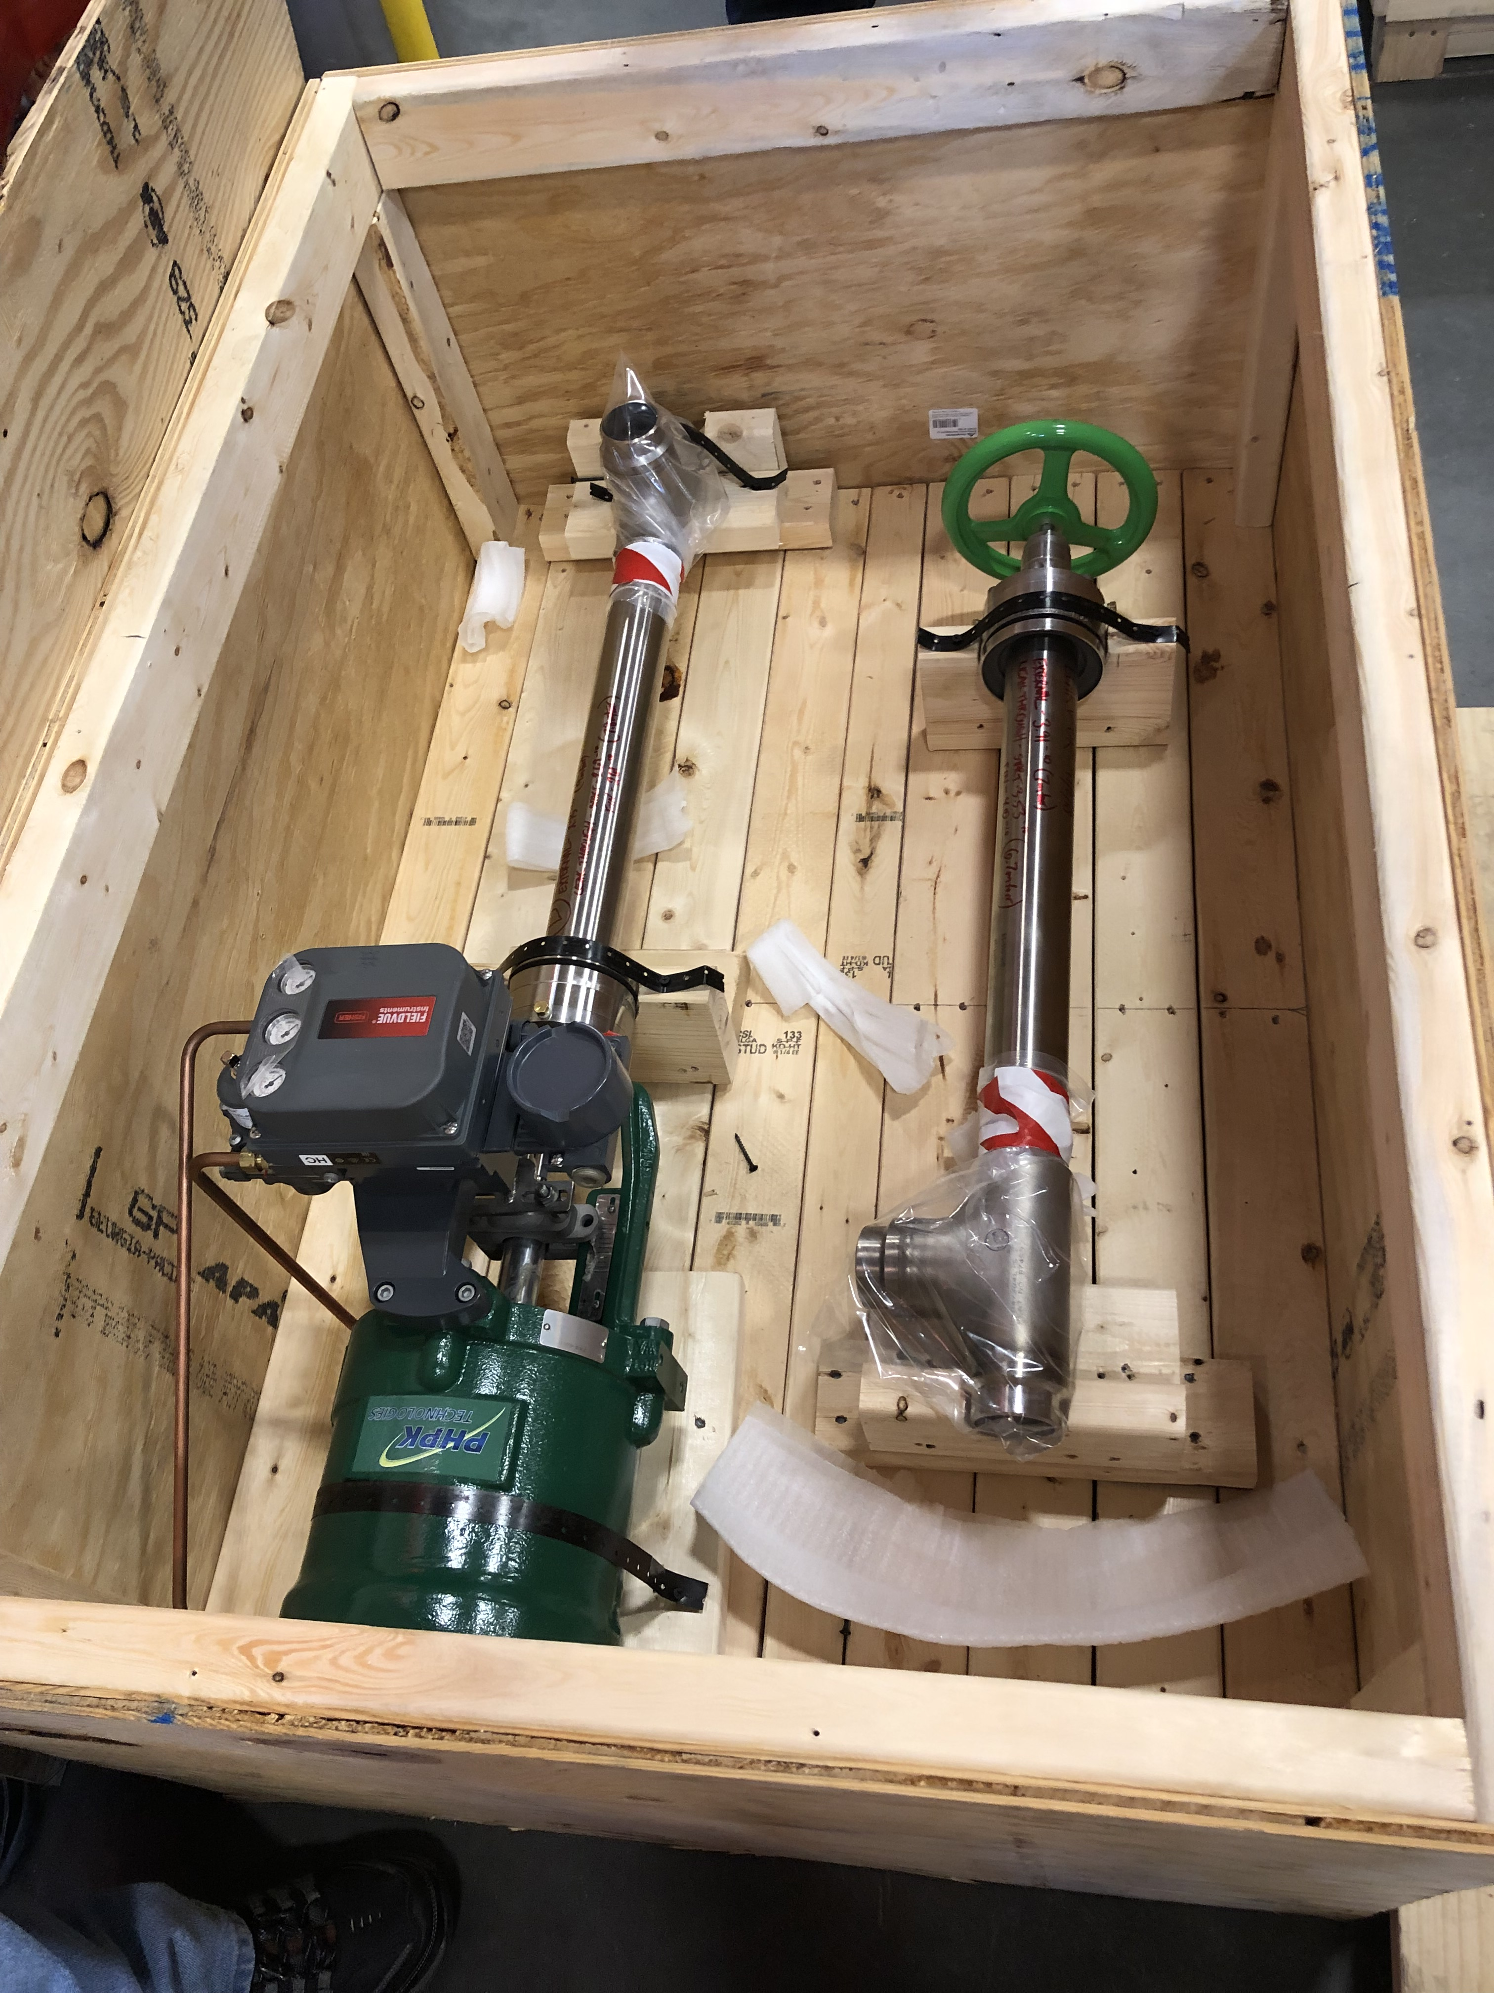
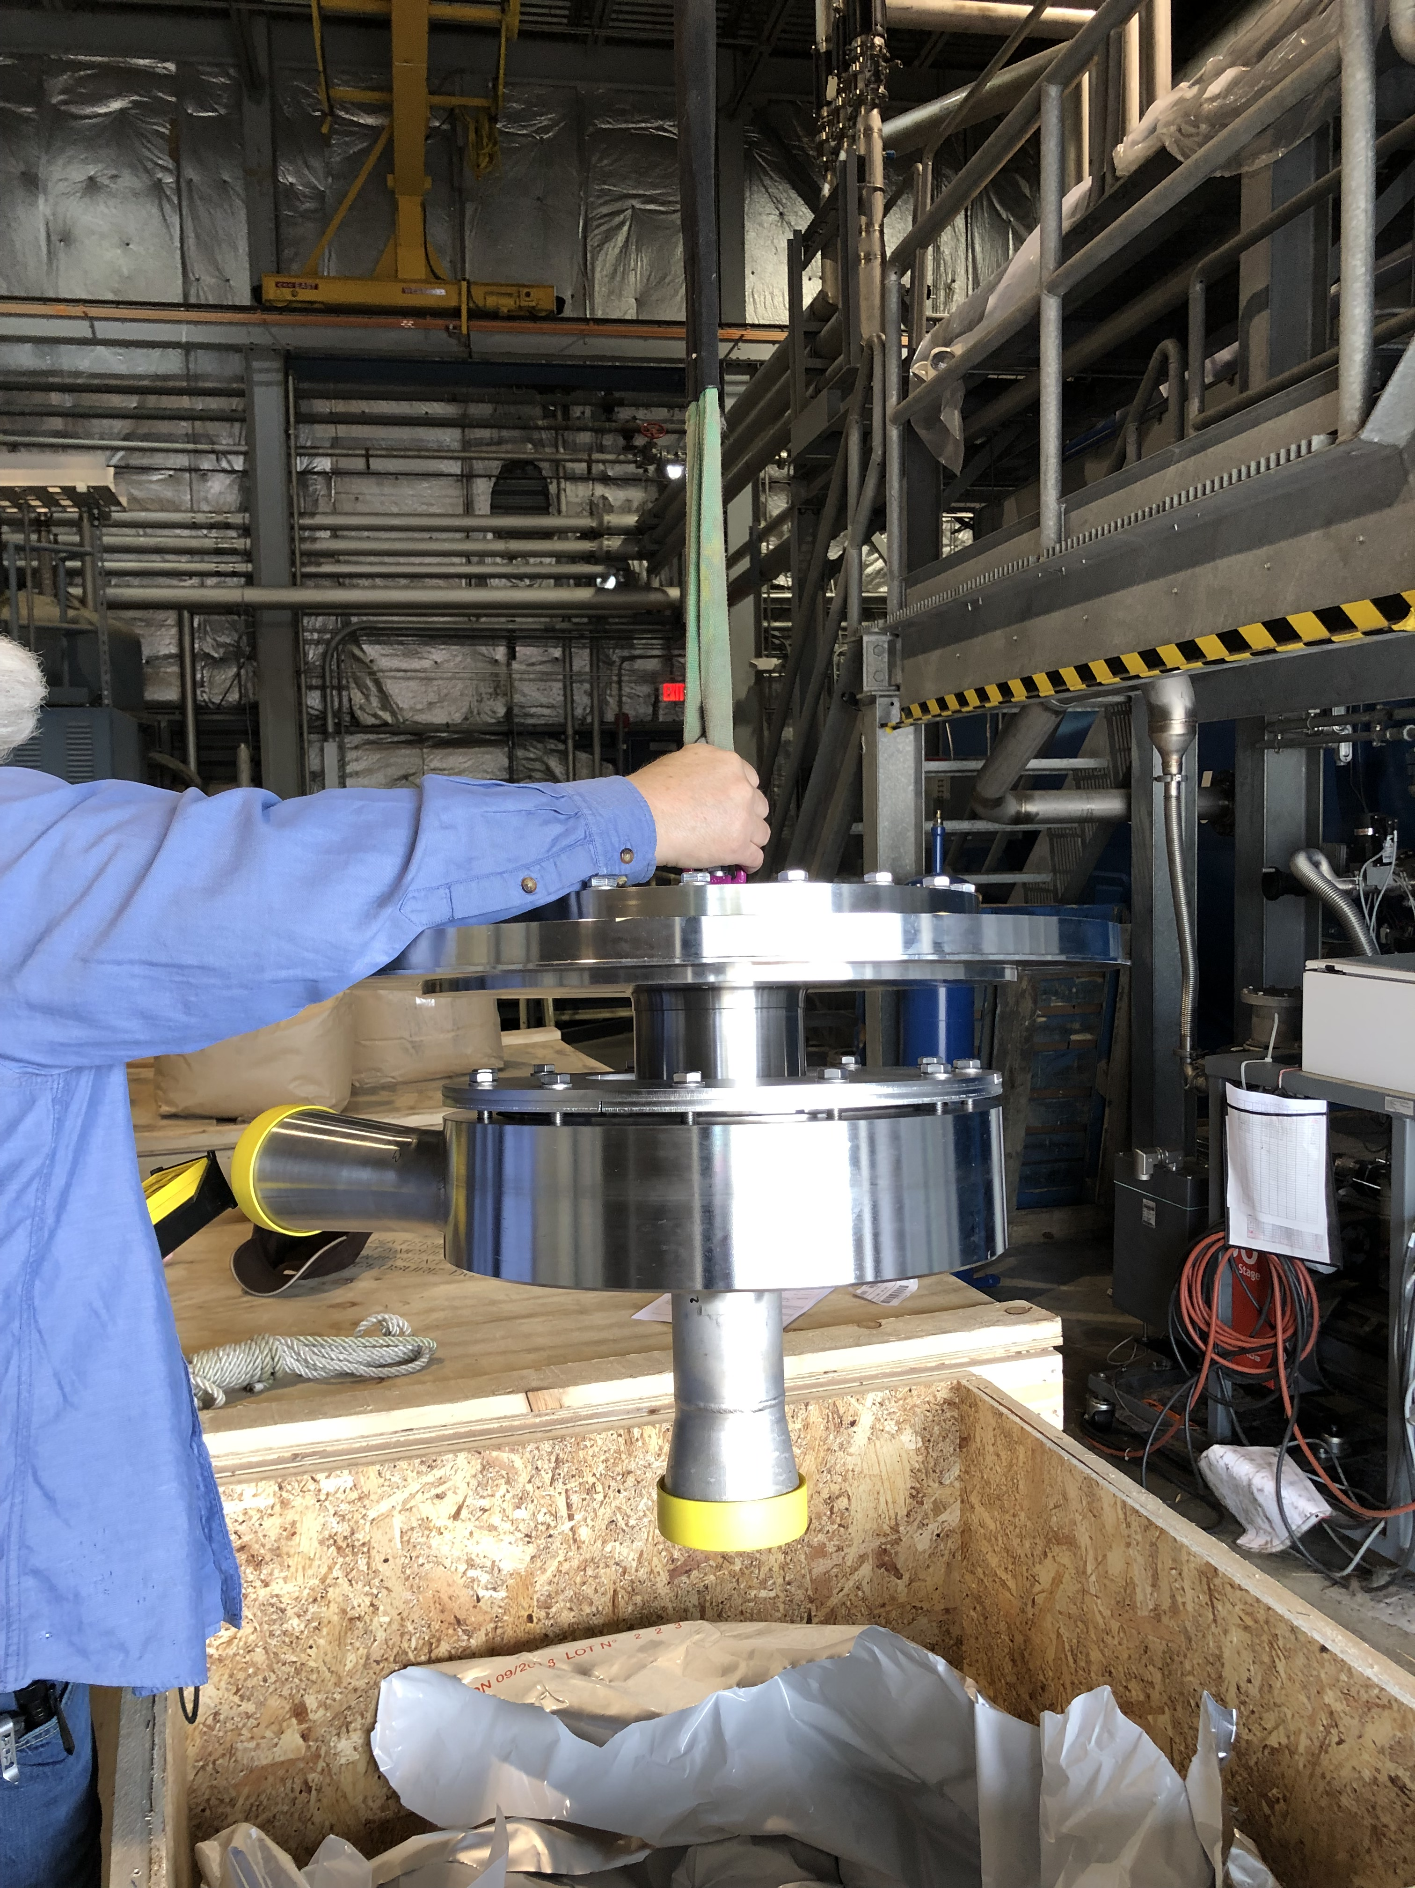
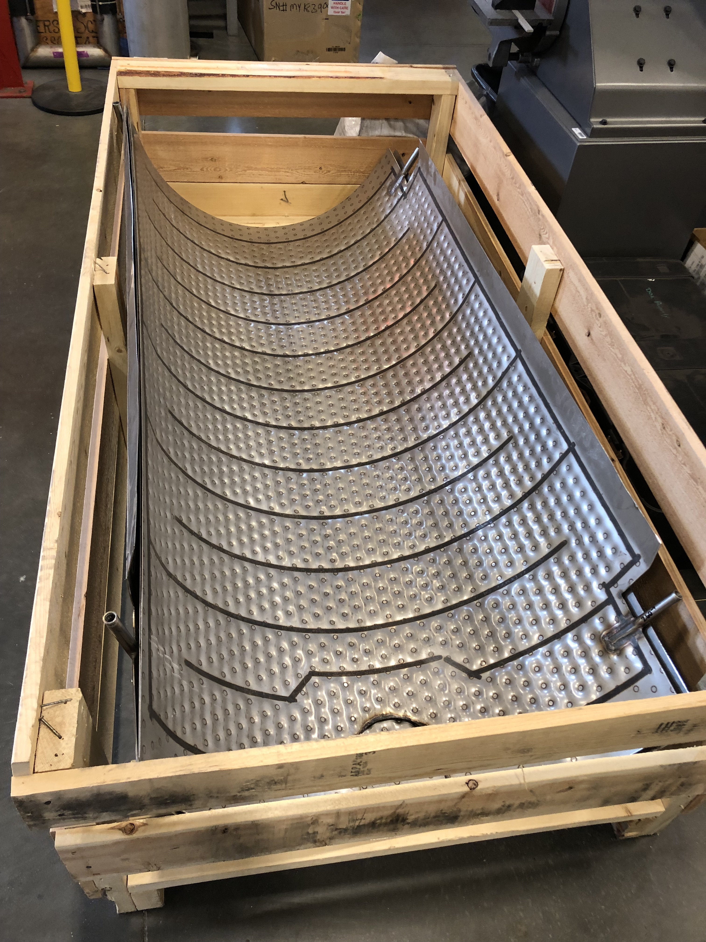
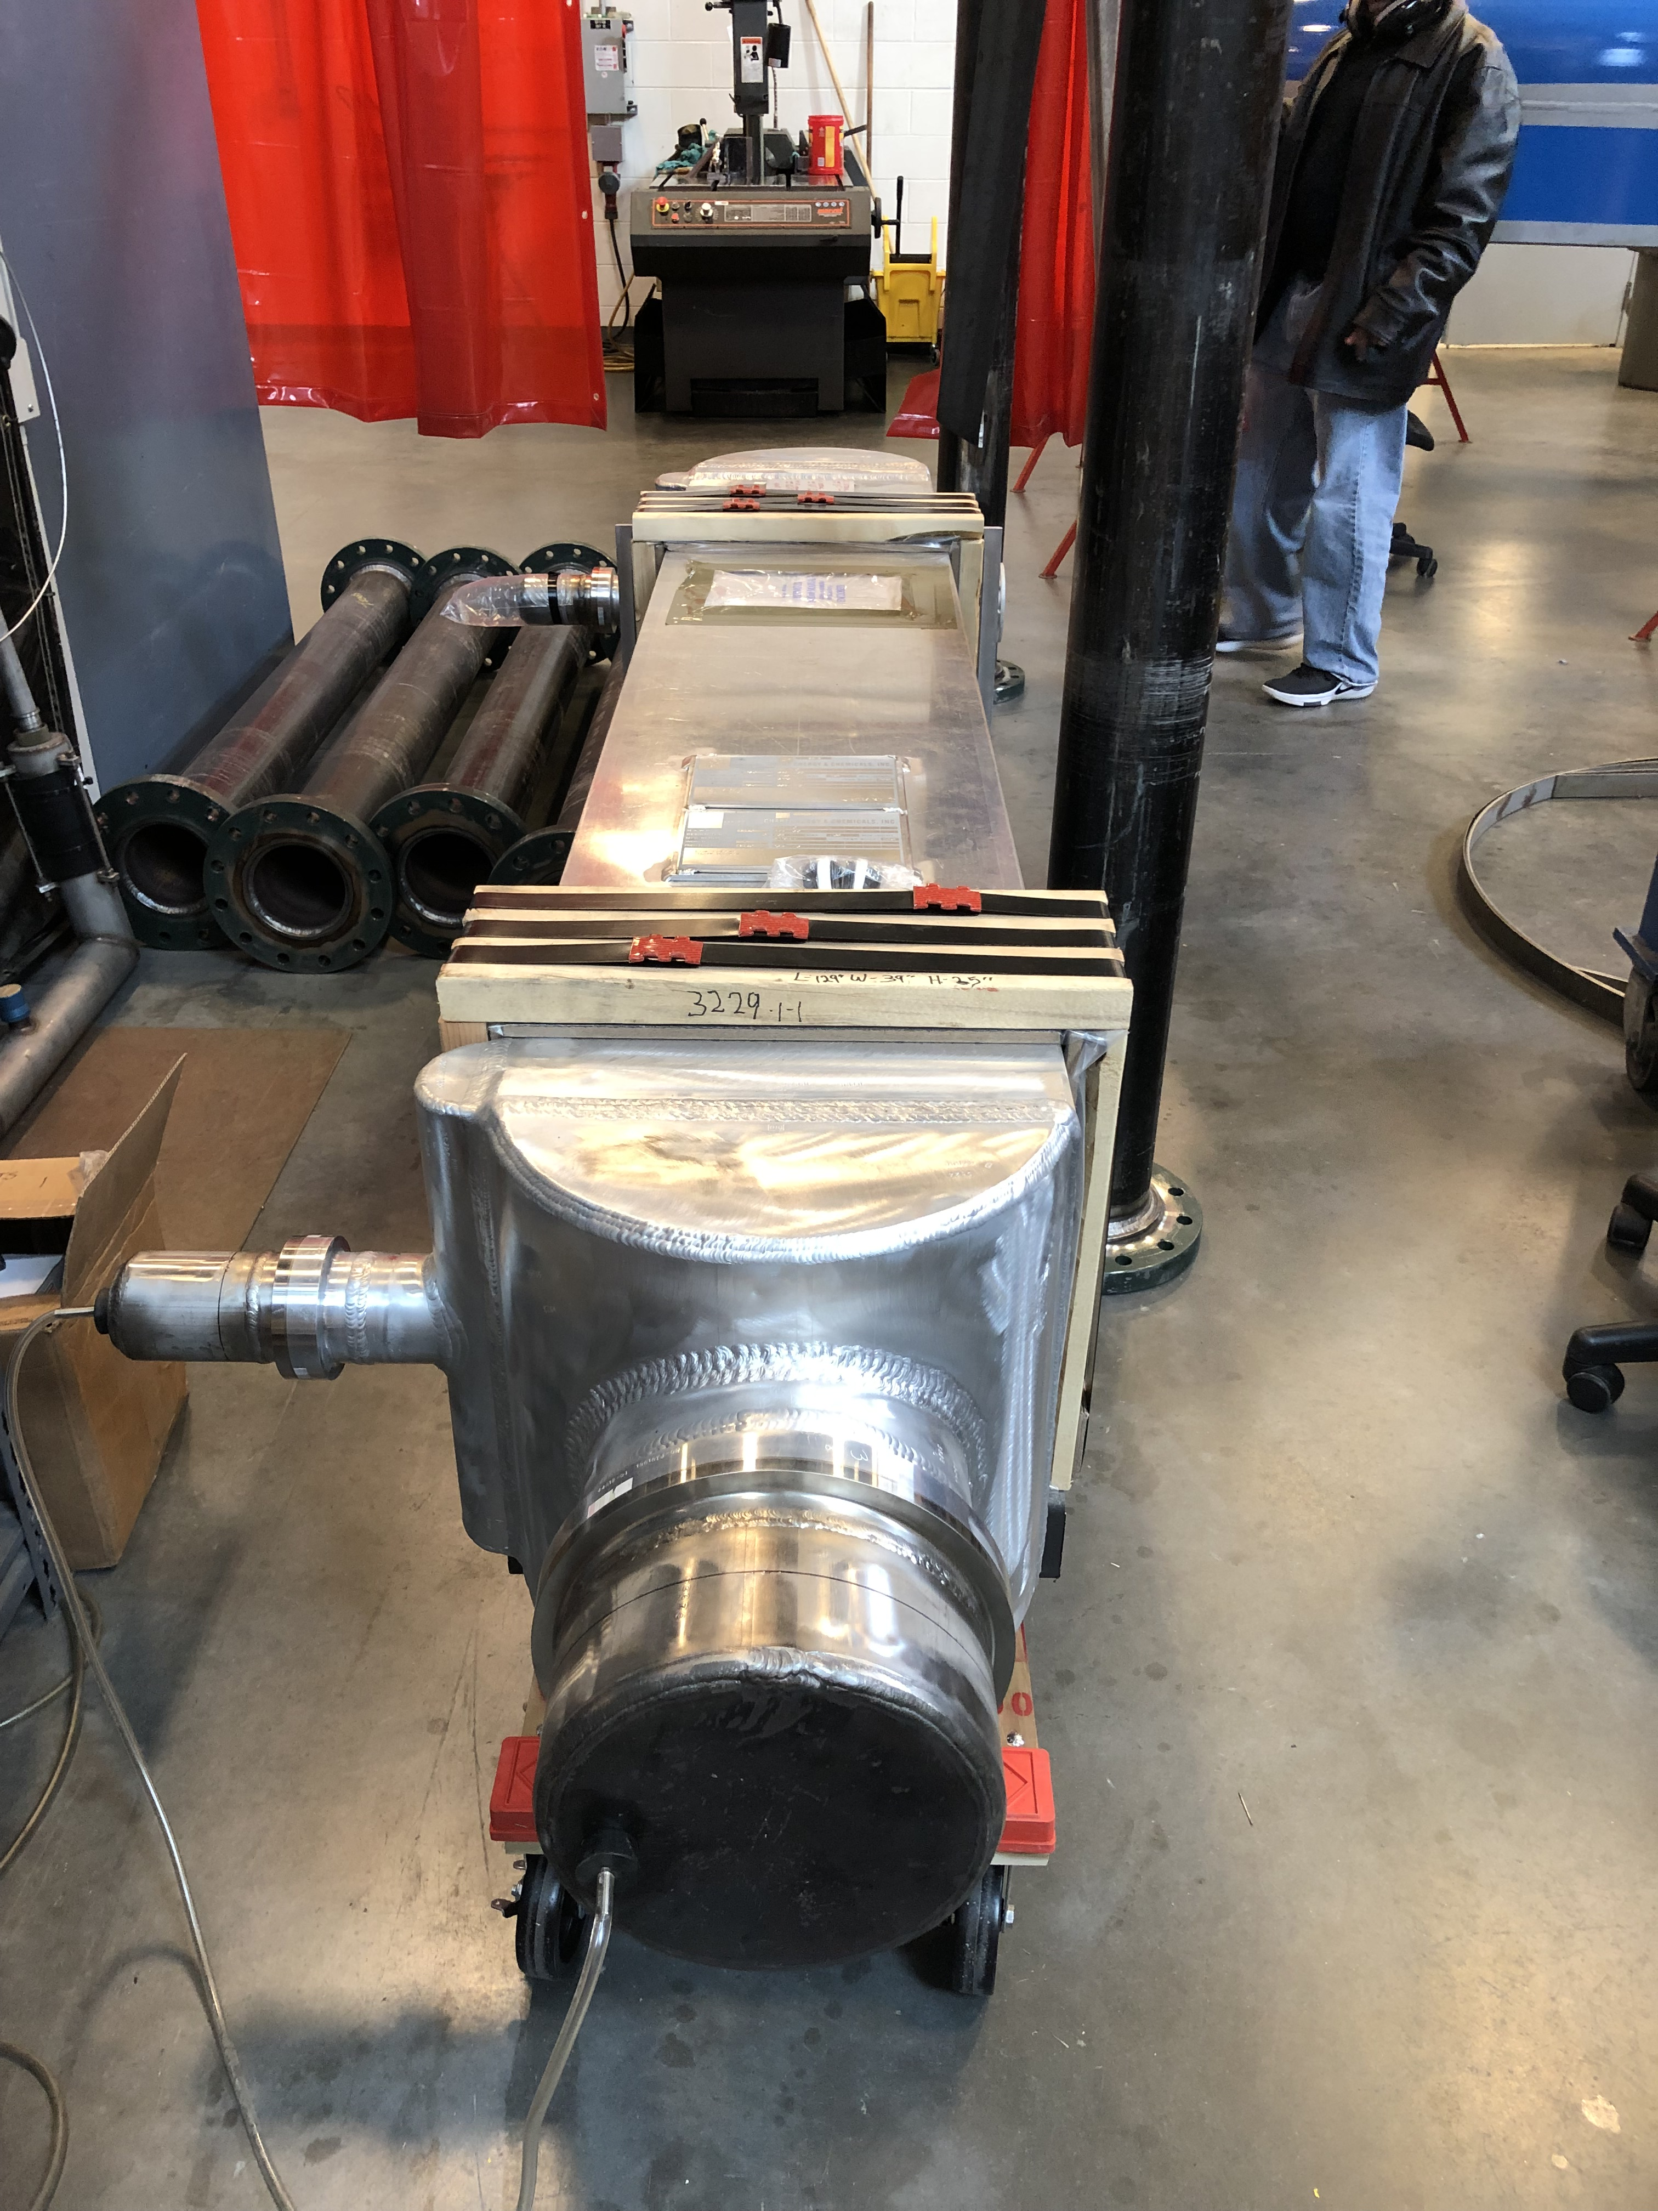
Critical Components Status
All Major Long Lead Items Impacting Fabrication Have Arrived!
Long Lead Item | Arrival date
Cryogenic control valves | Jan. 11, 2019 (remaining 2 of 9)
Vacuum vessel shell sections | Jan. 9, 2019
Cold compressor scroll casings | Dec. 7, 2018
Dimpled Shield HX | Oct. 23, 2018
2K/4K Plate-Fin HX | Sep. 19, 2018
SC1R Installation Review - Introduction

Slide 7
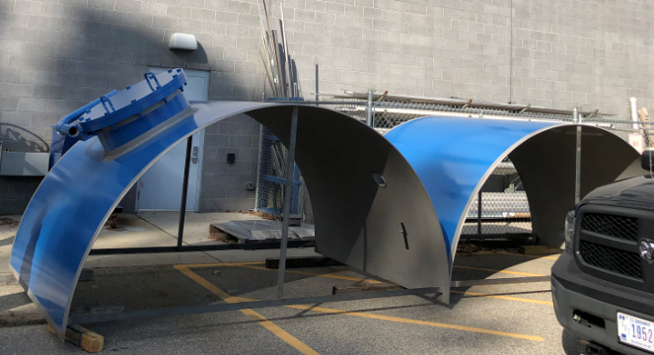
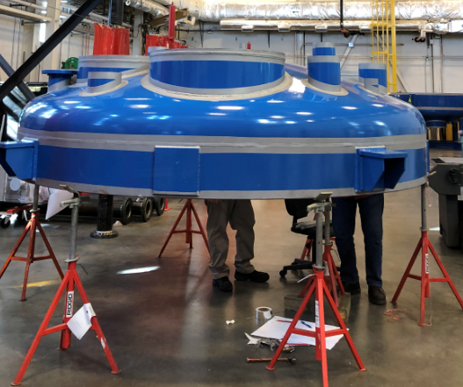
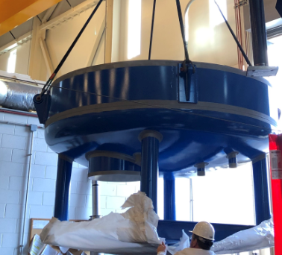
Critical Components Status
Vacuum Vessel Sections
SC1R Installation Review - Introduction

Slide 8
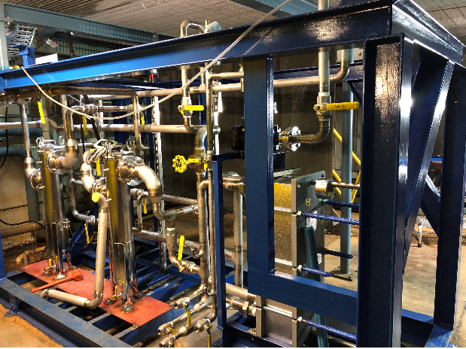
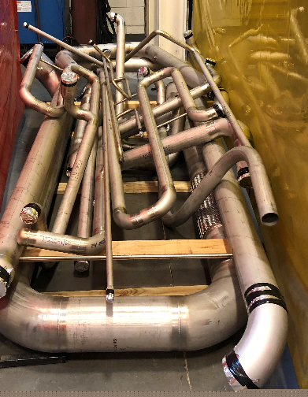
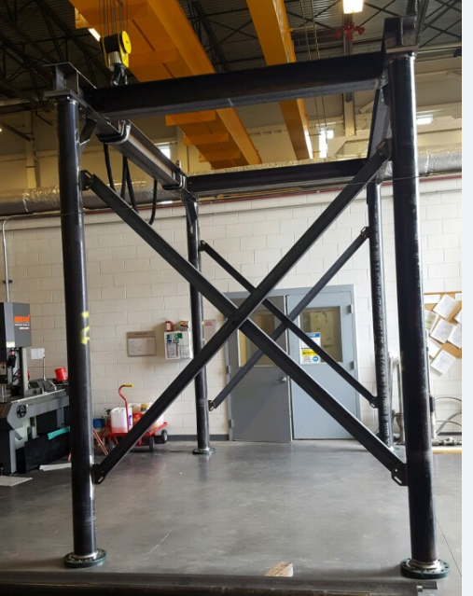
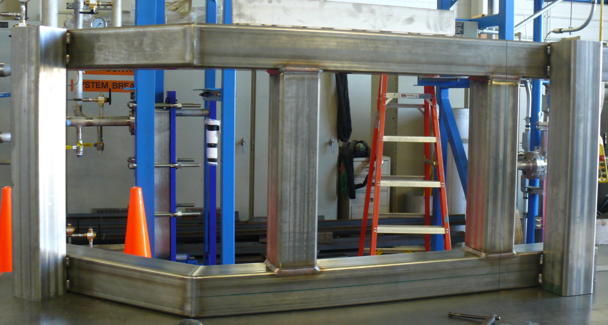
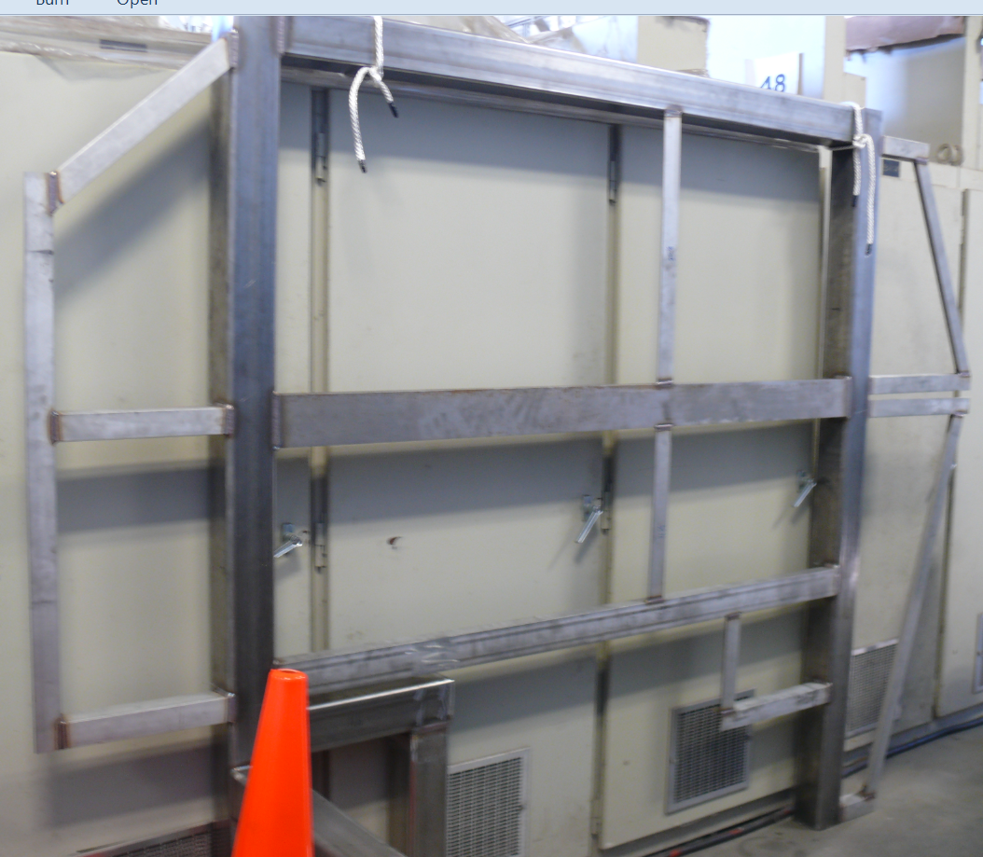
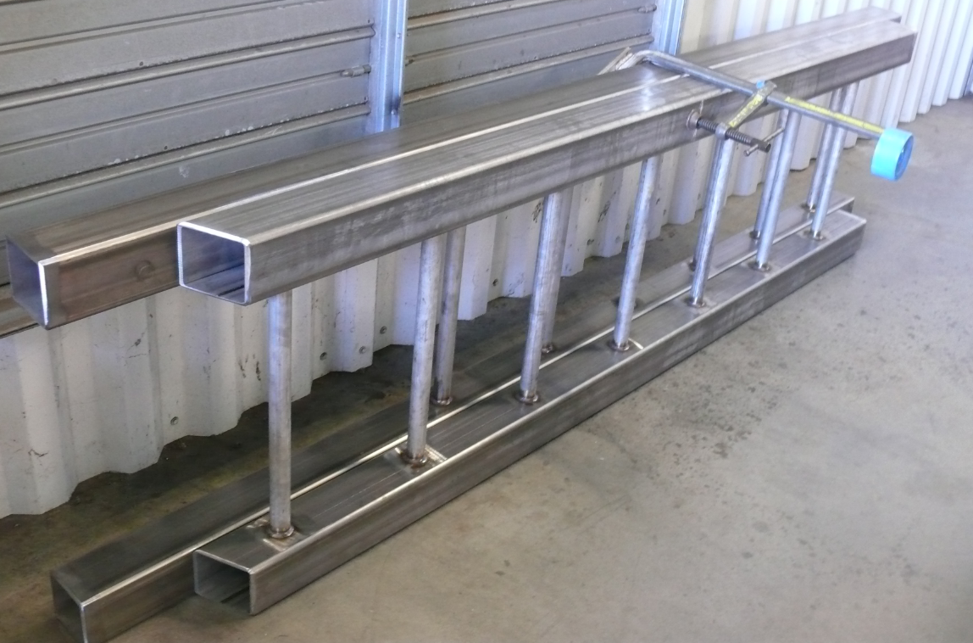
Fabrication Status
Fabrication and Installation
Construction of internal piping spools
  21 of 30 spools have been fabricated and leak tested.
Secondary cooling water system
  100% mechanically assembled
  Electrical enclosure has been ordered
Heat Exchanger Internal Frame
  Finished and awaits attachment to bottom head
Valve Panel
  85% done and awaits some valves
Fabrication of Female Bayonets
  1 ½” LN2 supply and return bayonets have been fabricated.
MLI
  Started to make MLI blanket for Top Head Assembly.
Upcoming Activities
  Power and controls for SCW system.
  Fabrication of the 4K and 2K bayonets.
  MLI blankets
  Cold Compressor (CC) Casings Leak test
  CC Casing nozzle fit-up test
SC1R Installation Review - Introduction

Slide 9
FDR Recommendations
Recommendations:
The idea of having a traveler is a good one and we recommend having this for fabrication.
This will be shown in later slides.
Vacuum vessel fabrication schedule seems tight and thus needs to be awarded ASAP and vendor must be tracked closely.
We expedited and tracked this procurement process.
Get started ordering materials and setup material tracking system ASAP
All long lead items have been procured, most have arrived and we believe that we still will meet schedule given delays in some items.
It was stated that design was on the critical path and not all drawings are complete. Priorities of the group must be such that engineers and designers stay ahead of the fabricators and materials are ordered to make sure the fabricators are not waiting.
We added designers and was able to meet our final cold box design of November 30, 2018. The pressure is now largely on fabrication.
We look forward to the installation review and recommend an operational readiness review.
The readiness review is expected to take place in December of this year.
Recommend that the full piping system be leak checked before closing the vacuum vessel.
Agreed and are carrying out this practice.
Recommend not to move SC1R twice, ie move it from the high bay directly to the CHL unless absolutely necessary.
Agreed.
SC1R Installation Review - Introduction

Slide 10
FDR Recommendations
Comments and Findings:
Cold Compressors casings are on schedule, but we must track the progress closely to support fabrication schedule
Casings arrived in sufficient time not to delay fabrication and overall schedules.
MLI is yet to be detailed. Committee will be happy to see and comment when ready.
Preliminary design ideas provided to committee chair on November 1, 2018. Design to be presented later during this review.
Material handling and stands need to be load tested and certified which is known
Major lifting fixture/stand has been tested and certified to withstand 125% of design load.
FMEA should be flushed out more for external failures can be handled
The FMEA thoroughly covered the failures of SC1R controlling devices in addition to leaks, loss of air, water, insulating and guard vacuum, fires, and even considered earthquakes. Aside from the secondary water system, the interfaces are the same as for the SC1 system.
May want to look at actual location of discharge nozzles on the cold compressors for loads and moments.
This was done and loads and moments are acceptable.
This is a complex fabrication and safety planning should be included as line item in the plan.
Safety planning is included in all aspects of our work and schedules—more later in this review.
SC1R Installation Review - Introduction

Slide 11
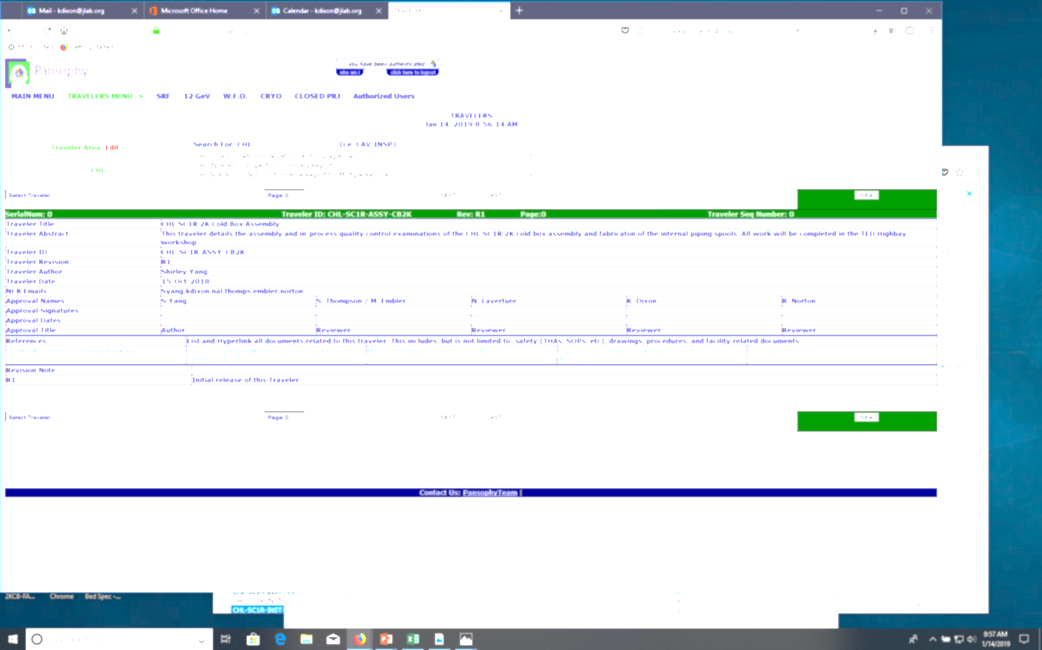
Traveler
Available in Pansophy: https://pansophy.jlab.org/Travelers
Developed with the help of M. McDonald & V. Bookwalter
Four of Six Travelers have been created for this project:
  CHL SC1R Cold Box Assembly
  Install Cold Compressor Casings
  Install Cryogenic Control Valves and Bayonets
  CHL Install TDs and TPs
  Receiving of Raw Materials
  Spool Fabrication
SC1R Installation Review - Introduction

Slide 12
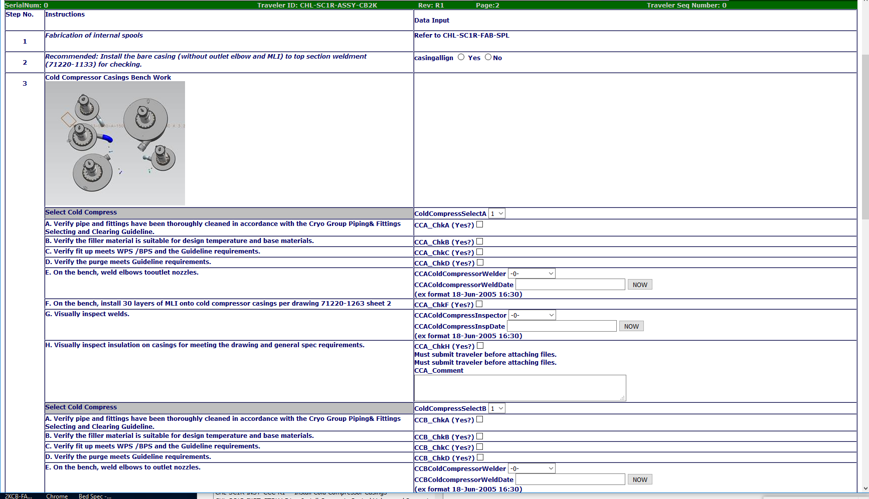
Traveler (cont.)
Example: cold compressor scroll casing preparation.
SC1R Installation Review - Introduction

