Slide 1
SC1R Insulation Strategy
Nate Laverdure

Slide 2
Overview
Purpose for discussion
Insulation on:
Internal piping spools
LN2 shield
CC casings
Top torispherical head of vacuum vessel
Cylindrical shell of vacuum vessel
Internal frame

Slide 3
Insulation – Internal piping spools
Preferred method
Spirally-wound cylinder of 30 layers
Cylinder length is equal to roll length (~50”) of the source material
Butt joints between adjacent sections:
Edges trimmed, spaced ~1/2” apart, and taped together at the accessible outer layer

Slide 4
Insulation – Internal piping spools
When the preferred method is not practical
Wrapped blanket of 30 layers
Longitudinal seam of wrapped blanket:
Interleaved in groups of 5-10 layers with at least 2” overlap
Folded-over “praying hands” technique
Butt joints between adjacent sections:
Interleaved in groups of 5-10 layers with at least 2” overlap
Edges trimmed, spaced ~1/2” apart, and taped together at the accessible outer layer

Slide 5
Insulation – LN2 shield
Treated as if it were (very large OD) piping
Wrapped blanket of 30 layers
Longitudinal seam of wrapped blanket:
Interleaved in groups of 5-10 layers with at least 2” overlap
Folded-over “praying hands” technique
Butt joints between adjacent sections:
Interleaved in groups of 5-10 layers with at least 2” overlap
Edges trimmed, spaced ~1/2” apart, and taped together at the accessible outer layer

Slide 6
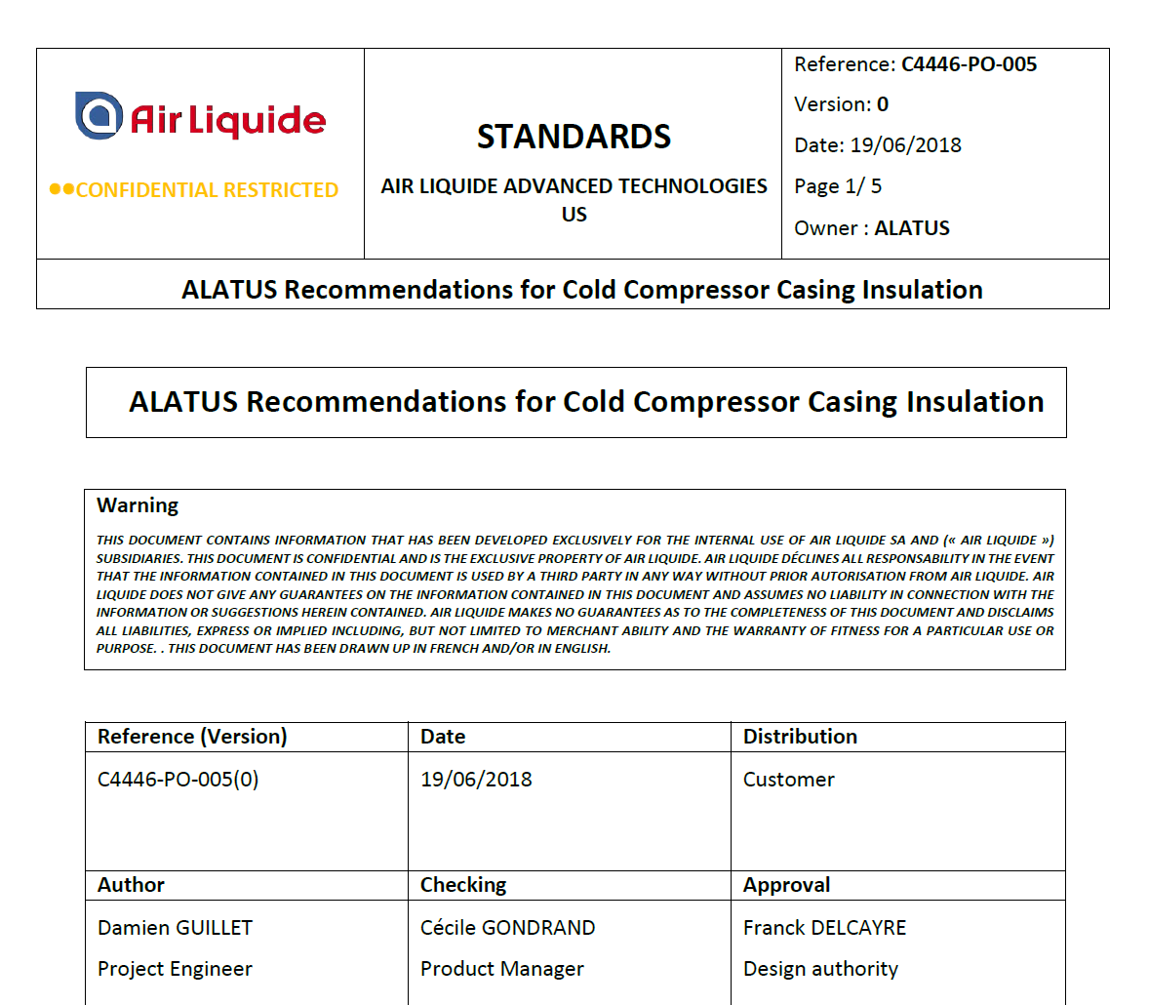
Insulation – CC casings
Reference document

Slide 7
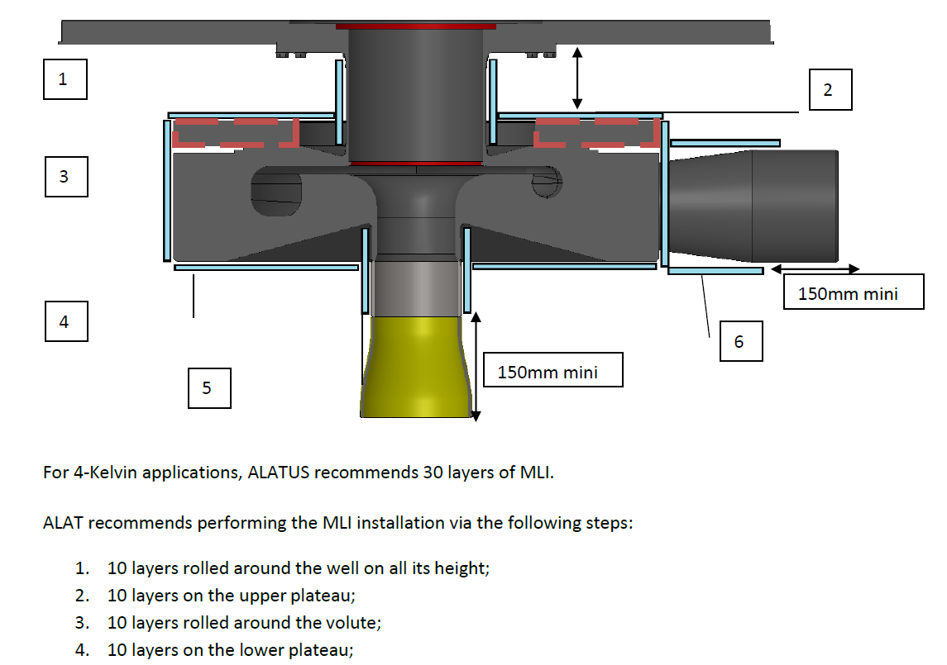
Insulation – CC casings
Reference document

Slide 8
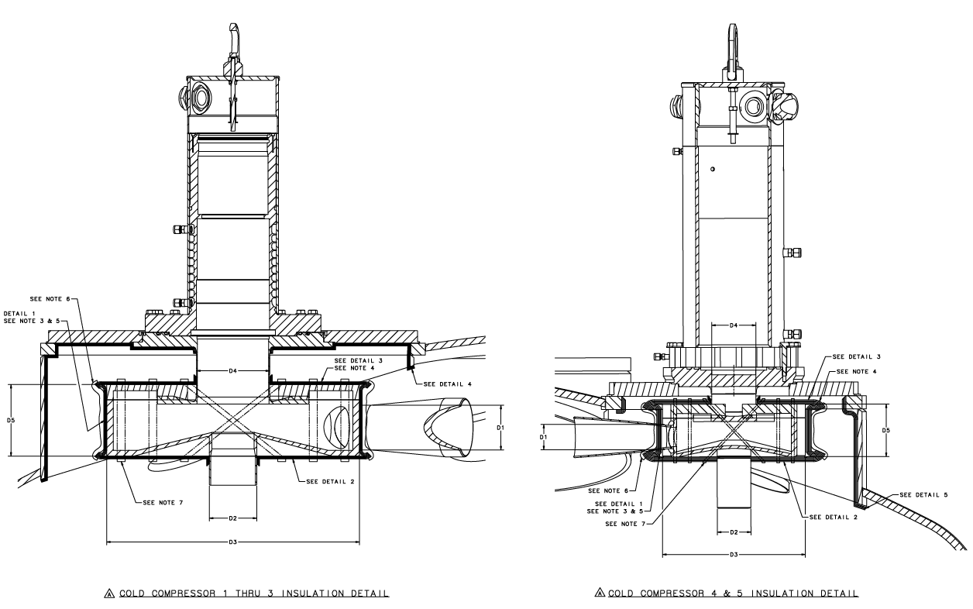
Insulation – CC casings
Design document [71220-1263]

Slide 9
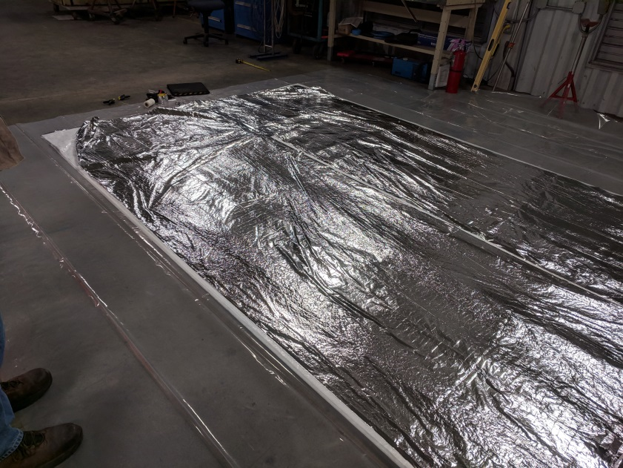
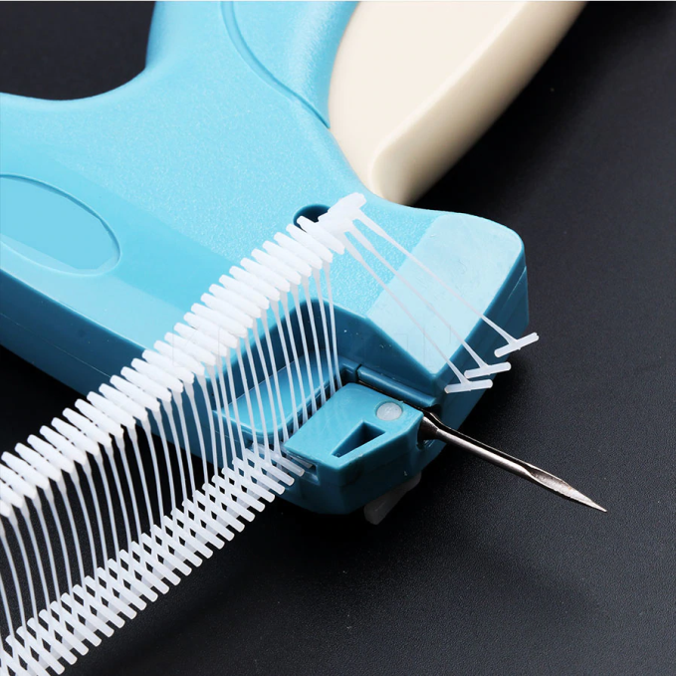
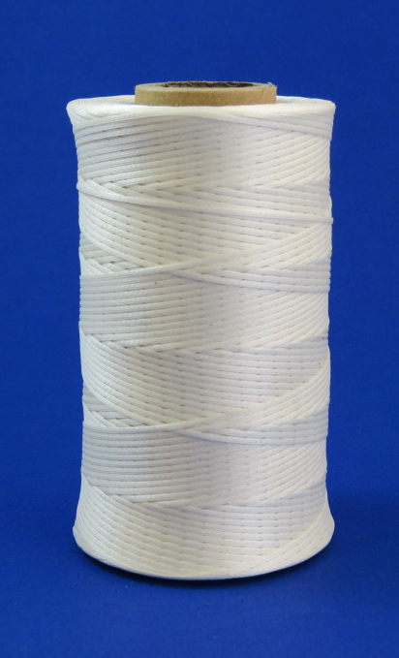
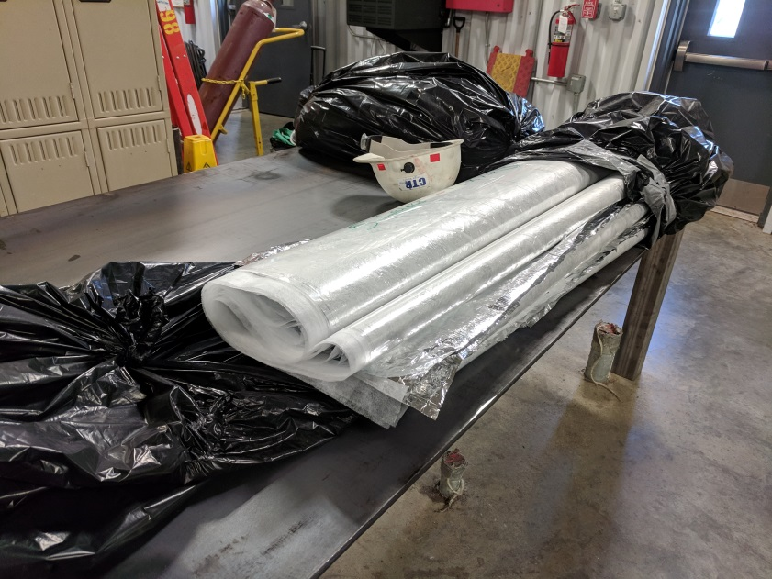
Insulation – Top torispherical head of vacuum vessel
Blanket of 20 layers total
4 interleaved panels of 5 layers each
Internal structural features
Tagged with nylon garment label tags
Seams sewn with Nomex lacing cord

Slide 10
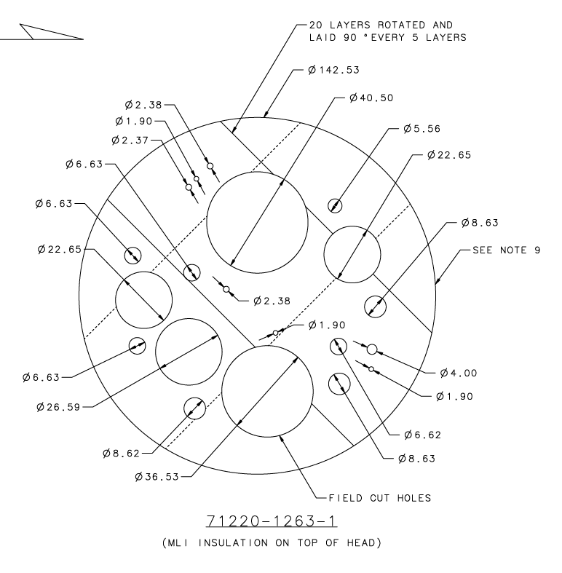
Insulation – Top torispherical head of vacuum vessel
Final shape is templated from interior of head

Slide 11
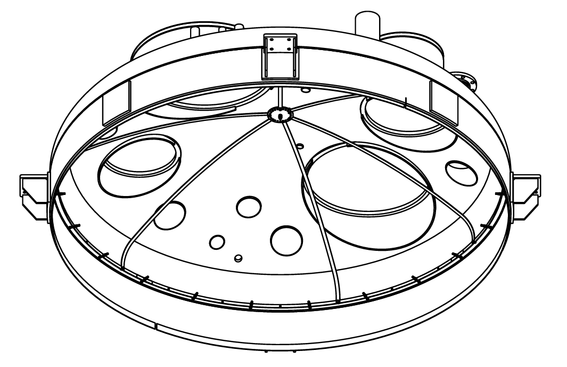
Insulation – Top torispherical head of vacuum vessel
External attachment
Suspended by hook & loop (velcro), sewn to blanket with lacing tape
Held against top head by skeletal frame

Slide 12
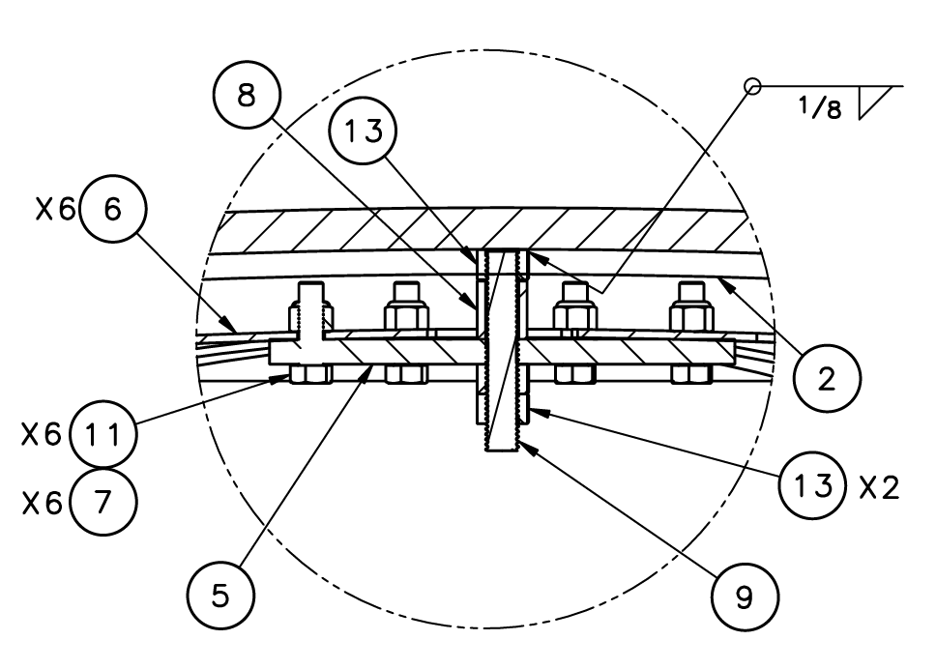
Insulation – Top torispherical head of vacuum vessel
Held against top head by skeletal frame

Slide 13
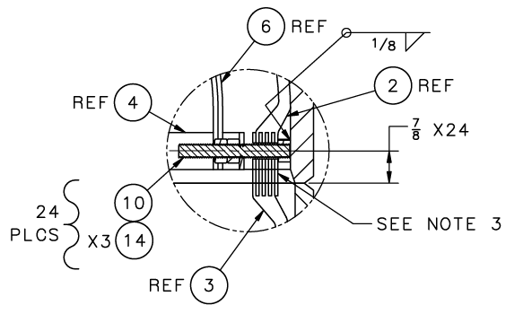
Insulation – Top torispherical head of vacuum vessel
Held against top head by skeletal frame

Slide 14
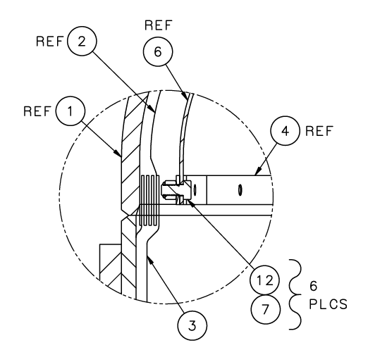
Insulation – Top torispherical head of vacuum vessel
Held against top head by skeletal frame

Slide 15
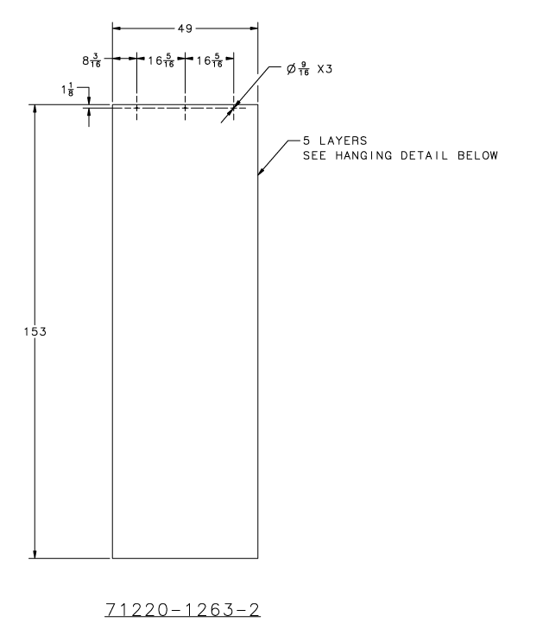
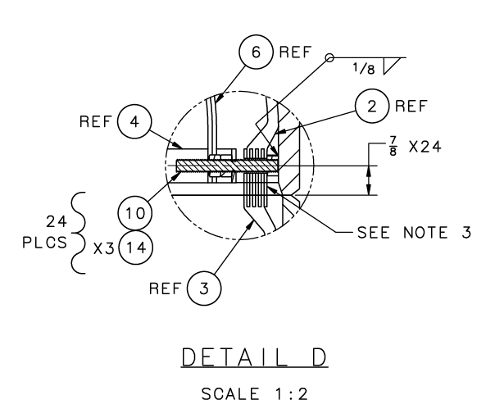
Insulation – Cylindrical shell of vacuum vessel
Blanket of 20 layers total
4 butting panels of 5 layers each
Shape
Bottoms of panels drape onto lower head and continue under internal platform
Internal structural features
Tagged with nylon clothes label tags
External attachment
Blanket panels are suspended from row of studs inside the top head
Holes have sufficient pull-out strength for the blanket weight

Slide 16
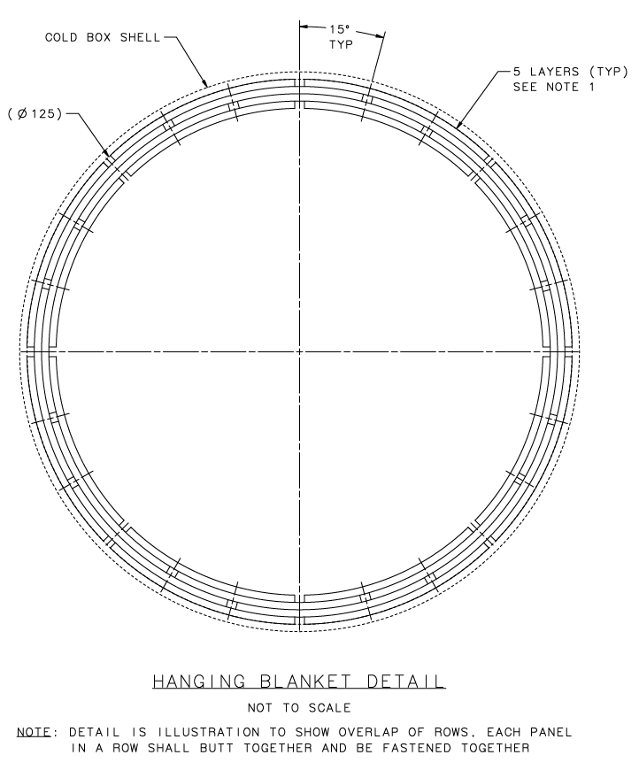
Insulation – Cylindrical shell of vacuum vessel
Panels arranged in 4 rows of 8
Simple (not interleaved) butt joint between sides of adjacent panels
Edges spaced ~1/2” apart and taped together at the accessible inner layer
Successive rows of panels are staggered, covering these butt joints

Slide 17
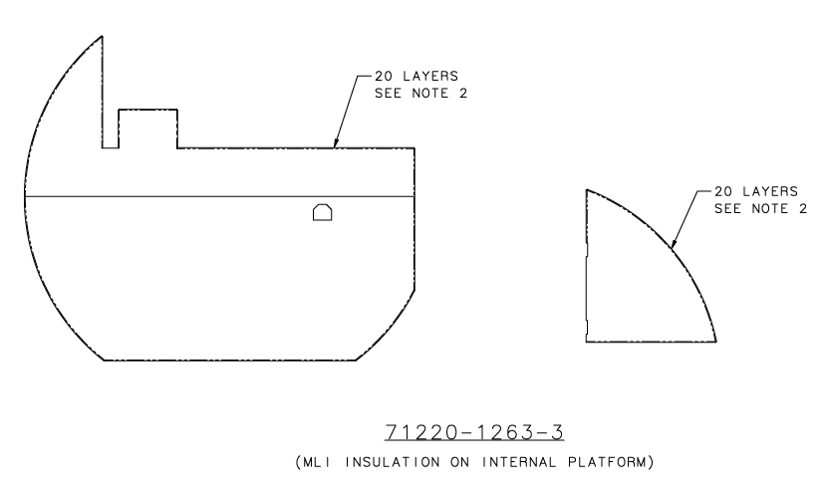
Insulation – Internal frame
Similar to top head blanket
Blanket of 20 layers
Templated from as-built platform
Internal butt joints within blanket are interleaved
Blanket overhangs 6” over all sides, overhangs are taped to frame

Slide 18
SC1R Insulation Strategy
Nate Laverdure

