Slide 1
Safety
Fabrication, assembly, and installation
Nate Laverdure

Slide 2
Core functions
Define the scope of work
Analyze the hazards
Develop and implement hazard controls
Perform work within controls
Provide feedback and continuous improvement
How does work get done at JLab?

Slide 3
Core functions – Define the scope of work
Define the scope of work
Analyze the hazards
Develop and implement hazard controls
Perform work within controls
Provide feedback and continuous improvement
Well defined project scope
  As discussed in other presentations

Slide 4
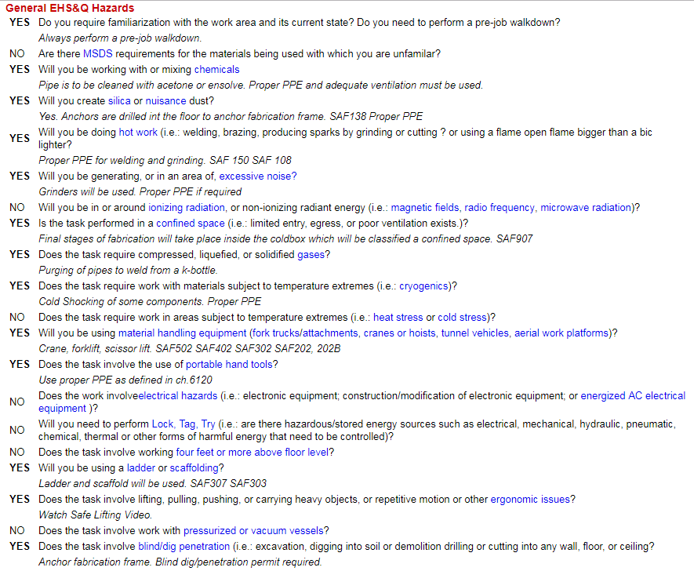
Core functions – Analyze the hazards
Define the scope of work
Analyze the hazards
Develop and implement hazard controls
Perform work within controls
Provide feedback and continuous improvement
Highly detailed THA worksheet within CTLis

Slide 5
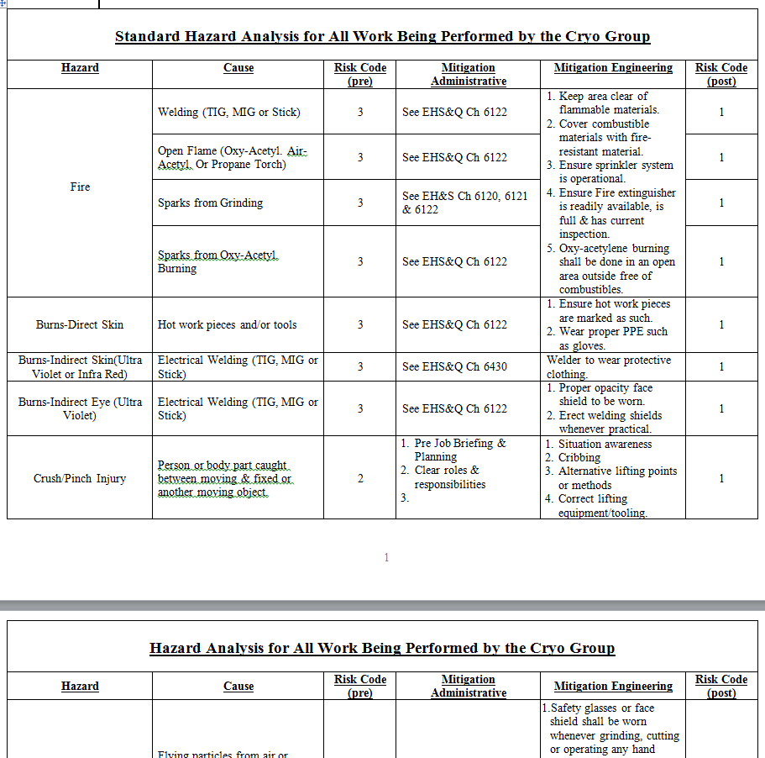
Core functions – Analyze the hazards (continued)
Define the scope of work
Analyze the hazards
Develop and implement hazard controls
Perform work within controls
Provide feedback and continuous improvement
Supported by highly detailed general THA

Slide 6
Core functions – Analyze the hazards (continued)
Define the scope of work
Analyze the hazards
Develop and implement hazard controls
Perform work within controls
Provide feedback and continuous improvement
Hazards are identified for each task through the fabrication, assembly, and installation
Each identified hazard is pre-mitigated and a risk code is assigned

Slide 7
Core functions – Analyze the hazards (continued)
Define the scope of work
Analyze the hazards
Develop and implement hazard controls
Perform work within controls
Provide feedback and continuous improvement
Some hazards considered:
  Fire
  Fall from elevated working positions
  Errors in material handling
  Confined space
  Blind penetration
  Air quality (dust, smoke, chemicals)
  Noise
  Contact with temperature extremes (cryogenics, hot work)
  Chemical exposure

Slide 8
Core functions – Develop and implement hazard controls
Define the scope of work
Analyze the hazards
Develop and implement hazard controls
Perform work within controls
Provide feedback and continuous improvement
Standard protecting measures
Improved safety via extensive engineering & design
  Minimization of confined space work
  Minimization of work at heights
  Engineered lifting devices
  Appropriate materials selected, appropriate welding procedures selected, appropriate safety factors used in calculations, etc.
  Formal design review process
Improved safety via extensive work planning
  Well-defined project schedule with all players including subcontractors

Slide 9
Core functions – Perform work within controls
Define the scope of work
Analyze the hazards
Develop and implement hazard controls
Perform work within controls
Provide feedback and continuous improvement
Monitoring tools
  CTLis
  Pre-job briefings
  STOP observation program
Work controls
  OSPs / TOSPs for higher risk code activities
  AHA for subcontractor coordination
  Permits (hot work, confined space entry, blind penetration, lift plans) for routine medium risk code activities
  Current training qualifications
Monitoring personnel
  Project manager for overall coordination of the effort of multiple groups
  Line supervisors for JLab workers
  SOTR for subcontractor coordination
  Subcontractor’s supervisor for sub workers

Slide 10
Core functions – Perform work w/in controls (continued)
Define the scope of work
Analyze the hazards
Develop and implement hazard controls
Perform work within controls
Provide feedback and continuous improvement
Identified OSPs / TOSPs for higher risk code activities
  CRY-16-62047-OSP Pedestal Grinder
  CRY-16-62046-OSP Drill Press
  CRY-16-62045-OSP Electric Mill
  CRY-16-62048-OSP Lathe
  CRY-16-62051-OSP Vertical Bandsaw
  CRY-17-66130-OSP Cryogenics Fabrication Hotwork Area
  CRY-17-68620-OSP Cryogenic Department Low-Energy Pressure Testing
  CRY-18-78773-OSP Cryogenic Department Bayonet Installation & Removal Procedure
  To be written: Overall Pneumatic Leak (Pressure) Testing of the CHL1 SC1R 2K Cold Box

Slide 11
Core functions – Perform work w/in controls (continued)
Define the scope of work
Analyze the hazards
Develop and implement hazard controls
Perform work within controls
Provide feedback and continuous improvement
Where will the work be?
  Fabrication and assembly takes place primarily in TEDF high bay
  Installation takes place in the CHL1 cold box room (across 3 different “floors”)
Several teams working in close proximity
  Using shift scheduling

Slide 12
Core functions – Perform work w/in controls (continued)
Define the scope of work
Analyze the hazards
Develop and implement hazard controls
Perform work within controls
Provide feedback and continuous improvement
Addressing air quality hazards
  Assembly process eliminates need for hot work within the confined space of the cold box shell, once closed.
  Piping is to be cleaned with acetone or EnSolv at weld joints. Proper ventilation and PPE are required to minimize exposure.
  FCAW is allowed for large structural welds. Secondary ventilation may be necessary, or we may switch to a different welding process.

Slide 13
Core functions – Perform work w/in controls (continued)
Define the scope of work
Analyze the hazards
Develop and implement hazard controls
Perform work within controls
Provide feedback and continuous improvement
Addressing confined space hazards
  Only limited MLI installation is expected to be done in the confined space
  Design includes provisions for cross-ventilation
  Design includes work platforms and ladders for access to all expected internal locations

Slide 14
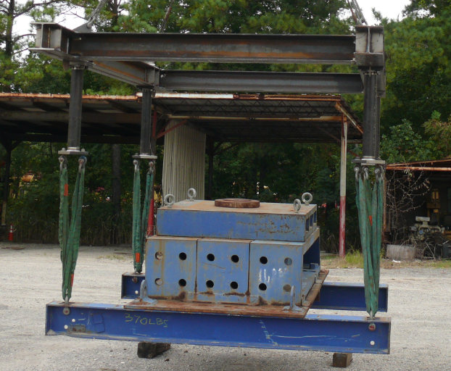
Core functions – Perform work w/in controls (continued)
Define the scope of work
Analyze the hazards
Develop and implement hazard controls
Perform work within controls
Provide feedback and continuous improvement
Addressing material handling hazards
  Fixture for cold box assembly has been load tested to 1.25 times of the design load capacity
  Fixture for cold box assembly shall be correctly anchored to the floor before starting the assembly

Slide 15
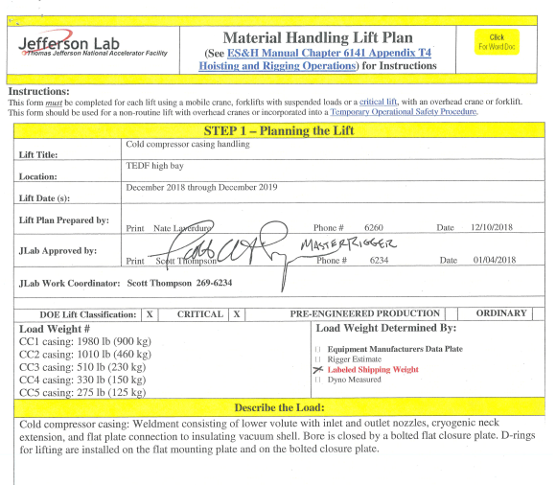
Core functions – Perform work w/in controls (continued)
Define the scope of work
Analyze the hazards
Develop and implement hazard controls
Perform work within controls
Provide feedback and continuous improvement
Addressing material handling hazards
  Lift plan for CC casing handling being developed

Slide 16
Core functions – Provide feedback and CI
Define the scope of work
Analyze the hazards
Develop and implement hazard controls
Perform work within controls
Provide feedback and continuous improvement
Stand-up toolbox meetings for statusing and deconflicting
  Meetings held pre-shift and at shift turnover
  “What will you do today?”
  “Are there any impediments in your way?”
Frequent walkthroughs
  By line management, engineers
  By SMEs as necessary
  Occasional use of STOP observation program
Stand-up debriefs following all major evolutions
  Major assembly steps
  Critical lifts
  Major QA steps (e.g. leak, pressure tests)
More formal debrief / review at project end

Slide 17
ISMS Guiding Principles
Line management responsibility
Clear roles and responsibilities
Competence commensurate with responsibilities
Balanced priorities
Identification of safety standards / requirements
Hazard controls tailored to work
Operation authorization
What things must we consider if we wish to do high-quality work together?

Slide 18
ISMS Principles – Line management responsibility
Line management responsibility
Clear roles and responsibilities
Competence commensurate with responsibilities
Balanced priorities
Identification of safety standards / requirements
Hazard controls tailored to work
Operation authorization
Direct oversight of the work and the workers
1st level of protection against unsafe decisions
Authority may be given away, but responsibility can only be shared

Slide 19
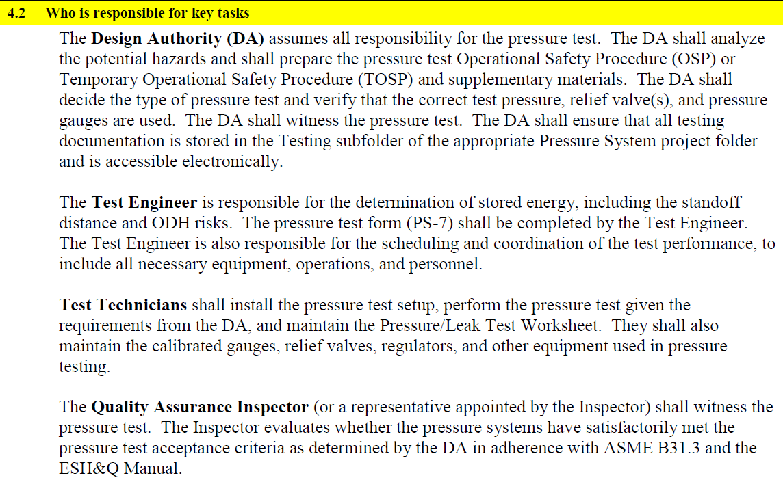
ISMS Principles – Clear R&Rs
Line management responsibility
Clear roles and responsibilities
Competence commensurate with responsibilities
Balanced priorities
Identification of safety standards / requirements
Hazard controls tailored to work
Operation authorization
Example from CRY-17-68620-OSP Cryogenic Department Low-Energy Pressure Testing

Slide 20
ISMS Principles – Competence ∝ responsibilities
Line management responsibility
Clear roles and responsibilities
Competence commensurate with responsibilities
Balanced priorities
Identification of safety standards / requirements
Hazard controls tailored to work
Operation authorization
Most personnel have already been assigned to the project
Personnel assigned to roles are qualified for the work

Slide 21
ISMS Principles – Balanced priorities
Line management responsibility
Clear roles and responsibilities
Competence commensurate with responsibilities
Balanced priorities
Identification of safety standards / requirements
Hazard controls tailored to work
Operation authorization
Timeliness of the project is critical to lab success, under high scrutiny
Safe execution of the project is also under high scrutiny
These priorities are balanced through a high degree of planning and preparedness
  Especially for the time-sensitive parts of the work

Slide 22
ISMS Principles – ID of safety standards / requirements
Line management responsibility
Clear roles and responsibilities
Competence commensurate with responsibilities
Balanced priorities
Identification of safety standards / requirements
Hazard controls tailored to work
Operation authorization
Standards & requirements originate with
  Current common understanding within our work groups
  JLab ESH&Q manual
  Actively solicited guidance from JLab & external SMEs
  Feedback from prior reviews such as this

Slide 23
ISMS Principles – Hazard controls tailored to work
Line management responsibility
Clear roles and responsibilities
Competence commensurate with responsibilities
Balanced priorities
Identification of safety standards / requirements
Hazard controls tailored to work
Operation authorization
Planned activities occur at all unmitigated risk codes 1 – 3
Implemented work controls range from formal to informal as shown

Slide 24
ISMS Principles – Operation authorization
Line management responsibility
Clear roles and responsibilities
Competence commensurate with responsibilities
Balanced priorities
Identification of safety standards / requirements
Hazard controls tailored to work
Operation authorization
Project schedule includes many opportunities to solicit authorization to proceed
  Upcoming readiness review

Slide 25
Safety
Fabrication, assembly, and installation
Nate Laverdure

