Slide 1
Daniel S. Carman, Mar. 5, 2019

Slide 2
CLAS12 Run Periods
Engineering Run:
2.2, 6.4, 10.6 GeV polarized electrons
Liquid-hydrogen target
Dec. 2017 – Jan. 2018
Run Group K:
3 experiments
6.6, 8.8 GeV polarized electrons
Liquid-hydrogen target
Nov. – Dec. 2018
0.35 PB, 45 mC
~7% of approved time
Run Group A:
13 experiments
10.6 GeV polarized electrons
Liquid-hydrogen target
1) Feb. – May 2018
1.1 PB, 126 mC
2) Sep. - Nov. 2018
0.6 PB, 99 mC
~40% of approved time
Run Group B:
8 experiments
10.6 GeV polarized electrons
Liquid-deuterium target
Feb. – Mar. 2019
0.28 PB, 36 mC (so far)
~30% of approved time
D.S. Carman, CLAS Collaboration Meeting – Mar. 2019

Slide 3
CLAS12 Calibration Status
# | Run | Run Group | Torus | Sol | <i> (nA) | E_{b} (GeV) | Date
1 | 3222 | A (Spring 18) | +100% | -100% | 25 | 10.6 | 2/15/18
2 | 3355 | A (Spring 18) | -100% | -100% | 35 | 10.6 | 2/20/18
3 | 4013 | A (Spring 18) | -100% | -100% | 50 | 106 | 4/18/18
4 | 5036 | A (Fall 18) | -100% | -100% | 45 | 10.6 | 10/11/18
5 | 5664 | A (Fall 18) | +100% | -100% | 50 | 10.6 | 11/26/18
6 | 5700 | K (Winter 18) | +100% | -100% | 30 | 7.5 | 11/30/18
7 | 6164 | B (Spring 19) | -100% | -100% | 35 | 10.6 | 2/10/19
8 | 6233 | B (Spring 19) | -100% | -100% | 35 | 10.6 | 2/25/19
Initial calibrations for all systems completed for pass-0 cooking
D.S. Carman, CLAS Collaboration Meeting – Mar. 2019

Slide 4
CLAS12 Calibration Sequence & Dependencies
DC Calibration:
time → distance calibration
relies on at least crude ST calibration from FTOF (few ns level)
FTOF (+ CTOF Time Matching) Calibration:
energy calibration
can be done before DC calibration using even crude DC calibration parameters for path length corrections
timing calibration
calibrate FTOF timing
defines event ST using electron in ECAL (1st option), positron in ECAL (2nd option), high momentum pion/track in DC/FTOF (3rd option)
calibrate offset between CTOF FADC and TDC time
CLAS12 Subsystem Calibration:
CND, CTOF, ECAL, FT (Hodo, Cal), HTCC, LTCC, RICH calibrations
timing calibration employs event ST from FTOF
energy calibration employs PID from EB
Assumption: CVT + FT-Trk do not require calibration (only good alignment)
recook
recook
D.S. Carman, CLAS Collaboration Meeting – Mar. 2019

Slide 5
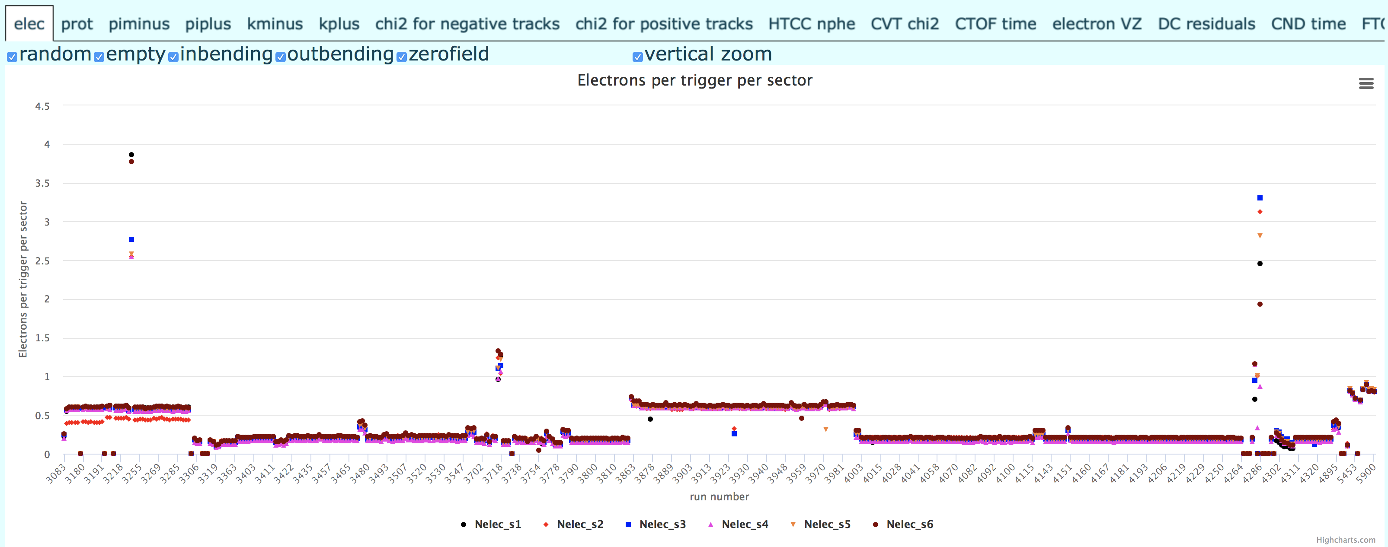
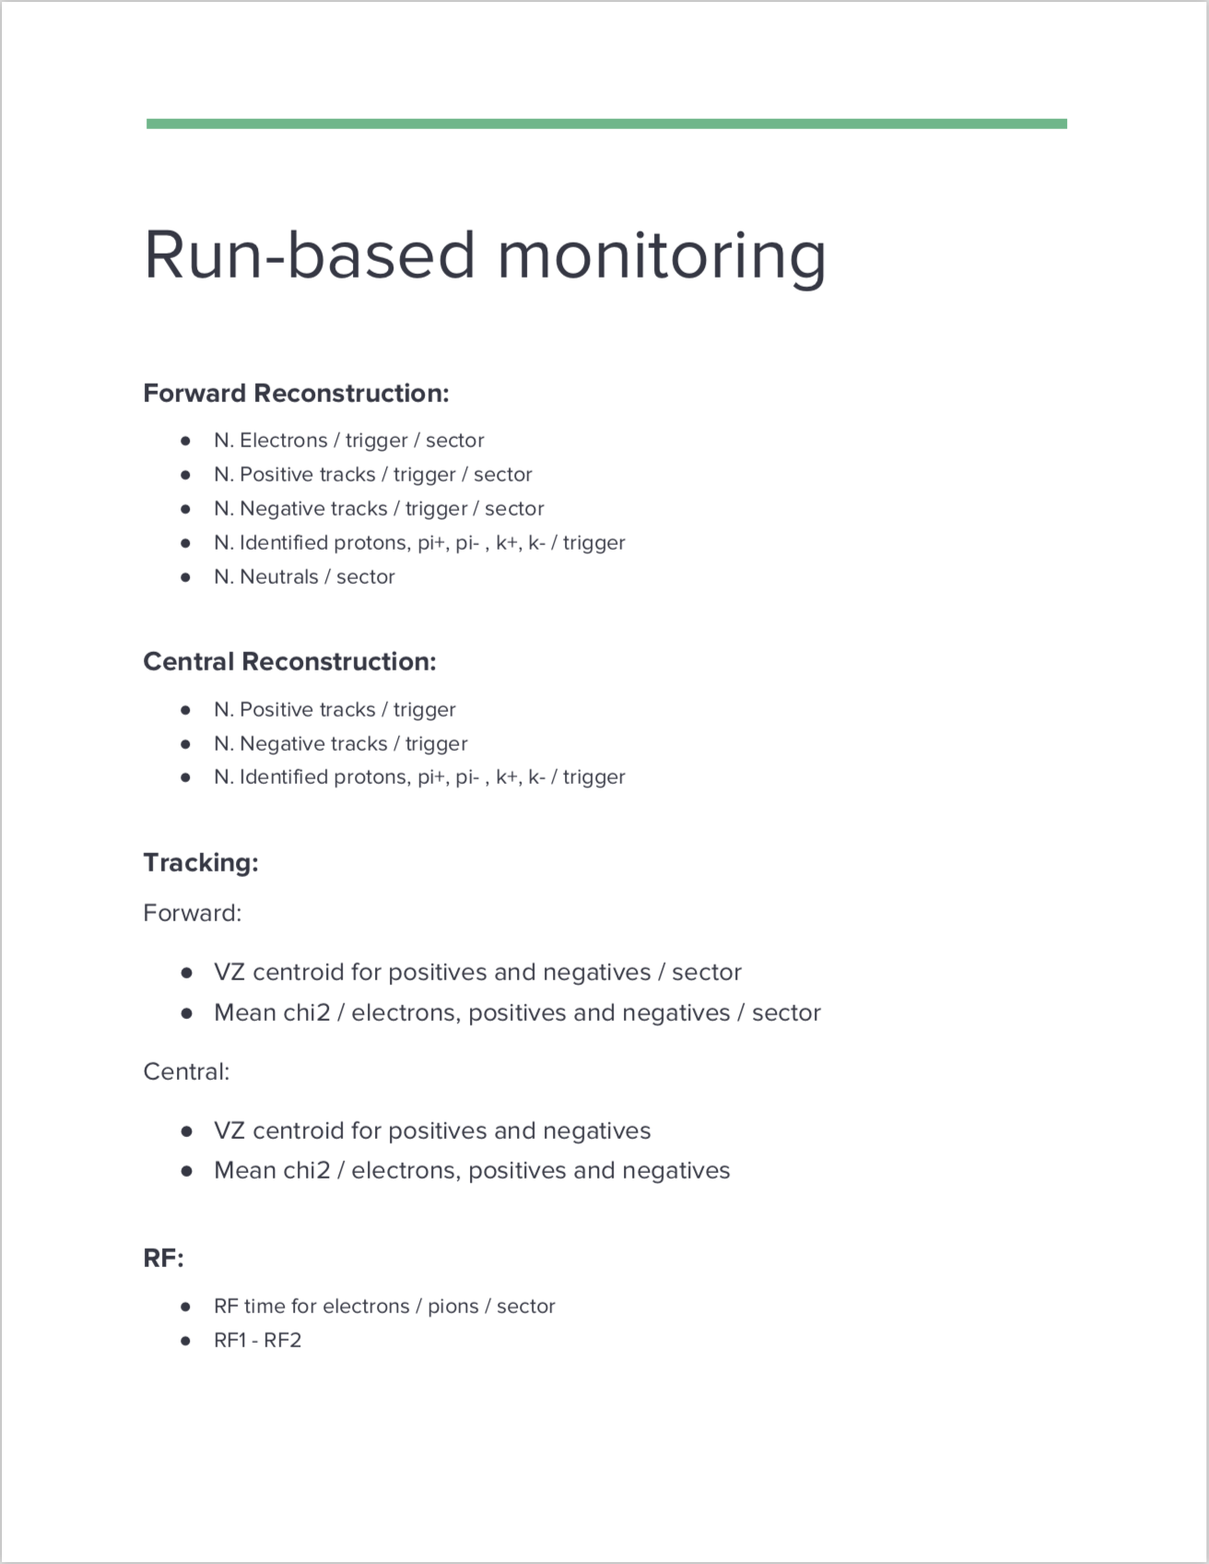
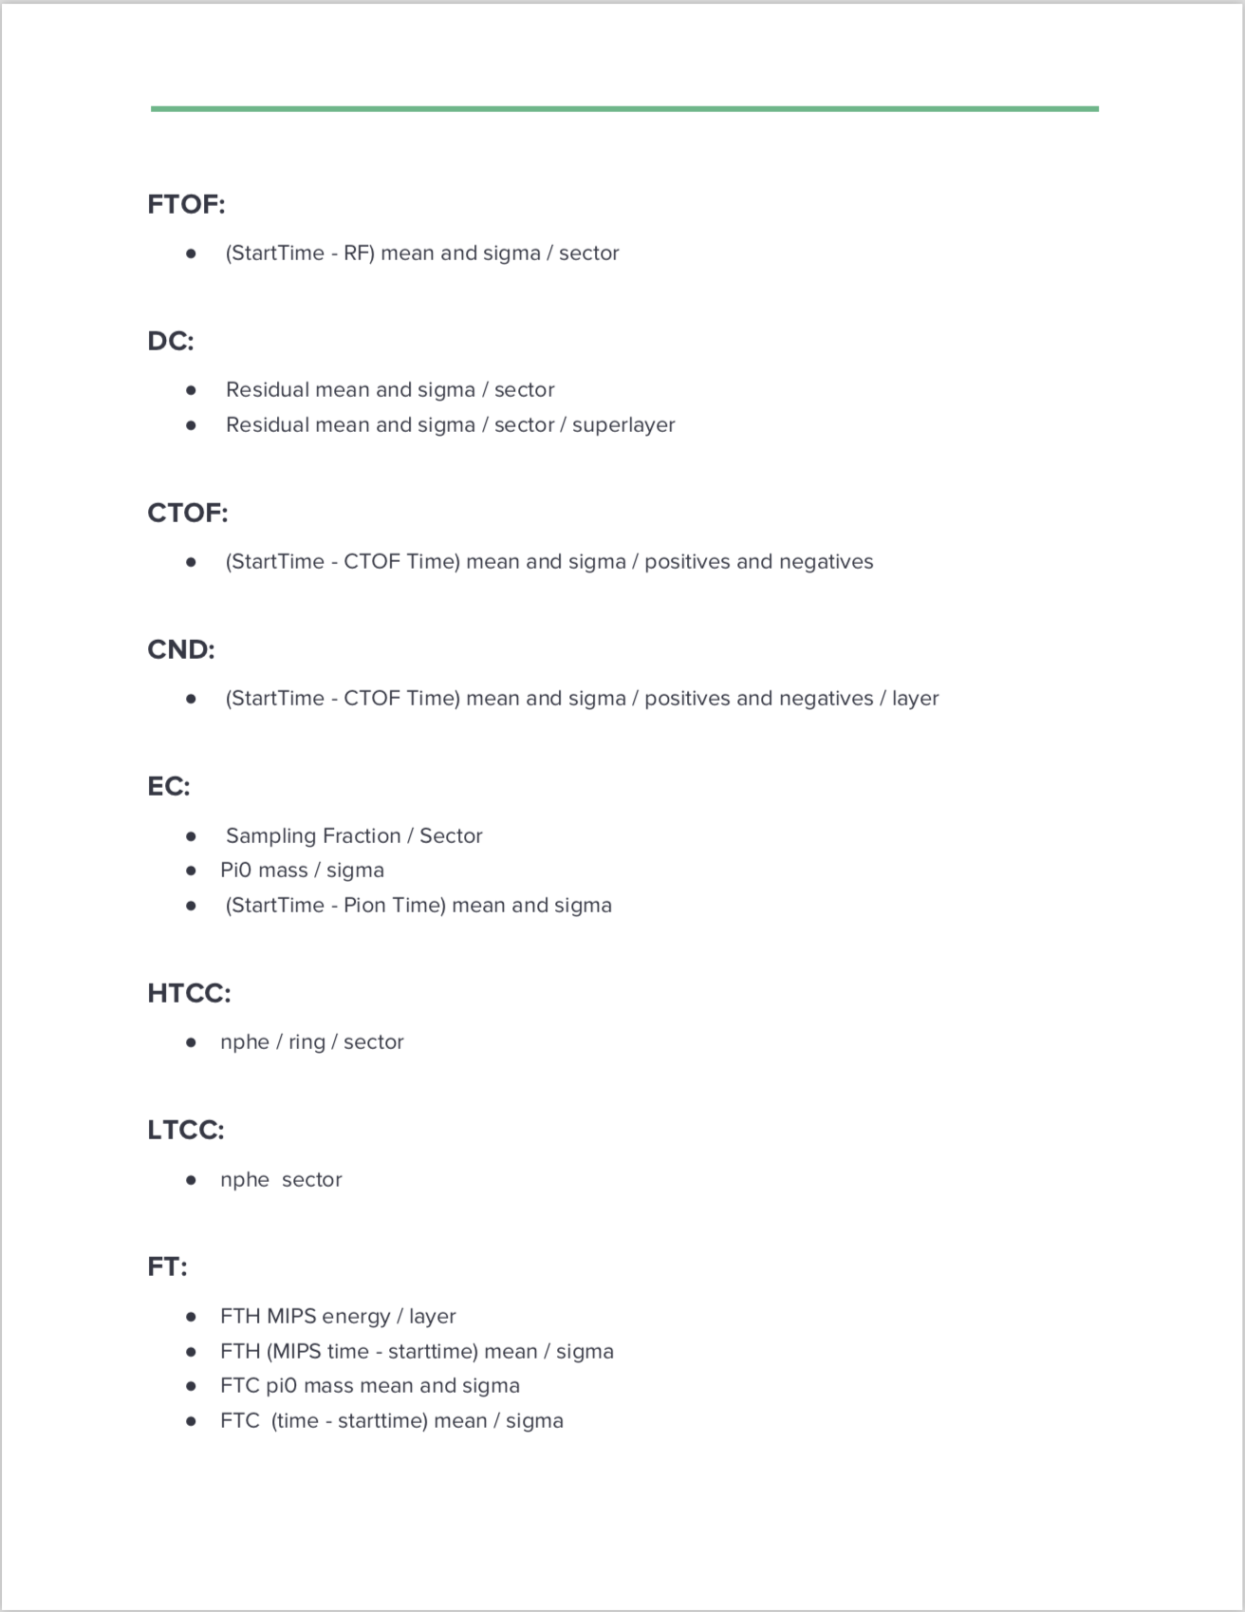
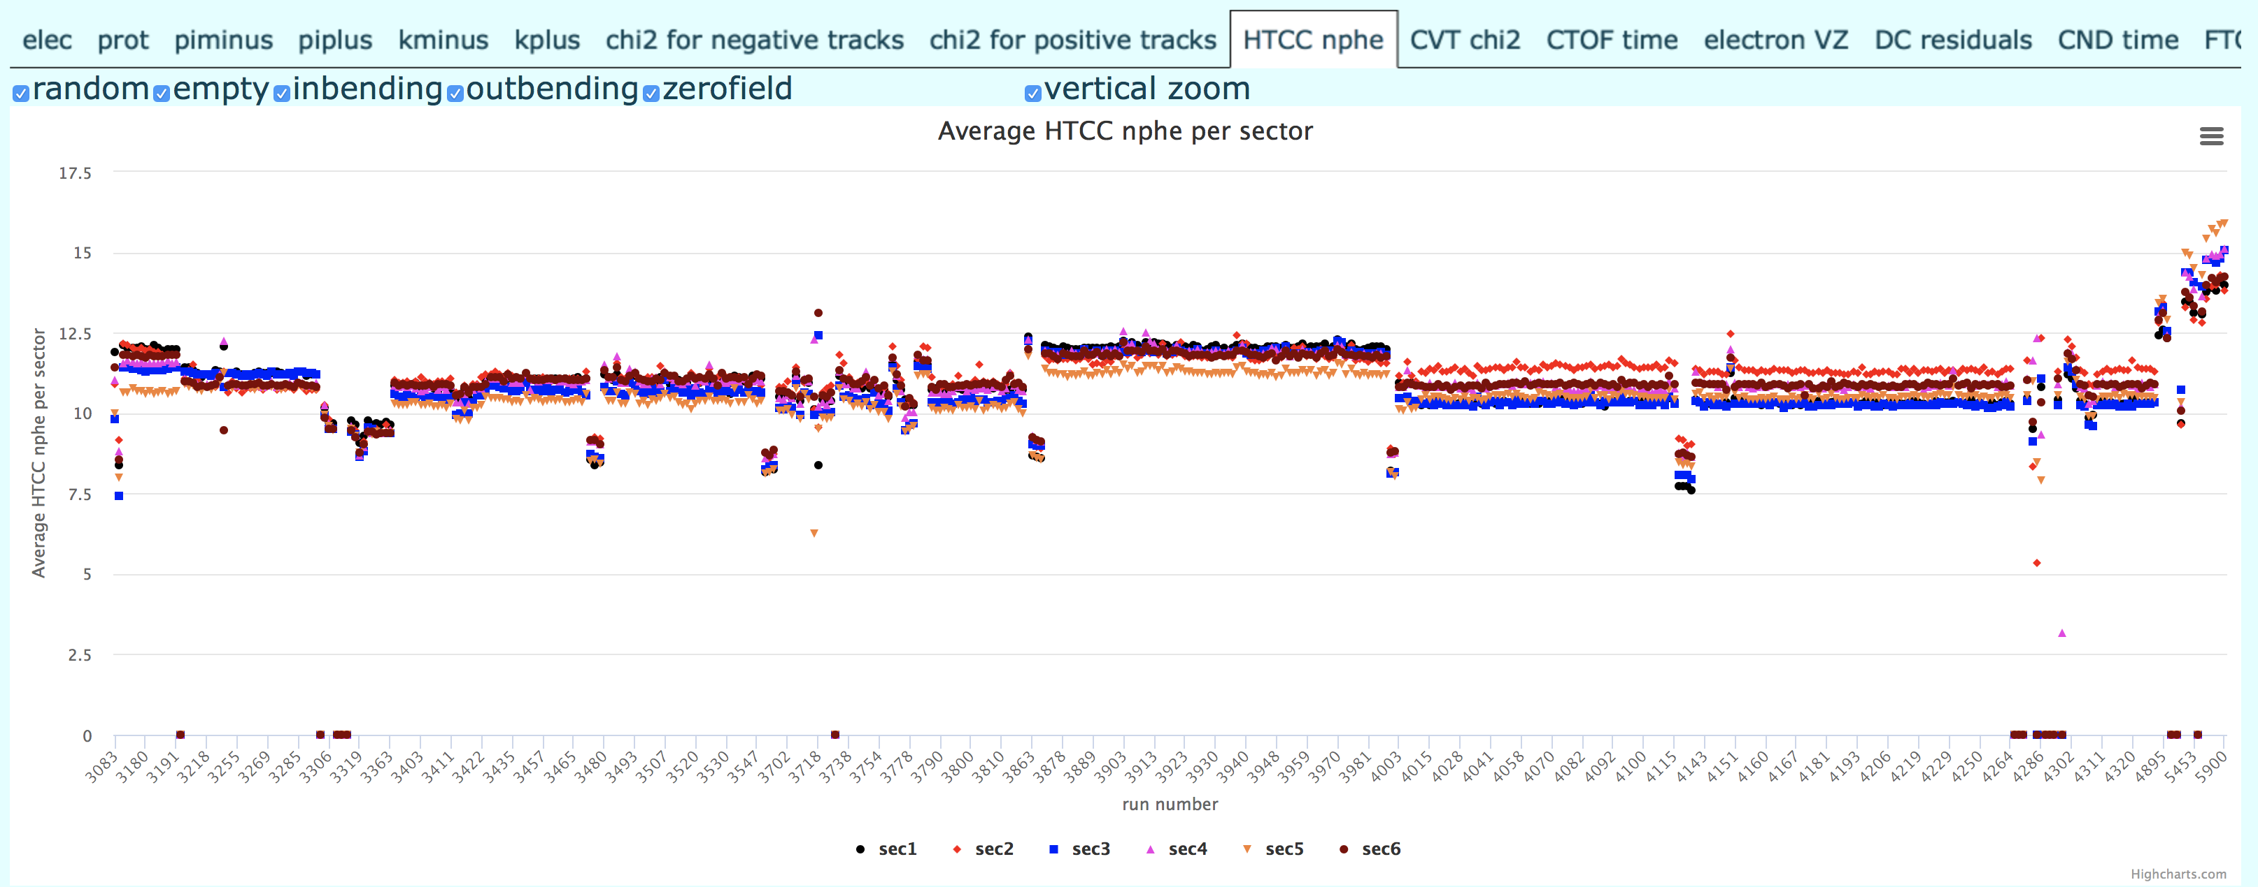
Monitoring Tools
Electrons per trigger per sector
Average HTCC nphe per sector
Andrey Kim
https://clas12mon.jlab.org/rga/timeline/
D.S. Carman, CLAS Collaboration Meeting – Mar. 2019

Slide 6
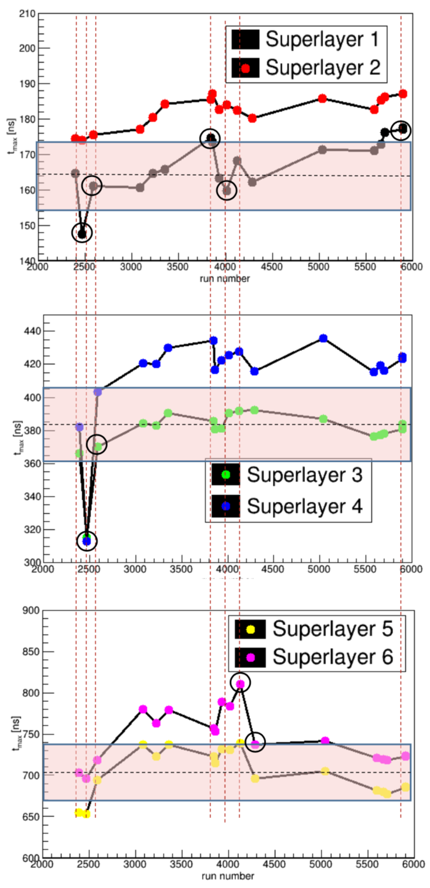
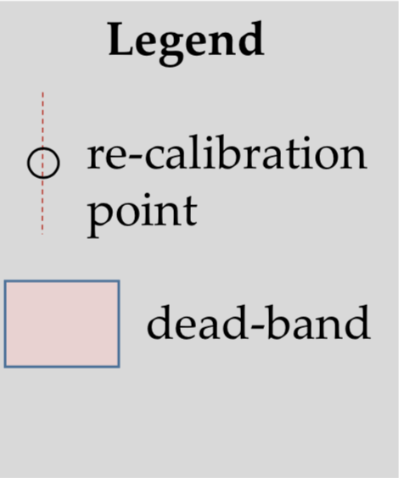
When to Recalibrate DC?
Time difference between superlayer pairs → avg. velocity:
R1: 362 μm difference ⇒ ~10 ns
Avg. velocity ~36 μm/ns
R2: 734 μm difference ⇒ ~40 ns
Avg. velocity ~18 μm/ns
R3: 860 μm difference ⇒ ~40 ns
Avg. velocity ~21 μm/ns
R2 and R3 are sensitive to 5 ns effects:
5 ns x 20 μm/ns → 100 μm
5 ns in middle of cell → ΔT_{max}=10 ns
Plan:
Update T_{max} when ΔT_{max} = ±5-20 ns
Full recalibration when ΔT_{max}>20 ns
R1 numbers → ±3-10 ns and >10 ns
D.S. Carman, CLAS Collaboration Meeting – Mar. 2019

Slide 7
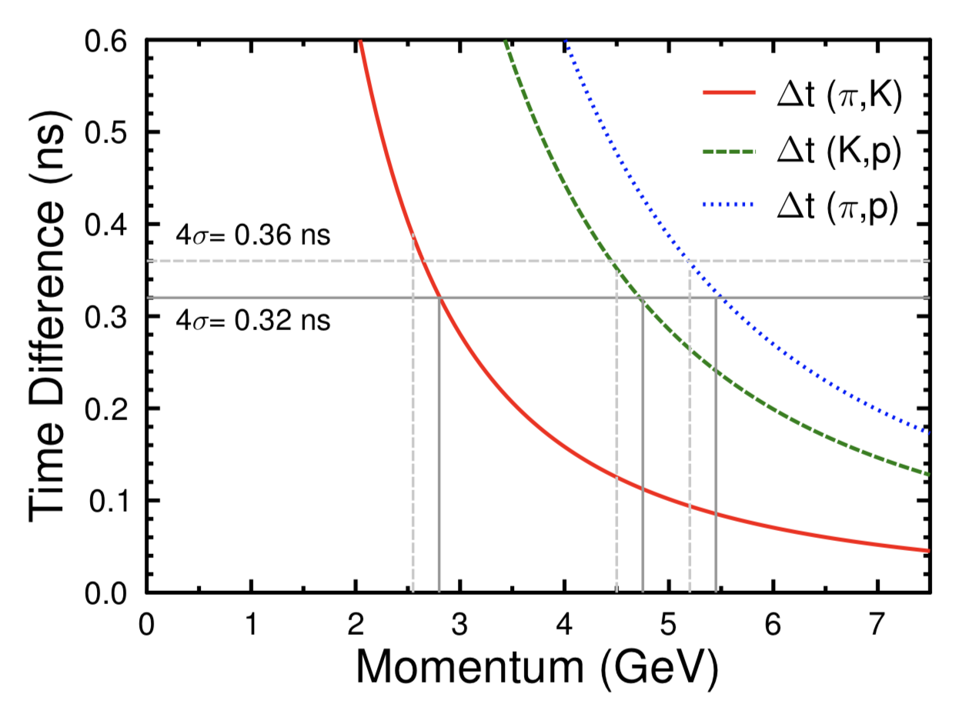
When to Recalibrate FTOF?
Nominal PID separation from design specs at 4σ level:
π/K | 2.8 GeV
K/p | 4.8 GeV
π/p | 5.4 GeV
Average FTOF δt = 80 ps
Recalibrate FTOF when <δt> worsens to shift separation by Δp = 250 MeV
⇒ Recalibrate FTOF when:
Panel-1a <δt> ≥ 170 ps (nominal avg. = 150 ps)
Panel-1b <δt> ≥ 90 ps (nominal avg. = 80 ps)
D.S. Carman, CLAS Collaboration Meeting – Mar. 2019

Slide 8
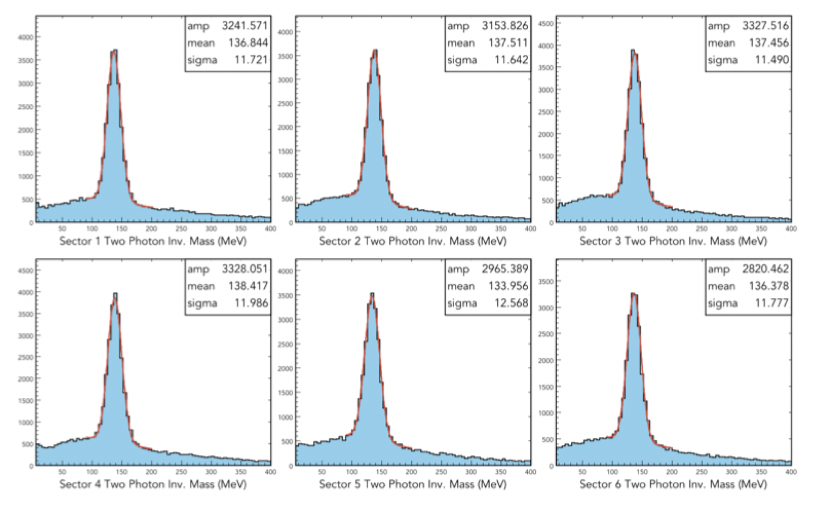
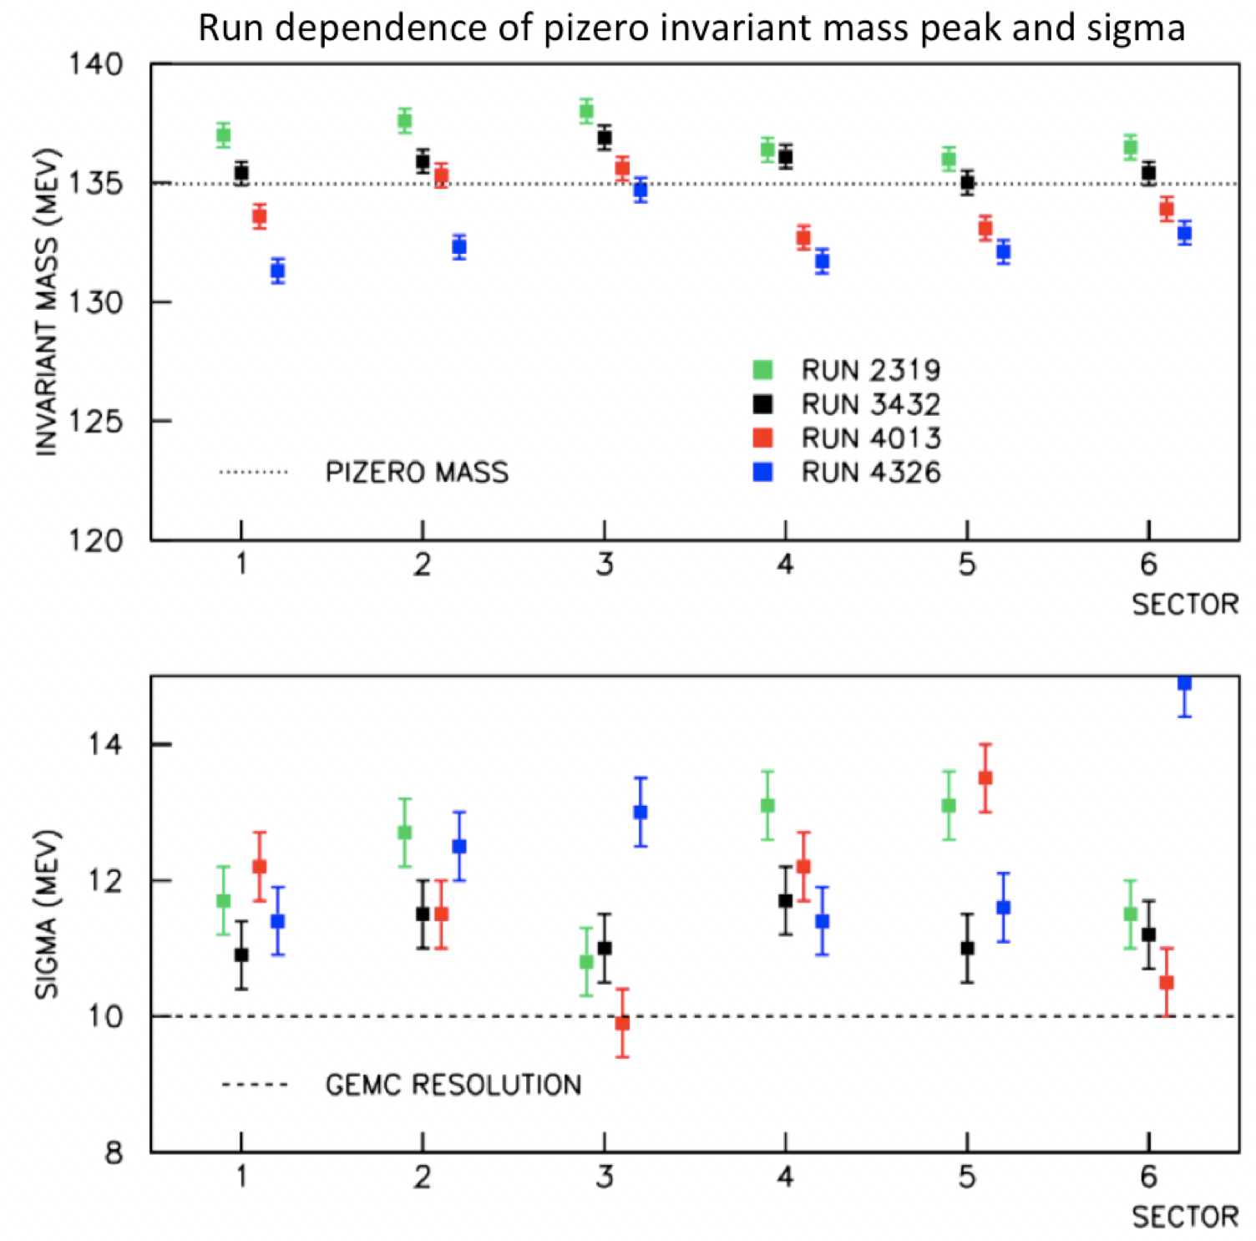
ECAL Status
S1
S2
S3
S4
S5
S6
Study ECAL performance using π⁰ analysis:
Change in π⁰ mass with time indicates ~5-10% loss of PMT gain in RG-A spring run
To track PMT calibrations need to match cosmic data to beam data
D.S. Carman, CLAS Collaboration Meeting – Mar. 2019

Slide 9
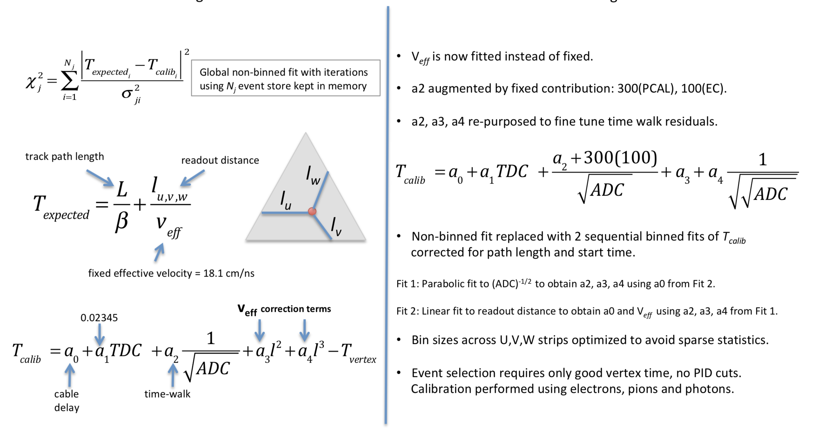
ECAL Timing Calibration
Previous algorithm
New algorithm
D.S. Carman, CLAS Collaboration Meeting – Mar. 2019

Slide 10
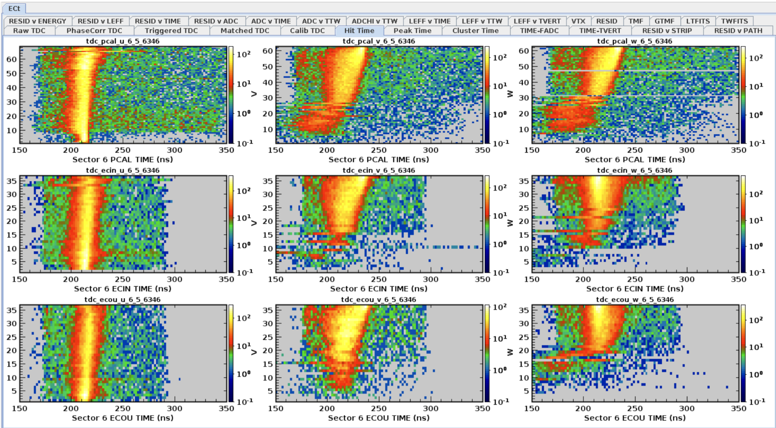
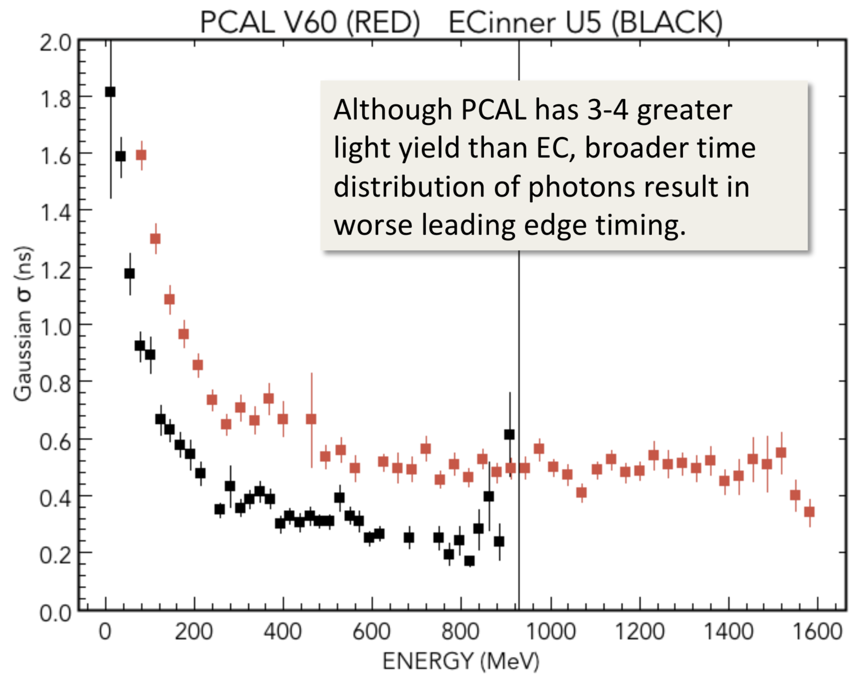
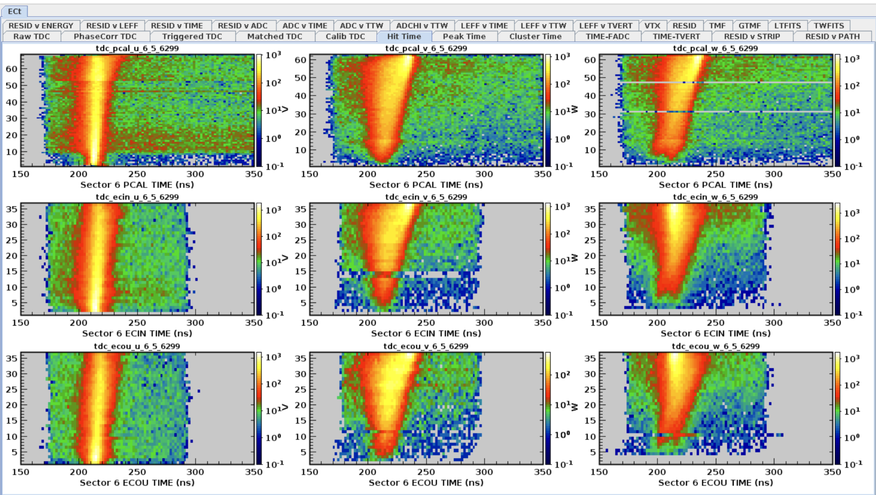
ECAL Timing Calibration
Previous algorithm
U V W
PCAL
ECin
ECout
New algorithm
U V W
PCAL
ECin
ECout
D.S. Carman, CLAS Collaboration Meeting – Mar. 2019

Slide 11
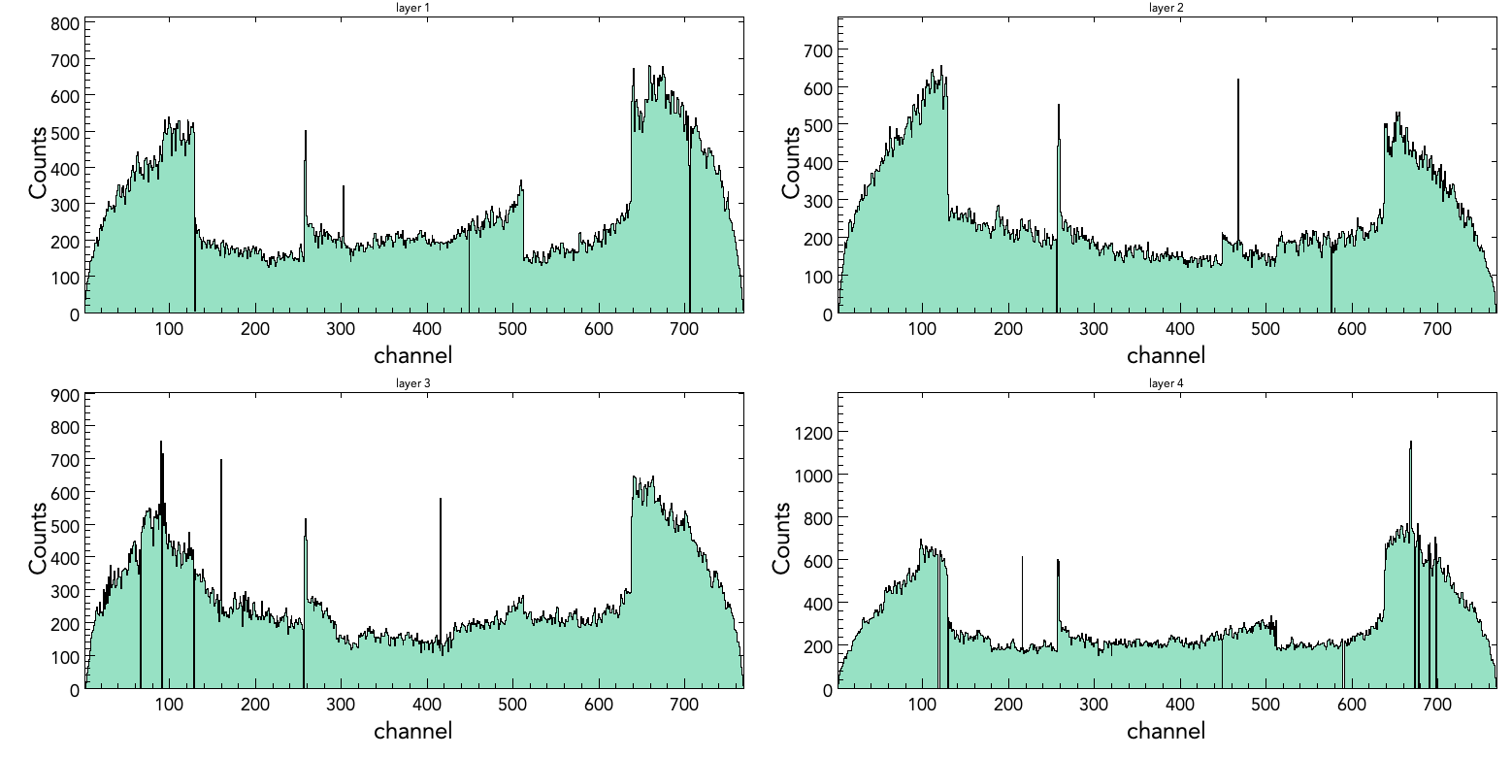
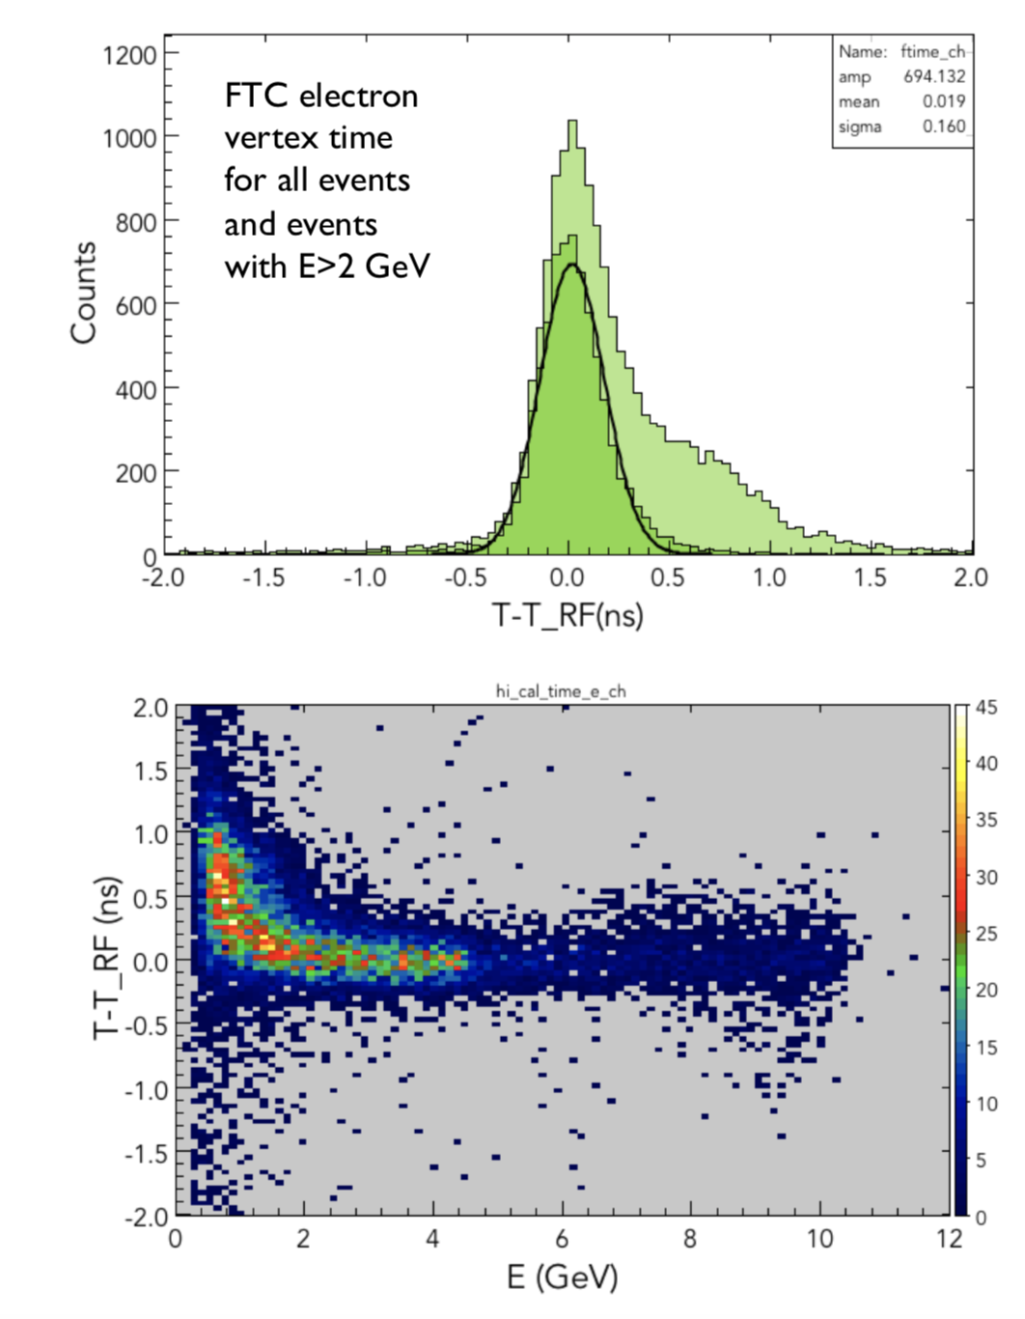
Forward Tagger Status
Spring18 FT-TRK occupancy after swap corrections
Hardware status
FT-Cal & FT-Hodo:
Stable operations (FT-Cal at 5° C, upgraded FEE for FT-Hodo to reduce gain dependence on beam current)
FT-Trk:
Cables swaps of 2018 Spring and Fall run understood and fixed in software
2 disconnects and 2 swaps after January installation: need to improve checkout procedure
Noisy PLC under investigation
Single crystal timing resolution < 200 ps with energy cut
Calibration & Performance
FT-Cal:
Resolutions:
σ_{e}/E ~ 3.3%
σ_{Mγγ} ~ 4.4%
Optimize shower leakage corrections
Add time walk correction to timing calibration
FT-Hodo:
Energy and timing calibrations fully implemented and tested
FT-Trk:
Track reconstruction implemented and being validated
Tracker alignment work not yet begun
D.S. Carman, CLAS Collaboration Meeting – Mar. 2019

Slide 12
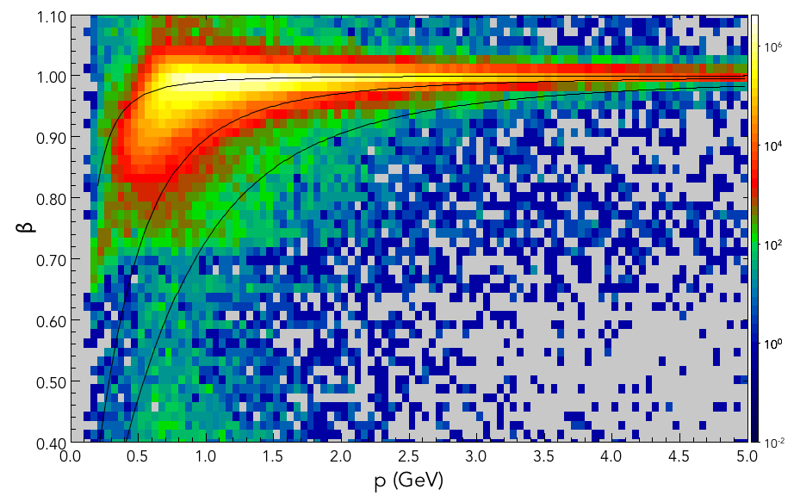
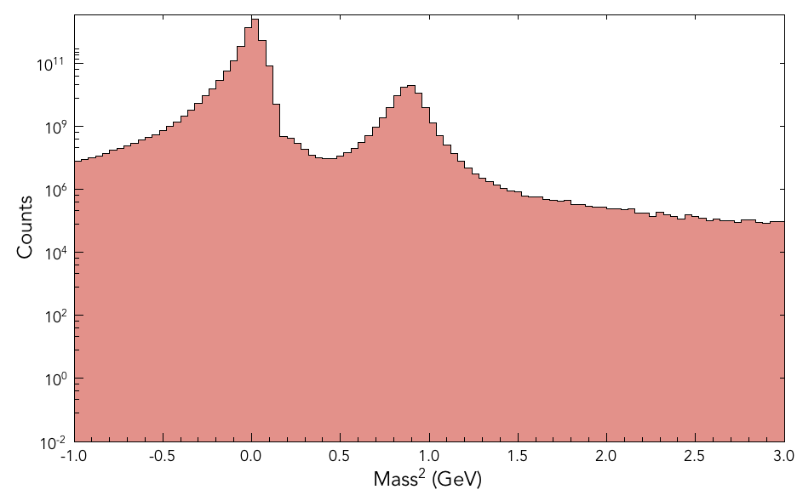
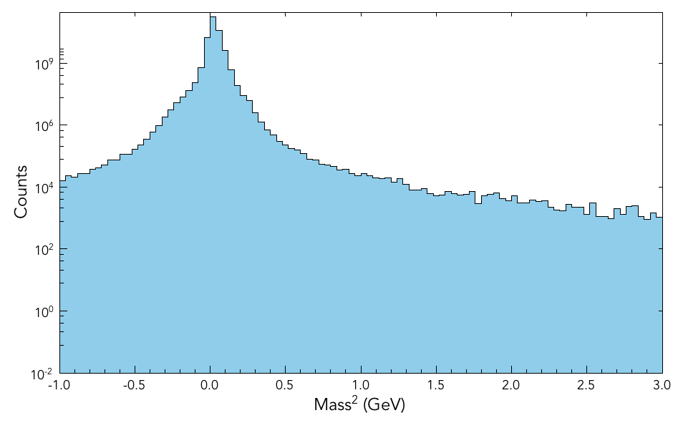
Forward Detector PID
positives
negatives
π⁺
K⁺
p
run 4013, 10.6 GeV, T:-100%, S:-100%
D.S. Carman, CLAS Collaboration Meeting – Mar. 2019

Slide 13
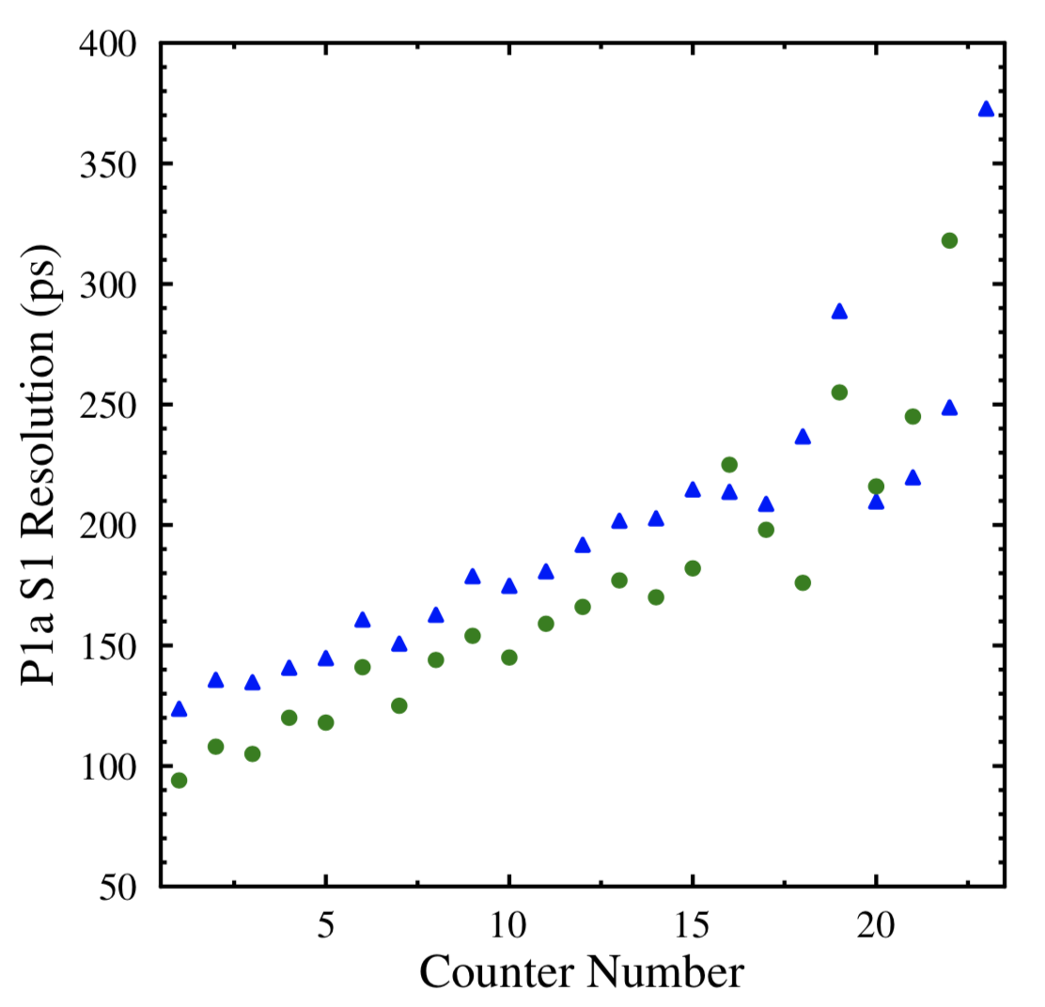
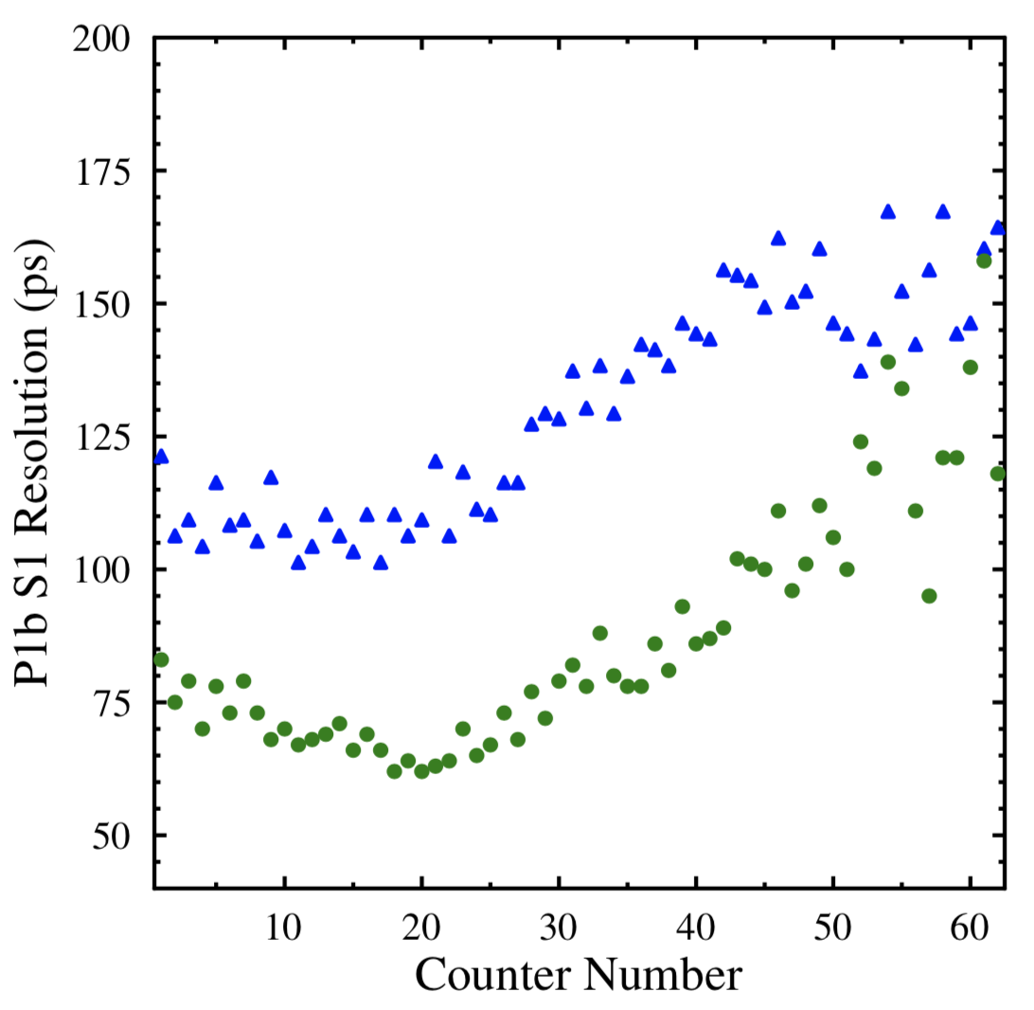
FTOF Status
10.6 GeV, Run 4013
Tor:-100%, Sol:-100%
tag 5b.7.1
Timing response limited to date:
need to turn on vz corrections to RF:
adds 83 ps in quadrature
need to turn on position-dependent corrections:
improves Δt by 15%
resolution smearing due to TDCs (100 ps LSB):
panel-1a/2 : all counters
panel-1b: counters #49-62
Combining times for panel-1b/1a:
work in progress using MC data:
improves Δt by 15% from using time from panel-1b alone
study includes optimize hit cluster definitions in each FTOF panel
corr off
corr on
D.S. Carman, CLAS Collaboration Meeting – Mar. 2019

Slide 14
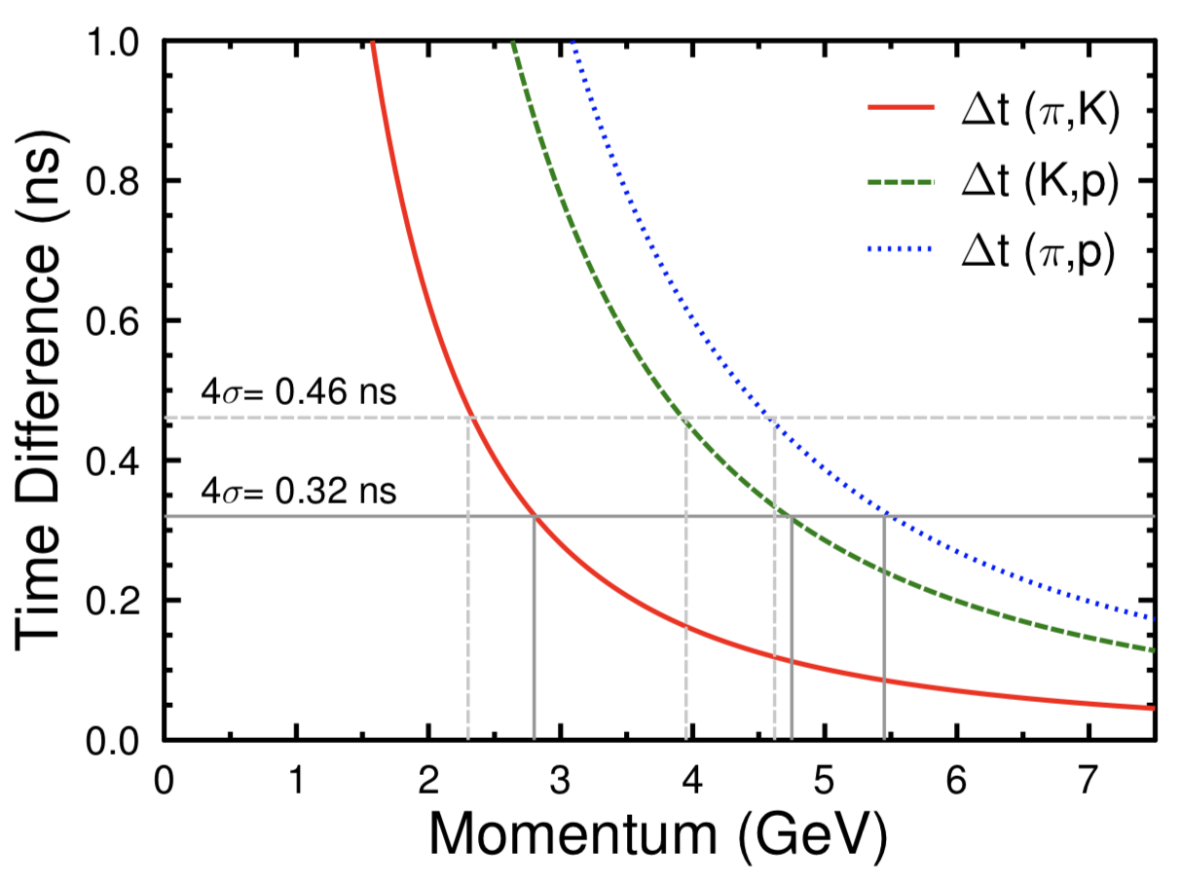
FTOF PID Limitations
4σ Limit | Current | Spec
π/K | 2.3 GeV | 2.8 GeV
K/p | 3.9 GeV | 4.8 GeV
π/p | 4.6 GeV | 5.5 GeV
D.S. Carman, CLAS Collaboration Meeting – Mar. 2019

Slide 15
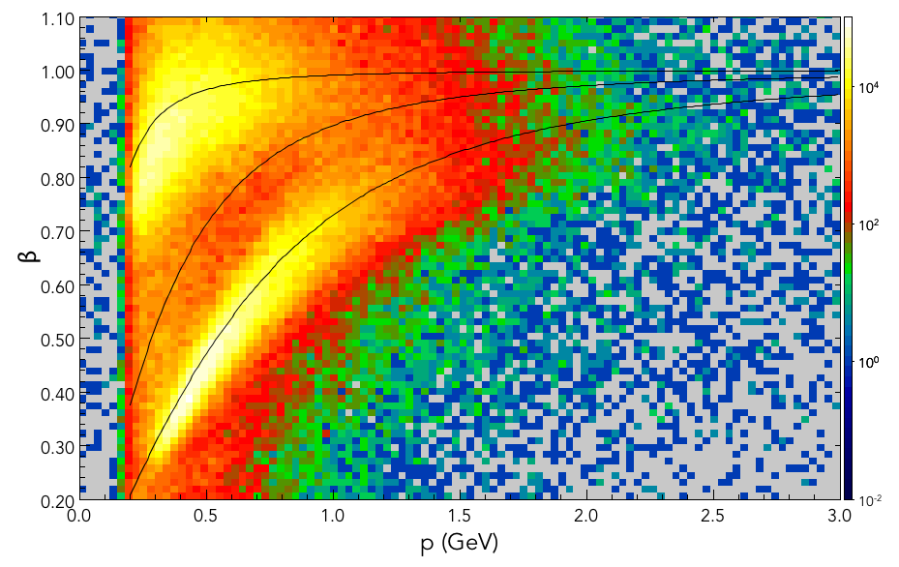
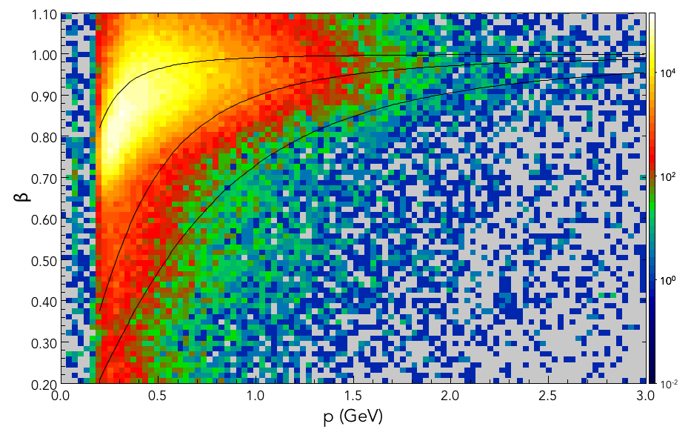
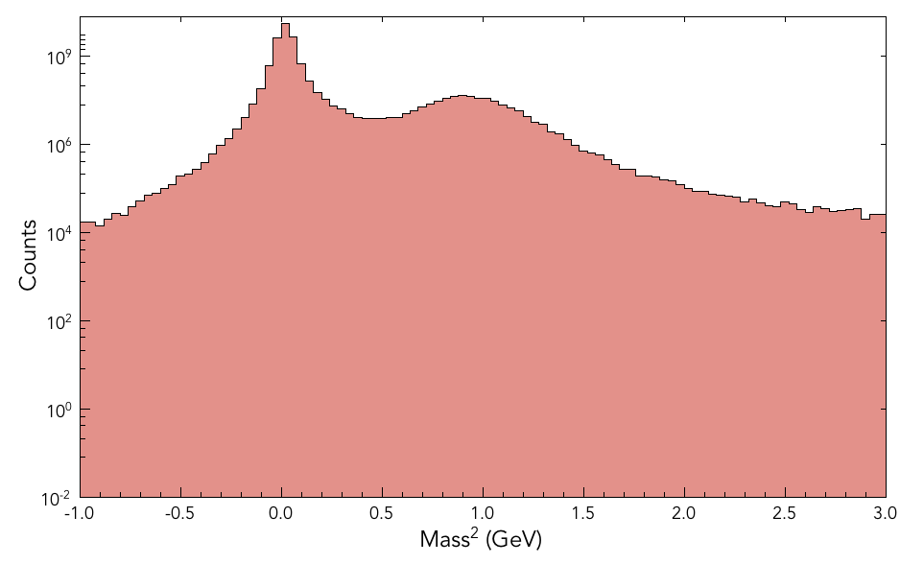
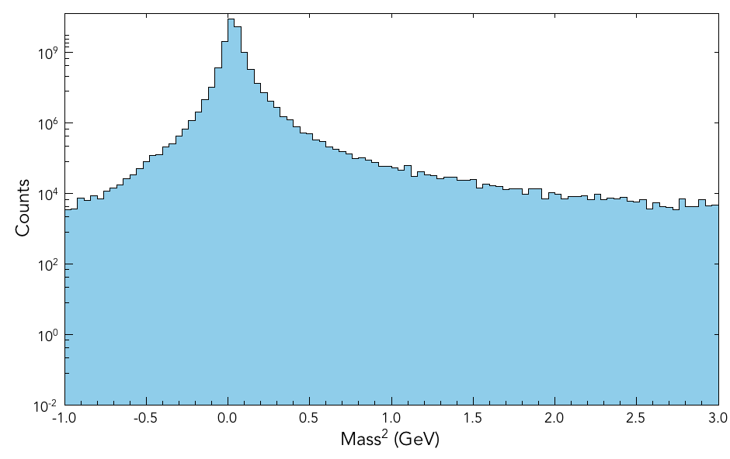
Central Detector PID
positives
negatives
run 4013, 10.6 GeV, T:-100%, S:-100%
D.S. Carman, CLAS Collaboration Meeting – Mar. 2019

Slide 16
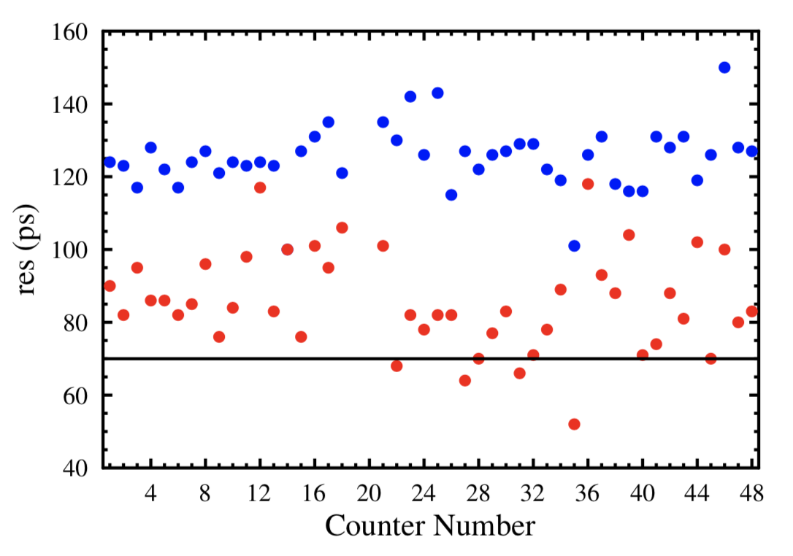
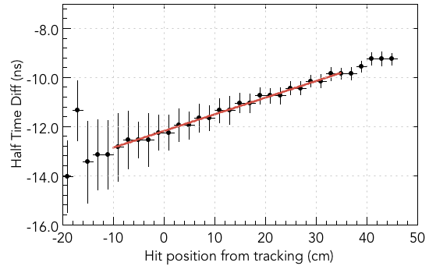
CTOF Status
10.6 GeV Torus=-100%, Solenoid=-100%
Run 4013, tag 5b.4.0
Time "residual" used for calibration:
DNP cooking, RF vzcorr
CTOF scintillation bar
Time resolution limitations (current):
Lack of RF vertex correction
Issues with curved end shapes
Response effects
Cherenkov light effect?
z = ½v_{eff} (t_{U}-t_{D})
D.S. Carman, CLAS Collaboration Meeting – Mar. 2019

Slide 17
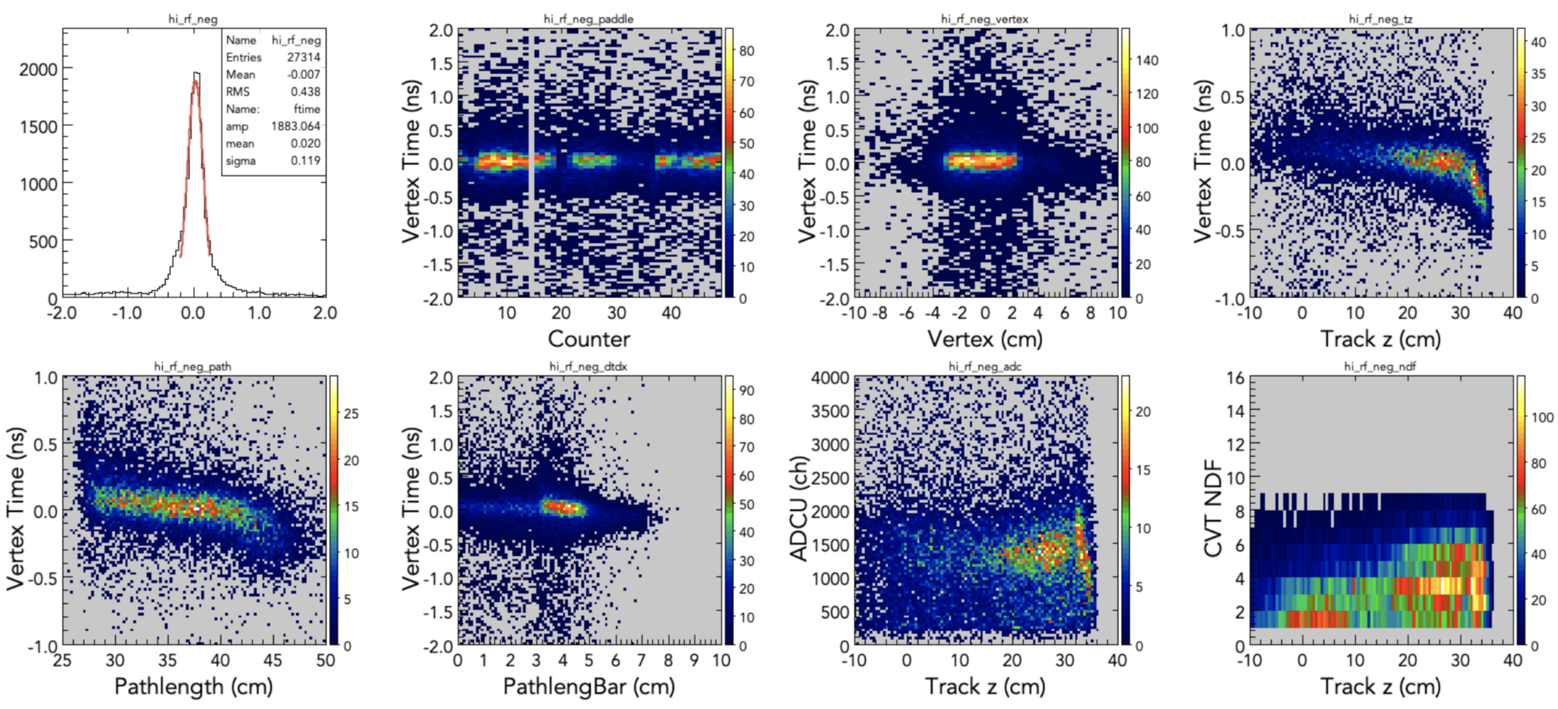
CTOF Status
Plan to remove vertex time dependence with ad hoc functional correction – work in progress
D.S. Carman, CLAS Collaboration Meeting – Mar. 2019

Slide 18
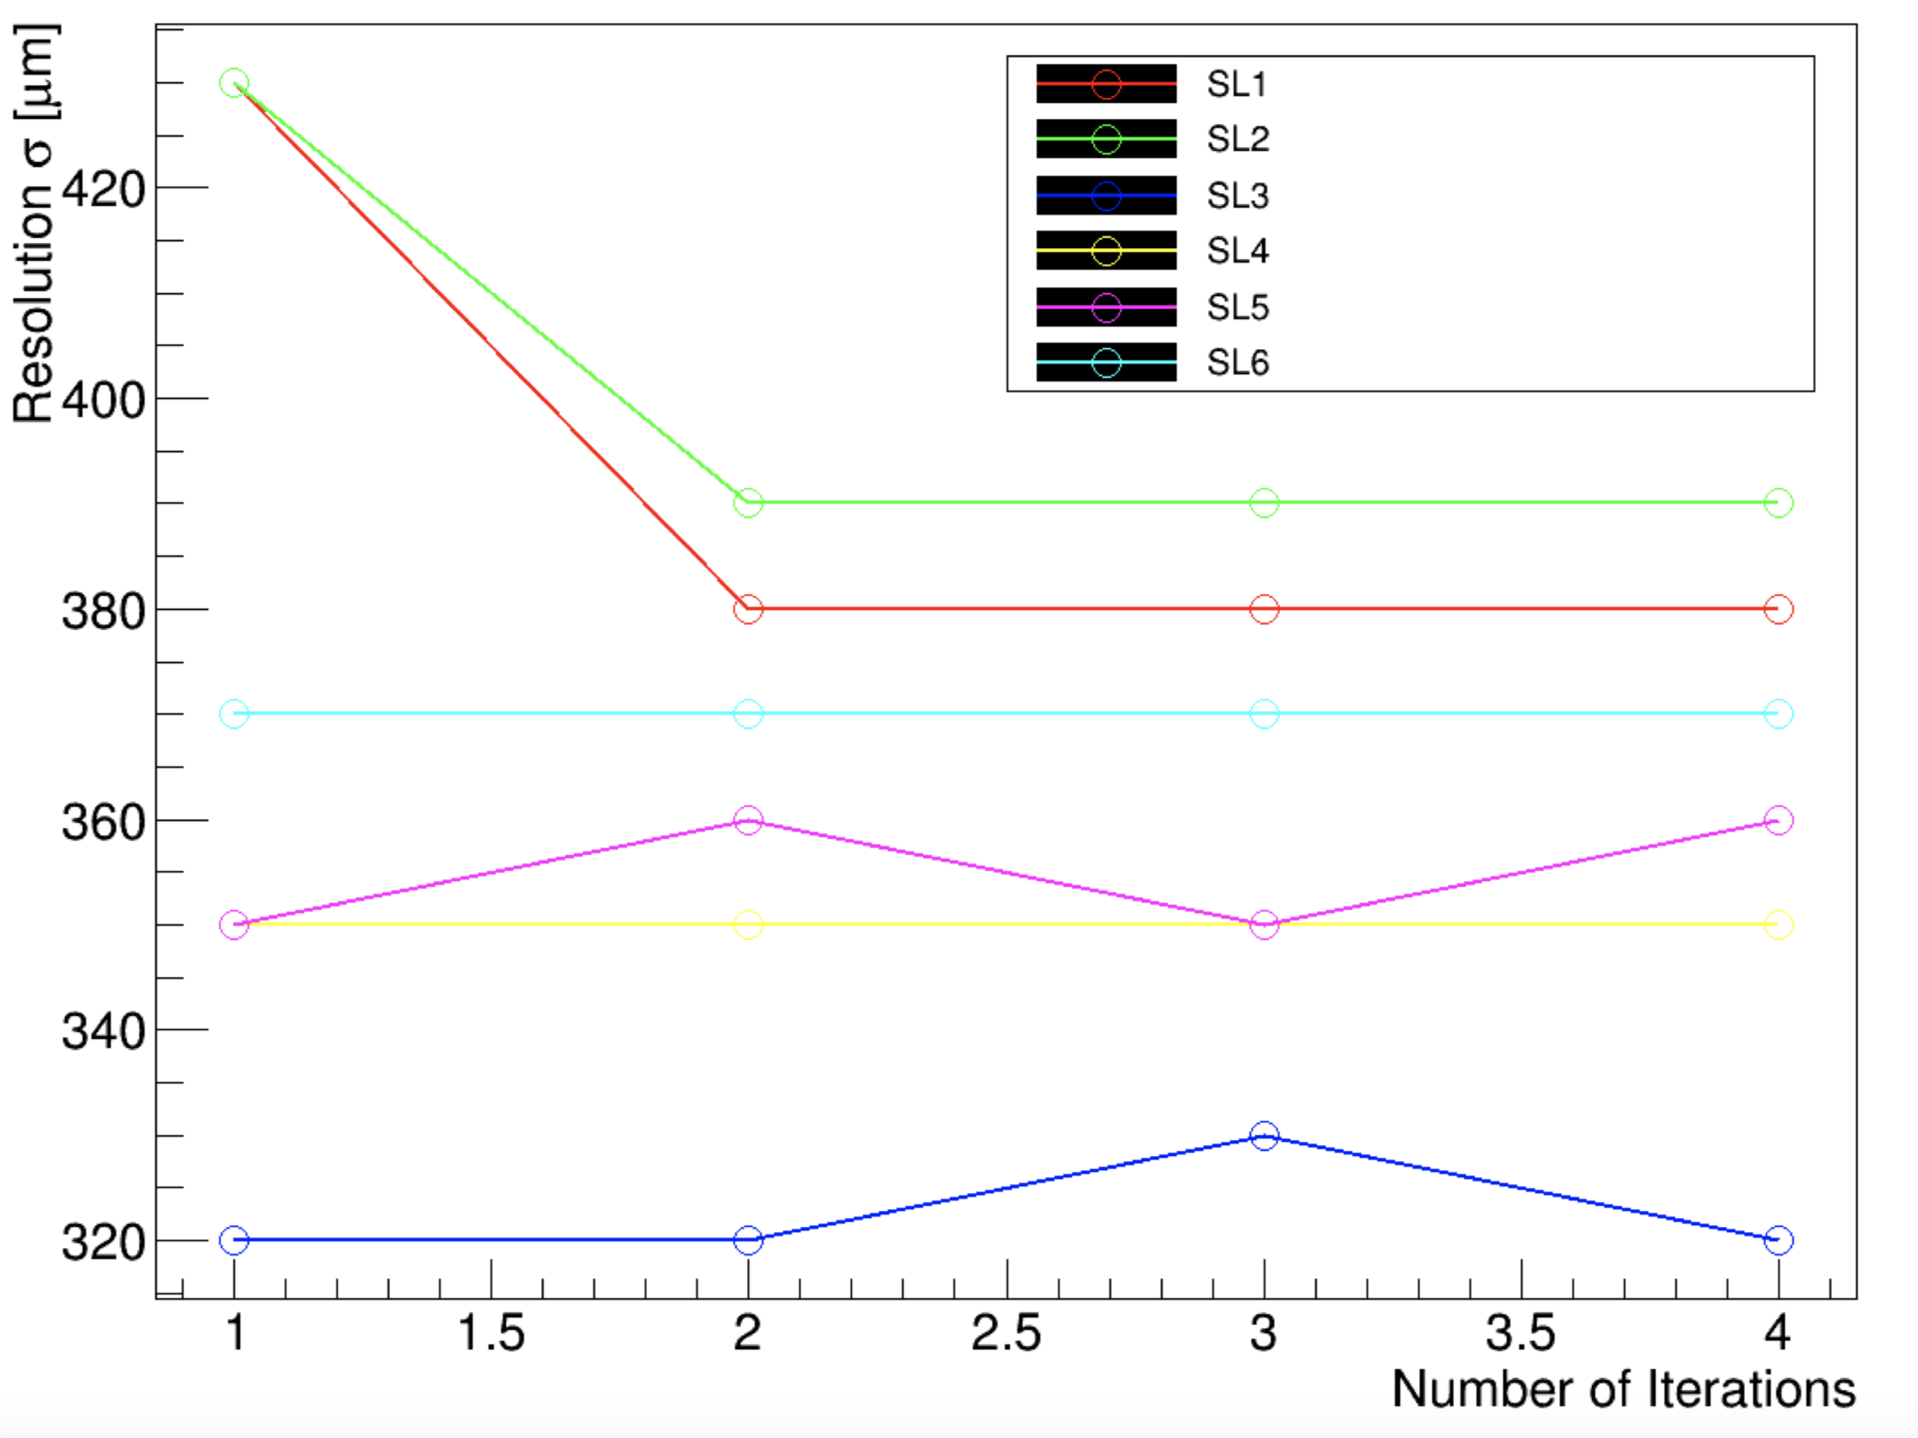
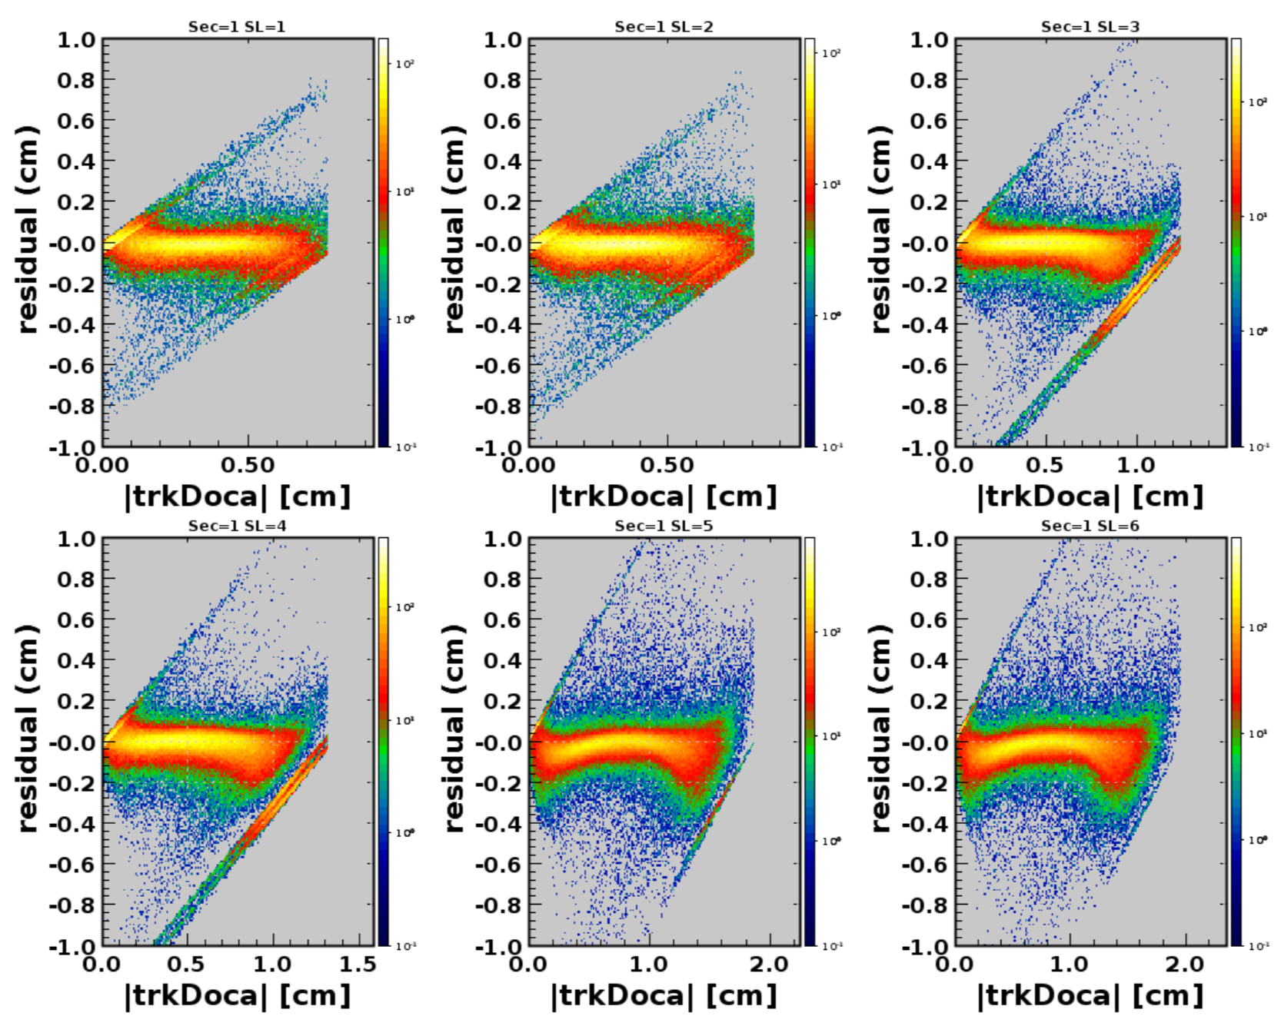
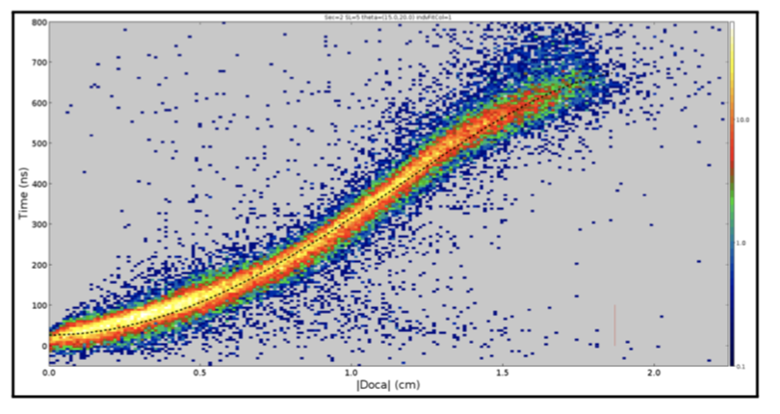
DC Status
Status and Plans:
Position resolutions 350-450 μm (typical)
Investigate different t→d function forms to better describe the data
Understand parameter correlations/limits
Develop status table for reconstruction and MC matching
Alignment (nearly done)
Recalibration monitoring metrics understood
D.S. Carman, CLAS Collaboration Meeting – Mar. 2019

Slide 19
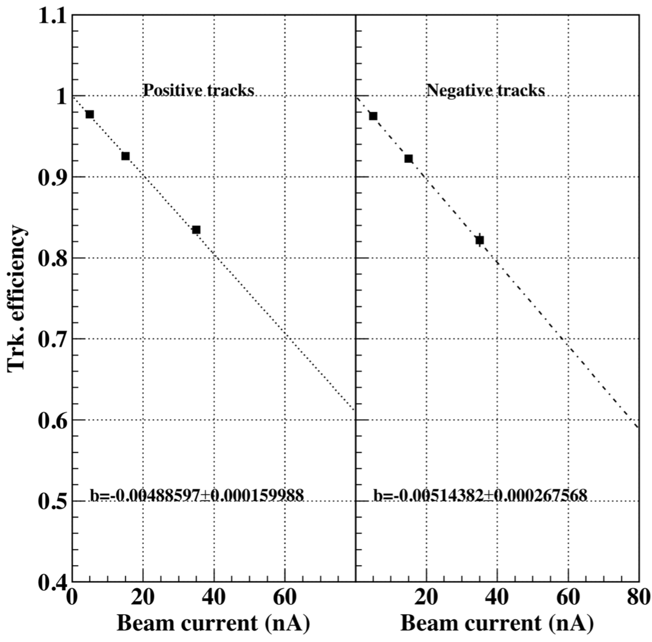
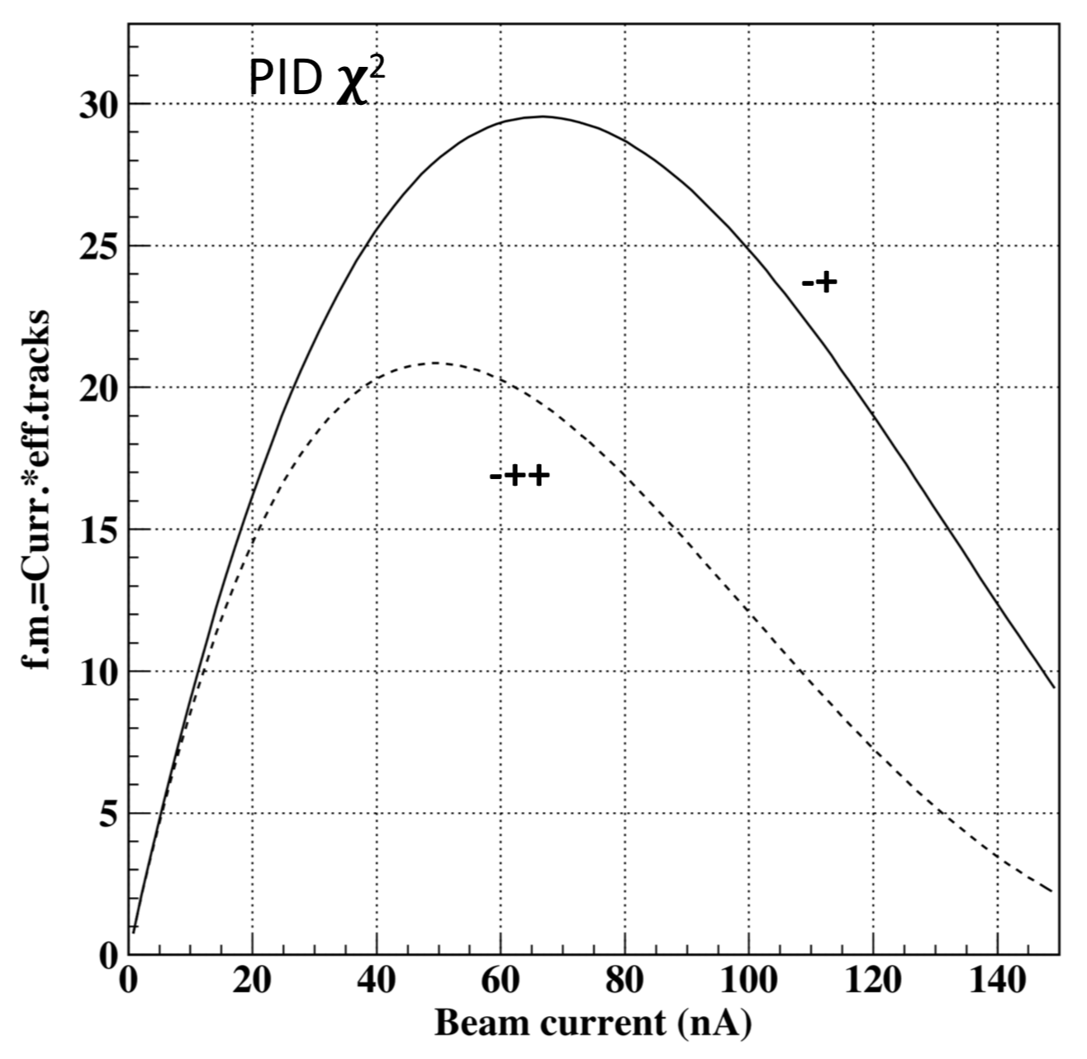
Forward Tracking Efficiency
Fall-off of tracking efficiency with beam current seen in RG-A, -K, and -B
Working to understand sources of loss; improvements expected moving forward
2/16/19
0.5%/nA
figure of merit
D.S. Carman, CLAS Collaboration Meeting – Mar. 2019

Slide 20
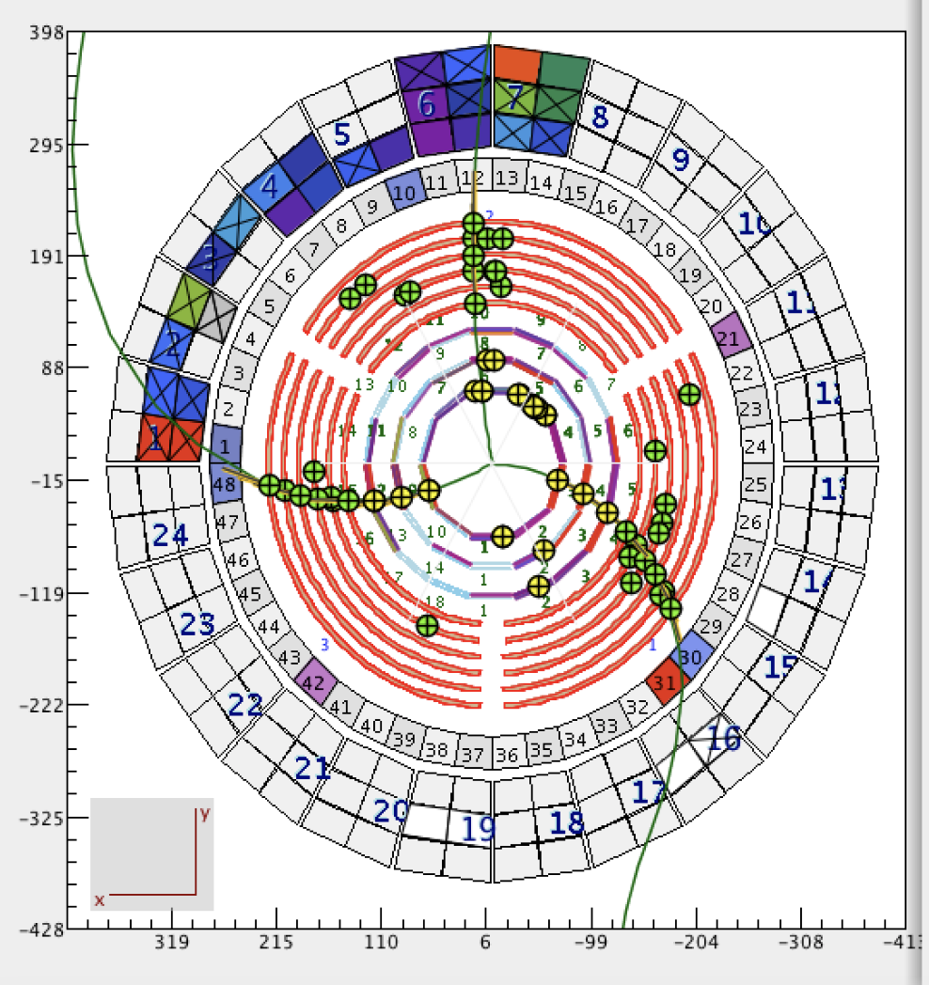
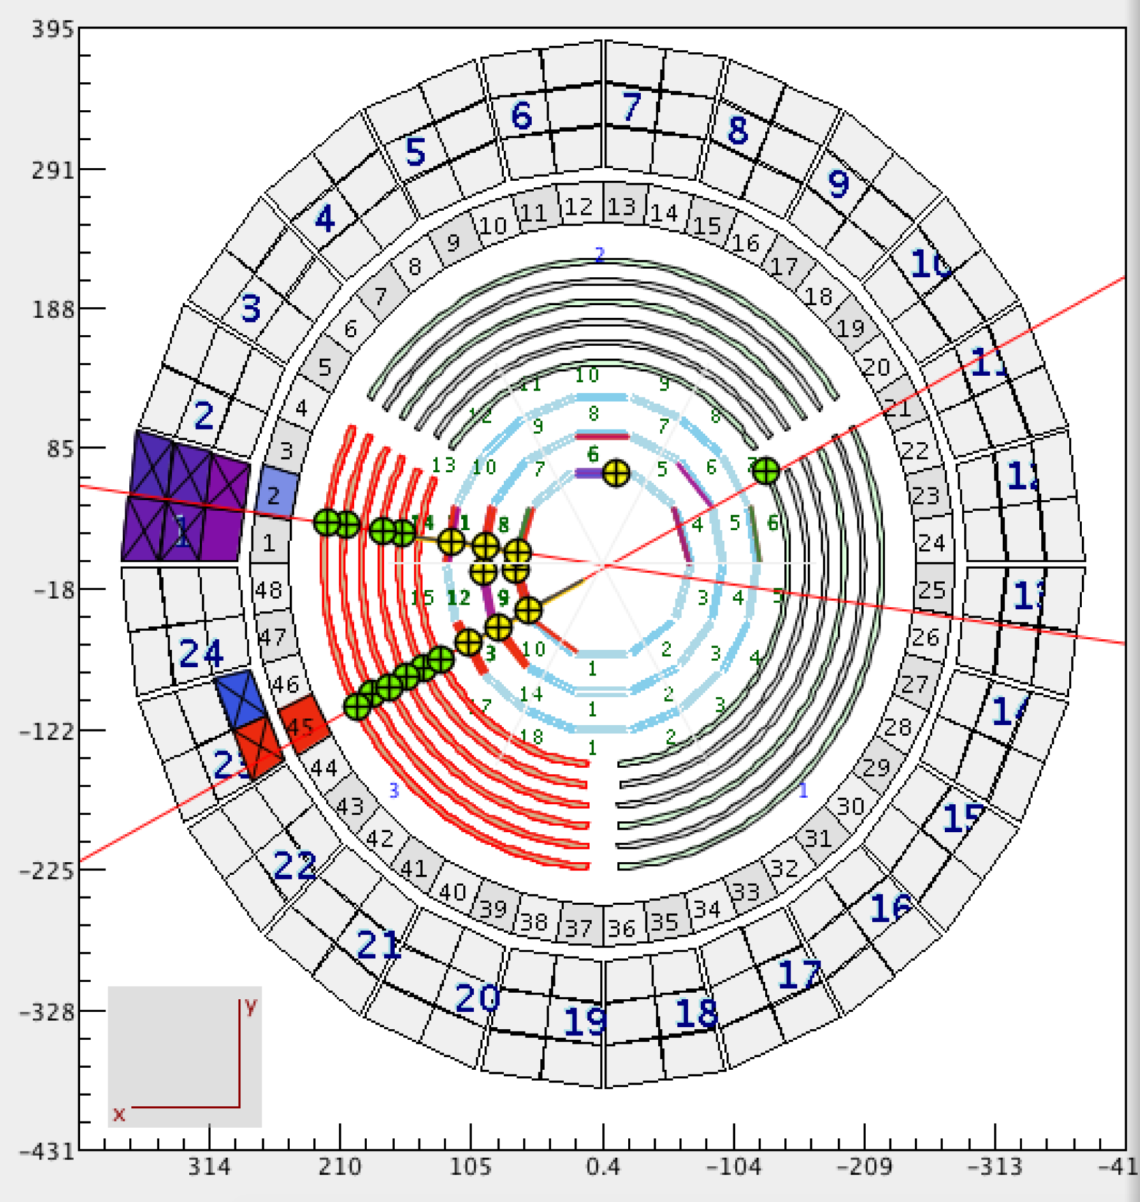
CVT Status
Production data @ 35 nA
Zero field alignment data
Repairs to BMT made in Jan.
SVT and MM performance good for RG-B (N.B. SVT leakage currents)
Alignment of CVT (MM and SVT) in progress – converging soon
Occupancies in SVT < 1% - should yield high efficiency, but this is not the case -
Possible deficiencies in tracking algorithm ??
D.S. Carman, CLAS Collaboration Meeting – Mar. 2019

Slide 21
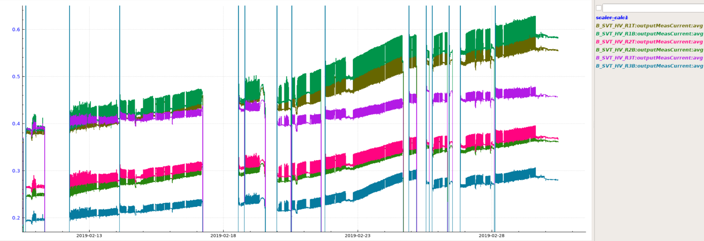
SVT Status
leakage currents
nA
L1
L2
L6
L4
L3
L5
500
400
300
200
Feb. 13 Feb. 18 Feb. 23 Feb. 28
nA
beam current
60
50
40
30
20
10
Feb. 13 Feb. 18 Feb. 23 Feb. 28
D.S. Carman, CLAS Collaboration Meeting – Mar. 2019

Slide 22
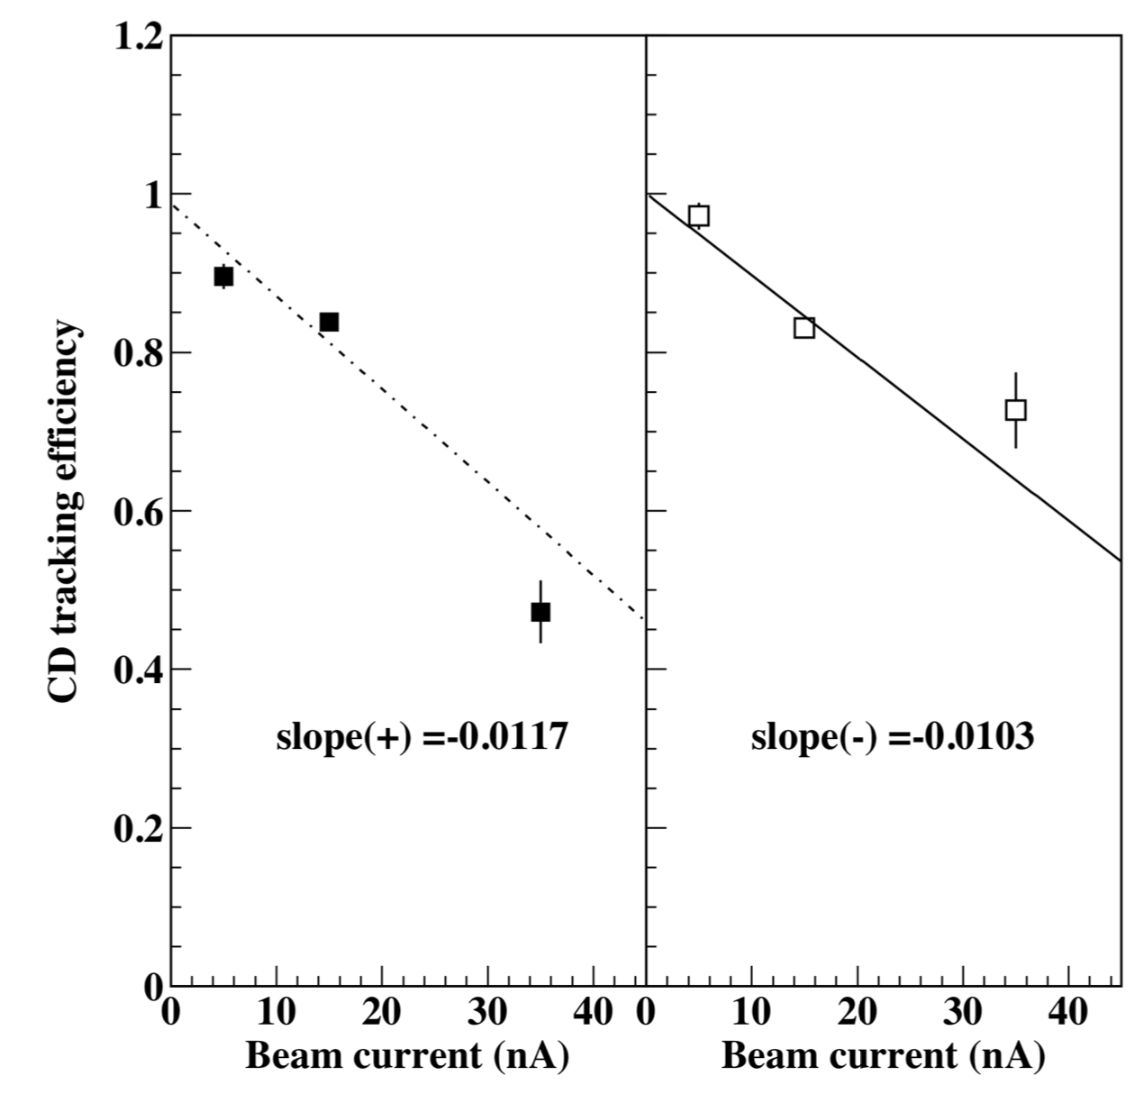
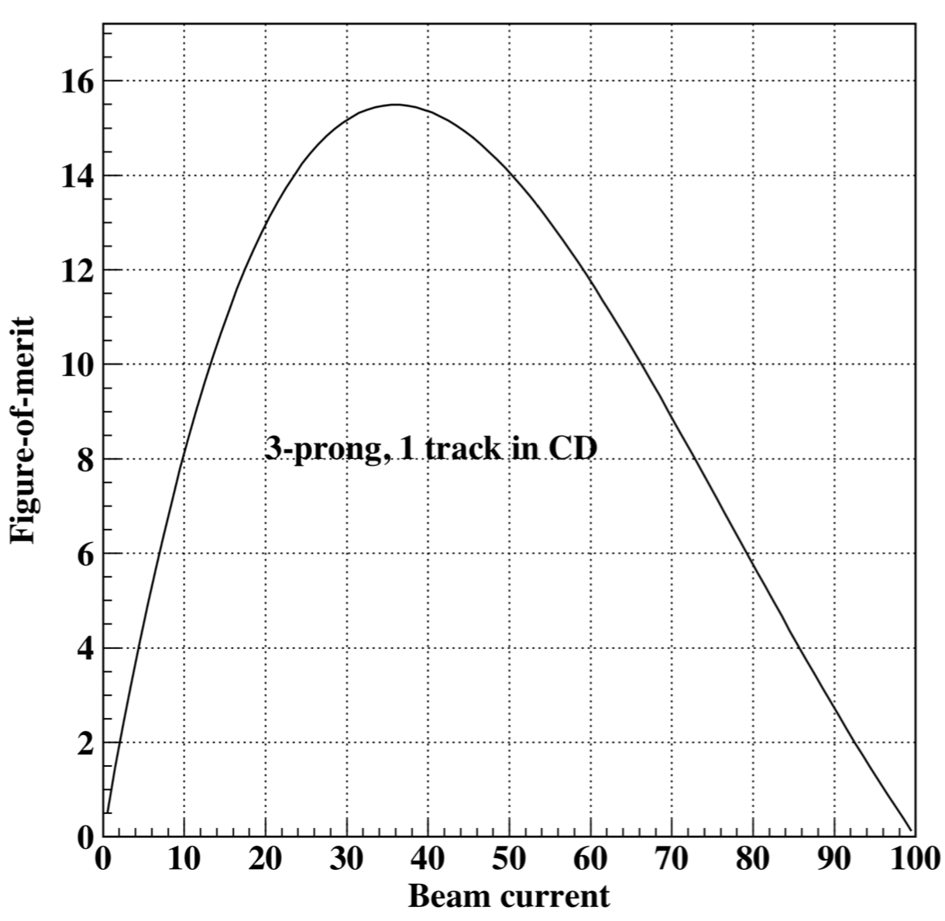
Central Tracking Efficiency
Fall-off of tracking efficiency with beam current
Working to understand sources of loss to see if improvements are possible
2/16/19
1%/nA
positive tracks
negative tracks
figure of merit
D.S. Carman, CLAS Collaboration Meeting – Mar. 2019

Slide 23
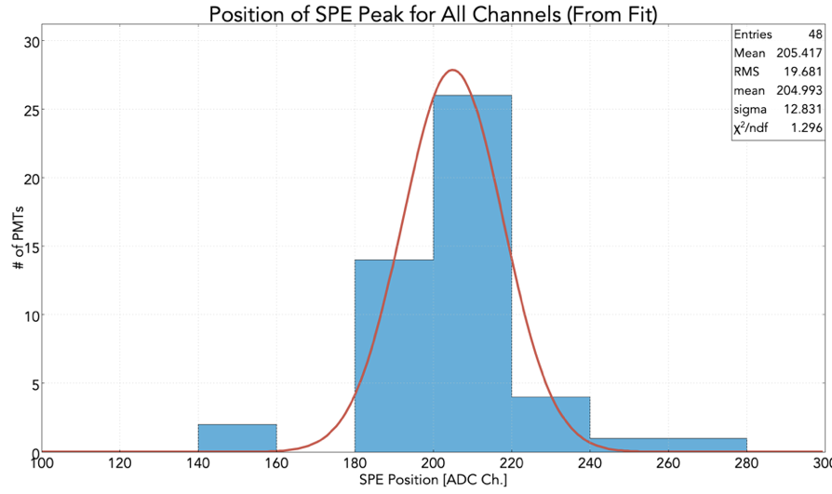
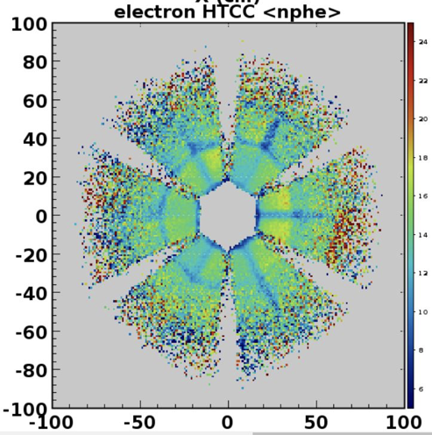
HTCC Calibration Status
Gain matching uniformity
Average NPhe Response
HTCC_{y}
HTCC_{x}
Typical Timing Calibration
D.S. Carman, CLAS Collaboration Meeting – Mar. 2019

Slide 24
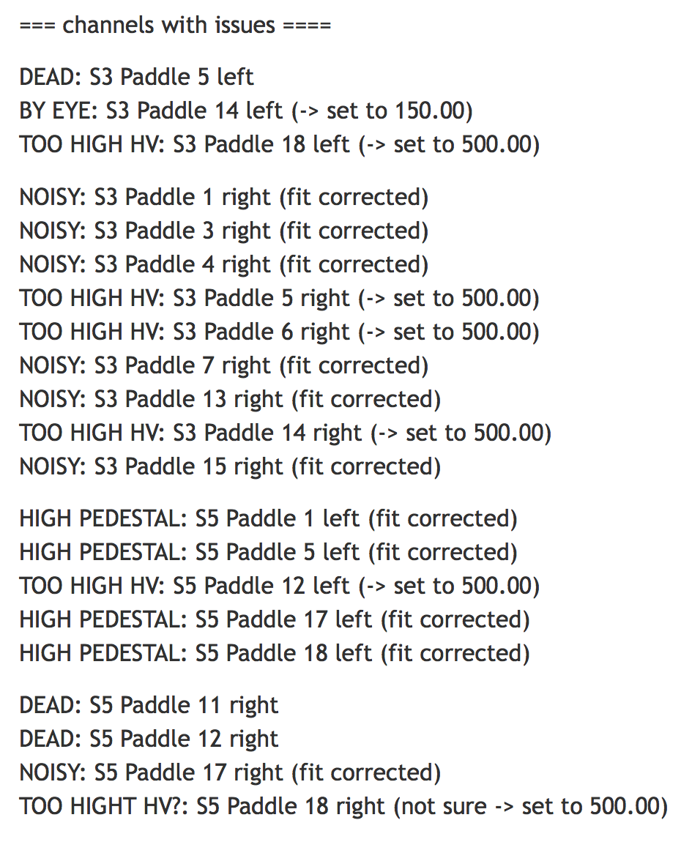
LTCC Status
Detector Configurations:
Spring run: S2, S3, S5, S6; only S5 was (partially) filled with C₄F₁₀
Fall run: S3, S5; only S3 was (partially) filled with C₄F₁₀
Gas levels of C₄F₁₀ varied with time in unknown way
Winter run: S3, S5 filled with C₄F₁₀
Minimal leak rate in both boxes
Gain calibrations completed for LTCC
hit cluster position and energy reconstruction not ready yet
Timing calibration algorithm needs to be developed and tested
D.S. Carman, CLAS Collaboration Meeting – Mar. 2019

Slide 25
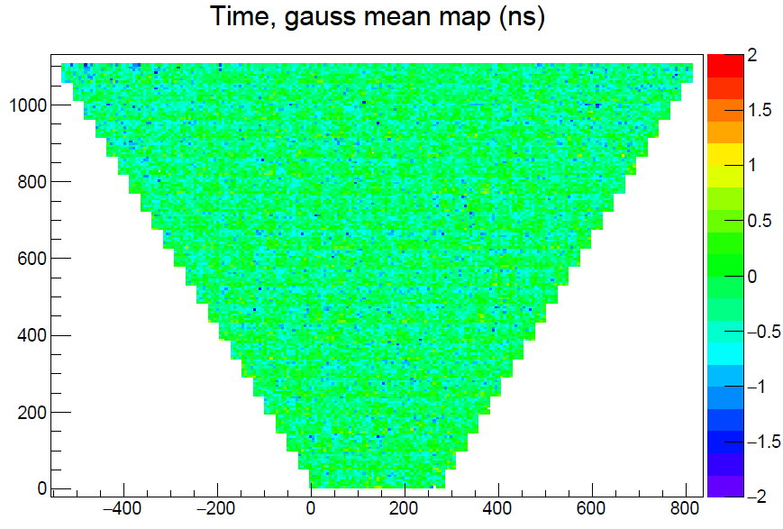
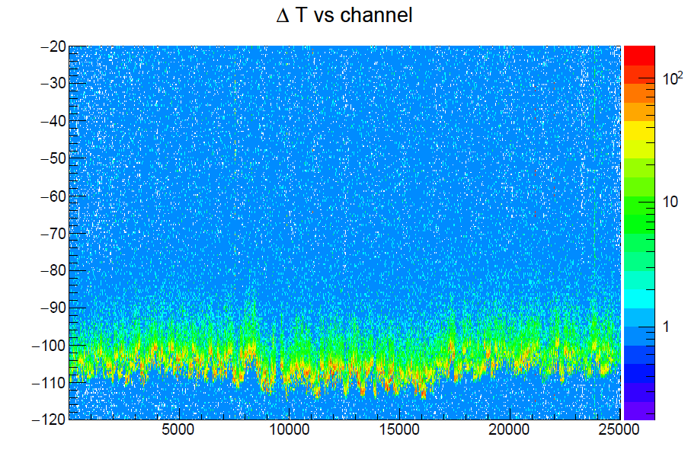
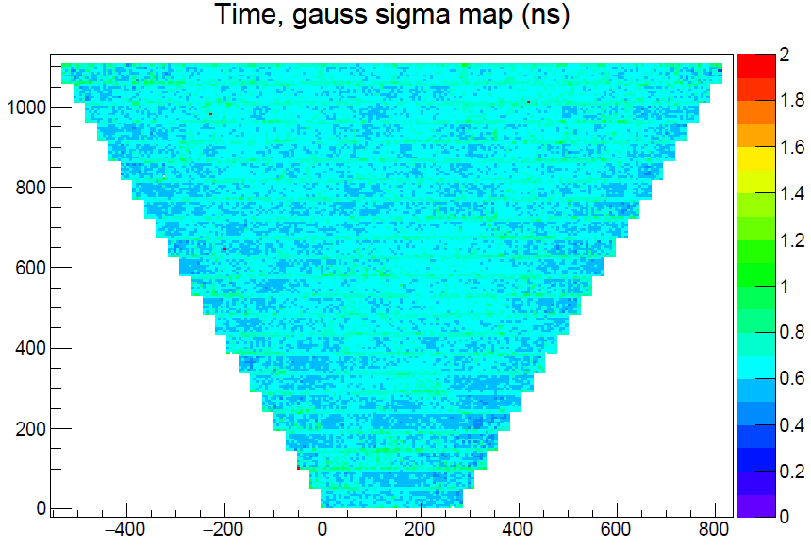
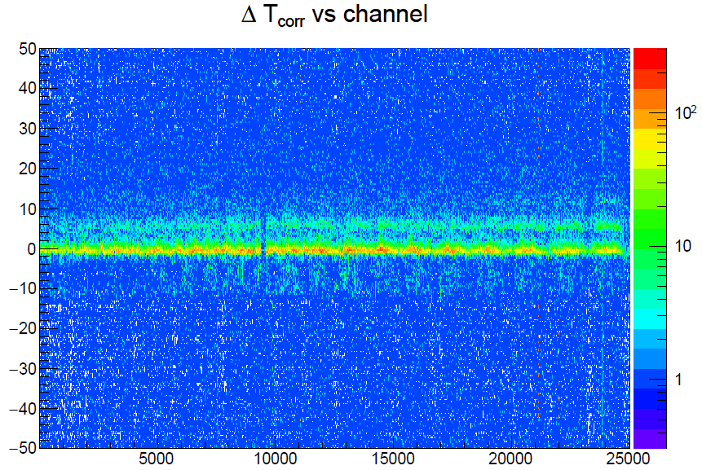
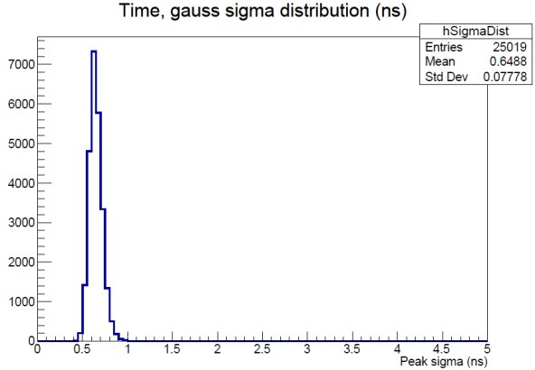
RICH Calibration Status
First version of the RICH time calibration suite ready
total number of parameters is 25024 time offsets and 1564 time walk constants
tested only on run 4013 (software tag 5b.7.4)
ΔT = meas. – expected
before correction
after correction
Avg. res
<σ> = 0.65 ns
D.S. Carman, CLAS Collaboration Meeting – Mar. 2019

Slide 26
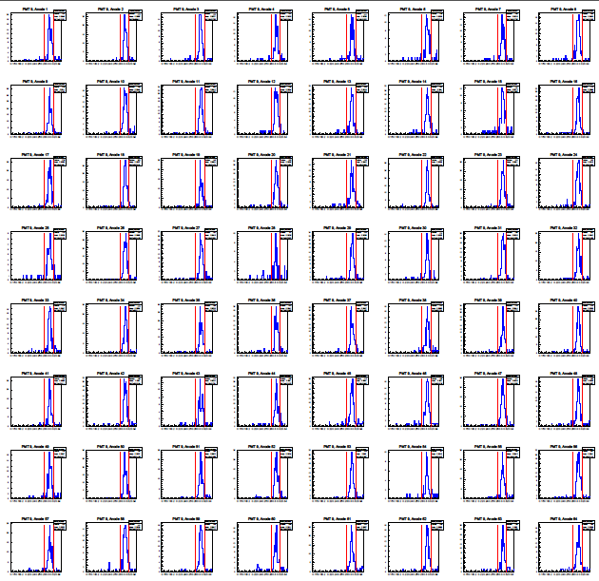
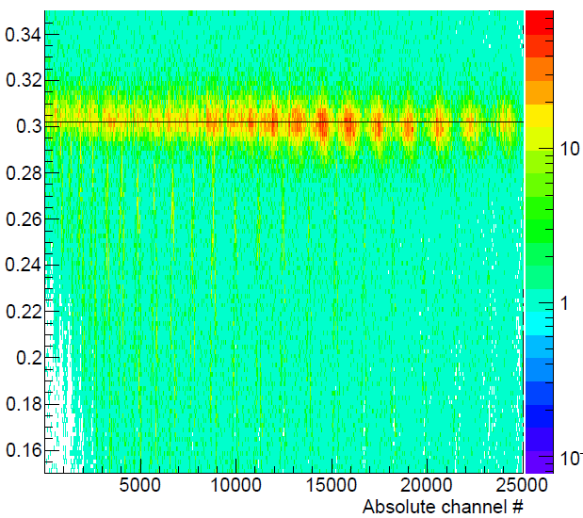
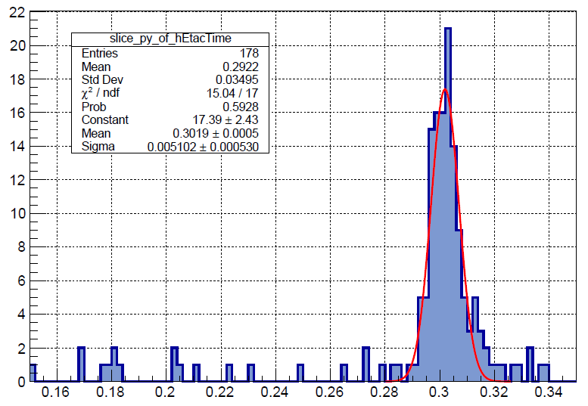
RICH Cherenkov Angle Reconstruction
Events with 1 electron in the RICH
On-time photons, direct detection (no reflections)
PMT 9
Cherenkov angle [rad]
channel 4416
σ(θ) ~ 5 mrad
Single photon resolution close to the goal
Expected improvement from misalignment corr.
Reflected photon reconstruction in progress
D.S. Carman, CLAS Collaboration Meeting – Mar. 2019

Slide 27
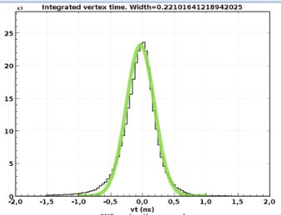
CND Status
Calibration suite fully functional
Work in progress:
Study resolution limitations
Develop neutral identification in EB
δt = 156 ps
p(e,e'π⁺)X
CND neutrons
= efficiency~8.2%
Missing neutrons
run 3842
D.S. Carman, CLAS Collaboration Meeting – Mar. 2019

Slide 28
BAND Status
Facing Downstream
Side View
beam
BAND Specs:
Angular coverage: θ ~ 155º-176º
Timing resolution < 300 ps
Design neutron efficiency ~35% at 2 MeVee deposited energy
Design neutron momentum resolution 1.5% at 450 MeV/c
D.S. Carman, CLAS Collaboration Meeting – Mar. 2019

Slide 29
BAND Status
$$σ≈1.5 \text{[}\text{ns}\text{]}$$
$$γ$$
n (250 MeV/c)
$$\frac{\left(t_{L}+t_{R}\right)}{2}−\text{RF} \text{[}\text{ns}\text{]}$$
Reconstructed BAND hits including:
Attenuation corrections
(L-R) timing offsets
Speed of light in individual bar
Paddle-to-paddle offsets from laser
(Still to come: time-walk and path length corrections)
D.S. Carman, CLAS Collaboration Meeting – Mar. 2019

Slide 30
Performance Status
System | Spec | Achieved | Spec | Achieved
BAND | <eff_{n}> = 35% | TBD | δt < 300 ps | TBD
CND | <eff_{n}> = 10% | TBD | δt = 130 ps | 160 ps
CTOF | δt = 65 ps | 130 ps
DC | δx = 250 – 400 μm | 350 – 500 μm
ECAL | σ_{E}/E = 10%/$\sqrt{\text{E}}$ | 10%/$\sqrt{\text{E}}$ | δt < 500 ps | < 600 ps
FT | σ_{E}/E < 2%/$\sqrt{\text{E}}$ + 1% | 3.3%/$\sqrt{\text{E}}$ | δt < 300 ps | ~200 ps
FTOF | 60 – 100 ps (p1b) | 100 – 150 ps (p1b) | 90 – 160 ps (p1a) | 110 – 250 ps (p1a)
HTCC | eff_{π} < 1% | < 1% | <nphe> = 16 | 16
LTCC | eff = 90% | TBD | δt = 1 ns | TBD
RICH | δt < 1 ns | 0.7 ns | π/K rej > 500 | TBD
SVT | S/N > 10 | ~15 | δx = 50 – 65 μm | ~75 μm
*Entries highlighted in red have not yet met spec's
D.S. Carman, CLAS Collaboration Meeting – Mar. 2019

Slide 31
Remaining Calibration Work
DC:
Complete detector alignment
Change to new t → d function to improve flexibility
FTOF:
Include vertex correction to RF time
Implement position-dependent time-walk correction
Include FADC/TDC hit matching
Understand systematics in MIP peak position (e.g. vs. torus polarity)
CTOF/CND:
Include vertex correction to ST (using optimal vertex)
Correct for time shift associated with event at end of bar
LTCC:
No timing calibration – need code development
BAND:
Implement time-walk corrections to timing
Include path-length corrections
Short term
Longer term
D.S. Carman, CLAS Collaboration Meeting – Mar. 2019

Slide 32
Remaining Calibration Work
Short term
Longer term
ECAL:
Complete studies of long-term energy calibration drift
Understand systematics in MIP peak position (e.g. vs. torus polarity)
Develop PMT gain corrections to account for loss with time
Develop new timing calibration scheme and implement into calibrations
Understand systematics in timing vs. PID, path length, geom
FT:
CAL: Refine fitting procedure for energy calibration
CAL: Include TW correction to optimize timing
HODO: Address small bias in fits to ΔE
TRK: Reconstruction code development underway
CVT:
Complete alignment work
RICH:
Complete development of PID scheme and implement in Event Builder
Complete alignment work
D.S. Carman, CLAS Collaboration Meeting – Mar. 2019

Slide 33
Run Group A/K – Calibration Team
Subsystem | Group Leader | RG-A/K Calibrator(s)
CND | Silvia Niccolai | Pierre Chatagnon
CTOF | Daniel S. Carman | Chan Kim
DC | Mac Mestayer | Dilini Bulumulla, Latif Kabul, Shirsendu Nanda
ECAL | Cole Smith | Cole Smith/Joshua Artem Tan
FT | Raffaella De Vita | Raffaella De Vita, Nick Zachariou
FTOF | Daniel S. Carman | Christopher McLauchlin
HTCC | Youri Sharabian | Nick Markov, Will Phelps
LTCC | Maurizio Ungaro | Maurizio Ungaro, Burcu Duran
MVT | Maxime Defurne | Maxime Defurne, Guillaume Christiaens
RICH | Marco Contalbrigo | Marco Contalbrigo, Andrey Kim
SVT | Yuri Gotra | Yuri Gotra
D.S. Carman, CLAS Collaboration Meeting – Mar. 2019

Slide 34
Run Group B – Calibration Team
Subsystem | Group Leader | Calibrator(s)
BAND | Larry Weinstein (ODU) | Florian Hauenstein (ODU), Efrain Segarra (MIT), Reynier Cruz Torres (MIT)
CND | Silvia Niccolai (Orsay) | Paul Naidoo (Glasgow)
CTOF | Daniel S. Carman (JLab) | Achyut Khanal (FIU)
DC | Mac Mestayer (JLab) | Shirsendu Nanda (MSU)
ECAL | Cole Smith (JLab) | Cole Smith, Susan Schadmand (Juelich)
FT | Raffaella De Vita (INFN) | Raffaella De Vita, Nick Zachariou (Edinburgh) Susan Schadmand (Juelich), Alessandra Filippi (INFNTUR)
FTOF | Daniel S. Carman (JLab) | Jose Carvajal (FIU)
HTCC | Youri Sharabian (JLab) | Isabella Illari (GWU)
LTCC | Maurizio Ungaro (JLab) | Maurizio Ungaro
MVT | Maxime Defurne (Saclay) | Maxime Defurne, Gerry Gilfoyle (RICH)
RICH | Marco Contalbrigo (INFN) | Hyon-Suk Jo (KNU)
SVT | Yuri Gotra (JLab) | Yuri Gotra
D.S. Carman, CLAS Collaboration Meeting – Mar. 2019

Slide 35
Detector Calibration Summary
The calibration suites for all subsystems are well advanced
Development work continues (optimization and fine-tuning in most cases)
Initial calibrations have been completed for all subsystems
For most subsystems, the calibrations will need to be redone due to improvements in the reconstruction, alignment, and algorithms
A complete pass-0 (in progress) studied with the available monitoring tools will be used to determine when calibrations need to be redone
Understand metrics for recalibration for each subsystem are being developed
Limitations of calibrations toward achieving design specifications being investigated
Most issues understood and work plans to overcome them in progress
Working closely with Software Group and RG-A Coordinator to track the remaining work necessary before pass-1 of RG-A spring data
D.S. Carman, CLAS Collaboration Meeting – Mar. 2019

