Slide 1
Physics Data Processing With Micro-Services
Reactive Data-Stream Processing Framework For Distributed Heterogeneous Computing Environments
V. Gyurjyan , G. Heyes
JLAB Data Acquisition Group

Slide 2
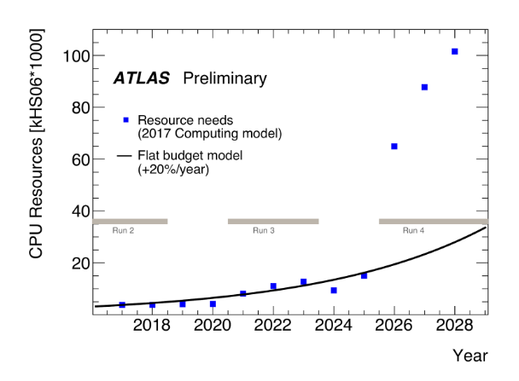
Problem we face
Notes:
HEP-SPEC 2006 includes also software performance measures.

Slide 3
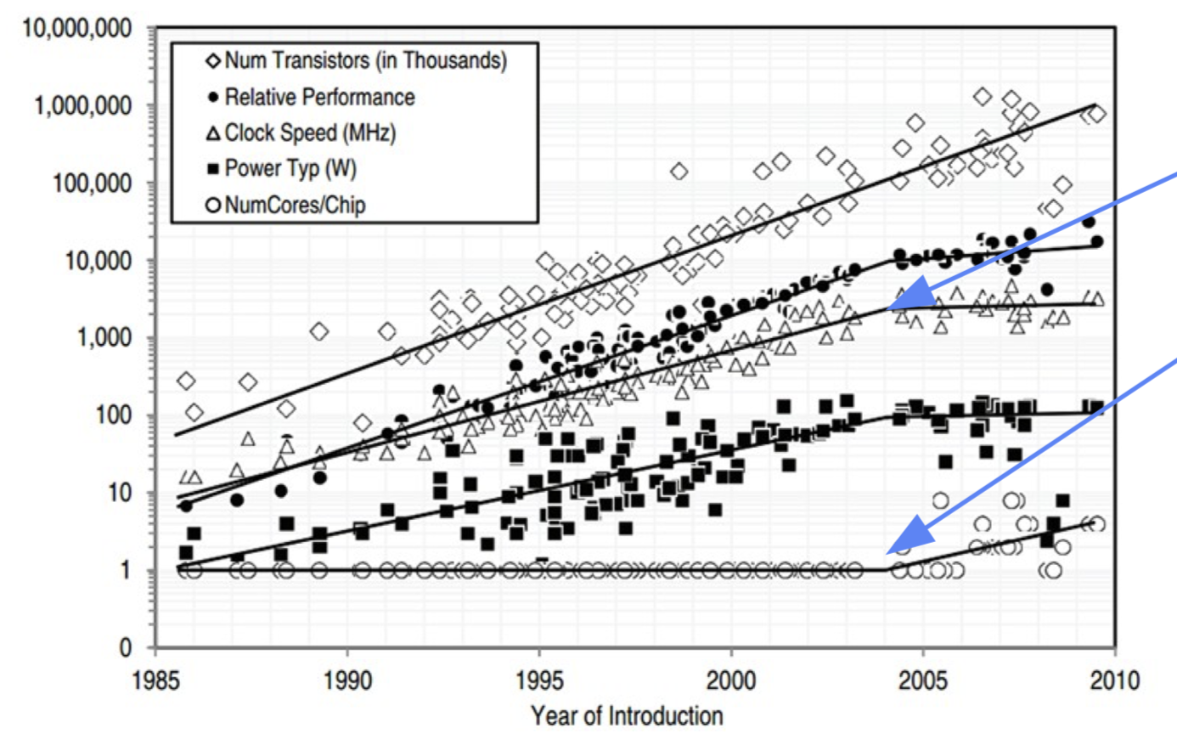
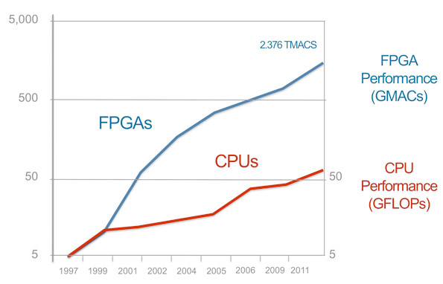
CPU based architecture limitations
MIPS/clock speed plateau
Squeezing more cores per chip becomes difficult

Slide 4
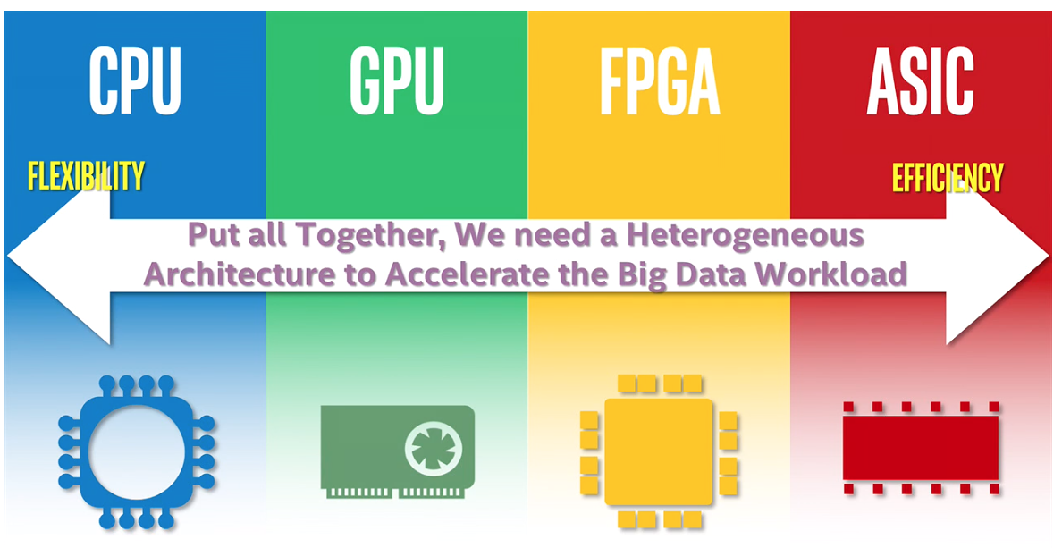
Only CPU based parallelism is not enough
Frameworks face the challenge of handling the massive parallelism and heterogeneity that will be present in future computing facilities, including multi-core and many-core systems, GPUs, Tensor Processing Units (TPUs), and tiered memory systems, each integrated with storage and high-speed network interconnections.
A Roadmap for HEP Software and Computing R&D for the 2020s. HEP Software Foundation, Feb. 2018
Future data processing applications must be able to scale within a multi-core CPU environment and utilize an increasing number of heterogeneous HPC platforms
High-Performance Computing” A.L. Lastovetsky, J.J. Dongarra, May, 2009

Slide 5
What are recommendations?
Better use of SIMD capabilities of current and future CPU architectures.
Improve the throughput of multithreaded software trigger and event reconstruction applications.
Utilization of computing architectures using technologies beyond CPUs (e.g. integrating FPGAs, GPUs into software trigger and online reconstruction applications)
Enable the development, automation, and deployment of extended quality assurance and quality control tools, and facilities for software trigger and reconstruction algorithms.
Enable full offline analysis chains to be ported into real-time, and develop frameworks that allow non-expert offline analysis to design and deploy physics data processing systems.
Develop and demonstrate efficient techniques for physics event reconstruction and identification in complex environments.
Evolve or rewrite existing toolkits and algorithms focused on their physics and technical performance at high event complexity.
A Roadmap for HEP Software and Computing R&D for the 2020s. HEP Software Foundation, Feb. 2018

Slide 6
What we currently have?
Reactive data stream processing framework that implements micro-services architecture and FBP.
Defines streaming transient-data structure
User data format agnostic
Provides service container to present user algorithm (engine) as an independent service. (think software LEGO)
Defines service communication channel (service bus) outside of the user engine.
Stream-unit level workflow management system and API
Supports C++, JAVA, Python languages
Communication channel
S9
S10
S10
Service container
S3
S1
S2
S4
S5
S6
S’3
Service engine
S7
S8
Workflow manager

Slide 7
Recognition at HSF

Slide 8
Framework’s components
Data Processing Station
Data-Stream Pipe
WFMS
Provides
Engine run-time environment
Engine multithreading
Engine configuration
Provides
MPI: pub-sub, req-rep
Data-quantum serialization
Metadata
Provides
Application deployment
Application monitoring and real-time benchmarking
Exception logging and reporting
Application recovery and data-flow synchronization
Farm (batch/cloud) interface
Hardware specific deployment optimizations
Service registration and discovery
Data-set handling and distribution

Slide 9
Service building
Data processing Engine
Data Processing Station
Data Processing Service

Slide 10
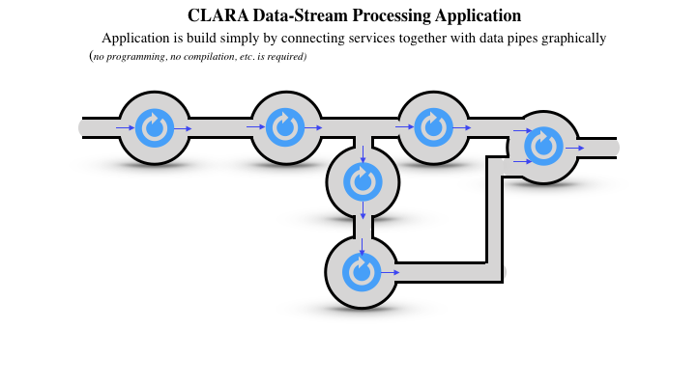
Application design

Slide 11
Work in progress
Generic K-Means clustering service on GPGPU.
Generic Fuzzy-C Means clustering service (unsupervised ML).
Heterogeneous data-processing optimization: adaptive WFMS
Make sure that the computing resources are optimal match for a service and the resource can be fully utilized.
RDMA-accelerated data transfer.
FPGA – CPU data stream pipe design.
FPGA MPI, utilizing RDMA or shared memory.
Streaming data-quantum redesign.
Achieve 0 copy
Avoid data serialization across heterogeneous hardware/software structures
Notes:
OpenFabrics for RDMA,
Google flat-buffers and Apache Arrow
RDMA-accelerated data transfer

Slide 12
Thank You

Slide 13
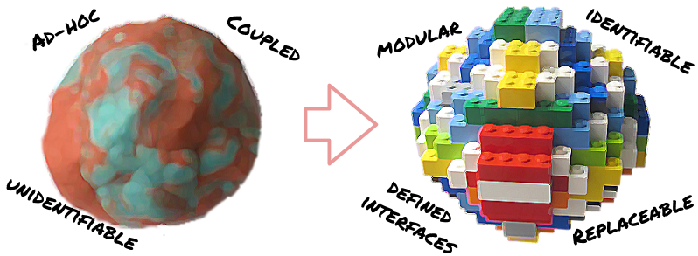
Micro-services in nutshell
Application is made of components that communicate data
Small, simple and independent
Easier to understand and develop
Less dependencies
Faster to build and deploy
Reduced develop-deploy-debug cycle
Easy to migrate to data
Scales independently
Independent optimizations
Improves fault isolation
Eliminates long term commitment to a single technology stack.
Easy to embrace new technologies

Slide 14
Flow based programming (FBP)
Glue between micro-services
How they connect to achieve computational goals
Makes application truly distributed
A
B
B reacts on message
Named inputs
Sync/async message passing
{ A calls B } v.s. { A message B }

Slide 15
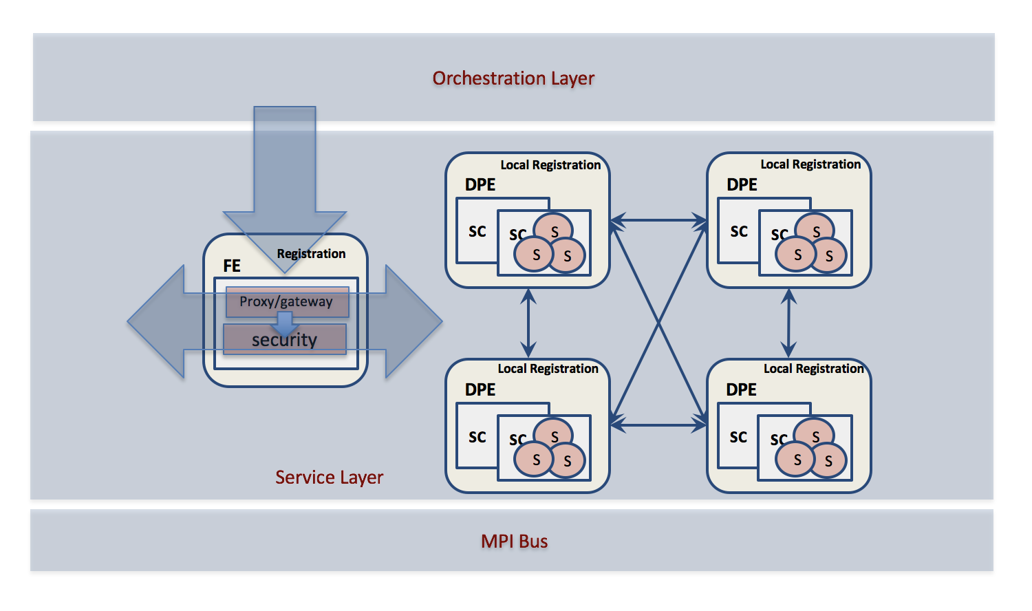
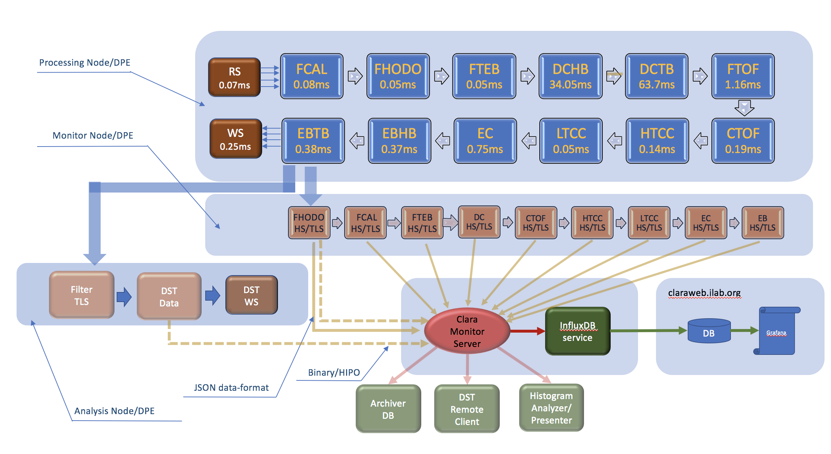
What we get by using this framework?
Different language bindings to present user engines in C++, C, Fortran, Java, Python, HLS, opneCL, Cuda.
Reacts to:
Streaming-unit (message-driven and responsive)
Service failure (resilient)
Variable load conditions (elastic)
Provides multi-threading:
Non blocking processing
Threads don’t block on async execution.
Task oriented orchestration
Can be altered dynamically based on running conditions
Graphical application representation and design.

Slide 16
Framework architecture
Orchestration Layer
Local Registration
Local Registration
DPE
DPE
SC
SC
SC
SC
FE
S
S
Registration
S
S
S
S
gateway
security
Local Registration
Local Registration
DPE
DPE
SC
SC
SC
SC
S
S
Service Layer
S
S
S
S
Service Bus (xMsg)

Slide 17
User engine multi-threading
Service Engine
Service
Service
SE
SE1
SE
SE
SE1
One request at a time
Multiple simultaneous requests

Slide 18
Data processing environment
Service Container 1
Service Container 2
SE1
SE
SE
SE
SE1
SEn
SE1
Registration
Admin
Service Container n
SE1
SEn
Data processing Environment

Slide 19
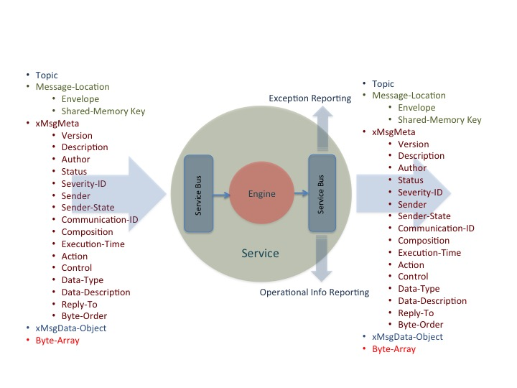
Transient data unit: streaming data quantum
Data driven, data centric design.
The focus is on transient data event modifications. Advantage over algorithm driven design is that a much greater ignorance of the data processing code is allowed (loose coupling).
Design = service composition + event-routing.
Self routing (no routing scheduler)
Event routing graph defines application algorithm

Slide 20
WFMS and API
S1
S2
S3
S4
S1 + S2 + S3 + S4;
S3 + S5 + S6;
S5
S6
F1
F2
S1 + S2 + S3;
while( S3 == ”needs calibration") {
F1 + F2 + S3;
}
S3 + S4 + S6;
S1
S2
S3
S4
S6

Slide 21
Heterogeneous streaming or triggered data processing (Hall-B)
VXI Crate
Flash ADCs/TDCs
Detector reconstruction services (DRS)
Full detector reconstruction
Calibration, alignment
Kalman filter
Note: some DRS services might run on GPGPU/TPU
VTP
Detector reconstruction services (DRS)
Cluster, segment finder
Road finder
SIS
Analysis services
Detector 1
Sector 1
Some detectors might need
other detector’s data to
complete their reconstruction.
DRS
ANAS 1
VXS
Sector reconstruction services (SRS)
Geometry matching
Partial software trigger
SIS
Stream interface services (SIS)
Runs on FPGA
0 suppression
Electronic noise removal
SRS
EBS
ERS 1
DRS X
ERS N
ANAS 2
SSP
SIS
Event reconstruction services
DSTP
ANAS N
EP
EB service (GT) or CODA (triggered)
Detector N
Sector N
DST persistency
Reconstructed data
DRS
Event persistency
Raw data
SIS
Note: FPGA based CLARA service’s code base (C++) will be deployed in CPU first for
verification and quality control, and only after will be deployed into FPGAs.
To use existing hardware in a streaming mode data must be reduced while streaming.

Slide 22
Conclusions
We developed a software framework for designing physics data processing applications deployed in a heterogeneous hardware and software environments. Basic characteristics:
Message passing interface (MPI) both for data and workflow-management
Data processing applications based on independent software building blocks (micro-services, think software LEGO).
Standard containers for user algorithms (service engine)
Technology agnostic
Service communications (Service Bus) defined outside of the user engine.
Process level workflow management and API
Fault tolerance
Elasticity
Easy design, deployment and maintenance

