Slide 1
Planning Roundtable Amber Boehnlein IT Division Director
Outline
IT Division News
SciComp News
Advanced Computing

Slide 2
SciComp Reorg
Organizational Changes:
SciComp Operations reintegrated into Computing and Network Infrastructure (CNI)
Leveraging CNI Sysadmin and networking resources
Sandy Philpott Retired; Austin Brazzel started July 1
Wes Moore moves into the group
Thomas Britten: New Staff Scientist started in August.
Machine Learning position—will attempt to repost
Many thanks to Chip and Sandy for their Leadership over the years

Slide 3
What do we hope to achieve with the Reorg?
Credit B. Hess
Simplify
e.g. Make batch scheduling more intuitive and understandable
Balance user experience with system utilization (wait time, down time, failover)
Decouple
Avoid linkages between systems that can be decoupled (e.g. Lustre and off-site data transfer; Data ingest from halls and Offline processing)
Monitor and Automate
Add monitoring that focuses on service availability, not just up/down state
Regularize Configuration Management of systems, networks, and software tools
Focus on Services, not just servers
Rearchitect-assessing a change to the storage model
Many of these changes have deep roots in the production systems, which incur long lead times, but we have had some early successes, particularly in new system and network designs for off-site processing.

Slide 4
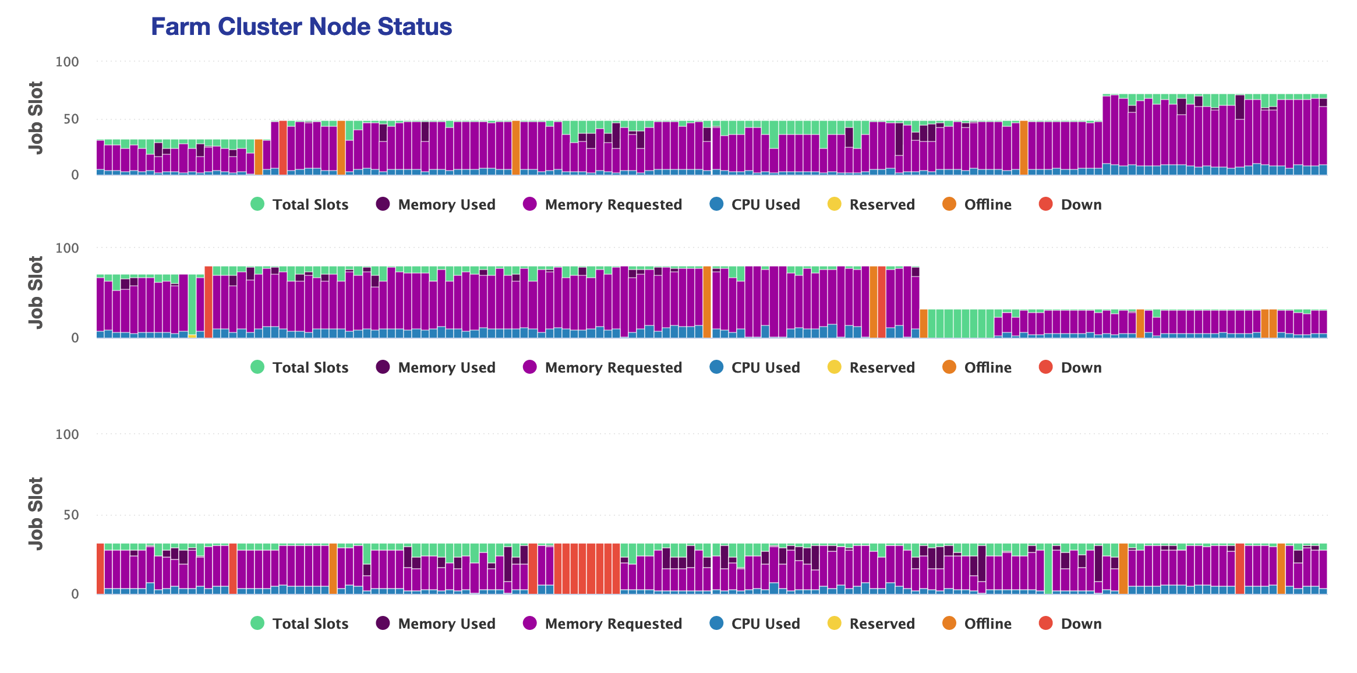
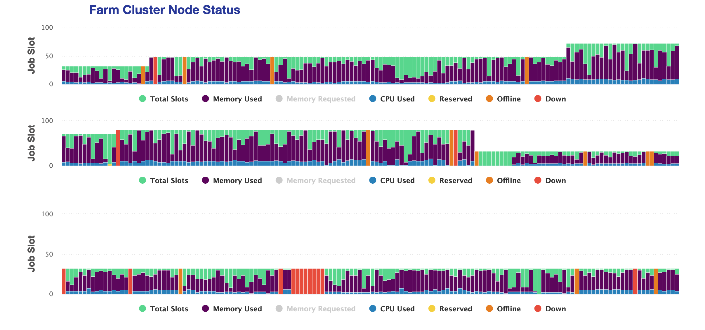
Memory usage on the farm
Memory Requested
Memory Used
Working to understand ‘quirks’ and develop better tools
Looking for more feedback

Slide 5
Planning
The goals are collaborative, which means we have to build a shared vision
The Distributed computing planning has paid off.
ENP—investments in disk and cpu in FY19
Preliminary planning has started
Last spring—three white papers with a two year outlook
Machine Learning, HPC into the future and SciComp Ops
The Scientific Computing Ops white paper has formed a basis for IT internal work and points of discussion across the lab
More will be white papers will be commissioned (I’m the bottle neck…)
For FY20, the Lab agenda includes three formal white paper deliverables
Develop an outline and plan for a modern distributed approach to bulk data processing.
Develop an outline and plan for a modern approach to data storage and management
Develop white paper on integrating current efforts into a programmatic approach that includes actions based on Lab Leadership Meeting at ASCR request targeted towards earning a core competency

