Slide 1
Jefferson Lab Scientific Computing Update
CLAS Collaboration Meeting
June 2019
Bryan Hess

Slide 2
Topics
The Scientific Computing Organization
The current state of systems and services
Tape storage
Disk storage
networking
Work In Progress and near-term projects
Looking Ahead: Strategies and Trends

Slide 3
Organizational Changes
Operations reintegrated into CNI
Sandy Philpott Retired
Wes Moore moves into the group
New Hire for System Administrator Wrapping up
Early in the life of this new organization
Leveraging CNI Sysadmin and networking resources

Slide 4
System Status: Tape Storage
A second Tape Library has been added
IBM TS4500 with 8 additional LTO-8 tape drives for a total of 16.
~1000 tape slots in the new library
~12000 slots in the old library
Old library will shrink over time, new library will grow
Using LTO 8 (12TB) and LTO M8 (9TB) there is sufficient capacity for the current era of experiments
Older generations of data on LTO-4 and LTO-5 is being migrated to M8 to maintain access.

Slide 5
System Status – Batch Farm
The batch farm is now runs under Slurm. PBS has been retired.
Slurm memory accounting differences
Job Memory allocation and accounting is now based on physical memory use
This may mean that you can decrease your memory request and consequently run more jobs than before
We have a summer undergraduate student studying resource usage with an eye toward what improvements we can make (e.g. notify when jobs are overprovisisoned)
Additional farm procurement for FY19 is underway.
Exact processor/core/thread count to be as part of best value determination
There will be 2GB Memory per job slot
Local storage will be SSD, just as with farm18 nodes.

Slide 6
System Status: Disk Storage
Lustre -- /cache, /volatile
The largest pool of disk storage
For high throughput workloads from the farm, not good for small files or small IO
All spinning disk, backed by ZFS RaidZ2 (functionally RAID6)
Not backed up
Currently near ~3PB partitioned between LQCD and experimental physics
NFS -- /work
For small files and interactive work
A single NFS fileserver backed by ZFS RaidZ2
Not suitable for for large file transfers to the farm
More stable than Lustre, but does not scale out
Not backed up
NFS -- /group
Part of Central Computing environment; also on desktops
Very reliable, backed up space suitable for source code and small metadata

Slide 7
Disk Storage Challenges
Disk Storage stability and space augmentation is a priority
What’s going on?
This summer we are adding an additional (net) 1PB of space to Lustre, which will roughly double the available capacity
Hardware is installed under testing now
The new Lustre servers include failover capability to reduce single-server outages
The new metadata server (orchestrator) is SSD-based and also be part of a failover pair
The new server is also being updates to a much newer version of Lustre (2.12.1)
Data will be migrated group-by-group in coming months
This gradual migration will spread the load in a way to decrease pressure on the existing system
Lustre is expected to stabilize with additional space, new code, and better failover
A redesign of /work is needed to remove bottlenecks and increase stability while providing a better space for small files. We are evaluting options.

Slide 8
Operational Themes
Simplify
e.g. Make batch scheduling more intuitive and understandable
Balance user experience with system utilization (wait time, down time, failover)
Decouple
Avoid linkages between systems that can be decoupled (e.g. Lustre and off-site data transfer; Data ingest from halls and Offline processing)
Monitor and Automate
Add monitoring that focuses on service availability, not just up/down state
Regularize Configuration Management of systems, networks, and software tools
Focus on Services, not just servers
Many of these changes have deep roots in the production systems, which incur long lead times, but we have had some early successes, particularly in new system and network designs for off-site processing.

Slide 9
System Status: Off-Site processing
New opportunities are in reach for data processing off site. We are committed to providing the tools and expertise to realize this.
Potential Resources
Office of Science/ASCR facilities (e.g. NERSC)
Open Science Grid
Contributions of Compute Cycles from collaborating institutions
Cloud burst capability (Amazon EC2 spot market)
Enabling Technologies – What has made this viable?
Wide Area Networking frequently matching data center link speeds (>100Gbit)
ESNet 6 (more on this in a bit) will bring >100Gbit/sec to Jlab in the next 2-3 years
Software tools like containers, CVMFS, and XROOTD are making jobs site-agnostic
Early successes in halls D and B point to new operational models
Software development with SWIF will ultimately create workflows that can do matchmaking between job requirements and site availability
Early pilot work with NERSC has helped to shake out performance issues

Slide 10
Pilot: Data Transfer Node (DTN) and Science DMZ – Approaching 10Gbit/sec

Slide 11
XrootD @ JLab
What is XrootD?
Highly-configurable data server used by sites in the OSG, but is not OSG-specific.
Exports existing filesystem(s) through multiple protocols or can act as a caching service.
At JLab, focus has been on leveraging key aspects:
Data streaming to off-site compute nodes.
Ability to stream parts of files, dramatically reducing network bandwidth and run-time.
GlueX demonstrated a reduction of 50% for their data transfers
Stepping stone to multi-cloud high-throughput computing (HTC).
User request
(from container w/ xrootd-client)
JLab Xrootd server
(exports local filesystems read-only)
Basic usage:
$> yum install xrootd-client
$> export LD_PRELOAD=/usr/lib64/libXrdPosixPreload.so
$> ls xroot://hostname.jlab.org//path/to/data/

Slide 12
Xrootd @ JLab (future)
Migrate to clustered configuration to provide redundancy and scaling:
User request
Xrootd redirector
Xrootd server
GLUEX
Xrootd server
CLAS12
Xrootd server
other
Xrootd server
GLUEX
Xrootd server
CLAS12

Slide 13
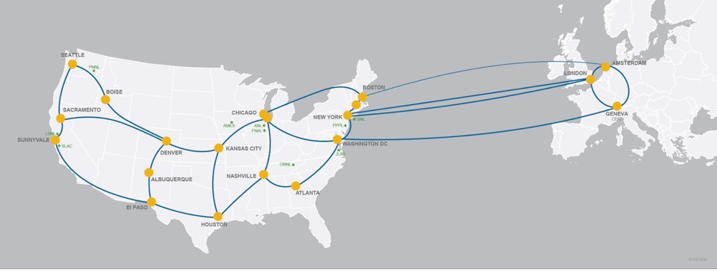
Looking Ahead: Networking and ESNet 6
ESNet is the DOE Office of Science program that inter-networks the national labs.
ESNet funds our wide area network connectivity, Currently at 10Gbit (20Gbit in July)
We are active in the ESNet coordinating committee and the requirements gathering process
ESNet 6 is the current project to expand the capacity which will bring the capability for multiple 100Gbit wavlengths to Jlab.

Slide 14
Science DMZ /Internet Architecture: 100Gbit/sec ready

Slide 15
Looking ahead: The Future of Tape
For decades the end of tape storage has been predicted, but tape has proven resilient because of several advantages
Cost/TB
Failure modes
Power requirements (don't have to keep it powered)
Is is now reasonable to expect that in 5 years all data for current experiments could be kept online.
This is a shift from the current model of keeping everything available forever
Off site services such as Amazon Glacier will eventually reach a price point that it is possible to use it for deep storage/disaster recovery.
We are currently processing data at multiple sites. It seems reasonable to anticipate a distributed storage environment as well.

Slide 16
Summary
We are pursuing a more service- and user-oriented focus for Scientific Computing
This includes using resources world-wide, enabled by software services and robust networking
Realizing this requires finding efficiencies in Scientific Computing Operations now
Getting notification out about operational changes is a perennial challenge, but we must avoid unexpected changes
With the Slurm transition, we reinstated the practice of face-to-face open sessions prior to the roll out and intent to continue that for significant transitions
Feedback and suggestions are always welcome and needed
What services do you need?

Slide 17
Bryan Hess
bhess@jlab.org
Questions?
Comments?

