Slide 1
Readiness Status
CLAS12 Run Group C
June 19, 2019
Sebastian Kuhn, Old Dominion University
Notes:
Image from PANDA

Slide 2
RG C Goals:
Measure inclusive spin structure functions (A₁, g₁) of the proton and deuteron -> neutron
Combine with flavor tagging (π, K) to extract Δq in the valence and moderate-x sea regions
Provide anchor for PDF fits, higher twist and duality studies, and tests of fundamental sum rules
Measure spin- and transverse momentum-dependent (TMD) PDFs (SIDIS)
Measure target single and beam/target double spin asymmetries in p and n DVCS

Slide 3
Approved Experiments in RG C
Total number of approved beam (PAC) days: 185 (120 p, 60 d, 5 auxiliary)

Slide 4
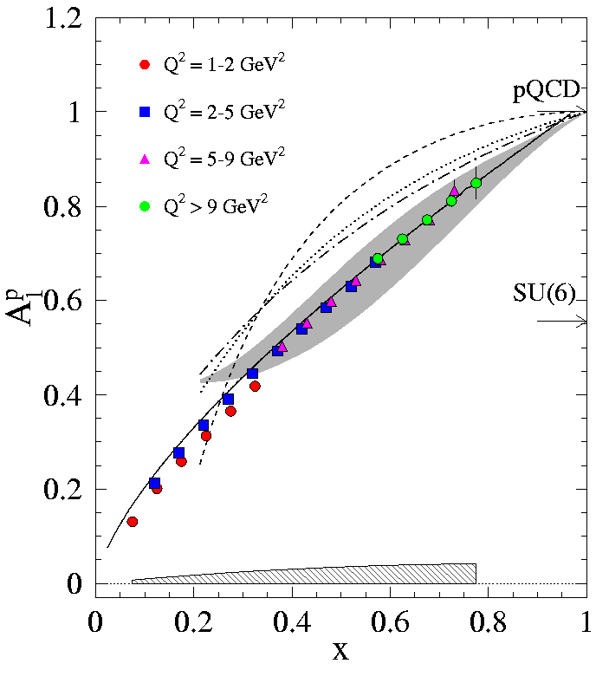
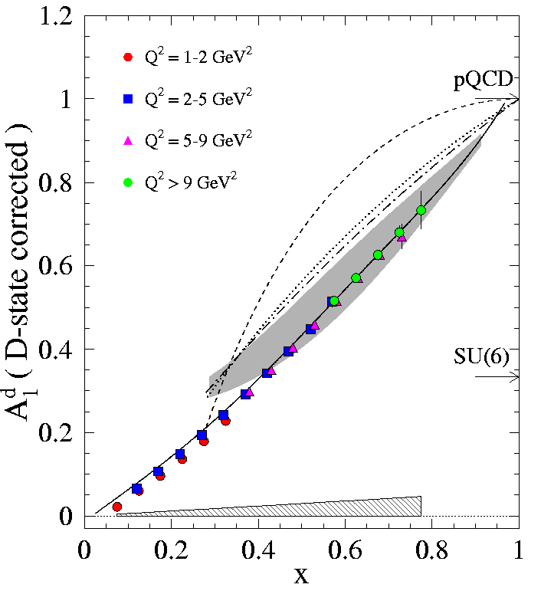
Predicted Data from CLAS12 - DIS
Proton
W > 2; Q² > 1
Deuteron
Notes:
Example of statistics achievable with specified running conditions vs. proposal

Slide 5
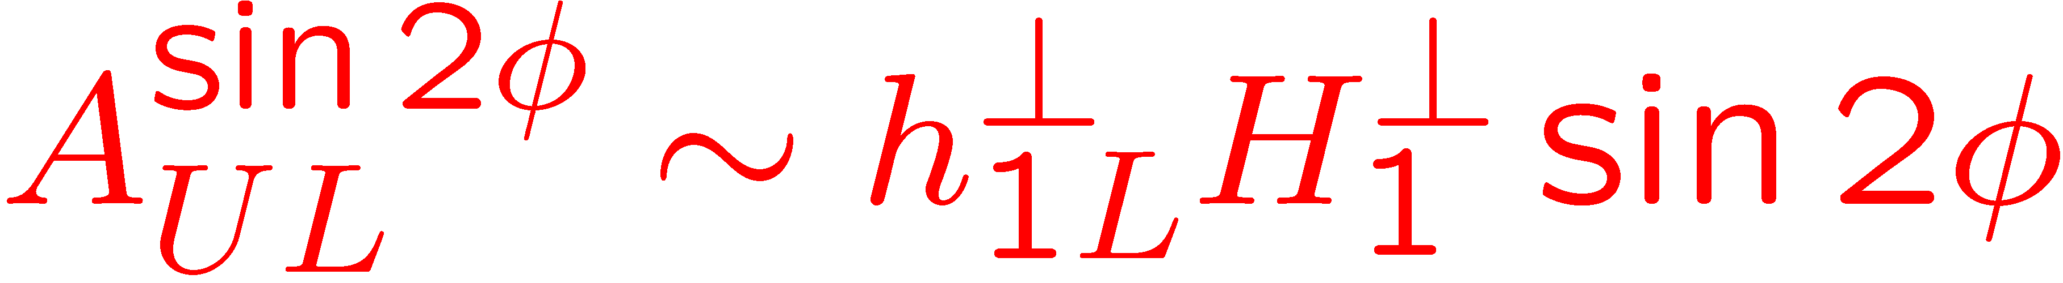
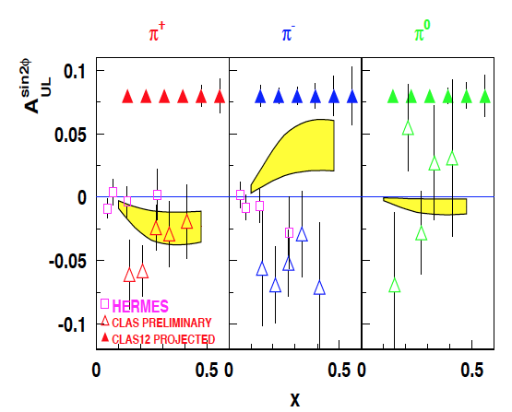
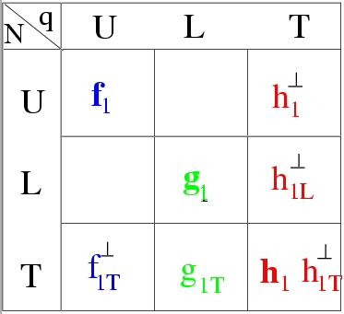
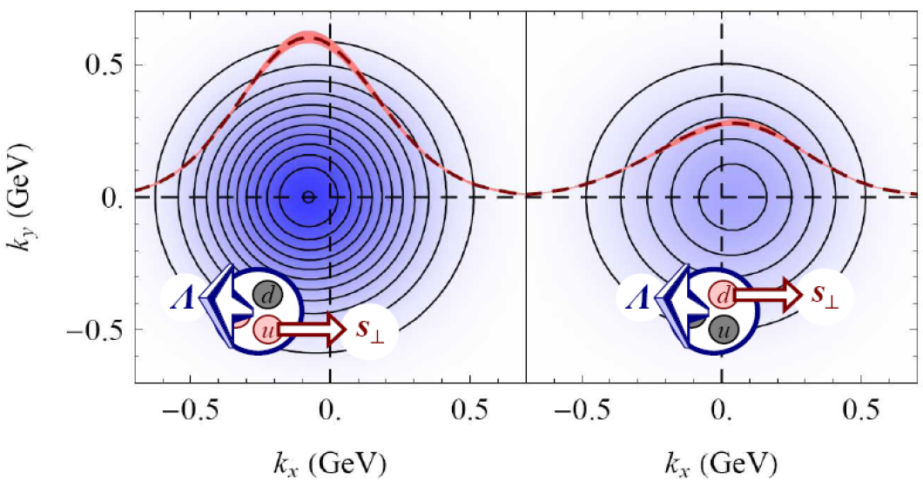
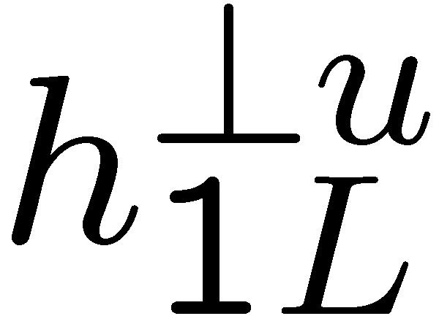
Kotzinian-Mulders Asymmetries
A.V. Efremov, K. Goeke and P. Schweitzer, Czech. J. Phys. 55 (2005) A189, hep-ph/0412420.
B.Musch arXiv:0907.2381
Worm gear TMDs are unique (no analog in GPDs)

Slide 6
n DVCS
Projected results: target-spin asymmetry
L = 3/20∙10³⁵cm⁻²s⁻¹, Time = 50 days , P_{t} = 0.4
-t
1.2
TSA ~ 0.2
Count rates computed with nDVCS+BH
event generator
+ CLAS12 acceptance from FastMC
+ CND efficiency from GEANT4 simulation
Asymmetries computed with VGG model
0
1
0
First time measurement
-1
• 4 bins in Q²
• 4 bins in −t
• 4 bins in x_{B}
• 12 bins in φ
(Same as E12-11-003)

Slide 7
Requirements
> 10.5 GeV electron beam (4 days at 2.2 GeV for commissioning/calibration), beam polarization > 0.85
p and d (ammonia and deuterated ammonia) targets polarized (via DNP) along or opposite to the beam direction
Standard CLAS12 Forward Tracker including 4 sectors of LTCC and 1-2 sectors of RICH; NO FT for part 1
Standard CLAS12 Central Detector with all components (SVT, BMT, FMT ^{*)}, CTOF, CND); no BAND
New Møller shield (preferred but not required), upgraded beam line with 2 cm diameter raster, new BOM for FSD
Standard e⁻ inclusive trigger; data rate and data storage similar to RG B
All target EPICS and Labview controls/readouts as well as raster magnet control and readout, and helicity-tagged gated FC
^{*)} If successfully modified by Saclay and re-commissioned during previous RGs; not absolutely necessary.

Slide 8
Proposed Run plan
Proposal:
  Complete the d/n part of RG C since it requires “only” 55 PAC days (plus ancillary runs) and no FT.
  Run at least 30 days (= approved time without E12-06-119b and hence without FT) on p.
  Reserve 6 PAC days for ancillary runs
  Sum total: 91 PAC days = 182 calendar days
  Take data in all possible combinations of target polarization (+/-), λ/2 plate (in/out), solenoid field (full field = +/-5 T 50/50) and Torus field (full field 80% inbending / 20% outbending)
  Outbending necessary to minimize systematic errors (false asymmetries) and collect sufficient data for calibrations, corrections, systematic studies and to subtract background from charge-symmetric (not scattered) electrons as well as improve coverage for negatively charged pions.

Slide 9
Proposed Run plan
Special Runs:
  Commissioning (7 calendar days), including
    Low energy
    Beam current scan
    Torus field scan (including no-field running)
  Empty target (5 additional shifts, once/month) – 1.7 calendar days
  ¹²C target (2 additional shifts/month) – 3.3 calendar days
  Outbending runs (20% of total regular run time)
Overhead during regular running: 3 shifts/week (of which 1 is concurrent with weekly beam studies)
  Polarization reversal (once or twice every day, 1 hour)
  Anneals combined with target exchange 2 times a week (1 shift each)
  TE measurements (at least before and after every target change)
  Møller runs (1-2 times a week, concurrent with anneals)
Notes:
Total FoM during production running about 65-70%, mostly due to reduced polarization but partially due to overhead. No-field includes no Solenoid field! All “days” are “calendar days”

Slide 10
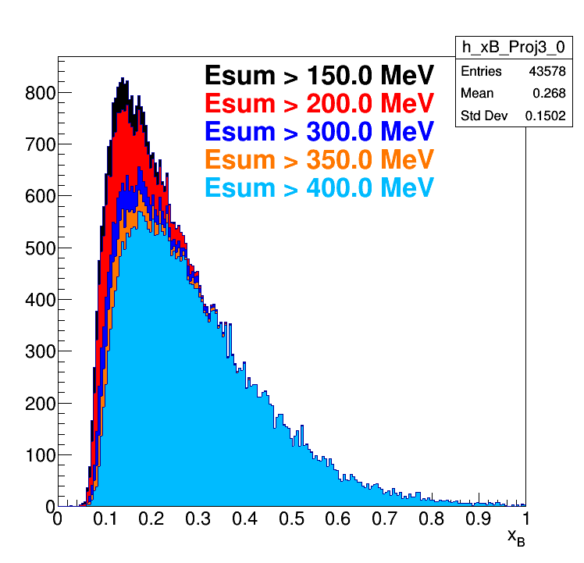
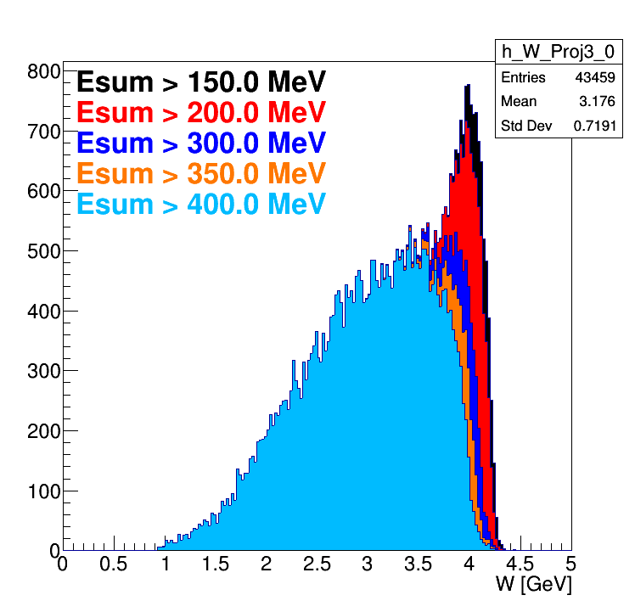
Trigger and Data Rate
Same trigger as RG B (e⁻ in Forward Tracker + random)
Data rate about 1/3 of RG B, about 2/3 of total data on tape
PCAL+ECAL=300 MeV corresponds P_{e}~1.6 GeV when trigger is 100% effective. W < 4.0, y < 0.85
Target | LD2
HTCC | > 2 phe
ECAL+PCAL | > 250-300 MeV
DC ROAD | Data based
Track-PCALU | Space correlation
Sign of the particle | Negative
Trigger purity | 54% of events have PID=11 particle
Current | 50 nA
Trigger Rate @50 nA | 5 kHz
About double for outbending
Notes:
RGB had “muon” and “photon” triggers raising the total to 15 kHz. Expect 5 kHz for inbending, up to 10 kHz for outbending

Slide 13
New Møller Cone Configurations

Slide 14
Extraction of P_{beam}*P_{target}
One Moller polarimeter run / week (similar to RGA/B) -> P_{beam}
Continuous monitoring with NMR: relative trends in P_{target}
Absolute determination of P_{b}*P_{t}:
(Quasi-)elastic ep coincidences (e⁻ in FD, p in CD)
  Highly selective – 4 constraints
  nuclear background strongly suppressed due to Fermi-Motion – see DVCS
  High rates at moderate Q² < 4 GeV²
Expected precision
  5% statistical uncertainty on Pb*Pt for H after 2 hour run
  12% statistical uncertainty on Pb*Pt for D after 2 hour run
  Enough to cross-calibrate NMR and observe drifts over 1 shift
  Final uncertainty (3-4%) determined by systematics (< 0.5% stat.)
P_{target} from Pb*Pt and Pb from Møller polarimeter -> 5%
Notes:
syst. uncertainties based on EG1dvcs.

Slide 15
Extraction of P_{beam}*P_{target}
Analysis from RGA – rates are consistent with simulation
Δφ < 5^{ο}
ΔE < 0.5 GeV
z_{vertex}
E_{beam} reconstructed from θ_{e} and θ_{p}
W

Slide 16
Manpower
IPN Orsay:
  Senior Staff: S. Niccolai ^{*)}, D. Marchand, …
  2 Ph.D. students, 1 postdoc
Saclay:
  Senior Staff: M. Defurne, F. Sabatié ^{*)}, …,
  2 Ph.D. students, 1 postdoc
Old Dominion University
  Faculty: S. Kuhn ^{*)} (contact), S. Bültmann ^{*)}
  Postdoc(TBD) [+ technician T. Hartlove (25% FTE)]
  Students: V. Lagerquist, P. Pandey,…
Fairfield U.
  Faculty: A. Biselli ^{*)}
  1 student
University of Glasgow
  Faculty: D. Sokhan
  1 Ph.D. student
Idaho State University
  Faculty: T. Forest
  Student: TBD
U. Va
  Faculty: Dustin Keller ^{*)}
  Partial postdoc; 1 Ph.D. student
William and Mary
  Faculty: K. Griffioen ^{*)}
  Postdoc: ? (Ph.D. Student, TBD)
Argonne National Lab
  Senior Staff: W. Armstrong
  2 postdocs
Jefferson Lab
  Senior Physics Staff: H. Avakian*),… E. Pasyuk (Physics Liaison)
  Target Group: C. Keith *), J. Maxwell, J. Brock, C. Carlin. Slow Controls: W. Moore
  Engineering/Design: R. Miller, C. Wiggins
  Simulation and Analysis software: M. Ungaro, V. Ziegler, N. Baltzell, V. Gyurjyan, G. Gavalian
  Acc/Ops: M. Tiefenback, B. Cade
^{*)} Co-spokesperson
+ Christopher Newport U.,…

Slide 17
Project Status
Design of the polarized target, including insertion cart, nearly complete
Refrigerator built and tested, most other components on hand
Beamline design, including raster system and target insertion cart, close to complete
New Møller shield conceptual design largely complete; detailed design with engineering input has begun
First round of simulations for all crucial channels and backgrounds complete
Manpower for timely completion of target and beamline in place
Operations, commissioning & calibration and safety documentation in progress – preliminary documents posted
ERR June 17, 2019:
https://clasweb.jlab.org/wiki/index.php/RGC_ERR

Slide 18
Timeline
Notes:
ERR Committee feedback: 1) Need more detailed plan for final design and fabrication of Moller; what-if scenarios for contingencies; what exactly are we missing with ½ run time and will we still have something to publish with even less statistics?
2) Need detailed breakdown of systematic uncertainties for q.el. d(e,ep)
3) More clarification how we can publish in 2 years instead of 4
4) Who will be responsible for overall run preparations, software, …

Slide 19
Draft ERR Recommendations
We recommend the development of a timeline for the final design and construction of the Moller Shield, as well as an estimate of the best-case/worst-case scenario for raster/luminosity based on the occupancy of the detector. Also, discuss the impact to the run-plan due to greater overhead cost or reduced luminosity should the Moller shield not be able to reduce the occupancy to the necessary level.
We recommend the inclusion of a more detailed error budget for the product P_{beam}*P_{target}, specifically for the extraction of Pb*Pt from d(e,e'p) quasi-elastic asymmetries.
We recommend the inclusion of a brief description of the changes in the analysis scheme relative to the framework used during the 6 GeV era, that could allow you to meet the publication schedule presented, which is significantly accelerated compared to the typical track record of 6 GeV-era analyses of similar scope.
We recommend the inclusion of a brief description of the physics impact (and effect on publication timetable) of the data that would be taken in "part I" of the run group as compared to the full proposal for each experiment.
We recommend the inclusion of a list of the primary responsible person/persons for the major efforts associated with the preparation of the experiment and the readiness for timely analysis/publication of the results.
J. Pierce and A. Puckett, private communication. NOT THE OFFICIAL ERR COMMITTEE REPORT!

Slide 20
Backup

