Slide 1

Welcome to Jefferson Lab
Bob McKeown
Strong QCD Workshop
November 6, 2019

Slide 2
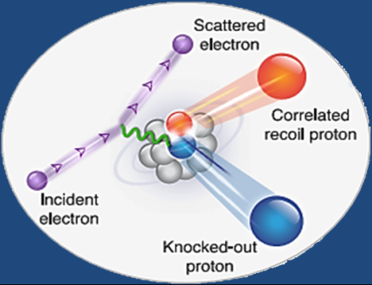
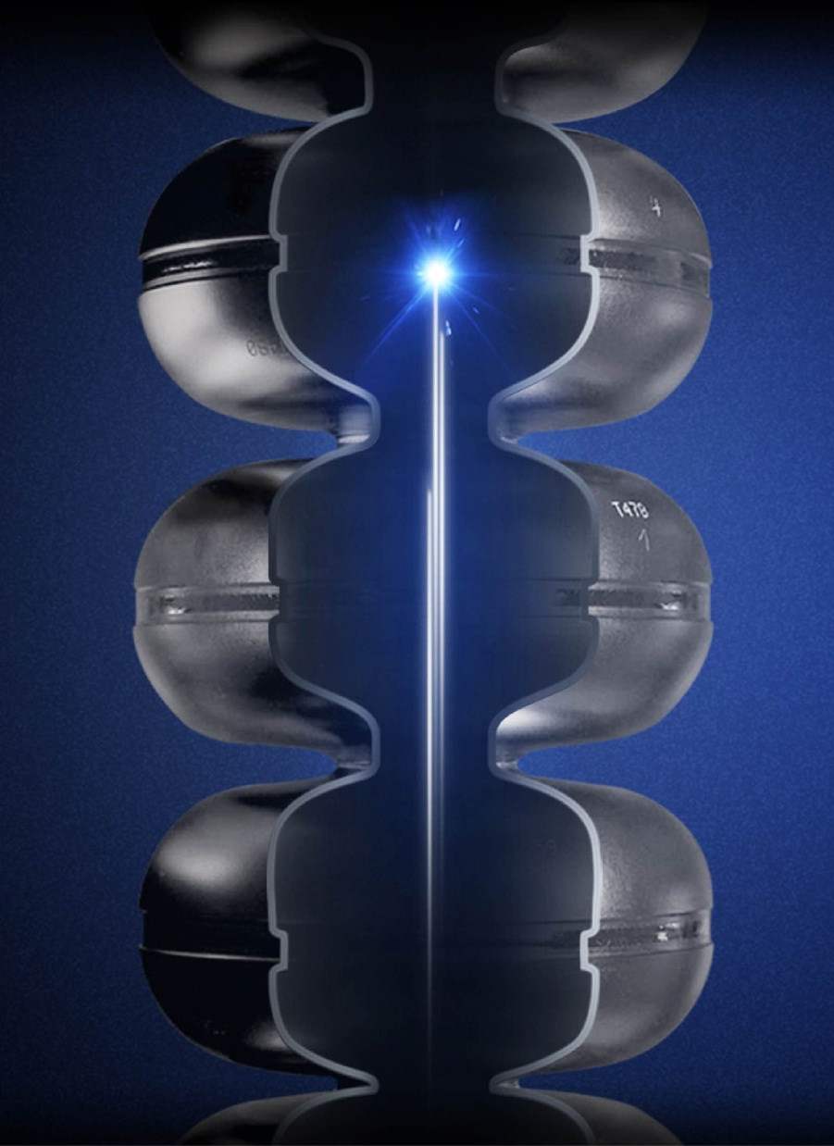
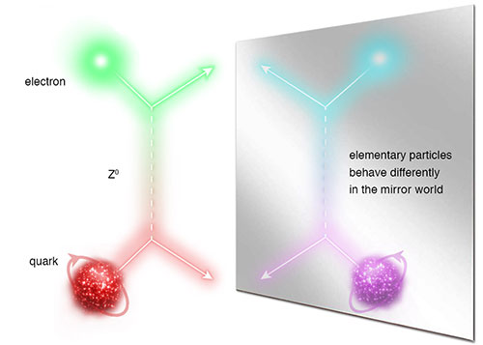
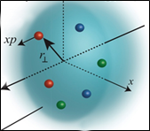
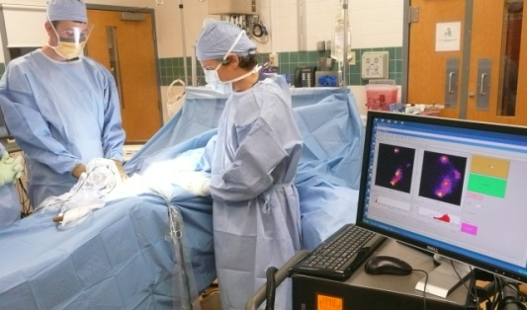
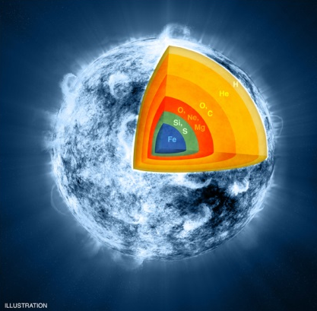
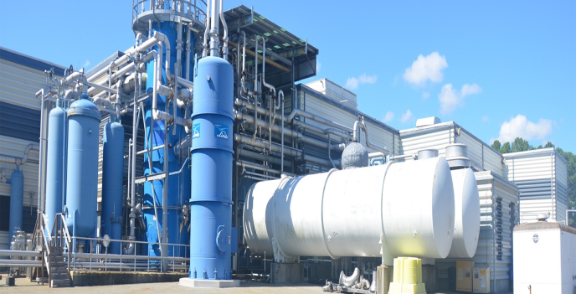
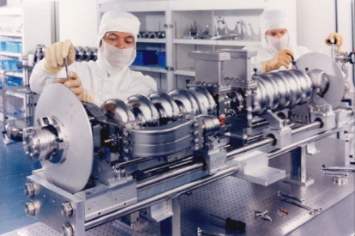

Jefferson Lab: A Laboratory For Nuclear Science
Z⁰
Nuclear Structure
Fundamental
Forces & Symmetries
Structure of Hadrons
Medical Imaging Technology
Nuclear Astrophysics
Cryogenics
Accelerator S&T
Theory & Computation

Slide 3
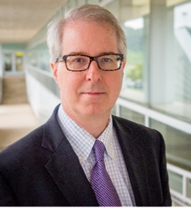
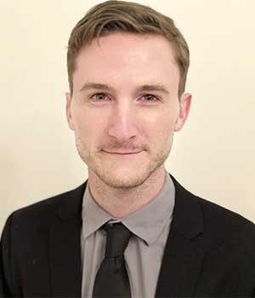
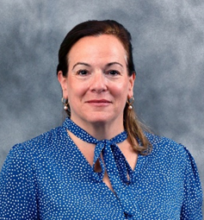
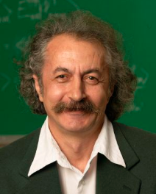
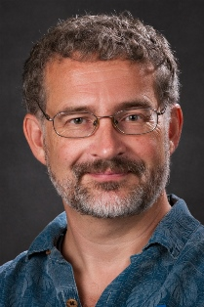
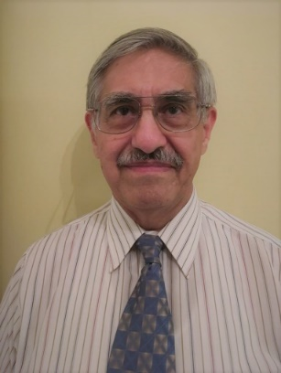
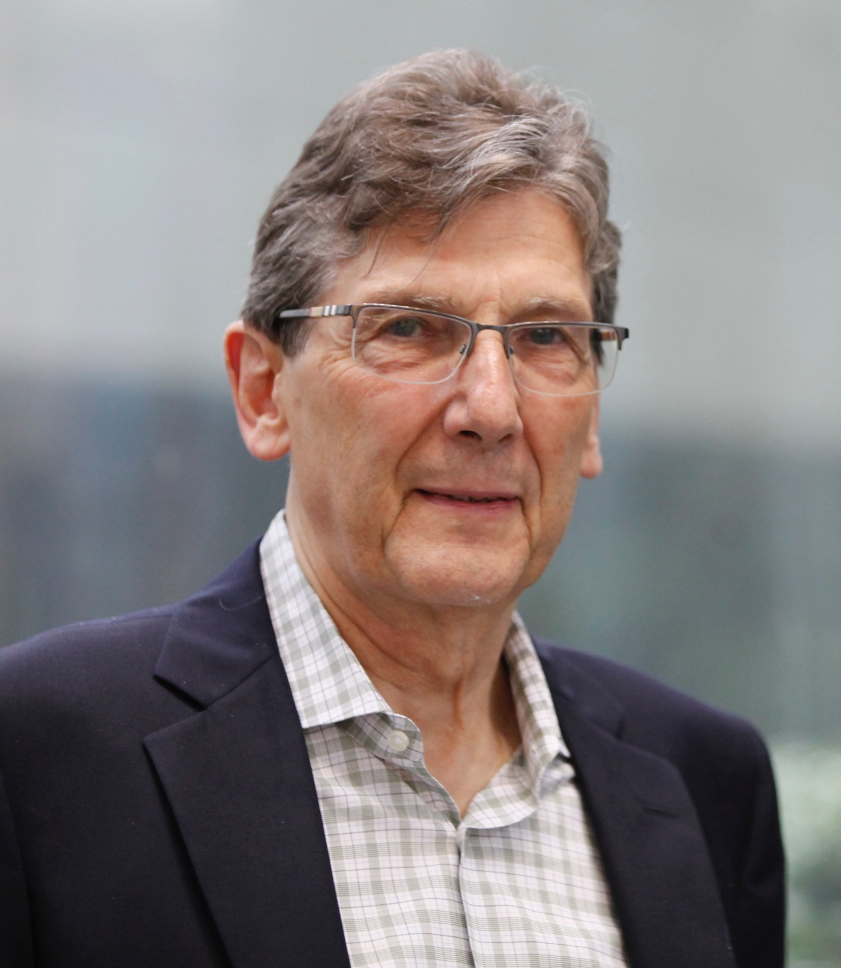
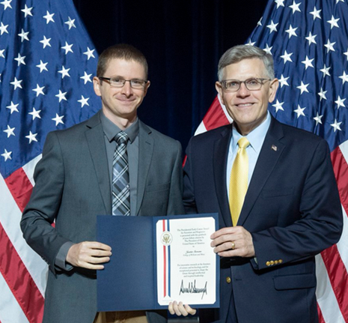
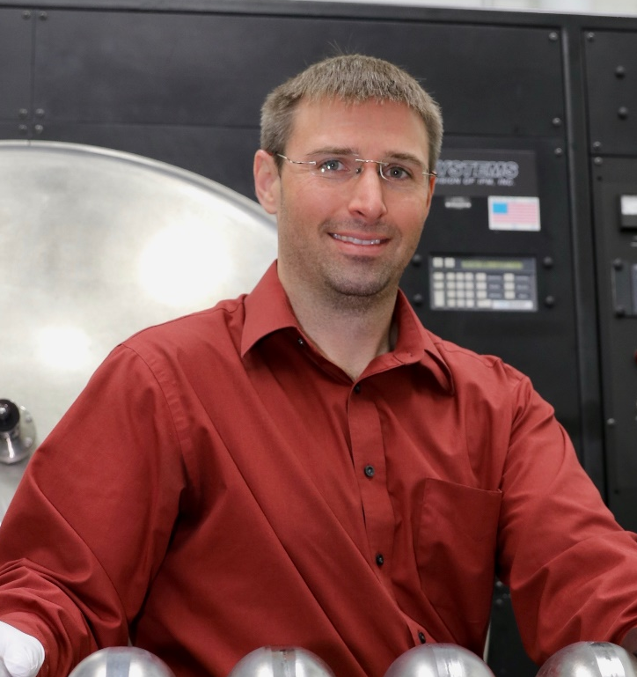
Congratulations!
Governors Distinguished CEBAF Professor at ODU: Stuart Henderson, Lab Director | APS/GHP Dissertation Award: Jacob Ethier (W&M/JLab User) | 2018 APS Fellowship: Cynthia Keppel (JLab)
2018 APS Fellowship: Moskov Amarian (ODU/JLab User) | 2018 APS Fellowship: David Armstrong (W&M/JLab User) | 2018 APS Fellowship: Oscar Rondon-Aramayo (UVA/JLab User)
2019 Virginia’s Outstanding Scientist: Volker Burkert (JLab) | 2019 PECASE Award: Justin Stevens (W&M/JLab User) | 2019 Office of Science Early Career Award: Ari Palczewski (JLab)
“…leadership on novel experimental techniques to study strong interactions, …contributions to CTEQ… instrumental role in founding the H.U. Proton Therapy Center and other work applying Nuclear Physics to Medicine…”
~APS Physics
"The Commonwealth is proud to have you at the helm and appreciative of ODU for helping secure your Governor’s Distinguished Continuous Professor appointment."
~Gov. Ralph Northam
“…achievements in developing a new approach to global analyses of parton distribution functions with modern statistical methods."
~APS Physics
“…pioneering work on Deeply Virtual Compton Scattering and Gluon Polarization with the HERMES experiment at DESY, and a creative and broad program in hadronic physics at HERMES and Jefferson Lab…”
~APS Physics
“…leadership in a career-long program of research centered on characterizing and understanding the role of the weak force and parity-violating phenomena in nuclear physics…”
~APS Physics
“…pioneering contributions to the study of quark-gluon correlations in nucleons using inelastic scattering of polarized electrons off transverse polarized proton and deuteron targets…”
~APS Physics
“…for his foresight and leadership in expanding the CLAS nuclear and particle physics detector capabilities, and utilizing the full power of CLAS and Jefferson Lab to deliver new insights into the origin of visible mass in our universe.”
~Gov. Ralph Northam and Science Museum of VA Chief Wonder Officer Richard Conti
“…the highest honor bestowed by the U.S Government to outstanding scientists and engineers who are beginning their independent research careers and who show exceptional promise for leadership in science and technology.”
~ Office of Science and Technology Policy
“To study advanced surface modifications of Nb for higher Q and higher gradient.”
~DOE Office of Science

Slide 4
PRAD: Solving the Proton Charge Radius Puzzle
To be published in Nature – Nov. 7, 2019

Slide 5
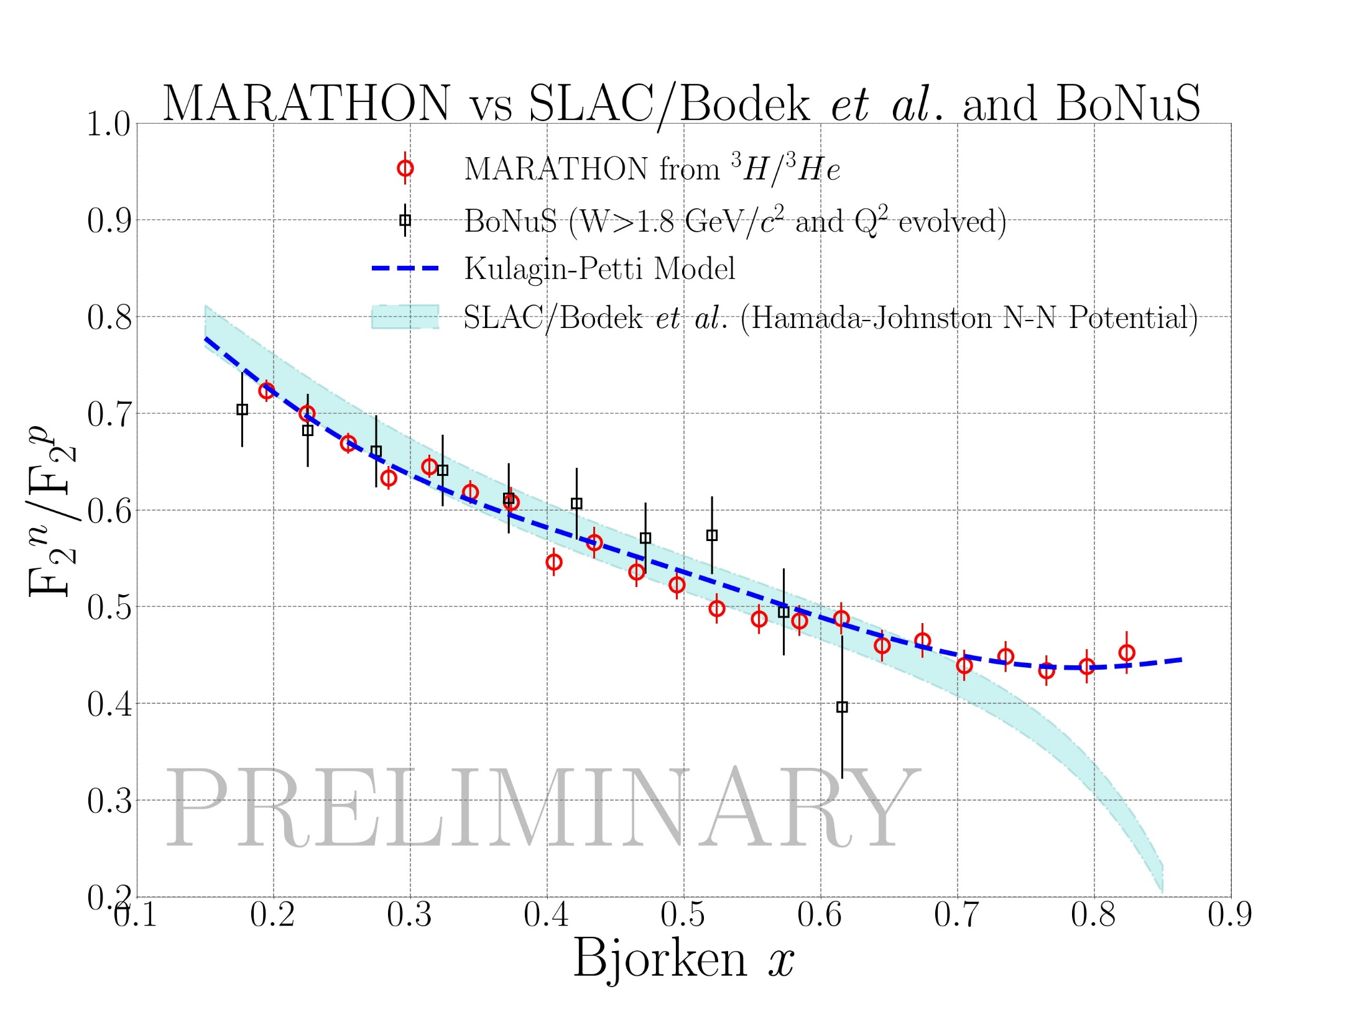
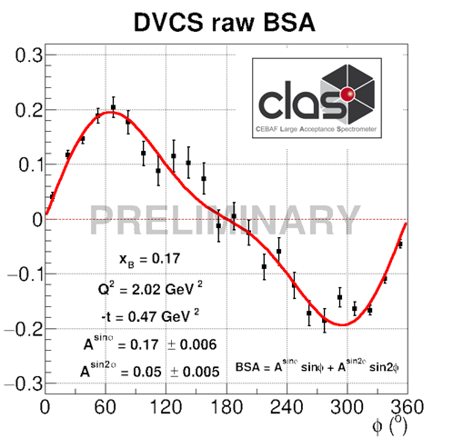
12 GeV Science Era in Full Swing!
Hall A:
  Tritium family of experiments – all 4 complete!
  Completed APEX (search for heavy photons)
  PREX complete
Hall B:
  First phase of CLAS12 Run Group A complete
  Started Run Group B (deuterium)
  PRad results to appear in Nature
  Heavy Photon Search run complete
Hall C:
  3.7 experiments completed
  F₂^{d}/F₂^{p} preliminary result
  Search for LHCb pentaquark complete
¹²C(e,e’p)
Search for Color Transparency
}
Theory (1994)
Hall D:
  GlueX phase I complete
  Threshold J/ψ published in PRL
  DIRC enhancement underway
  Primex-η started

Slide 6
CEBAF is Approaching Optimal Weeks of Operation
Optimal weeks
12 GeV Construction
Scheduled >30 weeks of operation in FY19
FY20 operations planning incorporates installation of replacement 2K Cold Box
Working towards optimal 34 weeks of reliable operations

Slide 7
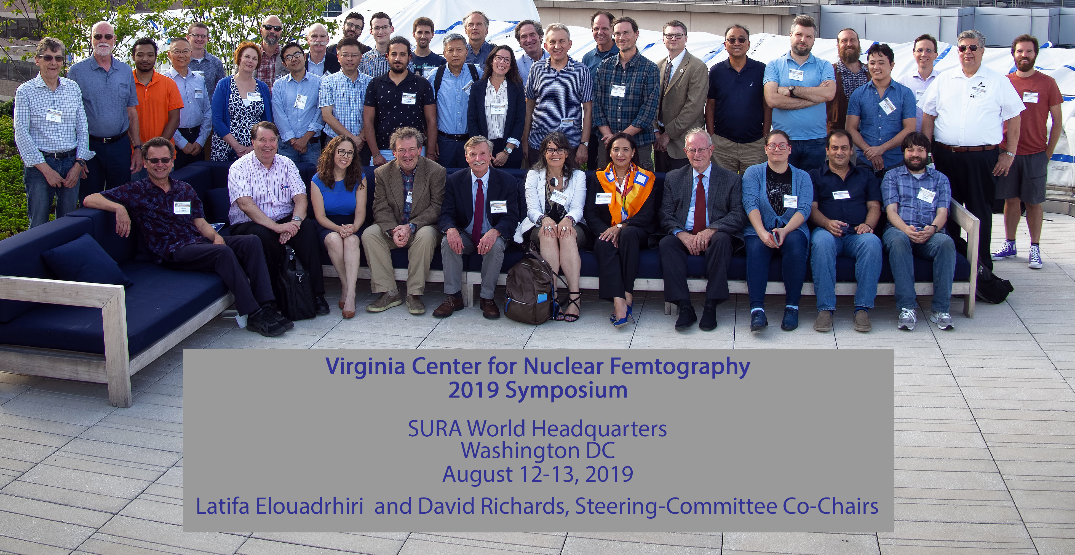
Center for nuclear femtography
Bringing together of those interested in Nuclear Femtography
Review, share, and capitalize on progress made so far.
Explore new avenues and ideas - e.g machine learning
Specific goals:
Development of next round of activities
Securing long-term future of effort
- Proposal to Commonwealth of Virginia
- Other Funding?

Slide 8
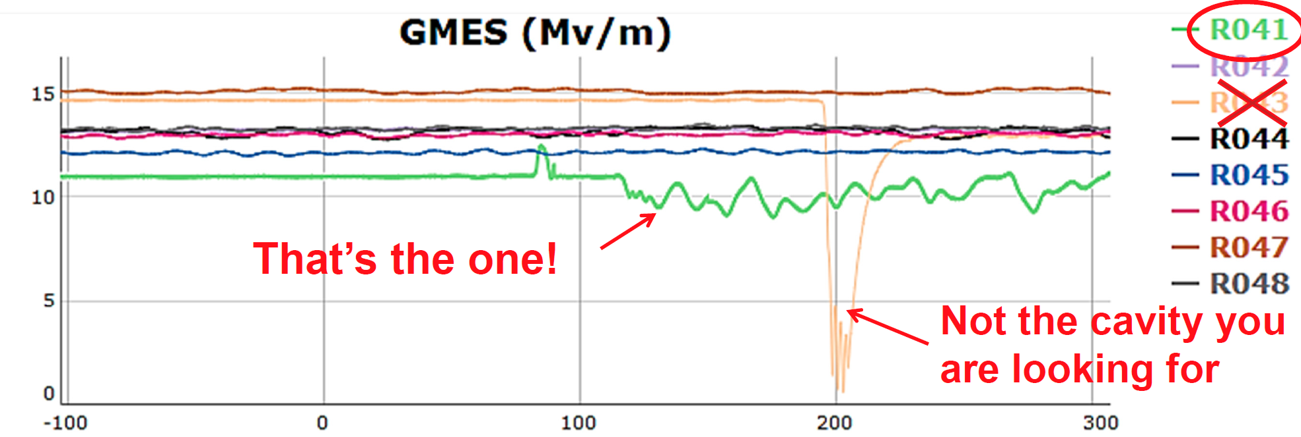
Machine Learning: Enabling Technology
Data Science is a component of all Advanced Computing Initiatives:
recent progress
Collaborations with universities and other labs
Lunch and Learn
Weekly Community of Practice
Dedicated ML Developer hire in process
Lab wide regular Machine Learning Challenge Contest
Satellite Site for
Pittsburgh Super Computing Center Big Data Training programs
JLab host to “AI for Nuclear Physics” workshop, Mar. 2020
Theory: Using Generative
Adversarial Networks to extract
observables from data
  Generated Pythia sample
  used to check
  methodology
Accelerator: Use data from CEBAF to diagnose and improve operational performance
  Significant progress applying machine learning to the problem of classifying C100 cavity faults
 | Machine Learning |  |  | Deep Learning
Problem | Which Cavity? | Which Fault? |  | Which fault
Feature engineering | tsfresh | tsfresh | auto-regression | none
Model | Random Forest | Decision Tree | Random Forest | RNN-LSTM
Result | 95.70% | 96.60% | 88% | 86%
Example of waveforms for several particular types of SRF cavity trips. There are 8 types of trips, and our ML already trained to recognize 4 of them with accuracy better than 86%

Slide 9

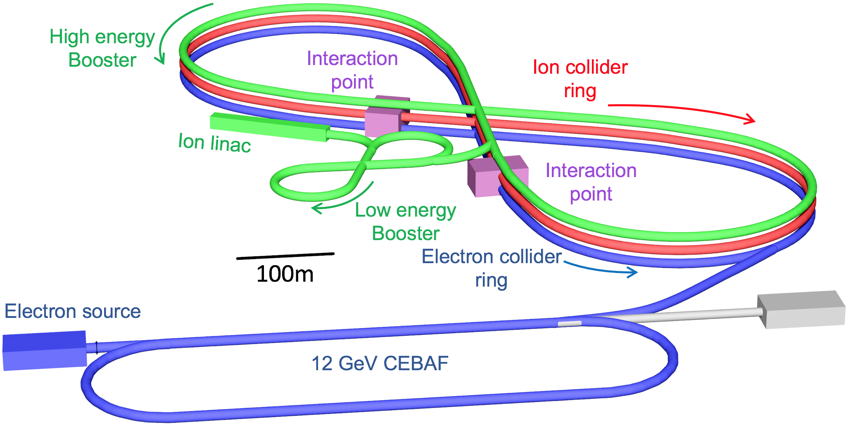

US-Based EIC Proposals
Brookhaven Lab
Long Island, NY
Jefferson Lab
Newport News, VA
Notes:
9

Slide 10
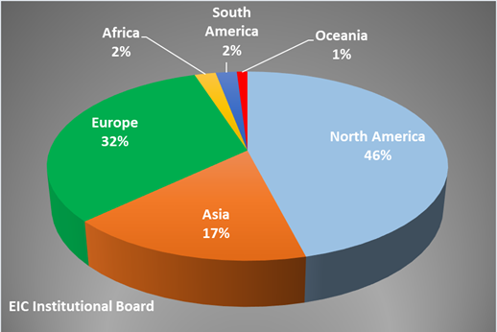
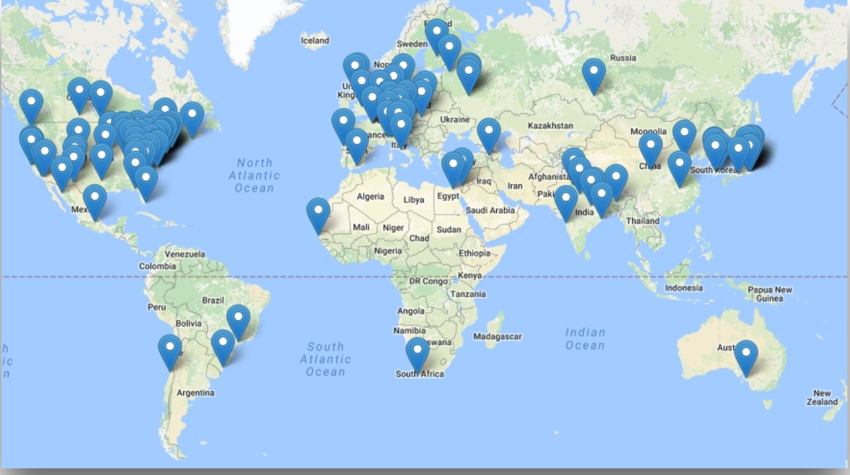
EIC Users Group and International Interest
Formed in 2016; currently:
  >900 members
  184 institutions
  30 countries

Slide 11
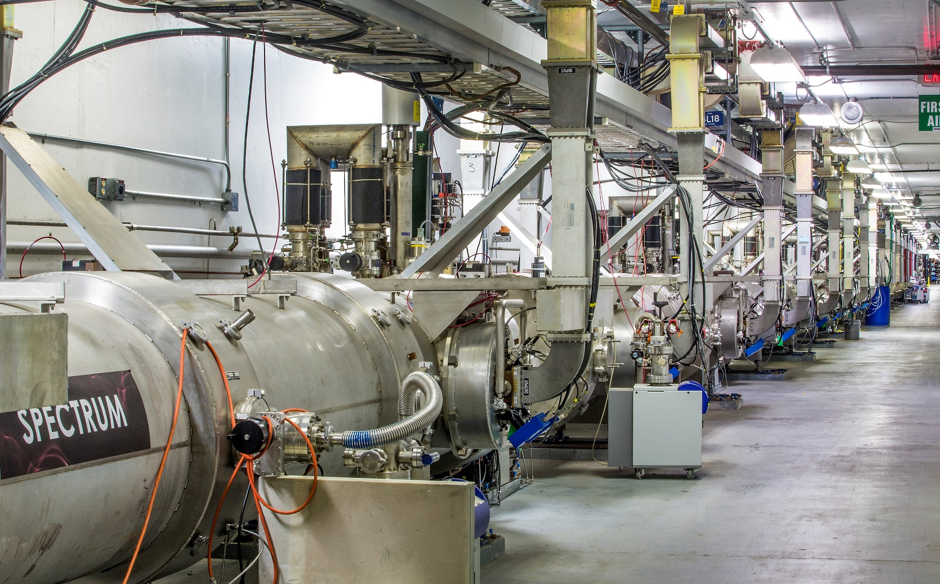
Welcome to Jefferson Lab!

