Slide 1
Jefferson Lab Status
Hall C Winter Collaboration Meeting
Jefferson Lab - January 28, 2020
Patrizia Rossi

Slide 2
Jefferson Lab News and Highlights
12 GeV Scientific era is in full-swing
Completed second full year of CEBAF 12 GeV Operations
  Delivered ~32 weeks operations in FY19; reliability 81.5%
  Challenges in achieving top energy due to gradient limitations
MOLLER Project is working toward CD-1
  Review January 14-16, 2020
SoLID Project updated pCDR, updated cost estimate, range, schedule with detailed Work Breakdown Structure
  In December Collaboration received funding for Pre-R&D
  Anticipating Science Review
  JLab CLEO-II magnet refurbish
EIC CD-0 (“Approve Mission Need”) approved on Dec. 19th 2019, and on Jan. 9th 2020 the DOE selected BNL as the site for building the EIC (see talk by Doug H.)
DOE Support for important Jefferson Lab initiatives:
  CEBAF Center Renovation and Expansion Project
  MOLLER Project start receiving OPC funds
  End Station Refrigerator funding
Continue to progress on Inclusion and Diversity initiatives – hiring full-time D&I lead

Slide 3
Jefferson Lab Inclusion Survey
Jefferson Lab’s first Inclusion Survey including staff and users
The goal is to measure the Lab’s culture from an inclusion lens and is centered on themes such as fairness, belonging, decision-making and voice. The survey data will allow Jefferson Lab to make decisions based on data and assist leadership with understanding the culture and changes needed. Results of the survey will be shared with the Jefferson Lab community in Q3 2020.
The survey will be active and open to all staff and Users until 11:59 p.m. EST, January 28, 2020.

Slide 4
CEBAF Operation
Cebaf is approaching optimal weeks of operation: working towards 34 weeks of reliable operations
FY20 operations planning incorporates installation of replacement 2K Cold Box

Slide 5
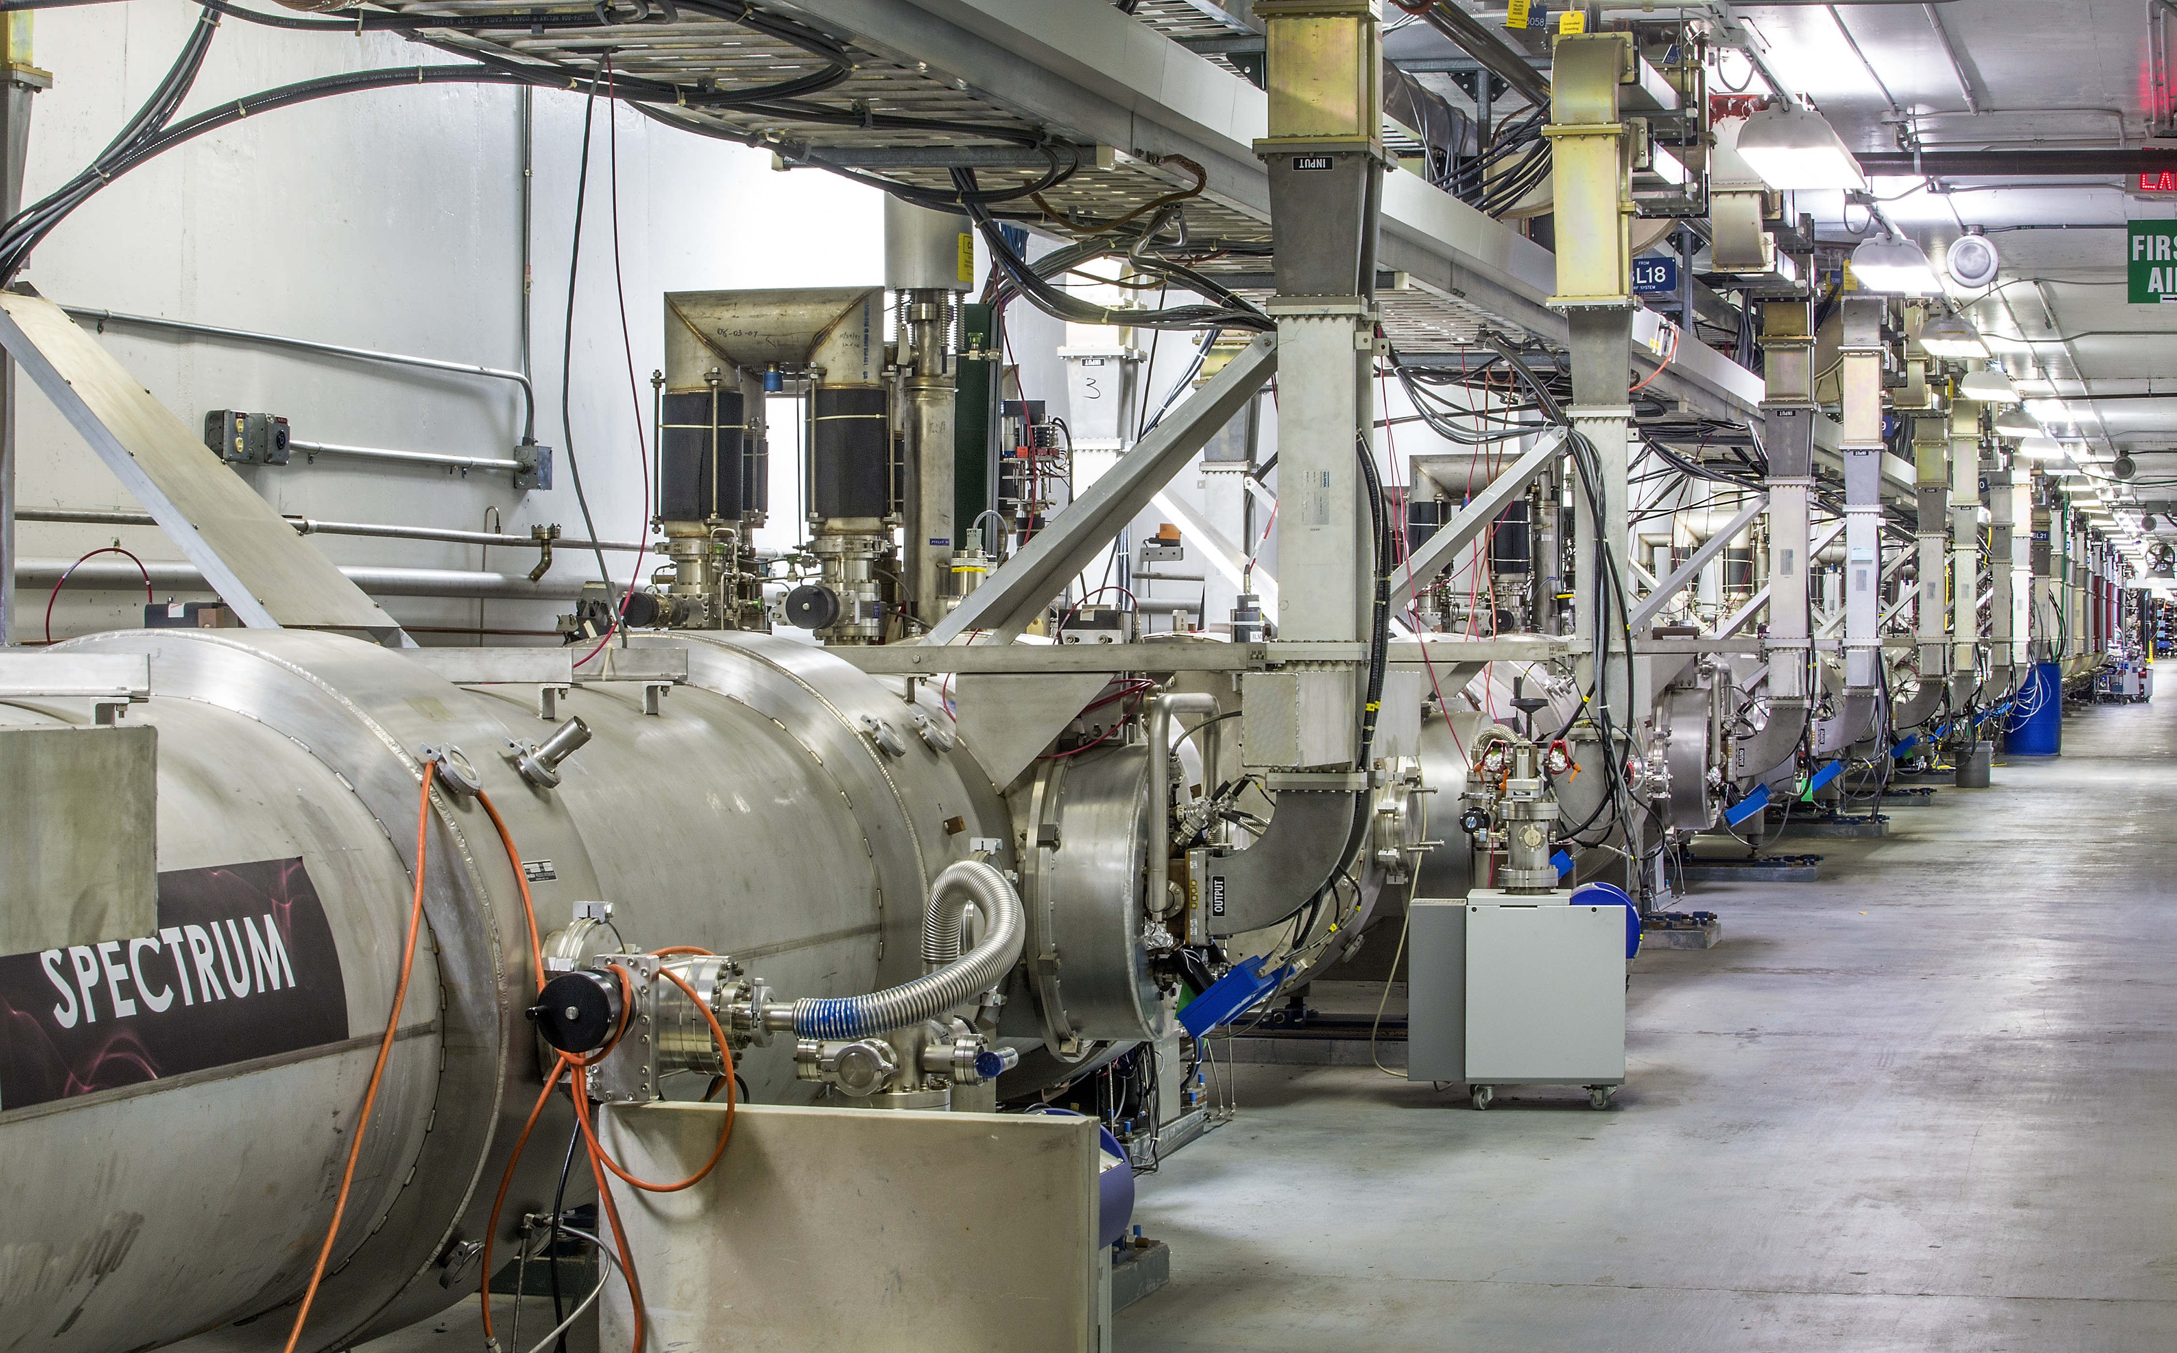
Jefferson Lab Budget Status
Recent challenge has been achieving adequate funding to fully operate our facility and address infrastructure and reliability limitations
Operations funding was increased in FY18 and FY19 approps
Jefferson Lab Nuclear Physics funding ($M)
FY16 | FY17 | FY18 | FY19
107.6 | 111.2 | 122.9 | 128.9
FY20 DOE-NP funding of $713M is a 3.3% increase relative to FY19 ($690M)
  Operations and maintenance is up 7.3% ($660M vs. $615M), construction reduced from $75M to $53M reflecting FRIB rolloff, including $1M for EIC
MOLLER TPC funding $2M in FY20

Slide 6
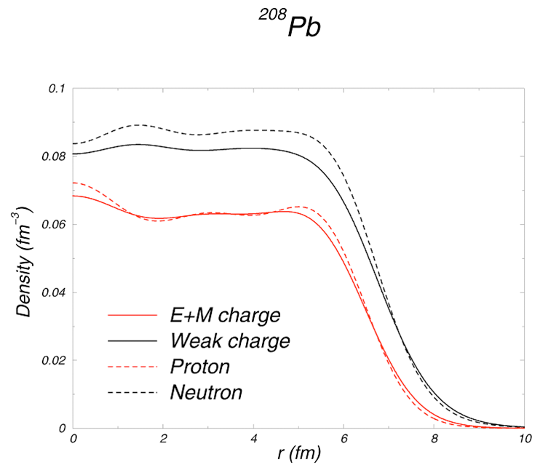
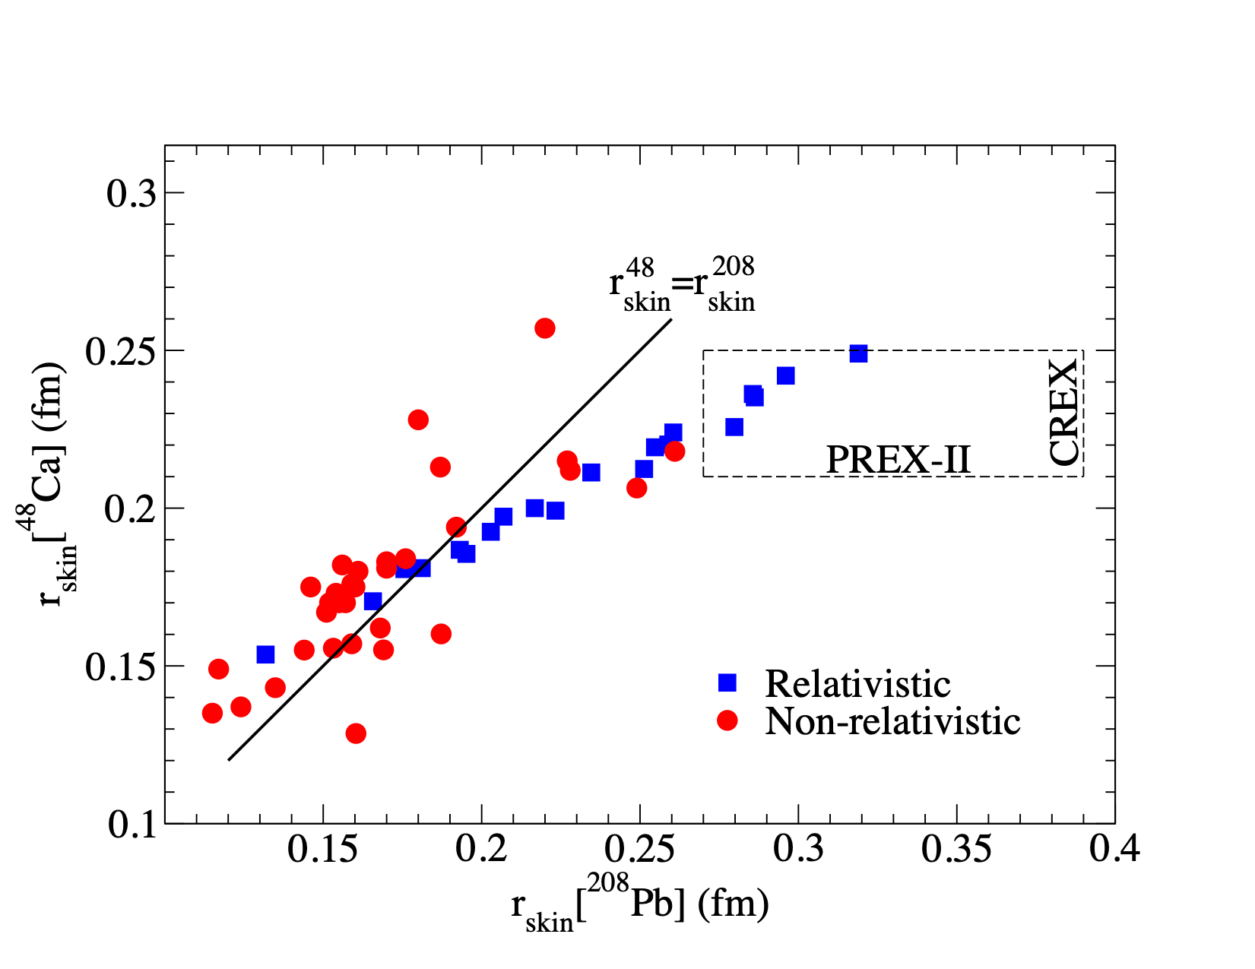
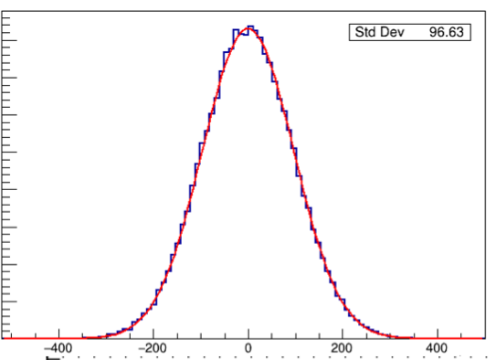
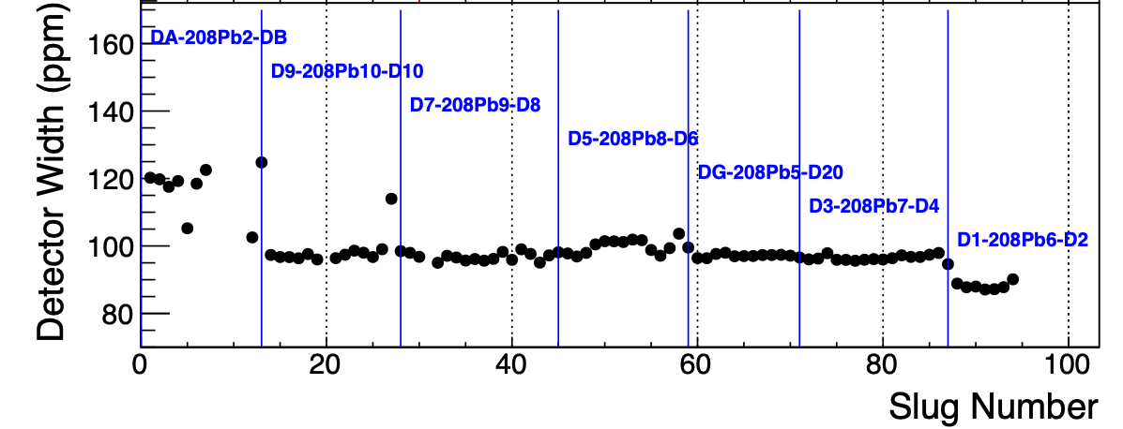
PREX-2 / CREX: Neutron skin of ²⁰⁸Pb and ⁴⁸Ca
Hall A
Goal: measure the neutrons “skin” predicted on heavy nuclei using A_{PV} measurements which are sensitive to the neutron r.m.s. radius R_{n}
²⁰⁸Pb
PREX-2
Installed in spring 2019, ran in summer 2019
Major experimental challenge: 5 GHz rate (2/3 of Qweak, but with ~10x the beam sensitivity)
Radiation shielding, target, beam asymmetry control - all as designed
75% of proposed data taken, δAPV / APV ~ 3%
Expect result fall 2020.
CREX
Started Dec ’19, runs through spring
On January 18 a beam excursion damaged the ⁴⁸Ca target.
The target has been repaired with a combination of disks from three separate targets we had in reserve for other experiments.
PREX-2 performance
χ² / ndf 9.5 / 7
Uncertainty ~15.0 ppb
plot by Tao Ye
preliminary asymmetry
50 μA
70 μA
85 μA
6

Slide 7
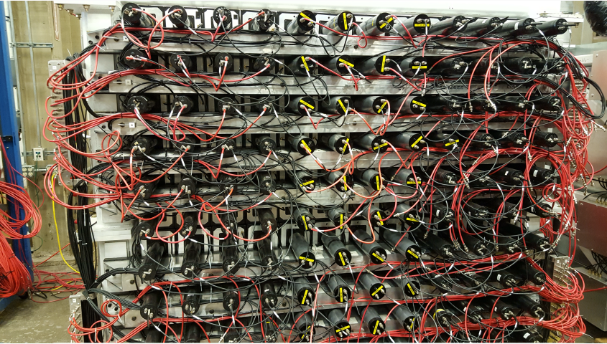
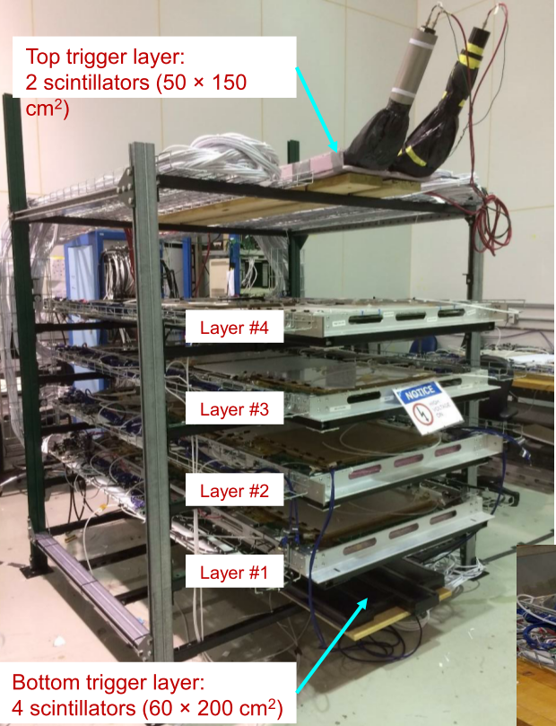
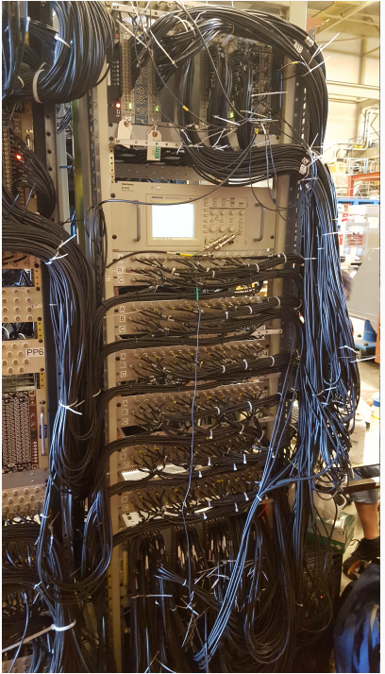
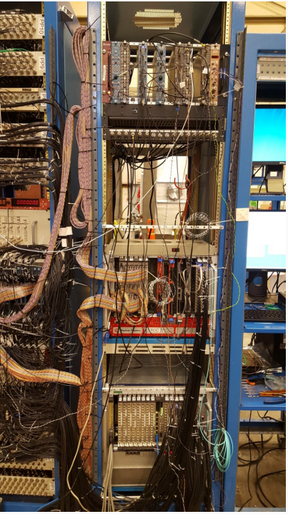
SBS GMn preparations
Hall A
Preparing detectors for 2020 installation
BigBite spectrometer under cosmic tests in TestLab
HCAL under cosmic testing
GEM under cosmic testing

Slide 8

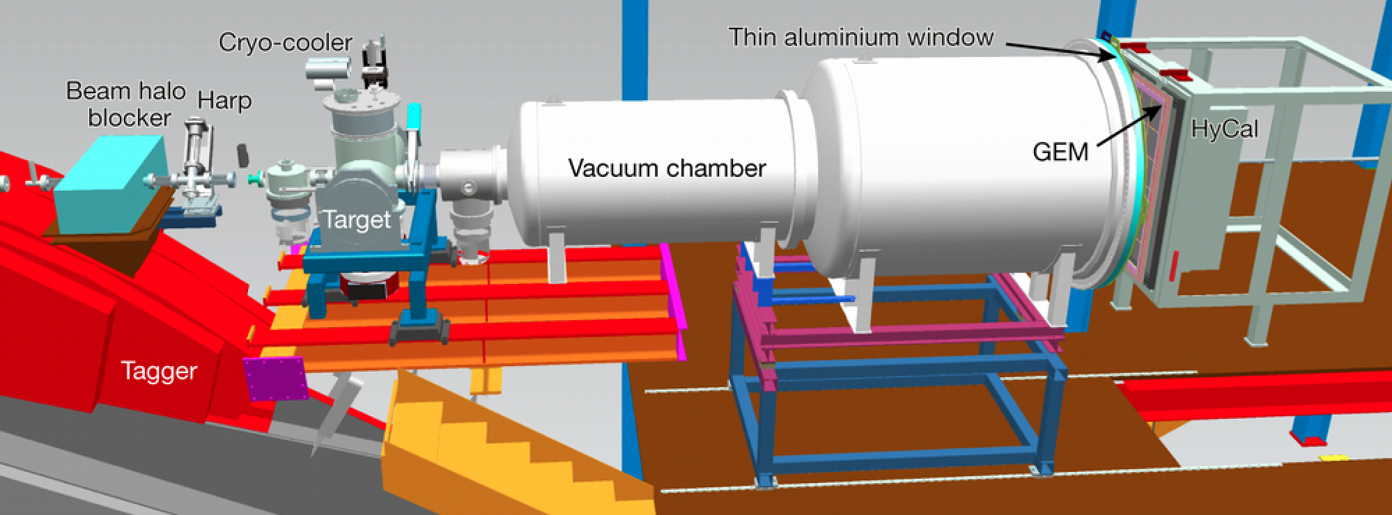
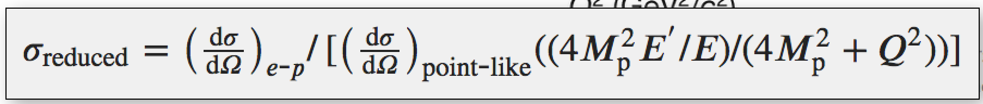
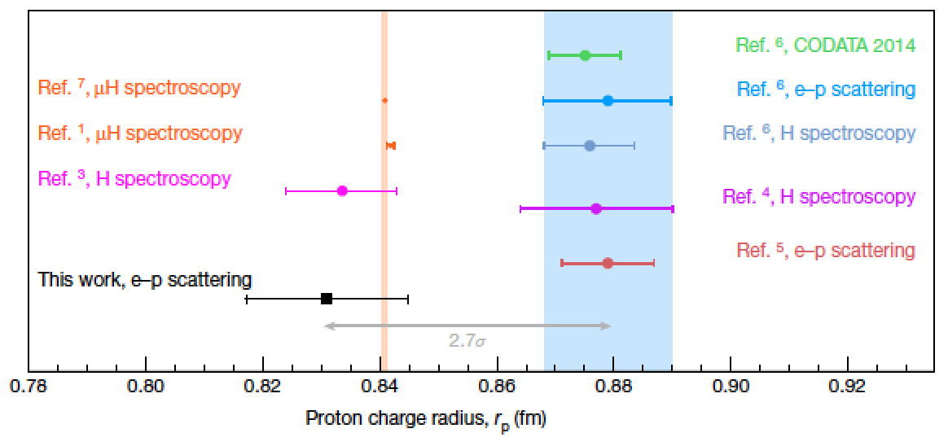
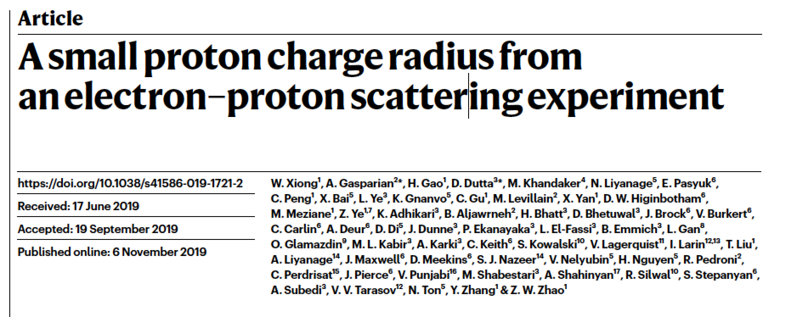
Proton Charge Radius
Hall B
High precision experiment
New windowless target system
Use a calorimeter as a spectrometer
Use e-e scattering to renormalise e-p scattering data
Very small angle coverage
The slope of G^{P}E(Q² → 0) is prop to r²p
Careful scrutiny of systematic errors
Nature volume 575, pages147–150(2019)
11
rp = 0.831± 0.007stat ± 0.012 syst

Slide 9
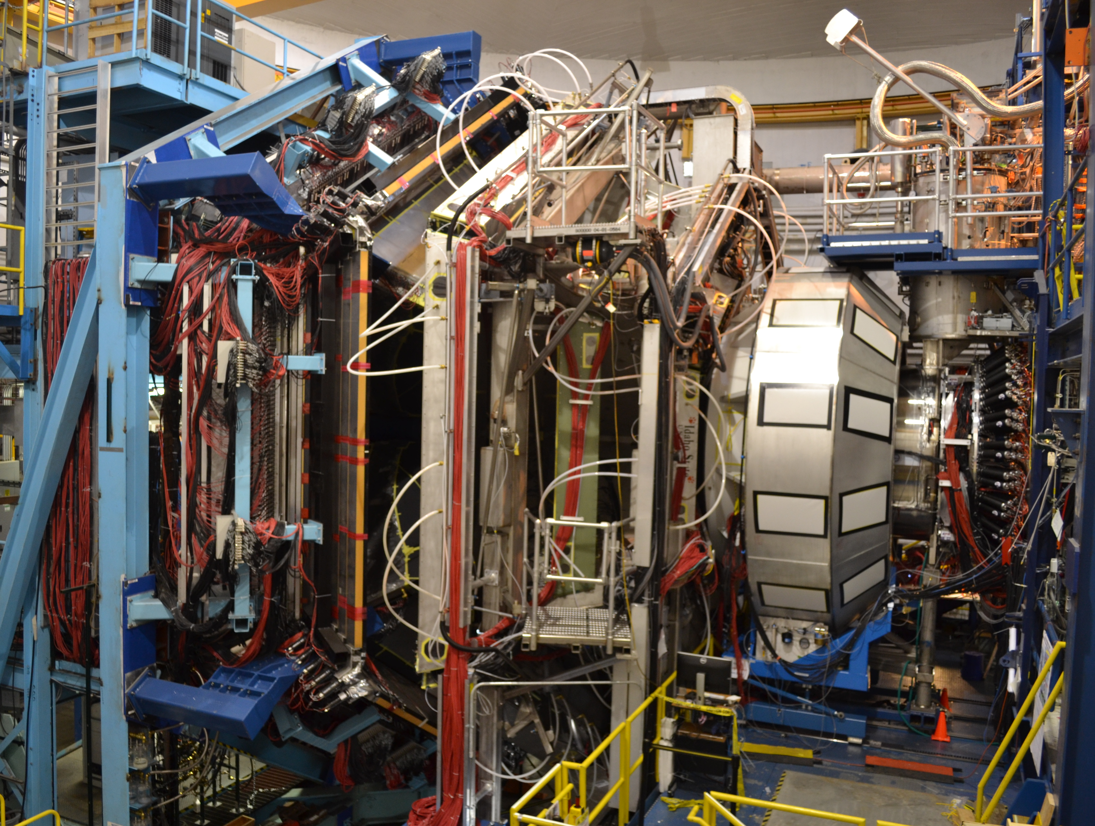
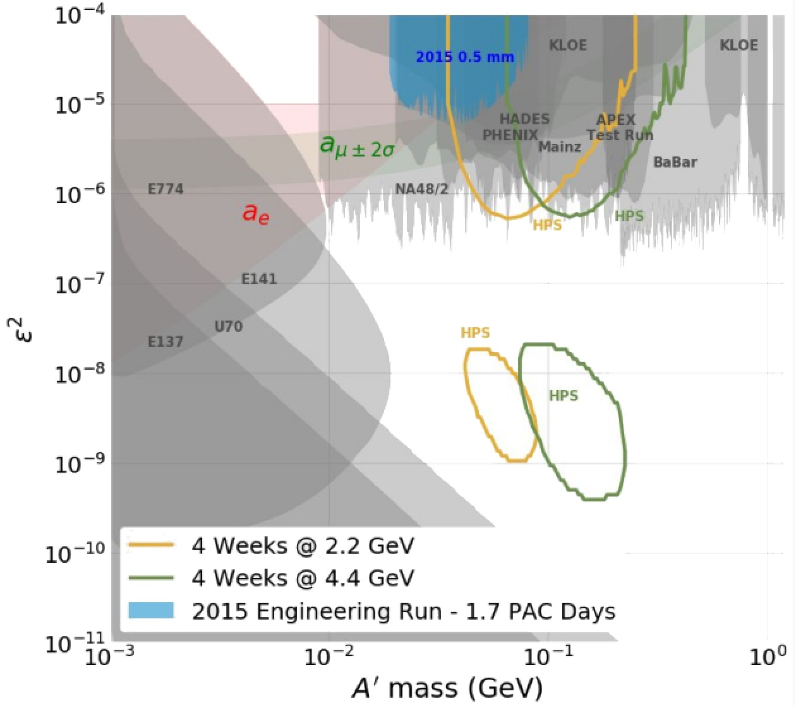
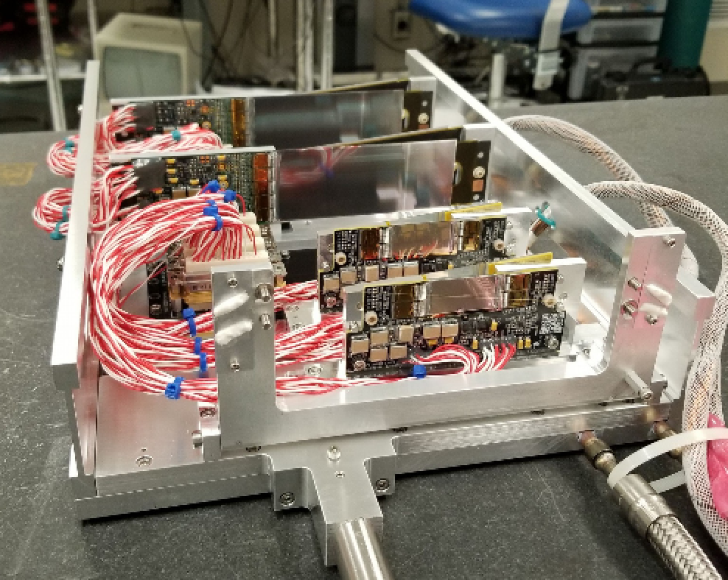
CLAS12 Data Taking
Hall B
Feb 2017 (KPP) - Spring/Fall 2019 (physics runs)
－Run Group A:
13 experiments
10.2-10.6 GeV polarized e-
Liquid-hydrogen target
~50% of approved beam time
－Run Group K:
3 experiments
6.5, 7.5 GeV polarizede- electrons
Liquid-hydrogen target
~12% of approved beam time
－Run Group B:
7 experiments
10.2-10.5 GeV polarized e-
Liquid-deuterium target
~31% of approved beam time
E_{e}: 10.6 GeV
HPS: Summer 2019 low energy running
  Collected ~ 60% of the expected data
  Two major upgrades:
    +1 layer Si tracker to extend the coverage
    a new hodoscope to trigger on e+e- pairs out of ECal accept.
Where we are:
180 total approved PAC days
2015/16 2 eng. run @ 1.1 & 2.2 GeV (15 PAC days)
2019: 30 PAC days
2021: ~30 PAC days at 3.7 GeV

Slide 10
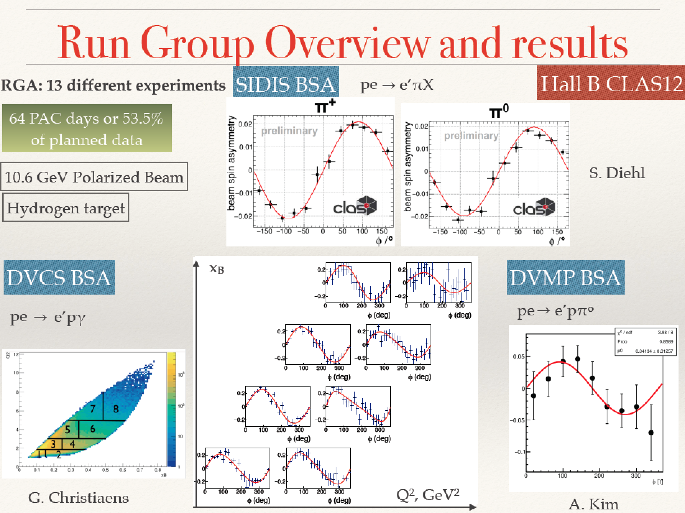
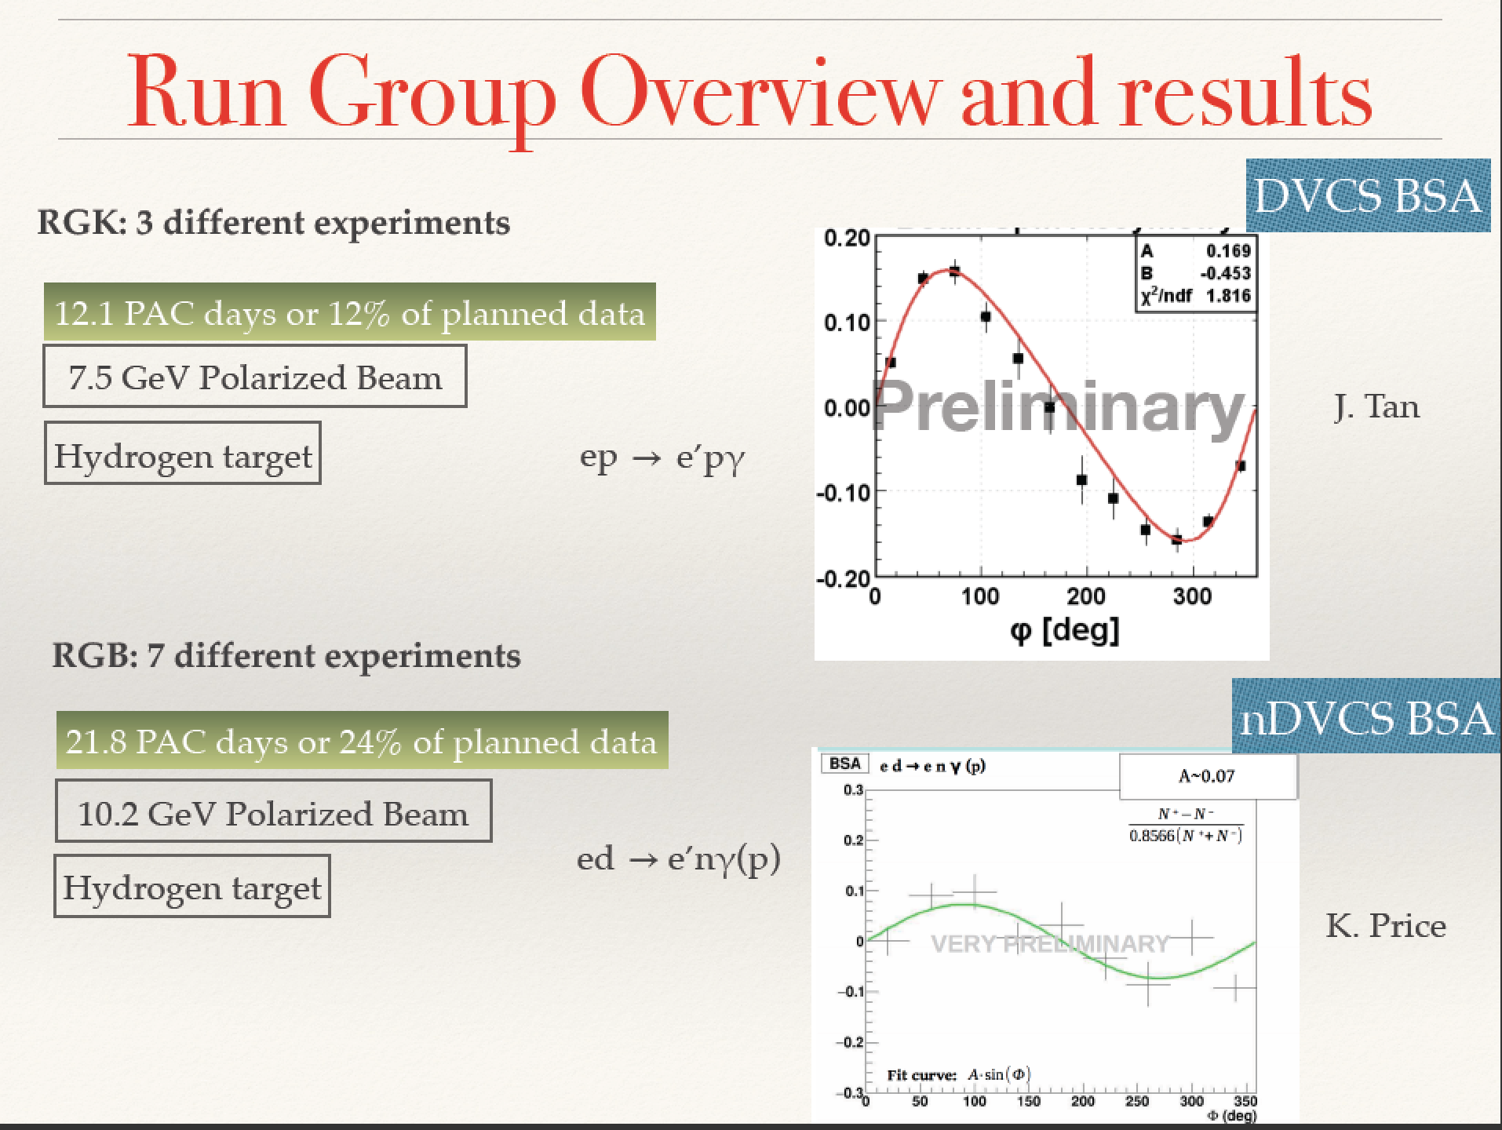
CLAS12 Analysis Status
Hall B
Results presented by N.Markov at the DNP, Fall 2019

Slide 11
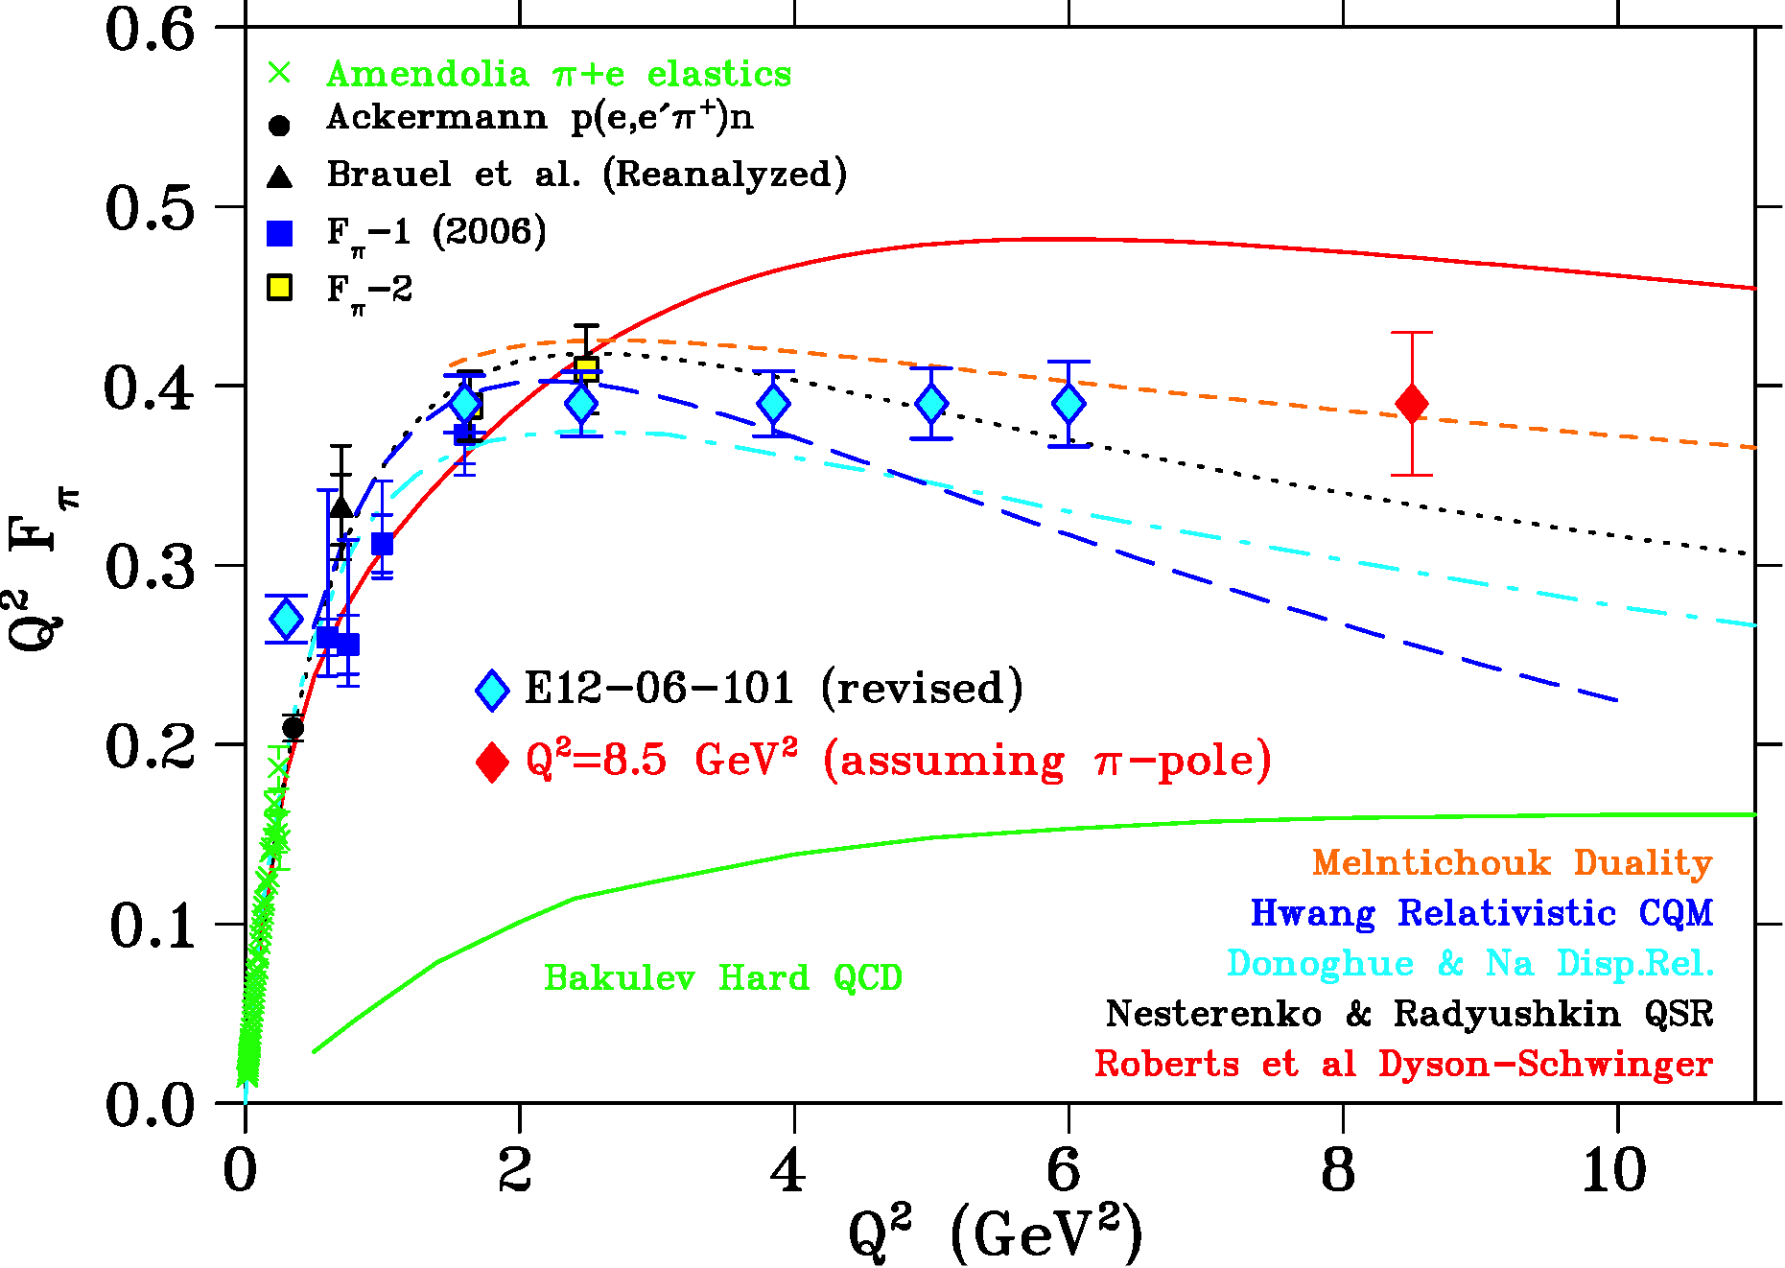

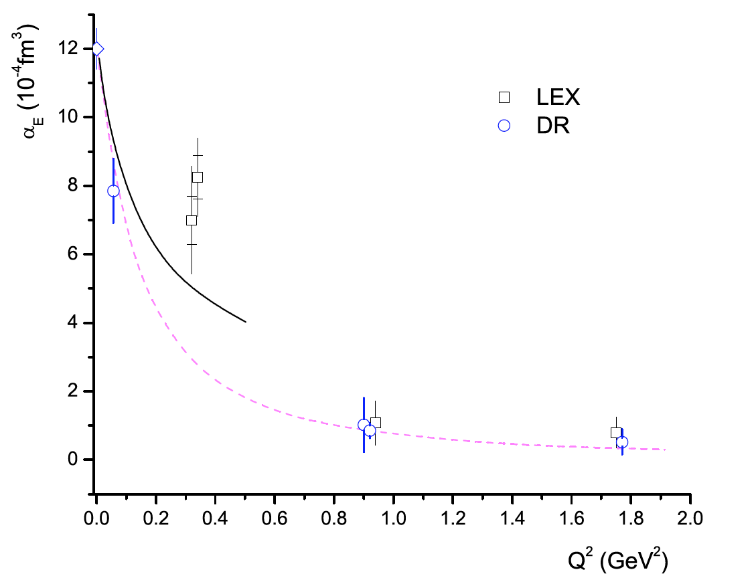
Summer 2019 low energy running
Hall C
E12-06-101 : Measurement of the Charged Pion Form Factor to High Q²
E12-07-105 : Scaling Study of the L-T Separated Pion Electroproduction
Q² (GeV²) | x_{B} | L/T complete | Purpose
0.375 | 0.09 | Yes | Form Factor
0.425 | 0.1 | Yes | Form Factor
1.45 | 0.3 | No | Reaction mechanism
2.12 | 0.4 | No | Reaction mechanism
Low Q² points match onto π⁺+e⁻ elastic scat. data
E12-15-001: Measurement of the Generalized Polarizabilities of the Proton in Virtual Compton Scattering - p(e,e’p)ɣ
Measure proton’s electric & magnetic Generalized Polarizabilities
Map nucleon polarization densities
Address puzzling α_{E} enhancement at low Q²
Preliminary results – Spring 2020
Photon Missing Mass reconstruction
Missing Mass ²

Slide 12
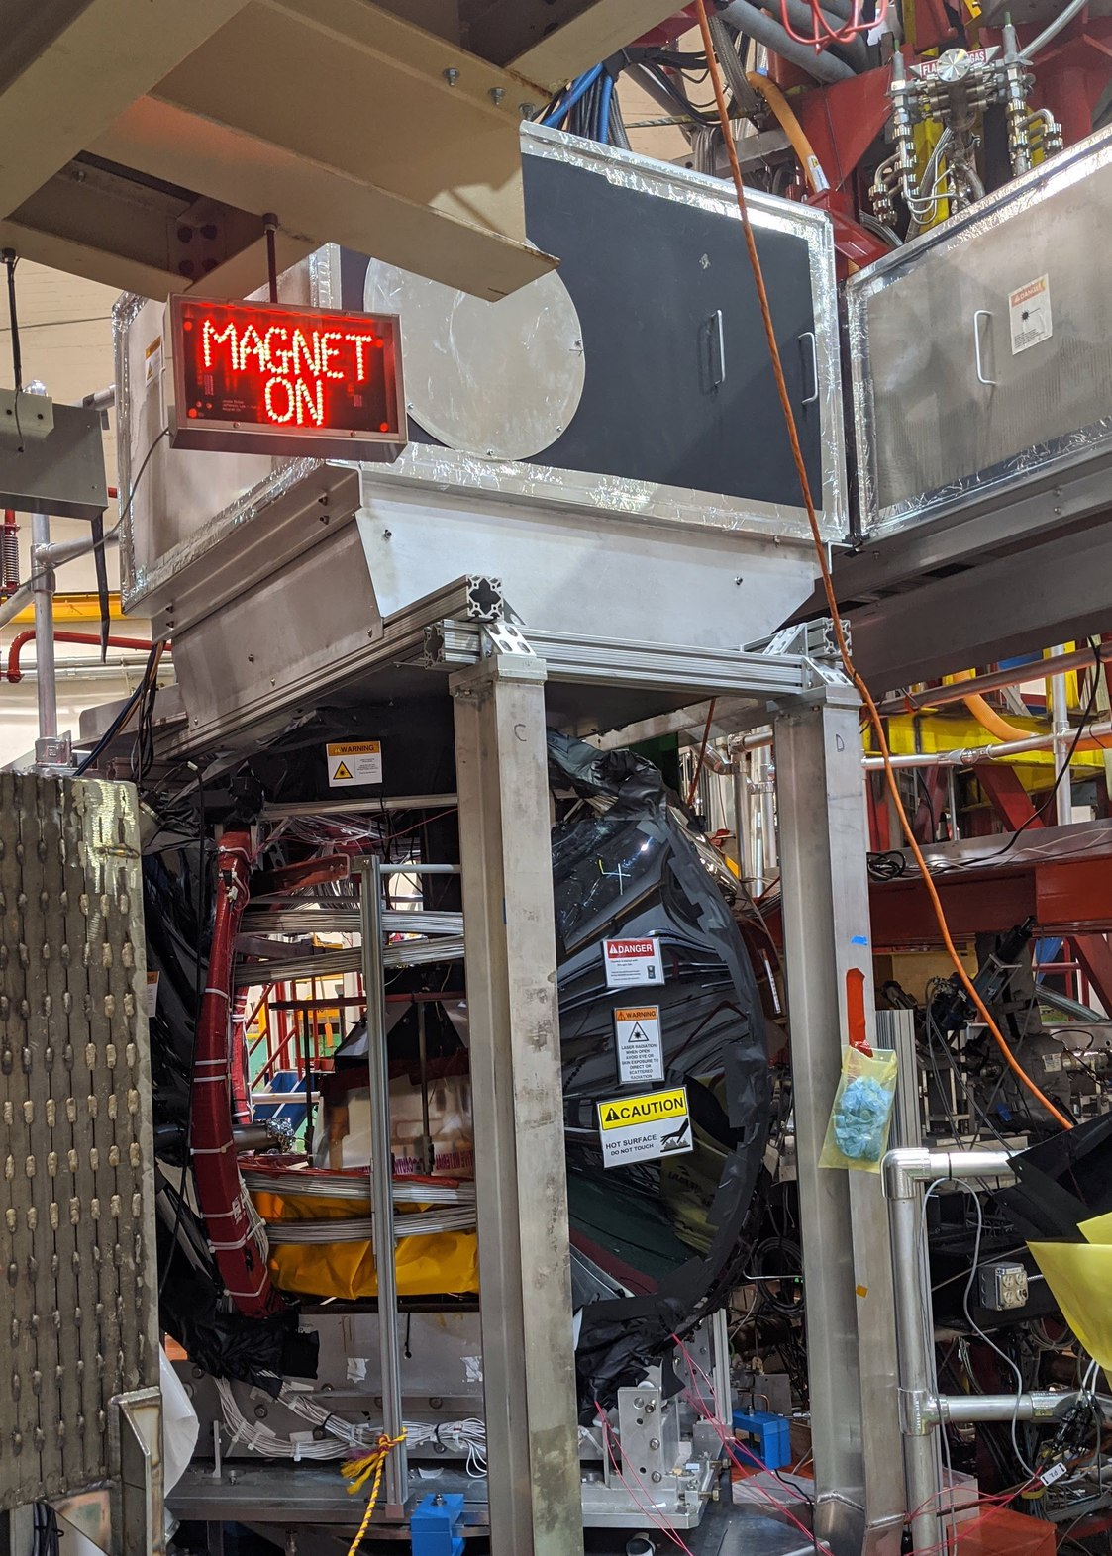
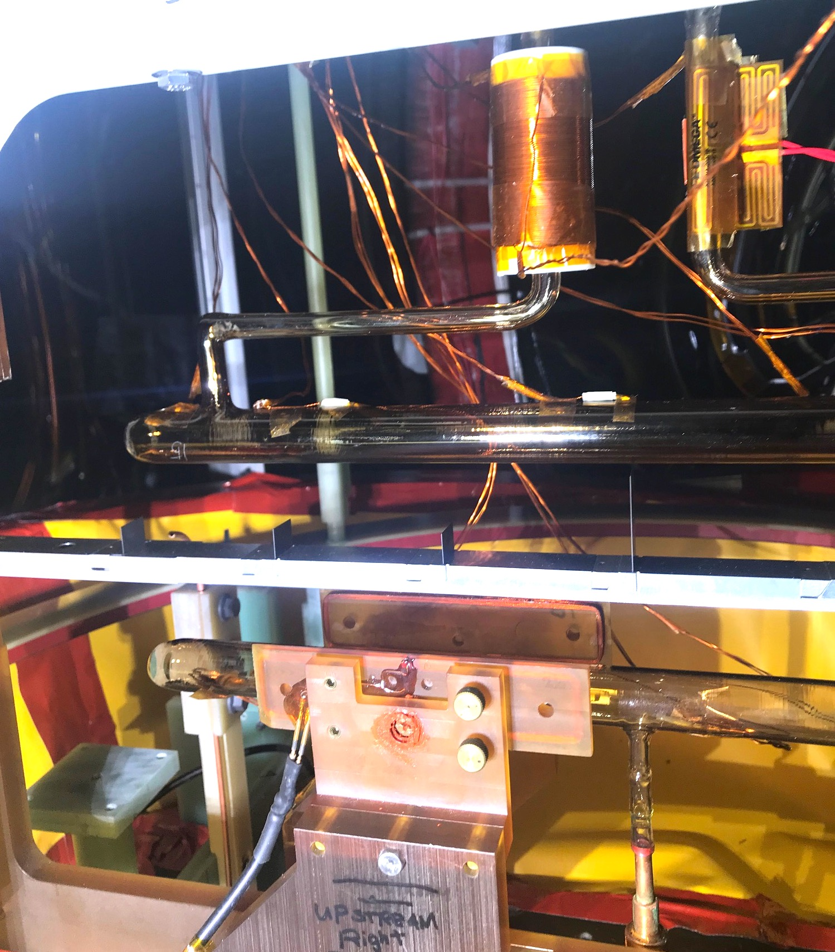
A₁^{n} /d₂^{n} (E12-06-110, E12-06-121)
Hall C
A₁^{n}: Measurement of Neutron Spin Asymmetry
d₂^{n}: Measurement of the Neutron g₂ and d₂ at High Q²
Polarized 3He target
Polarized 3He target installed
Run started – data taken for optics studies (extended target), reference cell and transverse polarization check
5+ good cells + back cells on hand. Cell production continues
Data taking at 5 pass
Target polarizations typically above 50% for the longitudinal polarization orientation and often above 60% for transverse.
³He Cell
Optics targets
Reference Cell

Slide 13
Highlights for Jan 2019 – Jan 2020
Hall D
2019 CY: 86 days with beam
  PrimeX-η: E12-10-011 30% data collected
  DIRC commissioned (Cherenkov for GlueX-II E12-12-002)
GlueX-I data analysis and publications
  100% of GlueX-I data processed (data from 2016-2018);
  Publications: 1 PRL, 1 PRC, 1 NIM, 3 for PRC are under internal review, based on 25% of data
2020 CY Schedule:
  117 days GlueX-II E12-12-002 (with DIRC) – 1/3 of approved time
GlueX @ high rate
  performance has been tested the last fall for a few hours. The data rate was a bit more than 1GB/s. The dead time was about 10%, caused mostly by two elements: the tripple polarimeter detector, and the DIRC. There is a plan to inprove both by the beginning of this run.

Slide 14
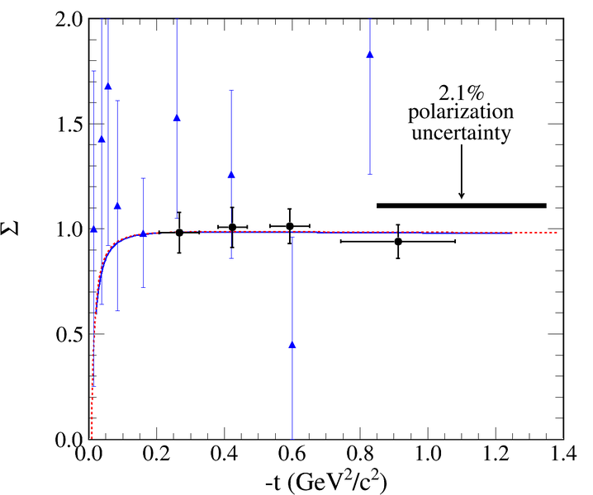
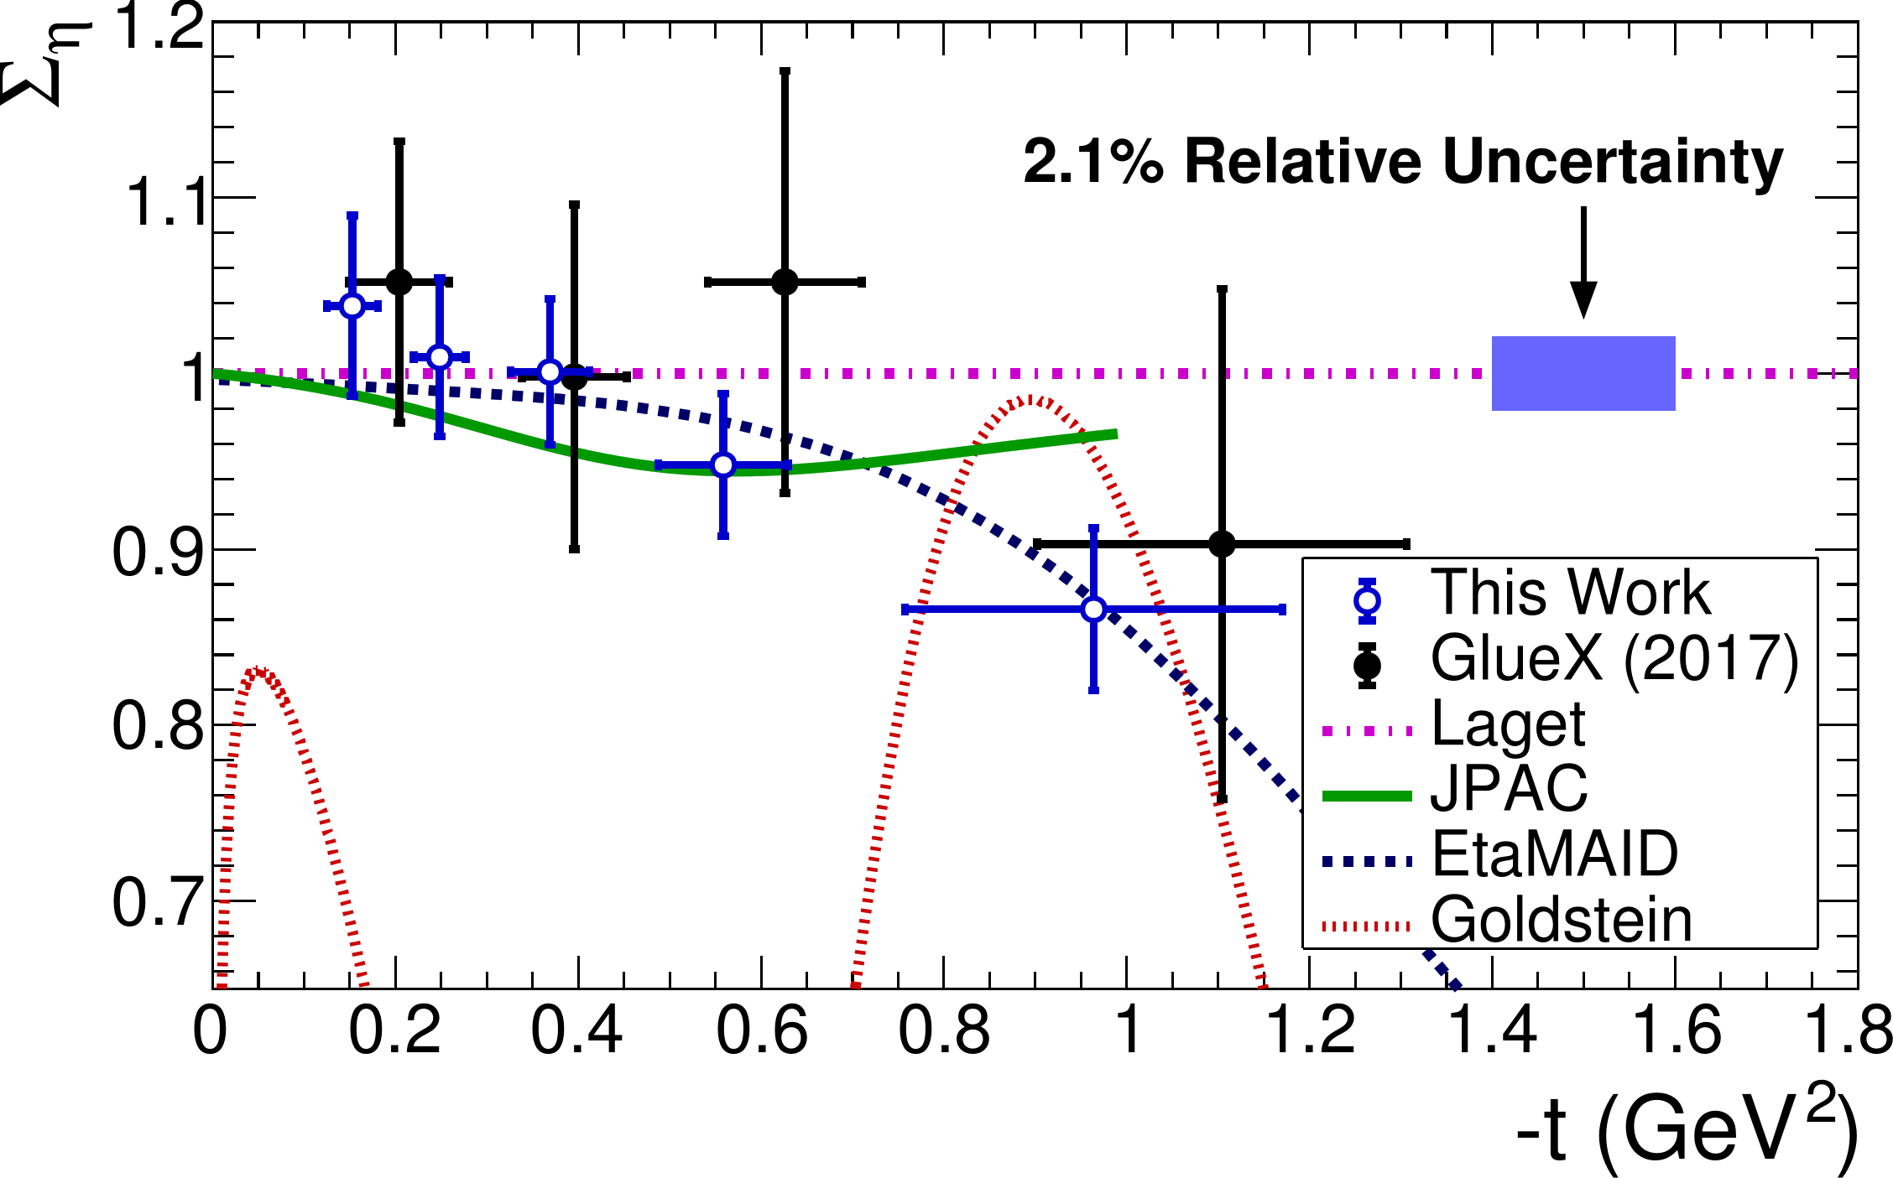
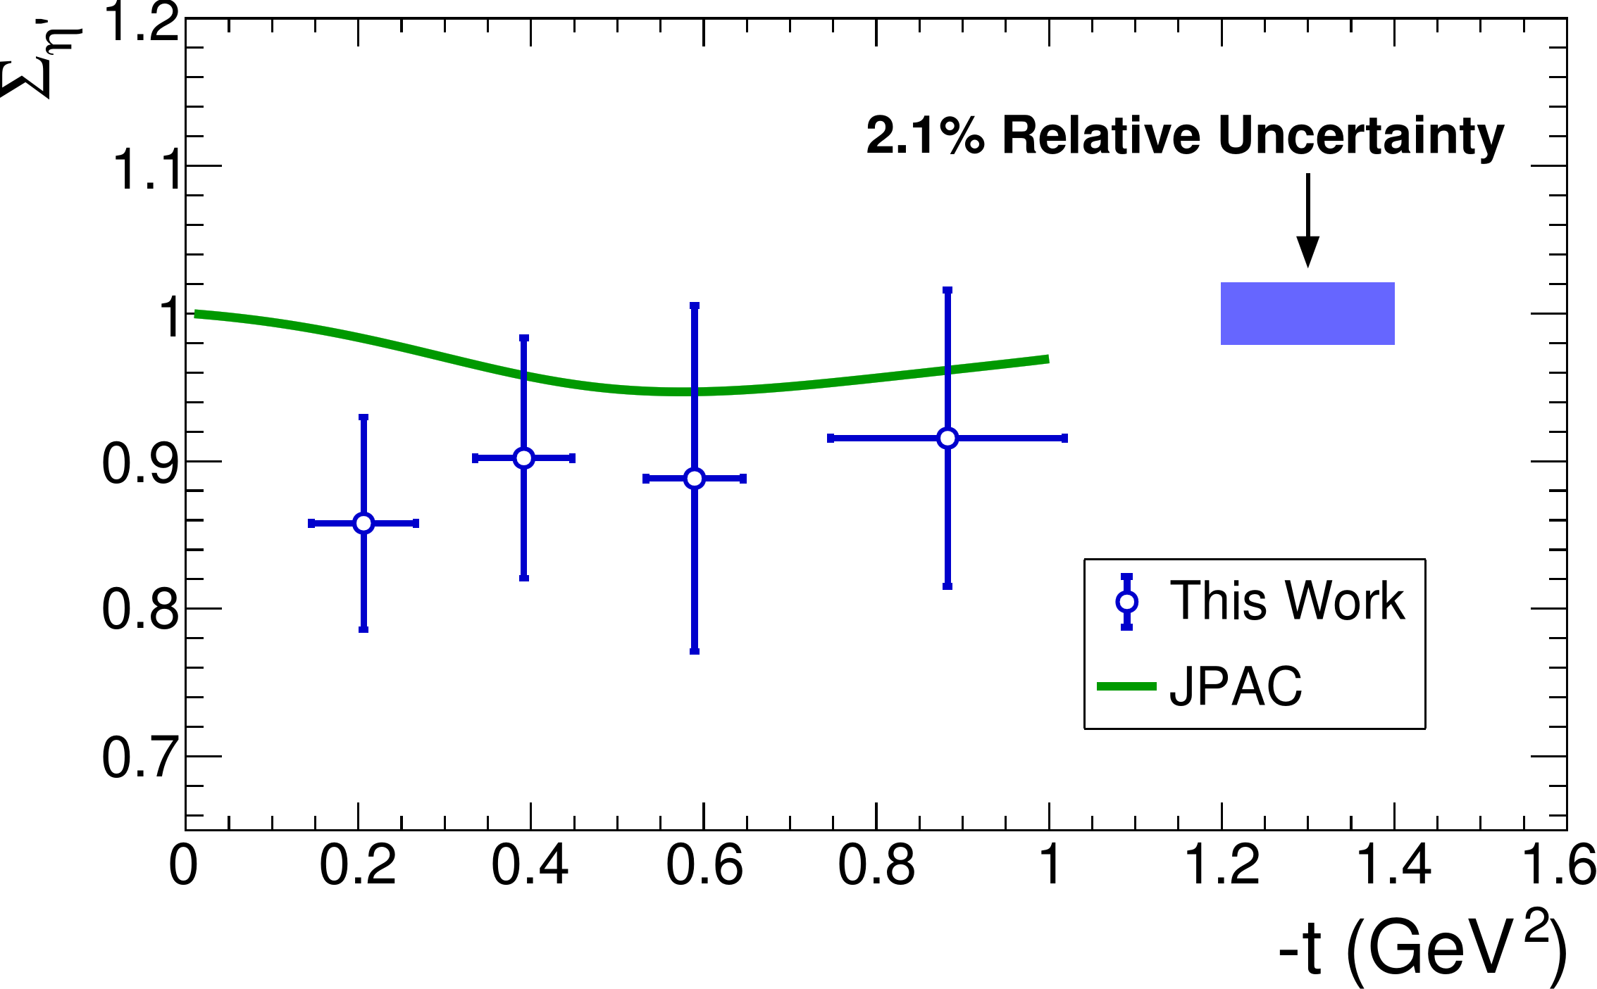
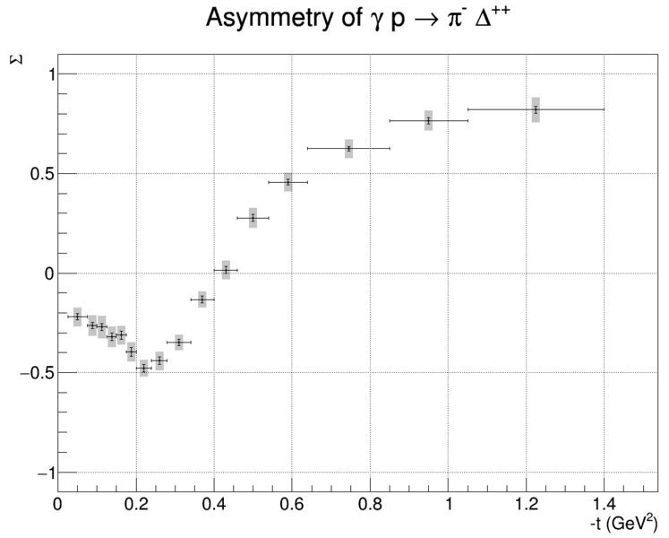
Beam Asymmetry Measurements
Hall D
Phys.Rev. C100, 052201R (2019)
For PRC, under internal review
ɣ p → η + p
ɣ p →K⁺Σ⁰
ɣ p → η‘ + p
First measurement
ɣ p →π⁻Σ⁺⁺

Slide 15
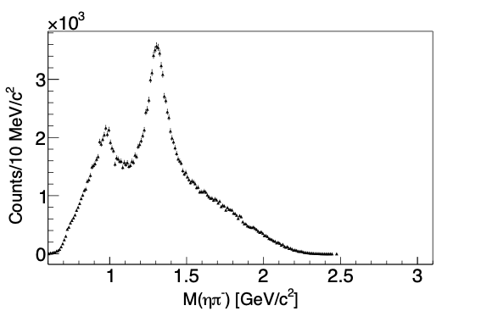

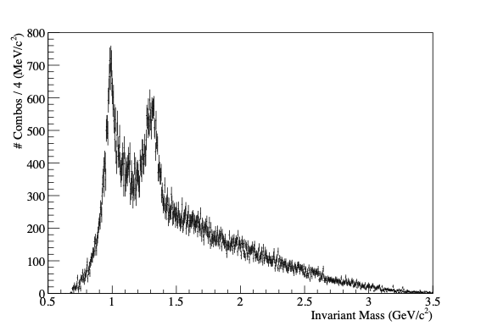
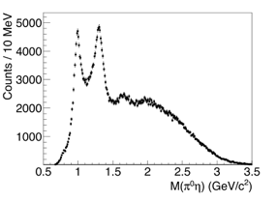
Spectroscopy Prospects: ɣ p → p + π η
Hall D
ηπ / ηʹπ important channels for early hybrid searches
With 20% of GlueX Phase-I data, we see several well-known mesons
Expect twice COMPASS πη / πηʹ events with full Phase-I data
ɣ p → Δ⁺⁺ + π⁻ η
η → ɣɣ
a0(980)
a2(1320)
a0(980)
ɣ p → p + π⁰ η
η → π⁰π⁺π⁻
a0(980)
ɣ p → p + π⁰ η
η → ɣɣ
a2(1320)
a2(1320)
M(ηπ⁰) (GeV/c²)

Slide 16
Publications in the last 6 months: Hall A, B, C (12 GeV)
Murphy et. al. Measurement of the cross sections for inclusive electron scattering in the E12-14-012 experiment at Jefferson Lab
Phys. Rev. C 100, 054606 (2019). November 2019
Cruz-Torres et. al Comparing proton momentum distributions in 𝐴=2 and 3 nuclei via 2H 3H and 3He (e,e'p) measurements
Phys. Lett. B797 134890 (2019) October 2019
W. Xiuong et al (PRad Collaboration) "A small proton charge radius from an electron–proton scattering experiment»
Nature 575, 147 (2019).
The CLAS12 Detector - submitted to NIM as special edition
Day et. al. Conceptual Design Study of a Compact Photon Source (CPS) for Jefferson Lab arXiv:1912.07355 December 2019
Horn et. al. Scintillating crystals for the Neutral Particle Spectrometer in Hall C at JLab arXiv:1911.11577 (accepted by NIM A) November 2019

Slide 17
Jefferson Lab’s User Community
User Community Continues to Grow !

Slide 18
Where we are with the 12 GeV program
Topic | Hall A | Hall B | Hall C | Hall D | Other | Total
Hadron spectra as probes of QCD | 0 | 2 | 1 | 3 | 0 | 6
Transverse structure of the hadrons | 6 | 3 | 3 | 1 | 0 | 13
longitudinal structure of the hadrons | 1 | 3 | 7 | 0 | 0 | 11
3D structure of the hadrons | 4.5 | 9 | 5.5 | 0 | 0 | 19
Hadrons and cold nuclear matter | 8 | 5 | 7 | 1 | 1 | 22
Low-energy tests of the Standard Model and Fundamental Symmetries | 3 | 1 | 0 | 1 | 2 | 7
Total | 22.5 | 23 | 23.5 | 6 | 3 | 78
Total Experiments Completed | 8.0 | 8.2 | 5.9 | 1.2 | 0 | 23.3
Total Experiments Remaining | 14.5 | 14.8 | 17.6 | 4.8 | 3.0 | 54.7
*
*
12 Fully Completed Exps.
13 Partially Completed Exps. + 4 Partially Completed Run Groups

Slide 19
Scheduling Status of the Experiments
Experiment | Hall | Contact | Beam Req. Submitted
Run Group B | B | S. Niccolai | 31-Jul-2016
Run Group D | B | L. El Fassi | *1*
Run Group F | B | S. Kuhn | 28-Jul-2017
Run Group K | B | A. D’Angelo | 13-Jul-2017
Run Group M | B | O. Hen | *1*
Run Group I | B | S. Stepanyan | 27-Jul-2017
E12-06-105 | C | D. Day | 28-Jul-2017
E12-06-110 | C | X. Zheng | 30-May-2018
E12-06-121 | C | B. Sawatzky | 30-May-2018
E12-10-008 | C | D. Gaskell | 6-Aug-2014
E12-10-011 | D | A. Gasparian | 1-Aug-2017
E12-12-002 | D | C. Meyer | 23-May-2019
E12-12-004 | A | K. Paschke | 28-Jul-2017
E12-17-005 | C | O. Hen | 31-Jul-2017
E12-19-003 | D | O. Hen | *2*
E12-19-006 | C | T. Horn & G. Huber | 1-Aug-2016
E12-09-019 | A | B. Wojtsekhowski | 31-Jul-2017
Scheduled Experiments until September 2021
*1* = Pending luminosity test with nuclear targets
*2* = Pending ERR completion
Experiment | Hall | Contact | Beam Req. Submitted
Run Group C | B | S. Kuhn | *1*
Run Group L | B | Z. Meziani | *3*
E12-06-104 | C | P. Bosted | 15-Aug-2019
E12-06-107 | C | D. Dutta | 19-Aug-2019
E12-13-003 | D | C. Meyer | 29-Jul-2016
E12-13-007 | C | R. Ent | 16-Aug-2019
E12-13-010 | C | C. Muñoz Camacho | 16-Aug-2019
E12-14-003 | C | B. Wojtsekhowski | *2*
E12-14-005 | C | D. Dutta | *2*
E12-17-004 | A | B. Sawatzky | *3*
New Experiments to be Scheduled
*1* = TBD, pending luminosity test with nuclear targets
*2* = TBD, passed ERR
*3* = TBD, pending ERR completion

Slide 20
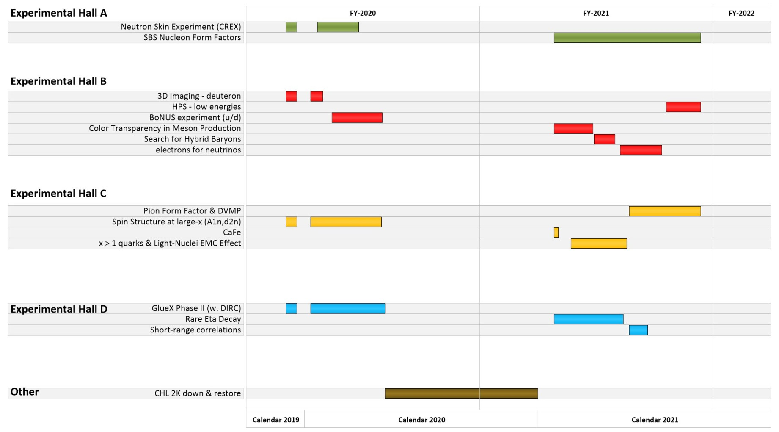
Scheduling 2020-2021

Slide 21
PAC48
New Chair: Markus Diehl
New members: Elke Aschenauer, Shinya Sawada, Concettina Sfienti, Feng Yuan
Meeting scheduled for week of July 13.
Proposals due June 1.
Will continue Jeopardy process...

Slide 22

Virginia Center for Nuclear Femtography
Funded by Commonwealth to “…..to facilitate the application of modern developments in data science to the problem of imaging and visualization of sub-femtometer scale structure of protons, neutrons, and atomic nuclei”
Multi-disciplinary, bringing together nuclear theorists and experimentalists, mathematicians, computer scientists,… … and architects and artists!
Seven joint lab/university initiatives funded by the Commonwealth of VA
1st Workshop at University of Virginia in Dec 2018
Symposium at SURA Headquarters in Aug 2019
  Review, share, and capitalize on progress made so far.
  Explore new avenues and ideas - e.g machine learning
  Specific goals:
Development of next round of activities
Securing long-term future of effort
Note: Increased funding ($1.25M/yr) in VA Governor’s budget for FY20.
22
Notes:
PAC days

Slide 23
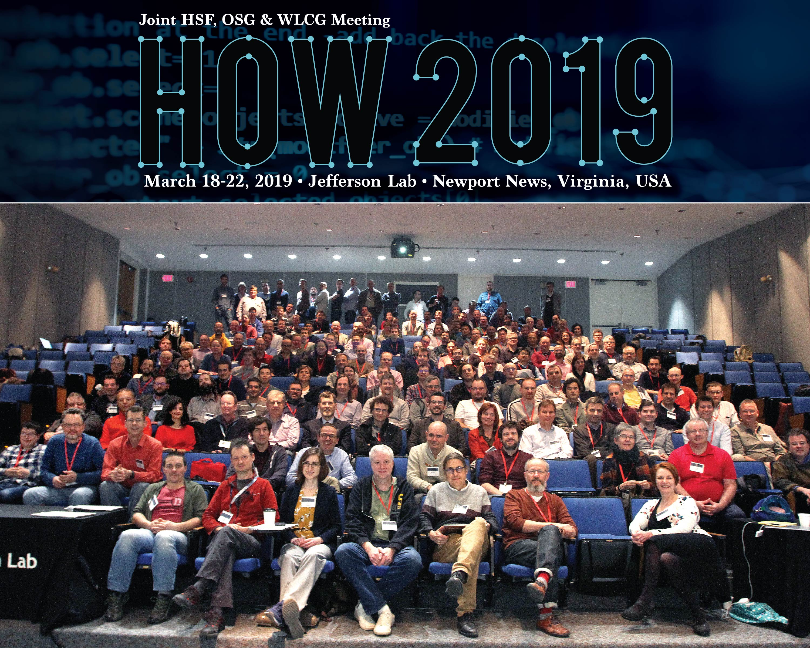
Advanced Computing Initiatives
Computation is crucial to all aspects of our NP Program
Initiative 1: Physics Centered Computing Model for 12 GeV Physics Program and future EIC to insure experiment-theory integration
  Modern computational and data science techniques and hardware technologies provide an opportunity to modernize the experimental computing paradigm.
  Streaming readout: Innovation in Nuclear Data Readout and Analysis: start to end streaming tests with GEM detector underway
  Data reconstruction at NERSC with GlueX Data in production
  Extracting 3-D distributions from experimental data is a large scale computationally challenging inverse problem: Developing next generation codes in consultation with OLCF.
Initiative 2: Develop computational and data science methodology and infrastructure to realize the scientific goals of
Nuclear Femtography.
  Established Center for Nuclear Femtography in 2018
  Topical areas: Visualization, imaging techniques QCD Theory, machine learning
Initiative 3: Particle Accelerator Simulation and Operation
  Focal area for 2020 is mining CEBAF operational data
October 31, 2019: Briefing to DOE-ASCR on computation at JLab
Hosted HOW2019 at JLab
Innovation in Nuclear Data Readout and Analysis (INDRA)
Lab operational
Invited talks on streaming at ASCR workshops
Invited talk on Streaming Data at the DOE booth at Supercomputing 18
Established streaming readout consortium
Co-organized Virginia Symposium on Imaging & Visualization in Science
Notes:
This workshop brings together communities from the HSF, OSG and WLCG to make progress on common challenges faced in HEP Software and Computing in the next decade
HSF=HEP Software Foundation
OSG=Open Science Grid
WLCG=Worldwide LHC Computing Grid
NERSC=National Energy Research Scientific Computing Center
OLCF=Oak Ridge Leadership Computing Facility
ASCR=Advanced Scientific Computing Research

Slide 24
Workshop Announcement
Local Organizing Committee
Amber Boehnlein (Jefferson Lab)
Latifa Elouadrhiri (Jefferson Lab)
Robert McKeown (Jefferson Lab)
Yves Roblin (Jefferson Lab)
Planning in progress

Slide 25
Some Safety Issues
04/26/2019: An engineer (E1) working on the CEBAF Radio Frequency (RF) Separator System received an electrical shock sufficient to cause temporary impairment. The E1 exited the building and was transported by a coworker to Occupational Medicine before being taken to a local hospital for overnight observation.
06/07/2019: A Graduate student, working in EEL Lab 102A, realized the while inspecting a laser fiber using a fiber inspection scope, that the 30W laser was still energized. Fortunately the student was wearing protective eye wear and did not feel any adverse effects from the exposure.
09/03/2019: Employee Receives a Shock While Troubleshooting IMAC Desktop Computer
DOE OFFICE OF ENFORCEMENT - NOV. 19-22
A team from the Department of Energy Office of Enforcement was on-site Nov. 19 - 22, to investigate recent safety events.

Slide 26
New Physics Division Work Planning Requirement
The Physics Division Work Planning Requirements are related to work planning, control and authorization for work projects and test setups in division work areas across the laboratory.
https://www.jlab.org/physics/work_governance
Any electrical work on equipment that is over 50 volts AC or 60 volts DC (Class 2 or 3) that is being worked above Mode 1 (meaning exposed & energized) is required to have an Electrical Work Checklist. This checklist must be signed off by the person doing the work and another electrical worker that is qualified on that piece of equipment, preferably a supervisor. Checklists must be recorded in either a task list or in an elog.

Slide 27
Non-Proprietary User Agreement (NPUA)
Problems with MOUs continue. MOUs can't get any moving, even if there are overarching agreements in place.
Temporary solution that can allow us to sign an agreement with Labs and University: Non-Proprietary User Agreement (NPUA)
Per our Legal office, the NPUA allows JLab to do everything we could do regarding collaboration with other labs and institutions as the MOU's did - i.e., visiting students and users, reimbursement for per diem and lodging for visitors, equipment loans, etc.
We have two NPUAs in place now (Kharkov in the Ukraine and Duke University) with Manitoba and Orsay pending.
There is no real write-up from anyone at this time and the form we are asked to use is on the DOE website.
The NPUA is temporary used by BNL and FERMILAB to do business with their users but they also want to go beyond it.
Notes:
with no substantive changes, this document goes into effect with signatures from JLab and our collaborating institution and needs no further approvals from DOE. Once signed by both parties, it is in place and ready to utilize. It is also now a Procurement document and tracked and filed by Procurement.

Slide 28
Backup Slides

Slide 29
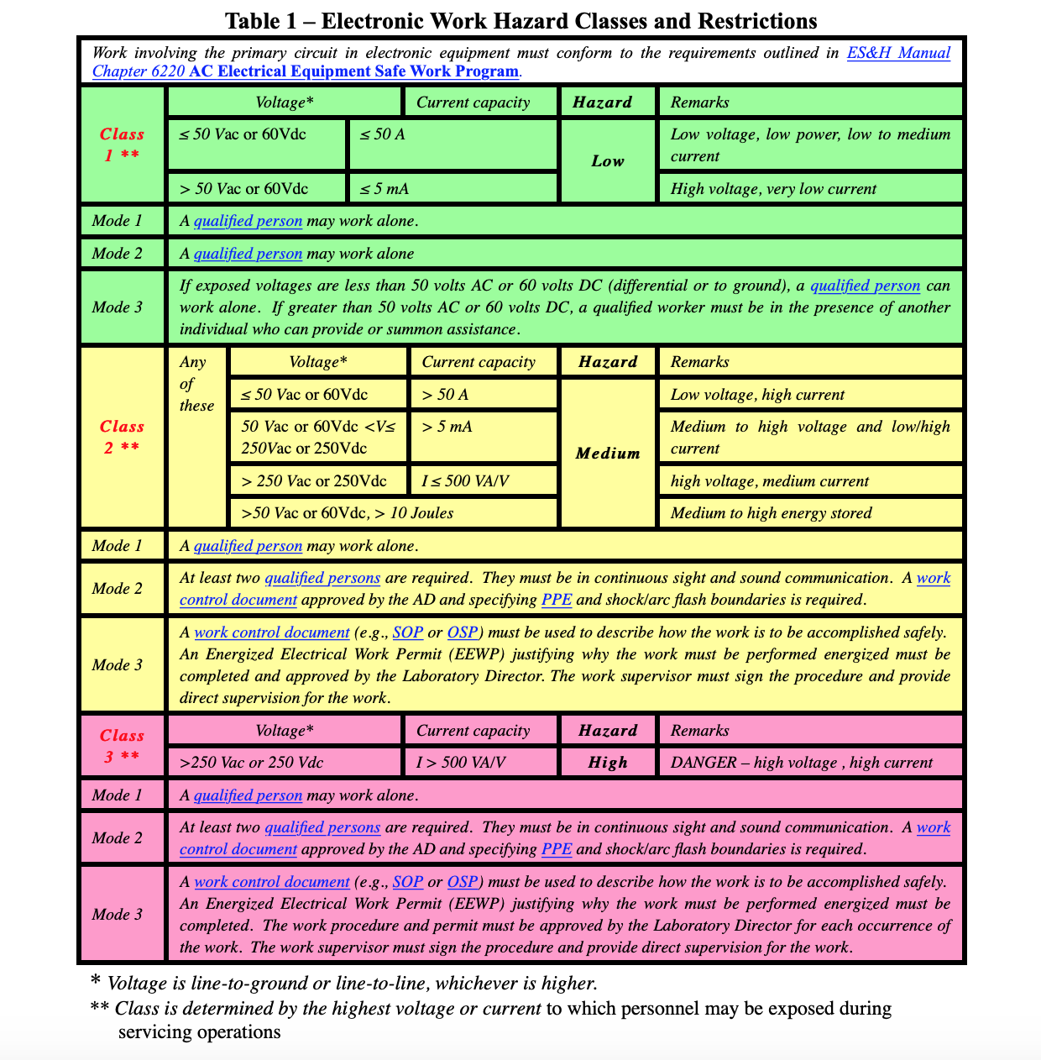

Slide 30
Where we are with the 12 GeV program
Topic | Hall A | Hall B | Hall C | Hall D | Other | Total
Hadron spectra as probes of QCD | 0 | 219 | 11 | 540 | 0 | 770
Transverse structure of the hadrons | 150.5 | 85 | 146 | 25 | 0 | 406.5
Longitudinal structure of the hadrons | 19 | 230 | 211 | 0 | 0 | 460
3D structure of the hadrons | 359 | 872 | 196 | 0 | 0 | 1427
Hadrons and cold nuclear matter | 220 | 275 | 205 | 15 | 14 | 729
Low-energy tests of the Standard Model and Fundamental Symmetries | 547 | 180 | 0 | 79 | 60 | 866
Total Days | 1295.5 | 1861.0 | 769.0 | 659 | 74 | 4658.5
Total Days - (includes MOLLER) | 821.5 | 1861 | 769 | 659 | 28 | 4138.5
Total Approved Run Group Days (includes MIE) | 1295.5 | 1026 | 726 | 459 | 74 | 3580.5
Total Approved Run Group Days (includes MOLLER) | 821.5 | 1026 | 726 | 459 | 28 | 3060.5
Total Days Completed | 211.5 | 221 | 129.0 | 138 | 0 | 699.5
Total Days Remaining | 610 | 805 | 597 | 321 | 28 | 2361

Slide 31
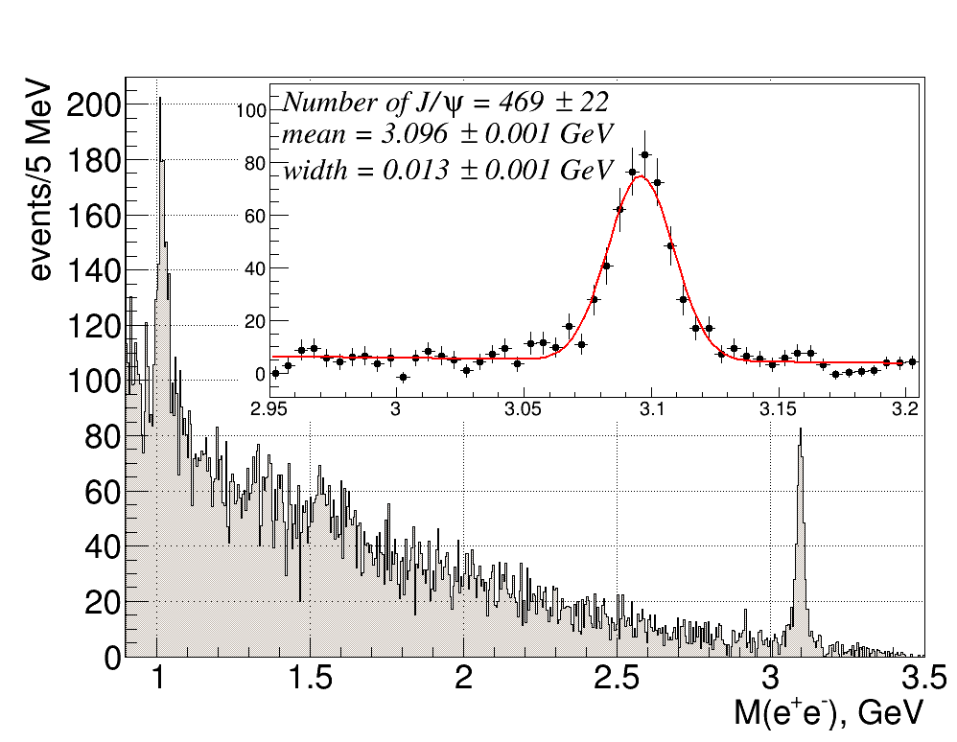
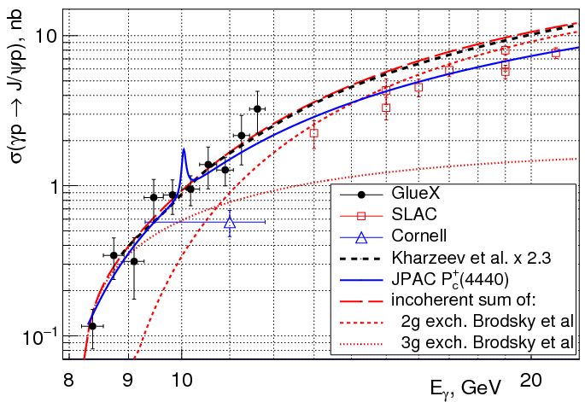
Near-threshold J/ψ photoproduction
Hall D
GlueX Collaboration, A.Ali et al PRL 123, 072001 (Aug 2019)
γ+p→J/ψ+p J/ψ→e⁺e⁻
Probes gluonic field in the nucleon at high x
- measured cross section is larger than expected from two-gluon-exchange models
- agrees with theoretical calculations with large gluonic contribution to the mass of the proton
Search for LHCb pentaquarks Pc produced in the s-channel: γ p → Pc → J/ψ p at Eg ≈ 10GeV -no evidence found, model-dependent upper limits on Br(Pc → J/ψ p) of 2-4% at 90%CL
Published: 25% of statistics, full data set has been processed (about 2000 J/ψ)

Slide 32
DIRC
Hall D
All bar boxes from SLAC installed
New mirror optics installed in photon detectors
Cherenkov photon performance:
  Hit patterns match the expected distributions from simulation
  Single photon resolution meets particle ID requirements

Slide 33
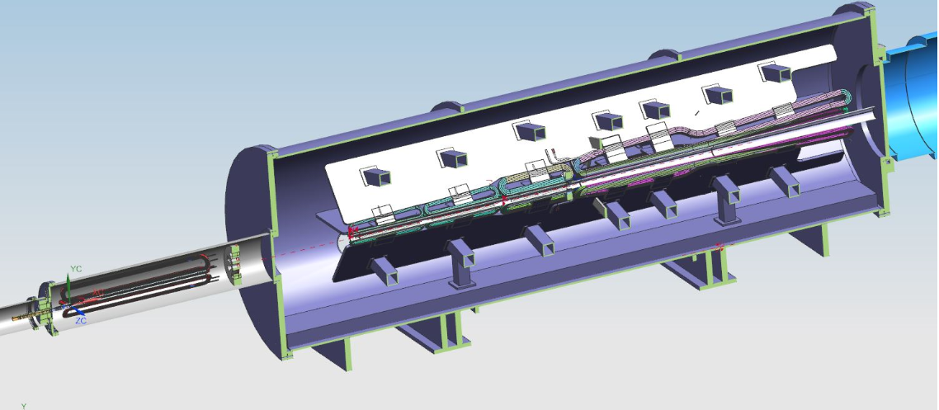
MOLLER – last six months
Hall A
June 2020 – Regular monthly DOE Project phone calls
August – OPC funding started
  Prepare CDR
  Prepare for CD1 review
November – Internal Cost Review
  Endorsed cost estimate, contingency and risk management
December – Convened Change Control Board
  Chose magnet coils in vacuum (vs. helium)
December – Moller Design Review
January – Director’s review
Early 2020? - CD1 review

Slide 34
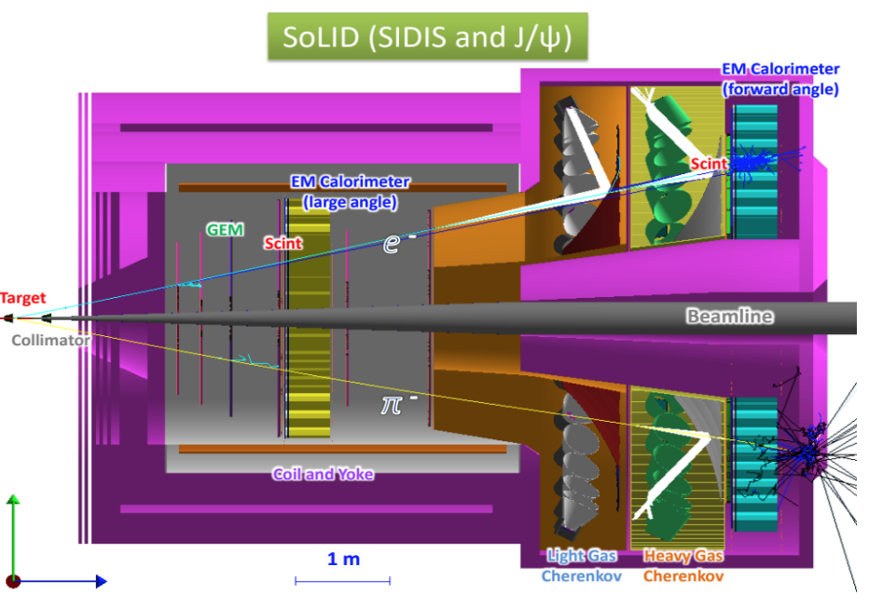
Recent SoLID Activities
Hall A
Updated pCDR, updated cost estimate, range, schedule with detailed Work Breakdown Structure
September – Director’s review
December – Received funding for Pre-R&D
    High rate Cherenkov detector studies
    DAQ tests – high rate and trigger
    GEM readout tests (Use VMM3 chip instead of APV25)
Anticipating Science Review
JLab CLEO-II magnet refurbish - capital equipment funding
    Received outer steel from Cornell
    Work defined and started to prepare for cool-down and low-power tests
    Cryo reservoir (based on JLab standard) near ready for procurement
    Detector Support Group started instrumentation rack and control software development

Slide 35
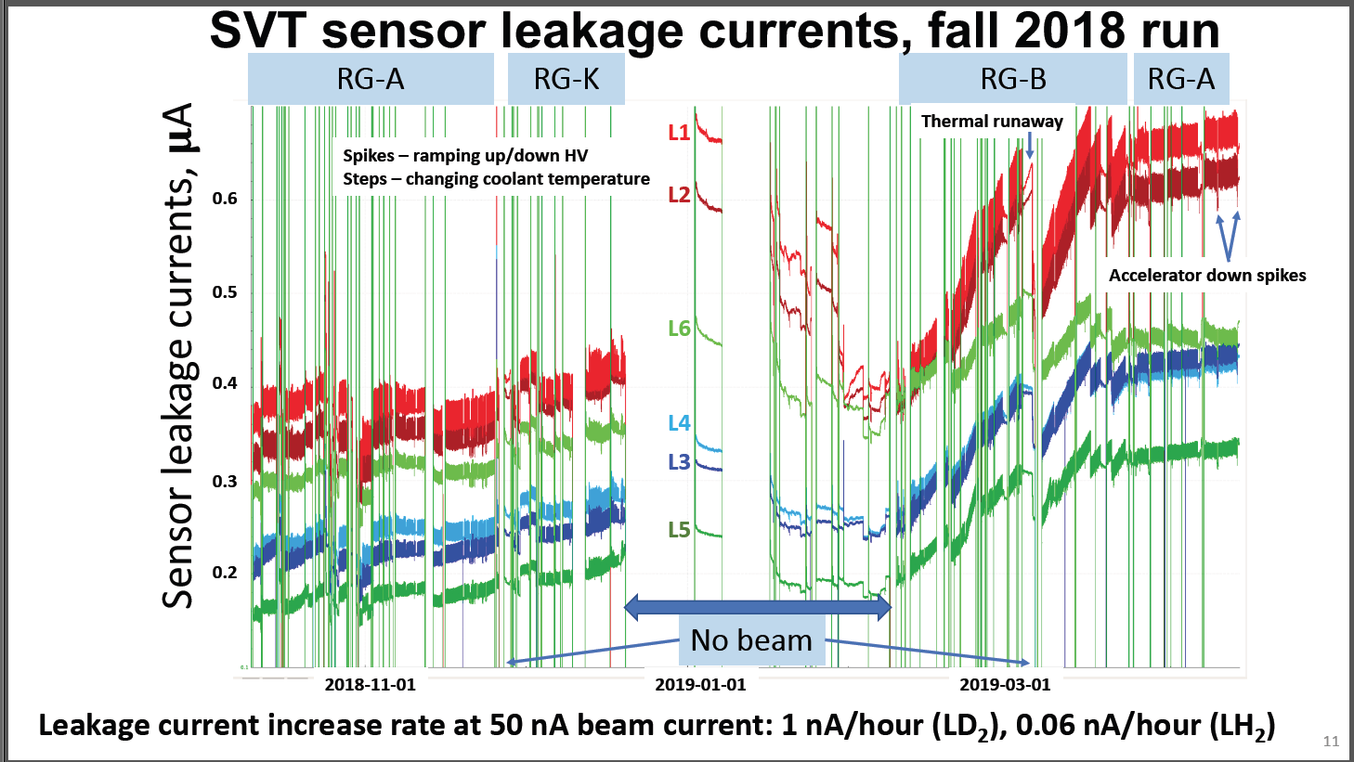
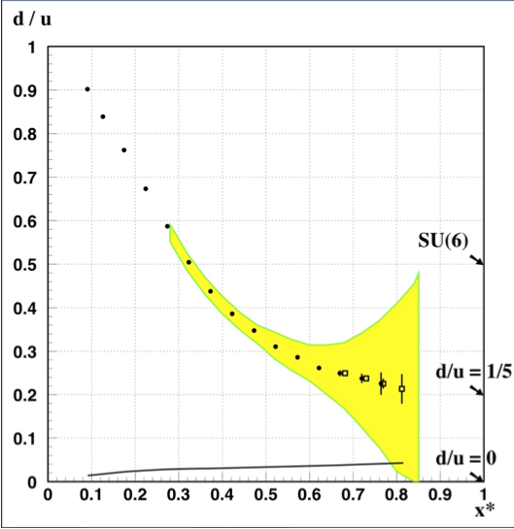
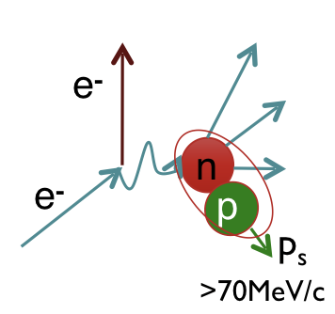
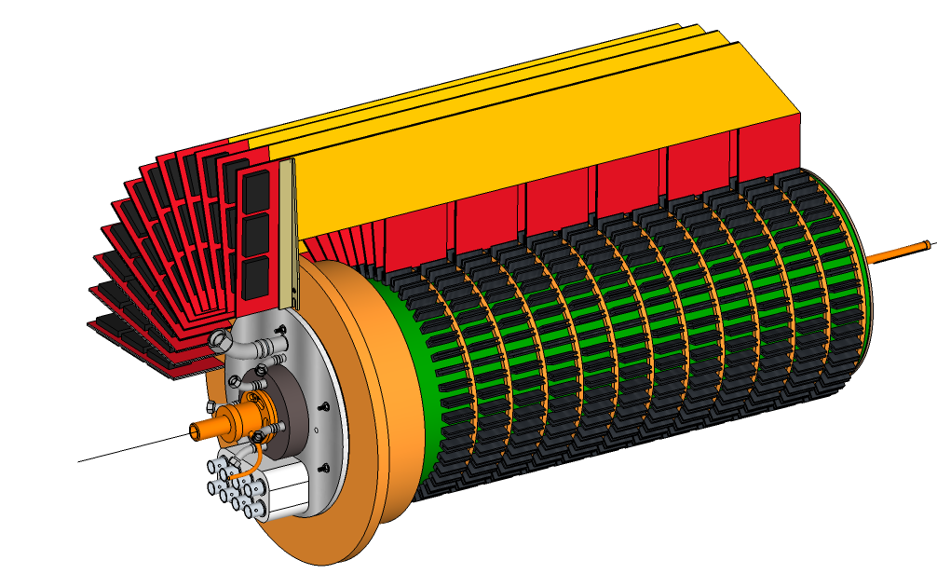
CLAS12 2020 Runs
Hall B
RG-B: January 2020
Nuclear Target Tests: February 2-8
BoNUS: February 12-May 1
Nuclear Target Tests
Measure occupancies and the leakage currents in the silicon sensor
Validate Simulation by measuring radiation dose at various locations around the target
Safe operation of the SVT requires a good estimate of the physical backgrounds and radiation exposure
BoNUS
Validate F2n/F2p ratio by tagging almost unbound neutrons using detection of low momentum protons in a radial TPC (RTPC)
e⁻D→e⁻p_{s}X
Projected results for d(x)/u(x)
at CLAS12
RTPC

Slide 36
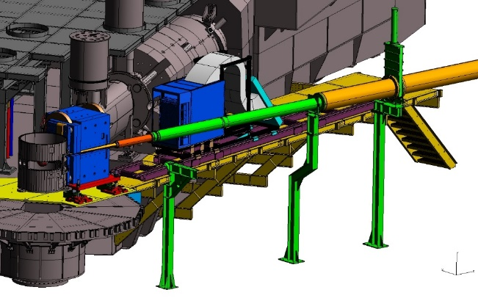
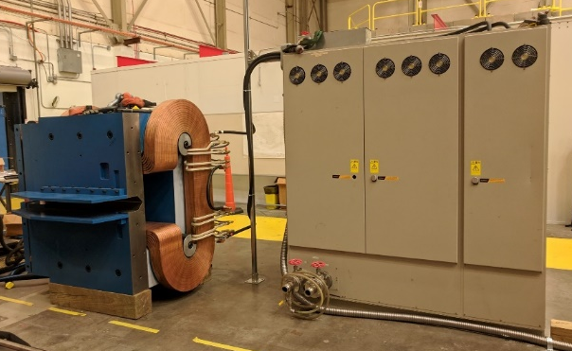
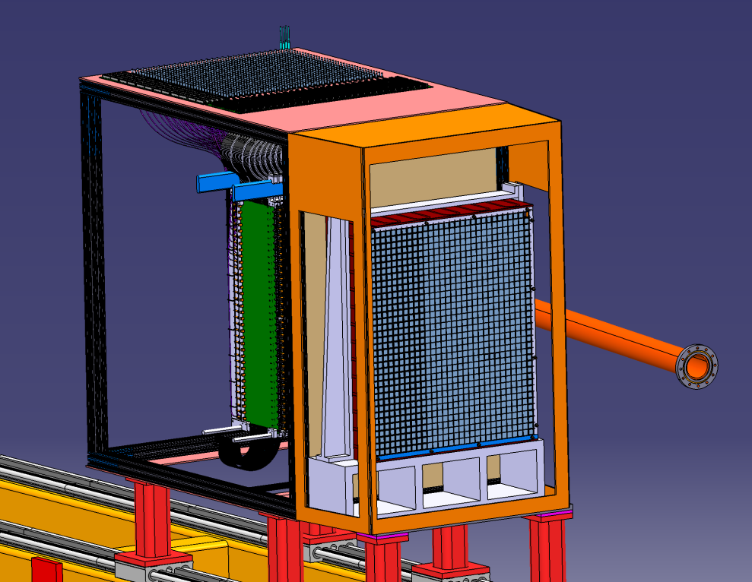
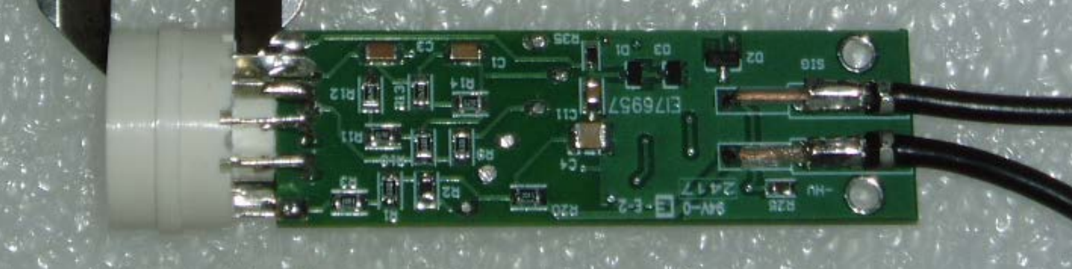
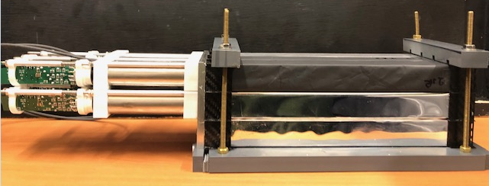
Neutral Particle Spectrometer
Hall C
NPS (Expts E12-13-010/E13-13-007, E12-14-003/E12-14-005) passed ERR, beam time request submitted
NPS Sweep magnet (CUA/ODU MRI) mapped in test lab
Calorimeter frame designed (Orsay).
Crystal testing ongoing (CUA). Crytur PbWO4 crystals in production, 464 received (of which 64 are for Hall D/Fcal) and tested. 500 more coming. NIM paper on crystals accepted. arXiv:1911.11577
Base fabrication (Ohio) complete, PMTs on hand.
Software/DAQ development ongoing (Orsay, JMU, Glasgow, JLab)

Slide 37
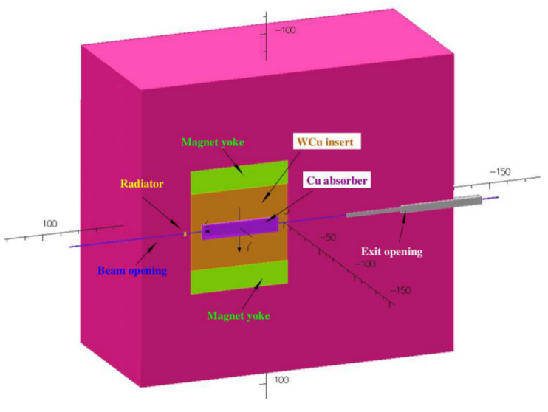
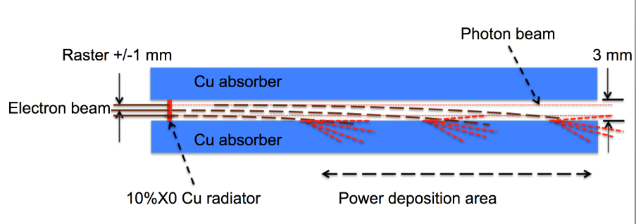
Compact Photon Source
Hall C
Combines in a single shielded assembly all elements necessary for the production of high-intensity photon beams and ensures that the operational dose rates are acceptable
Optimized to minimize weight
CPS concept successfully passed a Technical Review in 2018
Magnet CAD design and preliminary drawings
CPS article submitted to NIMA (arXiv:1912.07355). Article has authors from both Hall C (CPS for polarized target experiments) and Hall D (CPS for K_{L})

