Slide 1
S&C Week, Valencia, last week
The ATLAS Data Carousel Project
Alexei Klimentov and Xin Zhao
NPPS and SDCC
BNL Physics Department
Software and Computing Round Table (JLab)
April 7, 2020

Slide 2
Outline
ATLAS Distributed Computing Software Stack
Data Carousel objectives and motivation
Data Carousel Phases :
performance metrics
highlights and results
More challenges ahead
Backup slides
ATLAS-Google hot/cold storage R&D project

Slide 3
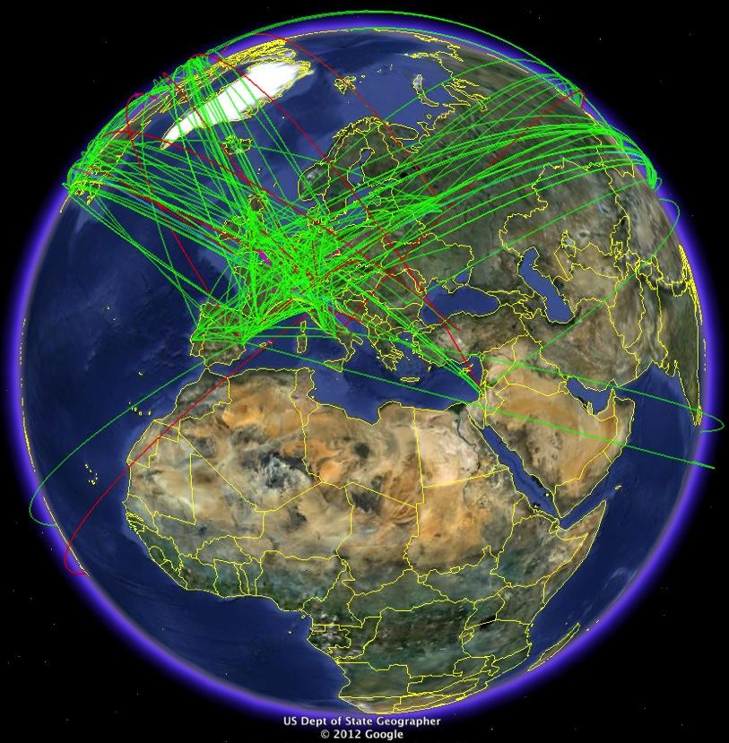
ATLAS distributed computing software tools
Data Management: bookkeeping and distribution of files & datasets. Rucio
Workflow Management: “translates” physicist requests into production tasks. ProdSys2
Information System (ORACLE backend) Queues and resources description. AGIS/CRIC
Workload Management: submission and scheduling of jobs & tasks. PanDA
Distributed resources
Databases: Conditions and data processing (ORACLE, mySQL, PostgresSQL)
Monitoring and Analytics production jobs & tasks, shares, users. BigPanDA, Kibana

Slide 4
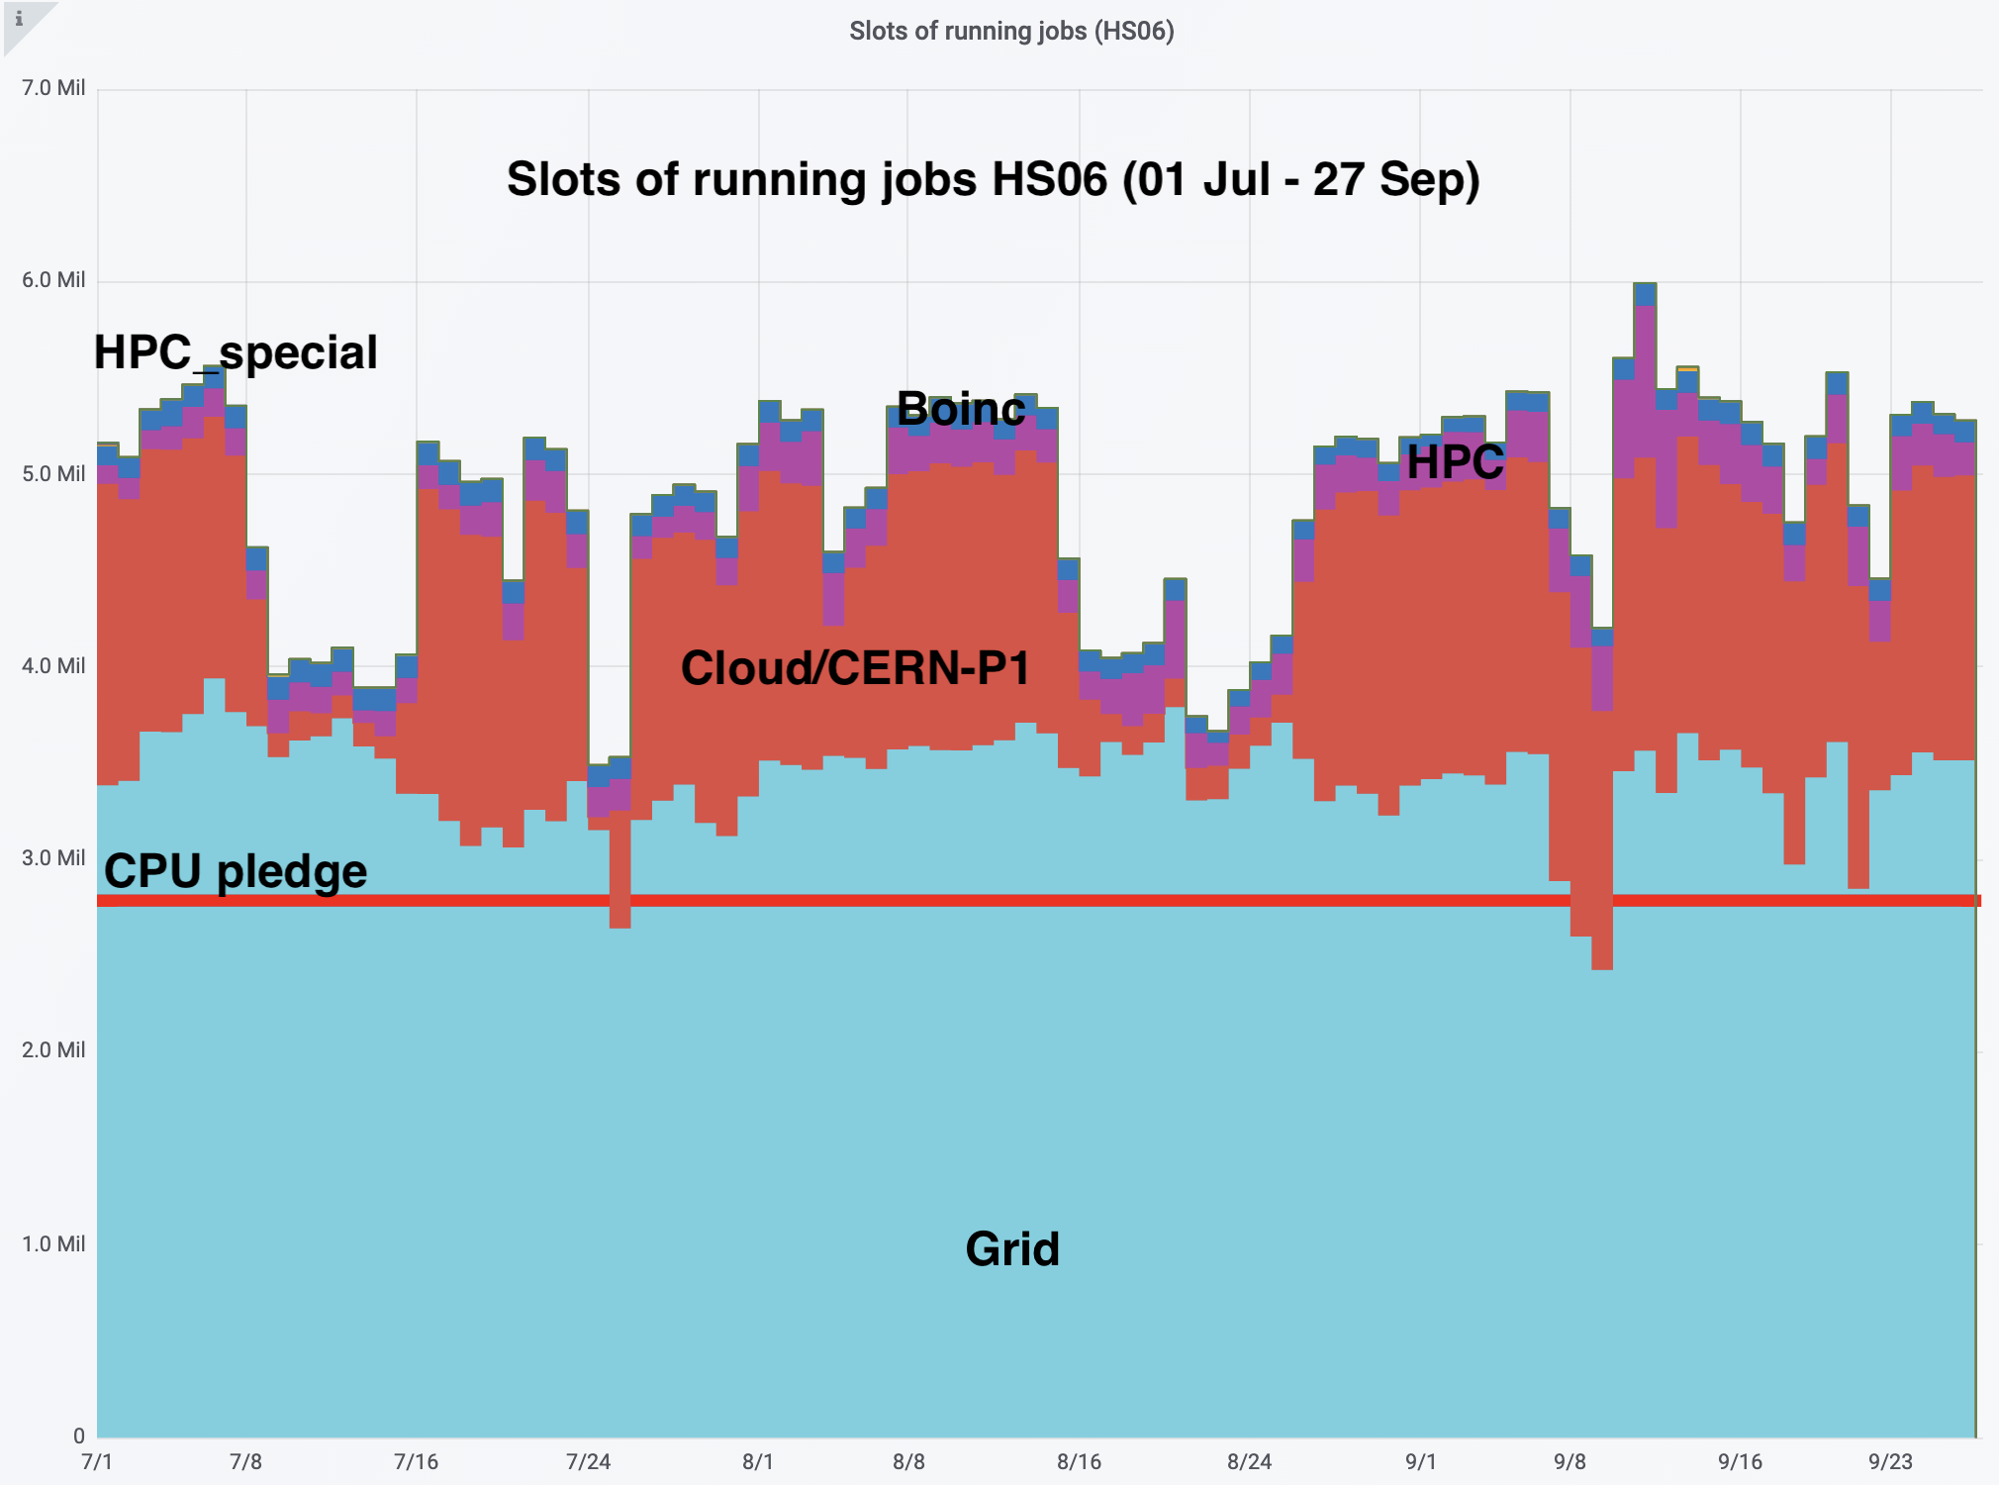
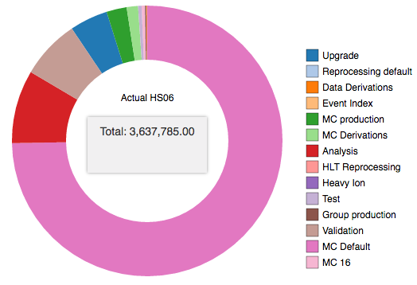
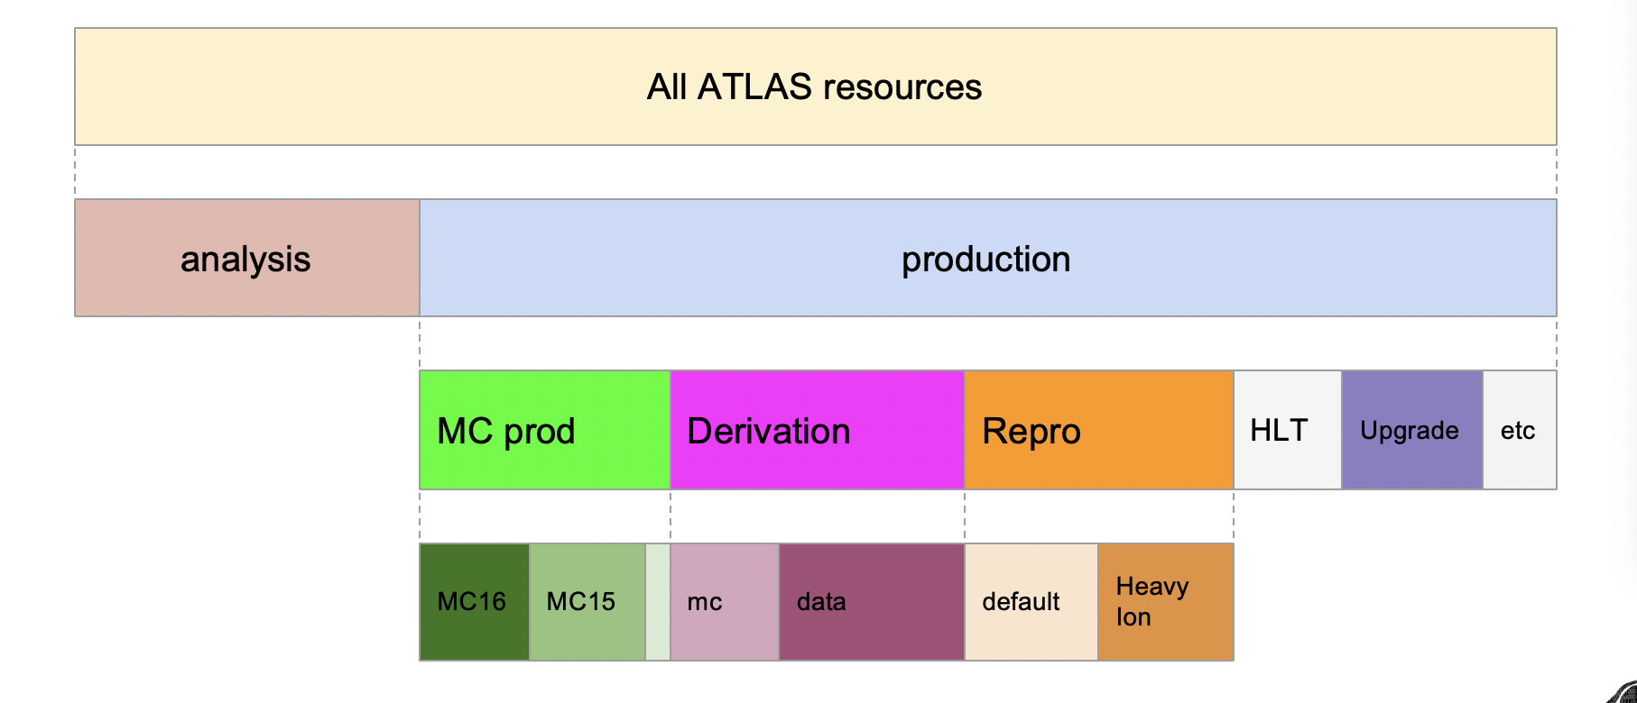
Global ATLAS operations
Up to ~1.2M concurrent jobs
25-30M jobs/month at >250 sites
~1400 ATLAS users
ATLAS Workflow and Workload Management. ProdSys2/PanDA
Physics Group
production requests
Meta-data handling
Distributed Data
Management
Orchestrate all ATLAS
Workflows :
MC Production
Physics Groups WF
Data reprocessing
T0 spill-over
HLT processing
SW validation
User’s analysis
ART
AMI
Rucio
WFM
WMS
pyAMI
DEFT DB
PanDA DB
ProdSys2/ DEFT
Requests,
Production Tasks
JEDI
PanDA server
Tasks
Tasks
Jobs
Shares/priorities
harvester
First exascale workload
manager in HENP
1.4+ Exabytes processed yearly in 2014/18
Exascale scientific data processing today
Analysis tasks
Jobs
ATLAS
production requests
harvester
pilot
harvester
harvester
ARC interface
ARC interface
Pilot scheduler
condor-g
pilot
pilot
pilot
pilot
OSG
NDGF
HPCs
EGEE/EGI
Worker nodes
Support ATLAS rich harvest of resources. Integrate WF and data flow

Slide 5
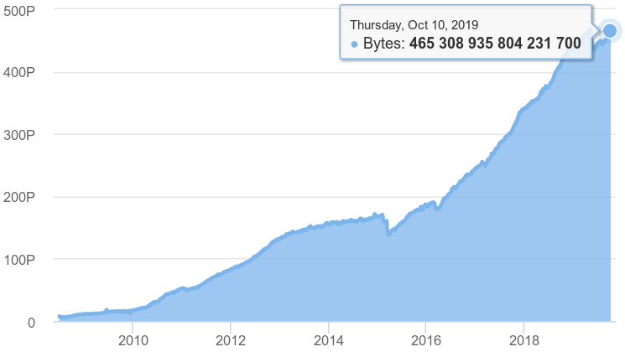
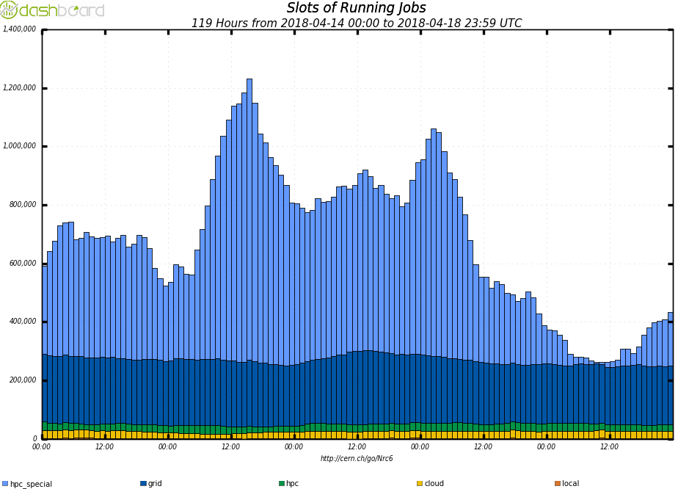
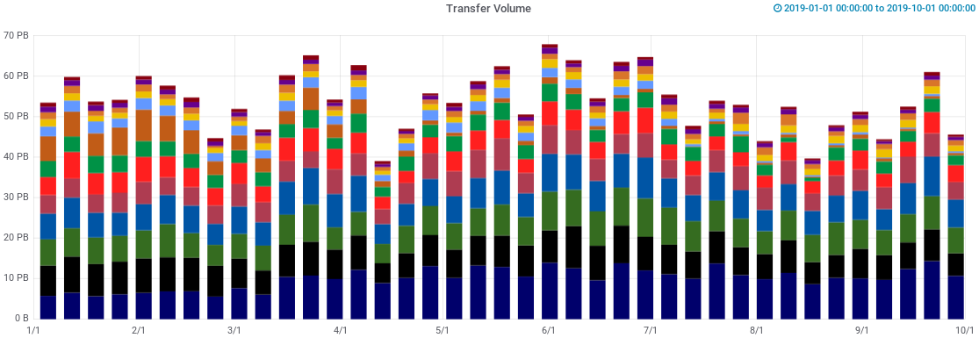
ATLAS Data and Workload Management
A few numbers to set the scale
PanDA
Up to 1.2M jobs/day, 25M-30M jobs/month@250 sites
~1400 users
~1.4 exabytes processed yearly
Rucio
1B+ files, 460+ PB of data, 400+ Hz interaction
120 data centres, 5 HPCs, 2 clouds, 1000 users
500 Petabytes/year transferred & deleted
2.5 Exabytes/year downloaded & uploaded
PB
LHC Run2
LHC Run1
Approaching a total of
0.5 EB of data in Rucio
Both systems are highly scalable
The first exascale scientific data and workload management systems today
Data Access Volume
2020
1.2M
Apr 2018
50 PB/week
Steady state of 400k+ running job slots
since the turn of the year

Slide 6
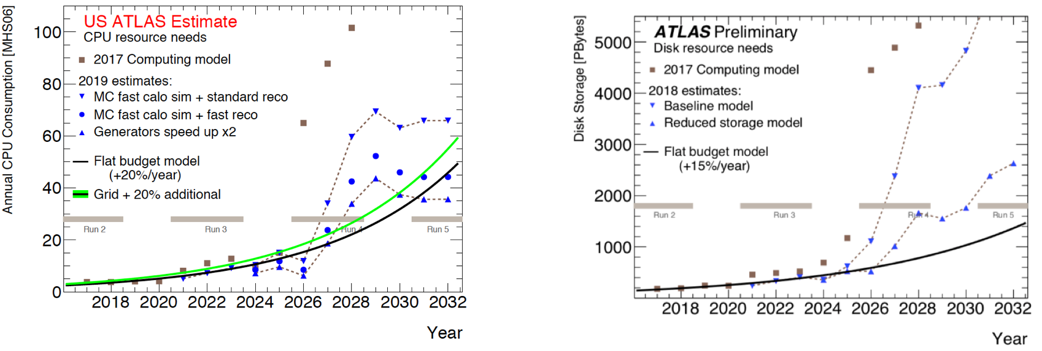
The High Luminosity LHC Challenge
High Luminosity LHC will be a multi-exabyte challenge where the envisaged Storage and Compute needs are a factor 10 to 100 above the expected technology evolution.
LHC experiments have successfully integrated HPC facilities into its distributed computing system. “Opportunistic storage” basically does not exist for LHC experiments.
The HEP community needs to evolve current computing and data organization models in order to introduce changes in the way it uses and manages the infrastructure, focused on optimizations to bring performance and efficiency not forgetting simplification of operations.

Slide 7
HL-LHC R&D Computing Projects
Data Lake. The aim is to consolidate geographically distributed data storage systems connected by fast network with low latency. The Data Lake model as an evolution of the current infrastructure bringing reduction of the storage and operational costs.
Intelligent Data Delivery Service (iDDS). The intelligent data delivery system will deliver events as opposed to delivering bytes. This allows an edge service to prepare data for production consumption (filtering out unnecessary events and objects), the on-disk data format to evolve independently of applications, and decrease the latency between the application and the storage.
Third Party Copy. Improve bulk data transfer between sites and find a viable replacement to the GridFTP protocol.
Operations Intelligence. Reduce HEP experiments computing operations effort by exploiting anomaly detection, time series and classification techniques to help the operators in their daily routines, and to improve the overall system efficiency and resource utilisation.
Data Carousel. Use tape more effective and active. An orchestration between workflow/workload management (WFMS), data management (DDM) and data archiving services whereby a bulk production campaign with its inputs resident on tape, is executed by staging and promptly processing a sliding window of X% (5%?, 10%?) of inputs onto buffer disk, such that only ~ X% of inputs are pinned on disk at any one time
Hot/Cold storage. Data placement and data migration between “Hot-Cold” storage using data popularity information (ATLAS – Google project)
Data format and I/O. Evaluating new formats (f.e. parquet) for HENP (ATLAS-Google project)
….

Slide 8
Data Carousel R&D Project
By ‘data carousel’, we mean an orchestration between workflow/workload management (WFMS), data management (DDM) and data archiving services whereby a bulk production campaign with its inputs resident on tape, is executed by staging and promptly processing a sliding window of X% (5%?, 10%?) of inputs onto buffer disk, such that only ~ X% of inputs are pinned on disk at any one time.
The project was initiated at BNL for RHIC experiments (in full production for STAR and PHENIX for more than 10 years. They manage to fetch files pretty much at tape speed for weeks in a row), today it is one of vital R&D projects to address High Luminosity LHC data processing challenge (scope and scale are different)
Ultimate goal : use tape more efficient and active
Cycle through tape data, processing all queued jobs requiring currently staged data
‘Carousel engine’: job queue regulating tape staging for efficient data matching to jobs?
Brokerage must be globally aware of all jobs hitting tape to aggregate those using staged data
No pre-set target on tape throughput, instead, we focus on efficiently using the available tape capacities
Introduce no or little performance penalty to tape throughput, after integrating tapes into our workflow
Improve efficiency and throughput of tape systems, by orchestrating the various components in the whole system stack, starting from better organization of writing to tapes
Solutions should scale proportionally with future growth of capacities of tape resources
‘Data Carousel’ LHC R&D was started in the second half of 2018 → to study the feasibility to use tape as the input to various I/O intensive workflows, such as derivation production and RAW data re-processing
…and “tape” could be any “cold” storage (it is led by A.Klimentov, M.Lassnig and X.Zhao)

Slide 9
Data Carousel R&D Project. Cont’d
DDM system : Rucio → more intelligent tape I/O
Bulk data staging requests handling
Use FTS features on more intelligent way
File Transfer Service → optimize scheduling of transfers between tape and other storage endpoints
DDM / WFM / Facilities integration. Optimize data placement to tape
Do data grouping for files known to be re-read from tape
Optimize file size (Larger file size, 10GB+ preferred)
Use novel (or request new) features of storage systems (dCache, EOS, CTA,…)

Slide 10
Data Carousel Project Phases
Phase I : Tape Sites Evaluation
Conduct tape staging tests, understand tape system performance at sites and define primary metrics
Phase II : ProdSys2/Rucio/Facilities integration
Address issues found in Phase I
Deeper integration between workflow, workload and data management systems (ProdSys2/PanDA/Rucio), plus facilities
Identify missing software components (if any)
Phase III : Run production, at scale, for selected workflows
Address it in cold/hot storage context
Now we are at the beginning of Phase III (‘run production at scale)
Goal : to have data carousel in production for LHC Run3

Slide 11
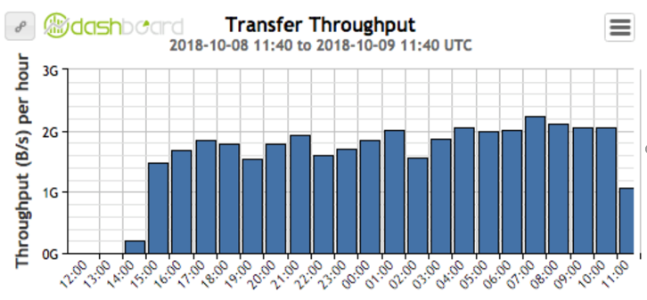
Data Carousel Phase I. Jun-Nov 2018
Established baseline measurement of current tape capacities
All ATLAS T1s (but NRC-KI and ASGC) and T0 (CERN) participated
Overall throughput from all T1s (as of Nov, 2018) reached ~600TB/day
CERN conducted its own Tape Archive (CTA) test, reached ~2GB/s throughput
Site | Tape Drives used | Average Tape (re)mounts # | Average Tape throughput | Stable Rucio throughput | Test Average throughput
BNL | 31 LTO6/7 | 2.6 | 1~2.5GB/s | 866MB/s | 545MB/s (47TB/day)
FZK | 8 T10KC/D | >20 | ~400MB/s | 300MB/s | 286MB/s (25TB/day)
INFN | 2 T10KD | Majority tapes mounted once | 277MB/s | 300MB/s | 255MB/s (22TB/day)
PIC | 5~6 T10KD | Some outliers (>40 times) | 500MB/s | 380MB/s | 400MB/s (35TB/day)
TRIUMF | 11 LTO7 | Very low (near 0) remounts | 1.1GB/s | 1GB/s | 700MB/s (60TB/day)
CCIN2P3 | 36 T10KD | ~5.33 | 2.2GB/s | 3GB/s | 2.1GB/s (180TB/day)
SARA-NIKHEF | 10 T10KD | 2.6~4.8 | 500~700MB/s | 640MB/s | 630MB/s (54TB/day)
RAL | 10 T10KD | n/a | 1.6GB/s | 2GB/s | 1.6GB/s (138TB/day)
NDGF | 10 IBM Jaguar/LTO-5/6 (@4 sites) | ~3 | 200~800MB/s | 500MB/s | 300MB/s (26TB/day)
CERN CTA test
Average Tape Throughput: throughput directly from local site tape monitoring
Stable Rucio Throughput: from rucio dashboard, over a “stable” run time
Test Average Throughput: total volume staged / total walltime of the test

Slide 12
Data Carousel Phase I. Lessons Learned
Tape frontend --- a potential bottleneck for an effective tape usage
Limiting number of incoming staging requests
Limiting number of staging requests to pass to backend tape
Limiting number of files to retrieve from tape disk buffer
Limiting number of files to transfer to the final destination
Data organization (file placement on tape) is vital
Good throughput seen from sites who organize writing to tape (especially in case grouping data by datasets)
Usually the reason for performance difference between two sites that have similar hardware and software setup

Slide 13
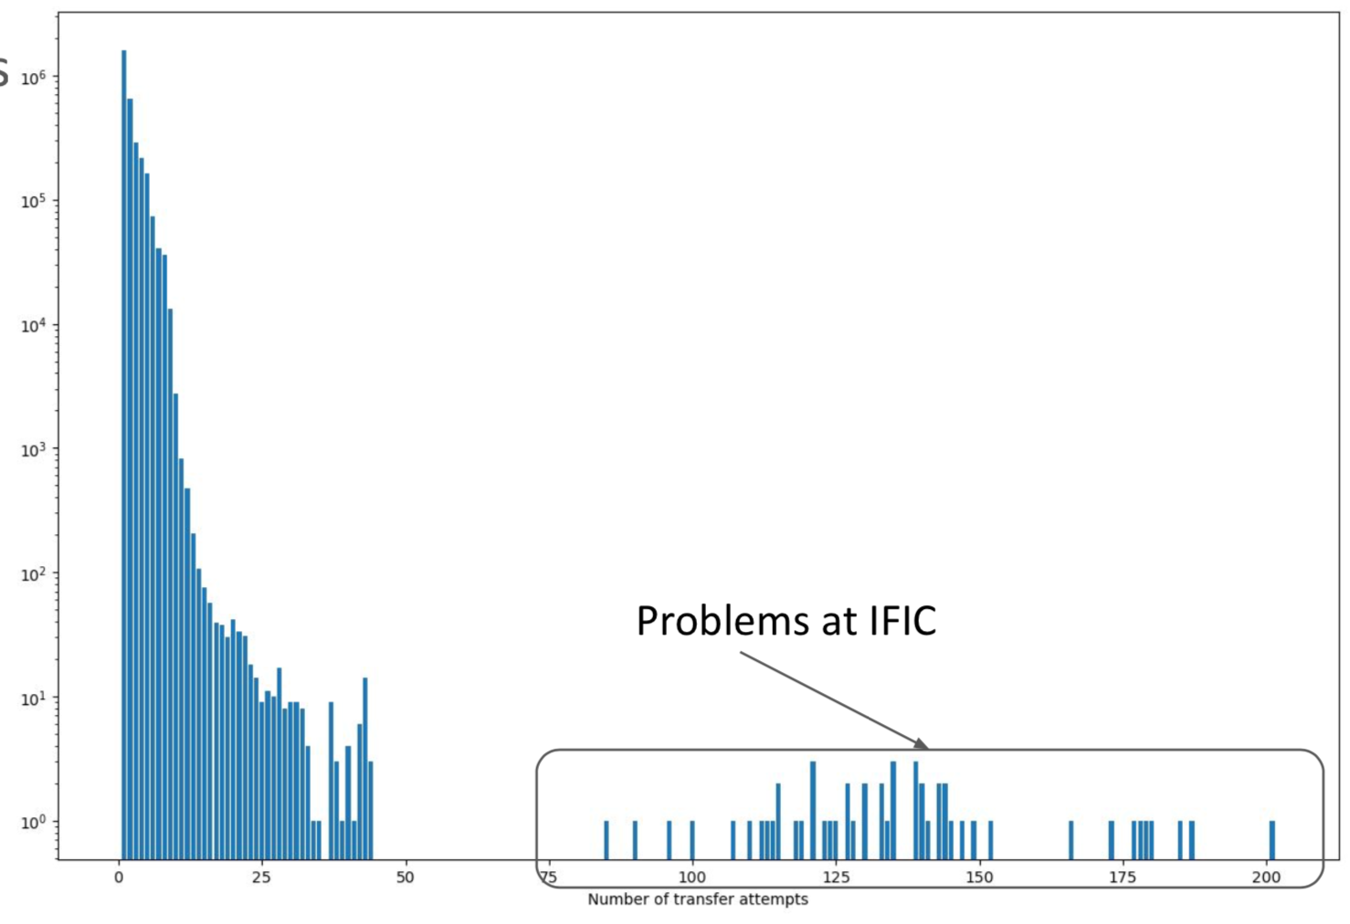
Data Carousel Phase II. Aug-Oct 2019
Deeper integration of workflow/workload management (ProdSys2/JEDI/PanDA), data management (Rucio) systems and facilities
ProdSys2/Rucio communication protocol
New algorithms for data staging to respect global shares and priorities, resources, and sites tape performance (staging profile)
Two rounds of data carousel exercises have been conducted :
the second round was combined with data reprocessing campaign
It took 5 days to have 70-90% data staged
FTS and dCache limitations
Staging throughput (GB/s) from three Tier-1s (colored) over time (Aug 8 – 13, 2019)
Long delay between 90% and
100%, which happened to
many sites
# of attempts
to transfer file
Frontend crashes

Slide 14
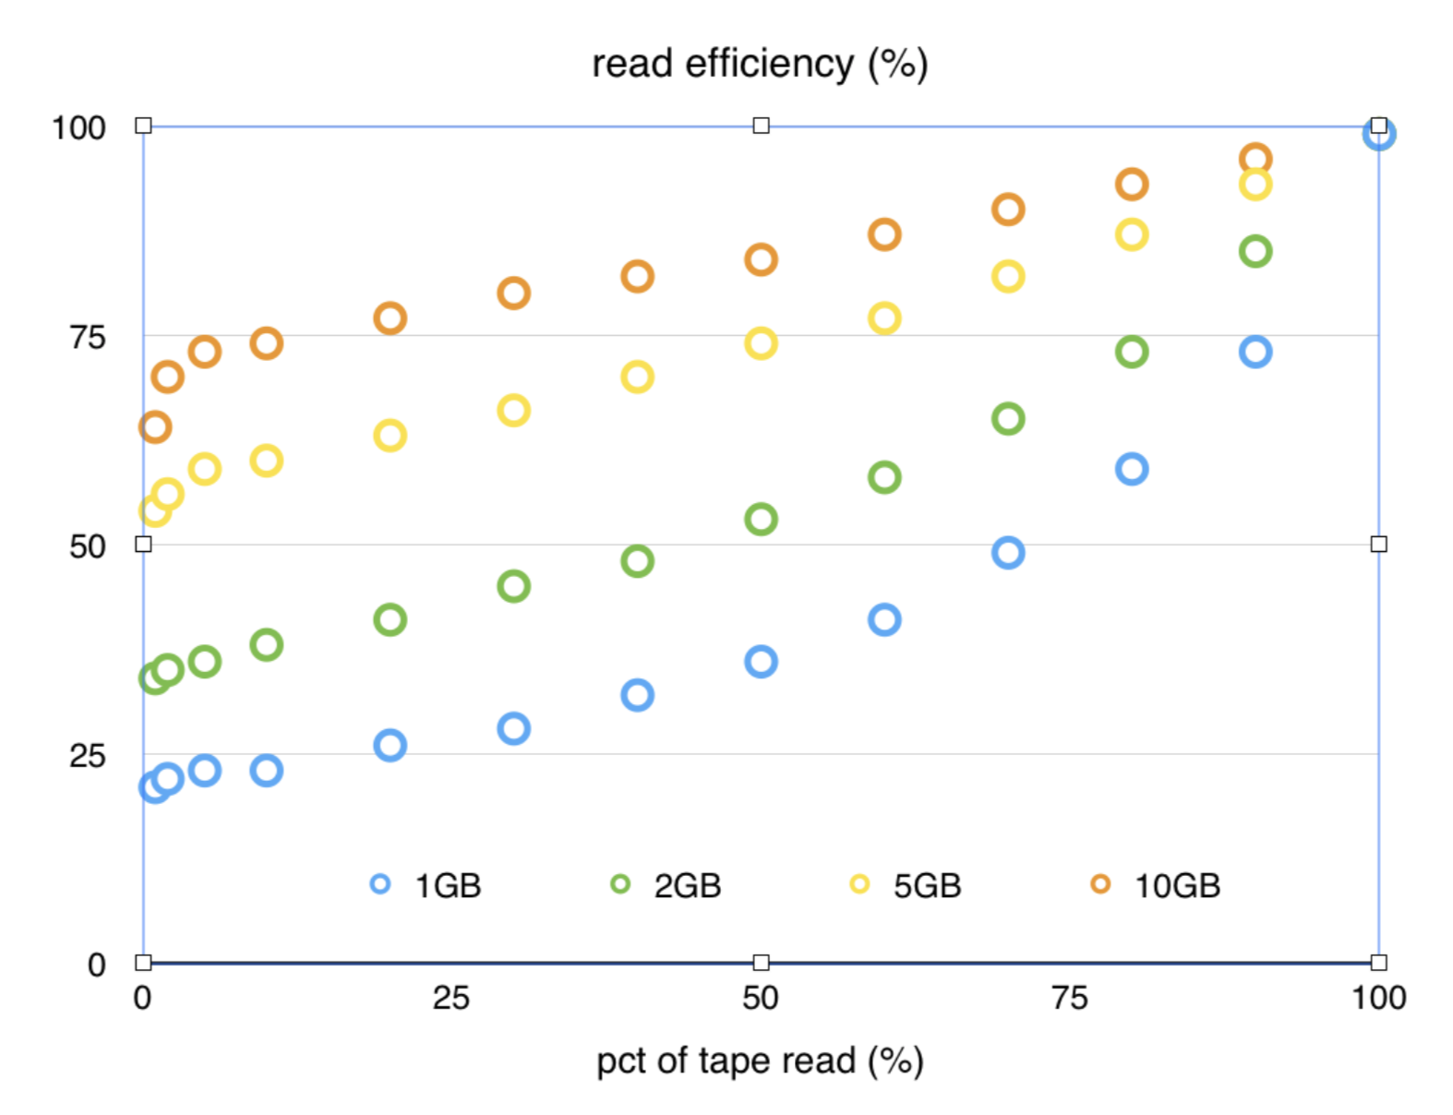
Data Carousel. Smart writing
Efficient data carousel is not possible without smart writing
It is a team effort between storage SW developers, sites and experiments (TRIUMF has a very interesting experience)
It is still under discussion how ‘ATLAS’ can pass meta information to ‘sites’
Possible options
Tape families --- too high of a layer than datasets, won’t help much
Bigger files
- Zip small output files before writing to tape.
- Target 10GB
Co-locating files from the same dataset on tape
- Since they will be recalled together, equivalent to “bigger fat file”
- We have a site that put all files of a dataset on one tape (or 1+ for bigger dataset). Reach almost stream reading speed of a tape drive per tape mount
%
(Plot is courtesy of Luc Goossens (CERN))

Slide 15
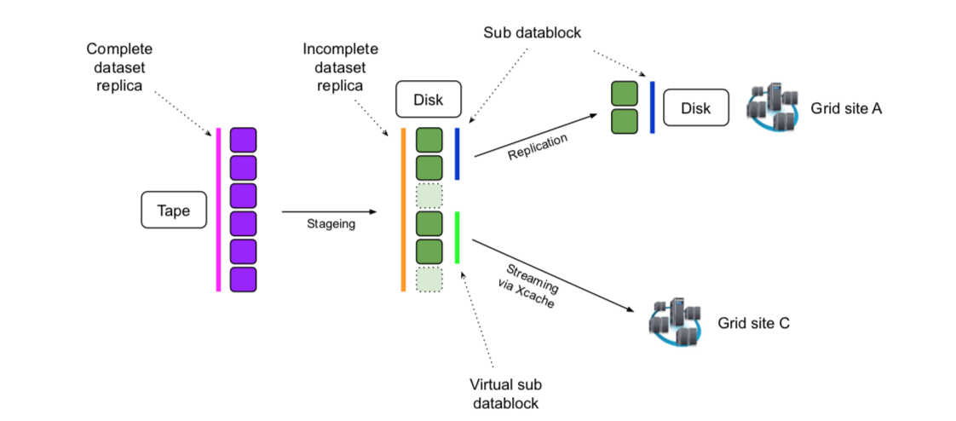
Data Carousel and iDDS (I)
A dataset is a unit of ATLAS data processing and replication
Data carousel works with datasets and ProdSys2 sends staging request per dataset although files are used in downstream systems
Files in each dataset are prestaged by the tape system rather randomly
Prodsys is an upstream component which is far from actual resources.
A possible solutions is an orchestration by iDDS with inter-service messaging
Mapping Data Carousel to iDDS workflow :
Original collection : Files on TAPE, New collection : File replicas on DISK
Delivery service : Rucio/FTS (near term) WAN/Xcache (for streaming mode)
Notification : The list of prestaged files
Courtesy of T.Maeno

Slide 16
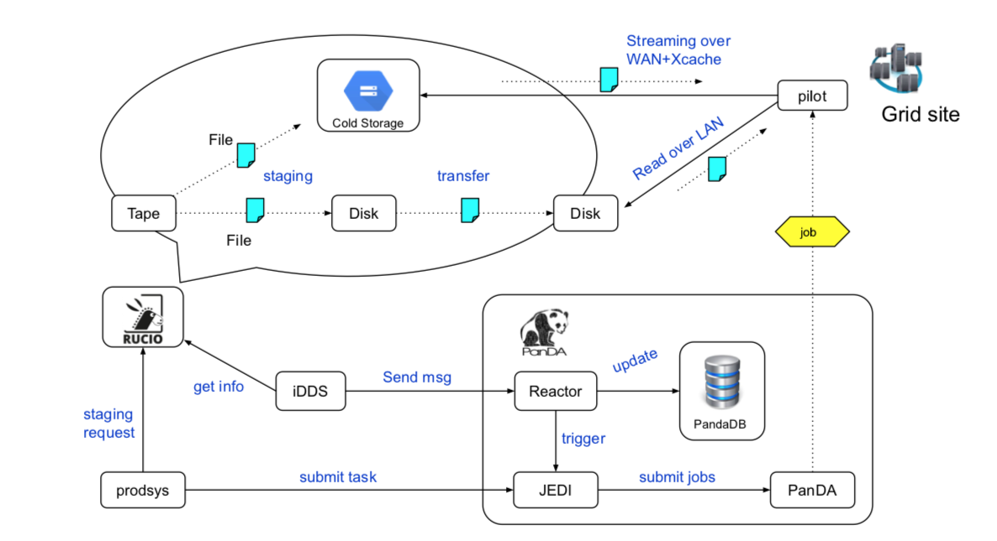
Data Carousel and iDDS (II)
Y2020+
Courtesy of T.Maeno
Improve data streaming granularity
from sub-block to file
A new PanDA component – Reactor
To receive messages from iDDS via ActiveMQ and take actions, e.g. update file and task information, dictate file grouping, and trigger job generation

Slide 17
Data Carousel Phase III. Run Production at scale. Feb-Apr 2020
Reprocessing of complete LHC Run2 ATLAS data (~18.5 PB in total)
Perform in data carousel mode to avoid data staging in advance
Respect reprocessing share and priority vs other workflows
Group production
Monte-Carlo simulation
Different scenarios
All Tier1s and CERN
Tier1s only
Data Carousel with iDDS component

Slide 18
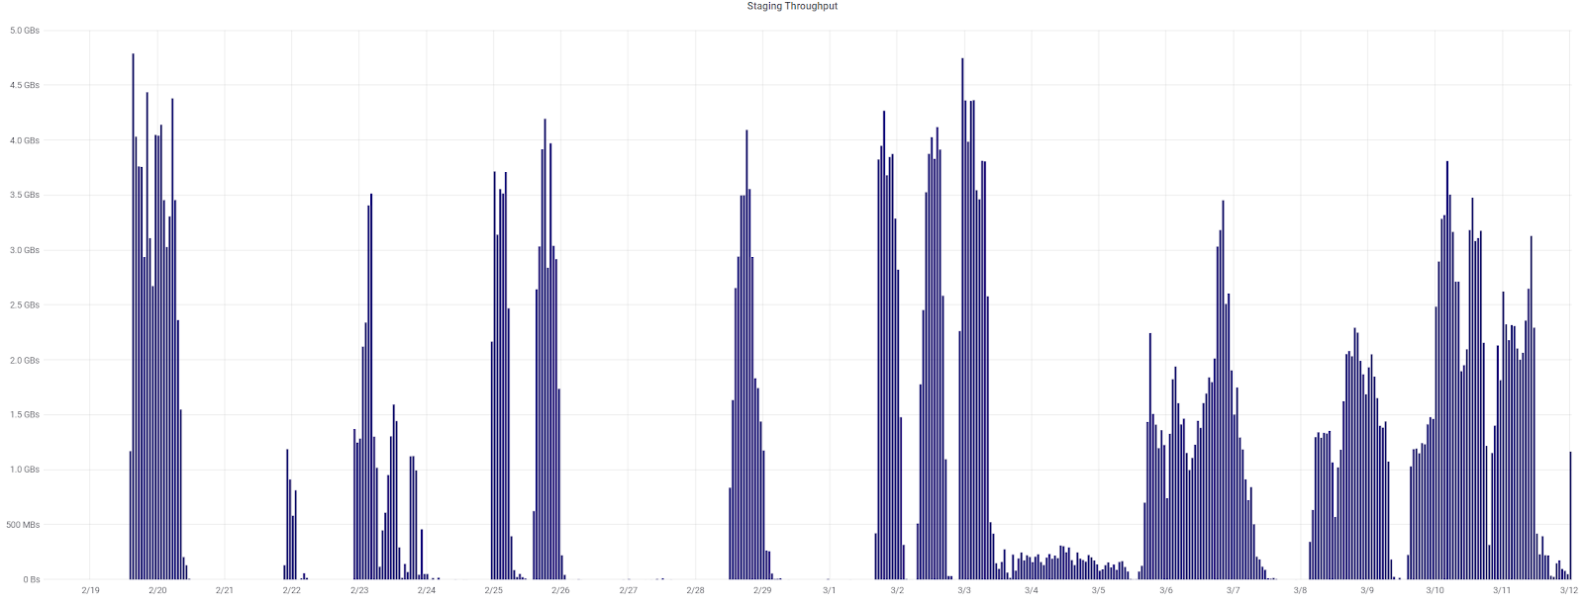
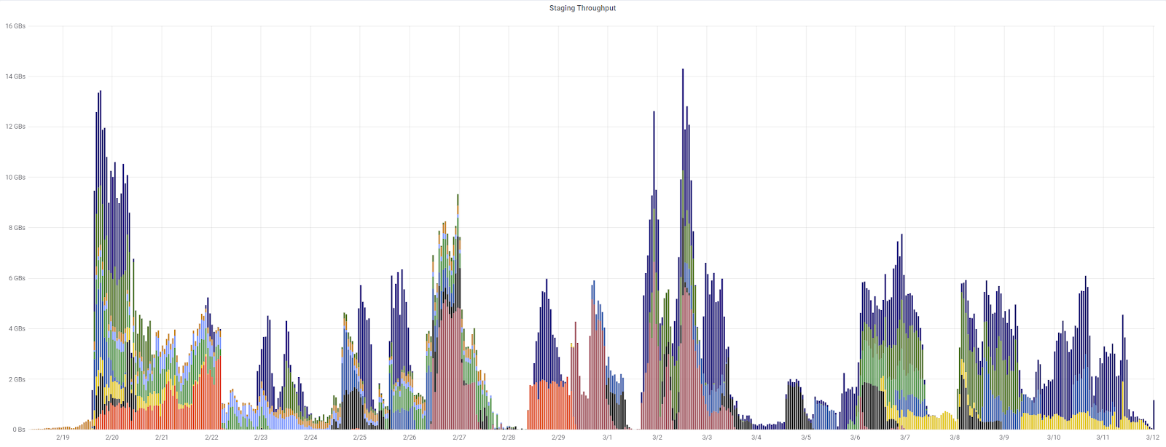
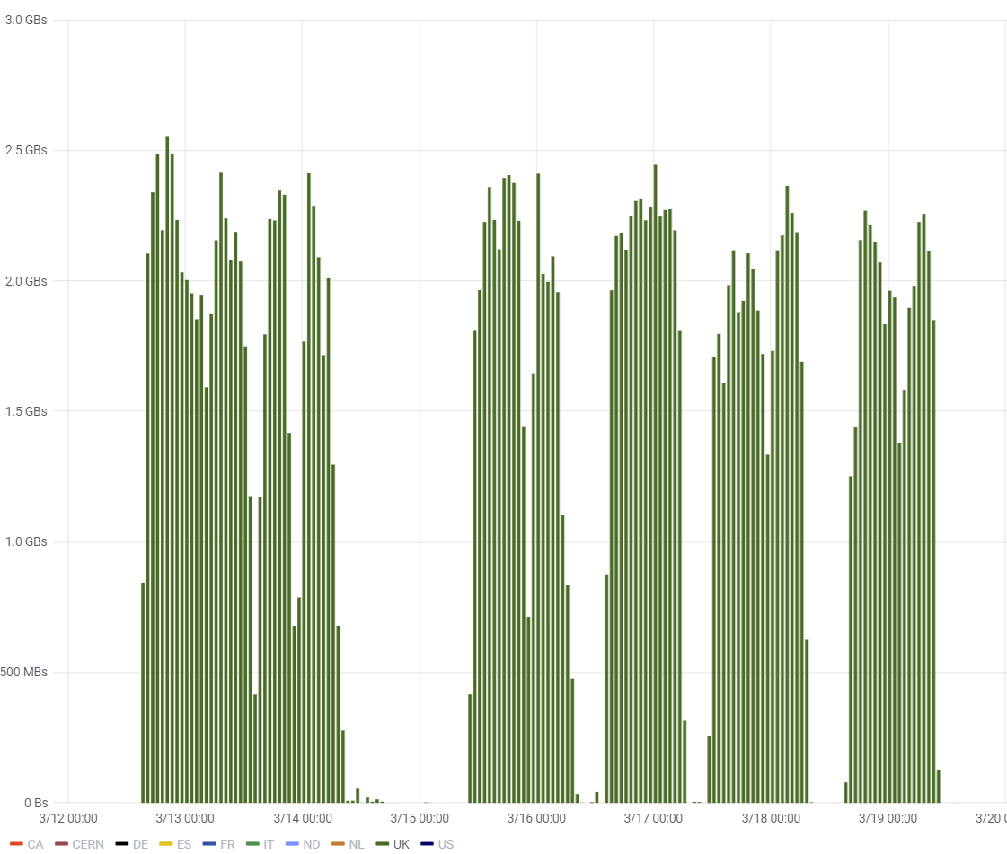
Data Carousel Phase III Highlights
Staging rate peak at 10+ GB/s
Limitations : reprocessing share, available disk space
Staging profile is a very close to an ideal “pulse shape”
Sites and dCache team continue
to tune tape system and tape frontend
Data staging throughput : all sites
Data staging
throughput
of one site

Slide 19
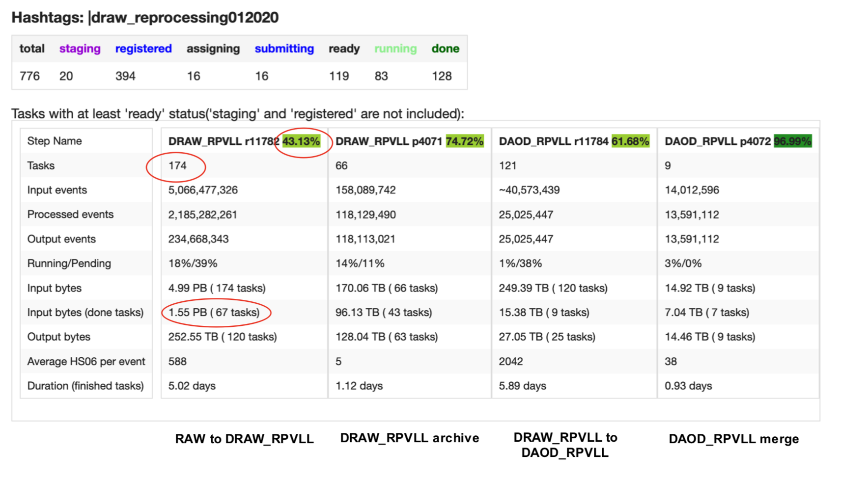
Data Carousel Phase III Highlights. Cont’d
iDDS integrated with Production System (ProdSys2), the last group of datasets is processed in April, data processing starts once the first files are staged on disk, no longer wait for the whole dataset to finish staging
iDDS is working. Processing jobs start earlier
More effect/impact to be analyzed later
Overall throughput drops:
Sites having downtime
data15 are on older generation tapes at many sites, meaning the staging rate is lower than the newer data
Advanced monitoring and task (campaign) execution time estimation
Daily data staging throughput (Prodsys2/iDDS)
Mar 30- Apr 4, all sites

Slide 20
More Challenges Ahead
We successfully and quickly passed “a pilot project phase” between ATLAS, FTS, dCache, CTA and T0, T1 centers
…and obtain metrics vital for the project
Many unknown unknowns problem retired/solved (FTS database limitation is only an example). Known unknowns (smart writing, meta-information passing…) still remain
We demonstrated a “real Data Carousel” mode in action, in a production environment with many other concurrent activities (data writing, data rebalancing, data consolidation, etc)
We respected reprocessing share and we are limited by the available disk space, that’s why we didn’t stress tape services hard enough. In the future, we need to put more pressure on tape sites, to find new bottlenecks, with the goal to see the same pulse-shape performance, at a much larger scale. May be repeat Phase I exercise.
New software module (iDDS) is being evaluated and integrated with the ATLAS Production System, which can potentially mitigate the latency issue of staging inputs from tape directly
New algorithms to be developed for an intelligent decision making

Slide 21
Thanks
It is a collaborative effort in ATLAS (Operations, Distributed Computing, Software developers), sites (T0 and T1s), dCache, FTS and CTA teams. Thank to all

Slide 22
Back up slides

Slide 23
Hot/Cold Storage R&D Project
Five tracks (US-ATLAS / Google White Paper, March 2019) :
Advanced data management across hot/warm/cold data sources;
Integration of machine learning and quantum computing for particle track reconstruction, filtering and data handling;
The first US ATLAS – Google workshop in Mar @CA
HEP data formats and I/O optimizations for object storage systems;
See I/O track materials on Mar 24th
Scaling end-user analysis across systems globally over heterogeneous computing infrastructure (WLCG grid sites, commercial cloud resources, HPCs);
Supporting local elasticity and autonomy of resources at WLCG sites
U Tokyo Experience and accomplishments
Primary goals :
to allow ATLAS to explore the use of different computing models to prepare for High-Luminosity LHC,
to allow ATLAS user analysis to benefit from Google Cloud Platform, and to provide Google with demanding scientific use-cases in order to evaluate and improve their current and future R&D efforts and product offerings.
ATLAS (and HEP experiments in general) needs to manage its data samples across a variety of mediums based on the types of data and its uses: from tape (or other cold storage technologies) to disk (spinning and ssd), to caches (including world wide accessed data in clouds and “data lakes”) …
CY2020
PoC

Slide 24
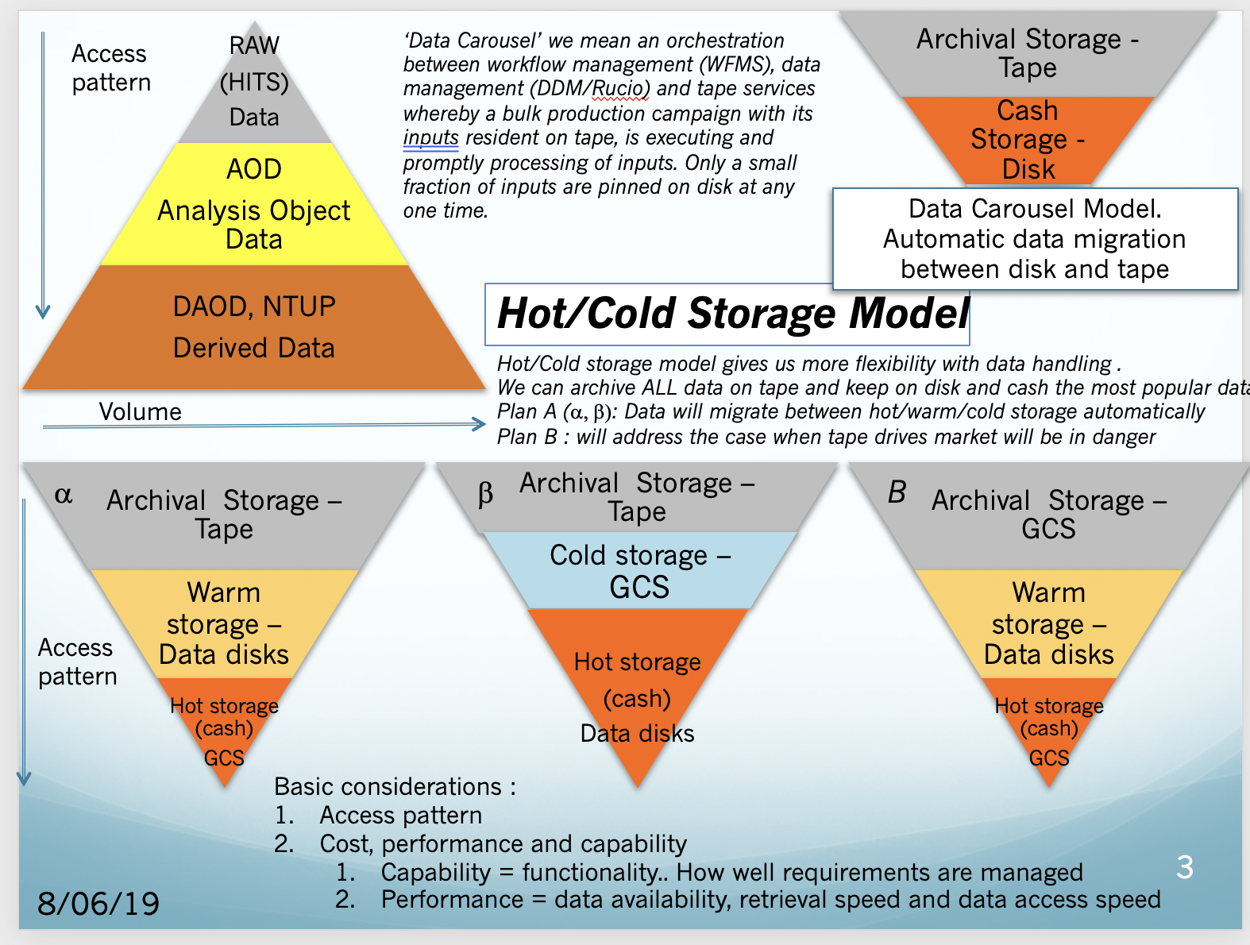
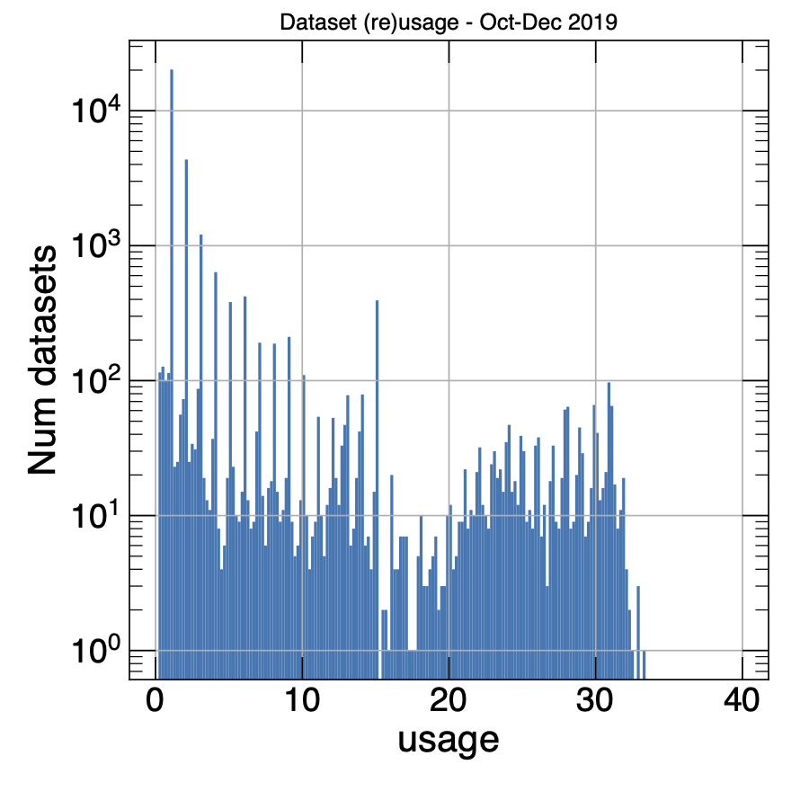
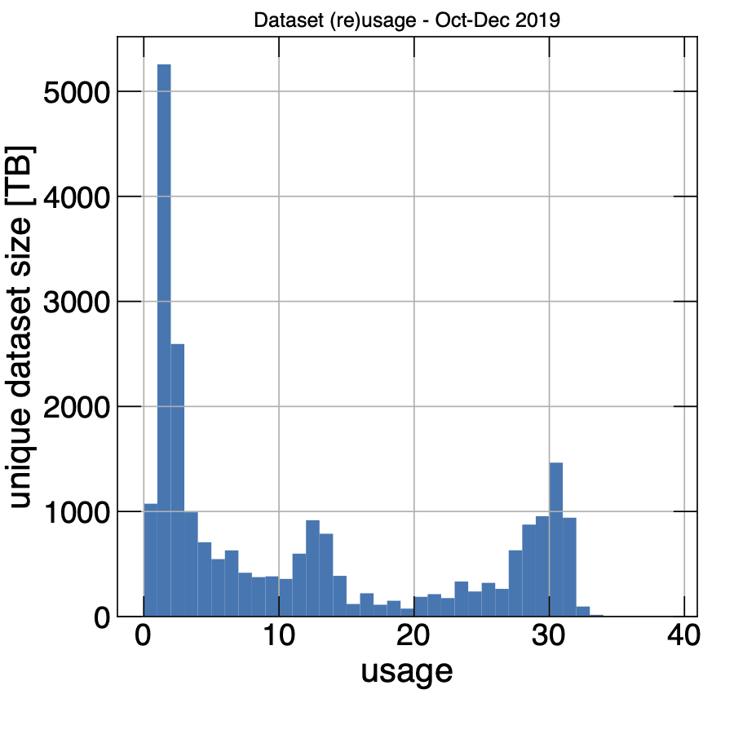
The distribution shows how
often a dataset has been
(re)used
The distribution shows the
unique sum of (re)used dataset sizes dependent on how often the datasets have been used.
AOD dataset usage in derivation production from October-December 2019 (J.Elmsheuser).

Slide 25
Hot/Cold Storage Track
Use of GCS as cold data storage between Archival storage (TAPE) and hot storage (ATLAS disks). Evaluate various scenarios of data access on GCS (remote and local) and for different ATLAS activities, such as derivation production (AOD → DAOD data conversion), physics analysis (DAOD data access by ATLAS physicists) (steps 1-3)
Storing ‘medium-warm’ data in Analysis Object Data (AOD) format on GCS, produce ‘hot’ data in Derivation Analysis Object (DAOD) format and store them on ATLAS data disks (step 4)

Slide 26
