Slide 1
SRO for CLAS12
Sergey Boyarinov, Ben Raydo
JLAB
May 13, 2020

Slide 2
Solution
Work scope and timeline
Implement streaming readout for Forward Tagger (Nov 2019 – Jan 2020)
Take beam data with FT (Feb 2020)
Continue streaming readout development in communication with other groups (current)
Convert VTP (VXS Trigger Processor board) into streaming readout board
Modify CODA software to move from Event Builder – based model to streaming one
Make CODA to supply data to streaming back-end framework (TriDAS)
NOTE: VTP-based streaming readout is NOT CLAS12 long term upgrade plan, it will be decided later based on the development over next few years

Slide 3
CLAS12 DAQ/Trigger Hardware Diagram

Slide 4
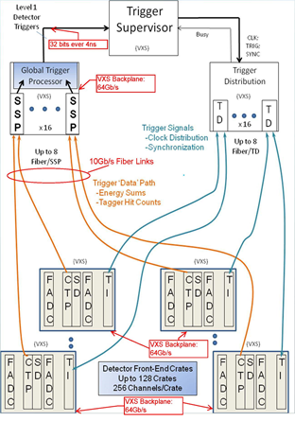
Using VXS crates with VTP boards for streaming readout
TCP/IP
Linux server
x
In existing trigger-based mode, all FADCs sends trigger information to VTP, which sends it to the following trigger system stage; FADC readout is performed by VME controller over VME bus
In streaming mode, there is no trigger information, and FADC readout is performed by VTP

Slide 5
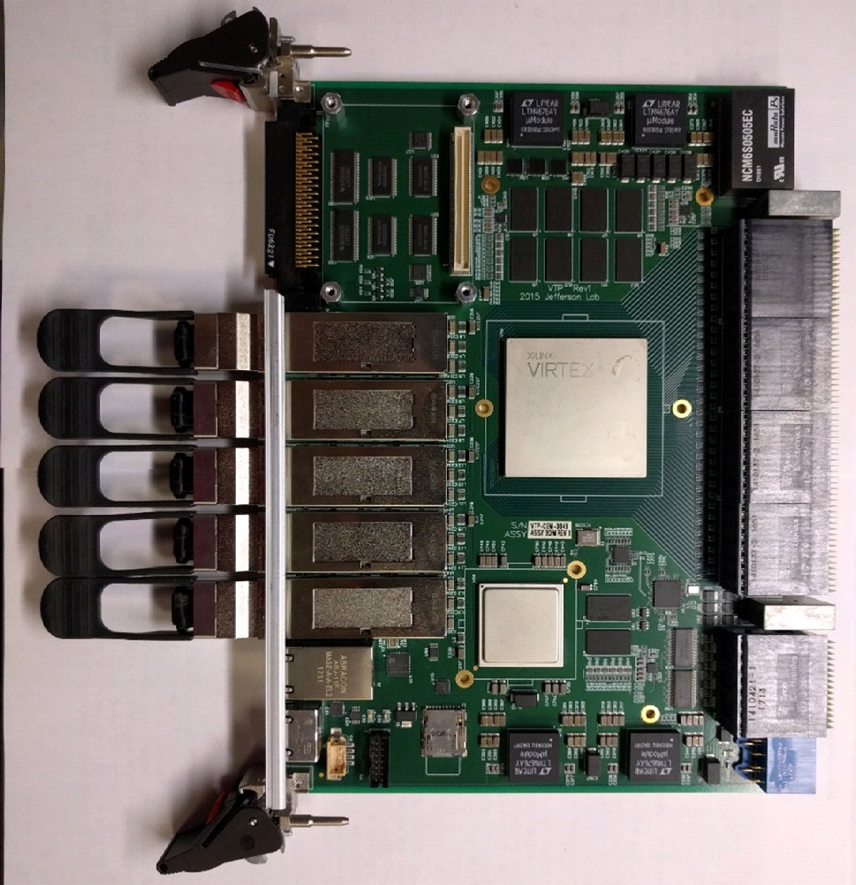
Upgrading VTP board for streaming readout
In existing trigger-based mode, VTP sends trigger information from QSFP1 to the following trigger system stage
In streaming mode, VTP sends stream of data from QSFP1 to Linux server with expected bandwidth 2 x 10Gbit/s link (bandwidth can be increased by using additional QSFP lanes)
New firmware was developed
FPGA based TCP/IP protocol is used between VTP and Linux server

Slide 6
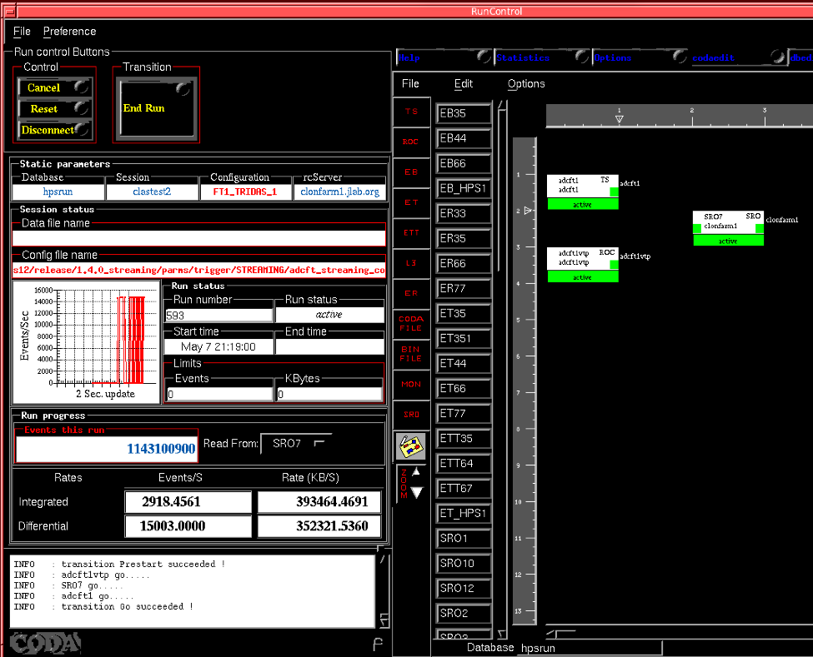
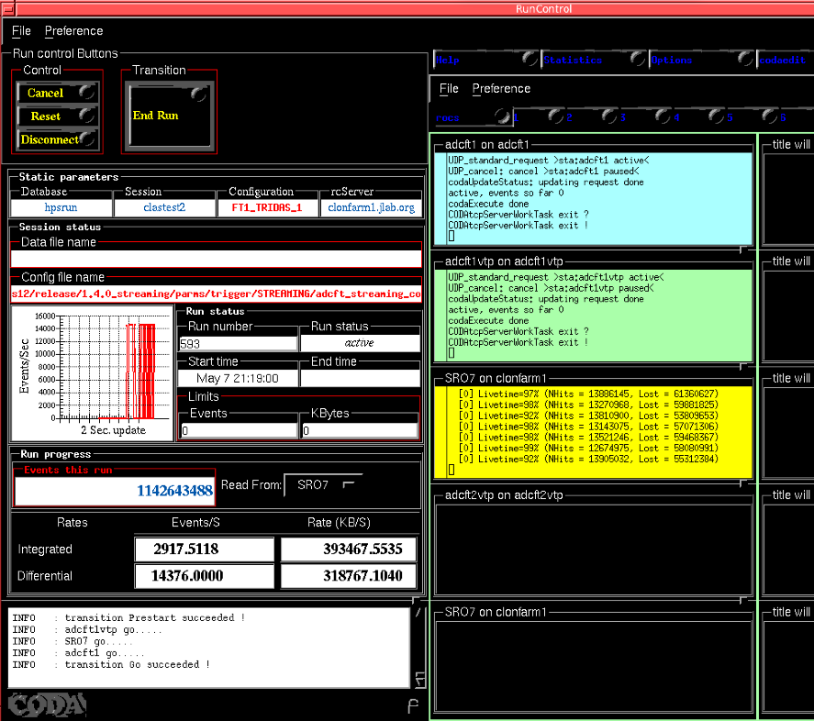
Upgrading CODA software for streaming readout
Pictures shows running streaming daq for single stream (half of VXS crate) from FTCAL
VME ROL (readout list) was modified for streaming mode
New VTP ROL was implemented for streaming mode
New CODA component type SRO was implemented to replace traditional EB-ET-ER backend
All needed information (host names and port numbers) to communicate with streaming frameworks (like TriDAS) is placed into database and json configuration file

Slide 7
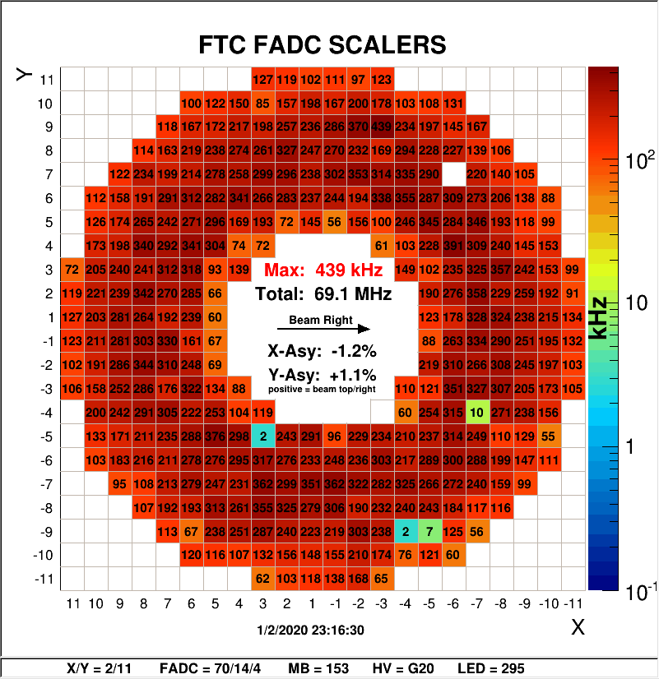
Forward Tagger in streaming readout
coda_sro component(s)
(processes on Linux server)
Circular
Buffer1
Output
Thread1
Input
thread
……….
……….
TO TriDAS
FTCAL (1st half)
10GBit
adcft1
VTP
Circular
Buffer10
Output
Thread10
FTCAL (2st half)
adcft2
VTP
6 input threads
60 output threads
60 mutex-protected circular buffers
FTHODO
adcft3
VTP

Slide 8
Implementation remarks
VTP operation is controlled by software running on built-in ARM processor under Archlinux OS.
In trigger-based mode: data is moving from FPGA to ARM and then sent over 1G link using TCP/IP protocol provided by OS.
It streaming mode: data sent directly from FPGA so TCP/IP protocol has to be implemented in FPGA for full performance. Low-cost COMBLOCK 10Gbps Ethernet TCP/IP packages were used. It took some time to identify and fix all problems, as result February beam test was running with not quite stable daq. At present time, all known problems are fixed and daq is running for days without crashes. Our efforts are shifted now to performance side to make sure 10G bandwidth per link is fully utilized. Up to 4x 10Gbps per VTP can be used in parallel.
So-called ‘tridas_dummy’ component was implemented (based on SRO type), it emulates streaming framework attached to the daq. It can be run as part of CODA configuration or started as standalone program. Initially it was done to check network socket handling on both sides. In future it can be developed into simple testing component to check data consistency if needed.
We prepared two test setup which are used to develop and test streaming frameworks. One is FT-based and includes 3 VXS crates, it is used by TriDAS team. Another one is based on single VXS crates (test2) located in counting room, it is used by JLAB group (Vardan). More test setups can be prepared if needed.
Several clon cluster Linux servers were designated for streaming daq development, in particular clonfarm1/2/3 and clondaq3 are used for that purpose. All needed software installed. CLAS12 group will continue to provide full support for streaming development.

Slide 9
Possible CLAS12-based full scale streaming readout test
ECAL
√
24 x 10G
adcecal1..6
Linux
farm
CODA_SRO
PCAL
adcpcal1..6
24 x 10G
FTOF
adcftof1..6
24 x 10G
CTOF/
HTCC
adcctof1
4 x 10G
CND
adccnd1
4 x 10G
CODA_SRO
FT/
HODO
adcft1..3
12 x 10G
To TriDAS or another framework or hardware
BAND
adcband1
4 x 10G
Network Switch
DC1
dc11..13
12 x 10G
DC2
dc21..23
12 x 10G
CODA_SRO
DC3
dc31..33
12 x 10G
DC4
dc41..43
12 x 10G
>168 input threads
1680 output threads
1680 mutex-protected circular
buffers
dc51..53
12 x 10G
CODA_SRO
DC5
DC6
dc61..63
12 x 10G

Slide 10
Possible CLAS12-based full scale streaming data rates
(based on CLAS12 RGA 50nA occupancies)
ECAL
√
24 x 10G
~0.6GByte/s (4% link capacity)
adcecal1..6
PCAL
adcpcal1..6
24 x 10G
FTOF
adcftof1..6
24 x 10G
~1GByte/s (6% link capacity)
CTOF/
HTCC
adcctof1
4 x 10G
~0.1GByte/s (1% link capacity)
CND
adccnd1
4 x 10G
~0.15GByte/s (1% link capacity)
FT/
HODO
adcft1..3
12 x 10G
~0.2GByte/s (1.3% link capacity)
DC
dc11..63
6 x 12 x 10G
~10GByte/s (11% link capacity)
SVT
svt1..2
8 x 10G
~1.70GByte/s (17% link capacity)
RICH
rich4
4 x 10G
~0.20GByte/s (4% link capacity)
MM
mmft1
mvt1..2
12 x 10G
Not clear if streaming compatible
Total Streaming Data rate: ~15GBytes/sec
Data rate in triggered mode: ~300MByte/sec
*Triggered mode records raw FADC waveforms, streaming mode would not – this provides a significant data reduction for fadcs in streaming mode in the comparison, which would satisfy most (if not all) CLAS12 detectors. Raw waveforms could also be recorded in streaming mode, resulting streaming rate would increase significantly: If 100ns waveforms per FADC hit, then streaming total rate would be: ~38GBytes/sec – still not unreasonable

Slide 11
Current Status
VTP-based front-end part of streaming DAQ is operational, two test setups are running
Based on equipment available in CLAS12, bigger test setups can be configured with reasonable time scale and expenses (estimate: up to 6 month, $100K-$200K equipment), up to full scale setup with 42 VXS crates involved with data rate on the level of 100GByte/s
We are working with streaming back-end developers providing testing environment

