Slide 1
ADIOS and Transport Protocols for Streaming RO
Carl Timmer
group, Jefferson Lab

Slide 2
Introduction
With a name like “Streaming” readout, the general idea is that data moves from upstream to downstream.
Since that moving involves software, are there existing packages we can use? Are they any good? Try not to reinvent the wheel.
Specifically, we’ll take a first-pass look at ADIOS.
Also like to briefly look at the protocol of the data we send over the wire, both currently and how that might change for SRO.

Slide 3
Considerations
What are we looking for in software?
Good performance
Reliable
Easy to obtain, build, and use
Well supported and maintained
Quality of programming (multilingual, latest features)
Complete documentation
Low cost – preferably none
Lifetime which has good overlap with current JLAB experiments and the EIC
Modifiable by users

Slide 4
ADIOS (ADaptable I/O System) ver 2
A data transport software package written and supported by the Scientific Data Group at Oak Ridge National Lab in collaboration with:
Kitware Inc. (commercial software consultant)
Lawrence Berkeley NL
Georgia Tech
Rutgers
Has language bindings for C++, C, Fortran, and Python
https://github.com/ornladios/ADIOS2
https://csmd.ornl.gov/adios

Slide 5
ADIOS2 Capabilities
Provides a simple, common interface to several I/O types.
There is a different “engine” for each of the following:
MPI (Message Passing Interface)
requires readers & writers to start together in the same job and allows only static communication patterns
In-process communication
very limiting API for something that’s much easier done other ways
Files
HDF5 format (Hierarchical Data Format)
BP4 (binary pack format)
Can read while file being written
Zeromq
readers not guaranteed to receive everything written (UDP-like)
Sustainable Staging Transport (SST)
designed for HPC environments
network over sockets or RDMA if available
can use TCP, UDP or RUDP
1 writer to multiple readers

Slide 6
ADIOS writer code
adios2::ADIOS adios(); adios2::IO sstIO = adios.DeclareIO("myIO"); sstIO.SetEngine("SST"); sstWriter = sstIO.Open(("/tmp/helloSst", adios2::Mode::Write);
uint32_t loops = 100;
uint32_t oneMoreLoop = 1; size_t size = 1000000; std::vector<int32_t> myInts; /////////////////////////////////////////////////////// auto again = sstIO.DefineVariable<uint32_t>(”OneMoreLoop"); auto bpInts = sstIO.DefineVariable<int32_t>("IntArray", size);
for (int i=0; I < loops; i++) { sstWriter.BeginStep(); sstWriter.Put(bpInts, myInts.data());
if (I < loops – 1)
sstWriter.Put(again, 1);
else
sstWriter.Put(again, 0); sstWriter.EndStep(); }
sstWriter.Close();
Writer
Node A
Reader
Node B

Slide 7
Speed Testing SST engine
The SST engine is the best suited to move data between nodes.
Between 2 nodes in our INDRA test lab, 100Gb ethernet, sending 4MB byte arrays:
Software Package | Max Data Rate (GBytes/s)
ADIOS SST engine | 1.4
iperf3 | 5.3
JLAB data blaster | 5.2
INDRA stream router | 5.0

Slide 8
Speed Testing SST engine
Between 2 nodes in our INDRA test lab, 100Gb ethernet, sending 4MB byte arrays:
Software Package | # Readers | # Writers | Data Rate (GBytes/s)
ADIOS SST | 1 | 1 | 1.4
“ | 2 | 1 | 2.0
“ | 3 | 1 | 2.6
JLAB blaster | 1 | 1 | 5.0
“ | 1 | 2 | 7.6
“ | 1 | 3 | 8.8

Slide 9
Speed Testing SST engine
Main reason for the poor network performance is the large amount of handshaking under the ADIOS hood. The writer sends metadata about what it’s going to send. The reader asks for specific kinds of data. This slows things down.
RDMA and MPI-based transports are the high performance focus of ADIOS.

Slide 10
ADIOS
PROS: 👍
Available on github, open source
Very easy to build (Mac & Linux)
Support is excellent, very responsive
API is simple
There is some documentation
Bindings in C++, C, Fortran, Python, Matlab
CONS: 👎
Documentation is barely adequate, deficient in some areas
Not built for speed, lots of reader/writer handshaking
Only one of the engines seems relevant
Not thread safe

Slide 11
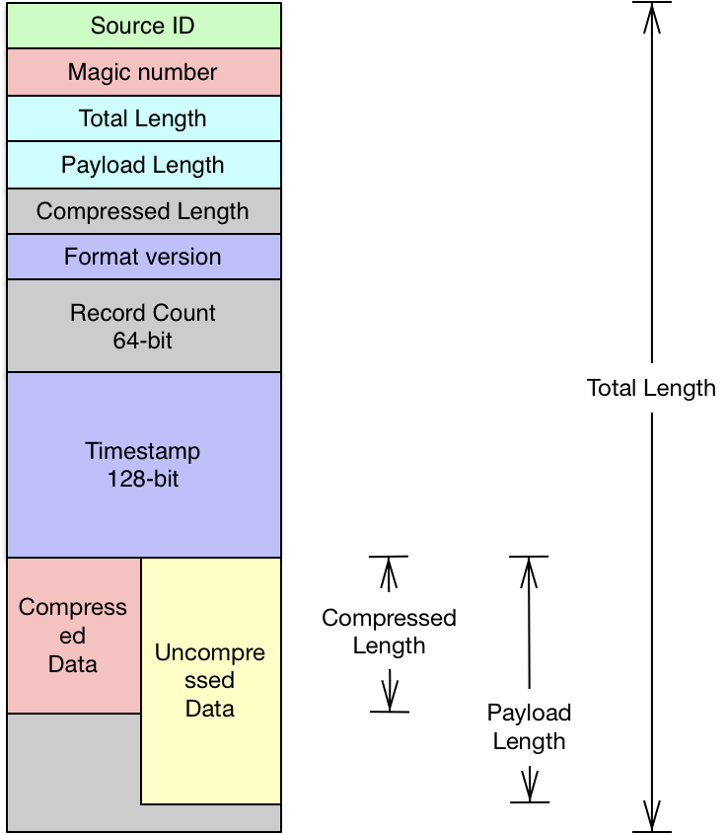
A Word on Wire Data Format out of Front End
Possible SRO format
Current CODA format
Magic number
Command
Once per connection
Format version
Total Length
Source ID
Record Length
Max buffer size
Record Number
Socket count
Header Length
Socket order
Event Count
Index Length
Version & content
User Header Length
Magic number
Uncompressed Data Length
Compression Type & Data Length
Index
Compressed
Data
Un compressed
Data

Slide 12
Conclusion
Adios Amigos

