Slide 1
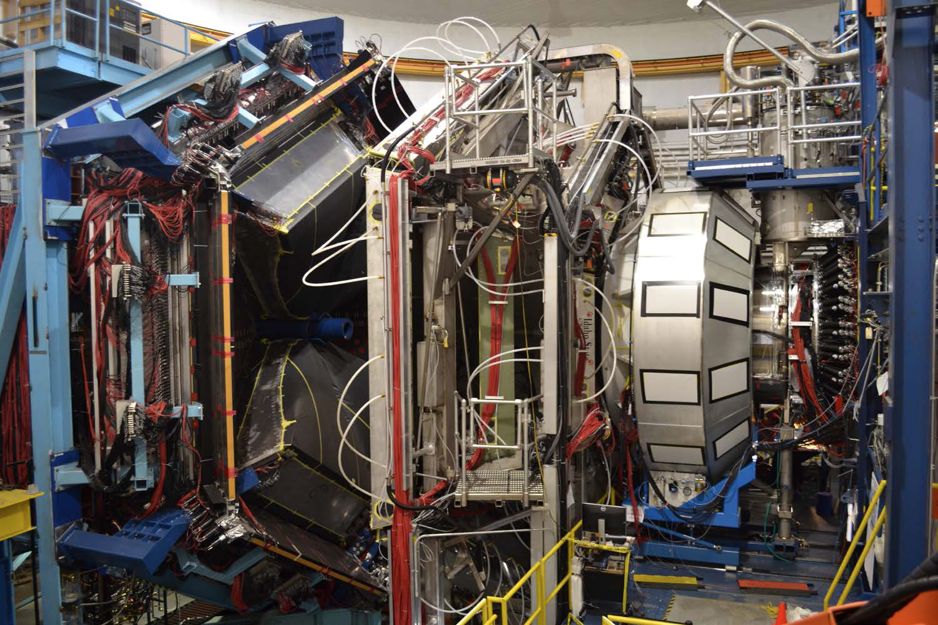
CLAS – Collaboration
RGA – Status and Path Forward
Latifa Elouadrhiri

Slide 2
Hall B/CLAS12 RG-A Experiments
Proposal | Physics | Spokespersons
E12-06-108 | Hard Exclusive Electroproduction of π⁰, η | P. Stoler, K. Joo, V. Kubarovsky, M. Ungaro, C. Weiss
E12-06-108A | Exclusive N*->KY Studies with CLAS12 | D.S. Carman, R. Gothe, V. Mokeev
E12-06-108B | Transition Form Factor of the η’ Meson with CLAS12 | M. Kunkel, D. Lersch
E12-06-112 | Proton’s Quark Dynamics in SIDIS Pion Production | H. Avakian, K. Joo, Z.E. Meziani, B. Seitz
E12-06-112A | Semi-inclusive Λ Productiuon in Target Fragmentation Region | M. Mirazita
E12-06-112B | Higher Twist Colinear Structure of the Nucleon | S. Pisano, M. Mirazita
E12-06-119 | Deeply Virtual Compton Scattering at 11 GeV | F. Sabatie, A. Biselli, H. Egiyan, L. Elouadrhiri, M. Holtrop, D. Ireland, W. kim
E12-09-003 | Excitation of Nucleon Resonances at High Q² | R. Gothe, V. Burkert, P. Cole, K. Joo, V. Mokeev, P. Stoler
E12-11-005 | Hadron Spectroscopy with Forward Tagger | M. Battaglieri, R. De Vita, C. Salgado, S. Stepanyan, D. Watts, D. Weygand
E12-11-005A | Photoproduction of the Very Strangest Baryons | L. Guo, M. Dugger, J. Goetz, E. Pasyuk, I. Strakovsky, D. Watts, N. Zachariou, V. Ziegler
E12-12-001 | Timelike Compton Scattering & J/ψ Production in e+e- | P. Nadel-Turonski, M. Guidal, T. Horn, R. Paremuzyan, S. Stepanyan
E12-12-001A | J/ψ Photoproduction and Study of LHCb Pentaquarks | S. Stepanyan, M. Battaglieri, A. Celetano, R. De Vita, V. Kubarovsky
E12-12-007 | Exclusive φ Meson Electroproduction with CLAS12 | P.Stoler, C. Weiss, F.X. Girod, M. Guidal, V. Kubarovsky

Slide 3
RGA - Science Program
RGA – Experiments (13):
Nucleon structure (E12-09-003, E12-06-108A, E12-06-108B): Study of the nucleon resonance structure at photon virtualities from 2.0 to 12 GeV²
Deep Exclusive Processes (E12-06-119, E12-06-108 and E12-12-00): Study of Generalized Parton Distributions (GPDs), (2 +1) D imaging of the proton and the study of its gravitational and mechanical structure.
Deep inclusive & SIDIS (E12-06-112, E12-06-112A and E12-06-112B):Study of the Transverse Momentum Dependence (TMDs) and the of 3D structure in momentum space.
Quasi photo-production (E12-12-001 and E12-12-001A): Study of J/ψ Photoproduction, LHCb Pentaquarks and Timelike Compton Scattering.
MesonX program (E12-11-005 and E12-11-005A): Study of meson spectroscopy in search of hybrid mesons

Slide 4
Experiment Parameters
Duration: 139 PAC days
80 days high luminosity (10³⁵cm⁻²s⁻¹)
39 days low luminosity (5x10³³cm⁻²s⁻¹)
20 days torus polarity = negative
Energy: 11 GeV
Target: LH2
Experiment | parameters
Beam energy | 10.6 GeV, electrons polarized
Beam current | 2nA (2.5 x 10³³) to 75 nA (1x10³⁵)
Torus field and polarity | 100% (75% negative particles in-bending & 25% out-bending)
Solenoid field and polarity | 100% (nominal)
Trigger(s) | Electron trigger (HTCC/DC/PCAL/EC) Electron in FT + 2 hadrons in CLAS12 Muon trigger Calibration/Normalization Triggers
Target | 5 cm LH2

Slide 5
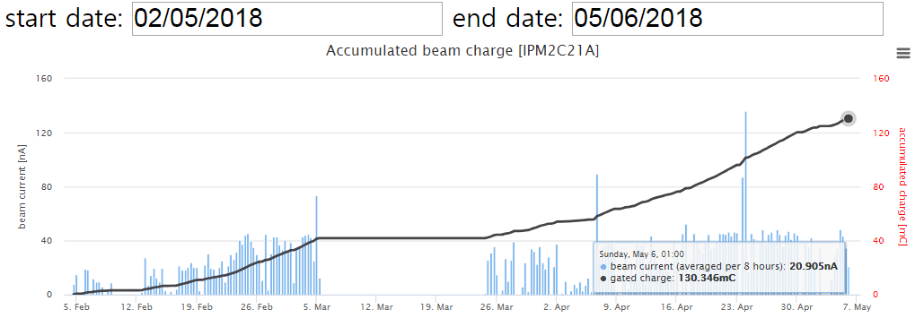
RG-A Production Charge
RG-A
Spring 2018
~130mC
Machine
retuning
Completed detector setting
Start 10.6 GeV RGA data taking
Machine Down
RG-A
Fall 2018
E=10.6GeV
~112mC
RG-A
Spring 2019
E=10.2GeV
Sum: Q ~ 300mC
Expect total: 648mC
Q/Q_{tot}~ 46%
58mC

Slide 6
Experiment Configuration
Run group A Fall 2018 :
  Central detector shifted 30 mm upstream
  No FMM
  Target (LH2) at (1.2, 1.1, -30) mm
  HTCC shfted 20 mm upstream
  FT On configuration
  FMT not present
  LTCC sectors: 3 (50% C4F10), 5 (N2)
  Torus polarity: -1, 1,
  Solenoid polarity: -1
  Beam Current: from 5 to 75 nA
  Beam energies: 10.6 GeV

Slide 7
RGA – Fall 2018 Production Summary
Outbending
Inbending
RUN number | Charge [μC]
All 253 inbending runs | 56 959.482
All 184 outbending runs | 39 867.308

Slide 8
RGA – Fall 2018 Data – Initial Focus
Focus on the inbending
Run period:
from 5032 to 5419
Note: DNP data set
from 5036 to 5262

Slide 9
RG–A Trigger Versions. Fall 2018
Date | Run | S, T | Trigger config file | PCAL+ECAL | DC Roads | Inbending
9/27/18 | 4763 | -1,-1 | Trigger_v20_1, _2, _3 | 300 MeV | No
10/09/18 | 5015 | -1,-1 | Trigger_v21_0 | 300 MeV | Yes | Add DC roads
10/19/18 | 5215 | -1,-1 | Trigger_v21_0_1phe | 300 MeV | Yes | HTCC=1phe
10/22/18 | 5247 | -1,-1 | Trigger_v21_0 | 300 MeV | Yes | HTCC=2 again
10/26/18 | 5299 | -1,-1 | Trigger_v22_0 | 300 MeV | Yes | No change in electron trigger
11/05/18 | 5411 5417 | -1,-1 | Trigger_v20_1_no_htcc | 300 MeV | Yes | No HTCC in the e trigger
11/06/18 | 5418 | -1,-1 | Trigger_v22_0 | 300 MeV | Yes
 |  |  |  |  |  | Outbending
11/06/18 | 5420 5433 | -1,+1 | Trigger_v22_0_out | 300 MeV | Yes
11/06/18 | 5424 | -1,+1 | Trigger_v22_0_no_dc_roads | 300 MeV | No
11/15/18 | 5504 | -1,+1 | Trigger_vv22_1_no_dc_roads | 300 MeV | No | No change in electron trigger

Slide 10
Pass1 Review took place on 2/28 & 3/9
Documentation completed on 3/17
Data processing started 3/20/2020

Slide 11
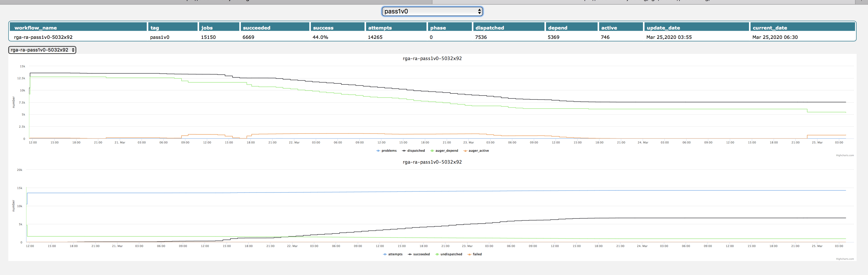
Data Processing Status
44% of the first batch completed

Slide 12
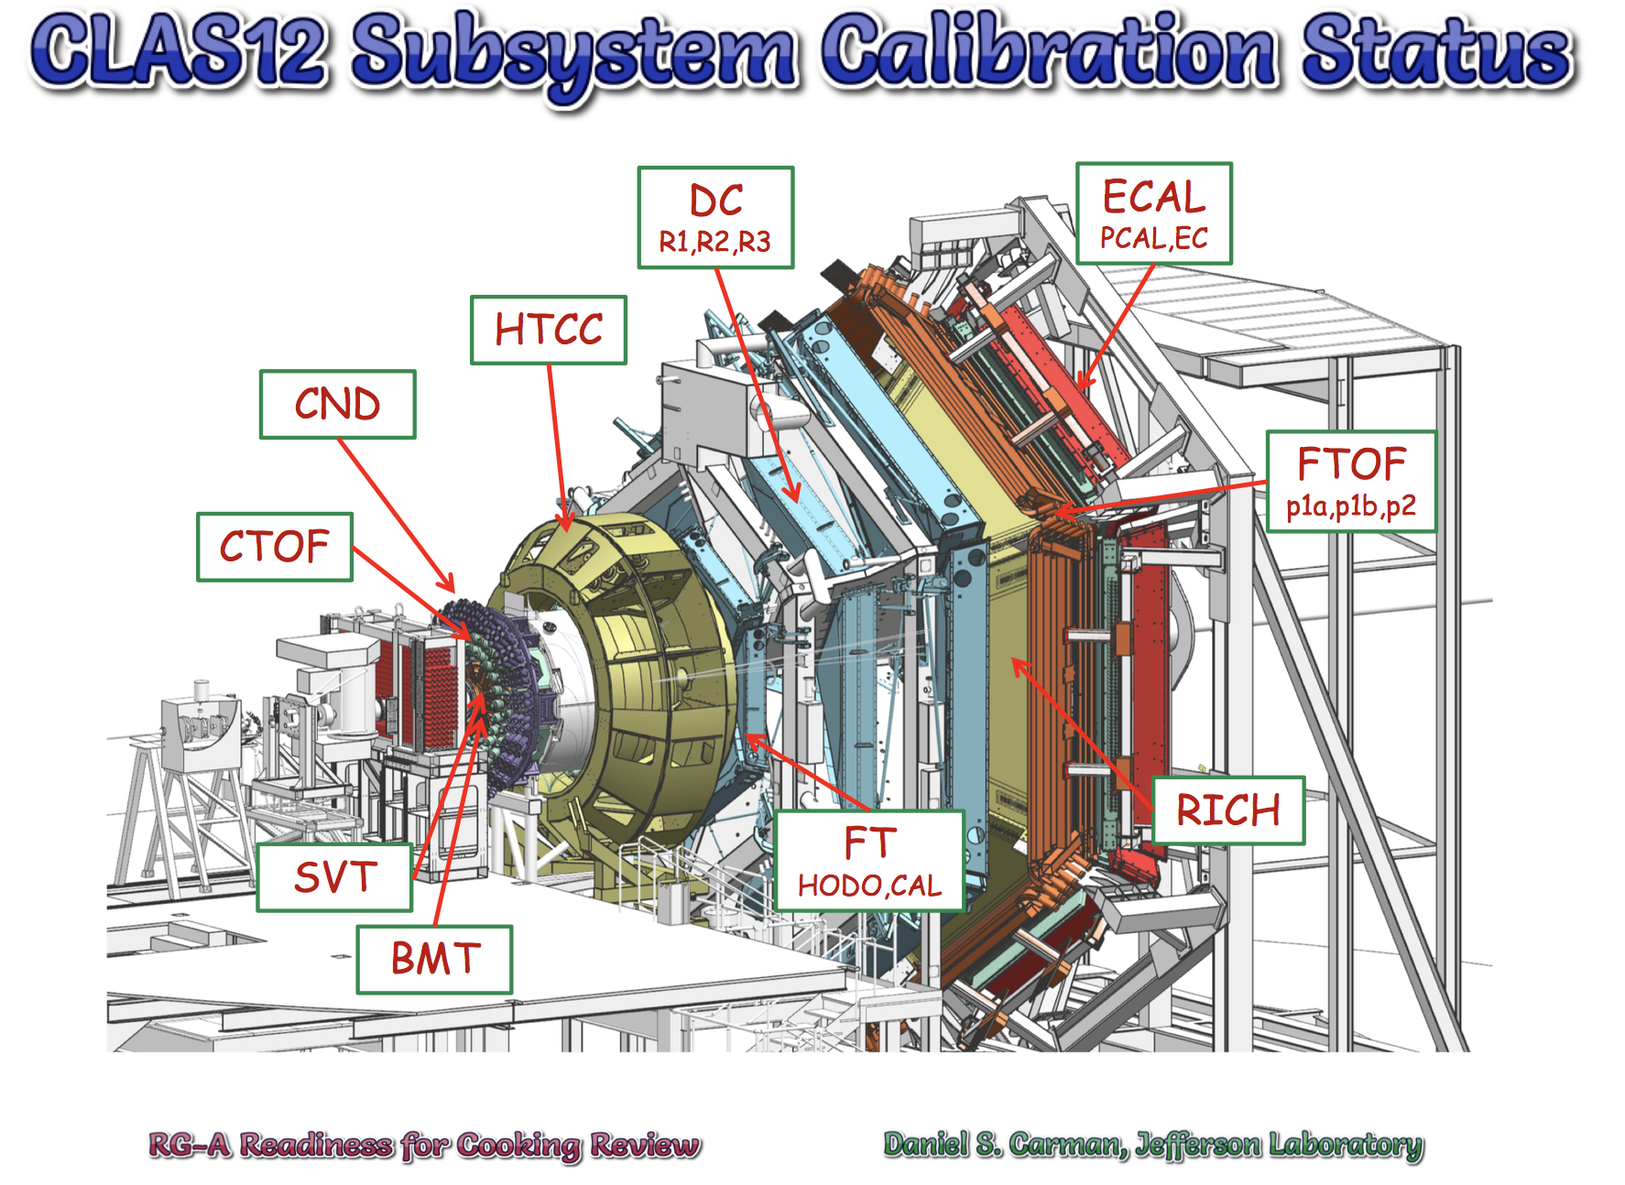
Today’s Agenda

Slide 13
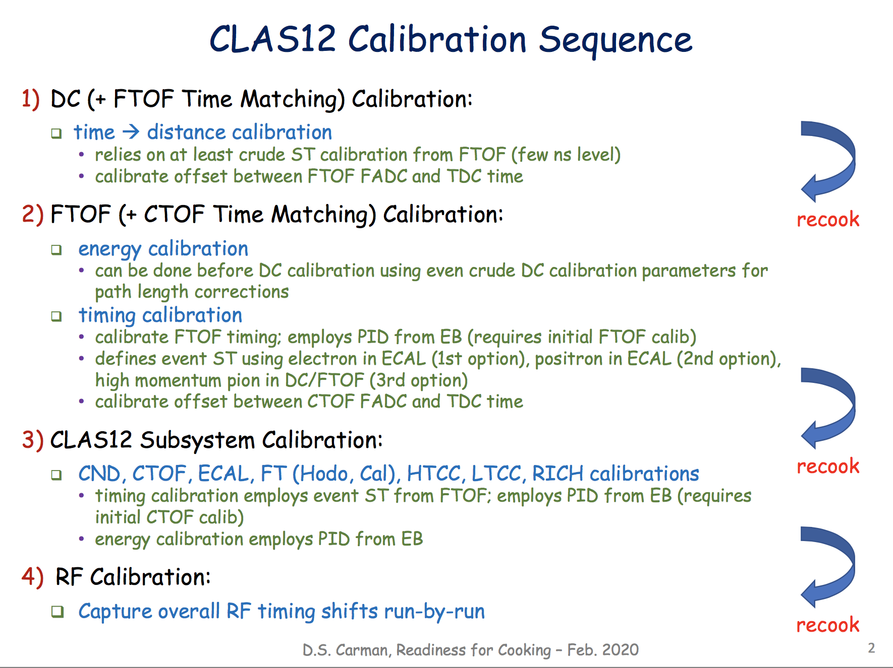

Slide 14
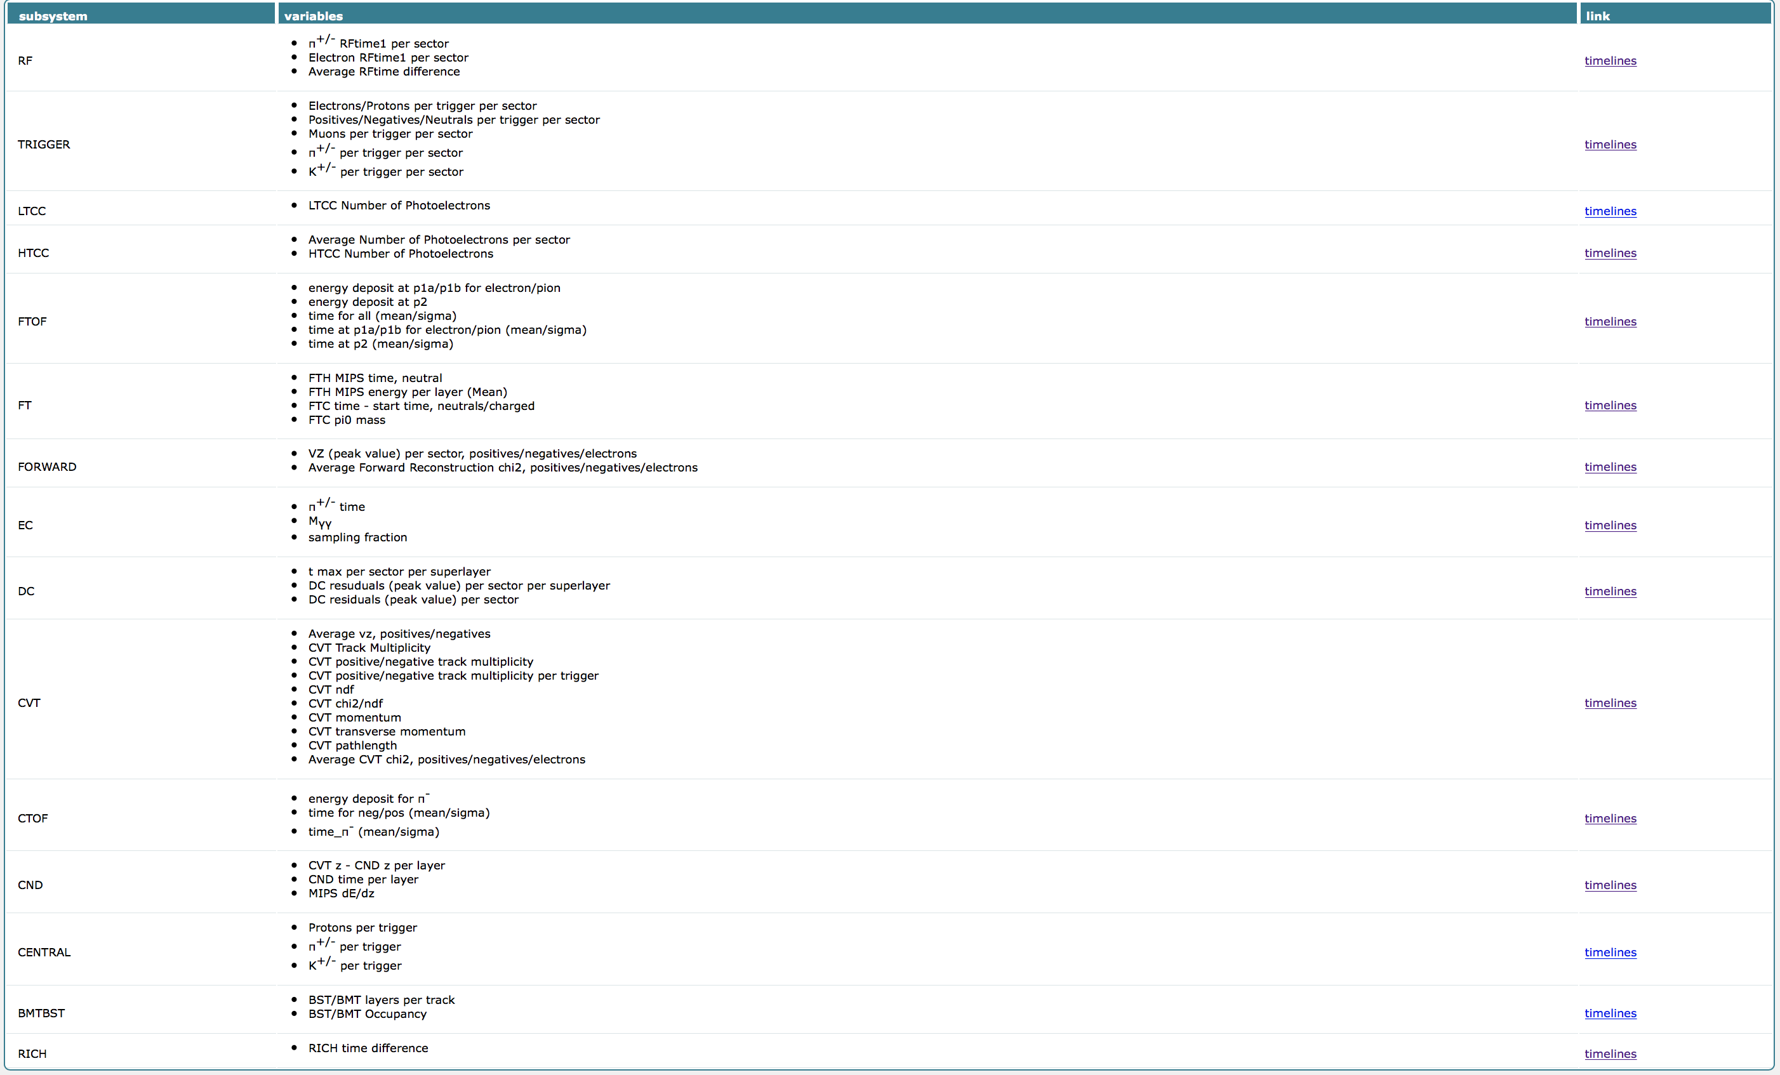
Andrey KIM
https://clas12mon.jlab.org/rga/pass0/v2.2.5a/tlsummary/
Click here for testing the automatic
Procedure for run selection being
Developed/validated
https://youtu.be/My5z3XvhMUo

Slide 15
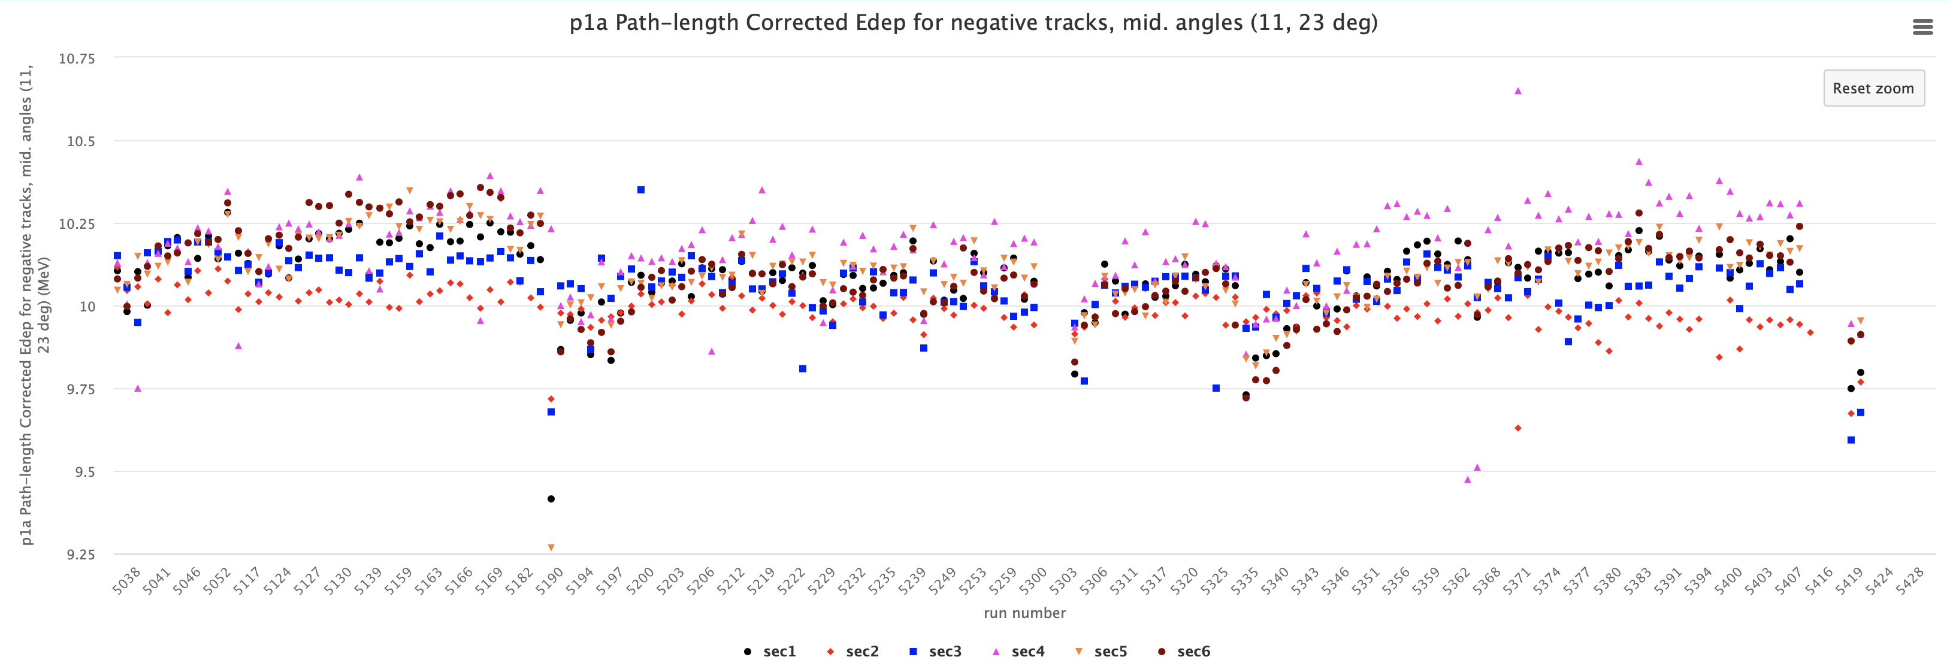
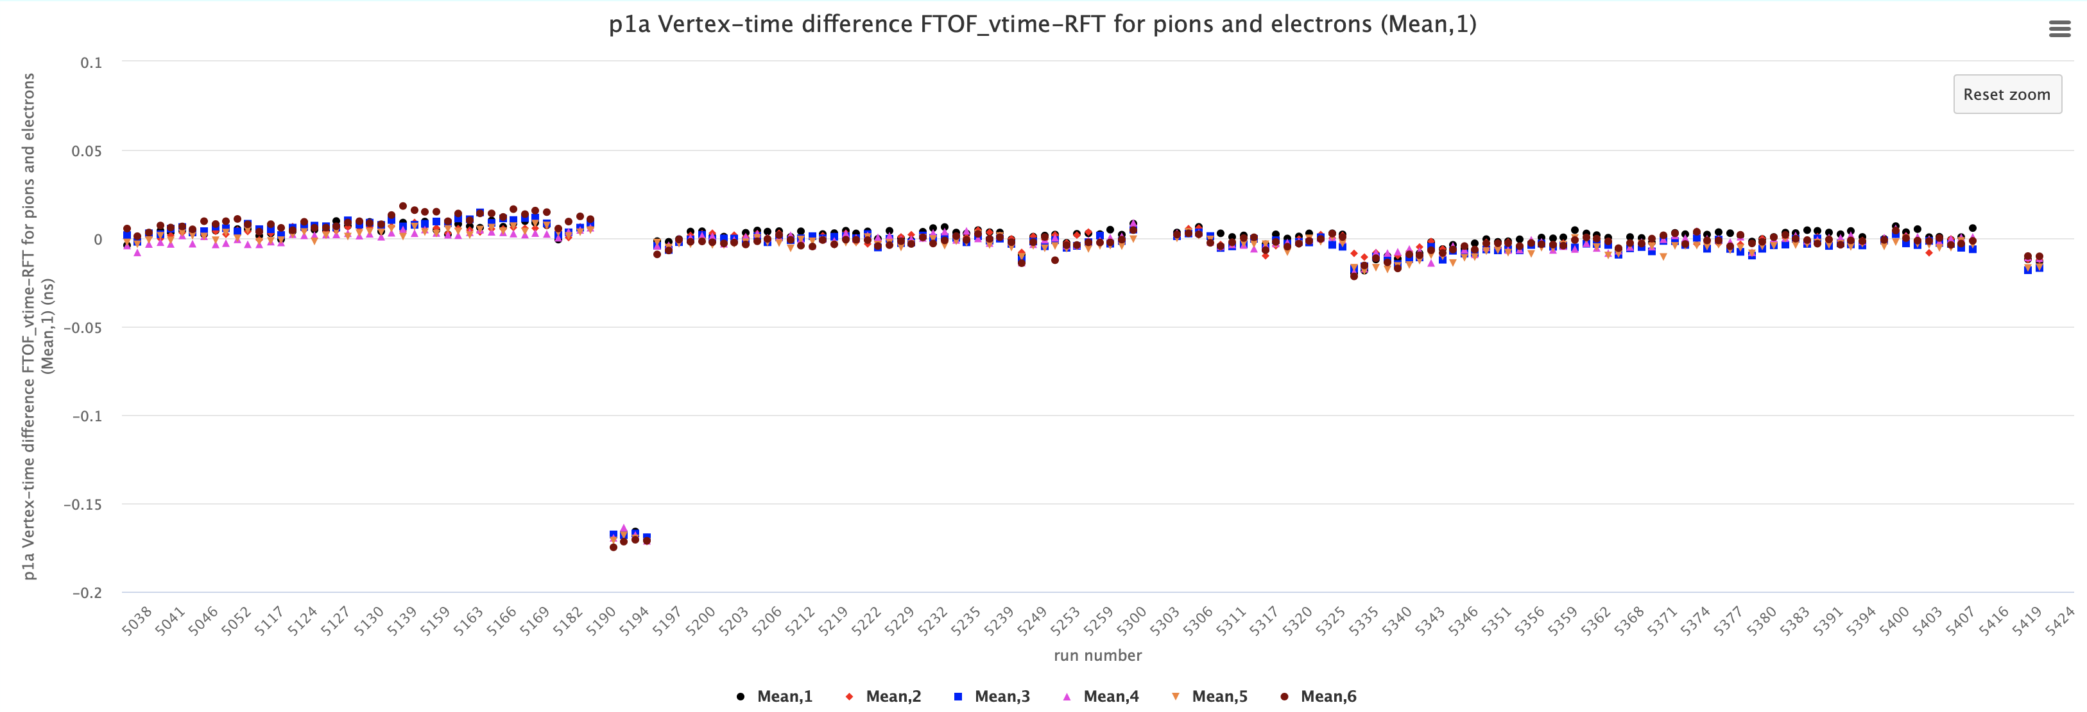
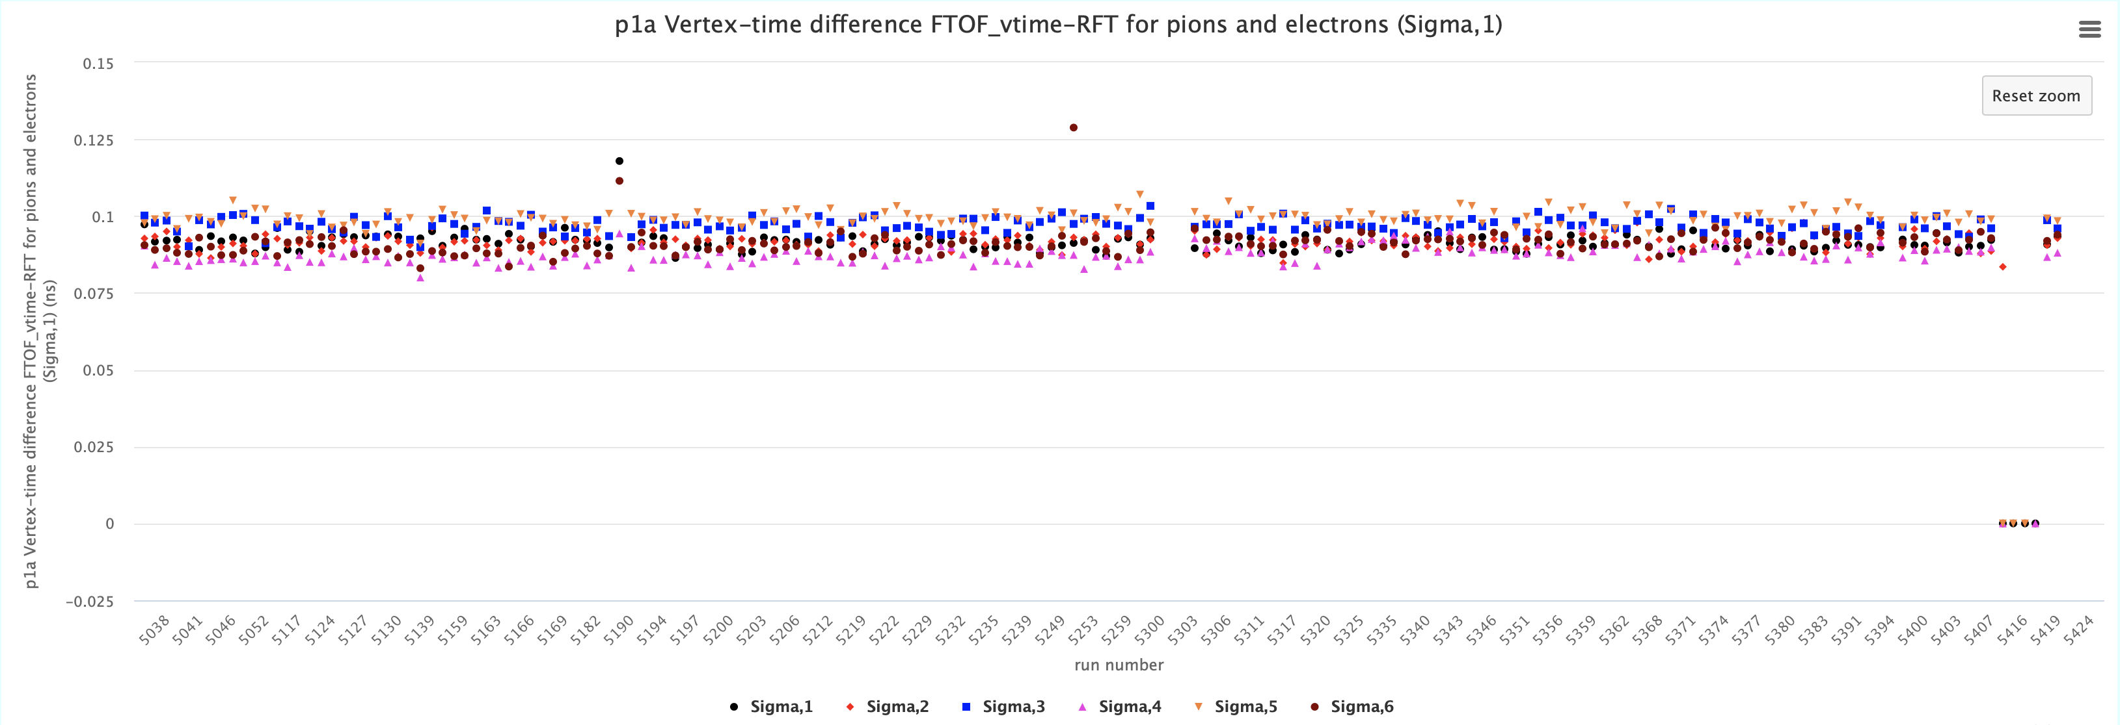
FTOF P1a Calibrations – RG-A fall 2018 (inbending)

Slide 16
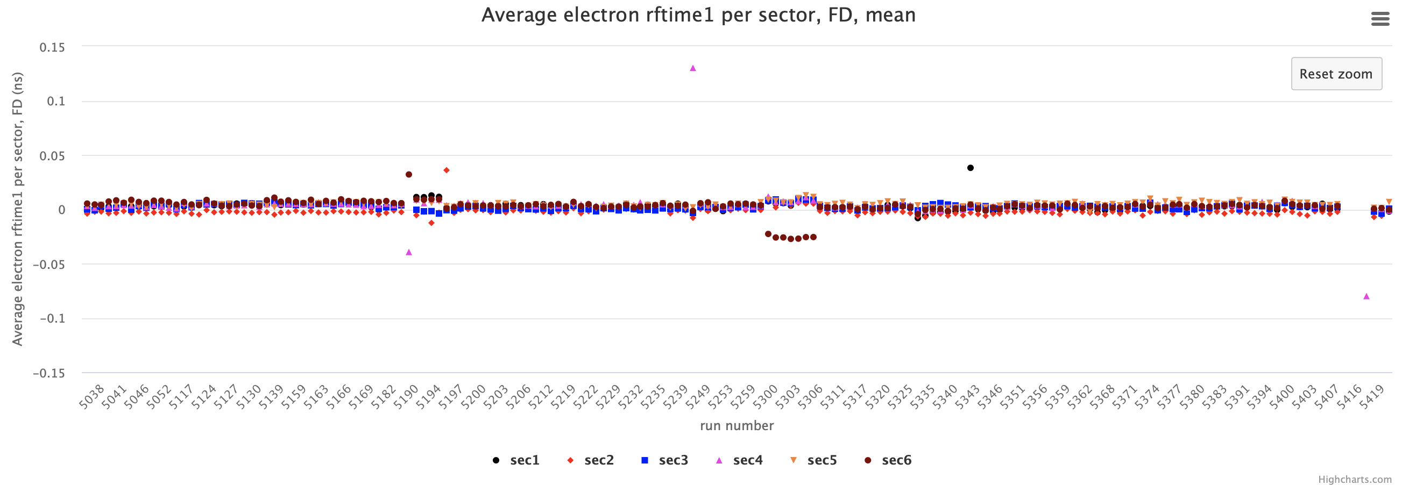
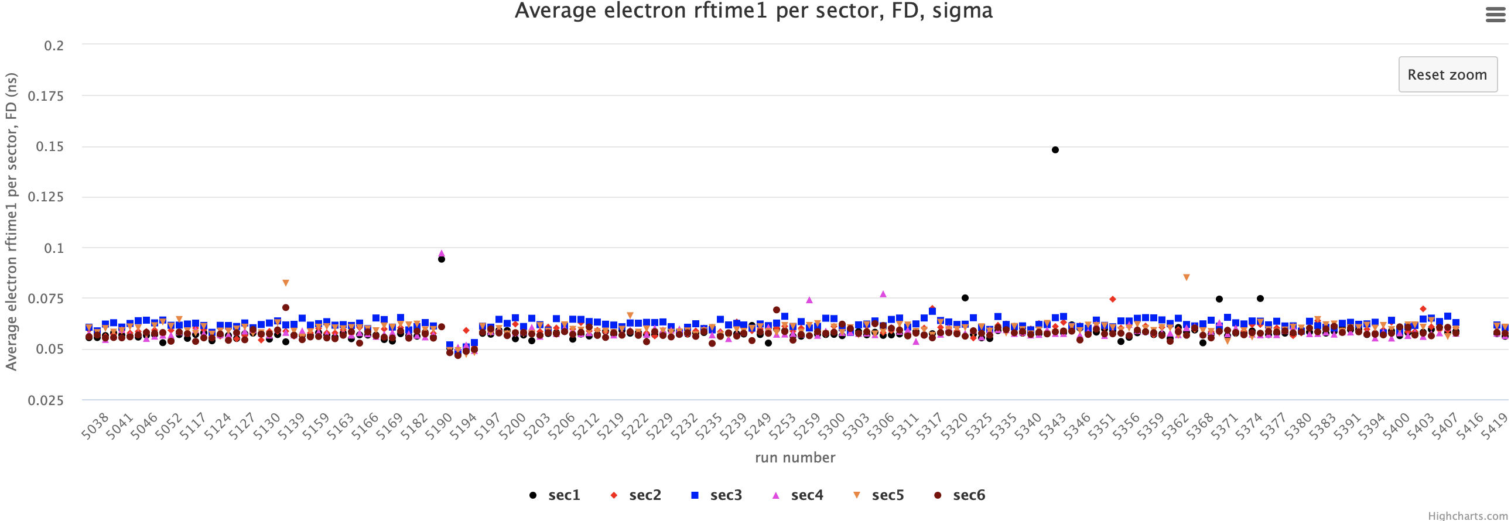
RF offsets
Variations of the mean <5 ps after run-by-run calibration
Sigma stable at ~55 ps
Only few problematic runs 5414-5417
Sector dependent shifts in runs 5189 and 5262-5305 may require new FTOF calibration ranges
Other outliers are failed fits

Slide 17
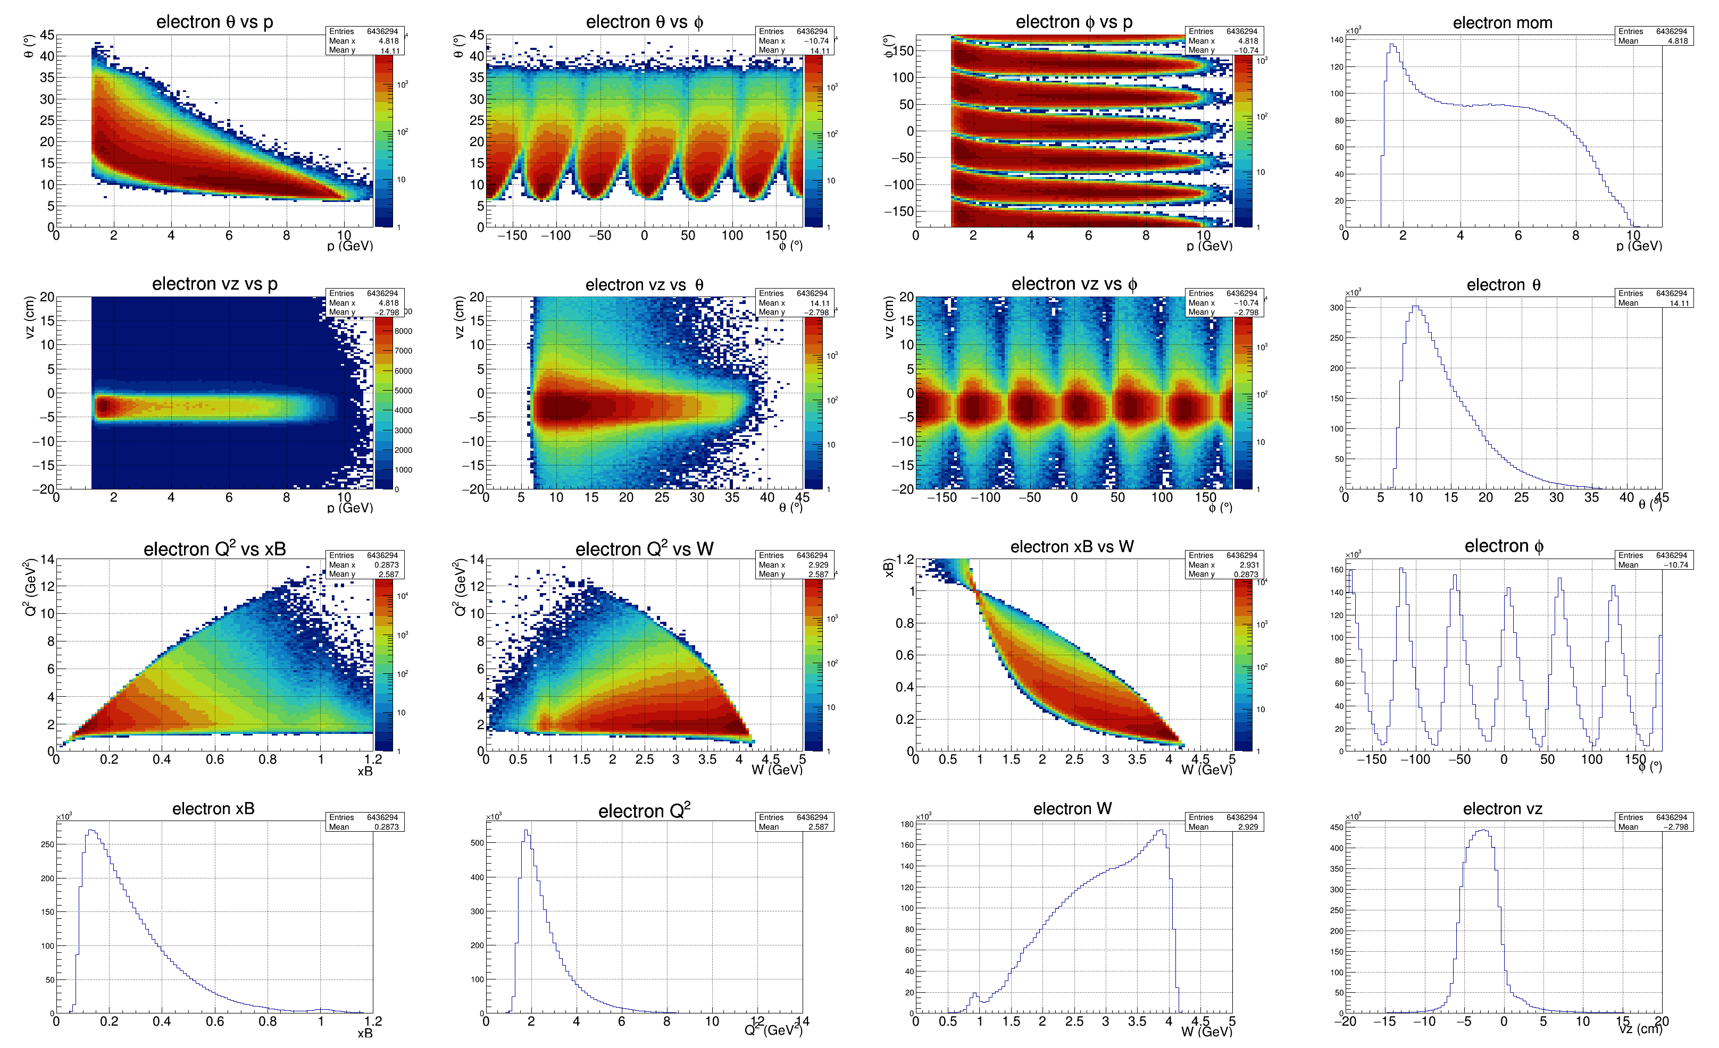
Overview - Electron

Slide 18
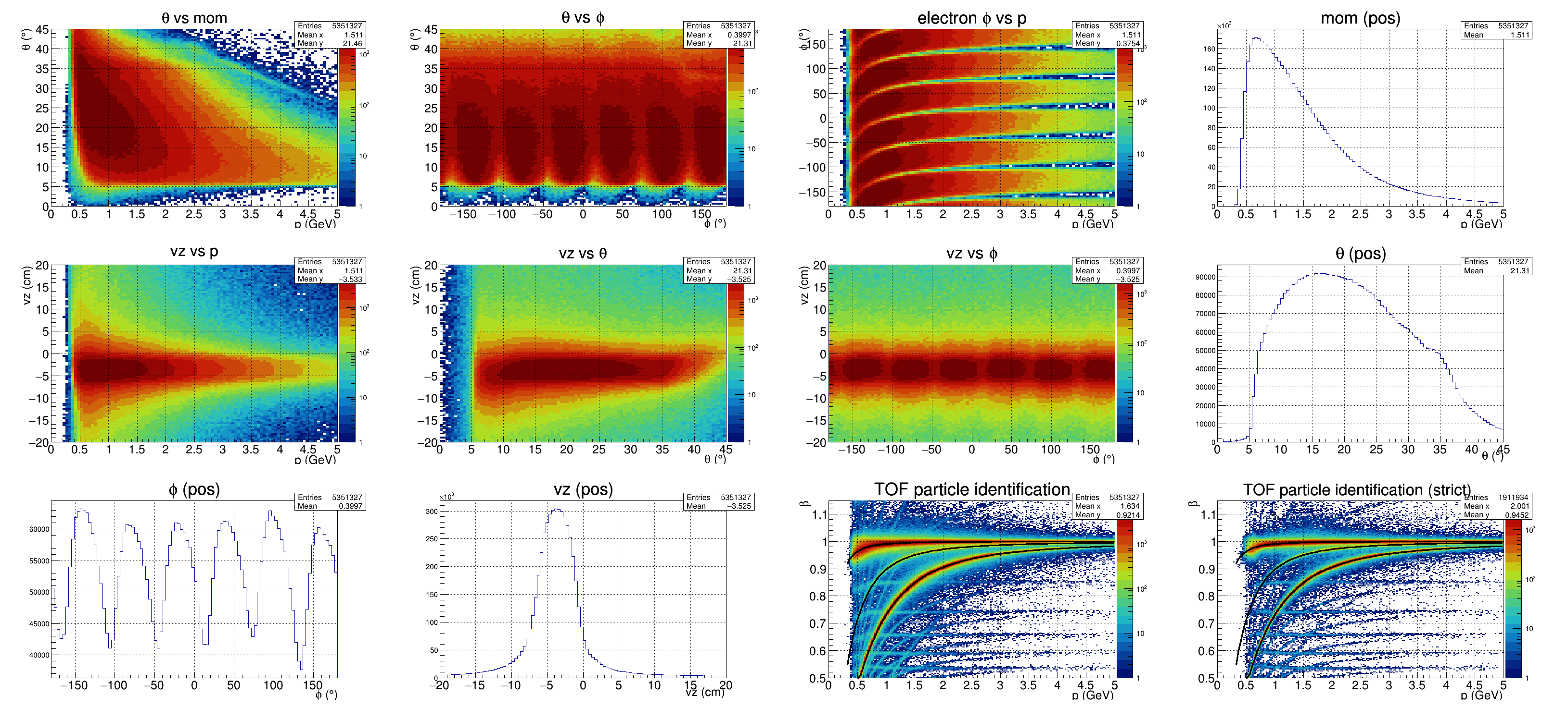
FTOF – Positive Charge PID

Slide 19
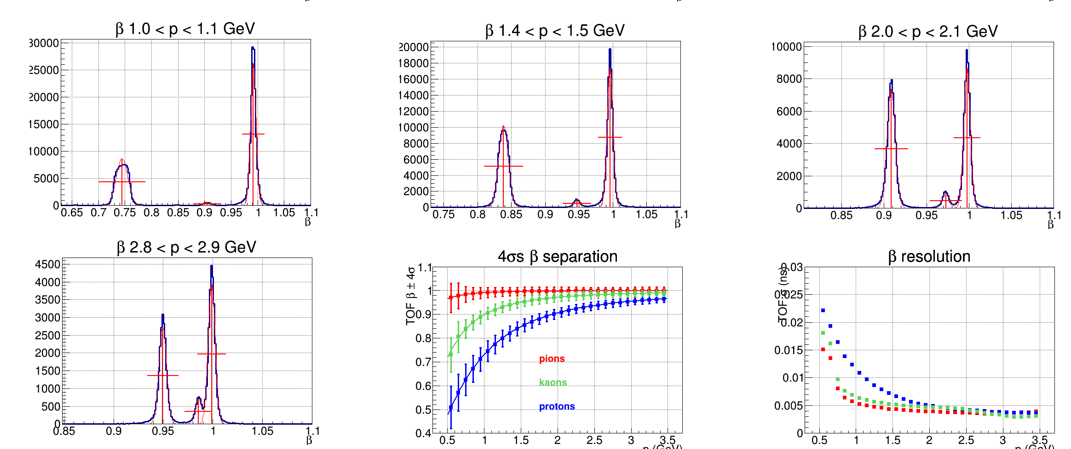
FTOF - PID

Slide 20
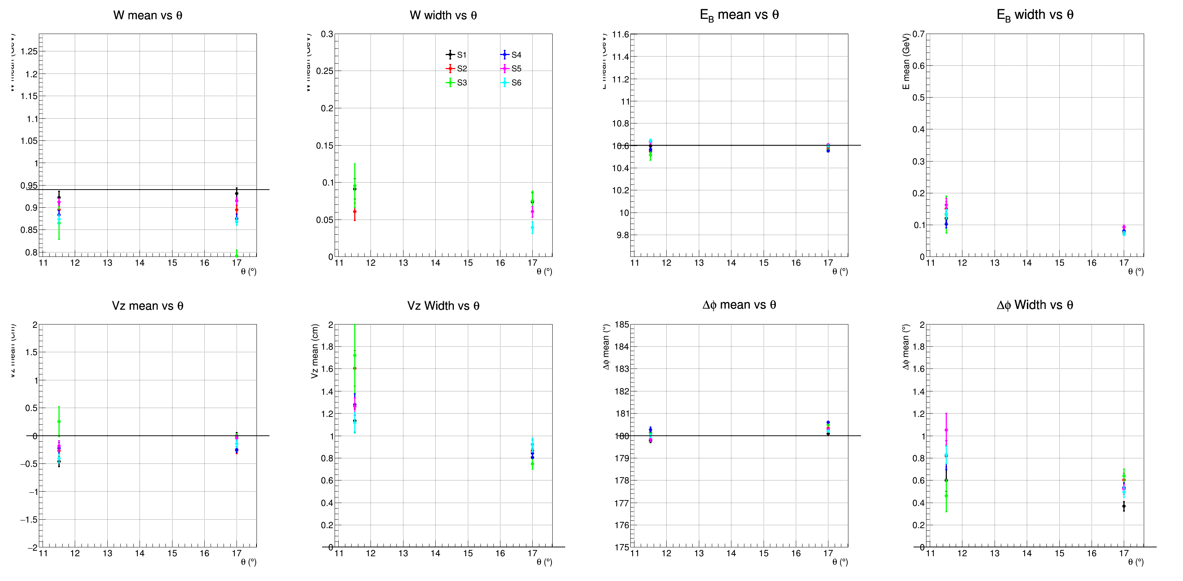
Elastic - Proton in the FD

Slide 21
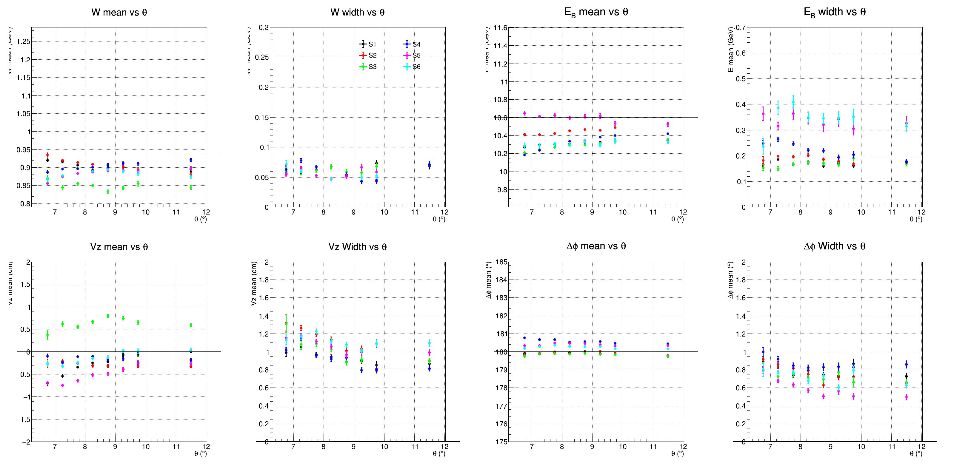
Elastic Proton in CVT

Slide 22
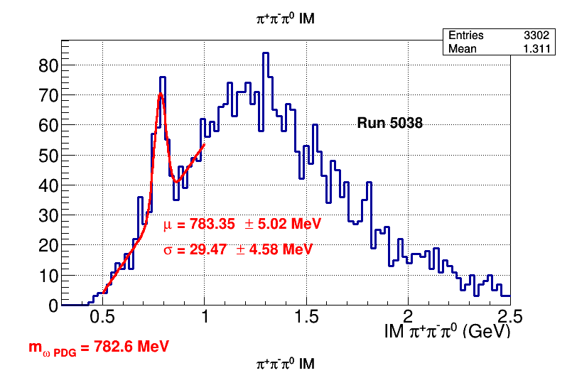
Two Pions

Slide 23
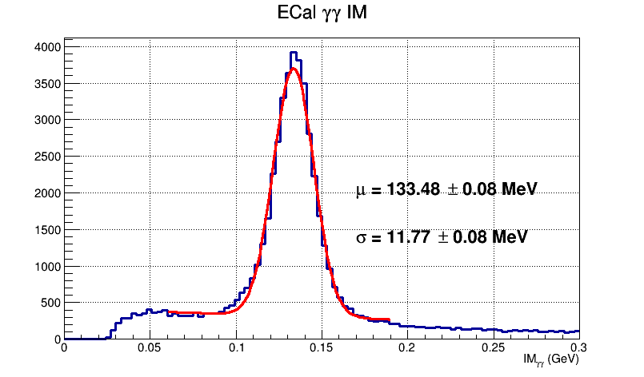
ECAL – Pi0 mass

Slide 24
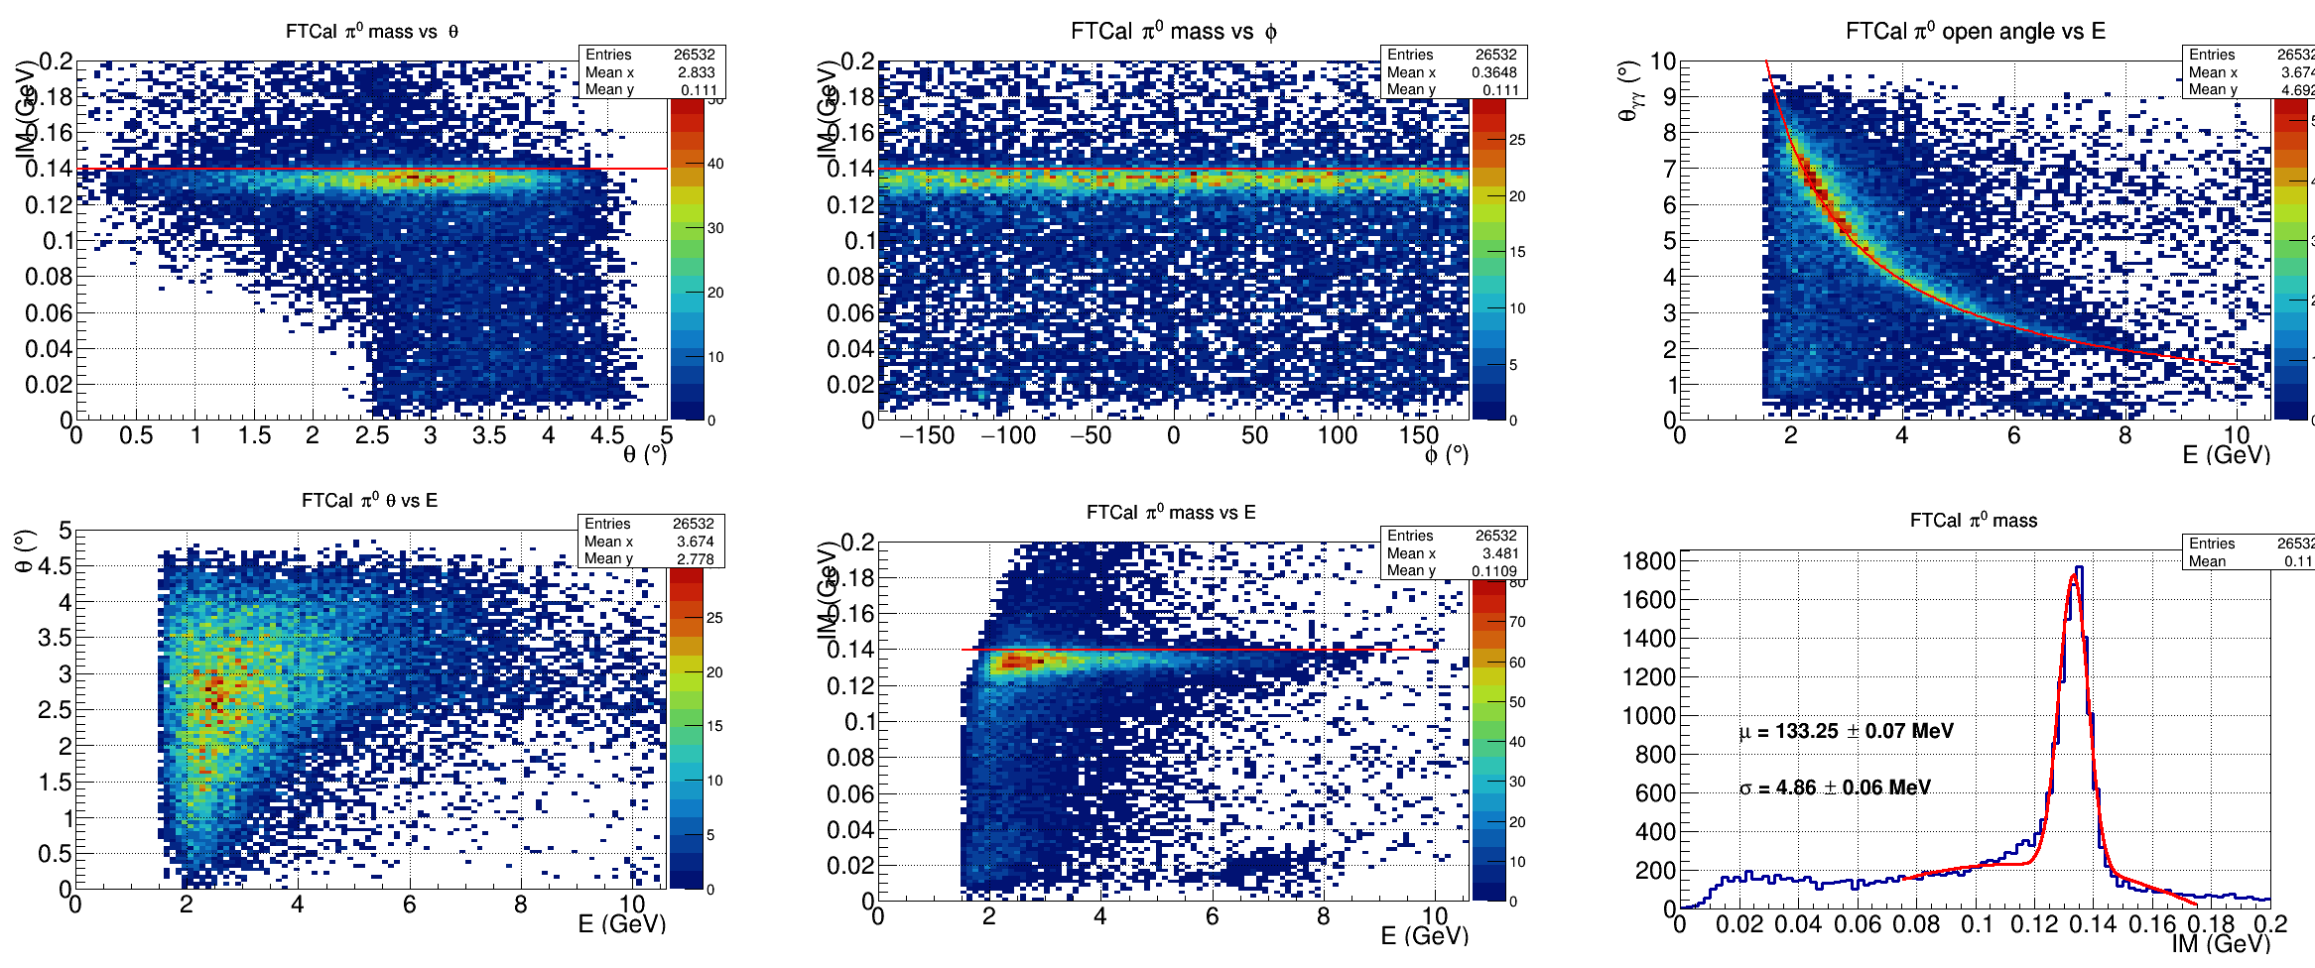
Forward Tagger Performance

Slide 25
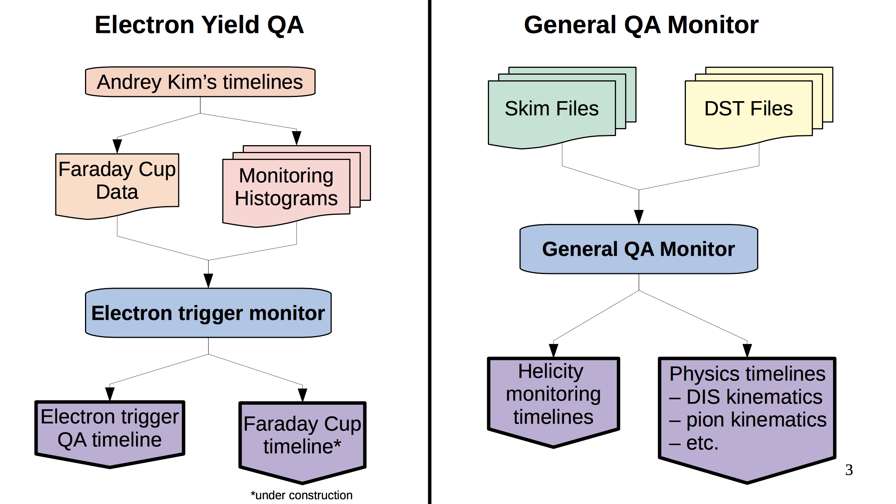
Monitoring of physics quantities

Slide 26
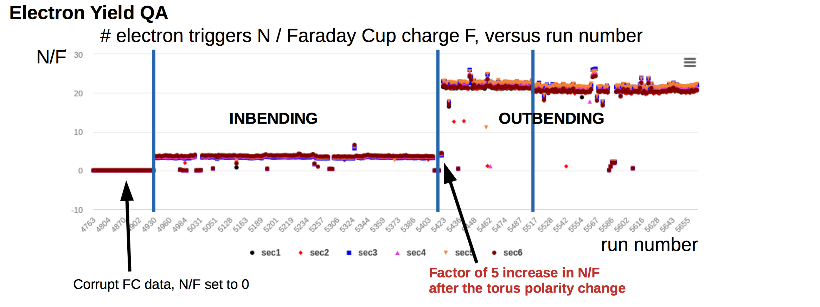
Electron Yield monitoring

Slide 27
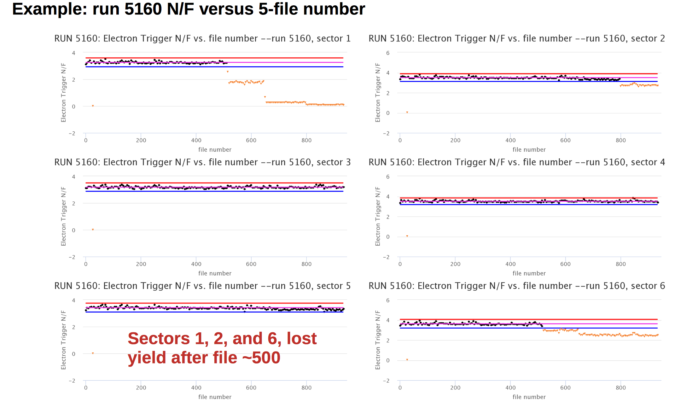
Monitoring examples

Slide 28
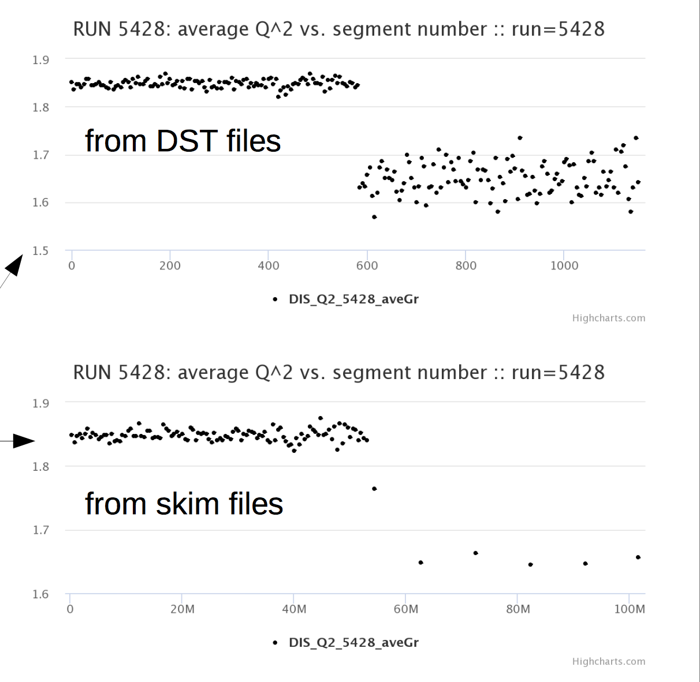
Monitoring at DST/Skim level - Examples

Slide 29
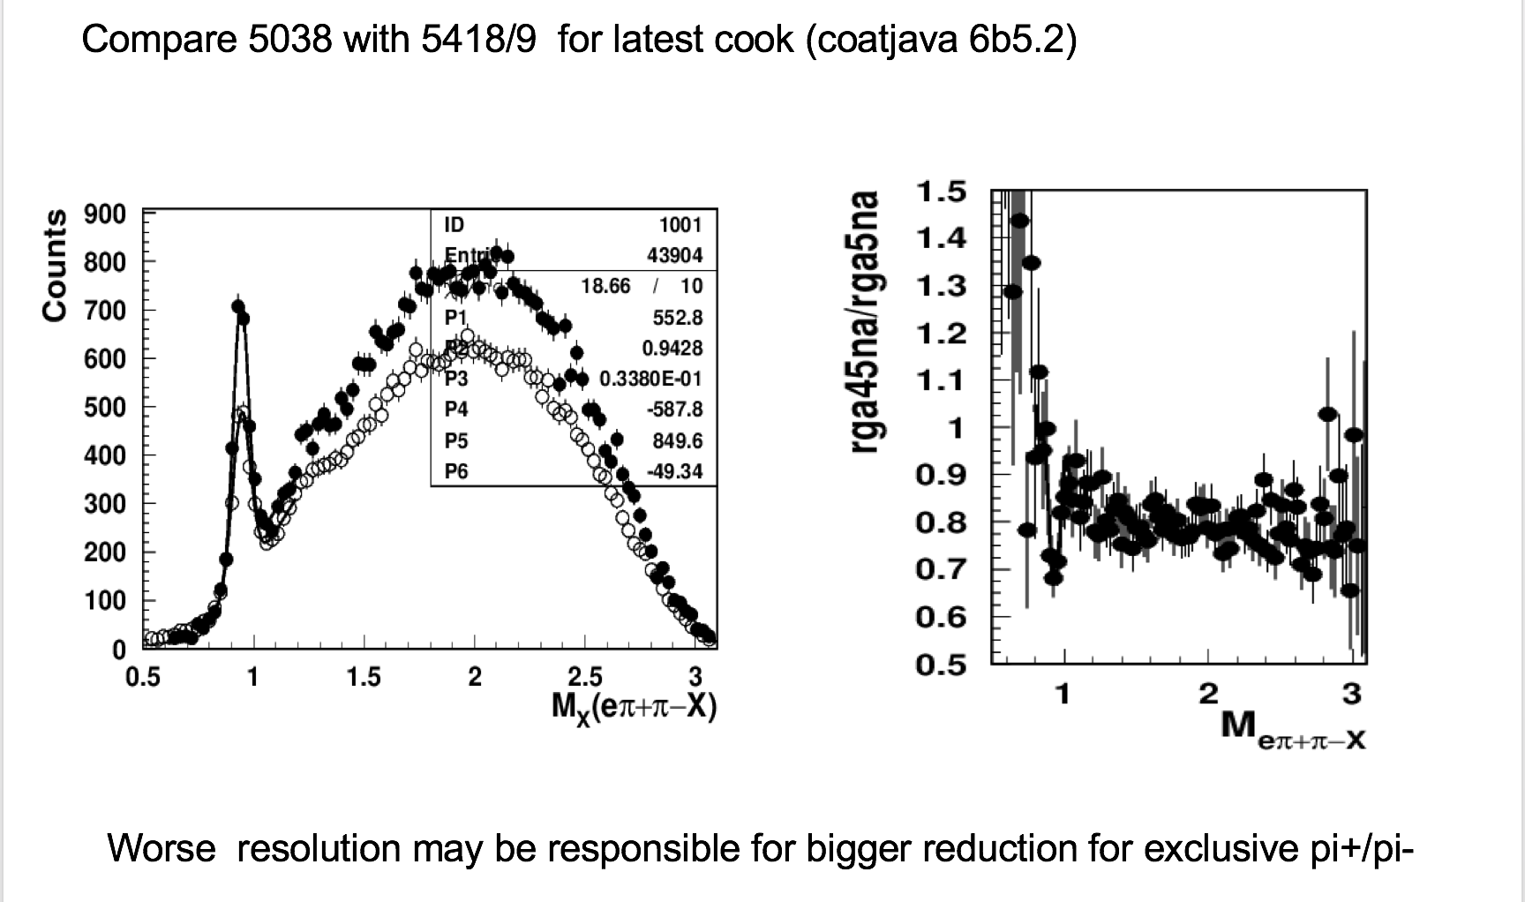
Event Reconstruction - Efficiency

Slide 30
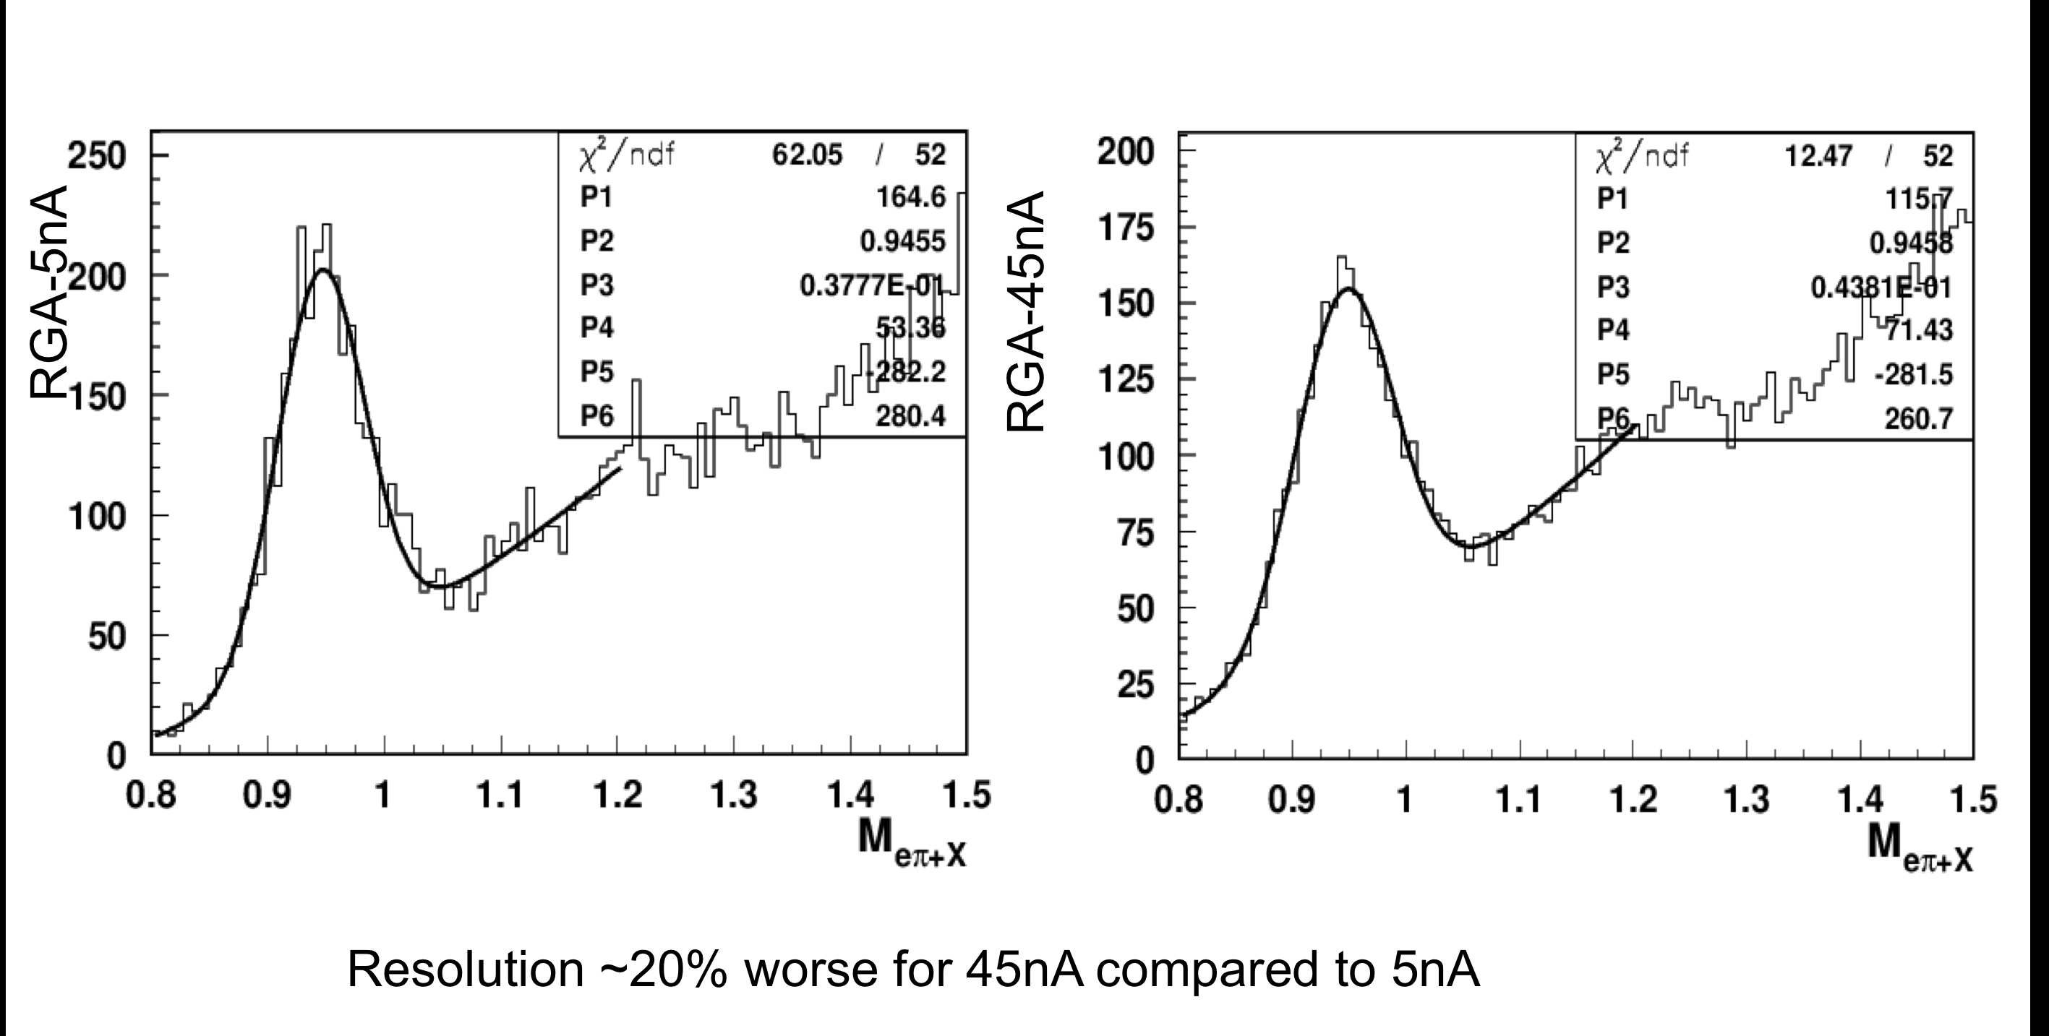
Event Reconstruction - Efficiency
Event Reconstruction – Efficiency: work has started

Slide 31
Summary
Pass1 – Data processing for RGA Fall 2018 - Inbending has started
Calibration for the outbending in progress
Team and monitoring tools in place, checking the data quality for each file of each run
Detailed event reconstruction efficiency has started
Preparation of RGA simulation plans underway
RGA- Data analyses have started (see RGA analysis presentations)
Planning for RGA – CLAS12 Analysis Note
PAC preparation – 2 pages update on each proposal by end of April.

