Slide 1
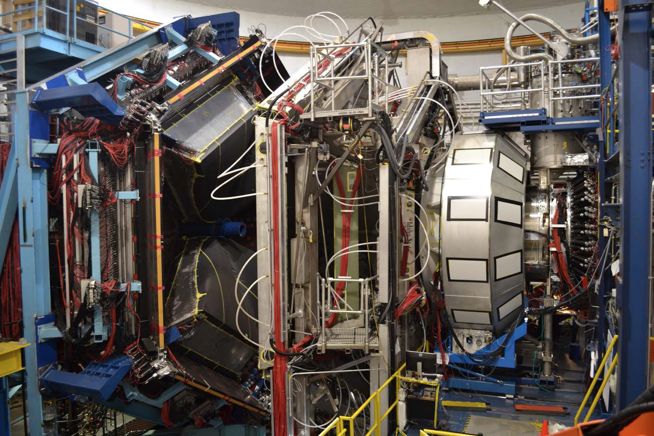
CLAS Collaboration Meeting
RGA – Path to Publication
Latifa Elouadrhiri

Slide 2
RGA-Science Program
The 13 Experiments of RGA could be grouped in the following five science categories:
Nucleon structure (E12-09-003, E12-06-108A, E12-06-108B): Study of the nucleon resonance structure at photon virtualities from 2.0 to 12 GeV²
Deep Exclusive Processes (E12-06-119, E12-06-108 and E12-12-00): Study of Generalized Parton Distributions (GPDs), (2 +1) D imaging of the proton and the study of its gravitational and mechanical structure.
Deep inclusive & SIDIS (E12-06-112, E12-06-112A and E12-06-112B):Study of the Transverse Momentum Dependence (TMDs) and the of 3D structure in momentum space.
Quasi photo-production (E12-12-001 and E12-12-001A): Study of J/ψ Photoproduction, LHCb Pentaquarks and Timelike Compton Scattering.
MesonX program (E12-11-005 and E12-11-005A): Study of meson spectroscopy in search of hybrid mesons

Slide 3
RGA – First Publication(s) - Scope
RGA Fall 2018 only
Scope and Initial focus on Inclusive and Transverse Mometum Distributions (TMDs) Science Program via SIDIS making use only of the CLAS12 Forward Detector (FD) with the aim of the following two publications in 2020:
  Di-hadron Analysis (C. Dilks talk)
  Single Hadron (S. Diehl talk)
  Inclusive Cross Section (N. Makov talk )
Spring 2019
19%
Spring 2018
44%
Fall 2018
37%
Note: Other RGA physics analyses will proceed for all other physics processes from all approved experiments. If any could lead to publication it will be reviewed and proposed to the appropriate physics working groups. (see this morning talks)
This analyses will also serve as input and provide tools for validation of further software development

Slide 4
RGA – Fall 2018 Data – Initial Focus Towards First publications
RGA – Fall 2018
Inbending
Data Processing
Complete.
Data analysis underway
Outbending
Data Processing Started
(4/27/2020)

Slide 5
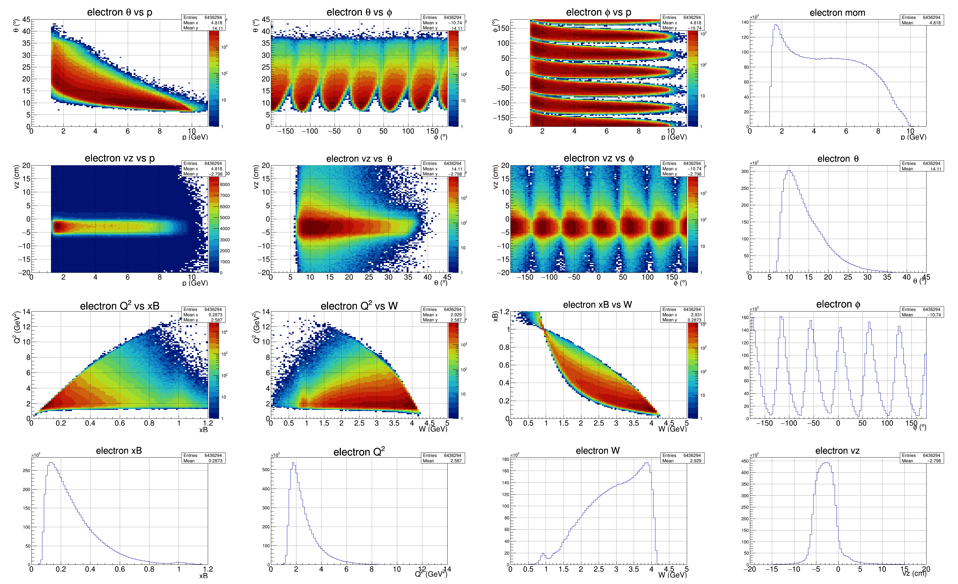
Overview - Electron
inbending data

Slide 6
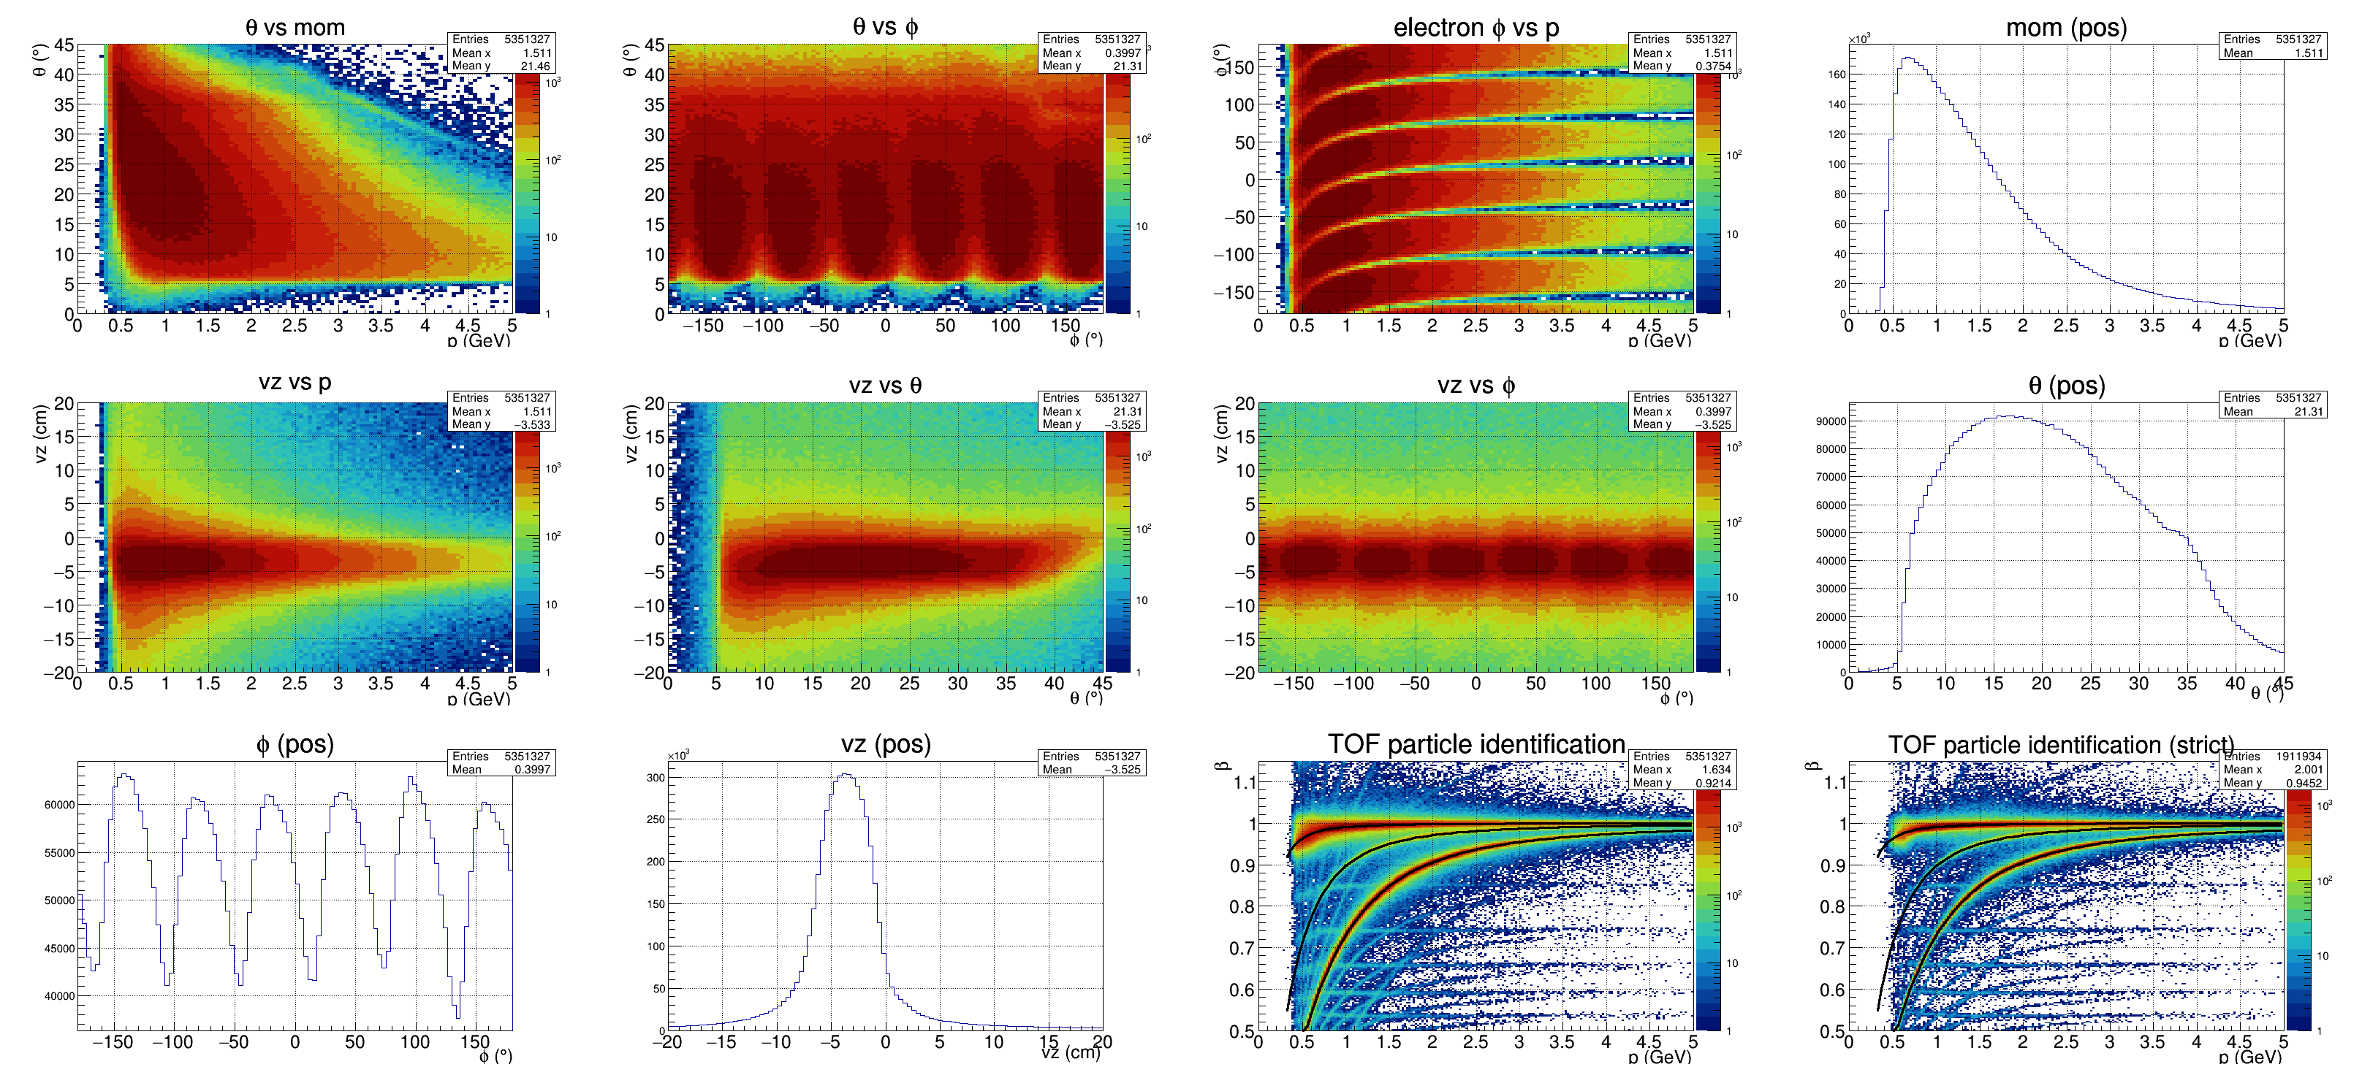
FTOF – Positive Charge PID
inbending data

Slide 7
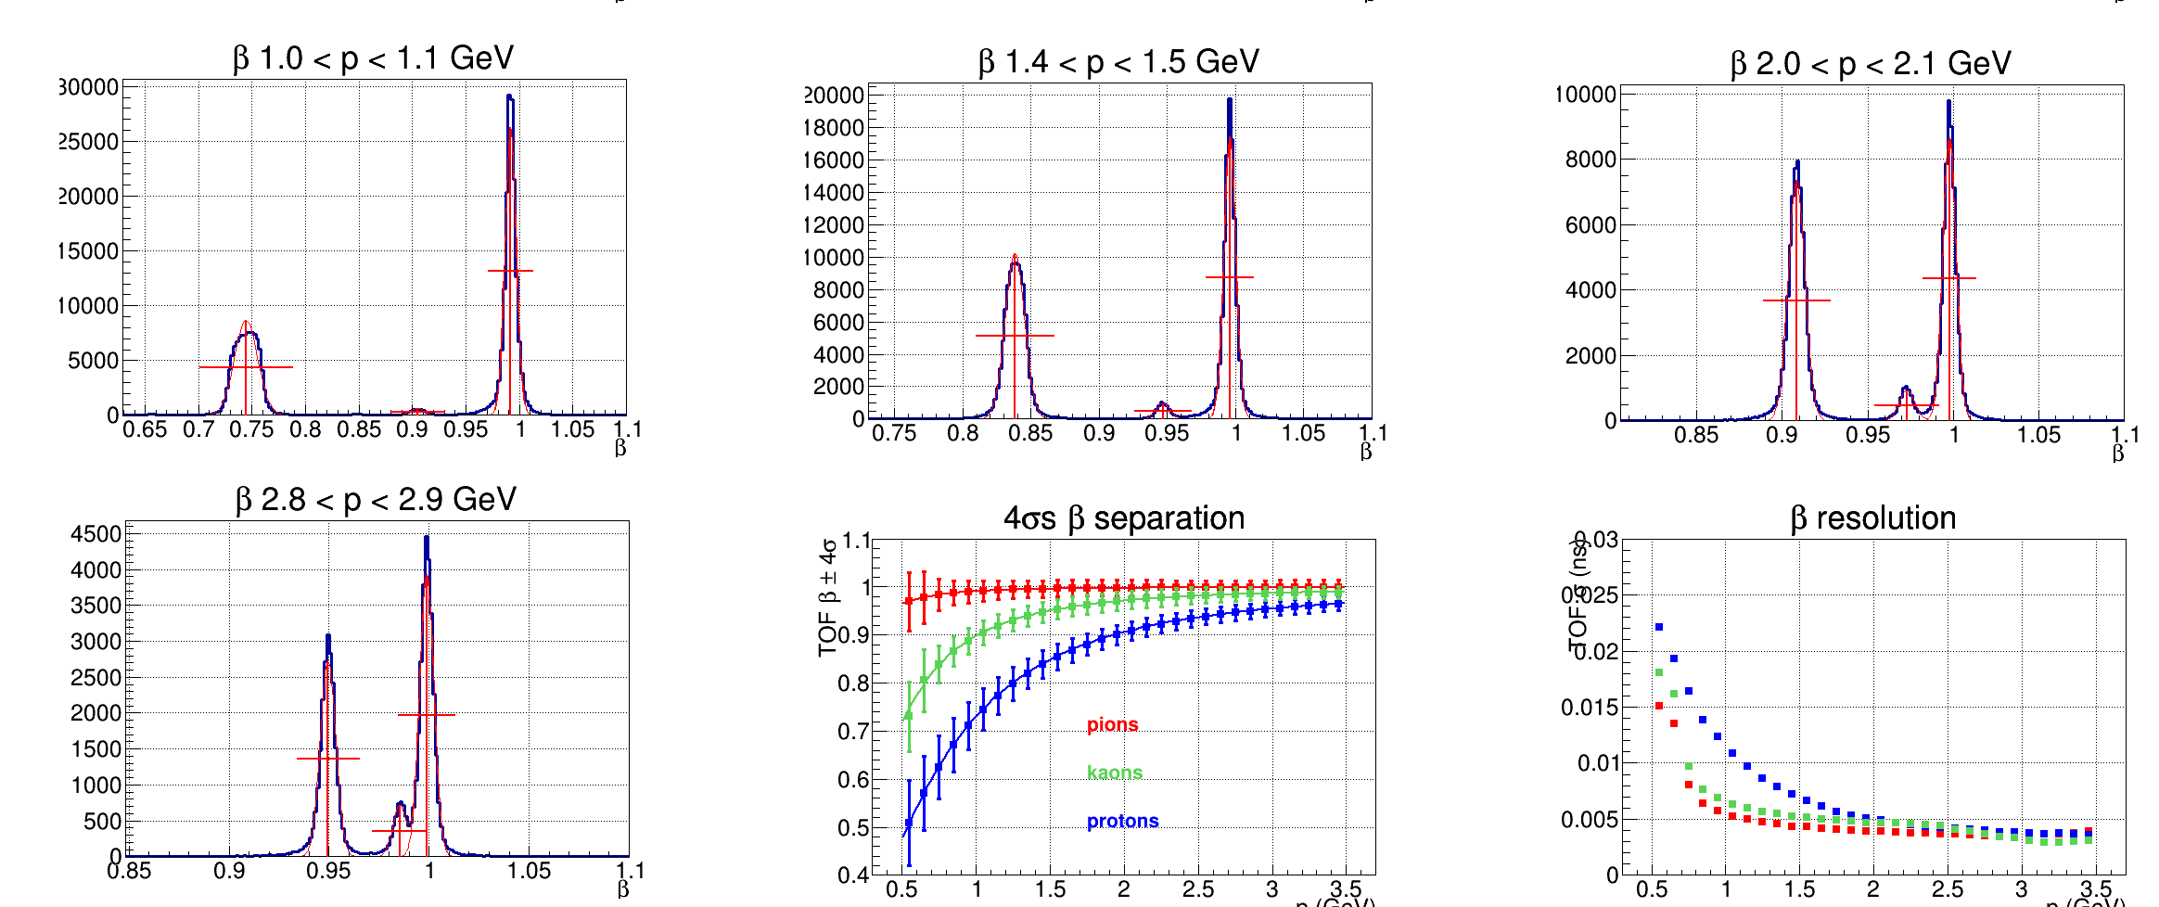
FTOF – Charge Particle Identification
inbending data

Slide 8
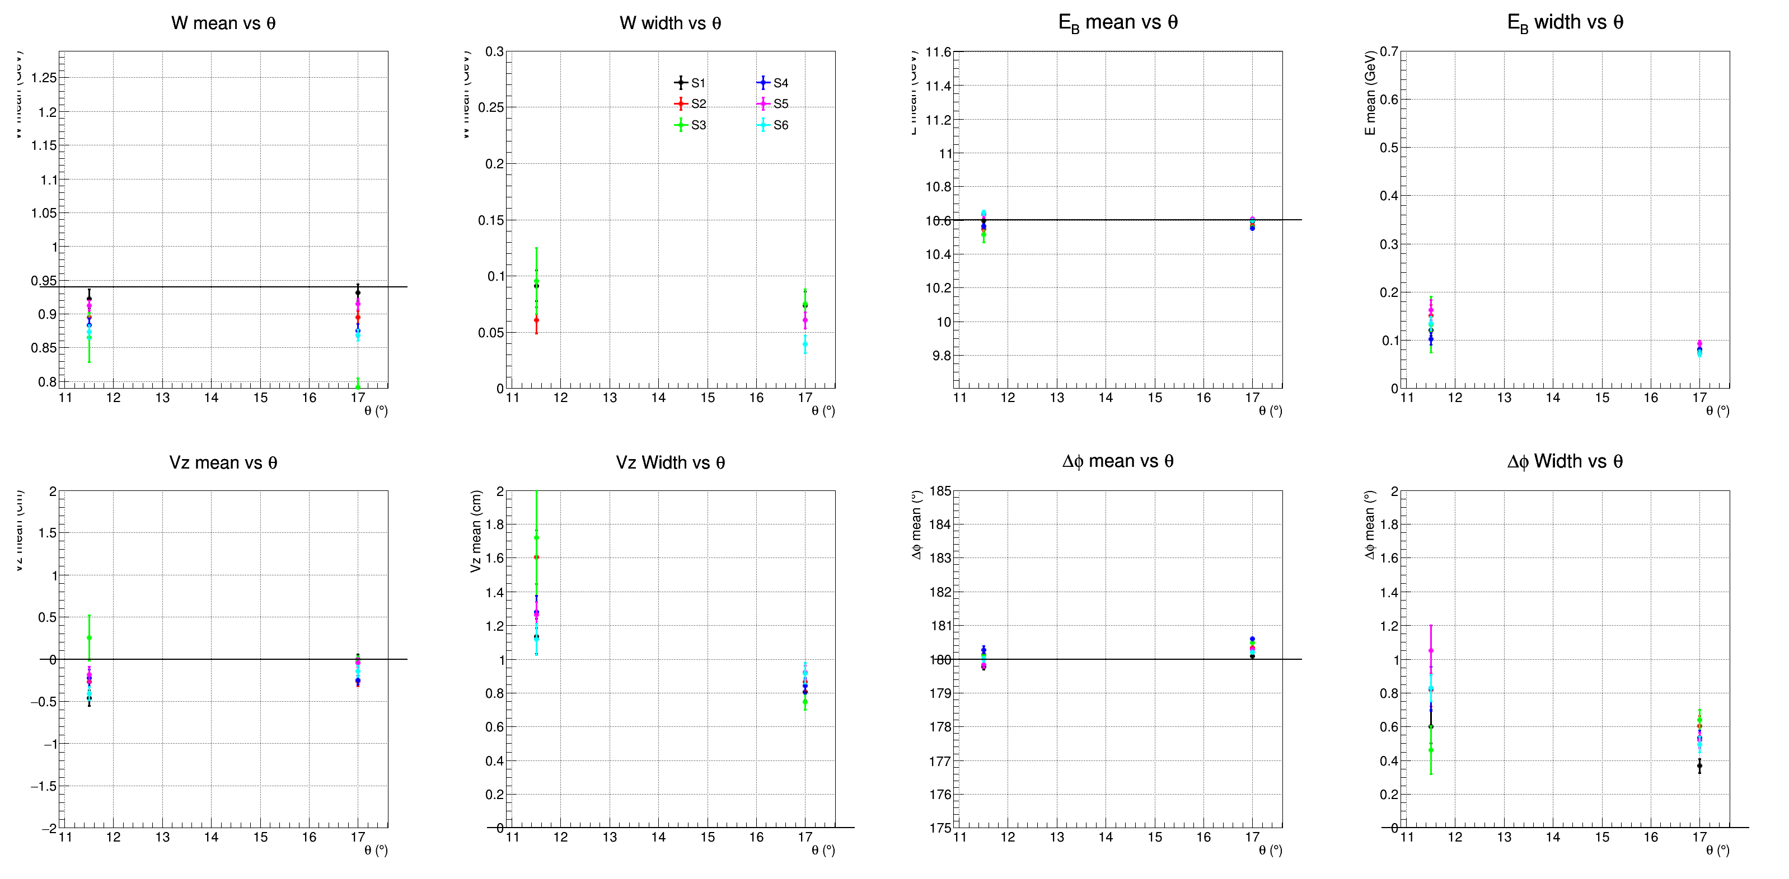
Elastic - Proton in the FD
inbending data

Slide 9
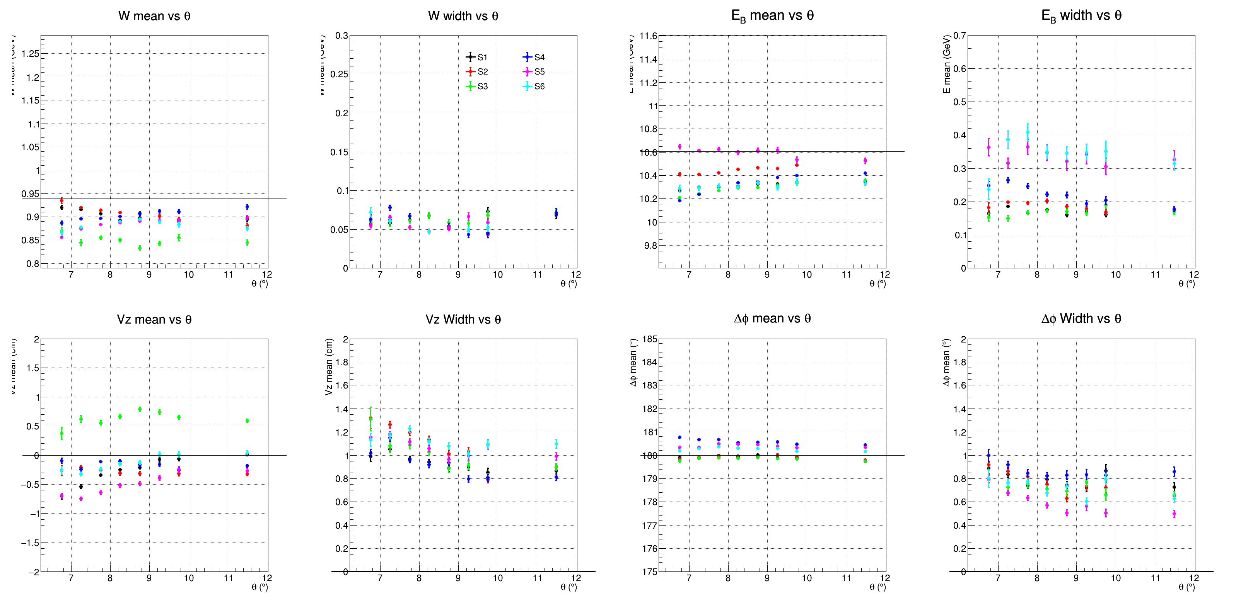
Elastic Proton in CVT
inbending data

Slide 10
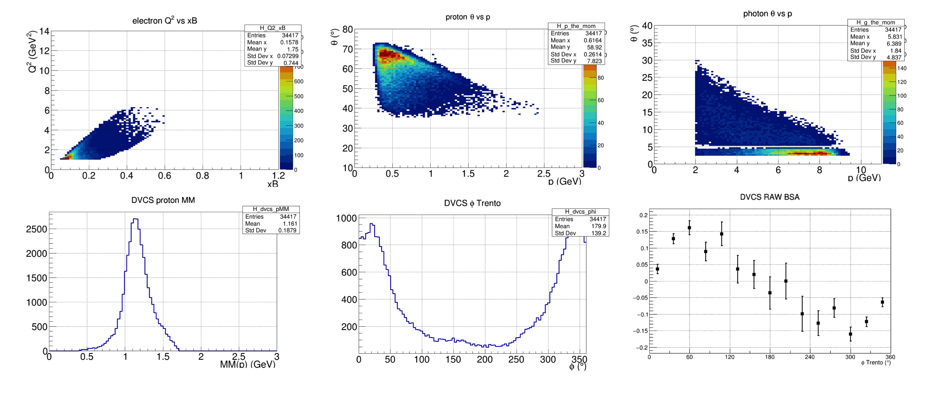
DVCS – From the outbending
Outbending data

Slide 11
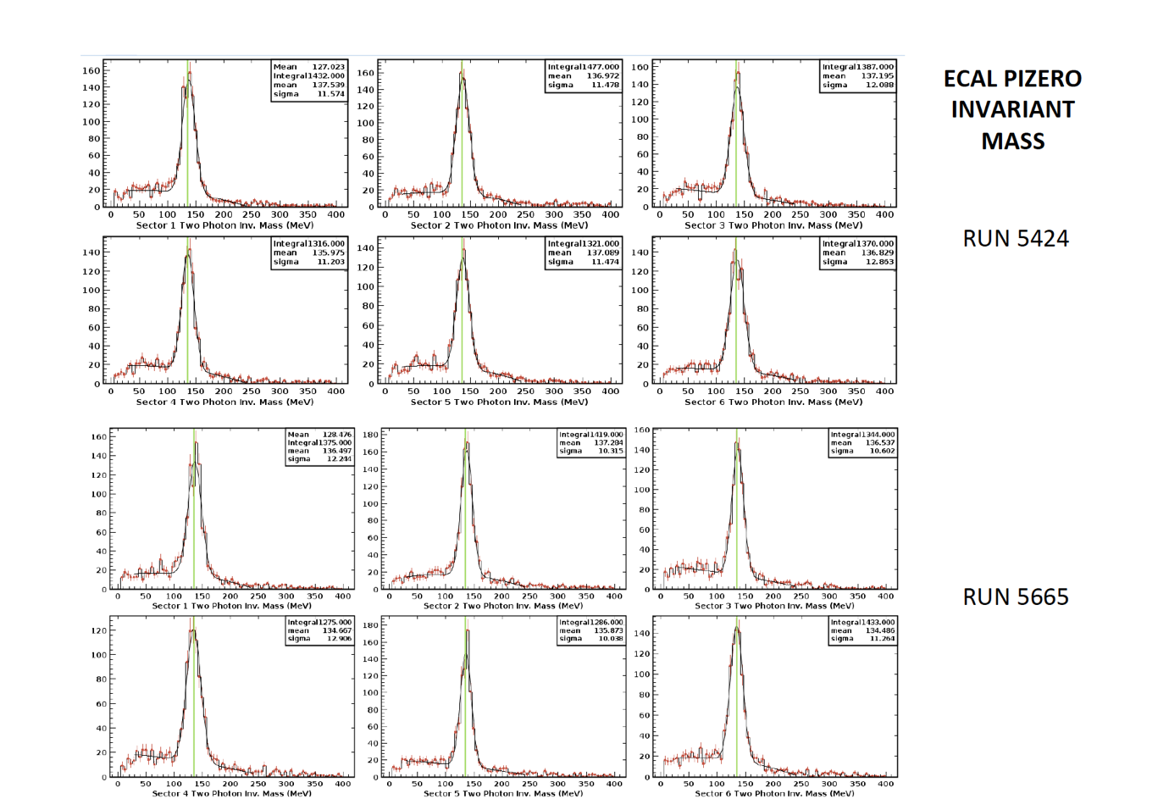
ECAL PIZERO Mass
Outbending data

Slide 12
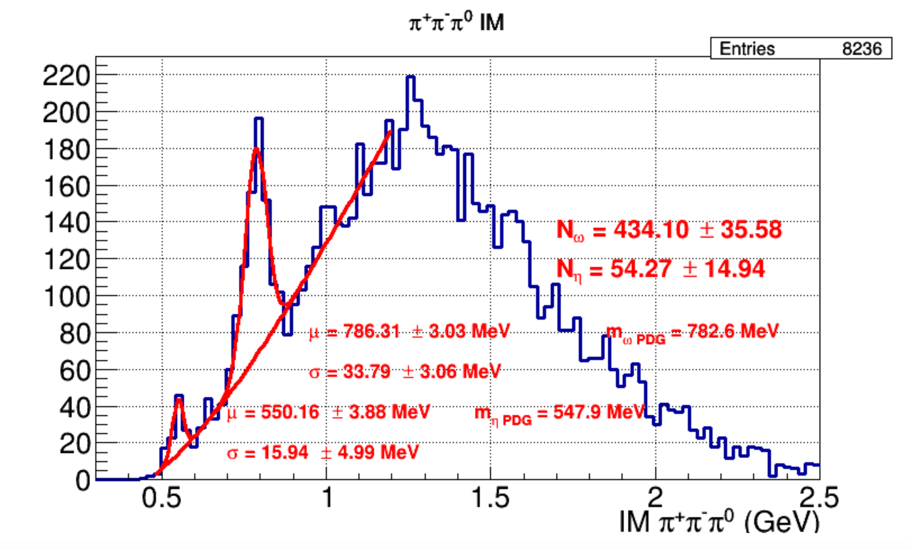
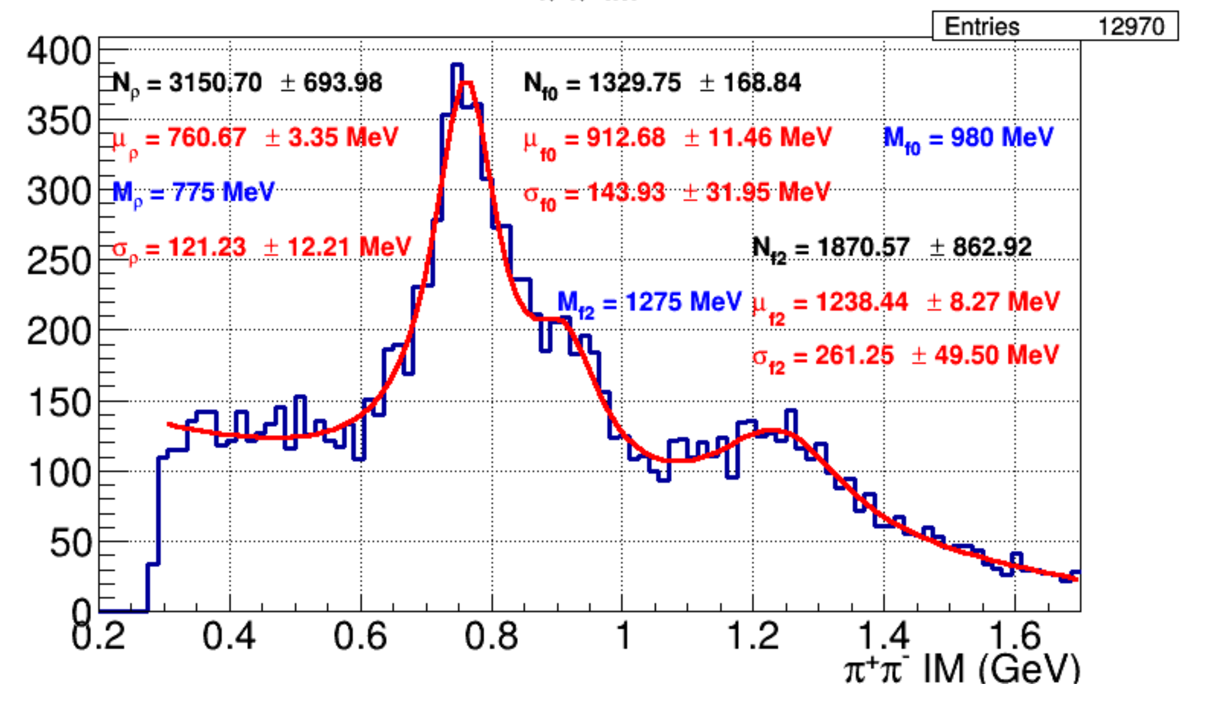
Two & Three Pions Invariant Mass
Outbending data

Slide 13
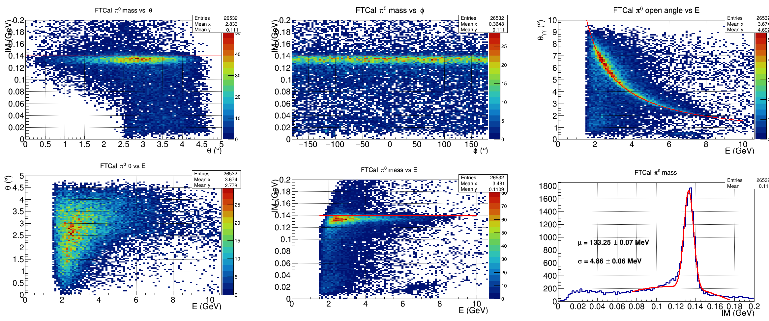
Forward Tagger Performance
inbending data

Slide 14
RGA- Fall 2018 Detector Performance Summary

Slide 15
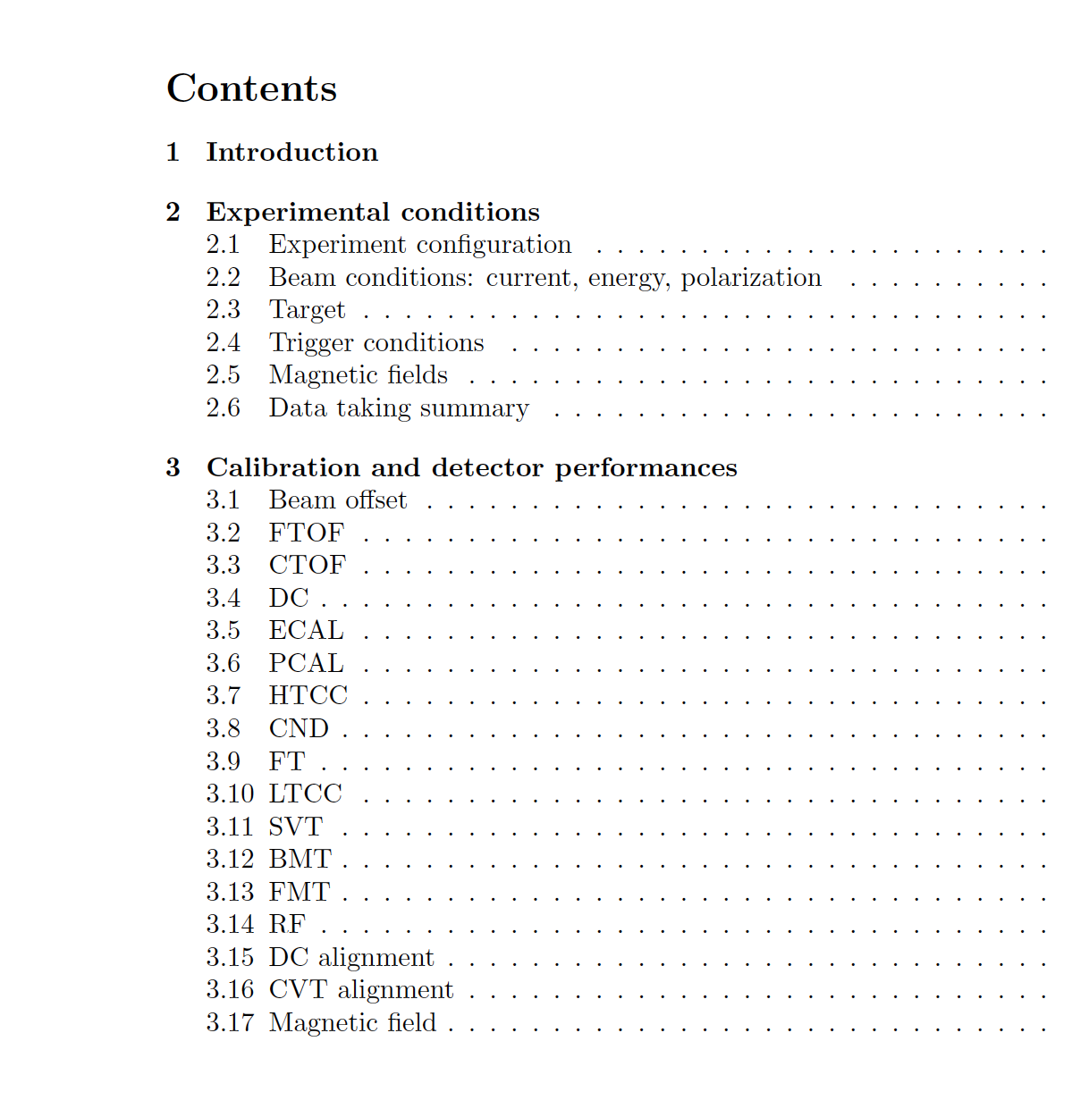
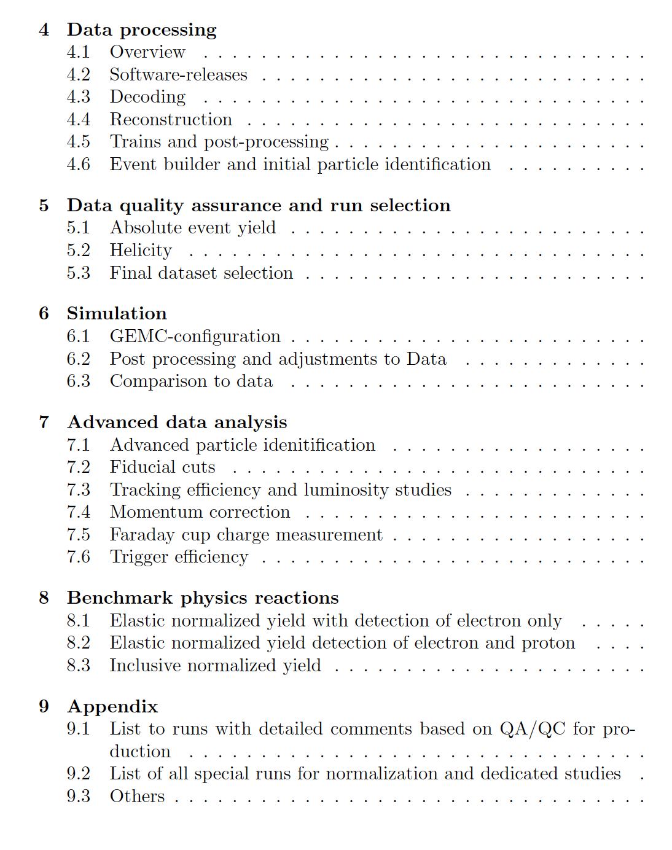
RGA– CLAS12 – Analysis Note – Overview and Procedures
Review Committee, Chair (Y. Ilieva); Appointed by CCC

Slide 16
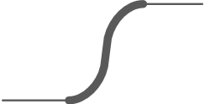
RGA - Common Analysis Note - Milestones
RGA
Analysis-Note
&
review complete
RGA-Fall 2018 Pass1 complete (IN & OUT)
QA/QC – Run selection complete
Final Draft RGA- Analysis Note complete
submitted to review
committee
RGA- Fall 2018 Outbending Pass 1 review (04/22)
Start Data processing (04/27)
05
07
02
08
TODAY
04/08
04/15
04/22
04/29
05/6
05/13
05/20
05/27
06/03
06/10
06/17
06/24
07/01
07/8
07/15
07/22
07/29
April 2020
May 2020
June 2020
July 2020
01
03
04
06
May 2020: Complete the data processing, QA/QC & develop the first draft of the RGA analysis note. Launch the necessary simulations
June 2020: Data analysis for both Inbending and outbending & simulations finalize the analysis note with interaction with the review committee & PWG
July 2020: Finalizing the analysis note taking into account/addressing the comments from the review committee
RGA- Fall 2018 Inbending pass1
Including decoding for the outbending
Detailed Outline
Finalized and Approved
First meeting with analysis review committee
Launch Simulations
Review and approve the priorities for simulations
First Draft – RGA
Analysis Note start interacting with the review committee

