Slide 1
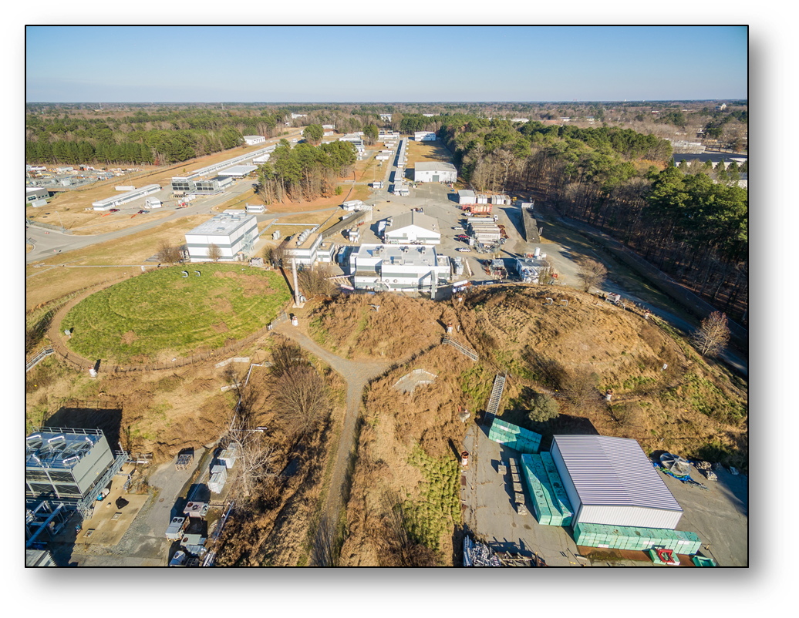
Jefferson Lab Status
Stuart Henderson

Slide 2
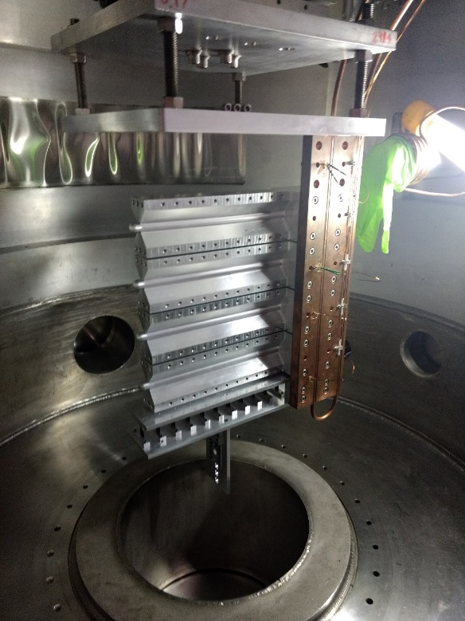
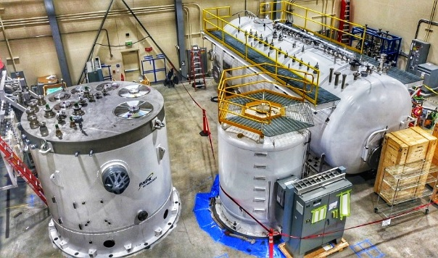
Jefferson Lab News and Highlights
Proton Radius: Nature 575, 147 (2019)
12 GeV Scientific era is in full swing
  Completed several high profile experimental programs
  Completed second full year of CEBAF 12 GeV Operations; delivered ~32 weeks operations in FY19, most weeks since 2010; reliability 81.5%
  Executing CEBAF reliability and gradient program; challenges in achieving top energy due to gradient limitations
EIC Project planning progressing in partnership with BNL
Moving toward CD-1 for MOLLER Project; SoLID Proposal submitted to DOE-NP
Stood up new Computational Sciences and Technology Division; Advanced computing initiatives underway
Supporting broader DOE mission with LCLS-II, LCLS-II HE, SNS-PPU
New staff adding depth and leadership in critical areas
Launched enhanced Fellows program (Isgur and Grunder)
Renewed focus on improving safety culture and performance
Significant progress on Inclusion and Diversity Initiatives
Tritium target cell
LCLS-II Cryoplant

Slide 3
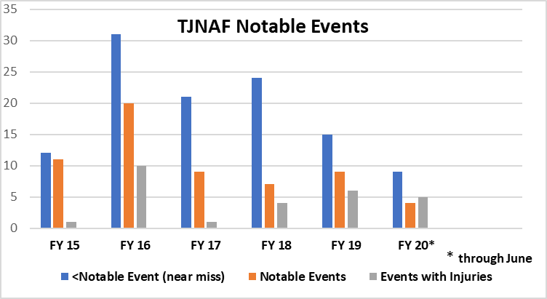
World Class Science Requires World Class Safety
We want you to be able to come to Jefferson Lab and safely carry out your research
Recent near-misses bring ongoing safety culture issues to the fore
We have been putting considerable effort into Human Performance Improvement, which is a proven approach for influencing safety and operational culture toward better performance
My message to you:
Have a questioning attitude
Ask yourself, what can go wrong?
Pay attention to your surroundings – situational awareness
If you have any concerns let them be known
Ensure that our students in particular are properly trained and supervised

Slide 4
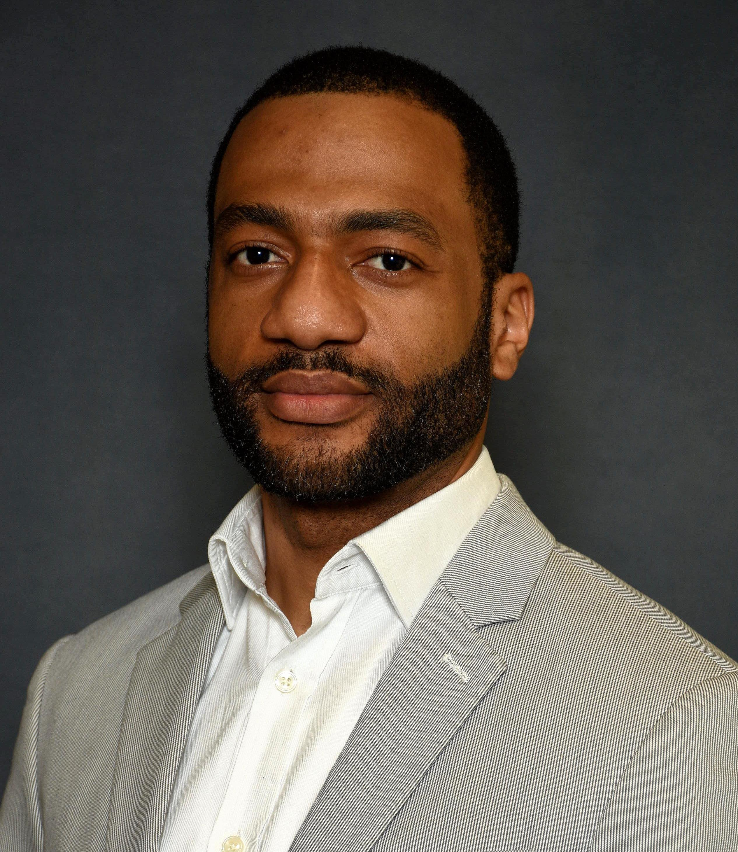
Diversity and Inclusion Initiatives at Jefferson Lab
D&I Culture Survey: Achieved 70% employee participation and 18% user participation in the D&I culture survey, with ~1100 comments. Survey results will be shared with lab staff and user community.
Steven Uwajeh has joined Jefferson Lab as our D&I Program Lead; he is an accomplished D&I and HR professional and joins us from Shell Oil.
New mandatory course: “Building a Respectful Workplace in a Technical Environment,” focusing on harassment, bullying, constructive communications, and creating a psychologically safe work environment
Launched Safe Zone Ally Training facilitated by D&I Council members
Message of Unity in response to death of George Floyd
Camille Ginsburg appointed Co-Chair of D&I Council
Education and Outreach – K-12/STEM events and programs; significant enhanced engagement in Newport News school system
Strengthened partnerships with local universities through targeted outreach events
Grew participation in the Introduce a Girl to Engineering Day program by 50%

Slide 5
Jefferson Lab Organization
Jefferson Science Associates LLC
Internal Audit
Gail Lucento
Electron Ion Collider Project
A. Lung
Laboratory Director
Stuart Henderson
Director’s Office
Communications
Lauren Hansen
CCO
Project Office
Multi-Lab Partnerships
LCLS-II, J. Preble
LCLS-II HE, J. Hogan
SNS PPU, E. Daly
CPO
CRO
COO
Performance
Assurance
Steve Smith
Planning
Allison Lung
S&T Programs
Bob McKeown
Operations
Mike Maier
Legal Counsel
Rhonda Scales
CIO
Experimental Physics
Rolf Ent
Accelerator
Andrei Seryi
Theoretical and Comp Physics
Jianwei Qiu
Computational Science & Tech.
Amber Boehnlein
Engineering
Will Oren
Tech Transfer and Commercialization
Drew Weisenberger
CTO
CHRO
CFO
Environment,
Safety, & Health
Steven Hoey
Human
Resources
Rhonda Barbosa
Business and Finance
Jennifer Logan
Facilities Mgt.
and Logistics
Rusty Sprouse

Slide 6
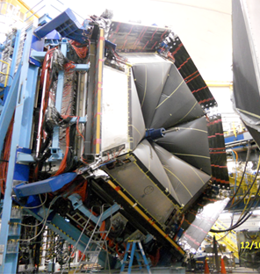
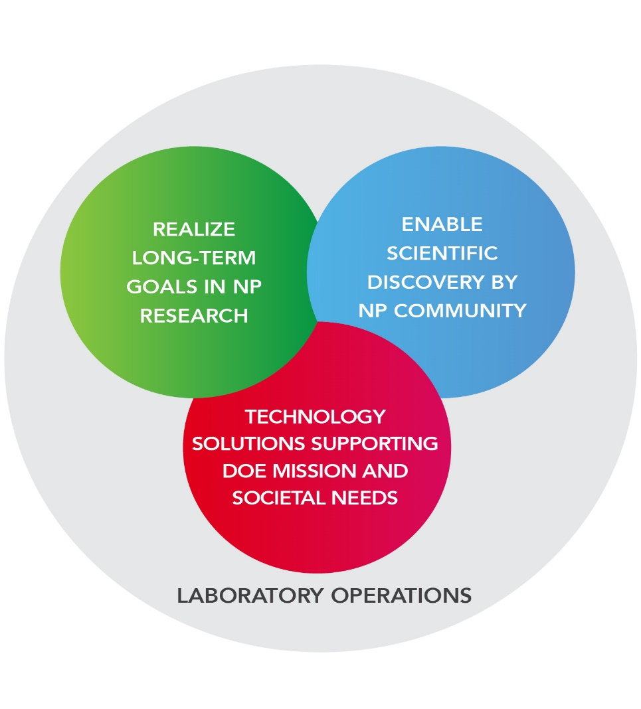

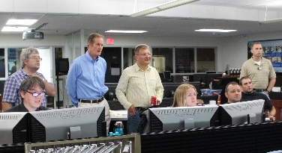
Vision for Jefferson Lab
Jefferson Lab supports the DOE Office of Science and serves the Nuclear Physics user community as a world-leading center for fundamental nuclear science and associated technologies
1. Deliver on 12 GeV Scientific Program
2. Support long-term goals in nuclear physics
3. Provide technology solutions supporting DOE mission
4. Enable world-class science through excellence in Laboratory Operations

Slide 7
Jefferson Lab’s User Community Continues to Grow

Slide 8
Highest Priority Has Been Increasing Weeks of CEBAF Operation
Adjusting the plan due to COVID-19
Optimal weeks
12 GeV Construction
FY19: delivered most weeks of operation since 2010
Long shutdown starts in September for 2K cold-box installation: resume CEBAF Operations in May
Working towards optimal 34 weeks of reliable operations

Slide 9
Impact of COVID-19
Jefferson Lab transitioned to “minimum safe” operations on March 23, 2020 (MEDCON 6)
  Terminated ongoing CEBAF run with ~6 weeks remaining
  Maintained safe operation of site and equipment with 20-50 staff on site, all other staff working remotely
  Prepared plans, site, buildings, processes, training for eventual resumption of on-site operations
Entered phase 1 of resumption of operations (MEDCON 5) on June 8, 2020, following approval by DOE
  Plan for ~200 staff on-site, with limited case-by-case user access
Users will be able to access the site in MEDCON 4, subject to new access requirements
Our plan is to resume the CEBAF run to complete the FY20 program, then proceed to the long Scheduled Accelerator Down
Jefferson Lab has had three staff with confirmed COVID-19

Slide 10
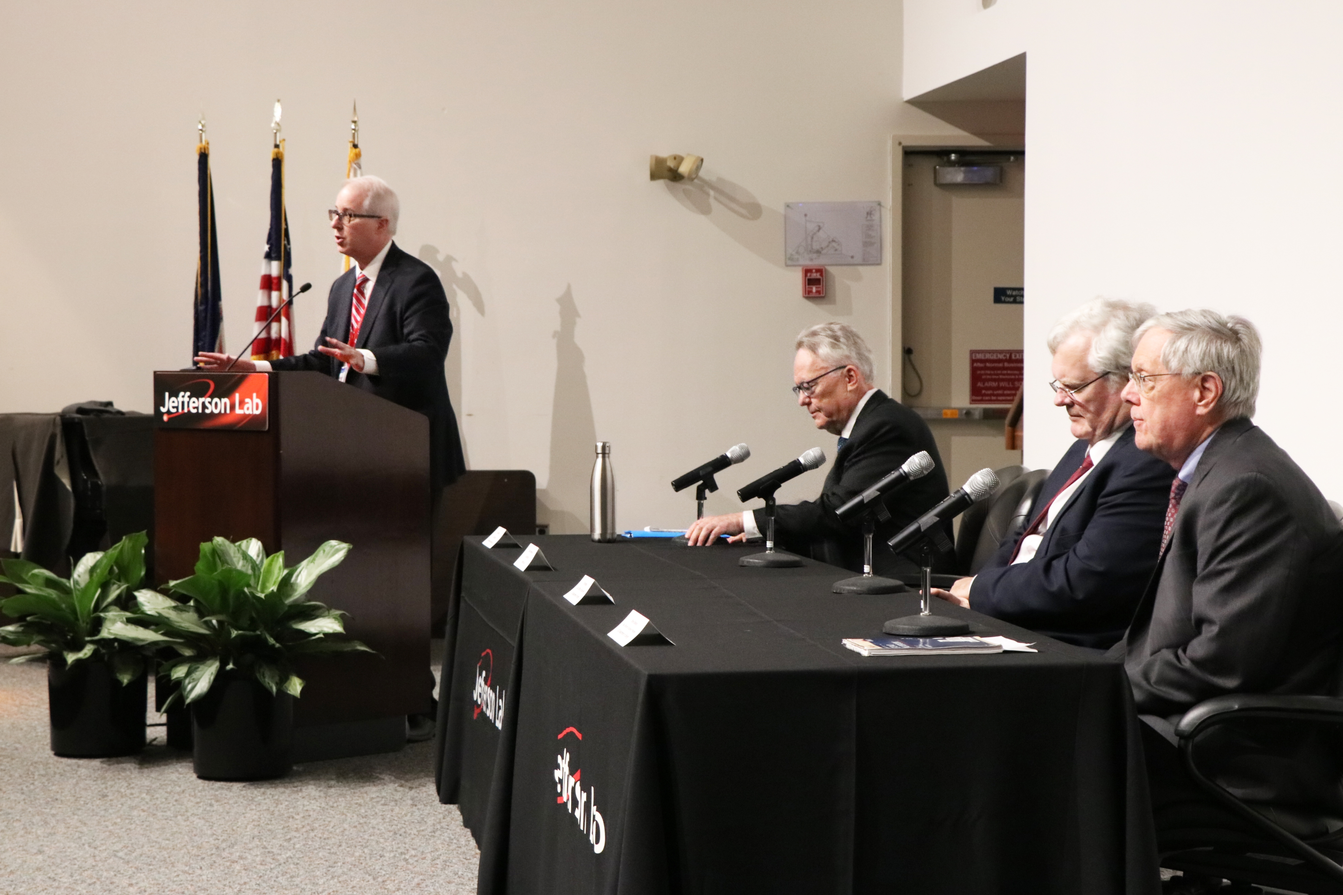
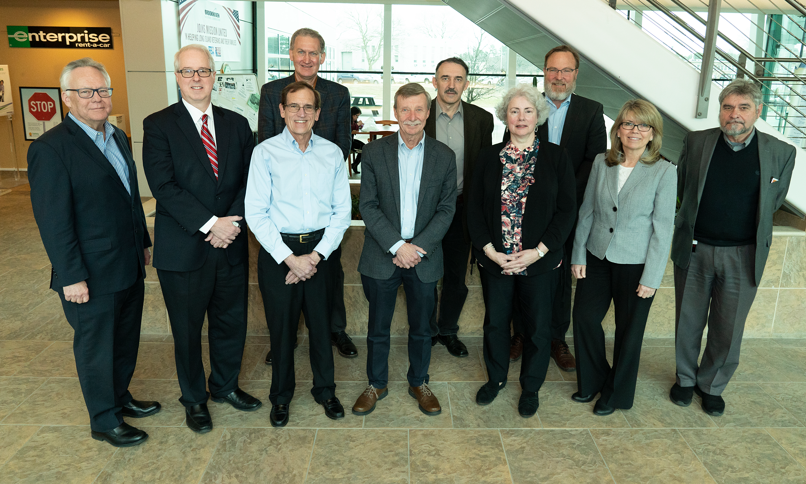
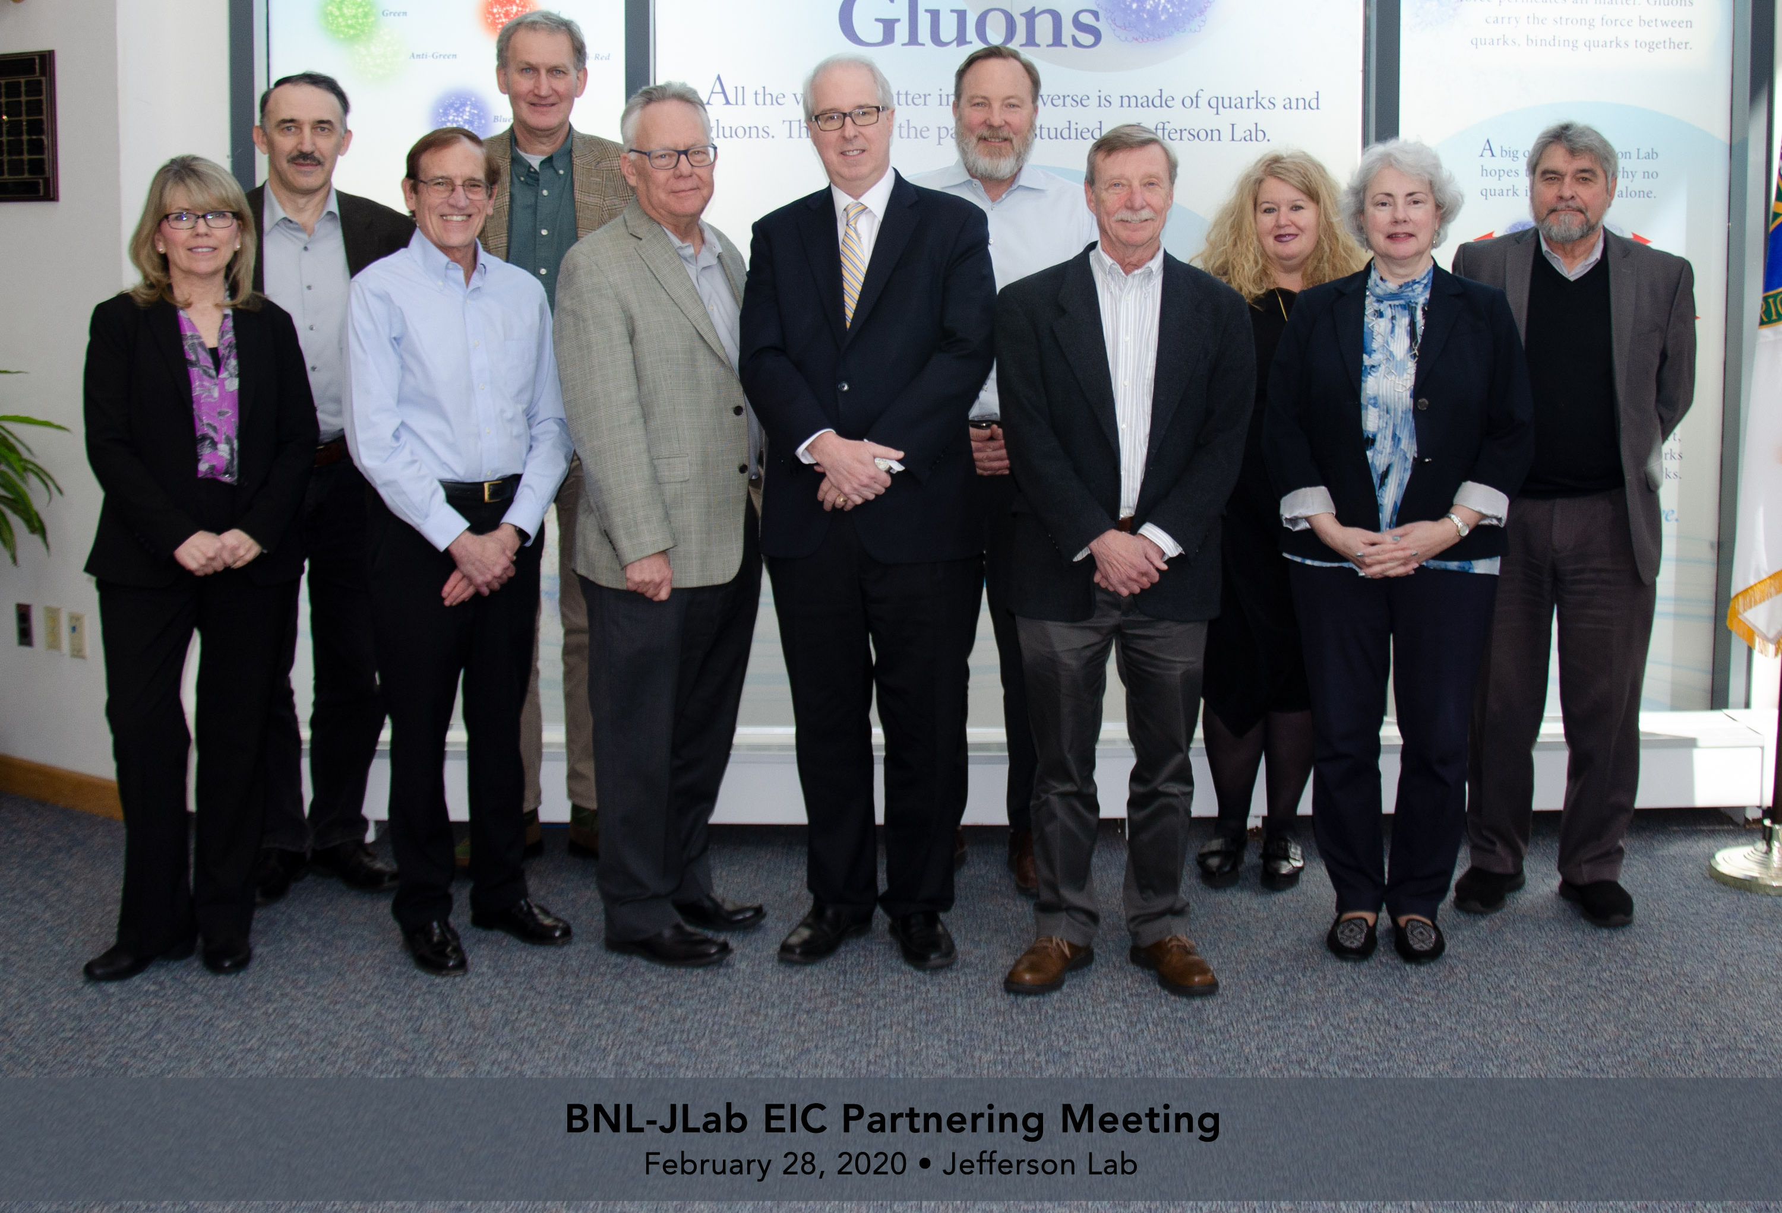
Electron-Ion Collider
CD-0 approved Dec. 2019
Site Selection at Brookhaven National Lab announced Jan. 2020
From T. Hallman (NSAC 3/2/20):
  “An SC Prime Directive: The Project will be carried out as a full intellectual partnership between the BNL and JLAB teams (and other collaborators) with major participation by all”
From S. Binkley (NSAC 3/2/20):
  “Look to strengthen smaller/single purpose laboratories to be more multidiscipline”
Positive, constructive engagement with BNL leadership on EIC partnership
Both labs firmly committed to EIC success
That commitment formalized in BNL-JLAB Partnering Agreement, signed May 7, 2020
Established JLAB EIC Project organization under leadership of A. Lung; Integrated BNL-JLAB team is being developed
Jan 23, 2020 @ JLab
Feb 10, 2020 @ BNL
Feb 28, 2020 @ JLab

Slide 11
Approved 12 GeV Experimental Program: A decade-long program is on the books
CEBAF has a long program ahead that is complementary to the envisioned EIC program
CEBAF will remain the prime facility for fixed target, high luminosity electron scattering with special role in the high-x region
PAC approved program includes two significant experimental system projects: MOLLER and SoLID
In addition, letters of intent and proposals have been received for
(Polarized) positron program
K-Long Program in Hall D
Double-deeply virtual Compton scattering (DDVCS) program
Some of these may motivate further enhancements of CEBAF and its experimental capabilities
Topic | Hall A | Hall B | Hall C | Hall D | Total
Hadron spectra as probes of QCD | 0 | 219 | 11 | 540 | 770
Transverse structure of the hadrons | 150.5 | 85 | 146 | 25 | 406.5
Longitudinal structure of the hadrons | 19 | 230 | 211 | 0 | 460
3D structure of the hadrons | 359 | 872 | 196 | 0 | 1427
Hadrons and cold nuclear matter | 220 | 275 | 205 | 15 | 715
Low-energy tests of SM and Fundamental Symmetries | 547 | 180 | 0 | 79 | 806
Total Days | 1295.5 | 1861.0 | 769.0 | 659 | 4584.5
Total Approved Run Group Days (includes SoLID) | 1295.5 | 1026 | 726 | 459 | 3506.5
Total Days Completed | 211.5 | 221 | 129.0 | 138 | 699.5
In full year running, can complete ~100 Run Group Days per year in each Hall

Slide 12
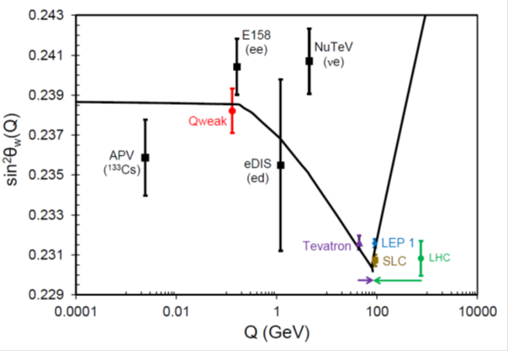
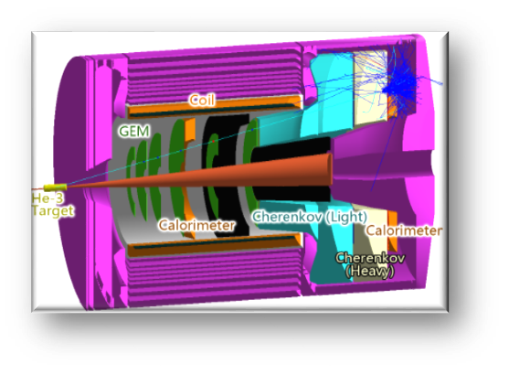
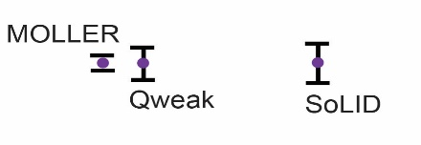
Making the most of the 12 GeV Upgrade: MOLLER and SoLID
MOLLER
SoLID
Parity violating electron scattering provides a high precision test of the standard model
Unique discovery space for new physics up to 38 TeV mass scale, with a purely leptonic probe
CD-0 approved 2017
Jim Fast joined Jefferson Lab to lead MOLLER Project
Preparing for DOE-OPA CD-1 Review Sept. 2020
    Solenoidal Large Intensity Device – new multipurpose detector facility optimized for high luminosity and large acceptance, enabling very broad scientific program
    Science program:
      precision 3D nucleon imaging
      J/Psi production near threshold
        both important prerequisite science for EIC
      parity-violating deep inelastic scattering: SM test and new physics
    Proposal submitted to DOE-NP; DOE Science Review May 8-10, 2021
Standard Model
JLab
Data
JLab
Data
Projected
JLab data:

Slide 13
Jefferson Lab’s Future Science and Technology Directions
CEBAF-based Program
Vibrant 12 GeV Program
Potential opportunities in fixed-target, high luminosity complementary to EIC
Theory and Computation supporting NP goals
Technology Development
Stewardship responsibility for superconducting RF and cryogenics technology within DOE
Scientific Mission Diversification
Jefferson Lab expertise can benefit other DOE Office of Science programs
Exploring potential in close coordination with Office of Science
Electron-Ion Collider
EIC Construction Project Scope and Responsibilities
Engagement/leadership in EIC scientific program

Slide 14
Perspective
The Lab is healthy and in a strong position moving forward
Our priorities are
  Ensuring that the 12 GeV program is successful
  Moving EIC forward aggressively in partnership with BNL
  Exploring potential areas of scientific diversification
What I would ask is that you keep in mind the competitive environment in which we are operating:
  Keep up the good work and proceed with an appropriate sense of urgency
  Let your voice be heard. Decision-makers need to hear from you about the importance of your work, training the next generation and the importance of Jefferson Lab in achieving your goals
Thank you for your continued enthusiasm and support for Jefferson Lab and its future

Slide 15
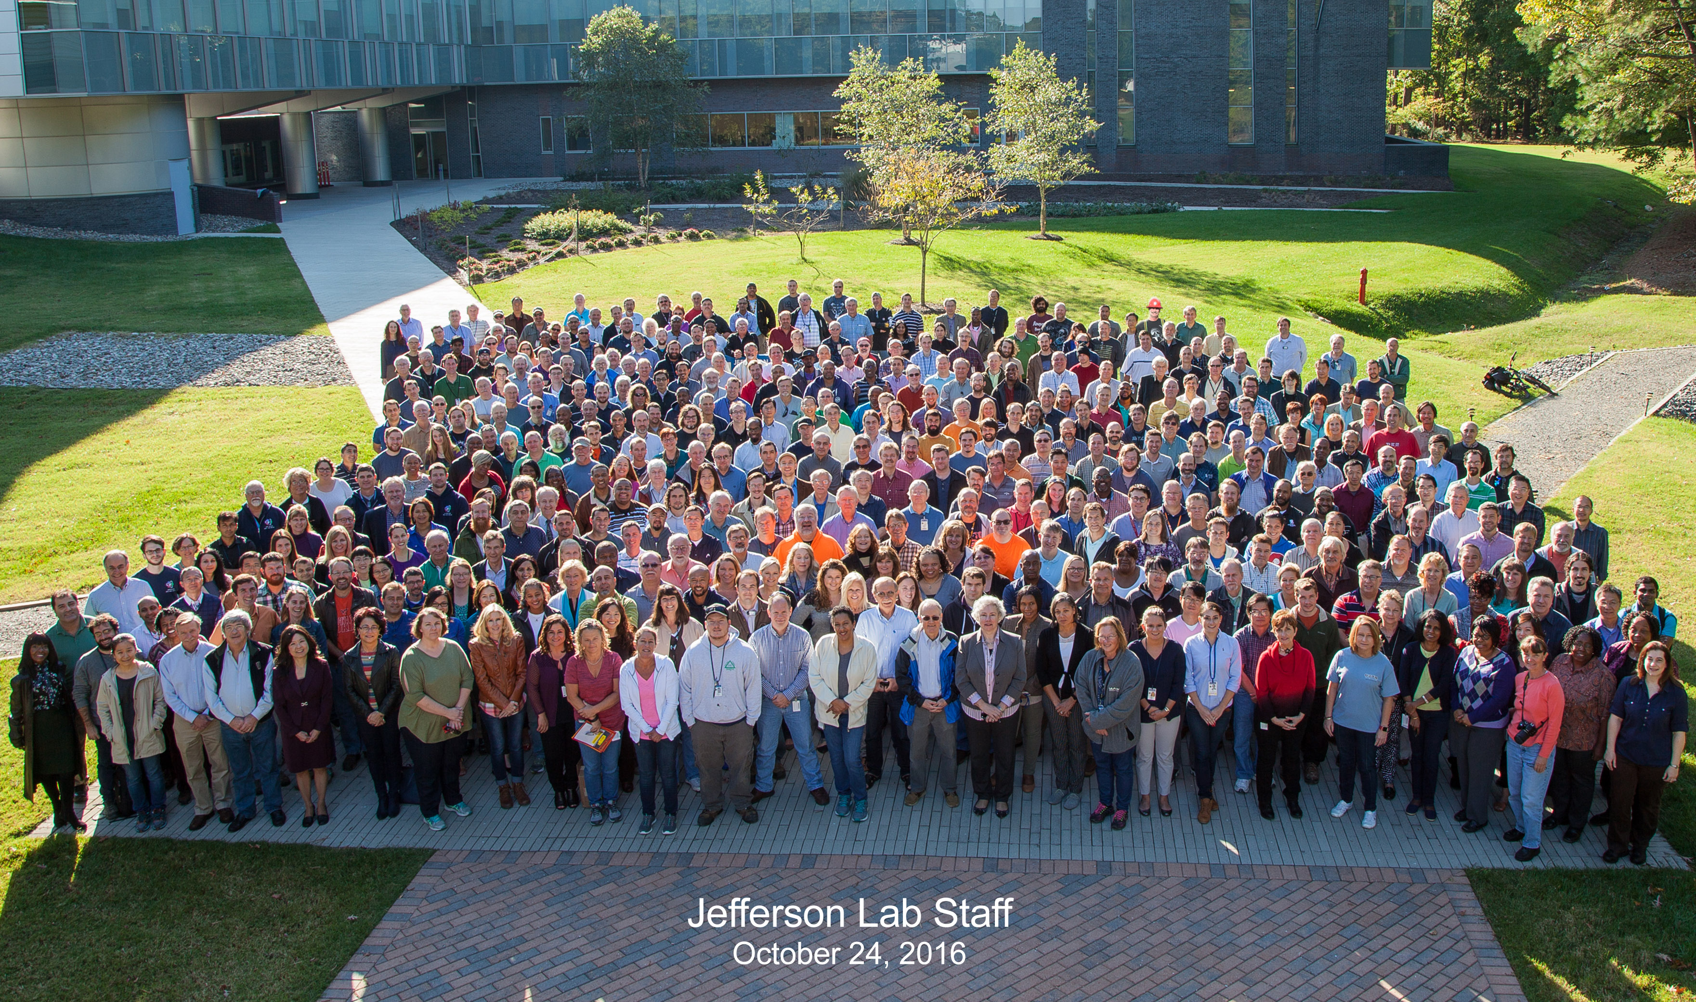
Thank you!

