Slide 1
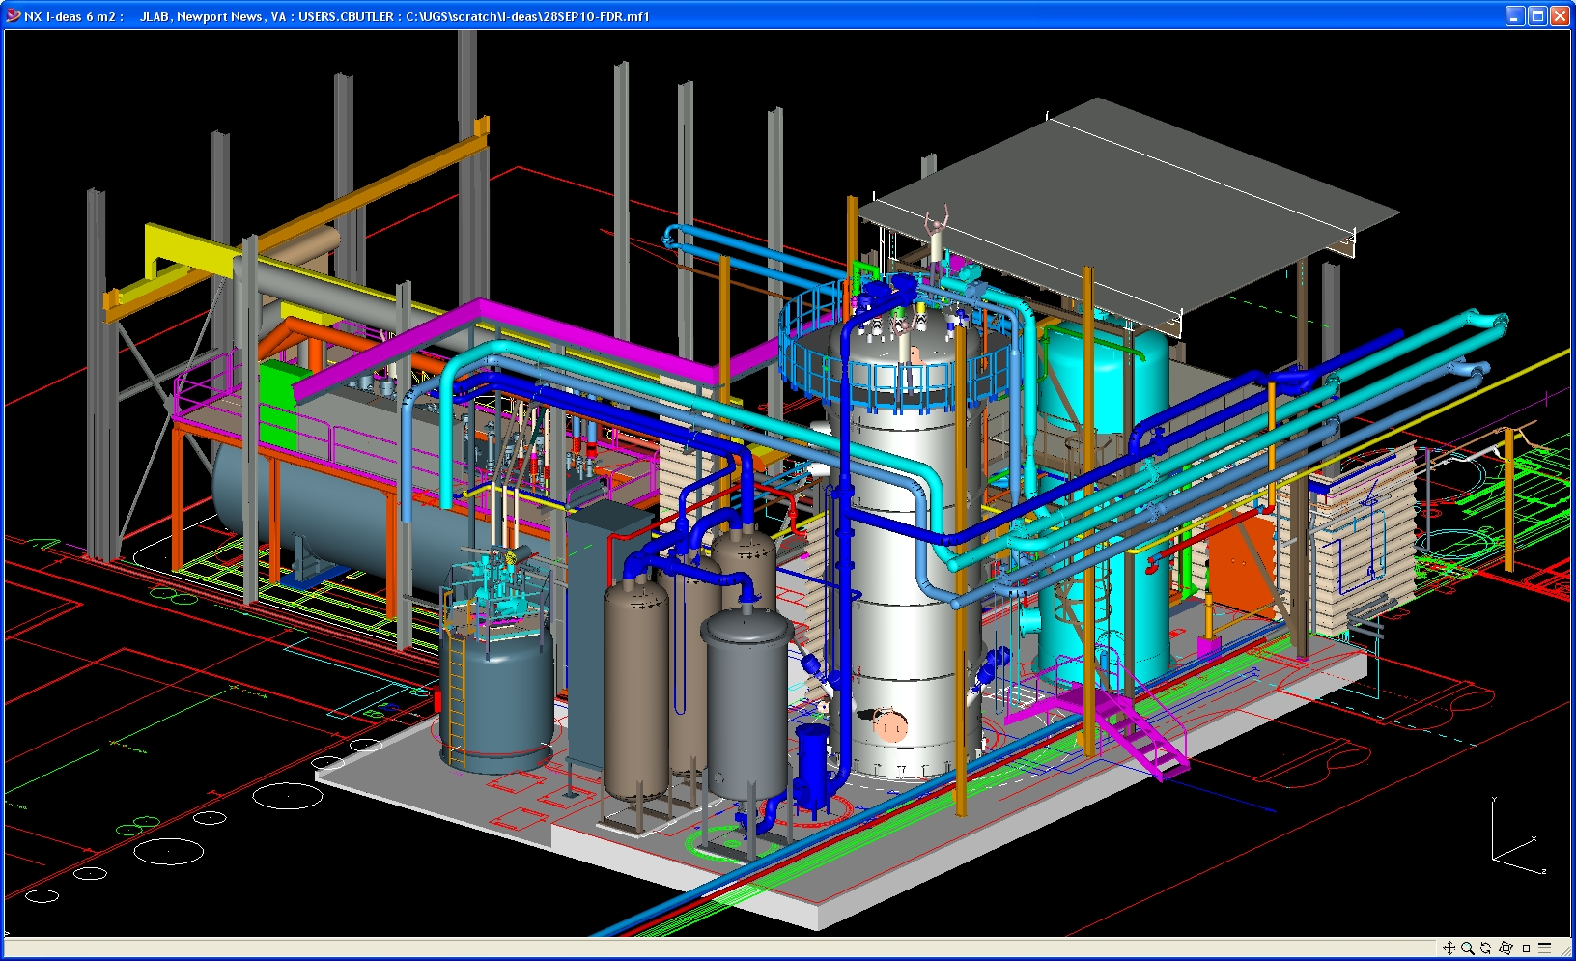
Cryogenic Systems
Dana Arenius
Rao Ganni
Jefferson Laboratory
Sept 13, 2013

Slide 2
Outline
Typical Cryogenic Plant Overview
What Are the Subsystems
Subsystem Specification Development
Sequence of Cryogenic Plant Subsystems
Integrative Design Coordination (SRF/Civil)
Plant Requirements Determination
Requirements for Civil Construction Estimation
Summary

Slide 3
JLab 12GeV Plant Overview
Two Refrigerator Systems, each on a linac
Each can provide 4600W@2K, 12kW@35K, 10-15 g/s 4K liquefaction, 100 micro bar pressure regulation
Newer refrigerator system uses far less electrical power, cooling water, etc….3.8 vs. 6.5MW electric power… JLab’s Ganni Thermodynamic Cycle (licensed to industry)
Subsystem designs have been “standardized” by JLab to reduce cost and improve performance, “build to print”
Warm helium compressors, gas management, oil removal, gas purification, controls, guard vacuum, installation
Saving rolls up into civil construction costs
Currently working with FRIB with cryomodule subcooler R&D to improve cryogenic plant efficiency by another 7%

Slide 4
Typical Sub Atmospheric Cryogenic Plant
Warm He Gas Storage
Tanks
Multi Stage Warm He Compressors
LN2
4.5K Refrigerator Cold Box w/ Turbines
Subatmospheric Multi-Stage Cold Compressor Cold Box
He Gas Purifier & Recovery Compressors

Slide 5
Plant Subsystems
Cryogenic Subsystems
Warm Helium Gas Compressors
Motor Control (MCC)
Oil Removal System
4.5K Helium Refrigerator
1.8K or 2K Cold Compressors
Cryogen Distribution System
Warm Helium Gas Storage
LN2 Storage
LHe Storage
Helium Gas Purification
Recovery Compressors
Purifier
Purity Monitors
Gas Management, Vaporizer
Process Control
Guard Vacuum
Safety Systems (ODH, etc.)
Civil Supportive Systems
Cooling Water
Electric Power
Medium Voltage
480V
120/208V
Emergency
Cranes
Lighting
Instrument Air
Indoor Ventilation (incl. Heating and Cooling)
Indoor Building Space
Outdoor Equipment Layout Areas
Cryogenic Equipment Installation Access
Safety Systems
Plant Subsystems are generally WBS structure for cryogenic plants

Slide 6
Typical Warm Helium Compressor

Slide 7
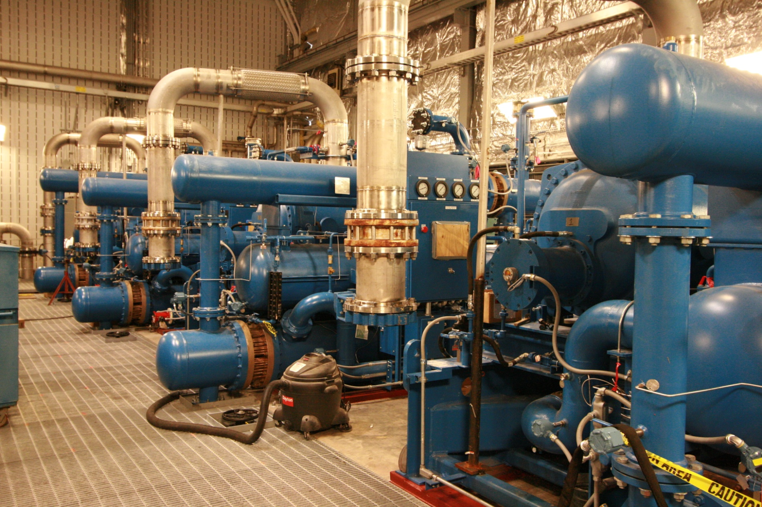
Warm Helium Gas Compressors
Compressor Room

Slide 8
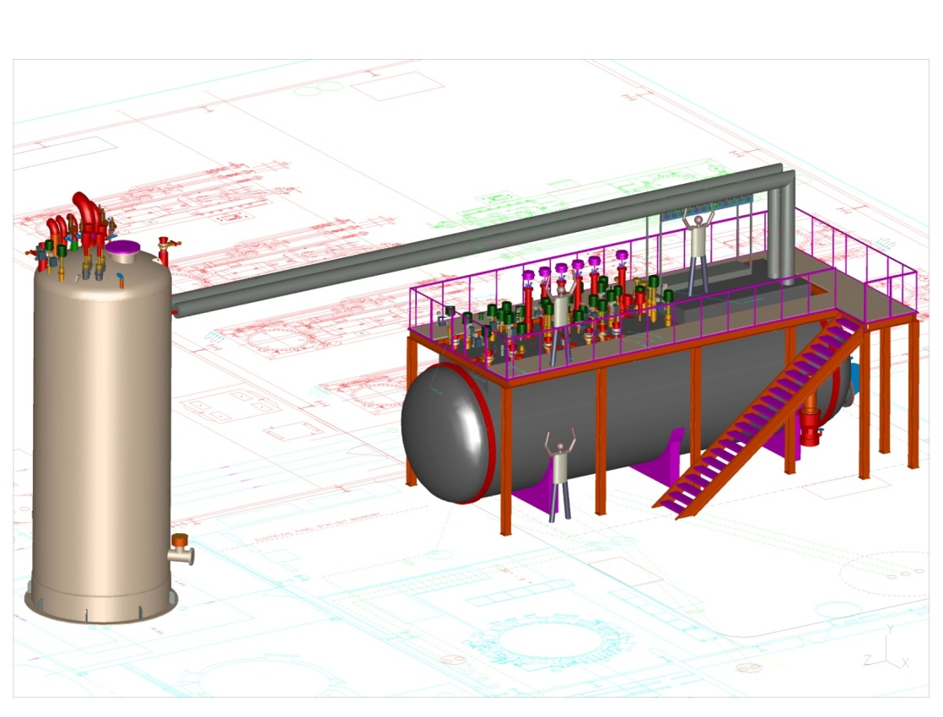
4.5K Refrigerator Cold Box
18 kW @ 4K Equivalent Shown
Upper Outside Box (vertical)
Lower Inside Box (horizontal)
Joined by transfer line

Slide 9
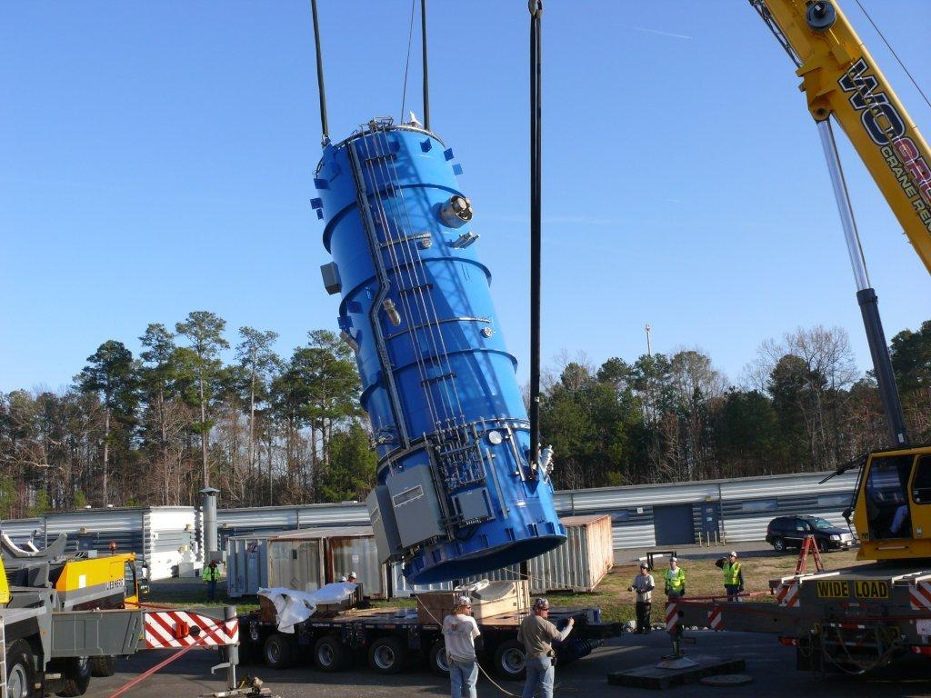
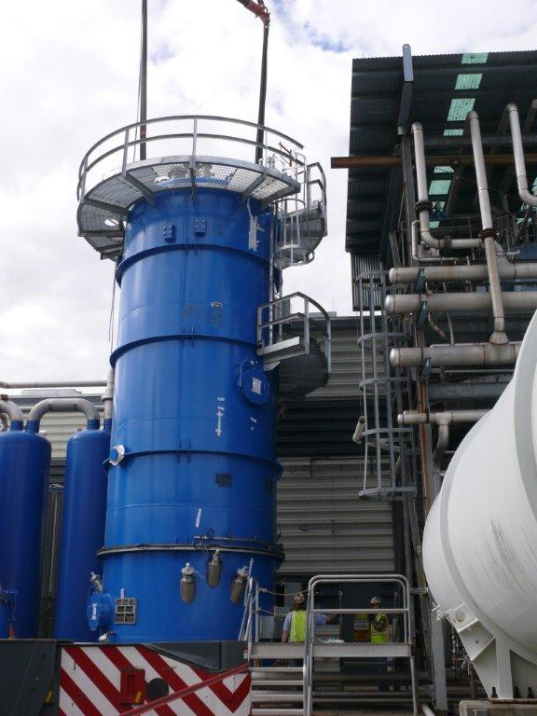
Upper 12 GeV 4.5K Cold Box Installation

Slide 10
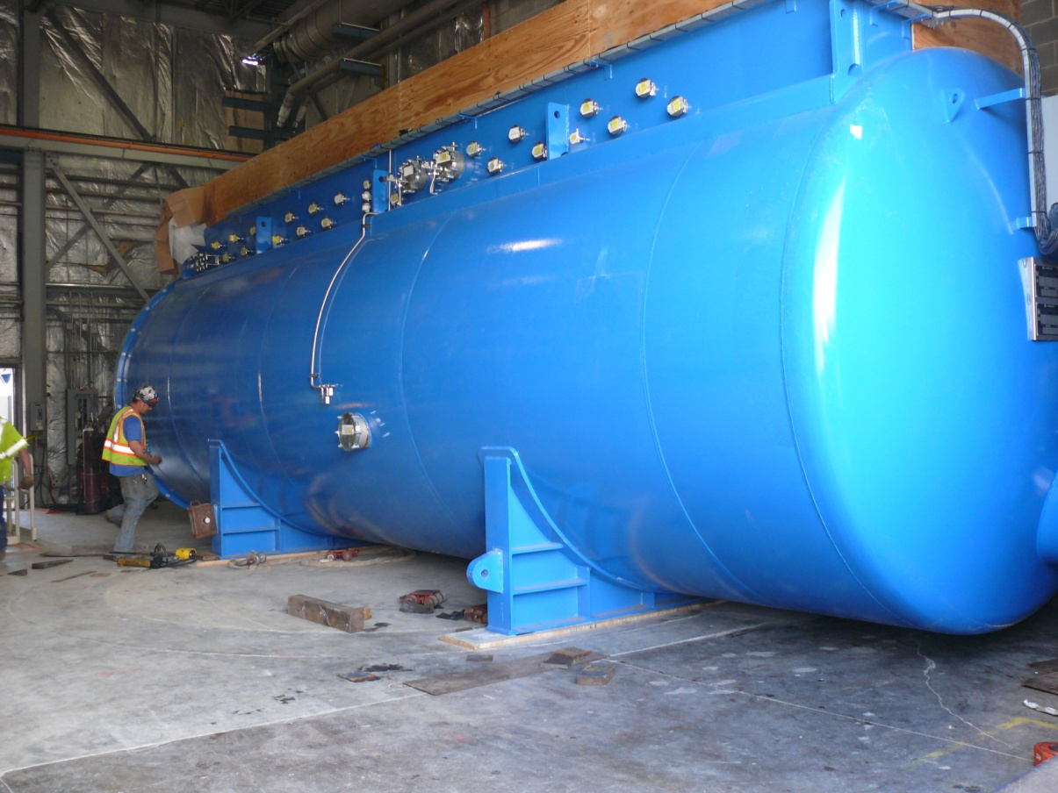
12GeV Lower 4.5K Cold Box Installation
Installed through the roll up door
With creepers

Slide 11
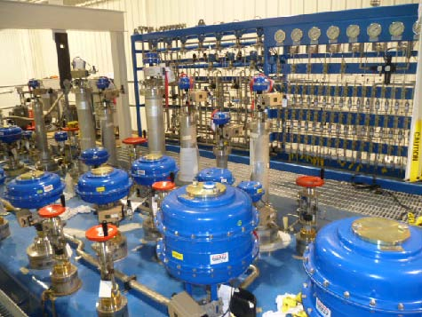
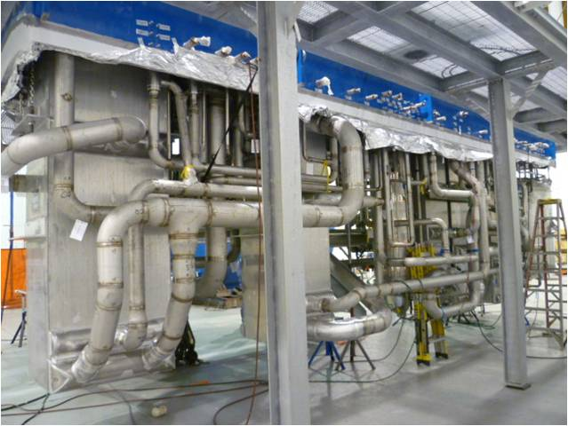
4.5K Cold Box, Lower Section
Top Head Valves and Control Rack
Internal Piping

Slide 12
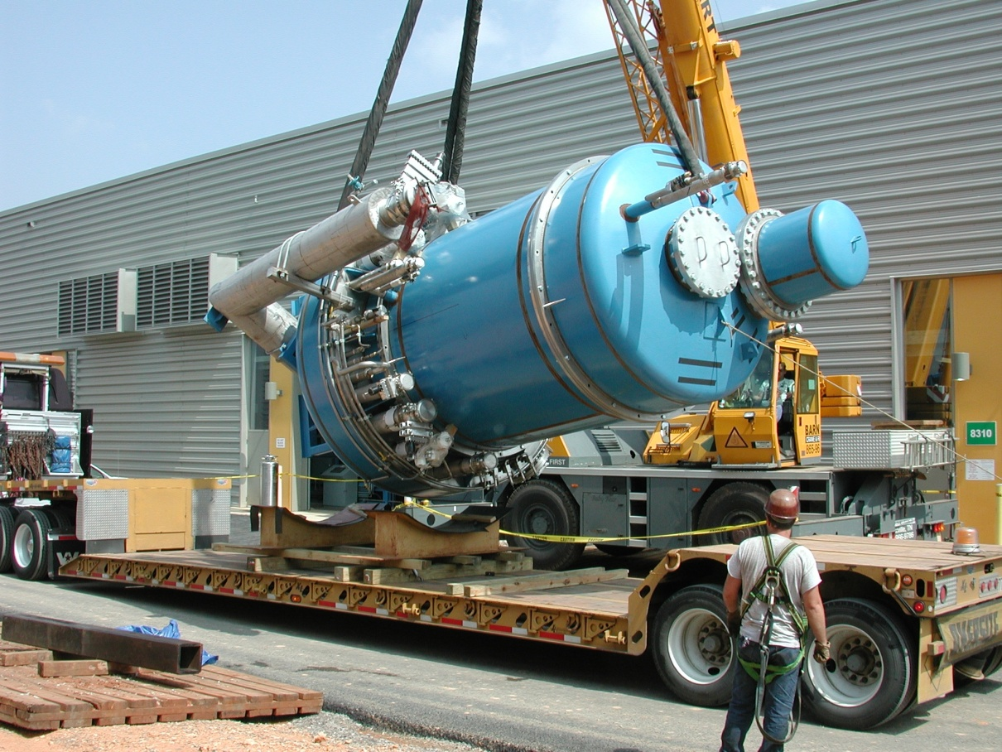
Sub Atmosheric Cold Box
Multi Stage Centrifugal Compressors
Variable Speed Motor Drives
Magnetic Bearing Technology
Mixed or Full Compression Ratio Designs

Slide 13
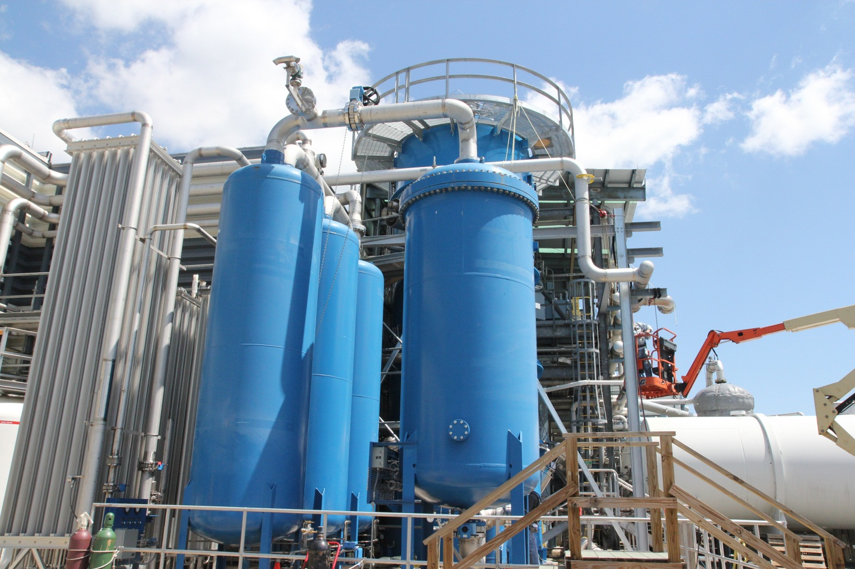
Typical Compressor Oil Removal Vessels

Slide 14
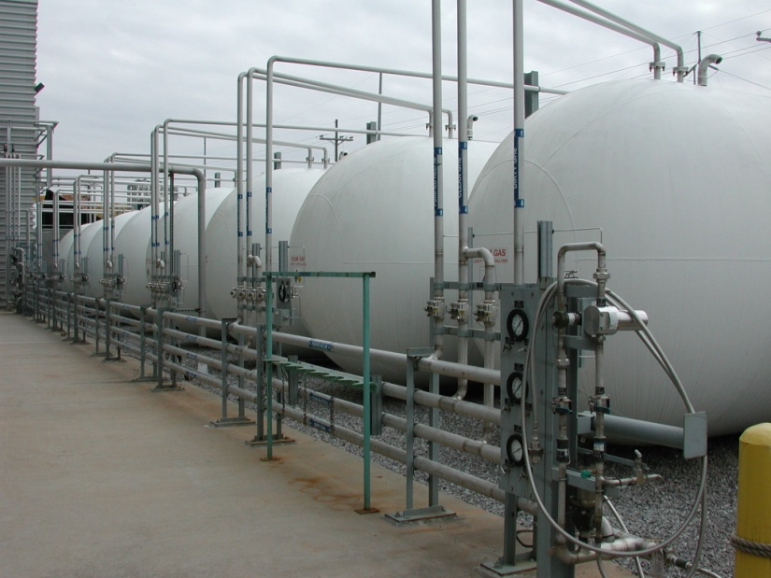
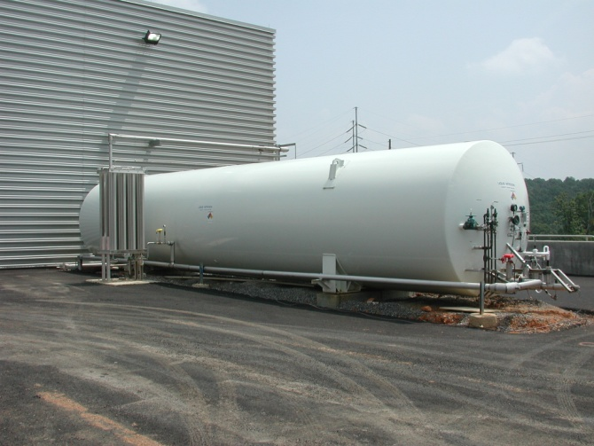
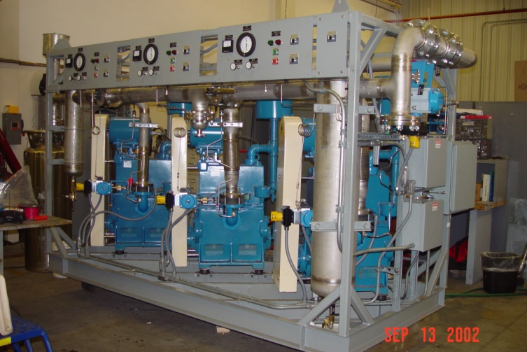
Other Needed Subsystems
Gas Storage
Purifier
Liquid Storage
Guard Vacuum System

Slide 15
Choice of Technology
Full Pressure Ratio vs. Mixed Mode Cold Compressors
Full Pressure Ratio has demonstrated higher linac pressure stability
~ 0.1mbar pressure stability
Very important operational consideration for CM technology vs. magnets
Faster turn around after a system trip (higher beam time availability)
Lower cryogenic capital equipment cost
Some what lower equipment foot print for Civil
~ Same Carnot Efficiency or slightly better
JLab Ganni Cycle Floating Pressure technology is applicable to both process options
Full cold compressors turn down limited to~70% of full capacity vs partial CC’s can turn down to ~35% of full capacity
Full pressure ratio CC system has no warm sub atmopspheric connections
Lower Contamination Issues
Higher reliability

Slide 16
Ganni Process Cycle Technology Use So Far (Industry may already have more worldwide)
Existing Plant Conversions (Partial Ganni Cycle ,Floating Pressure )
Jefferson Lab...all six refrigerators, 2K/4K, 200 to 4.6 kW Capacities
Brookhaven RHIC ….Central Helium Liquefier
Spallation Neutron Source (SNS)…Central Helium Liquefier, 2.3 kW @ 2.1K
Michigan State University….Cyclotron Test Facility
NASA Johnson Space Center, Environmental Test Chamber A, twin 3.5 kW 20K refrigerators
New Facilities Under Construction (Full Implementation of Cycle)
Jefferson Lab 12 GeV Upgrade, 4.6 kW @ 2.1K (completed)
Jefferson Lab’s 4kW End Station Refrigerator (ESR-2)
NASA JSC Houston, James Webb Telescope Test Facility, 12.5 kW @ 20K (completed)
MSU FRIB, 2.4kW@2k, 3kW@4K, 12.2kW@38K, 3.2 g/s 4K liquefaction

Slide 17
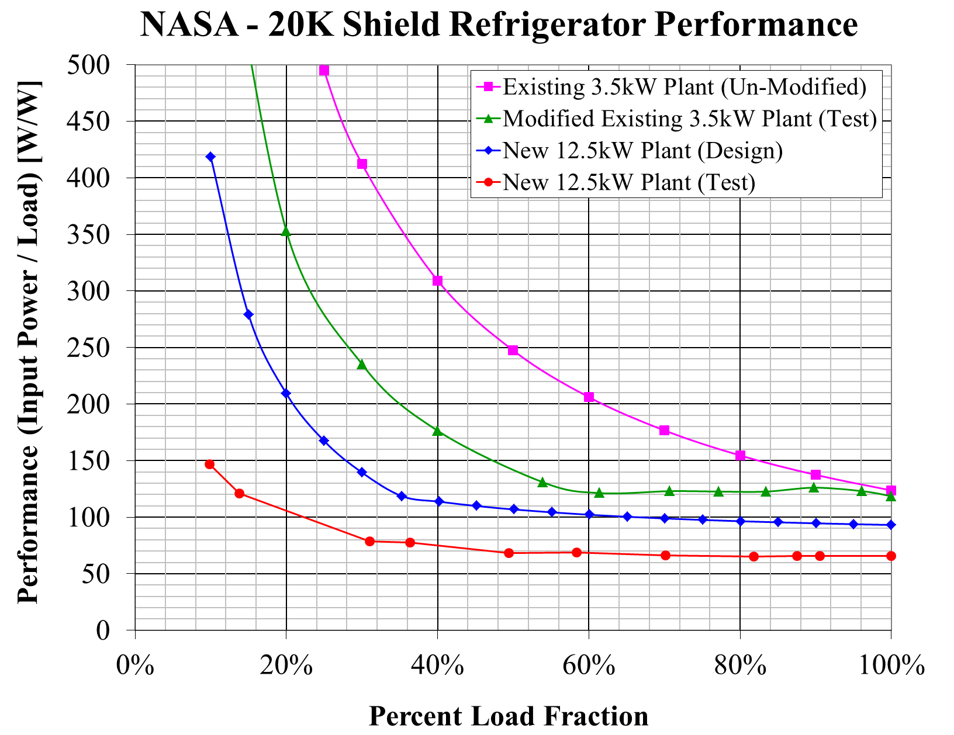
Commissioning of NASA CBX-3
Performance
Essentially constant efficiency down to ~1/3 of max. 20K load!
Note(1) – Offset due to actual expander efficiency higher than minimum required by refrigerator specification (so as not to restrict competition).
Note(2) – Increased offset due to using the slide valve at low loads during commissioning (which is more efficient) than adding heat.
Note (2)
Note (1)

Slide 18
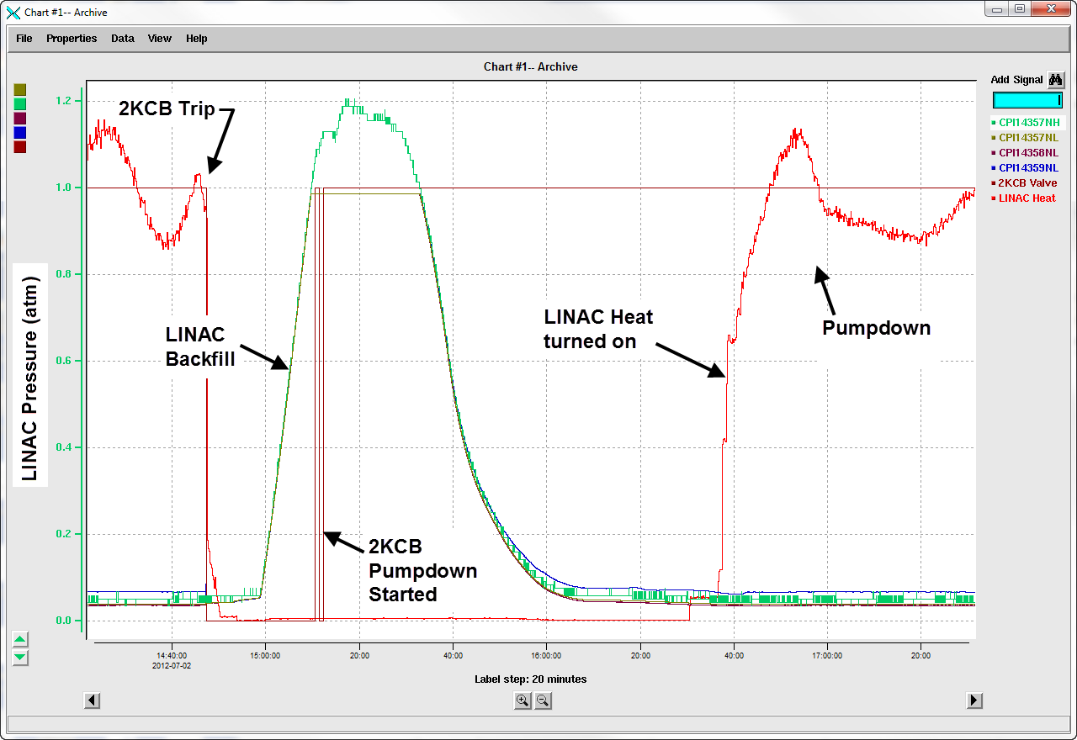
Full Pressure Ratio Pump Down Time and Stability

Slide 19
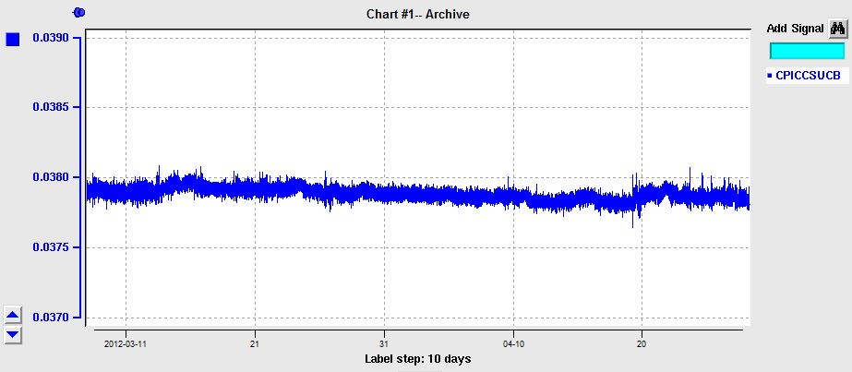
Linac Pressure Stability

Slide 20
Operating Temperature Choice
1.8K vs 2.05K Temperature Choice from Cryogenic Point of view
Carnot power is 14% higher (Just for the temperature effect)
Higher pressure ratio leads to lower Carnot Efficiency
Net effect ~ 20% higher wall plug power per unit cryo load (W/W)
The first cost ~20-30% (W/W)
No operating complete cold compressor option exists today (for a pressure ratio of 80); May need 6 stage cold compression process. Some developmental time will be required
Need more building/ civil space for a given capacity

Slide 21
Subsystem Suppliers
Subsystems come from a wide variety of suppliers based on purchase specifications or designs provided by an integration engineering team
The integration design and procurement may be provided by one of the major subsystem providers (turn key) but recent projects indicate that equipment pass through and risk costs appear to be very large in N. America….lack of subsystem partnership infrastructure, JLab integration engineering reduced FRIB from $74M (mixed mode CCs) to $32M for refrigerator system (Full CC pressure ratio)
Some subsystems do not have multiple or no vendor sources /designs (Helium gas purifiers, guard vacuum systems, etc.) Viewed as high risk and/or new designs by industry, pass through costs appear to be 100%+ additive
Many of the technologies used in the plant may not be included in the core technology of a single supplier

Slide 22
Integrative Engineering Design Standards
Importance of very early Civil/Cryogenics to control costs
Engineering design standards and units
Ex: ASME, 10CFR851, NEMA, ISA, etc. through out the project
System documentation….design symbols, device tag identification standards and assignment allocation..ISA, etc.
Engineering and Change Control Documentation
Ex: DRD /DSD/ICD (design requirements/solution documents)
Control hardware and software that is compatible with existing support organizations

Slide 23
Sequence of Engineering Design/Procurement
SRF Coordination of Loads, Operational Modes, Distribution
Budgetary Civil Determination and Coordination
Process Engineering Cycle Design
4.5K Cold Box (longest delivery, milestone progress)
Civil Design Verification
Warm Helium Compressors (2nd longest delivery)
2K or 1.8K Cold Box w/ cold compressors
Purification
Oil Removal
Gas Storage
LN2 /LHe Storage Dewars
MCC, Medium and Low Voltage
Instrument Air, Guard Vacuum
Installation Construction Package
Vendor technical reviews and calculation verification are conducted throughout the procurement process and system testing

Slide 24
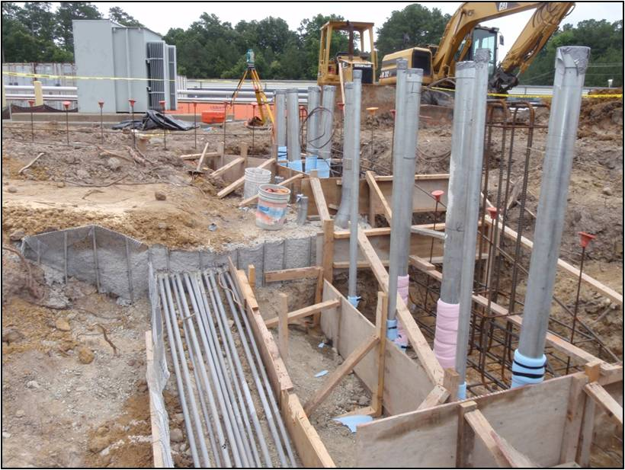
Civil and Cryomodule Coordination
Very early accurate civil budgeting eliminates costly change orders and schedule delays
Need to accurately budget civil utilities, equipment space, etc. usually far in advance of equipment procurement
Civil construction and cryogenic engineering by sub suppliers are often conducted at the same time during CD-3
Cryogenic equipment delivery to be coordinated with building RFE to minimize double rigging
Compressor in-slab electrical conduits

Slide 25
Civil requirements
Preplanning the requirements…..
Establish equipment heat loads and distribution system estimates and locations*
Apply overall margins for each temperature level
For budgetary electrical power and cooling water….
Transpose the heat loads of the cryomodules to established known industrial “equivalent baseline” temperature standards (20K, 4K) applying known efficiency corrections in terms of Input Electrical Power/Watt Refrigeration for the specific temperatures.
Recognizing most all of the electrical power goes into the cooling water, the amount of cooling water is determined for 10F delta T
From this procedure fairly accurate budgetary estimates can be derived for use in determining civil utility requirements
* Deep accelerator tunnels generally require the sub atmospheric cold box to be located near that elevation due to process static head pressure losses

Slide 26
Summary
Coordination of cryomodule heat loads, operating modes, locations and maintenance requirements ensure proper cryogenic plant sizing and operational design capability
Budgetary civil requirements are important in coordinating and controlling project costs, change orders and schedule prior to detailed cryogenic engineering. Deep tunnel installations will require local cold compressors.
Establishing project engineering standards, device nomenclature, documentation hierarchy, etc. are coordinated with all sub system providers and other project technical areas
A subsystem engineering sequence was presented which is representative of delivery durations, and installation/testing scheduling
Major required cryogenic subsystems are attached along with general civil requirements based on a normalized 18 kW @ 4K equivalent plant

Slide 27
Thank you for your kind attention…….
May we answer your questions at this time?

Slide 29
Backup Slides
Civil Examples for Typical
18kW @ 4K Equivalent Refrigerator

Slide 30
Primary Plant Electrical Power Example
For Electrical Power Redundancy and Maintenance
Loop Feeds for Medium and Low Voltage Feeds
Transformation from 480V 3w to 4W for small 277V loads
Main Feed #1
Main Feed #2
MAIN
SUB
MASTER SUBSTATION
AND FEEDER SWITCH
MAIN
SUB
A
LOOP POWER FEED
B
M
LOOP POWER FEED
480V
AUX1
MTR CTRL CTR
M
MAIN COMPRESSORS
4160V MCC
M
M
4160V
SUB 1
M
M
CB
480V
AUX2
SWITCH
BOARD
MTR CTRL CTR
M
M
M
M
4160V
SUB2
M
M
CB
MTR CTRL CTR
M
M
M
D
Outlets, etc.
Lights, AC, etc.
PNL
BRD
3w
4w
LP
PNL
T
C

Slide 31
Civil requirements
Electric Power (continued)
Helium Compressor Medium Motor Protection Requirements
Under voltage, voltage imbalance, run up motor ampere/time over current (motor characteristic curves for compressor application), running current, number of starts per hour, motor winding over temperature, bearing temperature monitors…NEMA MG-1 standards
Because of the above compressor/motor protection coordination, the compressor drive MCC is normally provided by the equipment supplier and serves as the civil interface boundary for electrical. Normally specified as double ended primary feed MCCs for civil capability of redundancy/maintenance/repair of the primary power system
Because of the voltage rating/safety/cost of installation, it is important to include an “in slab” compressor skid conduit design between the MCC location and compressors as part of the early civil plan/estimate

Slide 32
Civil requirements
480 Volt Cryogenic Equipment “House Power”
Avoid 480V/3ph/4w in lieu of 3w for major 3 phase industrial loads which is the majority of the house power requirement. Use separate 480v 3ph 3w to 4w transformer for 277V loads such as lighting etc., (i.e. avoidance of minor ground faults bring down the power on the whole facility)
Typical cryogenic plant equipment loads (compressor room)
480V, 3ph, 3w 400A feed for compressor MCC or switchboard (oil pumps, instrument air, motor space heaters)
480V, 3ph, 3w, 5 ton overhead crane feed
480V, 225A, 3ph, 4W, 42 circuit power distribution panel
225A 120/208V 3ph, 4W 42 circuit power distribution panel
(2) 480V, 225A, 3 ph 3w power feeds for recovery compressors
(2) 480V, 100A, 3ph, 3w welding outlets
(2) 208V, 30A, 3ph, 4W utility equipment outlets (vacuum pumps)
(6) 120V, 20A, 1ph outlets
Typical for most all large cryogenic systems

Slide 33
Civil requirements
Typical Cold Box Room Cryogenic Electrical Loads
480V, 225A, 3ph, 4w, 42 circuit power distribution panel
480V, 400A, 3ph, 3w feeder to cold compressor switchboard
225A 120/208V 3ph, 4W circuit power distribution panel
(2) 480V, 225A, 3 ph 3w, 42 circuit power distribution panel
(2) 480V, 100A, 3ph, 3w welding outlets
(2) 208V, 30A, 3ph, 4W utility equipment outlets (vacuum pumps)
(6) 120V, 1 ph, 20A ground fault outlets
Local Cryogenics Control Room
120/208V, 225A, 3ph, 4W, power distribution panel
120V/208V, 8-10 KVA UPS/panel/transfer switch for ½ hour
8-10 KVA emergency generator, backing UPS, natural gas
(6) 120V, 20A utility outlets
Typical for most all large cryogenic systems

Slide 34
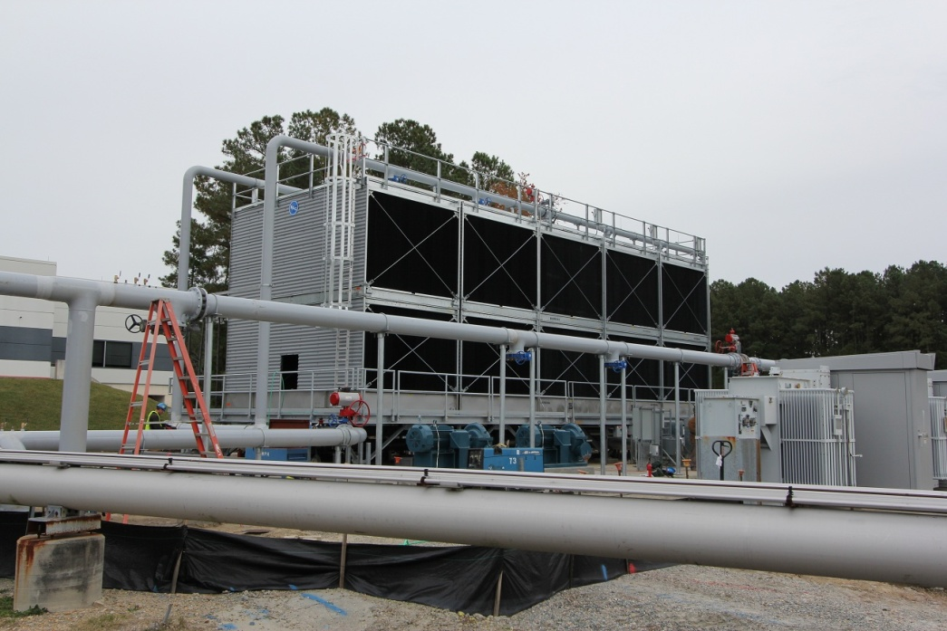
Civil requirements
Compressor Cooling Water
For 18 kW @ 4K equivalent refrigerator system
3300 gpm treated cooling tower water
90F with 10F delta temperature
33 gpm is evaporative makeup
10 gpm is added for chemistry control
Additional cell for maintenance while running

Slide 35
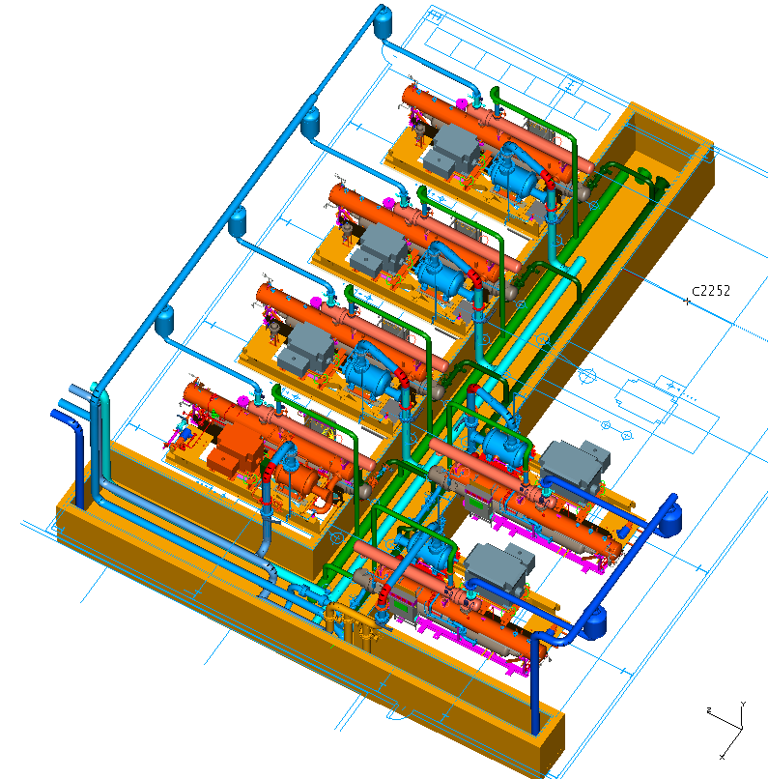
Civil requirements
Compressor Building
Typical for 18 kW @ 4K equivalent plant
76” x 71’x inside, 31’ H
Overhead 5 ton crane
3500 psi concrete floor, 2’ D
(4) 20,000 cfm roof fans
Freeze protection heat only
Piping Trench, 8’W x 5.5”D
75’ x 75’ outside equipment area
14’ x 17’ roll up door
Metal Wall Panel
Batten Wall Insulation
Will need to characterize micro phonics

Slide 36
12 GeV Oil Removal and Cold Box Layout
Building size that of the compressor room, 76’x71’x31’
18 kW @ 4K equivalent size
Roll Up Door 14’Wx17’H
100,000 lb + cold box floor loading
Indoor horizontal cold box
Outdoor equipment area requirements ~2x indoor space
Vaporizer, Oil Removal

Slide 37
Other Backup Slides

Slide 38
Compressor Characteristics
FIGURE 1.3 BRV=2.2 1st Stage
FIGURE 1.4 BRV=2.6 2nd Stage

Slide 39
Standard Cycle

Slide 40
Ganni Cycle

Slide 41
Brookhaven RHIC Conversion Results
Brookhaven Reports Its Very Successful Energy Conservation Improvement Program Results After One Year of Operation
Brookhaven TODAY, Feb 11, 2008 http://www.bnl.gov/today/story.asp?ITEM_NO=544
“Jefferson Lab technology saving BNL $1.5M in electricity alone for typical 30 week experiment”
Brookhaven RHIC Cryogenic Staff
“ Seen increased reliability, stability, and efficiency”

Slide 42
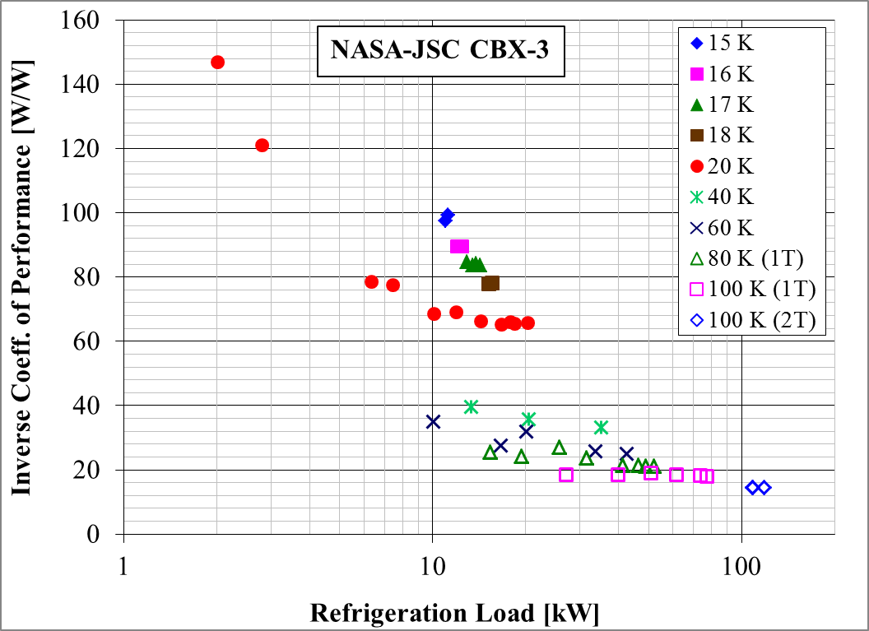
Commissioning of NASA JSC
Performance
Unprecedented load range: 11.2 kW at 15K…to…118 kW at 100K
Note: x-axis (refrigeration load) is a log scale

