Slide 1
LCLS-II Introduction
Notes:
The slides pasted below are from LCLS_SC_Sept_3_high_level_summary_v8

Slide 2
LCLS-II Project Plan and Scope Overview
13 September 2013

Slide 3
Outline
LCLS-II Background
BESAC Recommendations
LCLS-II Project Definition
Operating Parameters and Source Considerations
Project Timetable
Partner Laboratory Integration

Slide 4
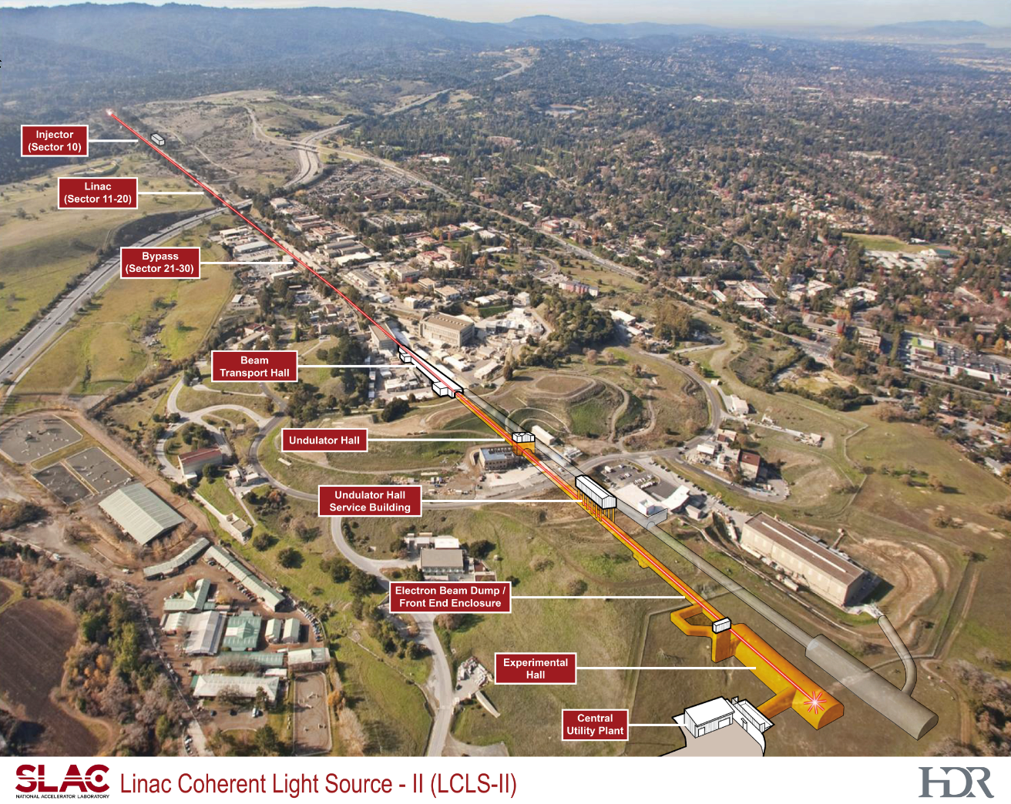
LCLS II Scope of Work
Injector at sector 10 (120Hz)
Two variable gap undulators
Soft x-ray instrument
302 m undulator tunnel
94mx15m experiment hall
Schedule
CD-0 | 4/2010
CD-1 | 10/2011
CD-3a | 3/2012
CD-2 | 2012*
CD-3b | 2014
CD-4 | 2019
*Ready for CD-2 8/2012 – Trapped by “no new starts” provision in FY13
Continuing resolution

Slide 5
LCLS-II Key Performance Parameters
Performance Measure | Objective KPP
Electron Beam Energy | 13.5 GeV
Photon Beam Tuning Range | 250-13,000 eV
Additional Space for Instruments | Space for 6 Experiment Stations
Facilities Gross Square Feet | ~90,000 GSF
250eV - 2,000 eV source:
Spectroscopy at moderate peak power
High-field physics at high peak power
Nonlinear optical phenomena @ soft XR wavelengths
2,000-13,000 eV source:
Single-shot imaging at ~1nm to ~0.1nm resolution

Slide 6
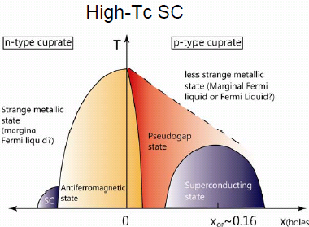
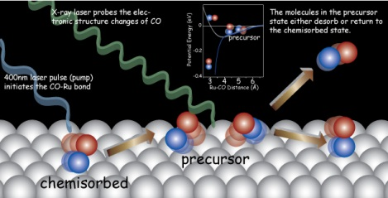
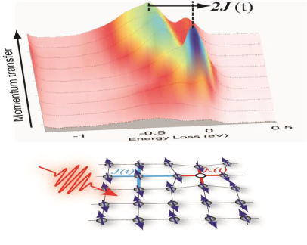
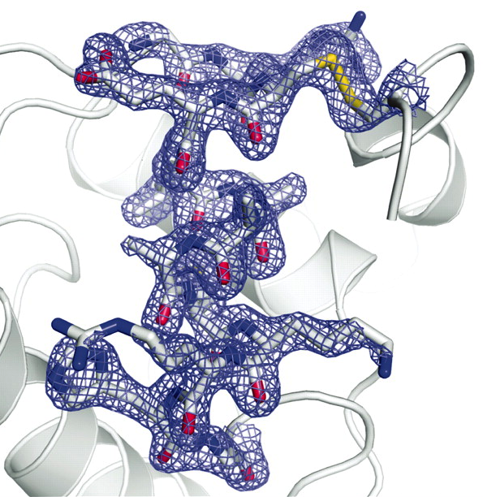
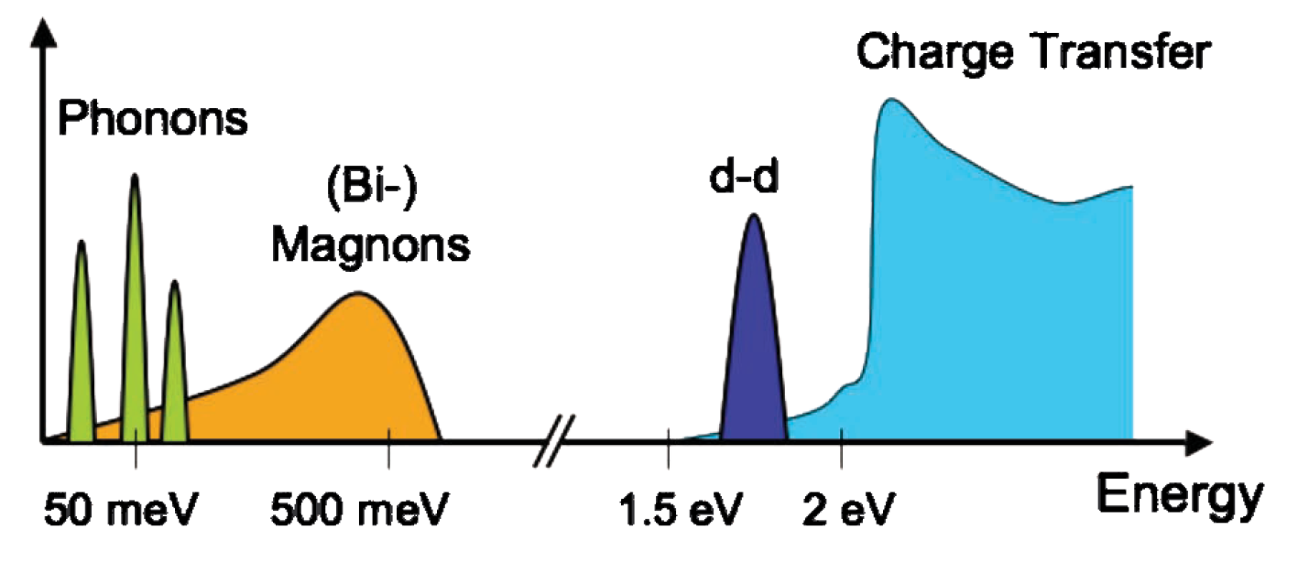
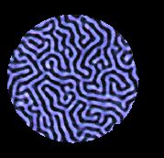
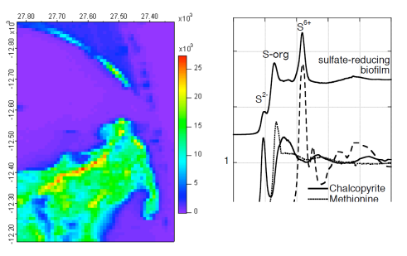
FEL Science – The BESAC recommendations: High repetition rate; at least 0.2-5 keV; high pulse energy 5-20 keV
High repetition rate lower peak power science: at least 0.2-5keV
High T_{C} Superconductors
Catalysis (CO on Ru)
Correlated Electron Systems
de novo phasing using
Single Wavelength Anomalous Diffraction from Sulfur: 4-5 keV
Time resolved RIXS
C K edge
0.284 keV
Cu L_{III} edge
0.932 keV
Ru L_{III} edge
2.838 keV
0.2 keV
Gd M_{V} edge
1.190 keV
S K edge
2.472 keV
5.0 keV
Coherent X-ray Imaging of magnetic domain in Gd/Fe
Sulfur spectro-microscopy in bio/environmental science
Non-periodic imaging: 2-5 keV
Notes:
Top left Catalysis figure: X-ray laser probes the electronic structure changes of CO molecules in desorption from Ru(0001) using X-ray emission spectroscopy and X-ray absorption spectroscopy. Upon exciting the substrate by using a femtosecond 400 nm laser pulse, molecules were pumped from the chemisorbed state to the precursor state. In the precursor state, the CO molecule is nearly free to rotate and to move parallel to the surface. The molecules in the precursor state either desorb or return to the chemisorbed state. – understanding carbon chemistry is crucial as we search for new catalysts that can meet the needs of society today. Free electron lasers operating at high repetition rate with energies matching the characteristic binding energies of electrons in carbon have the potential to unravel chemical reactivity at catalyst surfaces on the time and length scales of surface reactions.
Understanding the origins of the emergent properties of strongly correlated electron systems is crucial to controlling these properties to grow materials that address needs for addressing energy and technology challenges in the 21st century. New resonant x-ray scattering techniques have recently been shown to permit measurements of the microscopic electronic and magnetic excitation in these systems and x-ray free electron lasers provide the x-ray source that naturally meets the time resolution and wavelengths to provide the nm scale spatial resolution to address these challenges.
De novo structure solution using single wavelength anomalous dispersion is one of several methods applied to this problem. The high peak power at wavelengths close to the sulfur edge, an element often found in important macromolecules whose structures are important to our overall understanding of biological function, that FELs provide will enable SAD studies using the newly developed ‘serial femtosecond crystallography’.
Understanding the time and length scales of the ‘writing’ of magnetic bits using light will directly impact the development of next generation magnetic storage devices aiming at much higher density and faster read/write times. Time resolved resonant x-ray scattering from such prototypical recording media will address the underlying principles of the ‘recording’ process and the temporal and spatial limits that one can achieve.
There are many large biological structures, viruses for example, where nm scale spatial resolution will be revolutionary. Coherent diffraction imaging can provide the way forward.
Sulfur is prevalent in biology, environmental science, as a poison in catalysts.

Slide 7
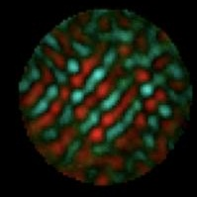
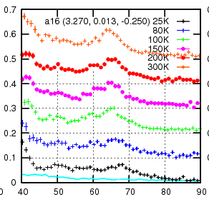
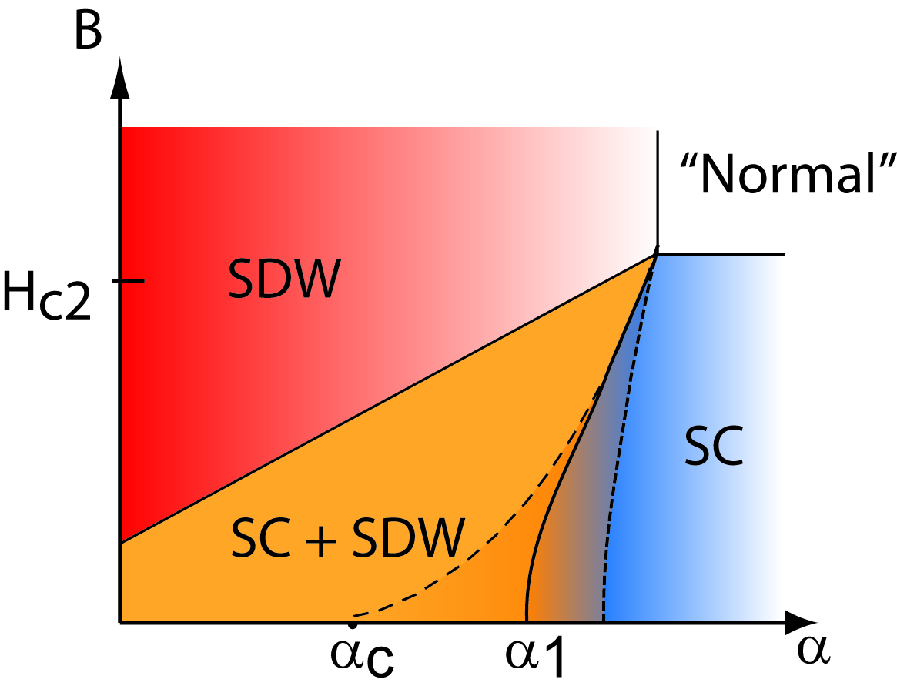
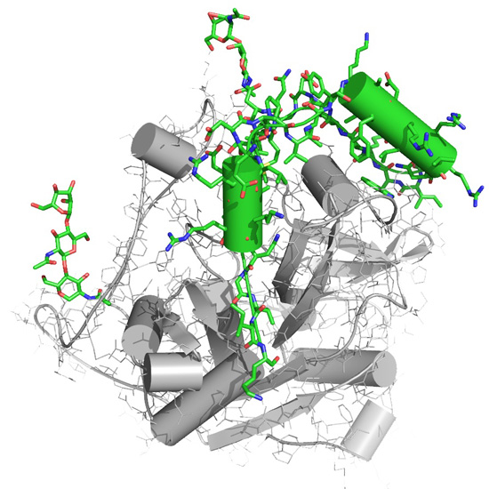
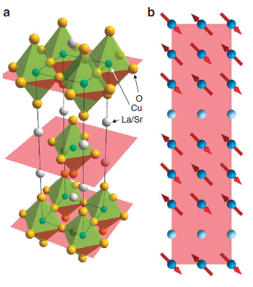
FEL Science – The BESAC recommendations: High repetition rate; at least 0.2-5 keV; high pulse energy 5-20 keV
High energy per pulse science 5.0-20.0 keV
Magnetic polarities of a cobalt alloy
Iridates: model strongly correlated materials
Phonons in superconductivity
High magnetic fields 14-20 KeV
disentangle competing orders
Energy Loss (eV)
Fe K edge
7.112 keV
Co K edge
7.712 keV
Ir L_{III} edge
11.215 keV
Si(777) backscatter
13.84 keV
5 keV
Se K edge
12.658 keV
20 keV
Cu K edge
8.979 keV
Solute-solvent interactions
in photo-excited reactions
Serial Femtosecond Crystallography
de novo phasing using
Multiple Wavelength Anomalous Diffraction from Selenium
Time resolved Resonant solution scattering
Charge-stripe ordering in LSCO superconductor
Notes:
Top left magnetic imaging figure. Polarized x-rays permit imaging of magnetic domains on the 10s of nm level in bulk matter. Technological applications for new magnetic recording materials require understanding the magnetic domains at the nm scale and time resolution at the limit of switching - picoseconds
Understanding the emergent properties of strongly correlated electron systems remains a central problem in materials science. The combination of resonant and non-resonant in-elastic scattering probes the magnetic and phonon excitations in these materials. Probing these systems in high magnetic fields provides an opportunity to disentangle the competing orders that are central to their emergent properties. Understanding the underlying principles will lead, almost certainly, to control and use.
Understanding the microscopic structure of solutes and their solvent cage as the system is excited by an external laser is crucial to understanding chemistry in solution at the microscopic level. Time resolved resonant x-ray scattering is a unique probe to unravel the subtle changes in structure of both solute molecules and the solvent cage on the nm length scales and femtosecond time scale – the natural length and time scales of chemical reactions.
What has been and will continue to be the tool for structure determination of macromolecules is x-ray crystallography. The challenge is to grow crystal of sufficient size to permit ‘conventional crystallography’. Recent use of x-ray FELs has clearly shown that their incredible peak brilliance permits structure determination on crystals 100s of times smaller than possible with synchrotron radiation today. Combining this capability with one of the crucial methods for de novo structure solution, multiple wavelength anomalous dispersion has the potential to lead to breakthroughs in the determination of structures of membrane proteins and large protein complexes that are not possible today.

Slide 8
The LCLS-II Project Definition (8/16/2013)
Accelerator | Superconducting linac: 4 GeV
Undulators in LCLS-I Tunnel | New variable gap (north) New variable gap (south)
Instruments | Use existing instruments (instrument and detector upgrades needed to fully exploit)
Cost (TPC) | TBD with SC/BES
NEH
FEH
4 GeV SC Linac
0.2-1.2 keV (100kHz)
1.0 - 18 keV (120 Hz)
1.0 - 5 keV (100 kHz)

Slide 9
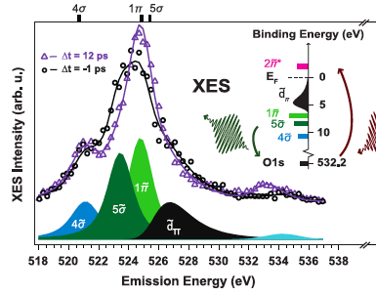
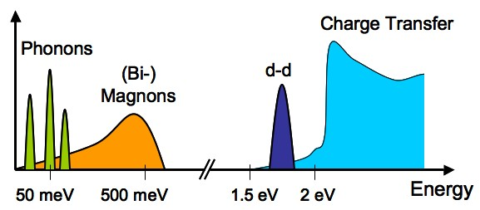
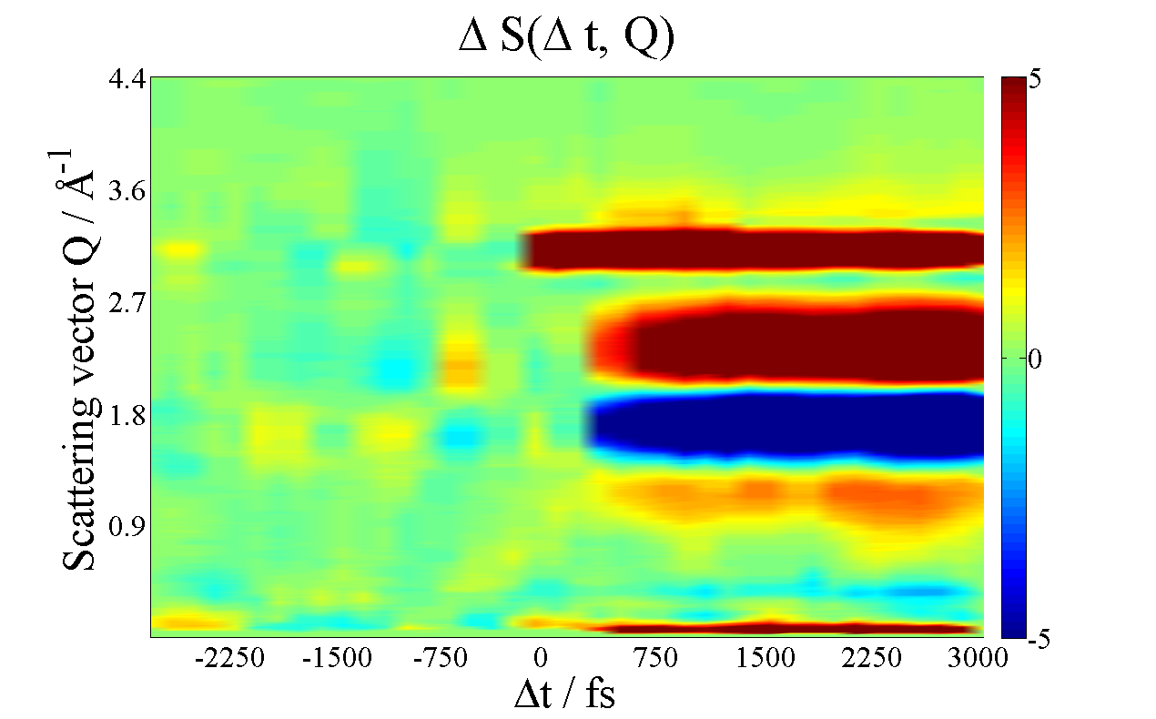
High repetition rate beam available to all instruments with two variable gap undulators
Instrument upgrades and R&D needed to fully exploit high rep rate
de novo phasing using
Single Wavelength Anomalous Diffraction from Sulfur: 4-5 keV
Catalysis
High T_{C} Superconductors
Time resolved
RIXS
Serial Femtosecond
Crystallography
Pump-Probe
0.2-1.2 keV (100kHz)
4GeV @100kHz
14 GeV @120Hz
1.0- 18 keV (120 Hz)
1.0- 5 keV (100 kHz)
Time resolved Resonant solution scattering
Time resolved RIXS
Iridates: model strongly correlated materials

Slide 10
Operating modes
North and south undulators always operate simultaneously in any mode
Undulator | SC Linac (up to 100kHz) | Cu Linac (up to 120Hz)
North | 0.25-1.2 keV
South | 1.0-5.0 keV | up to 18 keV higher peak power pulses
Concurrent operation of 1-5 keV and 5-18 keV is not possible
4 GeV SC Linac
0.2-1.2 keV (100kHz)
Cu Linac
1.0 - 18 keV (120 Hz)
1.0 - 5 keV (100 kHz)

Slide 11
Preliminary Operating Parameters
Preliminary LCLS-II Summary Parameters |  | v0.7 |  |  | 8/30/13
 | North Side Source | South Side Source
Running mode | SC Linac | SC Linac |  |  | Cu Linac
Repetition rate | up to 1 MHz* | up to 1 MHz* |  |  | 120 Hz
Electron Energy | 4 GeV | 4 GeV |  |  | 14 GeV
Photon energy | 0.25-1.2 keV | 1-5 keV |  |  | 1-20 keV
Max Photon pulse energy (mJ) (full charge, long pulse) | up to 2 mJ* | up to 2 mJ* |  |  | up to10 mJ
Peak Spectral Brightness (10 fs pulse) (low charge, 10pC) | 3.9x10³⁰ ** | 12x10³⁰ ** |  |  | 247x10³⁰ **
Peak Spectral Brightness (100fs pulse) (full charge, 100pC) | 3.0x10³⁰ ** | 6.9x10³⁰ ** |  |  | 121x10³⁰ **
* Limited by beam power on optics
**N_photons/(s*mm^2*mrad^2*0.1% bandwidth)

Slide 12
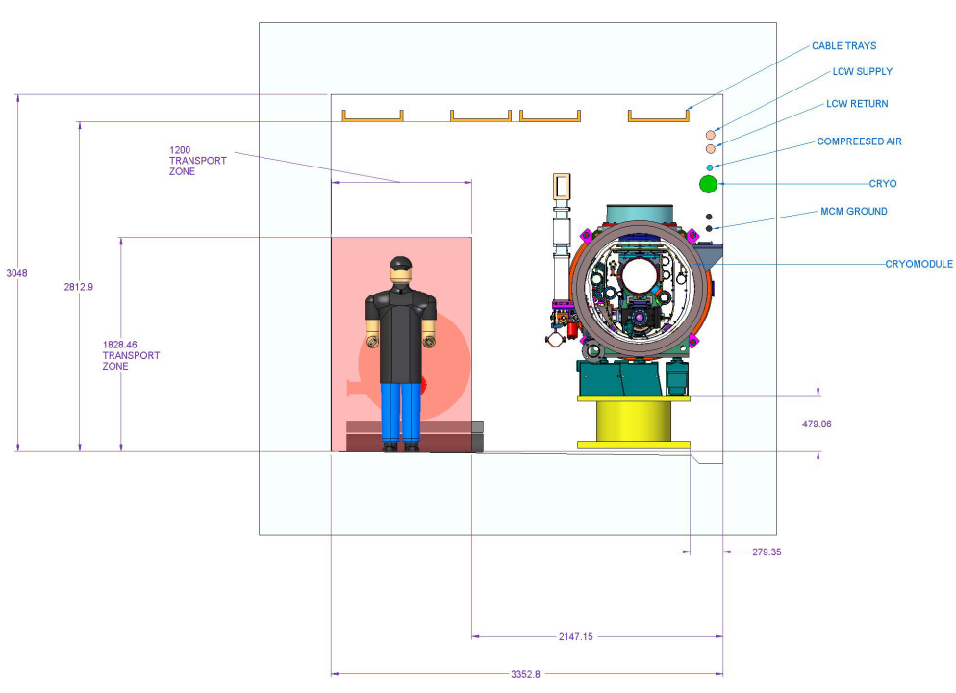
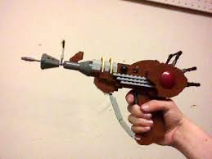
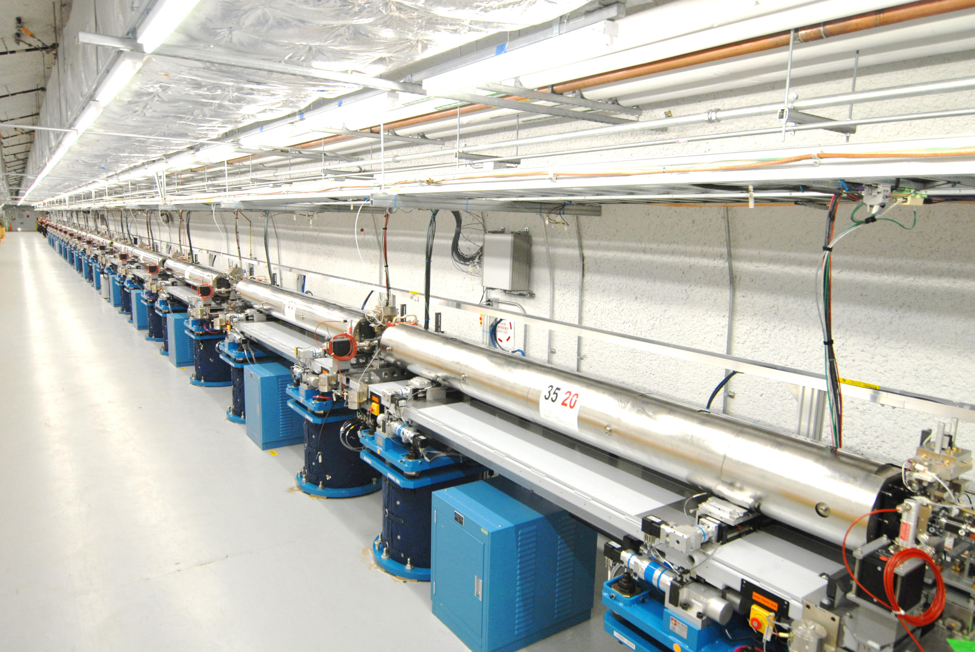
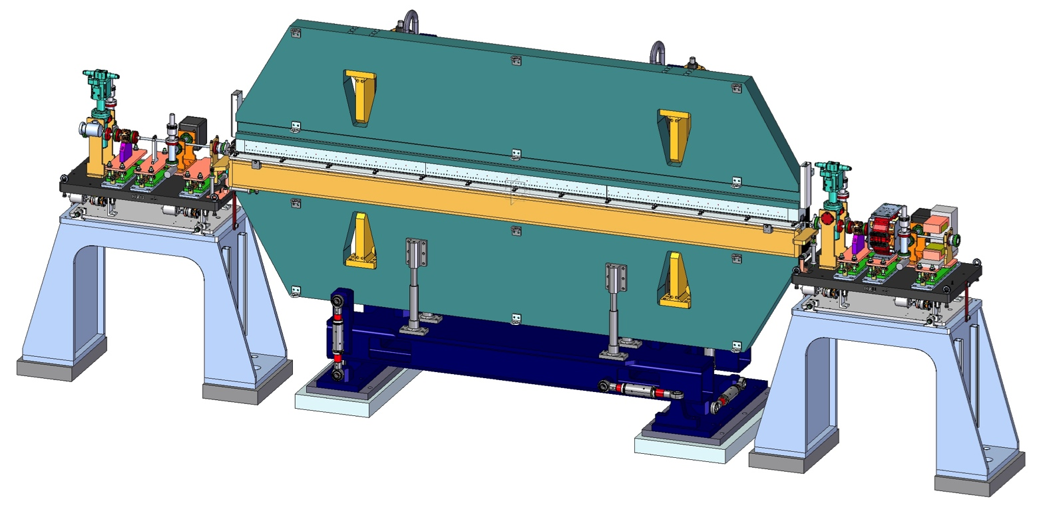
We Need the Help of Partner Labs for
Superconducting linac and cryosystems
High brightness, high repetition rate gun/injector
New soft x-ray undulator and
A hard x-ray undulator that replaces the existing LCLS undulator

Slide 13
The Next Steps for SLAC to Engage Partners
Visit the prospective partner labs:
LBNL 5 Sept.
FNAL 10 Sept.
ANL 11 Sept.
JLAB 13 Sept
Share parameter list
Ask for preliminary information on scope, schedule, cost
Ask readiness assessment for each element from the lab
Ask for development: scope, schedule, cost
Share information during workshop
Refine project plan

Slide 14
Potential Areas of Collaboration with Partner Labs
 | SLAC | LBNL | FNAL | JLAB | ANL | Cornell | Wisconsin
Injector |  | X |  |  |  | X | X
Undulator |  | X |  |  | X
SC linac prototype |  |  | X | X |  | X
SC Linac |  |  | X | X
SC cryo line |  |  | X | X
Cryo plant |  |  | X | X
LLRF | X |  | X | X |  | X
RF systems | X
Beam Physics | X |  |  |  |  | X
Instruments/ Detectors | X | X
PM/Integration | X
Installation | X |  | X | X
Commissioning | X

Slide 15
Timeline for the next 6 month
Next 6 weeks: Partner lab visits
Oct 15 -17: Workshop at SLAC with all partner labs to freeze preliminary design, scope, prototype development plan
Development basis of estimate documents, integrated schedule, integrated cost estimates.
Negotiate with partner labs and review on scope, schedule and cost.
In parallel: Start prototype developments and procurements
November 25: integrated scope-schedule-cost assembled
Revise documents
Directors review Dec 13-14-15
Adjust arrangements based on review outcome, if necessary
Revise documents
Lehman review Jan 14-15-16, 2014
Adjust arrangements based on review outcome, if necessary

Slide 16
SLAC Points of Contact
For ongoing exchange of information
Leading to definition of the collaboration
Labs’ scopes of work
Personnel and RRAA
Exchange of technical/cost/schedule information
FEL/Accelerator Physics | Tor Raubenheimer | Tor@slac.stanford.edu | 1 650 926 2474
Injector | John Schmerge | schmerge@slac.stanford.edu | 1 650 926 2320
Undulators & photon systems | Michael Rowen | rowen@slac.stanford.edu | 1 650 926 3487
Linac | Marc Ross | mcrec@slac.stanford.edu | 1 650 926 3574
Cryoplant | Robert Law | rlaw@slac.stanford.edu | 1 650 926 4586
Business Systems | Cindy Lowe | cindy@slac.stanford.edu | 1 650 926 2279
Cost/Schedule/EVMS | Richard M. Boyce | boyce@slac.stanford.edu | 1 650 926 3441
QA & System Integration | Lori J. Plummer | lorijp@slac.stanford.edu | 1 650 926 4834
Management | Galayda | galayda@slac.stanford.edu | 1 650 926 2371
 | Schultz | dcs@slac.stanford.edu | 1 650 926 2459

Slide 17
Integration Between SLAC and Partner Labs
Basic Roles and Responsibilities:
SLAC | Partner Laboratory
Interface with DOE: BES & SC Accountable for performance of the entire project including oversight of partner labs’ performance Baseline, EVMS & contingency control Overall project management | Responsible for management of work on agreed-upon scope Meeting project requirements for subsystems Effective, efficient management of project activities to meet overall goals
System design and integration Setting performance specifications Performance verification Building construction Integration / QA / Safety / Schedule Construction overhead rate agreement | Designing/detailing to specification Procuring / Manufacturing Delivering Conformance Interlab QA Construction overhead rate agreement
Installation Testing + Commissioning & Operation | Supporting installation Supporting commissioning

Slide 18
Project Collaboration
The Project (SLAC, partner labs and all) must function as a SINGLE organization with a SINGLE set of priorities
The Project must face and resolve challenges to the success of the project in all areas (cost/schedule/technical)
This requires commitment to the Project’s goals at SLAC and at partner labs
This requires the collaborating labs have confidence that the burden of solving problems is shared fairly
This requires that each of the collaborating labs accept responsibility for achieving best all-around performance through good management, planning and execution

Slide 19
Project Collaboration
Technical teams discuss and agree to (if possible):
PM/PLM software packages
Procurement database
Staffing profiles, org charts, time sheet verification etc
Lab Senior Management discuss and agree to:
High Level time line
Establishment of Lab Directors council
Roles and responsibilities between partner labs
Construction overhead rates
Senior team leaders in each lab

Slide 20
Summary
Envisioned facility fulfills all BESAC Light source subcommittee recommendations
New Scientific Capabilities
Leverages Existing SLAC infrastructure
Partner laboratories

Slide 21
Discussion

Slide 22
Back-Up

