Slide 1
Cavity/CM Considerations for CW Operation
Cryogenic loads and cryogen distribution
End Group cooling: HOM antenna redesign
HOM loads and suppression requirement
Coupler design and cooling
Cost, gradient, Qo, QL and RF power
Achieving higher cavity Qo
Microphonics - size and suppression
Chris Adolphsen, SLAC, Sept 12, 2013 Visit to JLAB

Slide 2
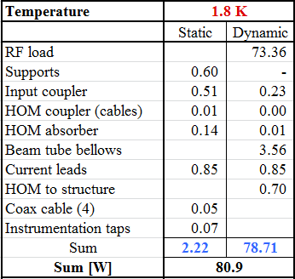
8 Cavity CM Heat Loads
(16 MV/m, Qo = 3e10)
With high dynamic load, may be able to lower cost or improve
performance with somewhat higher static load
(12 W for ILC)

Slide 3
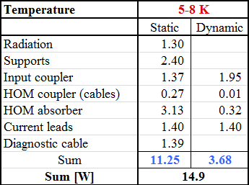
8 Cavity CM Heat Loads
(16 MV/m, Qo = 3e10)
(16 W for ILC)

Slide 4
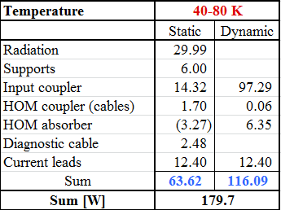
8 Cavity CM Heat Loads
(16 MV/m, Qo = 3e10)
(155 W for ILC)
Total: The AC cryoplant power required per CM is 106 kW assuming a 30% overhead – with 32 CMs, a 3.4 MW plant is required.

Slide 5
Modifications to 2 K Pipes to Accommodate Larger Heat Flow
Slightly larger nozzle from helium vessel to 2-phase pipe
  Increase from 55 mm to about 70 mm
Slightly larger 2-phase pipe
  Depends on string lengths and liquid management plan
  Retain option for 1.8 K in all piping
  Increase from 72 mm to about 90 mm
Segmentation of 2 K liquid and 2 K flow distances may also impact this pipe sizing
The cryomodule itself will be the most likely source of fast (< 1 sec) pressure changes, so attention to piping and valve configurations are critical

Slide 6
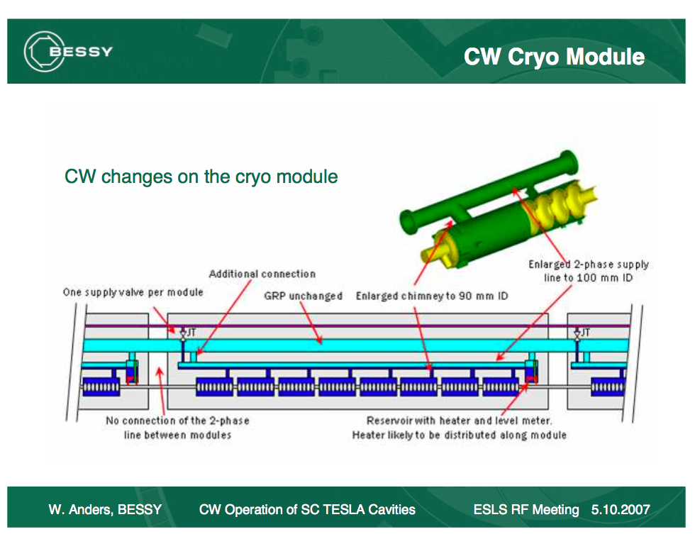
Separate liquid management in each cryomodule but no external transfer line
650 MHz Cryomodule Design, 21 Feb 2011
Page 6

Slide 7
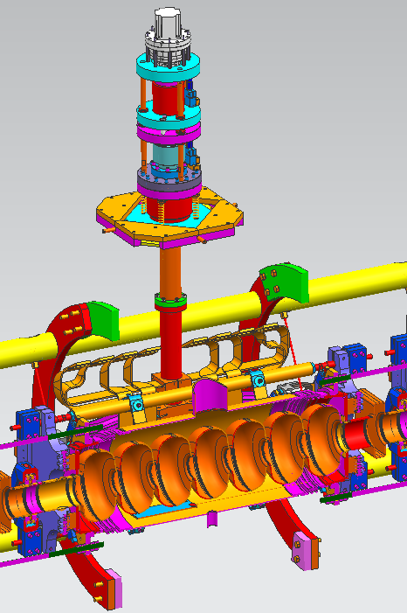
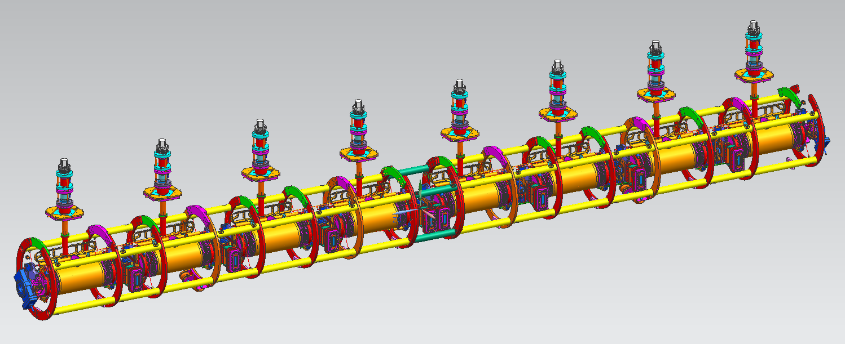
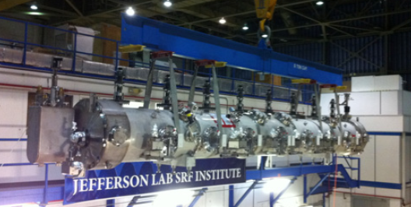
JLAB C100 ‘Stand-Alone’ Cryomodule

Slide 8
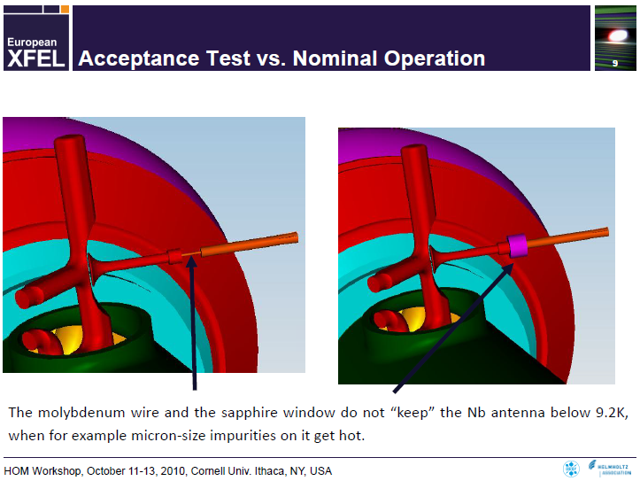
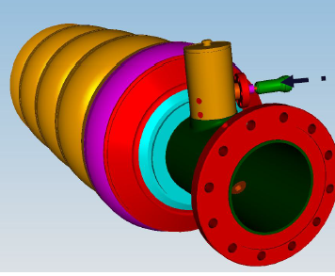
HOM Antenna Heating
J. Sekutowicz

Slide 9
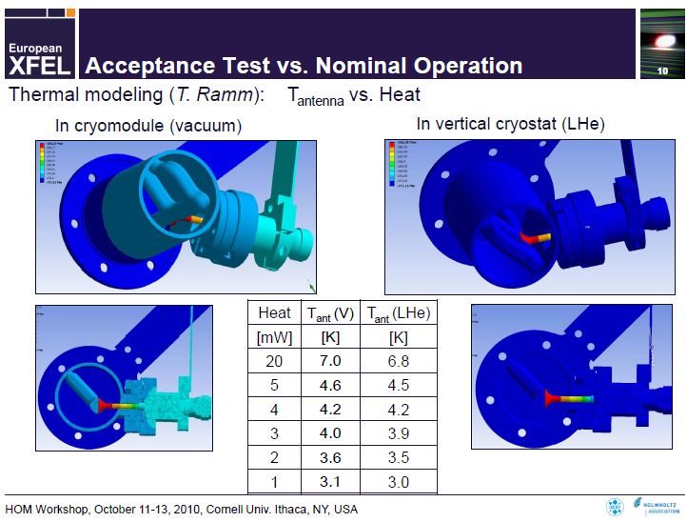
J. Sekutowicz

Slide 10
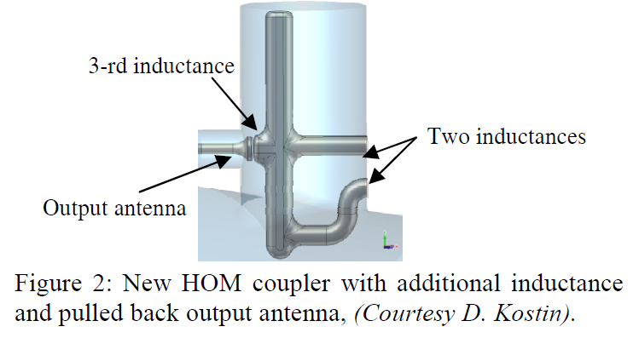
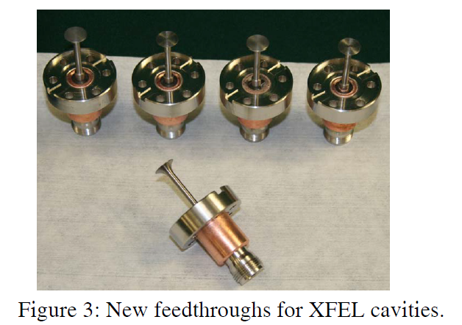
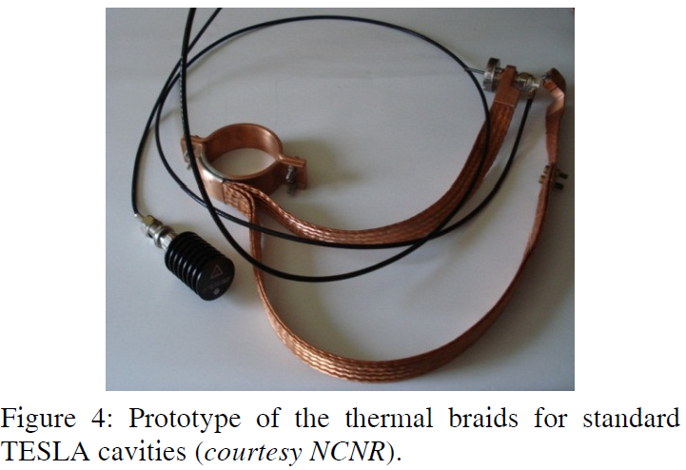
Antenna Modifications for E-XFEL
“The feedthroughs are made of high conductivity materials, pure niobium, molybdenum and sapphire. They will be connected thermally to the 2-phase tube with copper braids for better heat transfer to the 2 K environment.”
J. Sekutowicz

Slide 11
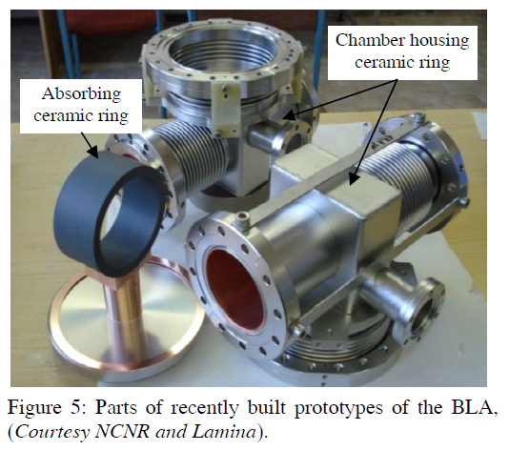
Beam Line Absorbers (One per CM)
“Total deposited HOM power by the nominal XFEL beam will be 3.81 W per cryomodule, if no synchronous excitation will take place. Most of this power, ~ 85%, will be dissipated in the beam line absorbers (BLA).... In the absorber design we took into account operations in the cw/lp modes, in which beam deposited power can be as high as 100 W.”
J. Sekutowicz

Slide 12
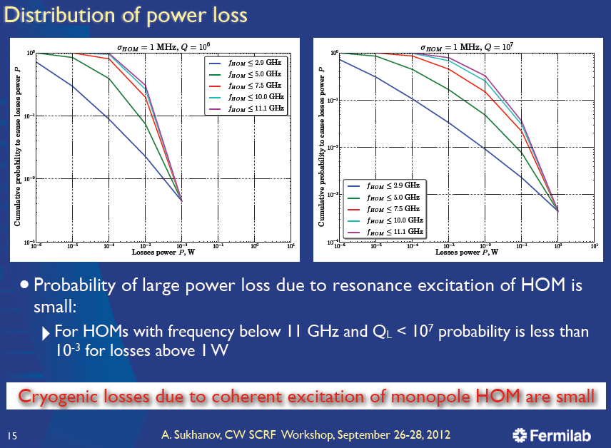

Slide 13
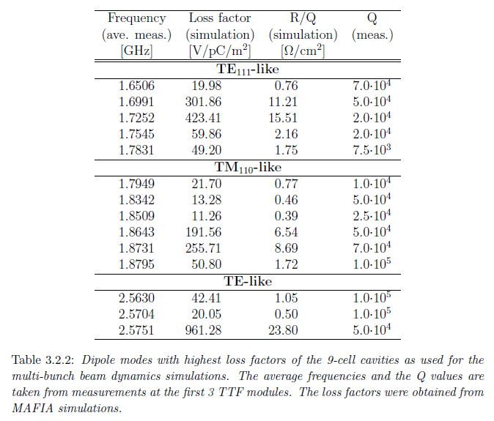
Reduced Dipole HOM Damping
With 1/30 of the current, 1/3 lattice beta, 1/30 of the linac length and 10 times the emittance of the ILC, can we increase QL considerably to simplify the damping ?
Also, would randomly varying the bunch timing (modulo a 1.3 GHz period) about the nominal 1 us bunch spacing significantly reduce the damping requirement

Slide 14
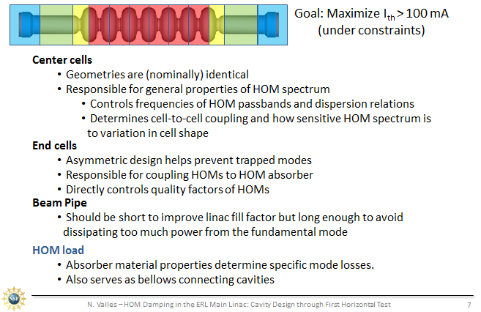
Cornell 200 mA, 7 Cell Cavity
No HOM Ports but Larger Beam Pipe and One Beamline Absorber/Cavity
200 W HOM Power/Cavity
Need such damping if eventually
convert LCLS IISC to an ERL

Slide 15
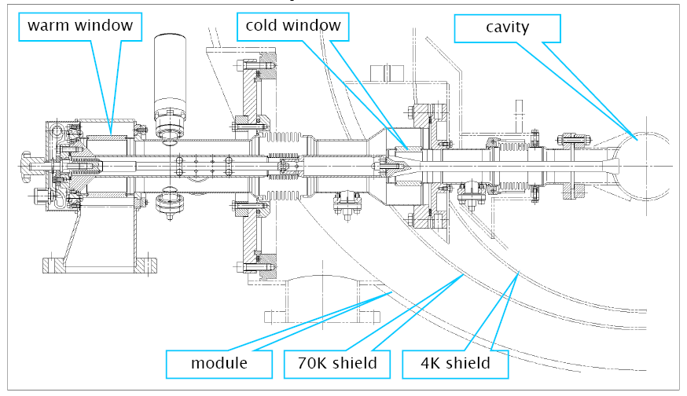
Powering the Cavities
Power coupler design complicated by need for tunablity (Qext), dual vacuum windows and bellows for thermal expansion.
For ILC, TTF3 design processed to 1.1 MW with 1.6 ms pulses – would run at only 5-6 kW for LCLS IISC, so may not need extensive rf processing, but would need to improve the warm section cooling (4 kW average for 10 Hz TESLA ).
Coaxial Power Coupler
Input
Power

Slide 16
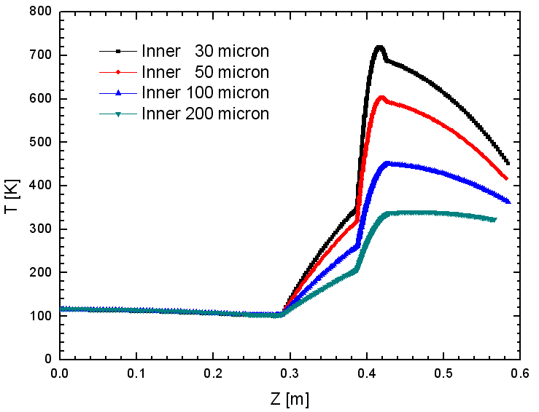

Inner Conductor Temperature Distribution with Different Thicknesses of Copper Coating for 15 kW CW RF Power
10µm on outer conductor with RRR=10
Shilun Pei

Slide 17
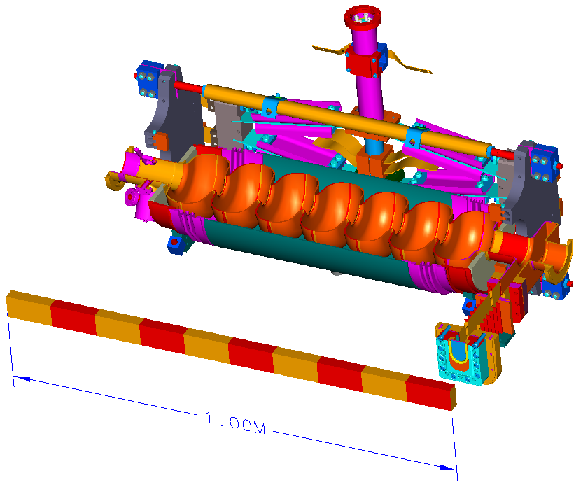
JLAB Upgrade 7-Cell Cavity with WG Couplers
Warm tuner actuator not shown
RF reference probe
λ/4 waveguide RF input coupler
HOM coupler (2)
Fundamental Power Coupler (FPC)
SST helium vessel
Warm ceramic RF window
Cu-plated waveguide between RT and 2 K

Slide 18
Relative NGLS Cost versus Cavity Gradient
They assumed Q₀=2x10¹⁰ - with higher Qo, cost optimal gradient increases – for now assume 16 MV/m and Qo = 3e10 for LCLS IISC, which pushes the cooling limit of a single cryoplant for a 4 GeV linac.
Total cost, construction + 15 yrs operations
Total cost, construction only
Cryomodules & enclosure
Cryomodules & enclosure
RF power
RF power
Cryoplant
Cryoplant
From John Corlett’s June 2013 Cornell TTC Talk

Slide 19
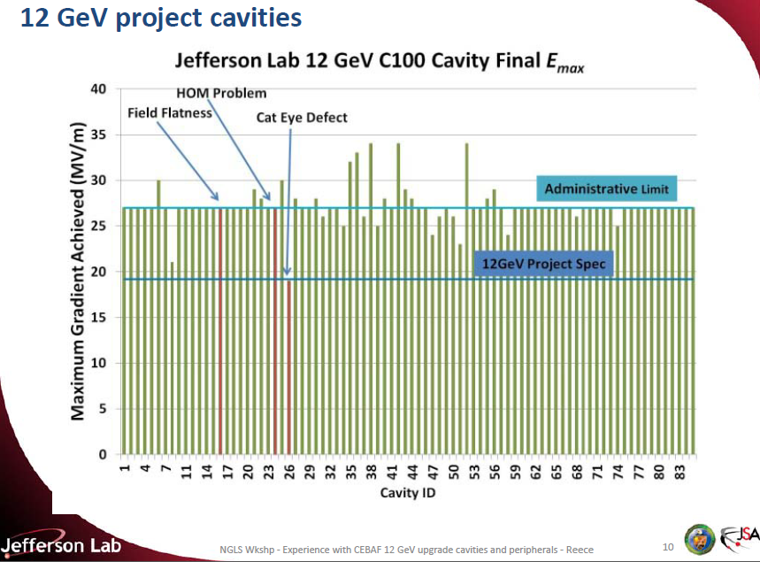

Slide 20
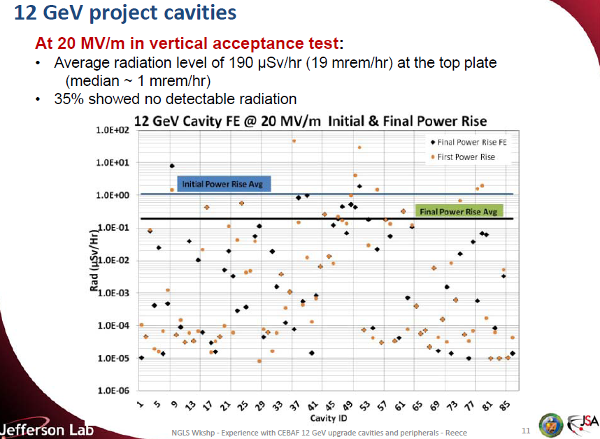

Slide 21
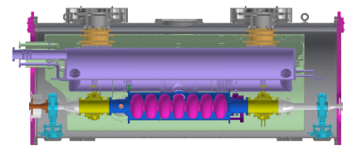
Cornell Horizontal Test 3
Full cryomodule assembly with power coupler and beam absorbers (cavity prep included a HF rinse)
Qo >= 3e10 at 16 MV/m in a CM is possible at 1.8 K

Slide 22
New Surface Treatments Developed at FNAL for Higher Q
Treatment | Q @ 16 MV/m, @ 2K, 1.3 GHz Demonstrated on several cavities | Improvement over baseline, component improved | Maximum Q achievable with ideal cool down (16MV/m, 2K, 1.3GHz)
EP+120C (standard ILC) | 1.5-1.7e10 | -- | ~2.2e10
EP + 120C + HF rinse | ~2.3e10 | ~30-40% , residual | 3e10
EP + Annealing + no chemistry | ~2.7e10 | ~50-60%, residual | 3e10
EP + Gas (nitrogen or argon) bake + EP | ~4e10 | ~100-150%, BCS and residual | 6.75e10
Golden opportunities!

Slide 23
RF Power, QL and Overhead
Parameter | Value | Comment
Gradient | 16 MV/m | On crest
Beam Current | 0.3 mA
Cavity QL | 4.12 e7 | Based on formula on next slide – minimizes power for 10 Hz microphonics (MP) offset
Max Power per Cavity ( w MP w/o overhead) | 5.72 kW | Power with 10 Hz MP offset – no overhead
Max Power per Cavity (w MP w overhead) | 6.32 kW | Assume 94% transmission and 4% overhead
Max Power for 48 cavities (w MP and w overhead) | 303 kW | Either one source per cavity so can track MP locally or one source for 48 cavities
RMS MP offset allowed with a 300 kW source | 9 Hz | For Gaussian distributed MP

Slide 24
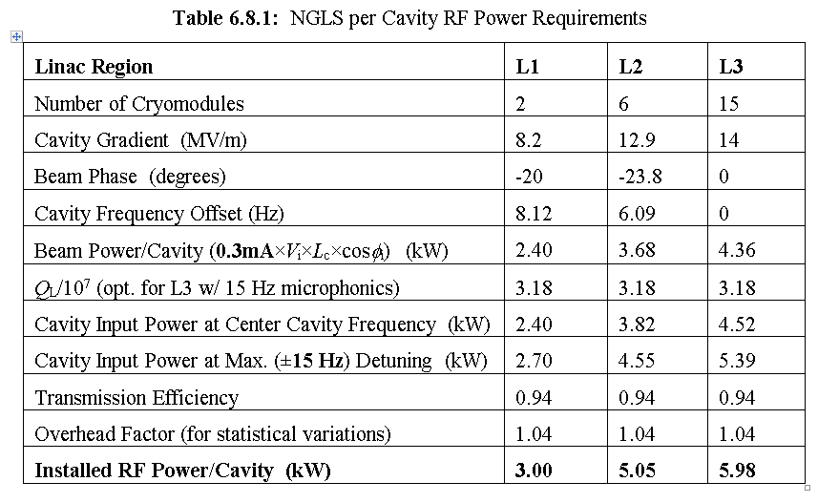

Slide 25
Relative Power vs QL (Units of 1e7) with a 10 Hz Offset

Slide 26
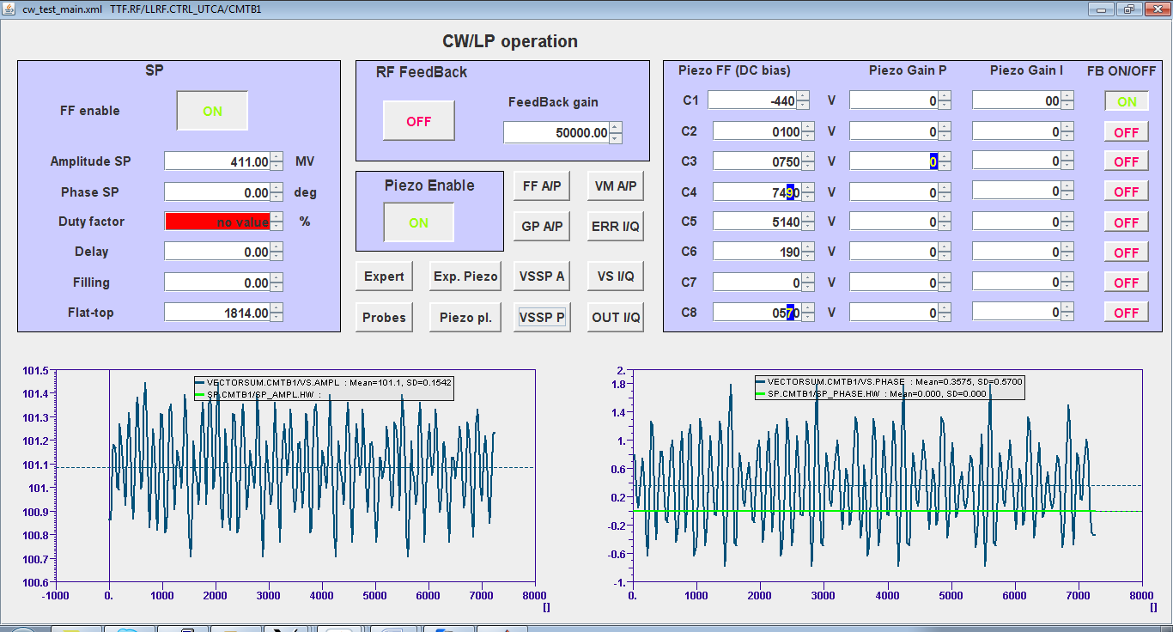
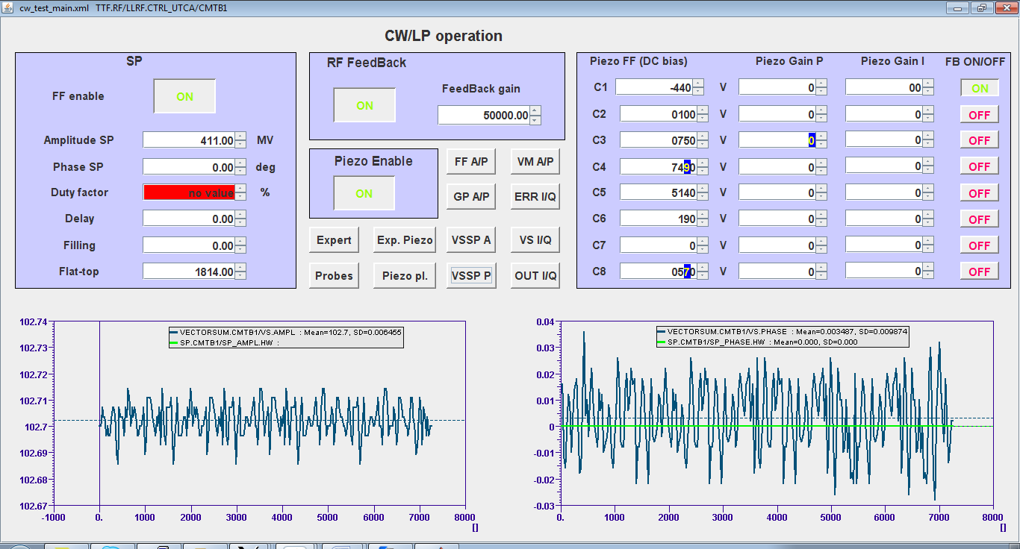
CM Gradient (Vector Sum) Stabilization at DESY
Goal: Stability of the vector sum for the cw operation with the new µTCA LLRF.
Conditions: E_{acc} = 3.5 MV/m, mode cw, piezo feedback off, bias on.
Test Result:
QL = 1.5e7
1s
1s
RF-feedback off
Standard deviations for:
Amplitude = 1.5E-3
Phase = 0.5°
Vector sum
phase
RF-feedback on
Standard deviations for:
Amplitude = 6.2 E-5
Phase = 0.0098°
Vector sum
phase
Conclusion:
New µTCA RF-feedback improves amplitude and phase stability by factor of 24 and 51 respectively, and fulfills spec for the XFEL linac.

Slide 27
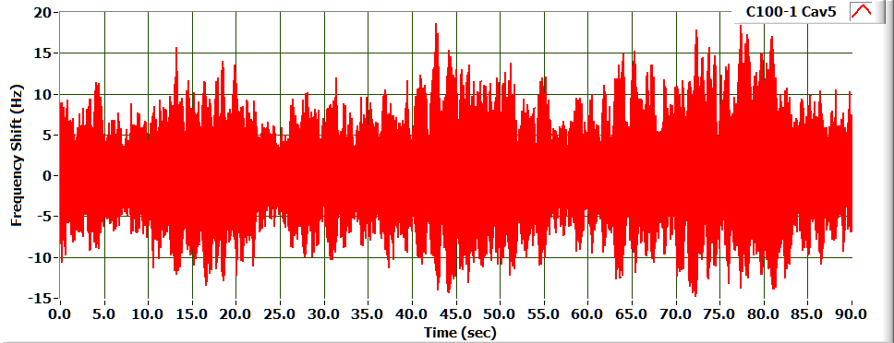
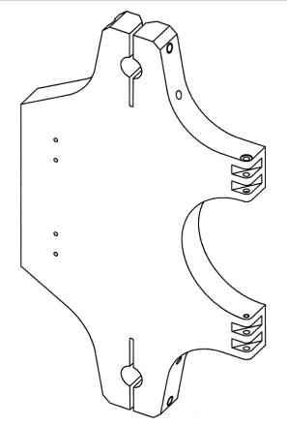
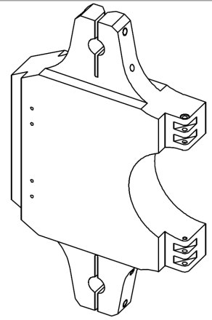
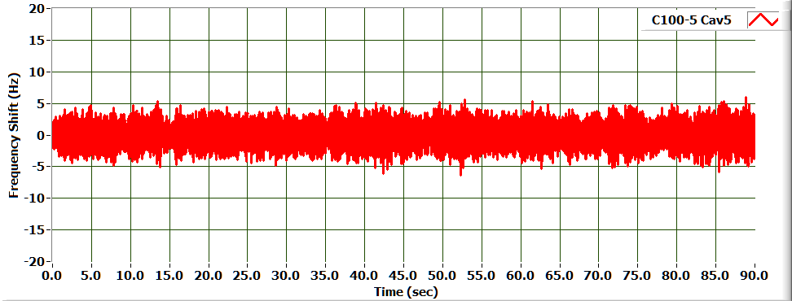
JLAB Upgrade Cavity Microphonics
Determines the Feedback Gain needed for control.
Effects are driven by Q_{L} and the available klystron power for lightly loaded cavities
Microphonic Detuning* | C100-1 | C100-4
RMS (Hz) | 2.985 | 1.524
6σ(Hz) | 17.91 | 9.14
Minor change to the tuner pivot plate substantially improved the microphonics for the CEBAF C100 Cryomodules.
While both meet the overall system requirements the improved design has a larger RF power margin
Cavity C100-1-5
Cavity C100-4-5

Slide 28
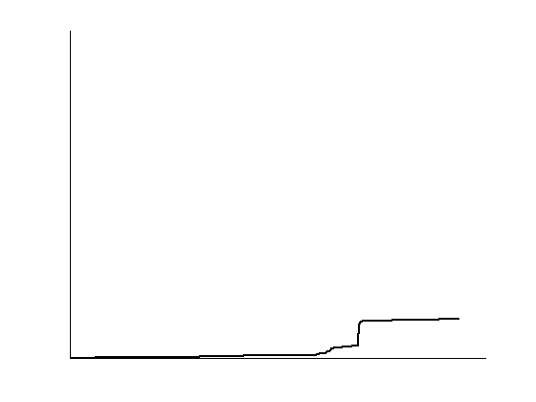
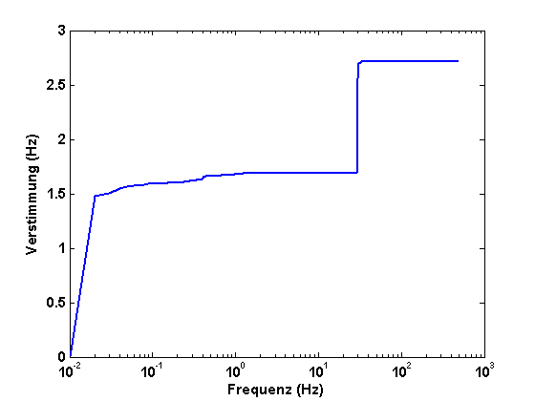
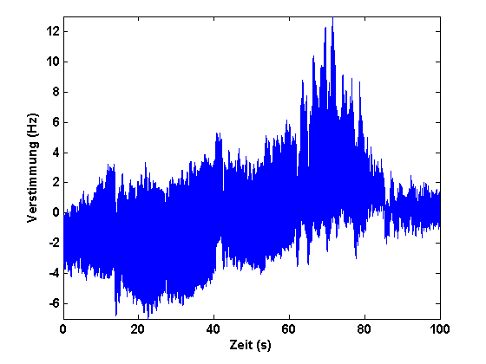
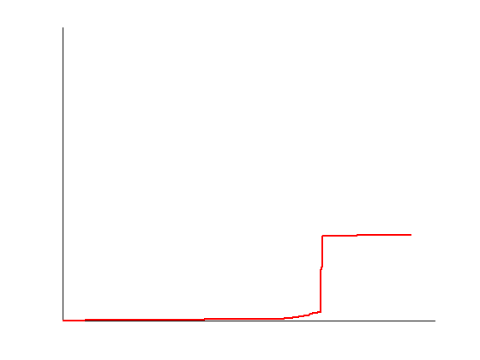
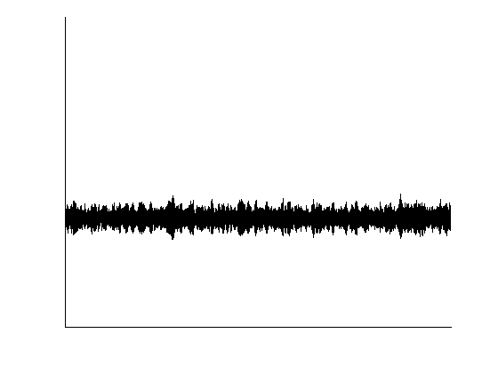
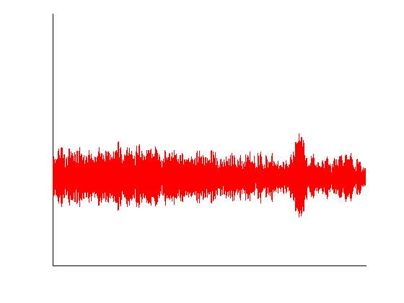
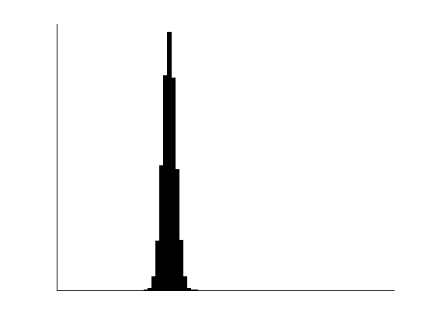
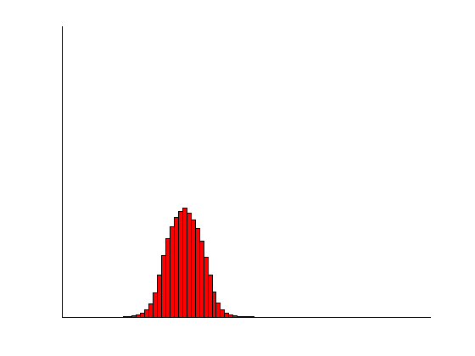
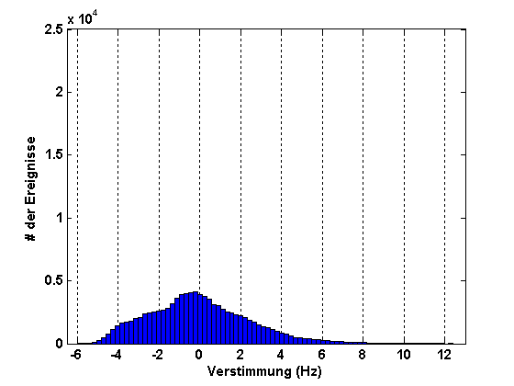
Microphonics compensation at HZB
ΣFFT
Detuning (Hz)
w/o
control
Detuning (Hz)
feedback
feedback &
feed-forward
compensation
Time (s)
Frequency (Hz)
Reduced detuning by an order of magnitude
Achieved „open loop“ phase stability:13.2° → 2.0°
0.02° phase stability achievable
Compensate multiple resonances
Needs implementation into LLRF control
and operation with beam
σ_{f} = 2.52 Hz
σ_{f} = 0.89 Hz
σ_{f} = 0.36 Hz
# events
Detuning (Hz)

Slide 29
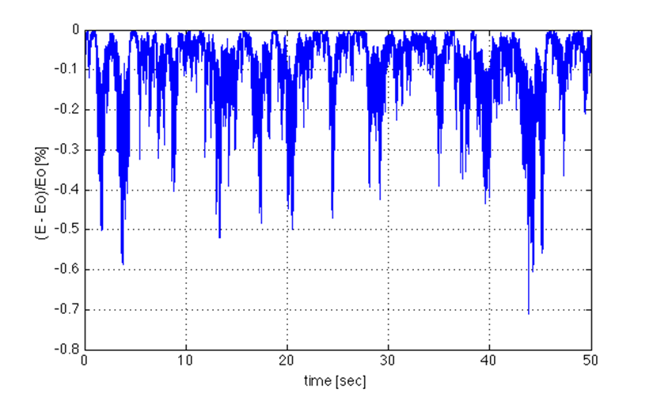
‘BESSY’ Microphonics Example
41 Hz mode driven randomly to yield a 1.5 Hz rms frequency variation – then solve cavity field level with a constant rf input and beam current
Resulting Energy Variation over Time: 9e-4 variation in a cavity energy gain, which if uncorrelated cavity to cavity, would produce 7e-5 beam energy variation at the end of the linac (ignoring the BCs and the various FB systems)
Claudio Rivetta

Slide 30
Summary
Recent improvements in cavity cooling, gradient, Qo and microphonics bode well for future CW SCRF linac driven light sources.
Let’s work together to bring this together and build a next-generation CW linac.

