Slide 1
5th International Workshop on "Thin films applied to Superconducting RF and new ideas for pushing the limits of RF Superconductivity"

Slide 2
Welcome to Jefferson Lab
•Sessions will start on time, overruns will consume break time.
Allocated times for open discussion on the various topics
•Typical: 25’ talk + 4’ Q & A + 1’ transition
•Speakers, please upload slides in advance to Indico
•Lunch break- Quark Café recommended
• Group Photo on Thursday (10:30)
• Workshop dinner @ the Yorktown Freight Shed

Slide 3
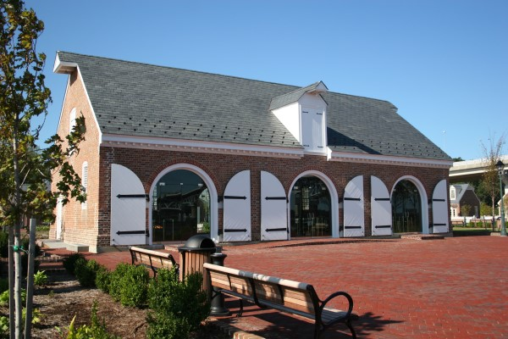
Bus Departure from Jlab @ 6:15pm Leave from the Freight Shed, return to hotels ~ 11pm

Slide 4
Organizing Committees
Local Organizing Committee:
Anne-Marie Valente-Feliciano Larry Phillips C. REECE R. GENG J. SPRADLIN X. ZHAO
Ruth Bizot
MeLaina Evans
Marty Hightower
Cynthia Lockwood
Stephanie Vermeire
Coordination and Secretariat:
C. CAMP
International Committee:
V. PALMIERI (INFN and Univ. of Padua, ITALY) A. ANDERS (Lawrence Berkeley National Lab, USA) S. CALATRONI (CERN, Switzerland) A. GUREVICH (Old Dominion University, USA)) L. PHILLIPS (Jefferson Lab, USA) T. TAJIMA (Los Alamos National Lab, USA) R. VAGLIO (Univ. Napoli and CNR-SPIN, ITALY) X. X. Xi (Temple Univ., USA)

Slide 5
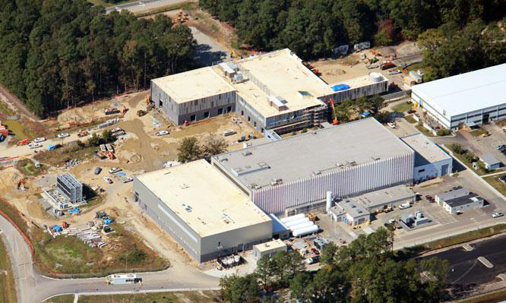
JLab Technology and Engineering Development Facility Project (TEDF)
A DOE Science Laboratory Infrastructure modernization project
Provides the first 2nd-generation SRF facility in the world
October 2011
New TED Building
Renovated SRF lab
New SRF lab

