Slide 1
Design specificities of the SPL cryomodule prototype
O. Capatina, V. Parma – CERN
On behalf of the SPL team

Slide 2
Overview
Introduction SPL cryomodule
Thermal efficiency of vapor cooling of supports
MLI performance measured on the LHC magnets
Material considerations for helium tanks
Summary

Slide 4
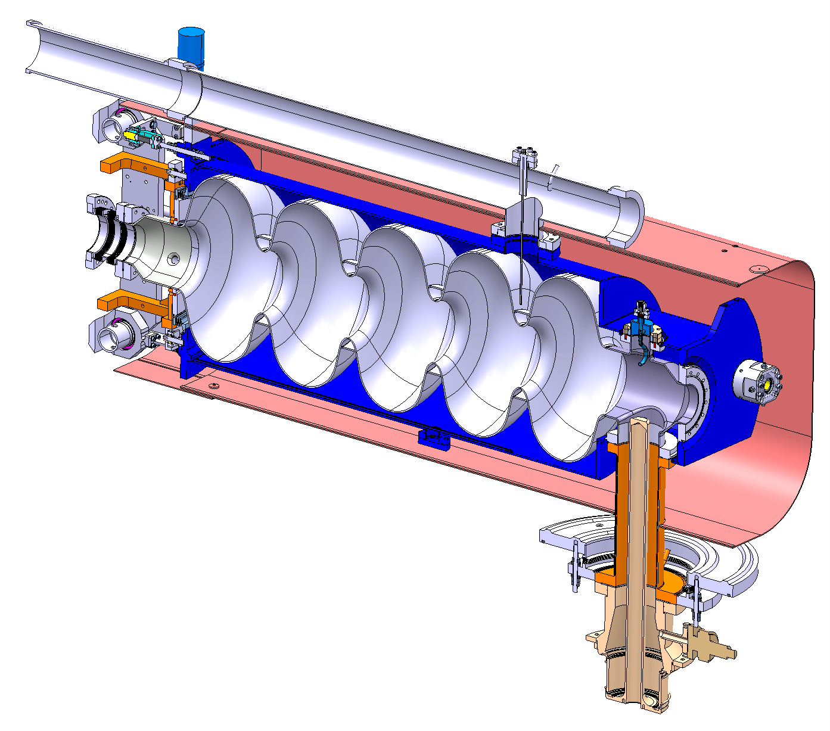
Bi-phase helium tube
Helium Tank
Bellows
CEA’s tuner
Bulk Niobium 5Cells cavity
Magnetic shielding
Hom Coupler
Inter-cavity support
Double walled tube
RF Power Coupler

Slide 5
Overview
Introduction SPL cryomodule
Thermal efficiency of vapor cooling of supports
MLI performance measured on the LHC magnets
Material considerations for helium tanks
Summary

Slide 6
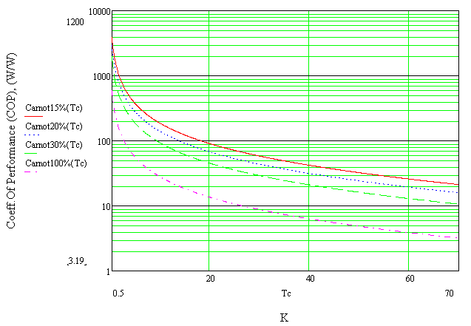
COP of cryogenic refrigeration
State-of-the-art figures (LHC cryoplants):
COP @ 2 K → ~ 15% Carnot (990 W_{el}/W_{th})*
COP @ 4.5 K → ~ 30% Carnot (210 W_{el}/W_{th})*
COP @ 50 K → ~ 30% Carnot (16 W_{el}/W_{th})
Cold temperature
* S. Claudet et al. “1.8 K Refrigeration Units for the LHC: Performance Assessment of Pre-series Units”, proceedings ICEC20

Slide 7
Ways of intercepting solid-conduction heat in-leaks
A) Pure conduction, no heat intercepts
300K
A
L
Q @ 2K
Case | Q @ 2K [W] | Wel [W] | Q @ 8K [W] | Wel [W] | Q @ 80K [W] | Wel [W] | vapours rate g/s | Q equiv. @ 4.5K [W] (1g/s=100W) | Wel [W] | Total Wel [W]
A) No intercept | 11.629 | 11512.71 |  |  |  |  |  |  |  | 11,513

Slide 8
Ways of intercepting solid-conduction heat in-leaks
B) Perfect heat intercept @ 80 K, in optimized position (w.r.t total power)
300K
x1~ 26% L
Minimizing using cost factors:
C₁ = 16 w/w
C₃ = 990 w/w
A
Q @ 80K
L
Q @ 2K
Case | Q @ 2K [W] | Wel [W] | Q @ 8K [W] | Wel [W] | Q @ 80K [W] | Wel [W] | vapours rate g/s | Q equiv. @ 4.5K [W] (1g/s=100W) | Wel [W] | Total Wel [W]
A) No intercept | 11.629 | 11512.71 |  |  |  |  |  |  |  | 11,513
B) 1 optimised and perfect intercept @ 80K | 1.816 | 1797.84 |  |  | 39.513 | 632.208 |  |  |  | 2,430

Slide 9
Ways of intercepting solid-conduction heat in-leaks
C) Perfect heat intercepts @ 80 K & 8 K in optimized position (w.r.t total power)
300K
Minimizing using cost factors:
C₁ = 16 w/w
C₂ = 210 w/w
C₃ = 990 w/w
x₁ ~ 38% L
A
Q @ 80K
L
x₂ ~ 90% L
Q @ 8K
Q @ 2K
Case | Q @ 2K [W] | Wel [W] | Q @ 8K [W] | Wel [W] | Q @ 80K [W] | Wel [W] | vapours rate g/s | Q equiv. @ 4.5K [W] (1g/s=100W) | Wel [W] | Total Wel [W]
A) No intercept | 11.629 | 11512.71 |  |  |  |  |  |  |  | 11,513
B) 1 optimised and perfect intercept @ 80K | 1.816 | 1797.84 |  |  | 39.513 | 632.208 |  |  |  | 2,430
C) 2 optimised and perfect intercepts @ 80K & 8K | 0.129 | 127.71 | 2.64 | 580.8 | 26.816 | 429.056 |  |  |  | 1,138

Slide 10
Ways of intercepting solid-conduction heat in-leaks
D) Self-sustained He vapour cooling, 4.5 K-300 K
Q in g/s
Assuming:
T_{vapour} = T_{support}
(perfect heat exchange)
Q_{4.5K} = L_{v} * dm/dt
(vapour generated only by residual heat conduction to 4.5 K bath)
300K
A
L
x, T(x)
4.5K
attenuation factor
Q @ 2K
Case | Q @ 2K [W] | Wel [W] | Q @ 8K [W] | Wel [W] | Q @ 80K [W] | Wel [W] | vapours rate g/s | Q equiv. @ 4.5K [W] (1g/s=100W) | Wel [W] | Total Wel [W]
A) No intercept | 11.629 | 11512.71 |  |  |  |  |  |  |  | 11,513
B) 1 optimised and perfect intercept @ 80K | 1.816 | 1797.84 |  |  | 39.513 | 632.208 |  |  |  | 2,430
C) 2 optimised and perfect intercepts @ 80K & 8K | 0.129 | 127.71 | 2.64 | 580.8 | 26.816 | 429.056 |  |  |  | 1,138
D) 4.5K self-sustained vapour cooling | 0.031 | 30.69 |  |  |  |  | 0.019 | 1.9 | 407 | 438
Conclusion: Vapour cooling on st.steel supports, if optimally exploited, can provide more than a factor 2 electrical power saving w.r.t. standard heat intercepts techniques

Slide 11
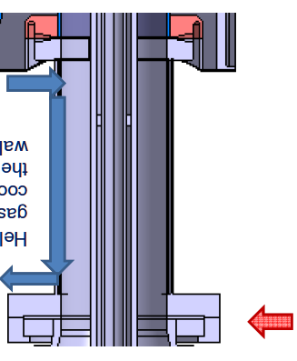
Ways of intercepting solid-conduction heat in-leaks
E) Real case, He vapour cooling, 4.5 K-300K
Q @ 2K
Assuming:
T_{vapour} ≠ T_{support}
(real convection)
dm/dt set to 0.04 g/s
Cu conduction (internal wall)
Radiation heat load
Electrical power to keep 300K (or > dew point): 60 W
4.5 K vapours (g/s)
Analysis of thermal performance:
Semi-analytical model, 3 layers, 1D meshing
Work done by R.Bonomi, CERN TE-MSC
300K
Case | Q @ 2K [W] | Wel [W] | Q @ 8K [W] | Wel [W] | Q @ 80K [W] | Wel [W] | vapours rate g/s | Q equiv. @ 4.5K [W] (1g/s=100W) | Wel [W] | Total Wel [W]
A) No intercept | 11.629 | 11512.71 |  |  |  |  |  |  |  | 11,513
B) 1 optimised and perfect intercept @ 80K | 1.816 | 1797.84 |  |  | 39.513 | 632.208 |  |  |  | 2,430
C) 2 optimised and perfect intercepts @ 80K & 8K | 0.129 | 127.71 | 2.64 | 580.8 | 26.816 | 429.056 |  |  |  | 1,138
D) 4.5K self-sustained vapour cooling | 0.031 | 30.69 |  |  |  |  | 0.019 | 1.9 | 407 | 438
E) Real case, He vapour cooling, 4.5K-300K | 0.1 | 99 |  |  |  |  | 0.04 | 4 | 880 | 1,039
Now the power gain appears marginal w.r.t. case C), which is an ideal simplified case.
But what about when RF power is on ???...

Slide 12
Ways of intercepting solid-conduction heat in-leaks
F) Real case, He vapour cooling, 4.5K-300K, RF power on
RF power on
G) Real case, No He vapour cooling, RF power on
RF heating on
inner wall
When RF is on, a distributed vapour cooling is essential to contain distributed RF heating (local heat intercepting can hardly provide efficient cooling)
Case | Q @ 2K [W] | Wel [W] | Q @ 8K [W] | Wel [W] | Q @ 80K [W] | Wel [W] | vapours rate g/s | Q equiv. @ 4.5K [W] (1g/s=100W) | Wel [W] | Total Wel [W]
A) No intercept | 11.629 | 11512.71 |  |  |  |  |  |  |  | 11,513
B) 1 optimised and perfect intercept @ 80K | 1.816 | 1797.84 |  |  | 39.513 | 632.208 |  |  |  | 2,430
C) 2 optimised and perfect intercepts @ 80K & 8K | 0.129 | 127.71 | 2.64 | 580.8 | 26.816 | 429.056 |  |  |  | 1,138
D) 4.5K self-sustained vapour cooling | 0.031 | 30.69 |  |  |  |  | 0.019 | 1.9 | 407 | 438
E) Real case, He vapour cooling, 4.5K-300K | 0.1 | 99 |  |  |  |  | 0.04 | 4 | 880 | 1,039
F) Real case, He vapour cooling, 4.5K-300K, RF power on | 0.5 | 495 |  |  |  |  | 0.04 | 4 | 880 | 1,435
G) Real case, No He vapour cooling, RF power on | 22 | 21780 |  |  |  |  | 0 | 0 | 0 | 21,780
Real model by R.Bonomi, CERN TE-MSC

Slide 13
Overview
Introduction SPL cryomodule
Thermal efficiency of vapor cooling of supports
MLI performance measured on the LHC magnets
Material considerations for helium tanks
Summary

Slide 14
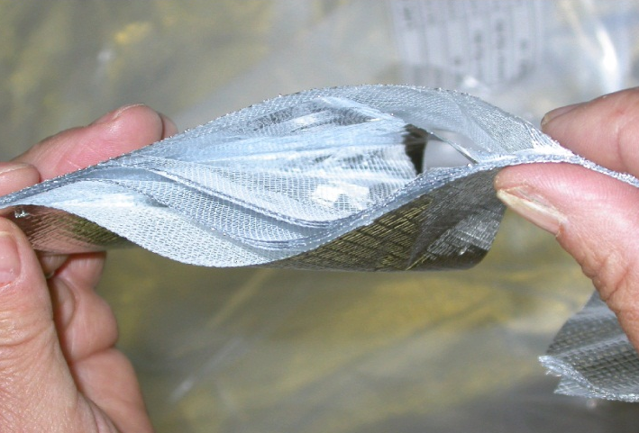
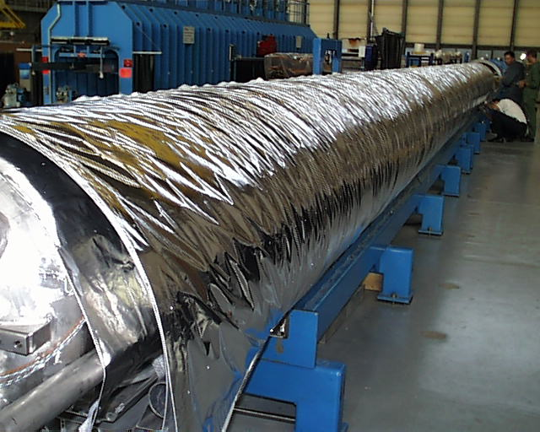
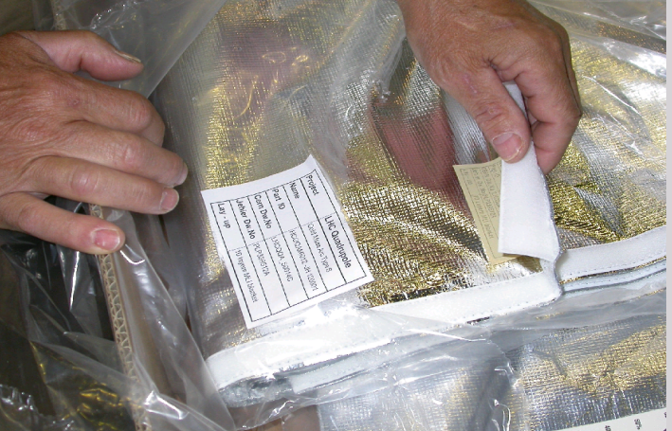
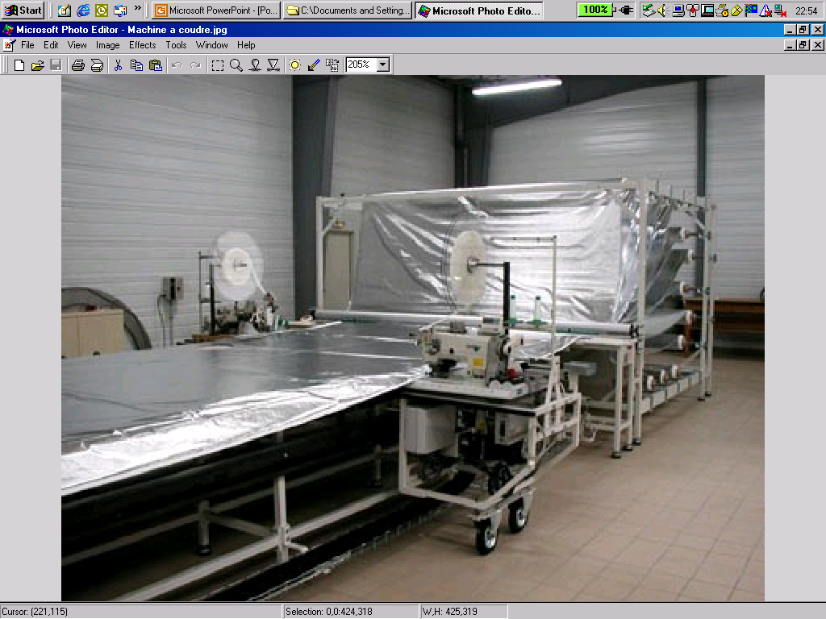
LHC Multi Layer Insulation (MLI)
Features:
1 blanket (10 reflective layers) on cold masses (1.9 K)
2 blankets (15 reflective layers each) on Thermal Shields (50-65 K)
Reflective layer: double aluminized polyester film
Spacer: polyester net
Stitched Velcro™ fasteners for rapid mounting and quality closing
Interleaved reflectors and spacers
Velcro™ fasteners
Blanket manufacturing
1 blanket on CM, 2 on thermal shield

Slide 15
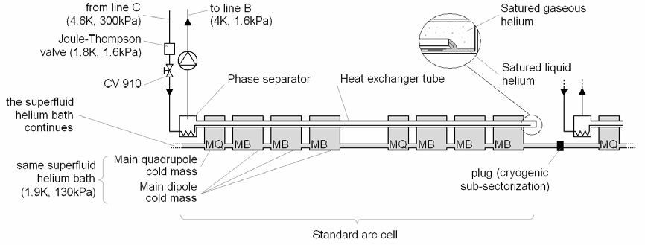
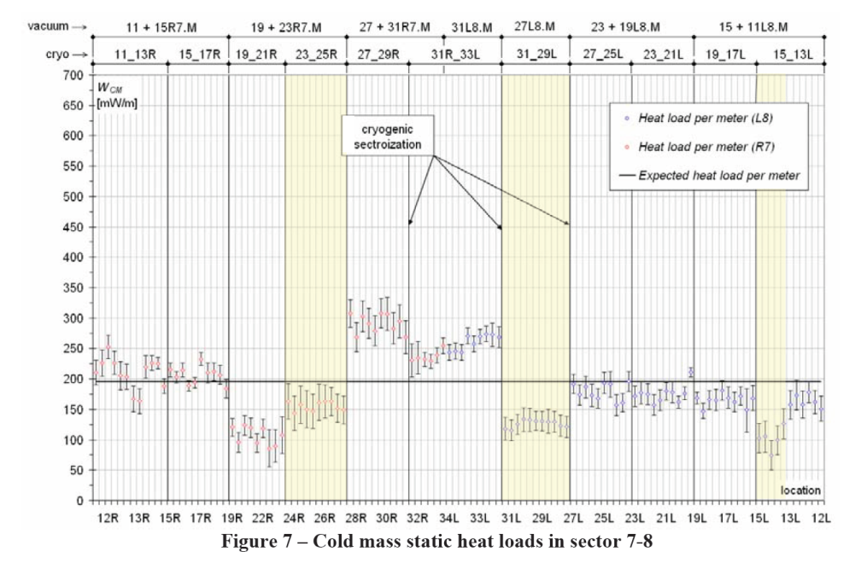
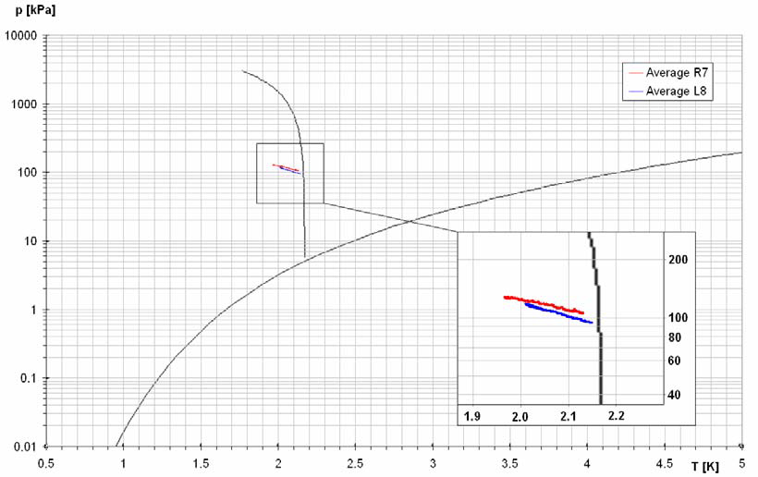
10 MLI layers @ 2K (from LHeII calorimetric measurements in LHC)
Static HL natural warm-up of cryogenic subsector after stop in cooling
Schematic cryogenic layout of a standard arc cell. A cryogenic subsector is defined as a unique common superfluid helium bath and includes two or three standard cells. A standard cell includes six dipoles and two quadrupoles and is cooled by a unique heat exchanger tube.
Average heat load to cold mass (10 MLI layers) ~ 0.2 W/m
Rescaled on cold mass surface: → ~0.1 W/m²
This is a conservative engineering figure:
Global figure, includes other sources of HL (conduction intercepts, radiation through thermal contractions plays, etc.)
Average transformation in p-T helium phase diagram for the pressurized superfluid helium in the two halves of the sector.
C. Maglioni, V. Parma: “Assessment of static heat loads in the LHC arc, from the commissioning of sector 7-8”, LHC Project Note 409, 2008.

Slide 16
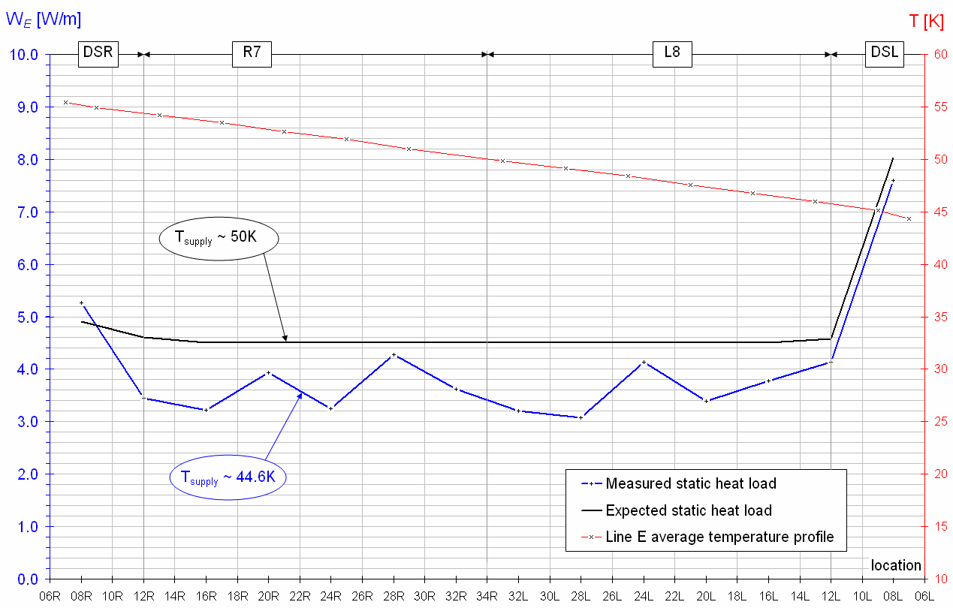
30 MLI layers @ 50K (non-isothermal heating along LHC thermal shield, 2.7 km)
[W/m]
Helium flow (measured)
Δh
Specific enthalpy change
(T measurements and He properties)
L^{TT}
Distance between T sensors
Thermal shield static heat load profile along sector 7-8
Average heat load @ 50K of ~ 4 W/m
Thermal shielding with MLI (30 layers)
Rescaled on thermal shield surface: → ~1.6 W/m²
This is a conservative engineering figure:
Global figure, includes other sources of HL (conduction intercepts, radiation through thermal contractions plays, etc.)
It is estimated on a long machine sector, lowly affected by end of sector singularities
C. Maglioni, V. Parma: “Assessment of static heat loads in the LHC arc, from the commissioning of sector 7-8”, LHC Project Note 409, 2008.

Slide 17
Overview
Introduction SPL cryomodule
Thermal efficiency of vapor cooling of supports
MLI performance measured on the LHC magnets
Material considerations for helium tanks
Summary

Slide 18
Helium tank material
Two types of helium tanks studied:
Titanium
Same coefficient of thermal contraction as Niobium
More expensive
Stainless steel (our baseline)
Cheaper
Design has to cope with differential thermal contraction / Nb

Slide 19
Helium tank material
Titanium helium tank – niobium cavity
DESY XFEL choice:
EB welding Nb to NbTi + EB welding NbTi to Ti
NbTi flanges
Choice motivated by the stability of the mechanical properties after heat treatment at 1400ºC => NbTi
Heat treatment no longer at 1400ºC but at 800ºC or lower => A properly selected Titanium (cheaper) could be then a valid option (instead of NbTi) for flanges and transitions to cavity
The grade 5 Titanium Ti6Al4V:
Has excellent mechanical properties at cryogenic temperature
Solution annealing temperature: 900-950ºC
=> The mechanical properties of Ti6Al4V not degraded after heat treatment at 800ºC

Slide 20
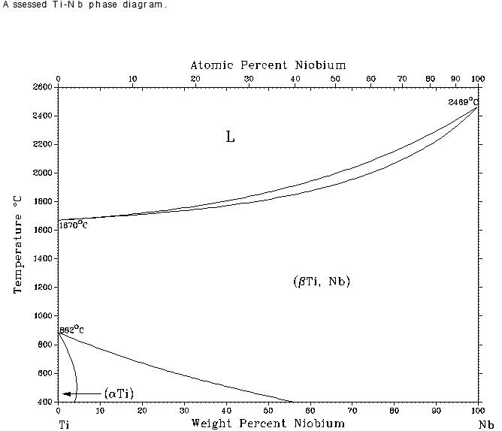
Helium tank material
Ti6Al4V to Nb EB welding fully qualified
 | Nb | Ti6Al4V
ρ (Kg/m³) | 8600 – 8700 | 4410 – 4450
T_{m} (ºC) | 2460 – 2470 | 1610 – 1660
K (W/m ºC) | 54 – 57 | 7.1 – 7.3

Slide 21
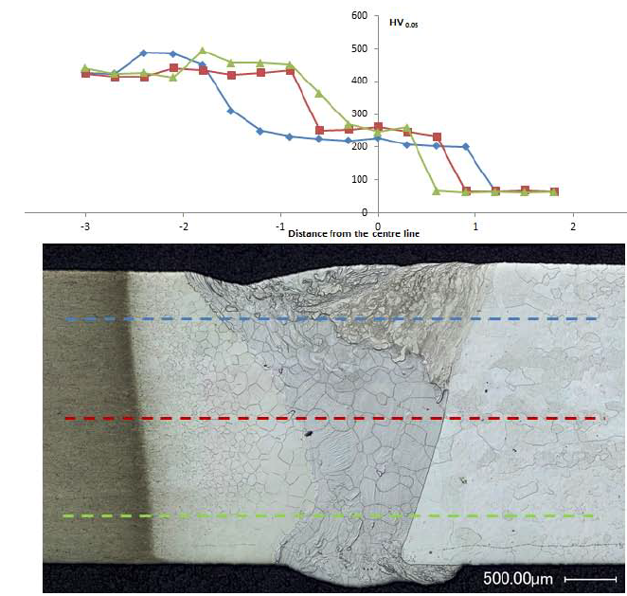
Helium tank material
Microhardness
Ti6Al4V to Nb EB welding fully qualified
Ti6Al4V
Nb

Slide 22
Helium tank material
Ti6Al4V to Nb welding fully qualified
Tensile tests
 | Before HT | After HT
UTS (MPa) | 152.7 ± 2.7 | 158.8 ± 2.2
Elongation at break (%) | 24.8 ± 2.7 | 26.6 ± 0.1

Slide 23
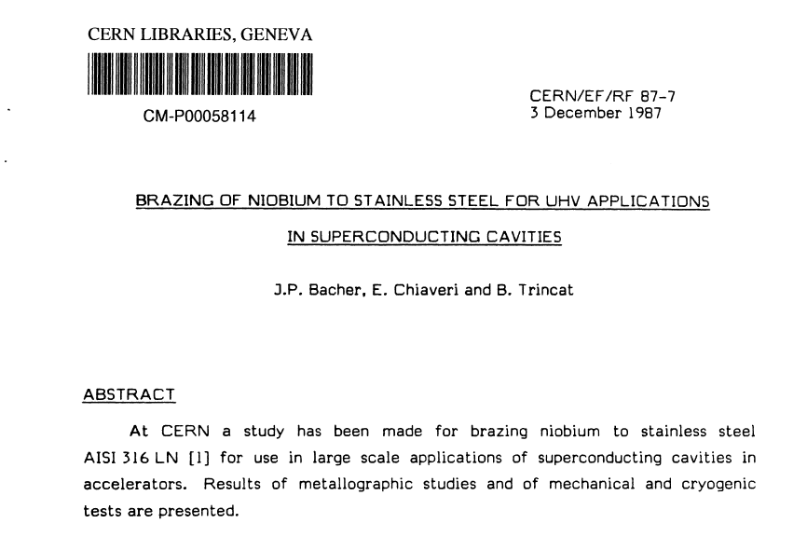
Helium tank material
Stainless steel helium tank – Niobium cavity
Vacuum brazing 316 LN to Nb: technology developed at CERN in 1987 and successfully used for the LEP cavities

Slide 24
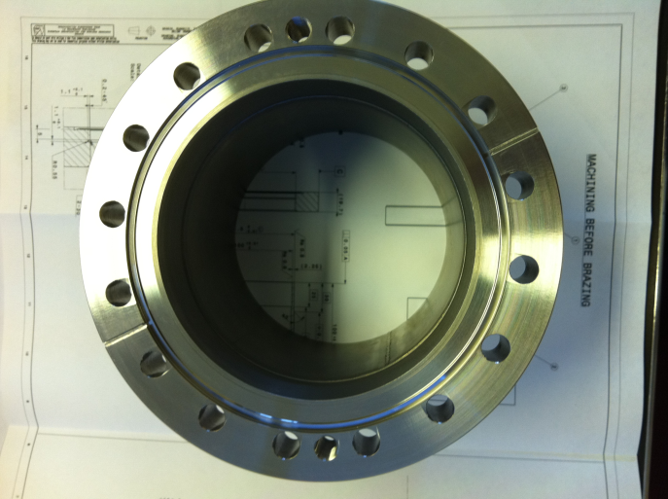
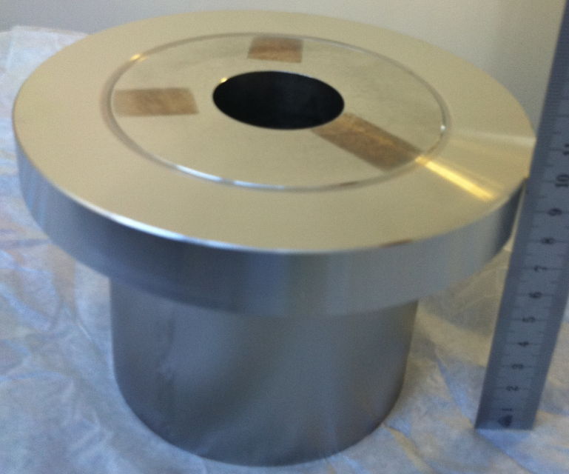
Helium tank material
Stainless steel helium tank – Niobium cavity
Vacuum brazing 316LN to Nb
316LN to Nb vacuum brazing fully qualified
Difference in thermal expansion of Nb/SS
Nb tube fitted to SS flange
Clearance ≤ 20 µm
SS plug to expand the Nb
Cu - OFE filler metal
Brazing temperature 1100°C, ∆time <<
P< 10-5 mbar
Nb tube
SS plug
SS flange
Flange after machining the SS plug

Slide 25
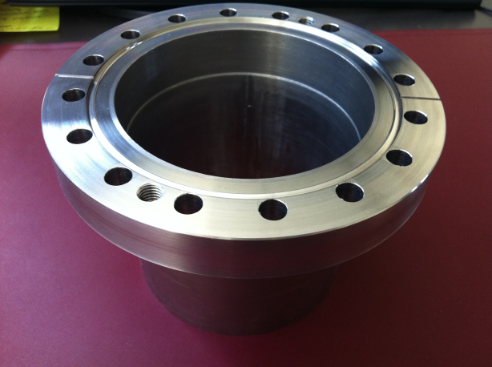
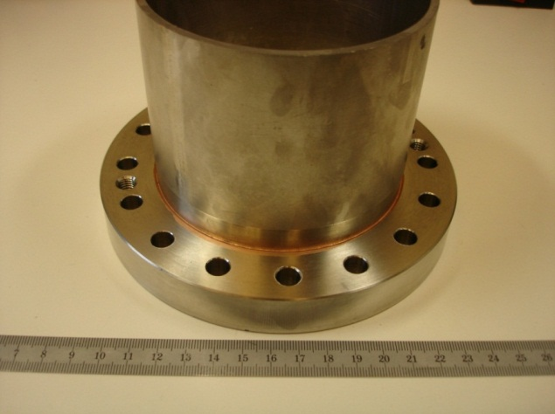
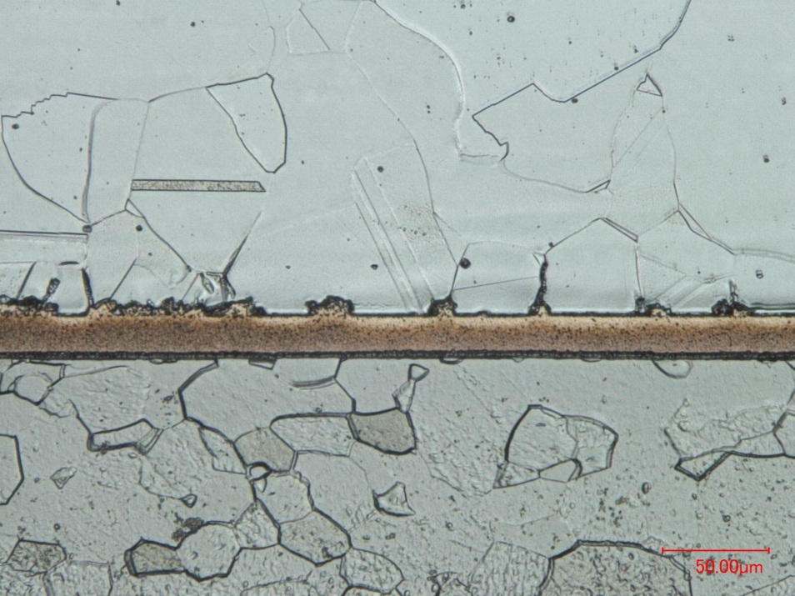
Helium tank material
316LN to Nb vacuum brazing fully qualified
Ultrasonic examination
Leak test
Thermal shock liquid N₂ (x5)
Ultrasonic examination
Leak test
Electropolishing
HT ( 600°C/24h)
Electropolishing
Leak test
Ultrasonic examination
Thermal shock liquid N₂ (x5)
Ultrasonic examination
Leak test
Shear test
Leak test
Ultrasonic examination
Assembly test
Metallographic examination
Fractography
SEM assesment + EDS
2 brazing samples tested
Metallographic examination
SS
Nb

Slide 26
Helium tank material
Some cost considerations:
Price per kg:
316 LN: ~ 10 euro/kg
Ti grade 2: ~ 65 euro/kg (sheets)
Ti6Al4V: ~ 65 euro/kg
NbTi: ~ 450 euro/kg
Manufacturability:
316 LN – manufactured at large scale in Industry
Ti
Shaping more difficult
Welding under protected atmosphere

Slide 27
Summary
Intercepting solid-conduction heat in-leaks – power saving by using Helium vapor instead of standard heat intercepts techniques
MLI – heat load values at 2K and 50K measured in an operating machine (LHC)
Material considerations for helium tanks:
SS cheapest solution – 316LN vacuum brazing on Nb technique qualified at CERN since 1987
For Ti helium tanks solutions, flanges made of Ti6Al4V (Ti grade 5) is a much cheaper solution than NbTi with similar mechanical properties

Slide 28
Thank you

