Slide 1
Improvement of Multilayer Film Growth for Accelerator Cavity by ECR deposition
Jiao, Fei
Notes:
Good morning, Ladies and gentlemen, thanks for giving me this chance to introduced my job about multilayered.

Slide 2
Contents
1
Background
2
Present work
3
Future Plan
Notes:
My report include three section, the first one is background, the second is ….,at last I will introduced our future plan

Slide 3
Background

Slide 4
Thin film technics to improve gradient and Q0
Magnetic field B (mT)
Quality coefficient Q₀
Accelerating Field E_{acc} (MV/m)
Two aspects:
Increase gradient: increase H_{sh}
Increase the Q₀: decrease surface resistance
Notes:
As shown in the picture, it is a typical Q-E curve for elliptical cavity at 2K. The development in surface treatment has gradually pushed the performance to the limit of niobium. For the future applications which demand for either higher gradient or lower heat load, the thin film technics is definitely a promising candidate to increase both the gradient and Q0.

Slide 5
Using multi-layer to increase gradient and Q0 further
H₀
Magnetic field B (mT)
H_{i}
Quality coefficient Q₀
Accelerating Field E_{acc} (MV/m)
layer bulk
d
A. Gurevich, APL 88, 012511 (2006)
Notes:
Pro. Gurevich bring us new landscape by introduced multilayer structure, firstly, by using this structure, the surface resistance can be expressed by this formulate, choose reasonable material and reasonable thickness, we can achieve lower surface resistance far from pure niobium cavity,

Slide 6
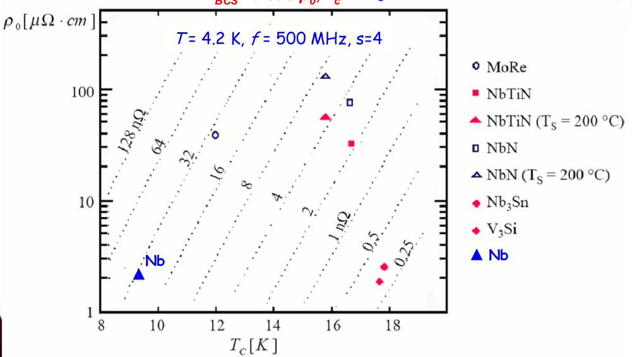
Candidate materials for thin film
Notes:
In terms of both BCS resistance and Hc, niobium seems not the best material. And the study on thin film materials such as NbN, Nb3Sn and MgB2 is being conducted all around the world. Though, there are still many problems to be solved. For instance, the multi-layer has strict requirement on the quality of the film, or else the potential performance will degrades.

Slide 7
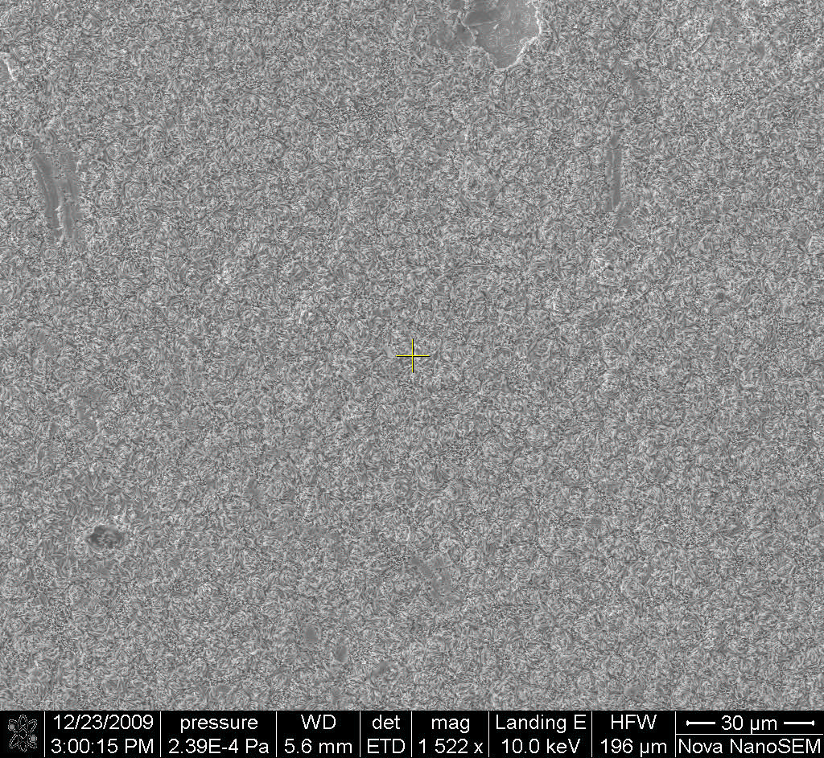
Problem : surface defect
Pit
Extrusion
Notes:
But in fact, there also have some problem. Whatever method we used to deposit the film , both the phenomenon in this figure can be observed, and that will destroyed the multilayer structure in part, and so it can result in quench and limit the performance

Slide 8
Surface defect may be caused by:
Dust on substrate
Pin-hole in the pre-layer
Damage from following deposition process
Notes:
To analysis the reason of the surface defect, we can consider that, dust or any other grains may produce a nucleus so ,the film will grow around the nucleus, so the convex continued.

Slide 9
ECR Method: Idea and Plan
Notes:
In order to solve these problems in fact, we must analysis how to avoid this problem or how to weaken it effect, so use ECR produced low energy sputtering particle

Slide 10
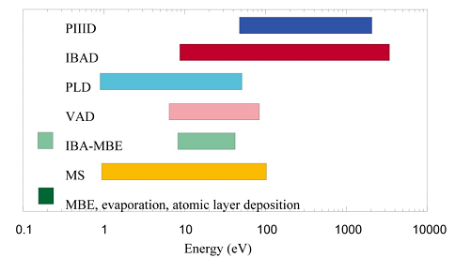
Low energy of deposited particle is preferred to reduce destroy to pre-layer
PIIID: Plasma Immersion Ion Implantation and Deposition
IBAD: Ion Beam Assisted deposition
PLD: Plasma Laser Deposition
VAD：vacuum arc deposition
IBA-MBA: Ion beam assisted molecular beam epitaxy
MS: Magnetron Sputtering
Notes:
Figure give us the most poplar method and its deposited particle energy, as we can see that , last four do benefit to protect the pre-layer, for these method prefer deposited particle energy is about 100 elector-volt. But can we find lower energy deposition method

Slide 11
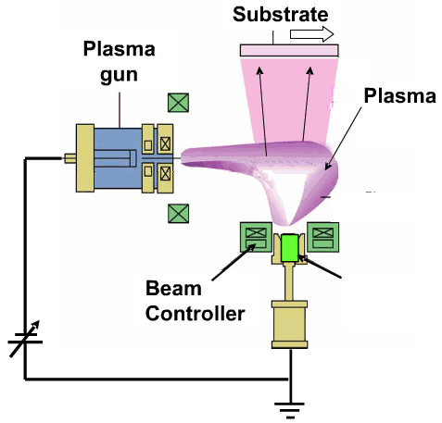
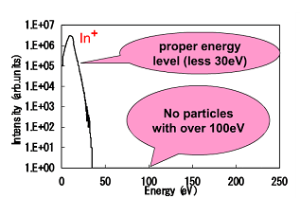
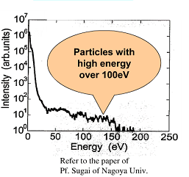
Low damage of Plasma method
Plasma evaporation
Nb+
Magnetron sputtering
source
Notes:
The left is figure of Sputtering, heat evaporation which are normal used. The right is used plasma gun to produce high density plasma, using the electromagnetic field to guide the plasma impact the target, because high density plasma carry high energy, so it can evaporate the surface of target, the method has been used for deposit Transparent Conductive Oxide thin film. We cite this idea but change its plasma source bye ECR source.

Slide 12
ECR: electron cyclotron resonance
Comparison between ECR and RF sputtering
 | ECR | RF sputtering
frenquency | 2.45GHz | 13.56MHz
Pressure | 0.05Pa | 10Pa
Electron density | 10¹⁸ | 10¹⁵
Particles energy | Less than 30eV | <100eV
Lower pressure, higher electron density, lower particle energy is good for multilayer deposition
Notes:
ECR used 2.45G hertz match resonance , and it can very high electron density. RF sputtering work on 13.56 million Hz, its ionization efficiency is far blow the ECR mode,

Slide 13
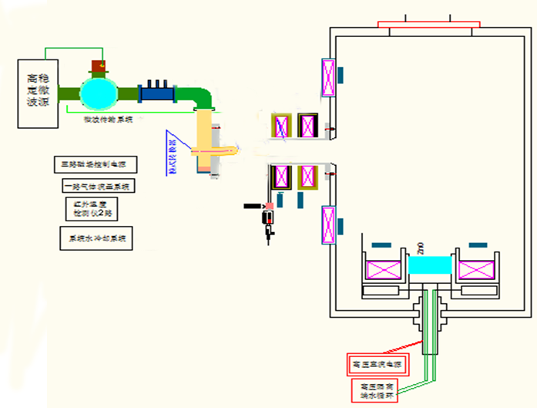
Newly designed ECR deposition system
substrate
Power
supply
ECR
produce
Microwave transport system
Deposition chamber
coil
benefit
No plasma gun pollution
Substrate cleaned by plasma
No target pollution
Target chamber
Notes:
Combination above idea , we design vacuum system based on ECR plasma. Include power supply/ microwave transport system, ECR produce chamber. Plasma control coil deposition chamber, target chamber.

Slide 14
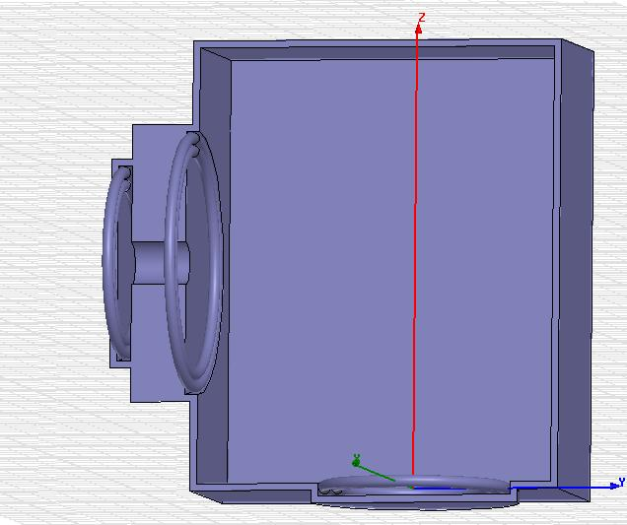
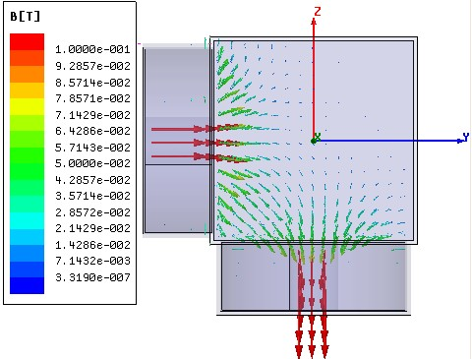
Deposition Vaccum and magnetic field distrubution

Slide 15
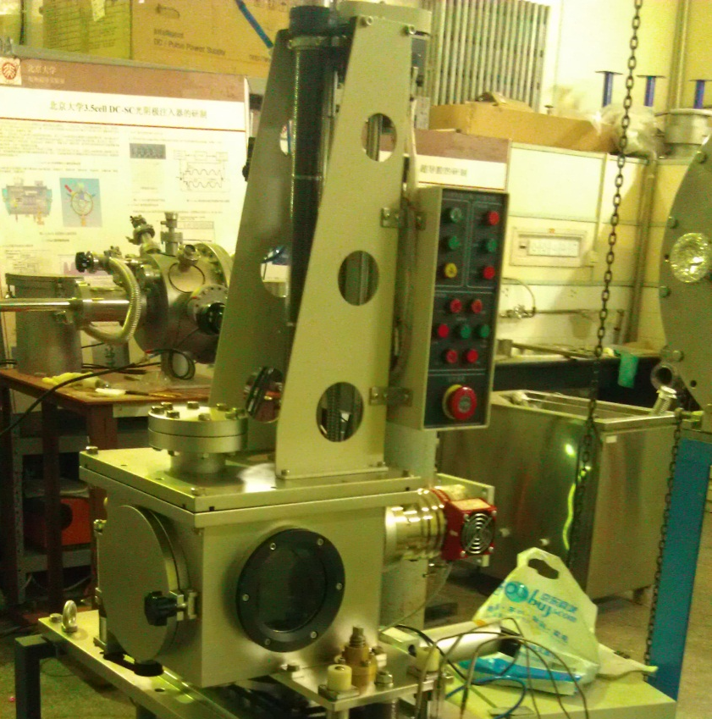
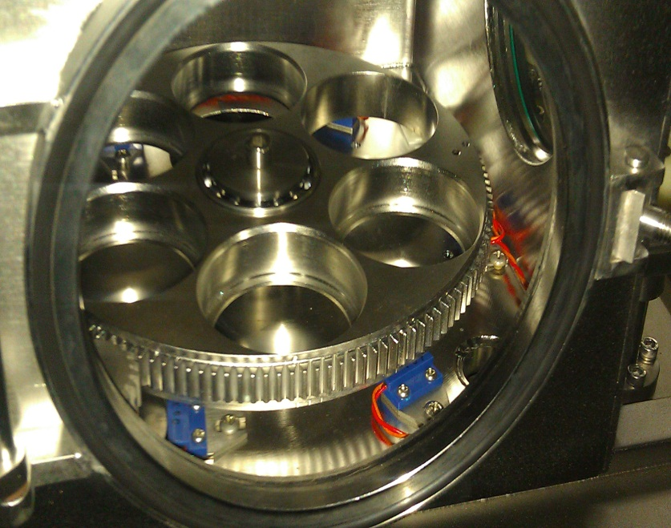
Target chamber
Notes:
Target chamber is a storage chamber, it can contain six cylinder target on the turn plate. When needed, the target can be transport to deposition chamber to be heated, and other target can be protect from polluting by the working target or other dust in deposition chamber..

Slide 16
characteristic
Low energy：protect the film deposited
Flash evaporation：high efficiency
cleaness

Slide 17
Future plan
Multilayer film research
H_{c1} Rs、Q0
Single-layer film research
H_{c1} R_{s}
Instrument design
Plasma transport, control
Investigation
Choose material
Notes:
We hope we can have some discussion with you during this workshop

Slide 18
Thank You !

