Slide 1

Physicists in Medicine
Vahagn Nazaryan, Ph.D.
(HUGS 2000)
Executive Director
Hampton University Proton Therapy Institute
June 11, 2018

Slide 2
Industrial Physics – Application Driven
Focus on Application
“Product” Driven Environment
  Subject Matter Expert
  Have relevant skills, experiences to enter the field
Cross-functional environment
Critical role in supporting the technology
Research and Development opportunities

Slide 3
Physics – HealthCare Industry
Various opportunities in
  Radiation and Health Physics
  Imaging Physics and Technologies
  Accelerator Physics
Responsible for aspects of technology development, Validation and Verification, Clinical Implementation
Quality Management, Industry Standards, Federal and Sate Regulations

Slide 4
Physics – HealthCare Industry
Cross-functional, team environment
Exposure to and close collaboration with Engineering (electrical, mechanical, software)
Deadlines and Commitments
Hierarchical Institution (typically)
Growth and promotion opportunities
Risk and Reward

Slide 5
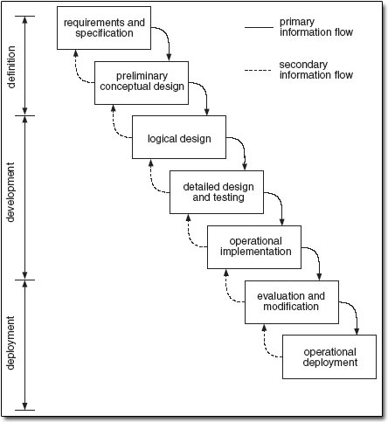
Systems Engineering – A Waterfall Model
Conception
Initiation
Analysis
Design
Construction
Testing
Production
Implementation
Maintenance
Notes:
The waterfall development model originates in the manufacturing and construction industries; highly structured physical environments in which after-the-fact changes are prohibitively costly, if not impossible.
The waterfall model is a sequential design process, often used in software development processes, in which progress is seen as flowing steadily downwards (like a waterfall) through the phases of Conception, Initiation, Analysis, Design, Construction, Testing, Production/Implementation, and Maintenance.

Slide 6
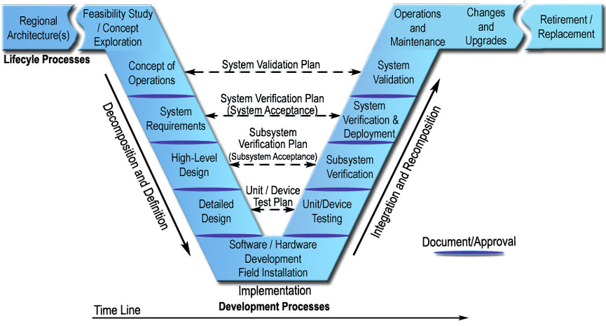
The Art of Product Development
Notes:
One of the first things that strikes you about the "V" is the symmetry between the left and right sides of the model. This symmetry reflects the relationship between the steps on the left and the steps on the right. The system definition that is generated on the left is ultimately used to verify the system on the right. For example, the user needs and performance measures that are identified in the Concept of Operations are the basis for the System Validation Plan that is used to validate the system at the end of project development. Similarly, a System Verification Plan is developed with the System Requirements so that the engineers consider how to verify each requirement as the requirements are written.
The connections between the left and right are indicated by the arrows that cross the "V", showing how plans developed on the left drive the process on the right. These connections provide continuity between the beginning and end of project development and ensure that the engineers are focused on the completion of the project from the beginning. The connections between the left and right sides of the model reflect one of the systems engineering principles – start with your eye on the finish line.

Slide 7
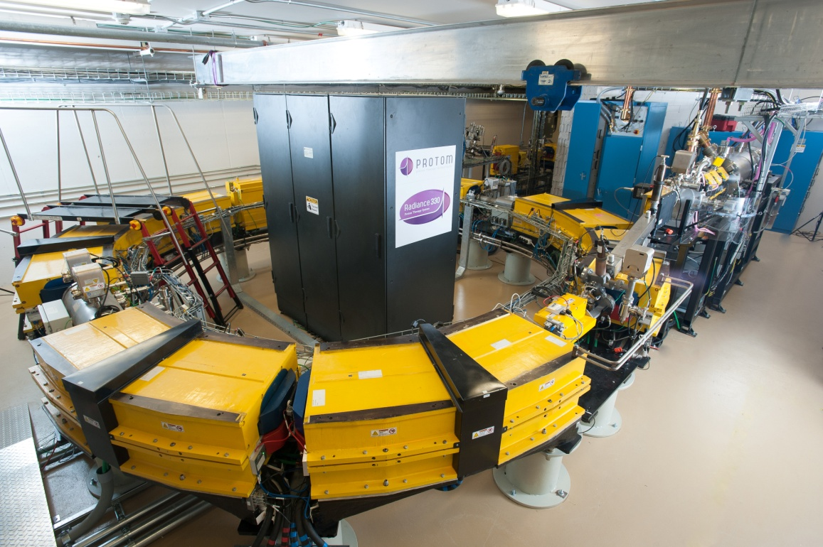
Radiance 330® - Synchrotron
Variable energy: 70 to 250 MeV for therapy; up to 330 MeV for proton radiography and tomography
Small beam emittance
Scanning equipped
Safety
Maintainability

Slide 8
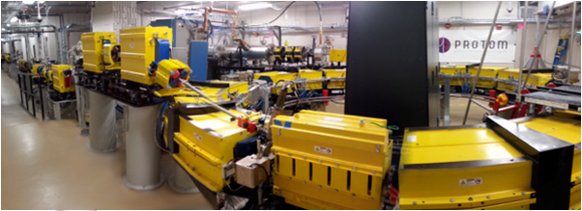
Beam Transport Line

Slide 9
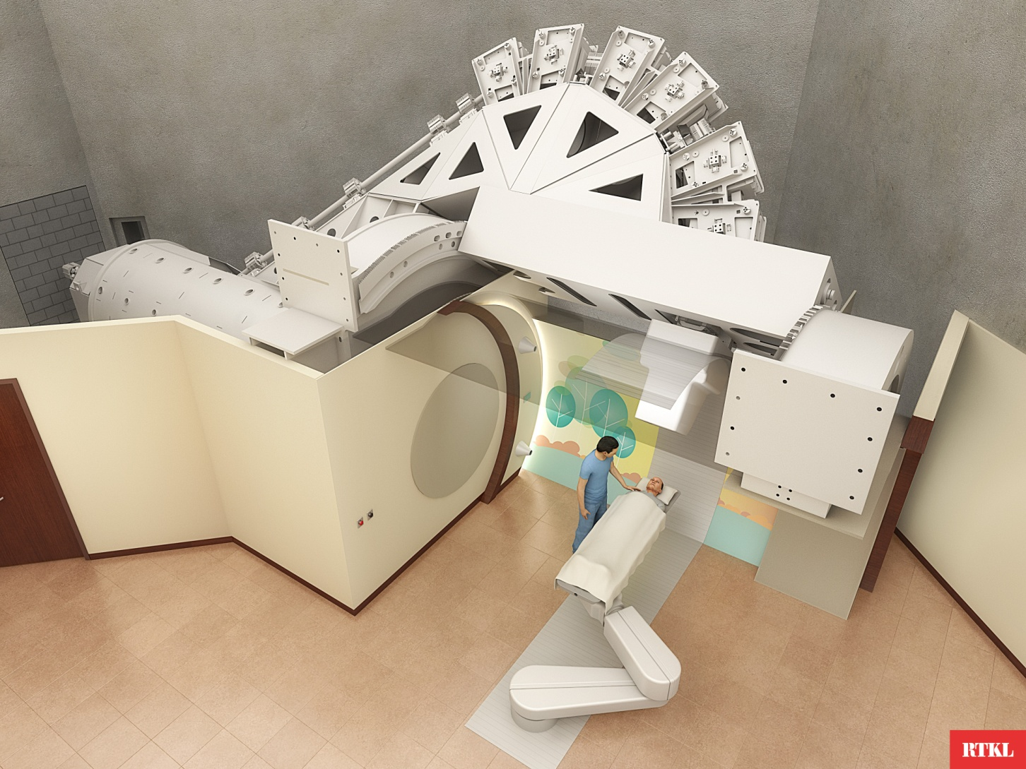
Gantry Treatment Room

Slide 10
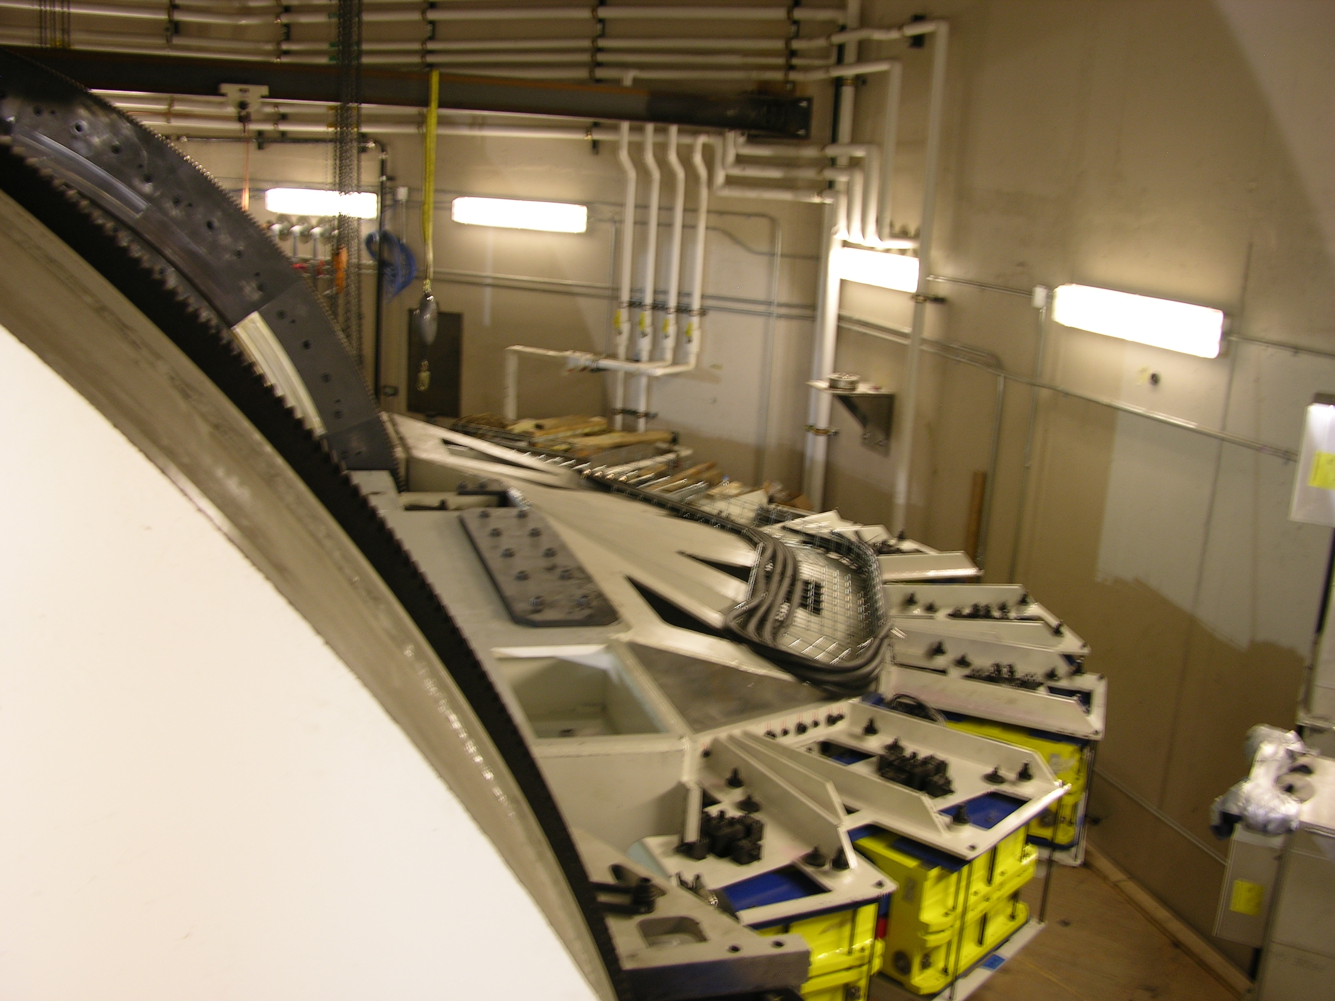

Slide 11
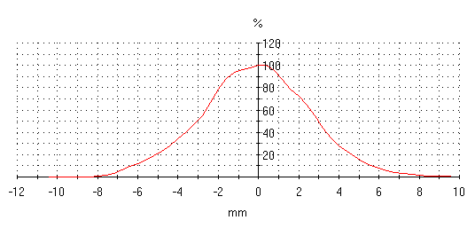
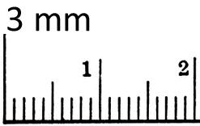
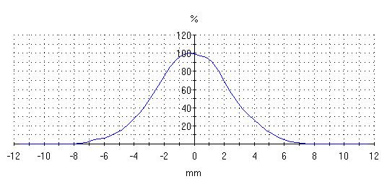
Clinical Utility
Scanning Beam Spot Size
Radiance 330 3mm-6mm σ
in air, at isocenter
Crossplane profile (horizontal scan) for 250 MeV.
Spot size = 2.57 mm.
Inplane profile (vertical scan) for 250 MeV. Spot size = 2.41 mm.

Slide 12
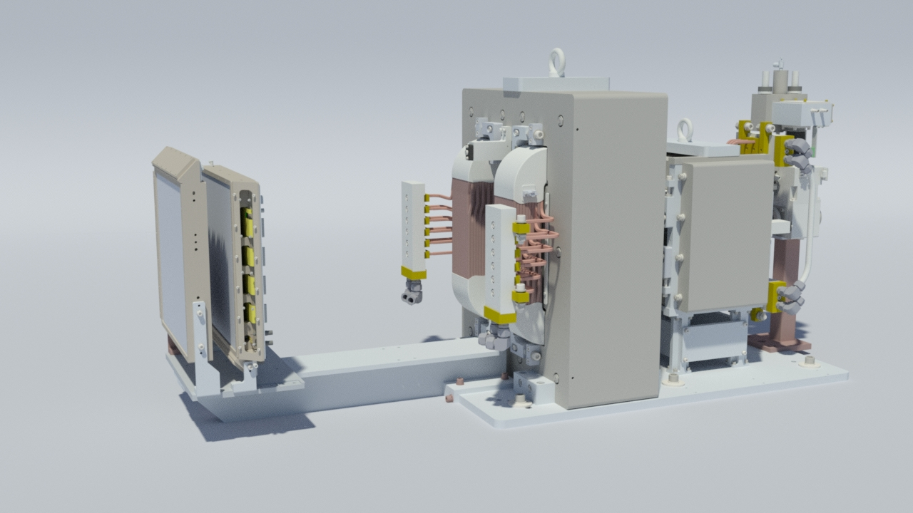
Proton Beam Scanning – Active Control
Narrow proton beam is positioned laterally by scanning magnets
Dose delivered layer by layer only to target area
Active energy tuning in range

Slide 13
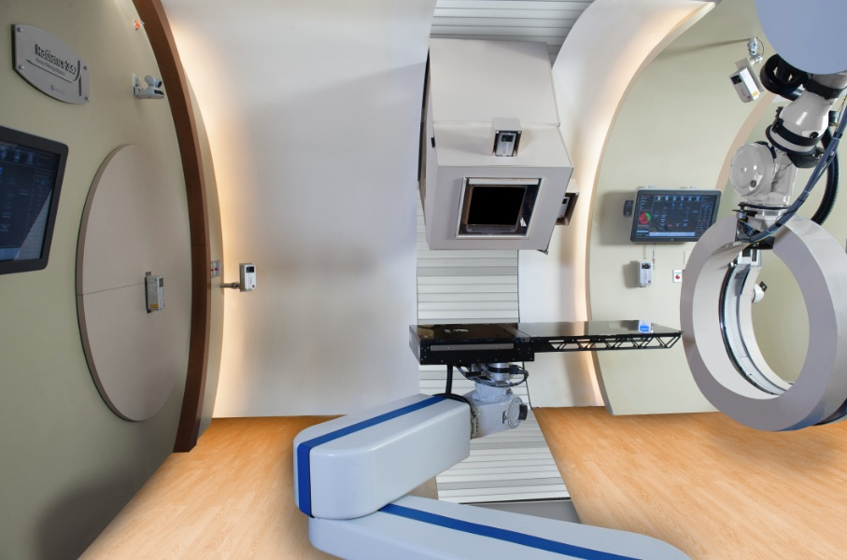
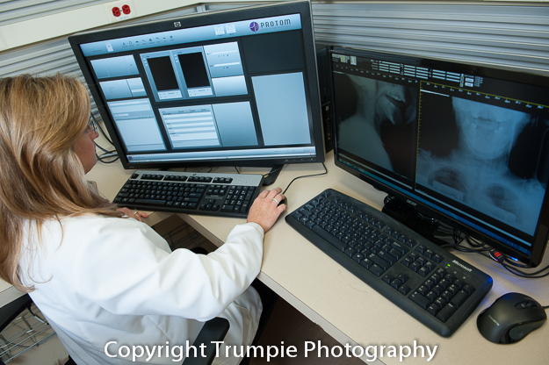
Control room and in-room machine components
Treatment Delivery Control System (TDCS) & 2D Imaging display
Motion Control System (MCS) & Workflow
Patient Positioning System (PPS)
Gantry Positioning
X-Ray / Imaging Positioning System (XPS)

Slide 14
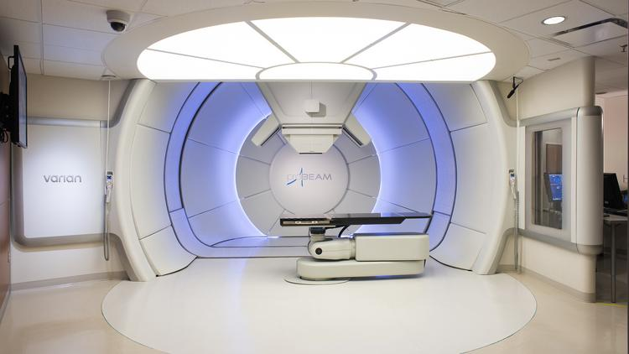
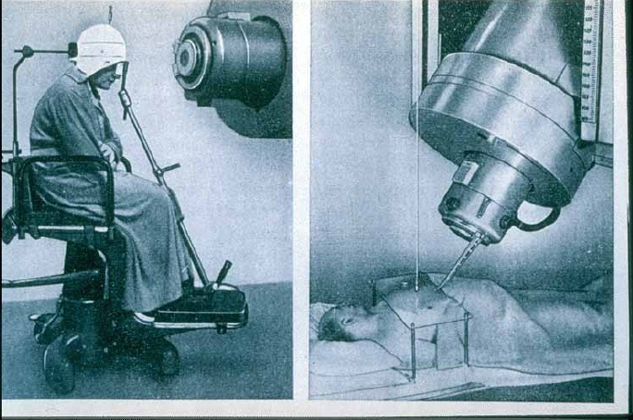
We have come a long way…
1933-37

Slide 15

American Association of Physicists in Medicine
AAPM is a scientific and professional organization, founded in 1958, composed of more than 8000 scientists whose clinical practice is dedicated to ensuring accuracy, safety and quality in the use of radiation in medical procedures such as medical imaging and radiation therapy.
The responsibility of the medical physicist is to assure that the radiation prescribed in imaging and radiation therapy is delivered accurately and safely.
Medical Physicists follow the guidelines developed by AAPM,

Slide 16
AAPM, ICRU, NCRP, ICRP…
Medical Physicists follow the guidelines developed by various professional organizations and federal and state rules and regulations in clinical practice:
  International Commission on Radiation Units & Measurements
  National Council on Radiation Protection and Measurements
  International Commission on Radiological Protection
  AAPM

Slide 17
Industrial Physics – Medical
Transition to Medical Physics from different specialty physics areas
  Graduate program in Medical Physics
  Postdoc or Clinical Residency in Medical Physics
  Commission on Accreditation of Medical Physics Educational Programs (CAMPEP) for clinically oriented carriers
  Experience working in HealthCare

Slide 18
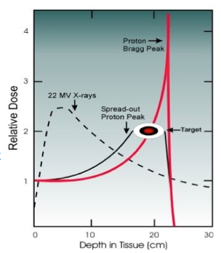
Proton Therapy:
Fundamental Physics
Conventional beam therapy delivers X-ray radiation along entire path through patient, and maximal dose in front of the tumor
Photons interact with matter (tissue) via photoelecric effect, Compton scattering, pair production
Proton beam treatments deliver minimal dose in front of of the tumor, maximum dose to the tumor region, and no dose behind it
Proton ionization energy deposition dE/dx is inversely proportional to the square of the speed of the particle (Bethe-Bloch)

Slide 19
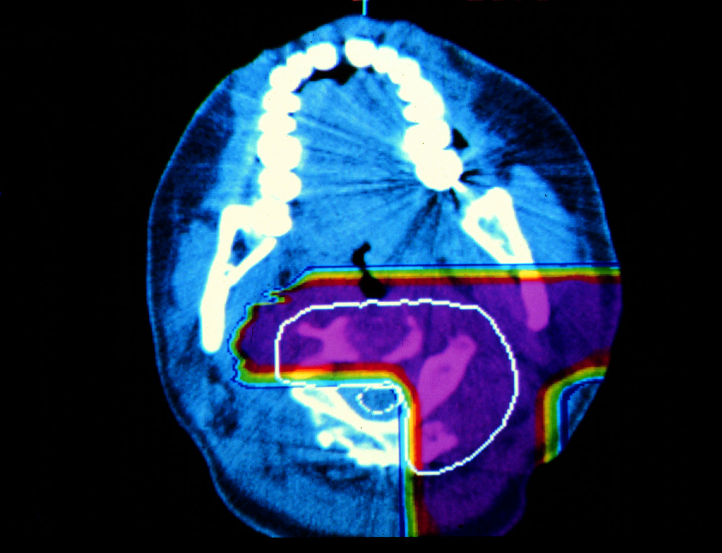

Slide 20
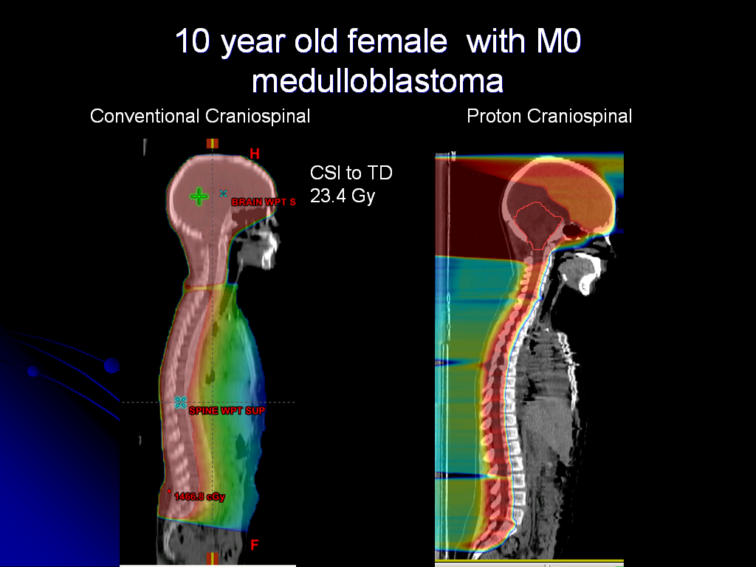

Slide 21
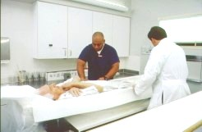
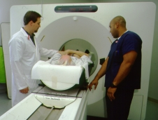
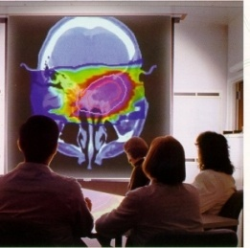
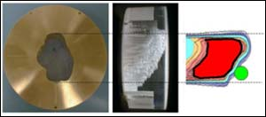
A brief tour…
Patient Setup
Imaging
Planning
4. 4D Customized treatment and QA

Slide 22
Treatment Planning
  Computerized simulation of treatment delivery – dose calculation, and evaluation
  Evaluation tools – DVH
  Robustness - against parameters that you can not control well
  Moving targets
    selection of technique of irradiation
    respiration gating
    Dose calculation algorithms
      Inhomogeneities – Monte Carlo simulations to improve accuracy
      RBE

Slide 23
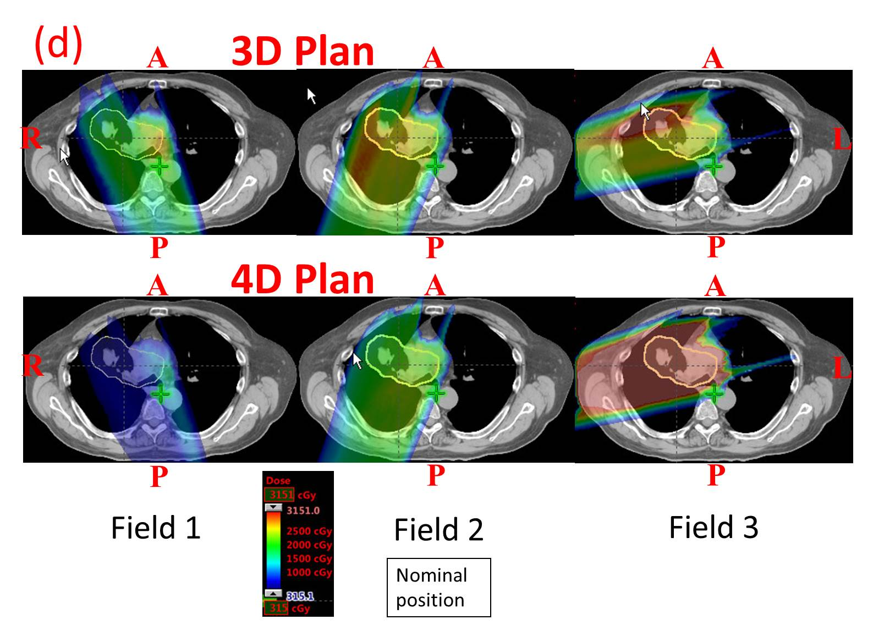
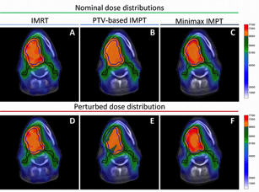
Robustness analysis

Slide 24
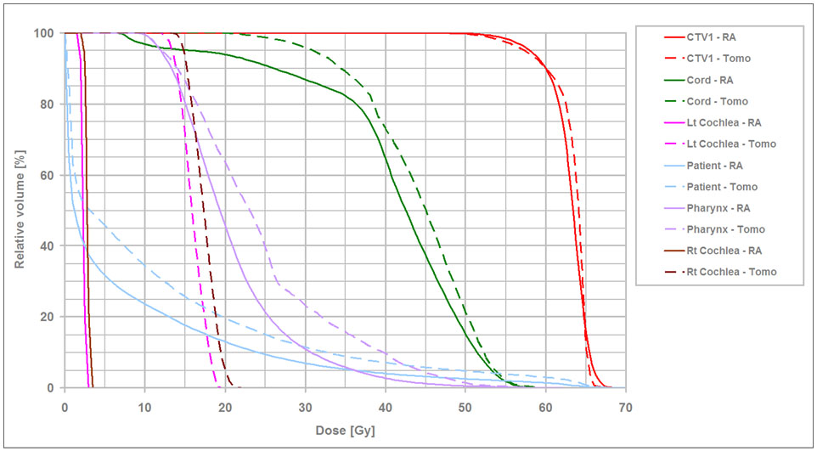
Dose-Volume Histogram
CC BY 3.0, https://en.wikipedia.org/w/index.php?curid=32800049

Slide 25
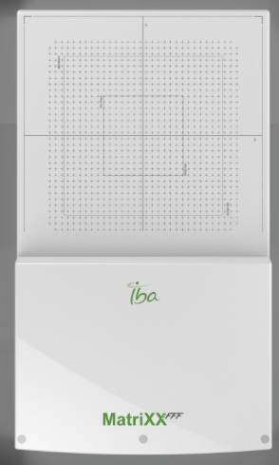
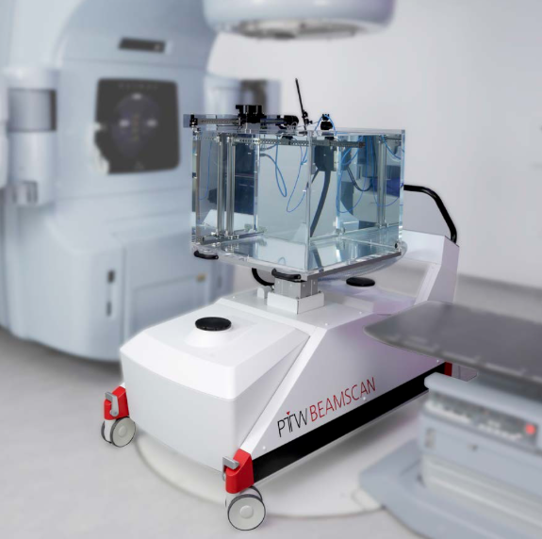
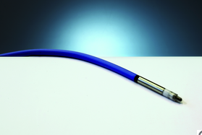
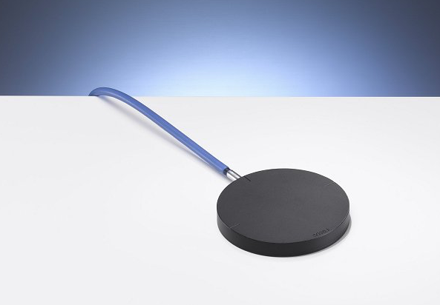
Tools of the trade
Quality assurance phantoms

Slide 26
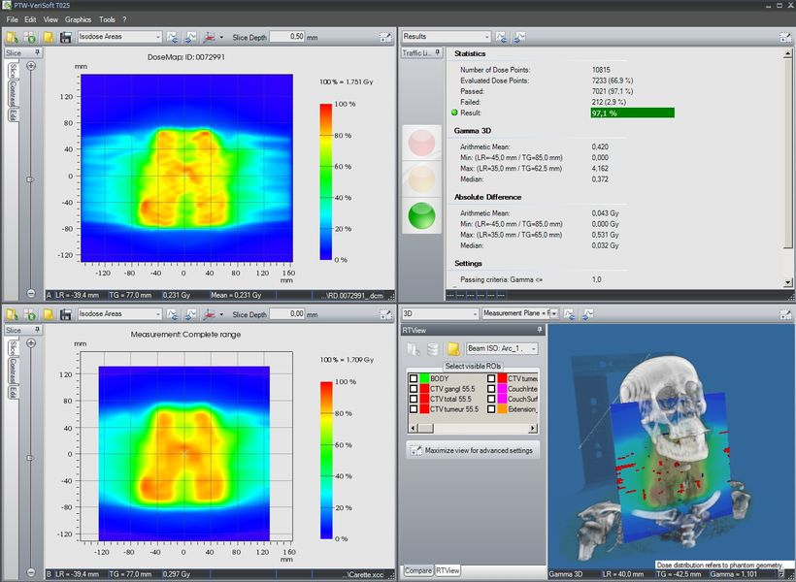
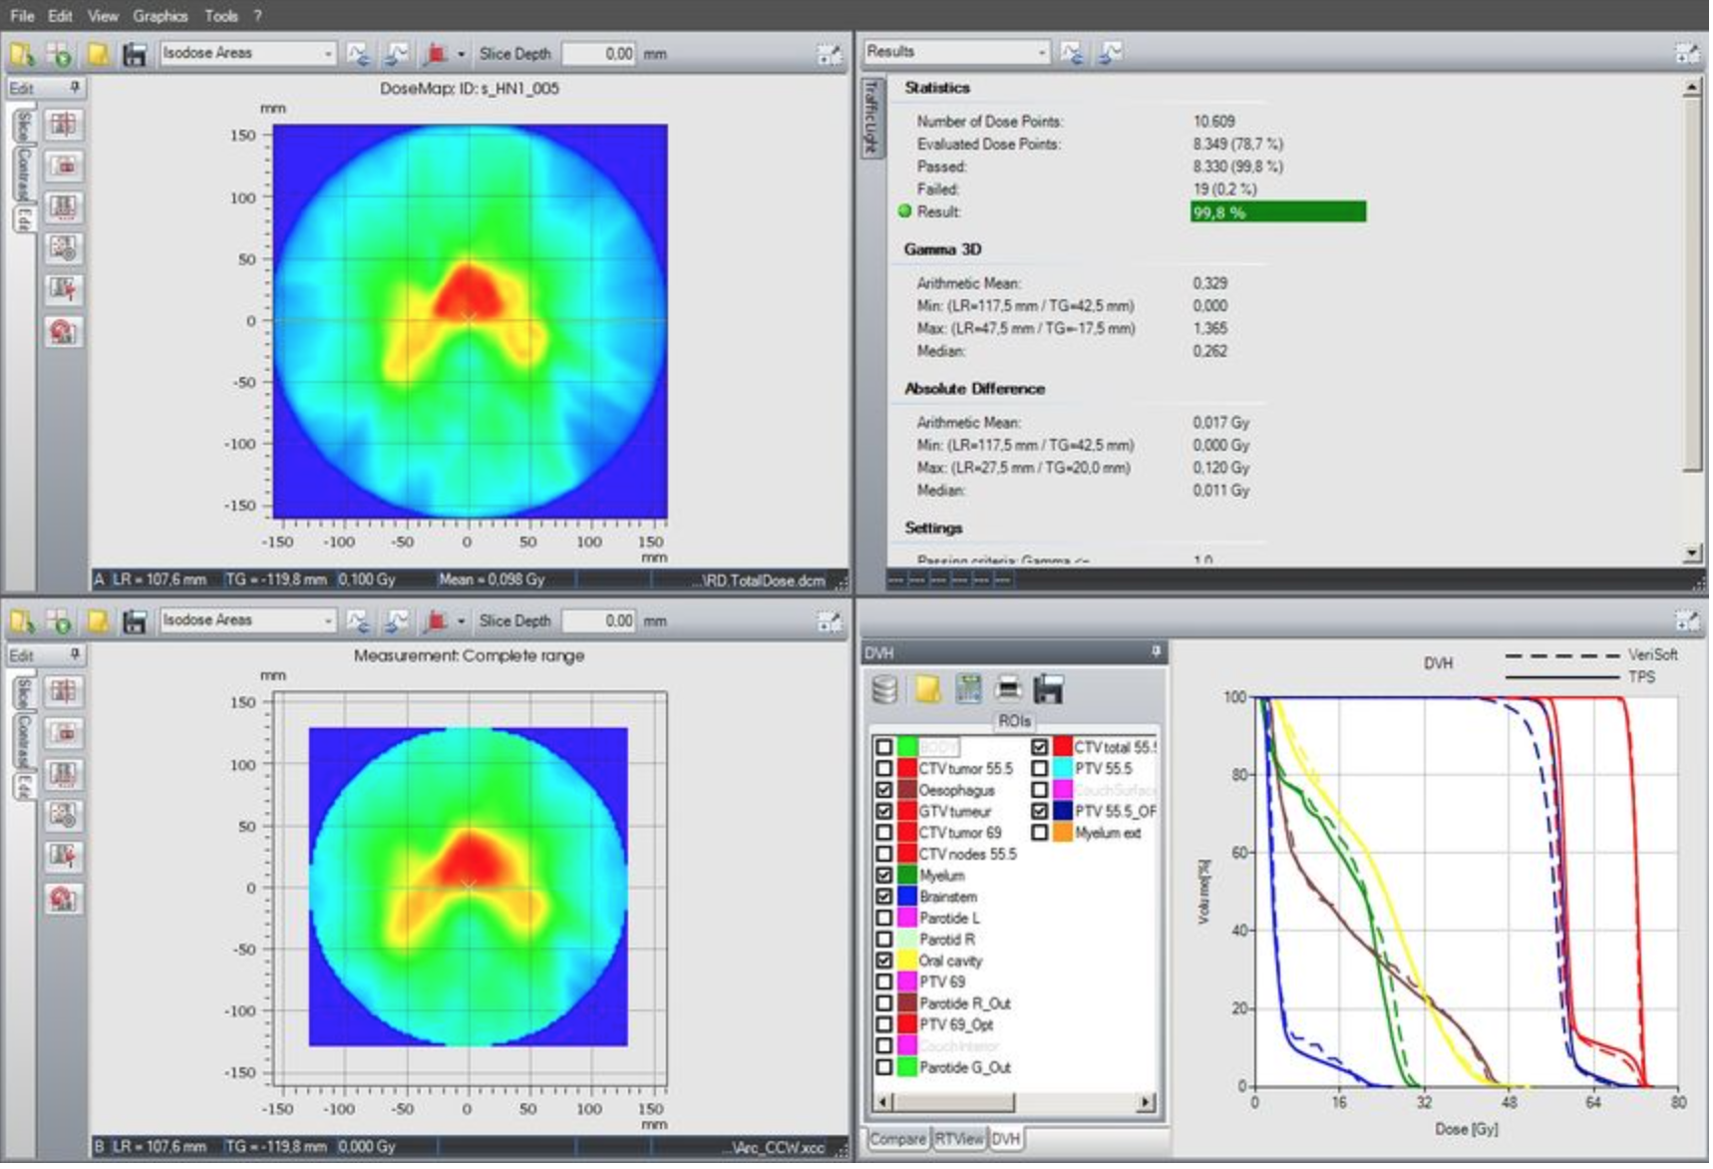
Quality Assurance
  Most commonly done in homogeneous media
    verification plan in water
    Measurements – ion chambers for absolute dose calibration, profile measurements with film, array of chambers
      Example of evaluation criteria – gamma index

Slide 27
A lot of room for improvement
A few examples
  Development of refined MC calculations for proton therapy
  Development Quality assurance tools
    Zebra, Lynx, IC array
      none is well designed for volumetric verification (dosimetric gel),
      none is designed for verification of dose delivery in inhomogeneous media
      tissue equivalent media exist
        Detector/phantom deveppment
Collaboration Opportunities

Slide 28
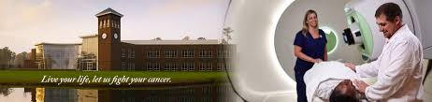
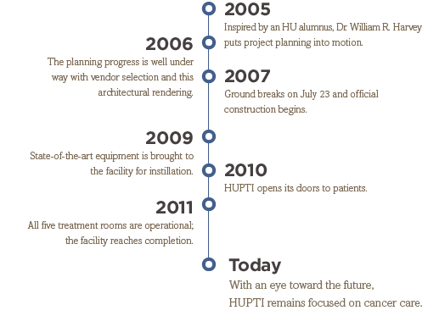
HUPTI is a genuine national resource: a $225M state-of-the-art
cancer treatment facility and the nation’s largest stand-alone proton beam treatment facility.
  Five treatment rooms
  Dedicated Research line
  PET/CT imaging suite
  Most advanced proton therapy technology available

Slide 29

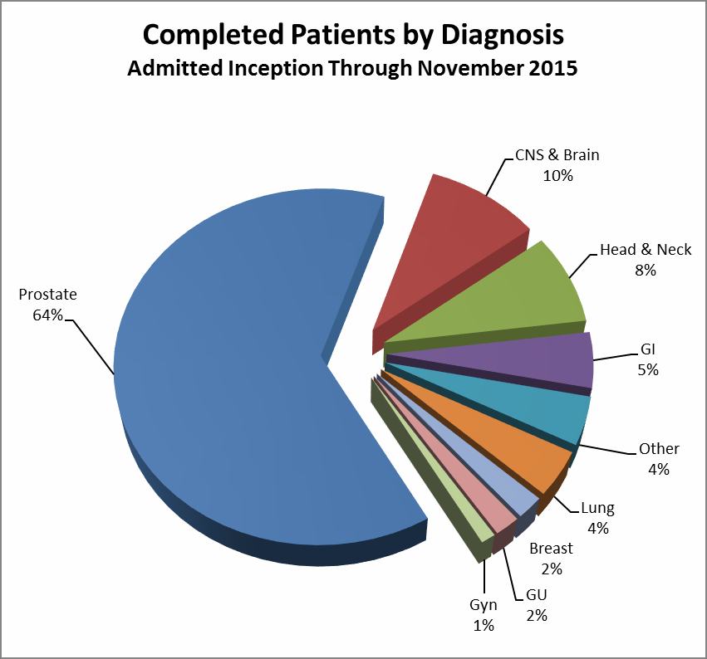
HUPTI IS A UNIQUE RESOURCE IN THE FIGHT AGAINST CANCER
The HUPTI treats a variety of cancer types, including prostate, lung, and breast cancers – all of which are associated with the highest incidence rates in the Commonwealth and nationally.
There is a vast underserved need, and most patients eligible for proton radiotherapy will not be able to receive this treatment. In fact, the Massachusetts General Hospital proton center recently published an article describing the difficulty in making decisions regarding patient selection for proton therapy, given their proton therapy waiting lists.

Slide 30
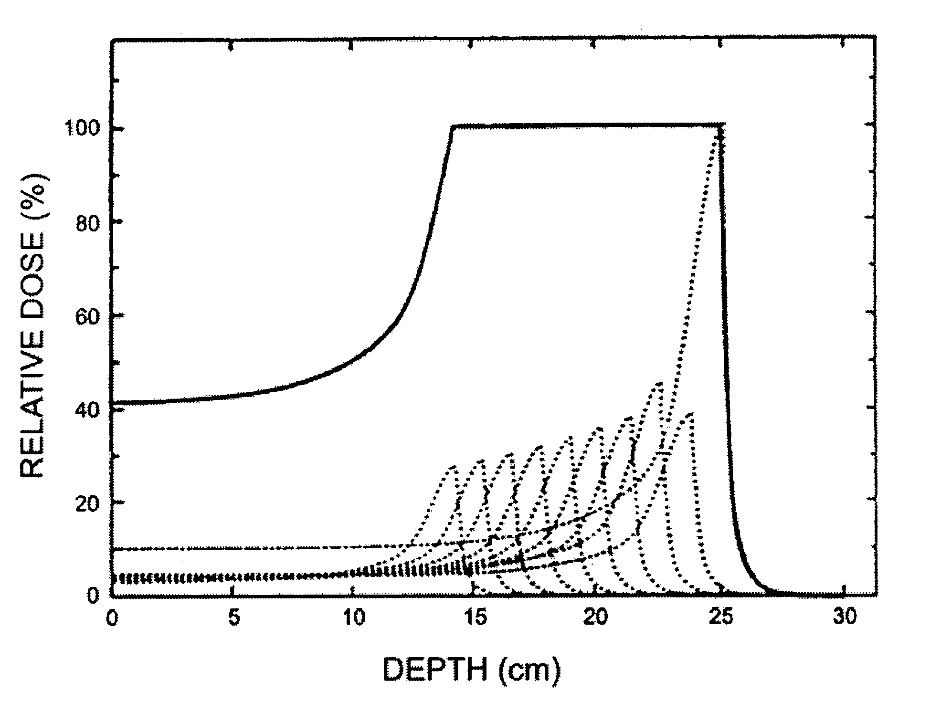
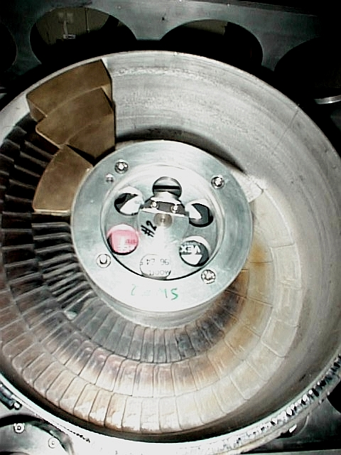
Planning the energies

Slide 31
Proton beam scanning nozzle
Measure
Spot position
Spot size
Number of delivered protons
Helium Chamber to reduce spot size
Snout to hold a range shifter, aperture, ridge filter, etc.

Slide 32
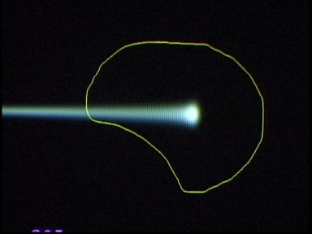
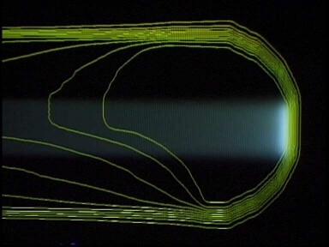
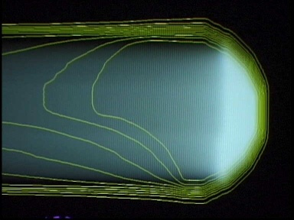
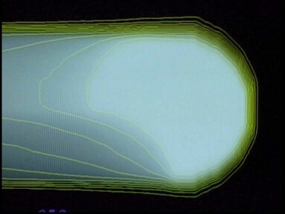
Spot Scanning

Slide 33
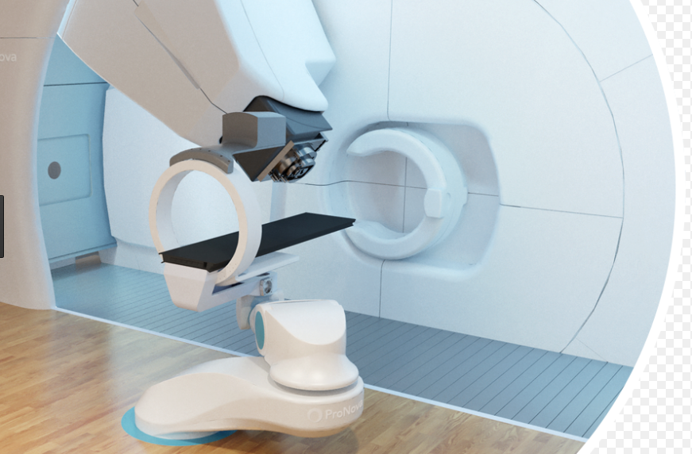
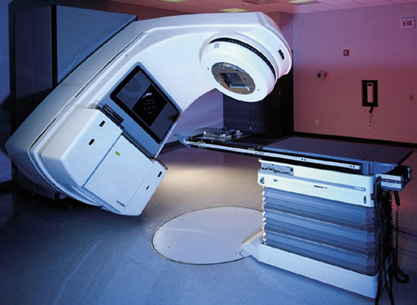
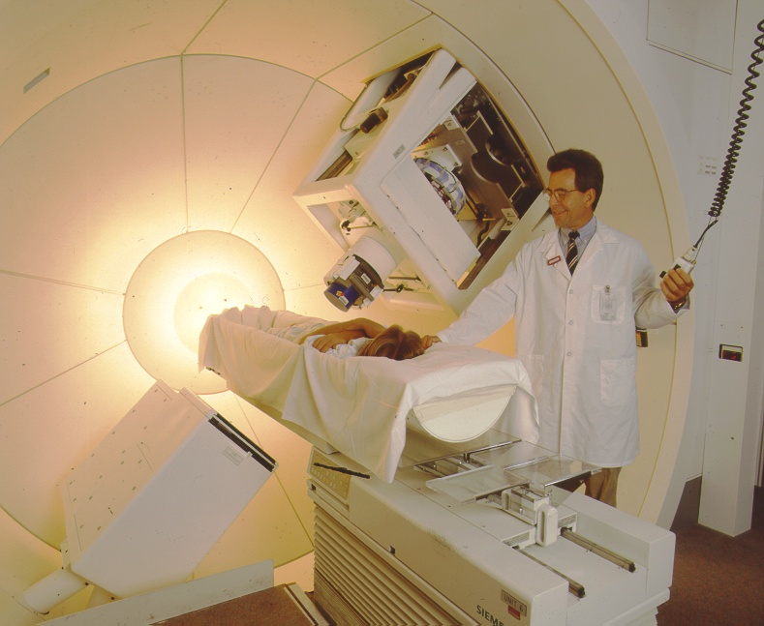
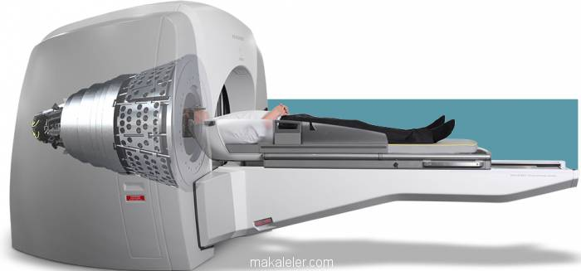
We have come a long way…
1933-37

Slide 34
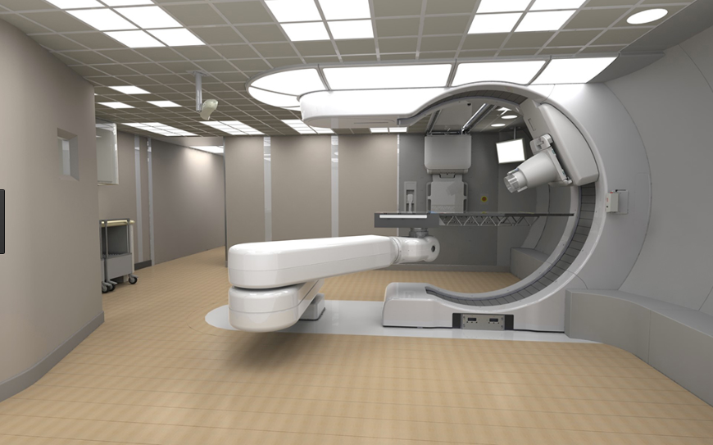
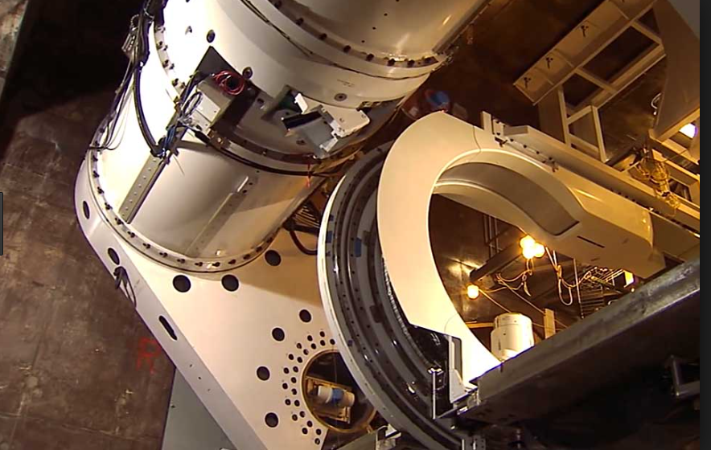
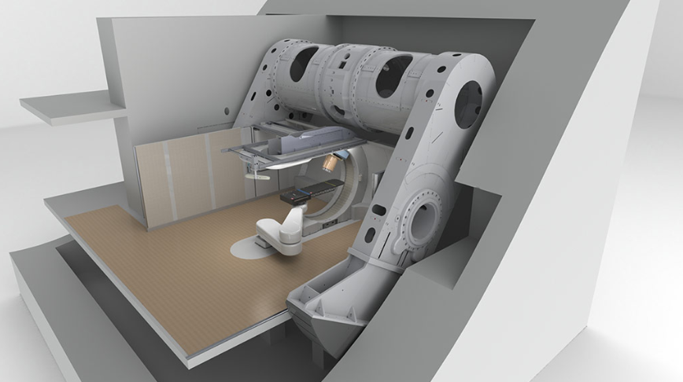
Mevion

Slide 35
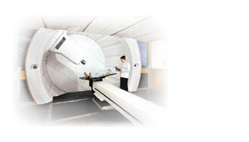
About Proton Therapy
Cancer is the (2nd) largest cause of disease-related death in the USA and other developed nations.
Cure achieved for ~45% of all cancer patients using available therapeutic strategies: chemotherapy (5%), surgery (22%), and radiation treatment (12%, 18% in combination with surgery). changing
Disease is well-localized in 2/3 of patients at time of diagnosis
50% of USA cancer patients receive radiation treatment, most with external beam.

Slide 36
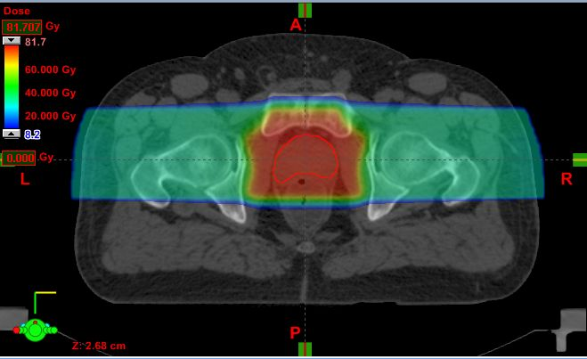
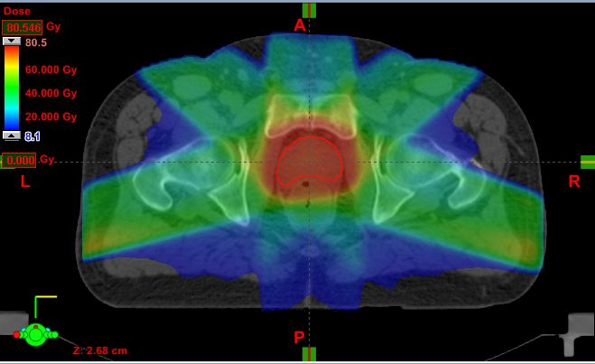

Proton Therapy vs. IMRT
Proton therapy delivers significantly less radiation to the bladder and rectum areas than conventional radiation, reducing likelihood of side effects.

Slide 37
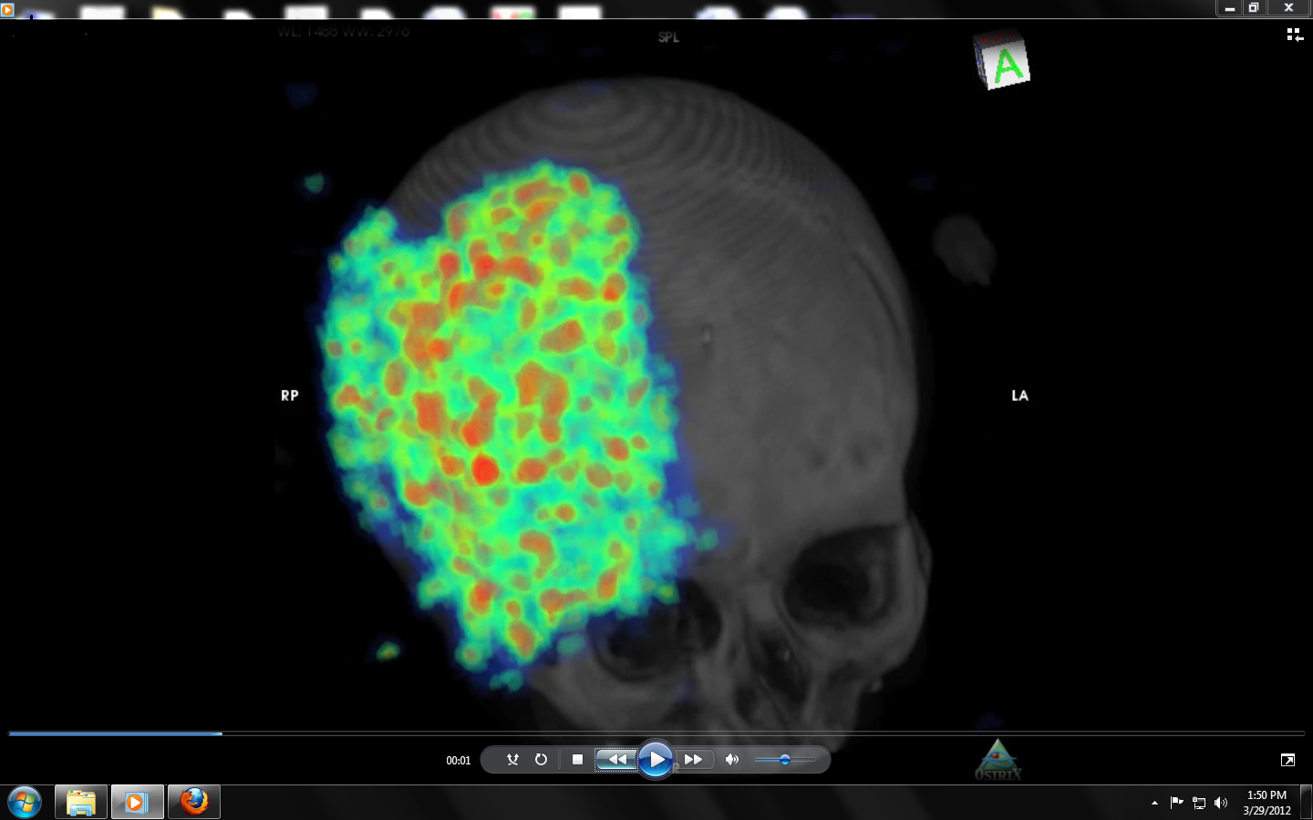
C¹¹ activation

Slide 38
The value of planning - Cure vs. Complications
For x-rays
A reduction of dose by 5% lowers the chances of cure significantly from 65% to 15%
On the other hand an increase of dose by 5% may kill all the cancer but increases the risk of complications from 10% to 80%.

Slide 39
Radiation Therapy
The goal
  deliver lethal doses of radiation to the tumor killing cancer
  minimize or eliminate healthy tissue injury.

Slide 40
Treatment Delivery protons vs. x-rays
150
125
100
75
% ABSORBED DOSE
50
25
0
0
5
10
15
20
25
30
35
DEPTH IN CM

Slide 41

Dose Shaping with Scattering

Slide 42



Patient Setup

Slide 43


Imaging

