Slide 1
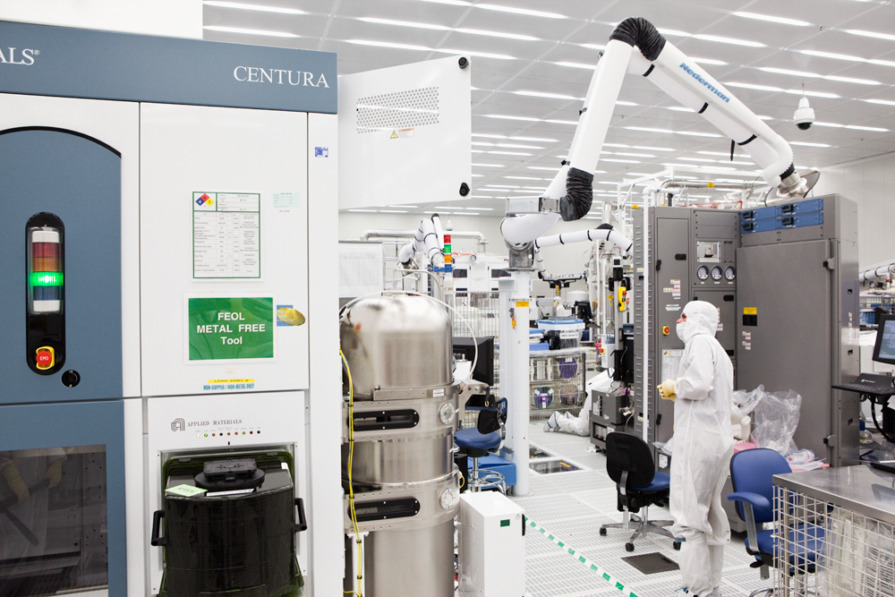
Industrial Careers ---
How to find a great job!
Dr. John Rumble
President
R&R Data Services
Gaithersburg MD
www.randrdata.com
john.rumble@randrdata.com
Notes:
1

Slide 2
Good News - You’re Getting Your PhD!

Slide 3
Good News - You’re Getting Your PhD?
2002 to 2016: 21566 Ph.Ds. total
2002 to 2016:~4200 Faculty hired!
~80% of advanced degree physicists work outside academia!

Slide 4
Ph.D.
Faculty Position
Private Sector - Industry
Post Doc
Nat’l Labs
You have Choices

Slide 5
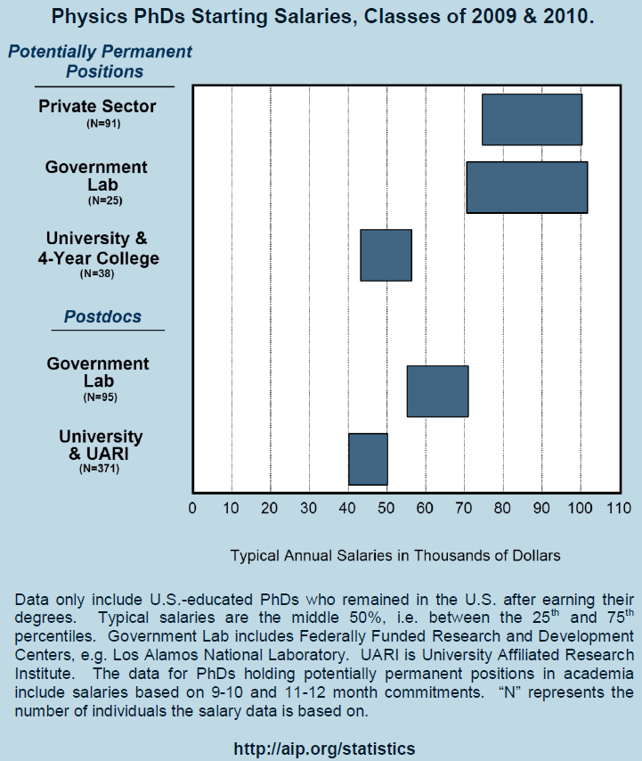
The private sector provides the highest-paying jobs, with a starting salary of $90K+
Typical starting salaries at Universities and 4-year colleges is $50K - $70K
University postdoc position typically offers between $45K - $65K
Private sector offers well-paying jobs to Physics PhDs
30

Slide 6
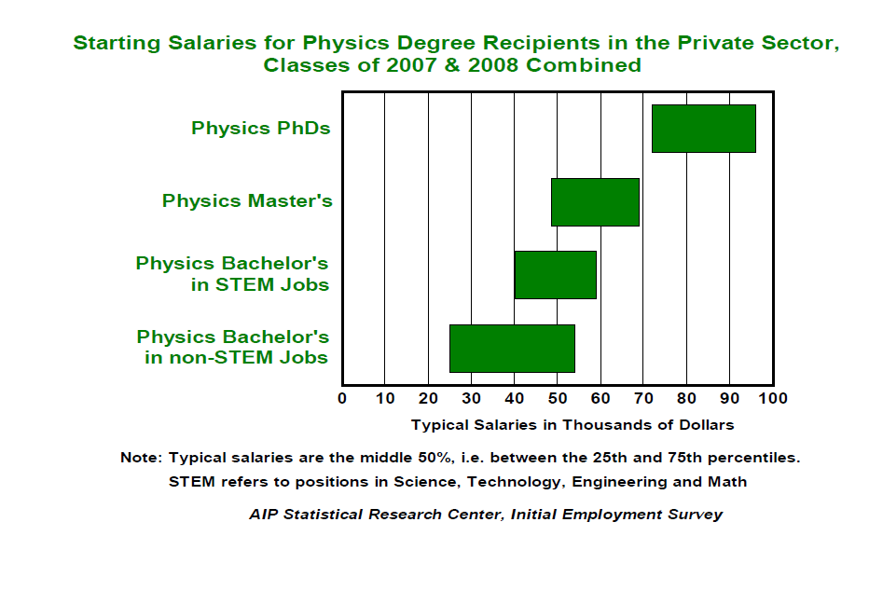
No surprise, the longer you study the higher your starting salary:
Note-
private sector jobs only
A graduate degree in physics degree will open the door to more advanced positions in a variety of technical fields, with higher salaries.
29

Slide 7
So why work in industry?
Advantages
Endless stream of interesting problems
Physicists valued for our approach to solving problems
Lots of smart people to collaborate with
Can usually publish at least some aspects of your work
But typically not a job requirement
Participate in conferences and meet colleagues
Good pay
Challenges
Many topics never understood at fundamentally
Less freedom to pursue your own interests
Work must support the company’s business
Product development is hard
Much more than a new idea and initial demonstration
Must evaluate manufacturability, yield, reliability, cost, etc.

Slide 8
Thoughts on Your Careers
2-5 careers
5-10 jobs
More than one geographical location
It’s an exciting time to be a physicist!
Some information on my career

Slide 9
Career Change
Careers don’t just happen; you create them!
Postdoc Sweden Quantum Chemistry
Graduate School Chemical Physics
Under-graduate Chemistry
Industry Analytical chemist
Postdoc JILA A&M Physics Data
IAEA Vienna A&M Physics Data
HBCP
Nanomaterials Informatics
NIST Division Chief Measurement Services
President CODATA
National Materials Property Data Network
R&R Data President CEO
Technical Expert
Information International Associates (industry) Exec VP
NIST Director Data Programs
NIST Materials Data
Identity (Latino Youth)
APS/ FIAP
Big Data
Editor CODATA Data Science Journal

Slide 10
Pursuing Big Data Successfully!
And why a physicist can do it!!

Slide 11
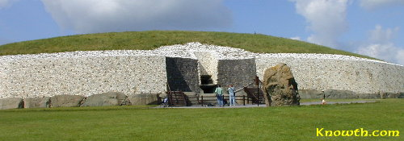
Big Data?
Newgrange – Ireland
6000 years old
Aligned to the rising sun in the winter solstice
Depended on careful observational data on the rising sun
One data point!

Slide 12
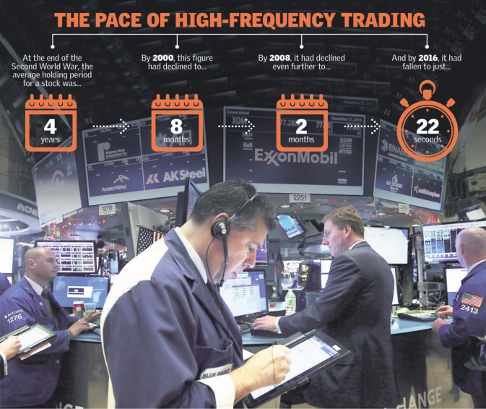
Let’s Make Money on Wall Street
Big Data Solution: When you have a model based on cause and effect, you can exploit it.
Do we make a lot of money at once?
Do we make a little money millions of times?
Think what is success? $$$

Slide 13
Big Data / Data Science
Generating and managing large amounts of data
Veracity
Velocity
Volume
Variety
Sensors, detectors, and models of every type and every speed
Physicists do all these things
Analyzing data quality
Different measurements, different instruments, different parameters
DC Data Science 5000+ members http://www.meetup.com/Data-Science-DC/

Slide 14
What are Big Data Products?
Knowledge
Competitive Advantage
Tools

Slide 15
The Big Data Cycle
Make measurements
Identify possible independent variables/parameters
Convert raw measurements into meaningful quantities
This is what physicists are trained to do
Recognize something to be measured
Isolate the important variables
Make predictions

Slide 16
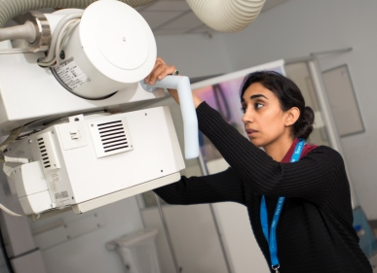
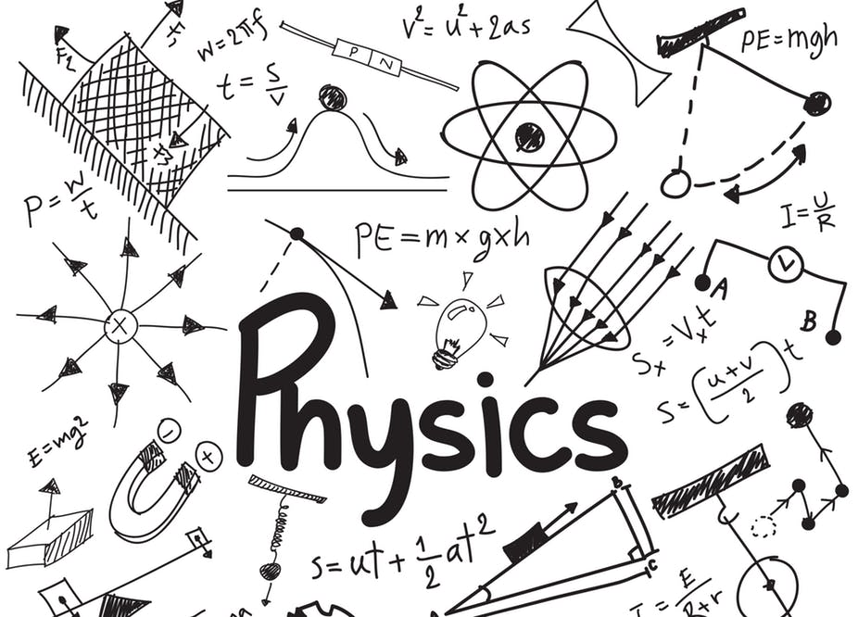
Getting a Job Part II

Slide 17
Job
1 Getting ready
3 Applying
2 Pursuing
4 Convincing
Four-Step Process

Slide 18
Job
1 Getting ready
Networking
Finding
3 Applying
Application letter
References
Interviewing
Follow-up
Resume
2 Pursuing
4 Convincing
Criteria
Informational Interviews
Resume adjustment
Four-Step Process

Slide 19
1 Getting Ready
Criteria
Where do you want to work – industry, post doc, national lab, other
Constraints – location, relationships, urgency, age, other
Scientific area – same, new, exciting, solid, risky
Work environment – team, collaborative, close to boss, lone wolf, size of organization
Other
Resume
Get them ready in advance
Different for industry, lab, post doc
Emphasize accomplishments
Highlight interests
Specify skills
More in a minute

Slide 20
2 Pursuing
Informational interviews
Talk to experts
Find out about careers
Not job interview
Ask for contacts
Much information on web
Finding
Talk to faculty
Join society(s)
Go to meetings (large & small)
Look at ads in subject magazines
Find people whose work you like and contact
Company websites
Search internet (if you must)
Networking
Most important
More in two minutes!

Slide 21
3 Applying
Resume Adjustment
What – adjust my perfect resume !!!!!!!
At least look it over
Post Doc
Do you show a tie to area
Are experimental skills directly relevant
Is modeling experience good
Industry
Do you meet every requirement
Can computer find right words
Application Letter
#1 - Well written
Post doc
3-6 lines
Directly relevant to position
Industry/Nat’l Labs
Can be longer
Why interested
Mention how you meet every requirement
Both
Have someone read critically
Emphasize accomplishments
Re-read !

Slide 22
Physics Today Ad
We seek an enthusiastic physical scientist with significant experience in data science (machine learning, AI, neural networks, or similar technology) for an entry level position in data science; Excellent working environment on exciting projects with well-defined deadlines; great benefits
Reply to
Dr. John Rumble
R&R Data Services
Gaithersburg MD
email

Slide 23
Dear Dr. Rumble
I wish to apply for the position of data scientist at R&R Data Services as advertised in the 18 March 2018 Physics Today.
During my Ph.D. thesis work on nanomaterials at Indiana University, I generated large amounts of data using high-throughput screening techniques. Using advanced machine learning tools, I was able to develop new insights on the relationship of nanoparticle morphology with potential toxicity. As a result, the models I have proposed show significant predictive promise
My enthusiasm for undertaking challenging work in data science together with my demonstrated commitment to completing assignments on time has well prepared for work in your company.
A resume detailing my accomplishments related to data science and other experience is attached.
I would be pleased to discuss this position with you further.

Slide 24
Dear Dr. Rumble
I wish to apply for the position of data scientist at R&R Data Services as advertised in the 18 March 2018 Physics Today.
During my Ph.D. thesis work on nanomaterials at Indiana University, I generated large amounts of data using high-throughput screening techniques. Using advanced machine learning tools, I was able to develop new insights on the relationship of nanoparticle morphology with potential toxicity. As a result, the models I have proposed show significant predictive promise
My enthusiasm for undertaking challenging work in data science together with my demonstrated commitment to completing assignments on time has well prepared for work in your company.
A resume detailing my accomplishments related to data science and other experience is attached.
I would be pleased to further discuss this position with you.

Slide 25
4 Convincing
Interviewing
90-150 second intro
Who you are as scientist
What you have done as scientist
Why you are interested in position
Research professor/organization well
Dress well
No jokes
Have great questions ready
No BS if you don’t know
If dinner/bar, one drink max (wine or beer)
References
Make sure they are good
Remind them of your accomplishments
If you have contact in company, let them know you applied, send copy of letter & resume
Follow-up
Immediate – 24 hours max
Short and sweet
Use formal names

Slide 26
Networking
Network, Network, Network
Rule of three – people remember you after 3 times
Informational interviews
Can be phone
Look on web for type of questions
Conferences
Society(s)
Local chapters
Career centers
Faculty members
Paper authors
Be polite
Be knowledgeable
Always hand out business card
Name, email, phone

Slide 27
Resume
This SELLs you
It needs to be GREAT – not just good!
ACCOMPLISHMENTS, not work
Perfect writing
Pertinent to the position
Can change with each application
This is YOUR opportunity to differentiate YOURSELF from all other Applicants

Slide 28
Han Solo
824 Star Avenue
Galaxy 2
(212) 555-1212
Wishful_thinking@gmail.com
EDUCATION
Physics, Ph.D. University of South Milky Way, Department of Physics and Astronomy—Expected Graduation May 2017, Concentration: Nuclear Physics
Bachelor of Science, Physics, Star Wars College, Class of 2011, magna cum laude
RESEARCH EXPERIENCE
Research Assistant May 2013—Present
University of South Milky Way, Galaxy 2
• Analyze and process data from the CLAS detector using ROOT and C++
• Applied analytical techniques to obtain first-ever estimates of polarization transfer coefficients for K 0 Λ photoproduction
• Attend weekly meetings as a member of the g13 collaboration
• Working to develop a time-of-flight detector
Research Assistant Jun 2009—Sep 2010
Star Wars College, New York, NY
• Worked with the Stars Wars College Ion-Beam Analysis Laboratory to collect and analyze atmospheric aerosols
• Learned how to operate a tandem electrostatic accelerator
• Presented research at American Physical Society and Division of Nuclear Physics
Conferences throughout 2009 and 2010

Slide 29
TEACHING EXPERIENCE
Teaching Assistant Aug 2011—May 2014
University of South Milky Way, Dept. of Physics and Astronomy, Galaxy 2
• Taught and supervised introductory physics laboratories
• Conferred the Physics and Astronomy Graduate Student Teaching Award in May 2014
TECHNICAL SKILLS
Languages & Software:
— LATEX, C++ , ROOT, R, Mathematica; Windows, Mac OS X, Linux; Git, Apple iWork, Microsoft Office;
AWARDS
• Physics and Astronomy Graduate Student Teaching Award, 2014
• Poster Presentation Winner, University of South Milky Way Graduate Student Day, Apr 2015
INTERESTS
University of South Milky Way Billiards Champion, 2013-2017
Tutor, Science and Math, Galaxy 2 Middle School, 2014 to 2016

Slide 30
Han Solo
824 Star Avenue
Galaxy 2
(212) 555-1212
Wishful_thinking@gmail.com
EDUCATION
Physics, Ph.D. University of South Milky Way, Department of Physics and Astronomy—Expected Graduation May 2017, Concentration: Nuclear Physics
Bachelor of Science, Physics, Star Wars College, Class of 2011, magna cum laude
RESEARCH EXPERIENCE
Research Assistant May 2013—Present
University of South Milky Way, Galaxy 2
• Analyze and process data from the CLAS detector using ROOT and C++
• Applied analytical techniques to obtain first-ever estimates of polarization transfer coefficients for K 0 Λ photoproduction
• Attend weekly meetings as a member of the g13 collaboration
• Working to develop a time-of-flight detector
Research Assistant Jun 2009—Sep 2010
Star Wars College, New York, NY
• Worked with the Stars Wars College Ion-Beam Analysis Laboratory to collect and analyze atmospheric aerosols
• Learned how to operate a tandem electrostatic accelerator
• Presented research at American Physical Society and Division of Nuclear Physics
Conferences throughout 2009 and 2010
Why start with education

Slide 31
Hans Solo
824 Star Avenue
Galaxy 2
(212) 555-1212
Wishful_thinking@gmail.com
EDUCATION
Physics, Ph.D. University of South Milky Way, Department of Physics and Astronomy—Expected Graduation May 2017, Concentration: Nuclear Physics
Bachelor of Science, Physics, Star Wars College, Class of 2011, magna cum laude
RESEARCH EXPERIENCE
Research Assistant May 2013—Present
University of South Milky Way, Galaxy 2
• Analyze and process data from the CLAS detector using ROOT and C++
• Applied analytical techniques to obtain first-ever estimates of polarization transfer coefficients for K 0 Λ photoproduction
• Attend weekly meetings as a member of the g13 collaboration
• Working to develop a time-of-flight detector
Research Assistant Jun 2009—Sep 2010
Star Wars College, New York, NY
• Worked with the Stars Wars College Ion-Beam Analysis Laboratory to collect and analyze atmospheric aerosols
• Learned how to operate a tandem electrostatic accelerator
• Presented research at American Physical Society and Division of Nuclear Physics
Conferences throughout 2009 and 2010
Why start with education
What did you accomplish? Why does “attending” meetings make you attractive. Working – are you going to succeed?

Slide 32
Hans Solo
824 Star Avenue
Galaxy 2
(212) 555-1212
Wishful_thinking@gmail.com
EDUCATION
Physics, Ph.D. University of South Milky Way, Department of Physics and Astronomy—Expected Graduation May 2017, Concentration: Nuclear Physics
Bachelor of Science, Physics, Star Wars College, Class of 2011, magna cum laude
RESEARCH EXPERIENCE
Research Assistant May 2013—Present
University of South Milky Way, Galaxy 2
• Analyze and process data from the CLAS detector using ROOT and C++
• Applied analytical techniques to obtain first-ever estimates of polarization transfer coefficients for K 0 Λ photoproduction
• Attend weekly meetings as a member of the g13 collaboration
• Working to develop a time-of-flight detector
Research Assistant Jun 2009—Sep 2010
Star Wars College, New York, NY
• Worked with the Stars Wars College Ion-Beam Analysis Laboratory to collect and analyze atmospheric aerosols
• Learned how to operate a tandem electrostatic accelerator
• Presented research at American Physical Society and Division of Nuclear Physics
Conferences throughout 2009 and 2010
Why start with education
What did you accomplish? Why does “attending” meetings make you attractive. Working – are you going to succeed?
Did you just put buttons? Did you accomplish anything?

Slide 33
TEACHING EXPERIENCE
Teaching Assistant Aug 2011—May 2014
University of South Milky Way, Dept. of Physics and Astronomy, Galaxy 2
• Taught and supervised introductory physics laboratories
• Conferred the Physics and Astronomy Graduate Student Teaching Award in May 2014
TECHNICAL SKILLS
Languages & Software:
— LATEX, C++ , ROOT, R, Mathematica; Windows, Mac OS X, Linux; Git, Apple iWork, Microsoft Office;
AWARDS
• Physics and Astronomy Graduate Student Teaching Award, 2014
• Poster Presentation Winner, University of South Milky Way Graduate Student Day, Apr 2015
INTERESTS
University of South Milky Way Billiards Champion, 2013-2017
Tutor, Science and Math, Galaxy 2 Middle School, 2014 to 2016
Han did not confer it; he received it !!
Office? Even my 94-year old mother-in-law knew Office !!
Why are these in italics?
You have to be kidding me!

Slide 34
Han Solo
824 Star Avenue
Galaxy 2
(212) 555-1212
Wishful_thinking@gmail.com
An experimental physicist with broad training in modern instrumentation and current data analysis technology
RESEARCH EXPERIENCE
Research Assistant – Experimental Nuclear Physics May 2013—Present
University of South Milky Way, Galaxy 2
Accomplishments
Obtained first-ever estimates of polarization transfer coefficients for K 0 Λ photoproduction using advanced analysis techniques
Designed novel time-of-flight detector and in process of completing its construction
Analyzed and processed key data from the CLAS detector using ROOT and C++
Became valued member of the g13 collaboration starting as junior member
Research Assistant - Ion-Beam Analysis Laboratory Jun 2009—Sep 2010
Star Wars College, New York, NY
Collected and analyzed atmospheric aerosols
Developed more efficient procedures for operating a tandem electrostatic accelerator

Slide 35
Accomplishment is something
New
Innovative
Saves money
Saves time
Han Solo
824 Star Avenue
Galaxy 2
(212) 555-1212
Wishful_thinking@gmail.com
An experimental physicist with broad training in modern instrumentation and current data analysis technology
RESEARCH EXPERIENCE
Research Assistant – Experimental Nuclear Physics May 2013—Present
University of South Milky Way, Galaxy 2
Accomplishments
Obtained first-ever estimates of polarization transfer coefficients for K 0 Λ photoproduction using advanced analysis techniques
Designed novel time-of-flight detector and in process of completing its construction
Analyzed and processed key data from the CLAS detector using ROOT and C++
Became valued member of the g13 collaboration starting as junior member
Research Assistant - Ion-Beam Analysis Laboratory Jun 2009—Sep 2010
Star Wars College, New York, NY
Collected and analyzed atmospheric aerosols
Developed more efficient procedures for operating a tandem electrostatic accelerator

Slide 36
Nobody cares
TEACHING EXPERIENCE
Teaching Assistant – Dept. of Physics and Astronomy Aug 2011—May 2014
University of South Milky Way, Galaxy 2
EDUCATION
Physics, Ph.D. , University of South Milky Way, Department of Physics and Astronomy—Expected Graduation May 2017, Concentration: Nuclear Physics, Advisor: John Rumble
Bachelor of Science, Physics, Star Wars College, Class of 2011, Magna cum laude
TECHNICAL SKILLS
Languages & Software:
LATEX, C++, ROOT, R, Mathematica
AWARDS
• Physics and Astronomy Graduate Student Teaching Award, 2014
• Poster Presentation Winner, University of South Milky Way Day, Apr 2015
ACTIVITIES
Tutor, Science and Math, Galaxy 2 Middle School, 2014 to 2016
Advisor is important, especially for post doc
Italics are correct
Only important stuff, not sure about Latex
Don’t hide what’s cool with junk

Slide 37
Resume – Post Doc Position
One page of experience
Second page of publications and talks
You can explain them if you wish – short and to the point
Lead with those you are first author
Effect of Electron Correlation in the Target Wavefunction on Electron-Molecule Scattering (with W. J. Stevens and D. G. Truhlar). Journal of Physics B: Atomic and Molecular Physics 17, 3151-3157 (1984).
This work explored the sensitivity of calculated cross-sections for low-energy e-N₂ elastic scattering to target wavefunctions quality. Results indicated low quality wavefunctions poorly represented N₂ scattering potentials.

Slide 38
Job
1 Getting ready
Networking
Finding
3 Applying
Application letter
References
Interviewing
Follow-up
Resume
2 Pursuing
4 Convincing
Criteria
Informational Interviews
Resume adjustment
Four-Step Process

Slide 39
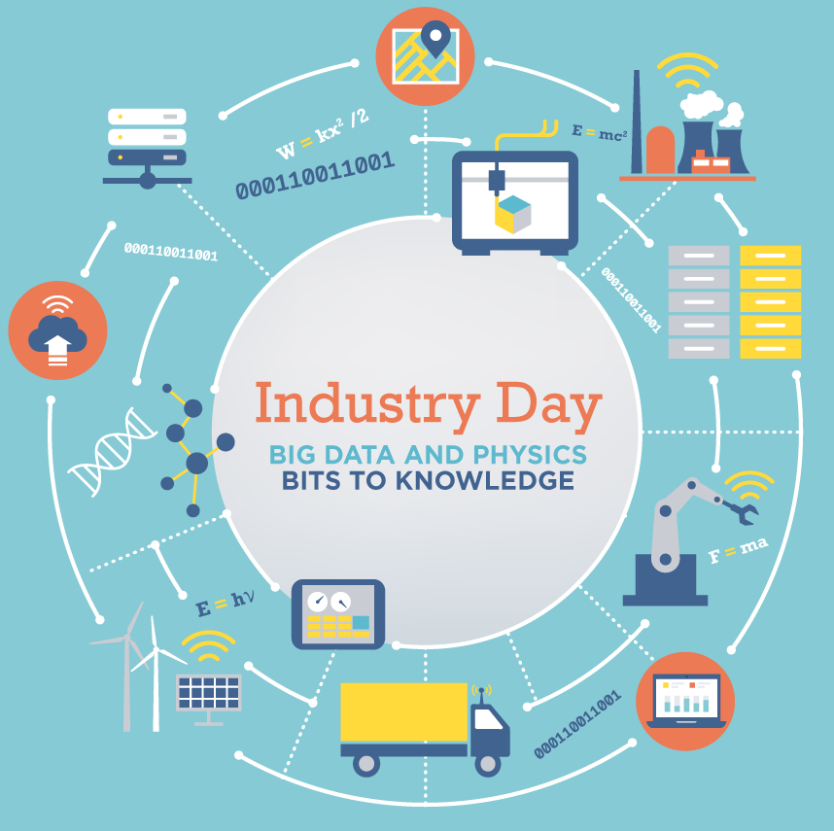
Join American Physical Society APS
Natural home for physicists
Inexpensive for students and post-docs
Forum on Industrial and Applied Physics (FIAP)
for people interested in physics in industry, Nat’l Labs, including entrepreneurs
Organizes Industry Day at APS March Meeting
Participates in many career events at APS meetings
Also note APS Forum on Graduate Student
Affairs (FGSA) & Forum for Early Career
Scientists (FECS)
Useful contacts, information,
and networking

Slide 40
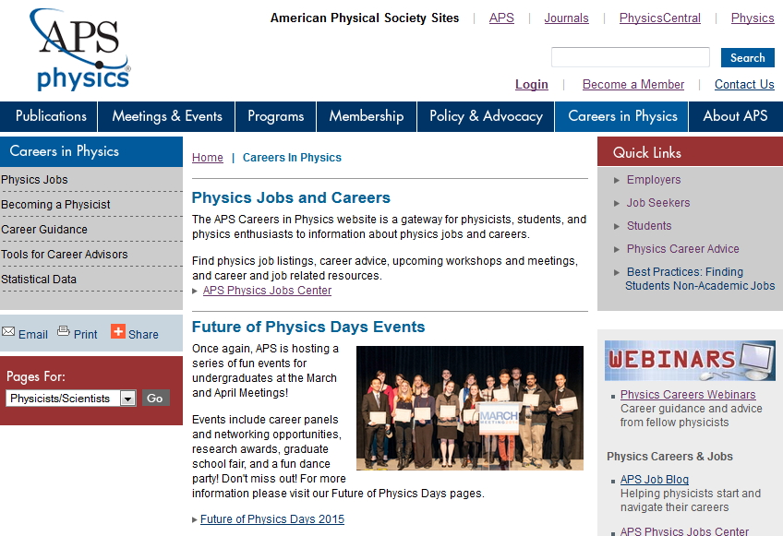
APS Careers Website
Library of Physicist Profiles
Advice from physicists representing a diversity of degree paths and careers
Job Prospects Pages
Profiles feature the most common career paths for physicists.
Include descriptions of day to day activities, additional skills and training needed, salary information, job outlooks, and links to other relevant resources
Physics Employment and Salary Information
Clearing house for most recent physics employment data from AIP SRC
Thumbnails and links to full reports for more information
APS Webinars Archive
On-demand viewing for all webinar presentations
32

Slide 41
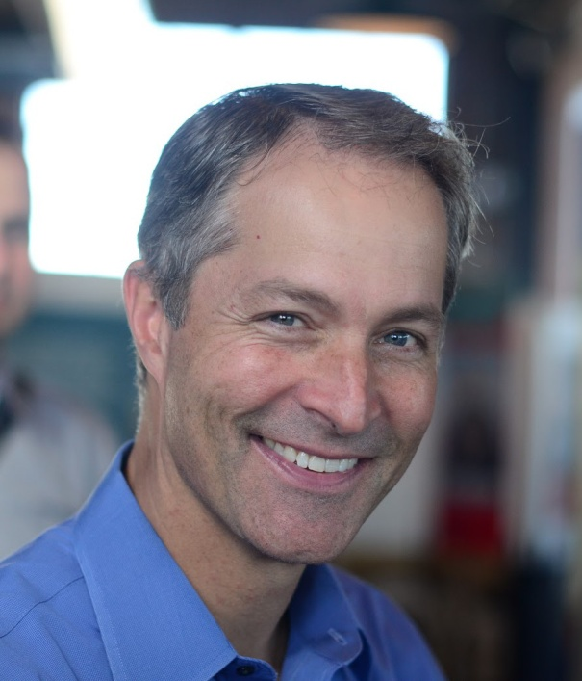
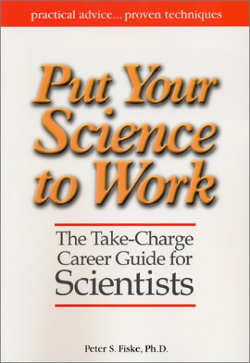
Watch This Webinar
Putting your Science to Work with celebrated author and science career coach Peter Fiske
Based off of Peter’s popular career workshop at APS March Annual Meetings
Webinar covers career planning, interviewing, building your network, and more!
Archived and freely available to APS members
Not an APS member? 1st year free for students After that annual fee $25 undergrad, $39 graduate
http://go.aps.org/apswebinars

Slide 42
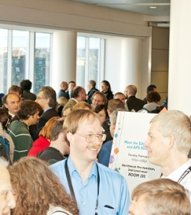
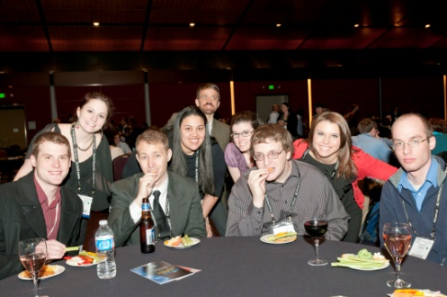
Panels and Networking Opportunities at APS Meetings
Career Workshops
Recruiting by many companies
Graduate Student “Lunch with the Experts”
Career Panel and Networking Reception
Shared database (Physics Today, IEEE Computing, AVS, and others)
Hundreds of jobs available on the site right now.
Job Seekers can:
Search for jobs on the Job Center (totally free).
Store your resume, cover letters, and other materials in your profile on the site.
Apply for positions directly through the Job Center.

Slide 43
APS mentoring program called IMPact
Easy to sign up. Must be an APS member
Suggest four conversations over three months
https://impact.aps.org
Industrial Physicists and Entrepreneurs
Grad Students and Early Career Physicists

Slide 44
Final Thoughts
Earning a physics degree opens the door to a wide range of job opportunities
Finding the right job for you is a well-defined process, but requires work
Working in industry has significant advantages
Many interesting problems
Lots of outstanding colleagues
Excellent salary
APS has many career resources to help you through the process of finding a job

