Slide 1
“Life of a Physicist at NASA”
33rd Annual Hampton University Graduate Studies (HUGS) Program at Jefferson Labs
Career Workshop
June 11, 2018
Julie Williams-Byrd
NASA Langley Research Center

Slide 2
Outline
Hampton University
My First Job - Electro-Optics Engineer
Senior Systems Analyst
Deputy Chief Technologist
Acting Chief Technologist
Advocating STEM Careers
Work Life Balance
Summary - Benefits of a Physics degree

Slide 3
Career Opportunities
After graduating from Hampton University, I started working at NASA Langley Research Center in Hampton and I’ve been there ever since.
I’ve had several opportunities to pursue meaningful and rewarding positions at NASA.

Slide 4


Hampton University
B.S and M.S. degrees in Physics from Hampton University.
Graduate degree was funded through NASA Langley Research Center
Graduate work directly related to work going on at NASA
While obtaining graduate degree, NASA started a solid-state laser research and development branch
NASA approached me asked if I would like to work there and I said “Of Course!!”

Slide 5
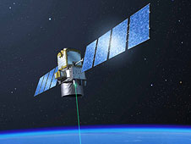
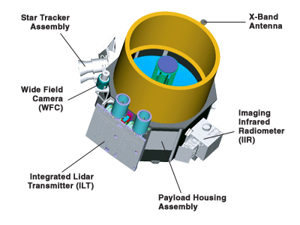
Electro-Optics Engineer
The first opportunity involved research and development of solid-state lasers for Lidar systems to be used for remote sensing of the atmosphere.
I’ve performed laboratory research along with developing lasers for Lidar systems that are currently taking data.
I developed a laser for a Lidar instrument that has flown on the shuttle and I’ve also designed and built a laser system that is part of a Lidar on the CALIPSO satellite.
CALIPSO is a suite of instruments flying about 400km up in space taking data that assist scientist in determining climate, air quality and weather.
CALIPSO uses a laser technique called lidar to provide data on the thickness and composition of clouds and aerosol layers and the altitudes at which they reside
CALIPSO’s Suite of Instruments

Slide 6
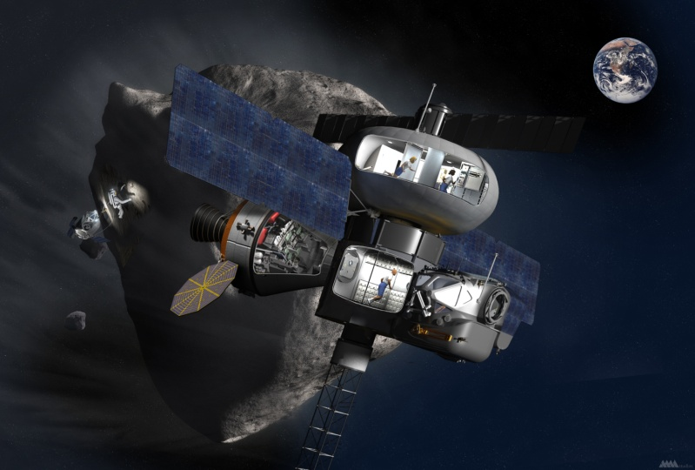
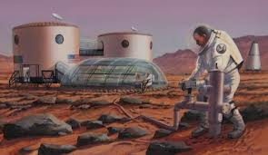
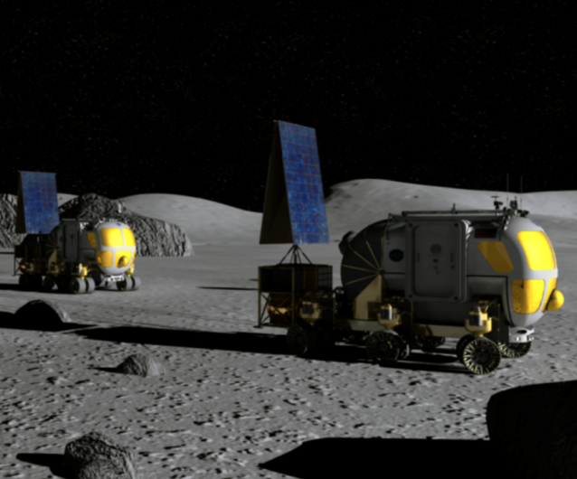
Senior Systems Analyst
Lead for the Capability and Technology Assessment and Integration team. This team has performed systems analysis, assessment, integration and prioritization of systems, capabilities and technologies for NASA’s human exploration mission studies.
That is kind of a generic term, but what it means is I use certain modeling and analysis tools to analyze advanced concepts and systems for space exploration.
I also use systems analysis tools to assess technologies that enable human spaceflight exploration missions.

Slide 7
Opportunity
Deputy Chief Technologist – Office of Chief Technologist
  NASA Langley Research Center Office of Director
    Opportunity to advocate innovation
  Headquarter Office of Chief Technologist
    Provide system, capability and technology data to decision-makers that assist with addressing NASA initiatives and strategic challenges

Slide 8
Newest Opportunity
Acting Chief Technologist – Office of Chief Technologist
  Langley Research Center Office of Director
    Opportunity to advocate innovation
    Direct early stage technology development investments
      Advise Center Director regarding early stage technology development efforts
  Headquarter Office of Chief Technologist
    Provide data to decision-makers that assist with addressing NASA initiatives and strategic challenges

Slide 9

Advocating STEM Careers
Committed and dedicated to encouraging young scientist and engineers to pursue STEM careers
  Through mentoring opportunities
  Performing community outreach activities
  Encouraging and championing young people to pursue careers in math, science, technology and engineering.
Featured on the NASA Modern Figures and Woman of NASA (WON) websites.

Slide 10
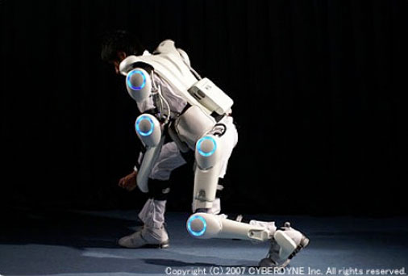
What I Like Best
Working with technically excellent people who are dedicated to pursuing NASA’s goals and objectives
Utilizing Physics training to solve problems
Advocating STEM careers

Slide 11
Work Life Balance
I am married and have two sons.
I enjoy spending time with family and friends. My favorite hobbies include reading mystery novels, running and Zumba.

Slide 12
Benefits of a Physics Degree
A Physics degree can lead you to a variety of opportunities.
Don’t limit yourself or wait until you are an expert
Have confidence in your ability and your degree
Take on an opportunity with confidence and courage
Incorporate your technical excellence with soft skills

Slide 13
Questions
Questions?

