Slide 1
National Security Technologies, LLC and the Nevada Test Site
A. C. Hollins, Jr., Director
Operations and Infrastructure
May 13, 2008
This work was done by National Security Technologies, LLC, under Contract No. DE-AC52-06NA25946
with the U.S. Department of Energy.

Slide 2
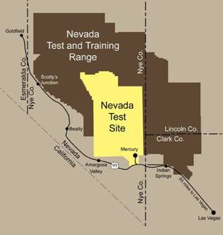
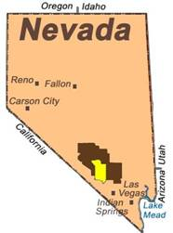
The Nevada Test Site
1,375 square-mile outdoor laboratory/national experimental center
65 miles northwest of Las Vegas
Larger than Rhode Island
Buffered on all sides by federal lands
Utilities and infrastructure comprise support for a small city
502 miles of power transmission lines
174 substations
3 public water systems
10 septic systems
3 landfills
340 miles of paved roads
300 miles of unpaved roads

Slide 3
NSTec Parent Companies and Partnerships
DOE/NV/25946--464

Slide 4
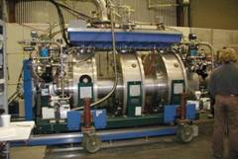
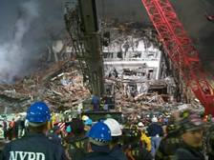
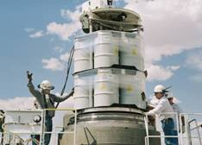
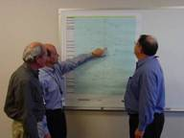
NSTec’s Mission
DOE/NV/25946--464
Our Vision
The NTS is the nation’s preferred location for conducting high-hazard national security missions in a safe, secure, and environmentally sound manner.
Our Mission
The mission of NSTec is to provide innovative solutions to enhance national security through the management and operations of the NTS and its associated facilities.
Our Core Mission Areas:
Stockpile Stewardship
National Security Missions
Environmental Management
Mission success demands we execute these missions safely and efficiently by establishing five supporting missions:
Reliable and Responsive Infrastructure
Project Management Excellence
Efficient Processes
Human Capital Excellence
Mutually Beneficial Partnerships

Slide 5
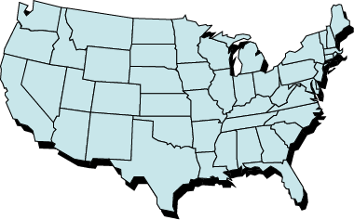
NSTec Operations and Locations
DOE/NV/25946--464
Livermore Operations, Livermore, CA
Special Technologies Laboratory, Santa Barbara, CA
★
★
★
Remote Sensing Laboratory, Andrews Air Force Base, MD
★
★
★
Nevada Test Site, Mercury, NV
Remote Sensing Laboratory, Nellis Air Force Base, NV
North Las Vegas
Facility North Las Vegas, NV
Los Alamos Operations, Los Alamos, NM
NSTec employs approximately 3000 individuals
2157 employees
734 union crafts

Slide 6
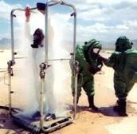
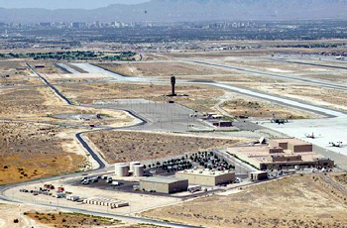
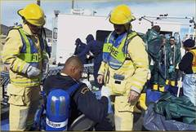
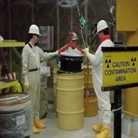
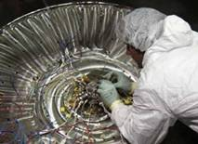
NSTec Direct Funding ($M)
DOE/NV/25946--464
Operations and Infrastructure
WFO
Note: NSR & WFO = National
Security Missions
National Security Response (NSR)
Defense Experimentation and Stockpile Stewardship
Environmental
Management

Slide 7
NSTec Organization Structure
DOE/NV/25946--464
PRESIDENT
CHIEF OPERATING OFFICER
ASSISTANT TO THE PRESIDENT FOR PERFORMANCE ASSURANCE
Critical Experiments Facility
Central Project Office
Defense Experimentation
& Stockpile Stewardship
Environmental Management
Executive Services
General Counsel
Chief of Staff
Counterintelligence
Human Resource Programs
Internal Audit
Occupational Medicine
Public Affairs & Community Relations
Safeguards & Security
Homeland Security
& Defense Applications
Operations & Infrastructure
Project Management
Business Operations & CFO
Mission Support Services
Environment, Safety, Health
& Quality

Slide 8
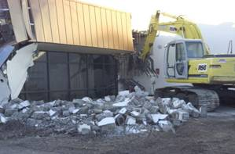
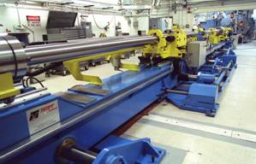
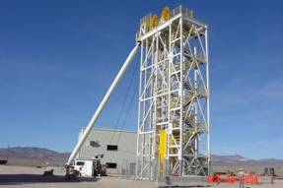
Defense Experimentation & Stockpile Stewardship
DOE/NV/25946--464
The Defense Experimentation and Stockpile Stewardship (DESS) Directorate is designed to ensure the safety, security, and reliability of our nation’s nuclear weapons stockpile in order to meet the security needs of the 21st century.
To maintain reliability, we conduct complex and high-risk tests or defense experiments. These experiments are accomplished with special nuclear materials and high explosives. Because experiments are performed without nuclear detonation, they are called sub critical experiments.
Our science and advanced-technology infrastructure includes not only world-class scientists and engineers, but also the physical complexes of the weapons laboratories and the Nevada Test Site (NTS). The Defense Experimentation and Stockpile Stewardship Directorate has three divisions:
Experimentation and Test Readiness
Nuclear Operations and Facilities
Readiness in Technical Base and Facilities (RTBF)

Slide 9
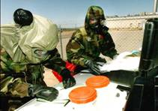
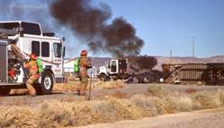
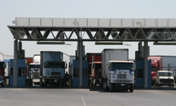
National Security Response Programs and Operations
DOE/NV/25946--464
Continue use of the NTS as the preferred site for Department of Homeland Security (DHS) radiological detector characterization.
Increase work with cities involved with radiological and nuclear detection, training, and surveys.
Working with DoD, develop cyber security capabilities in realistic operating environments.
Establish the National Security Development and Test Center.

Slide 10
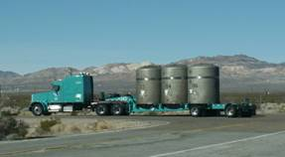
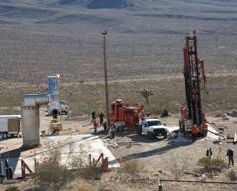
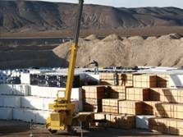
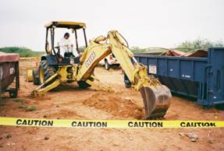
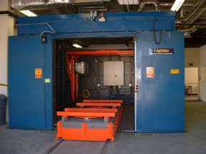
Environmental Management
DOE/NV/25946--464
The NSTec Environmental Management (EM) program consists of two primary tasks:
Waste Management
To support the Nuclear Operations and facility closure projects of sites across the United States by providing compliant and cost-effective low-level waste and mixed low-level waste disposal capability.
Environmental Restoration
To assess and perform appropriate corrective actions at sites contaminated as a result of past nuclear testing and support activities.

Slide 11
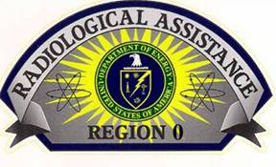
Work For Others
Work for Others strengthens National Nuclear Security Administration/Nevada Site Office (NNSA/NSO) technological capabilities by developing, enhancing, and retaining core competencies and supporting technologies essential to support the NNSA/NSO missions and national security.

Slide 12
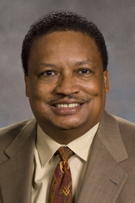
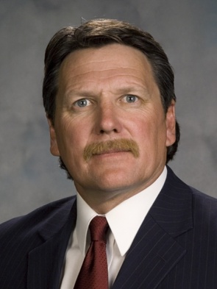
Operations & Infrastructure Directorate
John Clymo,
Deputy
A. C. Hollins, Director
Linda Caldwell
Assistant Director
John Clymo,
Site Operations
Greg Mitchem,
Facilities & Infrastructure
Management
Bob Knudson,
Engineering
Davey Matthews,
Emergency Services &
Operations Support
Melissa Hunt,
Work Process Imp.
Bill Parson
Critical Experiment Facility
Notes:
Performance objectives, measures, and expectations are established in partnership with NNSA/NV, key sponsors, and other stakeholders
Contract was effective Jan 1, 1996, for 5 full years
The Option to Extend the contact (4 year, 9 month) was exercised in 1999, bringing the completion date of this contract to Sept. 30, 2005
Thru Mod. #91 current value of contract is $1,805,313,000

Slide 13
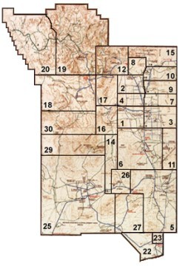
Site Operations
Zone 1 – Maintenance, Construction, Power Operations and Maintenance, Roads and Grounds, Steam and Water, and Solid Waste Operations - NTS Areas 22, 23, 25, & 26; TTR; Communications’ Sites
Zone 2 – Construction, Heavy Equipment Services, Field Engineering, and Maintenance - NTS Non-Zone 1 or 4 Areas
Zone 3 – Construction, Maintenance, and A-1 Machine Shop - All Non-NTS Areas (NLV Facilities, RSL-Nellis, RSL-Andrews, Livermore Operations, Los Alamos Operations, and Special Technologies Laboratory)
Zone 4 – Work Control, Maintenance and Construction, and DAF Maintenance - NTS Nuclear Facilities (DAF, G Tunnel, Area 5 RWMS, and Area 3 RWMC)
Notes:
Increased funding for National Defense (before and after 9/11)
Increase work (WFO) of Defense Threat Reduction Agency (DTRA). Most of the work revolves around Hardened Buried Targets….Guidance Systems, Detectors, Sensors, Smart Weapons, etc. Some of our technology have been implemented recently in Afghanistan. PCM is very active in providing consistency in our WFO process. More on the WFO process later.
NTS is vying for the National Center for Counter Terrorism. Numerous states are lobbying for this, and if it materializes, could be a large increase for NTS. Our role is ensuring not only funding (AFP) but more importantly, the authorization. We are working with possible changes to our Annual Contracting Plan, which would be signed by the CO.
Discussions of resumption of U/GNT – accelerate from the current period of up to three years, so as quick as 18 months.
PCM has kept Senior Management aware of numerous issues. Contract and Non-contract is a constant issue. Have successfully completed a company procedure, with NNSA/NV’s approval, addressing this point. Is based on past IG, Comptroller General, and other audits. More on this later.
We have some challenges dealing with the PBIs and Award Fee areas of EM, and are keeping on top of these issues.
The issues we raise to Senior Management has strengthened PCMs role to the NTS team.

Slide 14
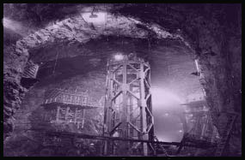
Site Operations (continued)
DOE/NV/25946--464
Implementing a construction and maintenance Zone Concept to centralize work responsibilities under discrete managers for each geographical area. This concept permits development of multi-tasking sections that meet a users full expectations while affording operational economies and specialization.
Work Control provides the Work Control Center for elements dealing with work planning, scheduling, work package preparation, etc.
Logistics Services manages and operates the Feeding, Housing, and Custodial services at the Nevada Test Site. Fleet Services, Transportation, Radio Services, Spectrum Management, and Materials Management ,including Warehouse Operations, are also provided through Logistics Services for the Las Vegas operations, as well as the Nevada Test Site.

Slide 15
Facilities & Infrastructure Management (FIM)
DOE/NV/25946--464
Provide services in strategic planning, conceptual design, and engineering, procurement, and construction (EPC) project execution. As the stewards of documents such as the Ten Year Site Plan, Annual Maintenance Plan, and Energy Management Plan, the FIM division has the capability for integrating the current and future activities being performed at NSTec to allow optimal implementation.
Maintains the integrated projects list for the site, capturing in one location, future and ongoing projects, as well as providing capability for development of conceptual design packages to better identify the basic building blocks of a successful project. As the project enters the execution phase, the FIM has a number of Project Managers, Project Control Engineers, and associated support staff for executing projects.
With approximately 30 to 40 projects being executed at any given time, the opportunity for sharing of lessons learned, building on work being performed simultaneously, and being able to reach out and touch various project professionals with differing backgrounds and expertise makes this group well qualified to accomplish whatever task is laid before them.
Notes:
Increased funding for National Defense (before and after 9/11)
Increase work (WFO) of Defense Threat Reduction Agency (DTRA). Most of the work revolves around Hardened Buried Targets….Guidance Systems, Detectors, Sensors, Smart Weapons, etc. Some of our technology have been implemented recently in Afghanistan. PCM is very active in providing consistency in our WFO process. More on the WFO process later.
NTS is vying for the National Center for Counter Terrorism. Numerous states are lobbying for this, and if it materializes, could be a large increase for NTS. Our role is ensuring not only funding (AFP) but more importantly, the authorization. We are working with possible changes to our Annual Contracting Plan, which would be signed by the CO.
Discussions of resumption of U/GNT – accelerate from the current period of up to three years, so as quick as 18 months.
PCM has kept Senior Management aware of numerous issues. Contract and Non-contract is a constant issue. Have successfully completed a company procedure, with NNSA/NV’s approval, addressing this point. Is based on past IG, Comptroller General, and other audits. More on this later.
We have some challenges dealing with the PBIs and Award Fee areas of EM, and are keeping on top of these issues.
The issues we raise to Senior Management has strengthened PCMs role to the NTS team.

Slide 16
Engineering
DOE/NV/25946--464
Over 100 engineers and designers providing facility and infrastructure design and technical support for internal and external customers.
Customers include Homeland Security and Defense Applications, Defense Experimentation and Stockpile Stewardship, Environmental Management, Yucca Mountain Project, WSI, Department of Defense, the National Laboratories (Sandia, Los Alamos, Livermore), and Department of Homeland Security.
Typical work includes sub critical experiment support design, electric power and water infrastructure upgrades, nuclear facility designs, and specialized designs for “one of a kind” projects.
Notes:
BCRs – Task Plans are developed annually for work activities planned for each FY. From this baseline, changes are identified and captured via BCRs. PCM has joined with Project Controls to review these BCRs from a contractual viewpoint (scope, cost, schedule) ensuring continuity with our prime contract.
WSS - (previously Necessary and Sufficient process) was based on adopting industrial/commercial standards, in lieu of DOE Orders. However, PCM wasn’t involved in what is a paramount contracts issue. PCM is actively involved with the Change Review Group (CRG) of the WSS, and as this process is evolving, PCM is actively inserting ourselves in the review process, in compliance with DEAR 970.5204-78 , Laws, Regulations, and DOE Directives. (WSS was too cumbersome to handle ES&H and Non-ES&H. Additionally, the Non-ES&H folks weren’t familiar with the intricacies of the WSS. Consequently, a decision to limit WSS to only the ESH stuff.)
YMP- Prime Contract requires BN to provide: Telephone system, Electrical Power, Bus service, Medical Services. Additional services that we provide: HR database system/payroll Processing, Labor Relations, Internal Audit, Workforce Enhancement. To date, have avoided $150k.
Six Sigma - Initiated 6 Sigma in the Fall of 2000. Currently, BN has trained 46 Champions (one is Kathy V., and 6 are our NNSA customer), 3 Certified Black Belts, and 45 Yellow Belts (one is Sue Otis, and 5 are our NNSA customer)
6 Process Improvement Projects (PIPs) have been completed, with an estimated cost savings of $1.3 million/year. A nominated PIP from PCM is the improvement of the development, approval and change control process of the Performance Based Incentive (PBI). This process is very important in terms of customer relations.
Misc. Corporate Work – Have assisted BNI with their effort in the Kwajalien Proposal. This included completing a series of workbooks, comparing the similarities of our site, and detailing how we’ve managed the many challenges we face. Also have provided assistance with the Nellis Range proposal, with special emphasis on consolidation and cost savings. We have been very careful to log all time against a separate charge number.

Slide 17
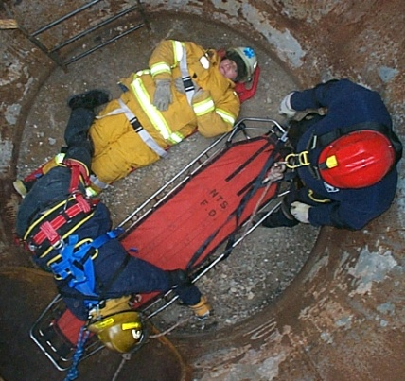
Emergency Services & Operations Support
DOE/NV/25946--464
Emergency Planning and Preparedness Department, whose prime mission is to do your worrying for you. Services include the following:
Analyze hazards
Provide policies for and help in developing Emergency Response Procedures and conducting Emergency Action Team training
Provide support for Facility Emergency Preparedness programs
Provide training and qualification tracking for over 250 members of the Emergency Response Organization
Plan and conduct functional emergency preparedness training drills
Plan, conduct, and evaluate emergency preparedness exercises

Slide 18
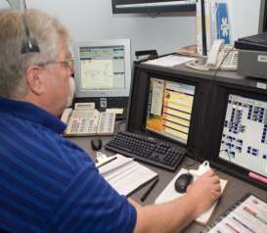
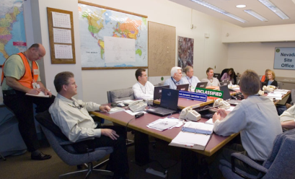
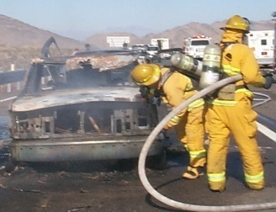
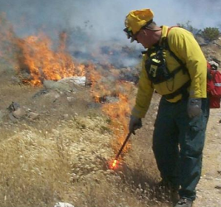
Emergency Services & Operations Support (continued)
DOE/NV/25946--464
Operations Coordination Center
Provide mission scheduling and deconfliction for both NTS ground and airspace activities.
Provide access tracking into/out of controlled areas of the site.
Staff 24/7 the Operations Coordination Center (OCC) with a Duty Manager and a Fire Dispatcher/911 Call-Taker.
Ensure readiness and operate eight emergency response facilities, including three facilities dedicated for emergency use.
NTS Fire & Rescue
Staff 24/7 two Fire Stations (Mercury and Area 6) with both paramedics and firefighters, trained in all aspects of fire response, technical rescue, and hazardous material response.
Staff Paramedic Station at Yucca Mountain Project when workers are present.
Provide regulatory compliance assistance and inspections.
Provide Fire Extinguisher services and hands-on training.

Slide 19
Work Process Improvement
DOE/NV/25946--464
Develop and Report Metrics/Dashboard
CaWeb/Issues Management
Overview of Assessments
Lead Improvement Studies
Oversight of Procedure Updates
Coordinate Impact of New Procedures and DOE Orders
Provide Guidance for Configuration Management Implementation
Coordinate Lean/Six Sigma Activities

Slide 20
Assistant Director
DOE/NV/25946--464
NTS Workers Quality of Life Program
Looking Sharp Project
Control Account Manager
Safety Awards Program
Employee Suggestion Program
Performance Evaluation Plan
Organizational Improvement
Customer Relations
Labor Alliance Safety Committee
Customer Satisfaction and Feedback
Staff Management
Safety Awards

