Slide 1
Security Operations at the Nevada Test Site
Phil Mertz
WSI Plan & Operations Division

Slide 2
Welcome to Nev-va-duh
Comedian George Carlin said there're 400,000 words in the English language and seven you can't say on television. Actually there're eight; the one George missed was Ne-vah-da.
Tom Brokaw (NBC News)
George W. Bush (President)
John Kerry (Senator & Presidential Nominee)
Michelle Obama (Wife of Barack Obama)
Mitt Romney (Governor)
Joe Scarborough (MSNBC & Congress)
George Stephanopoulos (Senior Political Adviser & ABC News)
Brian Williams (NBC News)

Slide 3
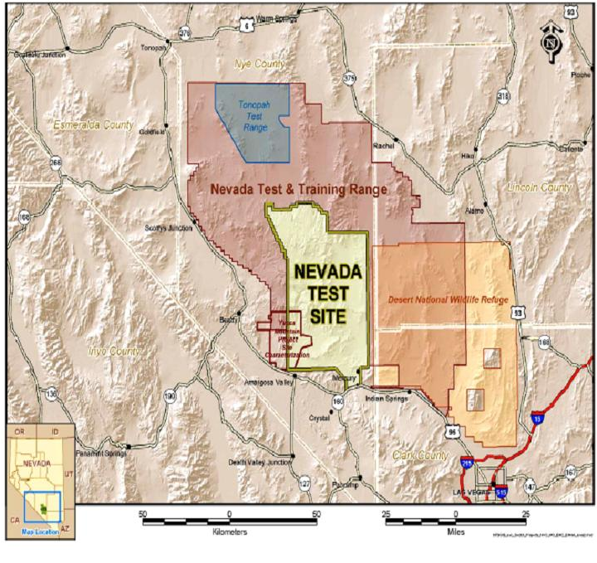
Nevada Test Site Geography
1,375 Square Miles
Safe
Secure
Remote
Surrounded by Nellis Air Force Range and Bureau of Land Management land
Controlled access
Emergency Services
Law Enforcement
Housing and Cafeterias
3 Air Strips
5 Helicopter Pads

Slide 4
Property Protection
Patrols Used to Conduct Inspections
Security Interests
Structures, Equipment, Classified Matter
Check for Unsecured NNSA Property
Warehouse and Storage Areas
Normally Secured Buildings Found Unlocked and Unattended
Report of Improperly Secured Material and/or Equipment
Patrols Randomly Check Unattended Vehicles
Found Unsecured with no Keys
Found Unsecured with Keys
Exceptions: Vehicles Located at DAF or Tunnel Portals used for Emergency Evacuation

Slide 5
Property Protection
Conduct Vehicle Searches In/Out Bound Traffic
Vehicle Search Matrix
Prohibited Articles
100% of All Temporary Badged Personnel
Property Removal Authorization
Radiological Material Clearance Sticker (Rad Free)
Radioactive Material Sticker
FRM-0946 Government Property Shipment, NLV Complex and the NTS
Property Pass
Removal of Portable Equipment on a Continuous Basis
Vehicle Property Pass
Removal of Property Transported in a Designated Vehicle on a Continuous Basis
Exemptions
FBI Agents
Office of Secure Transport
Emergency vehicles
U.S. Mail

Slide 6
Primary Mission and Strategy
Defense in Depth
Concentric Layers of Security
Security Stations and Active Patrols Support
Denial Strategy to Protect Category II or Greater SNM Against
Theft
Sabotage
Diversion
Unauthorized Control
Capable of Forming Tactical Response Teams
Armored Vehicles
Increased Caliber Weaponry

Slide 7
Primary Mission and Strategy
Special Response Teams
Resolve Incidents that Require Force options
Dedicated Teams with Specialized Weapons/Equipment
Trained and Equipped for Effective Ready Response
Interdiction
Interruption
Neutralization
Strategies Conducted Against Adversary
Containment
Denial
Recapture
Recovery
Pursuit

Slide 8
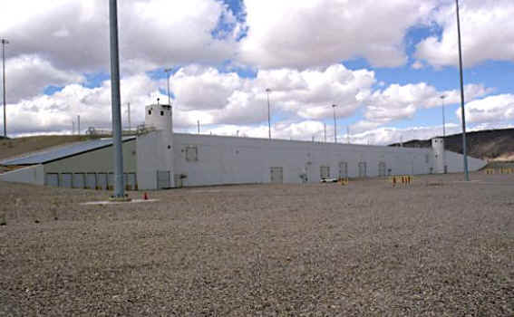
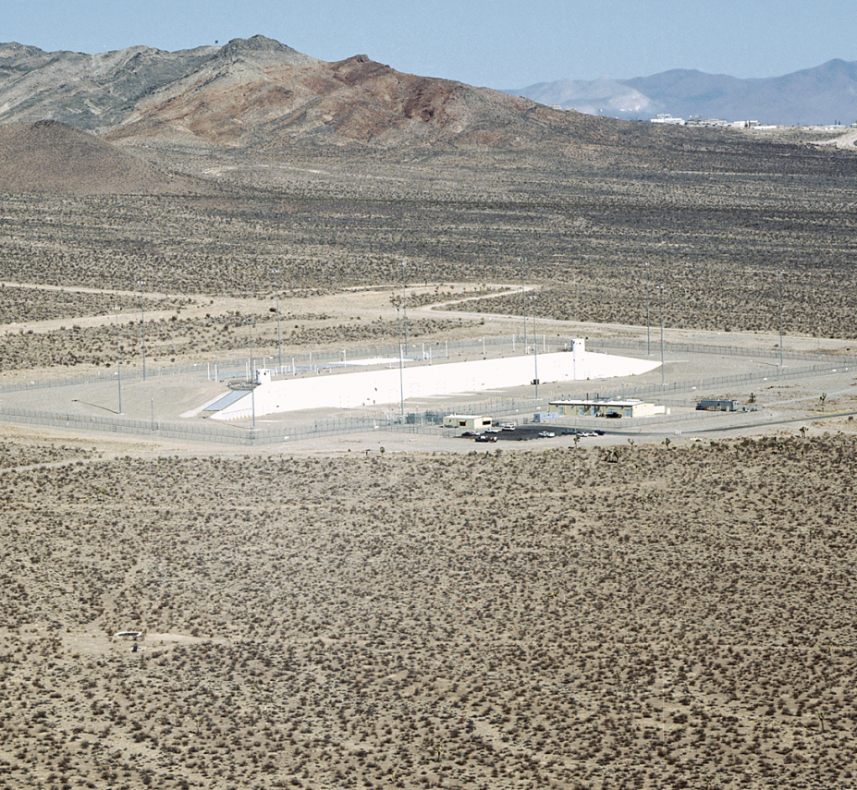
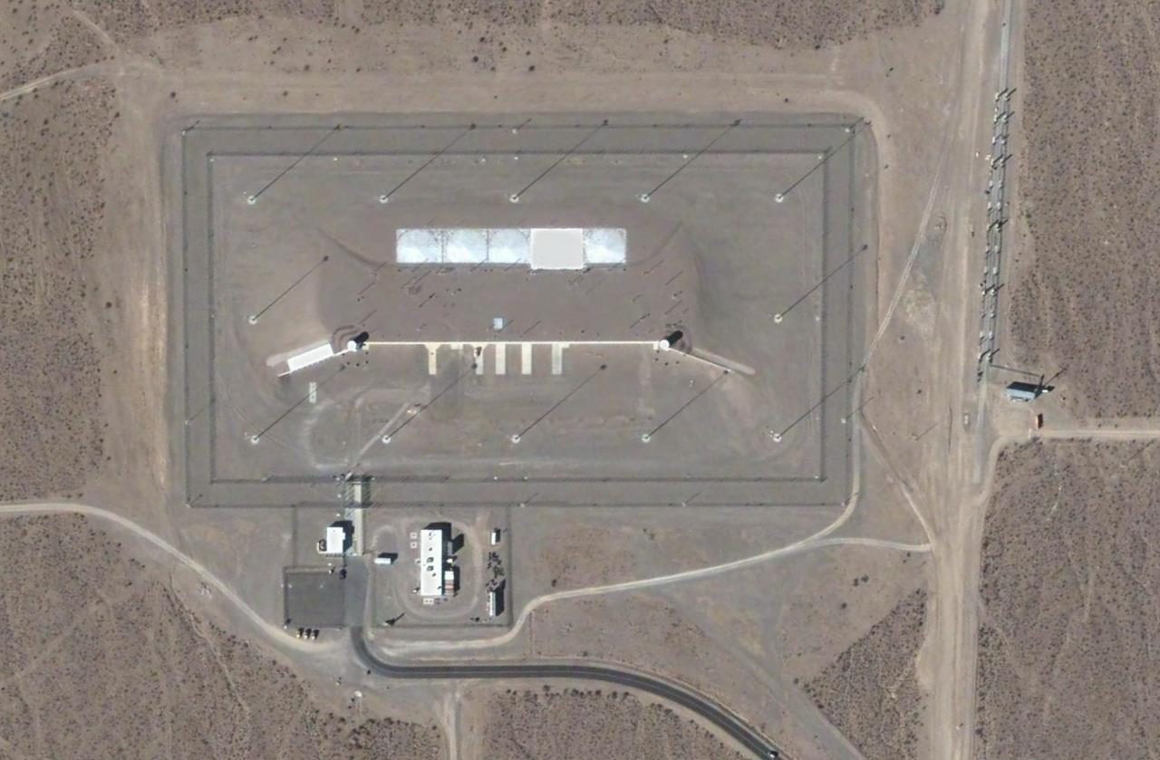
Device Assembly Facility
The DAF is a Collection of 30 Individual Steel-Reinforced Buildings
Entire Complex Covered by Compacted Earth
Complex Spans 100,000 Square Feet

Slide 9
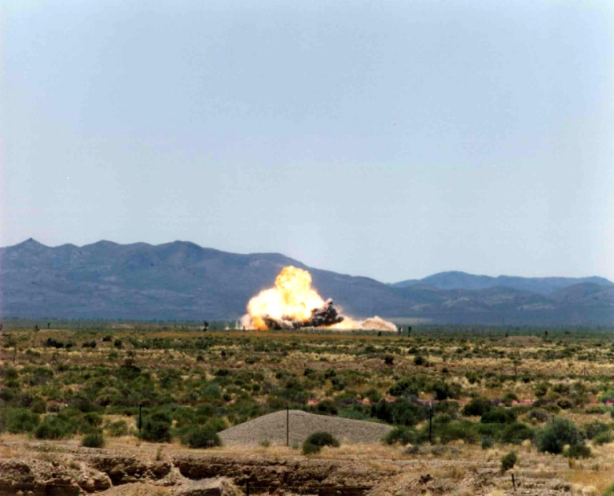
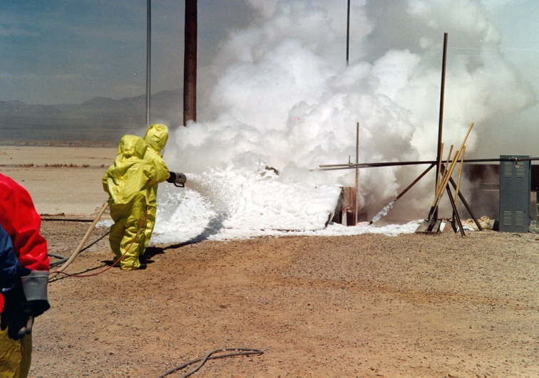
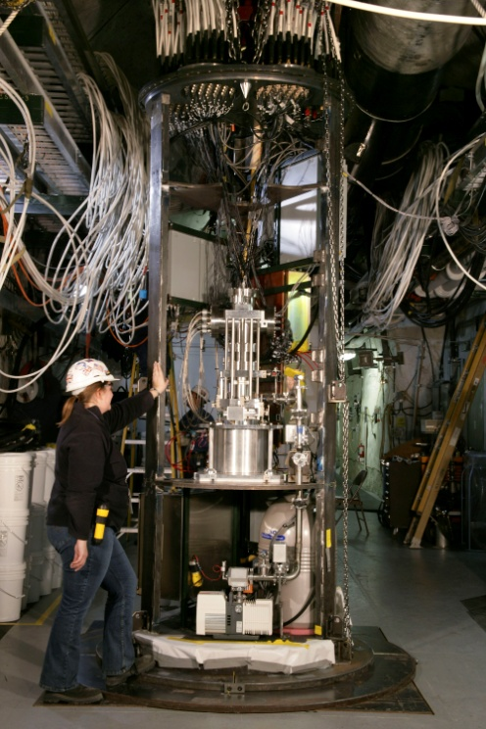
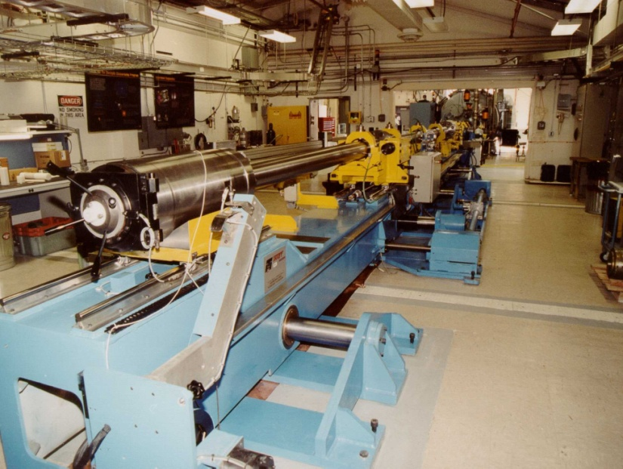
Support Stockpile Stewardship
Big Explosives Experimental Facility (BEEF)
Nonproliferation Test Evaluation Complex (NPTEC)
Joint Actinide Shock Physics Experimental Research (JASPER)
Subcritical Experiments

Slide 10
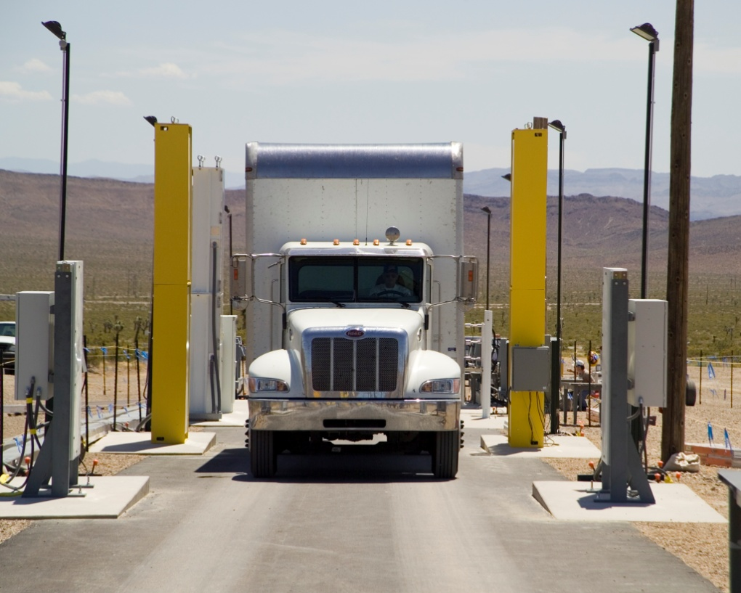
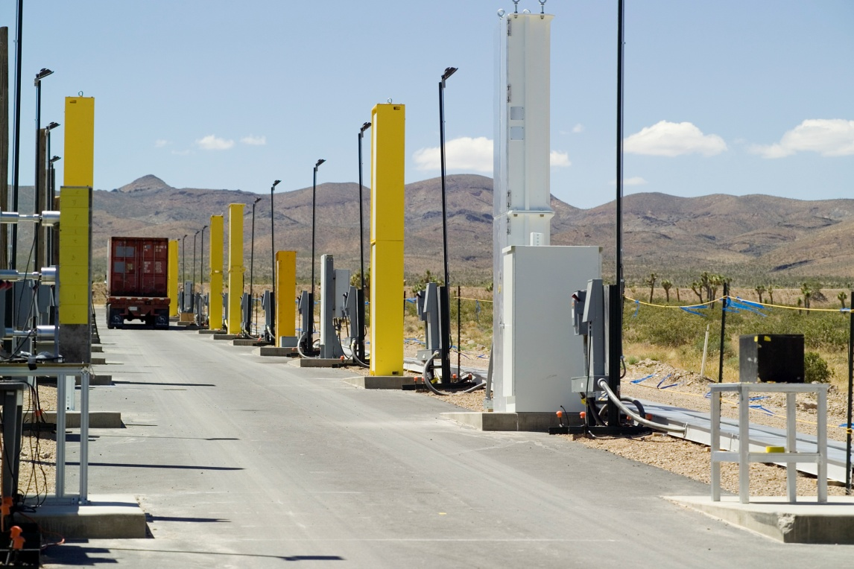
Support Homeland Security
Radiological/Nuclear Countermeasures Test and Evaluation Complex (Rad/NucCTEC)
For More Information on These Programs
http://www.nv.doe.gov/nationalsecurity/stewardship/daf.htm

Slide 11
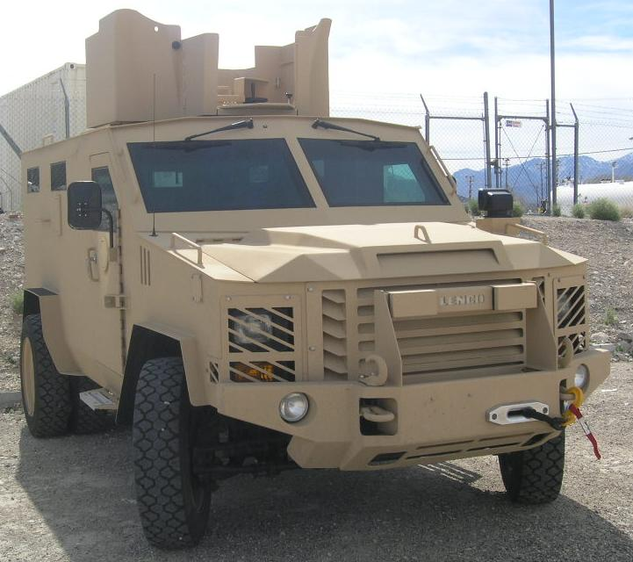
Vehicle Support and Maintenance
Armored Patrol and Response Vehicles
HMMWV’s
Badgers
Bearcats
Preventive Maintenance and Safety Checks
Conducted by Supervisors/SPO’s During Shift Exchange
Special Attention
Vehicle is Safe to Operate
Mechanically Sound
Fleet Services
Performs Due/Major Maintenance Services
Vehicle Services Performed Every 500 Hours

Slide 12
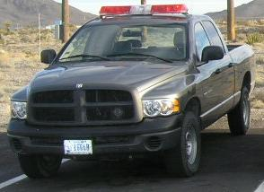
Vehicle Support and Maintenance
Commercial Vehicles
Chevy, Ford, and Dodge
Full Size Pick-up Trucks
Vans
Sedans
Preventive Maintenance and Safety Checks
Conducted by the Operator
Fleet Services
Performs Due/Major Maintenance Services
Vehicle Services Performed Per Manufacture Guide

Slide 13
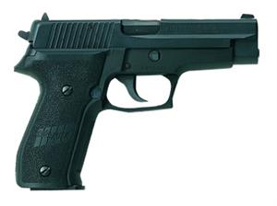
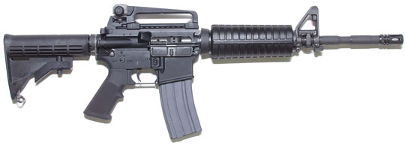
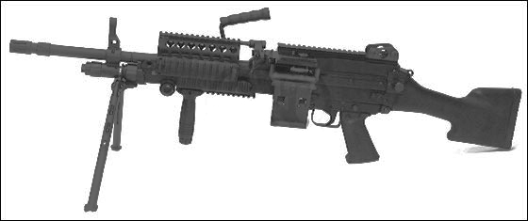
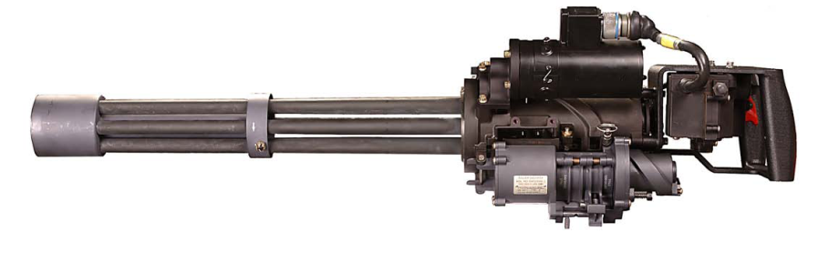
Weapon Support and Maintenance
SPO’s Responsible for
Daily Maintenance
Maintenance After Firing on Range
Disassembly
Clean and Lube
Assembly
Function Check
Scheduled Training, Assigned Weapons will be Function Checked

Slide 14
Weapon Support and Maintenance
Armors Responsible for
Routine Maintenance of all Weapons
Semi-Annually IAW Weapons Maintenance Schedule
Directed by the Director, Training Division
All Repairs and/or Maintenance Performed in Accordance
Department of Defense Manuals (Military Type Weapons)
Factory Repair Manuals (Commercial Type Weapons)
All Weapons will be Technically Inspected Every Six Months
Repair and/or Adjustments Affecting the Function or Accuracy
Weapon must be Test Fired
Recertification for Duty Use.
Defective Weapon Which Cannot be Immediately Repaired
Tagged "DEFECTIVE" IAW Equipment Tag-Out Procedures
Removed from Operational Use
Stored Until Repairs can be Effected

Slide 15
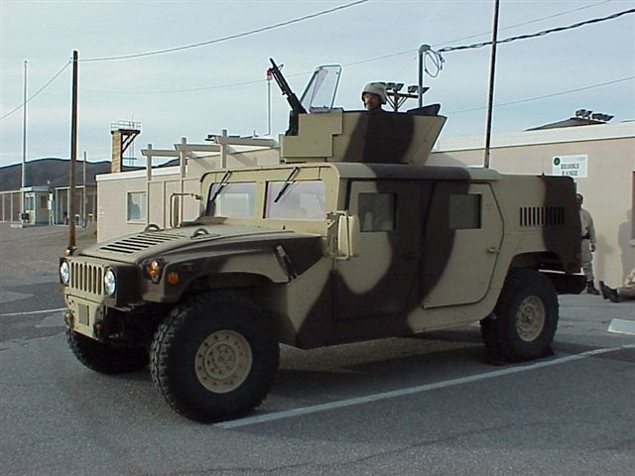
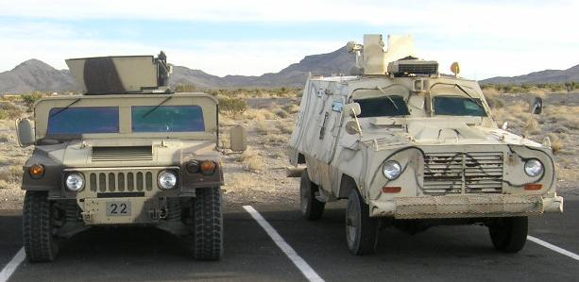
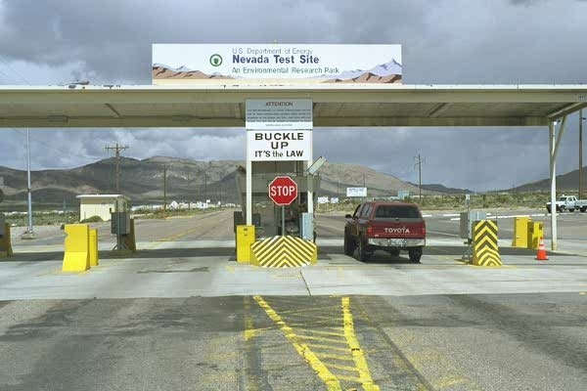
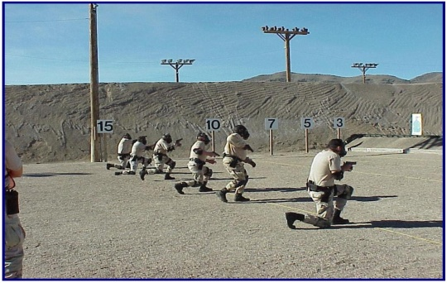
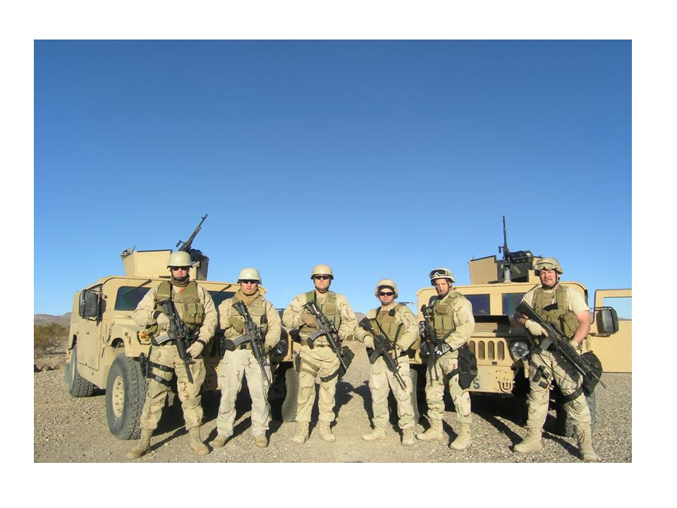
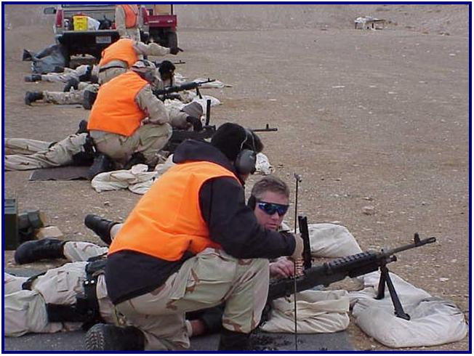
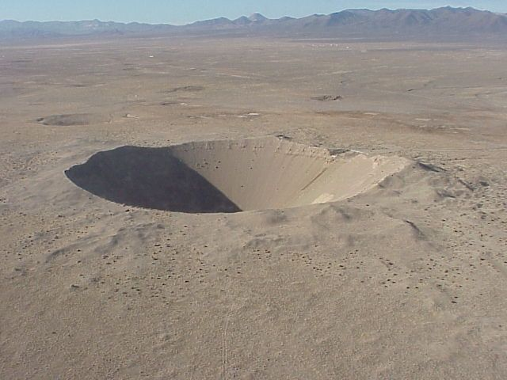
QUESTIONS

