Slide 1
Problems In Quasi-Elastic Neutrino-Nucleus Scattering
JLAB
September 9,2011
Gerry Garvey
Los Alamos Nat. Lab.

Slide 2
Outline
What is quasi-elastic scattering (QES)?
Why has neutrino-nucleus QES Become Interesting?
Inclusive Electron QES; formalism and results.
(longitudinal and transverse, scaling)
Extension to neutrino-nucleus QES processes.
Differences between electron and neutrino QES
experiments.
Problems with impulse approximation.
Possible remedies and further problems.
Determining the neutrino flux??

Slide 3
What is Quasi-elastic Scattering?
QES is a model in which the results of elastic lepton-nucleon scattering (neutral or charge changing, (n p)) is applied to the scattering off the individual nucleons in the nucleus. The cross-section is calculated as the square of the incoherent sum of the scattering amplitudes off the individual nucleons. Pauli exclusion is applied and a 3-momentum transfer q > 0.3GeV/c is required to resolve individual nucleons.

Slide 4
Why has QES ν-N become Important?
Research involving neutrino oscillations has required the extension of QES (CCQE) to neutrino-nucleus interactions.
For 0.3<E_{ν}< 3.0 GeV it is the dominant interaction.
CCQE provides essential information for neutrino oscillations, neutrino flavor and energy.
CCQE is treated as readily calculable, experimentally identifiable and allowing assignment of the neutrino energy.
Some 40 calculations published since 2005
Oscillation period: 1.27Δm_{ij}²(ev²)× (L(km)/E_{ν}(GeV))
atmos: Δm₂₃²=10⁻³ L/E≈10³ LBNE
sterile: Δm_{AS}²=1 L/E≈1 SBNE

Slide 5
Long-Baseline News, May 2010:
“ *** LSND effect rises from the dead… ?“
Sterile neutrinos
Notes:
Today I will present the latest observation from the MiniBooNE experiment. I will give a brief motivation and description of the experiment, present the latest anti-neutrino data, make a comparison the the old LSND results, and if the is enough time, talk about the future of the experiment.

Slide 6
And it’s Getting Worse!!
New Subatomic Particle Could Help Explain the Mystery of Dark Matter. A flurry of evidence reveals that "sterile neutrinos" are not only real but common, and could be the stuff of dark matter.
HIDDEN CLUE: Pulsars, including one inside this "guitar nebula," provide evidence of sterile neutrinos. Scientific American
Cosmology, decay of sterile neutrino (dark matter), calibration of Ga solar neutrino detectors, increased flux from reactors, larger
cross section,

Slide 7
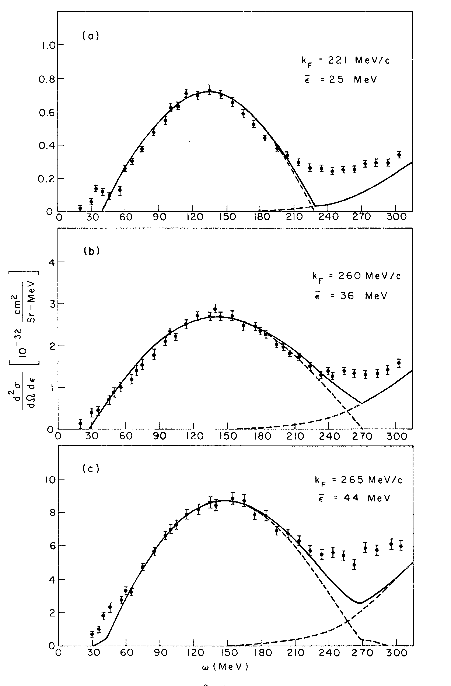
QES in NP originated in e-Nucleus Scattering
Moniz et al PRL 1971
C
Simple Fermi Gas 2 parameter , S_{E}, p_{F}
Impulse Approximation
Ni
Pb

Slide 8
Inclusive Electron Scattering
Electron Beam ΔΕ/E ~10⁻³
Scattered electron
Magnetic Spectograph
Because the incident electron beam is precisely known and the scattered electron well measured, q and ω are precisely known without any reference to the nuclear final state

Slide 9
Quasi-Elastic Electron Scattering
Single nucleon vector current

Slide 10
Scaling in Electron Quasi-elastic Scattering (1)
The energy transferred by the electron (ω), to a single nucleon with initial Fermi momentum
T_{N} is the kinetic energy of the struck nucleon, E_{s} the separation energy of the struck nucleon, E_{R} the recoil kinetic energy of the nucleus.
Instead of presenting the data as a function of q and ω, it can be expressed in terms of a single variable y.
The scaling function F(y,q) is formed from the measured cross section at 3- momentum transfer q, dividing out the incoherent single nucleon contributions at that three momentum transfer.

Slide 11
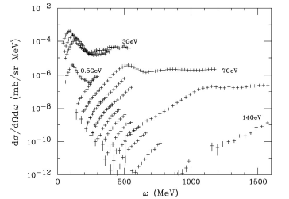
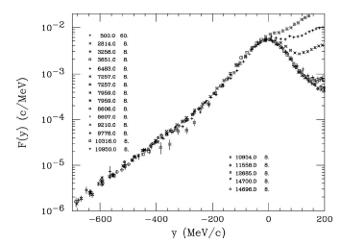
Scaling in Electron Quasi-elastic Scattering (2)
³He
Raw data
Scaled
Excuses (reasons) for failure y > 0: meson exchange, pion production, tail of delta resonance.

Slide 12
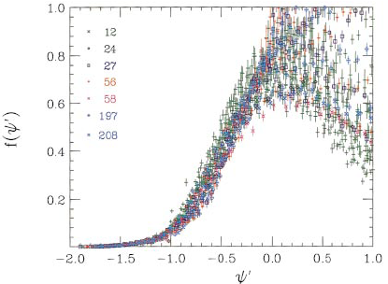
Super Scaling
The fact that the nuclear density is nearly constant for A ≥ 12 leads one to ask, can scaling results be applied from 1 nucleus to another? W.M. Alberico, et al Phys. Rev. C38, 1801(1988), T.W. Donnelly and I. Sick, Phys. Rev. C60, 065502 (1999)
A new dimensionless scaling variable is employed
Note linear scale: not bad for
Serious divergence above

Slide 13
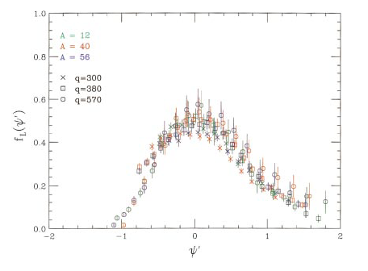
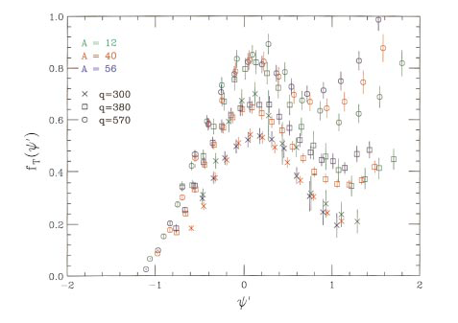
Separating Super Scaling into its Longitudinal and Transverse Responses Phys. Rev. C60, 065502 (1999)
Longitudinal
Transverse
Transverse
The responses are normalized so that in a Relativistic Fermi Gas Model:
f_{L} satisfies the expected Coulomb sum rule. ie. It has the expected value.
f_{T} has mostly excuses (tail of the Δ, meson exchange, pion production etc.) Fine for fixed q and different A. Note divergence, even below ψ’=0
Trouble even with the GOLD standard

Slide 14
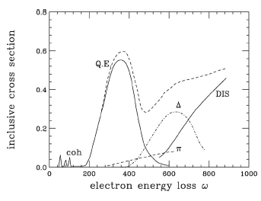
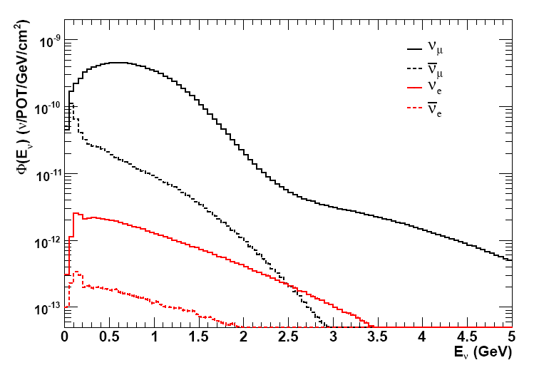
Contrast of e-N with ν-N Experiments
Electron
Electron Beam ΔΕ/E ~10⁻³
Scattered electron
Magnetic Spectograph
Neutrino
Neutrino-Mode Flux
Don’t know E_{ν} !!!
E_{ν}
Neutrino Beam ΔE/<E>~1
l ⁻
What’s ω ???
What’s q ????
QE peak???
Very Different Situation from inclusive electron scattering!!

Slide 15
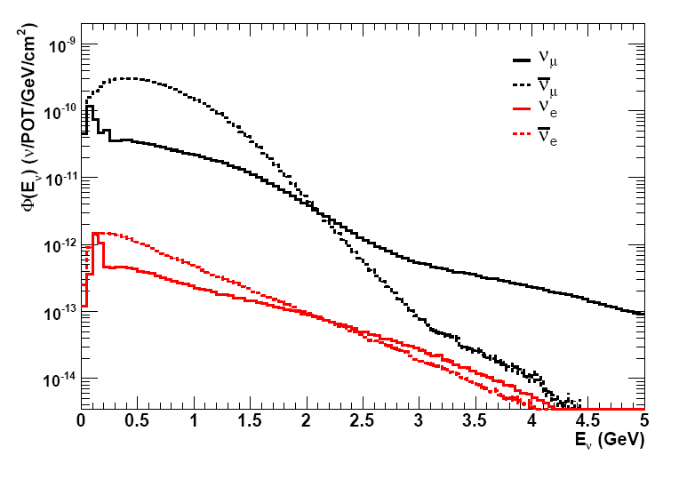
MiniBooNE Setup
ν mode flux
ν mode flux
neutrino mode: ν_{μ}→ ν_{e} oscillation search
antineutrino mode: ν_{μ}→ ν_{e} oscillation search

Slide 16
While inclusive electron scattering and CCQE neutrino experiments are very different, the theory hardly changes.
Neutrino (+), Anti-Neutrino(-) Nucleon CCQE Cross Section
Charged lepton mass=0
The f₁ and f₂ are isovector vector form factors that come from electron scattering. g₁ is the isovector axial form factor fixed by neutron beta decay with a dipole form, 1.27/(1+Q²/M_{A}²). M_{A}=1.02±.02

Slide 17
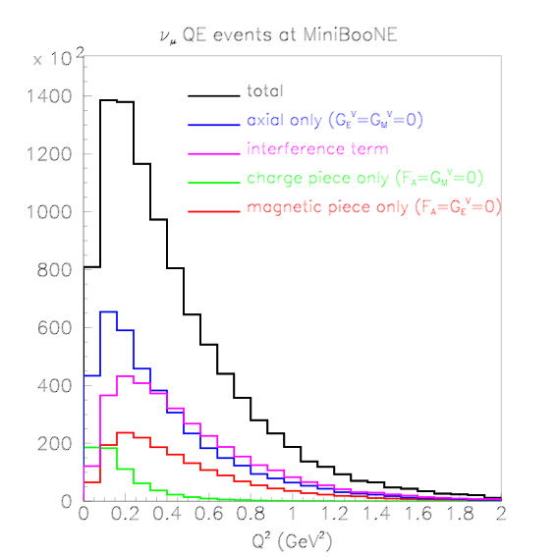
NUANCE Breakdown of the QE Contributions to the MB Yields

Slide 18
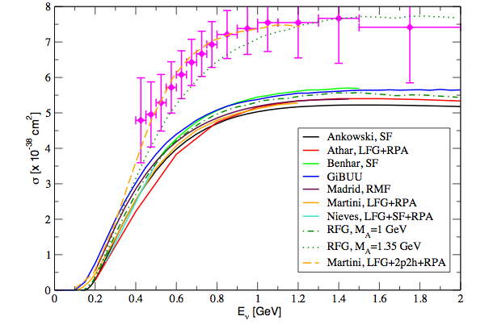
What is Observed? CCQE
MiniBooNE
Theory
consensus
Note: MiniBooNE E_{ν} inferred from μ⁻ energy. Assumes a symmetric uncertainty do to Fermi momentum.

Slide 20
Other Experimental Results from CCQE

Slide 22
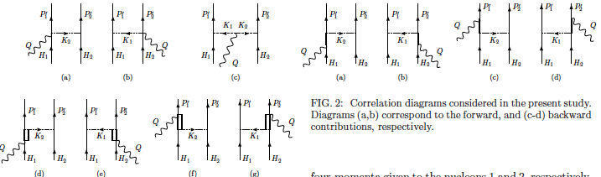
Diagrams of Some Short Range Correlations
External interaction
nucleon-hole
nucleon
Some RPA p-h diagrams
from Martini et al.
PR C80, 065501
Particle lines crossed by are put on shell
virtual SRI π,ρ, contact
delta
Correlation
Exchange Current and pionic correlation diagrams in Amaro et al. PR C82 044601
Exchange

Slide 25
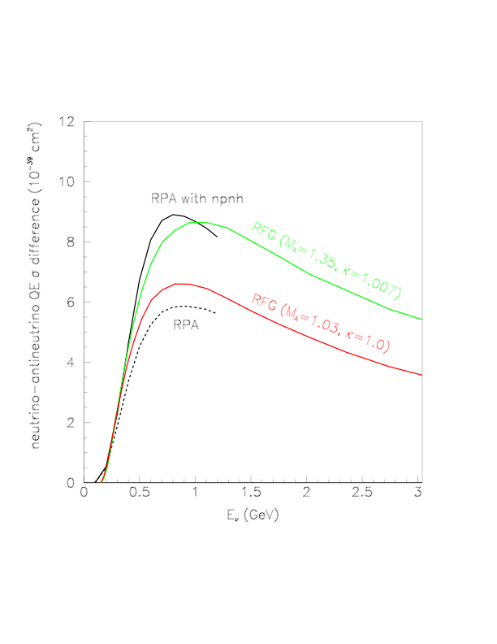
Martini et al RPA

Slide 26
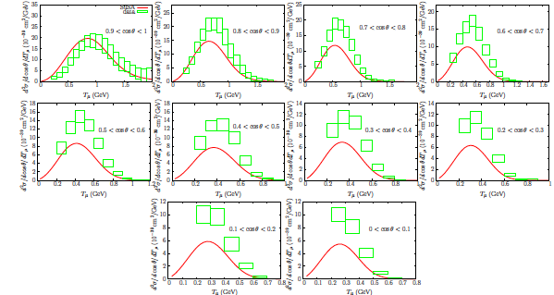
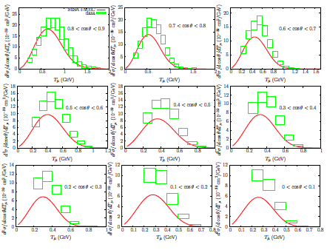
Further Reaction
Amaro et al; Phys. Lett. B696 151(2011). arXiv:1010.1708 [nucl-th]
Included Meson Exchange into their SuperScaling (L) Approach
Straight impulse App.
Meson Exchange Included
Angular Dependence
Experiment shows surplus yield at backward angles, and low energy

Slide 27
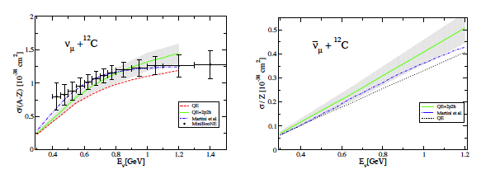
MORE RPA
J.Nieves, I. Ruiz and M.J. Vincente Vacas arXiv: 1102.2777 [hep-ph]
MiniBooNE
SciBooNE

Slide 28
OTHER INTERESTING APPROACHES: Relativistic Potentials-FSI
arXiv:1104.0125 Scaling Function, Spectral Function and Nucleon Momentum Distribution in Nuclei A.N. Antonov, M.V. Ivanov, J.A. Caballero, M.B. Barbaro, J.M. Udias, E. Moya de Guerra, T.W. Donnelly
arXiv:1103.0636
Relativistic descriptions of quasielastic charged-current neutrino-nucleus scattering: application to scaling and superscaling ideas
Andrea Meucci, J.A. Caballero, C. Giusti, J.M. Udias

Slide 29
Can the CCQE Cross Section/N Exceed the Free N Cross Section?
J. Carlson et al, PR C65, 024002 (2002)
Returning to the scaling of e-N QE cross section
Scaling variable
Scaling function
Longitudinal-Transverse

Slide 30
PR C65, 024002 (2002) Investigated the increased transverse response between ³He and⁴He

Slide 31
Euclidian Response Functions:
PR C, 65, 024002 (cont.)
Is presented, removing the trivial kinetic energy dependence of the struck nucleon, and the Q² dependence of the nucleon FF
R_{T, L}(|q|,ω): Standard response functions from experiment.
:Nuclear gs, E=E₀ calculated with realistic NN and NNN interactions
H: True Hamiltonian with same interactions as above
τ: units (MeV)⁻¹, determines the energy interval of the response function
NOTE: The group doing these calculation are extremely successful in reproducing all the features of light nuclei; Masses, energy spectra, transition rates, etc. for A≤12.

Slide 32
What are the EM Charge and Current Operators??
Covariant single nucleon vector current
neglecting relativistic corrections
Current Conservation requires:
A 2-body current

Slide 33
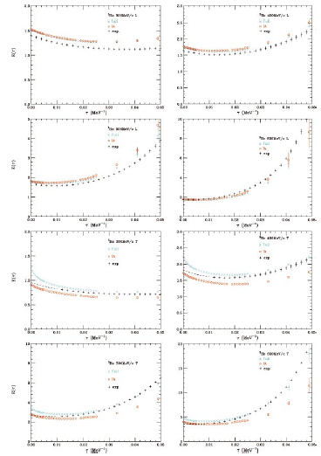
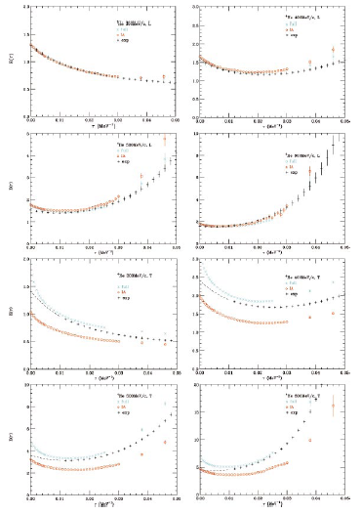
Results of Calculation for fixed q
³He L
⁴He L
Note: QE data stops here
Note: QE data stops here
³He T
⁴He T

Slide 34
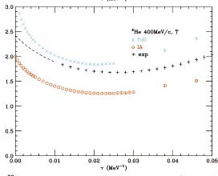
Let’s Look more carefully
E_{T}(τ)
SRC produce interactions requiring large values of ω.
SRC + 2-body currents produce increased yield.

Slide 35
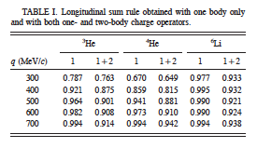
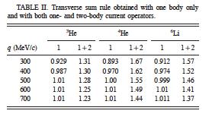
How Big are these Effects Relative to Free Nucleons?
Sum Rule at fixed 3 momentum transfer q:

Slide 36
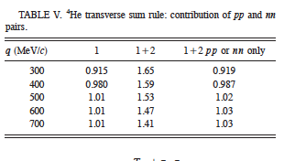
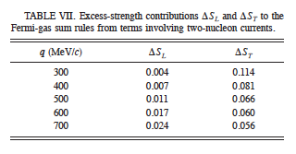
Further Info from PR C65 024002
Effect is due to n-p pairs
Small effect of 2-body currents evaluated in the Fermi Gas:!!!

Slide 37
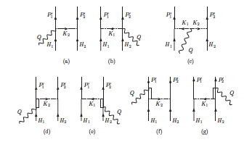
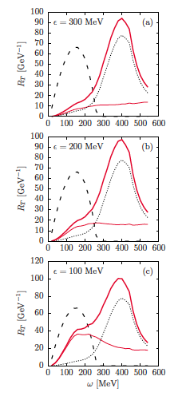
Some More Evidence
Amaro, et al, PHYSICAL REVIEW C 82, 044601 (2010)
Meson Exchange Diagrams.
Correlation Diagrams.
2p-2h fin. sts.
Knowing the incident neutrino energy to 10% or better is crucial to neutrino oscillation experiments!.
Electron Scattering
⁵⁶Fe, q=0.55GeV/c
Meson exchange
One body RFG
Correlation

Slide 38
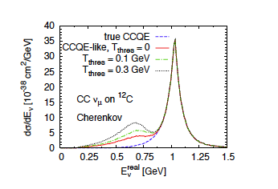
Mosel, Lalakulich, Leitner
http://arxiv.org/abs/1107.3771

Slide 39
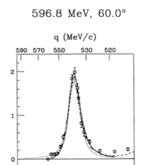
Absolute Normalization of the Flux
The d the rms charge radius is 2 fm. p_{F}≅50MeV/c
Spectator proton (p_{p}) spectrum
p_{n}
p_{p}
p_{p}
p’_{p}
e+d inclusive scattering
With ω and E_{μ} known, E_{ν} is determined!!
With q and ω known, y=(ω+2mω)^{1/2} - q < O can be selected.

Slide 40
Conclusions
Impulse approximation is inadequate to calculate ν-nucleus CCQE, correlations and 2-body currents must be included. Transverse vector response most important
Experimentalists must carefully specify what they term QE.
Establishing the incident neutrino energy is a very serious issue, especially for neutrino oscillation experiments.
Measured Cross Sections are essential. ν flux determination absolutely necessary. Requires a good calculation of ν-d cross section (<5%).
More work, theory and experiment on e-N transverse response might be the most fruitful avenue to pursue. Need to know the q and ω of QE-like events for ω above the QE peak.

Slide 41
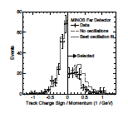
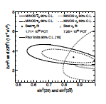
MINOS arxiv: 1104.0344 [hep-ex]

Slide 42
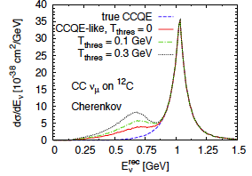
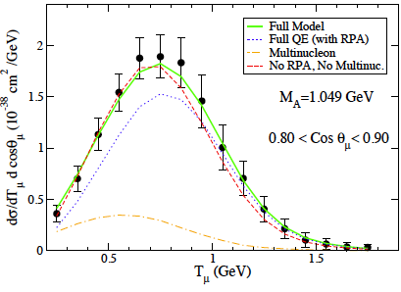
They’re Catching On
1107.3771
Mosel et al
1106.5374
Nieves et al

